Slide 1
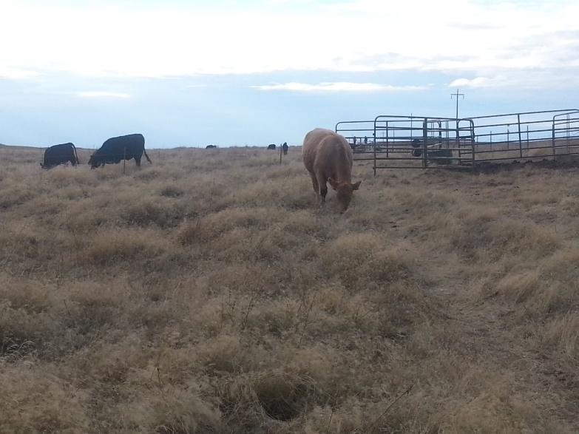
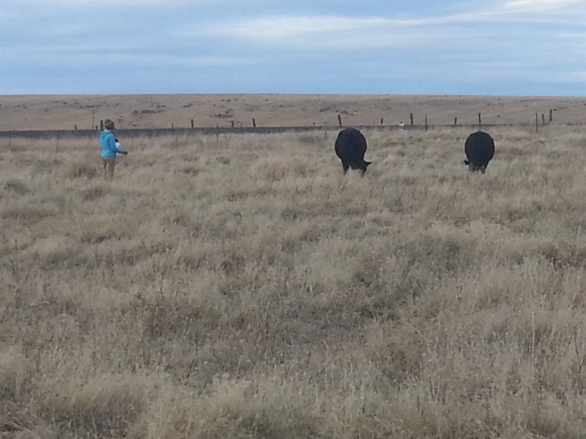
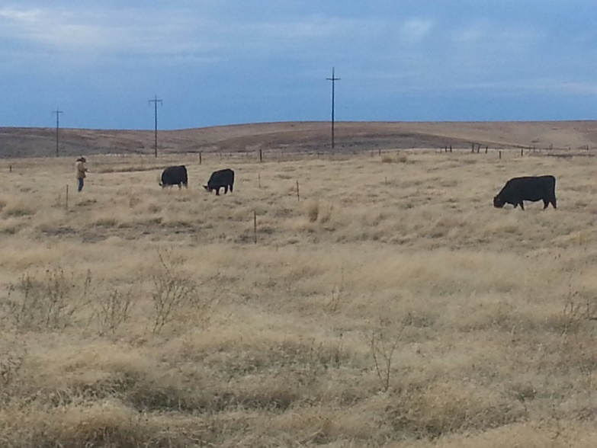
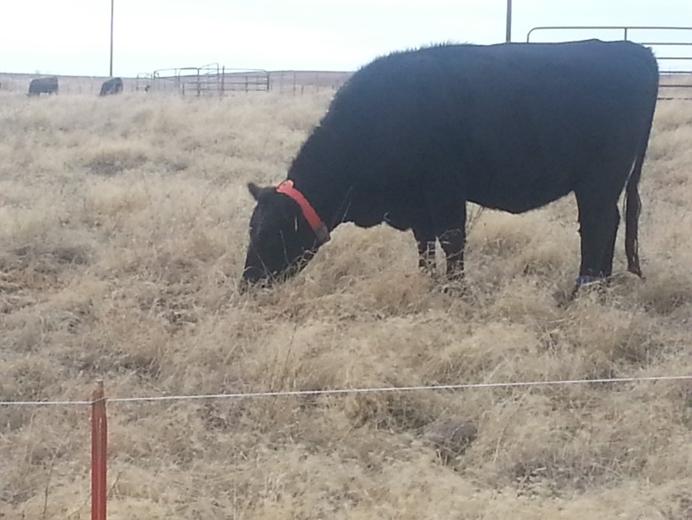
A
B
Figure 3. Grazing experiment in the fall of 2015. Panel A. Animals grazed improved rangeland for 45 min/d and then they grazed medusahead-infested rangeland for 8 h/d (Treatment) and 2) Control animals just grazed medusahead-infested rangeland (8 h/d). All animals were penned overnight. Panels B and C. We assessed the incidence of foraging events on plant species at 2-minute intervals using scan-sampling. Panel D. Activity for all treatment groups was measured using automatic behavior recorders (IceTags).
C
D

