Slide 1
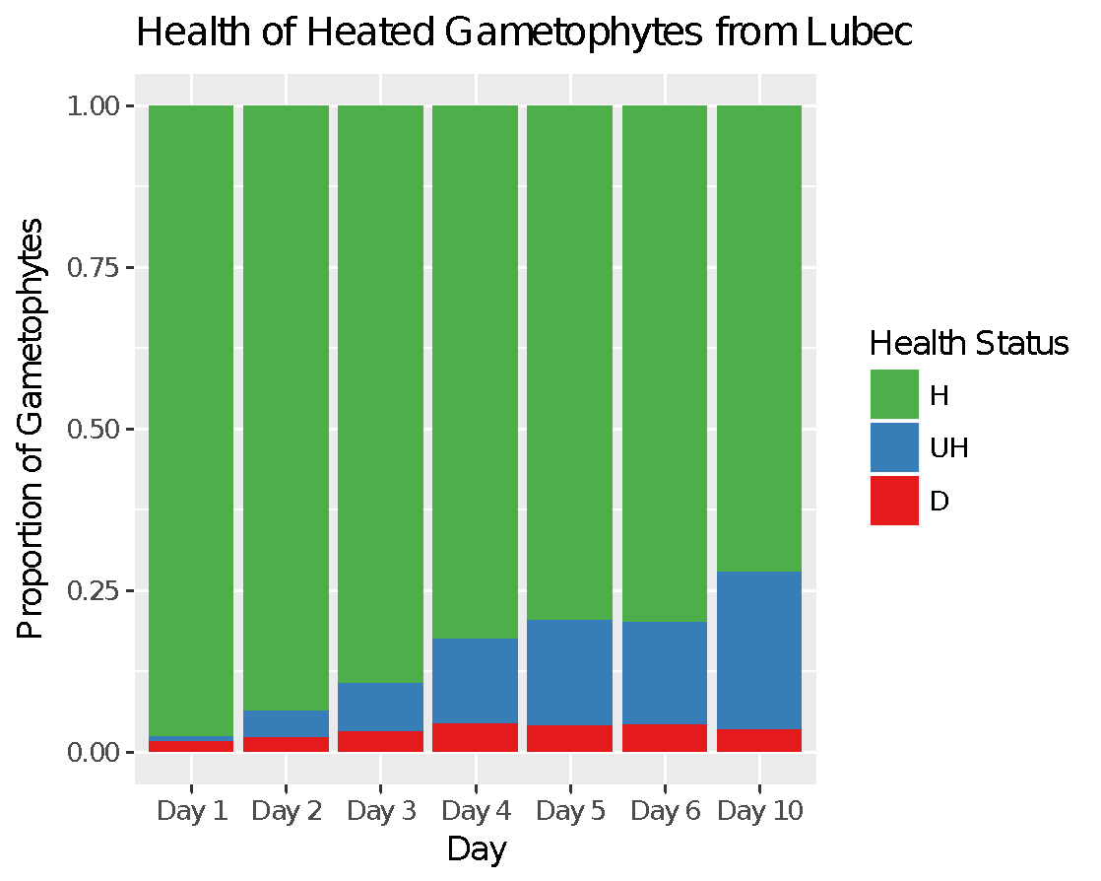
12C 14C 16C 18C 20C 22C 22C
Figure 1. Example of Lubec gametophyte health assessment throughout the thermal adaptation experiment. Note the large proportion of healthy gametophytes remaining at the end.

Slide 2
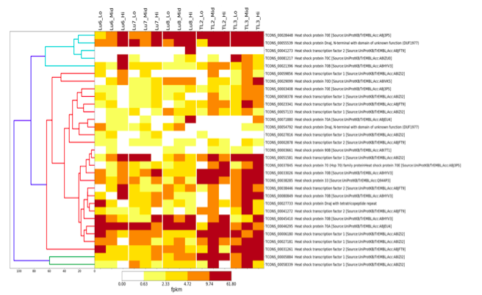
Figure 2. Heatmap of gene expression with Lubec gametophyte strains on the left, and Two Lights Gametophyte strains on the right; each strain has expression patterns of Lo (12C), Mid (18C), and Hi (22C). FPKM values increase with hotter/darker colors, denoting larger changes in gene expression.

Slide 3
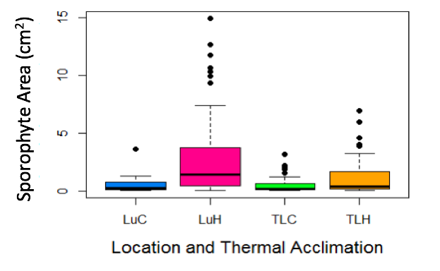
Figure 3. Sporophyte blade surface area by location and thermal acclimation (C = control, H = heat acclimated, L = Lubec, TL = Two Lights). Note the large blades from the thermally acclimated seedstock from Lubec.

