Slide 1
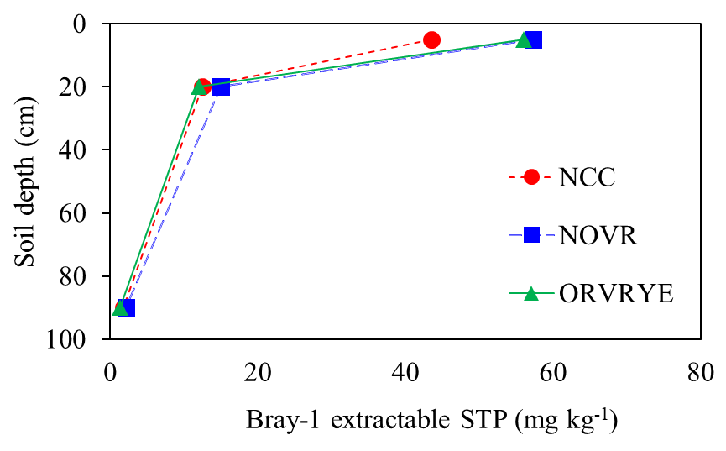
b
--a--
ns
ns
Figure 1. Bray-P as influenced by cover crops (NCC, NOVR, and ORVRYE) over three depths (0-5, 5-20, and 20-90 cm).
NCC: no cover crop; NOVR: no cover on corn row, Vetch on middle row, and rye on the outside row; ORVRYE: Oats and radishes on the corn row, vetch on the middle row, and rye on the outside row.
Different letters indicate differences among treatments (P<0.05).

Slide 2
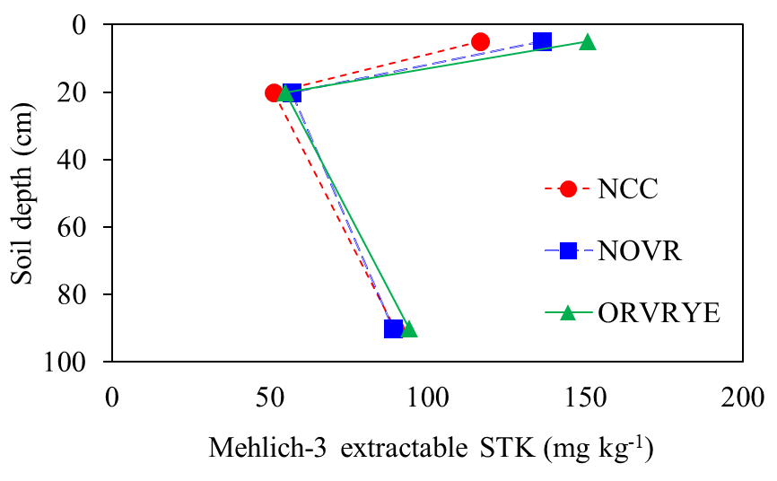
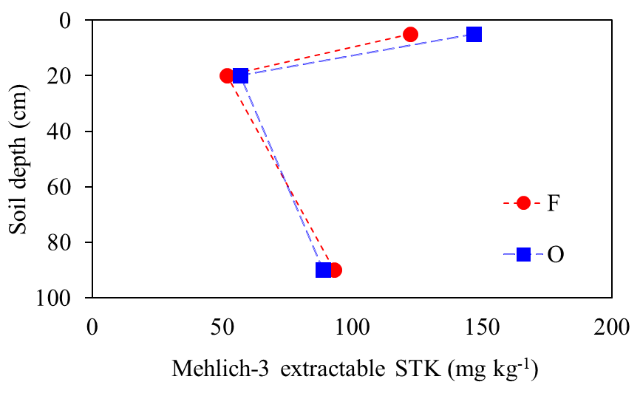
b
a
a
ns
ns
b
a
ns
ns
Figure 2. Soil test K (Mehlich-3 K) as influenced by cover crops (NCC, NOVR, and ORVRYE) over three depths (0-5, 5-20, and 20-90 cm) and on (O) and off (F) the corn row.
NCC: no cover crop; NOVR: no cover on corn row, Vetch on middle row, and rye on the outside row; ORVRYE: Oats and radishes on the corn row, vetch on the middle row, and rye on the outside row.
Different letters indicate differences among treatments (P<0.05).

Slide 3
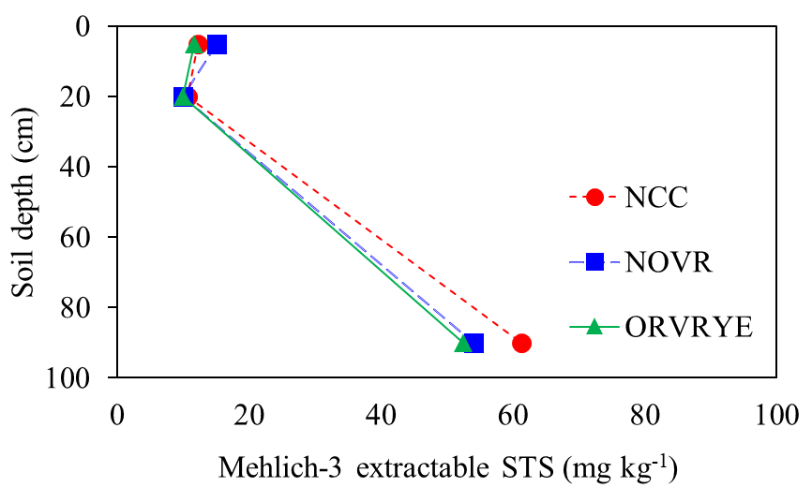
ns
ns
ns
Figure 3. Mehlich-3 soil S as influenced by cover crops (NCC, NOVR, and ORVRYE) over three depths (0-5, 5-20, and 20-90 cm).
NCC: no cover crop; NOVR: no cover on corn row, Vetch on middle row, and rye on the outside row; ORVRYE: Oats and radishes on the corn row, vetch on the middle row, and rye on the outside row.
Different letters indicate differences among treatments (P<0.05).

Slide 4
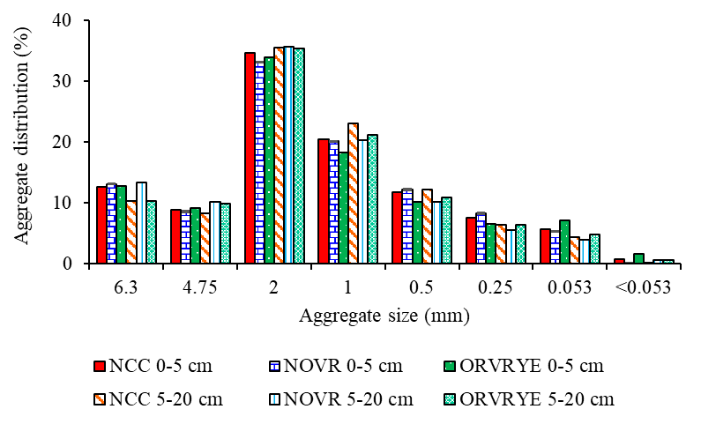
--------------------------------------ns--------------------------------
Figure 4. Interaction of sampling depth by cover crop (P>0.1) for different aggregate sizes. NCC: no cover crop; NOVR: no cover on corn row, Vetch on middle row, and rye on the outside row; ORVRYE: Oats and radishes on the corn row, vetch on the middle row, and rye on the outside row.
ns means no significant differences at 0.1.

Slide 5
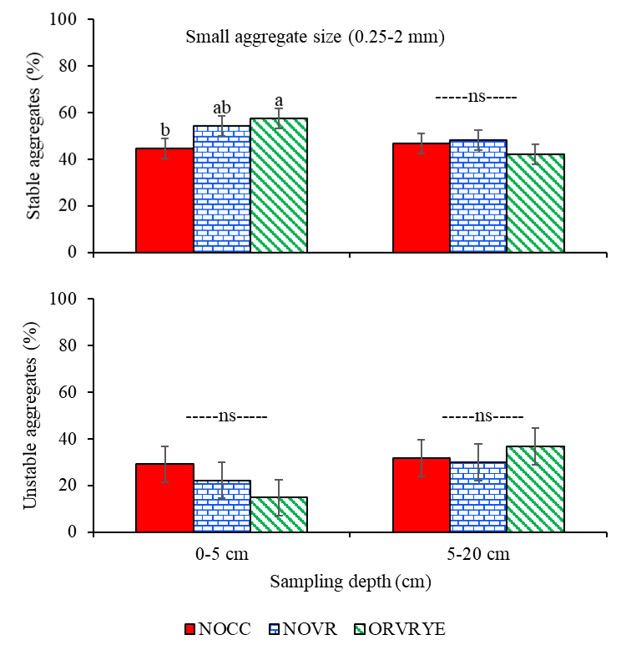
(A)
(B)
Figure 5. Interaction of sampling depth by cover crop for small (0.25-2 mm) stable (A) and unstable (B) aggregates. NCC: no cover crop; NOVR: no cover on corn row, Vetch on middle row, and rye on the outside row; ORVRYE: Oats and radishes on the corn row, vetch on the middle row, and rye on the outside row.
Different letters indicate differences among treatments (P<0.1).
ns means no significant differences at 0.1.

Slide 6
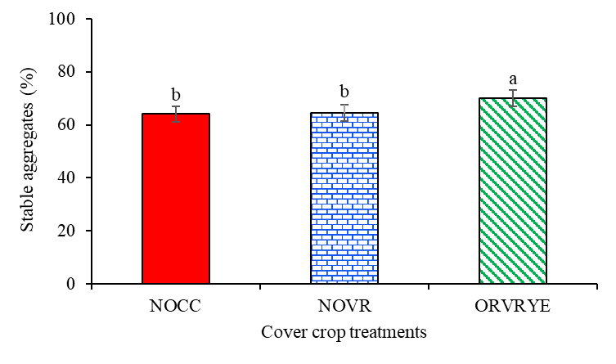
Figure 6. Cover crop effect on large, stable aggregates (2-4.75 mm). NCC: no cover crop; NOVR: no cover on corn row, Vetch on middle row, and rye on the outside row; ORVRYE: Oats and radishes on the corn row, vetch on the middle row, and rye on the outside row.
Different letters indicate differences among treatments (P<0.1).

Slide 7
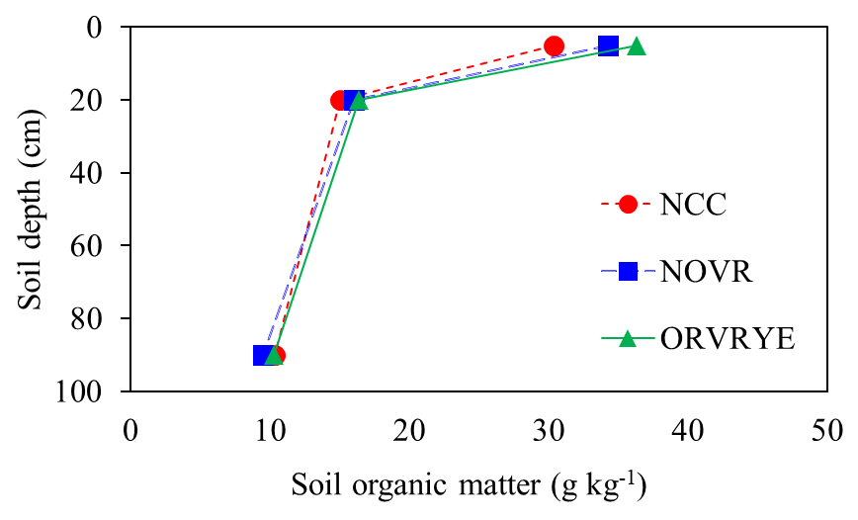
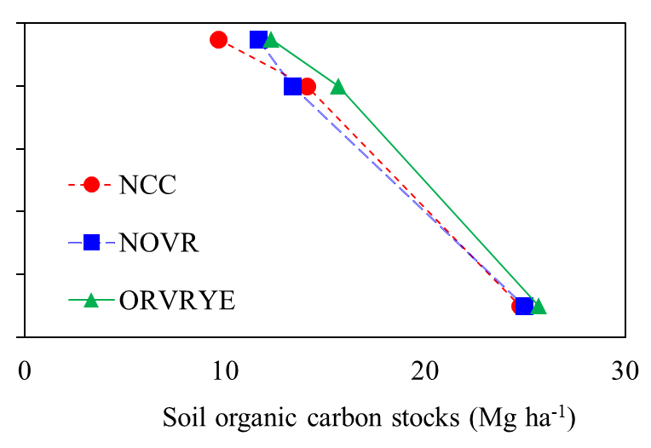
b
--a--
b
--a--
ns
ns
ns
ns
(A)
(B)
Figure 7. Soil organic matter (left) and soil organic carbon stocks (right) as influenced by cover crops (NCC, NOVR, and ORVRYE) over three depths (0-5, 5-20, and 20-90 cm).
NCC: no cover crop; NOVR: no cover on corn row, Vetch on middle row, and rye on the outside row; ORVRYE: Oats and radishes on the corn row, vetch on the middle row, and rye on the outside row.
Different letters indicate differences among treatments (P<0.05).

