Slide 1
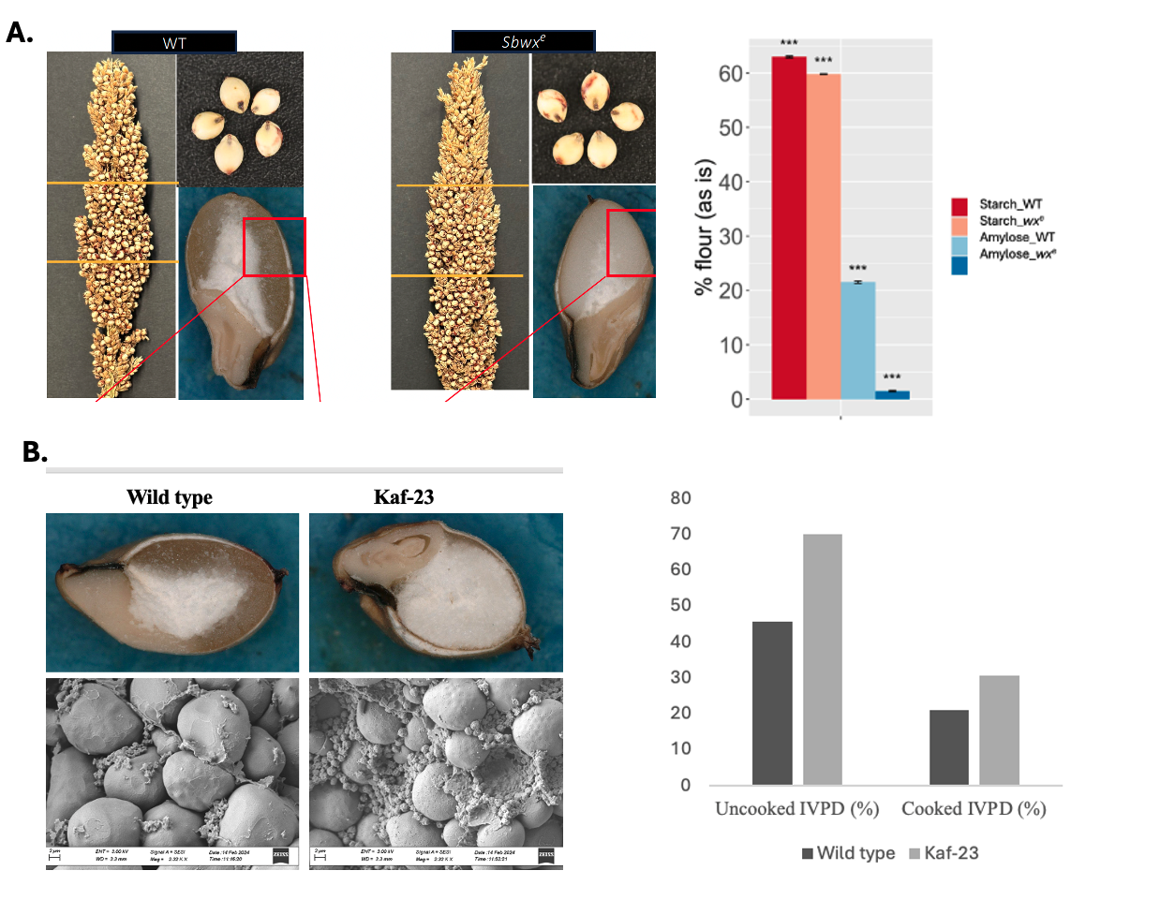
Figure 1. A). Left: The image of the kernel of the wild type and waxy endosperm sorghum; Right: the reduced the amylose content in the waxy mutant (Pallavi et al., under review); B). Left: The image of the kernel of the wild type and high protein digestible mutant. Right: the increased protein digestibility of the kaf23 mutant by in vivo analysis (Application Number: PCT/US25/21601 )

Slide 2
Figure-2: The overall methodology for generating the breeding population by the crossing events and validation for the enriched silage sorghum lines
High Starch Digestibility (Waxy)
High Protein Digestibility (kaf23)
F1 Population (AaBb)
(Preliminary data)
Obj.1
Obj.2
AaBb
Silage Sorghum
AaBb
(Backcrossing-1; BC₁F₁)
Selfing
(Backcrossing-2; BC₂F₁)
Segregating F2 population
(Backcrossing-3; BC₃F₁)
(Backcrossing-4; BC₄F₁)
Homozygous F2 Selection
Selfing
Homozygous F2 Selection
Nutrient-enriched Silage Sorghum
Characterization of homozygous F2 seeds

Slide 3
Table-1: Methodology for analyzing Protein and Starch Content along with Physical and Structural Seed Trait Evaluation
Trait/Parameter or Component | Method/Instrument | Sample Details
Kernel hardness, weight, diameter | Single Kernel Characterization System (SKCS) | 3 replicates of 100 kernels per line
Kernel vitreosity | Digital microscopy and image analysis | 10 longitudinally bisected kernels per line
Seed density | Gas pycnometry (Anton Paar Ultrapycnometer 5000) | Whole seed samples
Starch granule morphology | Cryo-SEM (Hitachi S3400, Phenom Pharos SEM) | Fresh developing seeds, freeze-fried
Endosperm structure (mature seed) | FIB-SEM (Zeiss Crossbeam 540) | Mature seeds, iridium coated
Starch granule size analysis | ImageJ software | SEM images at varying magnifications
Histology (starch/protein localization) | Light microscopy (Olympus BX53) with Lugol & Coomassie staining | Paraffin sections of developing seeds
Total Protein Content | LECO FP828 Nitrogen Combustion Analyzer | Ground grain samples; converted using 6.25 factor
Moisture Content (for dry basis) | Near-Infrared Spectroscopy (Perten DA-7250) | Same samples as above
Kafirin Content | Reverse-Phase HPLC | Lyophilized powder from seeds at 11, 16, 21 DPA
Total Starch Content | Megazyme K-TSTA Kit with GOPOD assay | Udy-milled meal (100 mg per assay)
Apparent Amylose Content | Iodine-binding spectrophotometry (A620) | DMSO/urea solubilized meal
Amylose Standard Curve | Reference amylose and amylopectin | Potato (Megazyme) and maize (Sigma) standards

Slide 4
High Starch Digestibility (Waxy)
(Sbwx^{e} )
High Protein Digestibility (HPD)
(kaf23)
Fig-3: Objective-1 showing Pre-breeding by introgression backcrossing to develop high-nutrition silage sorghum
F1 Population
(AaBb)
(Preliminary data)
AaBb
Silage Sorghum
(A²A²B²B²)
KASP genotyping for screening.
- Heterozygous carriers (A²aB²b)
- Homozygous double recessive (aabb) in BC4F2.
Genotyping strategy – MAS (Marker-Assisted Selection)
KASP Marker Design
KASP PCR - Bio-Rad CFX96 with PACE™ 2.0 Master Mix.
DNA Extraction– Modified CTAB Method
(Backcrossing-1; BC₁F₁)
50% silage background
Silage A²aB²b x Silage A²A²B²B²
(Backcrossing-2; BC₂F₁)
75% silage background
Silage A²aB²b x Silage A²A²B²B²
(Backcrossing-3; BC₃F₁)
87.5% silage background
Silage A²aB²b x Silage A²A²B²B²
(Backcrossing-4; BC₄F₁)
93.75% silage background
Selfing
Homozygous F2 Selection (aabb)
Nutrient-enriched Silage Sorghum

Slide 5
High Starch Digestibility (Waxy)
High Protein Digestibility (kaf23)
F1 Population (AaBb)
(Preliminary data)
Single Kernel Characterization System (SKCS)
- Hardness Index-
- Kernel weight
- Kernel diameter
Structural Seed Imaging
- Digital Microscopy
- SEM / Cryo-SEM / FIB-SEM
- Light Microscopy
- Image Analysis Tool: ImageJ
Protein Content
- LECO FP828 (combustion analyzer)
- NIR spectroscopy
Kafirin Protein Analysis
- Reverse-Phase HPLC
Starch Analysis
- Megazyme K-TSTA kit
- Iodine-binding assay
Metabolome and transcriptome analysis
Selfing
F₂ Population Generation – Selfing
Growth and phenotyping for agronomic and silage traits
Genotyping & Selection (KASP Markers)
- select homozygous recessive (aabb)
Segregating F2 population
Homozygous F2 Selection (aabb)
Characterization of homozygous F2 seeds
Fig-4: Objective-2 evaluating the combined impact of high protein and high starch digestibility traits

