Slide 2
Research Problem and Objectives
Problem: Traditional agricultural tools are often designed for male body sizes, causing ergonomic mismatches that increase musculoskeletal disorder (MSD) risks among women farmers.
Simulate
Test
Design
Goal:
Develop ergonomic auxiliary handles for shovels and pitchforks tailored to women.
Objectives:
Develop ergonomically adaptive auxiliary handles
Reduce MSD risks during farm tasks
Improve comfort, posture, and ease of tool use for women farmers

Slide 3
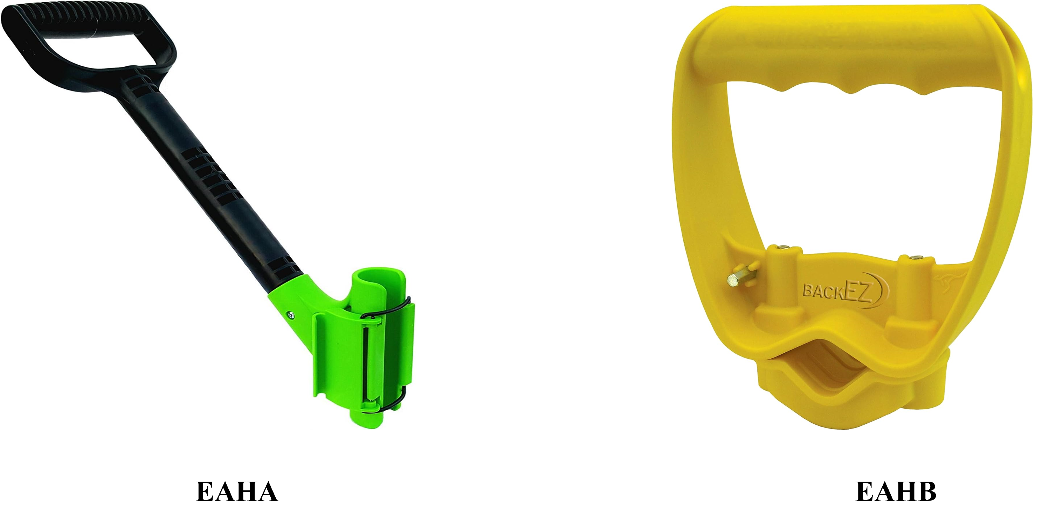
Research Motivation & Preliminary Findings
Baseline Findings (Conventional vs Ergo)
Hip Flexion: 60° → 44°
Wrist Flexion: 79° → 47°
Energy Expenditure: 4.98 → 4.29 kJ/kg
Elbow Strain: Increased slightly (Design Trade-off)
Key Insights Driving Innovation
Rigid handles improved posture but increased elbow strain
Ergonomic improvement was offset by new joint stress
Static designs couldn't balance all biomechanical needs
Need for adjustable, adaptive, and inclusive solutions
Ergonomic Auxiliary Handle (EAHA)
Ergonomic Auxiliary Handle (EAHB)

Slide 4
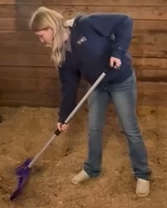

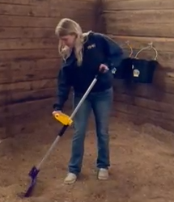

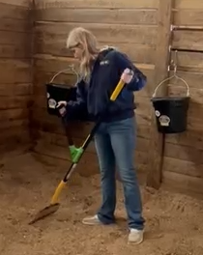
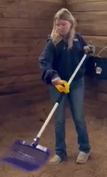
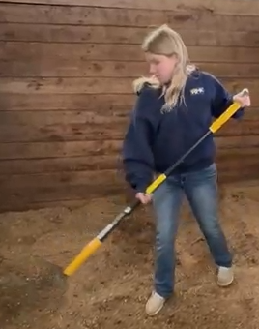
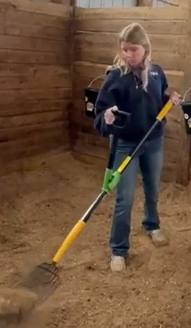
Postural and Joint Angle Comparison Across Tool Designs
+60°
(+4)
🔴
(+3)
🟡
0-20°
(+2)
🟢
20°-60°
Conventional Tool
Ergonomic Modified Tool (EAHB)
Ergonomic Modified Tool (EAHA)
LIFTING
Trunk flexion > 60° Poor posture
Medium trunk flexion < 60°(poor)
More upright posture angle > 20°
(+2)
🟡
(+1)
🟢
100°+
(+2 +1)
🔴
Elbow flexion angle (better Improved handle position)
Elbow flexion angle < 100° (increased strain)
THROWING
Elbow flexion angle < 60°
60-100°
(increased strain)
0-60°

Slide 5
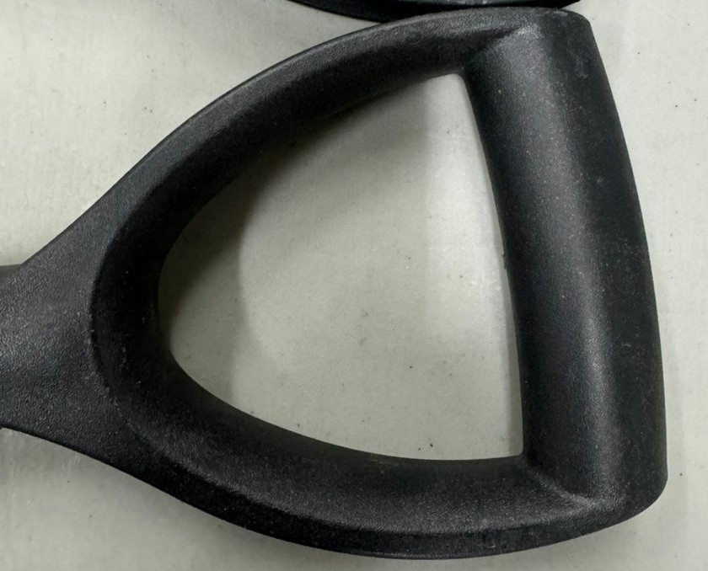
Methodology – Human-Centered Design Approach
Ergonomic Design
Used NIC (Natural Inward Curved) grip to support neutral wrist posture
Chose handle lift angles: 16°, 32°, 48°
Anthropometric Fit
Based on CAESAR, BIFMA, Dreyfuss, Woodson
Handle height: 700 - 1100 mm (adjustable in 20 mm steps)
Grip diameter: 35 - 40 mm for women’s hand comfort
Covers 1st - 99th percentile of female users
Prototype & Testing
Created ErgoFlex 1, 2, 3 with adjustable features
Posture Simulations/Lab-tested for posture (REBA/RULA) and comfort
Improved through user feedback and motion capture analysis
Notes:
🔍 Ergonomic Design
Used NIC (Natural Inward Curved) grip to support neutral wrist posture (~12° ulnar deviation)
Chose angles: 16°, 32°, 48° to match natural scooping and lifting motion
👩‍🔧 Anthropometric Fit
Based on CAESAR, BIFMA, NASA HIDH, Dreyfuss, Woodson
Handle height: 700–1100 mm (adjustable in 20 mm steps)
Grip diameter: 35–40 mm for women’s hand comfort
Covers 1st–99th percentile of female users
🛠️ Prototype & Testing
Created ErgoFlex 1, 2, 3 with adjustable features
Lab-tested for posture (REBA/RULA) and comfort
Improved through user feedback and motion capture analysis

Slide 6
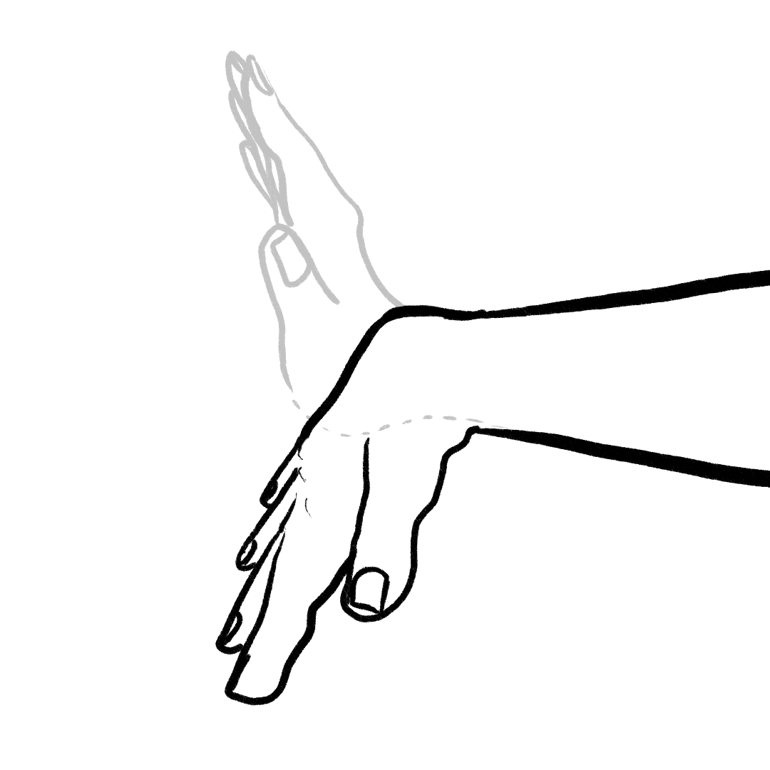
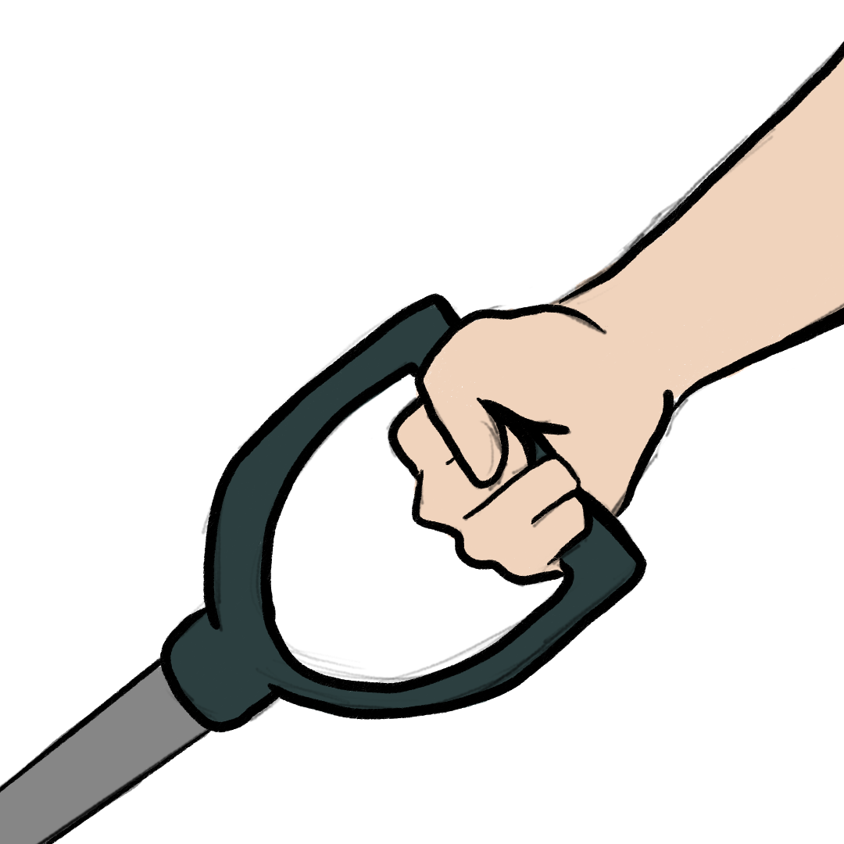
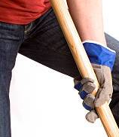
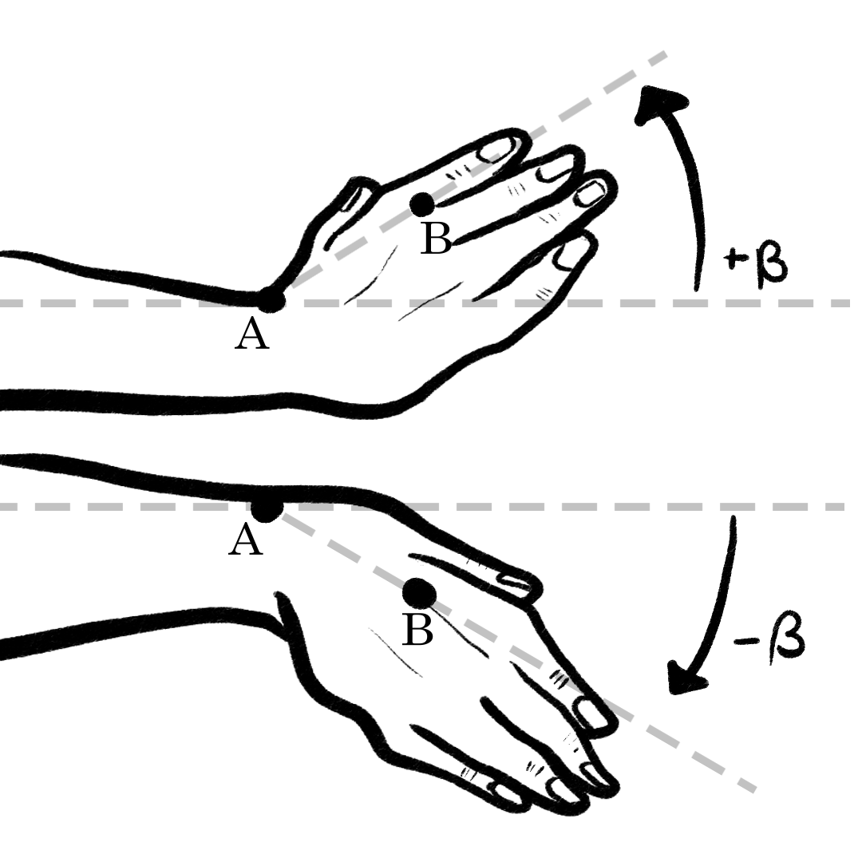
Technical Justification - Biomechanical Optimization
NIC (Natural Inward Curved) grip keeps wrist in neutral (>12° ulnar deviation)
Based on ergonomic principle: "Bend the tool, not the wrist"
Preset ergonomic angles: 16°, 32°, and 48°
Wrist angle comparison
Flexed Wrist Neutral Wrist
NIC Handle
(+3)
🔴
(+1)
🟢
Extension
Flexion
Neutral Wrist
0°
< 22°
Radial Deviation
Reduce Strain
Ulnar Deviation

Slide 7
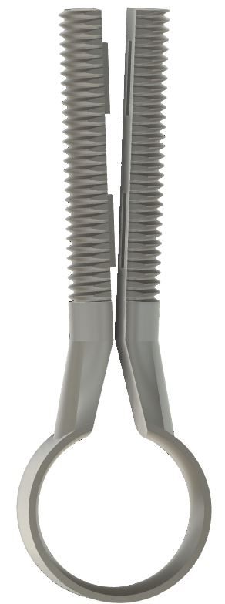
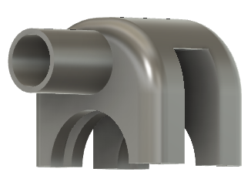
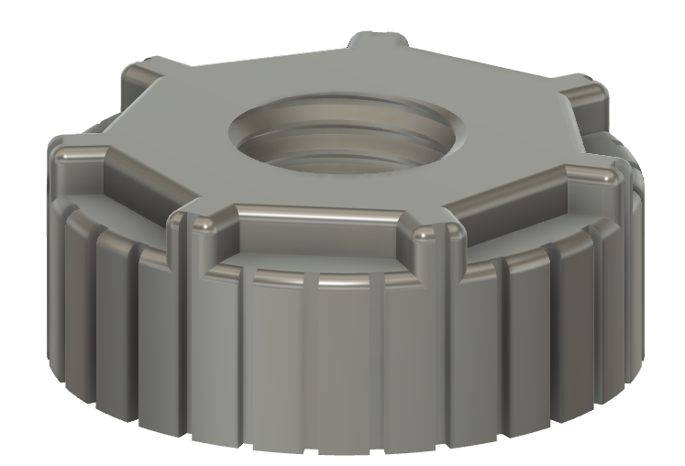
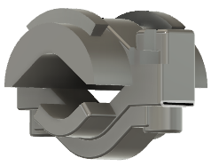
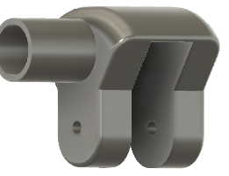
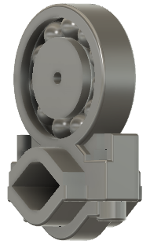
Technical Justification - Mechanical Design
Castle Nut + Cotter Pin System:
Secure under vibration
Slider Clamp + Sliding Housing:
Linear Micrometer grip adjustment
Ball-Bearing Joint:
Smooth rotation, less wear
Threaded Clamp
Castle Nut
Slider Clamp
Ball-Bearing

Slide 8
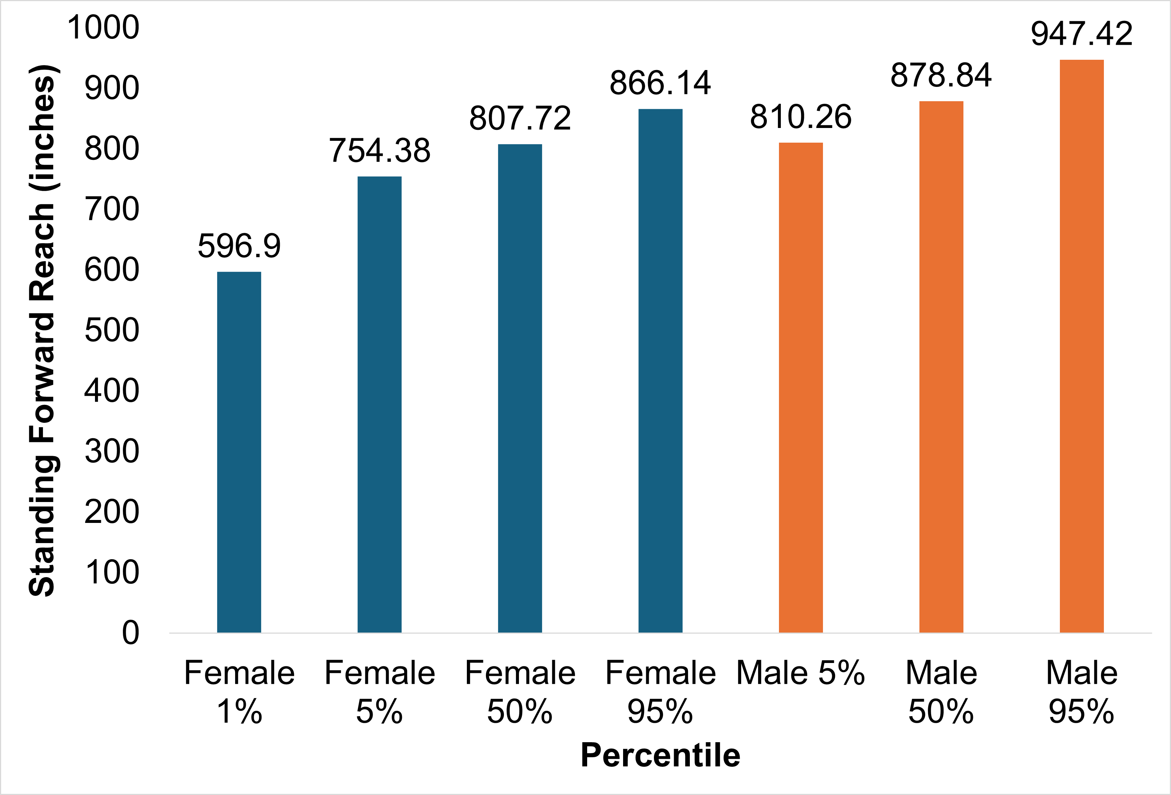
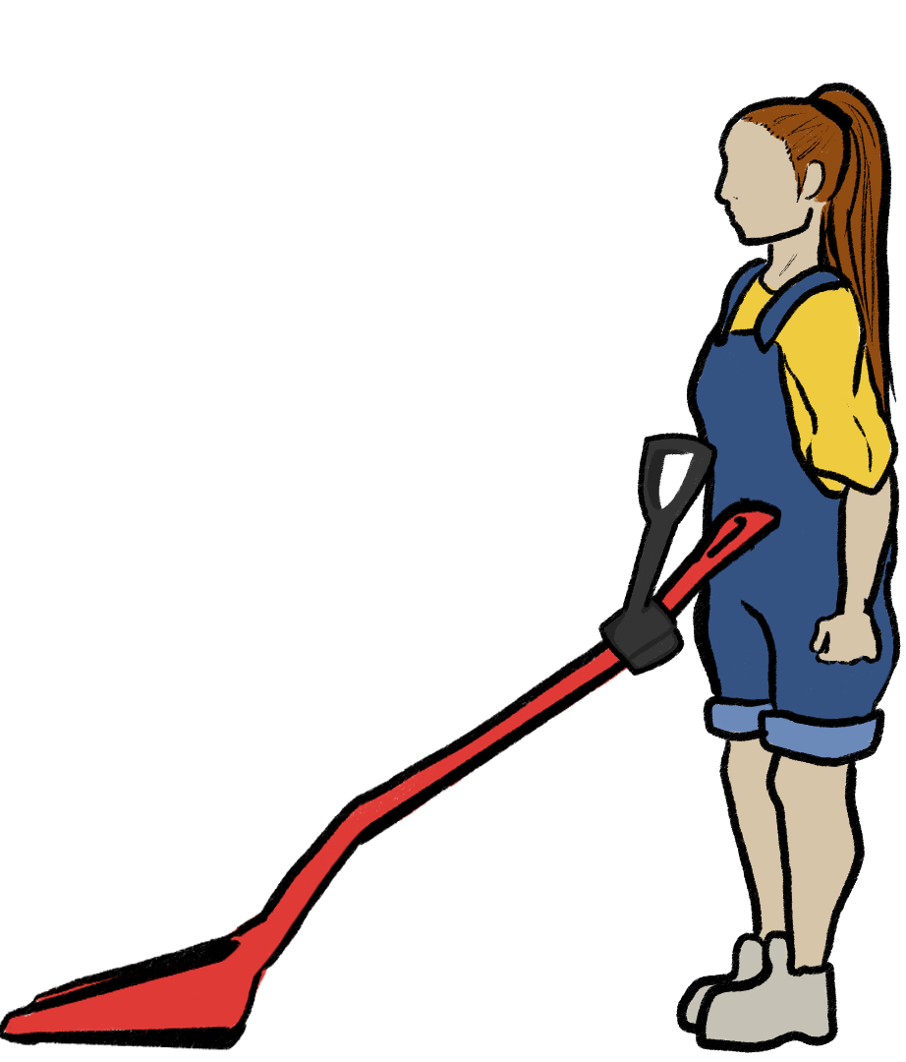
Anthropometric Basis for Design
Key Parameters:
Handle Height: Adjustable from 590 mm to 1100 mm
NIC Grip Diameter: 35 - 40 mm (women's comfort range)
Target Elbow Height: Matches 1st to 99th percentile
Data Sources: CAESAR, BIFMA, Woodson, Dreyfuss
Ergonomic reach zone
Notes:
Interpretation:
The female range (1st–95th percentile) varies from 23.5″ to 36.1″, depending on source.
The male range spans from 31.9″ to 39.5″.
Designing for tool grip forward reach should accommodate approximately 30″–36″ to cover the majority of female users, and 32″–39″ for males.

Slide 9
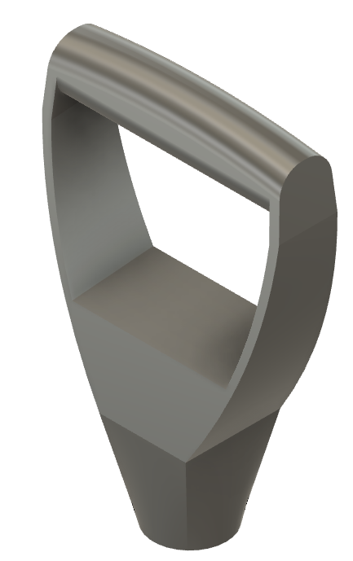
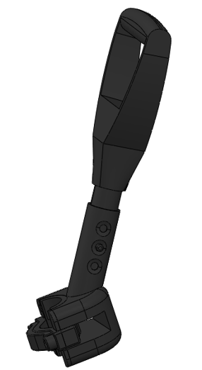
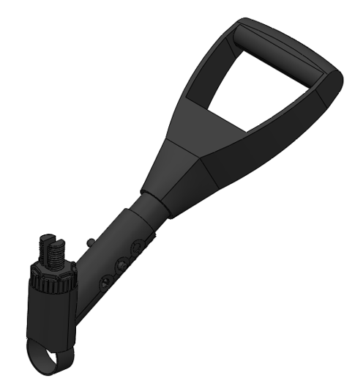
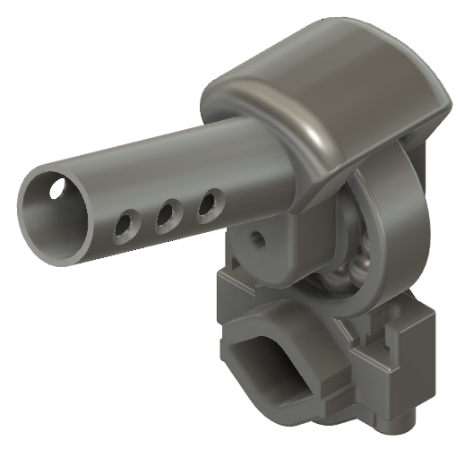
Design Concept
ErgoFlex-1
ErgoFlex-2
ErgoFlex-3
Natural Inward Curvature (NIC) D-grip
Natural Inward Curvature (NIC) D-grip
Natural Inward Curvature (NIC) D-grip
Adjustable Height (20mm Increment)
Adjustable Height (20mm Increment)
Adjustable Height (20mm Increment)
Preset lift angle
16º 32º 48º
Preset lift angle
16º 32º 48º
Preset lift angle
16º 32º 48º
±45º
Dual rotation support
± 360º Rotation

Slide 10
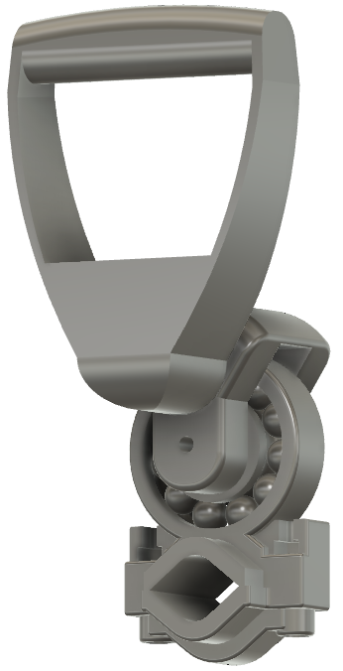
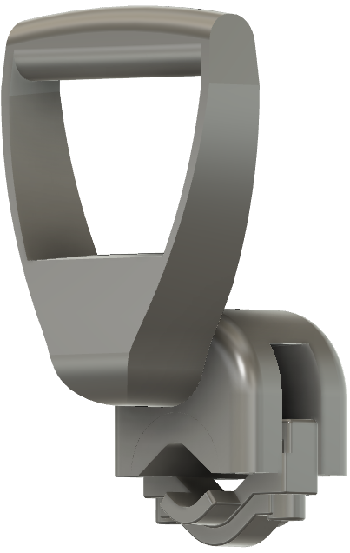
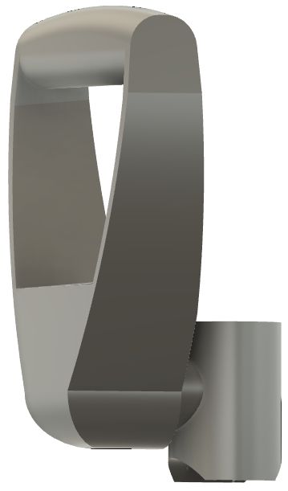
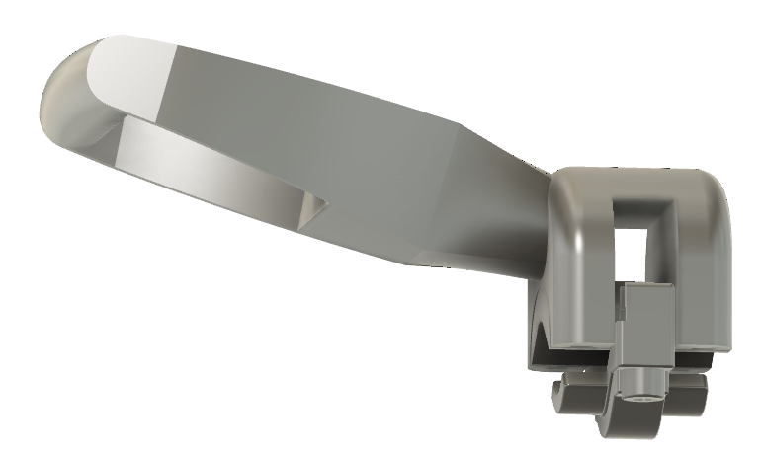
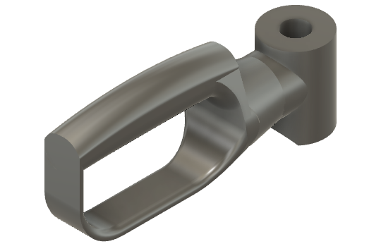
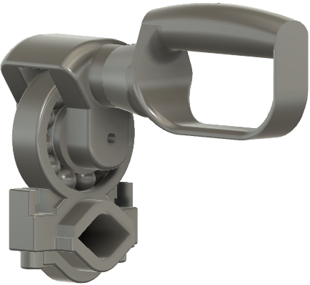
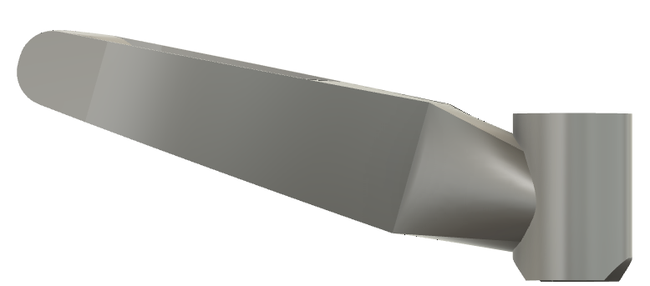
ErgoFlex Handle Prototypes
ErgoFlex-1
ErgoFlex-2
Dual rotational support (±45°)
Flexible clamping system (±360° full rotation for alignment)
ErgoFlex-3
Ball bearing Locking system (±60° rotation both ways)
Notes:
Interpretation:
The female range (1st–95th percentile) varies from 23.5″ to 36.1″, depending on source.
The male range spans from 31.9″ to 39.5″.
Designing for tool grip forward reach should accommodate approximately 30″–36″ to cover the majority of female users, and 32″–39″ for males.

Slide 11
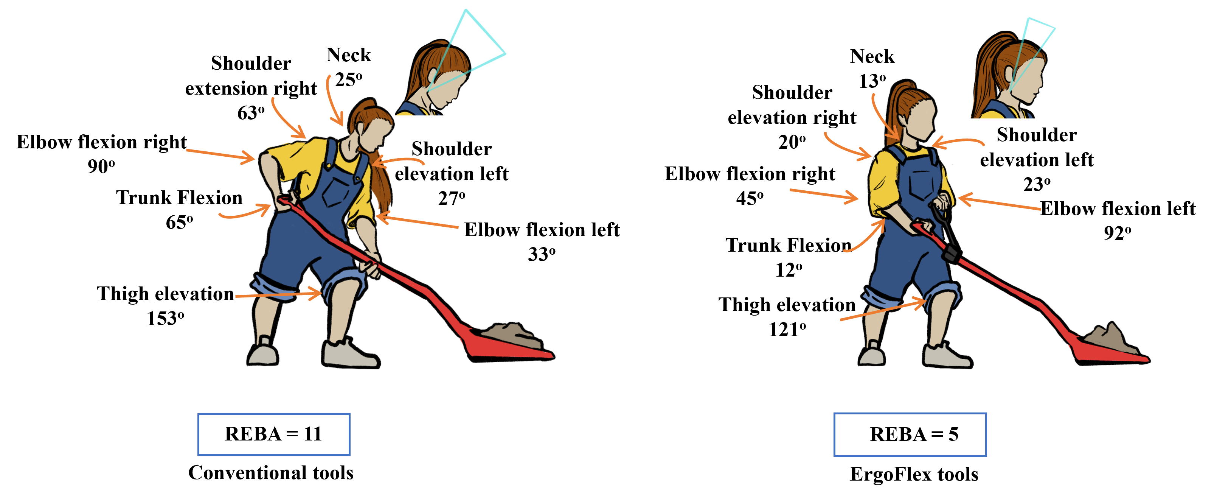
Results (Ergonomic Evaluation - lifting and scooping straw)
Posture Simulations Using RULA and REBA
Simulated common tasks: lifting and scooping straw
REBA score dropped from 11 → 5 with ErgoFlex
Reduced trunk and wrist strain, better elbow/shoulder alignment
Notes:
Measured Results:
REBA Score: Reduced from 11 to 5 (high to medium risk)
RULA Score: Improved wrist/elbow postures
User Feedback: Reported higher comfort and control

Slide 12
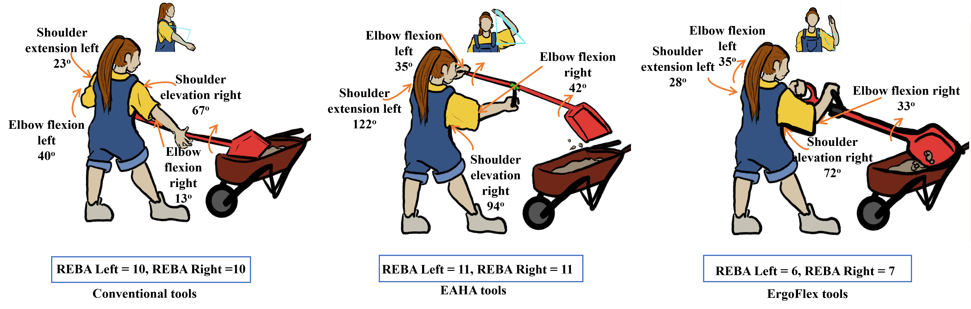
Results ( Ergonomic Evaluation-throwing straw)
Posture Simulations Using REBA
Simulated common tasks: throwing straw
REBA score increased from 10 → 11 with EASA dropped from 10 → 7 ErgoFlex
Increase elbow/shoulder alignment

Slide 13
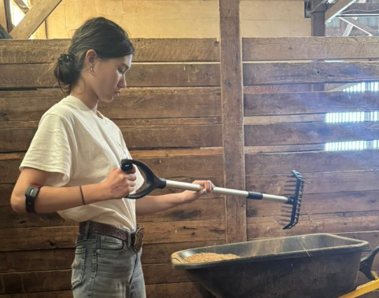
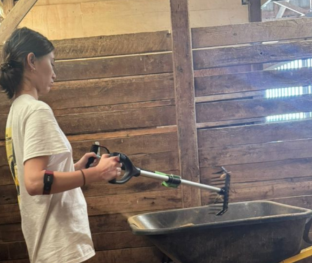
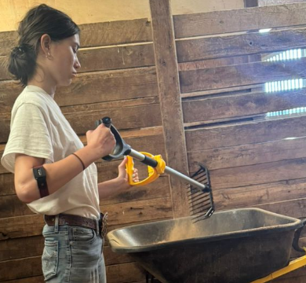
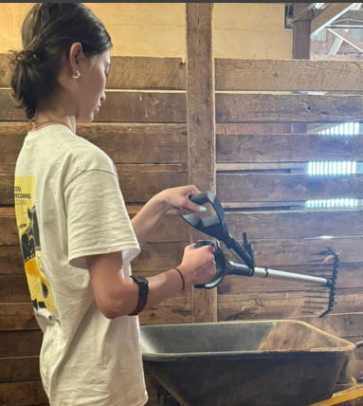
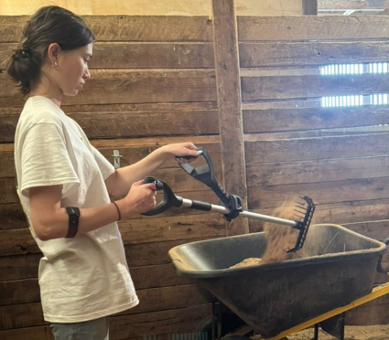
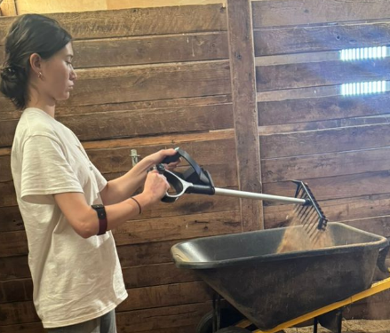
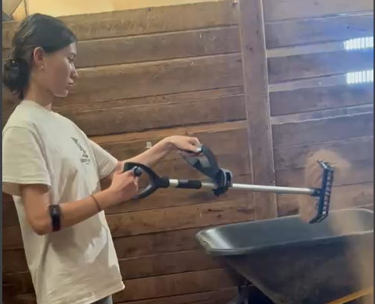
Discussion
CONVENTIONAL
EAHA
EAHB
NIC grip and adjustability reduce strain, improve usability
Designs inclusive of 1st - 99th percentile body sizes
Castle nut system proved durable during repetitive motion
Findings validated by REBA/RULA scores and anthropometry
Increased Elbow Flexion & Wrist Deviation
High Elbow Load & Lateral Bending (Fixed Handle)
Moderate Elbow Load & Side Bending (Fixed Handle)
ERGOFLEX
Participant feedback:
More stable grip
Feel easier on the back
Reduced Wrist Flexion via Rotational Joint
Reduced Side Bending & Shoulder Strain
Neutral Grip Alignment, Less Wrist Load

Slide 14
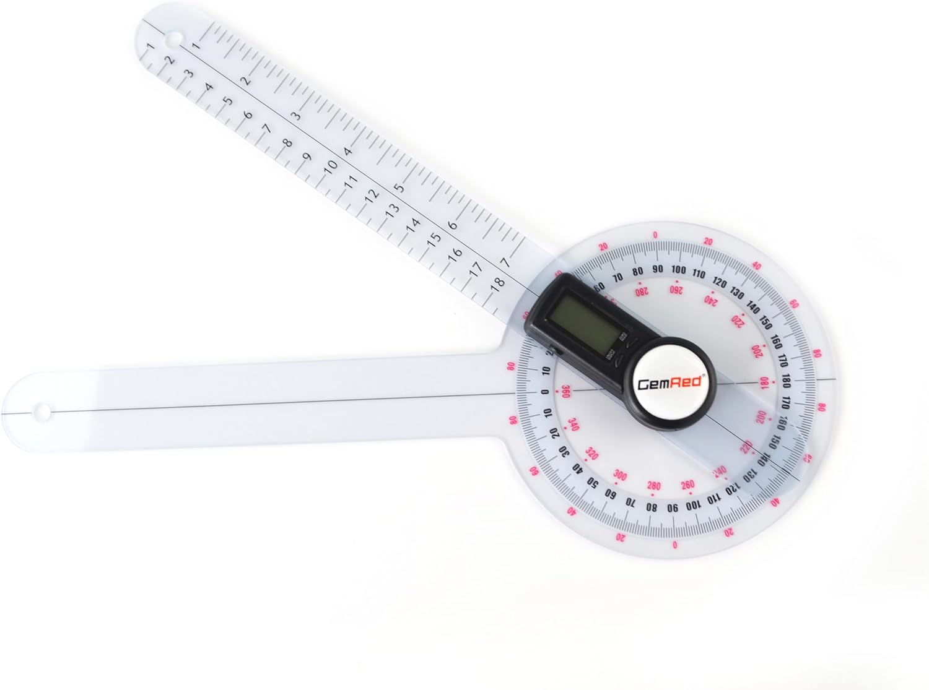
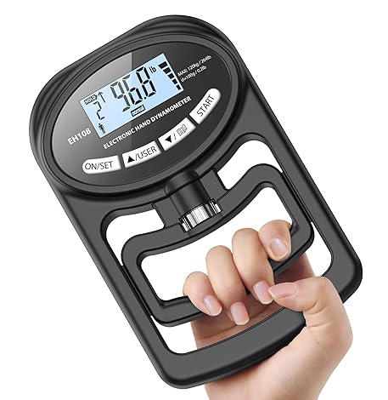
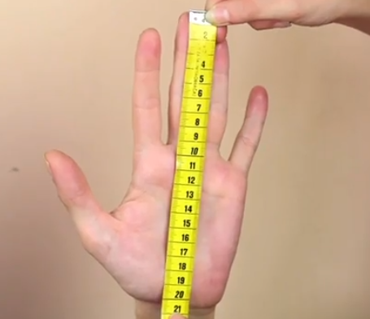
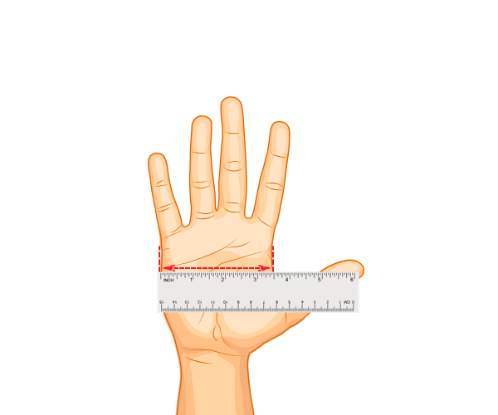
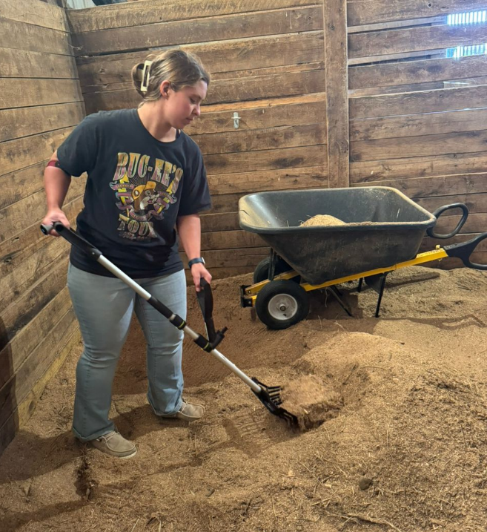
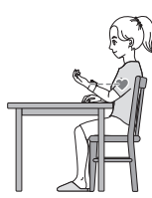
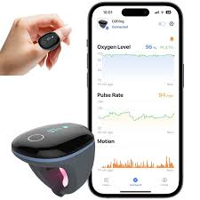
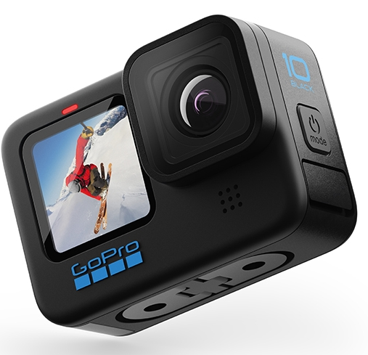

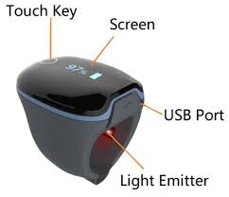
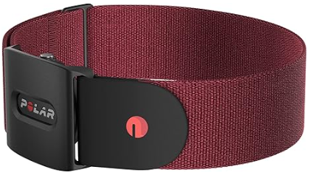


Future Work
What’s Next?
Real-world field validation (EMG, heart rate, posture sensors)
Modular quick-adjust handle design
Smart posture-correcting feedback system
Polar H10
Field Photo

Slide 15






Acknowledgments
North Central Sustainable Agriculture Research & Education (SARE) for their generous support and funding.
National Institute for Occupational Safety and Health (NIOSH) and the United States Department of Agriculture (USDA) for their support and guidance.
Jianfeng Zhou, Karen Funkenbusch, and Marcia Shannon, University of Missouri for their mentorship and guidance.
Aaron Yoder and Central States Center for Agricultural Safety and Health at the University of Nebraska Medical Center for their support.
Agricultural women at the University of Missouri who participated in this research study
Colleagues for their feedback and assistance.
Jianfeng Zhou
Karen Funkenbusch
Marcia Shannon
Noel Aloysius
Teng Teeh Lim
Notes:
Visual Aid: Summary infographic highlighting key findings and recommendations. Statement: "Future research will refine ergonomic designs for better health outcomes."
Imagine starting your day with the tools designed to ease your workload, but ending it with intense back pain and sore wrists. This is the daily reality for many women farmers using conventional tools. Our study aims to change that."

Slide 16


Thank you for your attention.
I’m happy to take any questions.
Let's talk or collaborate.
Felix Michael Oguche
PhD Student | Biological Engineering
📧 fofdt@umsystem.edu
🌐 https://farmtechforher.com
Let's revolutionize farm tools for a safer and more equitable future.

