Slide 1
UNDERSTANDING HOW AGRICULTURAL PRACTICES SHAPE MICROBIAL DYNAMICS AND SOIL HEALTH
SAKSHI PAUDEL
MS THESIS DEFENSE SEMINAR
DEPARTMENT OF MICROBIOLOGICAL SCIENCES

Slide 2
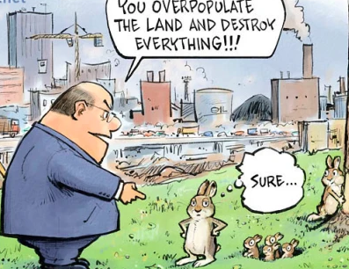
Introduction
Projected global population of 10.88 billion by 2100 (United Nations, 2022)
Steady growth of pesticide and fertilizer sales, projected to reach USD 309 billion by 2025 (United Nations Environment Programme, 2022)
Beyond the farm, loss of biodiversity and contribution to global warming
Notes:
Unsustainable farming practices and pressing issues like desertification, greenhouse gas emissions, soil nutrient depletion, the emergence of new pest strains, soil erosion, and deterioration of soil quality

Slide 3
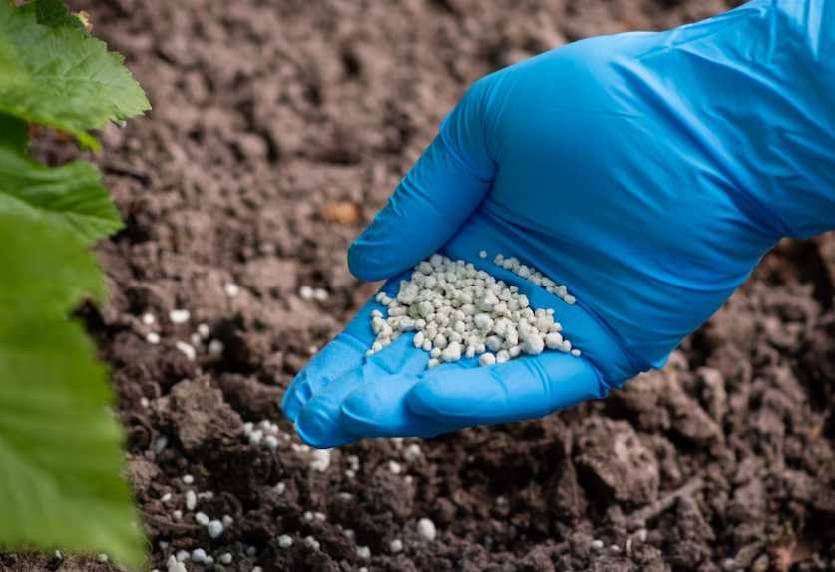
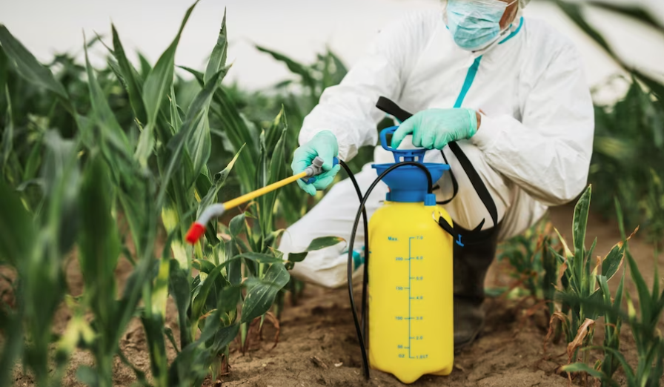
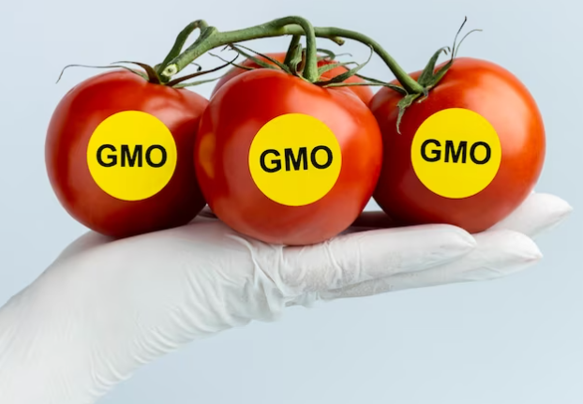
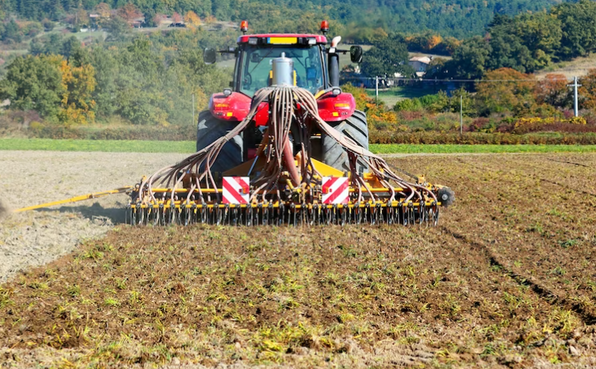
Conventional Farming
Chemical Fertilizers
Chemical plant protection
Capital intensive, large-scale, highly mechanized with monoculture of crops and extensive use of artificial fertilizers, herbicides, and pesticides, along with intensive animal husbandry.
A system that leverages modern technologies to optimize efficiency while also striving to preserve natural resources.
2022
1984
Genetically modified organisms
Intensive Tillage

Slide 4
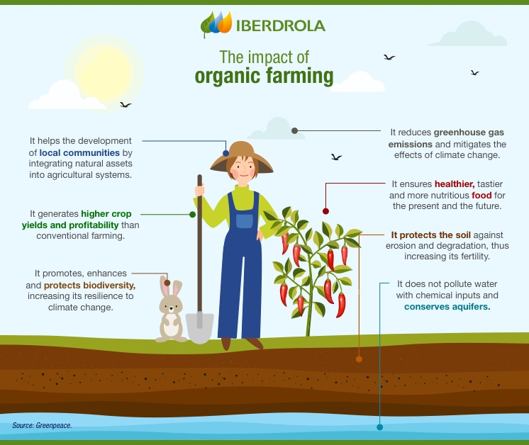
Organic Farming
Conservation of wetlands, woodlands, and wildlife, as well as the preservation or improvement of soil and water quality, and the avoidance of synthetic fertilizers, sewage sludge, irradiation, and genetic engineering

Slide 5
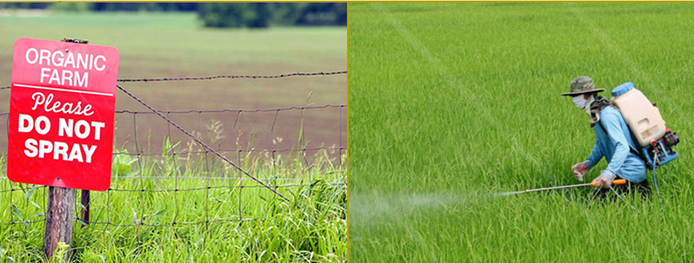
Organic and Conventional Farming
Employ natural processes and materials in the development of farming systems and adhere to certification standards, which strictly prohibit the use of chemical inputs
Use of chemical inputs for agricultural activities

Slide 6
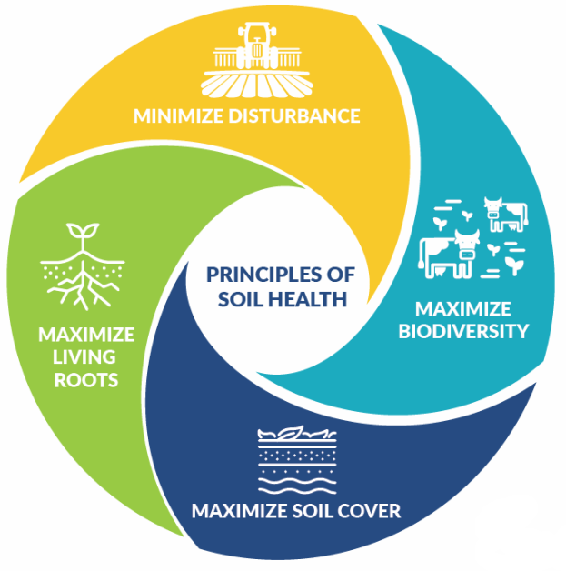
Soil Health
Persistent ability of soil to serve as a crucial living ecosystem that supports the well-being of plants, animals, and humans and establishes a connection between agricultural and soil sciences, addressing policy considerations, stakeholder requirements, and sustainable supply-chain management (Lehman et.al.,2020)
Natural Resources Conservation Service (NRCS), USDA

Slide 7
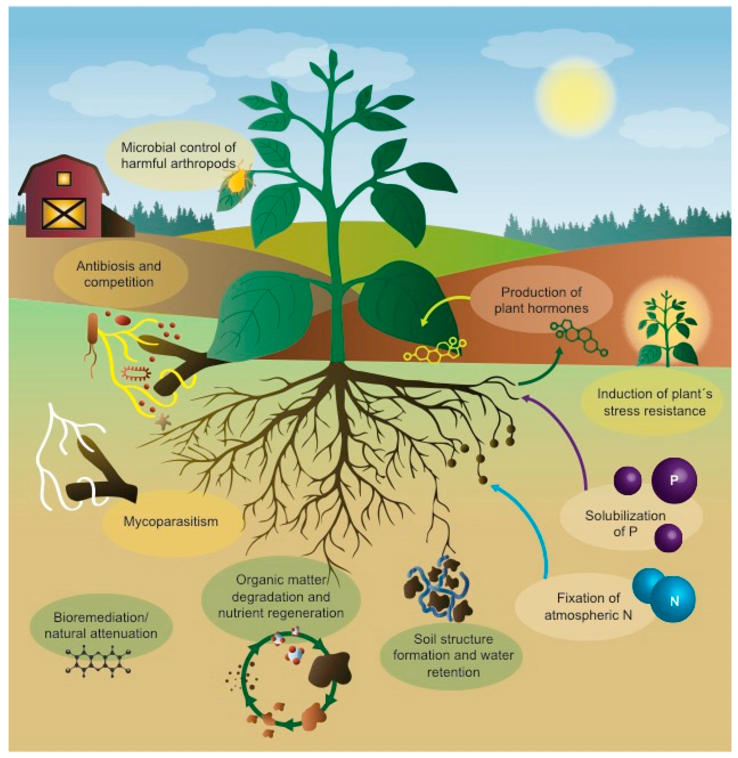
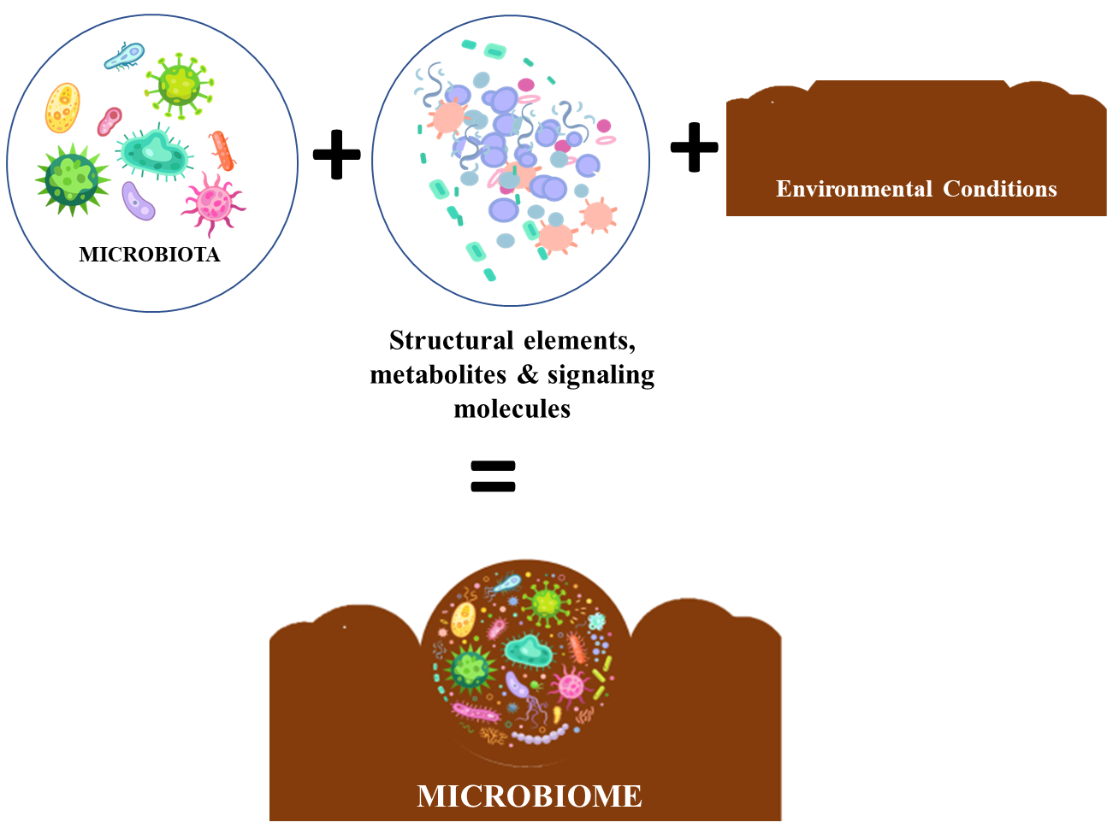
Microbes and Microbiome
Sundh,et.al.2021

Slide 8
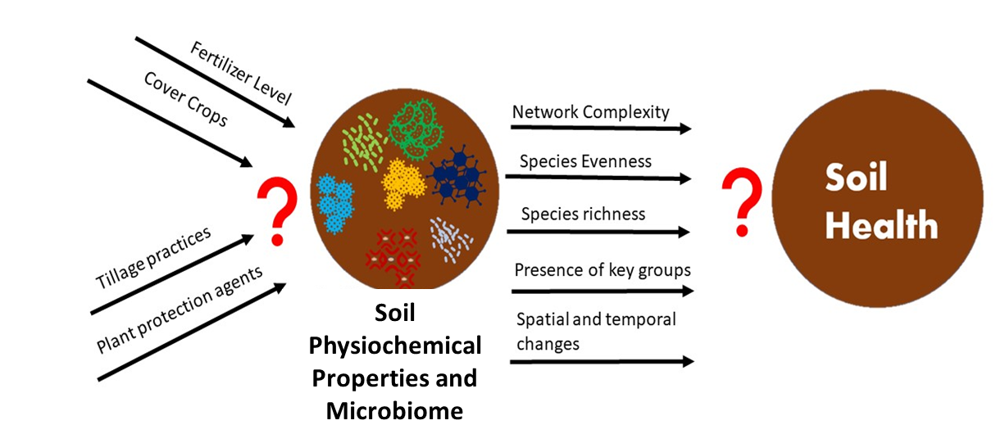
Agricultural practices, soil properties, microbial dynamics, and soil health

Slide 9
Objectives
Evaluate the effects of conventional and organic farming on soil physiochemical properties, mycorrhizal colonization, and microbial enzymatic activities
Derive a comprehensive soil health index for both farming systems by assessing physical, chemical, and biological soil indicators
Investigate microbial diversity, community composition, and network complexities in bulk soil and roots to understand the impact of different agricultural practices and inform sustainable farming strategies

Slide 10
Two chapters
Soil enzyme activities, mycorrhizal colonization, and soil health
Soil microbiome structure, composition, and network connectivity

Slide 11
Chapter 1: Soil enzyme activities, mycorrhizal colonization, and soil health

Slide 12
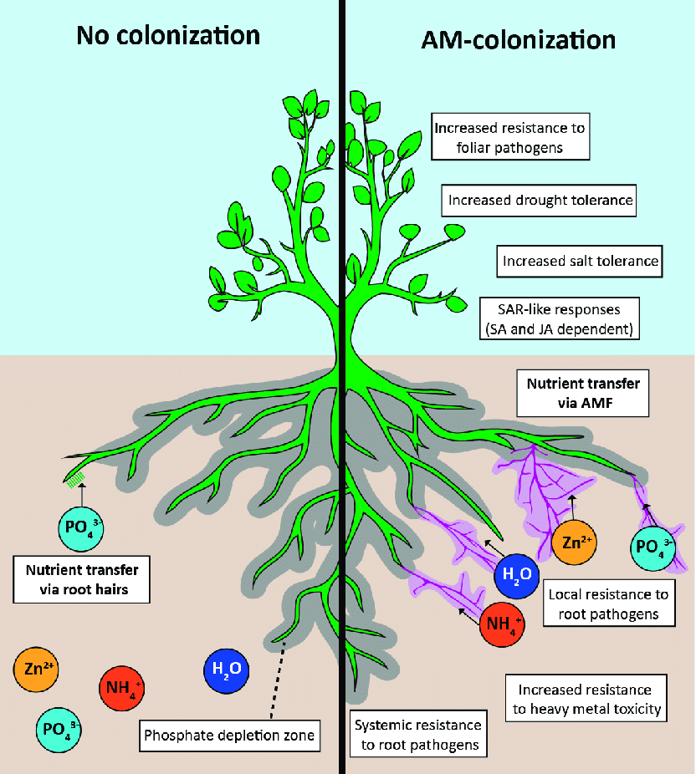
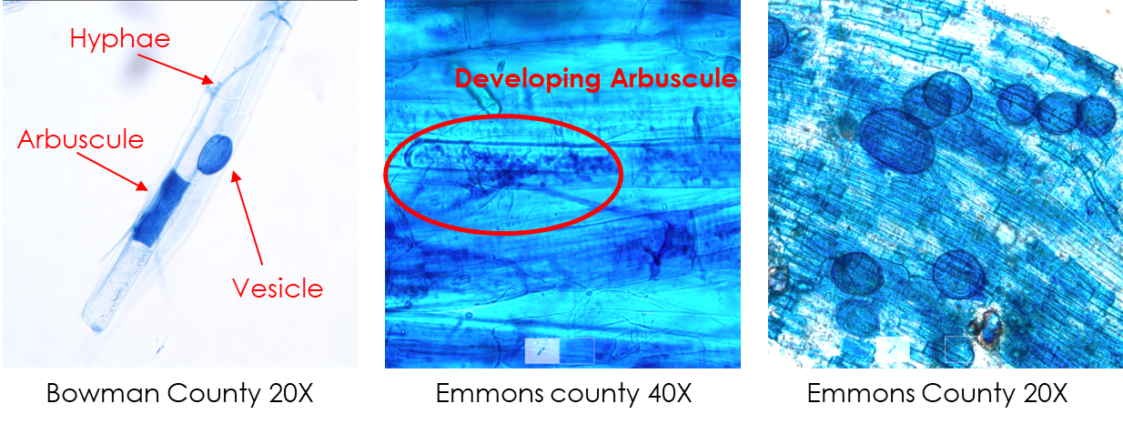
Mycorrhizal Colonization
Jacott et.al. 2017

Slide 13
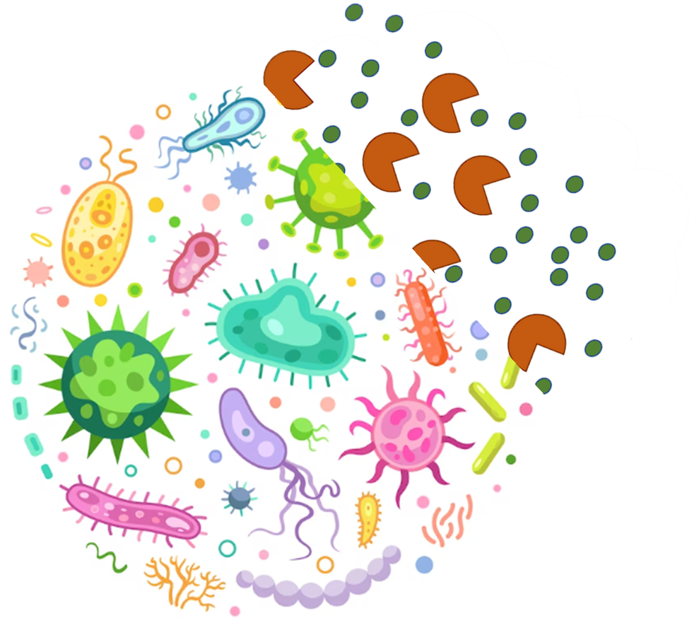
Extracellular enzyme activities
Play a vital role in nutrient cycling, organic matter decomposition, and soil ecosystem dynamics.
Phosphatase assists in breaking down organic phosphate compounds, releasing inorganic phosphate.
Glucosidase breaks down complex organic compounds like cellulose and hemicellulose into simpler forms, including glucose.
Cellobiohydrolase selectively cleaves cellulose chains and releases cellobiose units.
Chitinase breakdown chitin, a complex polysaccharide found in the cell walls of various organisms.

Slide 14
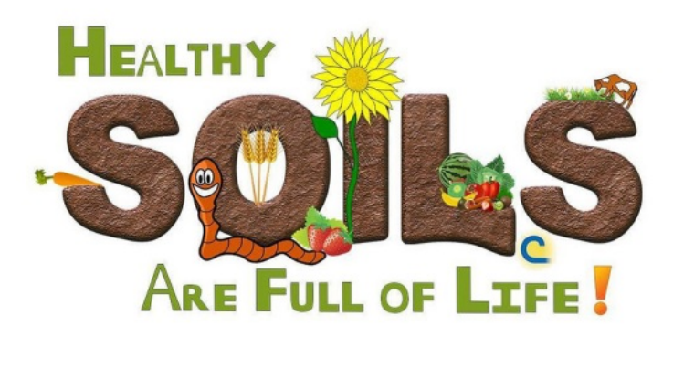
Soil Properties and Soil Health Index
Knowledge of soil properties helps farmers optimize fertilization and soil amendments, leading to better nutrient uptake by crops.
Healthy soil : good structure, nutrient availability, water-holding capacity, and biological activity.
Understanding soil quality and fertility, guiding informed decision-making, and targeted soil management.

Slide 15
Research questions and hypothess
1. What is the effect of organic and conventional farming practices on soil microbial enzyme activities involved in organic matter decomposition and nutrient cycling?
2. How does mycorrhizal colonization change with organic and conventional farming practices?
3. How does soil health, as indicated by the soil health index, vary between organic and conventional fields?
1. Organic fields have higher levels of mycorrhizal colonization macronutrients and extracellular enzyme activities compared to conventional farming.
2. Soil health index for organic fields will be higher compared to conventional fields.

Slide 16
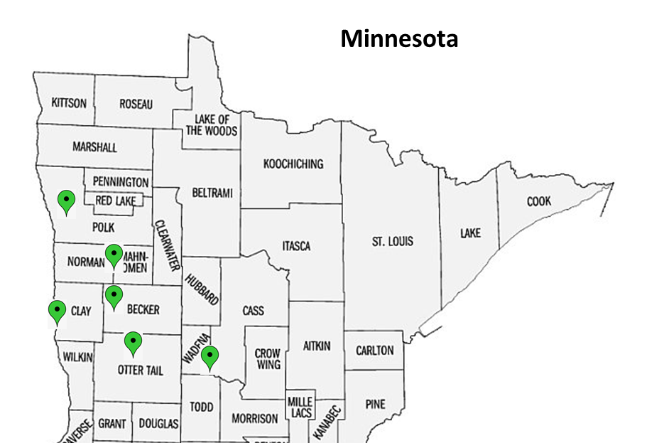
Survey and Sampling
North Dakota
17 Counties
61 Fields

Slide 17
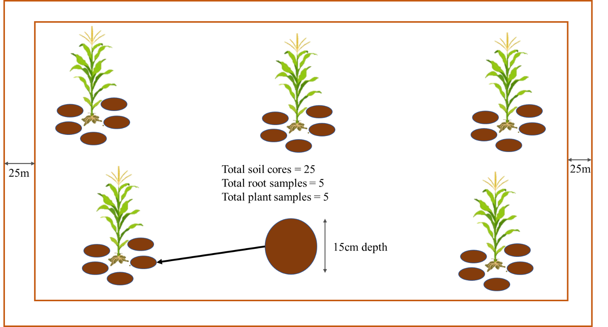
Survey and Sampling
Management Info:
Crop rotation
Tillage
Fertilizers
Pesticides
Drainage
Irrigation
Corn Variety
Year of Transition
Cover crop
Planting density
Samples collected
Bulk soil
Roots
Plant
Sample collection scheme

Slide 18
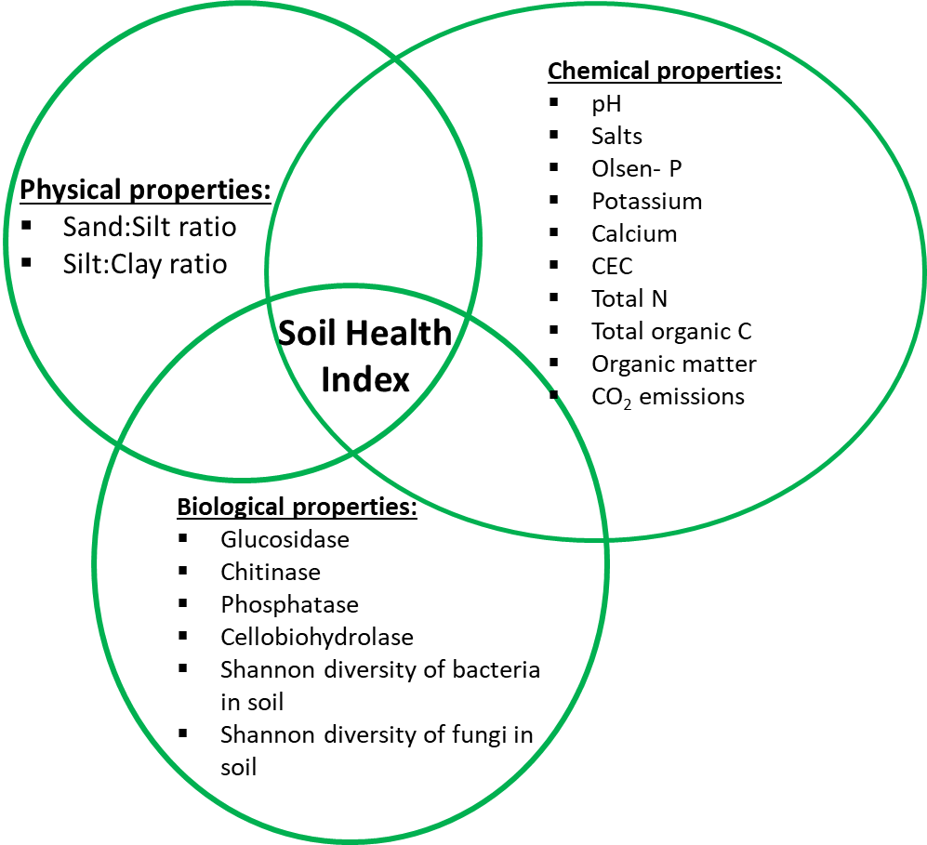
Soil Properties and Soil Health Index
Samples were sent to Agvise laboratories for physical and chemical properties assessment.
Fluorometric method involves utilization of 4-methylumbelliferone (MUB)-linked model substrates for enzymes assessment
Soil Health Index was calculated using the Z-Score approach.

Slide 19
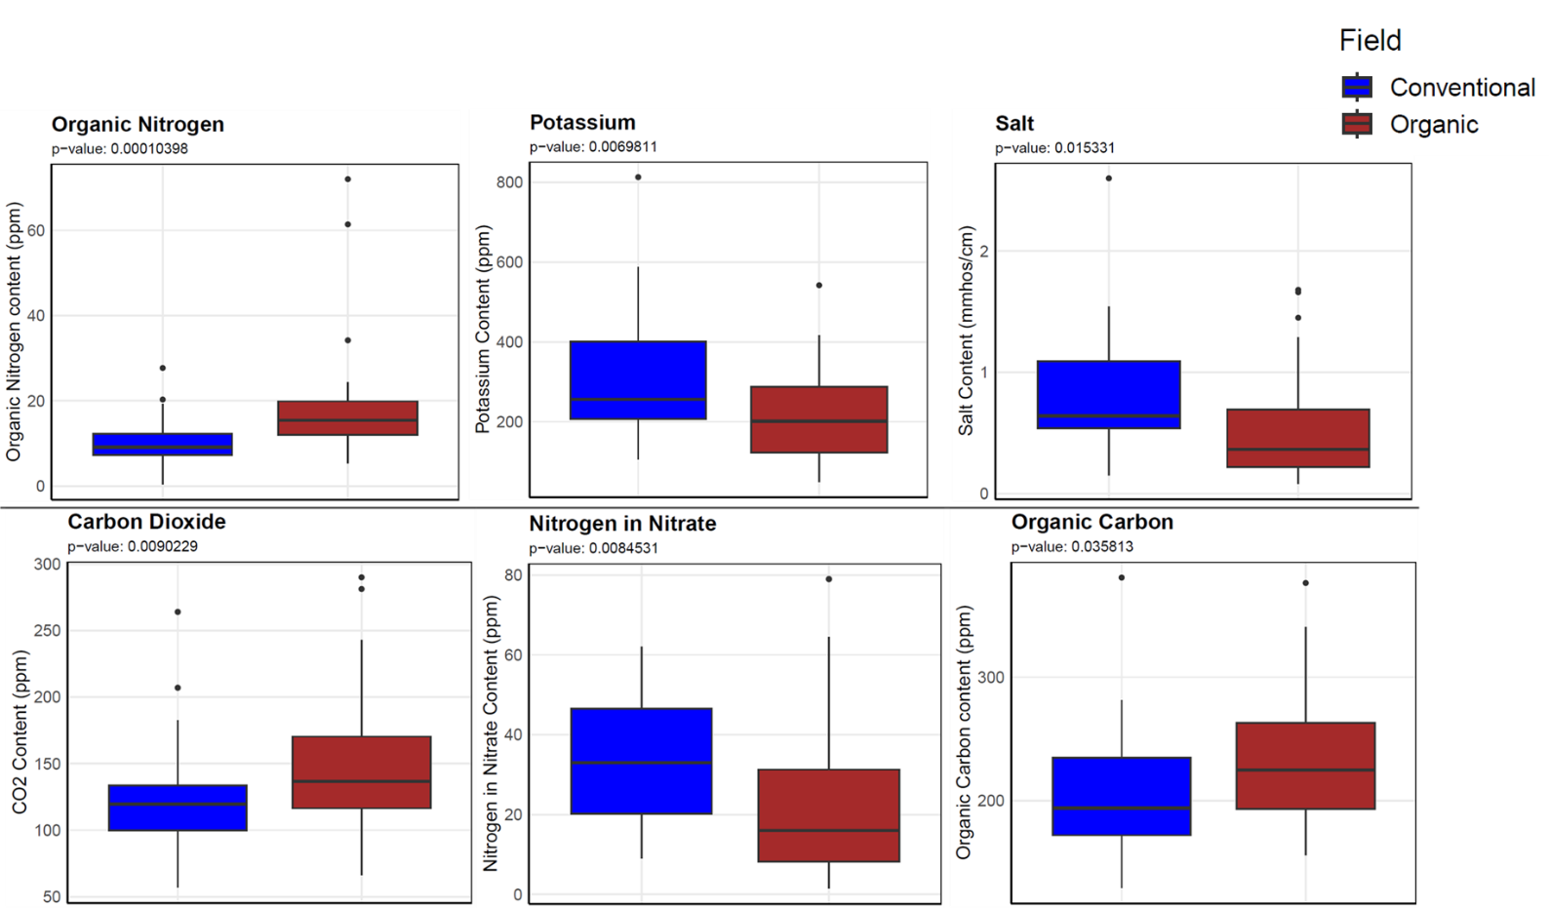
Soil properties
Use of organic amendments, implementing cover crops and perennial crops, and reduced reliance on mineral nitrogen fertilizers
Organic farming shows a consistent annual increase of 2.2% in soil organic carbon content (Leifeld and Fuhrer, 2010).

Slide 20
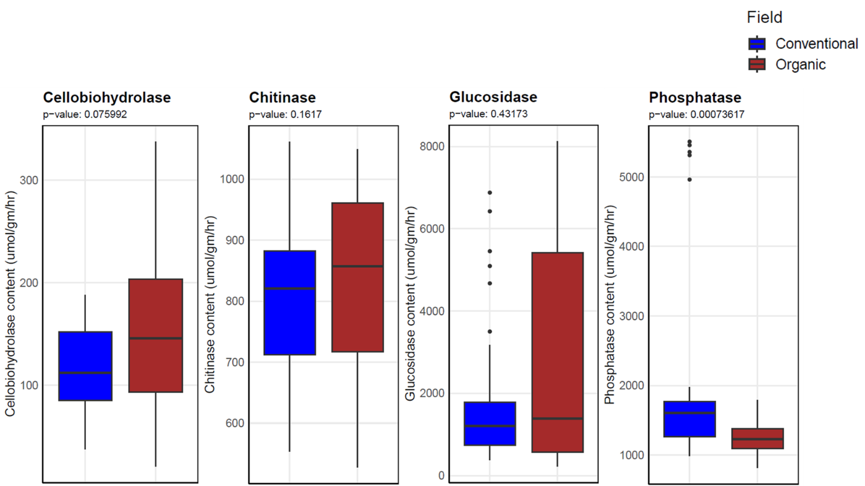
Extracellular enzyme activities
Phosphatase activities in the topsoil layer approx. 8 times higher in conventional farming than in organic farming (Maharjan et al., 2017)

Slide 21
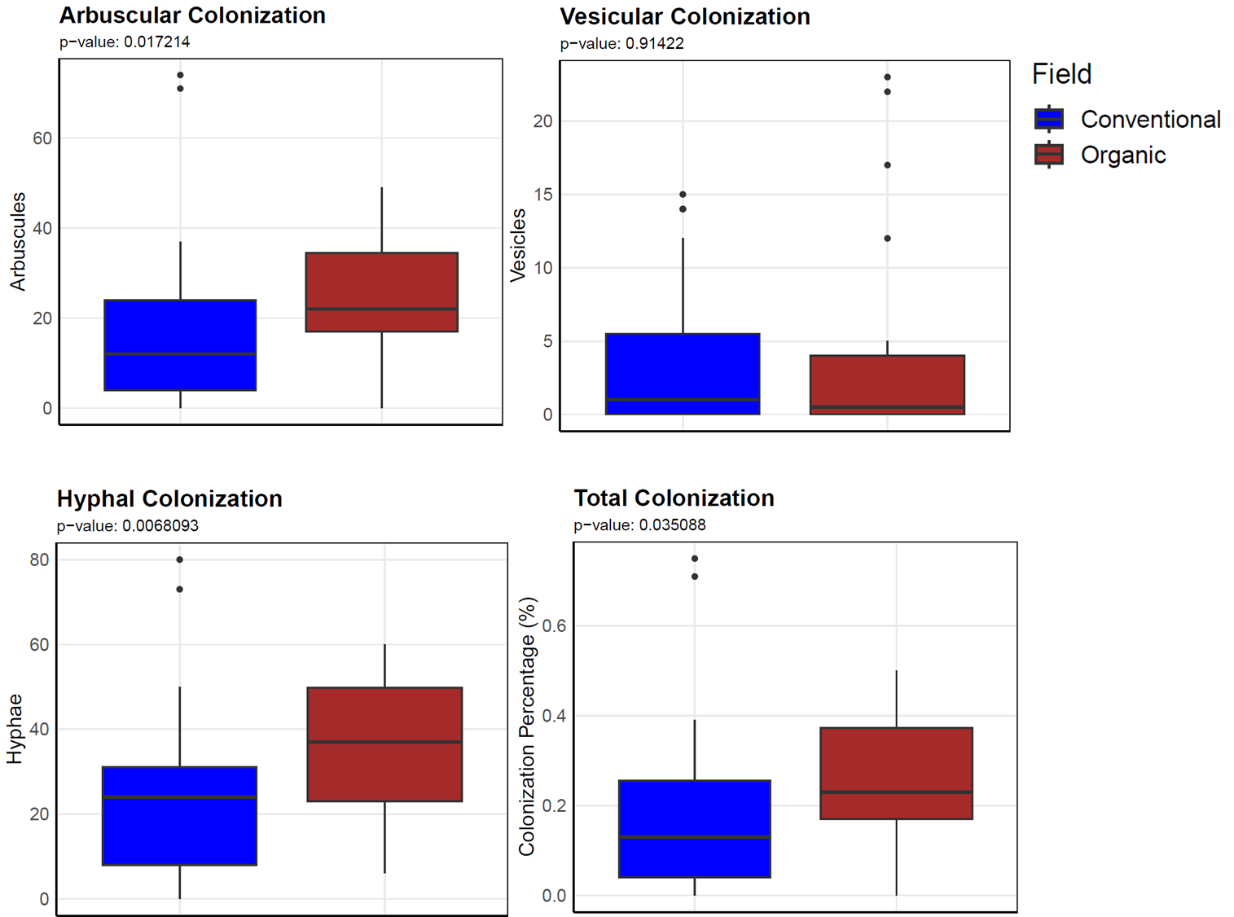
Mycorrhizal Colonization
Organic farms organic manage organic matter and soil fertility, providing a nutrient-rich environment that supports the growth and proliferation of mycorrhizal fungi.
Plants grown in soils from organic farms had 30-60% higher root colonization compared to conventionally farmed soils (Mäder et al., 2000).

Slide 22
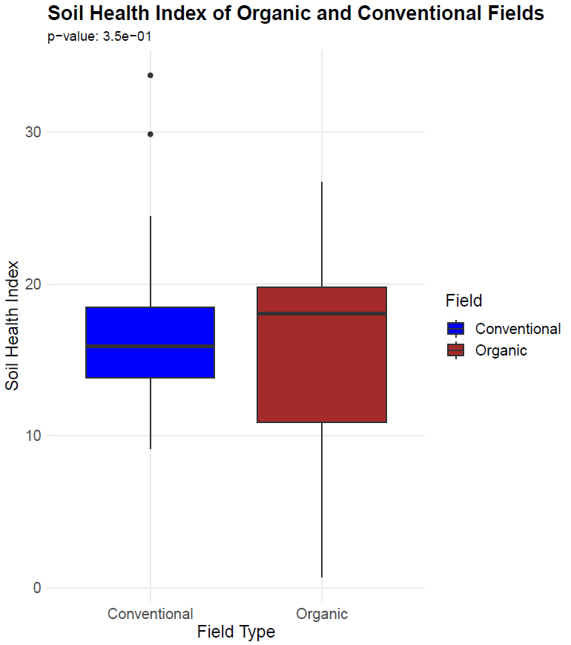
Soil Health Index
Both farming practices aim to maintain soil health and productivity through different approaches.
A composite index that combines various parameters. Although it offers a valuable overview of soil health, it may not capture specific variations in individual indicators.
Influenced by the specific context and characteristics of the study sites, such as soil type, climate, and duration since the farm conversion to organic.

Slide 23
Conclusion
Organic farming practices have positive effects on soil health, including higher levels of organic nitrogen, microbial respiration, and organic carbon, indicating improved nutrient cycling and microbial activity.
Conventional farming practices show higher concentrations of potassium, nitrates, and salts, suggesting increased synthetic fertilizer use and potential risks of nutrient leaching and soil salinization.
Organic fields exhibit higher biomass nitrogen content, reflecting efficient utilization of nitrogen sources and availability in these systems.
Enhanced activities of cellobiohydrolase, chitinase, and glucosidase enzymes in organic fields indicate improved organic matter decomposition and nutrient release, contributing to soil fertility and plant nutrition.
Although not statistically significant, the overall soil health index is higher in organic fields compared to conventional fields, highlighting the holistic benefits of organic farming practices on soil quality and ecosystem functioning.
However, further research is needed to provide more comprehensive and reliable recommendations, including long-term monitoring, evaluations involving diverse crops, and consideration of different crop rotations to strengthen the scientific foundation for advocating organic farming practices and formulating sustainable agricultural policies.

Slide 24
Chapter 2: Soil microbiome structure, composition, and network connectivity

Slide 25
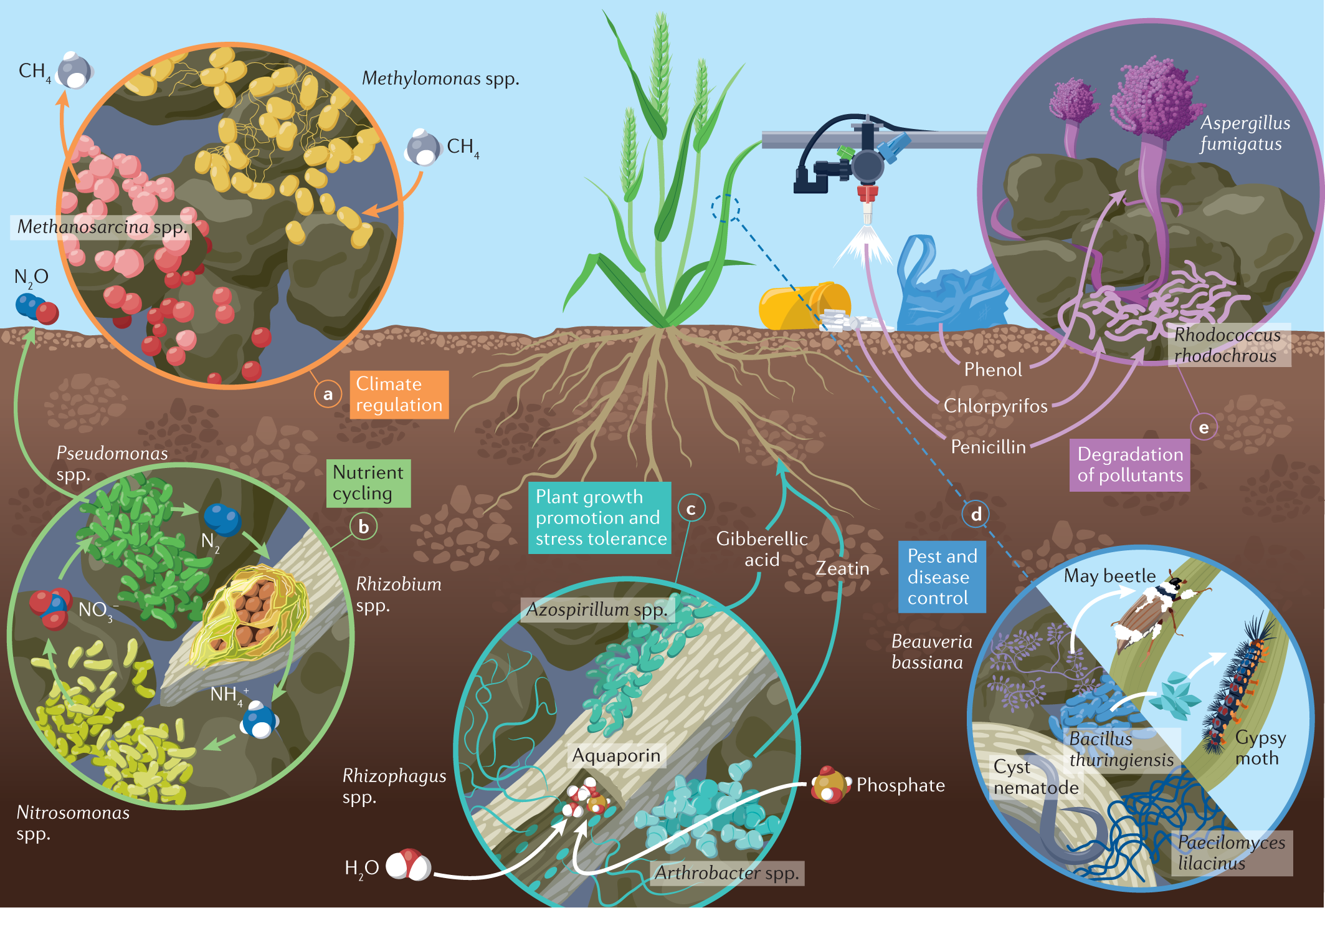
Microbial key functions
Hartman, et.al.2022

Slide 26
Research objectives and hypothesis
1. To assess the niche preference of microbial communities and their diversity in conventional and organic farming systems.
2. To identify key microbial taxa within the microbial networks and assess their potential roles in nutrient cycling and plant-microbe associations
1. Owing to sustainable farming practices, we expect that microbial richness and diversity will be higher in organic fields compared to conventional fields.
2. We expect higher microbiome network connectivity in organic fields compared to conventional fields.

Slide 27
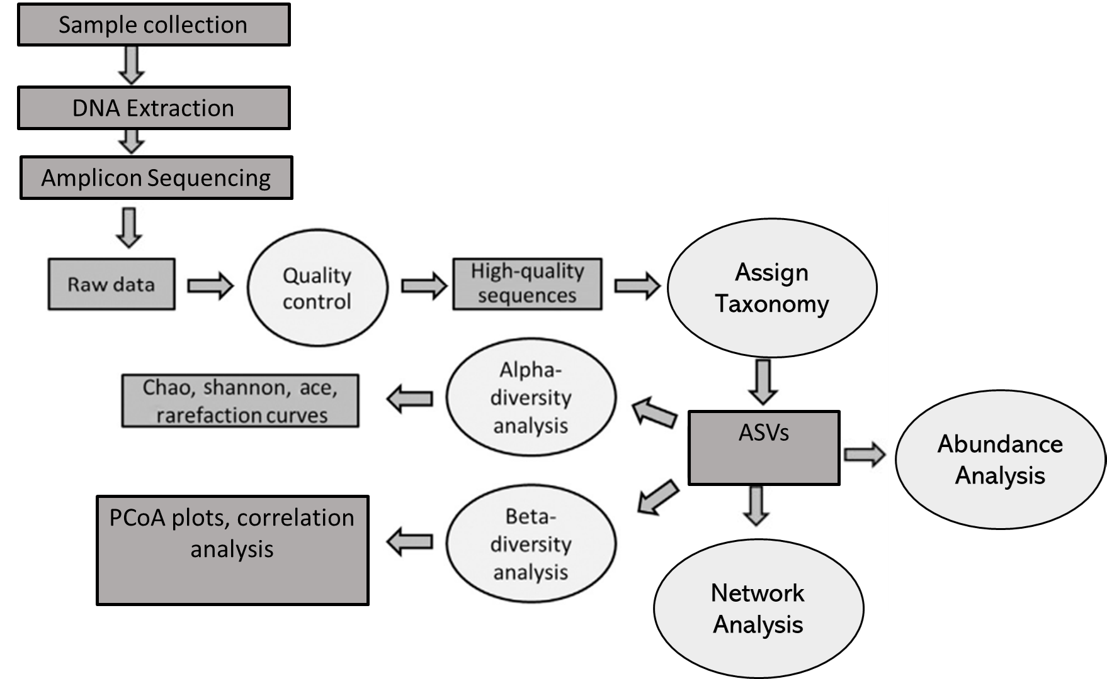
Methodology

Slide 28
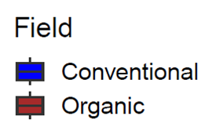
Microbial Community Diversity
Bacteria
Fungi
Notes:
Organic fields employ a diverse range of organic materials as fertilizers, which can lead to variations in the availability and composition of nutrient pools.

Slide 29
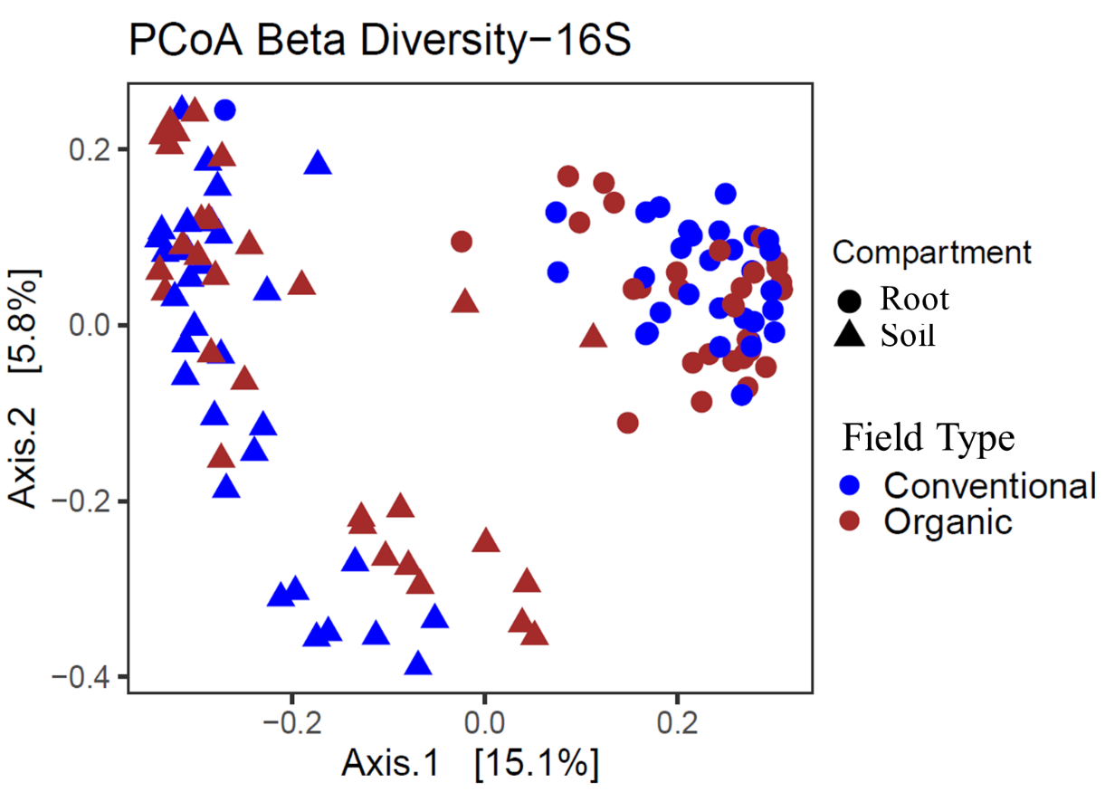
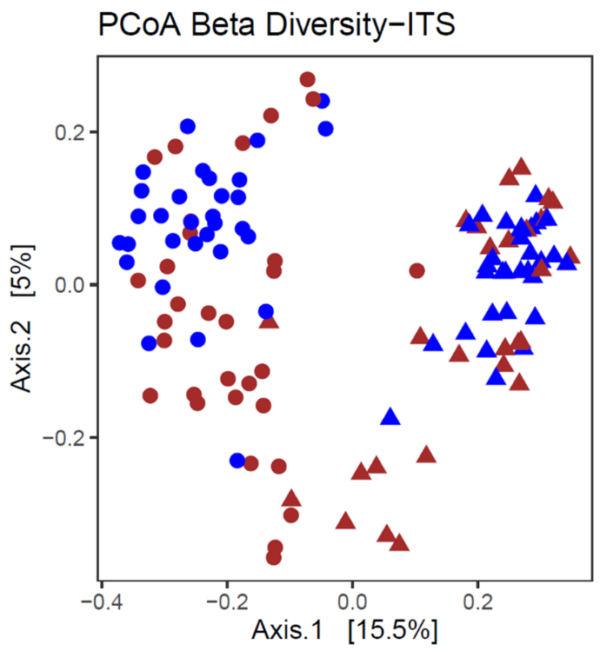
Microbial Community Structure
Substantial portion of the variance in both bacterial (20.9%) and fungal (20.5%) communities.
Niche has a stronger influence on microbial community composition as compared to farming practices.
Highlights the dominant role of habitat-specific factors in shaping microbial community composition.
Microenvironments exert strong selective pressures, leading to the formation of niche-specific microbial populations.

Slide 30
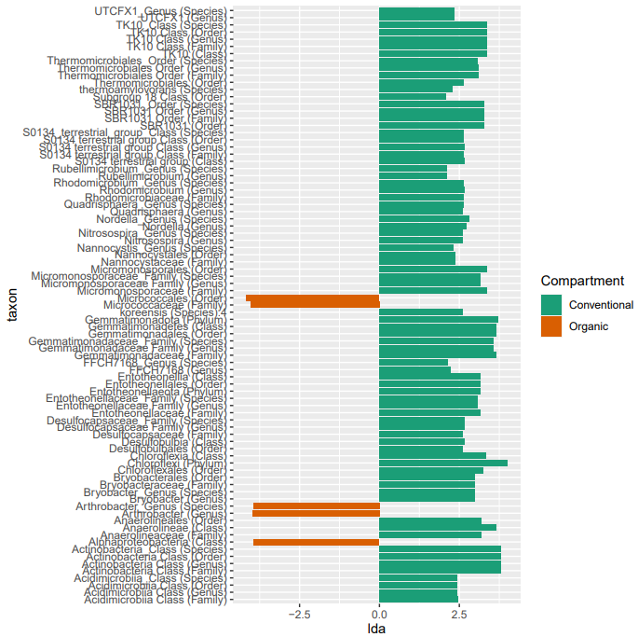
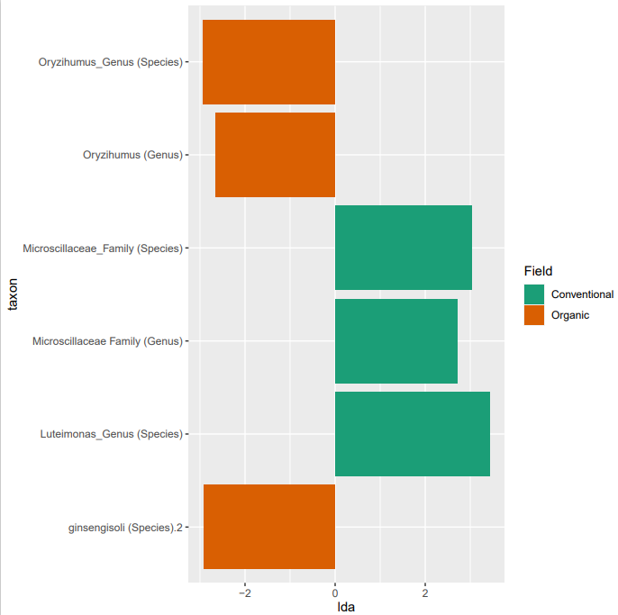
Differentially abundant taxa of bacteria
Soil (p<0.01)
Root (p<0.01)

Slide 31
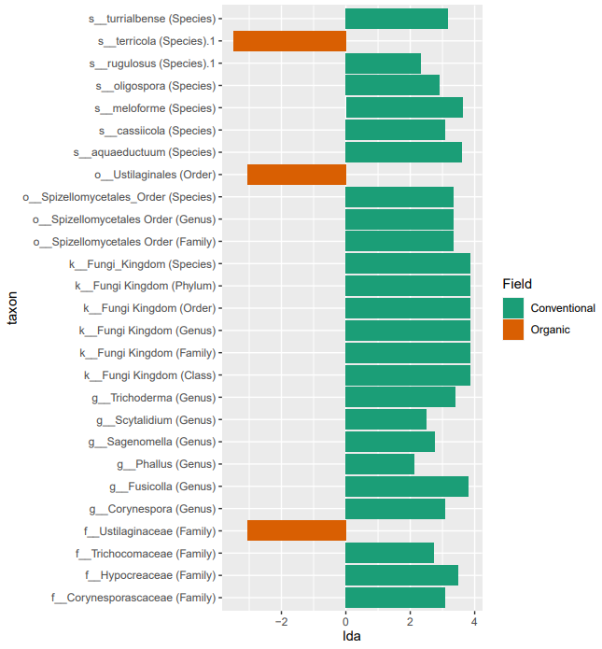
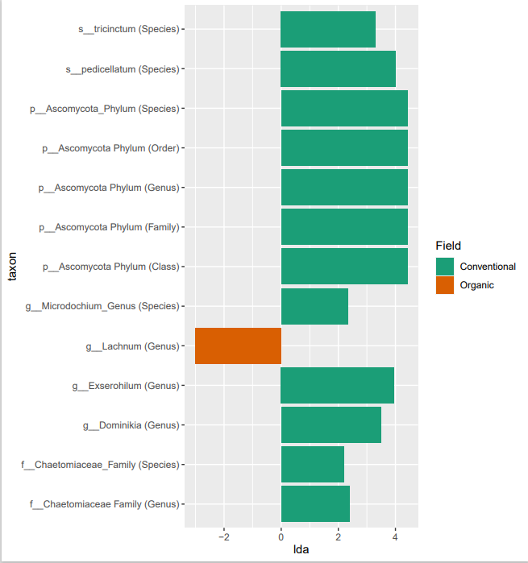
Differentially abundant taxa of fungi
Soil (p<0.001)
Root(p<0.01)

Slide 32
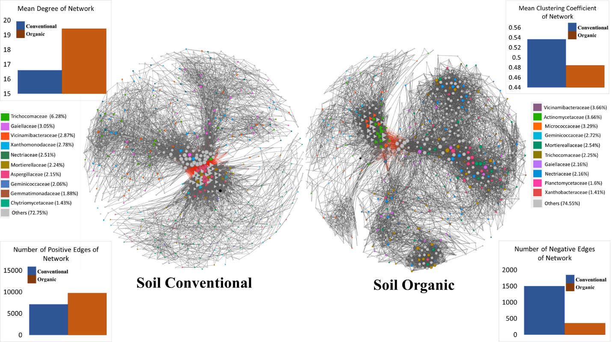
Soil microbial network
Higher number of edges in organic fields indicates a more interconnected and complex microbial network.
Higher modularity indicates a higher level of community specialization and compartmentalization, potentially associated with specific functional roles and ecological niches.

Slide 33
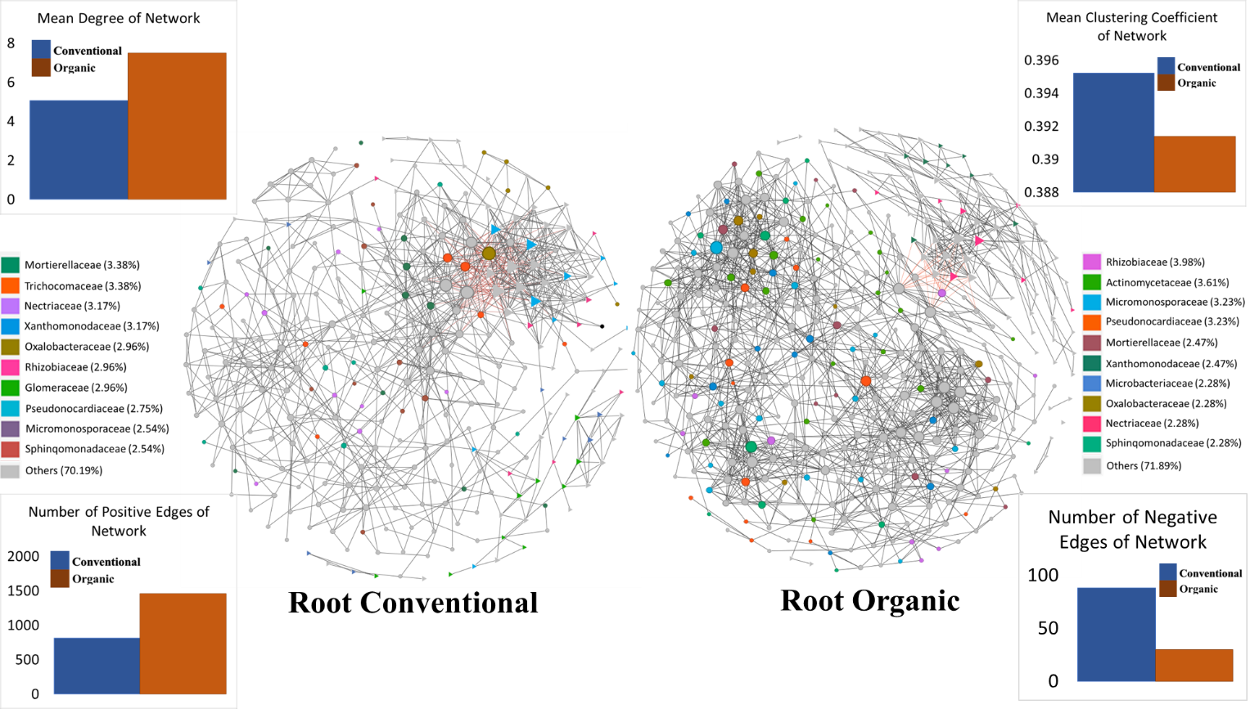
Root microbial network
Higher positive edges indicate the prevalence of cooperative and mutualistic associations.
Increased complexity observed in organic microbial networks may indicate a higher level of resilience to environmental stresses.

Slide 34
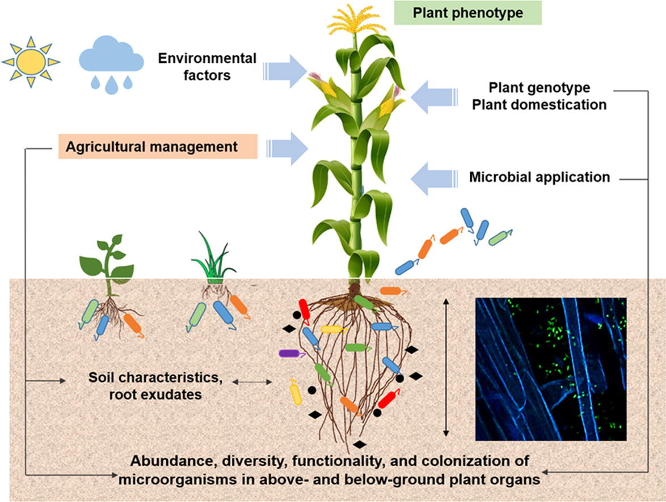
Conclusion
Differences in management practices, the period of transition from conventional to organic farming, and the varying intensities of farming practices may affect the diversity and richness.
Utilization of different organic pools as fertilizers in organic farming practices can contribute to differential microbial diversity patterns.
Conventional farms exhibited higher organic matter content compared to organic farms which could potentially explain the higher diversity observed in conventional soils relative to organic soils.
Understanding microbial niches and their preferences is crucial, as it was observed that microbial community differentiation based on niches was more significant than farming practices alone.
Network analysis revealed the impact of farming practices on microbial connectivity, providing insights beyond diversity measures.
Further research is needed to understand the functional implications and long-term dynamics of microbial networks under different farming practices, informing strategies for improving soil health and agricultural productivity.
Compant,et.al.2019

Slide 35
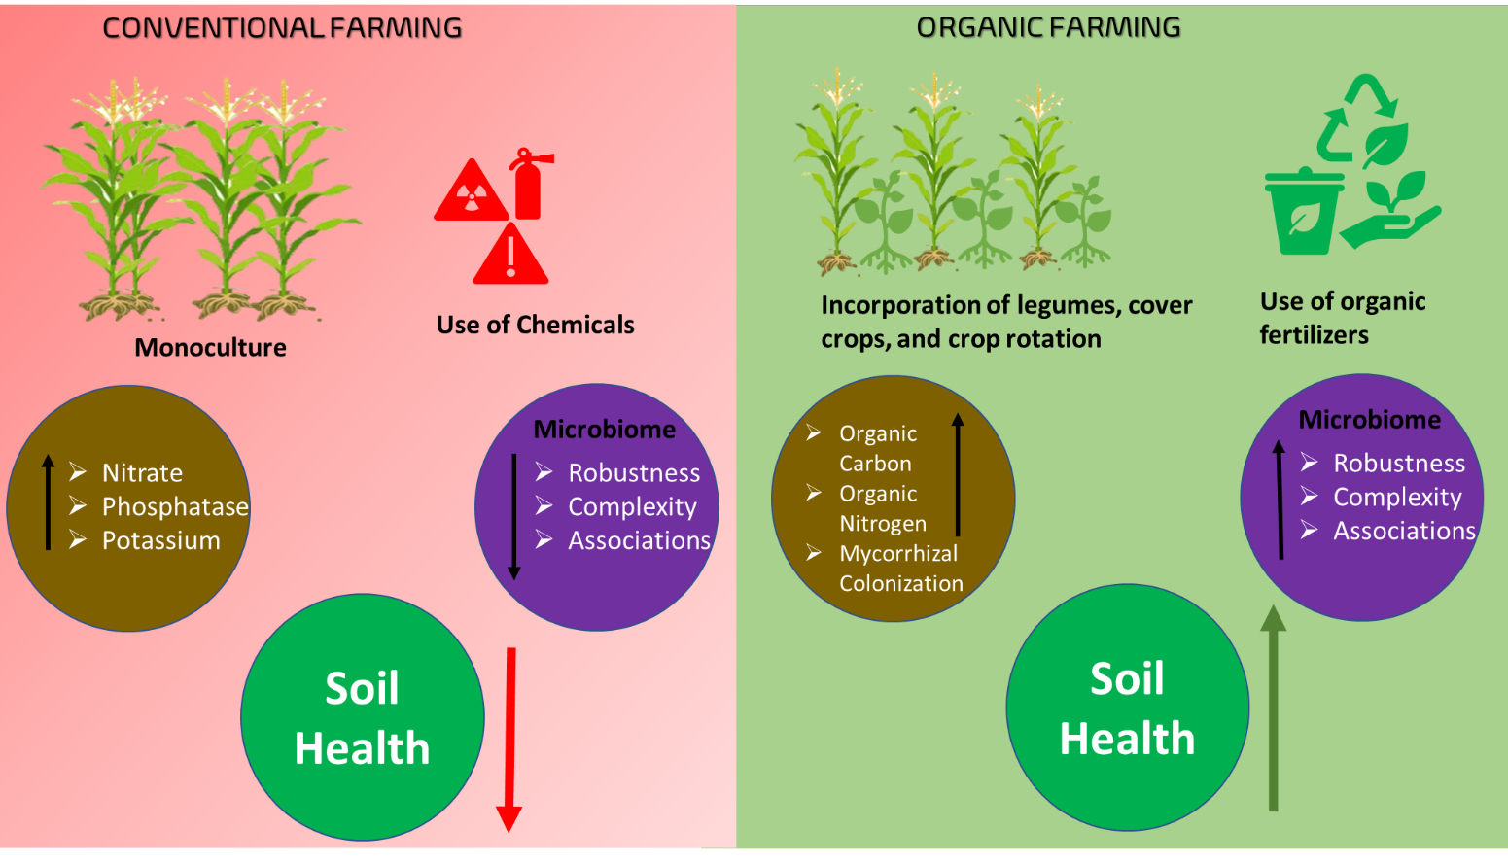
General discussion

Slide 36
Study implications
Organic fields represent a mere 1% of the total agricultural lands worldwide and it comes at a cost.
Understanding the complexity of agricultural systems.
There may be increasing awareness among farmers about the restricted use of chemicals and the need for more conscious application practices.
Importance of understanding the microenvironment of microbes before making broad conclusions based on farming practices.
Future research should further investigate the factors including the duration of the transition, long-term field trials, soil characteristics, and specific management practices on different varieties of crops.

Slide 37
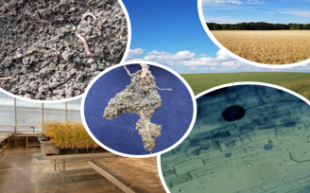
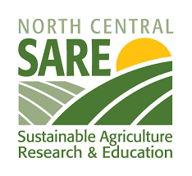
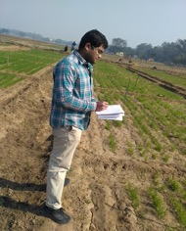
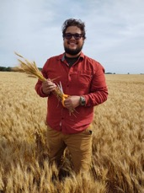
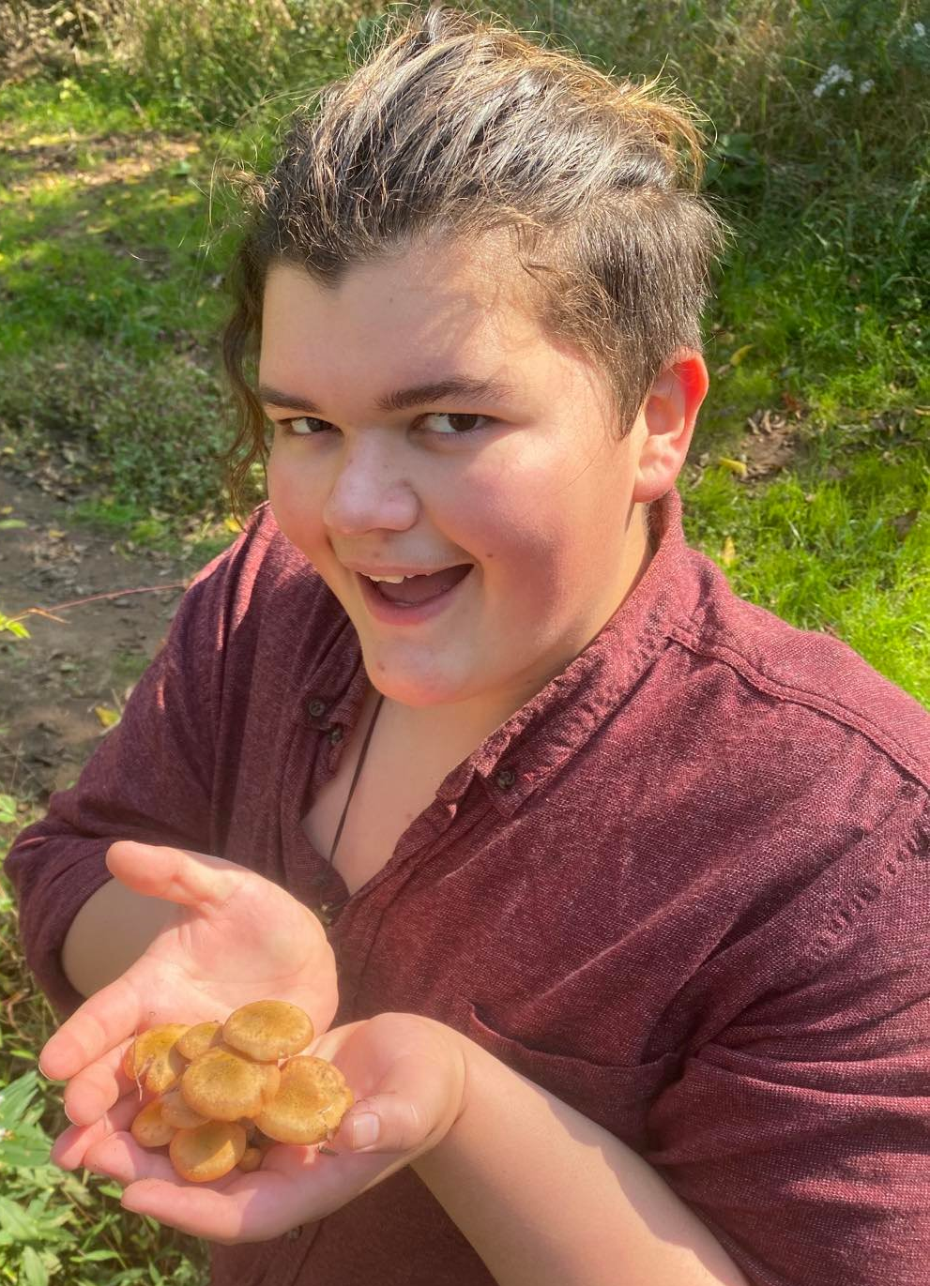
Thank You!!
Committee Members:
Samat Amat (Ph.D.)
Marisol Berti (Ph.D.)
Mark Liebig (Ph.D.)
www.sbanerjeelab.org

