Slide 1
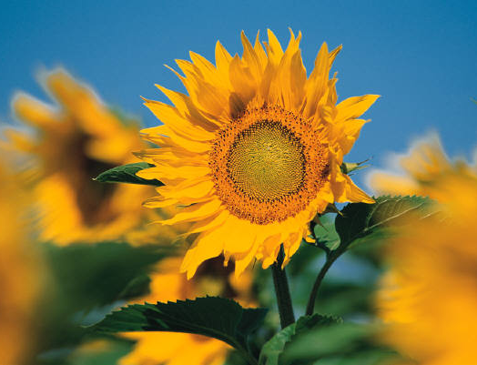

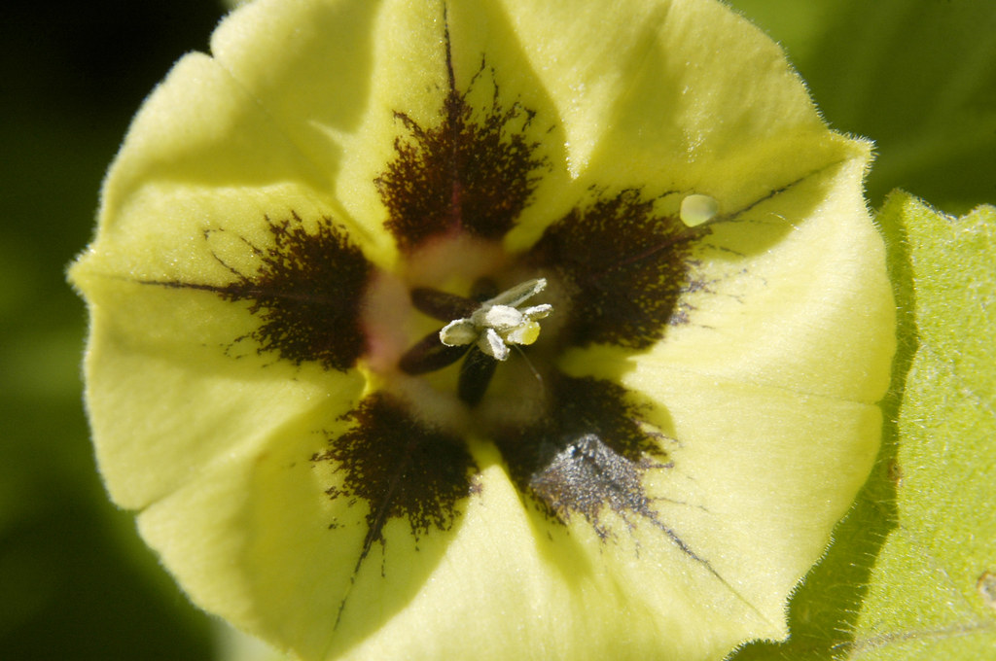
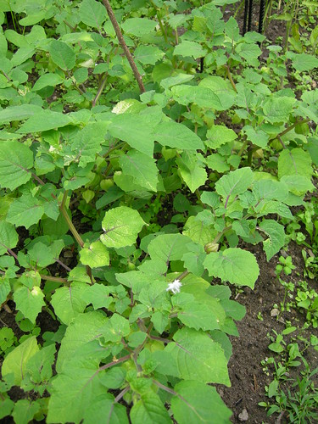
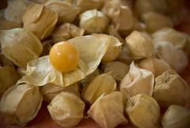

SARE Grant 2022 Pepper Berries Urban Farm
Ground Cherries Hill Side System

Slide 2
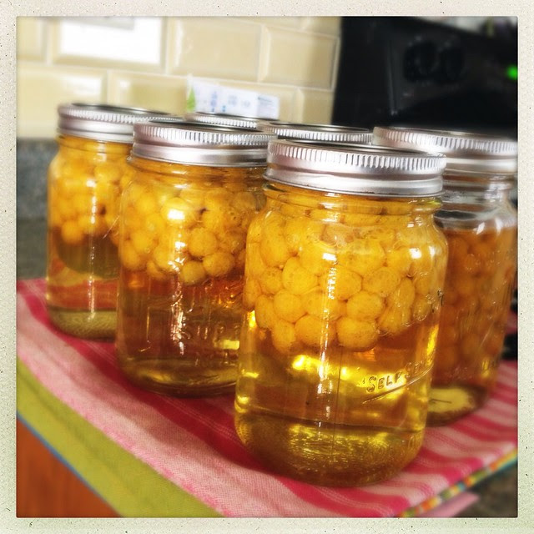
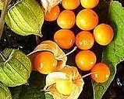
Ground Cherries have many anti inflammatory and immune boosting properties due to it orange golden yellow color from phytochemicals called carotenoids. They can also protect against risk of heart disease, poor eye site, improve skin and bone health.

Slide 3
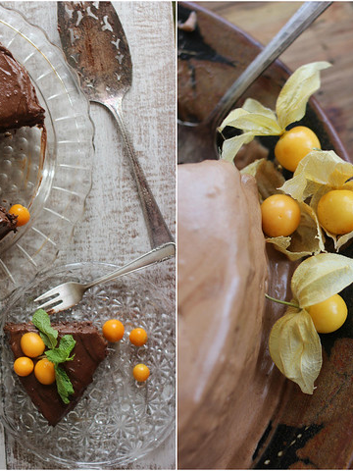
Ground Cherries is a Superfood….
It is high in Vitamin A, C, thiamin, riboflavin, and niacin. The ripe fruit also have a concentration of beta-carotene. Ground cherries have a good amount of calcium, iron, phosphorus, potassium, bioflavonoids, fiber and protein.

Slide 4
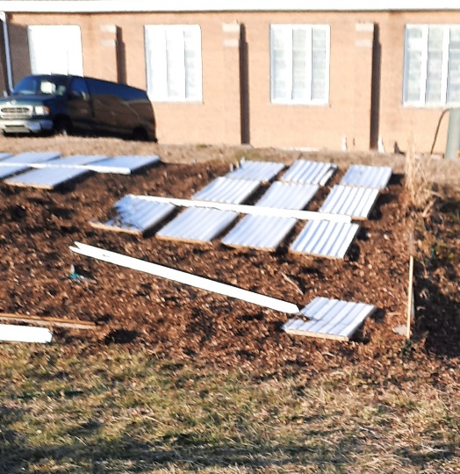
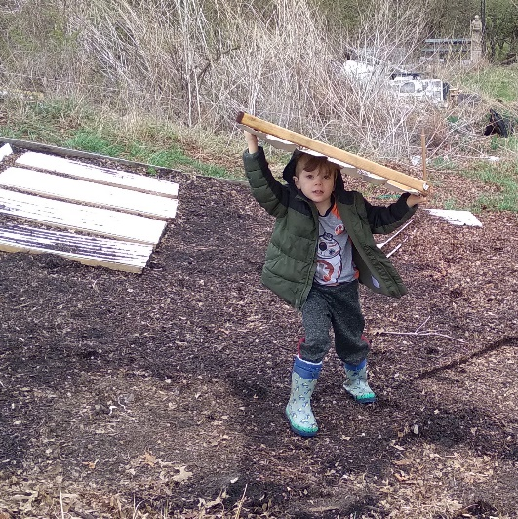
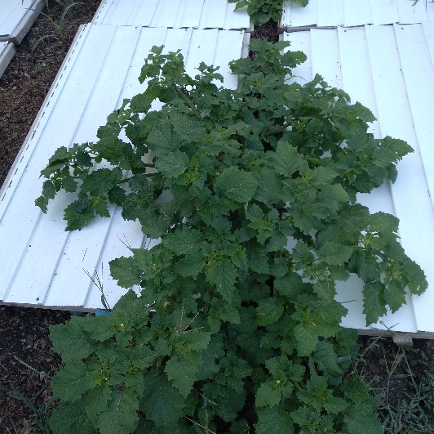
Building the Hill -Side System
The vinyl panels are made light enough to remove by one person or even a 7 year old can help remove them to prepare for the next season. The panels are connect together with a gutter added every 8 ft. to catch the cherries.

Slide 5
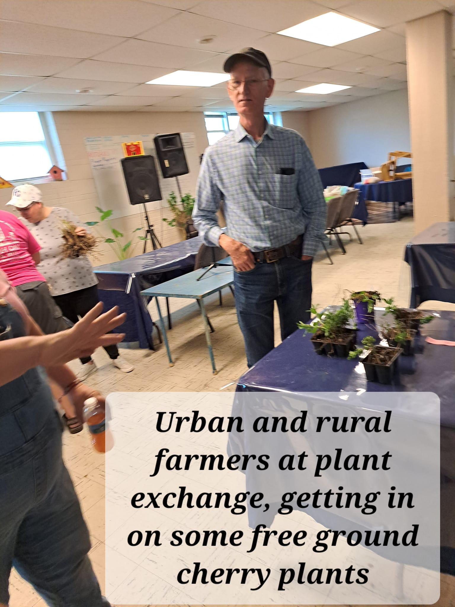
Ground Cherries are in the Night Shade family and are cousins to the Tomatillo, they grow like a dwarf bush tomato but have paper husk around the cherry like tomatillos. They have a sweet, tropical taste to them, a mango, banana, pineapple, vanilla, strawberry or tomato flavor. I call them a smoothie in your mouth!
Like tomatoes they are sensitive to frost, they love warm climates. They will self seed, so plant them where you want them every year. There are 10 types of ground cherries with Cape Gooseberry being the most common. Each variety has it’s own wonderful flavor and size.

Slide 6
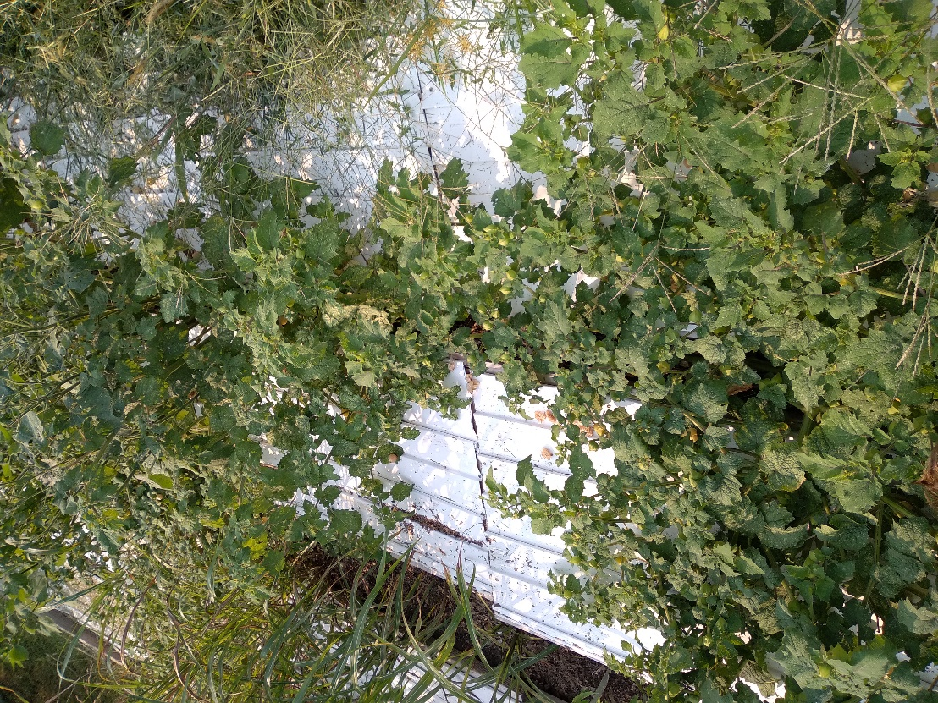
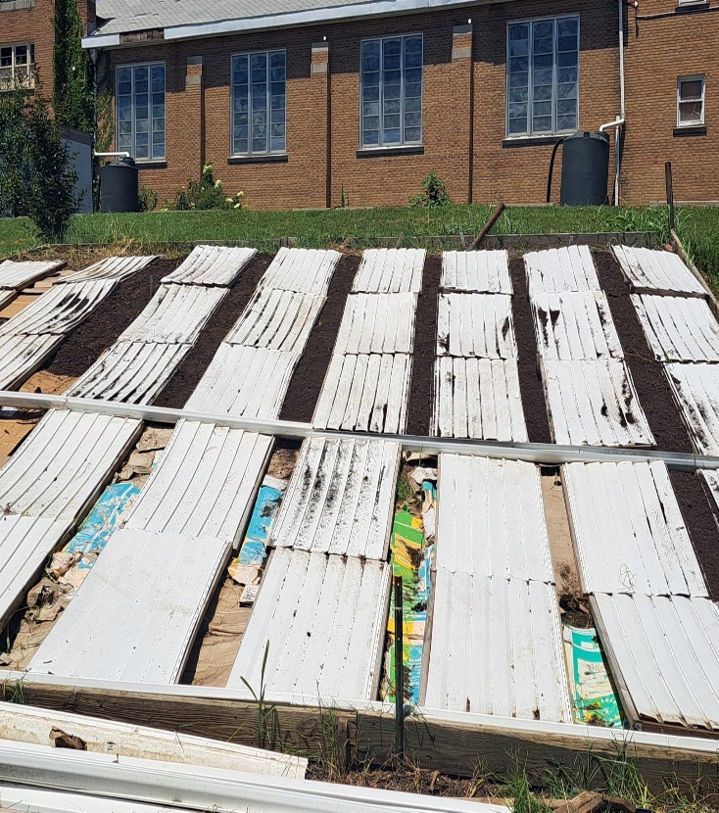
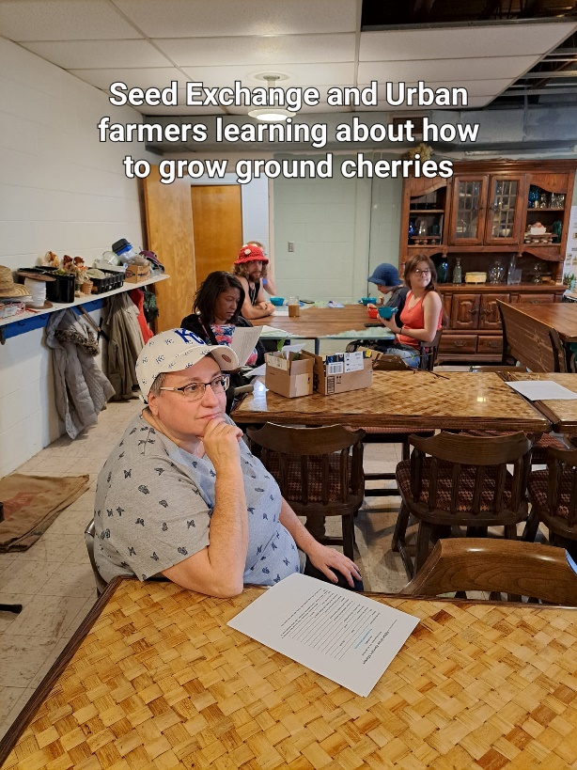
The Hill -Side System is built with Vinyl panel 3 x 4 using 2x2 on back with 8 in. spacing between panels. Build up a 10 to 12 in. mound of soil between panels to plant the ground cherries into. This will allow the plants to grow higher than the panels so the cherries will fall and roll down the hill into a gutter system for easy harvest. This works well with using heavy canvas and setting up the same way with a gutter system also. It is less expensive and easier to be maintained.

Slide 7
