Slide 1




Culturally meaningful seed: Navigating the complexities around accessibility, sustainability, and marketability in seed value chains in the Northeastern United States
Sally Burke¹, Chanda Robinson Banks², Alexis Yamashita², Claire Fischer¹, Carina Isbell¹, Tomia MacQueen², Bonnetta Adeeb², Jasmine Hart¹, Eric von Wettberg¹, Daniel Tobin¹
The University of Vermont¹
Ujamaa Cooperative Farming Alliance²
ASFS/AFHVS Conference
May 31-June 3, 2023
Boston University
This material is based upon work supported by the National Institute of Food and Agriculture, U.S. Department of Agriculture, through the Northeast Sustainable Agriculture Research and Education program under subaward number LNE22-456R. Any opinions, findings, conclusions, or recommendations expressed in this publication are those of the author(s) and do not necessarily reflect the view of the U.S. Department of Agriculture.
Notes:
Slide lead: Dan

Slide 2
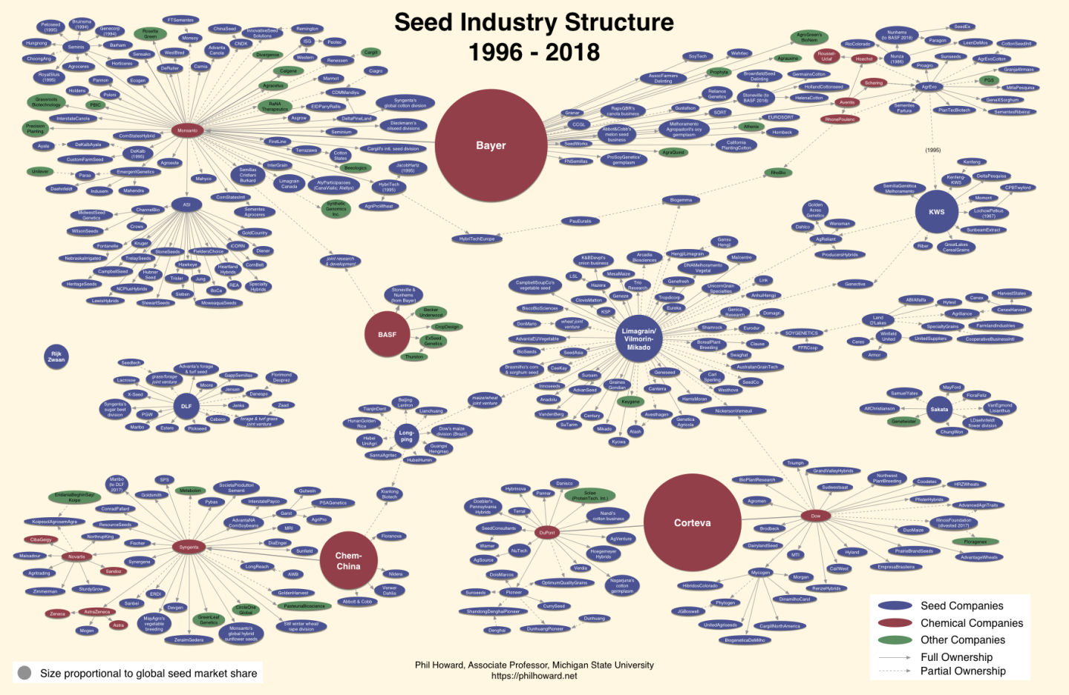
The State of Seed
Four companies now control 60% of the global market share (Mooney, 2018).
Consolidated seed industry leads to homogenized production: corn and soybean cover 56.6% of total field area in the US (Spangler, 2020).
Notes:
Slide lead: Dan

Slide 3
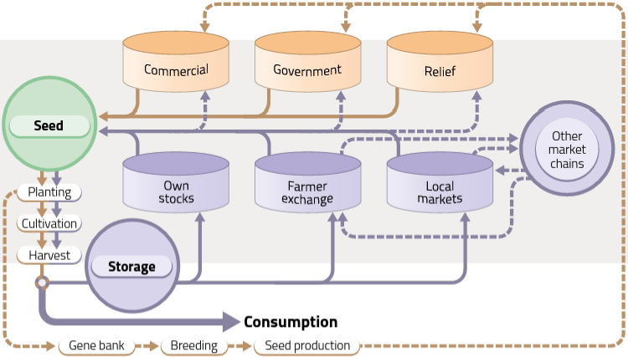
Seed Systems
Adapted from Sperling (2008)
Notes:
Slide lead: A/C

Slide 4
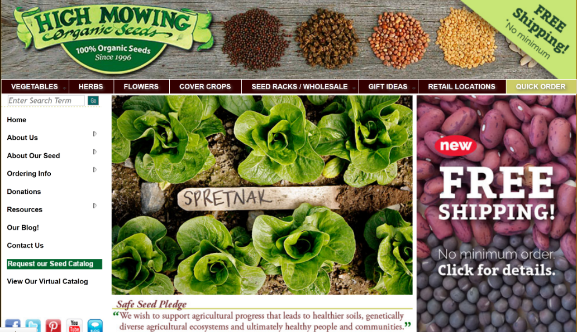
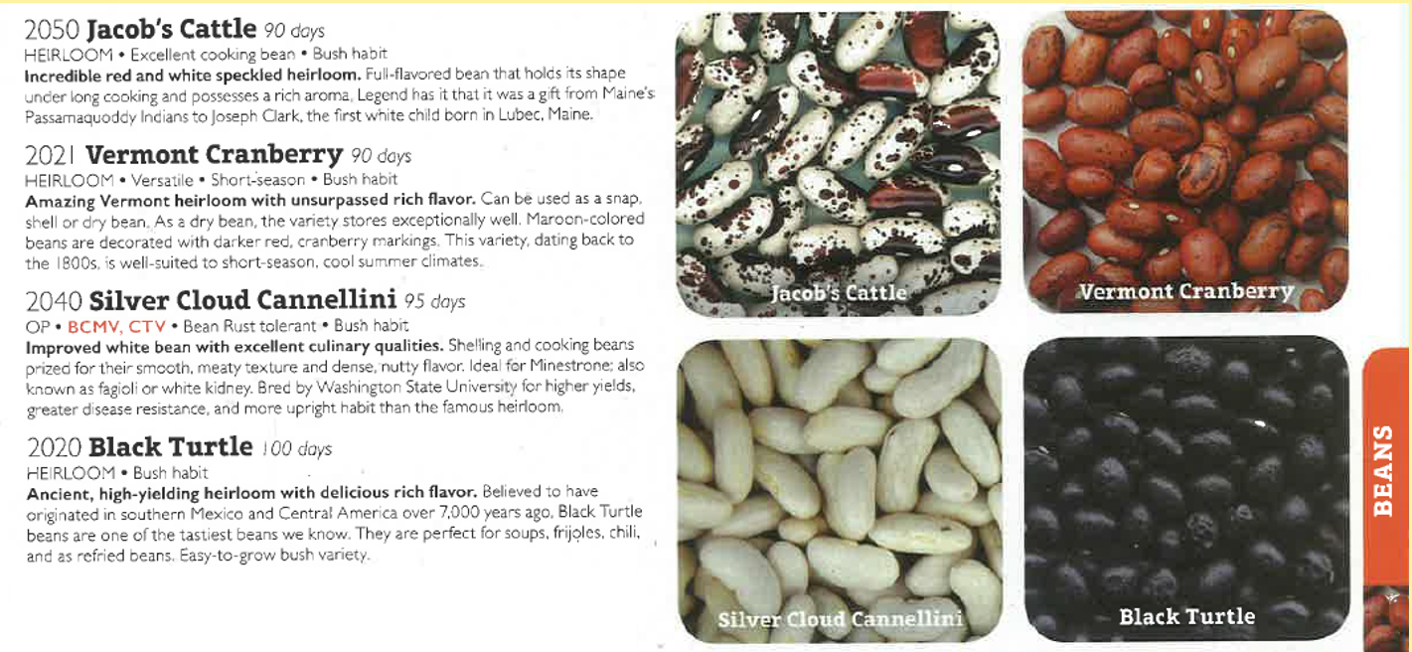
Alternatives to the Dominant Seed Industry
Though these alternatives provide more diverse options, legacies of historical injustices persist.
  “Basically, Vermont cranberry, the name was a marketing ploy as best I could discover… So, this is how white people are taking these beans that the Native people have been growing” (Nesbitt, 2023).
Seed catalogues, even from small-scale seed companies, do not adequately provide culturally meaningful (CM) varieties important to BIPOC growers and consumers.
Source: High Mowing Seeds
Notes:
Slide lead: Dan & A/C

Slide 5
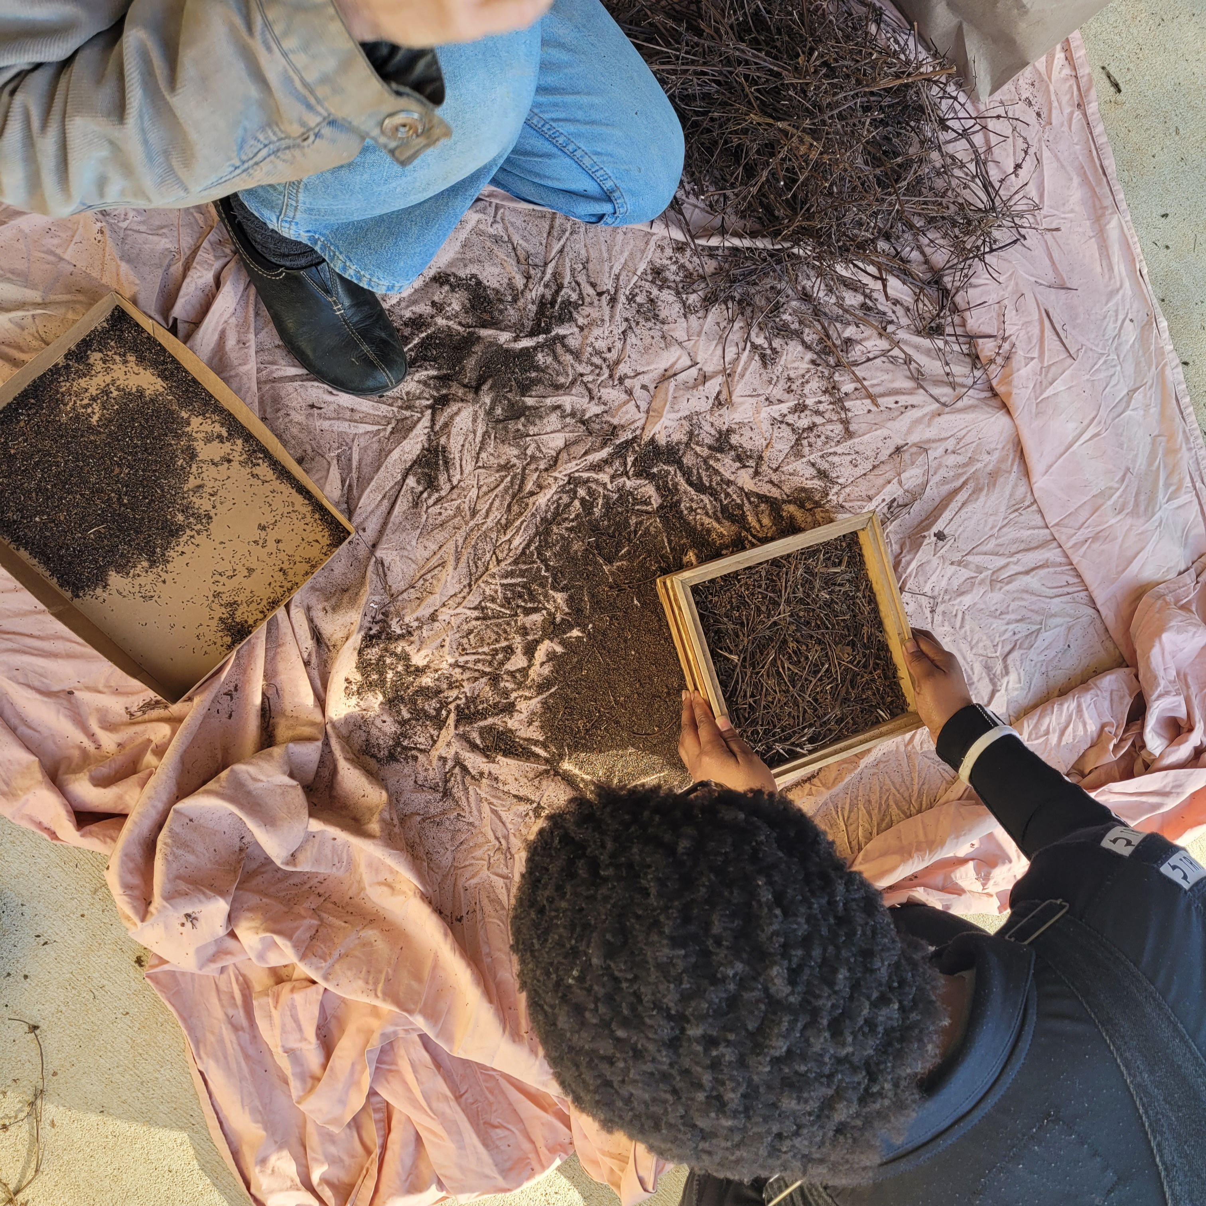
Insufficient access to CM seed and food has prompted BIPOC communities to call for greater seed sovereignty to redress issues of racism.
(“About Ujamaa Seeds” n.d.; Lyon et al., 2021)
Notes:
Slide lead: A/C

Slide 6
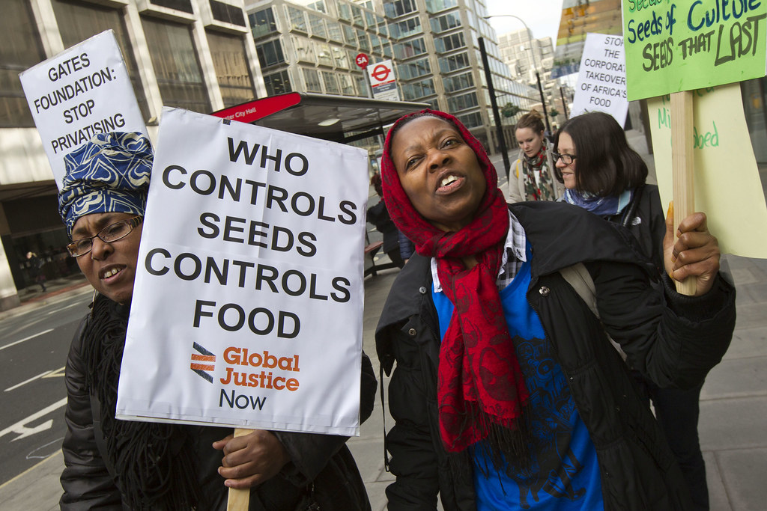
Seed sovereignty is the availability, access to, and control over seeds.
(Adhikari, 2014; Alkon & Mares, 2012; Kloppenburg, 2014)
Notes:
Slide lead: Sally
Speak to second two:
A food sovereignty approach can be used to build power and mobilize individuals for a broad-based transformation of the corporate food regime.
But questions remain regarding how CM seed can be produced and distributed in ways that promote availability and accessibility among BIPOC growers and consumers.

Slide 7
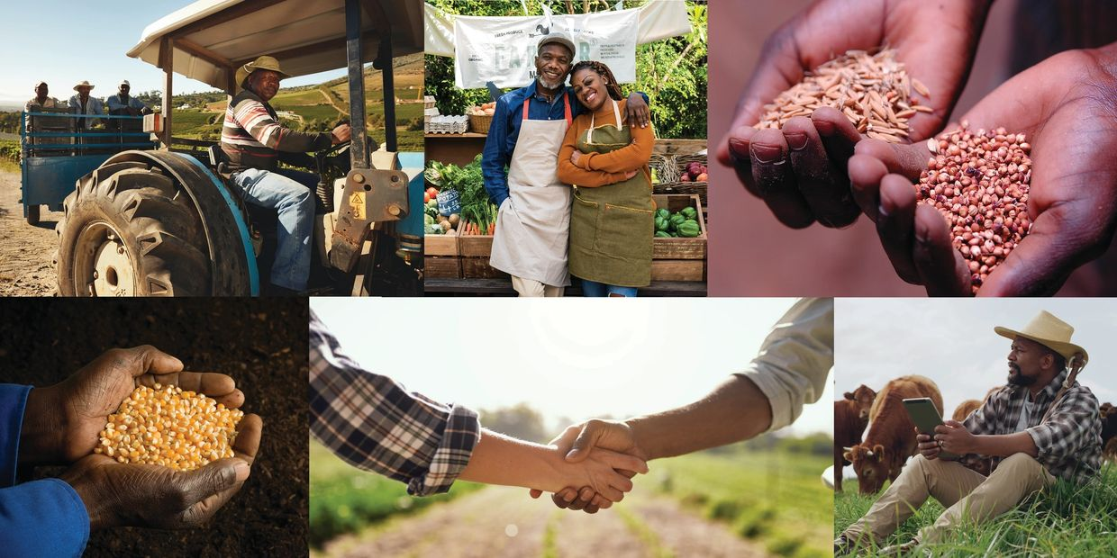
Ujamaa Cooperative Farming Alliance (UCFA)
UCFA is a BIPOC-led organization working to provide access to culturally meaningful food and promote seed sovereignty.
Notes:
Slide lead: A/C

Slide 8
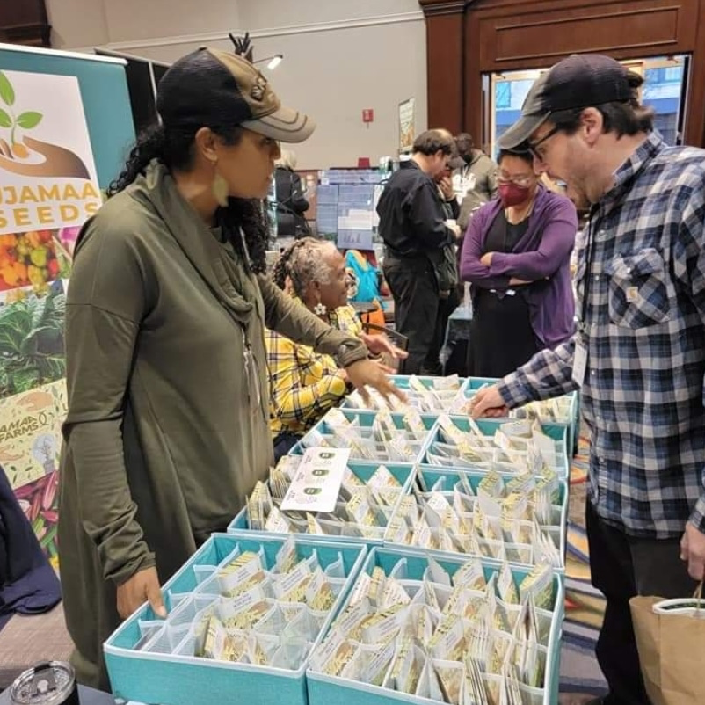
Research Questions
What synergies and disconnects exist within the Northeastern United States seed value chain for the production and distribution of CM seeds?
How do we address these disconnects to build a more representative seed value chain?
Notes:
Slide lead: Sally

Slide 9
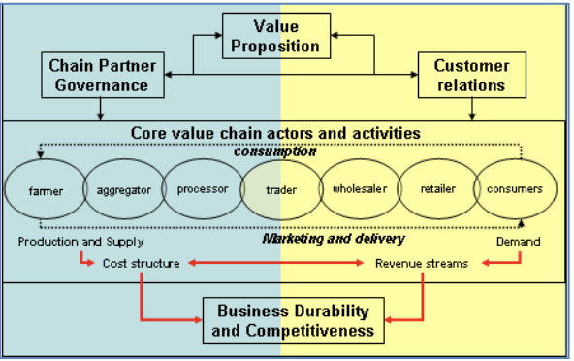
Seed Value Chain Model
Value chain analyses help elucidate where in the value chain power is held and how power is exercised.
For value chain development initiatives to be successful, purposes and objectives across value chain stakeholders must be aligned (Tobin & Glenna, 2018).
Ujamaa Growers
Seed Companies
Farmers/Gardeners
Chefs/Restaurants
Specialty Grocers
Wholesalers
(Ferris et al., 2014)
Notes:
Slide lead: Dan

Slide 10
Methods
Focus groups, each with a different seed value chain stakeholder group (n=31)
Data coded and analyzed in Nvivo 12
Ujamaa
Growers
Seed
Companies
Farmers/
Gardeners
Chefs/
Restaurants
Specialty
Grocers
Wholesalers
4 participants
7 participants
3 participants
9 participants
4 participants
4 participants
(Blue circles represent upstream stakeholder groups; yellow circles represent downstream stakeholder groups)
Notes:
Slide lead: Chanda

Slide 11
Results: Synergies
“In Philly where I'm based, there's been a lot of Black and Asian solidarity work around seeds and building out seed libraries, and it feels like a really beautiful building out of the culture around local food and solidarities between people and bridging a lot of shared histories as well…holding onto those stories and sharing them with each other.”
-Farmer/gardener
“I created these relationships with all these farmers here in Vermont where I grow some of the stuff with them there. So, I grow corn with some farms. I grow some beans with some farms…my whole menu is locally sourced.”
-Chef
Notes:
Slide lead: Alexis

Slide 12
Results: Disconnects
“Somehow, we got this group of us that are in the Palestinian cuisine space in the DC area. So, as far as sourcing goes, for me, my main focus has moved from local to as much as I can from Palestinian growers and farmers. Now, that poses its own challenges, obviously, for multiple reasons, depending on what the status of the homeland is and what I can get at what time of year. We have really, it's like almost like mafioso sketchy-like connections.”
-Chef
“Sometimes just unfamiliarity of something that comes from a particular, like, minority cultural group might be a barrier to getting our customer base to buy it.”
-Seed company representative
Notes:
Slide lead: Sally

Slide 13
Results: Addressing disconnects
“I think we need a handful of champions…I think that [if] there are champions for eating closer to home, you know, kind of reclaiming different culinary ways. And I think that just increasing the number of champions who can speak into the listening of different groups of people is really important at this stage in the game.”
-Ujamaa grower
“I think there's a lot of brands that are coming out with ready-to-eat meals, that did a really good job incorporating their culture into that food… they're convenient and successful and they did a really good job telling their story and introducing people to the flavors of their country or culture.”
-Specialty grocer
Notes:
Slide lead: Chanda

Slide 14
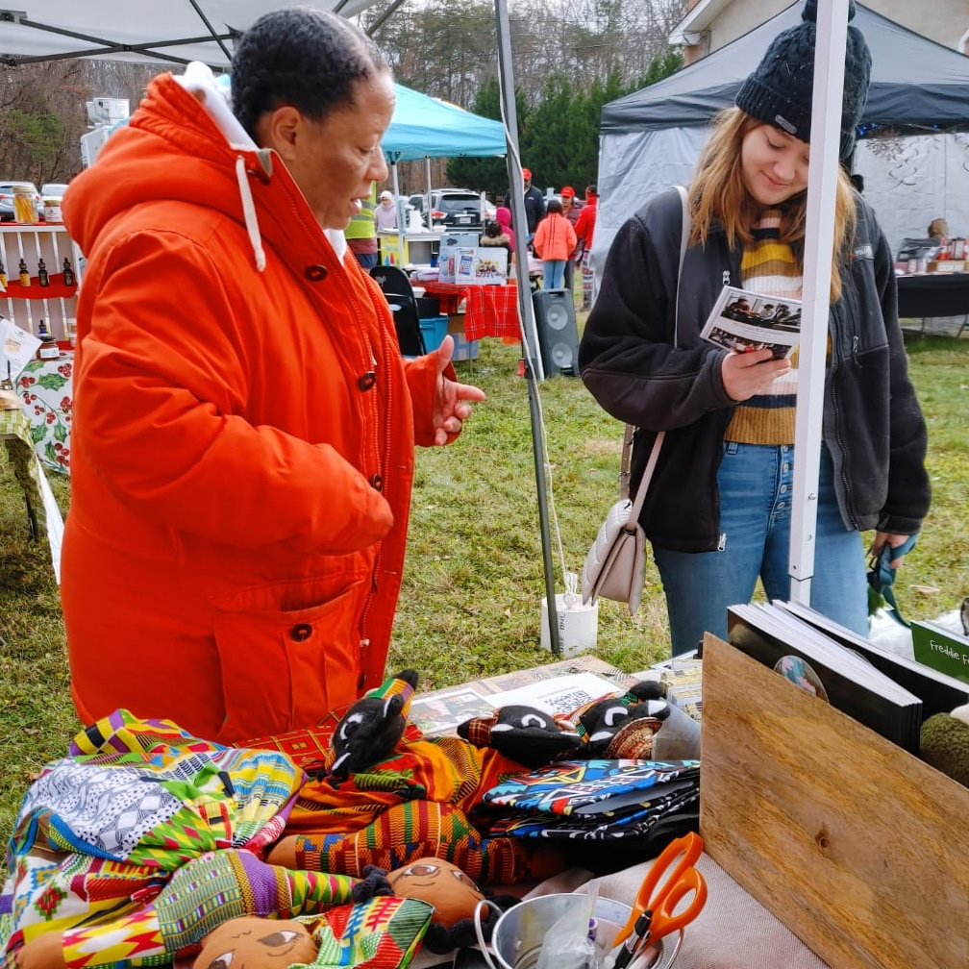
Discussion
Symbiotic relationships among stakeholders along the seed value chain can enhance access to CM food products.
However, these efforts do not seem to be supported systemically.
Connecting producers to consumers is an important undertaking.
Markets will be critical to enhancing access to CM seeds especially retail-oriented strategies that pursue seed sovereignty.
Notes:
Slide lead: Dan w/ backup
Original text:
Some seed value chain stakeholders have been able to forge symbiotic relationships with others along the chain, thus enhancing access to CM food products.
However, these efforts appear to be the result of individual and community efforts and not supported systemically.
Connecting producers to consumers – especially through education and storytelling – is an important undertaking.
Markets will be critical to enhancing access to CM seeds and retail-oriented strategies that pursue seed sovereignty will be important to monitor.

Slide 15
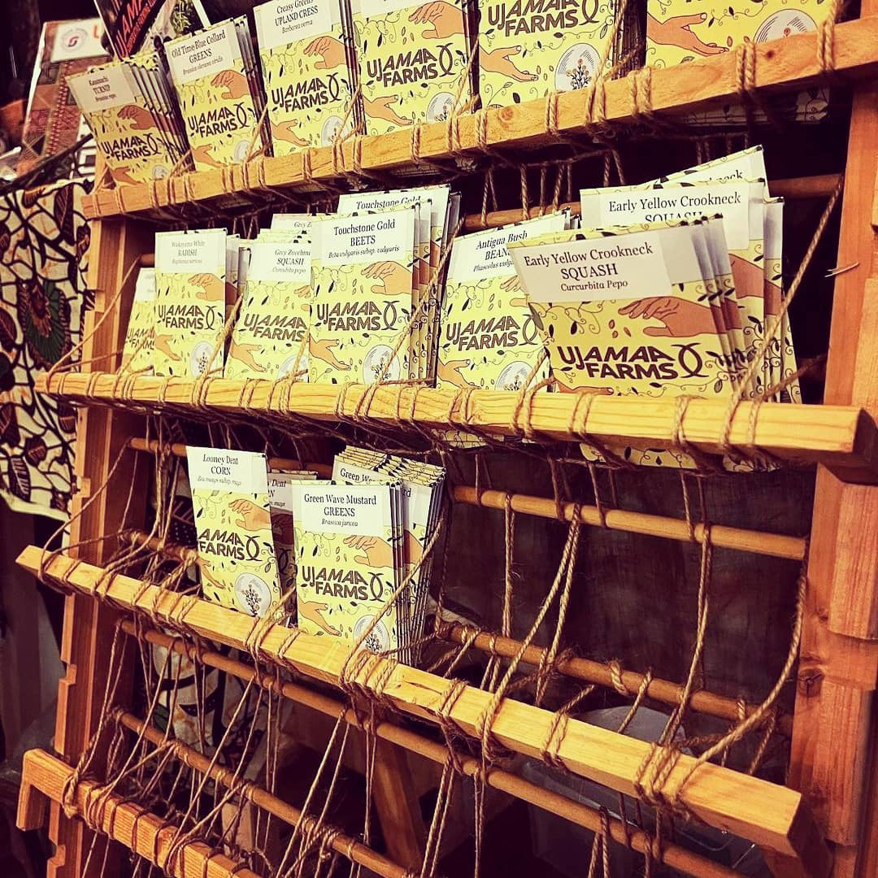
Next steps
Phases of research
Survey targeting seed value chain stakeholders to be deployed in Fall 2023
Continued analysis of focus groups
Integration of qualitative and quantitative data
Implications
Develop a better understanding of the needs and priorities members and clients of Ujamaa have
Inform organizational planning and business development of Ujamaa
Enhance availability and accessibility of CM seed
Notes:
Slide lead: Sally (phases) & Alexis (implications)

Slide 16
References
About Ujamaa seeds. UJAMAA SEEDS. (n.d.). Retrieved April 27, 2023, from https://ujamaaseeds.com/pages/about-us
Adhikari, J. (2014). Seed sovereignty: Analysing the debate on hybrid seeds and GMOs and bringing about sustainability in agricultural development. Journal of Forest and Livelihood, 12(1), 33-46.
Alkon, A. H., & Mares, T. M. (2012). Food sovereignty in US Food Movements: Radical Visions and neoliberal constraints. Agriculture and Human Values, 29(3), 347–359. https://doi.org/10.1007/s10460-012-9356-z
Cachelin, A., Ivkovich, L., Jensen, P., & Neild, M. (2019). Leveraging Foodways for Health and justice. Local Environment, 24(5), 417–427. https://doi.org/10.1080/13549839.2019.1585771
Chennault, C. (2021). Relational life: Lessons from black feminism on whiteness and engaging new food activism. Antipode, 54(2), 357–377. https://doi.org/10.1111/anti.12775
Ferris, S., Robbins, P., Best, R., Seville, D., Buxton, A., Shriver, J., & Wei, E. (2014). Linking smallholder farmers to markets and the implications for extension and advisory services. MEAS Brief, 4(10), 13-14.
Holt-Giménez, E. (2018). Overcoming the Barrier of Racism in Our Capitalist Food System. Food First, 24.
Kloppenburg, J. (2014). Re-purposing the master's tools: the open source seed initiative and the struggle for seed sovereignty. Journal of Peasant Studies, 41(6), 1225-1246.
Lyon, A., Friedmann, H., & Wittman, H. (2021). Can public universities play a role in fostering seed sovereignty?. Elementa: Science of the Anthropocene, 9(1).
McGuire, S., & Sperling, L. (2013). Making seed systems more resilient to stress. Global Environmental Change, 23(3), 644–653. https://doi.org/10.1016/j.gloenvcha.2013.02.001
Mooney, P. (2018). Blocking the chain: Industrial food chain concentration, Big Data platforms and food sovereignty solutions. ETC Group.
Nesbitt, L. (2023). Seed & Story Conservation: A Rooted Historical Documentation and Analysis of Living Seed Stories in the US Northeast [Master's thesis]. University of Vermont.
Smith, B. J. (2019). Building emancipatory food power: Freedom Farms, Rocky Acres, and the struggle for food justice. Journal of Agriculture, Food Systems, and Community Development, 8(4), 33-43.
Spangler, K., Burchfield, E.K., Schumacher, B., 2020. Past and current dynamics of US agricultural land use and policy. Front. Sustain. Food Syst. https://doi.org/10.3389/fsufs.
Sperling, L., Cooper, H. D., & Remington, T. (2008). Moving towards more effective seed aid. The Journal of Development Studies, 44(4), 586–612. https://doi.org/10.1080/00220380801980954
Tobin, D., & Glenna, L. (2018). Value chain development and the agrarian question: Actor perspectives on native potato production in the highlands of Peru. Rural Sociology, 84(3), 541-568.

