Slide 1
Market niches for culturally meaningful seed in the Northeastern US: A seed value chain analysis to encourage accessibility
Claire Fischerª, Chanda Robinson Banks^{b}, Sally Burkeª, Carina Isbellª, Alexis Yamashita^{b}, Bonnetta Adeeb^{b}, Eric Bishop-von-Wettbergª, Daniel Tobinª
ª University of Vermont
^{b} Ujamaa Cooperative Farming Alliance
The 85th Annual Meeting of the Rural Sociology Society
August 5, 2023
University of Vermont
This material is based upon work supported by the National Institute of Food and Agriculture, U.S. Department of Agriculture, through the Northeast Sustainable Agriculture Research and Education program under subaward number LNE22-456R. Any opinions, findings, conclusions, or recommendations expressed in this publication are those of the author(s) and do not necessarily reflect the view of the U.S. Department of Agriculture.
Notes:
- Collaborative project with Ujamaa

Slide 2
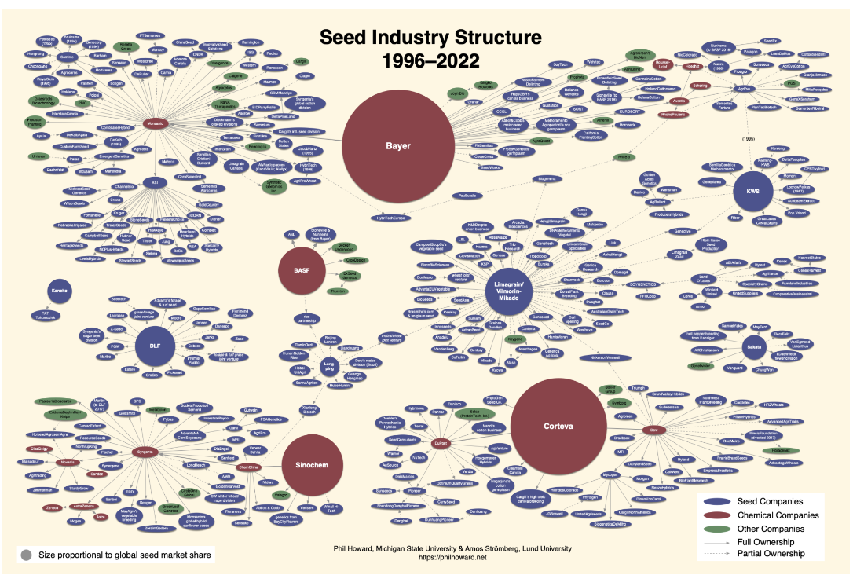
The Dominant Seed System
Just 9 species account for 67% of global crop production (FAO, 2010)
Crop homogenization disconnects communities from culturally important seeds and food, threatening seed and food sovereignty (McGuire & Sperling, 2011)
Notes:
The dominant global seed system is one marked by market consolidation and a concentration of power, with just 4 firms having a majority market control
there have been vast environmental and social ramifications of this consolidation
The FAO has declared the decline in global plant diversity as one of the most serious issues facing the planet
Just 9 species account for 67% of global crop production
This homogenization have disconnected communities from their culturally important foods and seeds, threatening seed sovereignty and undermining food security
The dominant seed system is failing to provide culturally meaningful seeds and foods

Slide 3
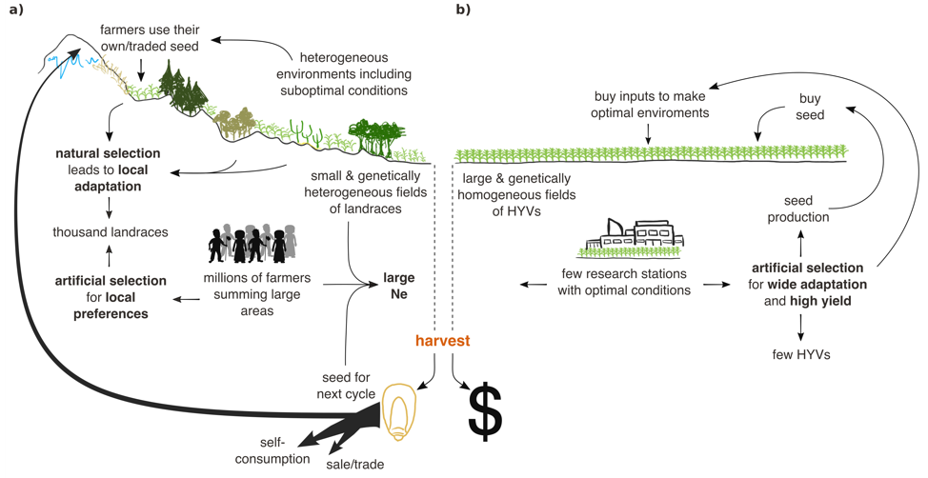
Seed Systems: Formal and Informal
Informal
Formal
Figure Credit: A. Mastretta-Yanes
Notes:
Globally, there are both formal and informal seed systems present
Formal seed systems are marked by institutional or private research and development and tend to focus on traits such as high yield and pesticide resistance, relying on formal markets for the sale distribution of seeds
Informal seed systems tend to focus on breeding seeds with a focus on local adaptation and use a wide array of networks, such as trade, gifting, and local markets for seed distribution, while also often saving some seed for personal use or continued breeding cycles
Although, as shown on the previous slide, formal seed systems are dominant in power over the global market, informal seed systems are incredibly prevalent and account for up to 90% of seed movement in some regions
As such, these informal systems supply a large portion of the seeds farmers are using and are responsible for the continued breeding efforts of many seed varieties, particularly those that are not used at an industrial scale

Slide 4
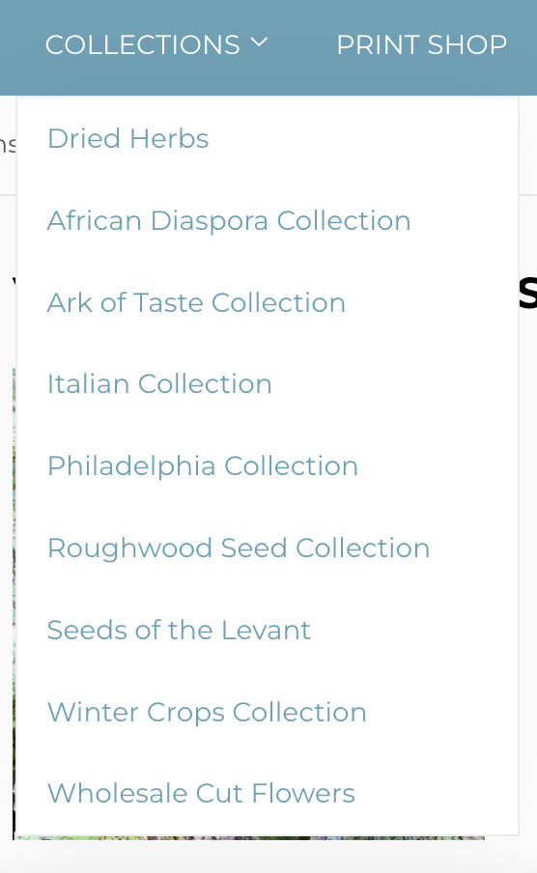
Alternative Seed Systems
Utilize both market- and non-market-based approaches to integrate plural values and goals (beyond yield and profit) (Helicke, 2015; Soleri, 2018)
Seed keepers identify the importance of cultivating culturally meaningful (CM) seeds (Carolan, 2017)
The US lacks availability of CM seed for consumers and growers feel disconnected from market opportunities (Isbell et al., 2021; Mulugeta et al., 2021)
Notes:
Alternative seed systems can represent a blend of formal and informal seed systems, in which seeds are bred and distributed through both formal and informal channels
In response to this consolidation and concentration of power in the dominant seed system, seedkeepers across the US have worked to increase seed sovereignty and reclaim power in the seed value chain, utilizing both market and non-market based approaches to integrate values beyond the scope of capital gain
Culturally meaningful seeds are seeds that growers, customers, and the broader community identify as important to their own cultural identities
Examples include Independent seed companies, community seed banks, seed libraries, participatory plant breeding
Despite these efforts ….
As such, there is a need to connect culturally meaningful seed growers and seed companies to market opportunities to make culturally meaningful seeds and food more widely available

Slide 5
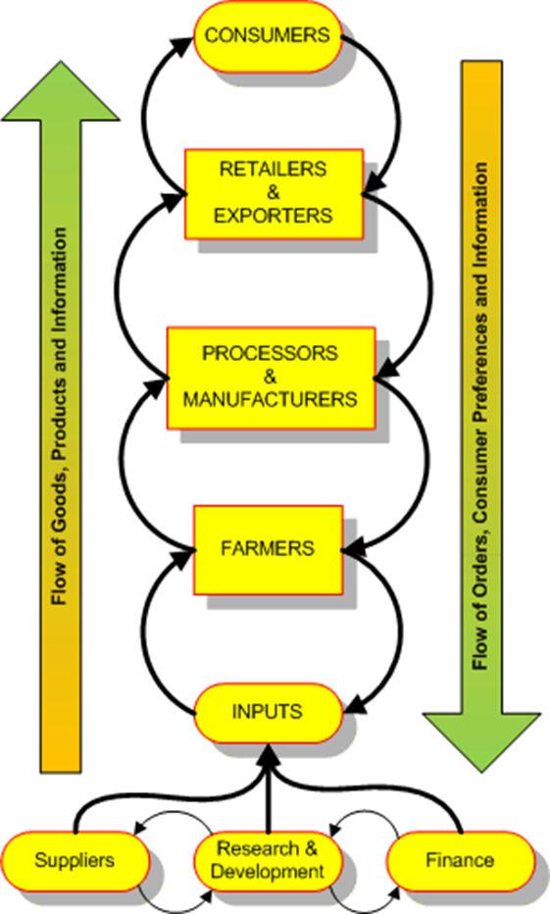
Value Chain Development (VCD)
Value chains include all activities and stakeholders involved in bringing a product from production to consumption or disposal
Unequal access to market opportunities persists despite goals and rhetoric of inclusion (Minh & Osei-Amponsah, 2021; Kilelu et al., 2017 )
Pro-poor VCD seeks to increase opportunities for stakeholders that are excluded from value chains based on social or economic status (Ros-Tonen et al., 2019)
Pro-poor VCD is one strategy to connect historically marginalized small-scale seedkeepers to market opportunities in the Global North (Donovan et al., 2021)
Notes:
- one way through which growers of CM seeds can be connected to market opportunities is through VCD
- Unequal market access persists
Research has found that market actors with more social, natural, and financial assets are better able to participate in value chains
VCD is more often situated in the Global South, but the same principles can be applied in the Global North

Slide 6
Seed Value Chain in the US
CM seed growers
Seed companies
Farmers &
gardeners
Produce wholesalers& distributors
Specialty grocers
Chefs &
restaurants
Notes:
Complex web of relations, rather than a linear relationship from seed grower to end users

Slide 7
Ujamaa Cooperative Farming Alliance
Notes:
One group working to enhance access to CM seeds is

Slide 8
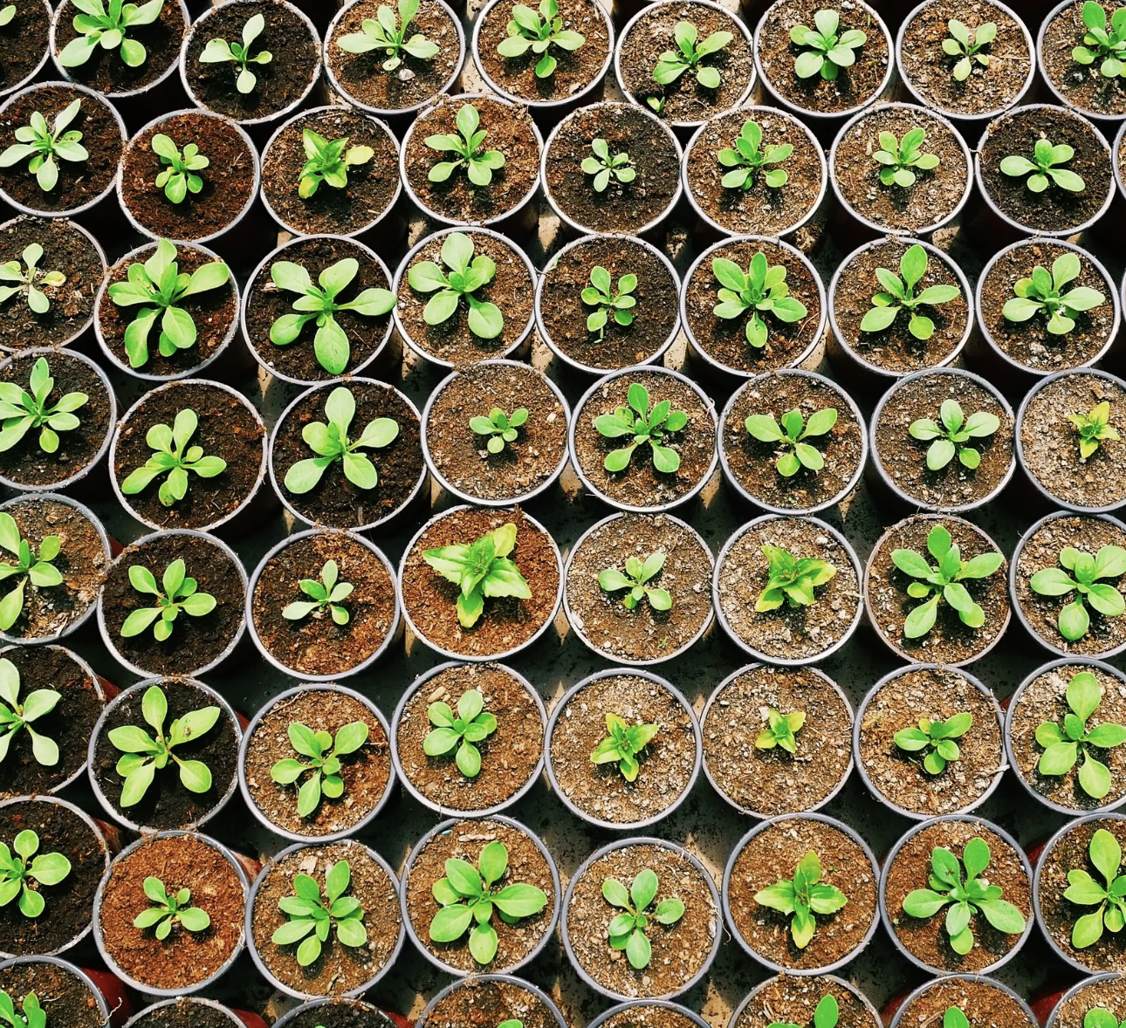
Research Questions
What are the opportunities to enhance access to culturally meaningful (CM) seeds across the Northeastern seed value chain (SVC)?
What are barriers to enhancing access to CM seeds across the Northeastern SVC?
Notes:
- chanda

Slide 9
Methods
Focus groups, each with a different seed value chain stakeholder group in the Northeastern US (n=31)​
Data coded and analyzed in Nvivo 12
Ujamaa Growers
Seed Companies
Famers/
Gardeners
Specialty Grocers
Produce Wholesalers/Distributors
Chefs/
Restaurants
n = 4
n = 7
n = 3
n = 9
n = 4
n = 4
(Green circles represent upstream stakeholder groups; orange circles represent downstream stakeholder groups)​
Notes:
- All data were collected and analyzed collaboratively with our Ujamaa partners

Slide 10
Results: Opportunities
“You might not be able to grow something, you're not gonna grow plantains in Vermont, but there are some crops that would work in your environments if you did a little bit of seed work.”
“…you really can't have a local food program unless you have a local seed program”
“…it doesn't scare us to pay more for something, especially when it has the attributes and kind of that story behind it that make it a unique product. Like, we're more than happy to pay a little bit more, you know, to our grower, right, to our local farm partner, especially if we know it has an importance that we're able to transfer to a customer…”
Chef
Produce Wholesaler
Specialty Grocer
Notes:
In focus groups with stakeholders, several opportunities for strengthening the seed value chain for CM seeds were highlighted… for example,
When discussing the possibility of collaboration between farmers and chefs in the Northeast to bring more crops into local cuisine, one chef noted…
In conversation about the importance and possibility of a strong local food system, one produce wholesaler explained…
When asked if they would be willing to pay a price premium for CM foods, one specialty grocer said…

Slide 11
Results: Barriers
“And it feels extractive and just us stepping in. And there's some varieties that I don't think have ever been sold in a big seed company way, at least. And I definitely don't want [our seed company] to be the ones always bringing new varieties. Like, that to a market, feels exploitative and … not our place. … it's just tricky constantly.”
“…introducing people to these new [foods] and then helping them to figure out, "Okay, how do you actually use this thing?" And then beyond that, like, not just how do you use it, but how do you then integrate it in a meaningful way into the cooking that you do, the hosting that you do…”
“…you're pricing people out. There are people who could benefit most from [access to CM foods], who have a heritage legacy, historical legacy in not only growing it on this continent, but where they originated, can no longer purchase that particular product. There's something wrong with that.”
Seed Company representative
Ujamaa Grower
Farmer
Notes:
In addition to opportunities for increasing access to CM seeds, stakeholders raised concerns about the barriers for proliferating CM seed access, such as
One seed company rep. expressed concern for extractive marketing practices, saying…
When discussing considerations for growing the market for CM seeds and foods, one Ujamaa seed grower noted…
In a discussion about the current state of the CM seed and food market, specifically a need to increase connectivity between producers and consumers, one farmer explained …

Slide 12
Discussion
Importance of maintaining the cultural stories attached to seeds and culturally sensitive marketing is a concern
Creating consumer familiarity with CM seeds and their products is necessary to increase market opportunities
Both seed keepers and downstream value chain stakeholders recognize the importance of CM seeds, but creating market opportunities that small-scale growers can take advantage of will require strengthening connectivity along the value chain
Seed keepers desire to grow CM seeds and make CM seeds and foods more widely accessible through channels supported by downstream stakeholders
There is a need for breeding CM seeds that are suited to grow in the Northeast climate
Notes:
Preliminary results provide insight to where opportunities and barriers to increase CM seed access exist
Both seed keepers and downstream value chain stakeholders recognize the importance of CM seeds, but creating market opportunities that small-scale growers can take advantage of will require strengthening connectivity along the value chain, such that downstream stakeholders are able to appropriately market CM seeds and create a consumer base and seed keepers have reliable outlets through which to distribute their seeds and sustain their livelihoods

Slide 13
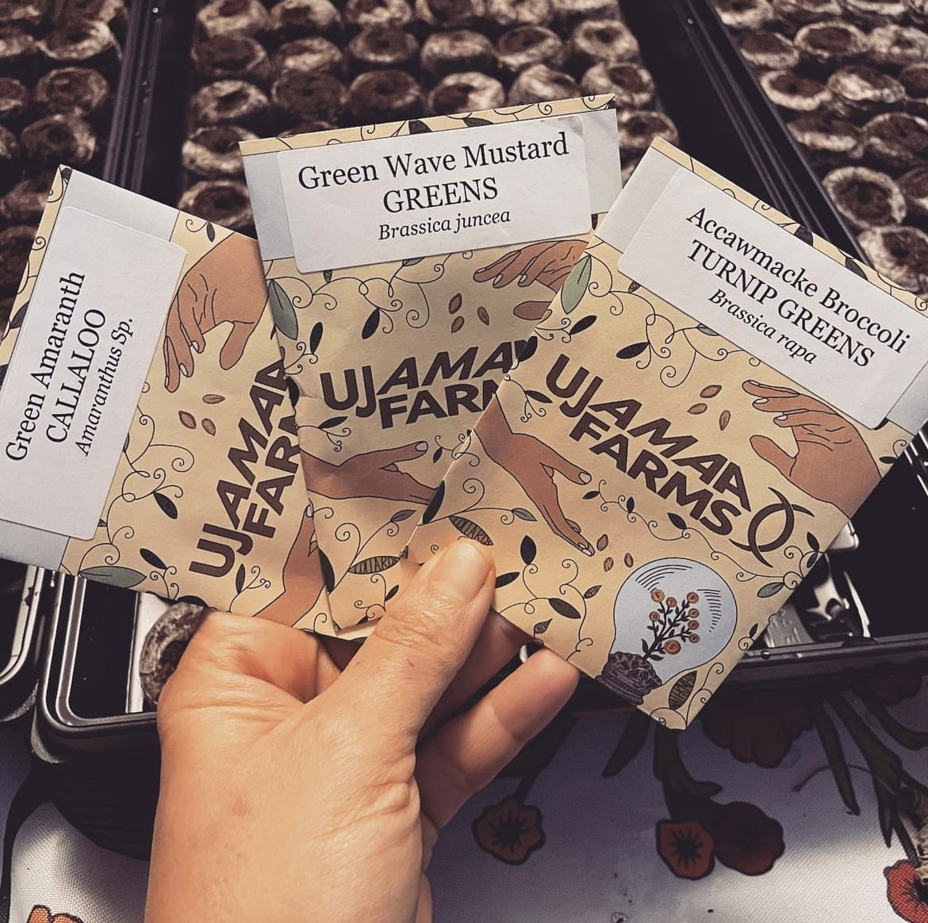
Next Steps
Implications of Research
Northeast SVC stakeholder survey to be deployed in Fall 2023
Notes:
- Alexis

Slide 14
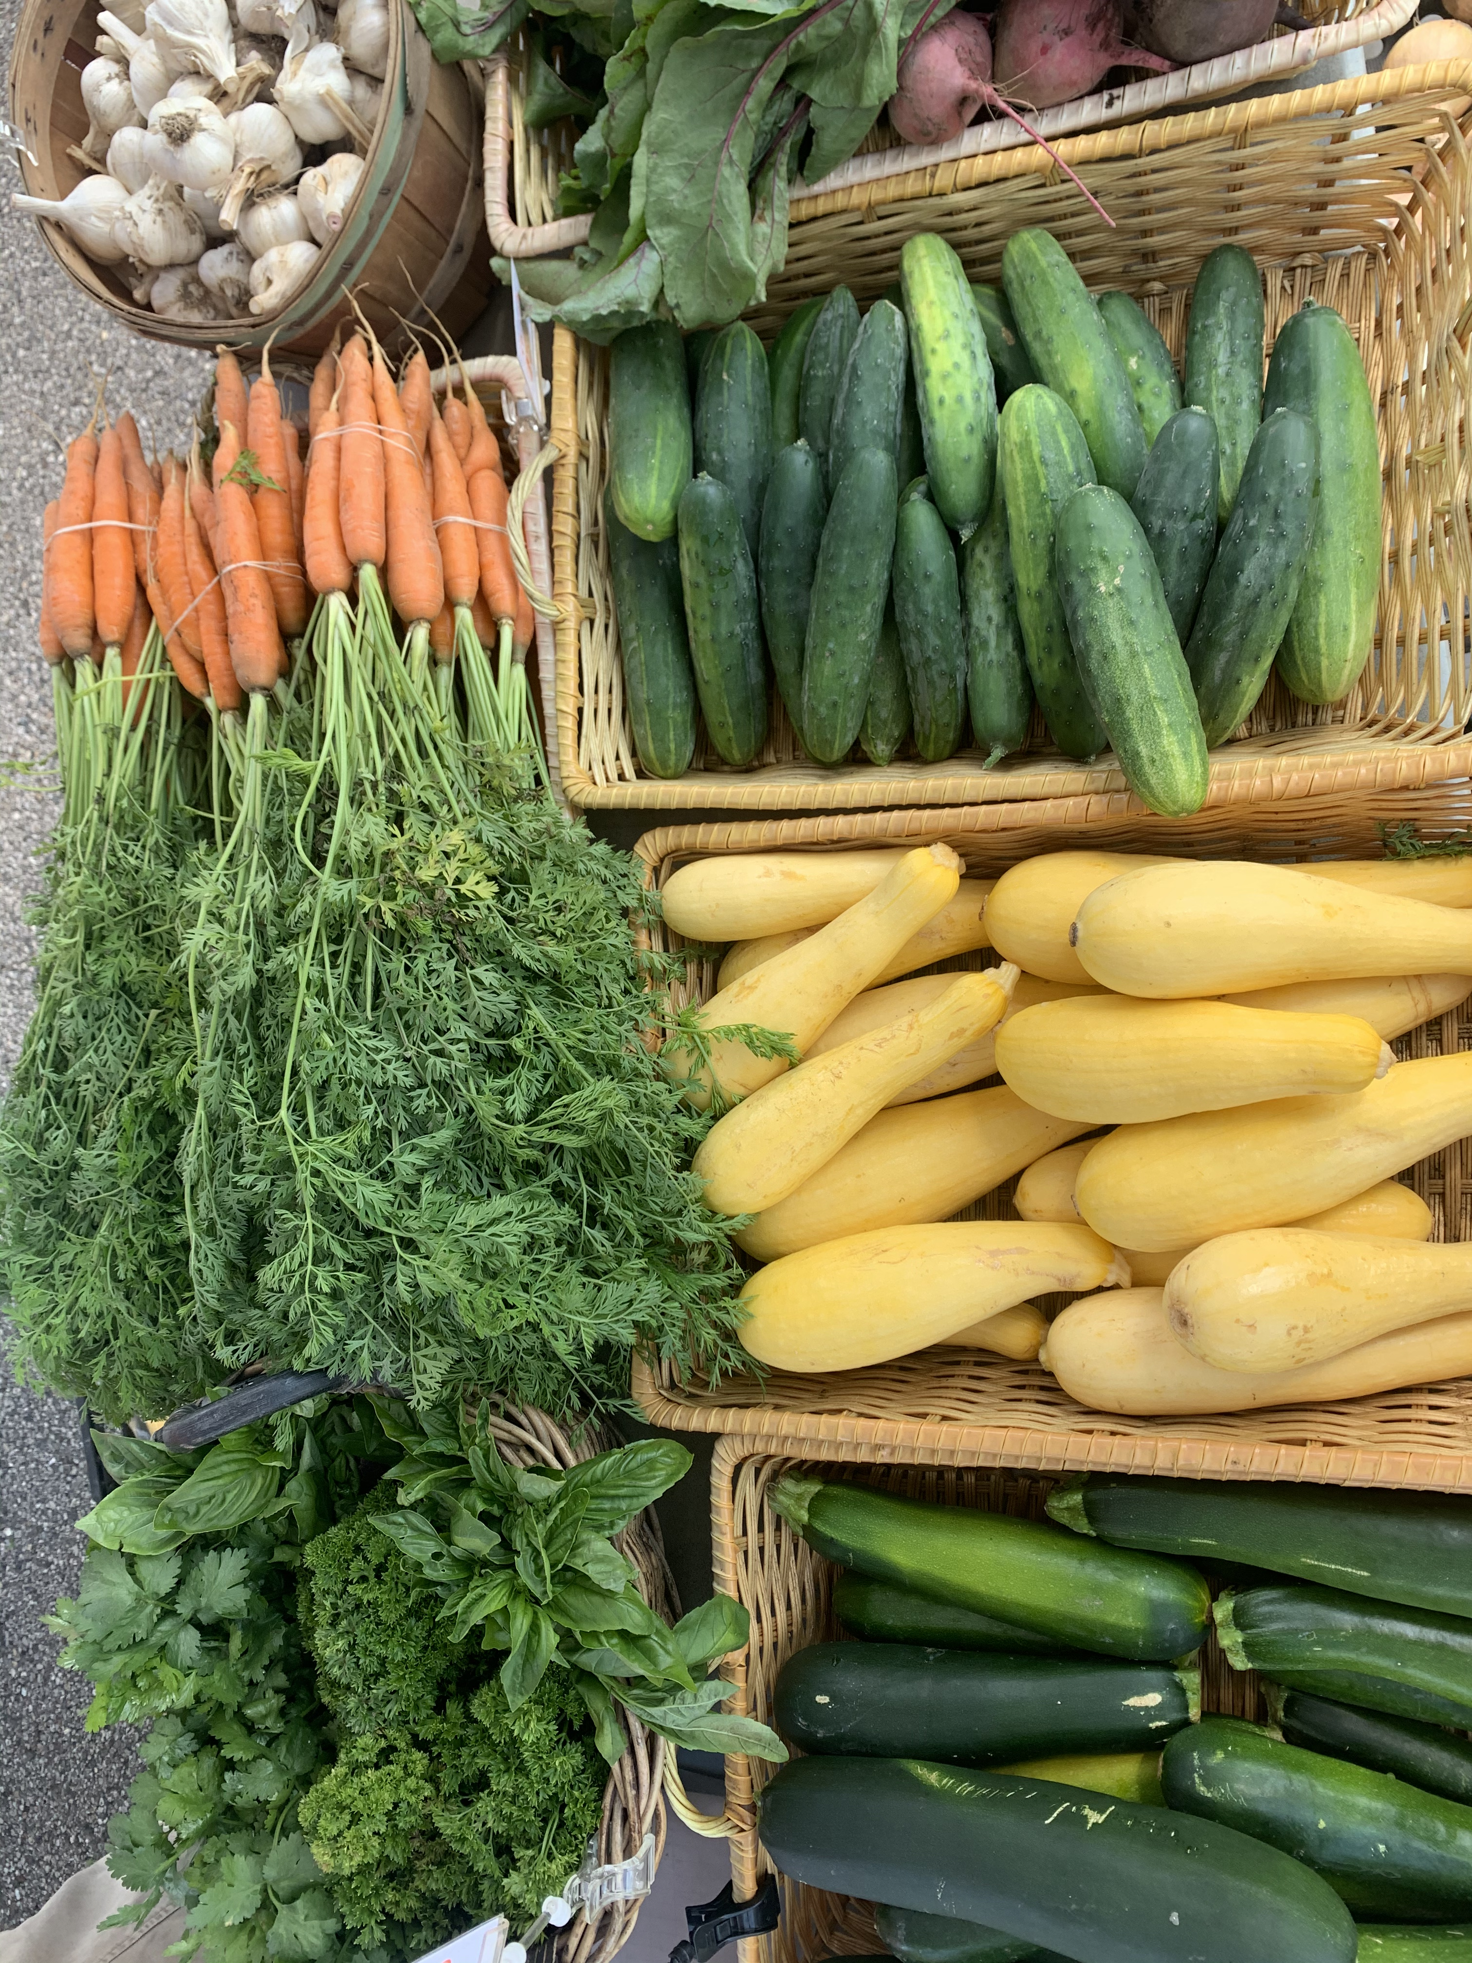
Thank you!
Please feel free to reach out with any additional questions or feedback at claire.fischer@uvm.edu

Slide 15
References
Carolan, M. S. (2007). Saving Seeds, Saving Culture: A Case Study of a Heritage Seed Bank. Society & Natural Resources, 20(8), 739–750. https://doi.org/10.1080/08941920601091345
FAO. Commission on Genetic Resources for Food and Agriculture (Ed.). (2010). The second report on the state of the world’s plant genetic resources for food and agriculture. Commission on Genetic Resources for Food and Agriculture, Food and Agriculture Organization of the United Nations.
Helicke, N. A. (2015). Seed exchange networks and food system resilience in the United States. Journal of Environmental Studies and Sciences, 5(4), 636–649. https://doi.org/10.1007/s13412-015-0346-5
Isbell, C., Tobin, D., & Reynolds, T. (2021). Motivations for maintaining crop diversity: Evidence from Vermont's seed systems. Ecological Economics, 189: 107138.
Kilelu, C., Klerkx, L., Omore, A., Baltenweck, I., Leeuwis, C., & Githinji, J. (2017). Value Chain Upgrading and the Inclusion of Smallholders in Markets: Reflections on Contributions of Multi-Stakeholder Processes in Dairy Development in Tanzania. The European Journal of Development Research, 29(5), 1102–1121. https://doi.org/10.1057/s41287-016-0074-z
McGuire, S., & Sperling, L. (2011). The links between food security and seed security: Facts and fiction that guide response. Development in Practice, 21(4–5), 493–508. https://doi.org/10.1080/09614524.2011.562485
Minh, T. T., & Osei‐Amponsah, C. (2021). Towards poor‐centred value chain for sustainable development: A conceptual framework. Sustainable Development, 29(6), 1223–1236. https://doi.org/10.1002/sd.2220
Ros-Tonen, M. A., Bitzer, V., Laven, A., Ollivier de Leth, D., Van Leynseele, Y., & Vos, A. (2019). Conceptualizing inclusiveness of smallholder value chain integration. Current Opinion in Environmental Sustainability, 41, 10–17. https://doi.org/10.1016/j.cosust.2019.08.006
Soleri, D. (2016). Civic seeds: New institutions for seed systems and communities—A 2016 survey of California seed libraries.
Strömberg, A. & Howard, P. (2023). Recent changes in the global seed industry and digital agriculture industries. Phillip H. Howard. https://philhoward.net/2023/01/04/seed-digital/
UCFA. Seed farming. UCFA. https://ujamaafarms.com/seed-farming
Isbell, C., Tobin, D., & Reynolds, T. (2021). Motivations for maintaining crop diversity: Evidence from Vermont's seed systems. Ecological Economics, 189: 107138.
Donovan, J., Rutsaert, P., Spielman, D., Shikuku, K. M., & Demont, M. (2021). Seed value chain development in the Global South: Key issues and new directions for public breeding programs. Outlook on Agriculture, 50(4), 366–377. https://doi.org/10.1177/00307270211059551
Mulugeta, M., Isbell, C., & Tobin, D. (n.d.). Northeast Organic Seed System (NOSS).

