Slide 1
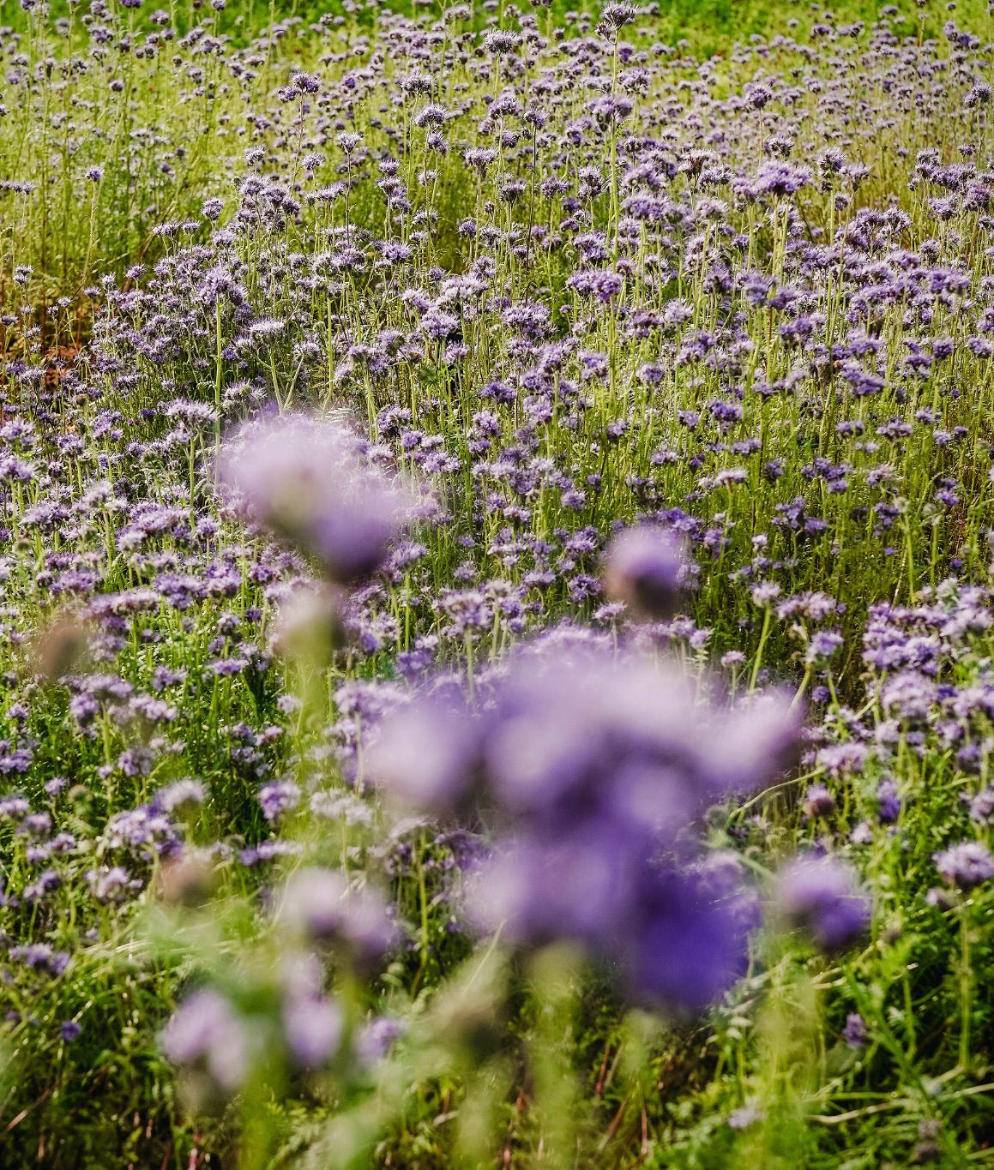


Using Flowering Cover Crops to Attract Natural Predators of Floriculture Pests
Brown Dog Flower Farm
Palmer, Alaska

Slide 2
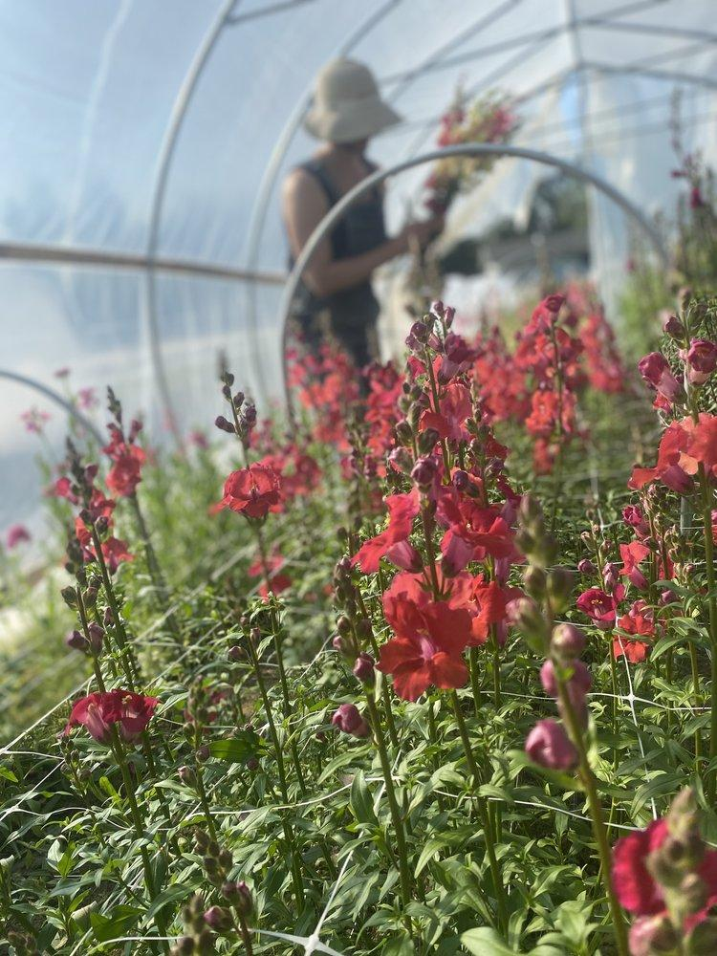
Brown Dog Flower Farm
Location: Palmer, AK
Size: 1.5 acre
Products: Cut Flowers - Annuals and Perennials
Markets: CSA (10 week, 70 member), Farmers Markets, Florists/Designers, Weddings/Events
Market Season: June - September
Practices: One (and a half) person workforce, Chemical-free, OMRI-listed products, “natural,” hand scale, passive season extension.

Slide 3
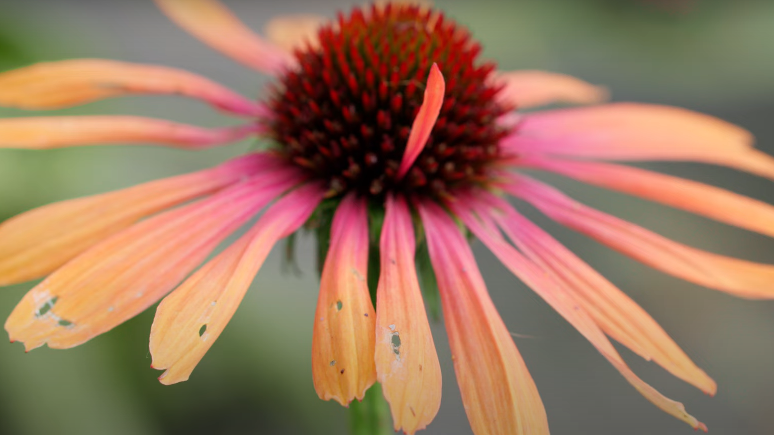
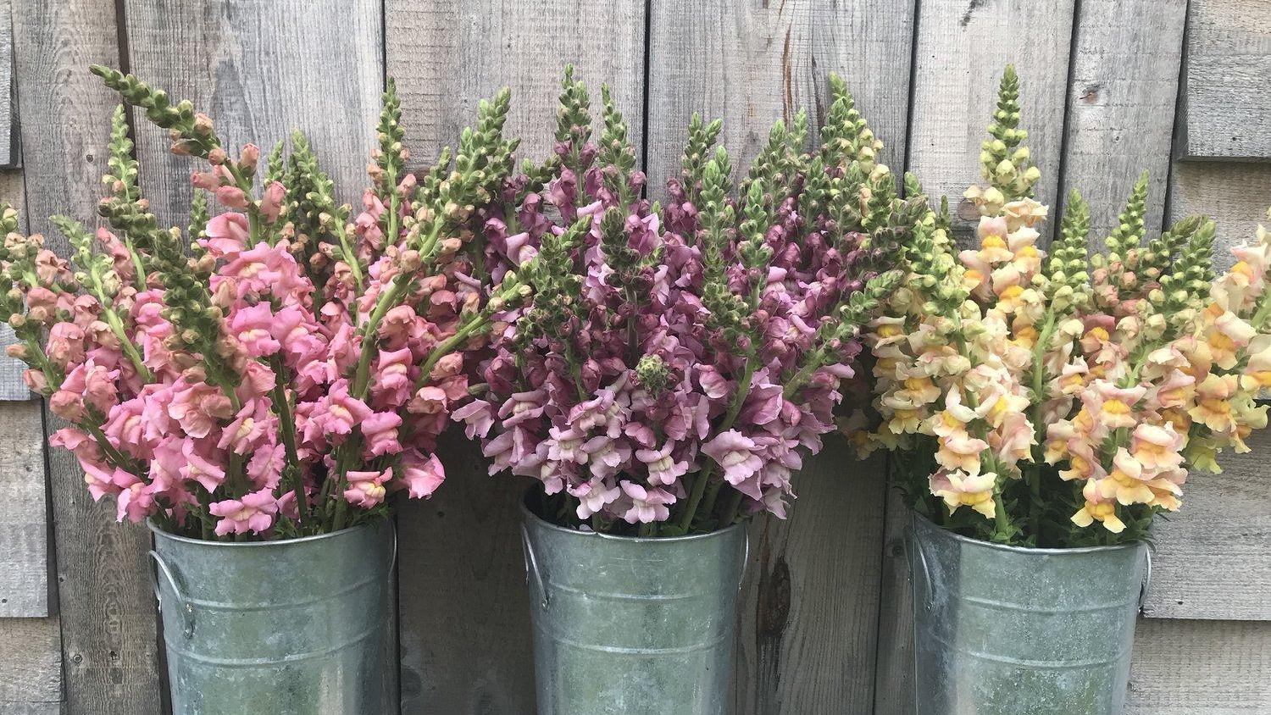
Challenge:
Managing insect pests on flower crops

Slide 4
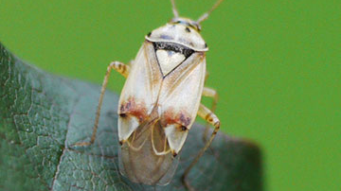
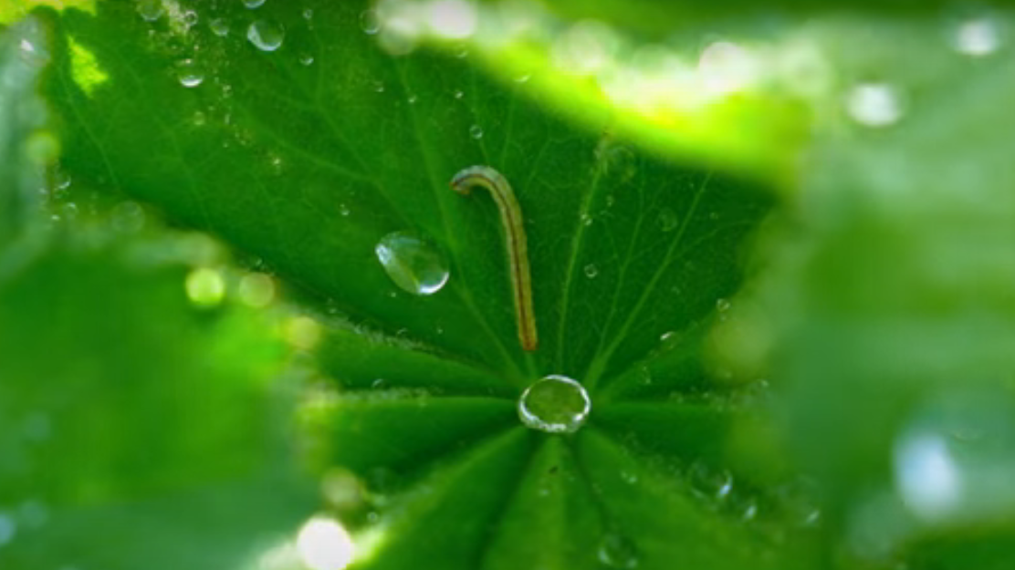
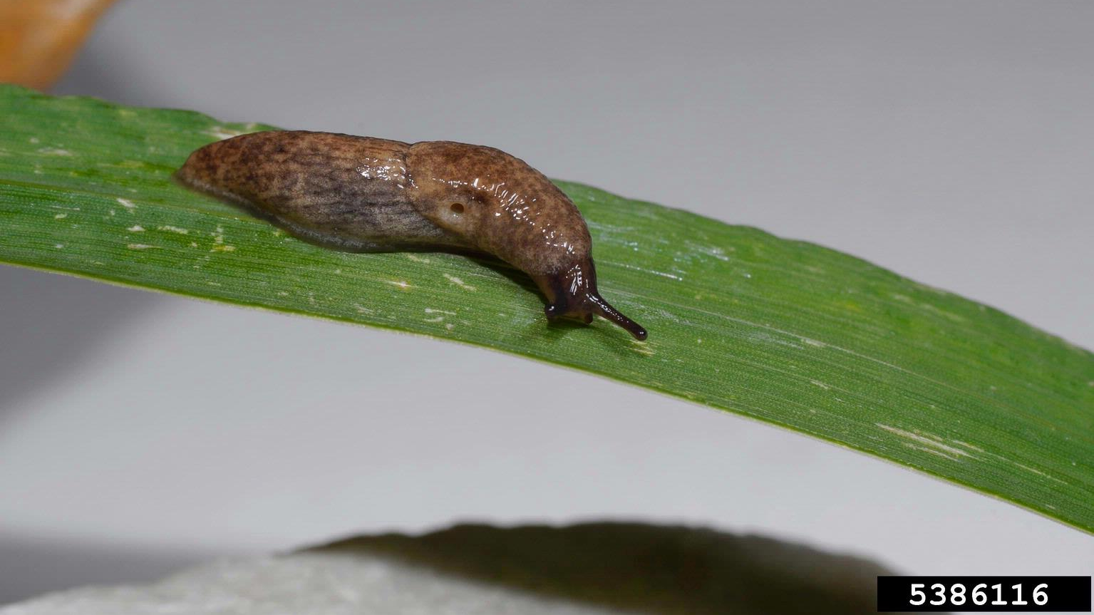
Some primary culprits
Lygus bugs
Caterpillars
Slugs
Mealy bugs
Other (not yet overly concerning):
aphids, thrips

Slide 5
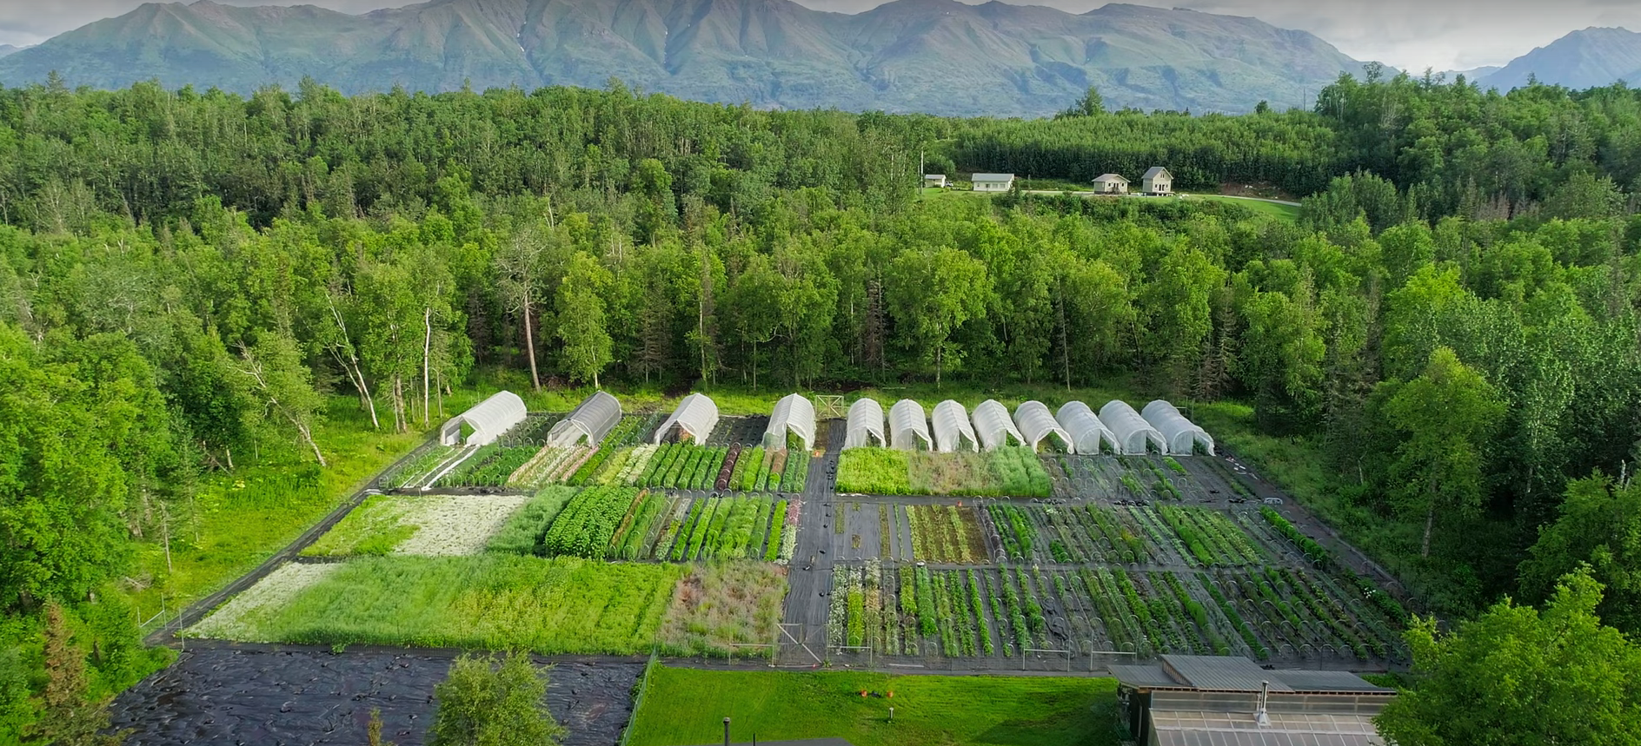
Question: What management practices can we use to encourage biological control of some of these pests?

Slide 6
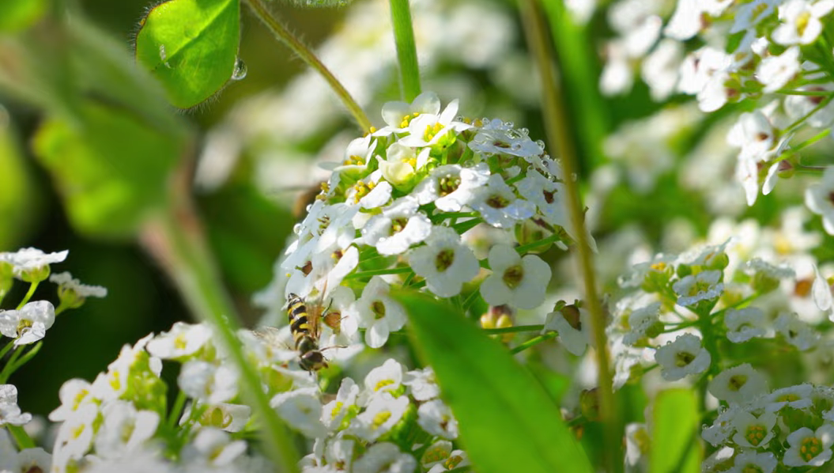
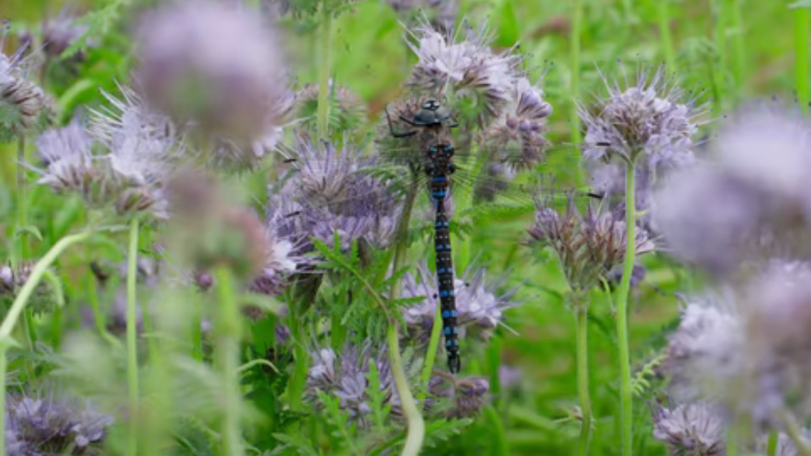
Could flowering cover crops attract more insect predators of these pests?
“During periods when pests are scarce or absent, several important generalist predators can subsist on nectar, pollen and alternative prey afforded by cover crops.” (SARE)

Slide 7
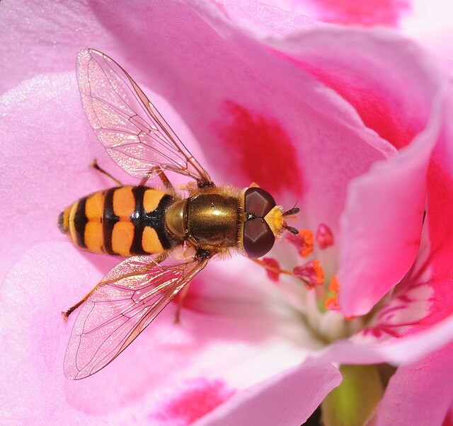
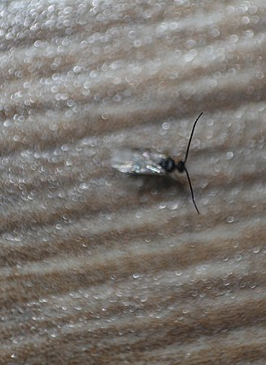
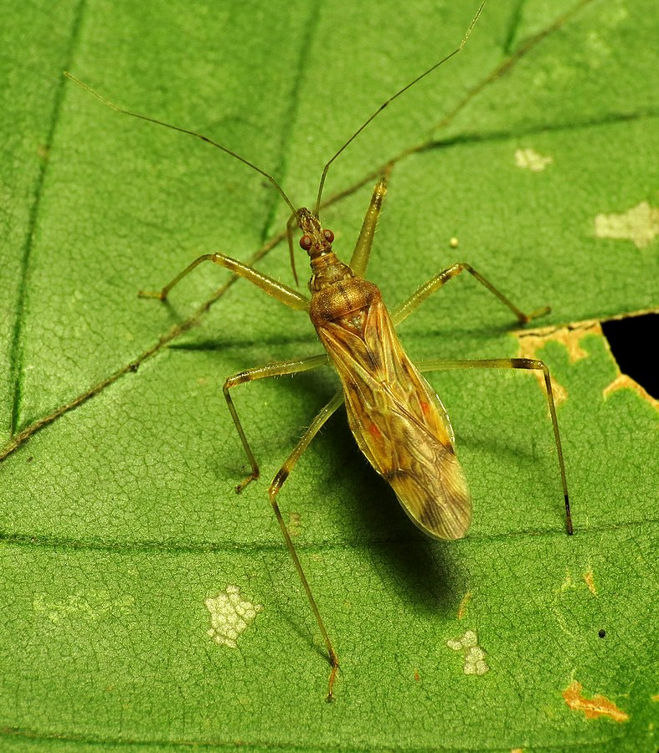
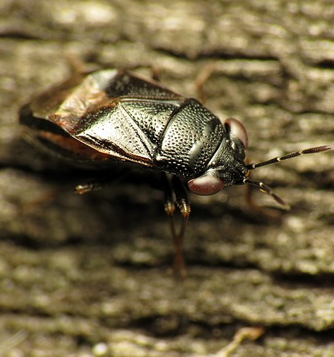
Big eyed bugs
Pirate bugs
Damsel bugs
Hover flies
Parasitic wasps
Spiders
Photo: Thomas Bresson

Slide 8
Methods:
4 species of flower cover crops trialed + 1 species of “control” cover crop (oats)
Plot size: 25 ft. x 50 ft.
# of plots: 10 - 2 plots of each crop, randomly assigned location.
Sampling method: bi-weekly “sticky cards”, 6 per plot.
Length of data collection: 2 year data collection
 | 4W: Permanent High Tunnels |  |  | 4E: Caterpillar Tunnels
 | 3W: Annual Flower Crops (2024) |  |  | 3Ea: Cover Crop Plots (2024) | 3Eb: Perennial Flower Crops
 | 2Wa: Cover Crop Plots (2024) | 2Wb: Annual Flower Crops (2024) |  | 2E: Perennial Flower Crops
 | 1W: Cover Crop Plots (2024) |  |  | 1E: Perennial Flower Crops

Slide 9
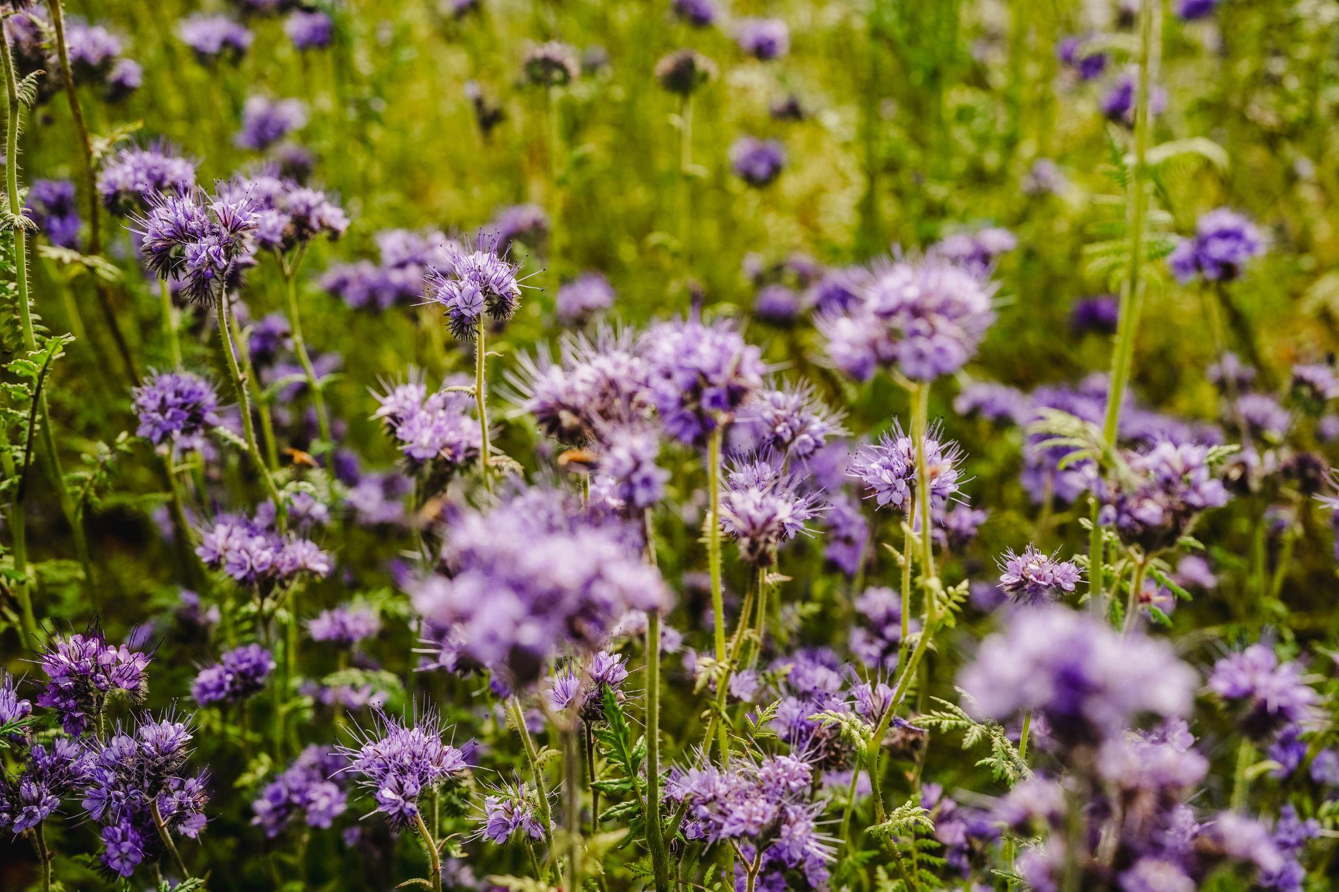
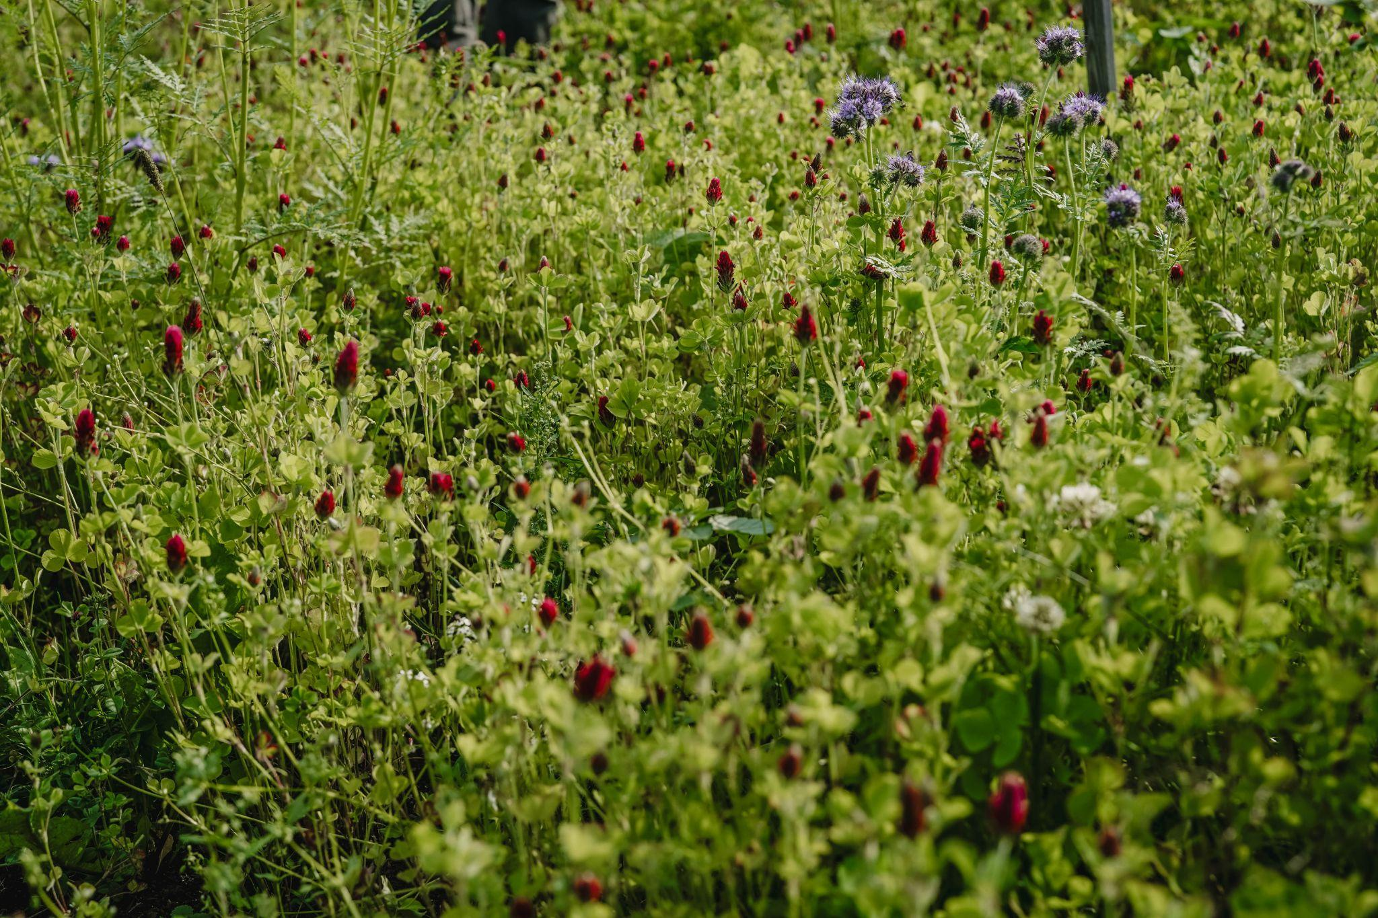
Methods:

Slide 10
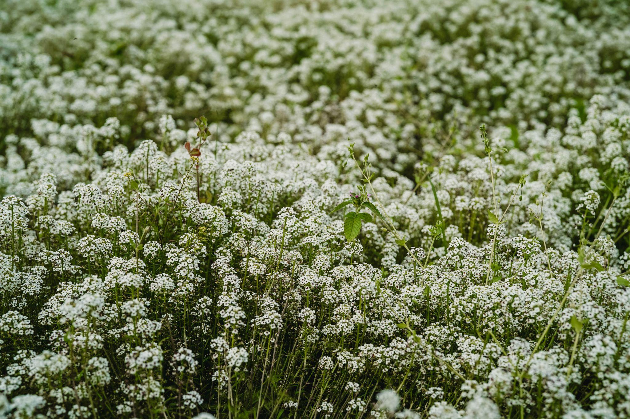
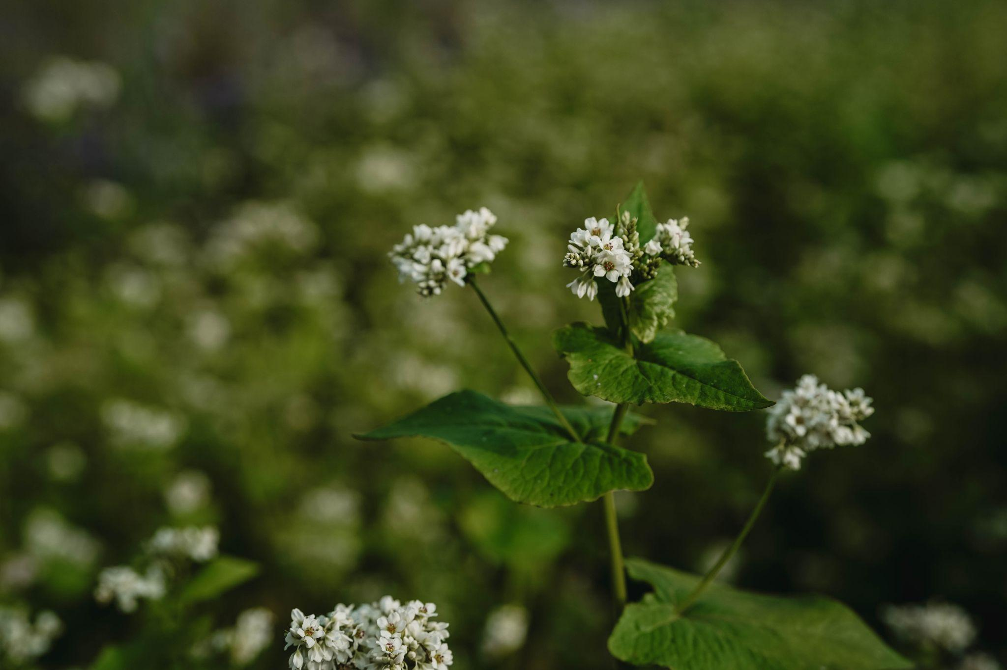
Methods:

Slide 11
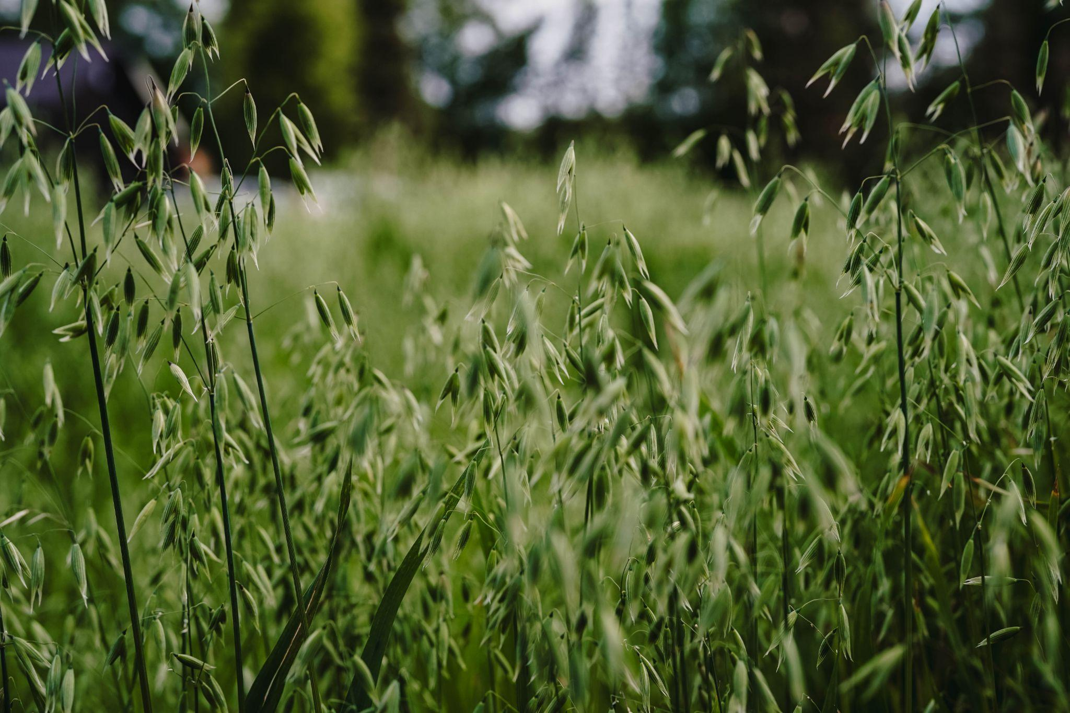
Methods:

Slide 12
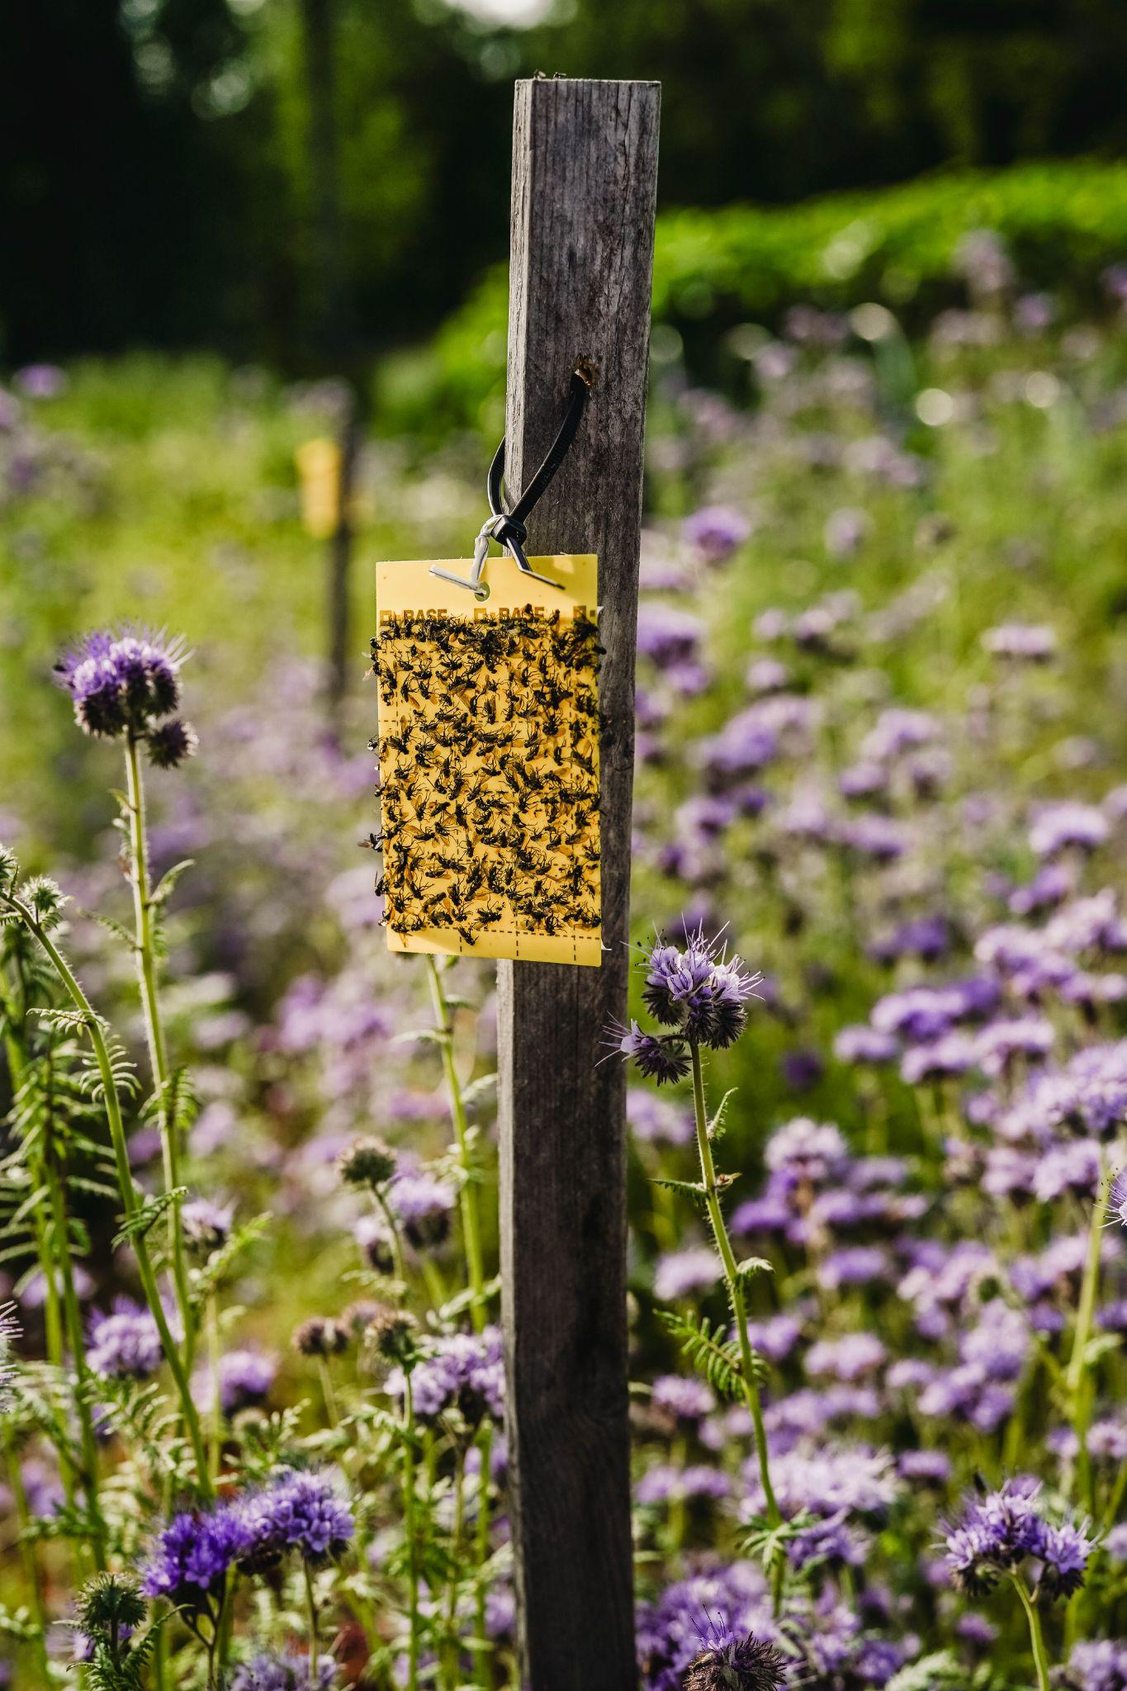
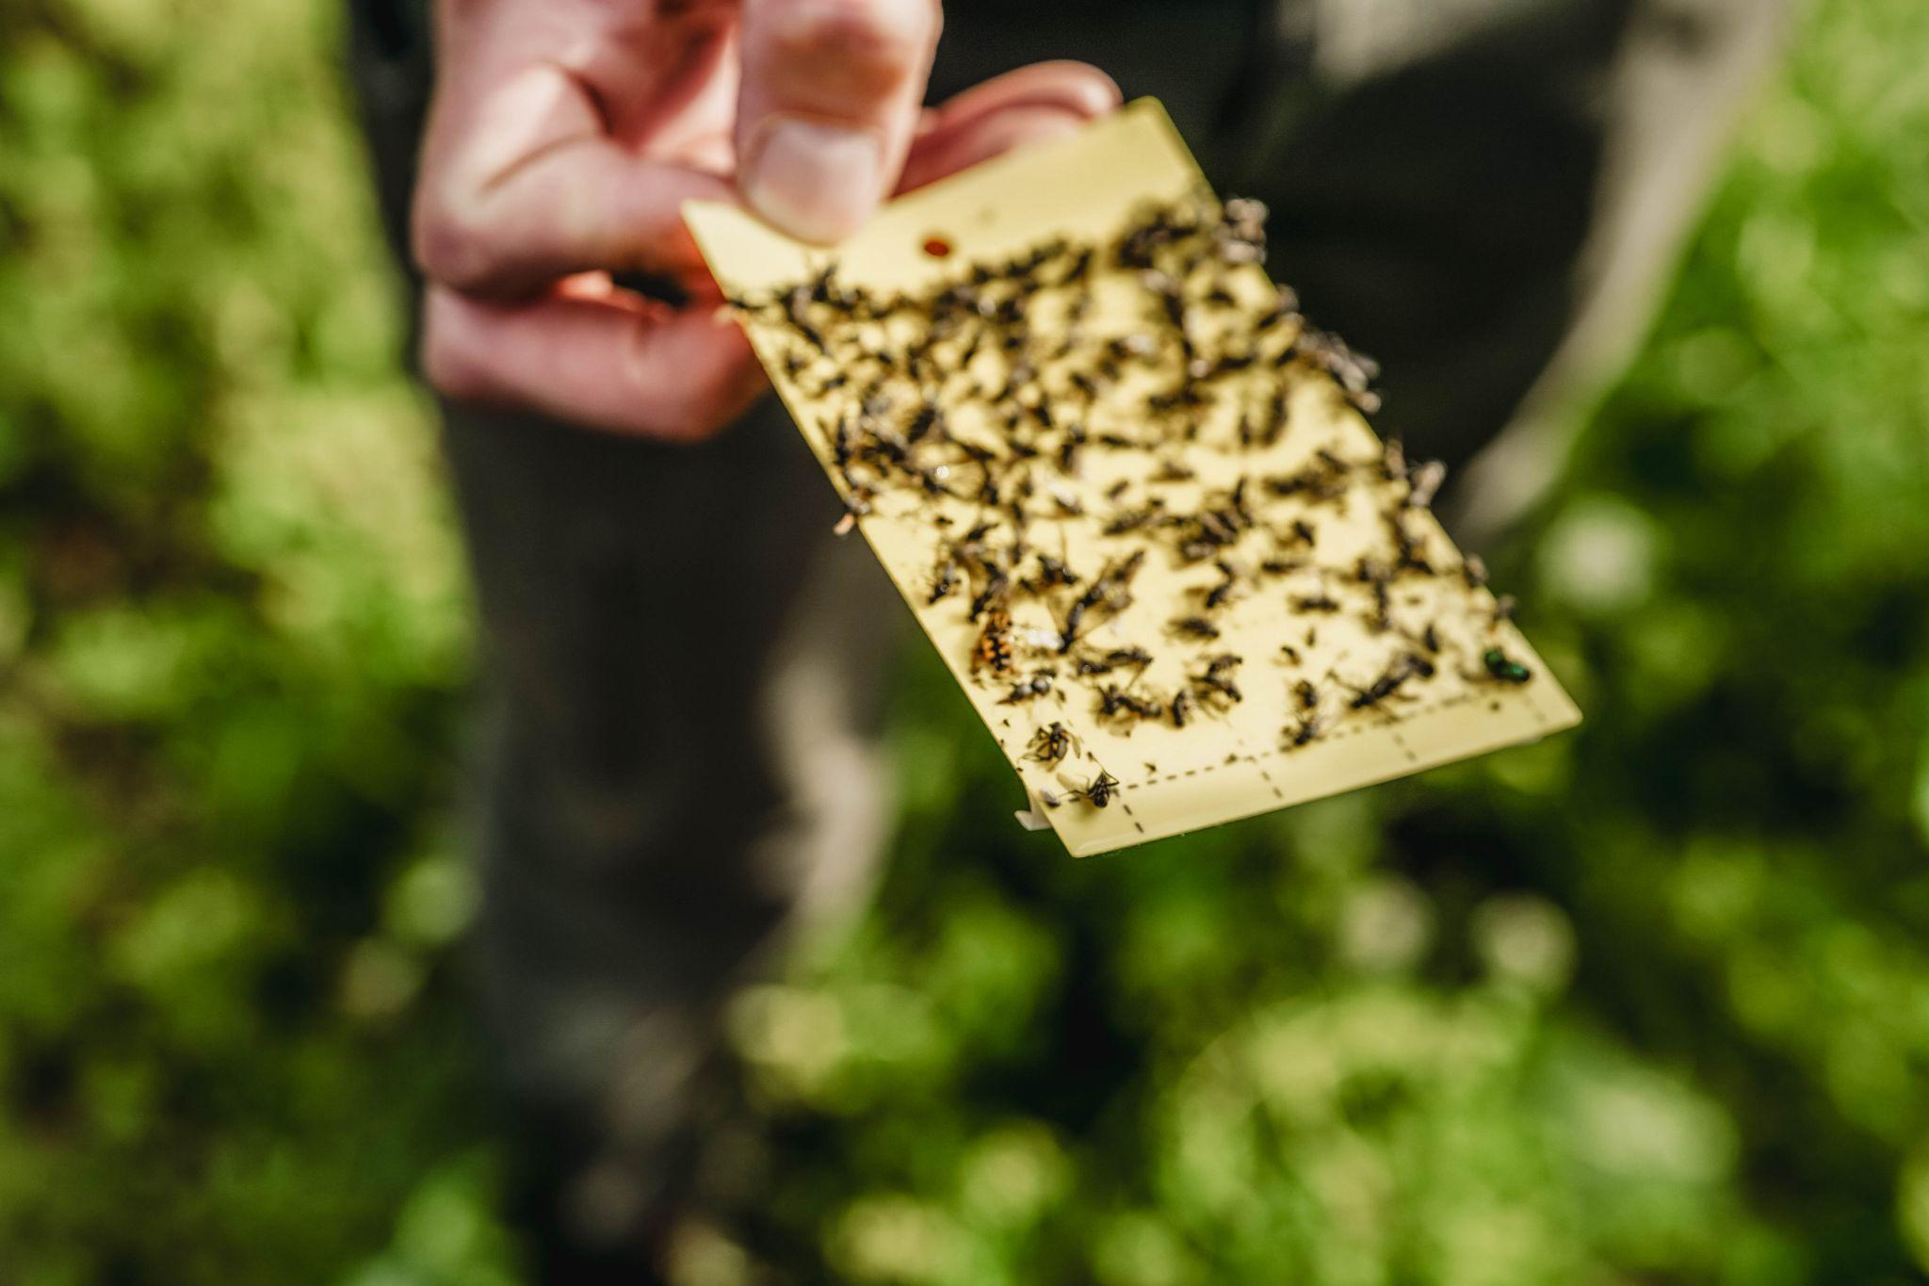
Methods:

Slide 13
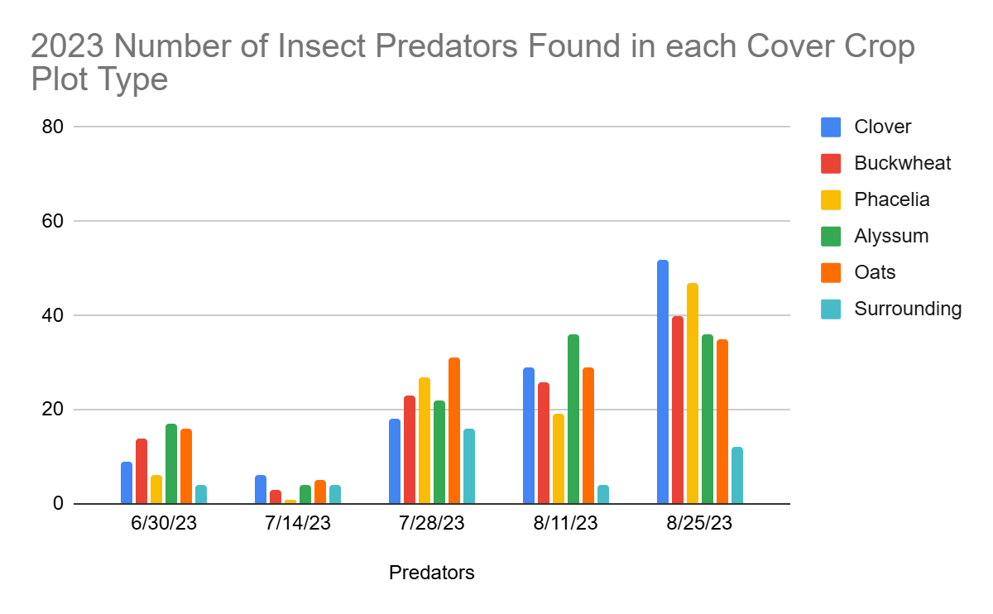
Results and Observations: Cover crop plots seemed to attract more predatory insects than surrounding area plots (especially after flowering began, but also after crop germination)

Slide 14
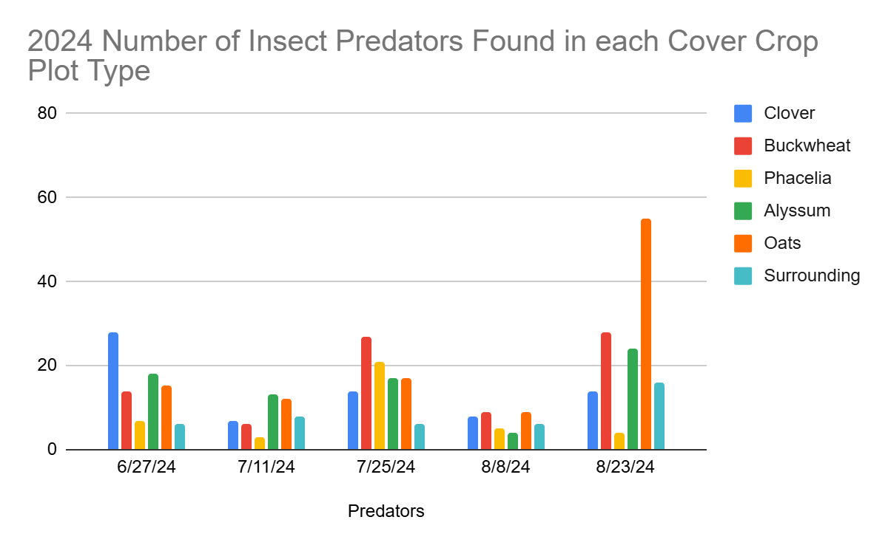
Results and Observations: Cover crop plots seemed to attract more predatory insects than surrounding area plots (especially after flowering began, but also after crop germination)

Slide 15
Results and Observations: Our 4 trial crops (insect pollinated flowering cover crops) did not seem to attract more predatory insects than our control (wind pollinated cover crop - oats).

Slide 16
Results and Observations: Our 4 trial crops (insect pollinated flowering cover crops) did not seem to attract more predatory insects than our control (wind pollinated cover crop - oats).

Slide 17
Year 2 anomalies
Very Rainy!

Slide 18
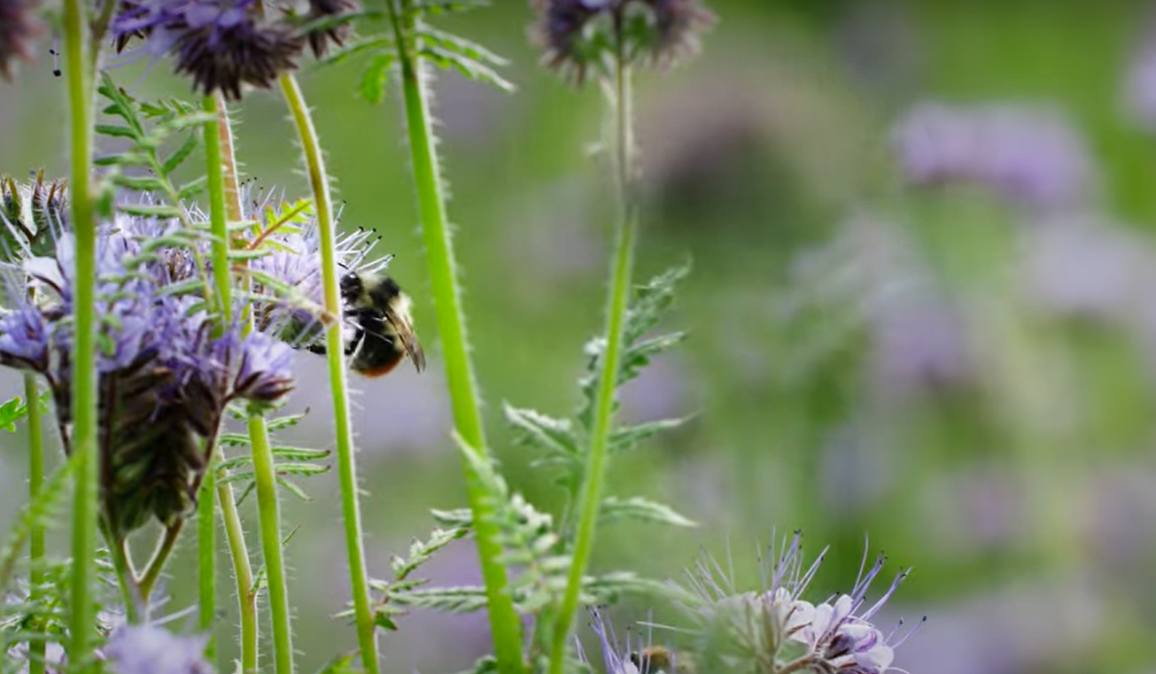
Many beneficials observed that were not captured with our sampling methods….
….the same was true for pests.

Slide 19
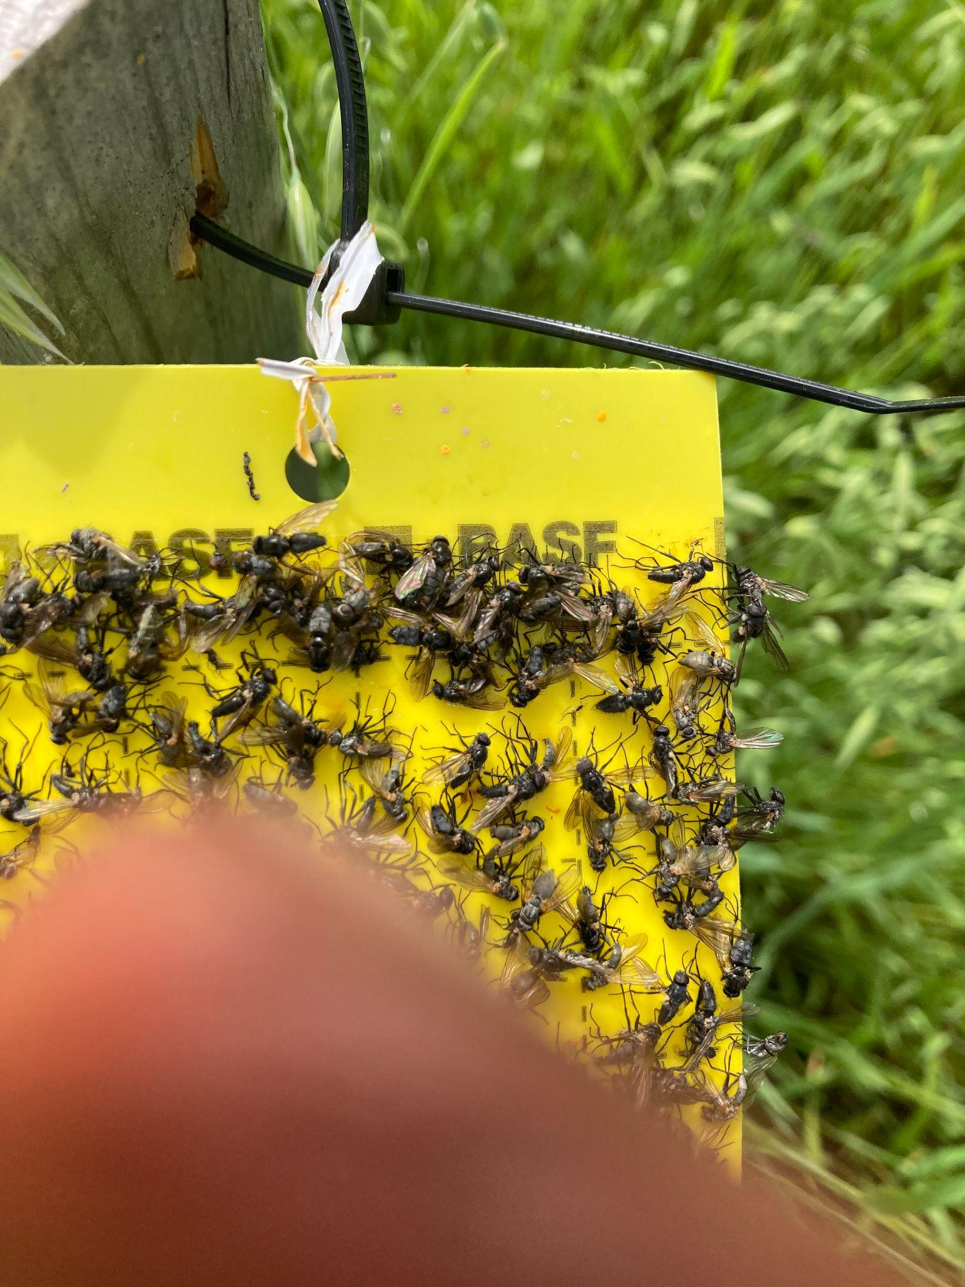
Unexpected Effects Made an Impact

Slide 20
Unexpected Effects…

Slide 21
Questions:
What role would integrated, undisturbed non-flowering cover crop plots play in providing insect habitat (pest OR beneficial)
What management practices can be used to increase earlier predator emergence?
What other sampling methods and/or experimental designs would better test our original question?
Are cultural practices for increasing beneficials and decreasing pests are at odds: mowing “weedy areas” at the end of the year. What to do?
How much do population fluctuations have to do with individual species’ lifecycle?
Our implementation plan moving forward: how do we maximize the benefits of providing habitat/food plots for insect predators while also mitigating the potential downsides?

Slide 22
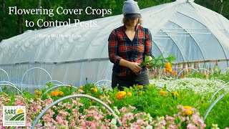
More Information

Slide 23
More Information
Stay in touch to hear more as we write-up final results
Website: www.browndogflowerfarm.com
(sign up for our email newsletter there)
Email: browndogflowerfarm@gmail.com
Social Media: @browndogflowerfarm (Instagram)
Mimi Rooney and Ben Swimm

Slide 24
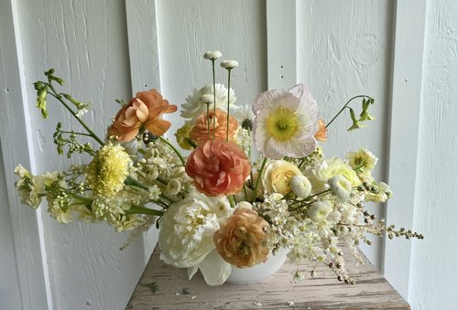
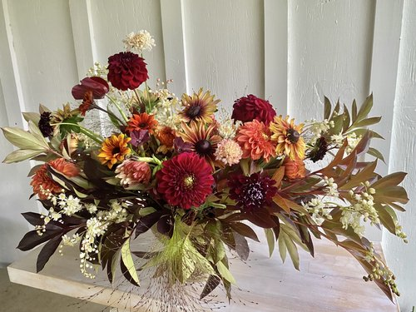
Questions?

Slide 25
"This material is based upon work that is supported by the National Institute of Food and Agriculture, U.S. Department of Agriculture, under award number 2022-38640-WS1FR through the Western Sustainable Agriculture Research and Education program under project number G304-23-W9982. USDA is an equal opportunity employer and service provider. Any opinions, findings, conclusions, or recommendations expressed in this publication are those of the author(s) and do not necessarily reflect the view of the U.S. Department of Agriculture.”
Acknowledgments

Slide 26
Thank you to Western SARE for funding and supporting this project.
Thank you to our Technical Advisor, Dennis Fielding of UAF.
Thank you to all the farmers and community members who wrote letters of support for our project or helped us workshop its concept.
Acknowledgments

Slide 27
Browns Dog Farm pictures used with the permission of Amber Lamphier, Wildwood Flower, Co., Palmer, AK
Stills taken from LD Productions Video: https://www.youtube.com/watch?v=x9ZZBuIsK-0
Insect picture credits:
Slide 4 Lygus bug picture: https://www.nwpotatoresearch.com/insect-library/lygus-bugs
Slug: https://www.invasive.org/browse/detail.cfm?imgnum=5386116
Damsel bug: This file is licensed under the Creative Commons Attribution 2.0 Generic license. https://commons.wikimedia.org/wiki/File:Damsel_Bug_-_Flickr_-_treegrow.jpg
Big Eyed Bug:This file is licensed under the Creative Commons Attribution 2.0 Generic license.
https://commons.wikimedia.org/wiki/File:Big-eyed_Bug_(29555652772).jpg
Parisitic Wasp: This file is licensed under the Creative Commons Attribution-Share Alike 4.0 International license. https://commons.wikimedia.org/wiki/File:Parasitoid_wasp_on_Caterpillar_-_Adult_wasp.jpg
Hover Fly This file is licensed under the Creative Commons Attribution 2.0 Generic license. https://commons.wikimedia.org/wiki/File:ComputerHotline_-_Syrphidae_sp._(by)_(3).jpg
SARE Cover Cropping publication cited on slide 6: Managing Cover Crops Profitably, Sustainable Agriculture Research & Education
Photos and publications

