Slide 1
Calling all Meat Producers and Buyers
in Green, Iowa, and Lafayette Counties
Sustainable Agriculture Research and Education (SARE) Farmer Rancher Grant program has funded a study to assess the feasibility and demand for a federally licensed, women led, niche processing butcher shop and mobile slaughtering unit (MSU) serving the tri-county area of Green, Iowa, and Lafayette Counties.
The initial investigation has shown that there is an unmet demand from area farmers for meat processing,especially a facility specializing in no stress kill, specialty cut or artisan-cured meats.
Thank you for answering the call

Slide 2
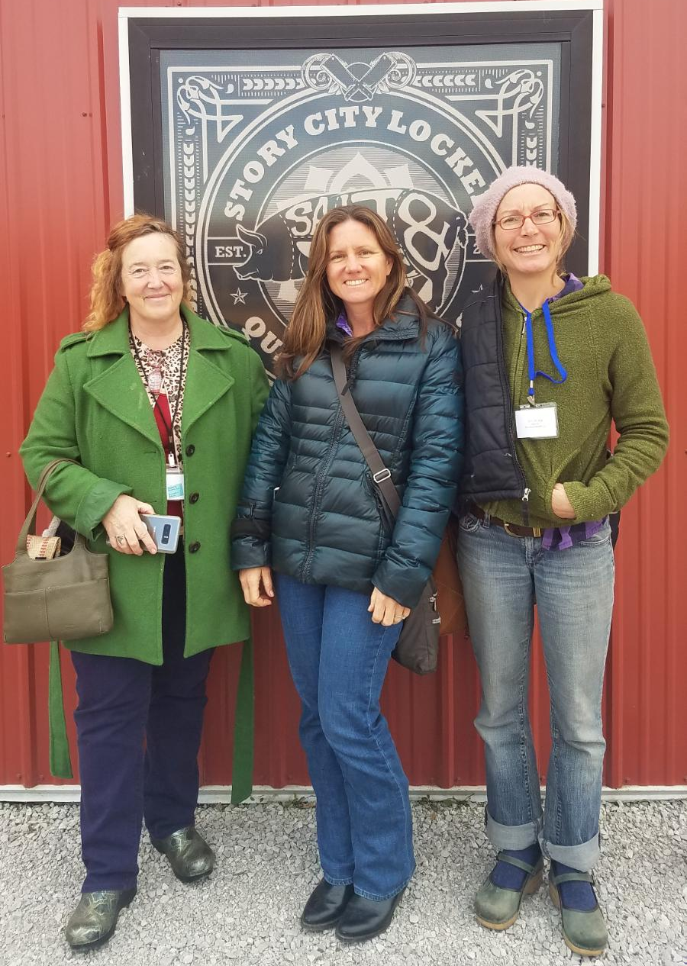
Introduction
April Prusia; Pastured Pork
Betty Anderson; Beef, Pork, Goat and Poultry
Bethany Emond Storm; Goat and Sheep
Survey results
Local resources
Next steps

Slide 3
Survey Monkey-Meat Survey
Goal:
To survey meat producers in Green, Iowa, and Lafayette Counties about their current butcher situation
Method:
Paper copies posted at farmers markets, post offices, grocery stores and banks.
Email links through the extension agents, local ag groups, and NRCS offices
Advertisements in several local papers
79 cohorts took the survey

Slide 4
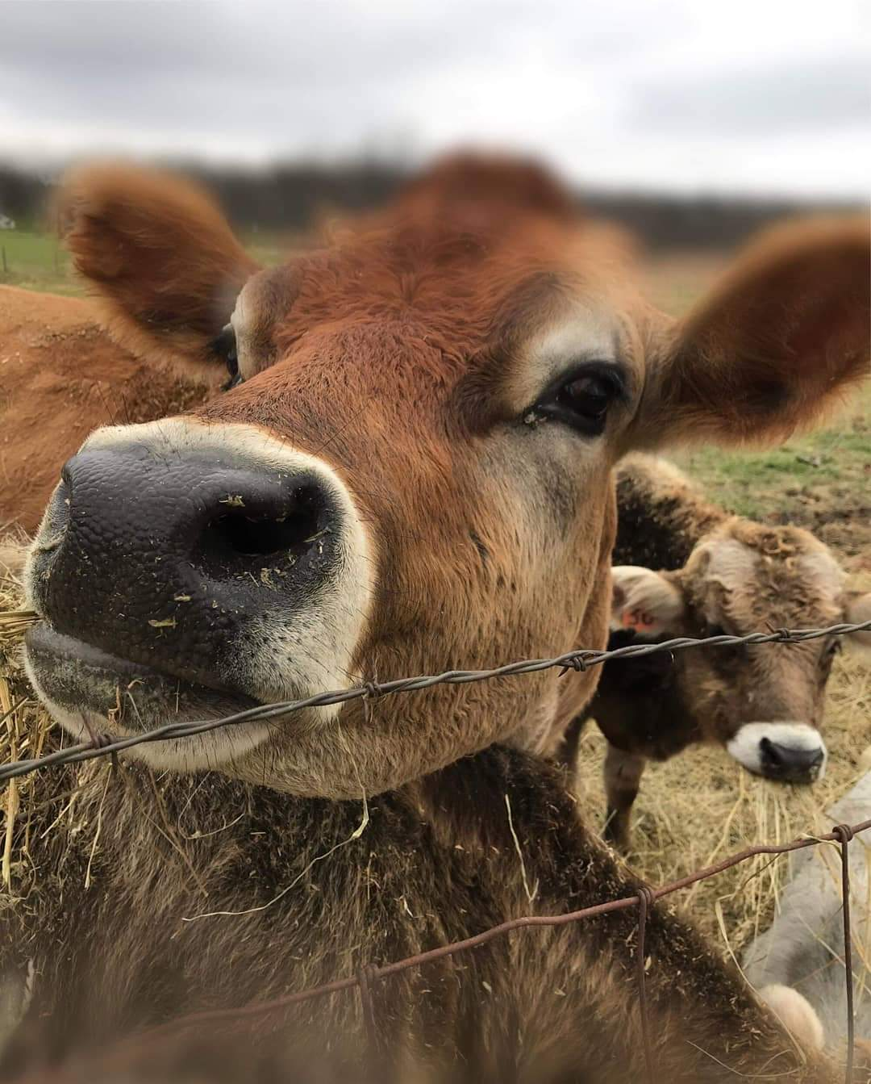
Could your business grow if you had access to additional meat processing options?

Slide 5
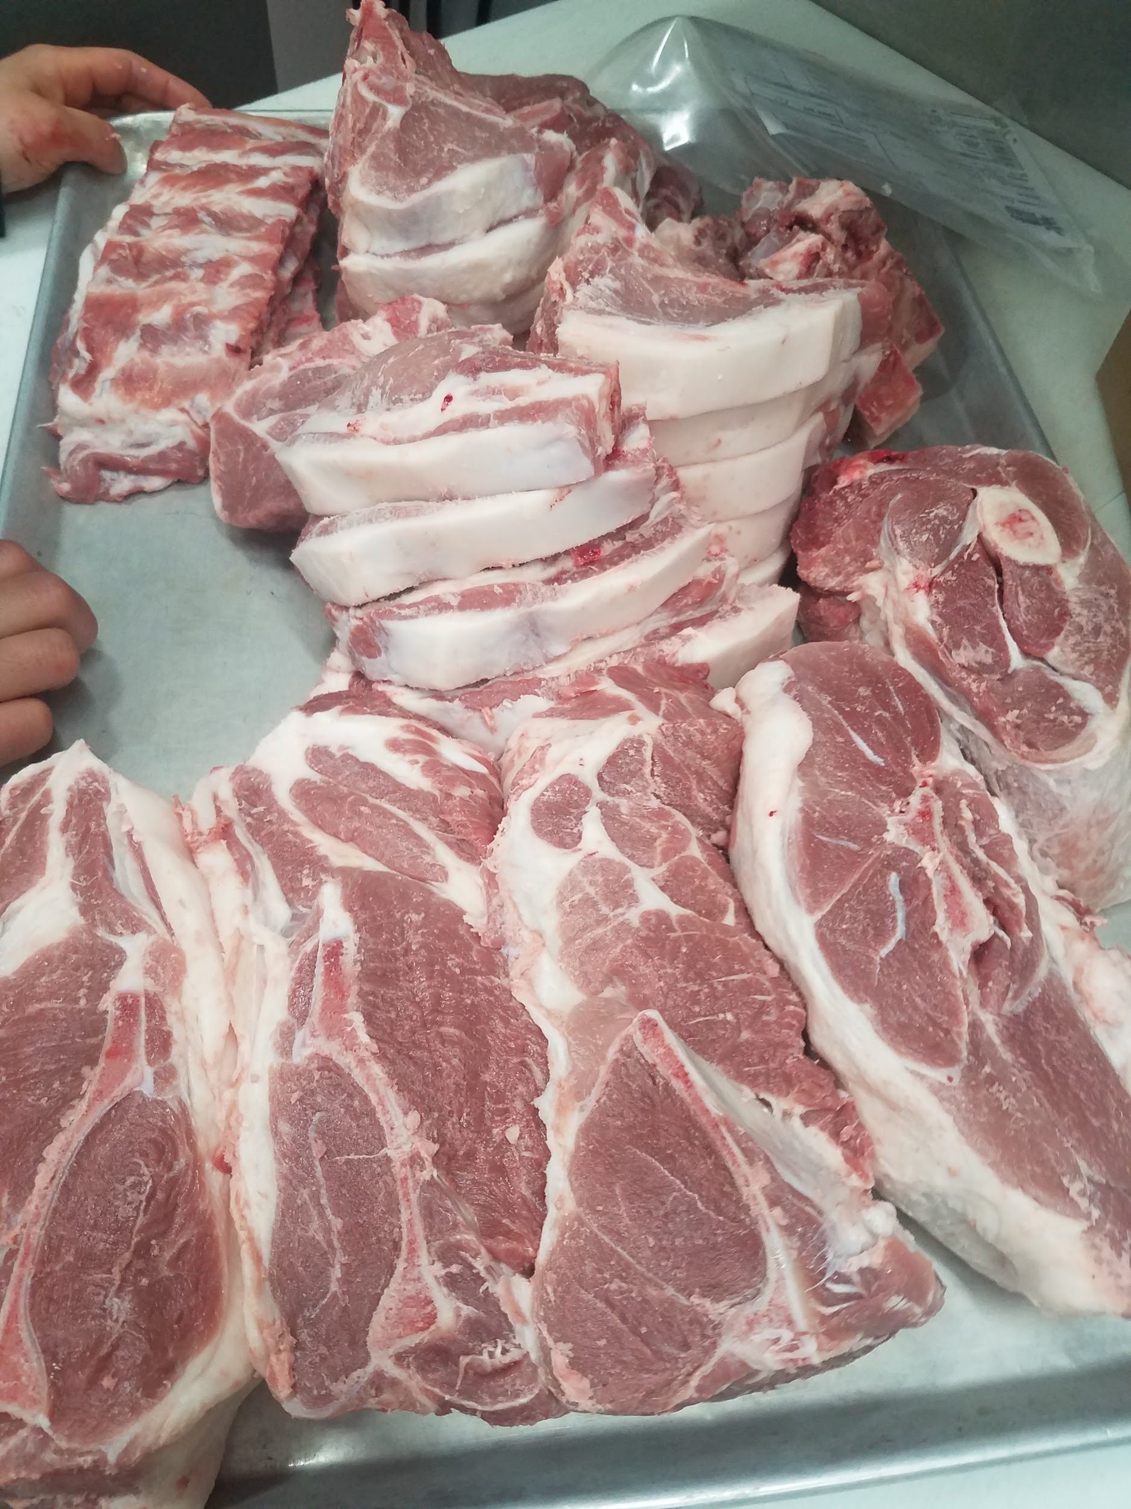
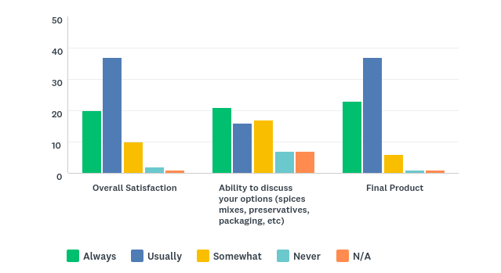
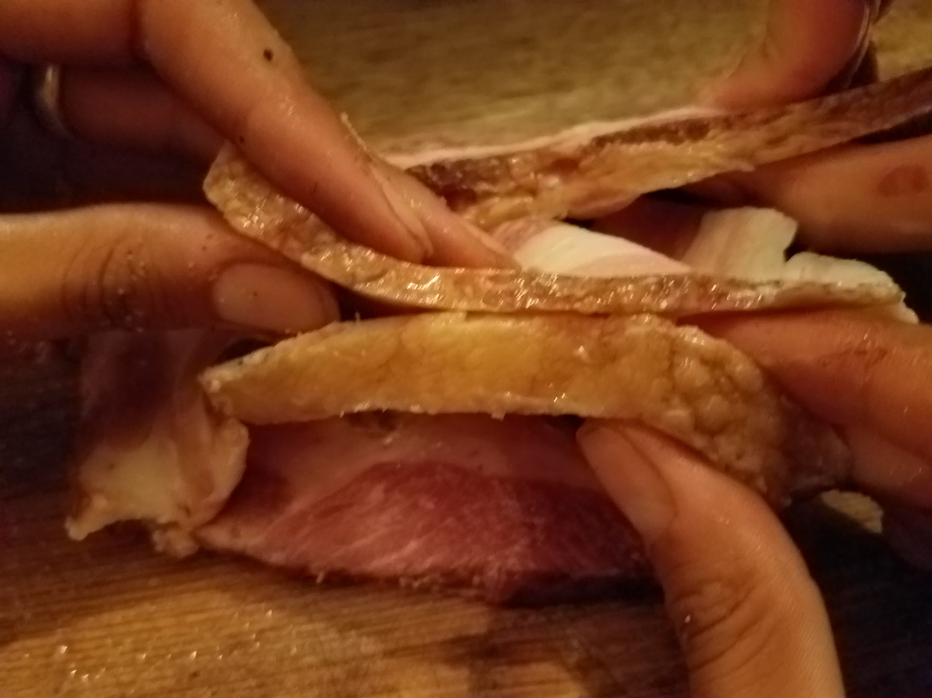
Rank your satisfaction with your current butcher

Slide 6
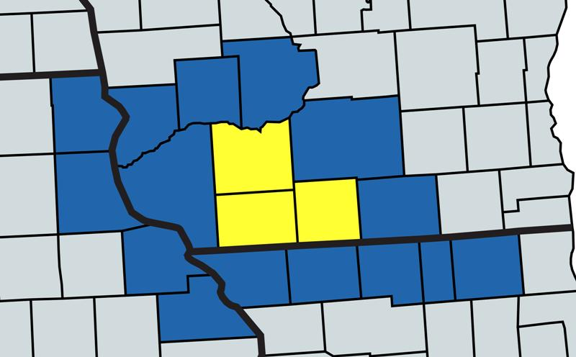
Community Statistics from USDA National Agricultural Statistics Service*
SHEEP/GOAT operations 235 primary & 943 total
HOG operations 140 primary & 907 total
BEEF operations (cattle/calves/veal) 49 primary & 244 total
Wisconsin: Green, Iowa, Lafayette, Rock, Dane, Sauk, Richland, Grant, Crawford
Illinois: Jo Daviess, Stephenson, Winnebago, Boone, McHenry
Iowa: Allamakee, Clayton, Dubuque, Jackson
*data may refer to farms, ranches, growers, or producers depending on source

Slide 7
How many animals do you raise annually for meat?
SHEEP/GOATS: 53 of 79surveyed with 896 animals total
Average: 18 Median: 10 Range: 2 to 200
HOGS: 45 of 79 surveyed with 1335 hogs total
Average: 30 Median: 7 Range: 2 to 750
CATTLE: 42 of 79 surveyed with 1475 cattle total
Average: 34 Median: 10 Range: 1 to 600
3700+ animals raised annually by the cohort surveyed
22%-85% of the producers in tri county area reached in survey

Slide 8
How many acres of land do you own or lease for your operation?
Average: 135 Median: 40 Range: 5 to 800
(10,046 acres of land owned by respondents)
How many miles do you travel to your butcher each year?
Average: 656 Median: 80 Range: 7 to 25,000 miles
“Can never keep a relationship with one butcher so it differs.”
“1,360 miles max. The 1,000 is to preferred State inspected/USDA certified butcher.”

Slide 9
What is your average waiting time for scheduling your butcher?
Average: 4.5 months Median: 4 months Range: 2 weeks to 1 year
“We schedule when we start growing.”
“I process monthly and schedule a year in advance”
“Depends on number of animals and time of year. Around deer hunting season it is impossible!!!!”

Slide 10
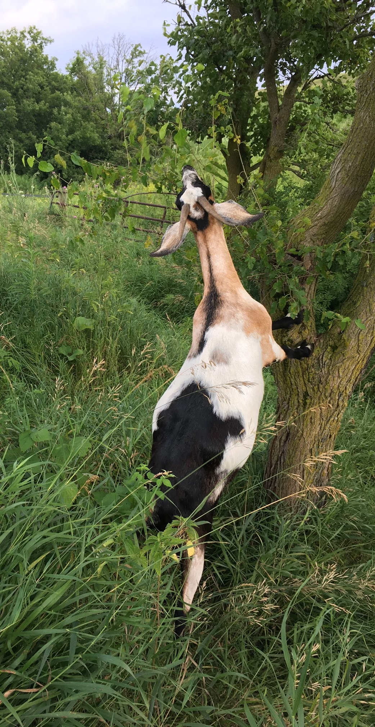
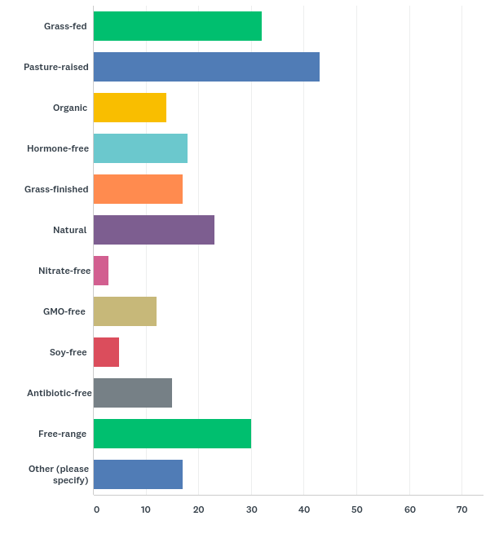
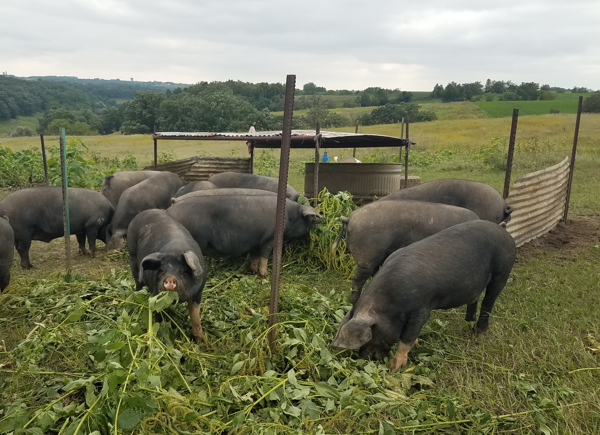
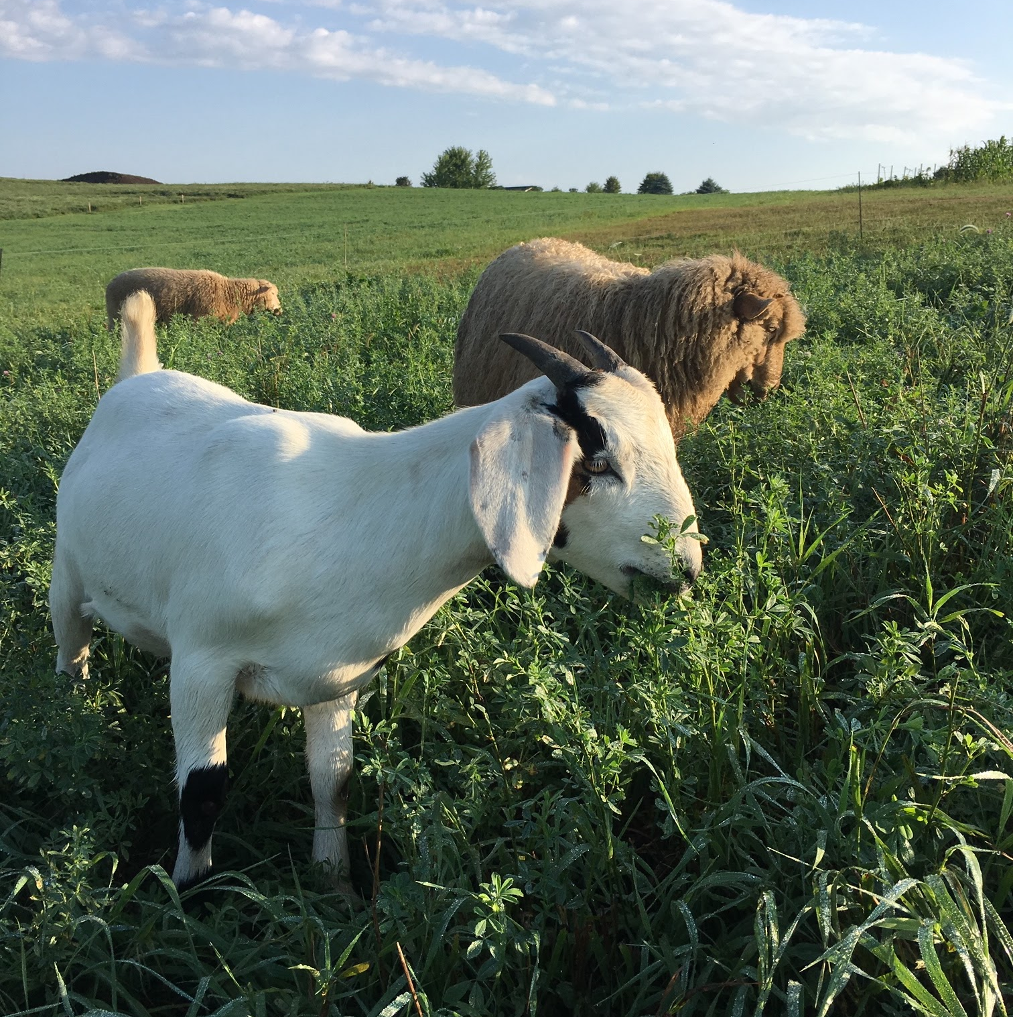
What labels do you use for your products?

Slide 11
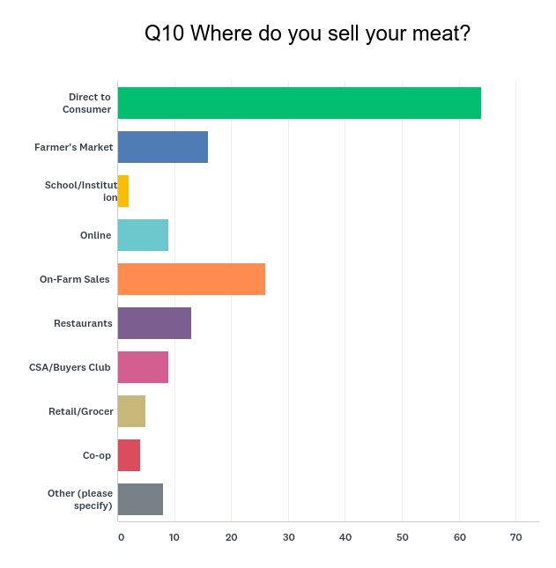
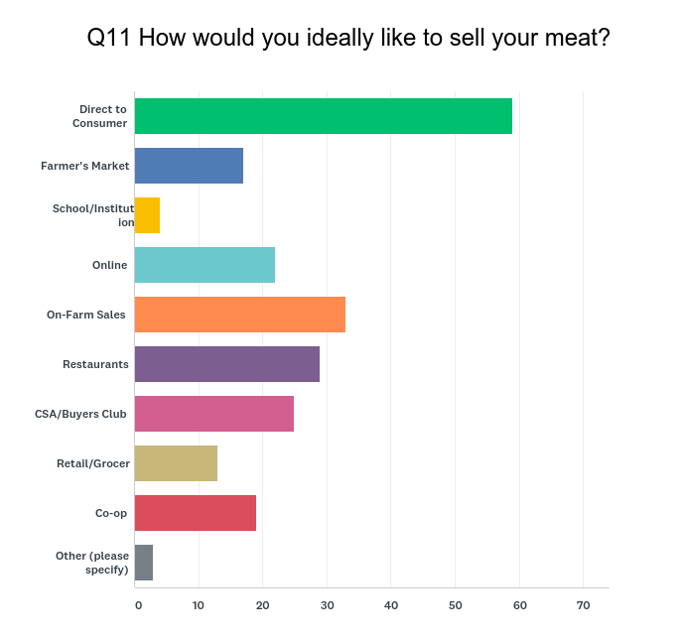
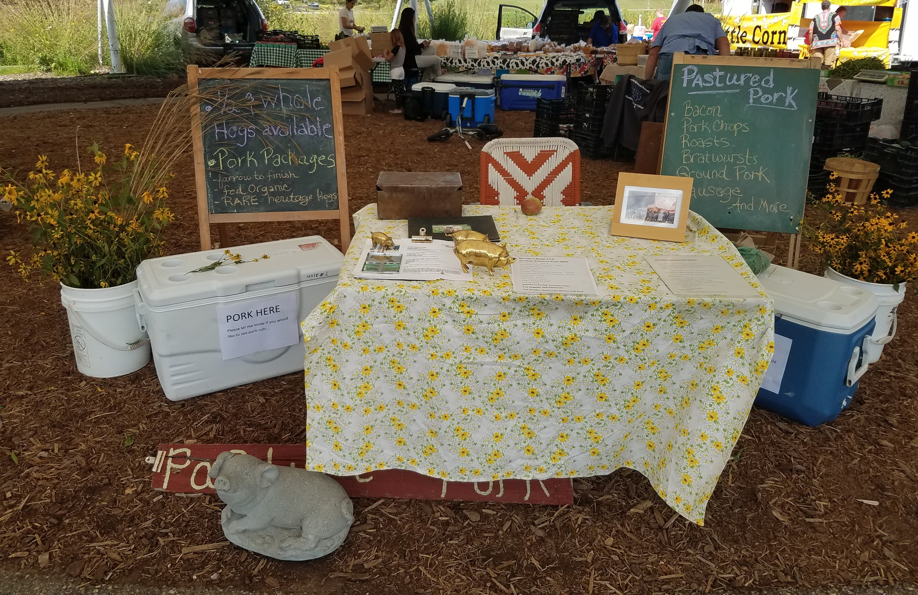
Who are your customers?

Slide 12
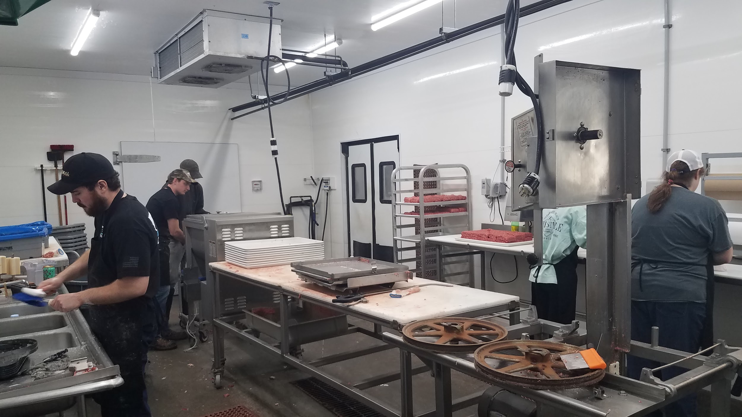
What would you change about your meat processing if you could?
*The words have been weighted by number of occurrence

Slide 13
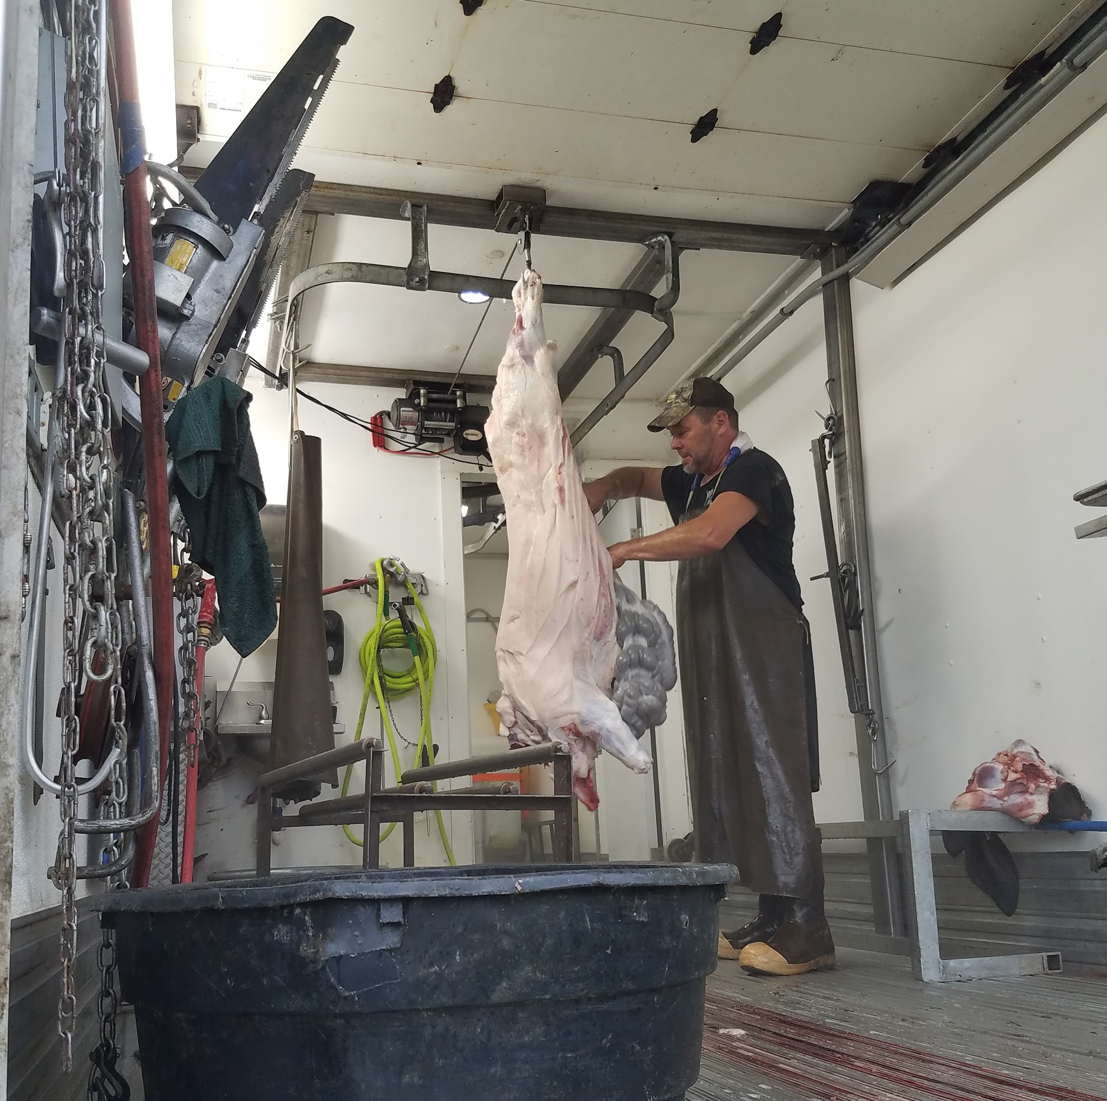
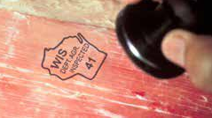
What is an MSU?
A Mobile Slaughtering Unit = mobile abattoir
Inspector (paid by taxpayers) meets MSU
Can be inspected or not
Has refrigerated truck for transport

Slide 14
USDA vs Wisconsin State Certification
Wisconsin’s State Meat Inspection Program
Bureau of Meat Safety & Inspection
Wisconsin’s Bureau of Meat Safety and Inspection regulates meat-processing plants within the state. Plants operating under the state inspection program are able to ship their products anywhere within the borders of the state of Wisconsin (intrastate). Products are marked with an inspection legend in the shape of the Wisconsin outline and contain their assigned number and words “Wis. Dept. Agr. Inspected.” State plants have the benefit of excellent customer service and quick response from their inspection program.
Federally inspected plants may ship their products interstate. They are inspected and regulated by USDA’s Food Safety and Inspection Service (FSIS) Their products are marked with a round seal.

Slide 15
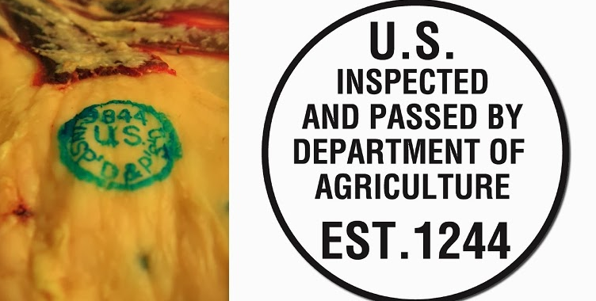
USDA vs Wisconsin State Certification
What is reciprocity?
Cooperative Interstate Shipment program; aka Title 5
The ability sell a particular State inspected product in states bordering Wisconsin
What is the latest gossip on Capitol Hill?
115th CONGRESS; 2d Session, S. 2814. IN THE SENATE OF THE UNITED STATES- May 10, 2018
Mr. Rounds (for himself, Mr. King, and Mr. Thune) introduced the following bill; which was read twice and referred to the Committee on Agriculture, Nutrition, and Forestry
A BILL: To amend the Federal Meat Inspection Act and the Poultry Products Inspection Act to allow the interstate sale of State-inspected meat and poultry, and for other purposes.
READ TWICE AND SENT TO COMMITTEE

Slide 16
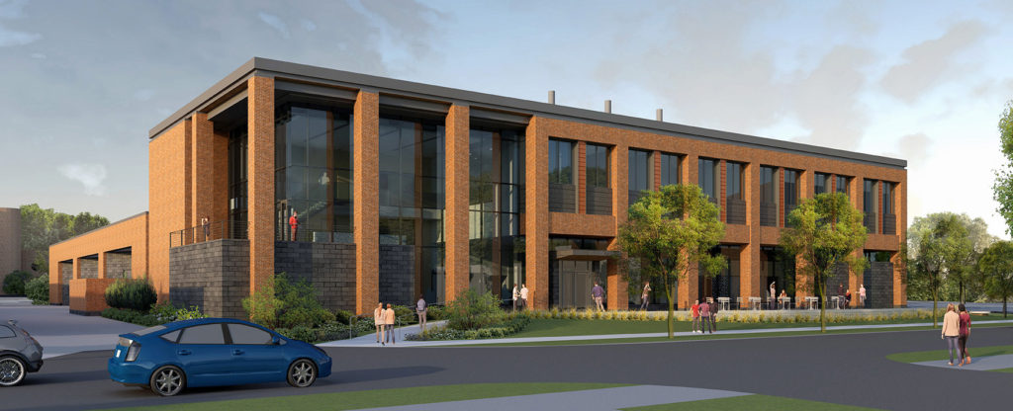
UW-Madison Meat Science & Animal Biologics Discovery Building
Train the next generation of meat industry leaders with cutting edge insightfulness and technologies
Support innovative research interests through interdisciplinary collaborative efforts
Provide outreach education to foster the production of wholesome meat products for the consuming public and the economic development of the meat industry
Training available
Meat for Modern living
7 principles of HAACP
(hazard analysis and critical control points)
Master Meat Crafter Program

Slide 17
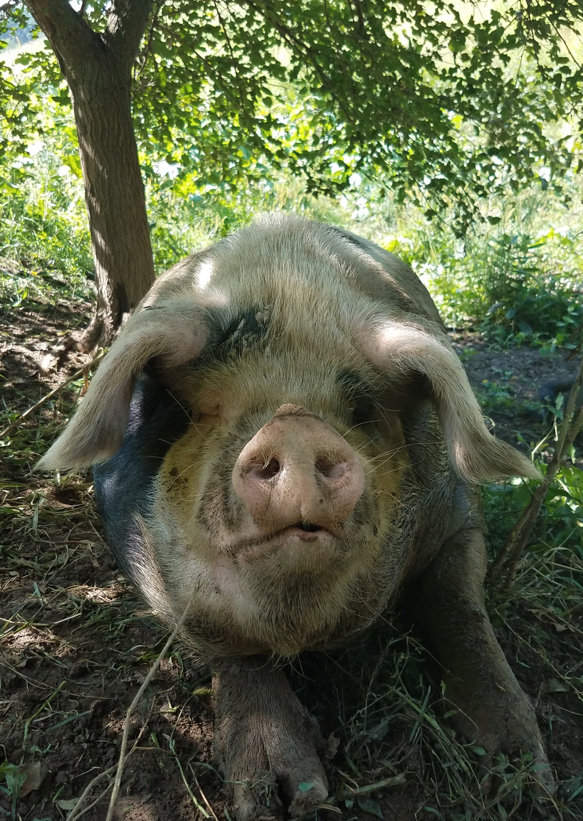
What are your thoughts?
What would you like to see for our community?
Why is it important for you to be here?
What stood out to you and why?
What do you see as barriers to opening an additional butcher shop in our area?
Are you interested in the next steps?

Slide 18
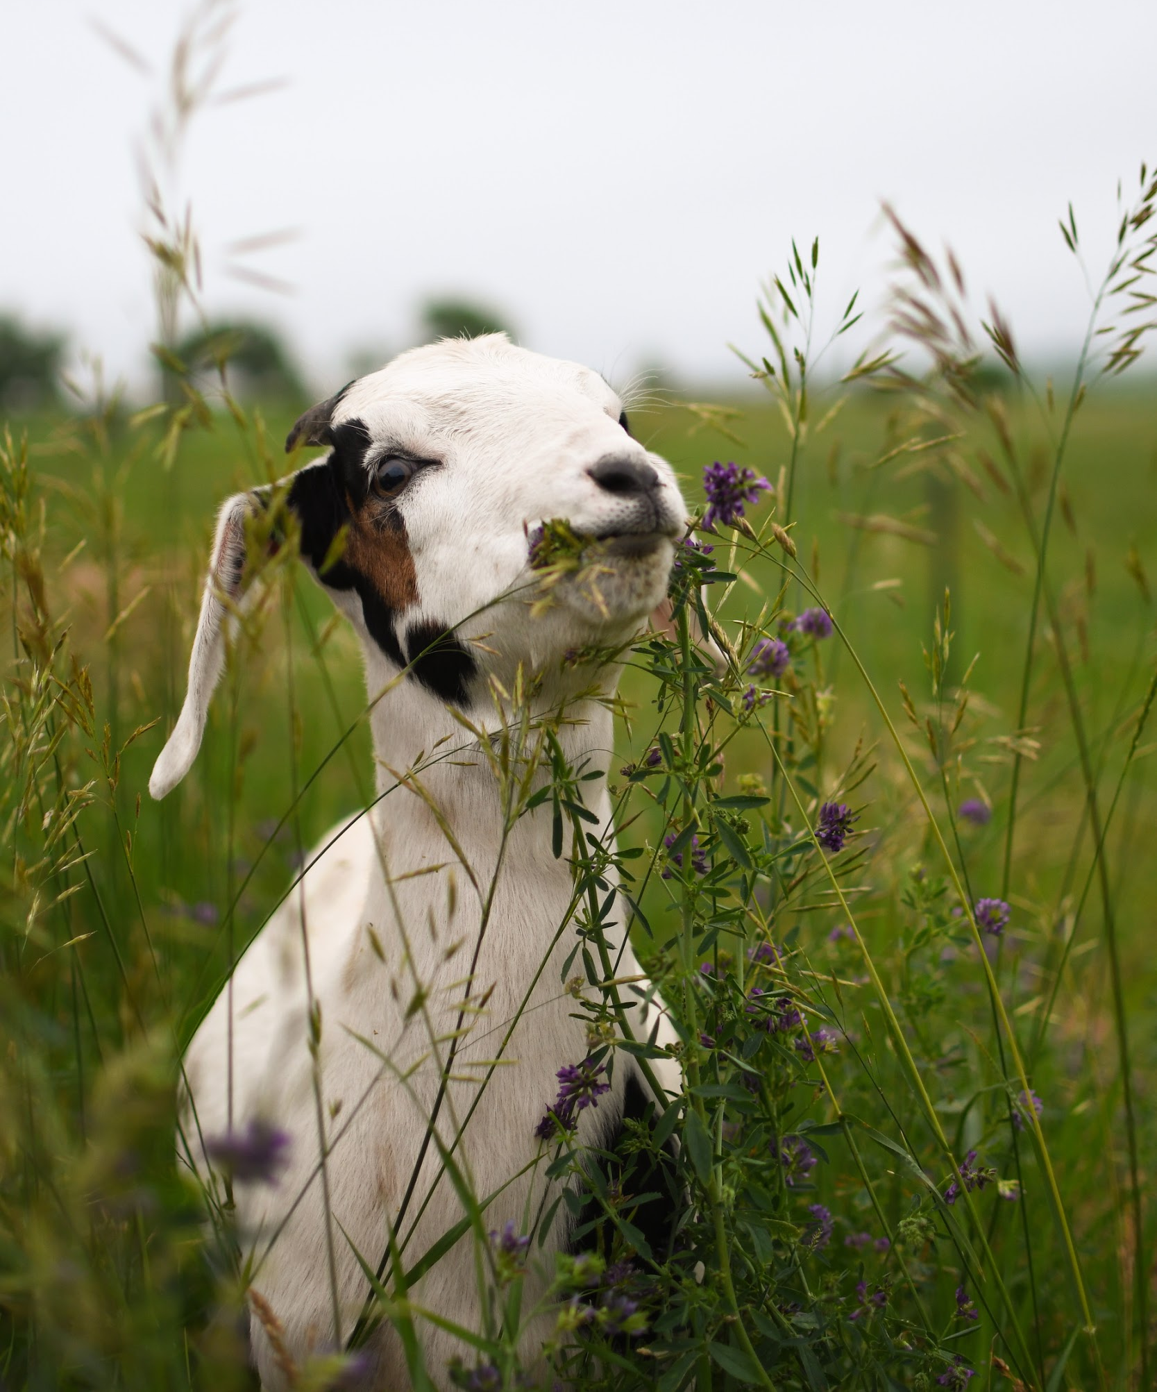
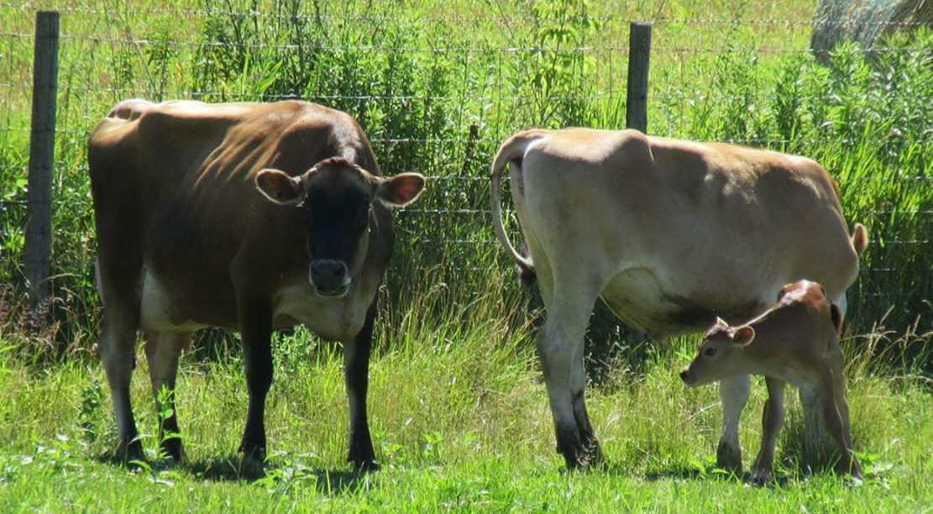
Next Steps
Avoid scope creep
Financial evaluation
Equipment cost
Certification cost
Energy cost
Break even point
Human capital availability
Five-year business plan/timeline
Funding, Investors and Partners

Slide 20
Thanks for coming out today!
You are a critical part of this process.
Please be sure to fill out the sign in sheet
Are you interested in a copy of the final report?
Are you interested in being involved in the next steps?
Are you interested in a career in Meat Science?

