Slide 1



Ujamaa NESARE
Focus Groups Training
7 – 01 – 2022
This material is based upon work supported by the National Institute of Food and Agriculture, U.S. Department of Agriculture, through the Northeast Sustainable Agriculture Research and Education program under subaward number LNE22-456R. Any opinions, findings, conclusions, or recommendations expressed in this publication are those of the author(s) and do not necessarily reflect the view of the U.S. Department of Agriculture

Slide 2
Data Collection: Qualitative vs. Quantitative
Qualitative:
Data collection in the form of words instead of numbers (Busetto et al. 2020)
Utilized to answer questions about meaning, perspective, or experiences.
More susceptible to biases.
Quantitative:
Data collection in the form of numbers, by systematically collecting data. Using a standardized methodology and statistical analysis.
Traditionally viewed as unbiased.
Busetto et al., 2020; Hammarberg et al., 2016
Notes:
They can be used in conjunction with one another.

Slide 3

Qualitative Research
Focus groups are a form of qualitative research.
Qualitative research is typically used to understand and explain a person’s views, experiences behaviors and social contexts (Fossey et al., 2002; Strauss & Corbin 1990).
Qualitative research normally doesn’t use statistics or quantification, unlike quantitative research.
Can be used along with quantitative research methods, like surveys.
https://ifmrlead.org/wp-content/uploads/2014/04/55.png

Slide 4
Qualitative Forms of Research
Other forms of qualitative research
Document study
  Or document analysis, is the study of written materials. For example: archives, annual reports, diary entries or letters
Observations
  Either participant (observer a part of a setting, like a farm worker on farm) or non-participant (outsider looking in trying not to stand out or influence things). Can be planned or ad hoc (random). Difficult to take notes during.
Semi-structured interviews
  Used to gain insight into an individual's subjective experience. A guided interview with open ended questions. Less biased than written surveys.
Focus Groups
Guided group interviews that investigate the participant’s experiences, expertise and why people behave a certain way.
Facilitates sharing between participants and brings together homogenous groups into one place.
A fast, inexpensive method for information sharing and group dynamic observation.
Our chosen method due to the reasons listed above.
Busetto et al., 2020
Notes:
Focus group vs. other qualitative methods, argue why we’re using them
Add an explicit “Why is Ujamaa using a focus group?” slide?

Slide 5

Choosing the Appropriate Method
Depends on the question that needs to be answered.
  We are trying to understand each of the selected groups relationship and views with culturally meaningful seed.
Dependent on phase of research:
  Like Ujamaa in the early phases of data collection.
Can be used in conjunction with other qualitative methods, for a more robust understanding of the topic.
Busetto et al., 2020
42466_2020_59_Fig2_HTML.png

Slide 6
What is a Focus Group?
Definition: “an informal, guided, discussion among selected individuals about a specific topic. Facilitated by a moderator and a form of a semi-structured interview” (Beck et al., 1986 Chestnutt and Robson, 2001; Plummer-D’Amato, 2008; Wilkinson, 1998).

Slide 7

What is a Focus Group?
Focus groups allow participants to interact with each other, fostering conversation and potentially generating new ideas. This can be beneficial when compared to other forms of qualitative research, like semi-structured interviews, which do not have inter-participant interactions like this (Plummer-D’Amato, 2008).
https://ctb.ku.edu/sites/default/files/chapter_files/womenfocusgroup.jpg

Slide 8

Focus Group Basics
The selected groups are a small subset of the broader target population.
Focus groups are usually comprised of 6-8 participants, but no more than 12.
The groups can have a pre-existing relationship with one another or be brought together by the researchers.
https://post.healthline.com/wp-content/uploads/2020/07/Male_Farm_732x549-thumbnail-732x549.jpg
Wilkinson, 1998

Slide 9
Ujamaa’s Research Approach
Ujamaa is using the common practice of combining focus groups with other quantitative research methods.
Focus groups are being used to understand complexities and barriers in the culturally meaningful seed market. These results will be used to guide and inform surveys for various value chain shareholder groups.
Notes:
Guide & inform surveys
complexities

Slide 10
Overall Focus Group Process
Step 1
Step 2
Step 3
Step 4
Step 5
Step 6
Brainstorming
Early Planning
Final Planning
Recruitment
Focus Groups
Analysis
What are you investigating? How will this differ from existing information? What is the ideal research method?
Draft a question set. Consider target demographics, compensation, facilitators, virtual vs. in-person.
Review & finalize question set. Obtain IRB approval. Confirm facilitators & notetakers. Finalize contact lists.
Reach out to individuals on the contact lists. Finalize the date & time of focus groups.
Follow the question guide and run focus groups. Remember to take notes and record the session.
Coding and grouping of data. Data management software is a great tool. Can either be used in a mixed method research capacity or on its own.

Slide 11

Early Planning
Consent
  Consent and informing participants is key. Making sure all participants are aware what we are doing with their responses and broadly what the topics of discussion are going to be.
  Send out a form ahead of time for them to sign a release of information when recruiting.
  Emphasize that we will be audio recording and transcribing, but their identities will remain anonymous.
  In-take forms can be helpful to get email addresses and phone numbers.
https://www.thedoctors.com/siteassets/images/social/informedconsent_1200x628_f.png

Slide 12
Early Planning
Location/Scheduling
  Making sure to schedule at a time that all can make it and in a central location if in-person.
  Room set-up:
    Making sure the room is set up in a way that facilitates an easy conversation.
    Chairs in a circle, facing each other.
    Central poster board or screen if needed.
  Refreshments:
    Providing snacks and beverages to help the participants feel comfortable.
Compensation
  Distribution depending on hosting method.
  How are they being compensated?
Notes:
Form of compensation is important too. We will discuss this more later.

Slide 13
Group Composition
Homogeneity is recommended to explore the diverse range of views from those familiar to the topic and discussion points. It also helps participants to feel comfortable sharing their views.
Sorting participants into different categories can be helpful for group homogeneity (ex. Ujamaa growers, grocers, etc.).
Some diversity is important to foster different views, there is a fine balance..
Awareness of prior acquaintanceship, whether or not that will negatively impact the results of the group. This is dependent on the purposes of your group.
Recruitment methods: in-person or online.
  If desired participants are outside immediate circles, reach out to other to facilitate introductions and recruitment.
Plummer-D’Amato, 2008; Halliday et al., 2021
Notes:
We are using virtual recruitment methods but an in-person example would be at the Juneteenth gathering, if there was a sign up sheet.

Slide 14
Overall Focus Group Process
Step 1
Step 2
Step 3
Step 4
Step 5
Step 6
Brainstorming
Early Planning
Final Planning
Recruitment
Focus Groups
Analysis
What are you investigating? How will this differ from existing information? What is the ideal research method?
Draft a question set. Consider target demographics, compensation, facilitators, virtual vs. in-person.
Review & finalize question set. Obtain IRB approval. Confirm facilitators & notetakers. Finalize contact lists.
Reach out to individuals on the contact lists. Finalize the date & time of focus groups.
Follow the question guide and run focus groups. Remember to take notes and record the session..
Coding and grouping of data. Data management software is a great tool. Can either be used in a mixed method research capacity or on its own.
Notes:
Can skip over step 3, most of that is self explanatory or dependent on an institutional partner (i.e. UVM)
Explicit “What is IRB?”

Slide 15
Drafting a Question Set
Use open-ended questions; Yes & No questions don’t provide responses with depth.
“‘Why’ is seldom asked. As an alternative, consider asking about specific components that directly relate to the project.” (NOAA, 2015)
  “Why?” Also makes respondents feel that they must defend their perspective.
Draft preliminary questions then have others provide feedback
  Attempts to deal with bias and makes sure the questions will get the info you want
Aim for 6-10 questions
Thoughts to keep in Mind:
“Does this allow for all perspectives to share?”
“Will this spur a discussion?”
“Is this question leading?”

Slide 16
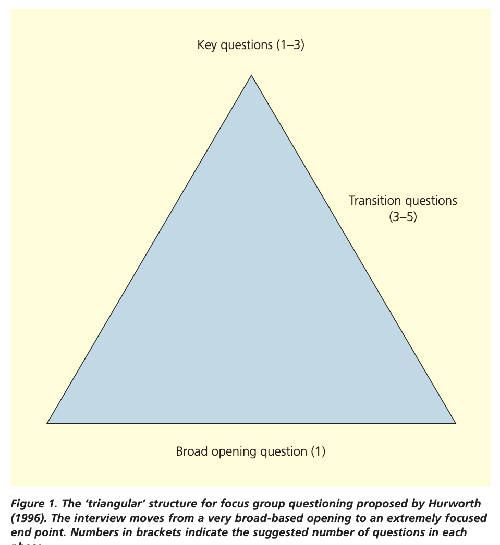
Drafting a Question Set
Notes:
We have a broad question set and more focused questions

Slide 17
Ujamaa’s Question Set
If you could pick five food crops which you believe are important to your identity and to the work that you do, which would you pick?
  Do you frequently purchase and/or produce these crops? If not, why is that? [seed not accessible, unsure where to purchase, no interest, other barriers, etc.]
  [if they purchase] Are you able to purchase them locally?
Tell me about your relationship with these different crops. How does it relate to the rest of the work that you do?
Consider the food crops you already purchase and/or produce. What are the most important aspects/characteristics of the food crops that you value?
  Can you think of any characteristics that are important to the seeds that produce these food crops in particular?
  Are there, if any, important cultural elements to these seeds that you purchase and/or produce? What do you think it means for a seed to have ‘embedded cultural meaning’?
What do you see as potential commercial opportunities for seed(/food) embedded with cultural meaning, and for whom?
What do you believe needs to be done to enhance the marketability of culturally important seed(/food)?
  What do you believe the main challenges to marketing culturally important seed are? Price/Understanding/Lack of Availability/Ethics/etc.?
  Should there be a price premium for culturally meaningful seed? Would you personally pay more?
Is it important for a business to incorporate issues of social justice? What is the role for commercial businesses in supporting socially conscious organizations?
Collaborating on a question set is very important. Making sure questions are direct, yet opened ended enough to see variations in responses creates a more robust conversation and data set.

Slide 18
Virtual vs. In-person
Online
Platform selection important to consider (Zoom is preferred).
Requires participants to have access to a smartphone or computer and reliable internet.
Participants must have a quiet, private area to call-in from (more chances of disruptions from children, pets, etc.)
Leave mics and cameras on during the entire session to make things feel more natural (unless facing technical difficulties).
Audio recording.
Three researchers suggested (Facilitator, Co-Facilitator/Notetaker and Technical Support Person)
In-person
Room considerations, easy to access location and a good size that helps participants feel at ease.
Covid-19 safety; masks, distancing and hand sanitizer.
Travel expenses and accomodations for those not local.
Consent can be signed and reviewed in person.
Audio recording only.
Unspoken communication more easily recorded and observed.
Two researchers needed (Facilitator and Co-Facilitator/Notetaker).
Plummer-D’Amato, 2008; Halliday et al., 2021; Menary et al., 2021

Slide 19
Online: Focus Groups in the Age of Covid
Due to Covid-19, many qualitative research methods have been shifted to virtual platforms (like Zoom, Teams or Google Meet). This is not a new method though.
  This is not limited to focus groups, but can also be used for semi-structured interviews.
It allows for geographically diverse participants.
Increased accessibility for many.
Protocol must be adjusted or initially written to reflect the slightly different methodology of conducting virtual focus groups.
Halliday et al., 2021; Menary et al., 2021; Tuttas 2015
Notes:
We are using online focus groups for this round.
It allows for geographically diverse participants, which is beneficial for our needs because it allows for variations in culturally meaningful seed relationships. For example, different gardeners/farmers may face different barriers to seed (drought, heat, cold, fungal issues, etc.)
It increases accessibility for many, including those without a car, disabled folks, caretakers (child or otherwise) and working people. Though there are some barriers to access, not everyone has a cellphone/laptop and reliable internet.
Conveniently enough, zoom has an automatic audio transcription service.

Slide 20
Overall Focus Group Process
Step 1
Step 2
Step 3
Step 4
Step 5
Step 6
Brainstorming
Early Planning
Final Planning
Recruitment
Focus Groups
Analysis
What are you investigating? How will this differ from existing information? What is the ideal research method?
Draft a question set. Consider target demographics, compensation, facilitators, virtual vs. in-person.
Review & finalize question set. Obtain IRB approval. Confirm facilitators & notetakers. Finalize contact lists.
Reach out to individuals on the contact lists. Finalize the date & time of focus groups.
Follow the question guide and run focus groups. Remember to take notes and record the session.
Coding and grouping of data. Data management software is a great tool. Can either be used in a mixed method research capacity or on its own.

Slide 21
Recruitment
Dear ________,
My name is _______ and I am reaching out to you to ask if you would consider being involved in a research study that we at the Ujamaa Cooperative Farming Alliance are conducting in collaboration with the University of Vermont (UVM). This study seeks to enhance the market viability of culturally meaningful, regionally adapted seed in the Northeastern region of the United States by understanding opportunities, strengths, and barriers to producing, selling, and purchasing culturally meaningful seed across the seed supply chain. We have received your contact info through _____________________.
To kick of this research, we will be conducting focus groups within the next few months with various seed supply chain actors and are looking for individuals that fit within the following areas of expertise: : UCFA growers, Seed Companies (representatives of), Farmers/Gardeners, Wholesalers, Specialty grocers, and Restaurant (owners/managers). We anticipate each focus group to last about an hour and will be held either in-person or online depending on the preferences of participants. If you decide to participate, you will be compensated for your time with a $50 gift certificate.
Please let us know if you would be interested in participating, and don’t hesitate to email or call the PI of this research study (Dr. Daniel Tobin - daniel.tobin@uvm.edu) or Carina Isbell (carina.isbell@uvm.edu) if you have any questions.
[Signature with contact info]
Stick to the approved contact list
  Written with group composition in mind
You MUST use the IRB approved paragraph when initializing contact
  Transparency is key!
Compensation is financial and moral
  “Think about the impact”
Notes:
Give IRB definition and contextualize it
Composition of these recruitment lists can look differently. We are using people already within our networks for this, but colleagues at other institutions could be helpful for facilitating participant selection outside of our immediate circles.
-MUST use the irb paragraph
-compensation is moral and financial

Slide 22
Overall Focus Group Process
Step 1
Step 2
Step 3
Step 4
Step 5
Step 6
Brainstorming
Early Planning
Final Planning
Recruitment
Focus Groups
Analysis
What are you investigating? How will this differ from existing information? What is the ideal research method?
Draft a question set. Consider target demographics, compensation, facilitators, virtual vs. in-person.
Review & finalize question set. Obtain IRB approval. Confirm facilitators & notetakers. Finalize contact lists.
Reach out to individuals on the contact lists. Finalize the date & time of focus groups.
Follow the question guide and run focus groups. Remember to take notes and record the session..
Coding and grouping of data. Data management software is a great tool. Can either be used in a mixed method research capacity or on its own.

Slide 23
The Role of a Facilitator
Essential qualities:
Keep participants focused, engaged, attentive and interested
Monitor time and use limited time effectively
Use prompts and probes to stimulate discussion
Keeps conversation focused to ensure all topics are covered.
Politely and diplomatically enforce ground rules.
Be prepared to explain or restate questions
Ability to produce relevant questions in an impromptu manner
Diffuse and pre-empt arguments
Stays away from jargon and uses accessible language.
Read IRB statements, confirm consent to record.
Establish ground rules
  i.e. Respect differing opinions, Don’t interrupt others, all responses are valid
Ask the research questions and any follow-up probes.
  Don’t be a robot when you read the questions, add conversational transitions so it feels natural
Moderate and direct the discussion
  Balance conversation participation; invite quiet members to speak by asking for other opinions.
  Try not to interrupt speakers, let them finish their thoughts
  Don’t be afraid of silence, it makes participants want to fill in the void
  Time management, keep the interview moving
Notes:
Say irb paragraph, consent to record

Slide 24
Using Probes & Clarifying Questions
Use follow-up questions to dig into responses.
  Ask about any unfinished thoughts.
  Let respondents finish their statement before you ask follow-up probes.
Good examples
  “Please tell me (more) about that...”
  “Could you explain what you mean by...”
  “Can you tell me something else about...”
Bad example
  “So you’re telling me that ............. Right?”
    Leading question that gives yes/no answers
(Center for Community Health and Development at the University of Kansas, n.d.)

Slide 25
Tips for Managing Group Dynamics
What do I do if someone is dominating the conversation?
  Acknowledge them then ask for comments from others.
What do I do if no one responds to a question?
  Reword the question or skip it if it’s clear the group isn’t comfortable with it.
What do I do if the group conversation begins to go off topic?
  Acknowledge the new direction then guide the conversation back on topic.
  Determine the realms of your research in advance; what is relevant?
(Center for Community Health and Development at the University of Kansas, n.d.)

Slide 26
Role of Notetaker/Observer
In charge of recording thorough notes throughout the entire focus group.
  Note general ideas and any particularly interesting quotes
  Goal is not to write everything word for word but to instead pick out key points and the flow of the conversation
  Note any interesting body language from participants.
    E.g. gutural reactions, inattentiveness, passionate agreement.
Outside of introductions the facilitator should be doing all of the conversation.

Slide 27
Role of Technical Support Person
In charge of:
  Letting people into the virtual meeting
  Making sure the focus group is being recorded properly. (Can we hear everyone?)
  Contacting participants who have disconnected and assisting them with reconnection
  Distribution of honorariums
This role can be pushed on the facilitator & notetaker if needed but it is useful to have a dedicated person.
  This role also allows for someone to be a “fly on the wall” in an inconspicuous manner.
  Also allows for someone to practice being a notetaker without the pressure they are the notetaker
Notes:
Limit to people in a role
Recorded, Listen after the fact

Slide 28
Overall Focus Group Process
Step 1
Step 2
Step 3
Step 4
Step 5
Step 6
Brainstorming
Early Planning
Final Planning
Recruitment
Focus Groups
Analysis
What are you investigating? How will this differ from existing information? What is the ideal research method?
Draft a question set. Consider target demographics, compensation, facilitators, virtual vs. in-person.
Review & finalize question set. Obtain IRB approval. Confirm facilitators & notetakers. Finalize contact lists.
Reach out to individuals on the contact lists. Finalize the date & time of focus groups.
Follow the question guide and run focus groups. Remember to take notes and record the session..
Coding and grouping of data. Data management software is a great tool. Can either be used in a mixed method research capacity or on its own.

Slide 29
Analysis
Focus groups and interviews can all be transcribed verbatim, with or without behavior observation notes.
Dialects and/or filler words can be recorded if relevant for the topic.
Transcripts should be coded (marked, tagged or labeled) with short descriptors of the content for each segment off content. This groups and summarizes the data so that in can be more easily synthesized. Highlighting common themes within the content.
This is typically done using a qualitative research management software like Nvivo, MaxQDA, etc.
After this step, it can be used for mixed method research like we’re doing, to create surveys.
Busetto et al., 2020
Notes:
Just a brief overview, this will be a separate training
.
Nvivo is written into the budget and you will have the software to do this work as well in the future. It is a lifetime subscription.

Slide 30
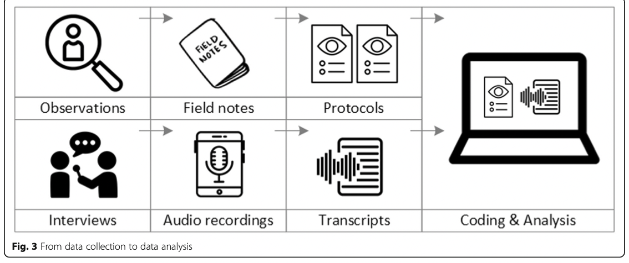
Analysis
Busetto et al., 2020

Slide 31
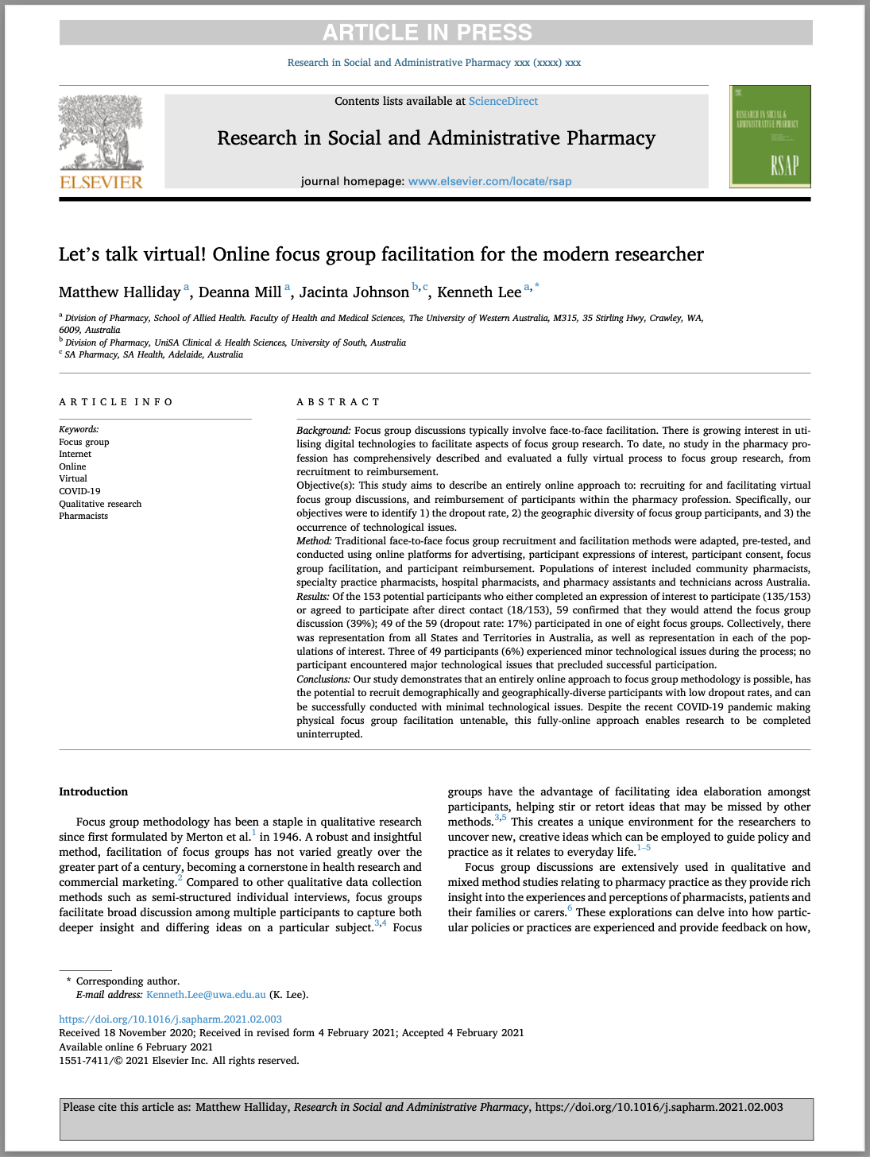
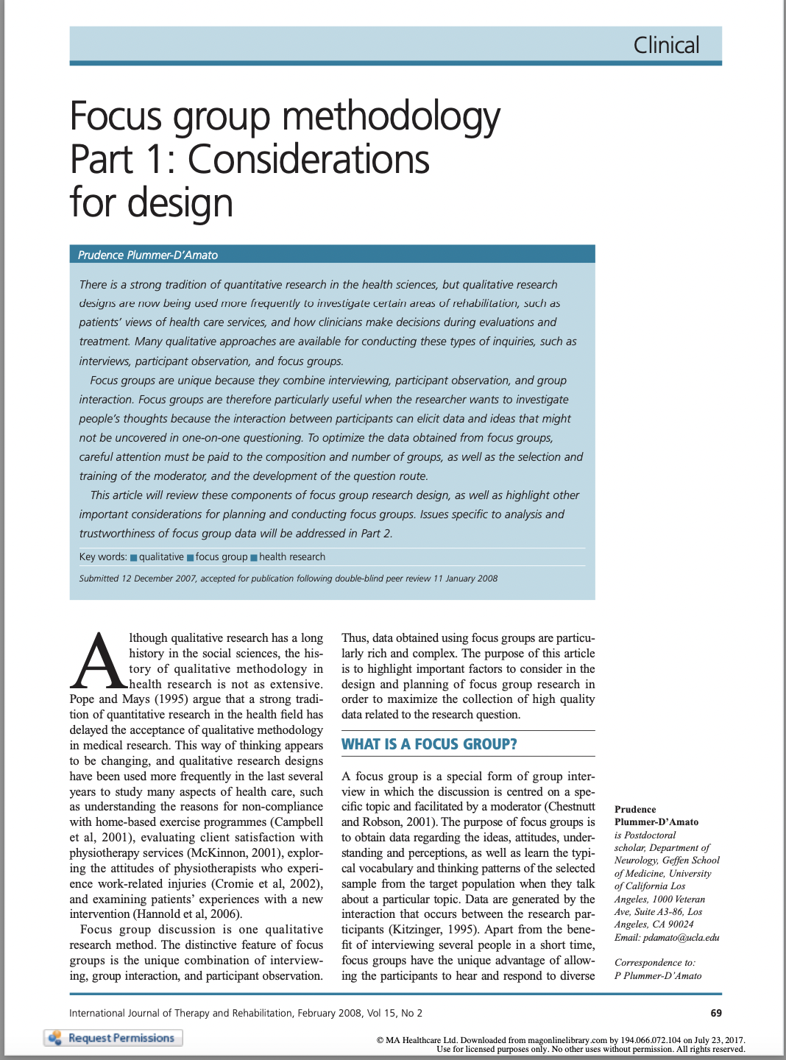

Resources (Ones we’re sharing)
Notes:
If you want to do a deeper dive into the literature behind focus groups, here are some shorter papers we have sent along in our agenda email. They are pretty accessible for academic papers. I can also share my annotated copies where I highlighted the most important parts.

Slide 32
Literature Cited
Busetto, L., Wick, W. & Gumbinger, C. How to use and assess qualitative research methods. Neurol. Res. Pract. 2, 14 (2020). https://doi.org/10.1186/s42466-020-00059-z
Chestnutt IG, Robson KF (2001) Focus groups - what are they? Dent Update 28: 189–92
Fossey, E., Harvey, C., McDermott, F., & Davidson, L. (2002). Understanding and evaluating qualitative research. Australian & New Zealand journal of psychiatry, 36(6), 717-732.
Halliday, M., Mill, D., Johnson, J., & Lee, K. (2021). Let’s talk virtual! Online focus group facilitation for the modern researcher. Research in Social and Administrative Pharmacy.doi:10.1016/j.sapharm.2021.02.003
K. Hammarberg, M. Kirkman, S. de Lacey, Qualitative research methods: when to use them and how to judge them, Human Reproduction, Volume 31, Issue 3, March 2016, Pages 498–501, https://doi.org/10.1093/humrep/dev334
Menary, J., Stetkiewicz, S., Nair, A., Jorasch, P., Nanda, A. K., Guichaoua, A. Rufino, A.,Fischer, A.R., & Davies, J. A. (2021). Going virtual: Adapting in-person interactive focus groups to the online environment. Emerald Open Research, 3, 6.
Plummer-D’Amato, P. (2008). Focus group methodology Part 1: Considerations for design. International Journal of Therapy and Rehabilitation, 15(2), 69–73. doi:10.12968/ijtr.2008.15.2.28189
Strauss A, Corbin J. Basics of qualitative research. Sage, California 1990.
Tuttas CA: Lessons learned using Web conference technology for online focus group interviews. Qual Health Res. 2015; 25(1): 122–133.
Wilkinson, S. (1998). Focus group methodology: a review. International Journal of Social Research Methodology, 1(3), 181–203.doi:10.1080/13645579.1998.108
https://ctb.ku.edu/en/table-of-contents/assessment/assessing-community-needs-and-resources/conduct-focus-groups/main
https://datainnovationproject.org/wp-content/uploads/2017/04/4_How_to_Conduct_a_Focus_Group-2-1.pdf
https://www.eiu.edu/ihec/Krueger-FocusGroupInterviews.pdf
https://coast.noaa.gov/data/digitalcoast/pdf/focus-groups.pdf
https://ctb.ku.edu/sites/default/files/chapter_files/toolkitforconductingfocusgroups-omni.pdf

Slide 33
Questions?

Slide 34
Practice Focus Group
Now we’re going to run a practice focus group with you all as the participants…
Notes:
Transition into HW if no time.
Ask if they want to schedule a practice before the HW

Slide 35
Homework Assignment
Conduct a focus group with 3-4 people. It can be done online or virtually.
Utilize the finalized question set.
Record responses to these reflection questions after:
  What went well? What didn’t?
  What did you wish you had?
  What would you change for next time?
  Were the responses different than you expected? How so?
We will discuss any questions and your reflections during the next meeting.
Notes:
We will be sending a follow up email with these instructions soon! This just gives you a chance to look over things now.

