Slide 1
Forage Systems for Alabama Beef Producers
Kim Mullenix, Ph.D.
Extension Beef Cattle Specialist
Alabama Extension/Auburn University

Slide 2
Outline
Forage Growth Keys
Systems for the Southeast
Putting it all Together

Slide 3
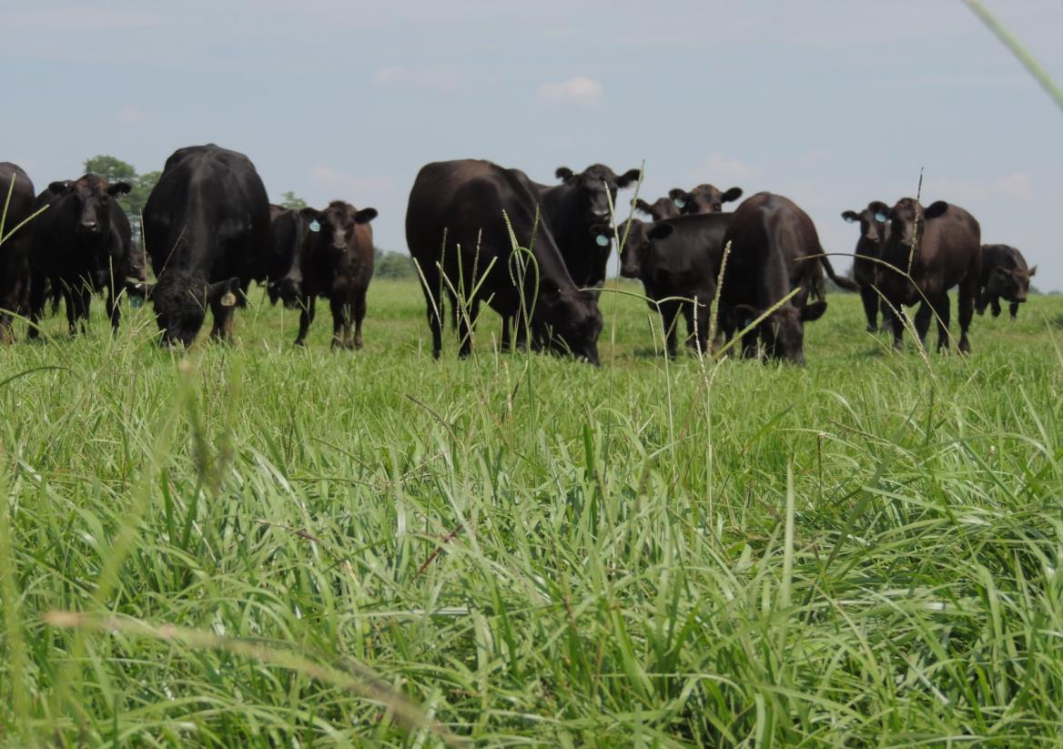
Measures of Forage Production Efficiency - YDP
Yield
Forage Production
(lb per acre)
Days
Grazing days per year
Pounds
Pounds of beef production per acre

Slide 4
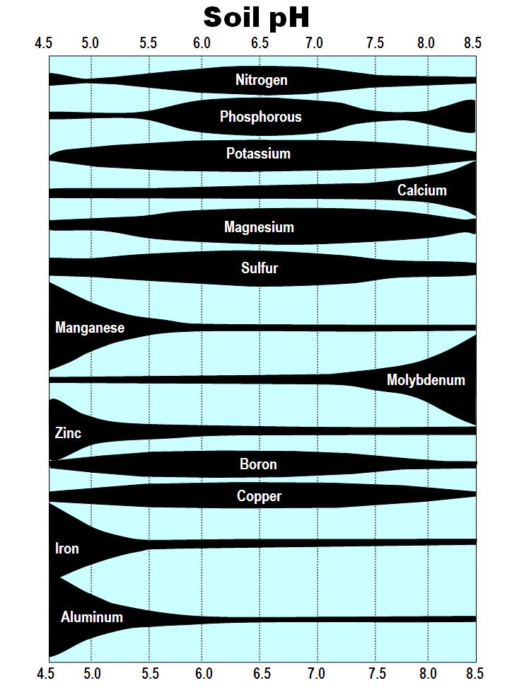
Yield is influenced by:
Forage adaptation to your area
Forage variety
Fertility
Management

Slide 5
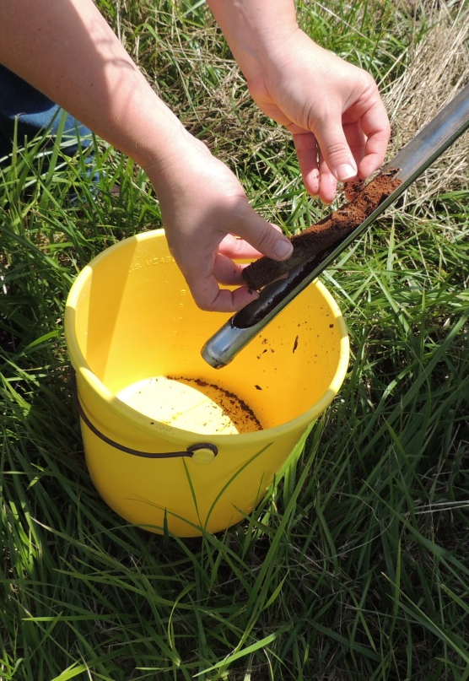
Understanding Your Soil Conditions
Soil fertility is key to successful forage production
Soil testing – hayfields every year, pastures every 2-3 years
  Requires adequate pH – lime!
  Requires fertilization with N, P, K

Slide 6
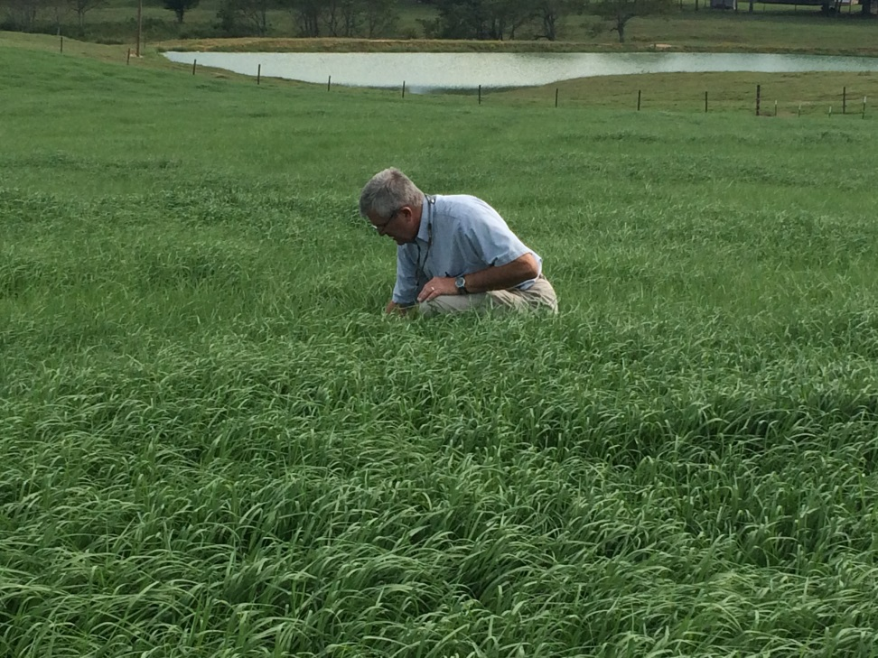
Fertility
An Input Cost with a Measurable Return
Yield Potential of Major Perennial Forages Adapted to Alabama
Bahiagrass – 1,500 to 6,000 lb/ac
Bermudagrass – 2,000 to 10,000+ lb/ac
Tall Fescue – 1,500 to 8,000 lb/ac
Dallisgrass – 1,500 to 7,000 lb/ac

Slide 7
Fertility
How Does it Improve Efficiency?
Source: Vendramini et al., 2013
Notes:
Blue line represents yield without fertility. Yield achieved above the blue line was with 55 lb N/acre applied in the spring of each year when bahiagrass broke dormancy.

Slide 8
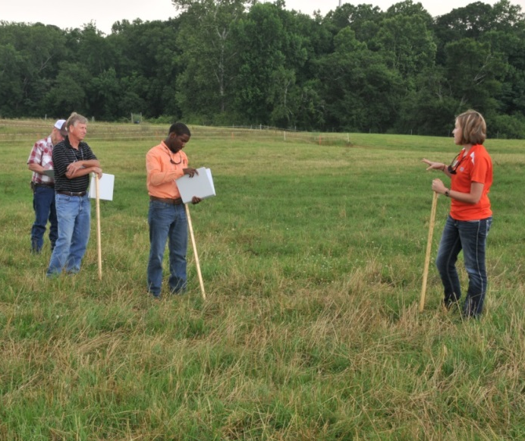
Pasture Stand Health
Measure of desirable forage production in the current system
G-O-A-L
  Get out and look
Actual vs. perceived

Slide 9

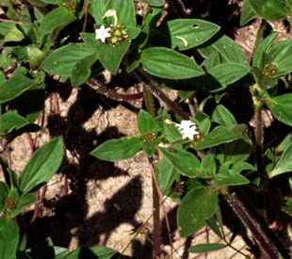
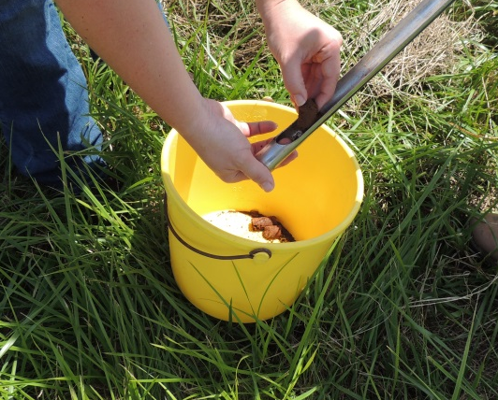
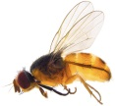
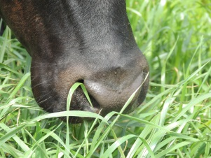
Pasture Stand Health
How Does it Improve Efficiency?
Visual appraisal
Start with soils
Secondary Factors
Identifies pastures that need renovation, rest, etc. – increasing potential pounds of forage per acre produced

Slide 10
Measures of Forage Production Efficiency - YDP
Yield
Forage Production
(lb per acre)
Days
Grazing days per year
Pounds
Pounds of beef production per acre

Slide 11
Management to Improve Grazing Days Per Year
Number of days you currently feed hay per year
Look at your current stocking rate
Select forages and practices to fill the gap

Slide 12
Measures of Forage Production Efficiency - YDP
Yield
Forage Production
(lb per acre)
Days
Grazing days per year
Pounds
Pounds of beef production per acre

Slide 13
What is the key time that can be improved on your operation?
1,200 lb cow
Oct Nov Dec Jan Feb Mar Apr May Jun Jul Aug Sept

Slide 14
Forage Systems in the Southeast
Systems for Success
Cool-Season Annuals
Warm-Season Annuals
Cool-Season Perennials
Warm-Season Perennials

Slide 15
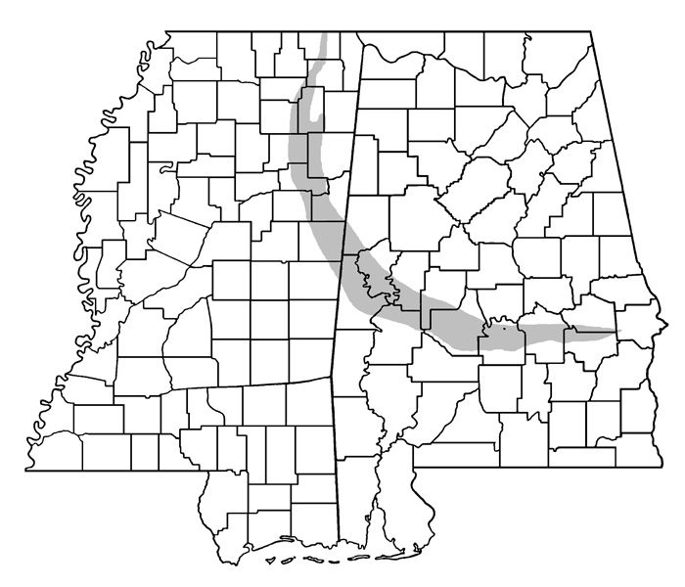
Upper:
Tall fescue
Bermudagrass
Bahiagrass*
Summer annuals
Cool-season annuals
Relative Adaptation of Forage Grasses in Alabama
Black Belt/Prairie Regions:
Tall fescue
Dallisgrass
Some bahia/bermuda
Summer annuals
Johnsongrass
Lower:
Bermudagrass
Bahiagrass
Summer annuals
Cool-season annuals
Notes:
Alabama and Mississippi can be divided into several ecological regions with varying forage adaptation. The predominant perennial grasses in the upper portion of these states are tall fescue and bermudagrass/bahiagrass. The lower half of these states, where tall fescue is not adapted, rely on warm-season perennials bermudagrass and bahiagrass, as well as cool-season annuals in year round forage systems. The Black Belt region consists of largely tall fescue, and various warm-season perennials such as dallisgrass, bahiagrass, bermudagrass, and even Johnsongrass.

Slide 16
How can we work towards year round grazing?
Match quality with animal needs
Perennial forages provide the base
Annual forages as a supplement – to fill in production gaps and/or provide higher quality
Notes:
In a grass-fed system, forage quantity and quality define production goals. Perennial forages form the base for our grazing systems, and additional forage species, such as annuals, can be used to fill in the quantity and quality gap.

Slide 17
Forages as the Foundation
Warm-Season Grasses
Cool-Season Grasses
% Total Annual Production
Jan Feb Mar Apr May Jun Jul Aug Sept Oct Nov Dec
Notes:
Learning to manage the forages adapted in your region can lead to year-round grazing. Cool-season forages are most productive from late winter through early spring, while warm-season forages are most productive from late April through early October. Understanding forage production growth curves allows us to provide forages nearly year-round.

Slide 18
Forage Growth Distribution and Calving Season
Fall Calving
Winter Calving
Spring Calving
Nov Jan Mar May Jul Sep Oct
Notes:
This chart illustrates when forages are most productive as compared to calving season. The goal is to use the above forage systems to provide high-quality grazing to cattle from calving through harvest.

Slide 19
Nutritional Requirements
Forage quality and livestock needs
Dairy cow, 50 lb milk/day
450 lb steer, 1.5 lb per day average daily gain
Dry, pregnant cow, gaining condition
Adapted from Lippke and Riewe (1976) and Ball et al. (2001)

Slide 20
Steps to Increasing the Number of Grazing Days Per Year
Know your starting point
    What do I currently have?
Identify forages to fill in the gaps
Manage, manage, manage
Notes:
After determining how many days of grazing you can achieve with the current system, think about what forages/management practices can be added to your system to increase the number of days grazed per year.

Slide 21
Warm-Season Perennial Grasses

Slide 22
Common Warm-Season Perennial Grasses in the Southeast
Bahiagrass
Bermudagrass
Dallisgrass
Johnsongrass

Slide 23
Production Potential – Warm-Season Grasses
Yield Potential
Bahiagrass – 1,500 to 6,000 lb/ac
Bermudagrass – 2,000 to 12,000+ lb/ac
Dallisgrass – 1,500 to 7,000 lb/ac

Slide 24
Nutritive Value Characteristics of Warm-Season Perennials
Early – high quality
Mid – highest quality
Late-Season – decreasing quality
General Range:
55 to 70% TDN
6 to 16% CP

Slide 25
Summer Annuals
More expensive than winter annuals
Require improved grazing management to keep in vegetative state
Can be grazed or hayed
Some potential for prussic acid poisoning/nitrate toxicity

Slide 26
Why Use Summer Annuals?
Temporary Pasture
Fast forage when other forage sources may be limited (60 d establishment period)
Quick emergence
Good quality and yield potential
Relative drought tolerance

Slide 27
When to Consider Summer Annuals
In an annual rotation of forages
  Example: crabgrass/ryegrass rotation
As an emergency forage option – when other forage supplies are low and quick growth is needed
AKA – to meet a production gap in your forage production cycle

Slide 28
Top 5 Summer Annuals in Alabama
Pearl millet
Sorghum-sudangrass hybrids
Sudangrass
Sorghums
Crabgrass

Slide 29
Summer Annual Forages – What are my options?
Species | 2014 ADG | 2015 ADG
Sorghum x sudangrass | 1.83 | 1.36
BMR sorghum x sudangrass | 1.89 | 1.78
Pearl millet | 1.87 | 1.17
Pearl millet + crabgrass | 1.84 | 1.42
Adapted from Harmon, 2015 – 70 d grazing period in 2014, 62 day grazing period in 2015 for finishing cattle

Slide 30
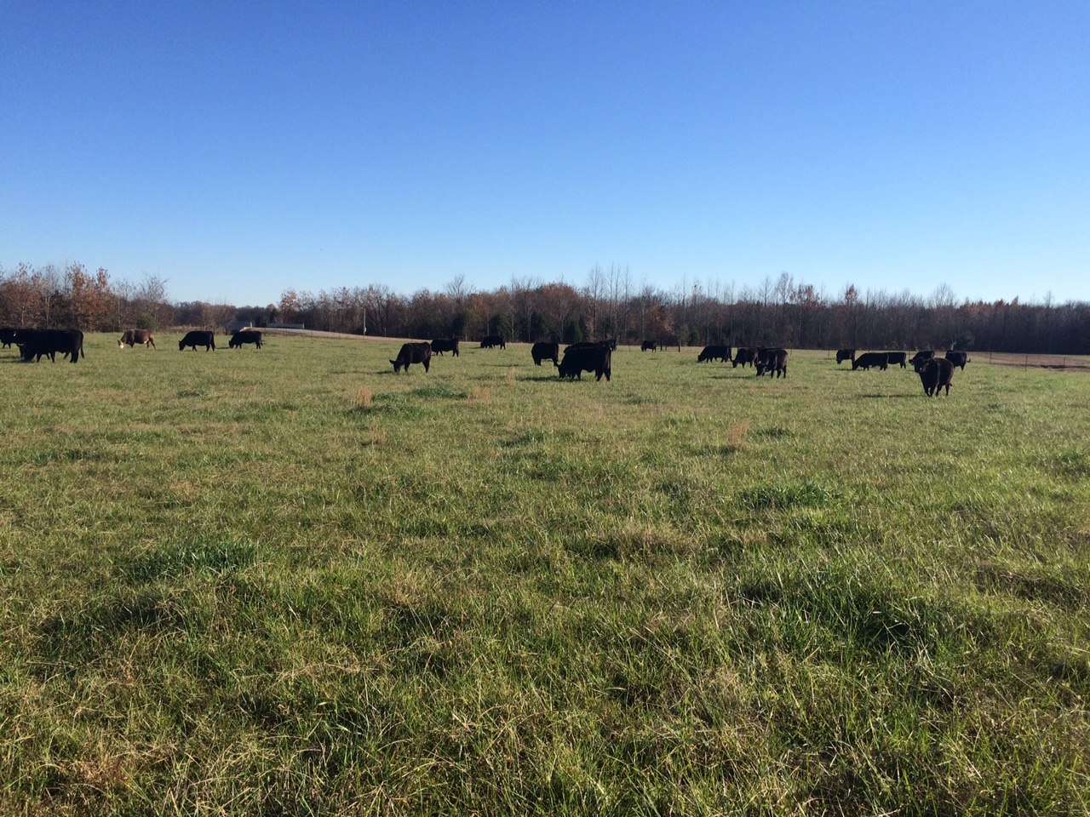
Transition from summer to fall

Slide 31
Fall-forage gap
Warm-Season Grasses
Cool-Season Grasses
% Total Annual Production
Jan Feb Mar Apr May Jun Jul Aug Sept Oct Nov Dec

Slide 32

Stockpiling Tall Fescue
Replacement heifers grazing stockpiled KY-31 tall fescue (Poore and Green, 1999)
56-d – late November through mid-January
16 to 13% CP and 68% to 60% TDN
Unsupplemented
    1.0 lb/d
Supplemented (7 lb/d of high energy feed)
  1.7 lb/d, +0.5 BCS compared to unsupplemented

Slide 33
Stockpiling Bermudagrass
Tifton 85
Forage mass
  4,700 lb DM/acre
  50 lb N/acre sufficient
Nutritive value
Animal performance
  Requires supplementation of digestible fiber/protein to maintain gains in stocker cattle
Table 1. Nutritive value of stockpiled Tifton 85 bermudagrass receiving different rates of N fertilization.
Sampling Date | CP, % | TDN, %
Early-Nov | 17 | 73
Late-Nov | 12 | 64
Dec | 11 | 58
Early-Jan | 11 | 53
Late-Jan | 10 | 53
Average | 12 | 60
Sources: Holland et al., 2017; Bivens et al., 2017

Slide 34
Why is Stockpiling Bahiagrass Less Desirable?
Yield and quality relatively low during stockpiling phase (less than 2,000 lb DM/acre accumulation after August)
Leaf shatter and deterioration occurs quickly
Less palatable relative to tall fescue and bermudagrass

Slide 35
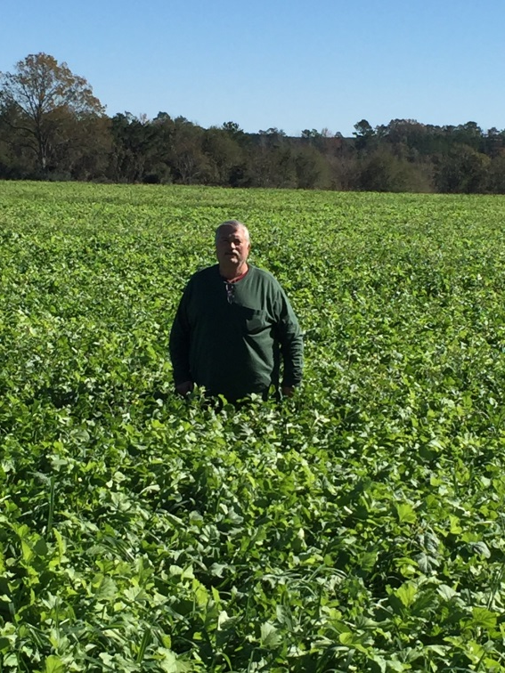
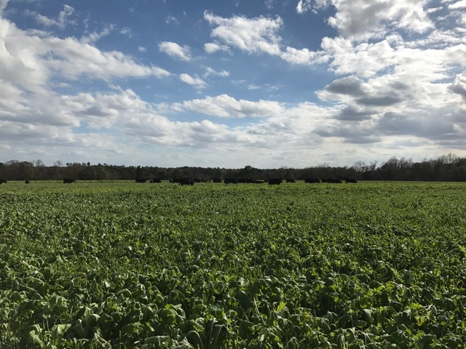
Brassicas – Prepared Seedbed
Turnips, hybrids, forage rape, kale, swede, radish
5.5 to 6.8 pH range
1 to 4 lb seed/acre depending on species
High quality
Cattle will trample – need to use limit or strip grazing approach
Oats + Radish
Uriah, AL
Triticale, T-raptor, Crimson Clover – Headland, AL

Slide 36
Limit Grazing
Allow access to pasture for a short period of time to stretch available grazing
Graze until cattle lay down – then move back
Usually 5 to 8 hours per day
May decrease hay needs by 30%
Source: Gunter et al., 2002; Lang and Broome, 2002
Notes:
Limit grazing allows cattle have access to a pasture for a short period of time (often hours per day), then move cattle back to a hay feeding area. This may be a good method to use when winter forages first become available.

Slide 37
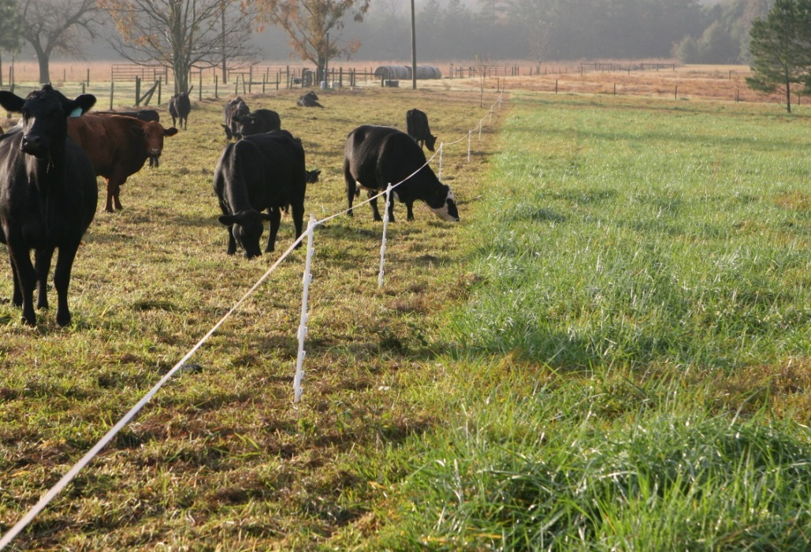
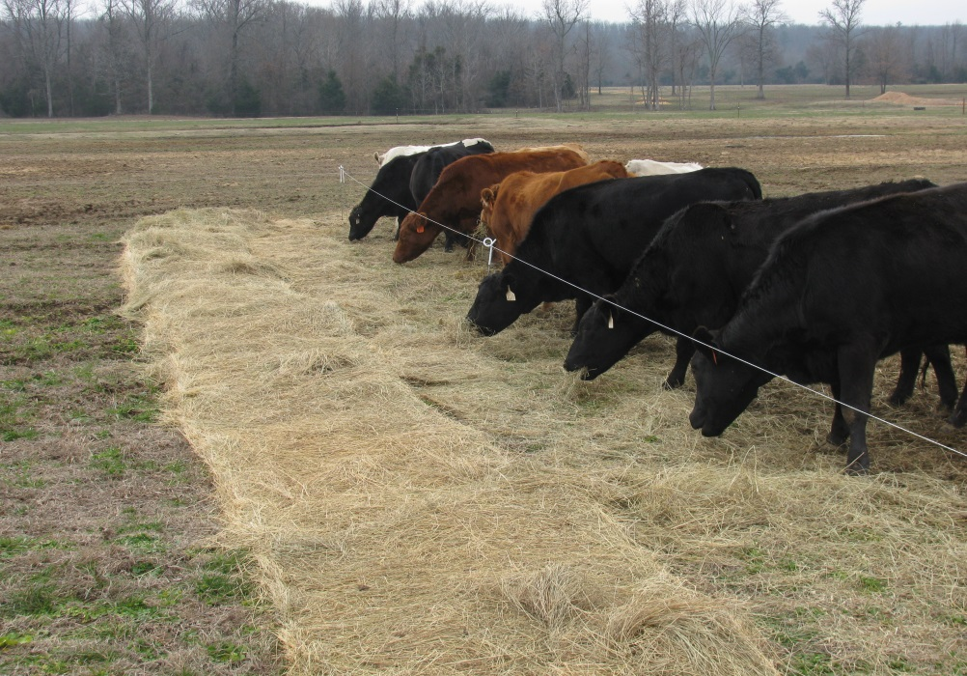
Using a strip grazing approach
Bale-grazing to spread nutrients
Strip-grazing tall fescue
Images from John Jennings, University of Arkansas
Notes:
Strip grazing allocates sections of forage to animals (usually enough for a 3 to 5 day supply) using temporary fencing. This improves forage utilization, as well as creates a unique way to spread animal nutrients across the pasture (much like the concept of bale grazing).

Slide 38
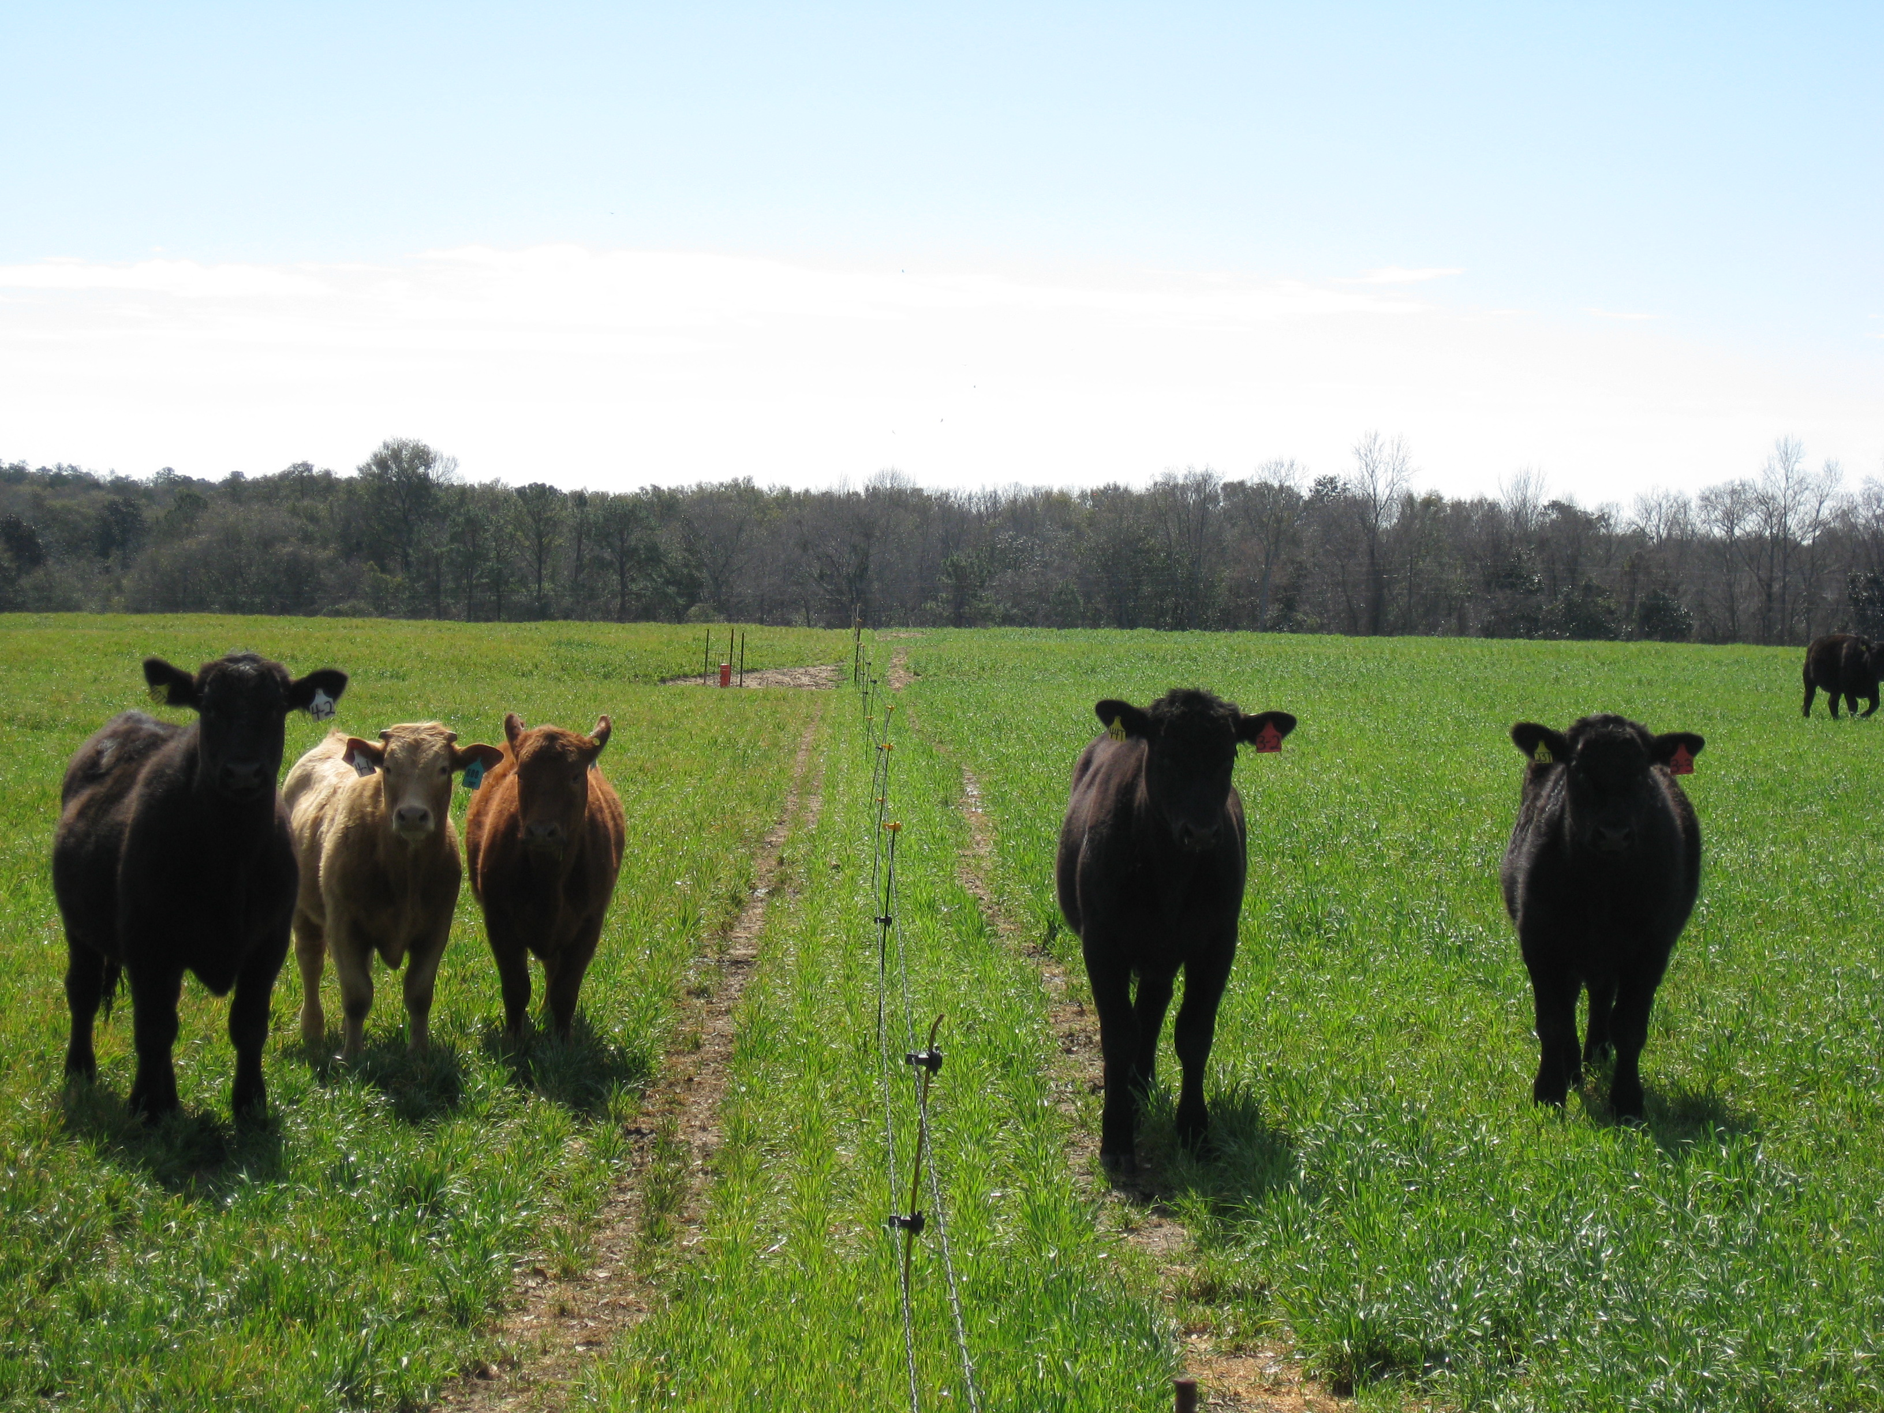
Cool-Season Annual Forages

Slide 39
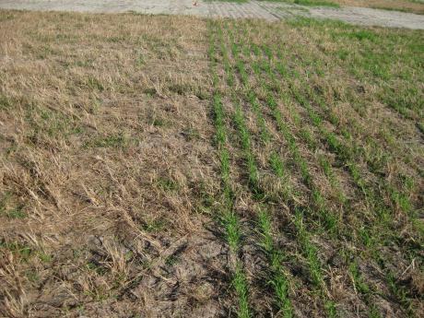
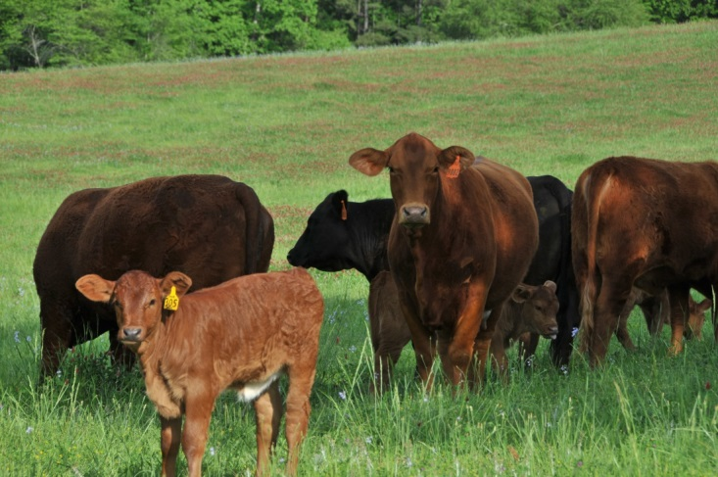
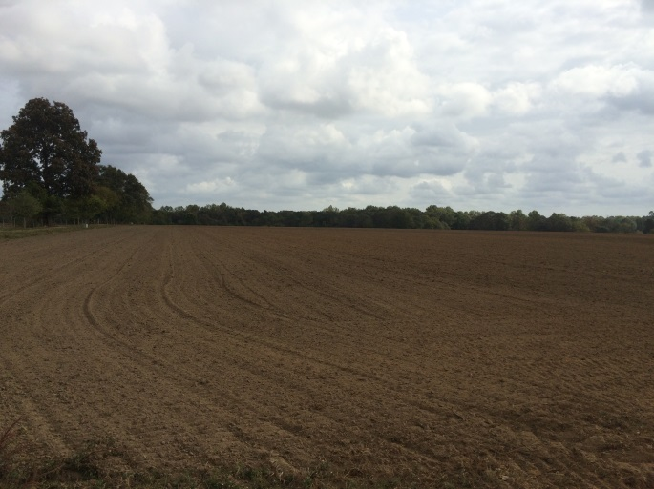
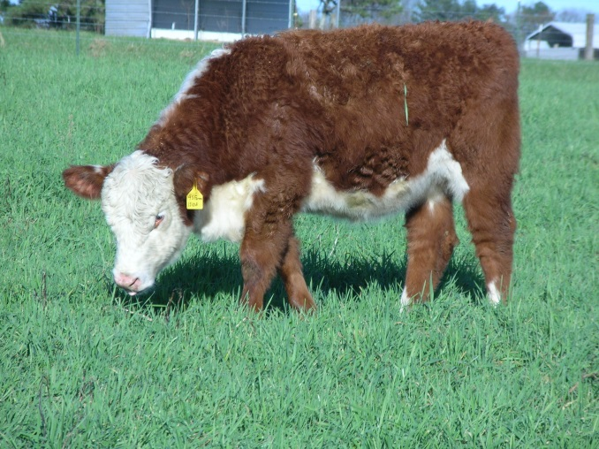
Cool-Season Annuals Can Diversity Land Use

Slide 40
Small-grain/ryegrass mixtures
Growth distribution
Ryegrass
Wheat
Oats
Rye
% of total production
Jan Feb Mar Apr May Jun Jul Aug Sep Oct Nov Dec

Slide 41
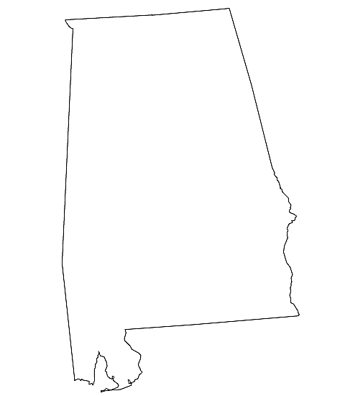
Small-grain/ryegrass mixtures
Rye + ryegrass
Earlier growth distribution for rye
More cold tolerant
Oats + ryegrass
Adapted to lower Coastal Plain region
More risk of winterkill at northern latitudes

Slide 42
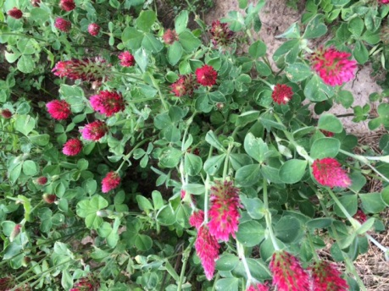
Cereal rye and rye-based mixtures
 | Grazing days | Stocking rate, animals/acre | ADG, lb/d | Gain/acre | Cost of gain ($/lb BW)
Rye | 84 | 1.9 | 2.7 | 430 | 0.43
Rye + wheat | 84 | 1.9 | 2.5 | 400 | 0.46
Rye + ryegrass | 134 | 1.6 | 1.9 | 407 | 0.53
Rye + clover | 129 | 1.5 | 2.3 | 445 | 0.42
Source: Ford et al., (2014)

Slide 43
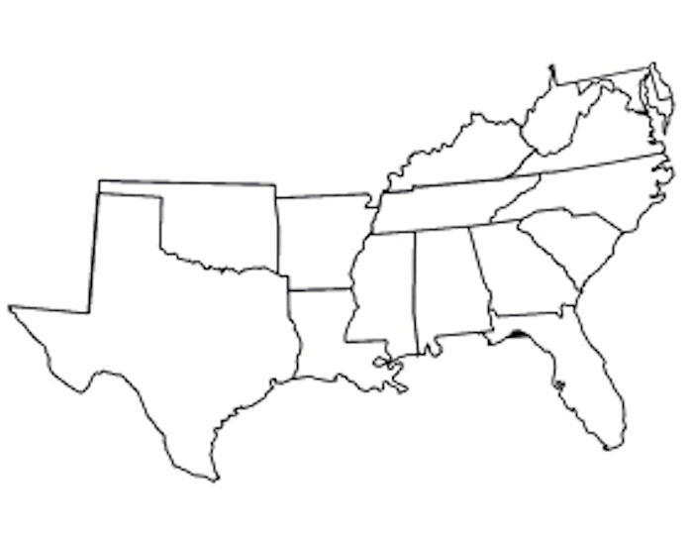
Use of prepared seedbed and overseeding perennial WSG sods
Goal is to have forage before Jan 1 for most
Increasing potential for fall growth: Coastal Plain Region
Seeding date – “early”
  Mid September to early October– Deep South
How early is early?

Slide 44

Where does fescue fit into the picture?

Slide 45
Novel-endophyte tall fescue and animal performance
Location: Crossville, Alabama
System | Grazing days | Stocking rate, animals/ acre | ADG, lb/d | Gain/acre
Jesup E+ | 224 | 1.5 | 1.6 | 366
Jesup E- | 224 | 1.5 | 2.2 | 436
Jesup NE | 224 | 1.5 | 2.0 | 448
25% increase in ADG for E- and NE types
23% increase in BW gain for E- and NE types
Bransby et al., 2002

Slide 46
Legumes

Slide 47
The addition of legumes
Evaluation of 37 grazing experiments in Alabama….
The most profitable (least cost/lb BW gain) system was tall fescue + white clover
Grazing dates: Oct. 15 to Jan. 15 and Mar. 15 to Jul. 19
Stocking rate, head/acre | 2.0
Average daily gain, lb/day | 1.6
Gain/acre | 576
Grazing season length | 205
Total pasture cost ($)/lb of gain | 0.10

Slide 48
Where do legumes fit?
In general:
  Legumes are higher in digestibility and protein than grasses
  Legumes fix their own nitrogen and can release some N back to plant-soil ecosystem over time
  Often planted in mixtures with grasses

Slide 49
Value and amount of Nitrogen fixed by various legumes
 | N Fixed | N Value, $, @
Crop | lb/A/year | $0.35/lb | $0.45/lb | $0.55/lb
Alfalfa | 150-250 | 53-88 | 68-113 | 83-138
Red Clover | 75-200 | 26-70 | 34-90 | 41-110
White Clover | 75-150 | 26-53 | 34-68 | 41-83
Vetch, Lespedeza, and other annual legumes | 50-150 | 18-53 | 23-68 | 28-83
Source: Southern Forages 5th edition

Slide 50
Most adapted to Alabama
Warm-Season
Cool-Season
Sericea Lespedeza*
Perennial Peanut*
Birdsfoot Trefoil*
Cowpea
Arrowleaf clover
Ball Clover
Berseem Clover
Crimson Clover
Red Clover*
White Clover*
Hairy vetch
Alfalfa*
*Act as a perennial or biennial

Slide 51
Challenges of Legumes
Establishment
Management
  Cattle will selectively graze legumes
  Need at least 30% in stand for measurable N contribution
Weed Control – limited options when legumes are in the system

Slide 52
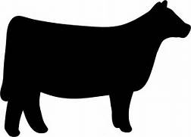
Putting it all together
Summer Perennials/Annuals
Cool-Season Annuals/Perennials
Fall Transition – Stockpiled Forage or Brassicas
Summer Perennials/Annuals
Weaning
Finishing

Slide 53
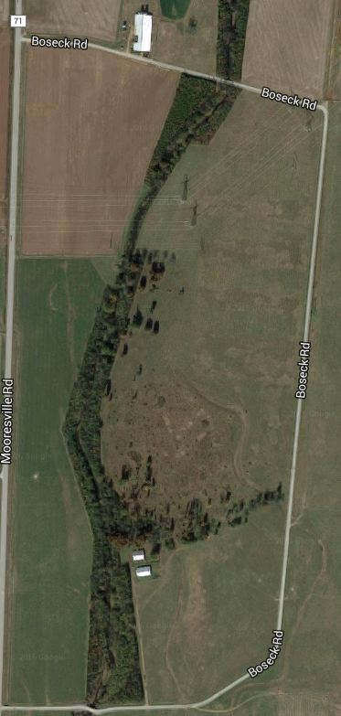
Establish a grazing management plan
Estimate supply and demand with available resources
Make adjustments to the system to improve grazing efficiency
Maintain pastures in adequate condition
Pasture 1
Sacrifice area
Stockpiled tall fescue
Pasture 2
Notes:
One of the biggest keys in forage management is having a plan – develop a strategy to manage pastures. Estimate forage supply/demand and determine how forage utilization can be improved. The greater production and utilization potential – the greater potential to gain pounds of beef per acre.

Slide 54
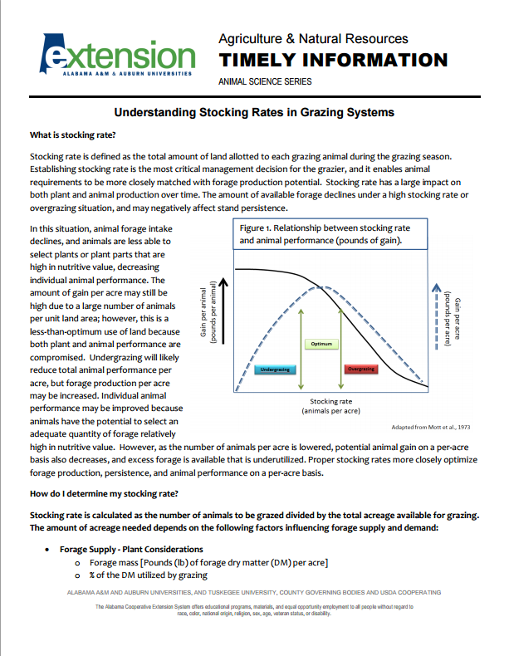

Understanding Stocking Rates in Grazing Systems

Slide 55
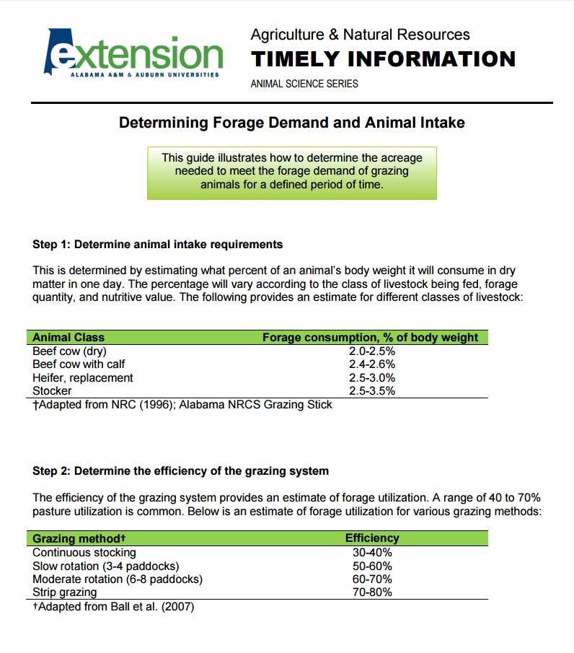
Determining Forage Demand and Animal Intake

Slide 56
Questions?
Visit www.aces.edu/beefsystems

