Slide 1
Figure 1. Average lbs of kale harvested per sq/ft of growing space with and without
addition of fish nutrients. Each point represents the average data from 40
replicates pots. Error bars represent 95% confidence intervals.

Slide 2
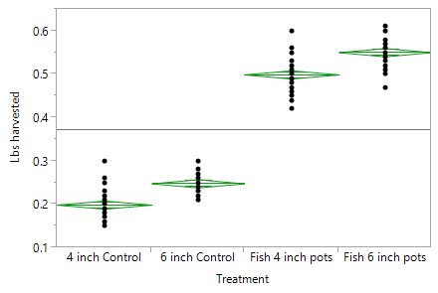
Or this one if you like it better – its directly from the
Stats package software – but shows the variance in each pot better.

Slide 3
Level Number Mean Std Error Lower 95% Upper 95%
4 inch Control 40 0.198750 0.00477 0.18933 0.20817
6 inch Control 39 0.247949 0.00483 0.23841 0.25749
Fish 4 inch pots 40 0.499250 0.00477 0.48983 0.50867
Fish 6 inch pots 39 0.550513 0.00483 0.54097 0.56006
Source DF Sum of Squares Mean Square F Ratio Prob > F
Treatment 3 3.6907809 1.23026 1351.928 <.0001*
Error 154 0.1401406 0.00091
C. Total 157 3.8309215
Rsquare 0.963419
Adj Rsquare 0.962706
Root Mean Square Error 0.030166
Mean of Response 0.373797
Observations (or Sum Wgts) 158

Slide 4
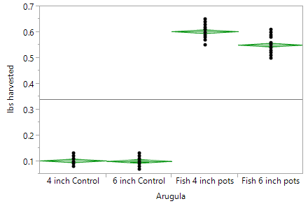
Arugula
Level Number Mean Std Error Lower 95% Upper 95%
4 inch Control 40 0.102000 0.00369 0.09471 0.10929
6 inch Control 39 0.100000 0.00374 0.09262 0.10738
Fish 4 inch pots 40 0.603250 0.00369 0.59596 0.61054
Fish 6 inch pots 39 0.551026 0.00374 0.54364 0.55841
Source DF Sum of Squares Mean Square F Ratio Prob > F
Arugula 3 9.0208324 3.00694 5520.850 <.0001*
Error 154 0.0838765 0.00054
C. Total 157 9.1047089

Slide 5
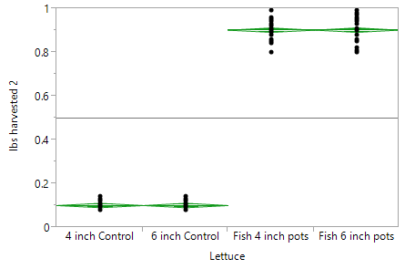
Lettuce
Source DF Sum of Squares Mean Square F Ratio Prob > F
Lettuce 3 25.368079 8.45603 8181.877 <.0001*
Error 154 0.159160 0.00103
C. Total 157 25.527239
Level Number Mean Std Error Lower 95% Upper 95%
4 inch Control 40 0.101000 0.00508 0.09096 0.11104
6 inch Control 39 0.101026 0.00515 0.09086 0.11120
Fish 4 inch pots 40 0.902250 0.00508 0.89221 0.91229
Fish 6 inch pots 39 0.902564 0.00515 0.89239 0.91273

