Slide 1

Converting Retired Poultry Houses Into Indoor Vegetable Growing Facilities – Growing Strawberries
Gordon Johnson
Department of Plant and Soil Sciences
And Cooperative Extension
University of Delaware

Slide 2
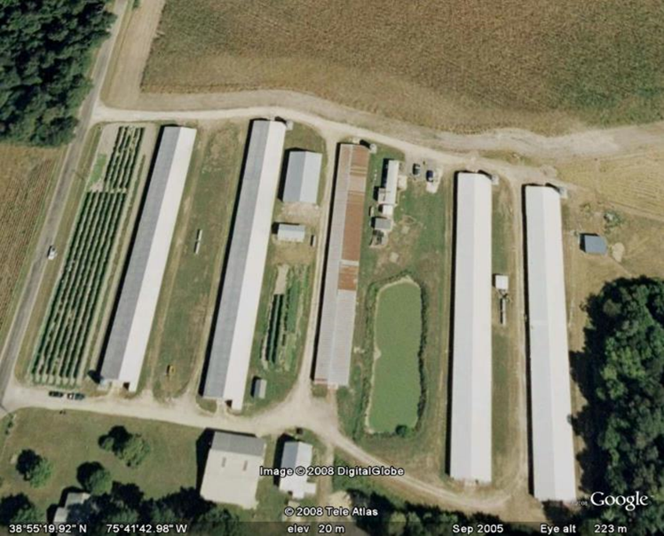
Situation
Over 2400 empty poultry houses on Delmarva
  Over 1000 houses in DE
  2x in 20 years

Slide 3
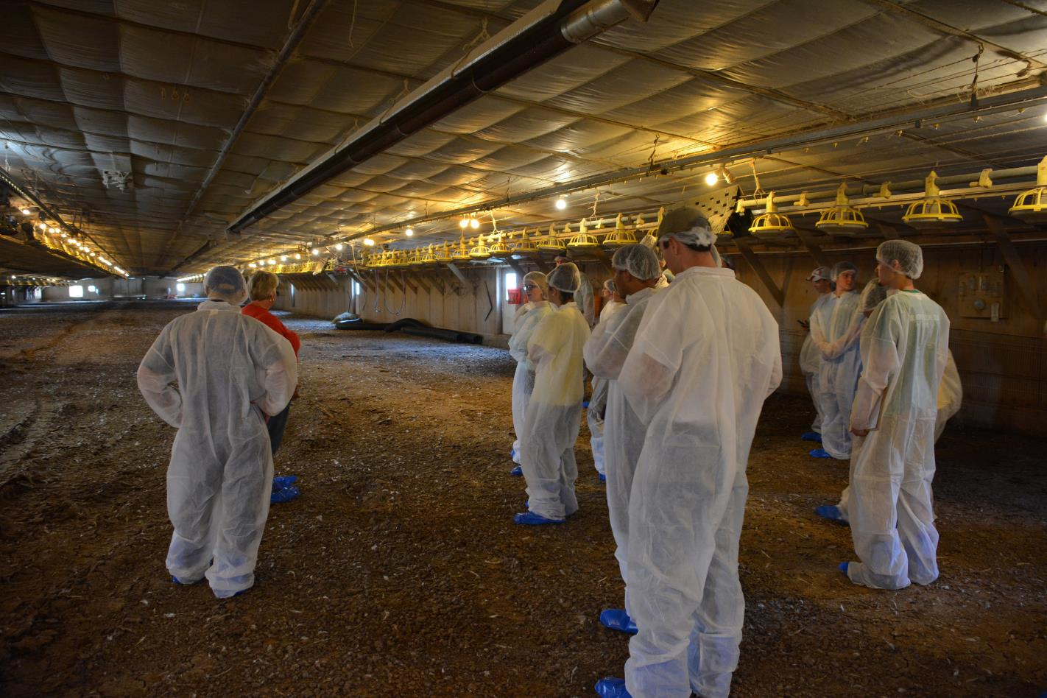
Appropriate houses for conversions
More modern houses that are clear span would be preferred over houses with interior posts. Houses should not have curtains.
Houses should have an intact well-maintained roof with no leaks.
Ceilings and walls in the house interior should be in good condition with no holes and should be well insulated.
Houses should not have areas where water collects or have floors that stay wet.?

Slide 4
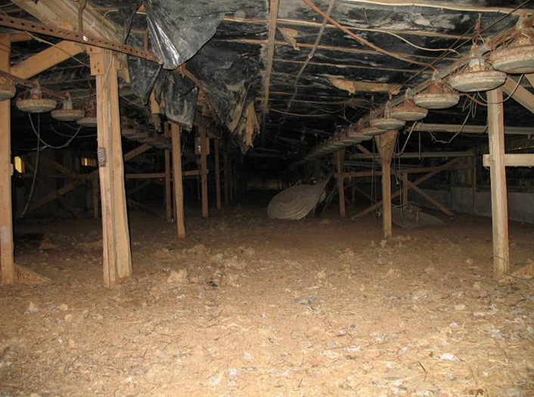
Not a good choice

Slide 5
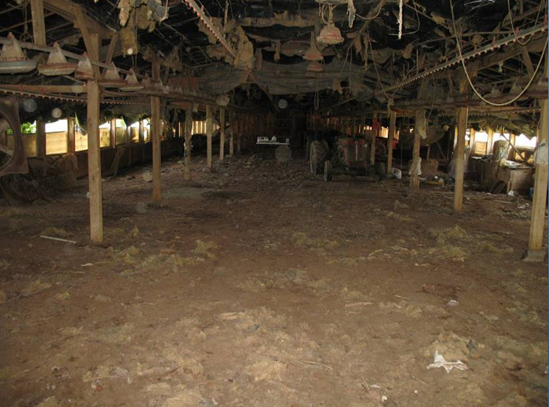
Some potential but not ideal

Slide 6
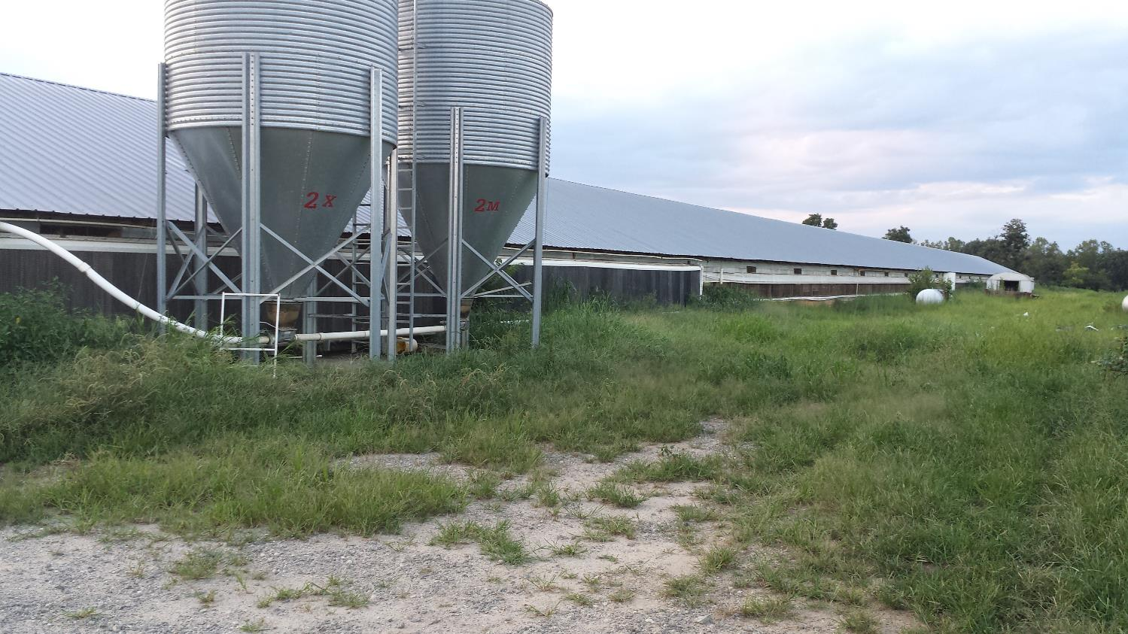
Good Potential

Slide 7
Current Modern House

Slide 8
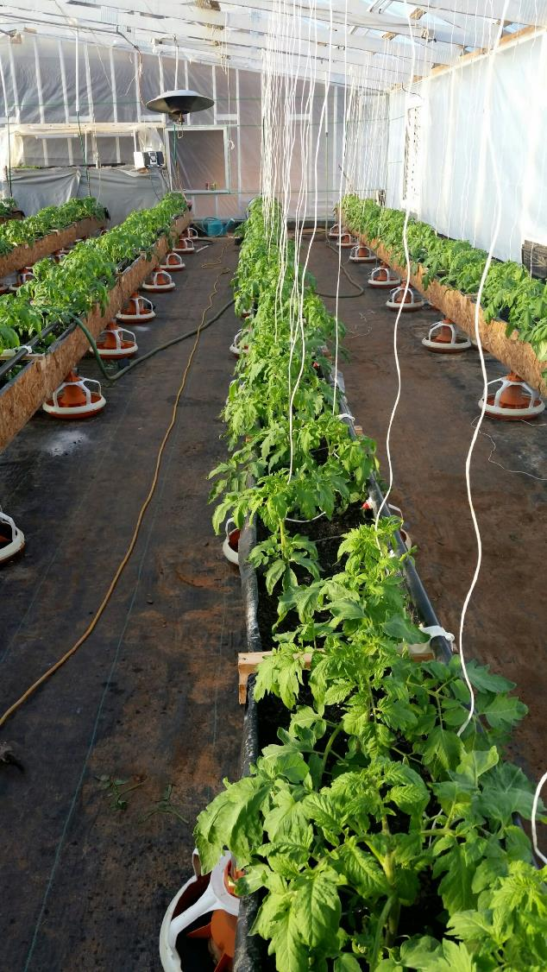
Conversion to Greenhouse

Slide 9
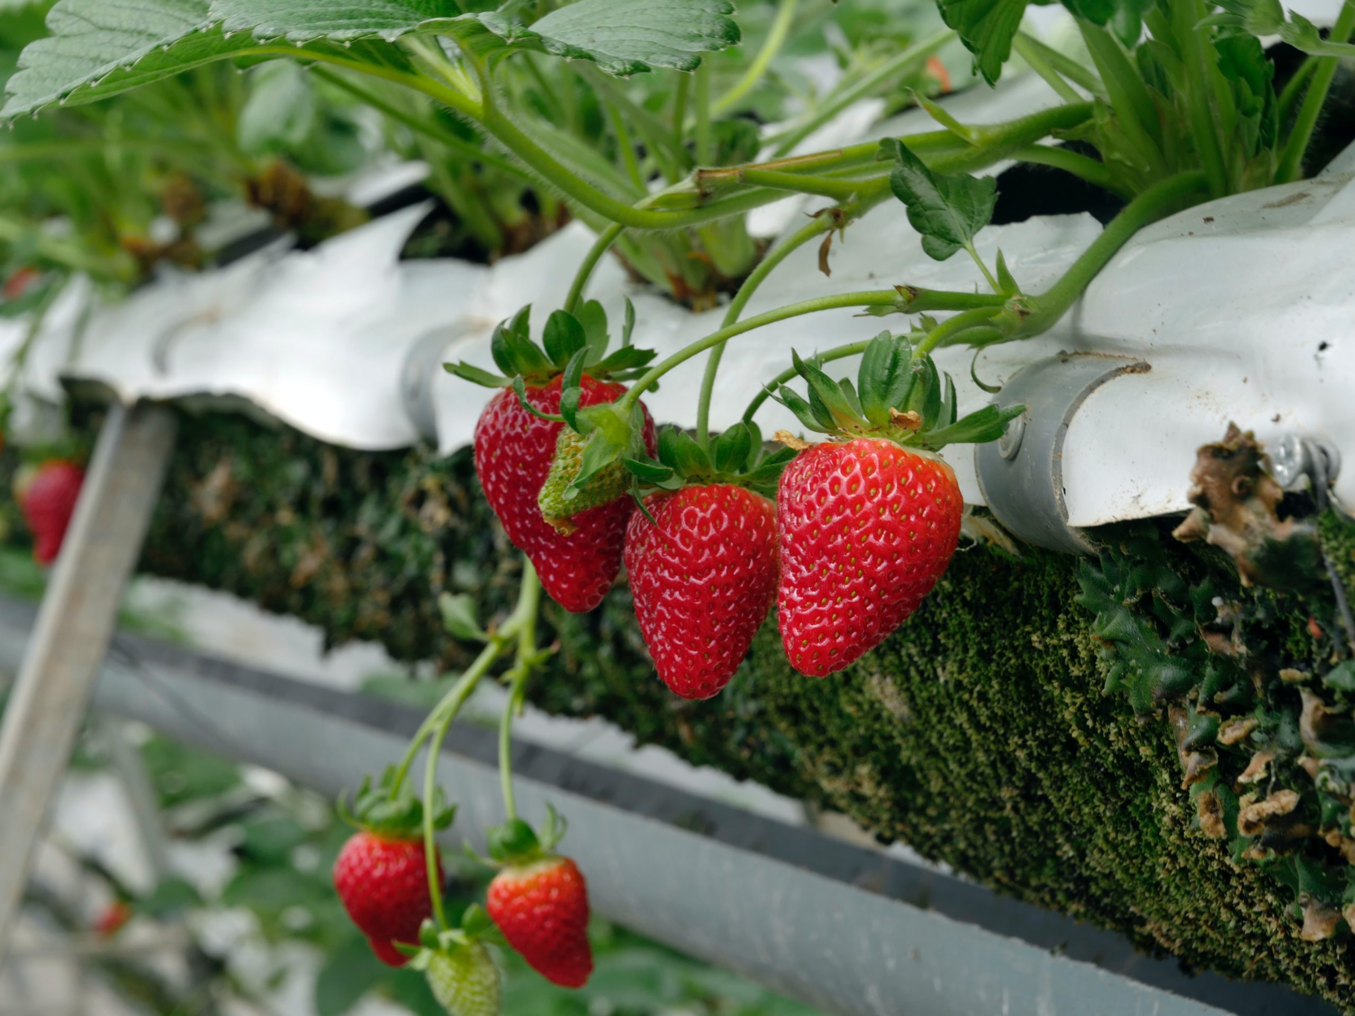
Can you convert to this

Slide 10
Conversion Process
Determine type of production
  Greenhouse
  Lighted warehouse
Test for Salmonella
Remove litter
Remove unnecessary equipment
Clean and sanitize
Make modifications
  Floors, ceilings, walls, doors, fans, heating
Install growing equipment
  Lighting
  Benches
  Growing units
  Water/nutrient systems
Establish a monitoring program

Slide 11
Testing
Because these facilities were used for poultry production there is some concern of the facilities harboring pathogens that are of concern for produce food safety and food borne illness.
In most cases, the houses have been out of production for a significant period and therefore pathogen loads should be low or non-existent.
The one pathogen group with ability to survive in the environment for a longer time are the Salmonella species. Pre and post testing for Salmonella is recommended (floors and surfaces).
Take floor samples paying attention to any wet areas and entrance areas. Swabs should be taken from ceiling and walls.
Another issue is rodents. Rodents can also carry pathogens of concern. Active rodent infestations must be controlled prior to any conversion.

Slide 12
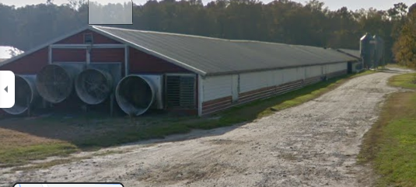
Converted house

Slide 13
1) Prior to renovation
Remove all feeders, brooders, and waterers and associated cables and pulleys
Determine what wiring will be kept and remove any that will not be used.

Slide 14
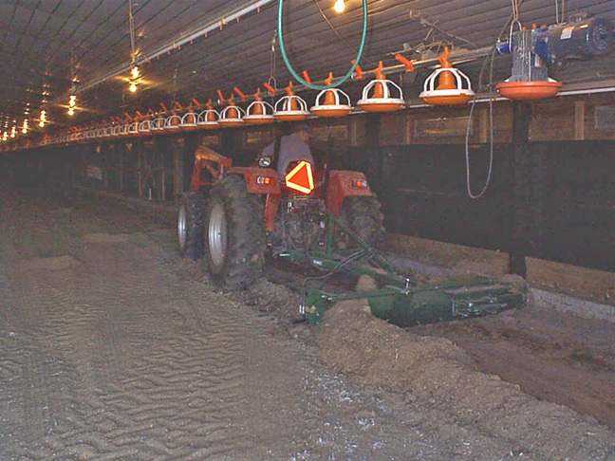

Slide 15
2) Floors
Poultry house floors are of concern for several reasons. During poultry production ammonium, nitrate, potassium, sodium, and other salts migrate into the floor. This results in a very caustic condition that damaging to equipment. In addition, ammonia can be released from the floor when wetted that can be damaging to plant health and worker safety. A third issue is the possible persistence of microbes that are of concern for produce food safety and food borne illness (Salmonella specifically)

Slide 16
2) Floors
Remove all litter completely with attention paid to sides
Then remove the top 2-6 inches of fill soil
Apply ammonia control – gypsum or alum
Then cover with the floor area with 2-6 inches of clean fill
Then cover the whole area with impervious geotextile fabric
Pouring cement floor is another option but expensive

Slide 17
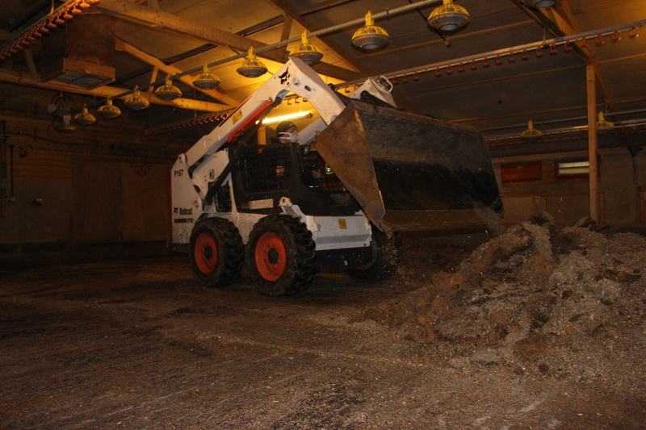

Slide 18
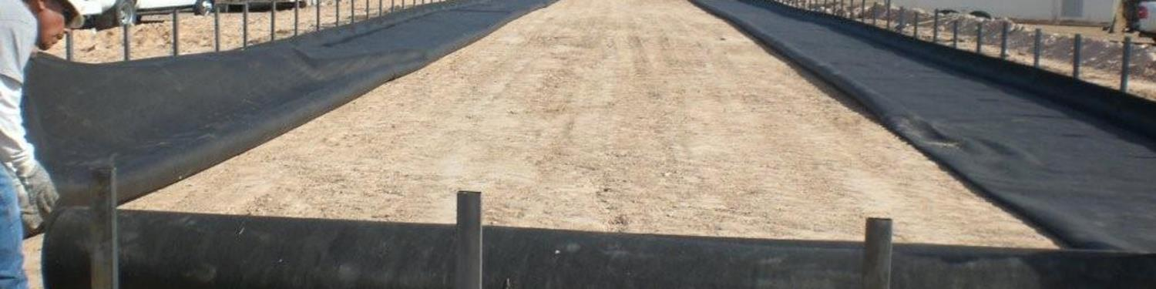
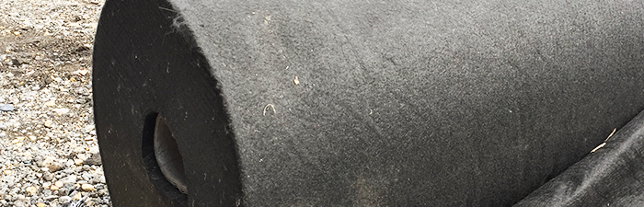

Slide 19
3) Ceiling
Evaluate current ceiling
Using commercial grade vacuum remove all loose dust, cobwebs, and other loose materials or power wash
Sanitize with dry sanitizers
  Liquid possible if it is intact and wettable
Cover the ceiling with 6 mil poly plastic
Run new wiring in plastic conduit (optional)

Slide 20
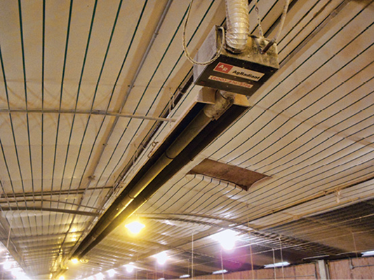
Ceilings – Clean, Cover?

Slide 21
4) Walls, doors
Evaluate current walls
Using commercial grade vacuum, remove all loose dust and other loose materials or power wash
Sanitize with dry sanitizers
  Liquid possible if intact and wettable
Cover walls with 6 mil poly plastic or seal in another fashion
Doors should be replaced or boarded over if not being used

Slide 22
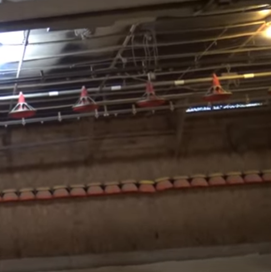
Evaluate Walls

Slide 23
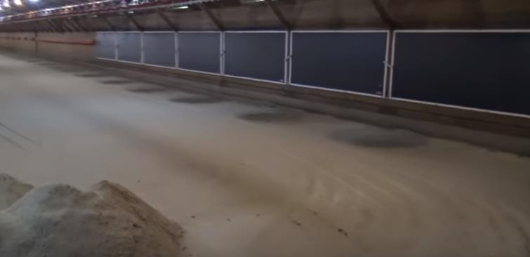

Slide 24
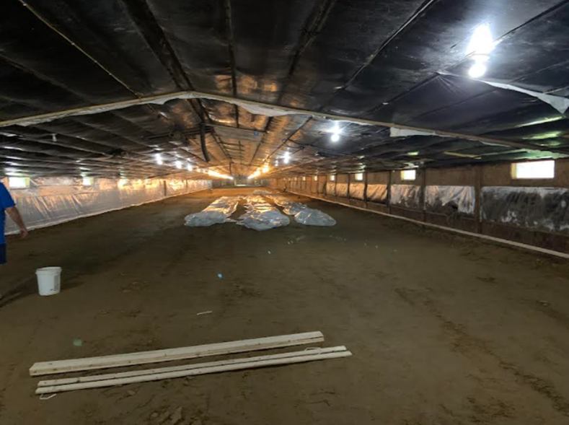
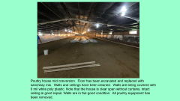
Poultry house mid conversion. Floor has been excavated and replaced with sand/clay mix. Walls and ceilings have been cleaned. Walls are being covered with 6 mil white poly plastic. Note that the house is clear span without curtains, intact ceiling in good repair. Walls are in fair-good condition. All poultry equipment has been removed.

Slide 25
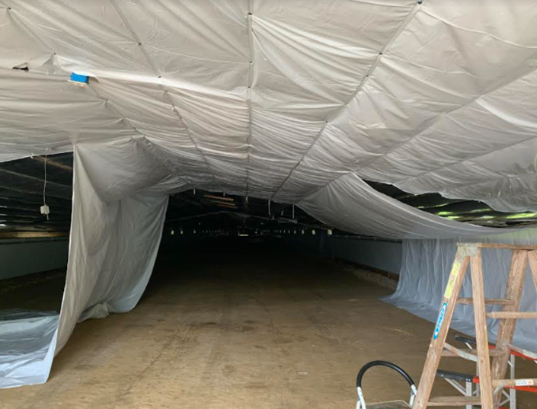
Ceiling being covered with white poly plastic.

Slide 26
5) vents, fans, and heaters
If side vents are to be used, vacuum and dry sanitize vent boxes, cables, and pulleys
If retained, cool pad vents should be replaced with new pads and water systems should be sanitized by running sanitizer in the water
If retained, fans and fan housings should be cleaned completely and then dry sanitized
Heaters should be removed and replaced with new vented heaters or other alternative heating, if reused should be cleaned and sanitized

Slide 27
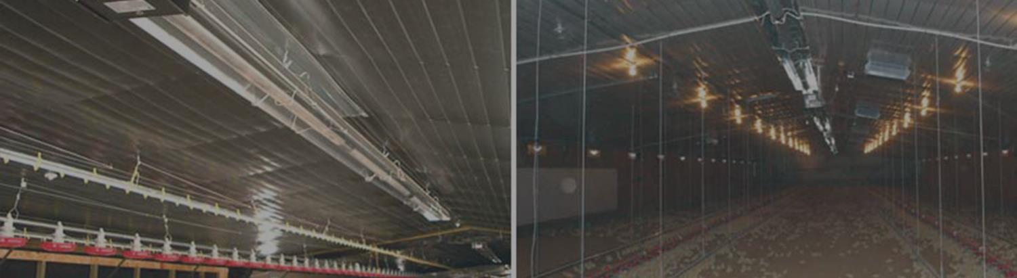
Replace Heaters?

Slide 28
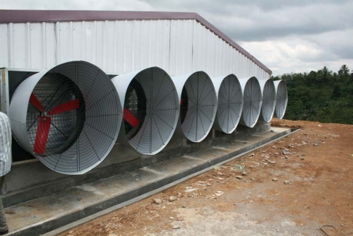
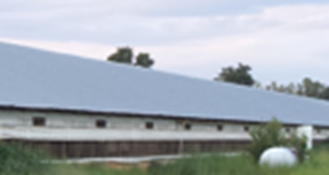
Fans, Clean or Replace, Side Vents Clean or Seal

Slide 29
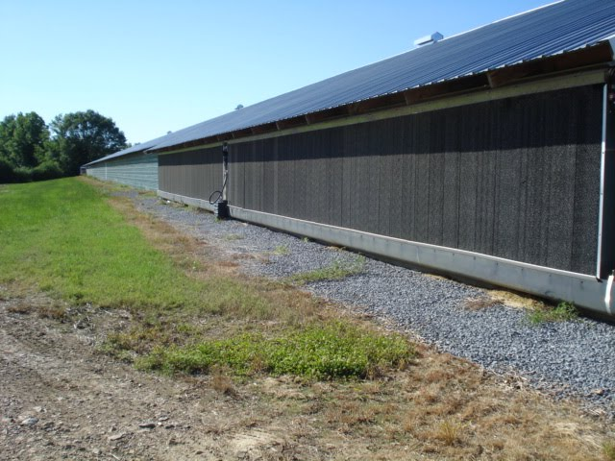
Replace or Remove

Slide 30
6) Other Treatments
Heat house to high temperature – above 120 F if possible
  4-7 days
Fumigation???

Slide 31
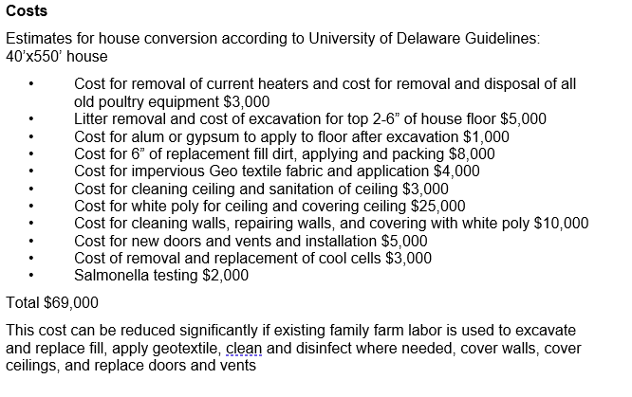
Costs

Slide 32
Growing system
Hydroponic facility costs
Air Circulation System $7,000
Overhead Vented Unit Heaters $15,000
Environmental Controls $5,000
NFT Growing System $60,000 (tank type systems would be less expensive)
Growing Supplies (approx. 1 year) $14,000
Grow Lights $150,000
Total $251,000

Slide 33
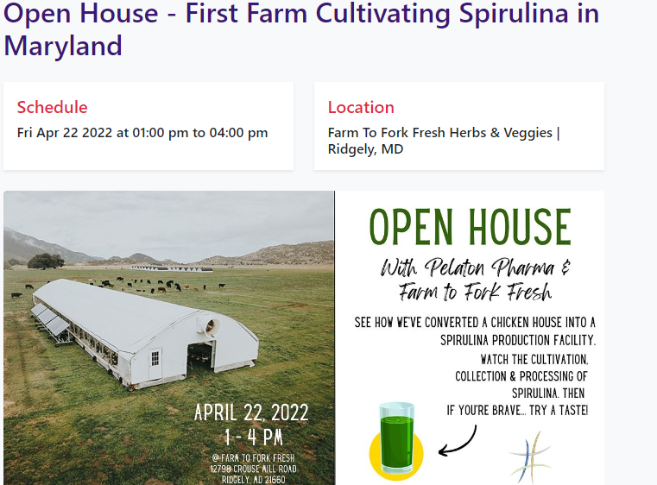
Current conversions
Spirulina
Greens
Baby Ginger
Medical Cannabis
Future Strawberries

Slide 34
Factsheet
http://croppers.farm/converting-poultry-houses-into-indoor-growing-facilities/

Slide 35
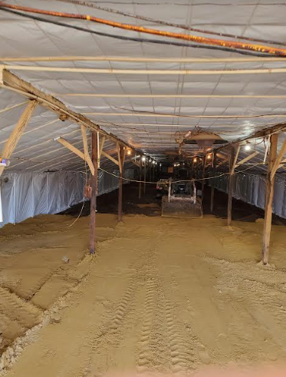
Strawberry Project – Bill Owens, Roxana Delaware
SARE and USDA Specialty Crop Block Grants
Indoor lighted production, hydroponics
Growing propagation tips currently
Yield study – Strawberry Varieties
  Day neutral – Albion, San Andreas, Cabrillo, Sweet Ann, Royal Royce, Monterey
  June Bearer – Keepsake, Camarosa, Fronteras, Ruby June, Camino Real, Flavorfest
Lighting study – different light levels
Vision – multiple growers with converted poultry houses growing strawberries

Slide 36
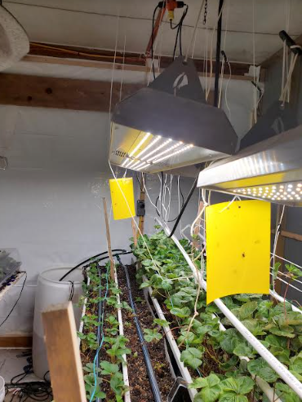

Gutter production, hydroponics, LED lights
Providing a Research Base for Indoor Lighted Production of Strawberries in a Repurposed Poultry House.

Slide 37
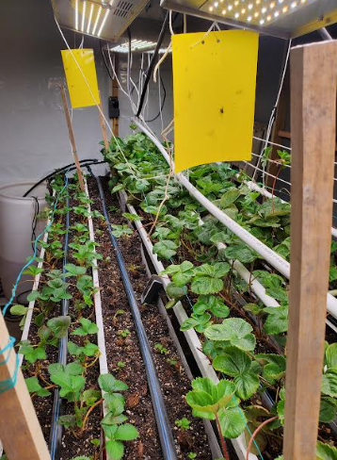
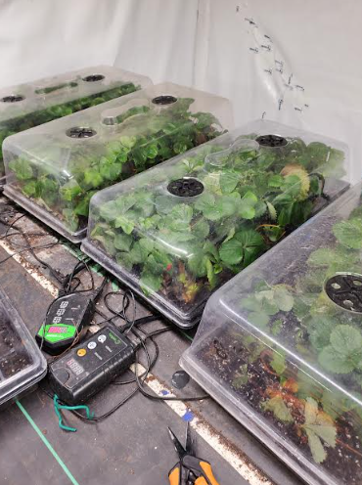
Tip Production and Rooting

Slide 38
Questions??
Gordon C. Johnson, PhD
Extension Fruit and Vegetable Specialist
Department of Plant and Soil Sciences
University of Delaware
Carvel Research and Education Center
16483 County Seat Highway
Georgetown, DE 19947 gcjohn@udel.edu
Office: (302) 856-2585 ext. 590
Cell: (302) 545-2397

