Slide 1
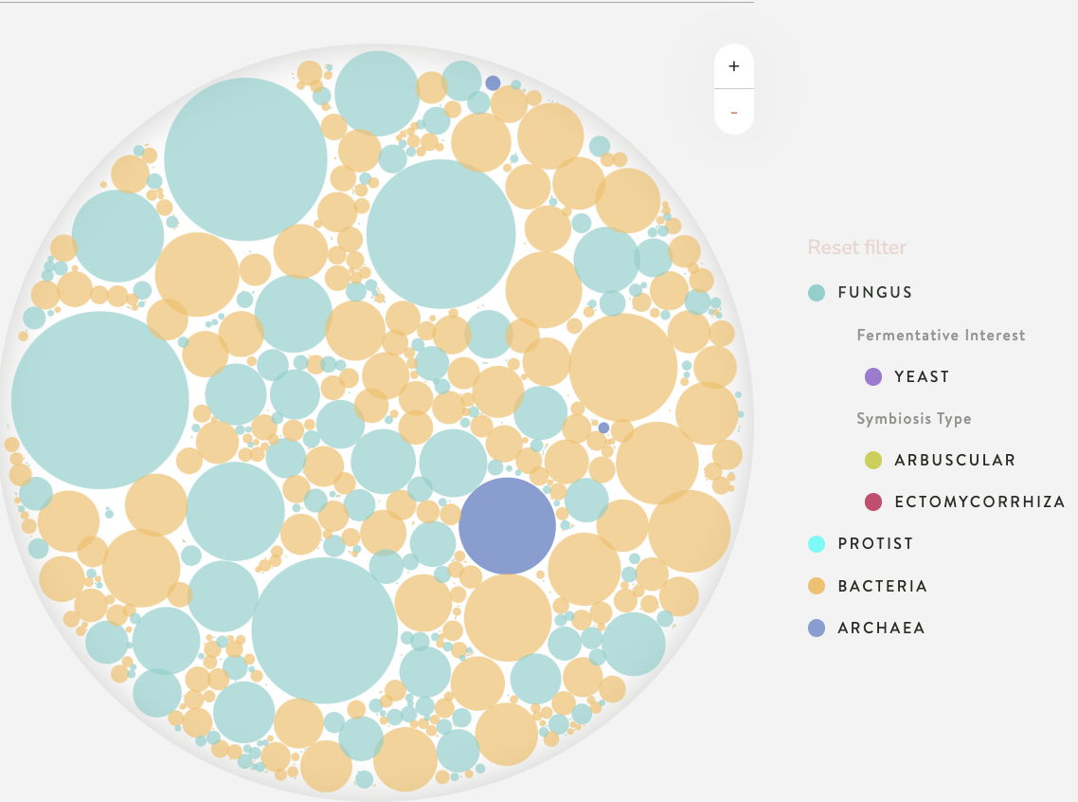
Soil Fungal Diversity Shift – DNA Analysis
Biome Makers DNA analysis
Trial conducted by Herb Young Squeeze Citrus LLC 2021-23
Each circle represents a unique funga species.The size indicates the fungal Biomass proportion of that species in the soil.

Slide 2
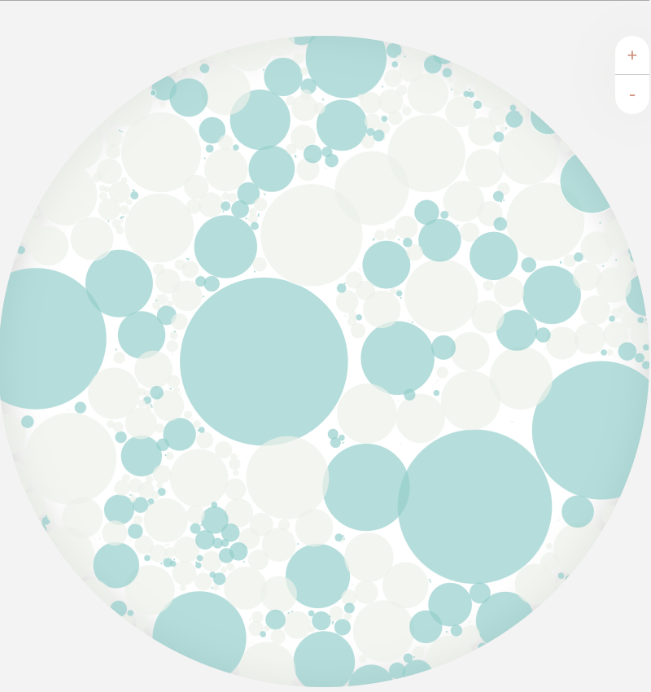
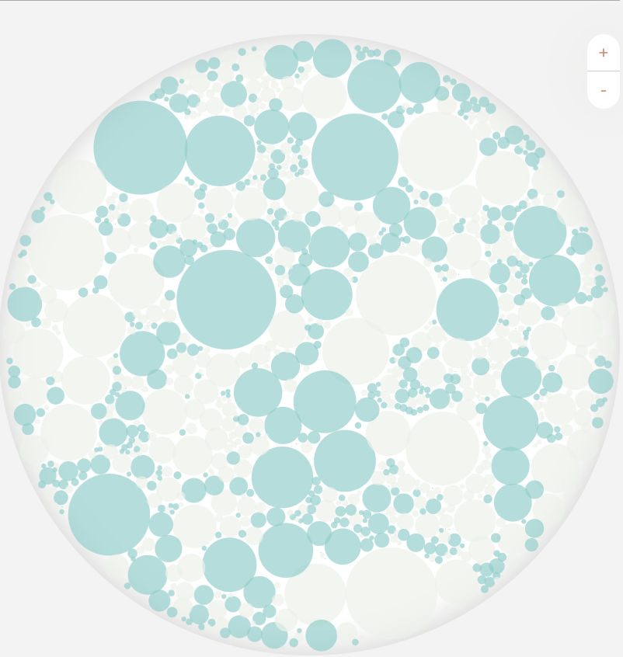
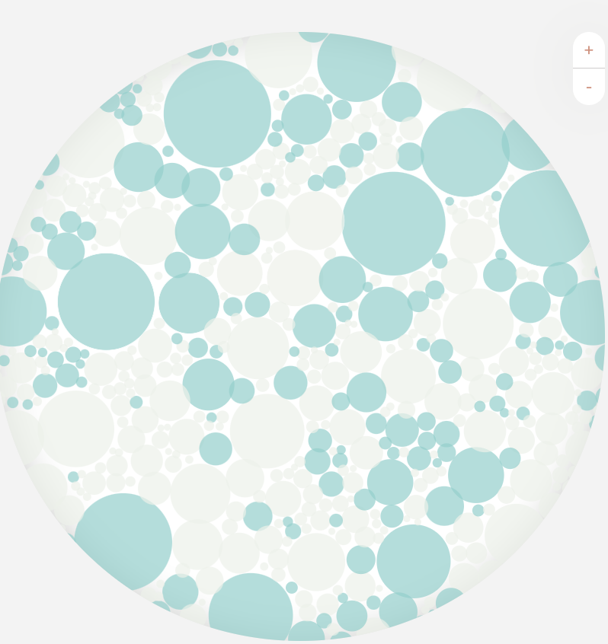
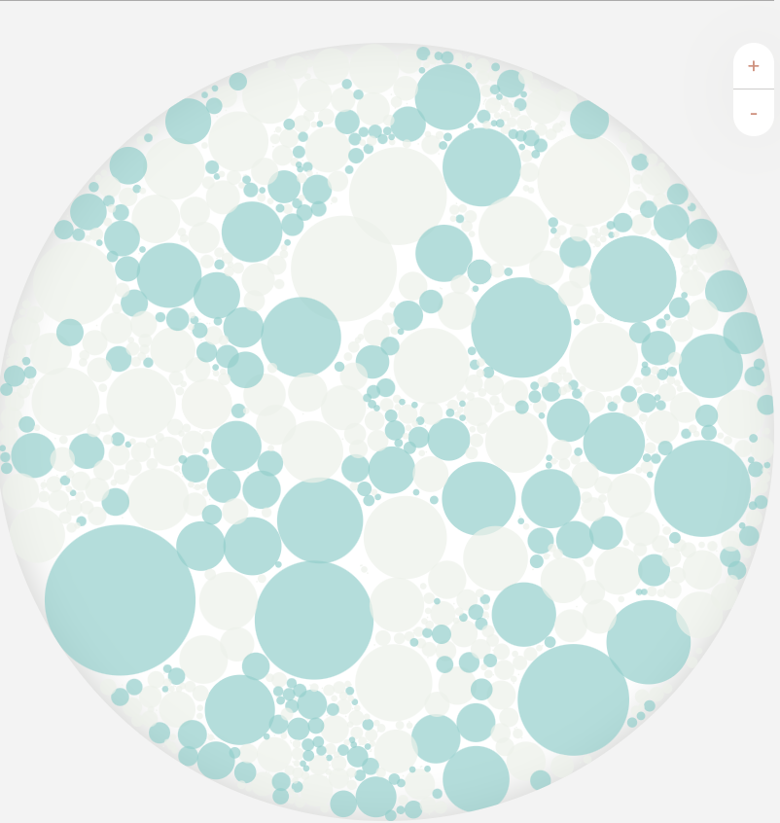
Evolution of the fungal population in REGENERATIVE plots
*
*
*
*
PREPLANT – 2/2021 Fall 2021 Summer 2022 Summer 2023
<< Winter fallow. Citrus Planted 4/9/21 Cover Crops (10 species) planted each spring and fall ---------------------------------------------------------------------
*45% of fungal biomass:
Penicillium brasilianum, Hannaella oryzae, Gibellulopsisens nigrescens, Cryptococcus sp.

Slide 3
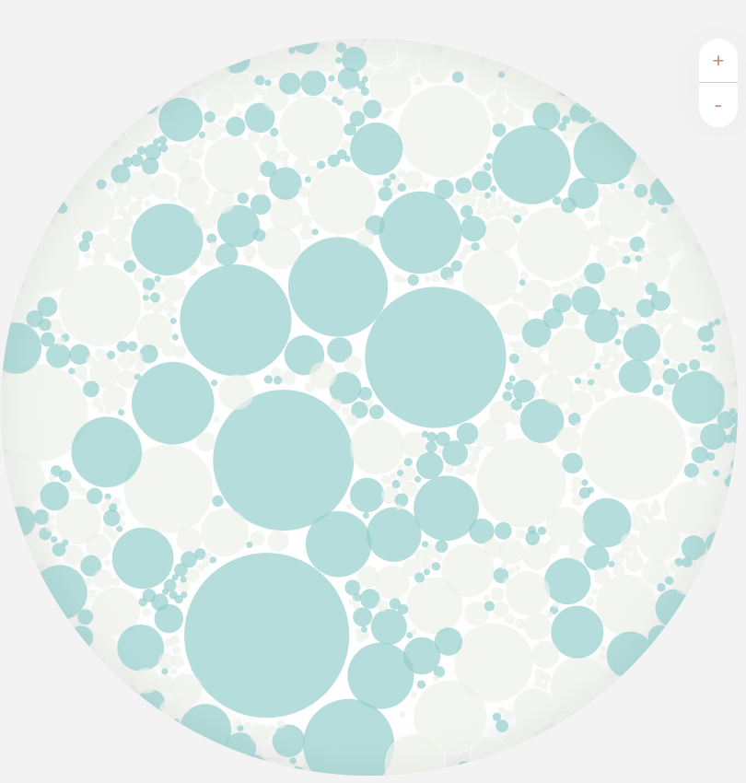
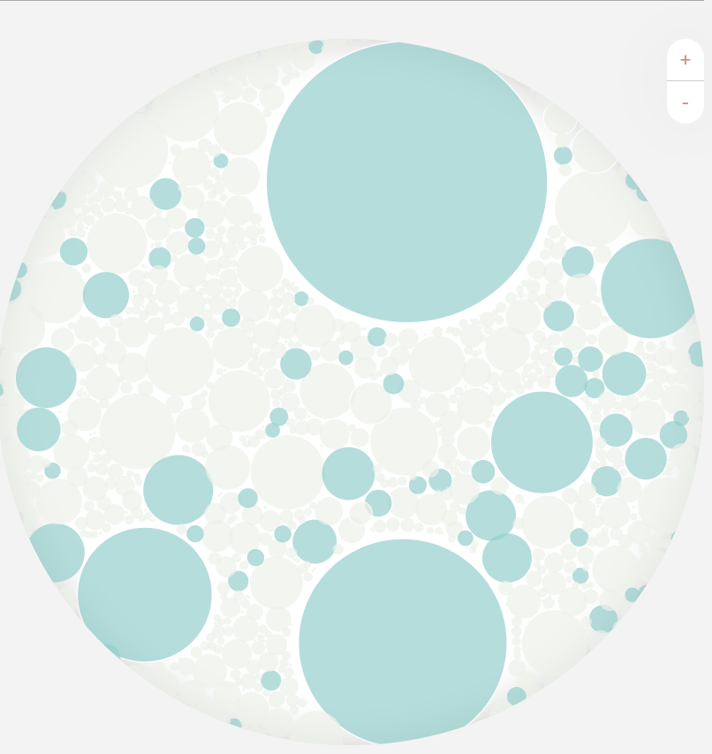
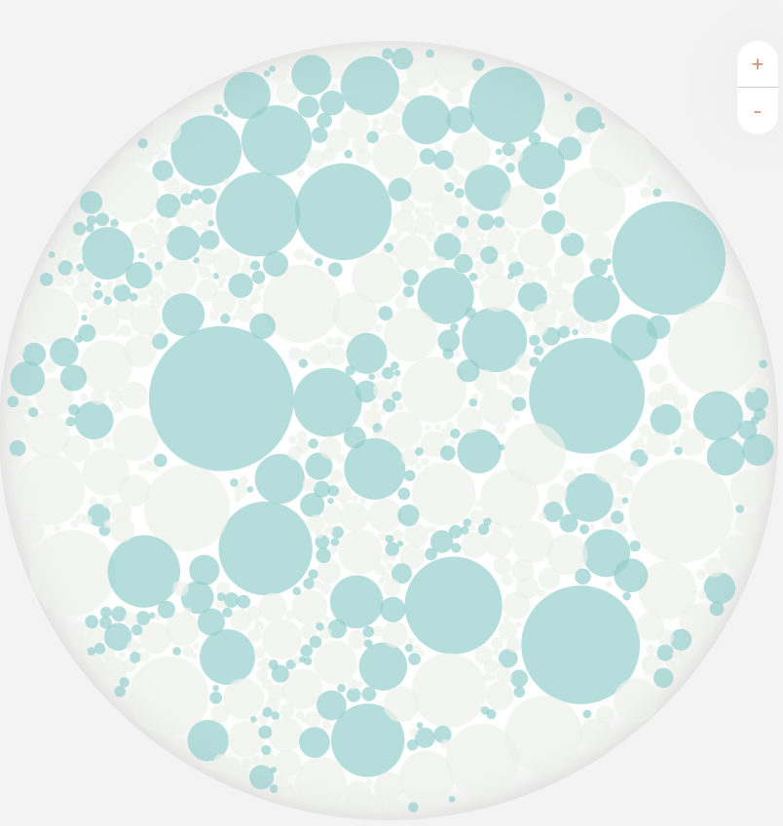
Evolution of the fungal population in INDIGENOUS plots (no inoculants)
Cladosporium
herbarum 38%
*
*
*
*
Epicoccum
nigrum 21%
PREPLANT – 2/2021 Fall 2021 Summer 2022 Summer 2023
<< Winter fallow. Citrus Planted 4/9/21 Cover Crops (10 species) planted each spring and fall ---------------------------------------------------------------------
*45% of fungal biomass:
Penicillium brasilianum, Hannaella oryzae, Gibellulopsisens nigrescens, Cryptococcus sp.

Slide 4
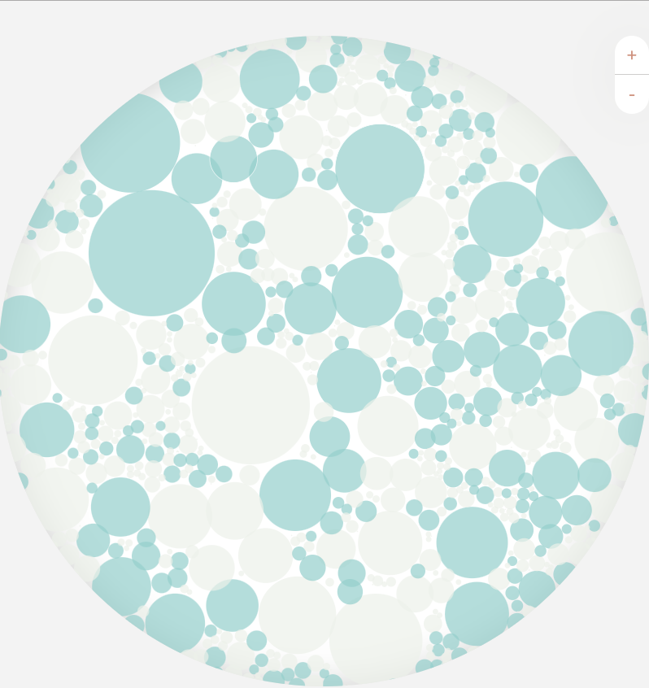
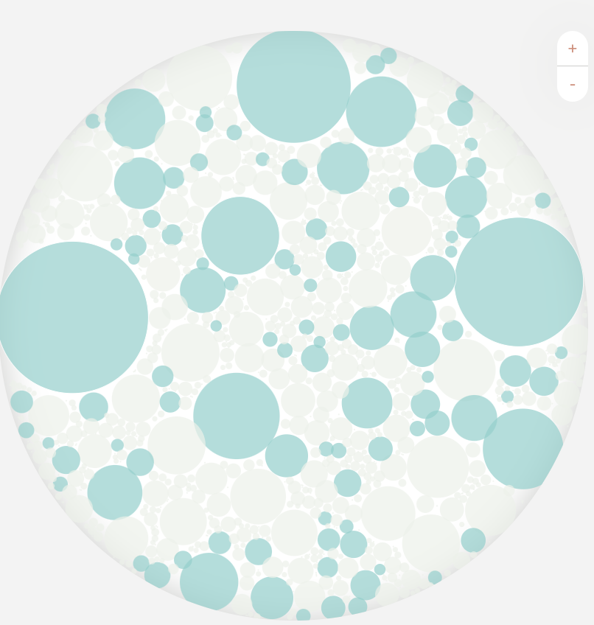
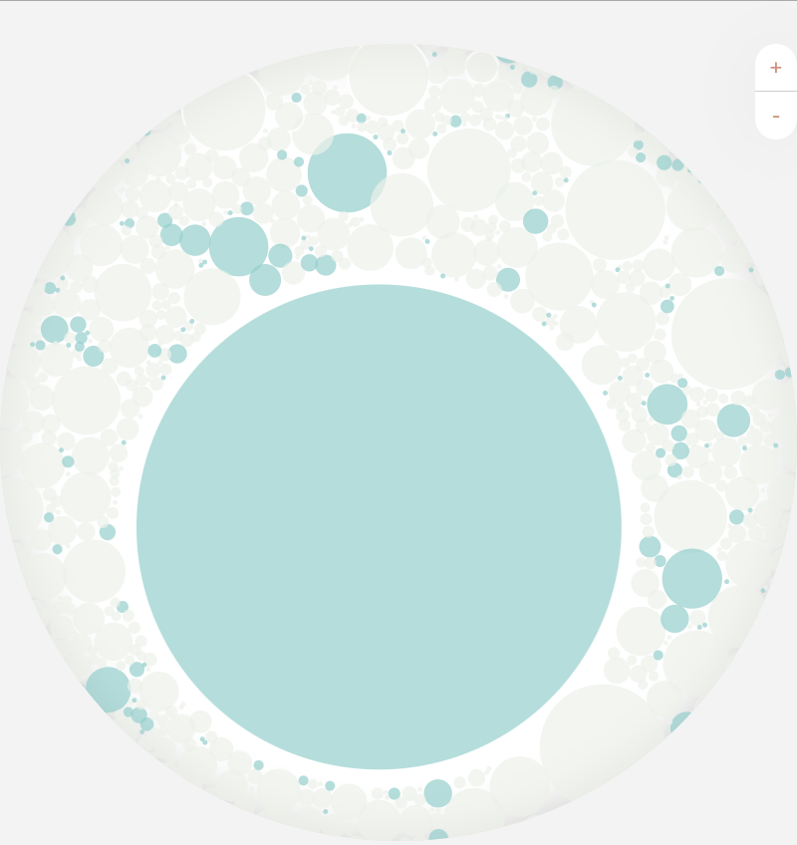
Evolution of the fungal population in CONVENTIONAL plots
Lycoperdon
dermoxanthum
Dwarf Puffball
89%
PRE – 2/2021 Fall 2021 Summer 2022 Summer 2023
<< Winter fallow. Citrus Planted Bare ground herbicide strip maintained with RU >>>>>>>>>>>>>>>>>>>>>>>>>>>>>>>>>>>>>

Slide 5
3rd Season Regenerative Indigenous Conventional
Dwarf Puffball
89%
Organic + Cover crops + Inoculants
Organic + Cover crops
Bare ground herbicide strip maintained with RU

Slide 6
3rd Season Regenerative Conventional
Dwarf Puffball
89%
Organic + Cover crops + Inoculants
Bare ground herbicide strip maintained with glyphosate and synthetic fertilizers.

Slide 7
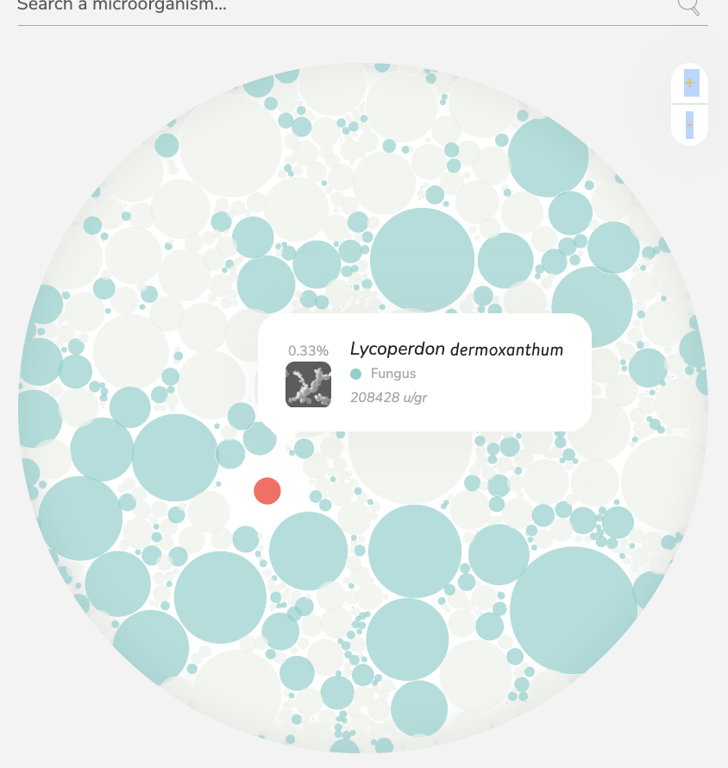
Conventional Soil Rebound: 3rd >>4th year
3rd Season fungal
4th Season fungal
Lycoperdon
dermoxanthum
Dwarf Puffball
89%

Slide 8
Methods and Observations
Soil DNA analysis was provided as a Fields4Ever grant from Biome Makers
Trial is on Shiranui mandarins. 15 trees/plot. 3 Replications (one row). All trees have Tree
Conventional treatment: herbicide strip (RU), synthetic fertilizer (2X/yr 2021-22, 3X 2023), limited insecticide & fungicide. Regenerative treatment: Cover crops (spring and fall planting = 10spp.), Organic fertility (foliar alternated with irrig injection biweekly), added microbes (mycorrhizae and bacteria).
Tree growth is >2X in the Conventional treatment.
Soil Penetration with a Penetrometer (200 psi) is 12.8” in the Conventional trt and 24.4” in the Regenerative and Indigenous treatments.
Winter 2022-23, the Conventional site was >80% winter weeds vs. <5% for Regenerative.
Soil in Regen & Indigenous plots (8” from Tpee) with cover crops was more porous assumingly from cover crop roots and microbial population. They both had a high level of fungal diversity. The Convention plot had extensive bacterial population but fungal popn. was dominated by the single species – dwarf puffball.
Conclusion: Regenerative practices lead to soil diversity, especially fungi and soil permeability.

Slide 9
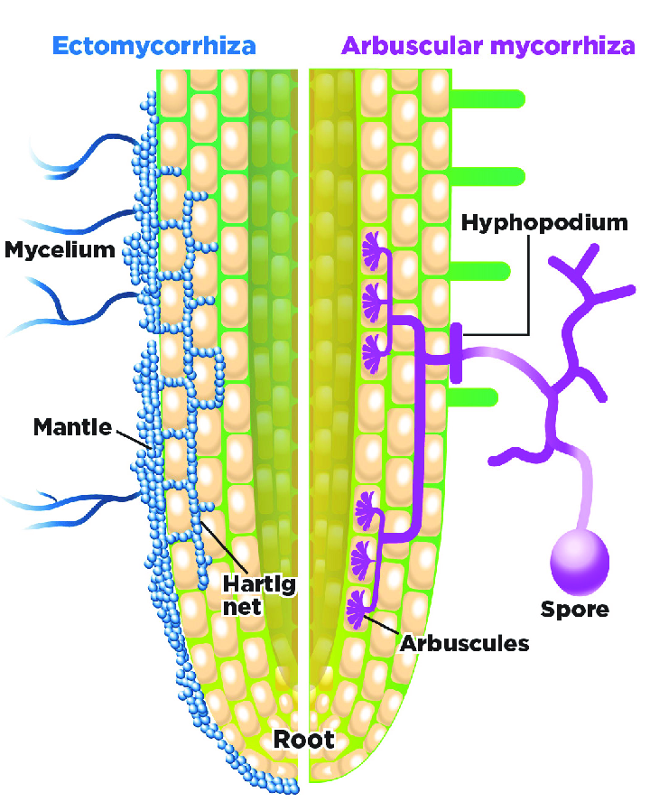
ECTOMYCORRHIZA versus ENDOMYCORRHIZE
in REGENERATIVE plots

Slide 10
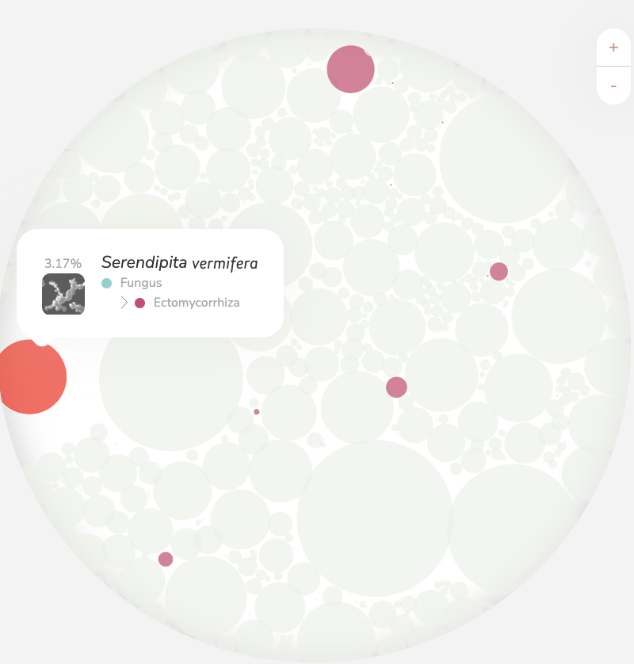
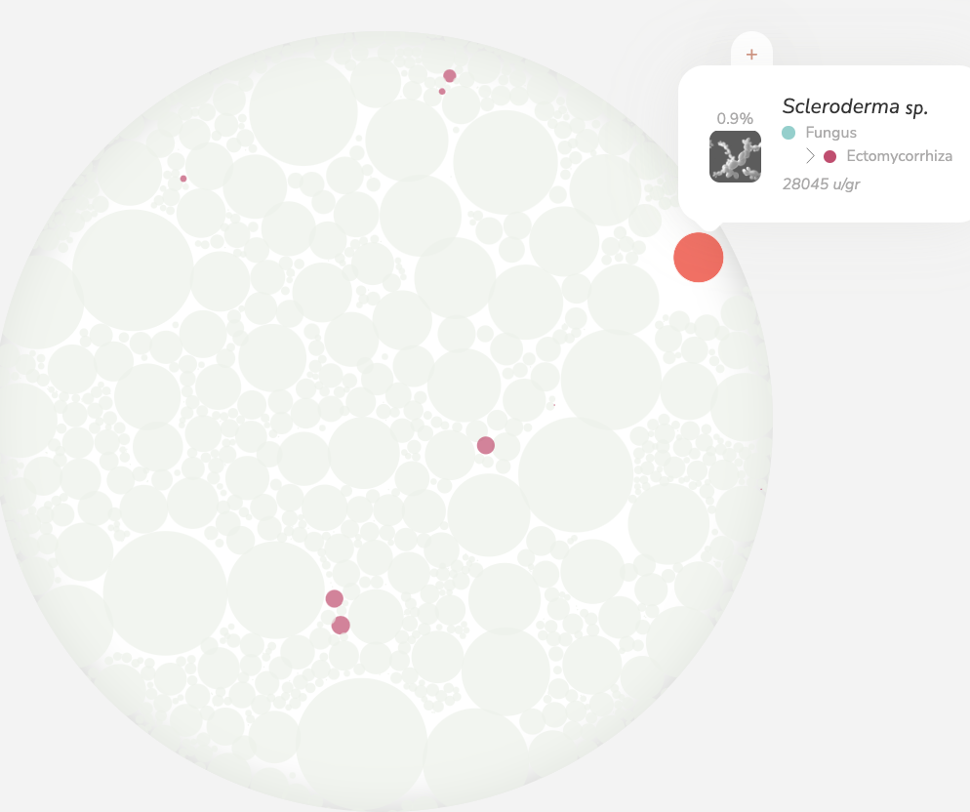
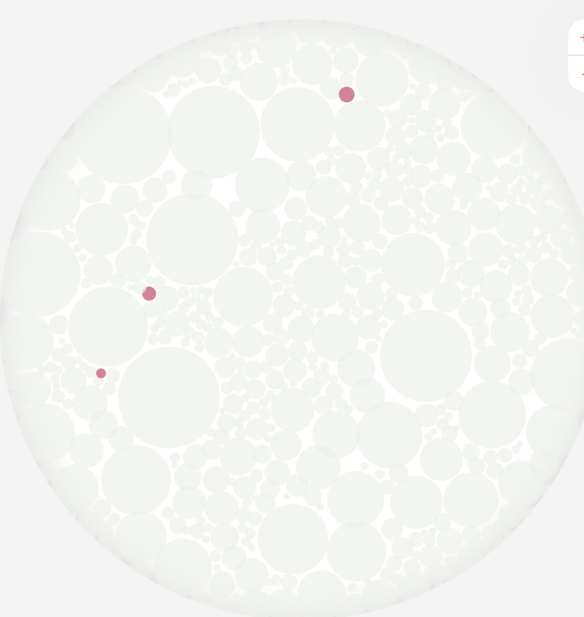
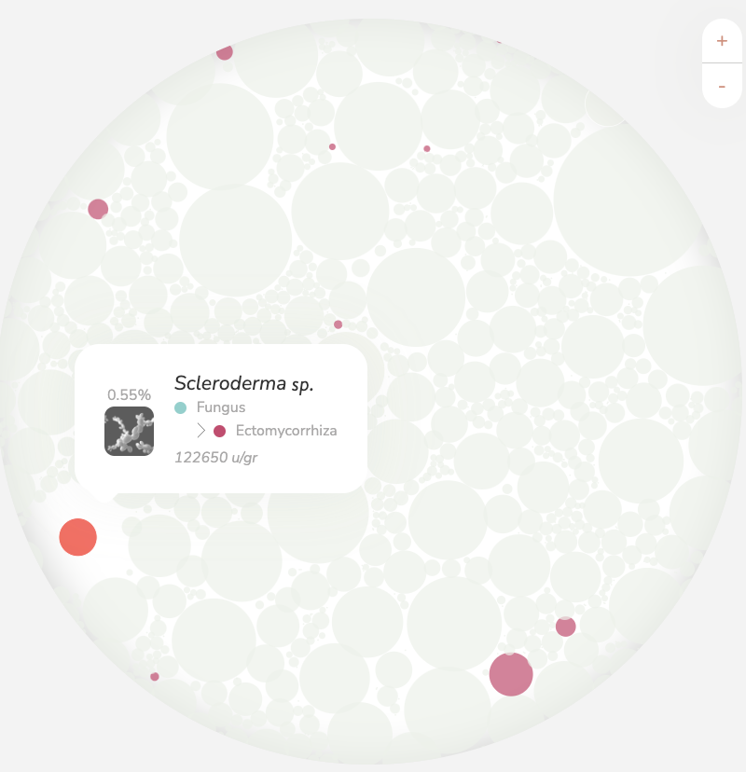
Evolution of the Ecotomycorrhiza population in REGENERATIVE plots
PRE – 2/2021 Fall 2021 Summer 2022 Summer 2023
<< Winter fallow. Citrus Planted 4/8/2021

