Slide 1
Monitoring the soil water balance
INs
OUTs
Storage
P + IRR = ET + R + DP + ΔS
Precipitation
Irrigation
Surface runoff
Deep percolation
Soil water storage
Evapotranspiration
Soil water balance related monitoring equipment
Data loggers accessed at surface
Soil moisture
Soil water potential
Shallow
Deep
Flux (below root zone)
Groundwater levels
Applied water
Precipitation
Evapotranspiration
Infiltration rate
Soil type analysis across depths
Irrometer
1 ft
Soil moisture probe
2 ft
3 ft
Soil water potential probe
Lysimeter
4 ft
5 ft
Monitoring well
6 ft
Water table
7 ft
***not quite to scale but close….

Slide 2
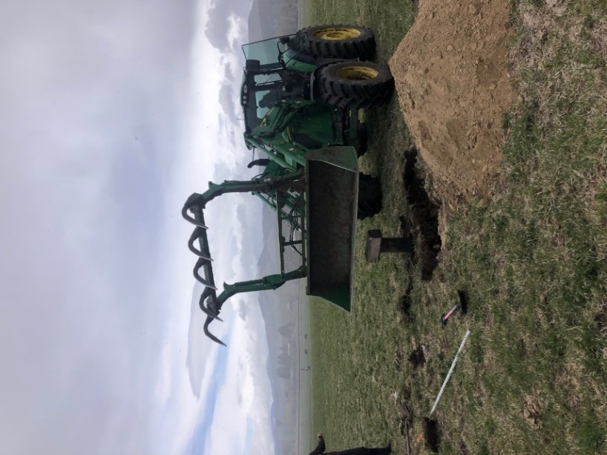
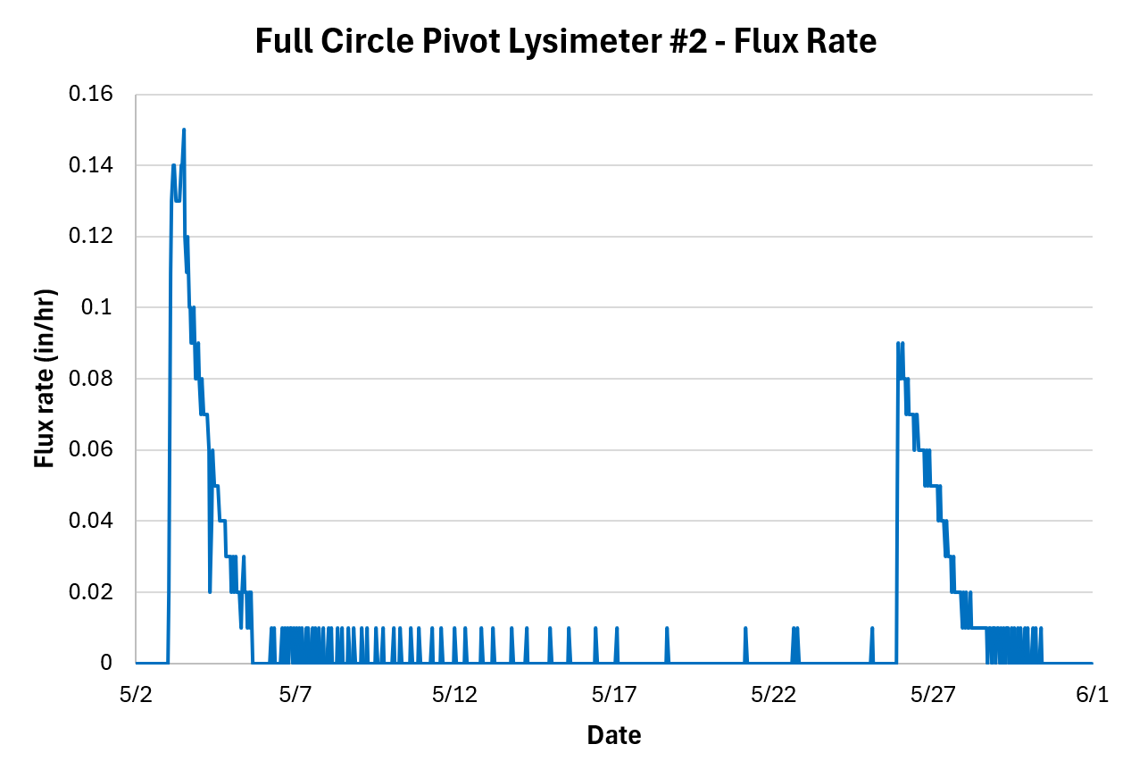
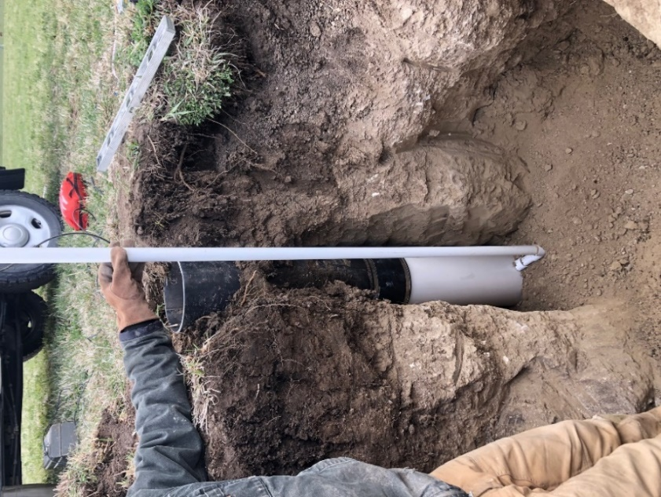
Passive wick lysimeters
PVC pipe routing tipping bucket to data logger at surface
20” hanging wick
Undisturbed soil
Design
Steel mesh protection
Plexiglass plate
8” diameter – 24 “ long steel divergence tube
Drain hole
Diatomaceous earth
Tipping bucket gauge
Spread wick fibers
lysimeter – a device that measures water movement in the soil (vadose zone)

