Slide 1
Average Daily Production per Cow:
Prior to our study there were numerous antidotal estimates of what Grass-fed farmers were producing. Below is the results over 2017 and 2018. There was a wide variation between our 22 herds. From a high of nearly 60 pounds per cow to a low of 14 pounds per cow

Slide 2
Milk Quality was important to our farmers. They received quality premiums the same as other dairy farmers. Farms below the Black (Maple Hill) and Green lines (Organic Valley) received premiums. Monthly reports back to our farms became a reminder whether they were leaving any money behind and how far were they from achieving the premiums.

Slide 3
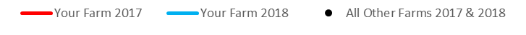
Milk Urea Nitrogen or MUN was a good way to observe how the diet of the grass-fed cow was being affected by the high protein – low energy diet. Average ranges between 10-15 are considered healthy. Higher ranges indicate the rumen is not able to handle the high protein (which is synonymous with Nitrogen). This can affect the health of the cow’s liver.
We expected higher readings. These results became a strong focus of the NIFA Grant written as a follow up grant to this one.

