Slide 1
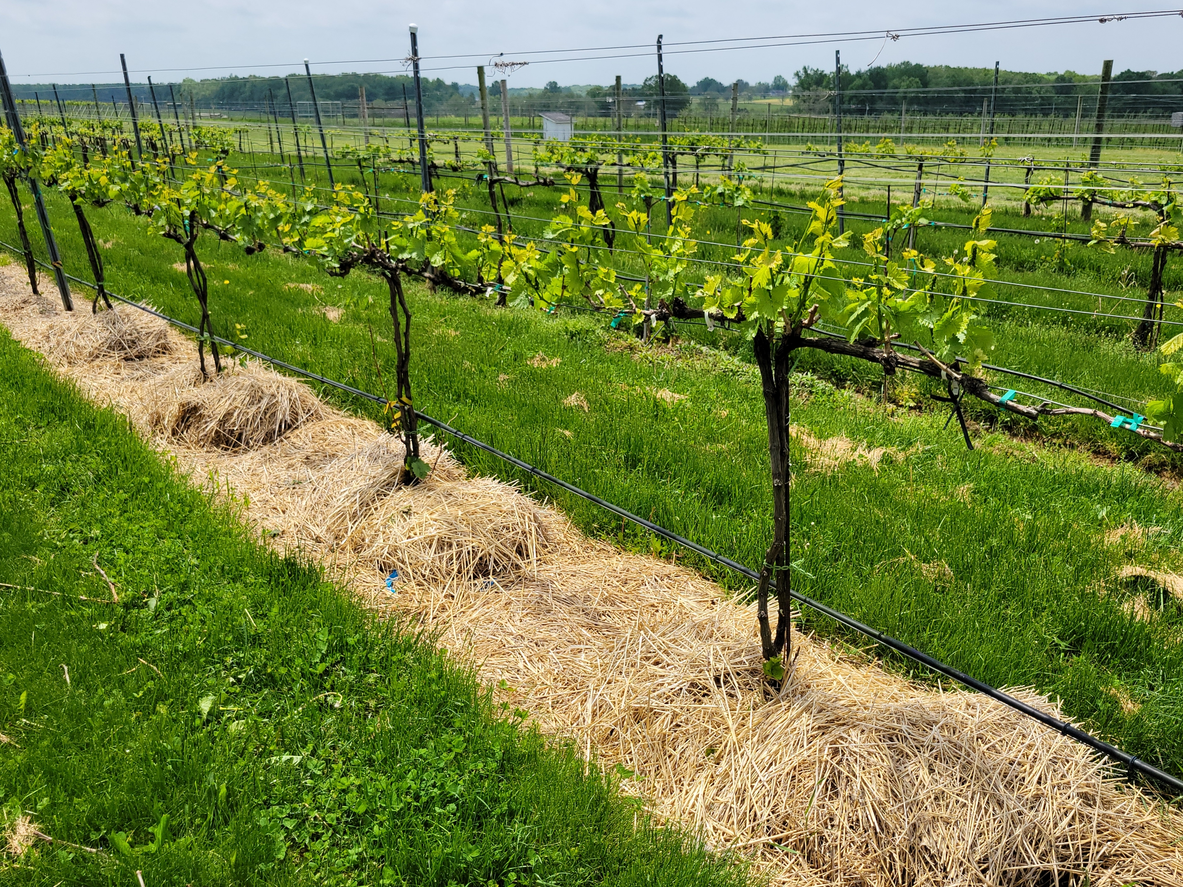
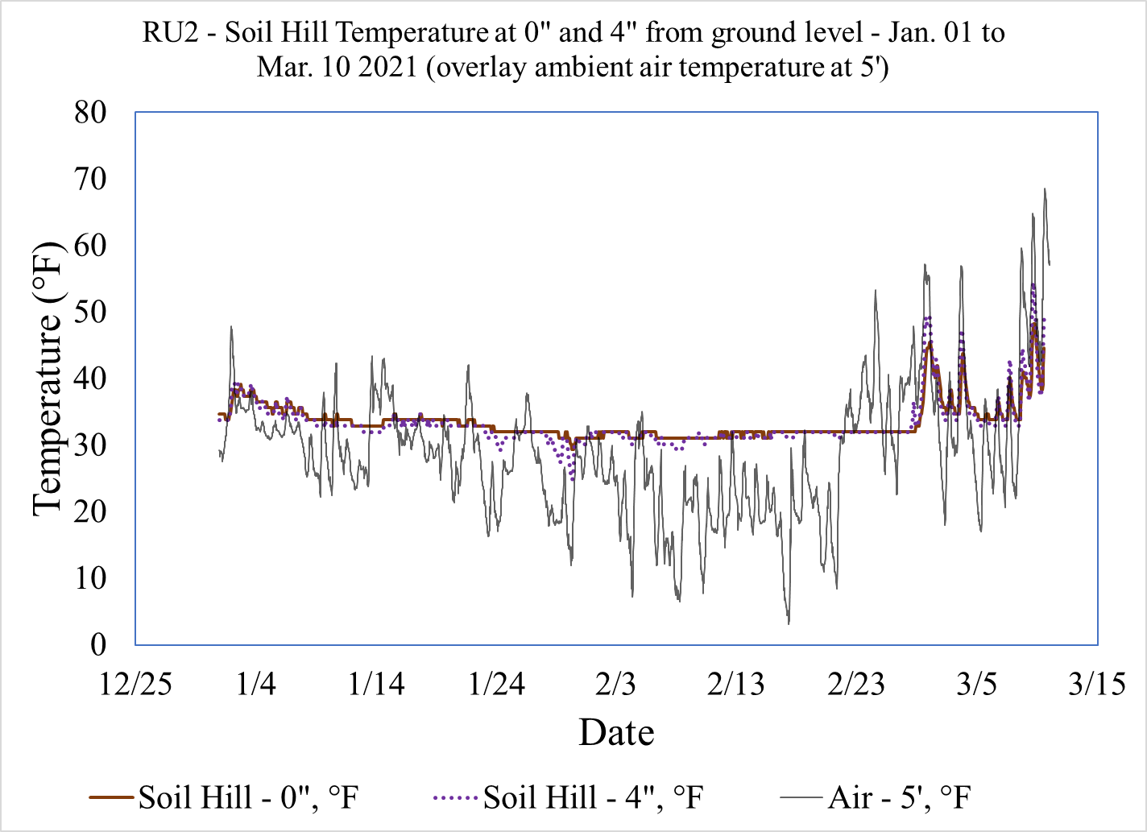
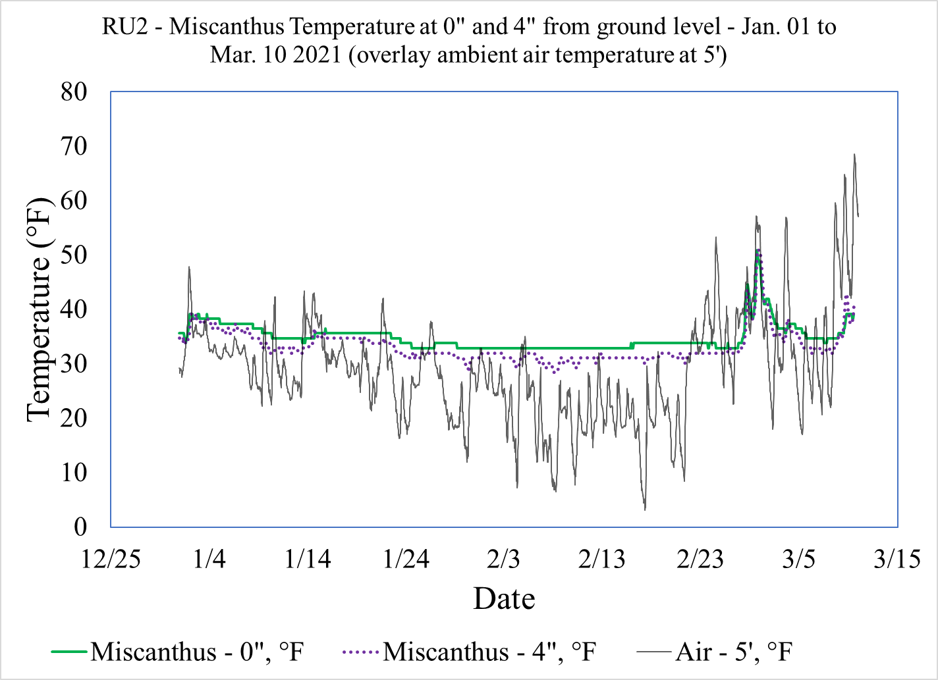
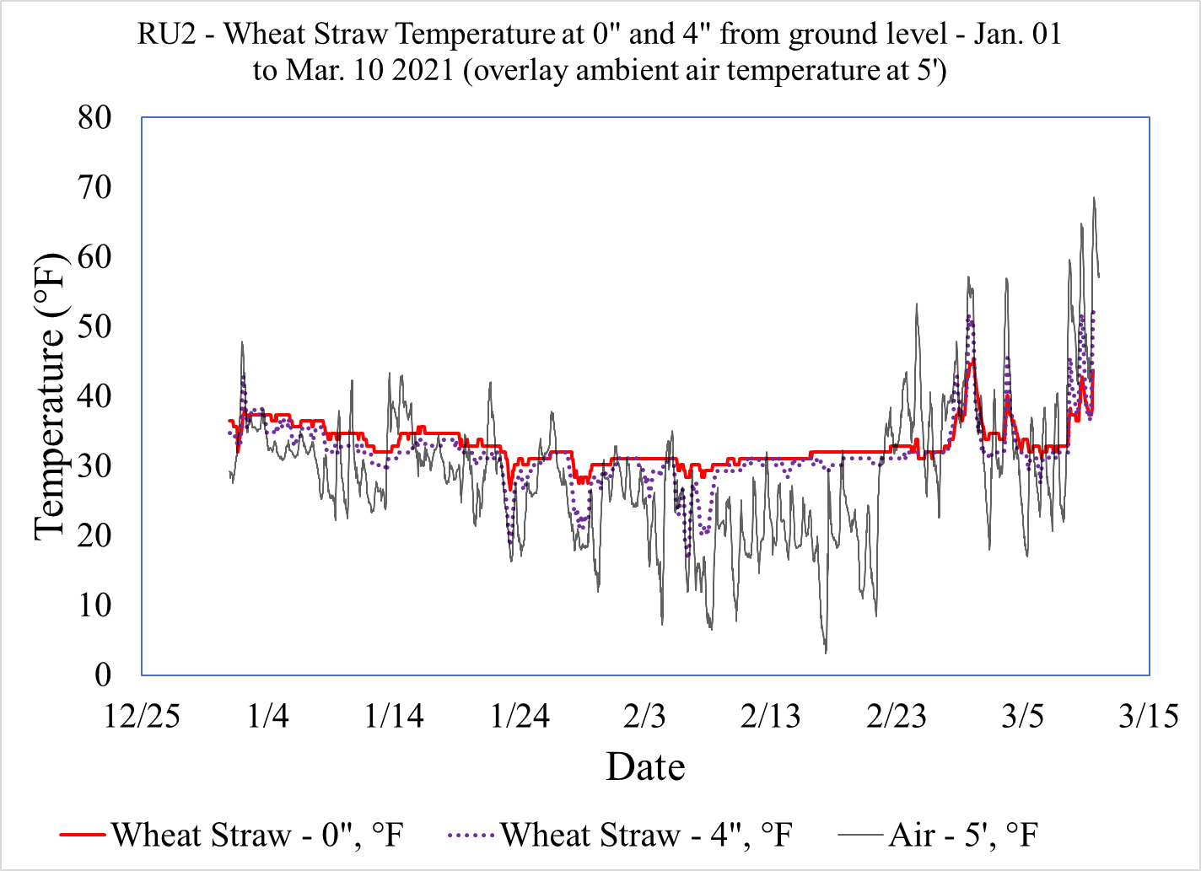
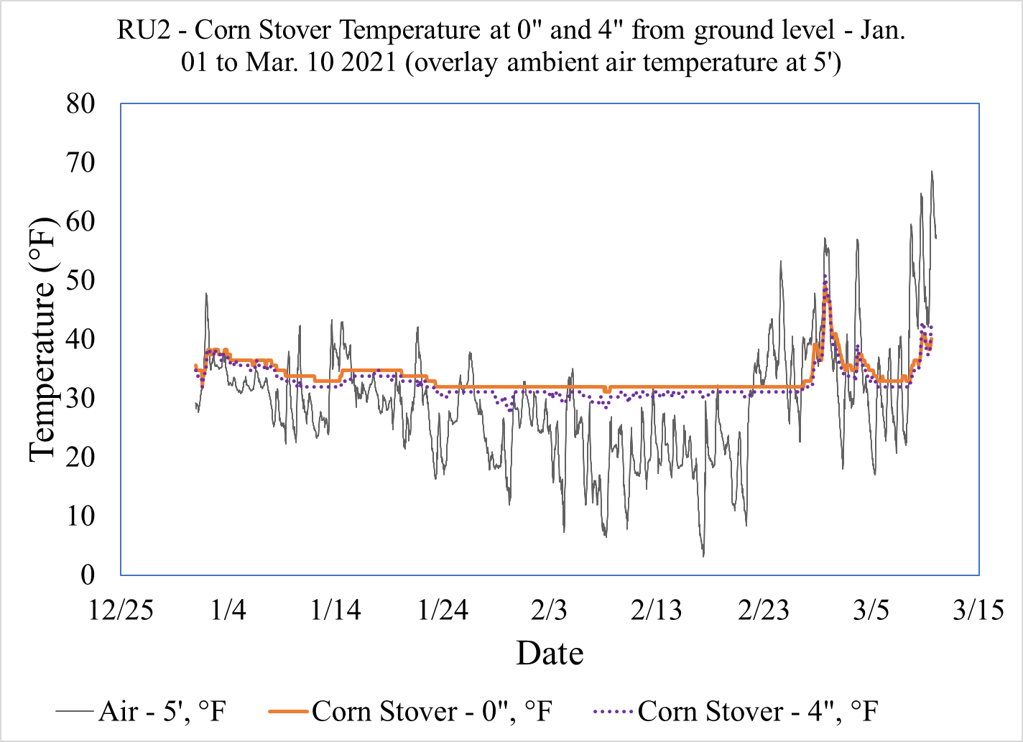
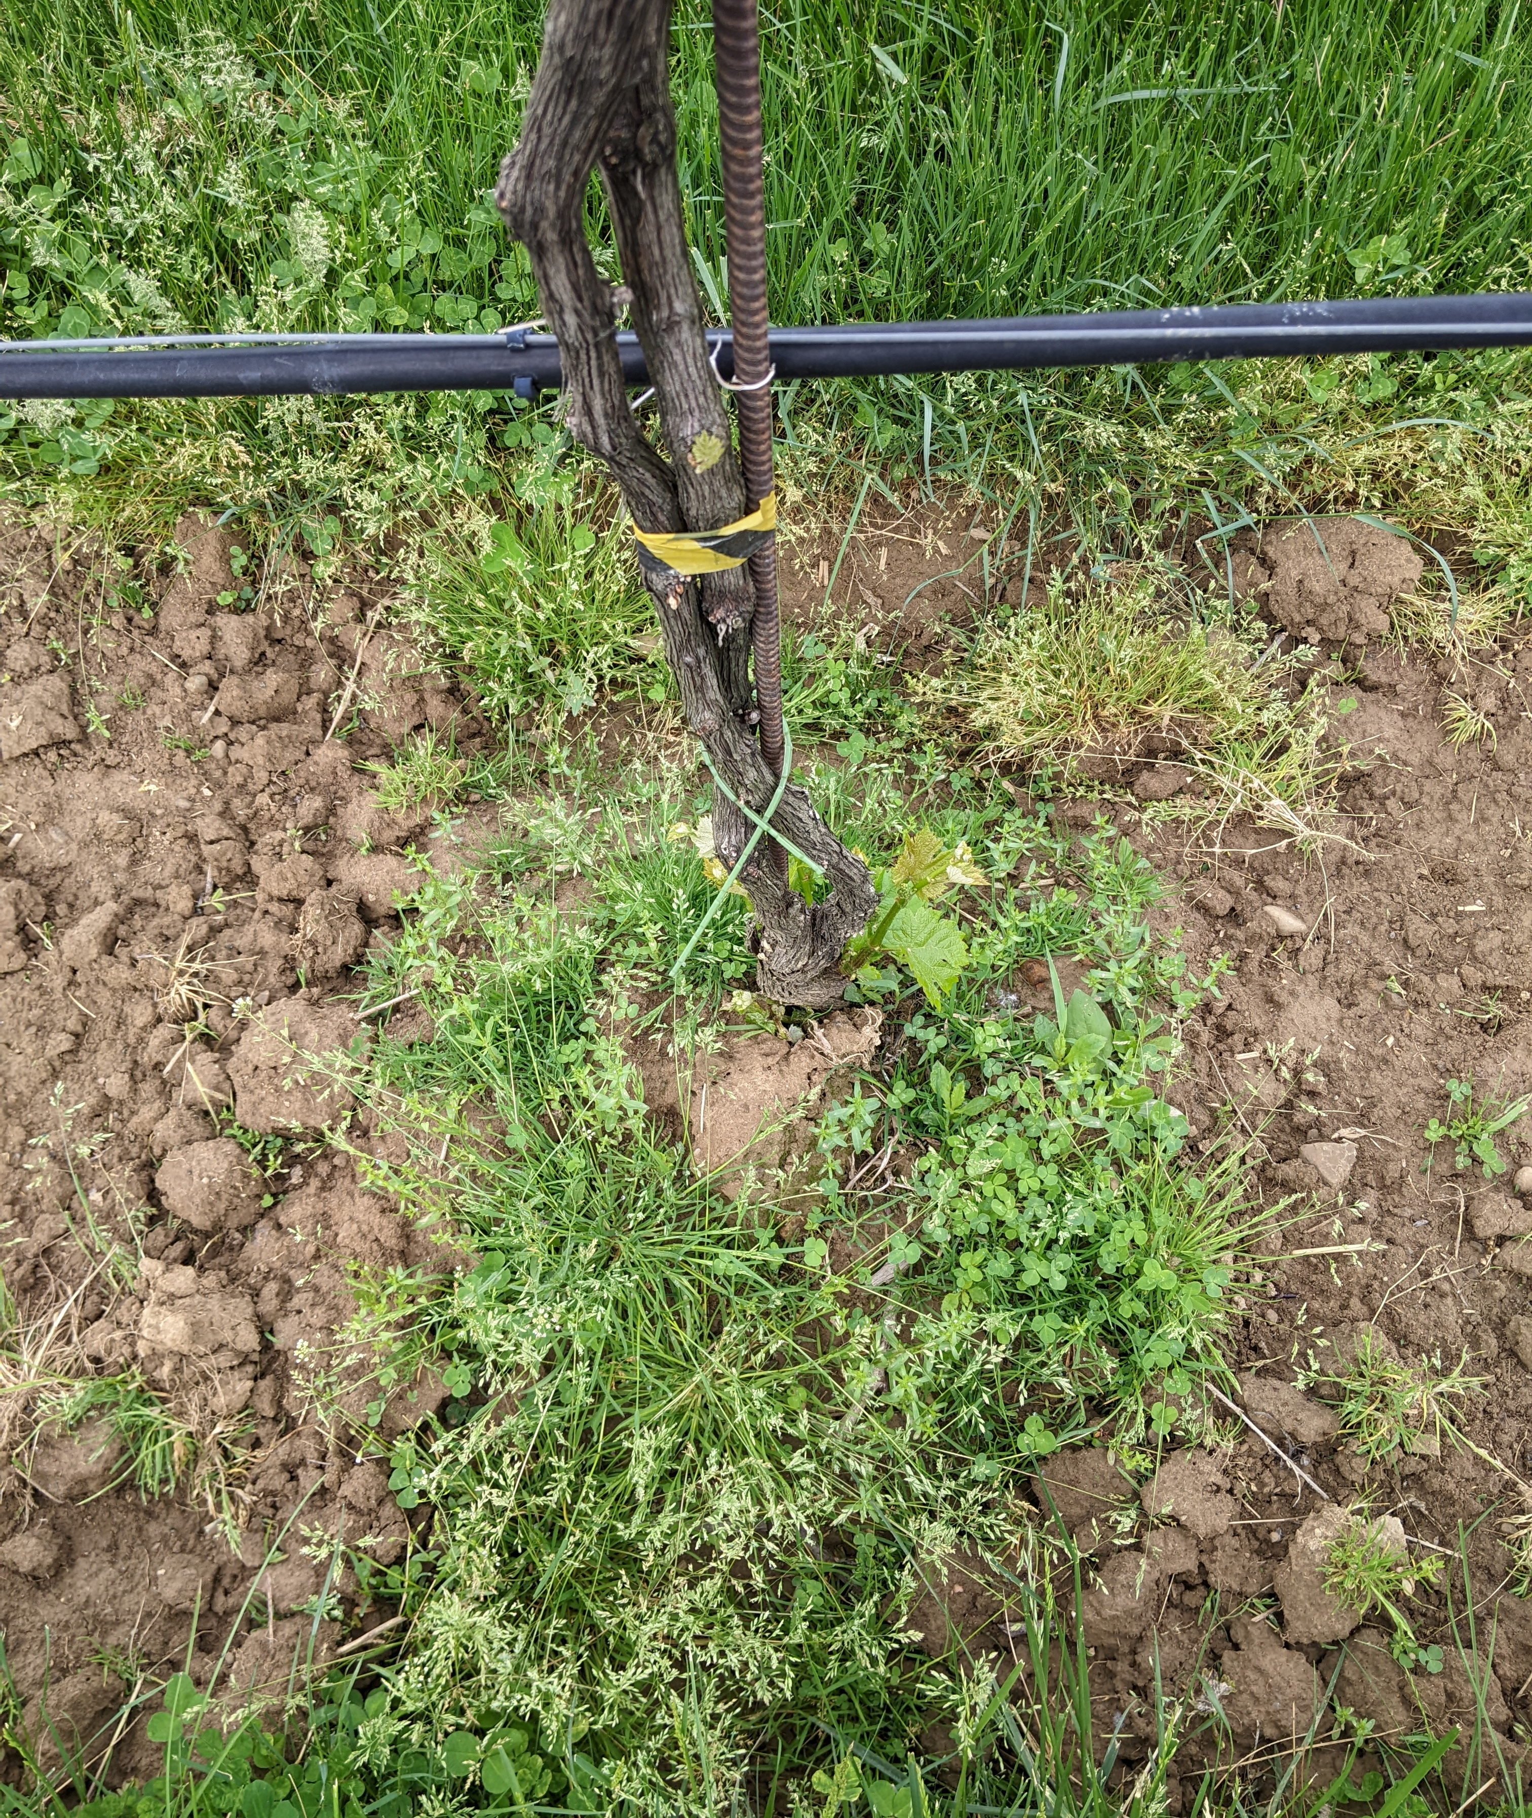
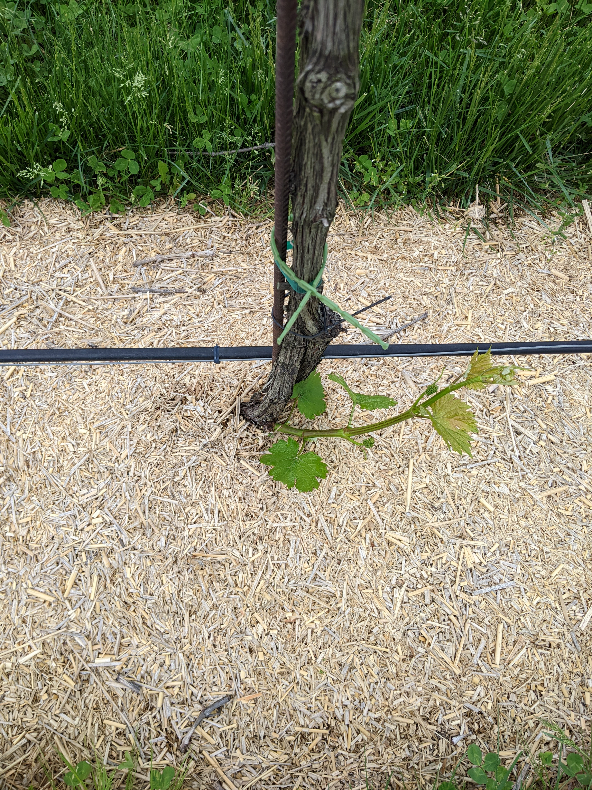
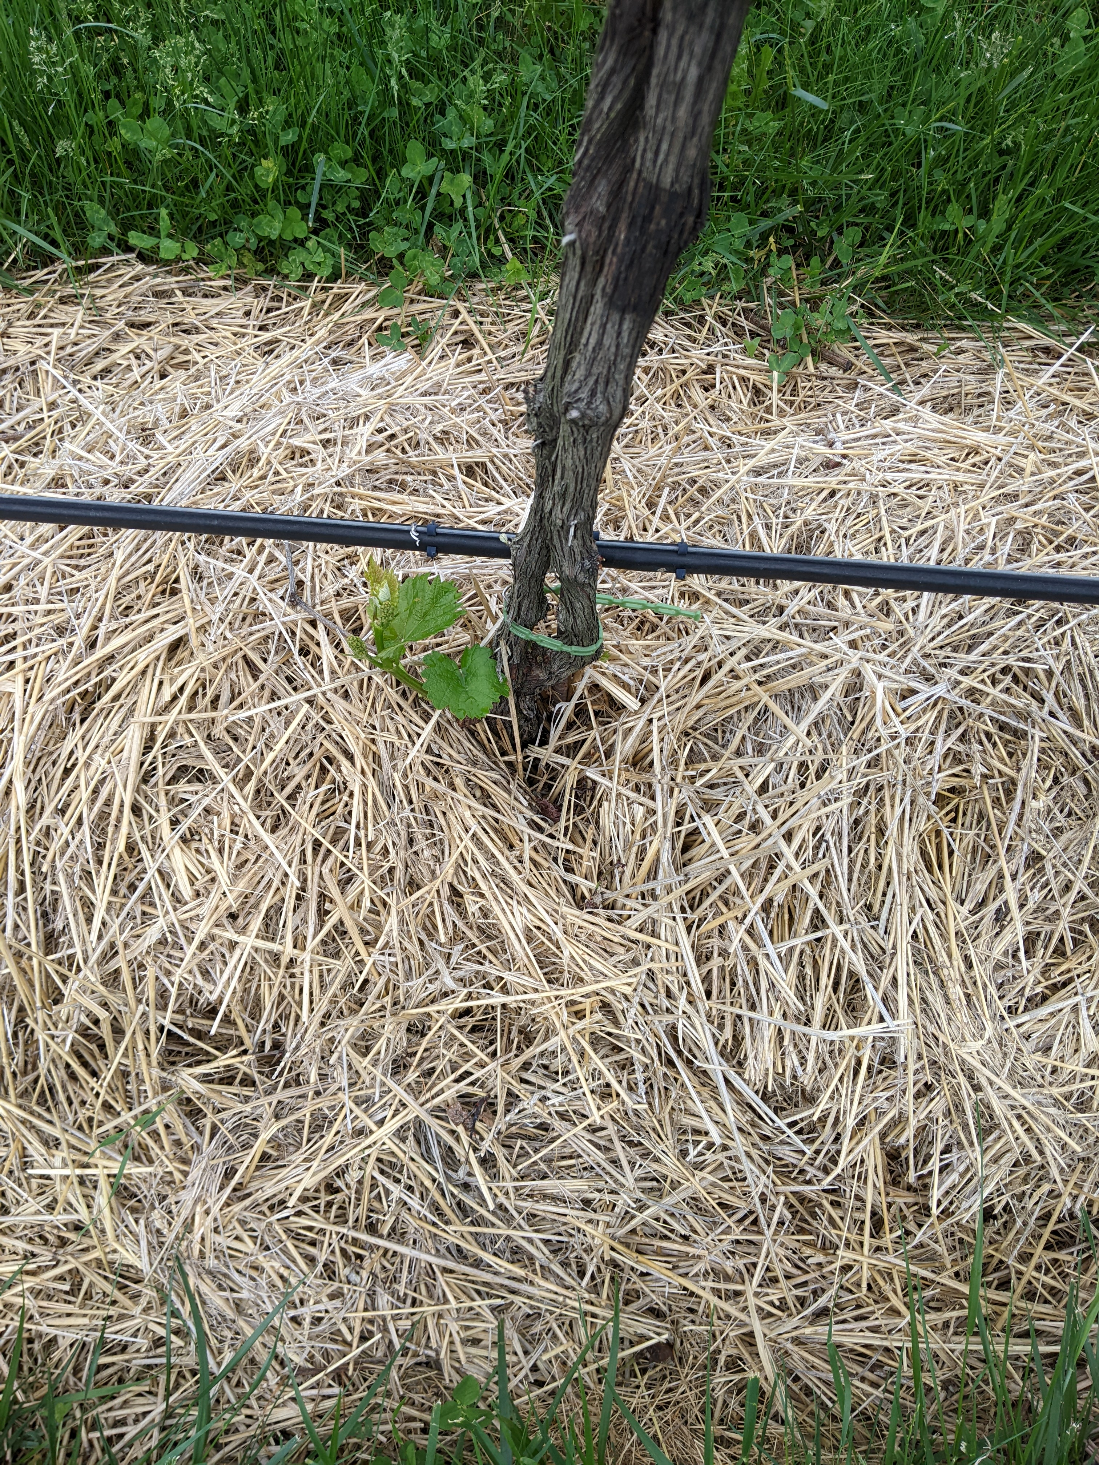
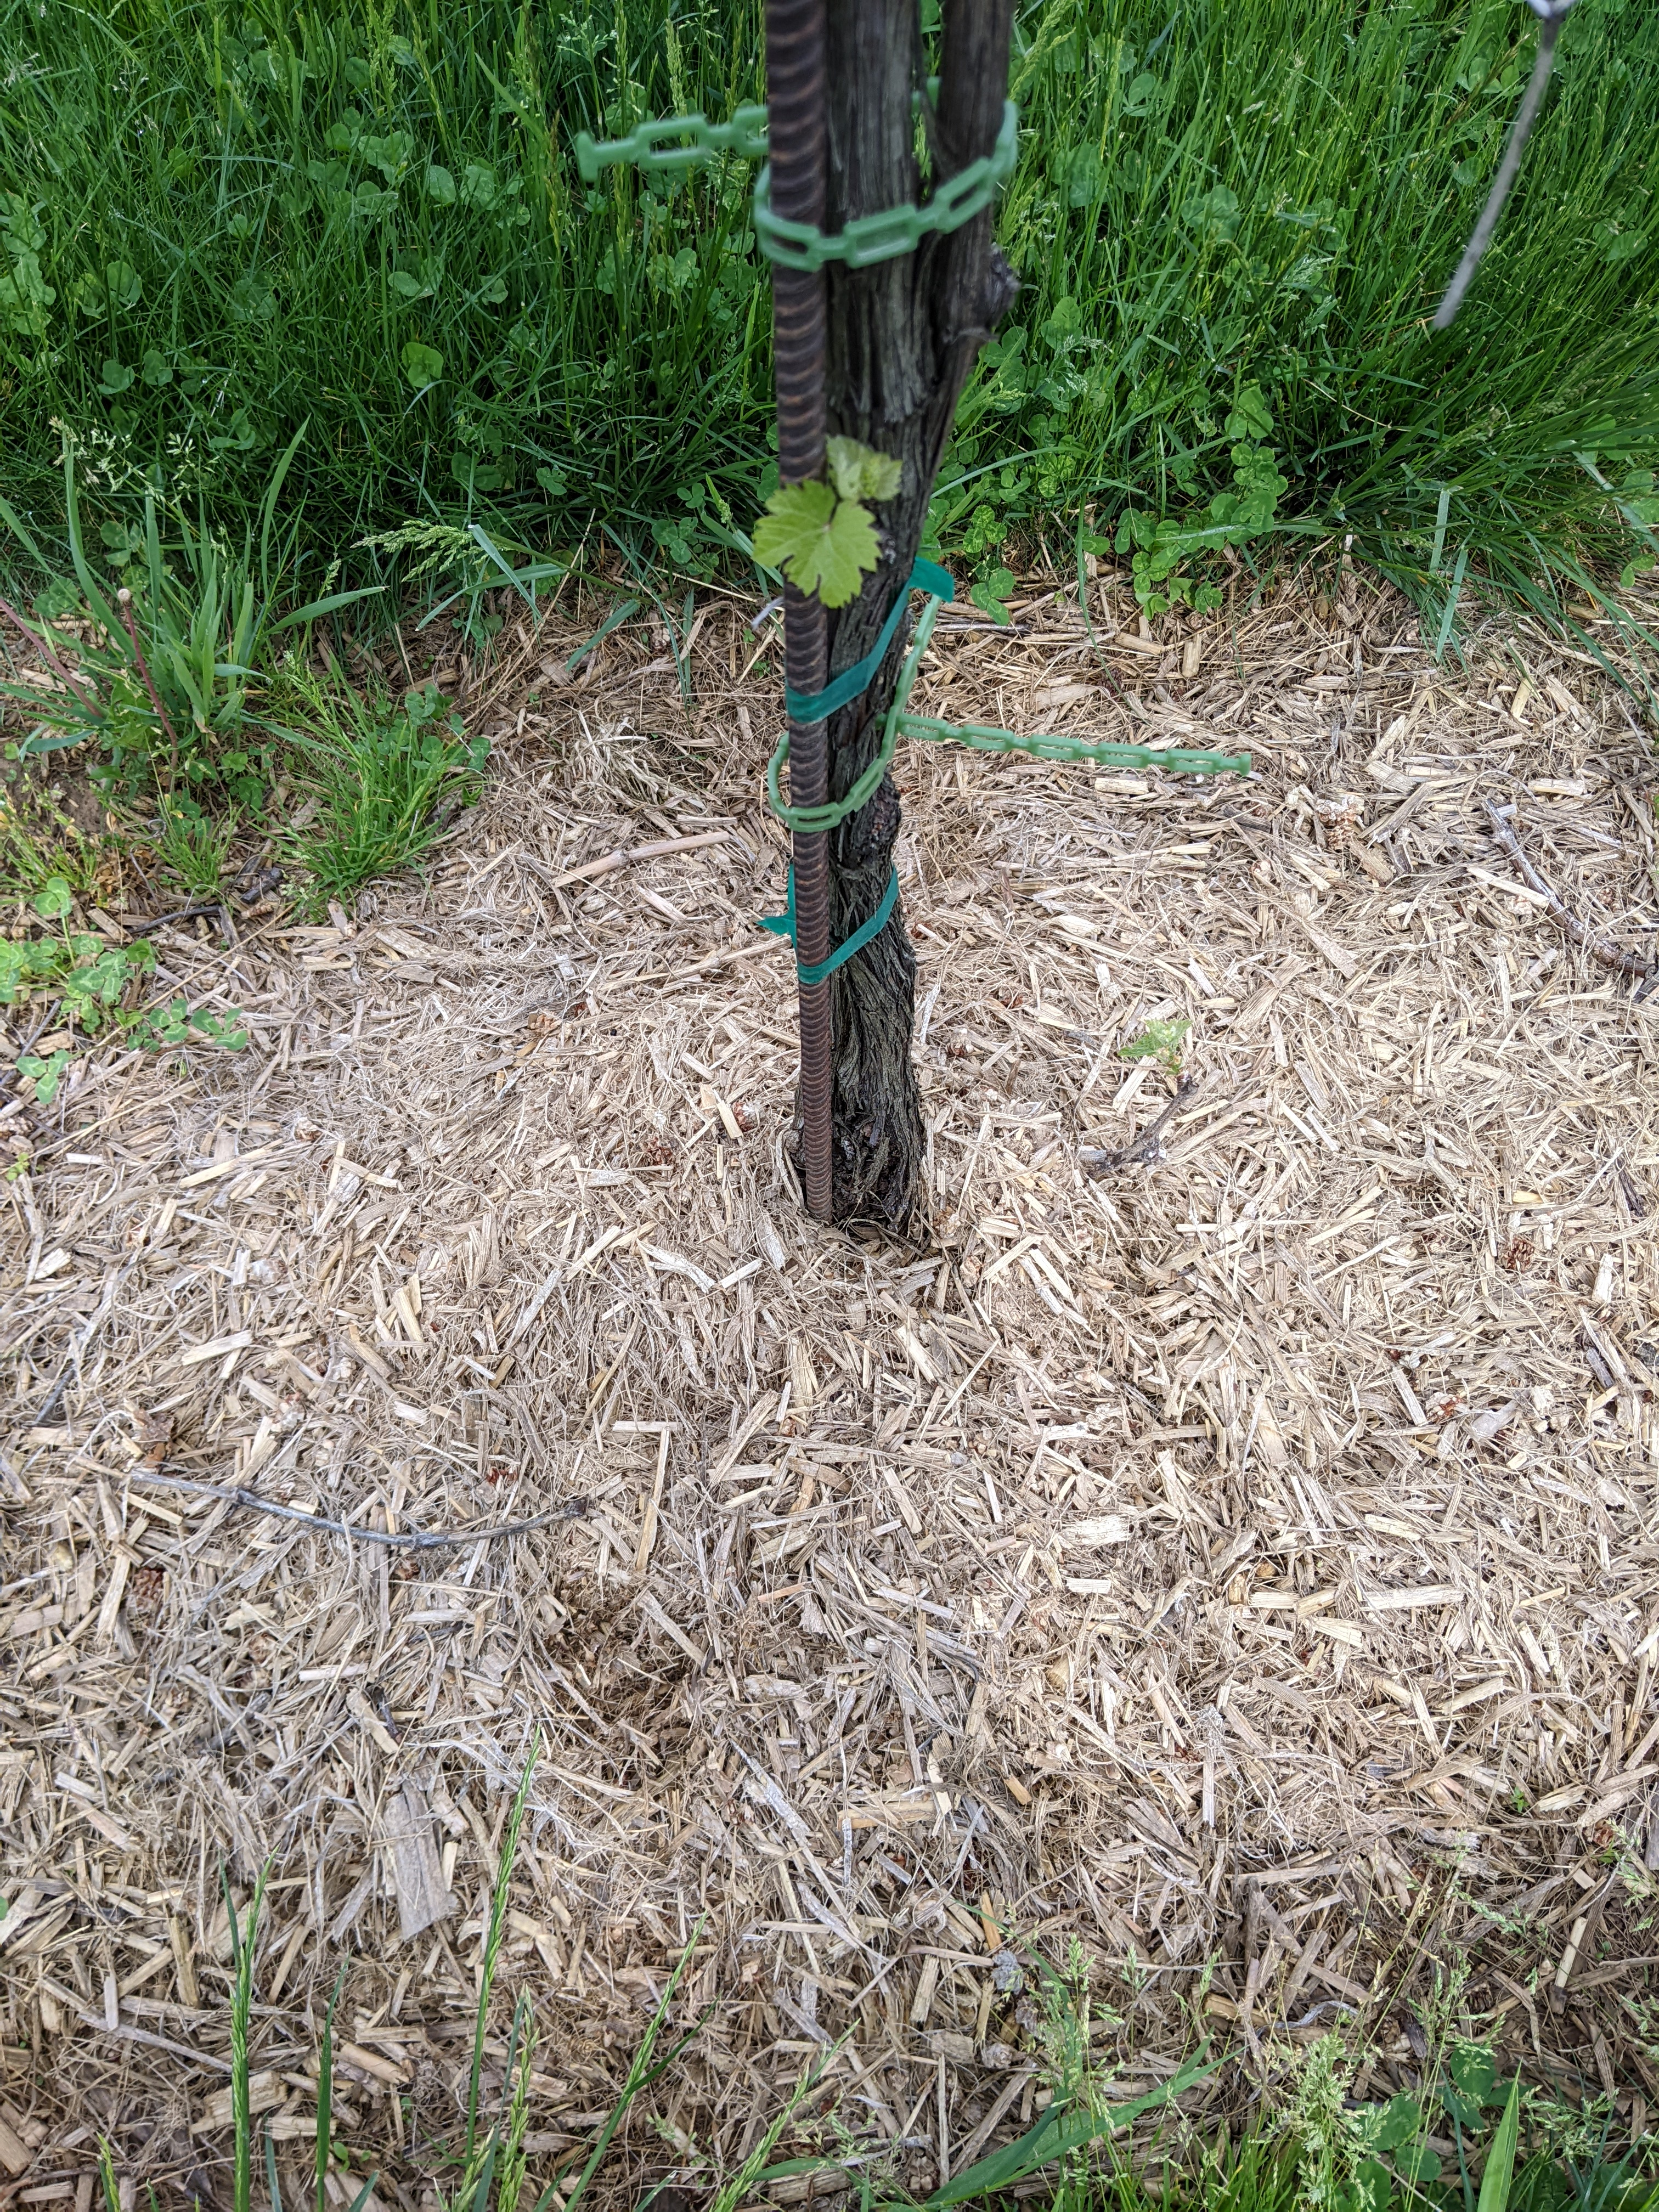
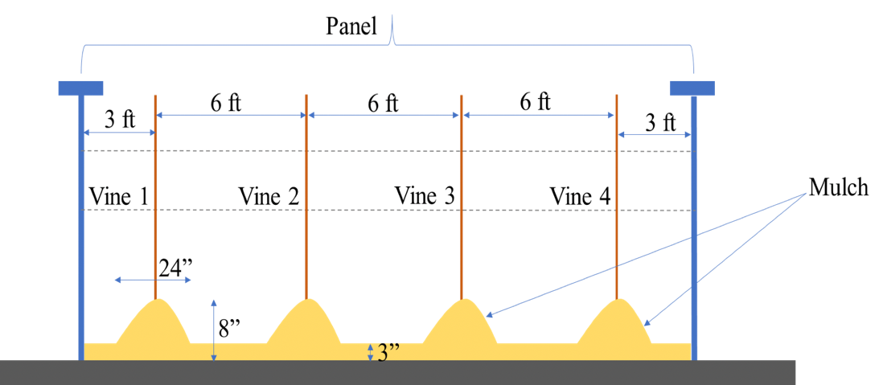
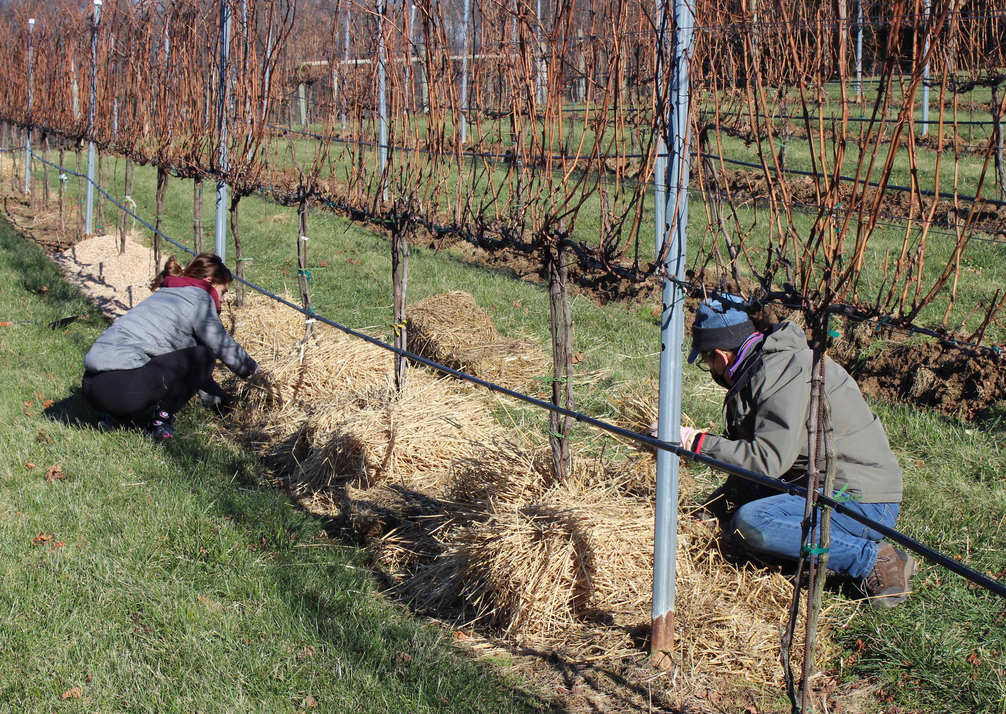
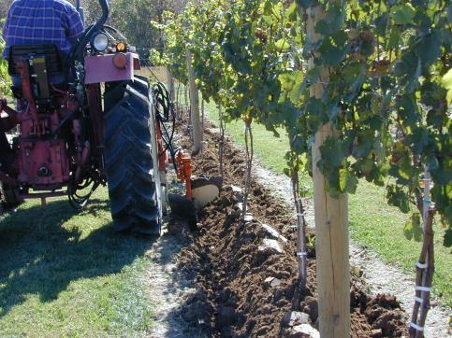
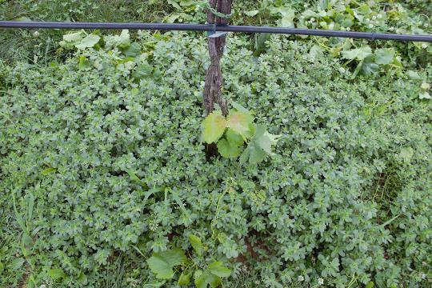
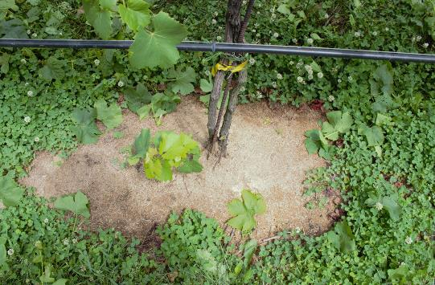
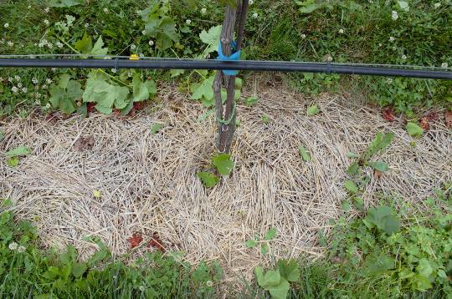
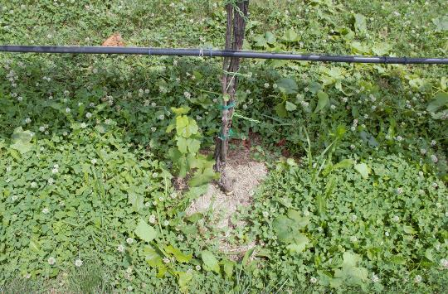
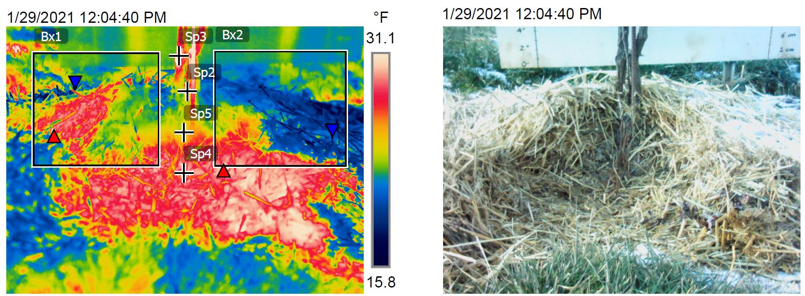
Vineyard Mulching Offers Many Benefits Beyond Winter Protection
Imed Dami¹, Cathy Herms¹, Megan Soehnlen¹, Diane Kinney¹, Anirudh Akula² & Ajay Shah²
¹Horticulture & Crop Science or ²Food, Agricultural & Biological Engineering, The Ohio State University/OARDC, 1680 Madison Ave., Wooster OH 44691
Context & Purpose
Impact of Mulching on Soil Compaction
Grapevines are susceptible to freezing damage at temperatures below -20°C. Preventing winter injury is a major challenge in many cold regions of the U.S. Hilling-up soil over the vine graft union is a conventional method for preventing winter vine loss. However, this practice can cause soil erosion, vine damage and crown gall development. We evaluated the method of mulching with organic materials as a sustainable alternative to soil hilling for winter protection of grafted grapevines in Ohio.
(a)
(b)
By the third summer following mulch application, mulching reduced soil compaction compared with soil hilling at a depth of 2” (Figure 8).
Methods
Plant-based mulches (miscanthus, wheat straw, corn stover) were compared to soil hilling (Figure 1 & 2) at two Ohio vineyard sites (Wooster, Geneva).
For mulch treatments, mulch was applied in November 2019 and re-applied in December 2021. For soil hilling treatments, soil was hilled 8” around the vines each December and de-hilled the following April.
Temperatures were monitored at 0” and 4” above ground level within the soil and mulch mounds around the grapevine from November 2019 to March 2021 and compared with ambient temperature monitored at 5’ above the ground.
Other data collected included weed cover, soil moisture, soil compaction, vine yield and fruit quality.
(c)
(d)
Figure 8. Soil compaction (PSI) from 2” to 10” depth in soil-hilled treatments compared with those that were mulched in July 2022. Note: Columns with different letters are significantly different from each other.
Figure 4. Temperature at 0” and 4” above the ground for soil hilling (a), miscanthus (b), wheat straw (c), and corn stover treatments (d). Note: Colored lines indicate temperature at 0” to 4” aboveground. The black line indicates air temperature.
Impact of Mulching on Yield & Fruit Quality
(a)
(b)
(c)
(d)
Grapevine yield (Table 1) and fruit quality (Table 2) of Regent did not differ between soil-hilled and mulched treatments.
Fruit pH was slightly lower for mulched vines compared to those that were soil-hilled (Table 2).
Impact of Mulching on Weeds
Table 1. Yield of Regent in the soil-hilled compared with mulched treatments in 2022. Note: For each variable, means with different letters are significantly different from each other.
Figure 1. Example of a grapevine that was hilled/de-hilled (a) compared with one that was mulched with miscanthus (b), wheat straw (c) or corn stover (d).
Weed cover was lower in grapevine panels that were mulched compared to those that were hilled even two summers after mulching (Figures 5 & 6).
Corn stover decayed more quickly than miscanthus and wheat straw, providing less of a barrier to weed growth.
Treatment | Cluster No./ Vine | Crop Weight/ Vine (lb) | Yield (t/a) | Cluster Weight/ Vine (lb) | 100-Berry Weight (g)
Soil Hill | 35 | 13.5 | 5.4 | 0.39 | 249
Miscanthus | 34 | 11.8 | 4.7 | 0.35 | 254
Wheat Straw | 36 | 12.8 | 5.2 | 0.35 | 253
Corn Stover | 35 | 13.1 | 5.3 | 0.37 | 247
Significance (p-value) | 0.56 | 0.30 | 0.30 | 0.18 | 0.74
(a)
(b)
(c)
Figure 5. Weed cover (%) in soil hilling vs mulching treatments in summer 2021. Note: Columns with different letters are significantly different from each other.
Table 2. Fruit quality of Regent in the soil-hilled compared with mulched treatments in 2022. Note: For each variable, means with different letters are significantly different from each other.
Treatment | SS (%) | pH | TA (g/L) | SS/TA*10
Soil Hill | 19.9 | 3.3 a | 7.2 | 28
Miscanthus | 19.5 | 3.0 b | 7.3 | 27
Wheat Straw | 19.8 | 3.0 b | 7.2 | 28
Corn Stover | 20.0 | 3.0 b | 7.0 | 29
Significance (p-value) | 0.40 | 0.02 | 0.19 | 0.20
Figure 2. A plot consisted of a panel with 4 vines (a). For mulching treatments (b), mulch was applied to a depth of 8” around the vine and 3” between vines in fall 2019, with some re-application in fall 2021 to maintain the desired mulch heights. For soil hilling treatments (c), soil was hilled to a depth of 8” uniformly across the panel each fall and de-hilled each spring.
(a)
(b)
(c)
(d)
Results
Figure 6. A grapevine from a panel that was hilled (a) compared with one that was mulched with miscanthus (b), wheat straw (c) or corn stover (d).
Impact of Mulching on Temperature around Grapevines
During the study period, the lowest air temperature recorded at each study site was 3°F.
Mulches provided adequate winter protection to the grapevine graft union similar to soil hilling (Figures 3 & 4):
Temperatures under the soil and mulch treatments were warmer at ground level (0”) than at 4” above ground.
During the coldest winter period, temperatures under the soil hills and mulch mounds remained constant and above 28°F.
Impact of Mulching on Soil Moisture
Summary
Mulching increased water retention in the soil compared to soil hilling, which would make vines less susceptible to water stress during periods of drought (Figure 7).
Mulch treatments provided similar thermal protection for grapevines as soil hilling during the winter months.
Mulching reduced weed problems in the vineyard compared with hilling.
Soil properties such as moisture and compaction were improved when using mulches as compared to soil hilling.
Mulches did not have any negative effect on yield or fruit quality.
In summary, mulching for winter protection provides additional benefits compared with soil hilling and should be considered in commercial vineyards to create a more sustainable grape production system.
Sp3 (trunk) | 32.5 °F
Sp2 (graft union) | 27.1 °F
Sp5 (graft union) | 24.8 °F
Sp4 (surface below mulch) | 29.6 °F
Bx1 (min.) | 8.0 °F
Bx1 (max.) | 31.5 °F
Bx2 (min.) | 15.1 °F
Bx2 (max.) | 30.1 °F
Figure 7. Soil water content (%) from 1.5 to 8” depth in soil-hilled treatments compared to mulched treatments in July 2022. Note: Columns with different letters are significantly different from each other.
Acknowledgements: This project was funded by a SARE Research and Education Grant (LNC19-417).
Figure 3. Thermal imaging of the winter insulation provided by wheat straw in January 2021.

