Slide 1
Grain and forage yield of “Kernza” managed as a dual-purpose crop
Jeremie Favre¹, Nicole Tautges² and Valentin Picasso¹
¹ University of Wisconsin-Madison, Agronomy Dept.
² University of Minnesota, Agronomy and Plant Genetics Dept.

Slide 2
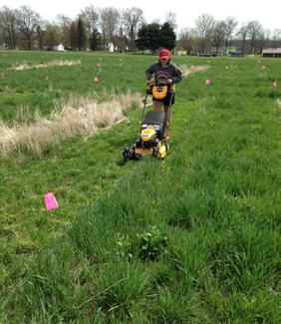
“Kernza dual-use = double the fun”
Why dual-purpose?
Additional source of income from forage
Reduce the decline in grain yield after year 1?
Maximizing the use of the crop
Preliminary data shows that grain yield is not affected by a spring or a fall forage harvest.

Slide 3
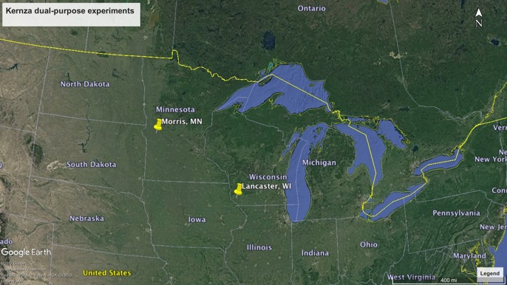
Experiment locations
Agricultural research stations in
a) Morris, MN (4 acres)
b) Lancaster, WI (10 acres)

Slide 4
Management
Grain harvest from every plot
Vegetation (2 treatments):
a) Kernza monoculture
b) Kernza + legume intercrop
Grazing (4 treatments):
a) Spring grazing
b) Fall grazing
c) Spring and fall grazing
d) No grazing
Grain harvest
Planting
Grazing
Grazing
Sept Oct Nov […] April May June July Aug Sept Oct

Slide 5
Spring grazing
Before stem elongation!
 |  | Biomass above 4’’ (lbs/ac)
 |  | Kernza | Red-clover
Lancaster WI |  | 500 a | 130
Morris MN |  | 526 a | -
Grazing
Sept Oct Nov […] April May June July Aug Sept Oct

Slide 6
Grain harvest
 |  |  | Grain (lbs/ac)
Vegetation | Lancaster, WI | Kernza + N | 838 a
 |  | Kernza + red-clover | 697 b
 | Morris, MN | Kernza | 268
No effect of spring grazing!
Grazing
Sept Oct Nov […] April May June July Aug Sept Oct

Slide 7
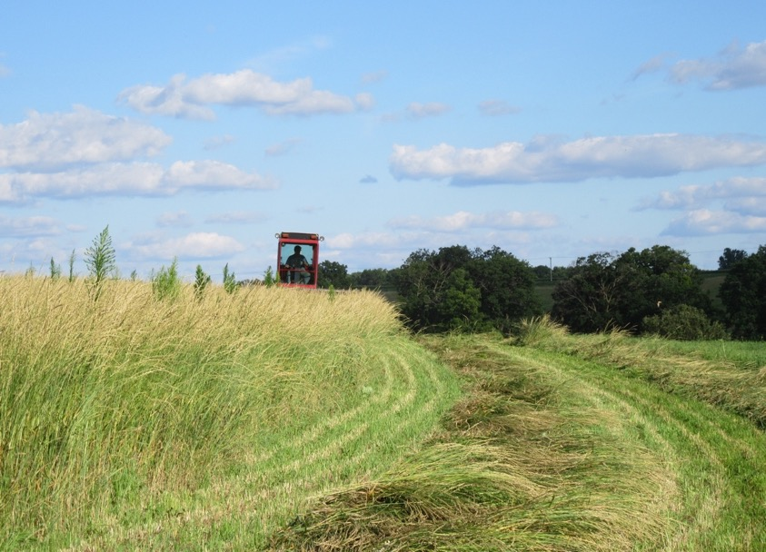
Summer forage
 |  | Biomass (lbs/ac)
 |  | Kernza | Red-clover | Weeds
Lancaster, WI | AVG | 7557 | 1804 | 339
Morris, MN | No grazing | 1842 | 46 | 1072 b
 | Spring grazing |  |  | 1865 a
No effect of spring grazing!
Grain harvest
Sept Oct Nov […] April May June July Aug Sept Oct

Slide 8
Fall grazing
 |  | Biomass above 4’’ (lbs/ac)
 |  | Kernza | Red-clover | Weeds | Total forage
Lancaster, WI | Kernza | 516 b |  | 163 | 680 b
 | Kernza + leg. | 552 a | 1744 | 21 | 2316a
Morris, MN | Kernza + leg. | 1958 | 38 | 11 | 2279
No effect of spring grazing!
Grazing
Sept Oct Nov […] April May June July Aug Sept Oct

Slide 9
Forage quality
Lancaster |  | Crude Protein (%) | NDF (%) | RFQ
Spring | Kernza | 23 | 42 | 230
Summer | Kernza | 5.6 | 73 | 65
 | Kernza + red-clover | 6.2 | 69 | 70

Slide 10
Conclusion
Spring grazing did not reduce grain yield, but increased weed biomass in Morris
Red-clover: trade-offs between grain yield and fall forage
2,000 lbs/ac of forage can be accumulated after grain harvest
Notes:
Spring grazing did not reduce grain yield, but increased weed biomass in Morris
Fall-planted red-clover reduced grain yield in Lancaster by 17% but tripled the amount of fall forage.
A forage production of 2.000 kg.ha⁻¹ after grain harvest can be achieved in a well fertilized monoculture stand with plenty of rainfall or with a legume intercrop.

