Slide 1
PASTURE SOIL COMPACTION
Fay Benson – Cornell COOPERATIVE Extension

Slide 2
TOPICS FOR TODAY
Identify indicators of soil compaction
How does compaction affect soil functions?
Remedies for compaction
About this grant and participation in compaction research

Slide 3
GRAZING HAS MAJOR IMPACT ON SOIL HEALTH
Either Good
Or Bad
Notes:
List the goods: Tall grass with deep roots provides: Adequate Feed per bite reduces walking, Soil protection from drying, and soil runoff. Rainfall percolation, Wildlife diversification helps with active biological cycle
The Bad: Over grazing leads to exposed soil which allows less water retention, less feed available/acre. Water does not percolate

Slide 4
GRAZING COVERS THE FIVE PRINCIPLES
Principle 1: Soil Armor Or Cover
Principle 2: Minimizing Soil Disturbance
Principle 3: Plant Diversity
Principle 4: Continual Live Plant/Root
Principle 5: Livestock Integration
Notes:
Armor- protects from sun, rain, wind, No Disturbance maintains soil infrastructure, Diversity comes from seed bank, provides variable microbe interaction.
Continual live roots provides energy transport from sun to microbes. Livestock integration provides faster carbon break down, faster return of macro nutrients to plants.

Slide 5
My First Epiphany to Pasture Compaction Issue
My Second Epiphany was that the Farmer Never Noticed It
Compaction is a Slow and Furtive Action
Is a Disturbance to the Soil
Notes:
Compaction happens over decades. Most farmers don’t realize they have it. Not only the functions of soil are impacted but also the types of plant which grow change.

Slide 6
NE SARE GRANT- “IDENTIFICATION AND REMEDIATION OF COMPACTION ON NORTHEAST PASTURE SOILS”
Convene educators from the Northeast for a Train the Trainers on soil compaction
Provide educators with funds and equipment (Soil Health Trailer) for on farm education on soil compaction
Enlist farmers and educators to collect data for
Pasture Compaction Ratio (PCR)

Slide 7
EDUCATORS RECEIVED: ½ DAY OF CLASSROOM ½ DAY IN THE PASTURE
Notes:
Two locations: Had educators from Maine, Vermont, New Hampshire, Pennsylvania, and NY

Slide 8
PASTURE EVENTS - 2019
Wolfe's NECK FARM, MAINE
Musgrave Organic Field Days, Aurora NY

Slide 9
PASTURE EVENTS - 2019
Grasstravaganza – Cobleskill, NY

Slide 10
WHERE IT COMES FROM
Animal hooves can exert pressure up to 200 kPa, (29 psi) which is considerably greater than the pressure exerted on the soil surface by a tractor, which can range from 30 to 150 kPa (5-21 psi)
(Profitt et al. 1993).

Slide 11
YOU CAN IMAGINE THE COMPACTION FROM RUNNING

Slide 12
WHY IS COMPACTION A PROBLEM?
“Is a problem when the increased soil
density and the decreased pore space limit water infiltration,
percolation, and storage; plant growth; or nutrient cycling.”
Rangeland Soil Quality—Compaction
USDA, Natural Resources Conservation Service May 2001
Notes:
When we see water movement problems it also means there is a problem with air movement

Slide 13
SOIL PORES WITHIN THE SOIL AGGREGATE
Aggregate Stability is
important for:
Small pores hold water for times of drought
Keep biology aerobic 45bil/T spoon)
Large pores allow water and air to move freely
Notes:
Challenge to grasp the concept that there are 4-5 Billion living things in a Porosity relates to aeration, Water availability, permeability, root growth
Biological habitat

Slide 14
Demonstrations Helped Tell the Story
Notes:
Slake test was always first. Explained, water movement equals gas movements, Breakdown of aggregates. OM role in feeding biology, and providing nutrients.
Each percent of organic matter in the soil releases 20 to 30 pounds of nitrogen, 4.5 to 6.6 pounds of P2O5, and 2 to 3 pounds of sulfur per year
18-20 times its weight in water and recycles nutrients for plants to use. hold approximately 27,000 gallons of water per acre!

Slide 16
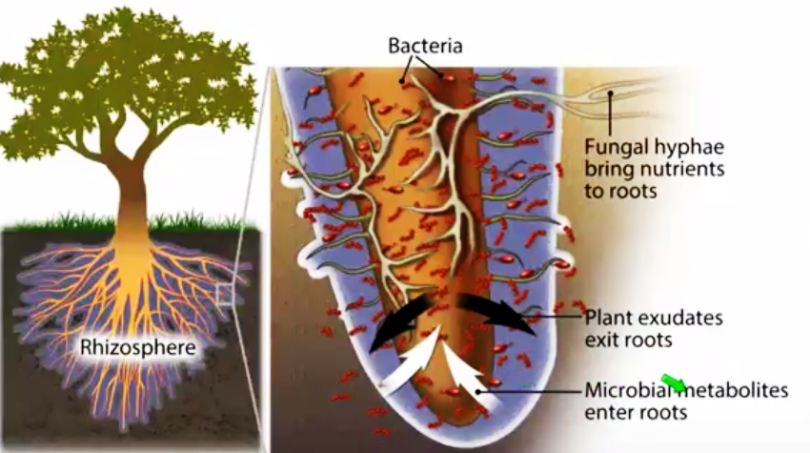
Compaction = Loosing Space
<50% of Carbohydrates Produced During Photosynthesis is “leaked” into the Rhizosphere
If Space is Reduced this Important Symbiotic Process is Also Reduced
Water and Minerals to the Plants are Reduced
Important to “Terroir.
RHIZOSPHERE
Notes:
Most people think that roots just take. Not true. Roots Give! In the Rhizosphere is where this takes place. Another reason for strong aggrogates. Reducing this symbiotic exchange is one of the long term affects of compaction.

Slide 17
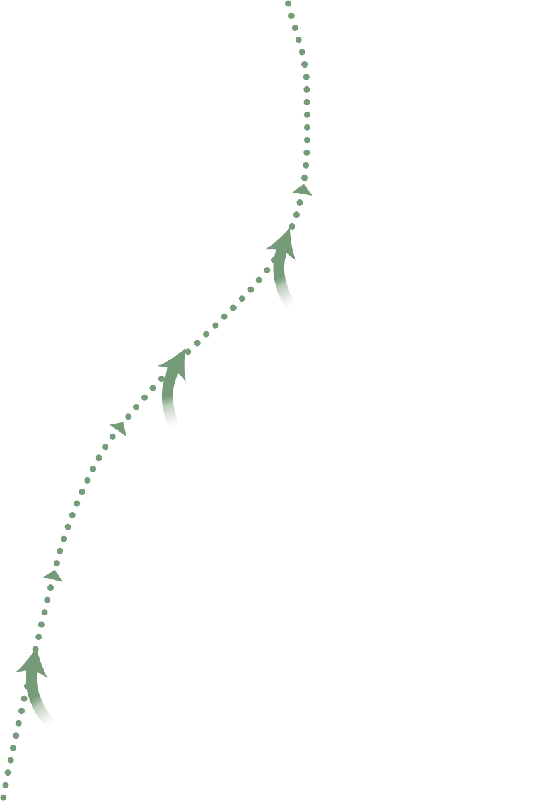
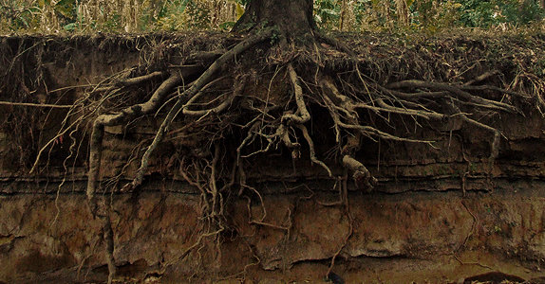
Carbohydrates for
Minerals & Water
Notes:
Tree created carbohydrates….
Plant or tree shares 20-80% of their carbohydrates to feed soil organisms
SO IMPORTANT
Point - how we thought about soil building is not the case…...

Slide 18
COMPACTION IDENTIFICATION – High Bulk Density

Slide 19
COMPACTION IDENTIFICATION - Root Penetration
Plant Roots
Restricted, flattened, turned, or stubby;

Slide 20
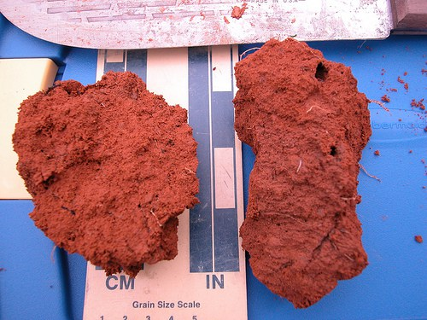
COMPACTION BLOCKY or IDENTIFICATION – PLATEY STRUCTURE

Slide 21
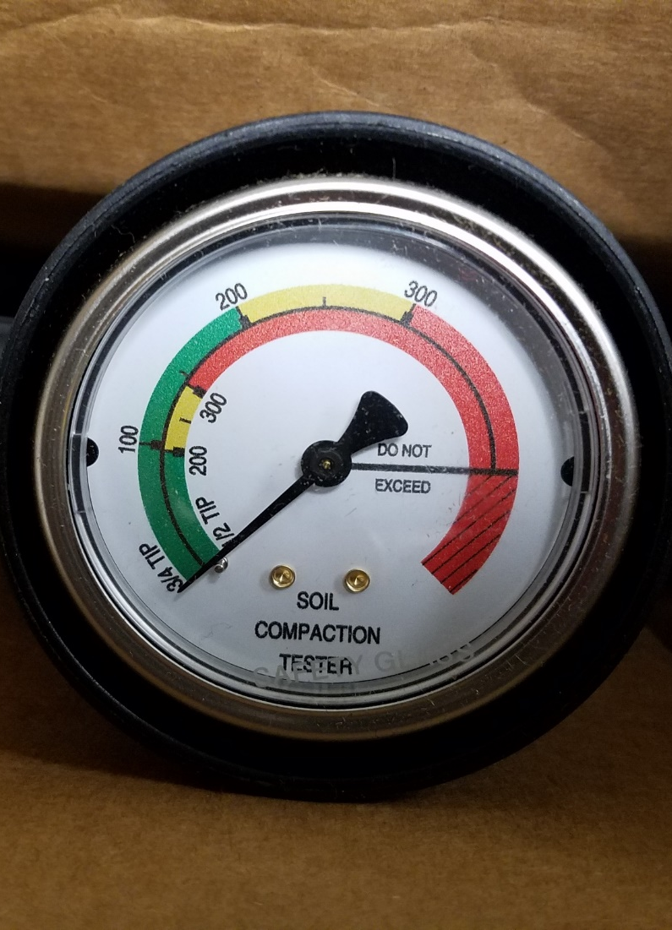
COMPACTION IDENTIFICATION - Soil Resistance

Slide 22
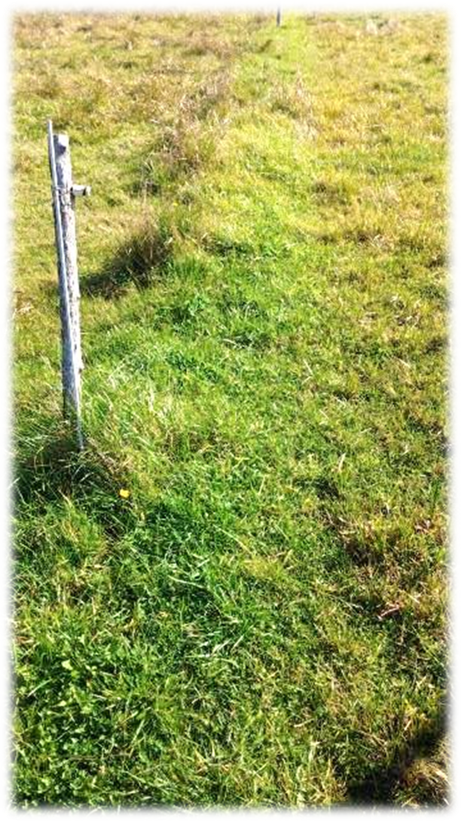
CHEMICAL SOIL TEST

Slide 23
Measured Soil Textural Class – Sandy Loam
Notes:
This soil was 50% Sand 30% Silt & 20% Clay

Slide 24
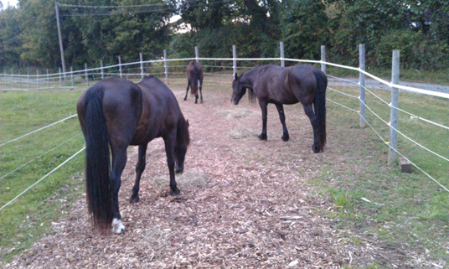
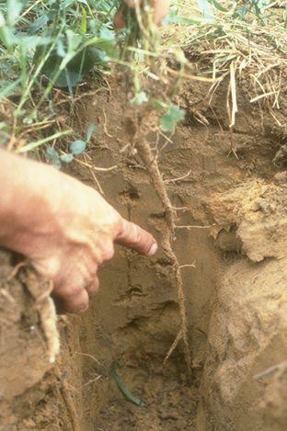
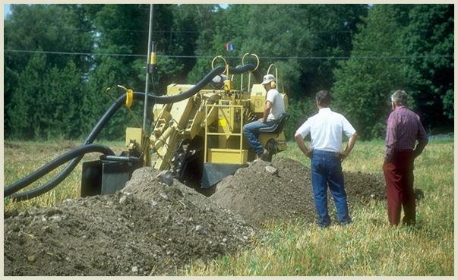
PREVENTING COMPACTION MUCH EASIER
Good Walkways Centralize Compaction
Organic Matter in soil Helps Cushion Weight
Graze Mature Plants with Mature Roots
Monitor Fertility to Assure Healthy Plants
Short Residencies In Paddocks
Know which Soils are more Prone to Compaction, such as Sandy Soils
Switch to Hay Production for a Year
Drain Perennial Wet Spots
Notes:
This material is included in “Pasture Soil Compaction” SARE manual

Slide 25
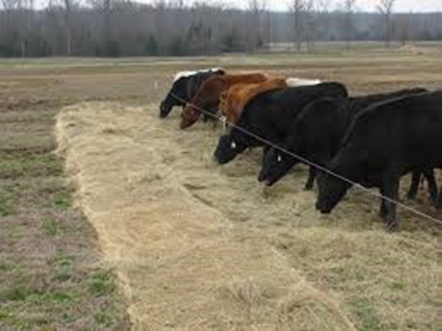
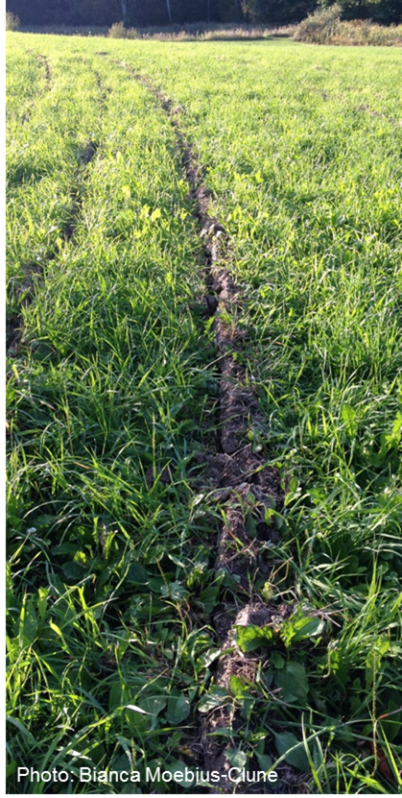
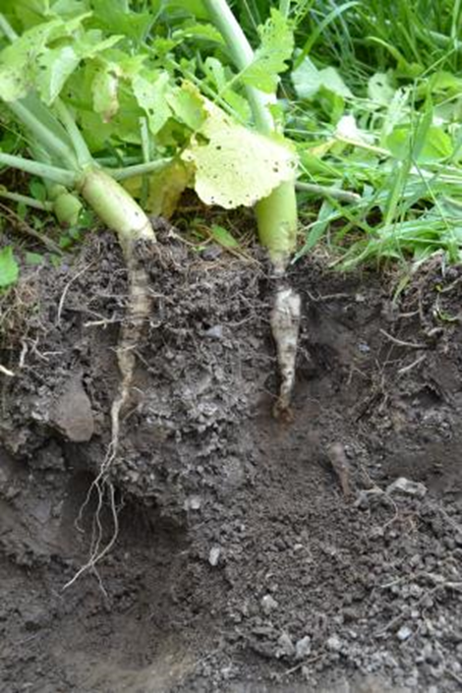
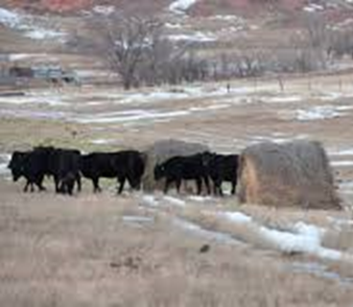
CURRING COMPACTION - TIME AND MONEY CONSUMING
Plowing and Reseeding – Effective but Costly
Zone Tilling – Temporary Fix Unless Roots Enter Zone
Anytime Metal is Used to Fix – Chance of Soil becoming “Addicted” to Tillage
Add Organic Matter with Bale Feeding “Stealing Nutrients From Your Neighbors”
#1 Best because of the Hay also acts as a Cushion, But Takes More Time than #2
Inter Seed Deep Rooted Plants
1
2
Notes:
This material is included in “Pasture Soil Compaction” SARE manual

Slide 26
BRASSICAS GOOD TOOL PROVIDED SWARD IS CONTROLED
Heavy feeder to take up Excess nutrients in sacrifice areas
Non-Mycorrhizae, adds diversity to soil
High in Nutrition, Good for Cool Season Slump
Tubers and Root Hairs loosen soil and feed biology

Slide 27
Grazing Management
% Leaf Removed
% Root Growth Stopped
10
0
20
0
30
0
40
0
50
2 to 4
60
50
70
78
Source: Dietz, 1999
80
100
90
100
Notes:
Removing leaves also affects the plant below ground. If too many leaves are removed, most of the stored energy to make new leaves is lost; the roots do not grow. As a rule, “taking half and leaving half” OF THE LEAF VOLUME allows some leaves to be removed while not slowing down root growth. Source: Dietz, 1999.

Slide 28
Grazing triggers soil carbon loss by altering plant roots and their control on soil microbial community Katja Klumpp1‡, Se´ bastien Fontaine1*‡, Ele´ onore Attard2, Xavier Le Roux2†, Gerd Gleixner3 and Jean-Francois Soussana1
After shift to high disturbance(Short Recovery Period) , photosynthesis decreased followed by a decline in root biomass and a change in plant community structure
Showed that high intensity grazing (NZ style) led to a decrease of soil fungi, a proliferation of Gram(+ ) bacteria and accelerated decomposition of old particulate organic C (<6 months).
Increased disturbance promotes bacteria in the soil which is less efficient at digesting SOM meaning that more CO2 is released. In Well managed grazing promotes fungal communities which are better at storing the carbon in the soil. Study exposed soil to 13C‐labelled CO2, which allowed them to trace both the incorporation of new litter C produced by a modified plant community in soil and the fate of old unlabelled litter C.
Notes:
50% of SOM is Carbon

Slide 29
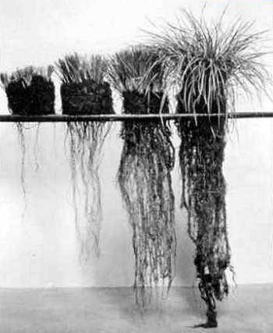
More Roots=More OM=Less Compaction
Grass and litter present
Grass with litter removed
Or Harvesting Hay
Grass and liter removed (bare soil)
0 1 2 3
Inches per hour
Notes:
Allowing a residual height of the pasture plants to produce leaves long enough for some of them to senesce and become litter will feed soil microbes, which helps plants take up more nutrients (minerals) to grow stronger and more nutrient dense for healthy food for cattle. Increasing microbial activity and soil life will also build the organic matter.
How much bare ground is on your pasture? Can I do some of these things to keep all the rainfall on my pasture?
“If I could sum up moisture management in one word, that word would be LITTER. Litter is the plant parts that senesced (died) from the previous grazing or the 1/2 left from the year before. It is old stems, leaves etc left from prior grazing rotations or prior years growth that is laying on the soil surface.
Look how important litter is to infiltration rates. Litter accounts for 60%. Where as grass only accounts for 20%, because if you remove all the grass and litter from the soil surface you will still infiltrate 20% of a 2.5 inch/hr rainfall event. Litter accounts for 1 1/2 inches of the 2 1/2 inches/hr storm.” Quote from North Dakota grazing specialist.
So what is the most common causes for loss of litter?? Grazing plants so short they could not produce leaves to last long enough to senesce to litter. This takes place during severe overgrazing. Remember Litter is the most important thing to manage for if you what production. Because it contributes to over 60% of managing for moisture.

Slide 30
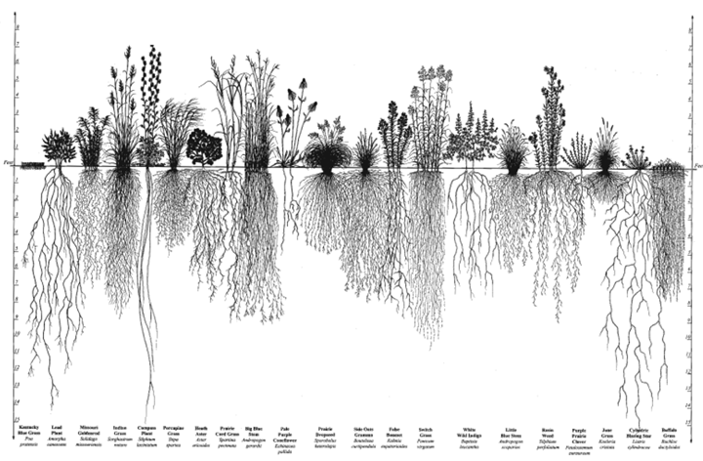
Diversity of plants above ground feeds
diversity of soil organisms belowground!

Slide 31
PASTURE COVER IMPACTS INFILTRATION AND RUNOFF
3 inches of rainfall in 90 minutes, 10% slope, silt loam soil
(University of Nebraska & USDA-SCS, 1937)
Excellent pasture 95% ground cover
Fair pasture 75% ground cover
Poor pasture 50% ground cover
8 7 6 5 4 3 2 1 0 10 20 30 40 50 60 70 80
Soil loss (tons/A) Percent runoff
Notes:
So let’s look at the differences in erosion and runoff of differently managed pastures. Read Slide. Unfortunately most pastures in the U.S. are overgrazed and overstocked – poor. How much of my pasture is at 50% ground cover?

Slide 32
PASTURE COMPACTION RATIO – Improved use of penetrometer
Penetrometer Readings Change with Soil Moisture.
NE SARE Proposal Sought to Use the ratio between fenceline and pasture
Retest as soil conditions change
Hypothesis: The resistance readings of the two areas would change equally. So the ratio would remain constant.

Slide 33
Experiment Design - PCR
No Change in Pasture or Fence Line for Five Years.
Five Good (no Rocks) Readings for Each Test Area.
Average These Readings and Divide Fence Line Reading by the Pasture Reading = PCR.

Slide 34
PASTURE COMPACTION RATIO (PCR) AT SIX INCHES
Zufall Fence line = 200 psi
Zufall Pasture = 300 psi
PCR = 200/300 = .66
A PCR of 1.0 Ideal

Slide 35
Results – Continuous Graze

Slide 36
Results

Slide 37
Results - Carey
Notes:
July through September Very Dry. Readings were over 500 psi so not recorded

Slide 38
Results - Carey

Slide 39
Results - Carey

Slide 40
Results – Adams 2019

Slide 41
ADAMS PASTURE 2019

Slide 42
Results – Adams Enclosure

Slide 43
PCR TAKE AWAY

Slide 44
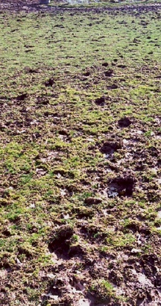
COMPACTION AND EXPOSTED SURFACE SOILS
Impedes active root growth
Causes ponding, runoff, erosion, nutrient loss
Limits soil aeration
Limits water infiltration, and therefore drainage and storage, increases drought frequency/severity
Causes stress for plants, leading to decreased yields & quality and greater input expense
Poor nutrient management
Limits forage growth in case of nutrient deficiencies, affecting all of the above
Bianca Moebius-Clune, Cornell University

Slide 45
Order of Remediation
Chemical: Quickest response
Biological: Bale Grazing - Composted manure or “Sheet Compost”
Physical: Longer Rest Periods, Tillage – (Short term fix), Plant Small Grain or Bio Drill Radish
Notes:
Explain differences between two photos. Increasing rest period allows roots to grow more robust

Slide 46
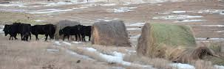
How you Feed on Pasture

Slide 47
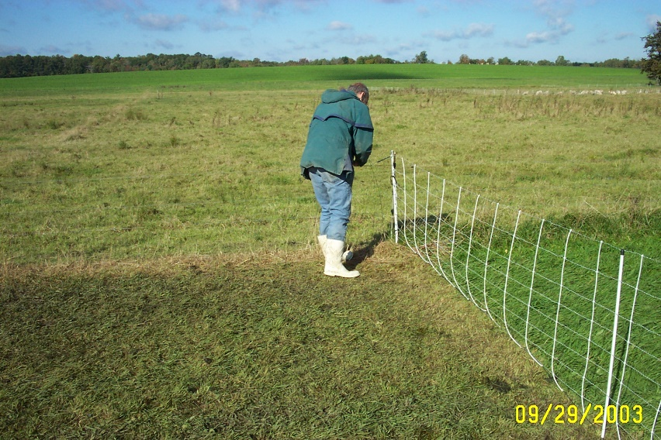
Preventing Pasture Compaction
Infrastructure
Good lane ways allow compaction to be kept in
specific area
Drainage will decrease time soil is wet and prone
to compaction
Increase watering areas and move often
Look into “No-Gate” system

