Slide 1
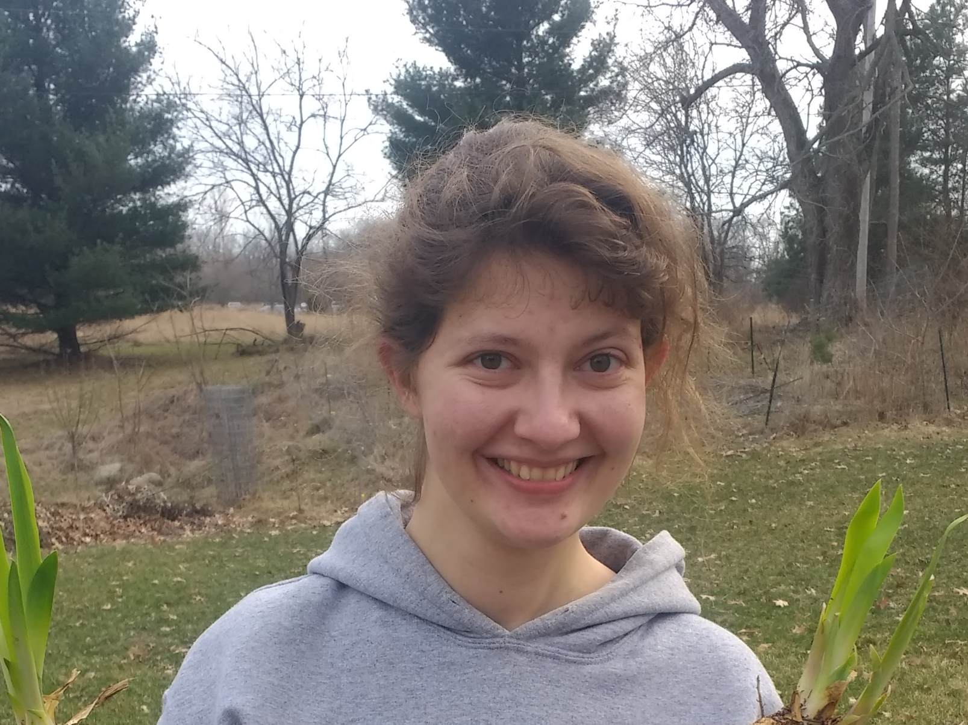
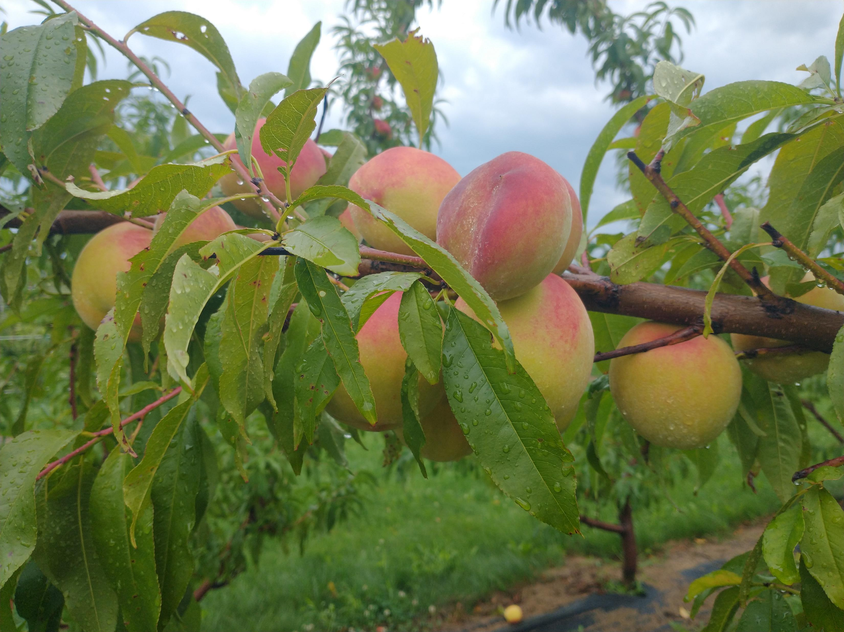
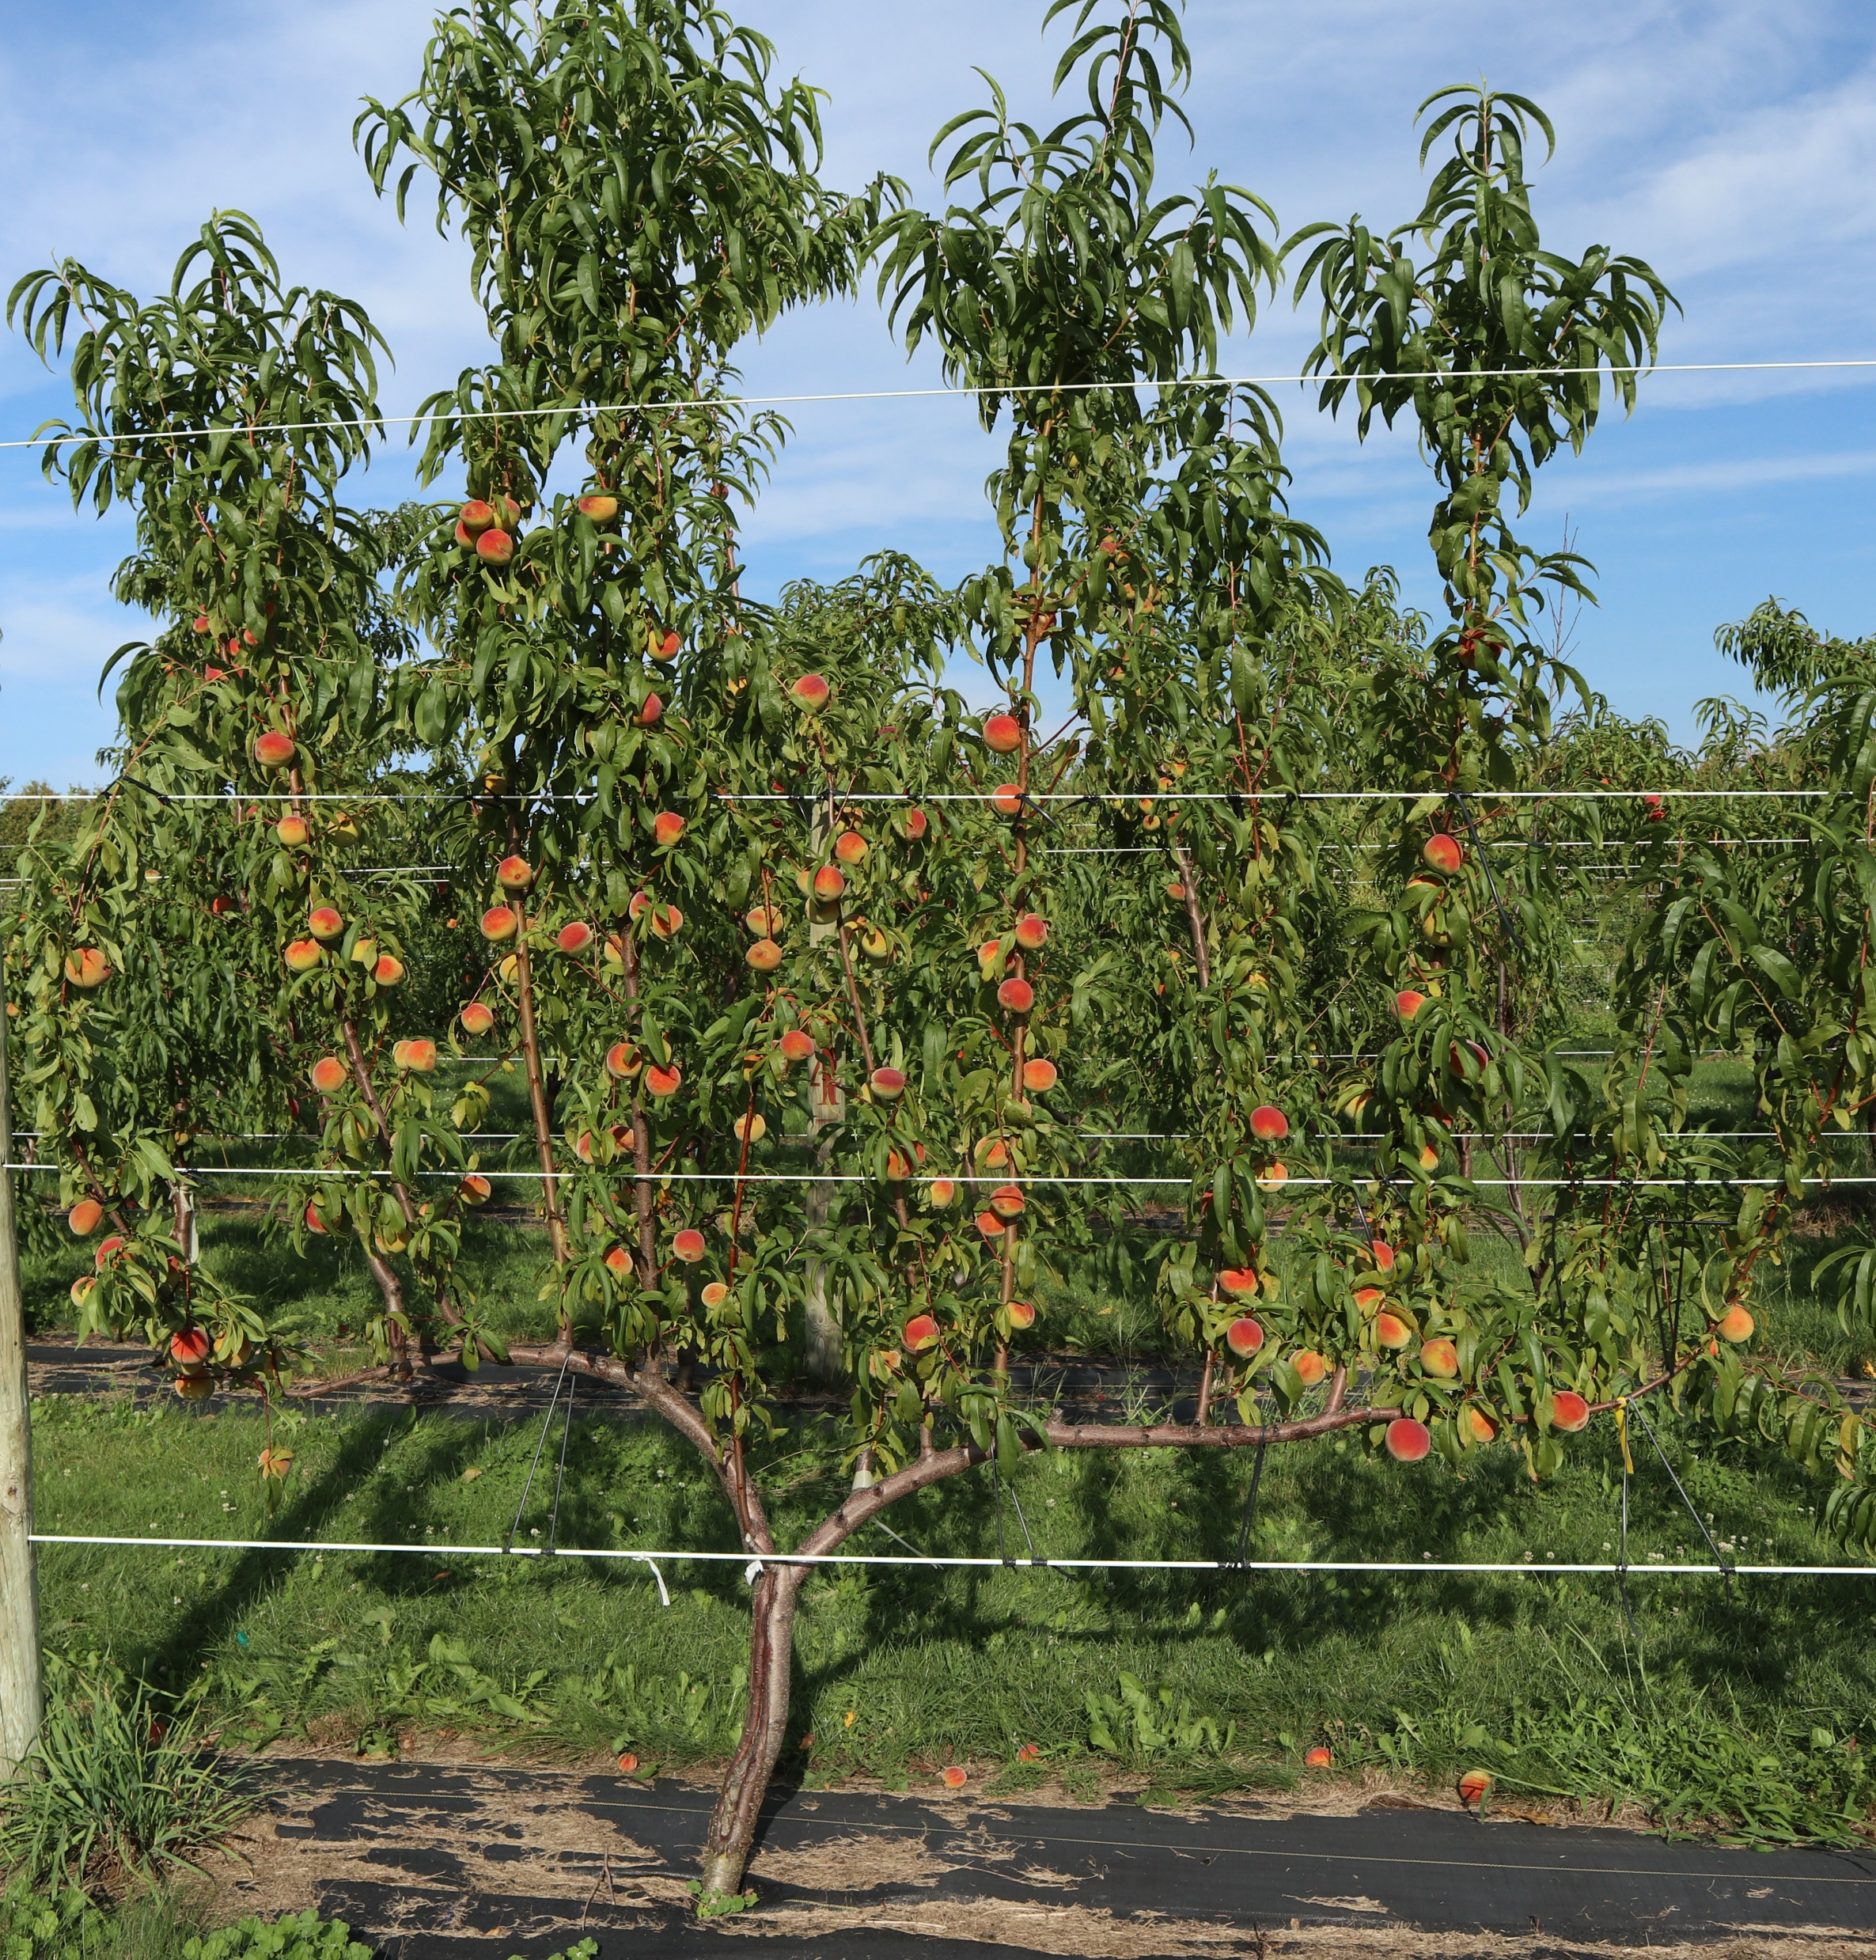
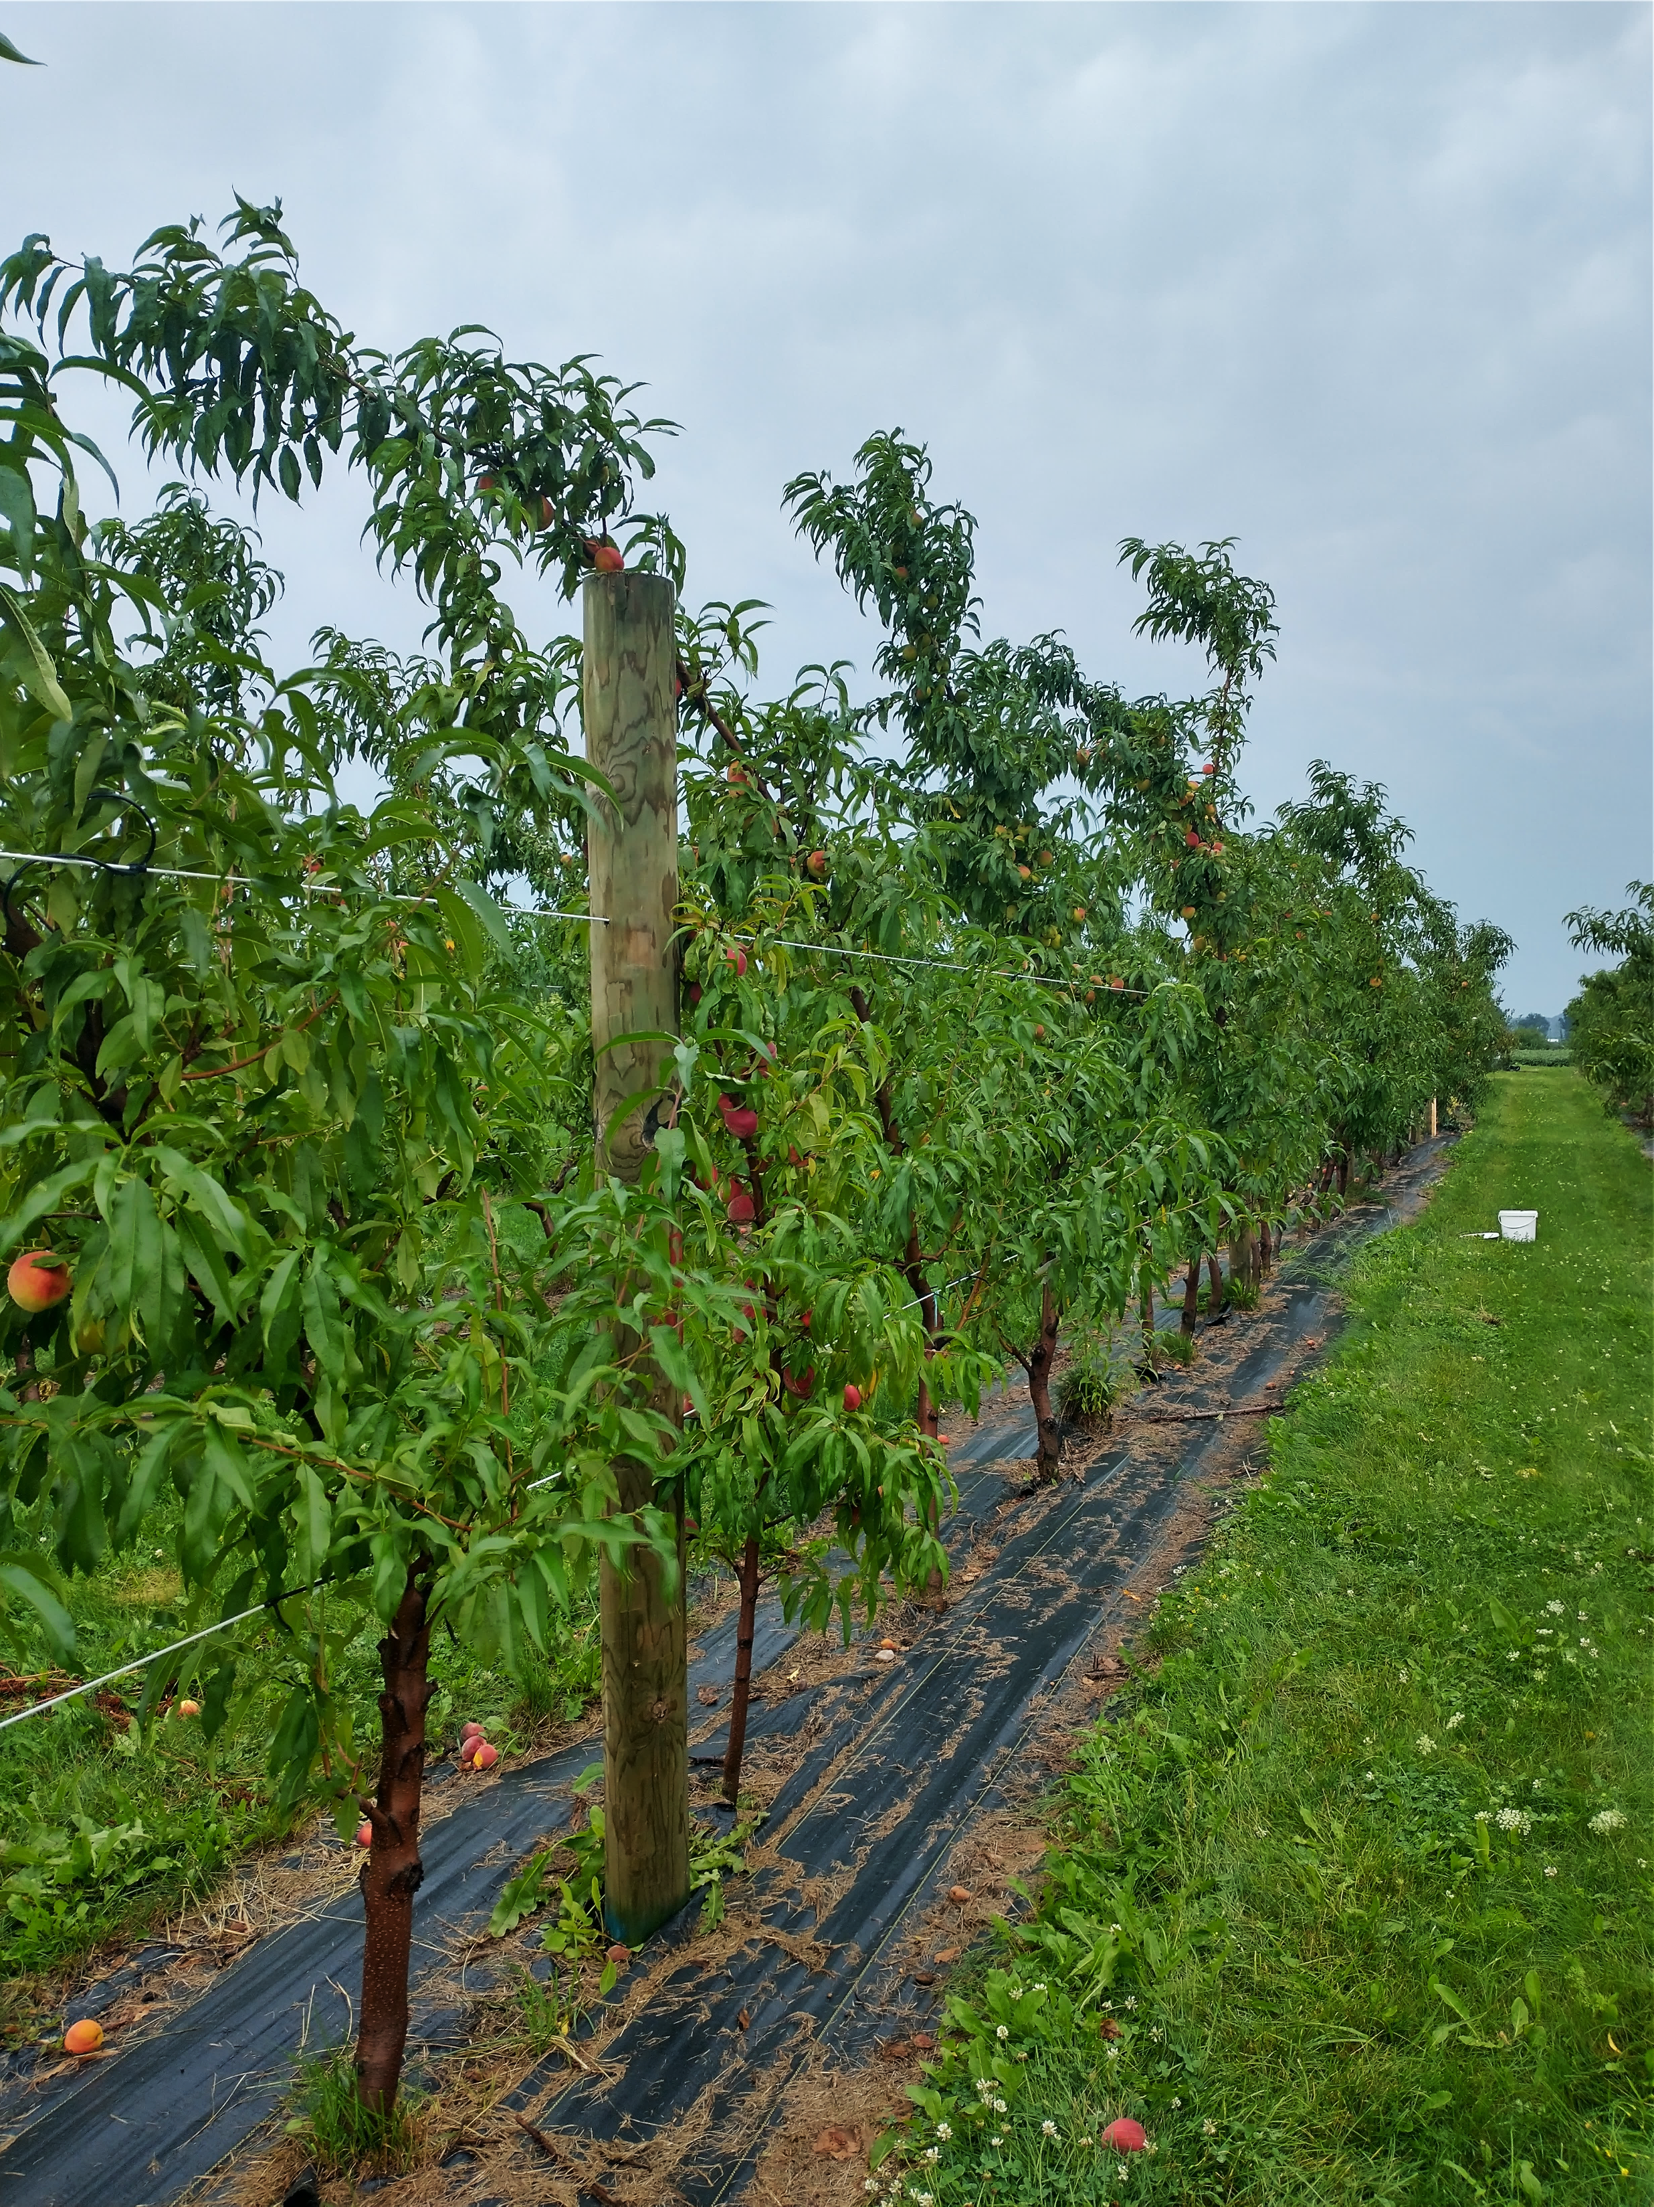
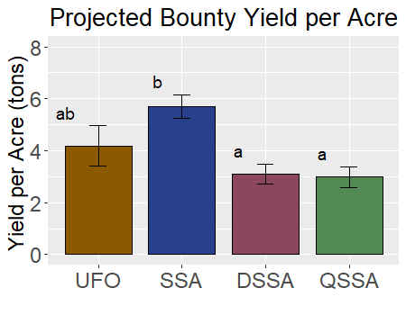
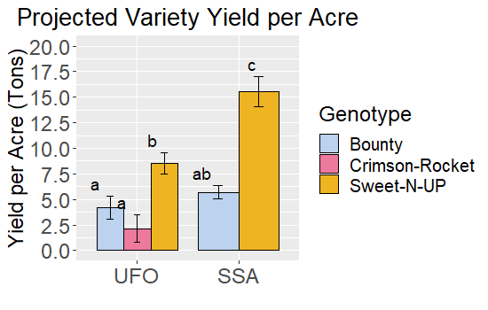
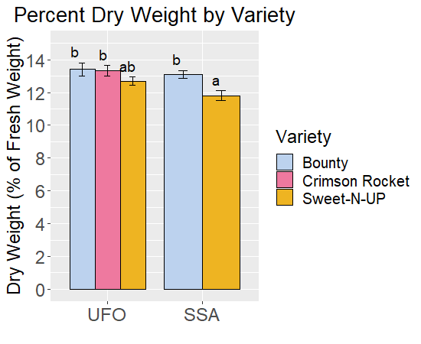
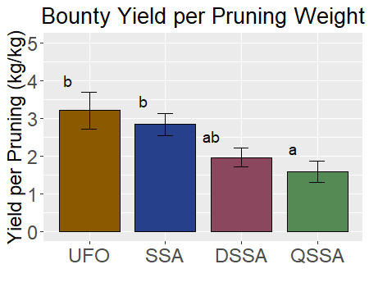
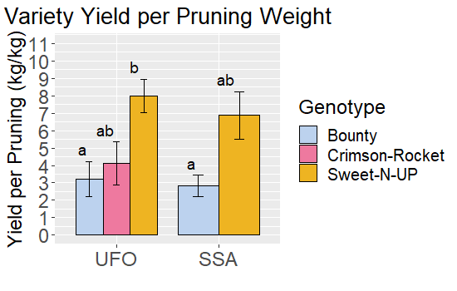

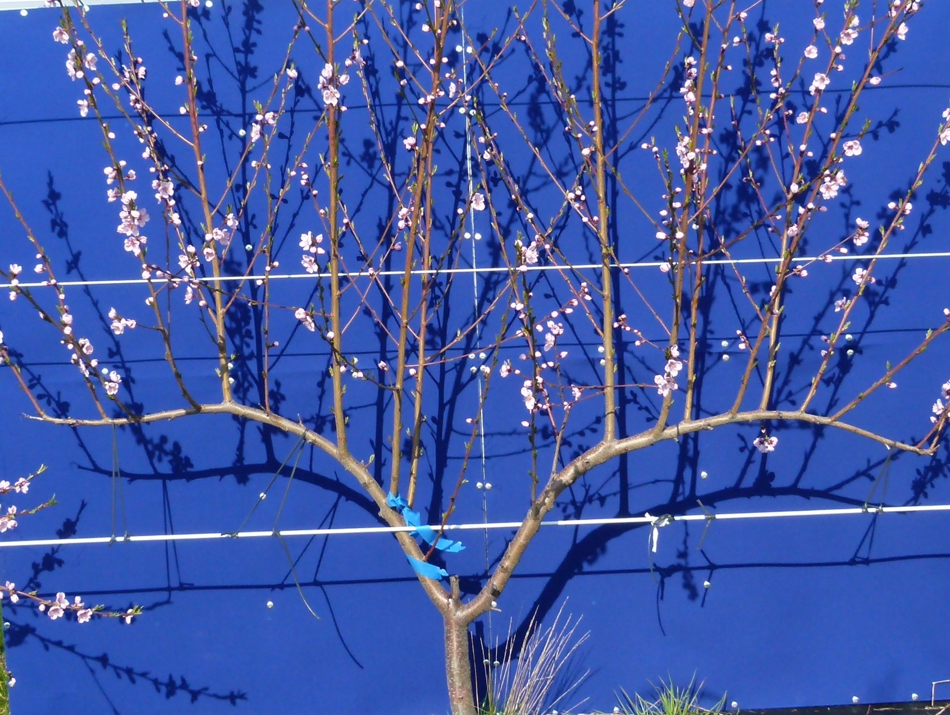
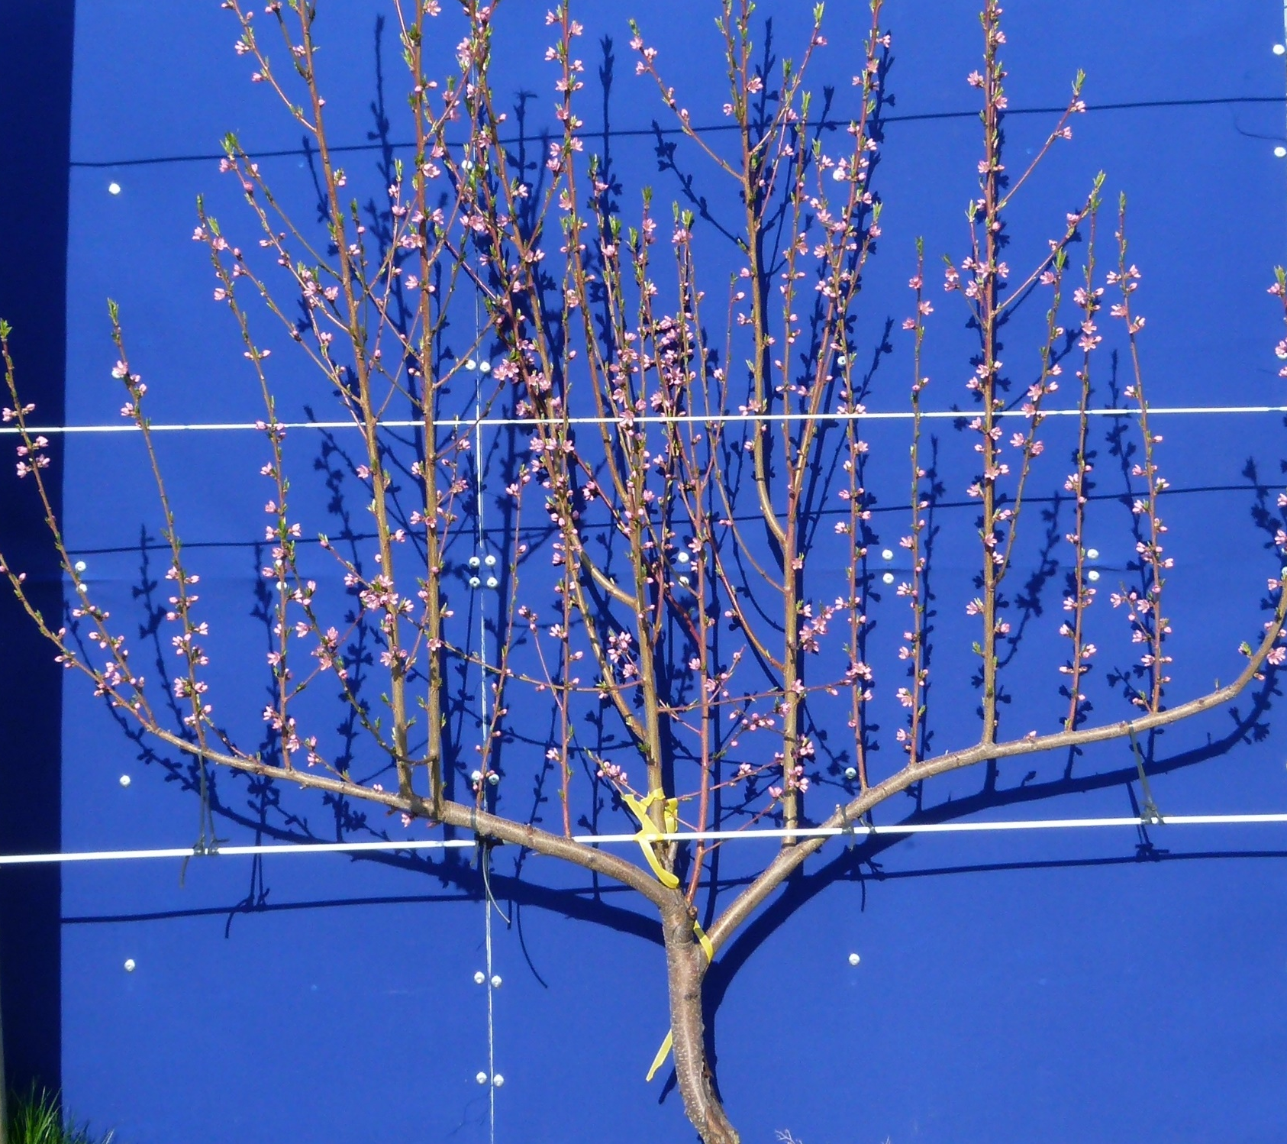
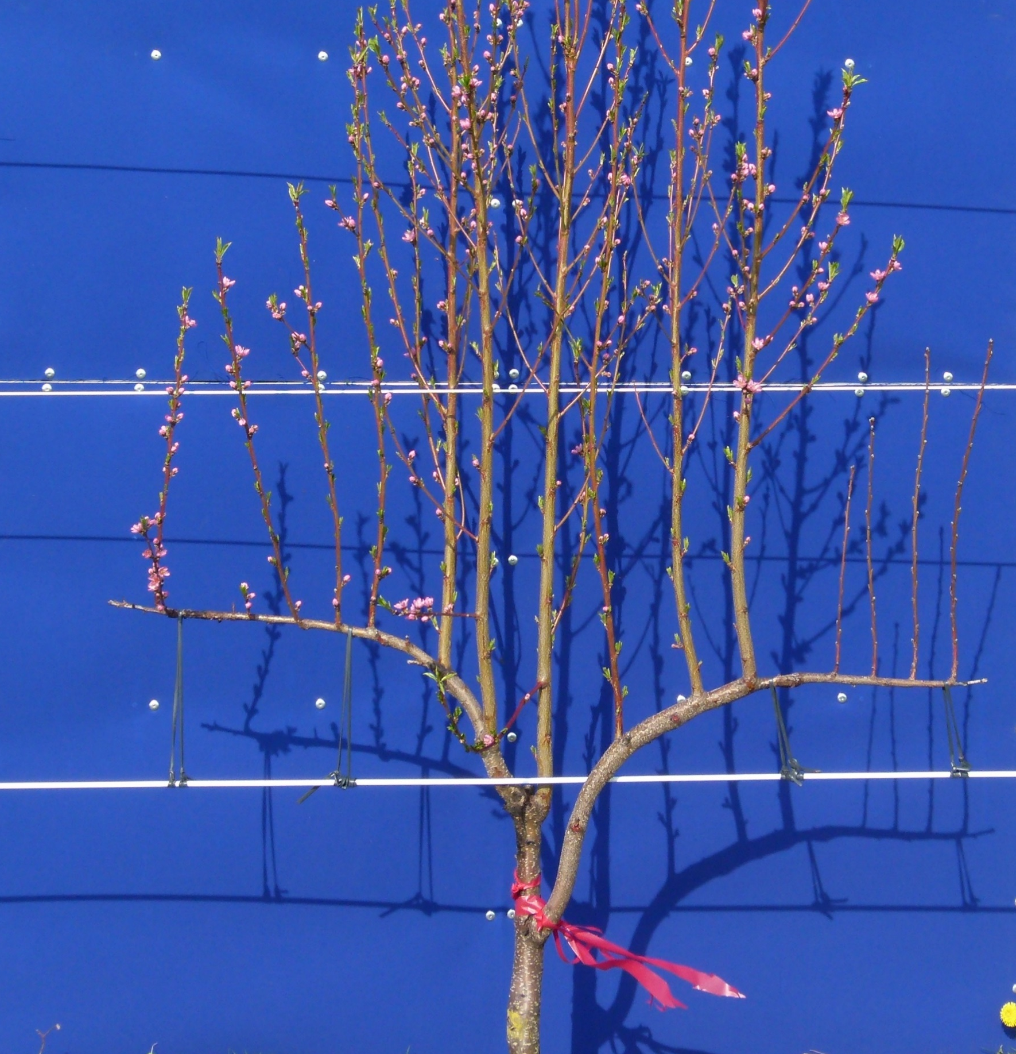
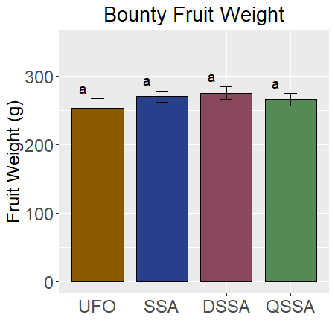
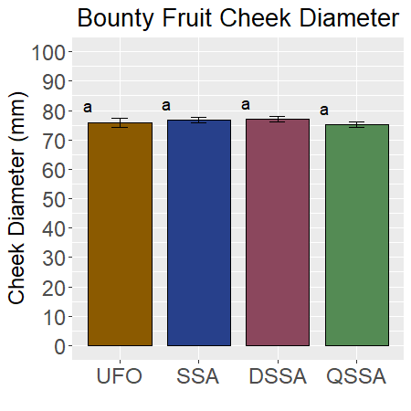
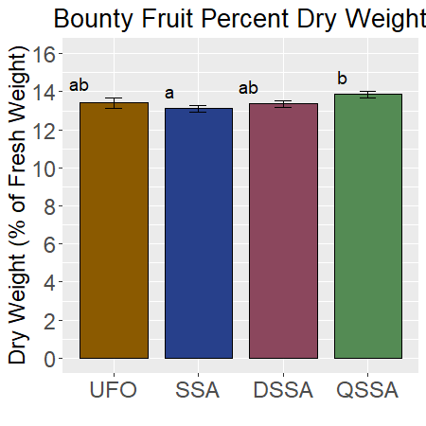
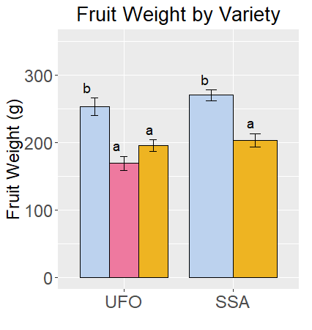
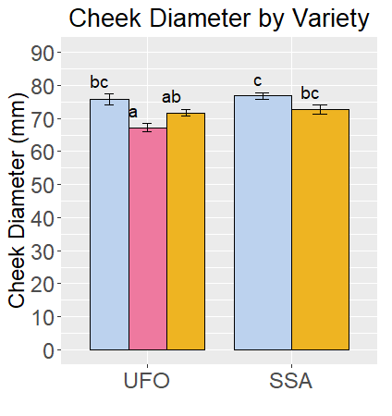
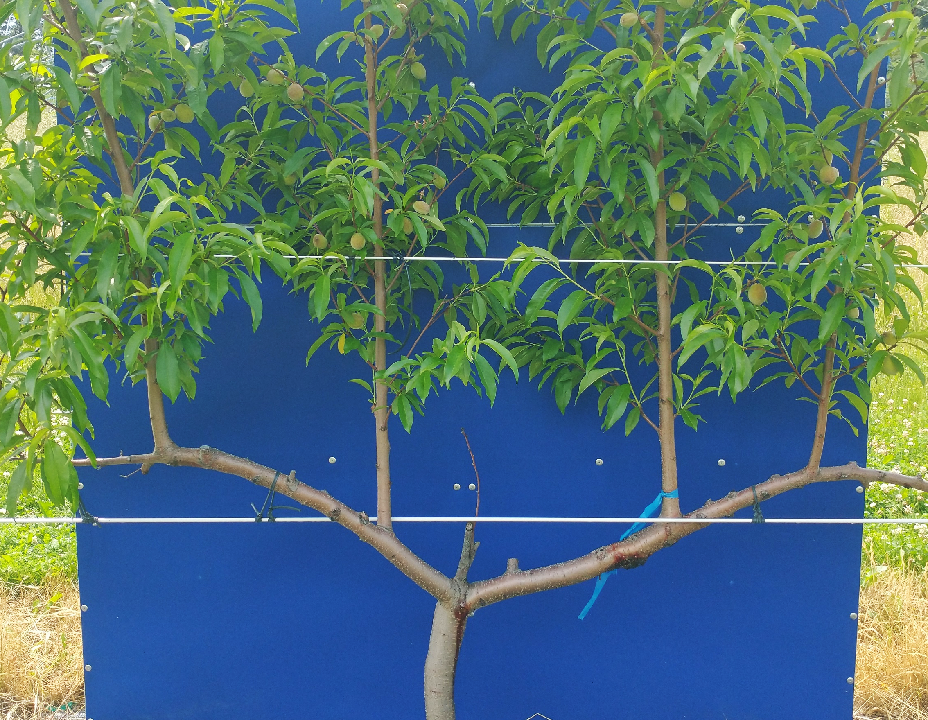
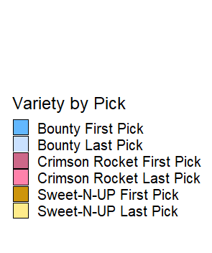
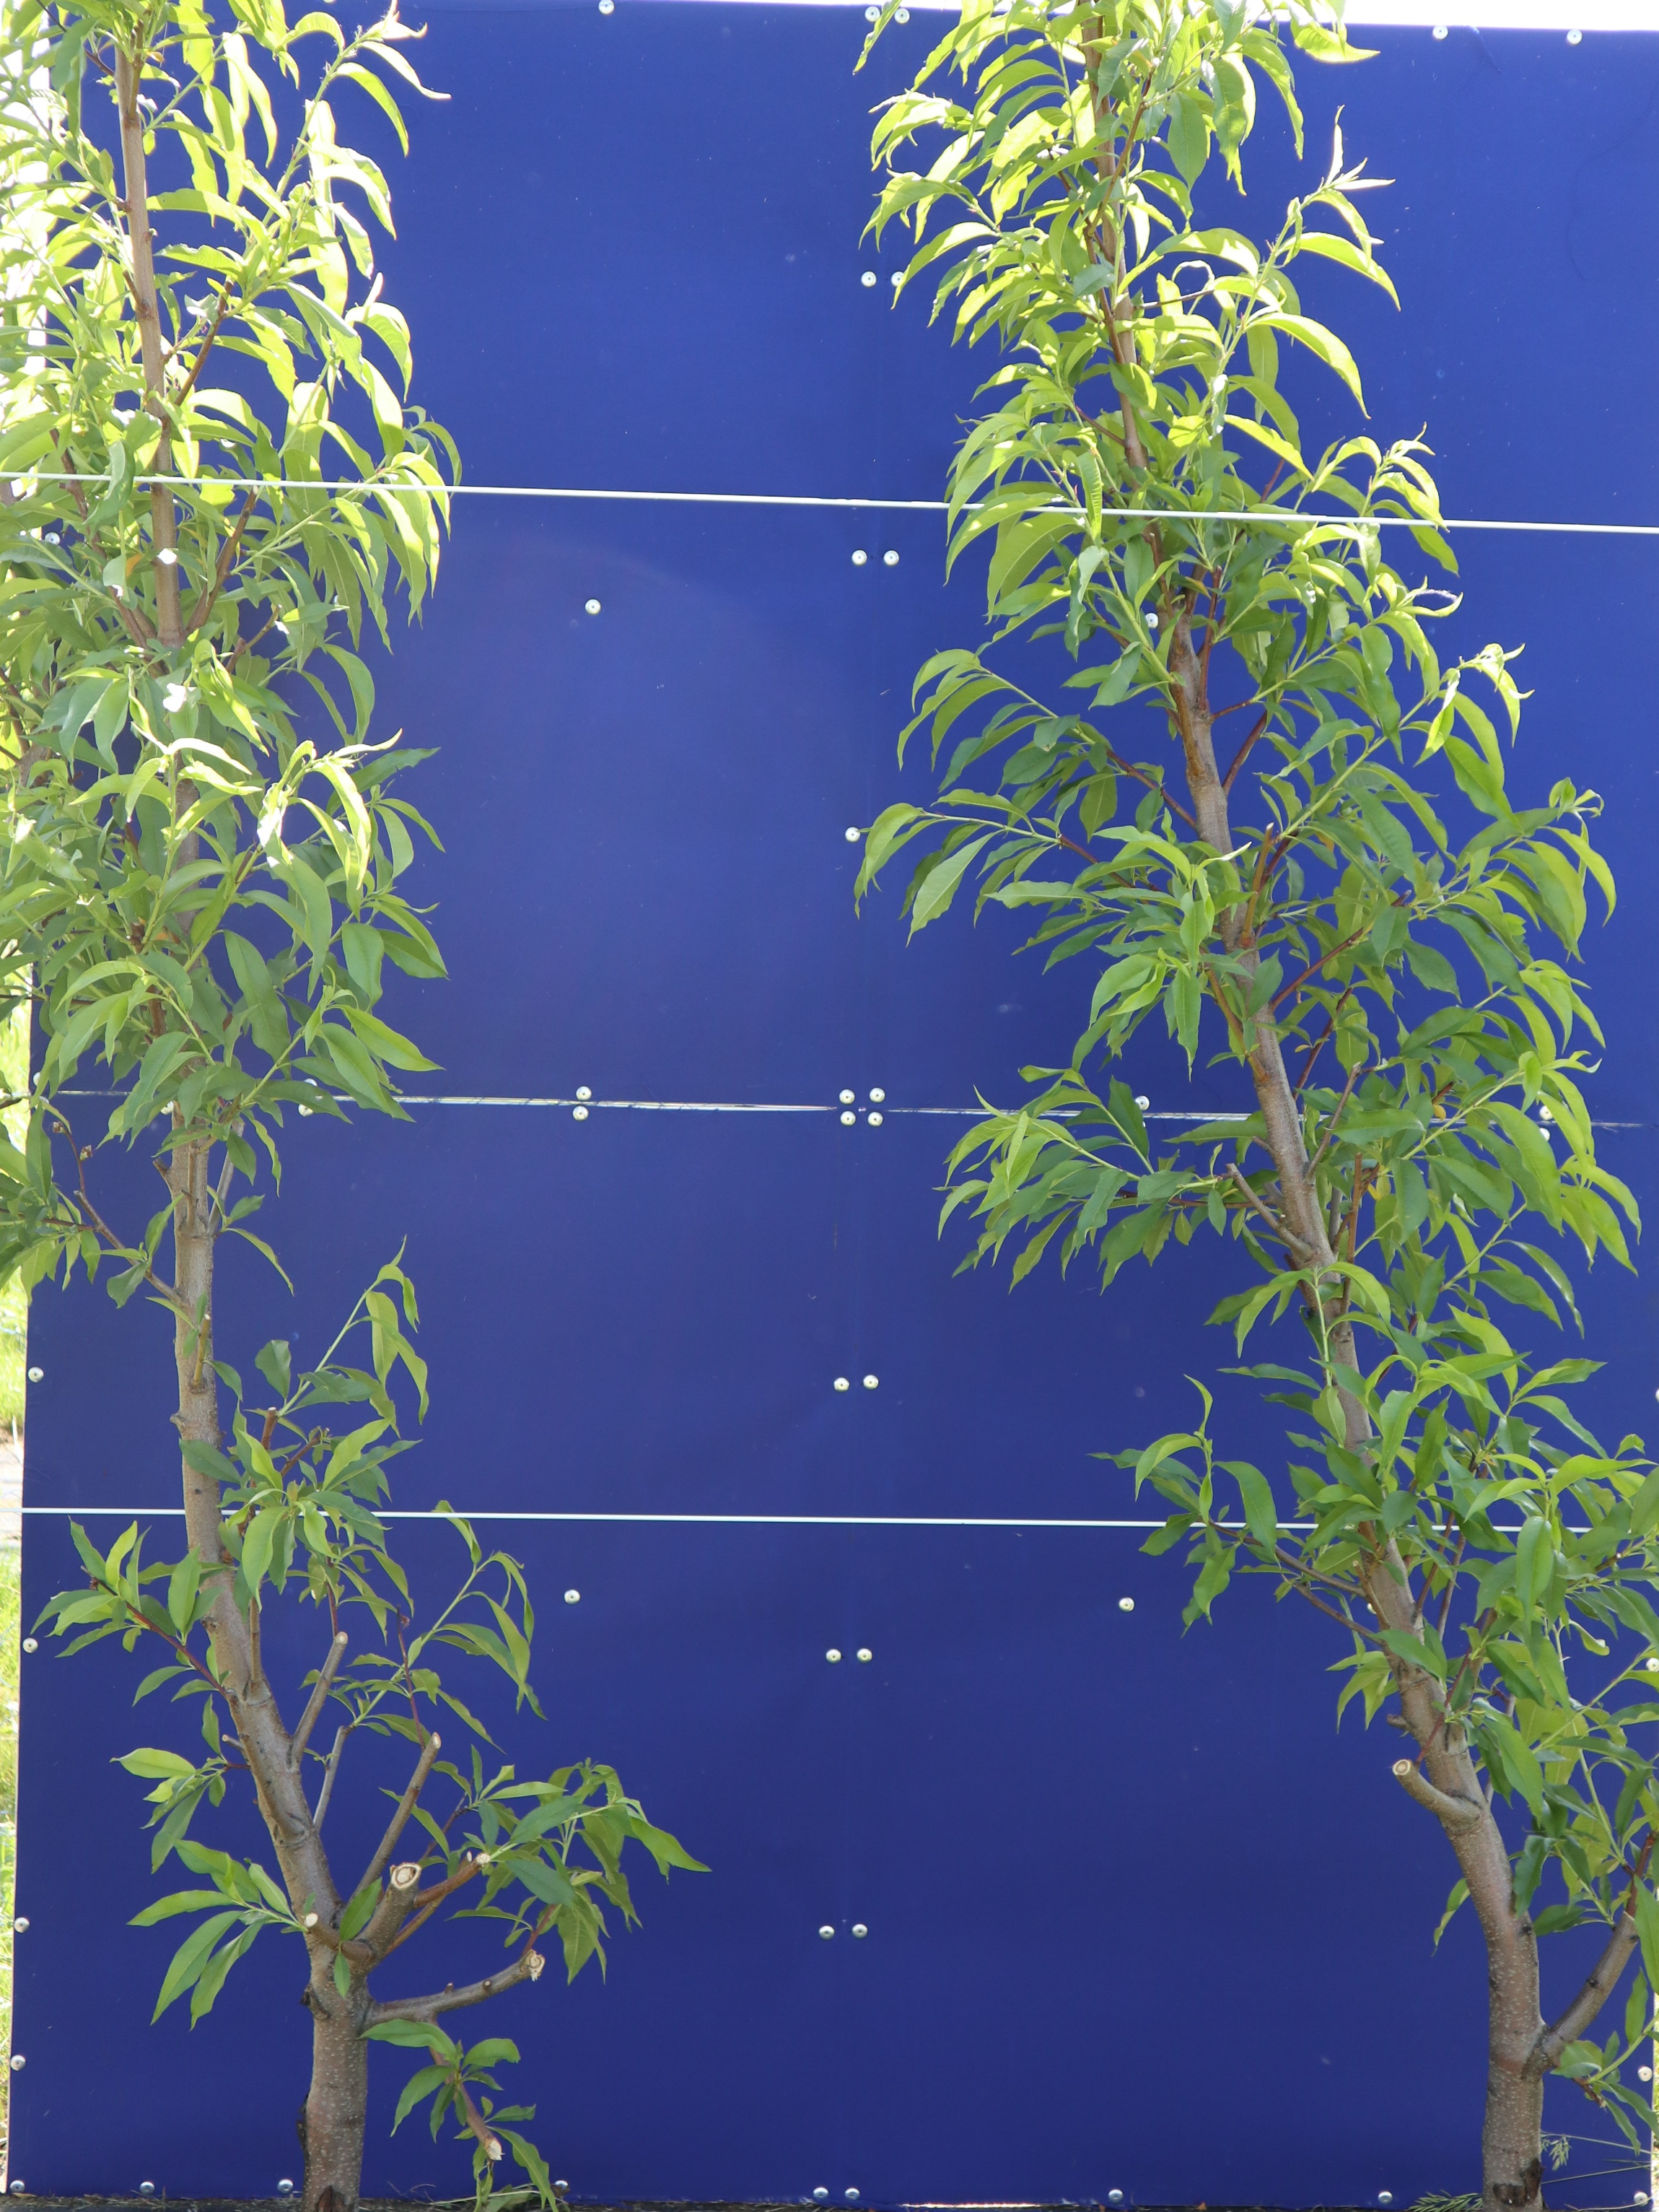
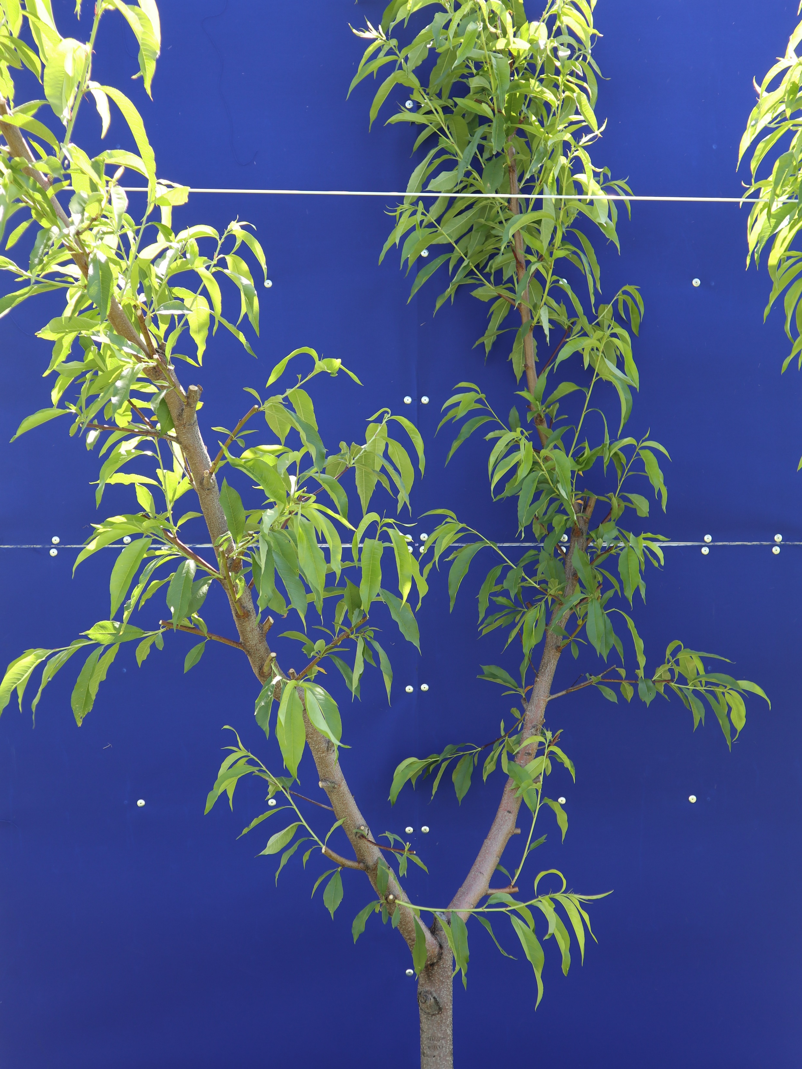
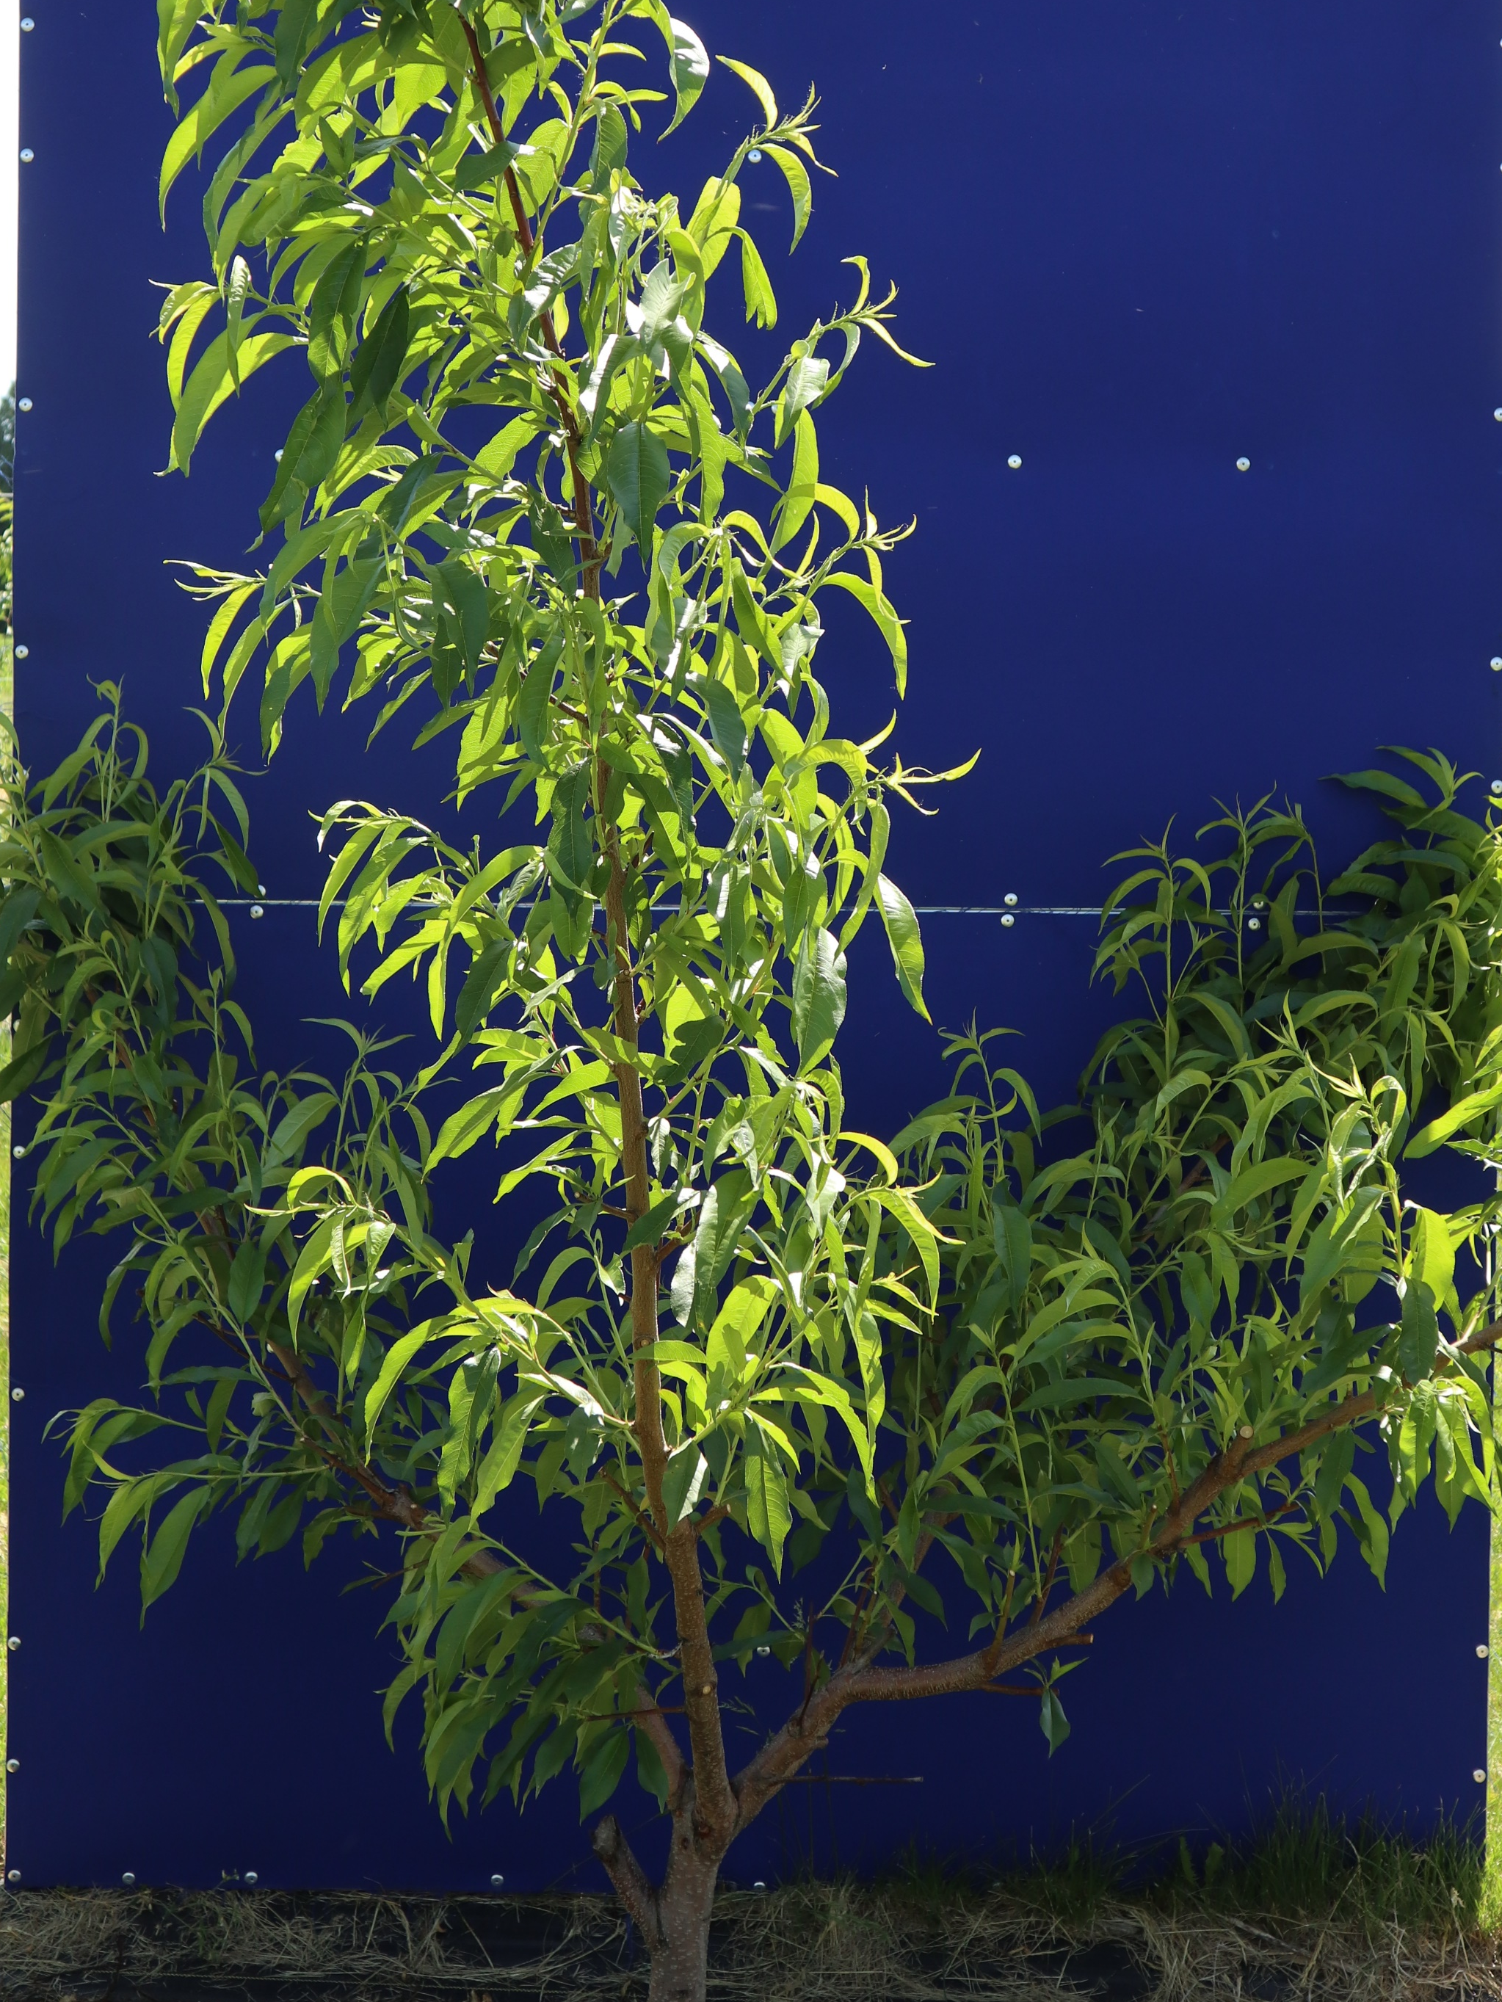
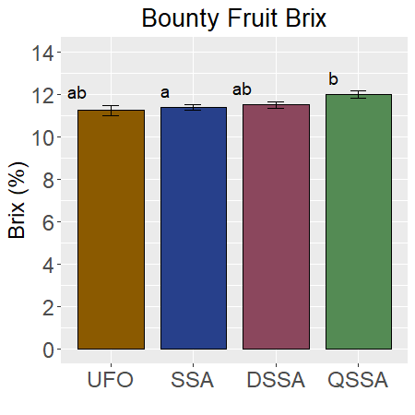
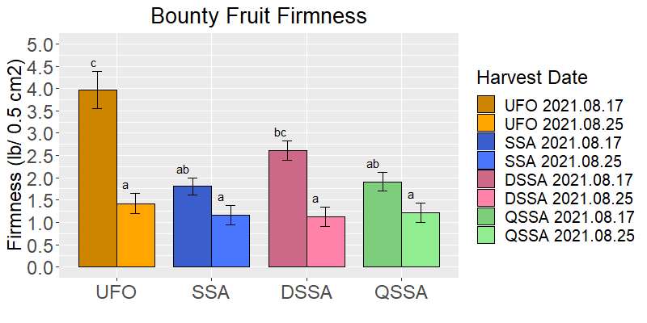
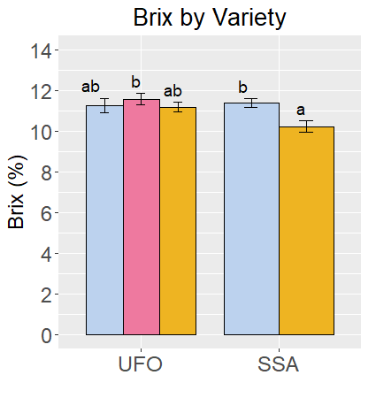
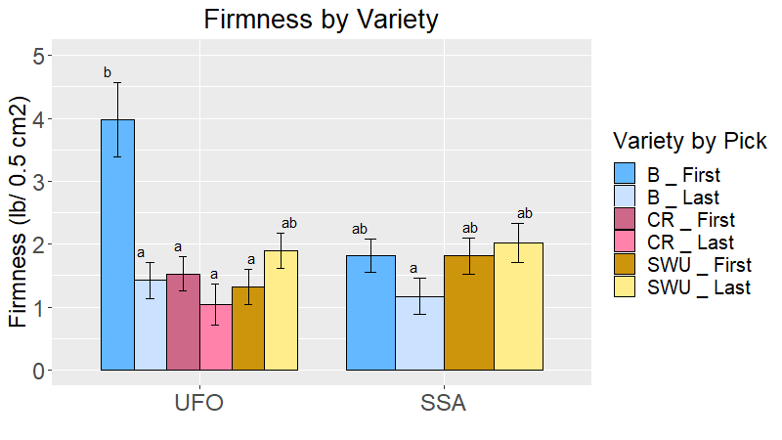









































Fruit Quality and Yield in Planar Training Systems for Peach
Andrea Kohler¹, Greg Lang¹, Bill Shane², Courtney Hollender¹
¹Department of Horticulture, Michigan State University; ²Extension Agriculture and Agribusiness, Michigan State University
High-density, Planar Training Systems may Increase Early Yield per Acre
Conclusions and Future Work
Planar Training Systems for Peach
b
Figure 5:
Planar training systems or “fruiting walls” for fruit trees use pruning, tying, and trellising to constrain the tree’s canopy to a single plane.
High-density systems involve planting trees at much closer spacing than a traditional orchard to increase the trees per acre.
High-density, planar systems are commonly used in apple, because they can increase yield per acre, facilitate mechanized pruning, and improve light interception.
Planar systems have been difficult to implement in peaches, because the lack of dwarfing rootstocks results in excessively vigorous trees.
In this research, we established several types of training systems, including three planar systems, with the goal of maximizing yield and fruit quality, while reducing excessive vigor and the associated labor inputs.
Projected yield per acre was calculated assuming the tree spacing used in this study for each style and a 12ft row spacing for all styles.
For Bounty, UFO and SSA trees had higher 4th leaf yields than DSSA and QSSA (Fig. 4A).
The highest 4th leaf yield for both Bounty and Sweet-N-UP was with SSA training, which is both planar and high-density (Fig. 4A and 4B)
Importantly, UFO and SSA also had higher yields per weight of branches pruned. This suggests UFO and SSA more efficiently partitioned growth resources into fruit (Fig. 4A).
Preliminary data from 2021 suggests that planar, high-density systems have the potential to increase early yield per acre and the ratio of harvestable fruit to excess growth, without reducing fruit quality.
Further study is needed to test whether these results are consistent as trees mature, during different growing seasons, on different soil types, and across different cultivars.
A)
B)
Figure 1: Peaches in a high-density, planar system (SSA)
Sweet-N-UP had similar yield improvements to Bounty in SSA over UFO.
We Want to Hear from You!
*
Cultivars and Training Systems
If you are a peach grower, we want your input!
Please share your experiences, concerns, and/or questions about using planar or high-density systems in your orchard.
The survey is anonymous and will help shape our research questions moving forward.
You can also contact us directly at peaches@msu.edu
Grower Survey
The peach varieties Bounty (spreading shape), Sweet-N-UP (upright shape), and Crimson Rocket (pillar shape) were planted at the MSU Clarksville Research Station in 2018. Due to freezes in 2020, the first harvest was summer 2021 (4th leaf).
To examine the effect of branch angle on training, three peach cultivars were selected with different architectures—Bounty (spreading growth habit) on Lovell rootstock; Sweet-N-UP (upright growth habit) on Early Red Haven interstock and Halford rootstock, and Crimson Rocket (pillar growth habit) on Early Red Haven interstock and Halford rootstock (Fig. 2).
Four training systems were used, three planar—Upright Fruiting Offshoots (UFO), Super Slender Axe (SSA), Dual SSA (DSSA)—and one three-dimensional—Quad SSA (QSSA)— which is similar to open vase (Fig. 3). UFO and QSSA were planted at moderate density (8’x12’). SSA and DSSA were planted at high density (3’ x 12’ and 6’x 12’, respectively).
Figure 4: Projected 4th leaf yield per acre in our trial plot and yields per weight pruned off the tree for Bounty (A) and for all three varieties (B).
The peach varieties Bounty (spreading shape), Sweet-N-UP (upright shape), and Crimson Rocket (pillar shape) were planted at the MSU Clarksville Research Station in 2018. Due to freezes in 2020, the first harvest was summer 2021 (4th leaf).H
Fruit Quality was not Altered by Planar Training Systems
While variety significantly impacted fruit weight and cheek diameter, training style did not (Fig. 5A and 5B)
Percent dry weight and ⁰Brix were very slightly higher for Bounty in QSSA than in SSA, but not significantly different for any other training style comparisons (Fig. 5A).
For Bounty, fruit firmness varied significantly by training style for the first pick, but not the last (Fig. 5A).
Together, these data suggest that the increased 4th leaf yield with UFO and SSA training did not result in decreased fruit quality.
Bounty
Sweet-N-UP
Crimson Rocket
A)
B)
Figure 2: Peach cultivars used in the study trained in UFO
Bounty was planted in all four training styles. Sweet-N-UP was planted in UFO and SSA, and Crimson Rocket was planted in UFO only.
The trial orchard was planted at the MSU Clarksville Research Station in 2018. The 1st harvest was summer 2021 (4th leaf), and data shown are from summer 2021.
There were three picks for Bounty and Crimson Rocket, and two for Sweet-N-UP. Fruit quality measures (weight, cheek diameter, ⁰Brix, dry weight %, and firmness) were measured for the first and last pick for each variety.
For yield and quality, averages were compared using Tukey’s test (α=0.05) .
SSA
DSSA
QSSA
UFO
Figure 3: Peach training styles
Figure 5: Fruit Quality Measures in Bounty across training styles (A), and Fruit Quality Measures for Crimson Rocket, Sweet-N-UP and Bounty (B)
G

