Slide 1
Tables and Graphs from ASD-Cover Crops Field Studies
Gursewak Singh and Matthew Cutulle

Slide 2
CREC Field Studies
2020-2021

Slide 3
Activities | Year 2020 | Year 2021
Cover crop seeding | April 28 | April 16
Cover crops Termination and ASD Set up | July 16 | July 7
ASD end and Weed rating 1 | August 16 | 8 August
Tomato Transplantation | August 22 | August 15

Slide 4
Figure 1: Daily average precipitation from planting through harvesting in both seasons
Precipitation data were obtained from the South Carolina State Climatology Office,
a division within the South Carolina Department of Natural Resources.

Slide 5
Figure: Daily average temperature from planting through harvesting in both seasons
Precipitation data were obtained from the South Carolina State Climatology Office,
a division within the South Carolina Department of Natural Resources.

Slide 6
Fresh, dry biomass production and plant density of cover crops in the field experiment.
Cover Crop | Fresh biomass | Dry biomass | Plant population
 | (Kg ha⁻¹) |  | (Plants m⁻²)
 | Year 1 (2020)
Sorghum Sudangrass | 55484 ± 4430 a | 11218 ± 789 a | 63 ± 3 a
Sunnhemp | 38931 ± 2289 b | 8284 ± 775 b | 67 ± 4 a
Sorghum Sudangrass + Sunnhemp | 41794 ± 2855 b | 8281 ± 753 b | 66 ± 6 a
P Value | 0.0001 | 0.0001 | 0.10
 | Year 2 (2021)
Sorghum Sudangrass | 57461 ± 3839 a | 11496 ± 525 a | 66 ± 2 a
Sunnhemp | 39533 ± 2973 b | 8648 ± 906 b | 72 ± 3 b
Sorghum Sudangrass + Sunnhemp | 42771 ± 3153 b | 8733 ± 537 b | 69 ± 5 ab
P Value | 0.0001 | 0.0001 | 0.0001

Slide 7
Weed Counts 2020
Cover crop | Soil aeration | Yellow nutsedge counts per bed |  |  | Grasses counts per bed
 |  | 0 DAT | 45 DAT | 90 DAT | 0 DAT | 45 DAT | 90 DAT
Sorghum sudangrass | Non-Aerated | 1 C | 5 D | 12 E | 0 C | 3 A | 8 A
 | Aerated | 10 B | 12 BC | 21 BC | 1 BC | 4 A | 10 A
Sunn hemp | Non-Aerated | 1 C | 5 D | 14 DE | 0 C | 5 A | 11 A
 | Aerated | 14 B | 17 B | 24 B | 3 AB | 6 A | 12 A
Sorghum sudangrass + Sunn hemp | Non-Aerated | 0 C | 6 D | 13 E | 0 C | 5 A | 9 A
 | Aerated | 10 B | 12 C | 18 CD | 1 C | 4 A | 10 A
No Cover crop | Non-Aerated | 1 C | 7 CD | 16 CDE | 0 C | 5 A | 10 A
 | Aerated | 21 A | 26 A | 32 A | 3 AB | 5 A | 11 A
P Values
Cover crop |  | 0.0396* | 0.0005* | 0.0003* | 0.1549 | 0.4858 | 0.3633
Plastic mulch |  | <.0001* | <0.0001* | <0.0001* | 0.0005* | 0.4618 | 0.3900
Cover crop*Plastic mulch |  | 0.0571 | 0.0091* | 0.0715 | 0.1549 | 0.6168 | 0.9592

Slide 8
Weed Counts 2021
Cover crop | Soil aeration | Yellow nutsedge counts per bed |  |  | Grasses counts per bed
 |  | 0 DAT | 45 DAT | 90 DAT | 0 DAT | 45 DAT | 90 DAT
Sorghum sudangrass | Non-Aerated | 1 C | 4 C | 9 D | 1 BC | 2 A | 4 A
 | Aerated | 10 B | 11 B | 19 BC | 2 ABC | 4 A | 7 A
Sunn hemp | Non-Aerated | 2 C | 3 C | 17 C | 1 BC | 2 A | 5 A
 | Aerated | 11 B | 15 B | 21 BC | 3 A | 4 A | 6 A
Sorghum sudangrass + Sunn hemp | Non-Aerated | 3 C | 7 C | 10 D | 1 BC | 4 A | 5 A
 | Aerated | 10 B | 14 B | 21 BC | 3 AB | 5 A | 6 A
No Cover crop | Non-Aerated | 9 B | 13 B | 22 B | 2 AB | 4 A | 6 A
 | Aerated | 20 A | 23 A | 30 A | 3 AB | 5 A | 5 A
P Values
Cover crop |  | <0.0001* | <0.0001* | <0.0001* | 0.199 | 0.3999 | 0.9910
Plastic mulch |  | <0.0001* | <0.0001* | <0.0001* | 0.005* | 0.0866 | 0.1736
Cover crop*Plastic mulch |  | 0.4594 | 0.4586 | 0.1768 | 0.241 | 0.4654 | 0.2885

Slide 9
Figure: Tomato plant response 28 days POST-ASD with Cover Crops.

Slide 10
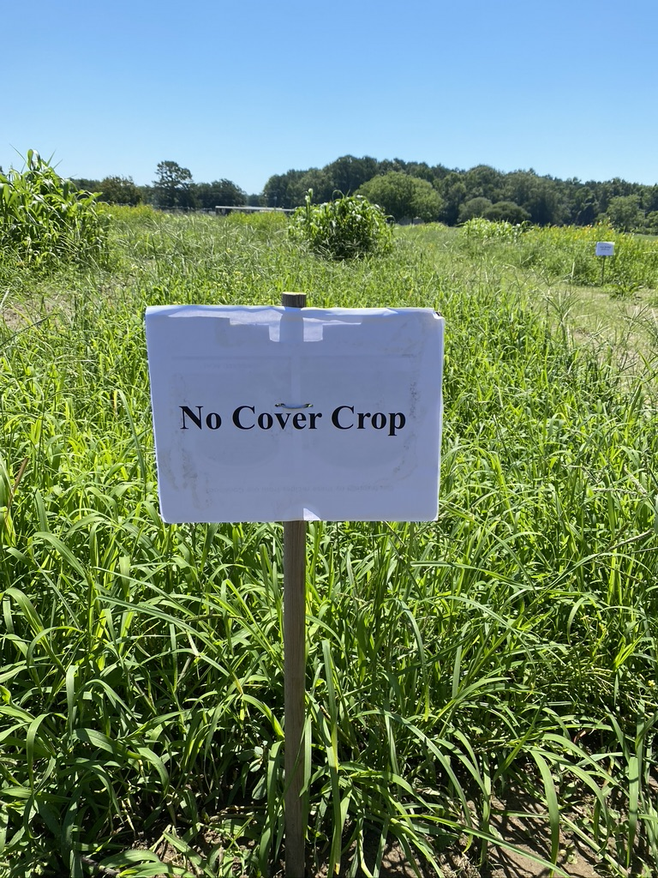
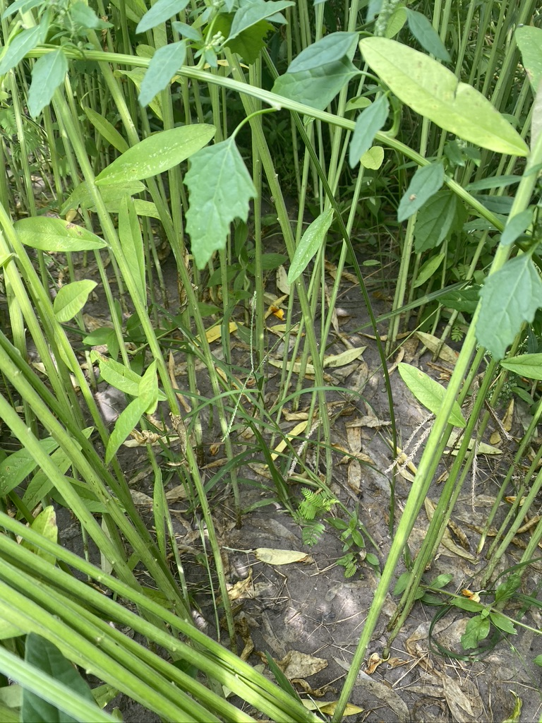
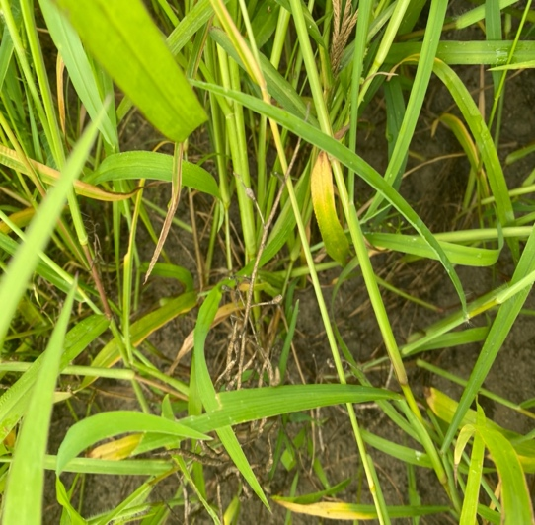
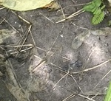
Leaving a field fallow vs. growing cover crops

Slide 11
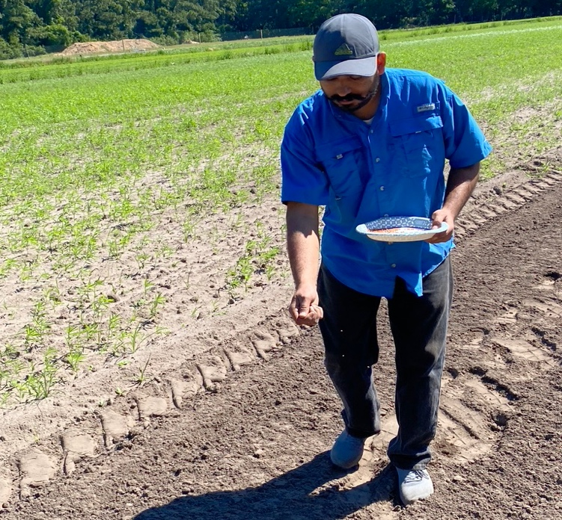
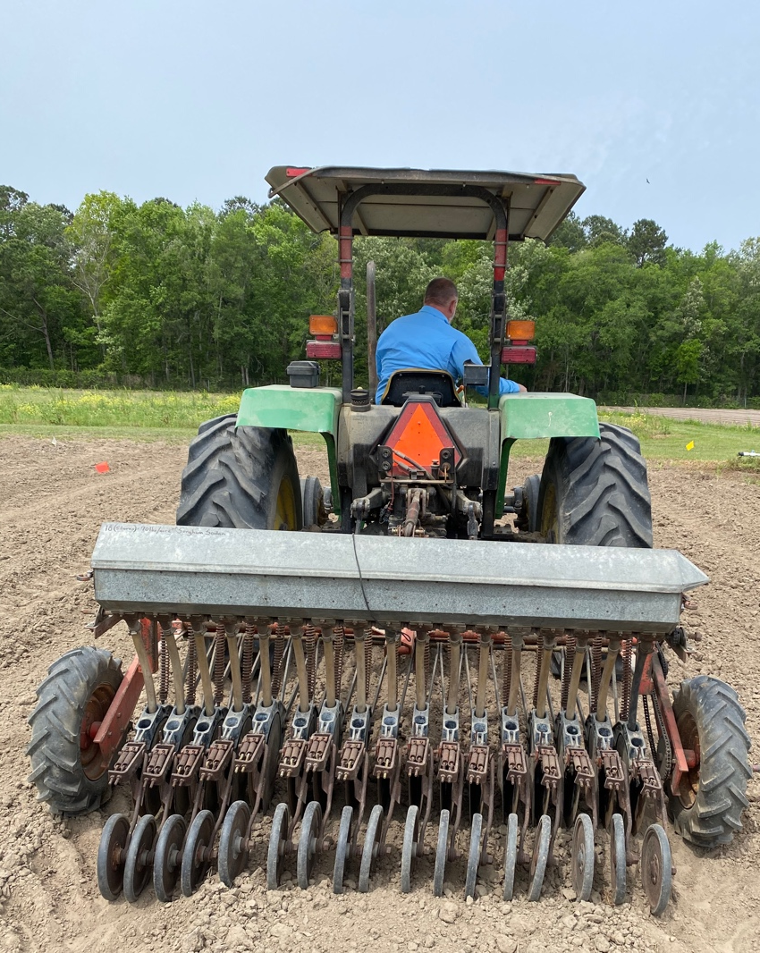
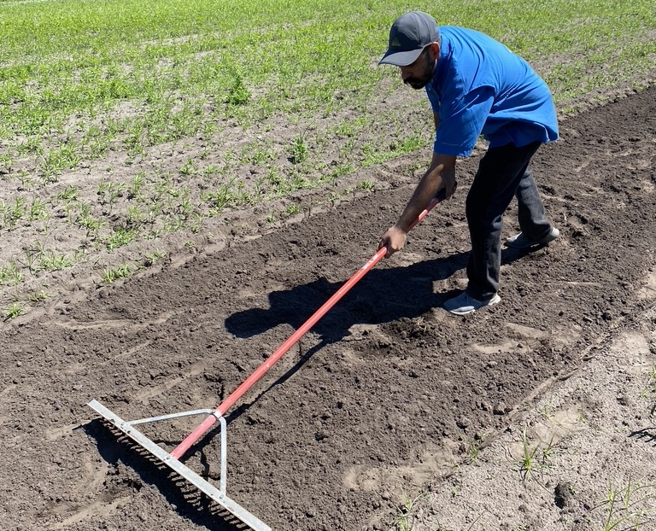
Broadcasting seeds results to similar biomass as drilling
Similar cover crop biomass and germination were found with broadcasting seeds.

