Slide 1
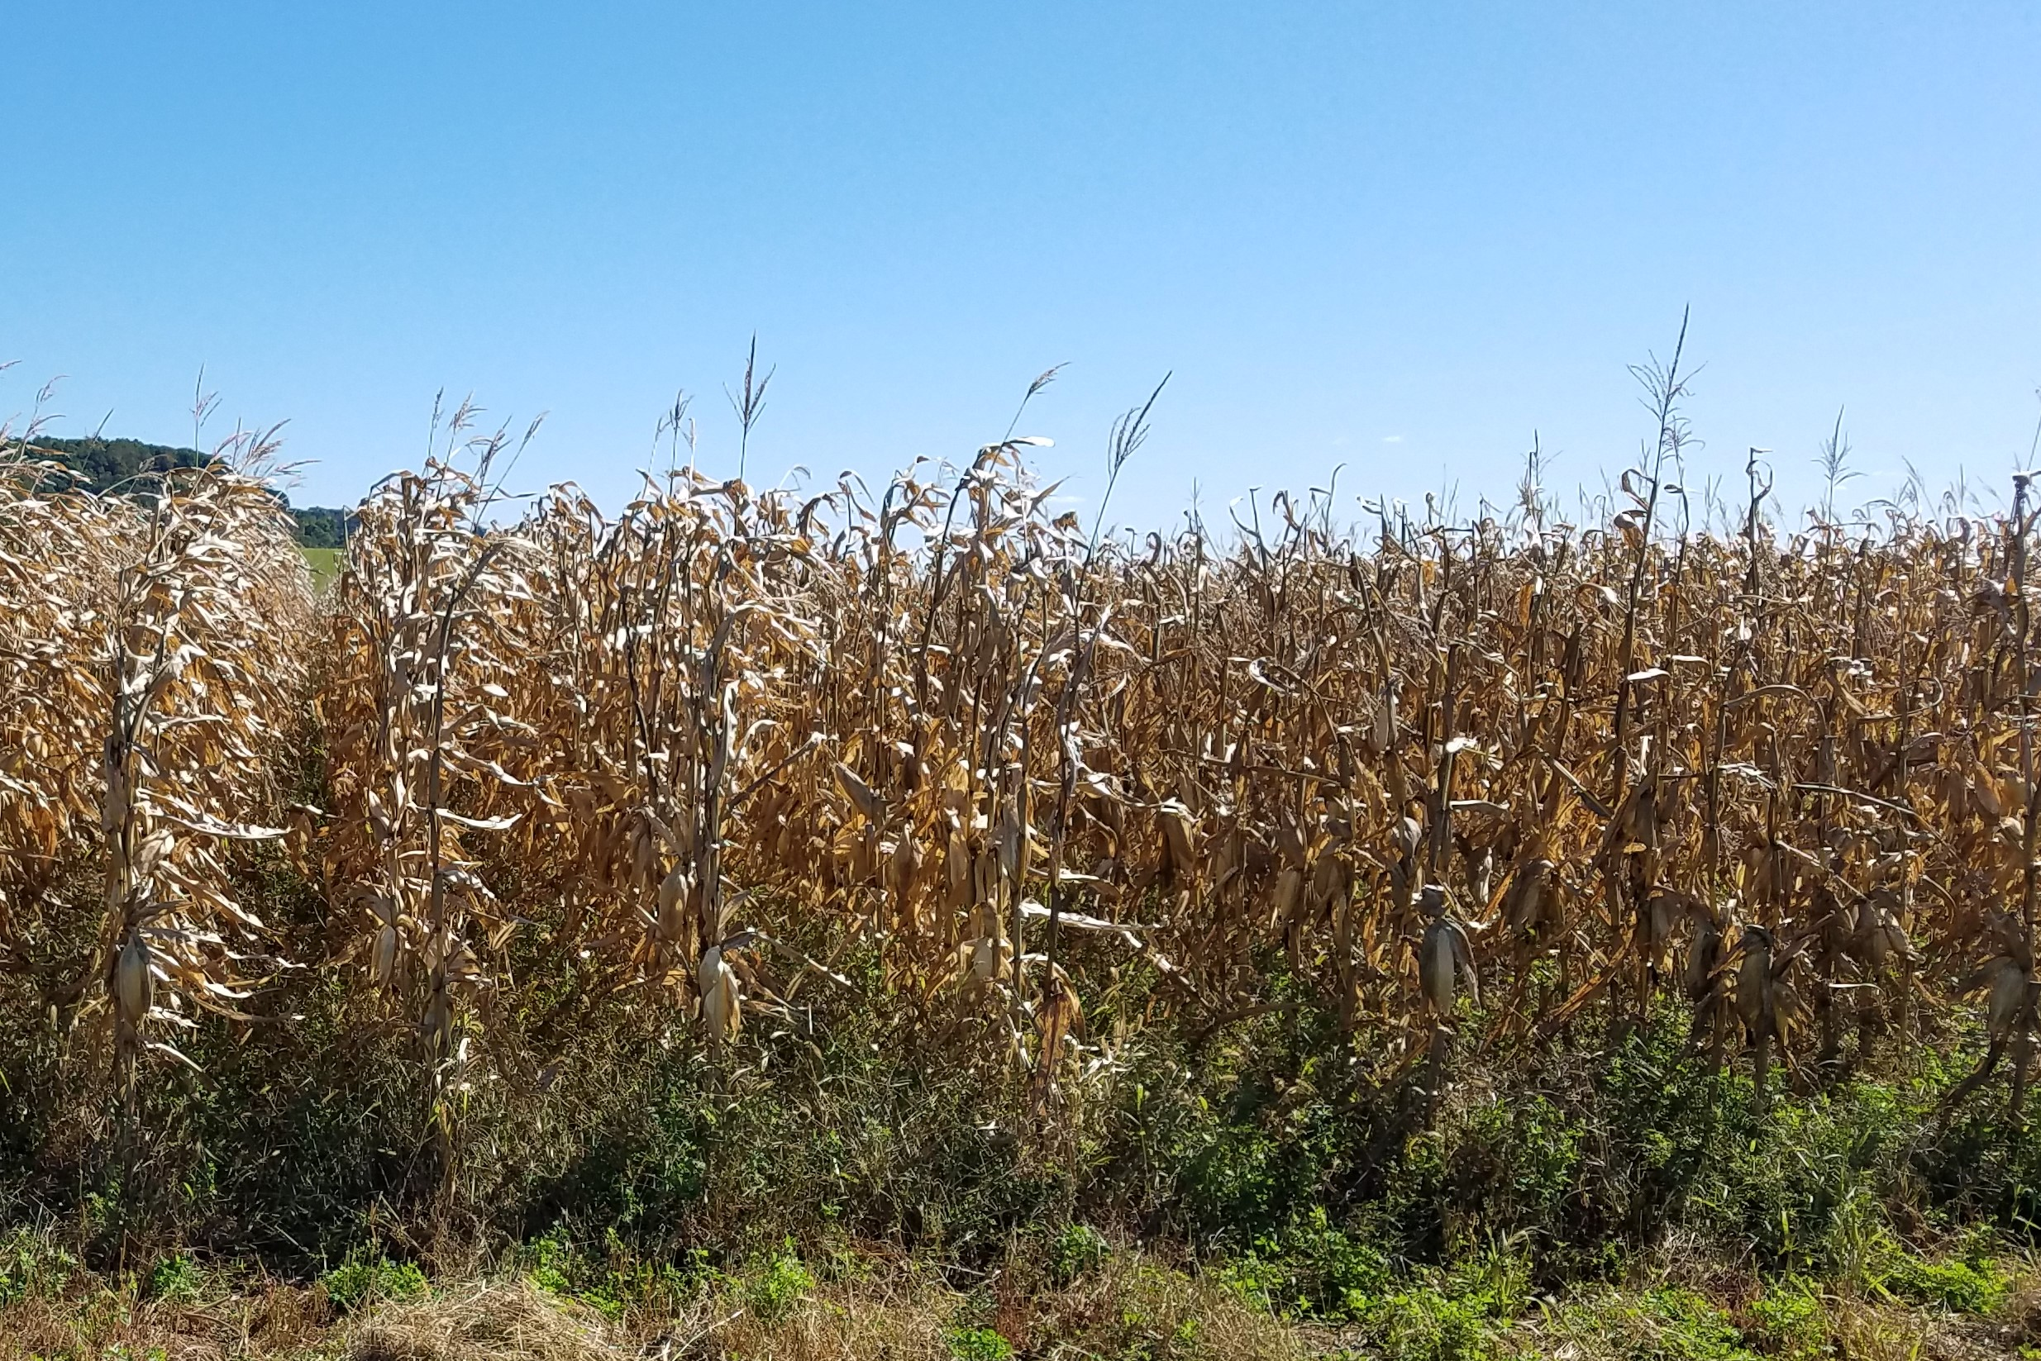
FOST 8507 Clark Farm SARE trial 2018 GLS problems C46xC2B4

