Slide 1
Grazing Management
Kim Mullenix, Ph.D.
Assistant Professor/Extension Specialist
Beef Cattle Systems
Auburn University

Slide 2
What is grazing management?
Defined:
  The manipulation of the soil-plant-animal complex of grazing land in pursuit of a desired result
  The manipulation of grazing in pursuit of a defined set of objectives
  Requires labor, capital, land, forage and animal resources

Slide 3
Forages as the Foundation of Grazing Management
Unique from a crop perspective
Why?
  Most plants are harvested after a reproductive stage of development – for fruit or seed
  Forages are harvested for their leaf area or the “solar panels” of the plant

Slide 4
What makes grazing management different from other crops?
A Unique Job
    Continuously or frequently removing leaf area, requiring regrowth throughout the grazing season
    Not just “one and done” like row crops
Job Requirements
  Yield
  Nutritional Value
  Regrow/Persist* Over Time
  Help me manage my input costs

Slide 5
Job Requirement - Yield
High forage leaf production over an extended period of time depends on:
  Effective light interception and high photosynthetic efficiency
  Low extent of leaf aging and decomposition of leaves
  Maintenance of a vigorous tiller or shoot population for regrowth
  Maintenance of adequate levels of carbohydrates in plant food storage structures

Slide 6
Animal impacts on plants

Slide 7
Grazing Management – Animal Perspectives
Understanding of what is required by the plants and animals to be productive
How the nutritional requirements of animals can be matched with the ability of the pasture to supply nutrients

Slide 8
Grazing Management - Defoliation
Defined: the removal of plant shoots/leaves by grazing
Effects pasture management depending on:
  Forage species
  Selectivity
  Frequency of grazing
  Intensity of grazing
  Stage of development
  Weather conditions at time of defoliation

Slide 9
Grazing Animals
Anything that defoliates forage
Commonly: cattle, sheep, goats, horses
Less frequently: swine and poultry
Wildlife: deer, turkeys, insects

Slide 10
Defoliation – Animal Selectivity
Ability to select the highest quality in the sward first
Livestock have preferred plants in the system
  “Ice Cream Plants”
  These areas are visited the most often
Legumes > Grasses

Slide 11
Defoliation – Animal Selectivity
Livestock prefer less mature plant tissue over stemmy material
Prefer leaves over stems and infloresences specifically
Preferences shift over the grazing season according to 1) plant availability and 2) changing maturity

Slide 12
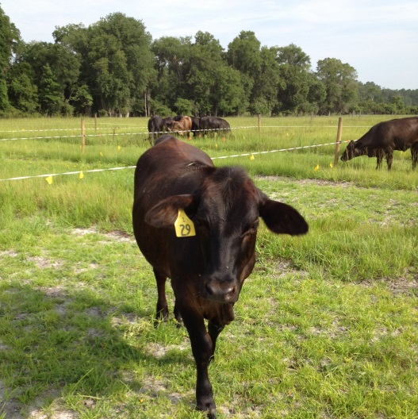
Defoliation – Animal Selectivity
Cattle and horses– grasses
Sheep – forbs
Goats – browse (shrubs and woody plants)

Slide 13
Defoliation – The effect of forage species
Bunch grasses
  Elevate their leaves and growing points higher in the canopy
Low-growth habit grasses
  Growing points at the soil surface level or slightly below the soil
Legumes
  Buds at the stem tip, crown buds – often where first and new growth comes from

Slide 14
Defoliation - Grazing Intensity
How close to graze
Has the greatest impact on pasture and animal productivity
Indicators of how close to graze:
  Grazing height
  Stocking rate (number of animals per acre)

Slide 15
Canopy Height and Grazing of Various Forage Crops
Crop | Begin Grazing (in.) | End Grazing (in.)
Alfalfa | 10 to 16 | 3 to 4
Bahiagrass | 6 to 10 | 1 to 2
Bermudagrass | 4 to 8 | 1 to 2
Clover, white | 6 to 8 | 1 to 3
Dallisgrass | 6 to 8 | 3 to 4
Tall fescue | 8 to 12 | 4 to 8
Annual ryegrass | 6 to 12 | 3 to 4
Small grains (rye, wheat, oats) | 8 to 12 | 3 to 4

Slide 16
Defoliation - Grazing Frequency
How often to graze a pasture area?
Not a set answer!
  Can stock pastures continuously
  May rotate animals from pasture to pasture
  Largely depends on goals, objectives, and resources of the grazier

Slide 17
Defoliation – Weather and Environment
Wet
  Hoof action may cause damage to forage crops, cause soil compaction, and reduce water infiltration (dependent on soil type)
Cold
  Reduces plant growth, Cool-season grasses 60 to 80°F, Warm-season grasses, 80 to 95°F, Legumes 70 to 90°F
Drought
  Reduces plant growth, especially regrowth when grazed – rest period is important here

Slide 18
Grazing Management – Nutrient Distribution
Cattle, sheep and goats recycle nutrients
    70 to 80% of nutrients can be returned to the soil
Significant sources of N, P, and K return
  Water, mineral, and shade – areas where animals congregate
Can maximize returns depending on grazing method used, animal stocking rate

Slide 19
Beef heifers grazing bahiagrass pastures – different grazing methods
Nutrients concentrated in about 20 to 30% of the total pasture area
Source: Vendramini and Sollenberger (2013)
Continuous grazing

Slide 20
Grazing Management – Trampling
Pugging – pressure of animal hooves on pasture
Impacts pasture plant response and regrowth
Main considerations:
  Number of animals
  Grazing tolerance of the plant – regrowth potential
  Pasture conditions

Slide 21
Grazing Management - Trampling
Reduces forage utilization
    The amount of available forage for grazing
Soil type considerations
  Clay soils > silt > sand
  Amplified under wet conditions

Slide 22
How plants respond to defoliation

Slide 23
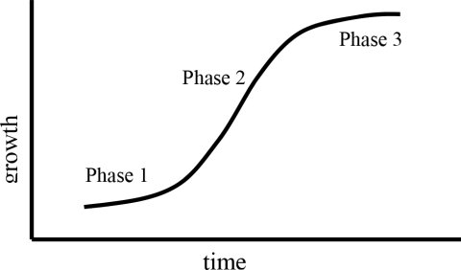
Understanding Plant Growth – Foundations of Grazing Management
Reproductive
Vegetative
Early growth
90% light interception

Slide 24
Phases of Growth
Phase 1 – Slow/transition growth
Phase 2 – Vegetative/rapid growth
Phase 3 – Reproductive/slow growth

Slide 25
Plant Responses to Defoliation
35 d
25 d
10 d
Pounds of DM/acre
0 d
Days since defoliation
Adapted from Holmes et al., 2007

Slide 26
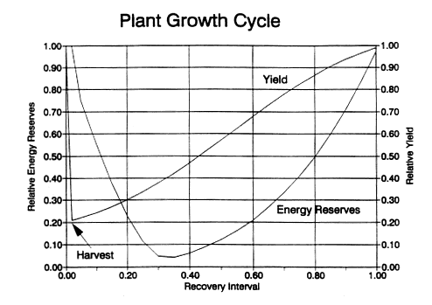
Plant Responses to Defoliation – Root Reserves
Adapted from Rayburn, 1993
Changes in plant height and carbohydrate energy reserves in a forage plant during regrowth

Slide 27
Impacts of Defoliation on Root Growth
Leaf Volume Removed | Root Growth Stoppage
-------------------------------------------------------------------- %--------------------------------------------------------------------
10 to 40 | 0
50 | 2 to 10
60 | 50
70 | 78
80 to 90 | 100
Source: Dietz, 1989

Slide 28
Overgrazing
Allowing animals to regraze plants before they are able to replace root reserves used for regrowth
Three Key Items:
  Reduces available leaf area for regrowth
  Reduces root reserve carbohydrates
  Impacts persistence of forage in stand, leads to species composition changes

Slide 29
Undergrazing
Increasing animal selectivity in pasture systems
  Spot-grazing
  Decreases total forage utilization
Increasing forage maturity – less nutritive value
Reduced regrowth potential

Slide 30
Plant Responses to Defoliation
Necessary to find a balance between plant growth and potential to maximize animal use
  Balance of plant regrowth and persistence
Dependent on stage of growth

Slide 31
Response is largely dependent on plant stage of growth
Grasses
First Growth
Vegetative | Leaves only, stems not elongated
Stem elongation | Stems elongated
Boot | Infloresence enclosed in flag leaf and not showing
Heading | Infloresence emerging
Anthesis | Flowering stage
Milk stage | Seed immature, endosperm milk
Dough stage | Well-developed seed, center is doughy
Ripe stage | Seeds ripe, leaves green to yellow brown

Slide 32
Leaves and Regrowth are Good But Do Not Last Forever
Leaf area is good – increases yield potential
Pasture leaf tissue cannot be stored over long periods of time – leaves live about 30 to 60 days
Aging leaves do not use sunlight as efficiently and eventually die

Slide 33
Figure 2. Changing proportion of dead leaves over time – Ball et al. 2015
Total Growth
Forage Production
Dead leaves
Green forage
Leaf Area Units

Slide 34
Maximizing Regrowth
Use management methods to keep forage in rapid growth phase
“Take half leave half” – as a starting point
Understanding the production range of the forage crop being grown

Slide 35
Maximizing Regrowth
Cool-Season Forages
  Average yield between 1,000 to 1,500 lb DM/acre per harvest to 3,000 to 3,500 lb DM/acre

Slide 36
Cool-Season Forages Growth Response
3500 lb DM/acre
2,000 lb DM/acre
Pounds of DM/acre
1,000 lb DM
Days since defoliation
Adapted from Holmes et al., 2007

Slide 37
Use management tools available to maximize forage production
Estimate forage availability in pasture systems
Know the range of production expected of species selected
Understand limitations – environmental, etc.
Use grazing methods to improve utilization

Slide 38
Questions?
Visit www.aces.edu/beefsystems

