Slide 1
Grazing Methods and Their Role in Pasture Management
Kim Mullenix, Ph.D., Extension Beef Specialist, Auburn University
Jennifer J. Tucker, Ph.D., Extension Beef Specialist, University of Georgia

Slide 2
Grazing Management: Objectives
To manage the pasture and other feed inputs to efficiently produce animal products
To effectively managing forage quantity and quality over the grazing season, regardless of grazing method utilized
To adjust livestock stocking rates to improve grazing efficiency and animal production per unit of land

Slide 3
Overall Goal
Efficient production and utilization of a forage base that is able to meet the needs of the livestock herd.
Can be achieved through:
  Implementing grazing methods within a grazing system

Slide 4
Animal
Plant

Slide 5
Grazing Methods:
Goals
Improved grazing efficiency
Reduce pasture waste
Conserve surplus forage (hay or silage)
Increased animal performance
Improved forage quality at time of use

Slide 6
Improving Grazing Efficiency

Slide 7
Efficiencies of Grazing Methods
Grazing Methods | Efficiency
Continuous Stocking | 30-40%
Slow Rotation (3-4 paddocks) | 50-60%
Moderate Rotation (6-8 paddocks) | 60-70%
Strip Grazing | 70-80%
Adapted from D. Hancock UGA

Slide 8
Conserving surplus forage

Slide 9
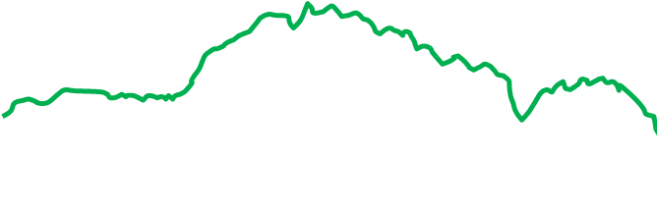
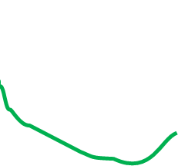

Forage Distribution
Ideal
Relative Forage Provided
Actual

Slide 10
Other Examples
Stockpiling
  A planned management technique allowing forage to accumulate for a time of later use
  Common forage crops in AL: Tall fescue and bermudagrass
  Harvest in early fall, remove dry matter from field, fertilize, accumulate 8 to 10 weeks
  Using improved grazing methods can help improve utilization of this standing forage

Slide 11
Increased Animal Performance

Slide 12
Animal Performance and Forage Quality
Animal Performance
Forage Intake
Nutritional Value

Slide 13
Intake
Intake = consumption
Influenced by:
  Bite size
  Bite rate
  Grazing time/time spent eating

Slide 14
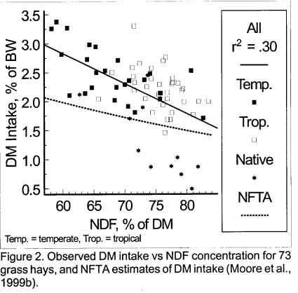
Intake and Forage Quality are Related

Slide 15
Intake – Grazed Tall Fescue
 | High Quality (+ Legumes, Mowed periodically) | Low Quality (Mowed once)
Intake, lb/hd/d | 24 a | 18 b
Digestible DM Intake, lb/hd/d | 14 a | 11 b
Cow Weight, Final | 1070 a | 1015 b
Calf Weaning Weight | 508 a | 470 b
150 d grazing
Holloway et al., 1979

Slide 16
Grazing methods

Slide 17
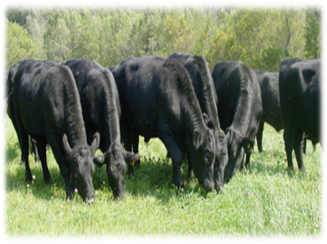
Continuous Stocking
Simplest, most commonly used in Southeast
Animals stocked on single pasture unit for duration of grazing season.
Can work well with warm season perennials like bahiagrass and bermudagrass

Slide 18
Continuous Stocking

Slide 19
Continuous Stocking
Pros
Cons
Simple
Animals are allowed to selectively graze
May result in overall high individual animal performance
May lead to overstocking, overgrazing, decreased forage production
Lowers overall potential for herd performance
Least efficient

Slide 20
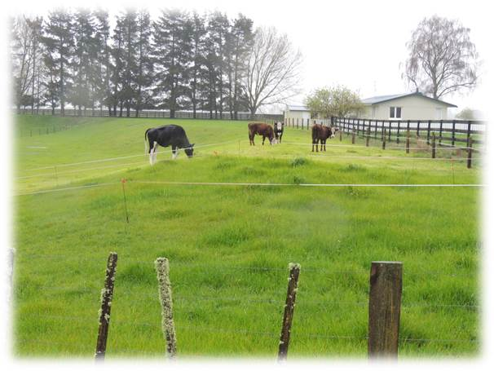
Rotational Stocking
Grazing system in which the grazing area is divided into several small “paddocks.”
Animals will rapidly graze plants to a desired height before “rotating” to a new paddock

Slide 21
Rotational Stocking

Slide 22
Rotational Stocking
Pros
Cons
Potential increase in forage utilization compared to continuous
Flexibility in managing excess
Better matching of animal nutrient requirements
Improved pasture management skills
Initial investment in fences, watering systems
Labor availability
More management decisions

Slide 23
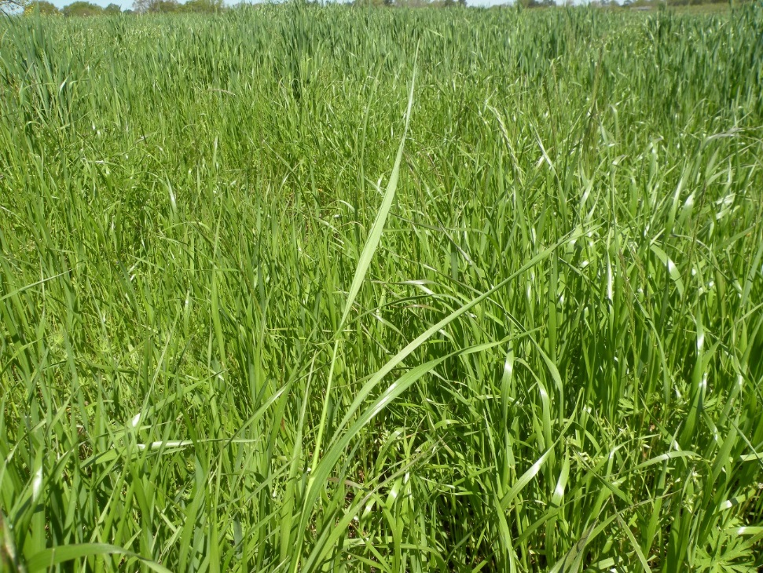
Using High Quality Forage Efficiently
Limit Grazing
Allow cows access to high quality forage for a few hours per day
May decrease hay needs in winter systems

Slide 24

Limit Grazing

Slide 25
Arkansas – Limit Grazing
Free choice bermudagrass/dallisgrass hay and:
  Corn gluten feed – fed 3x per week
  Limit grazing – 7 hr/d, 2x per week
  Limit grazing – 7 hr/d, 3x per week
  Stocking density = 0.1 acre per cow per day
Gunter et al. (2012)

Slide 26
Arkansas – Limit Grazing
What did they find?
  Cows limit grazed maintained similar BCS compared to cows fed concentrate-based supplement (5+)
  No difference between 2 vs. 3 days per week
Gunter et al. (2012)

Slide 27
Arkansas – Limit Grazing
0.1 acre per cow per day
2 days per week
30 cows x 0.1 acre per cow per day = 3 acres for each limit grazing event
3 acres x 2 days per week = 6 acres
12 acres – come back to the same area every 2 wk
Gunter et al. (2012)

Slide 28
Strip-Grazing/Frontal Grazing
Strip-Grazing
Frontal Grazing

Slide 29
Strip Grazing/Frontal Grazing
Pros
Cons
Another form of rotational stocking
Efficient use of forage
  Animals graze area for a period of a few days before fence is moved forward
  Especially good in stockpiled forage systems
  Decreases animal selectivity in pastures
Labor – medium to high
Adaptability to large operations – need to broken into manageable land units

Slide 30
Concepts to Review
Goals of using improved grazing methods
Potential efficiencies of grazing methods
Pros/Cons of Each for Your Operation

Slide 31
Questions?
Visit www.aces.edu/beefsystems

