Slide 1
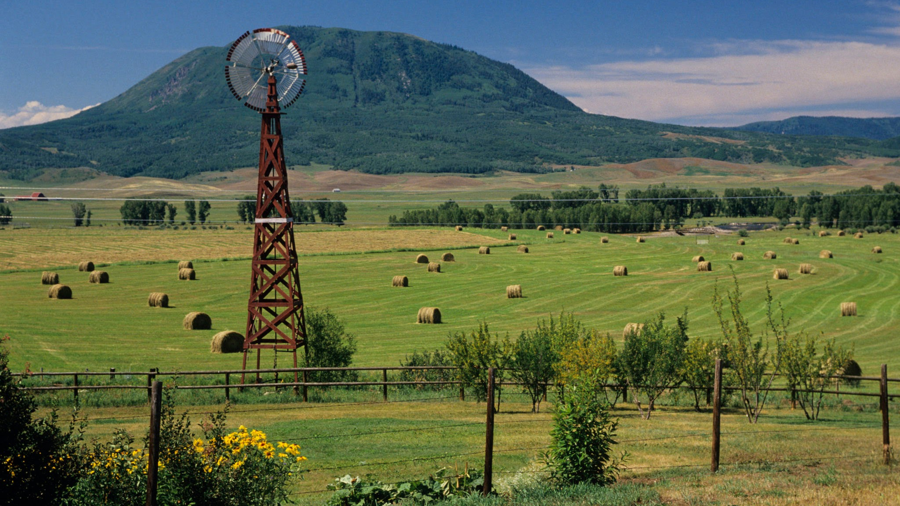
Farm Internship Experience
ICCSD Student Presentation to Community
Cumulative Presentation

Slide 2
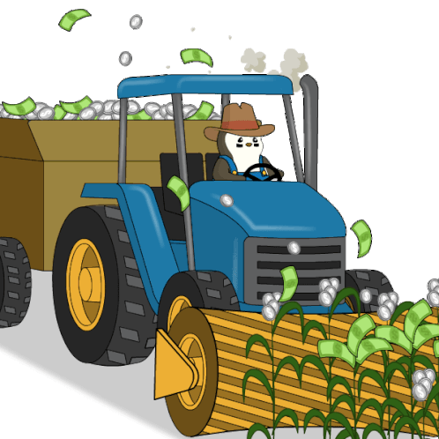
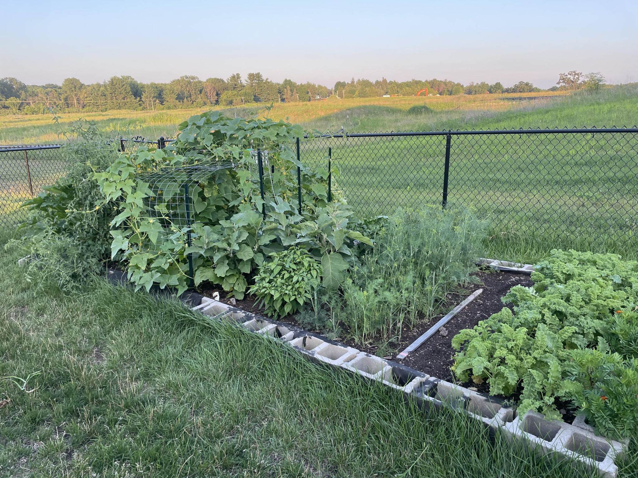
Why We Chose This Internship
Most of us chose it because of past curiosities, or experiences with gardening or farming.

Slide 3
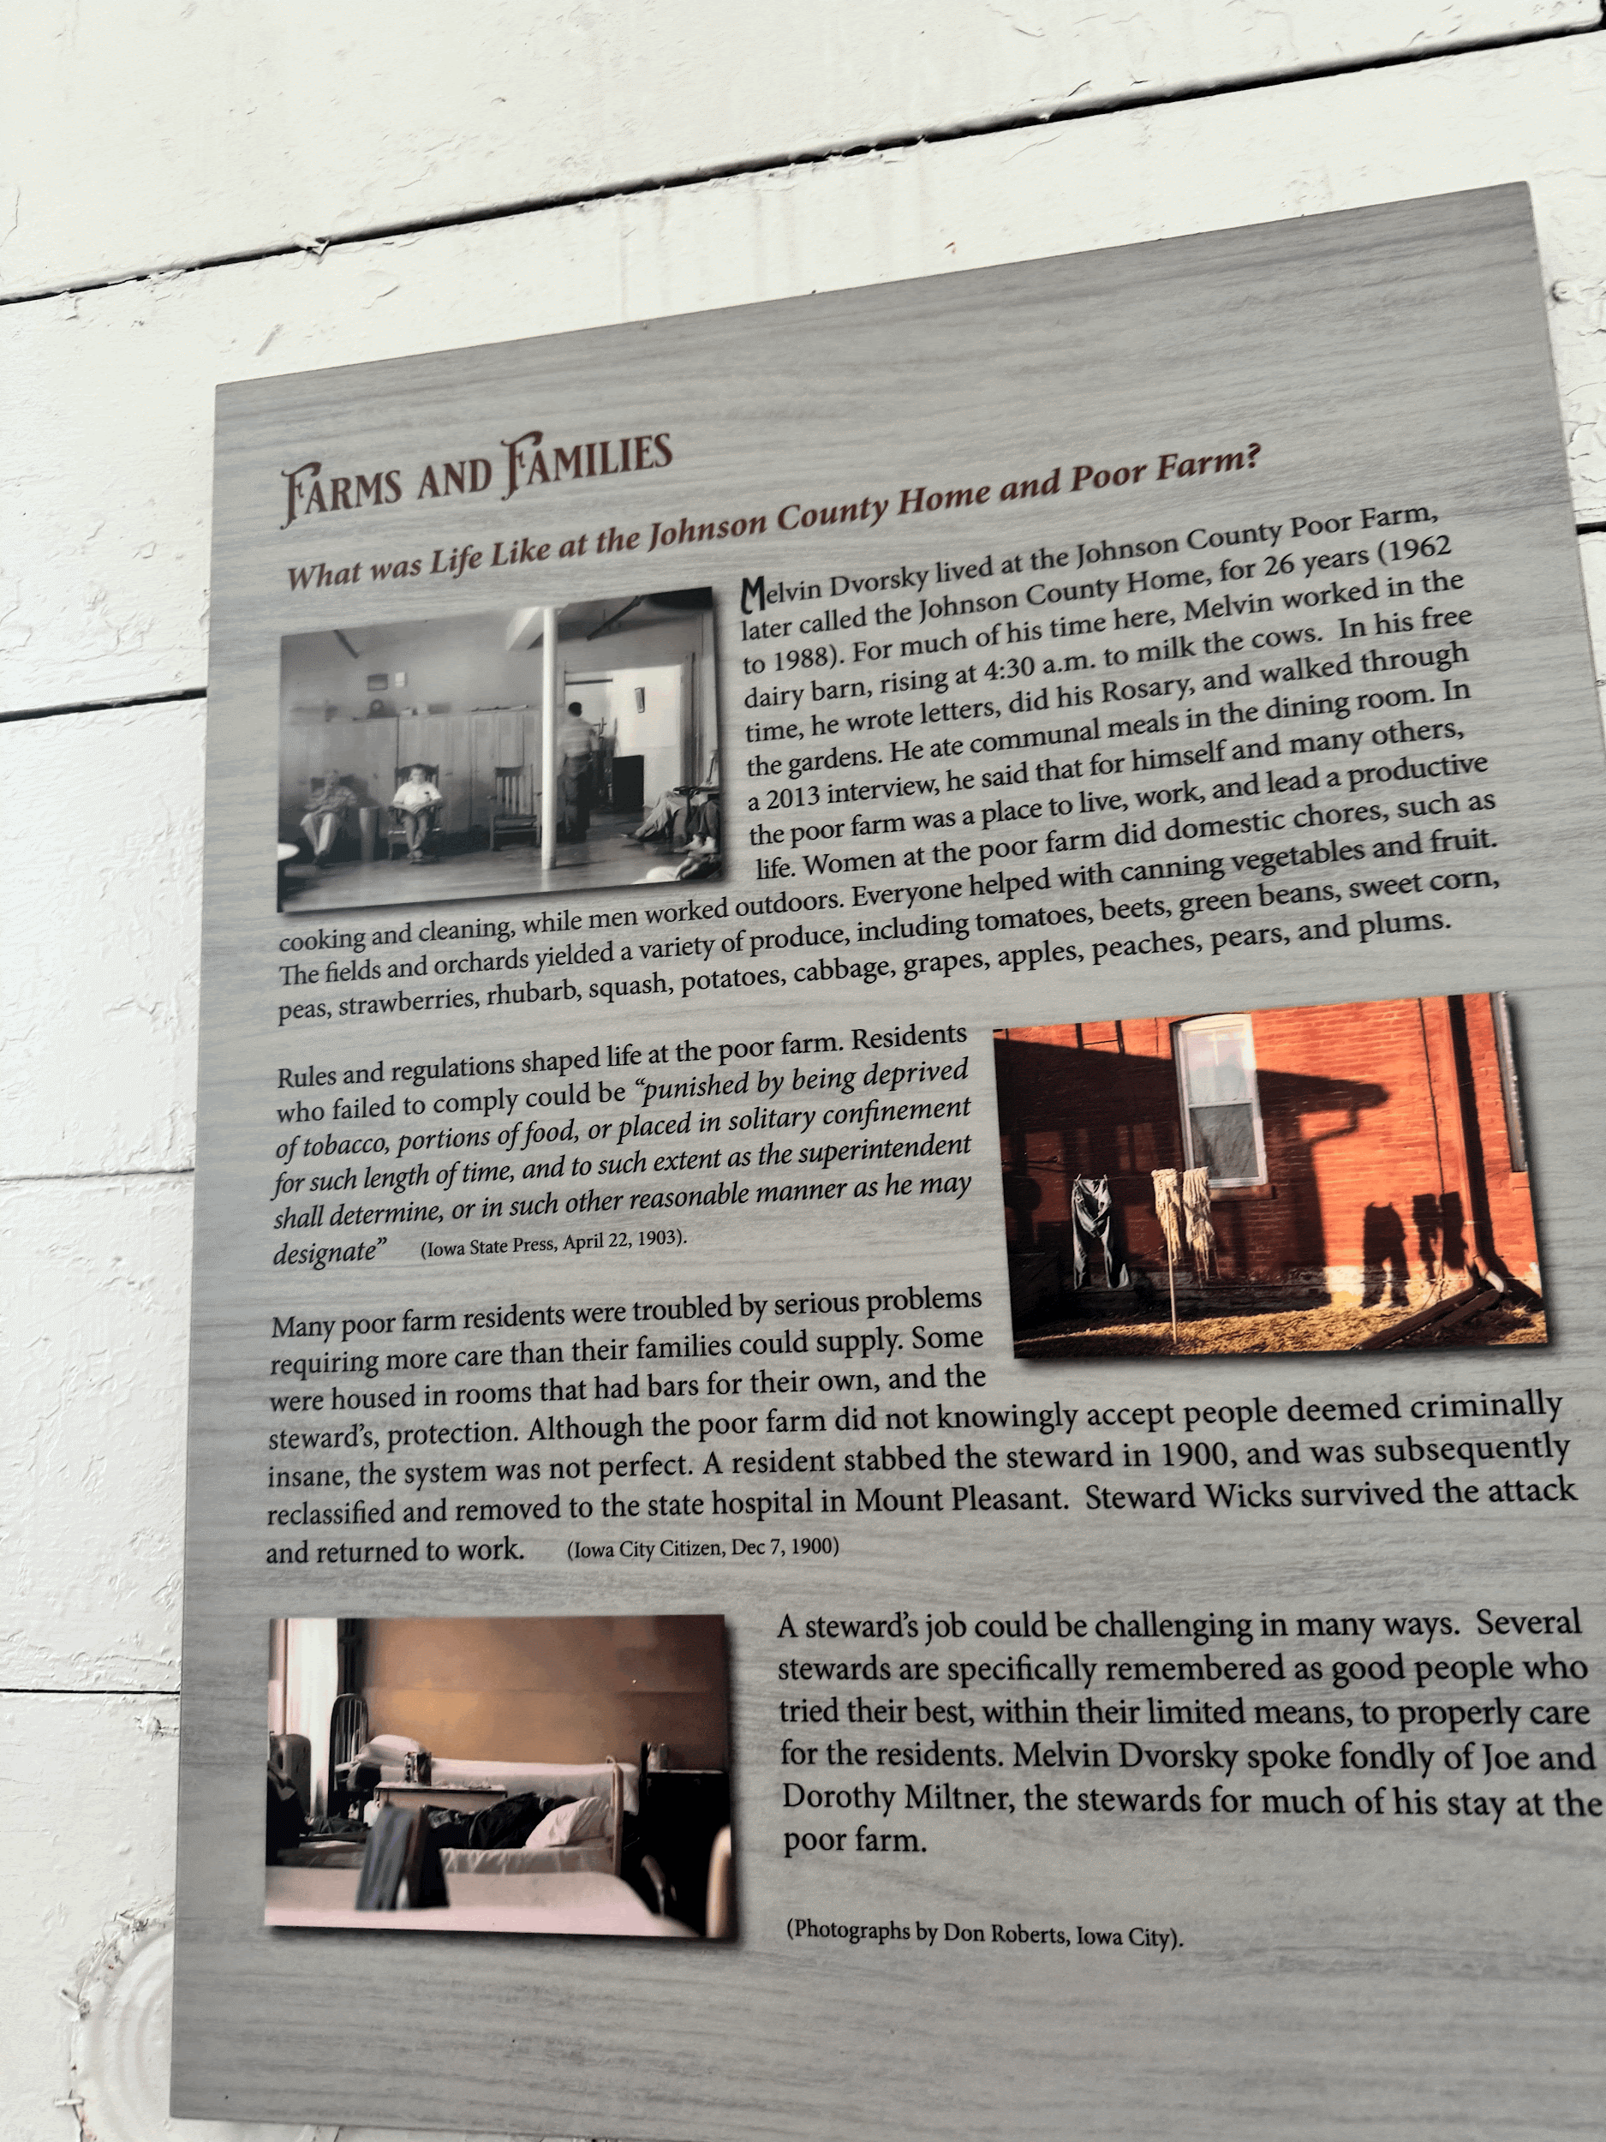
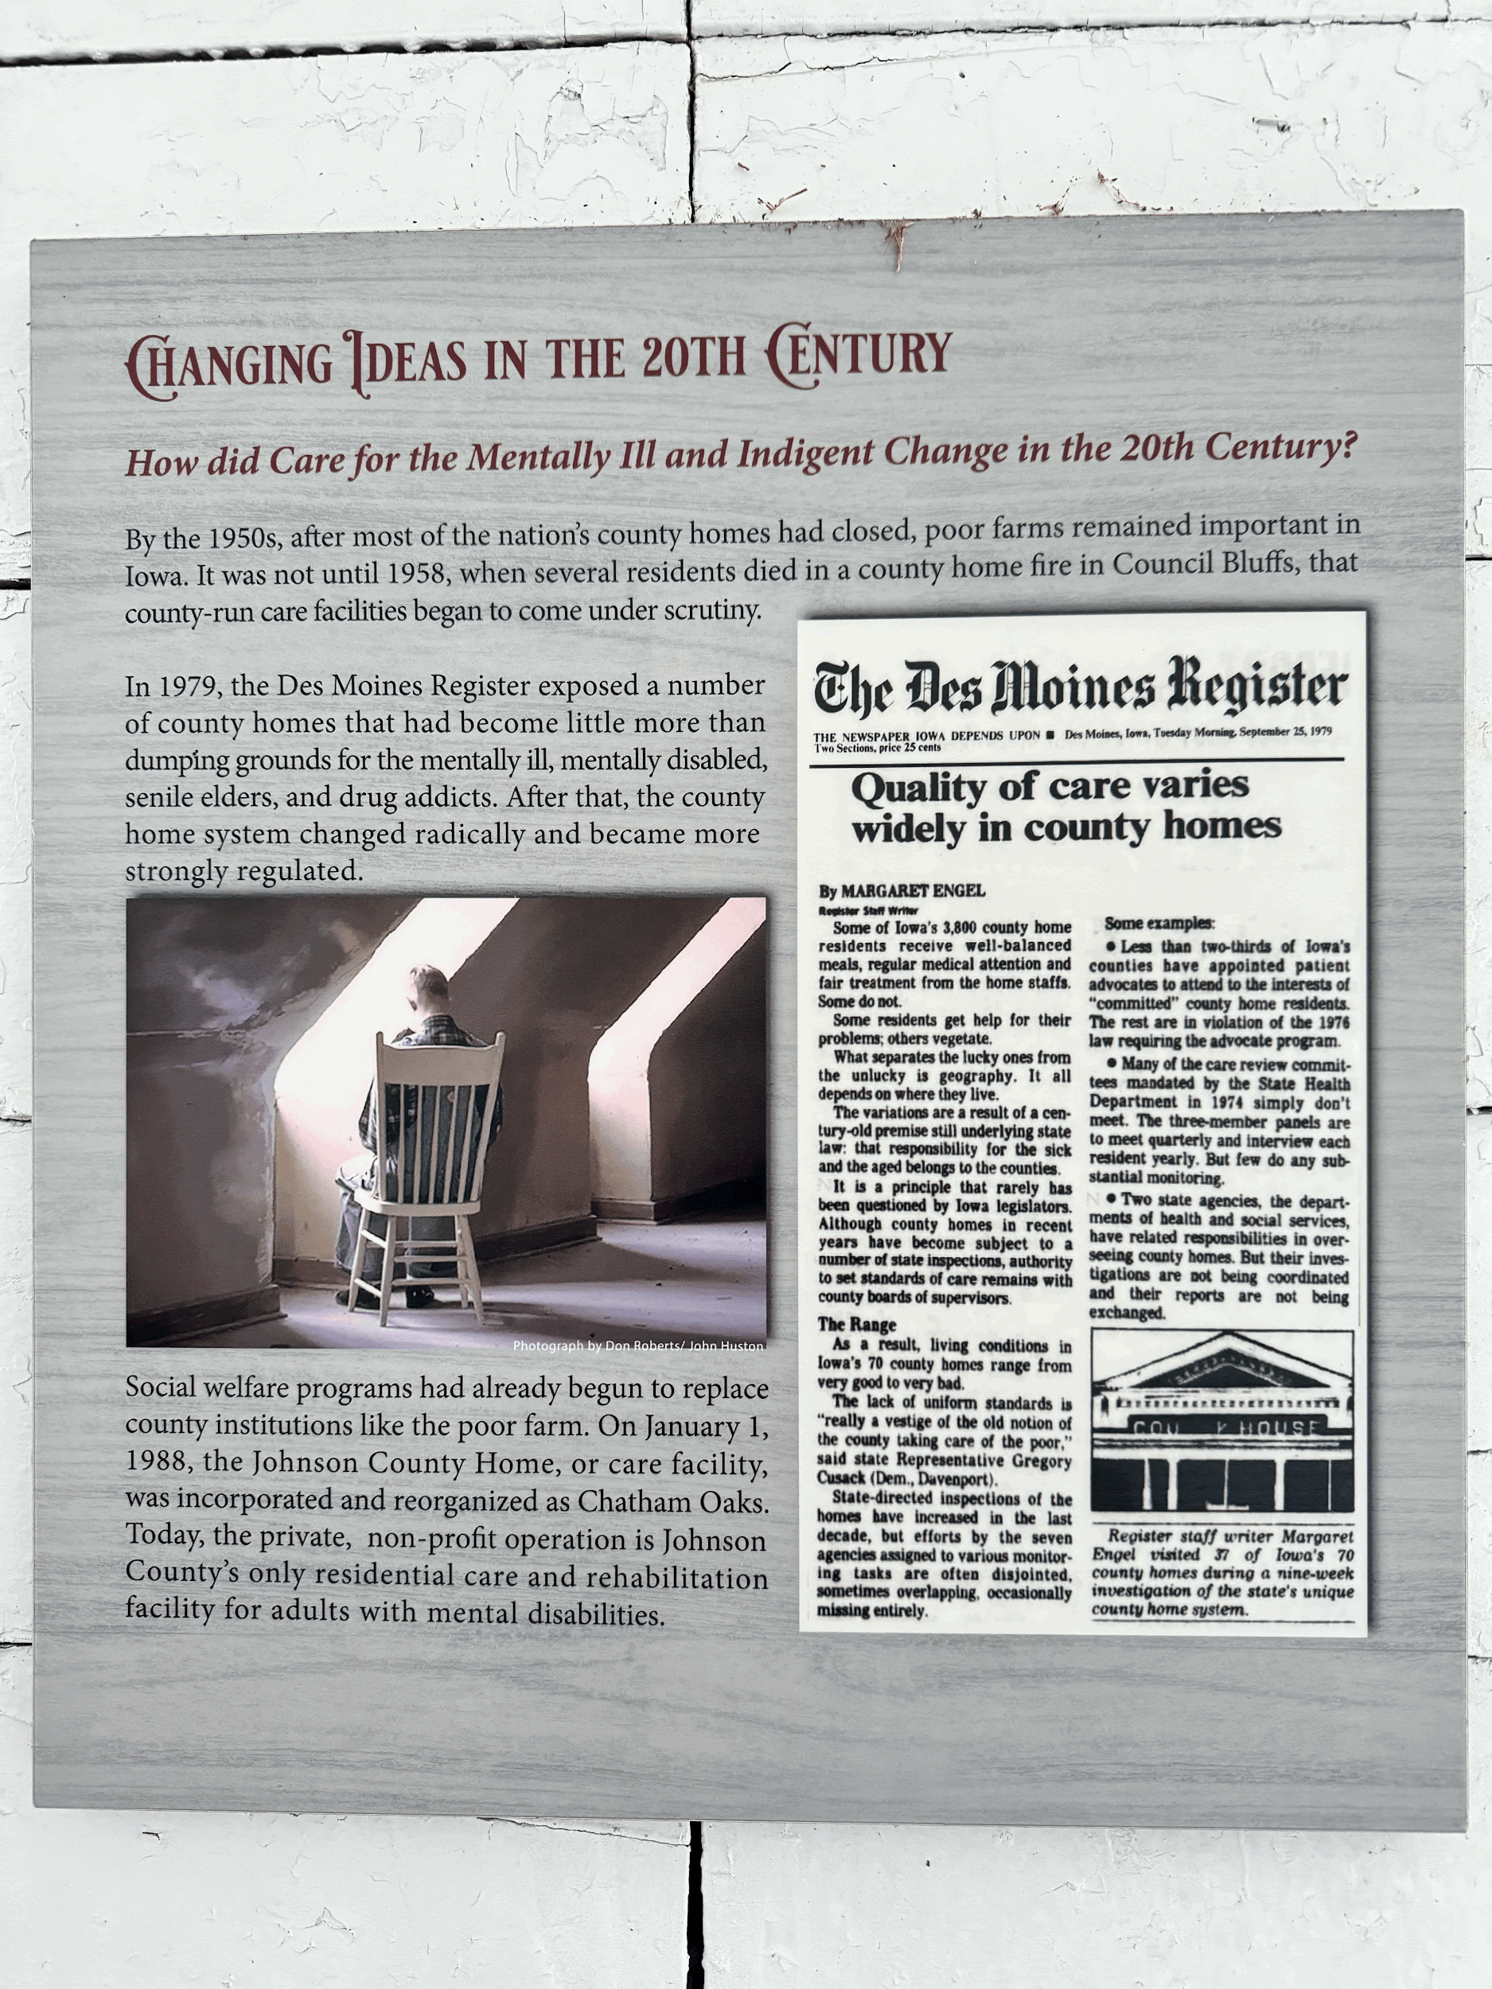
History of the Poor Farm:
The Johnson County Poor Farm was started in 1855 for residents who struggled with many deficients, such as health issues/disabilities and poverty. The Poor Farm was a way to support those surrounded by unjust situations. With residents contributing labor to its dairy and crop operations. It provided food for both residents and customers.
Notes:
Do not

Slide 4
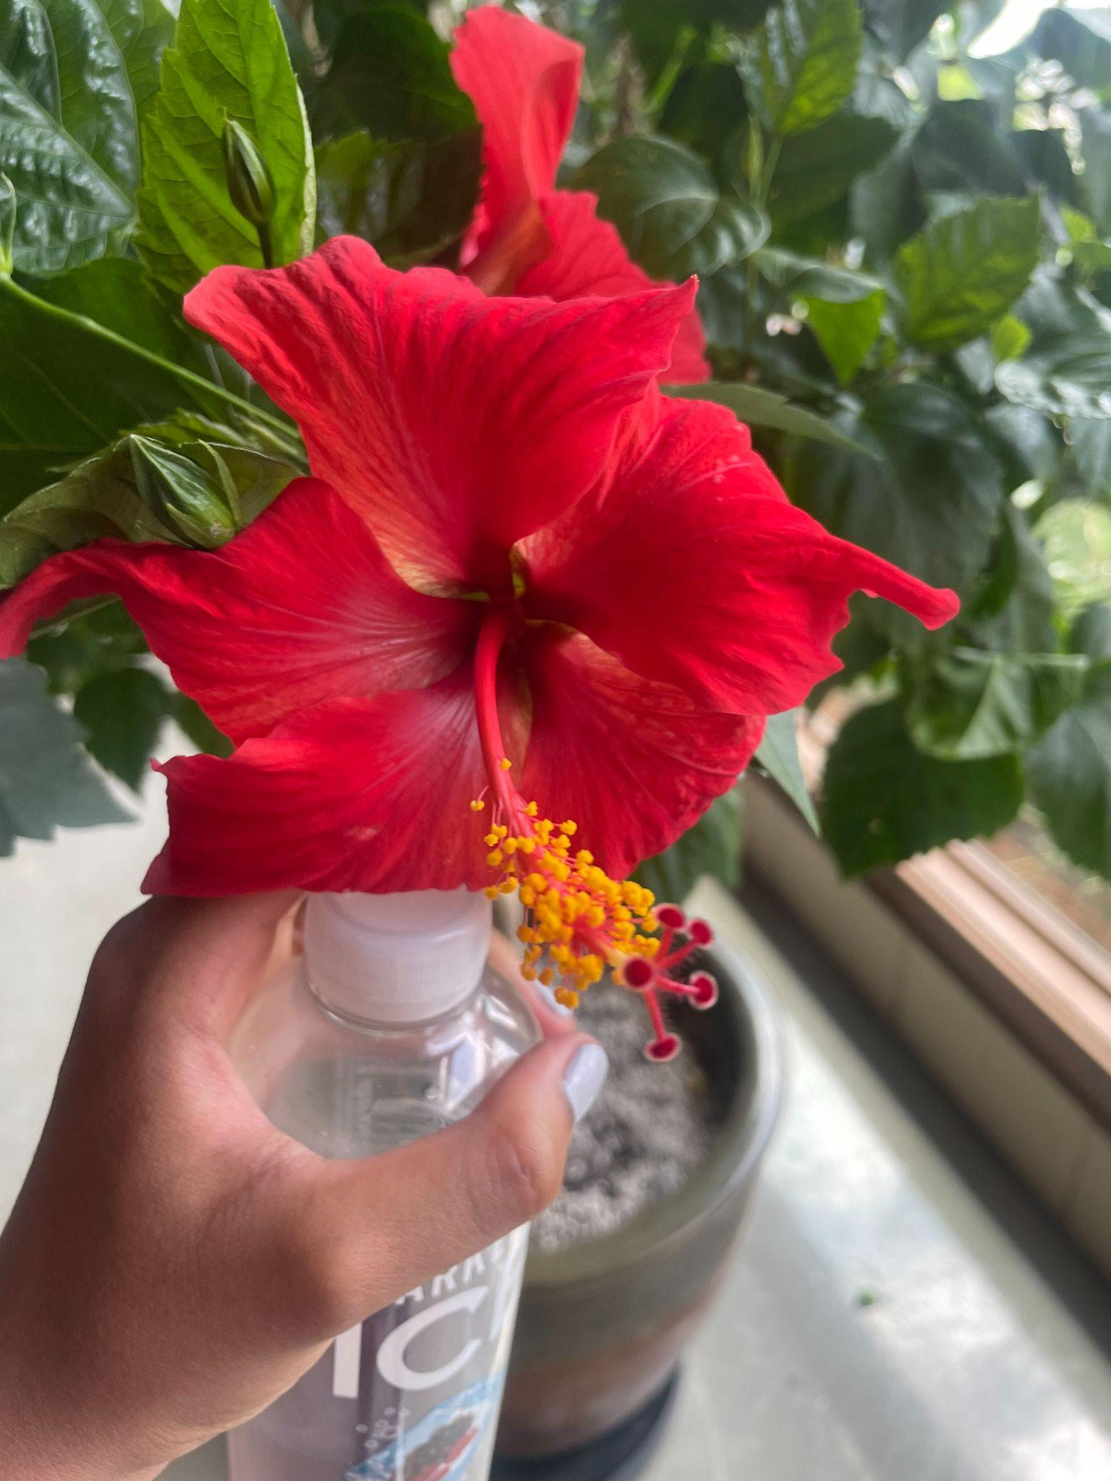
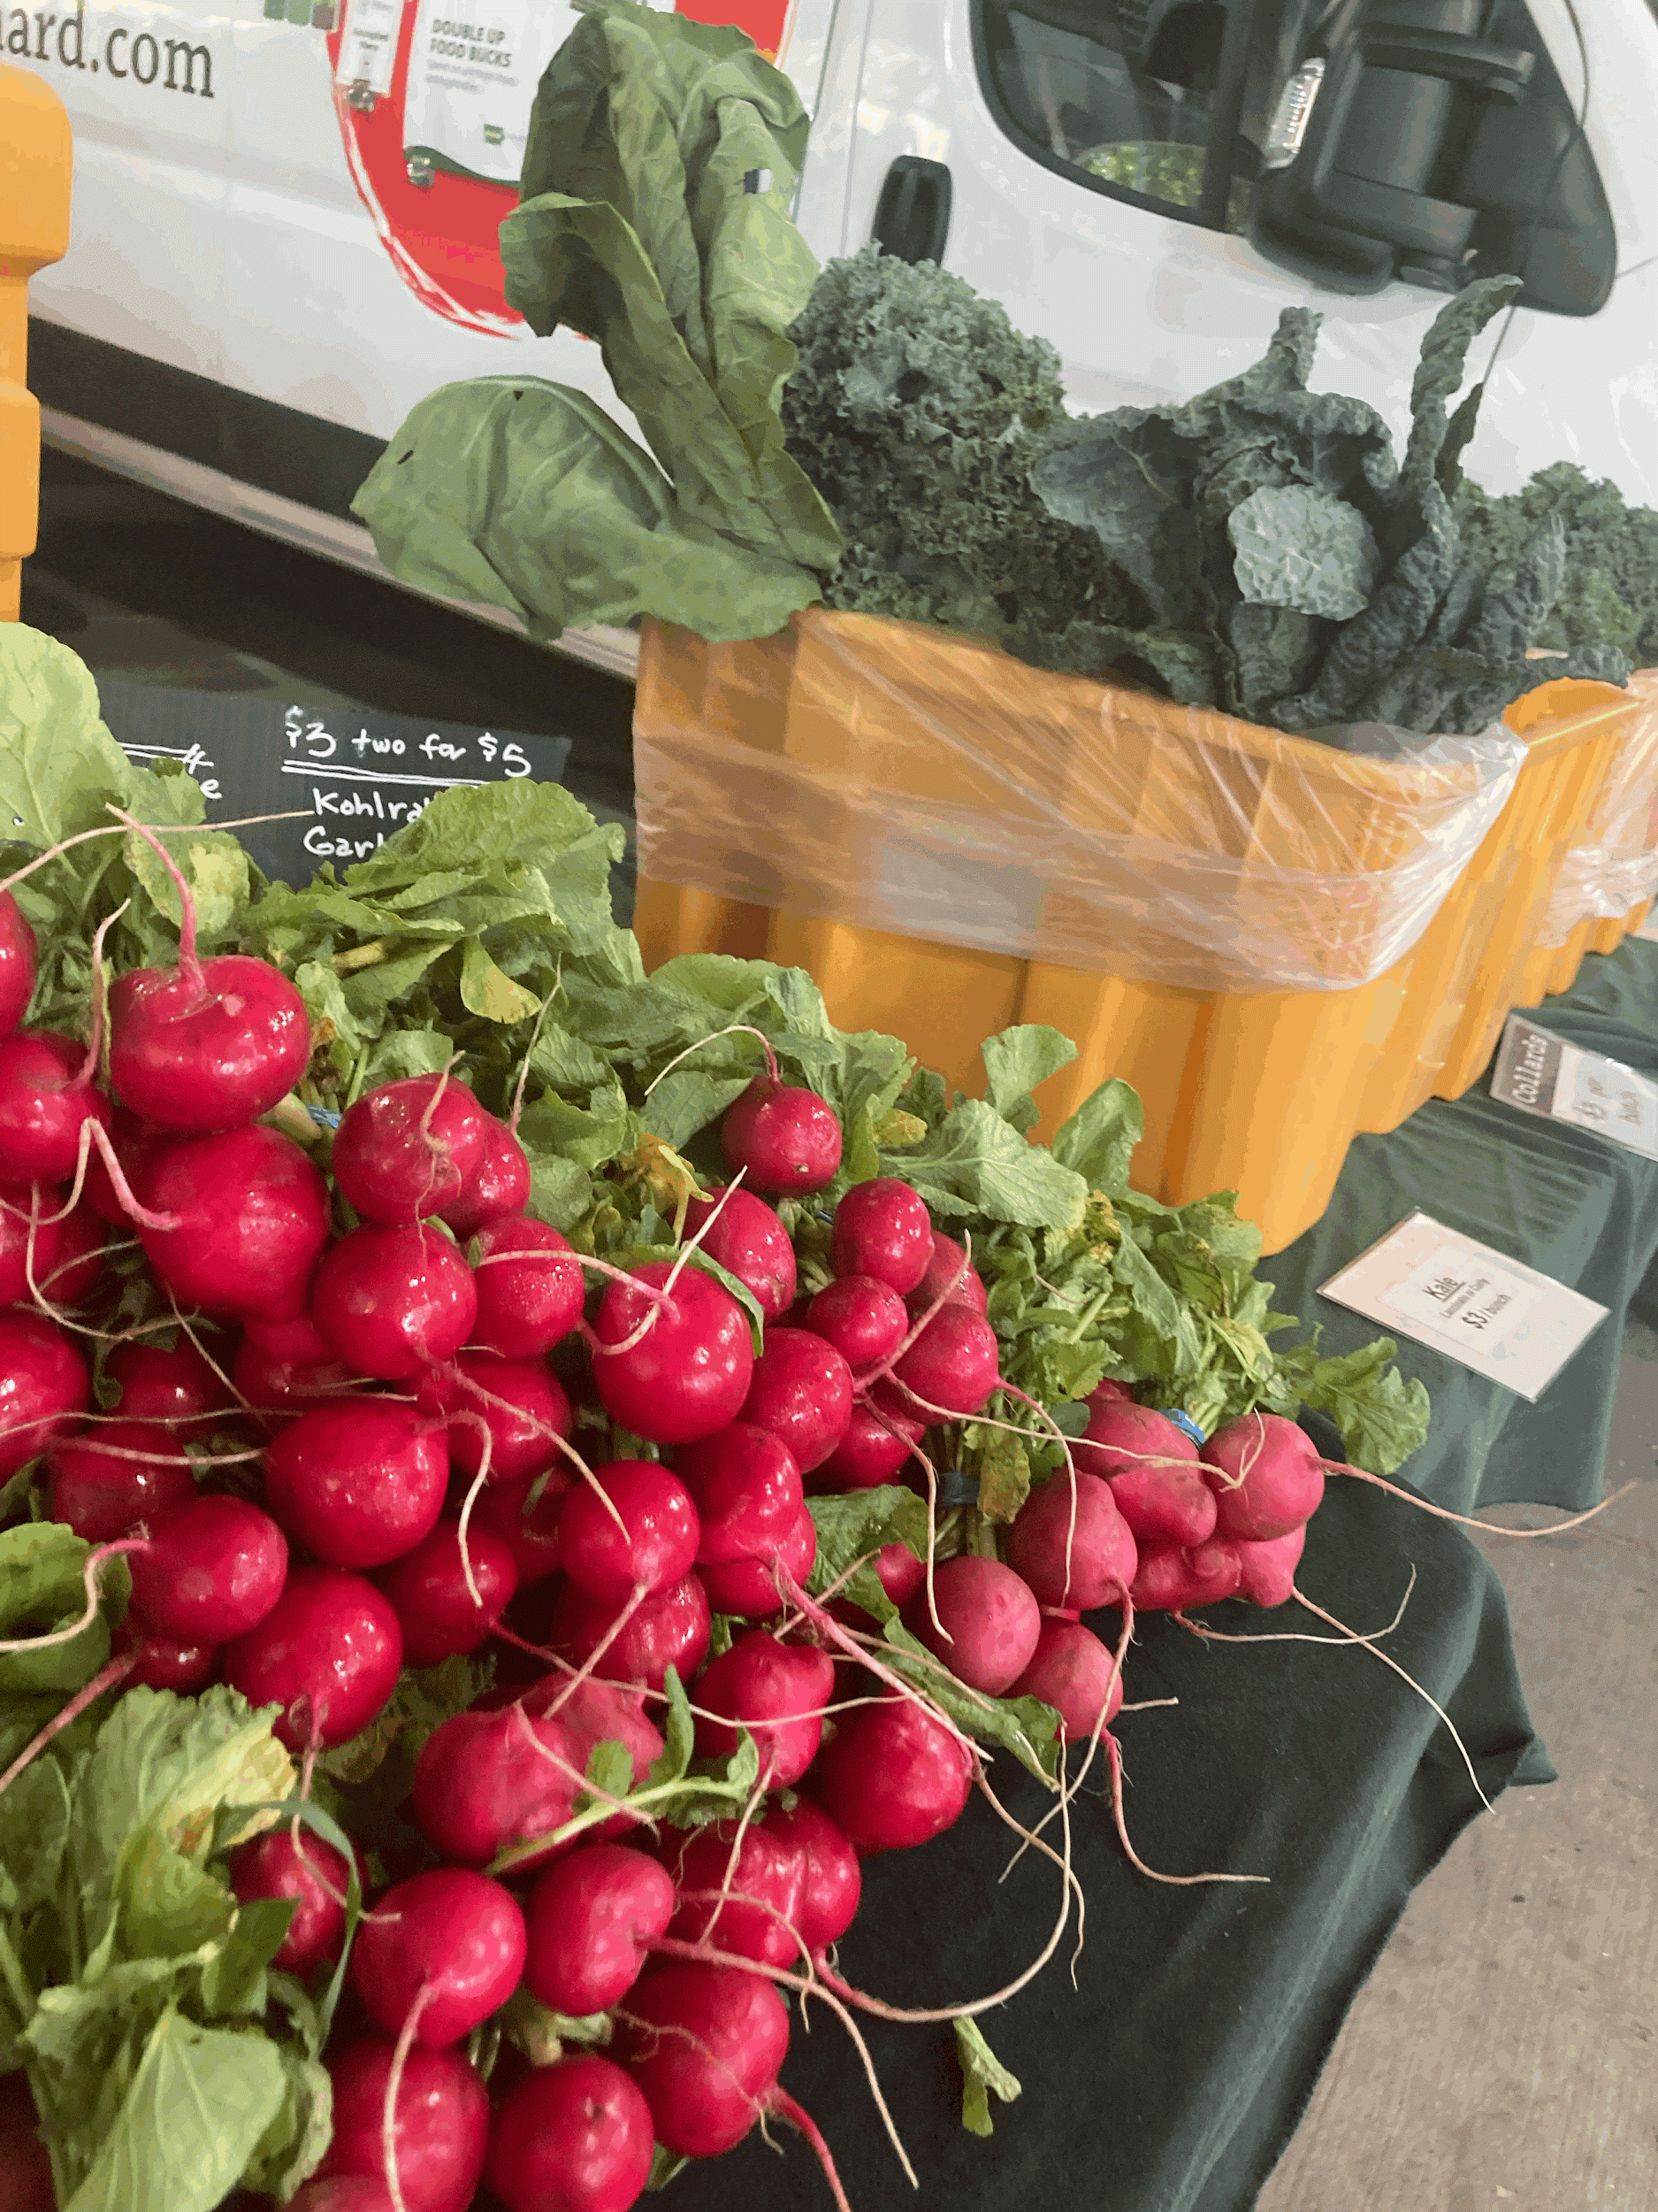
Challenges
Working on the farm meant adapting to any form of weather, sometimes we found this unpleasant but completed our tasks, Such as picking bugs off of plants/crops, cutting off dead stems, washing bins, and more. Any form of contribution towards the farm came with a challenge but where glad to have gotten it all done, no matter the circumstances.

Slide 5
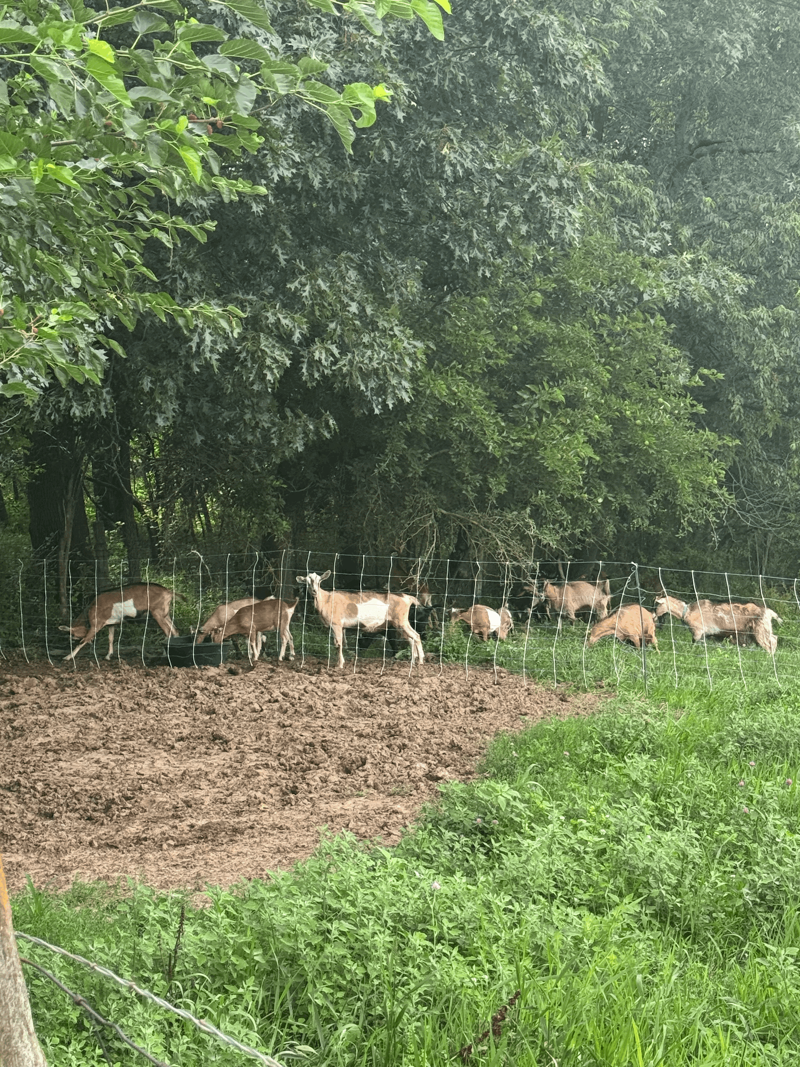
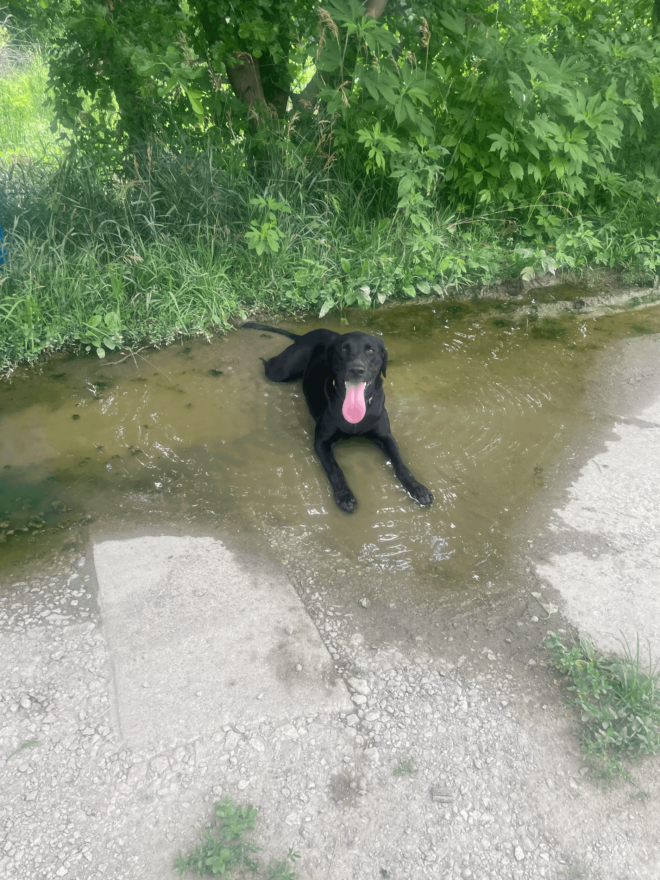
Farms
The Solon farmers explained to us how they have built a connection with their customers, keeping them informed of their produce even though they’re not certified.
Visiting other farms gave us a better insight into how farming really works. We visited a farm in Solon that consisted of dogs, goats, chickens, etc. It was very different from the Poor Farm, and we found this really interesting—to be able to connect in different ways.

Slide 6
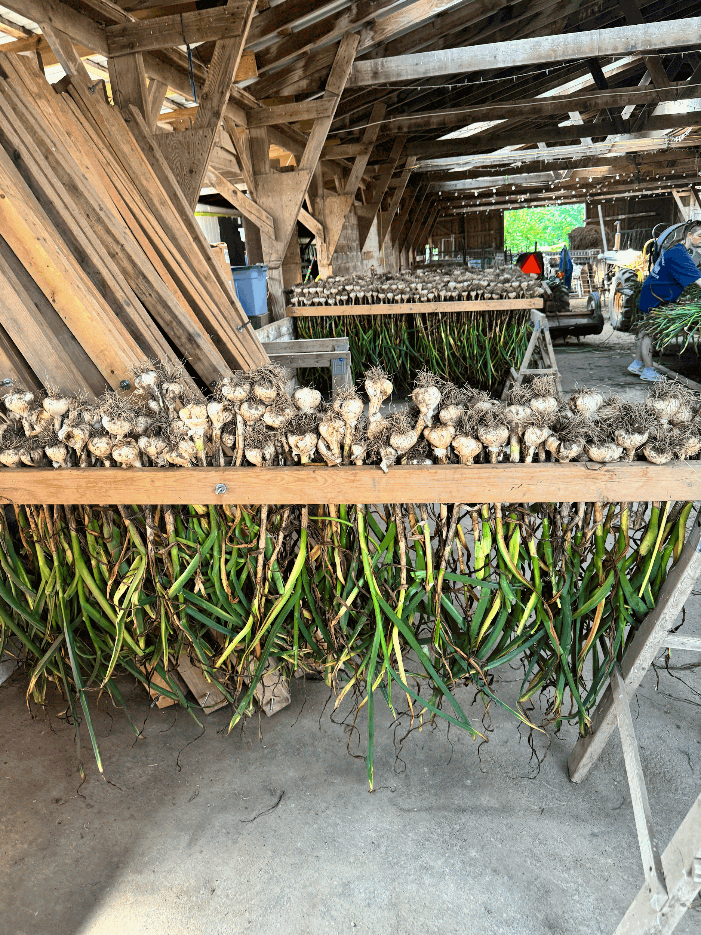
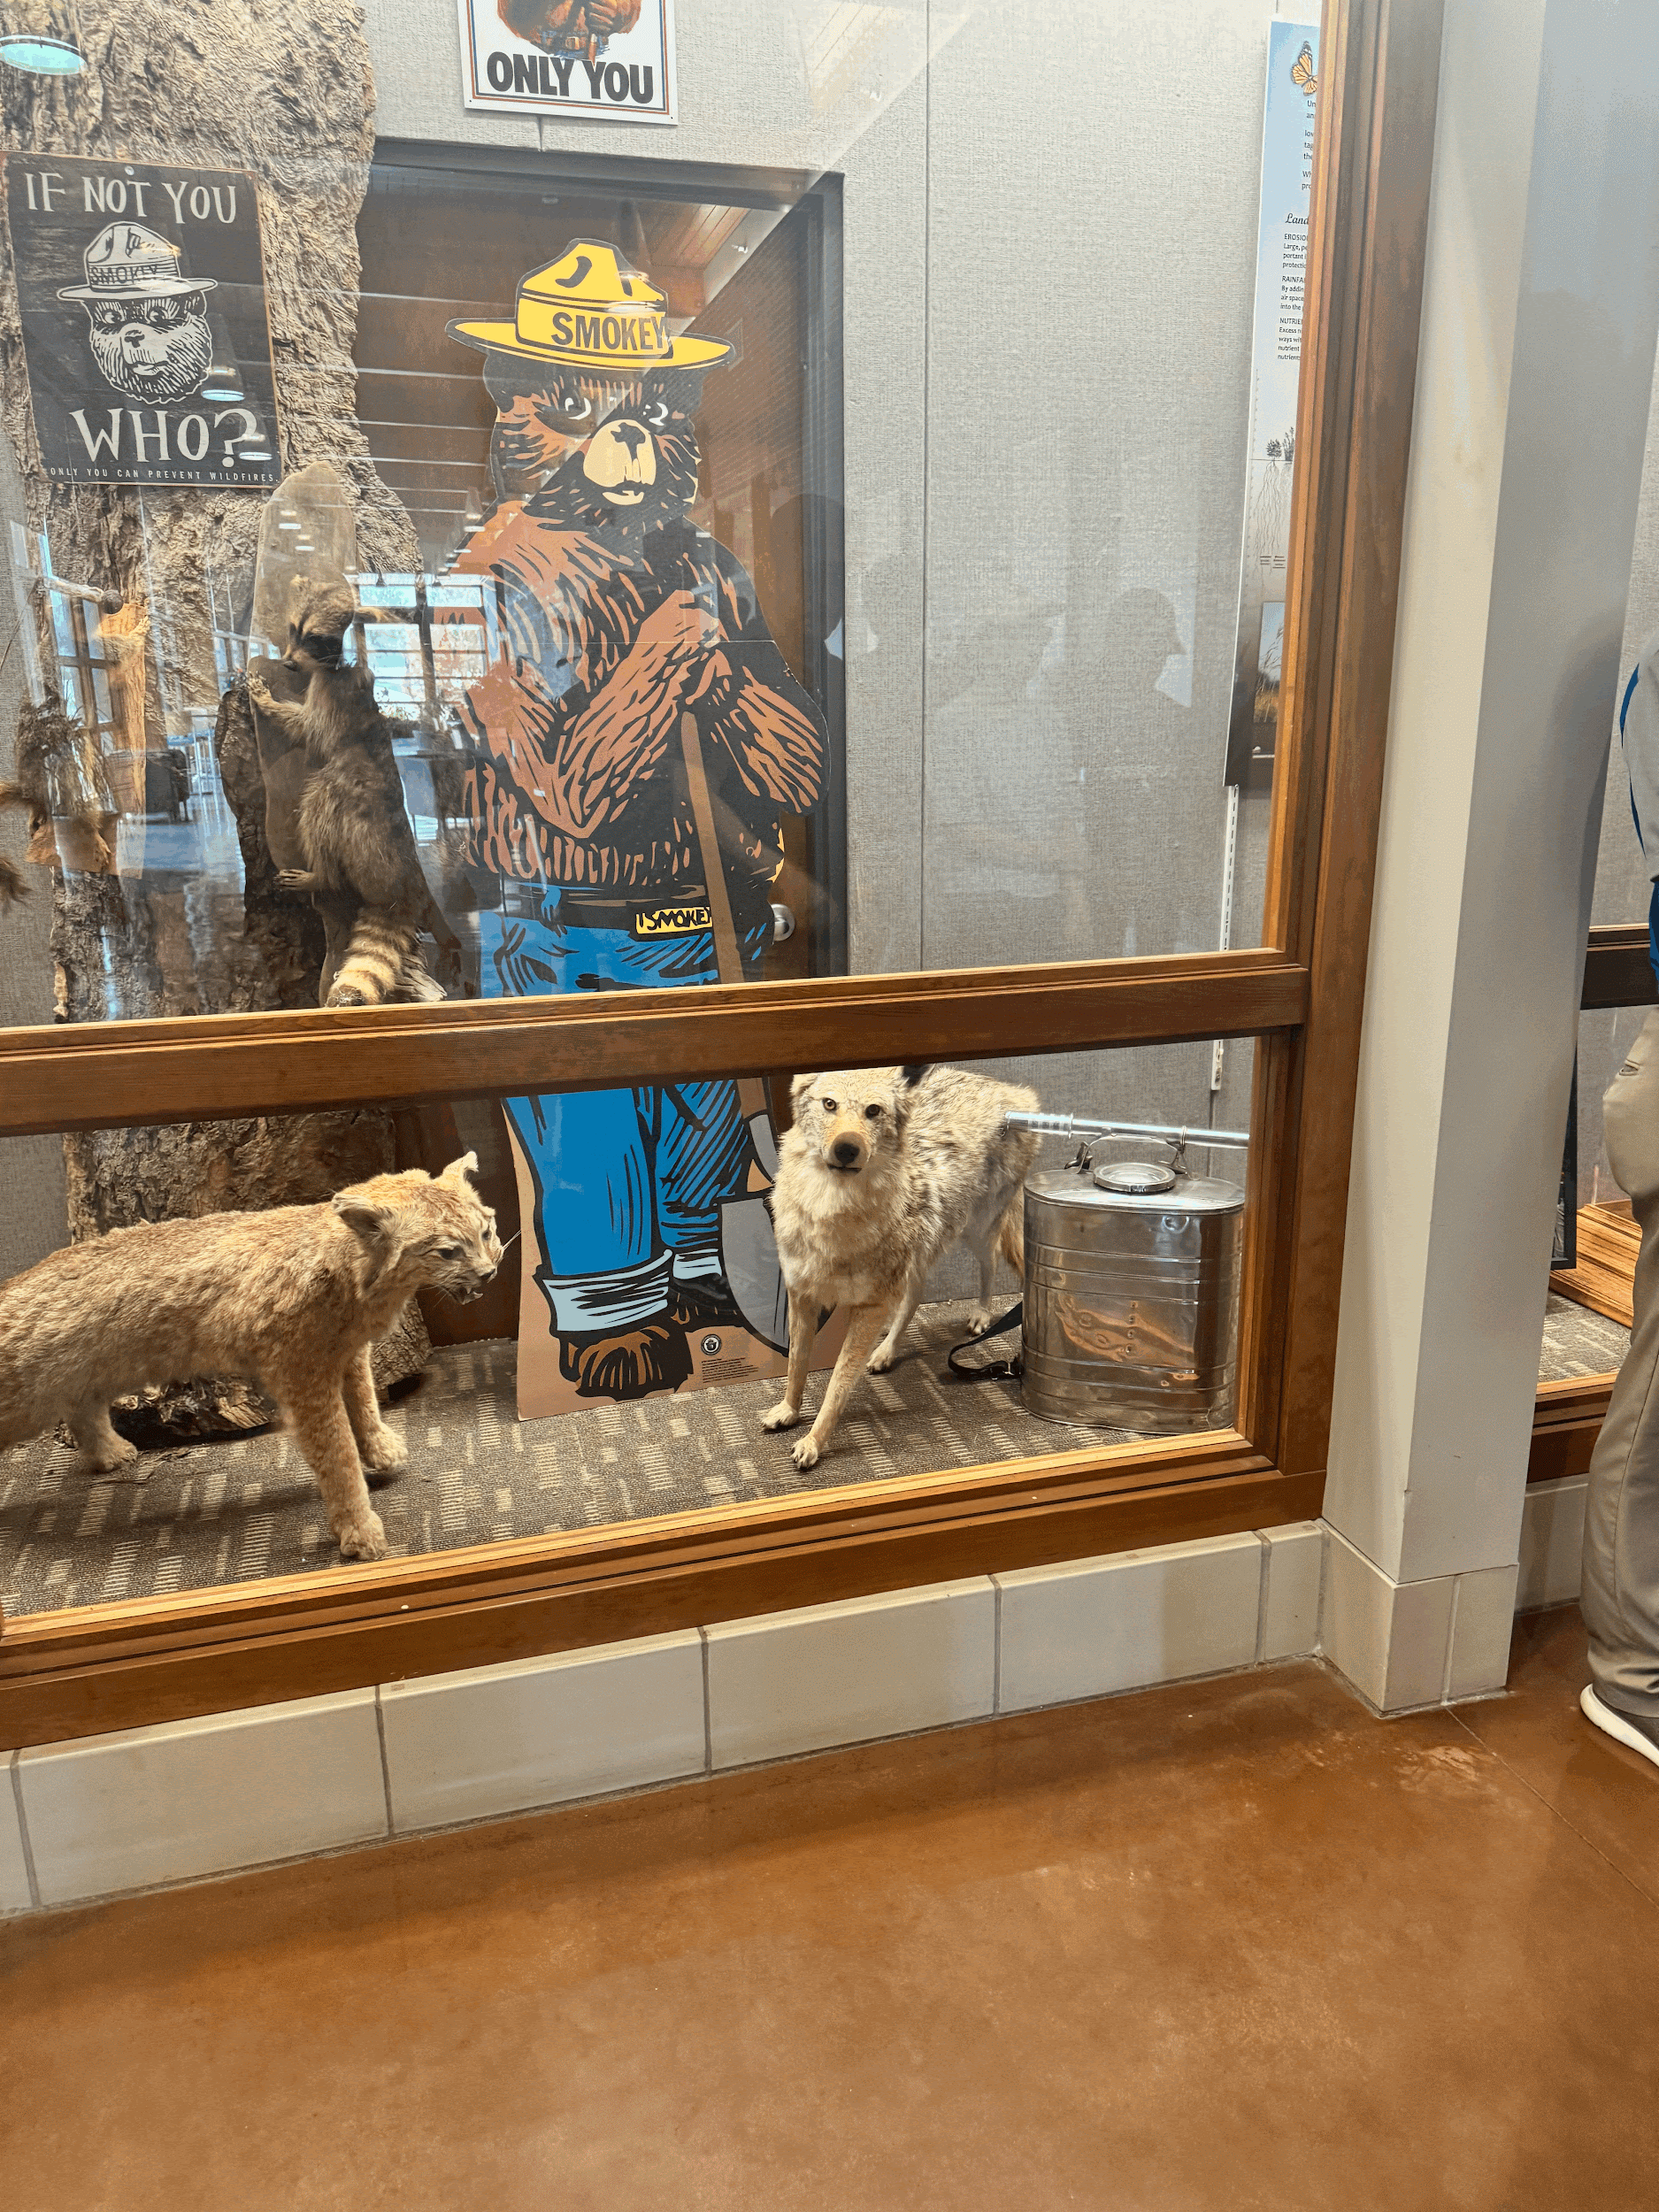
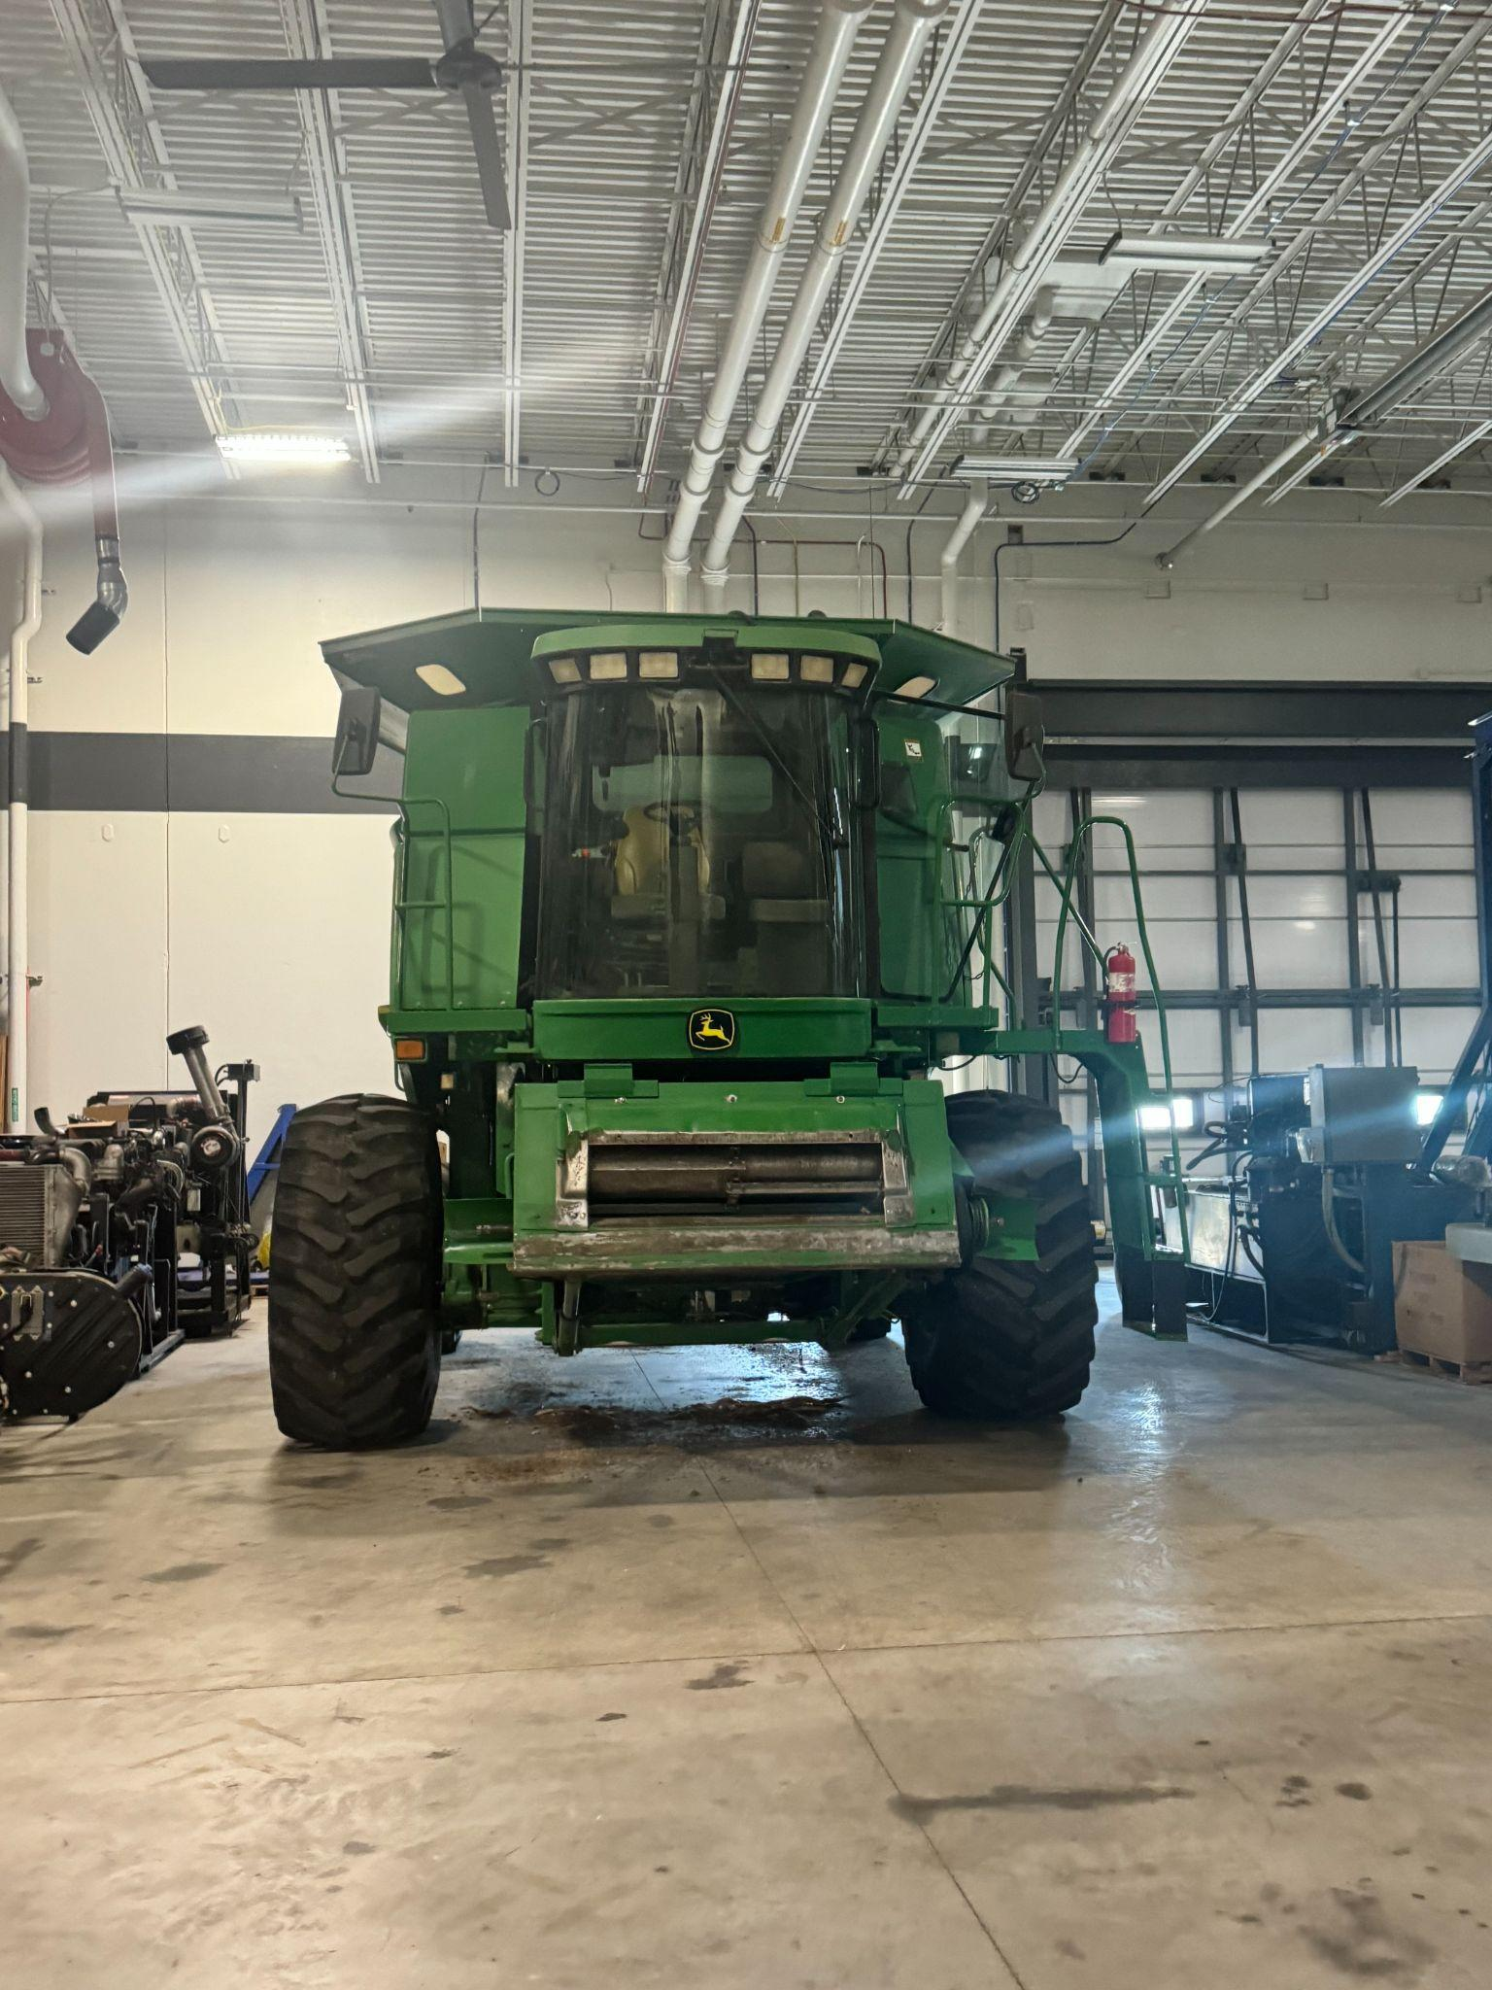
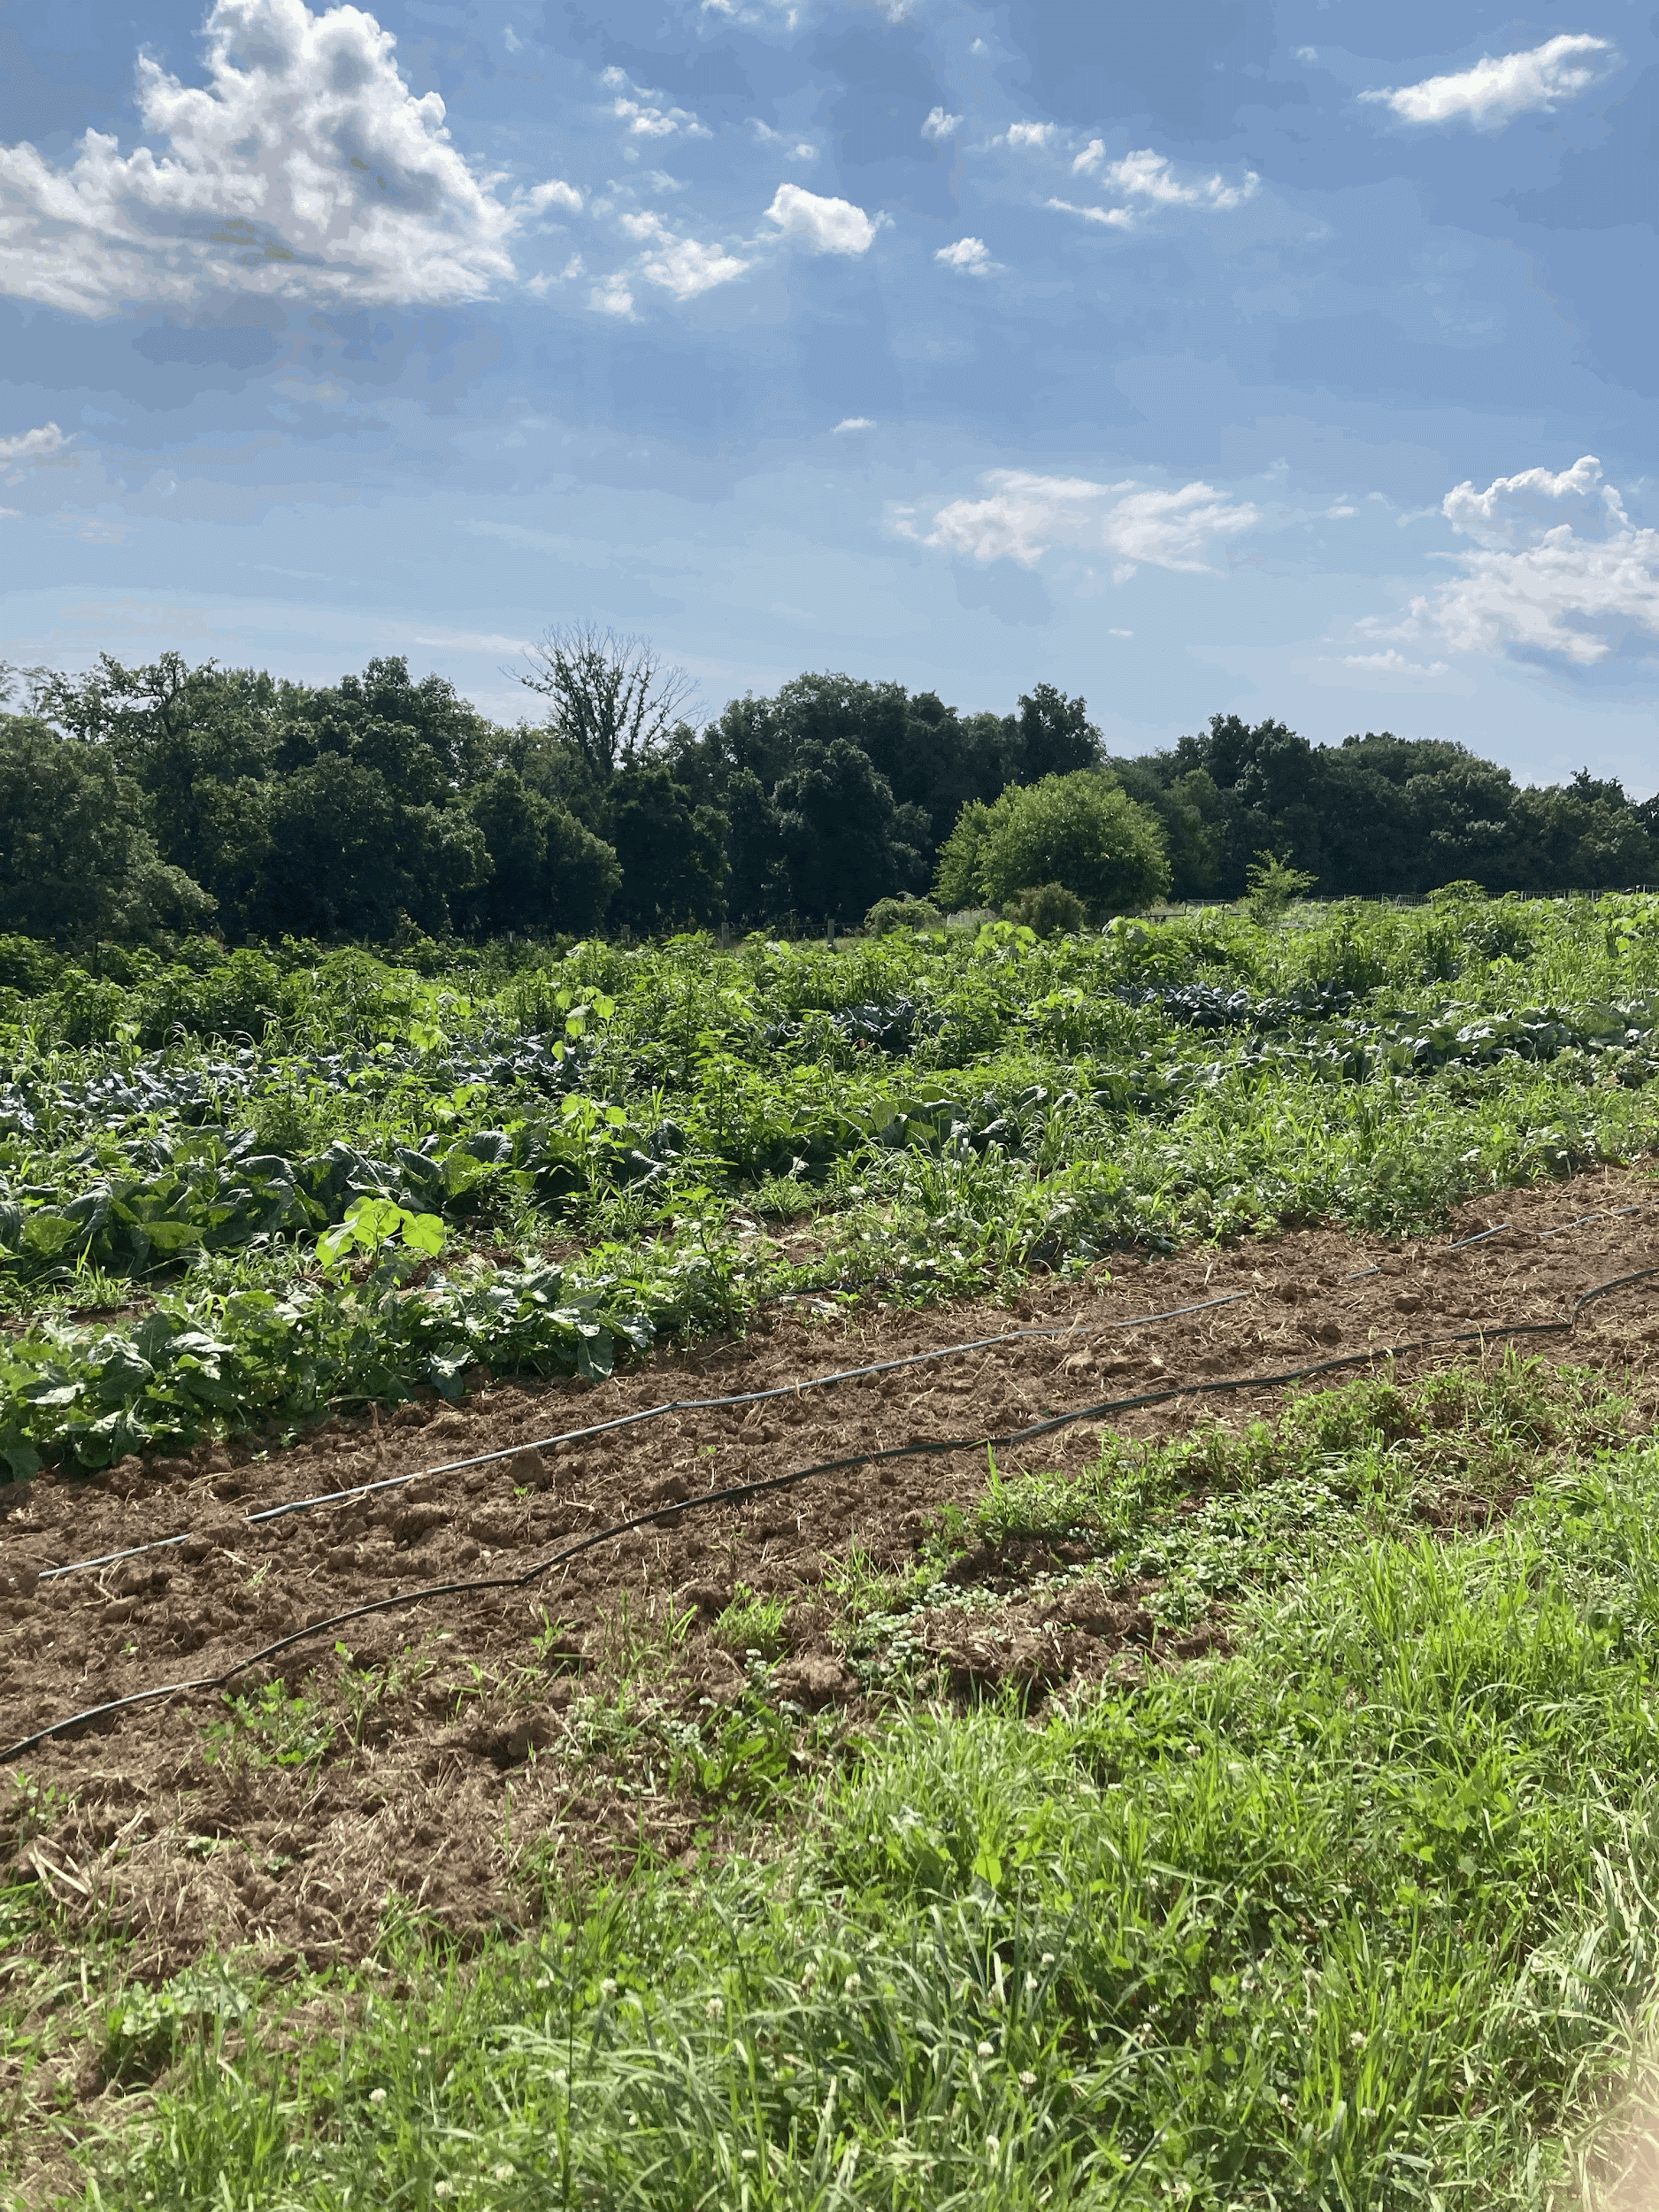
Things We Learned
Photos from
Kirkwood Field Trip etc.
This internship taught us the dedication it takes to farm. We learned how to tell the difference between naturally grown crops and GMOs, and how crops are maintained. We learned different harvesting techniques, natural pesticides as well as food safety procedures.

Slide 7
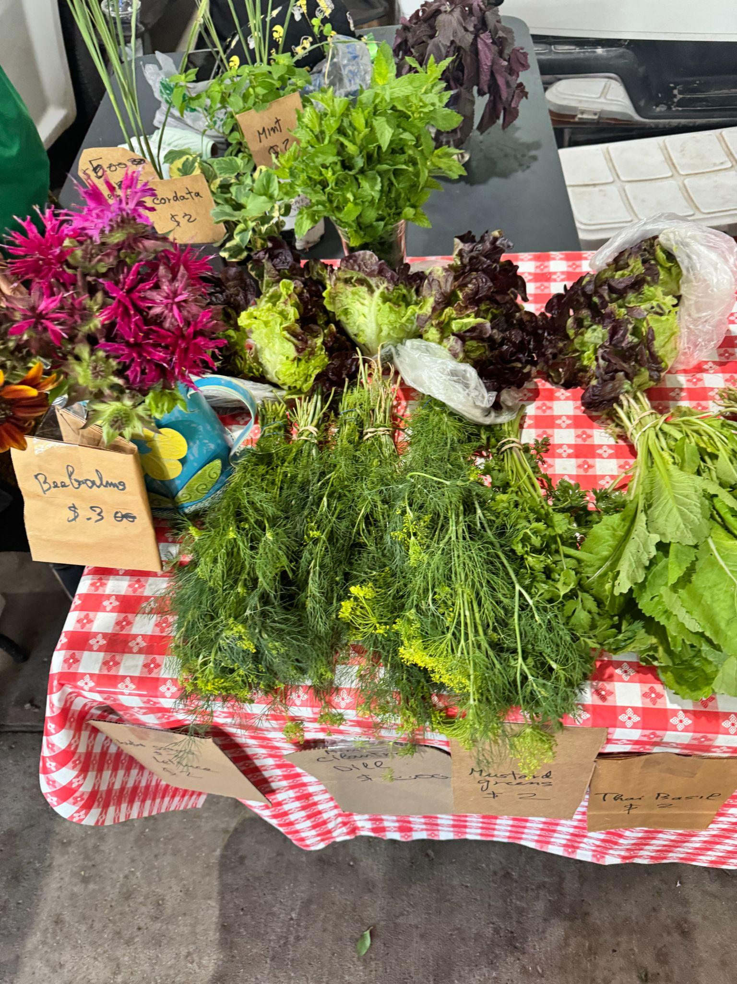
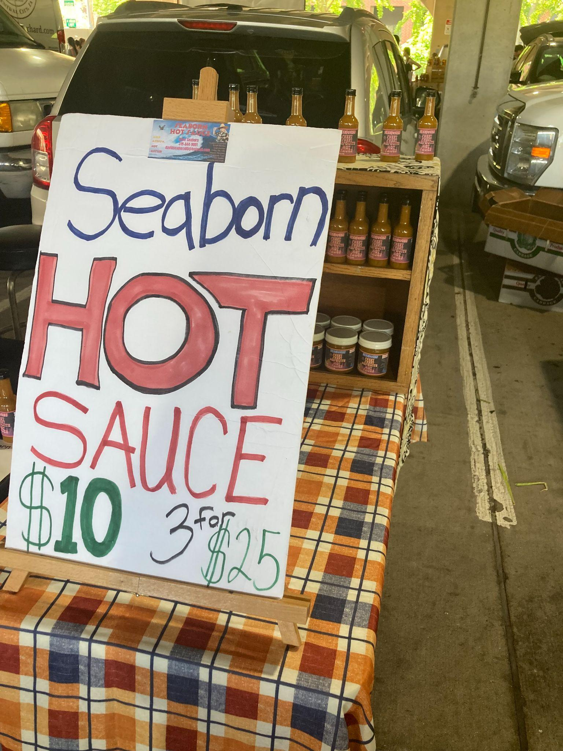
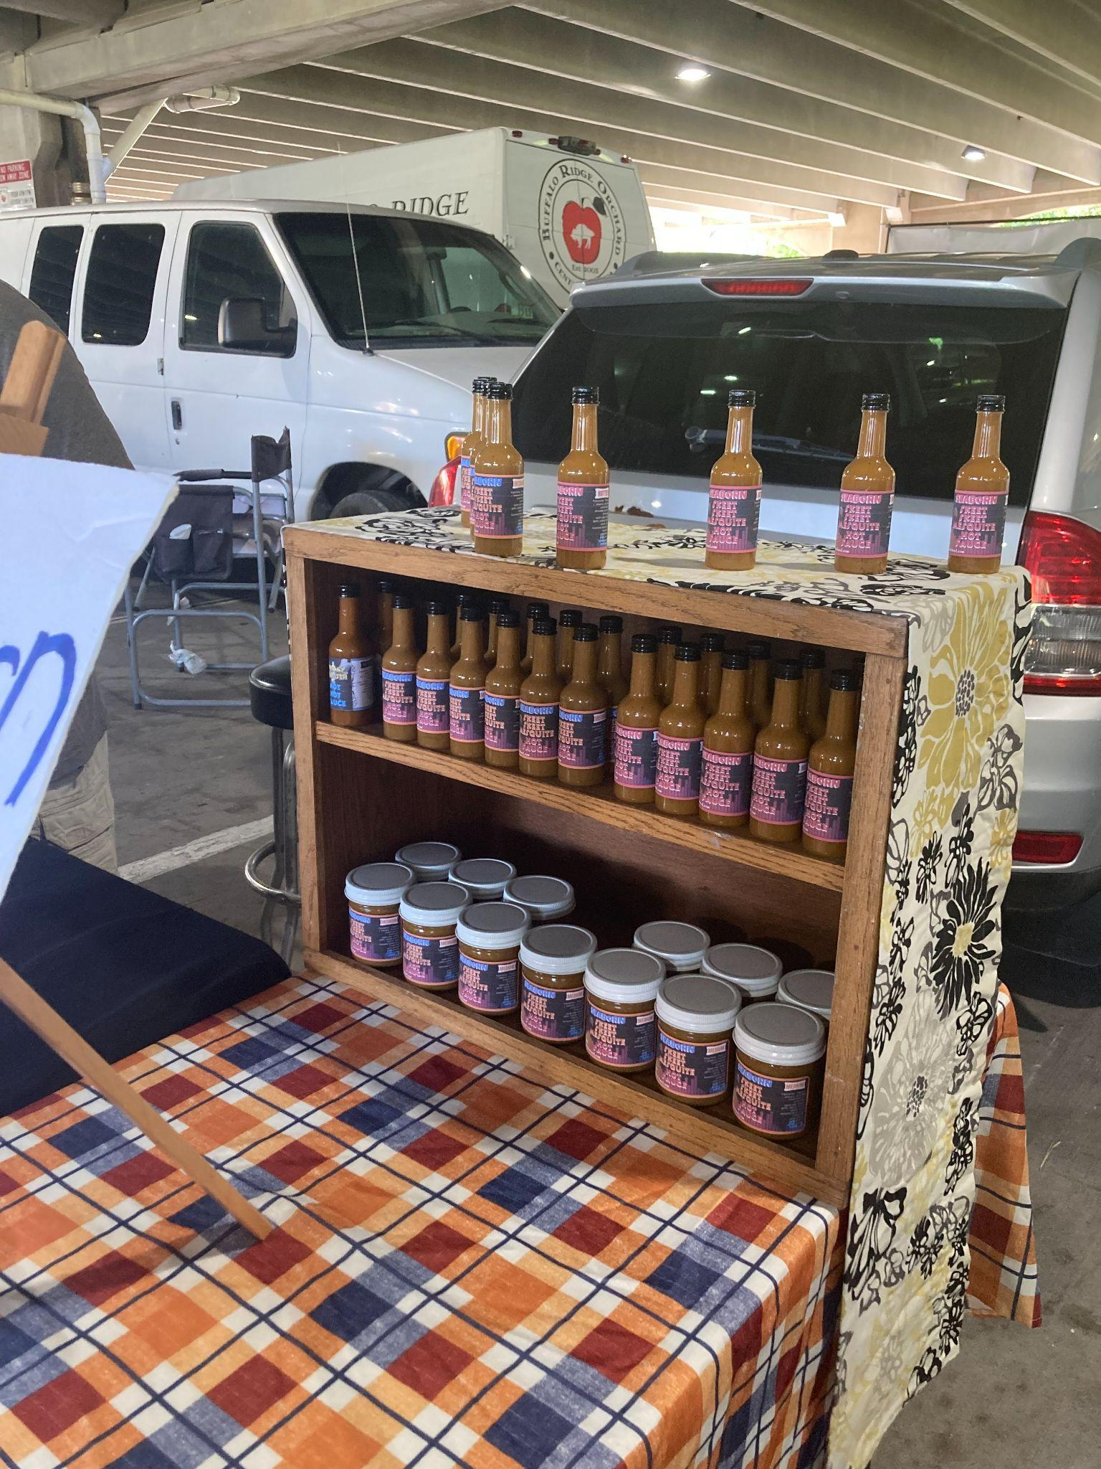
Supporting Local Farmers
As said previously, working on the farm meant adapting to the various circumstances presented. While we only had to do a few days worth of work, the farmers do it every day in order to give us fresh, local produce. The amount of hard work that goes into the upkeep and maintenance of the farm in unfathomable. Moving forward, we hope to be able to support these local farmers and all the work they do.

Slide 8
Moving Forward
This internship taught us far more than ‘how to take care of plants’. It taught us the value of hard work and dedication. We were able to see through the life of our saplings we started in the greenhouse. This showed us that hard work does, in fact, pay off. We hope to take these lessons into future endeavors.

Slide 9
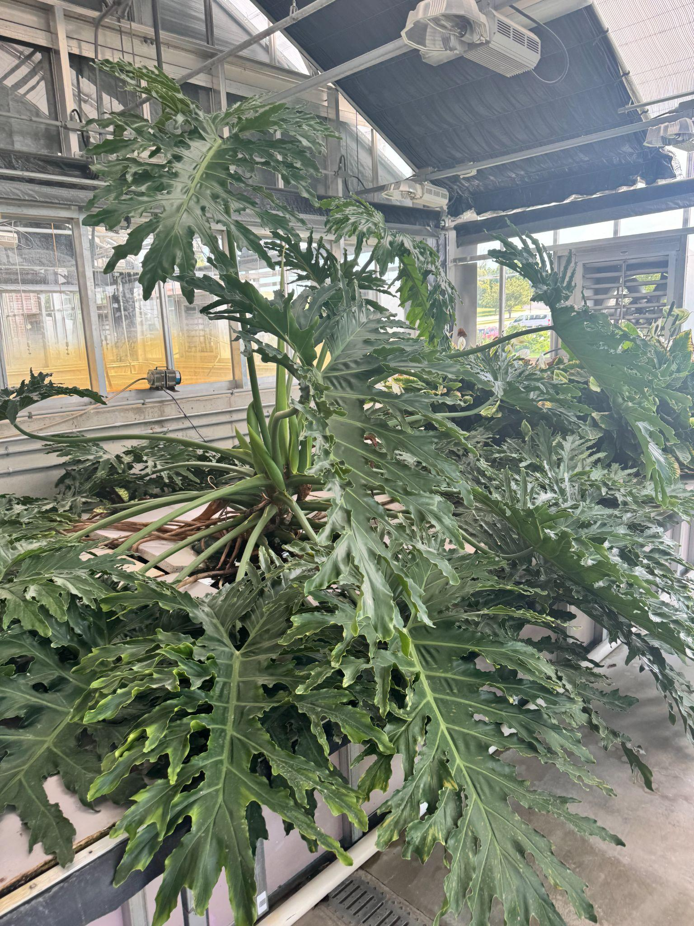
Our Futures on the Farm:
Even though some of us may not consider a full time job on the farm as our career, we will definitely, in some way, be connected to local farms, and farmers. We hope to be able to support local farms as much as possible in our futures, whether that being eating more locally sourced foods, or even volunteering at a farm from time to time.

Slide 10
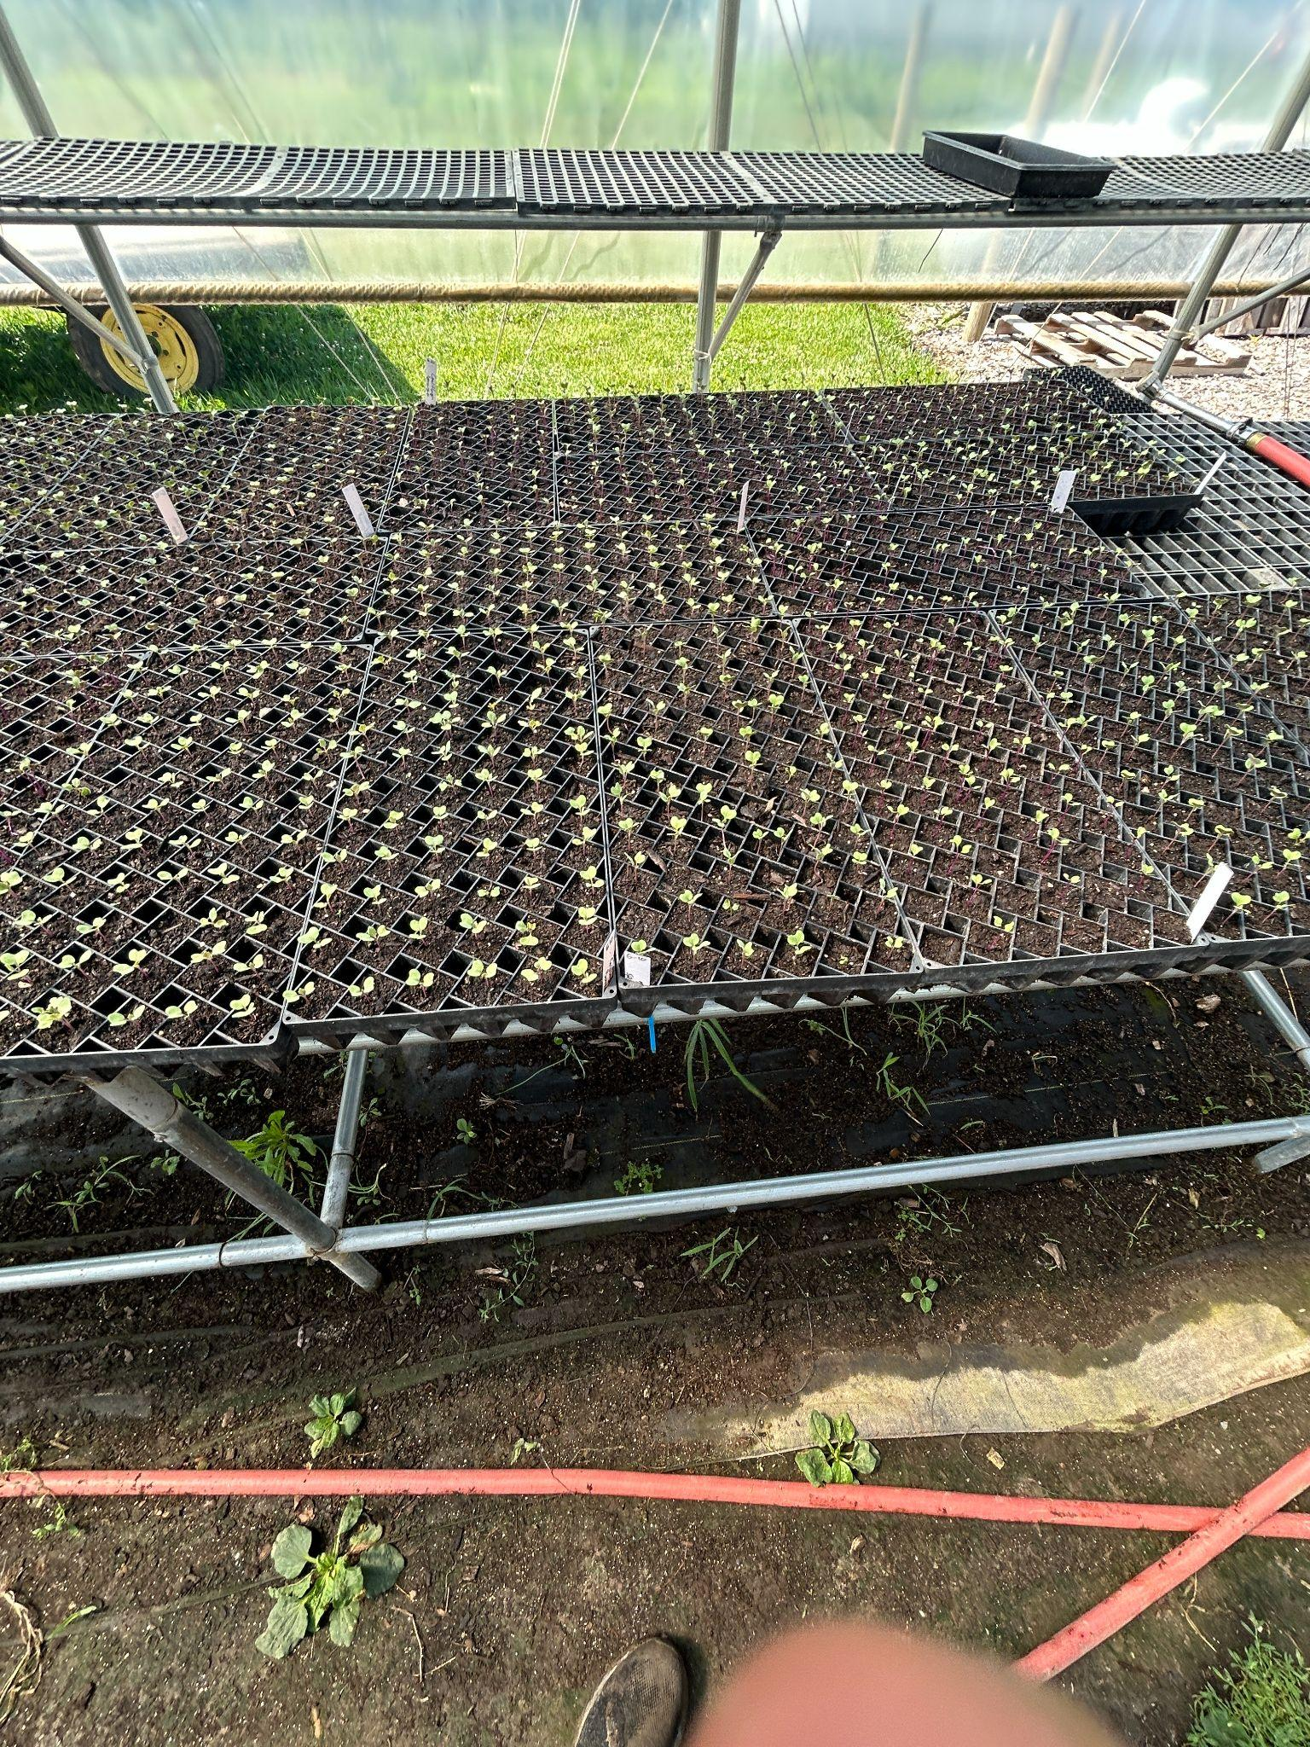
Planted cauliflower in trays
My favorite thing about the experience was planting seeds, harvesting garlic and lettuce, and learning how food is grown.

Slide 11
Thanks for the opportunity.

Slide 12
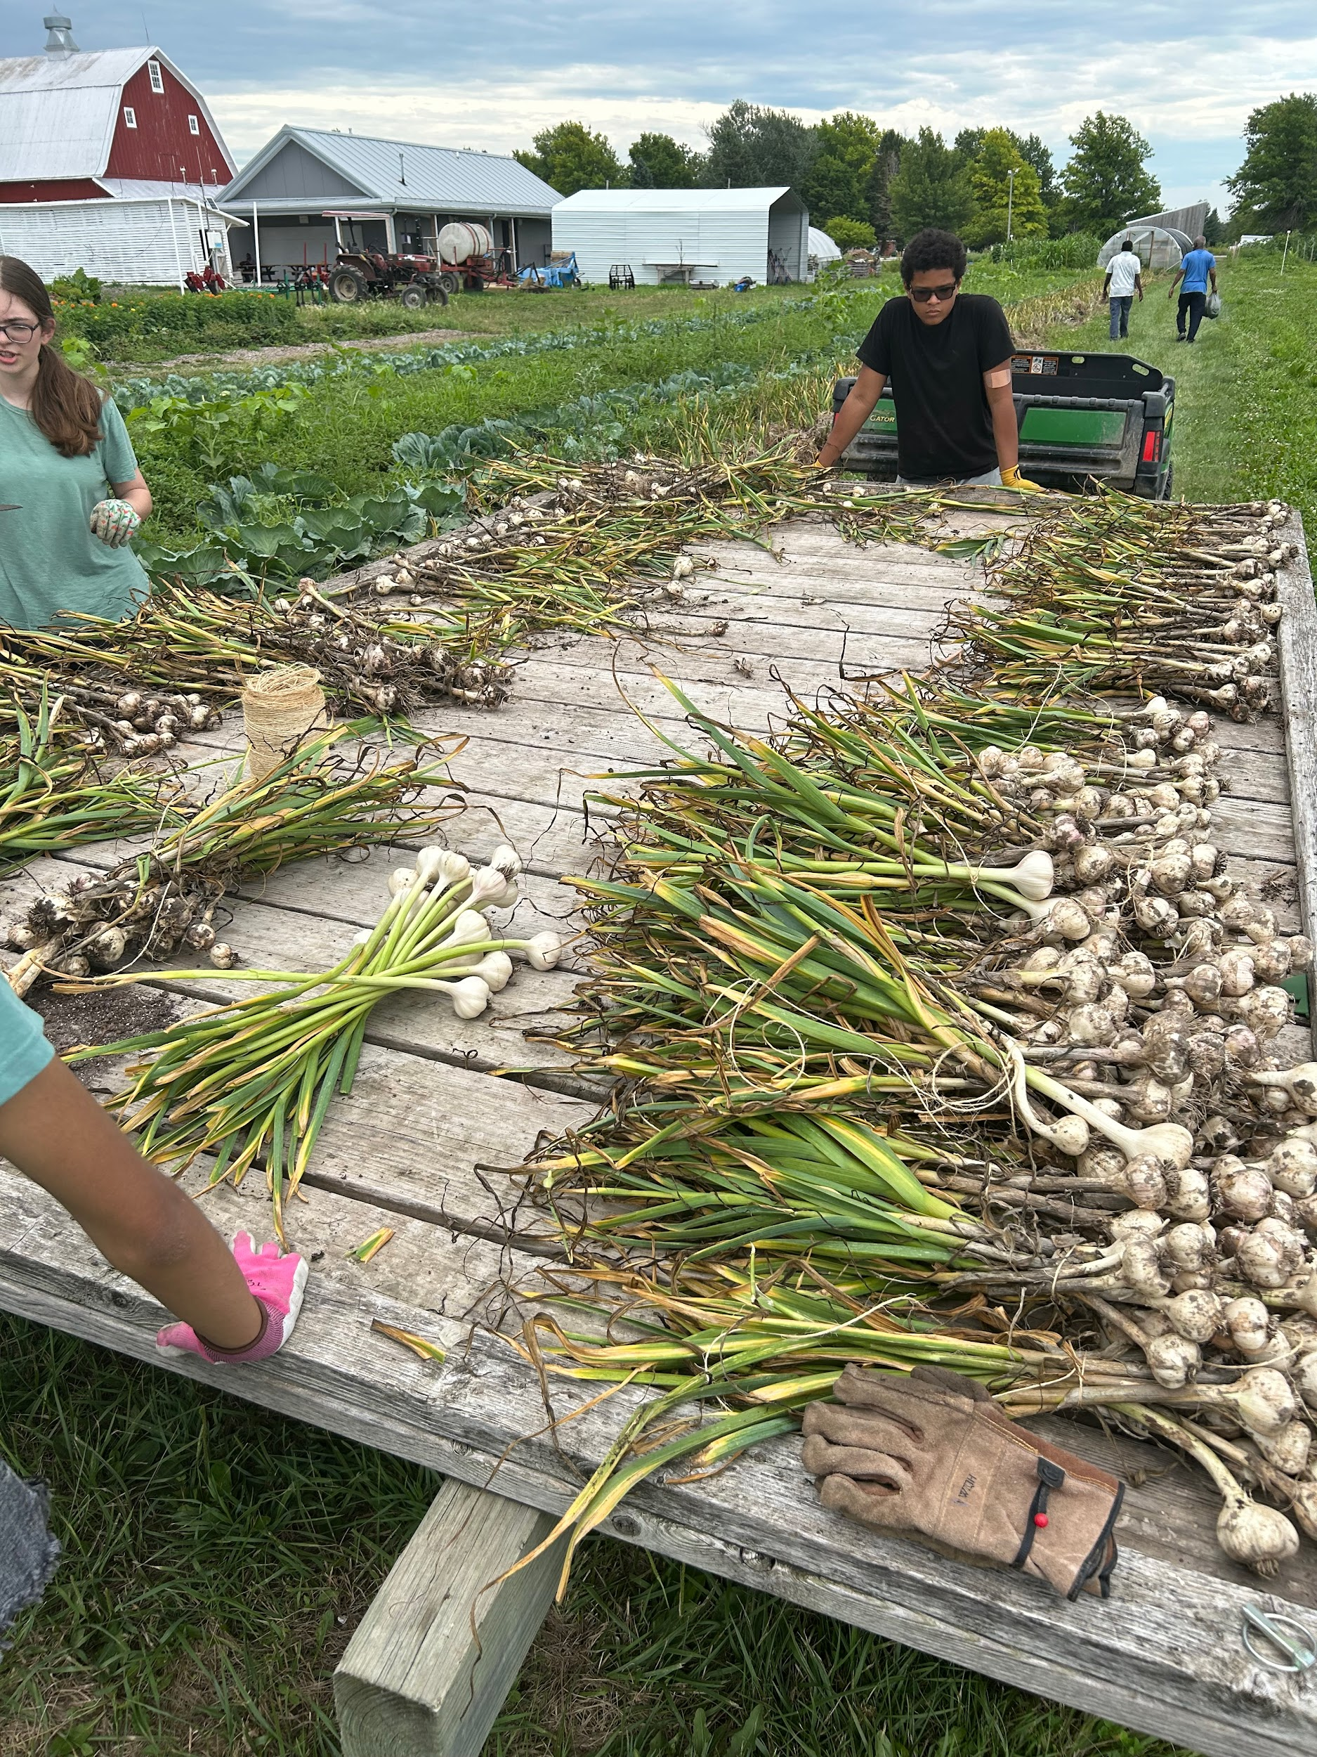
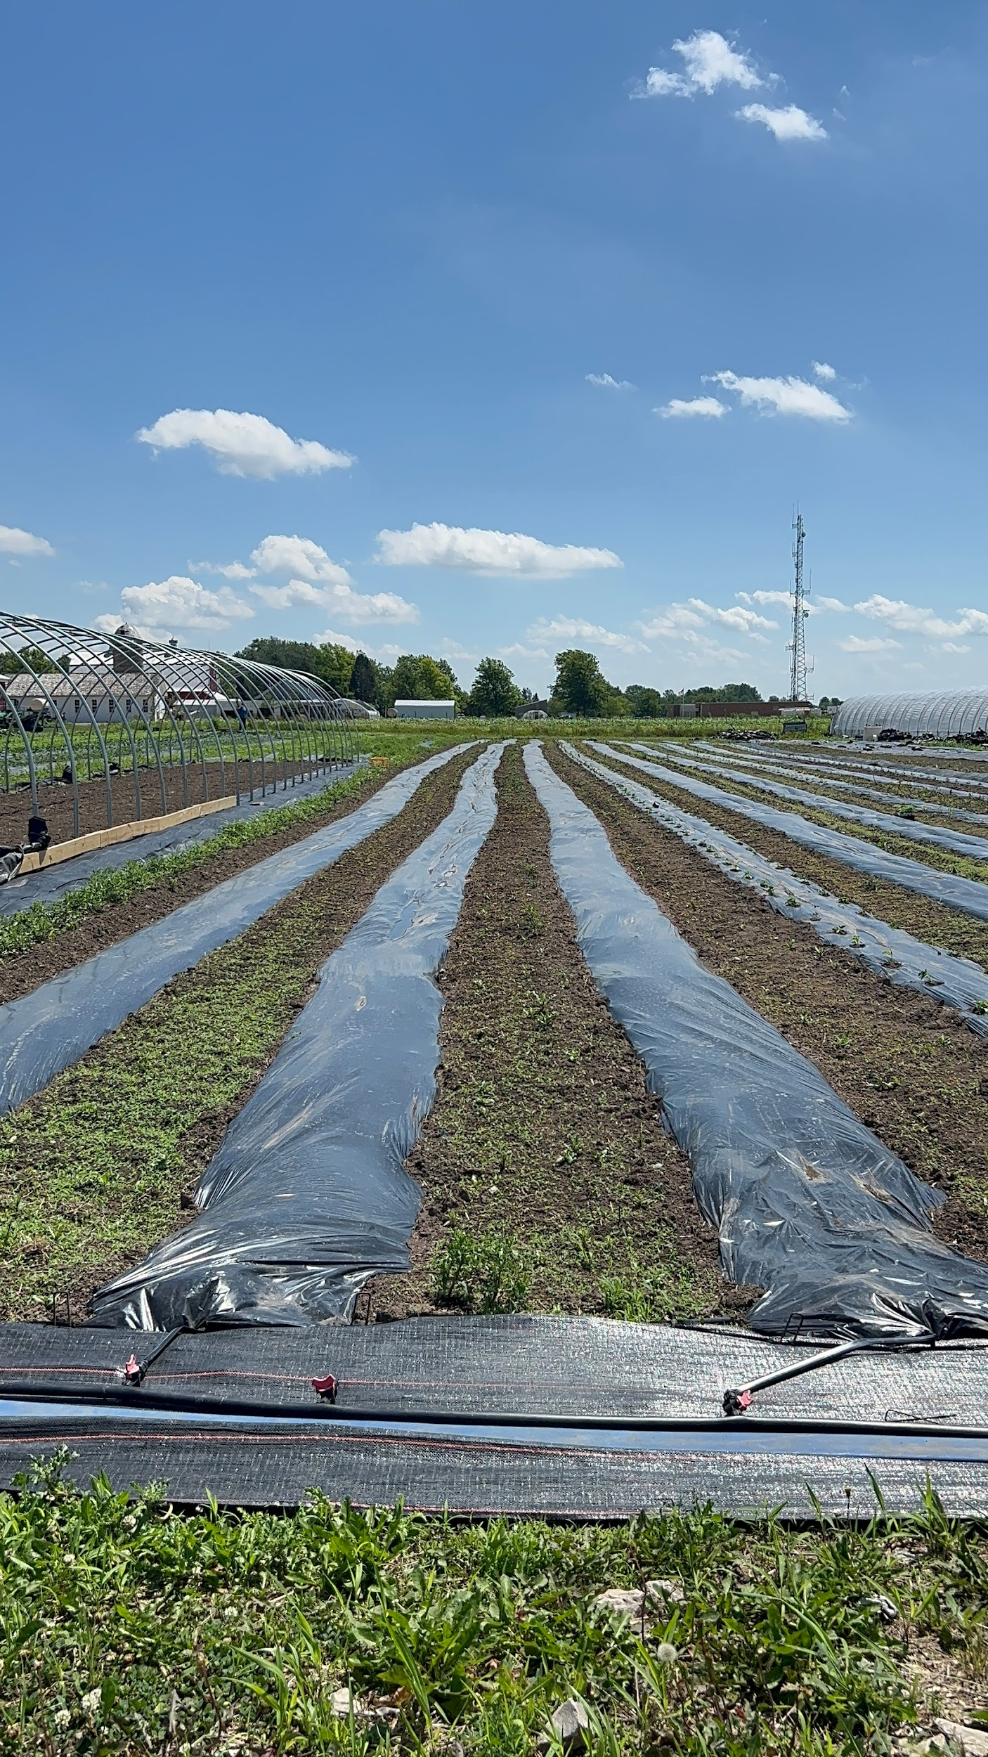

Slide 13
Conclusion
Overall, the ICCSD Farm to Future Earth Summer Internship was a valuable experience that taught us about sustainable farming, community connection, and the importance of supporting local food systems. It gave us hands-on learning and new perspectives on agriculture and its impact on our future.

Slide 14
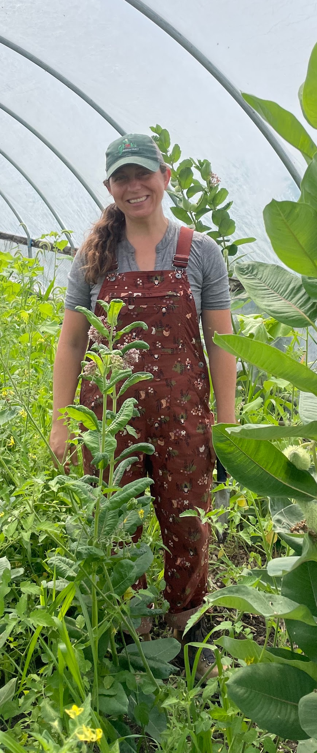
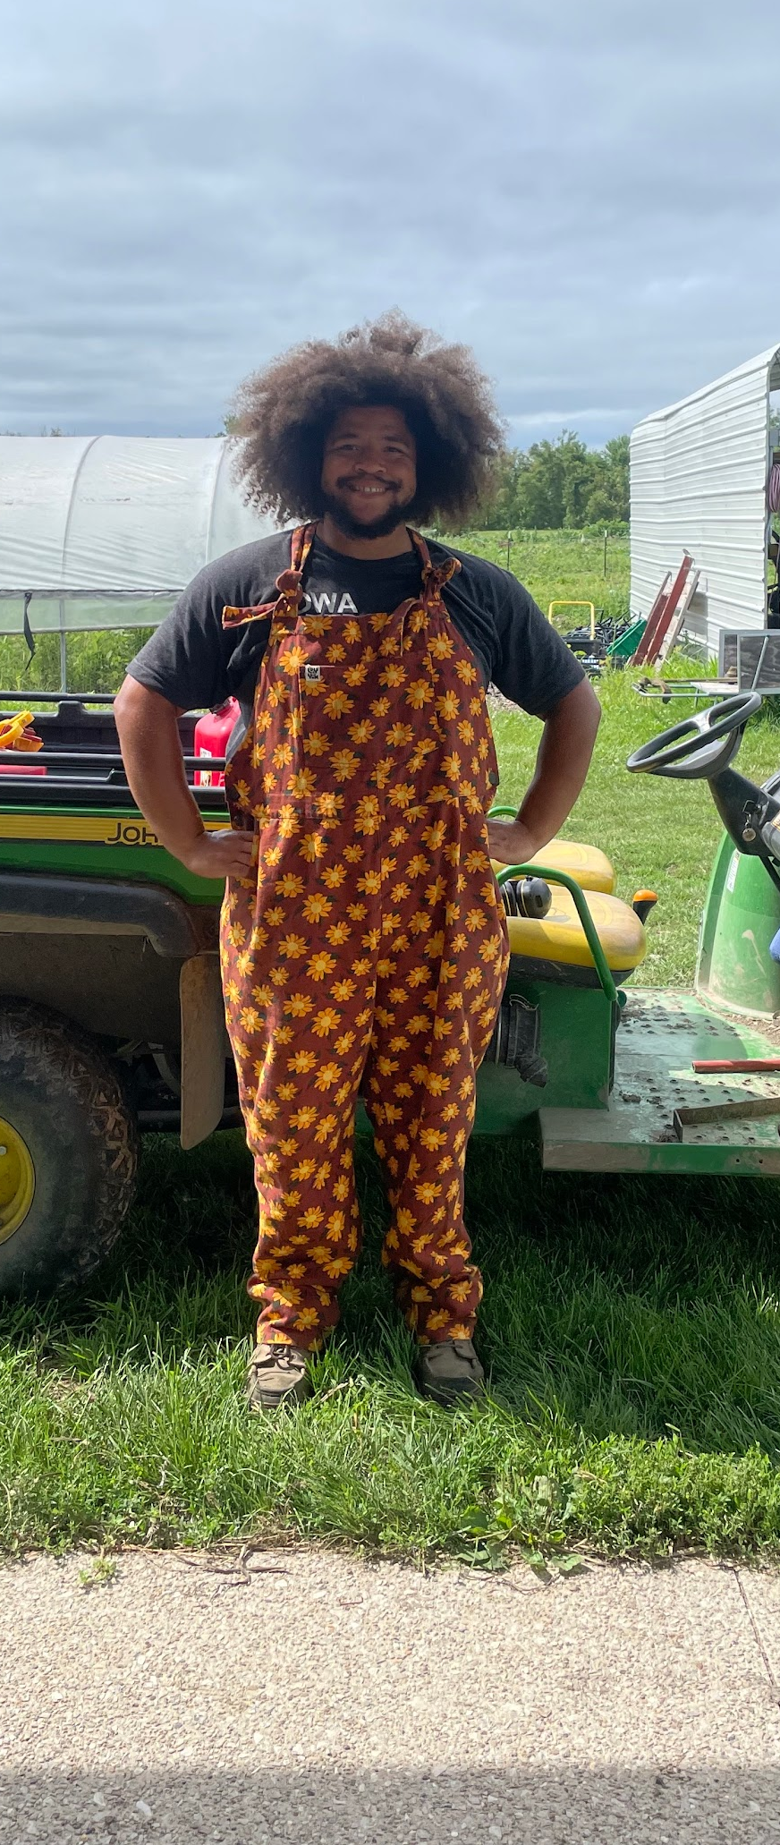
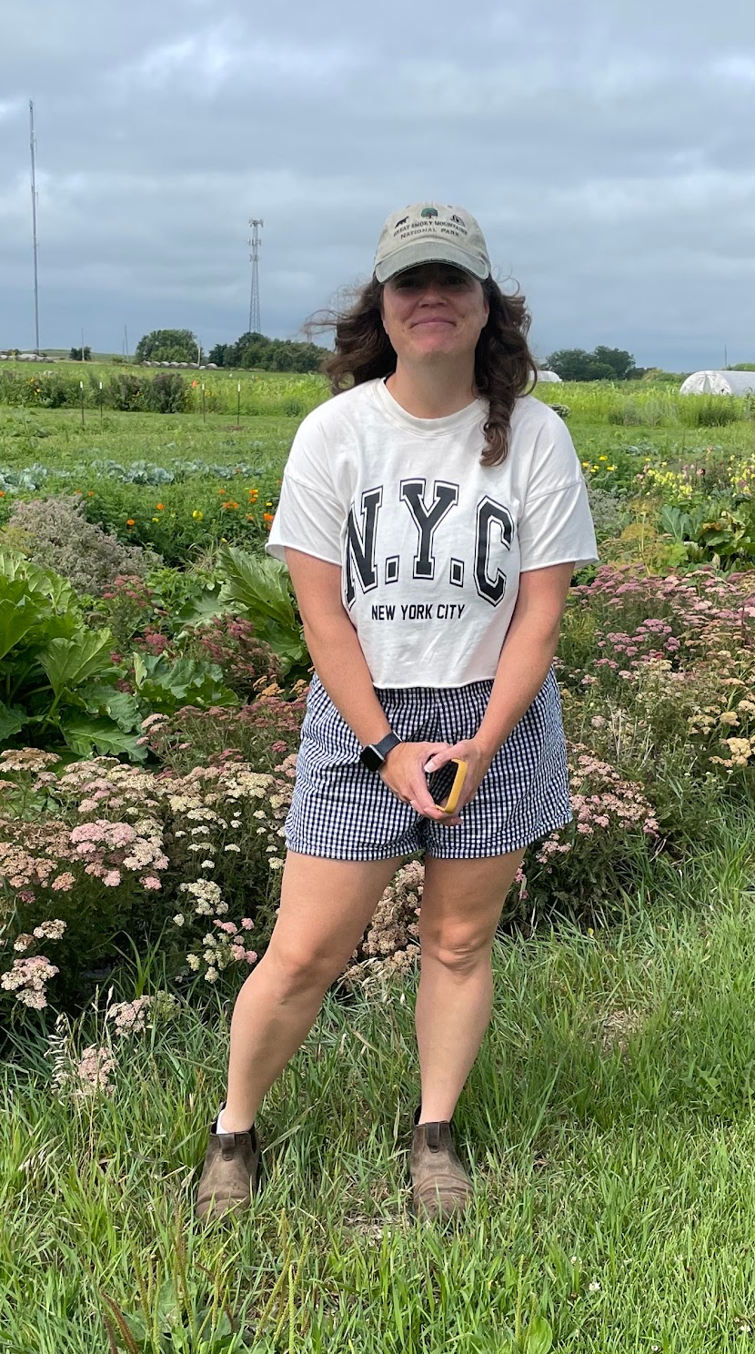
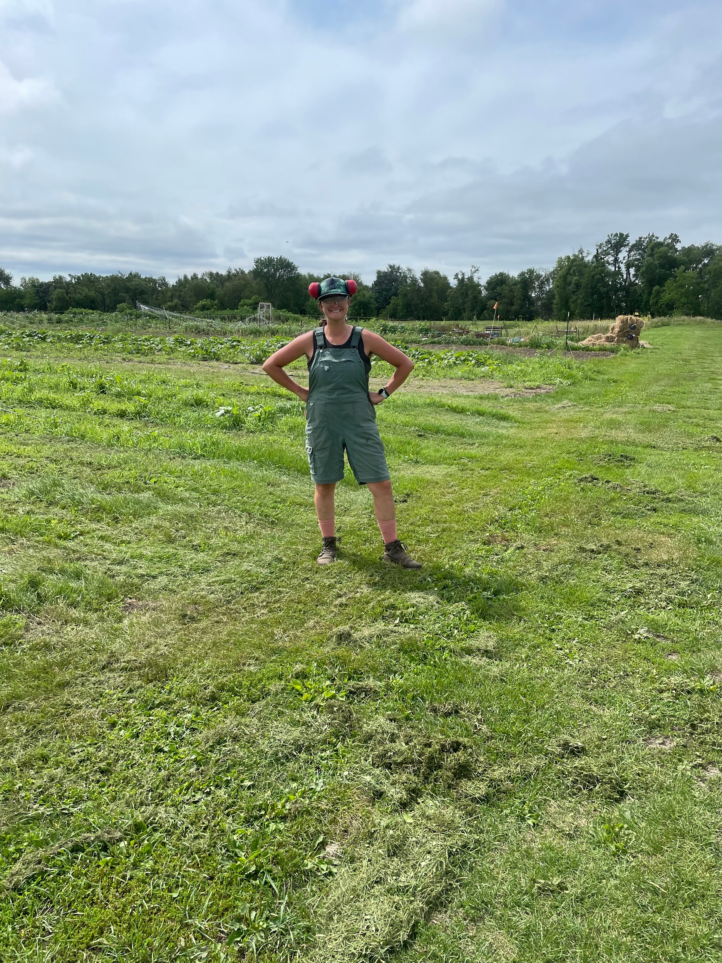
Thank you to our hosts: Grow Johnson County Farm
Grow Johnson county is a non profit local farm that donated all of its crops. It also focuses on using environmentally mindful practices, such as avoiding pesticides.

