Slide 1
Grow your Garden, Grow your Pantry
Classes by Pepper Berries Urban Farm Christine Williams aka Chef Chris

Slide 2
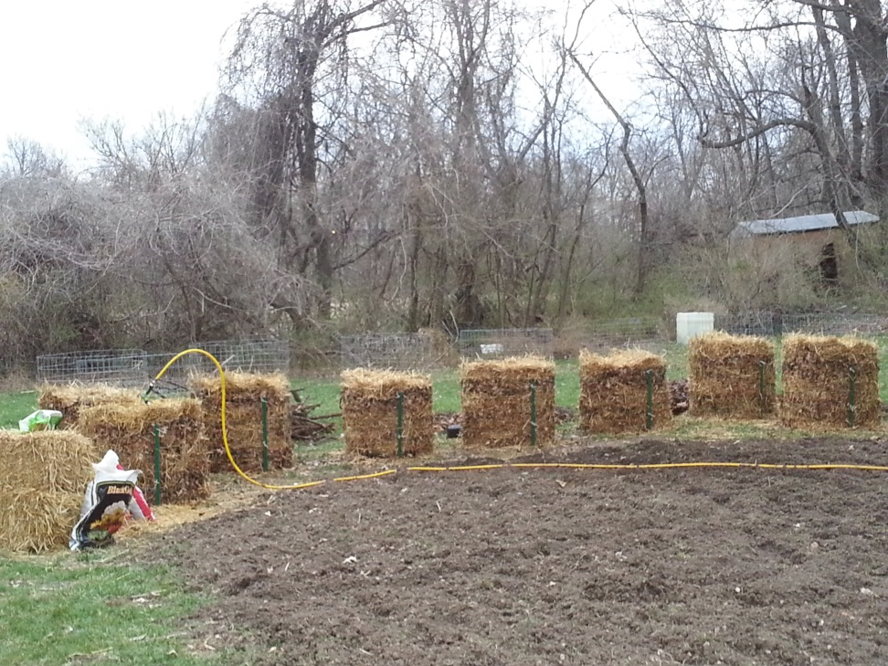
February 2017
Growing Potatoes 5 Ways
Classes at Habitat Garden
505 N Dodgion
Independence, MO
11:00 – 12:30
Bring 1 pound of potatoes and take home a container of potatoes planted!
Free

Slide 3
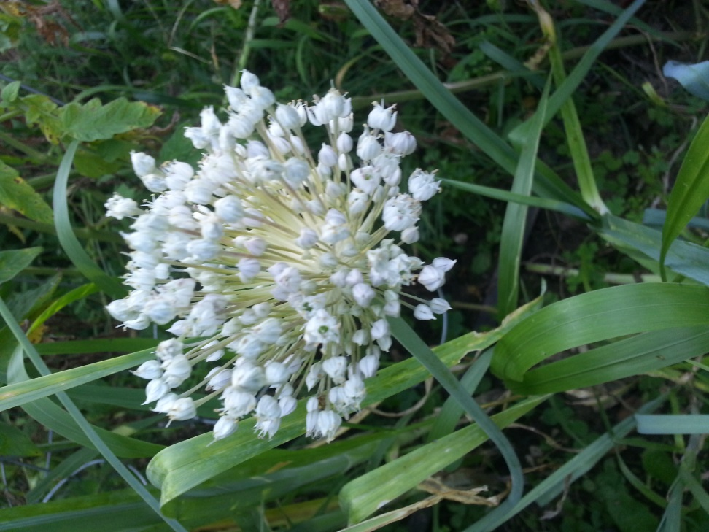
March 2017
Seed Starting wherever you are!
Habitat for Humanities Garden
505 N Dodgion, Independence, Mo
3/7 4:00 – 6:00 sign up for a plot at the community garden
Starting seeds 101, take 3 types of seeds home with you.
3/14 4:00-6:00 $10.00
3/18 11:00 – 12:30 $10.00

Slide 4
April 2017
Types of Gardening for Urban Landscaping
4/4 4:00-6:00 Milk Crate Gardens
Habitat Harden $10.00
Milk Crate Gardens
Container Gardens 55 gallons gardens
Pallet Gardens
Wall Gardens
Gutter Gardens w/drip system
Tower Gardens w/drip irrigation
4/8 11:00 – 12:30 Gutter Gardens Habitat Garden $10.00
4/11 5:30-7:00 Pallet Gardens
Ivanhoe $10.00
4/15 11:00-12:30 Wall Gardens The Farm $Free
4/22 11:00 -12:30 Container
Gardens The Farm $10.00
4/25 4:00 – 6:00 Tower Gardens The Farm $10.00

Slide 5
May 2017
Types of Gardening for Urban Landscaping
Classes
Square Foot Gardening
Hay Bale Gardening
Companion Planting
Lasagna Gardening
Front Yard Gardening
You will be taking home some transplants to start your own gardens!
5/6 11-12:30 Square Foot Gardening Habitat Garden $Free
5/13 11-12:30 Companion Planting Habitat Garden Free
5/16 4-6:00 Hay Bale Gardens The Farm $10.00
5/23 4-6:00 Lasagna Gardening The Farm $10.00
5/27 11-12:30 Front Yard Gardening The Farm $10.00

Slide 6
September 2017
What do I do now with all this produce?
Water Bath Canning
Freezing
Dehydrating
All supplies for class are provided--just bring your hands ready to pitch in and learn
9/9 9-12:00 Water Bath Canning 101 Tomato!! The Farm $30.00
9/12 5:30-7:00 Water Bath Canning Pickled Veggies $20.00 Ivanhoe Community Center
9/16 10:00-12:00 Freezing
and Dehydrating $10.00
The Farm

Slide 7
October 2017
The Pressure is on to get your food put up and ready for winter!
Water Bath Canning
Pressure Canning
Planting & Growing Garlic
All supplies are included--just bring your hands and be prepared to pitch in
10/3 4:00 – 7:00 Pressure Canning 101 The Farm $30.00
10/14 3:00 – 5:00 Water Bath Canning Jellies & Jams Place to be announced. $20.00
10/10 5:30-7:00 Planting Garlic Ivanhoe $Free

Slide 8
November 2017
Pressure Canning
All supplies are included just bring your hands and be ready to help out!
11/14 5:30-7:00 Pressure Canning Ivanhoe $20.00

Slide 9
What You Need to Know!!!
The Farm “Pepper Berries Urban Farm” 105 N Rogers St., Independence, Mo 64050 816*230*0007
Habitat for Humanities Community Gardens
505 N Dodgion, Independence, MO
816*230*0007
Ivanhoe Community Center 3700 Woodland Ave. KC, MO 64109 816*927*6611

