Slide 1
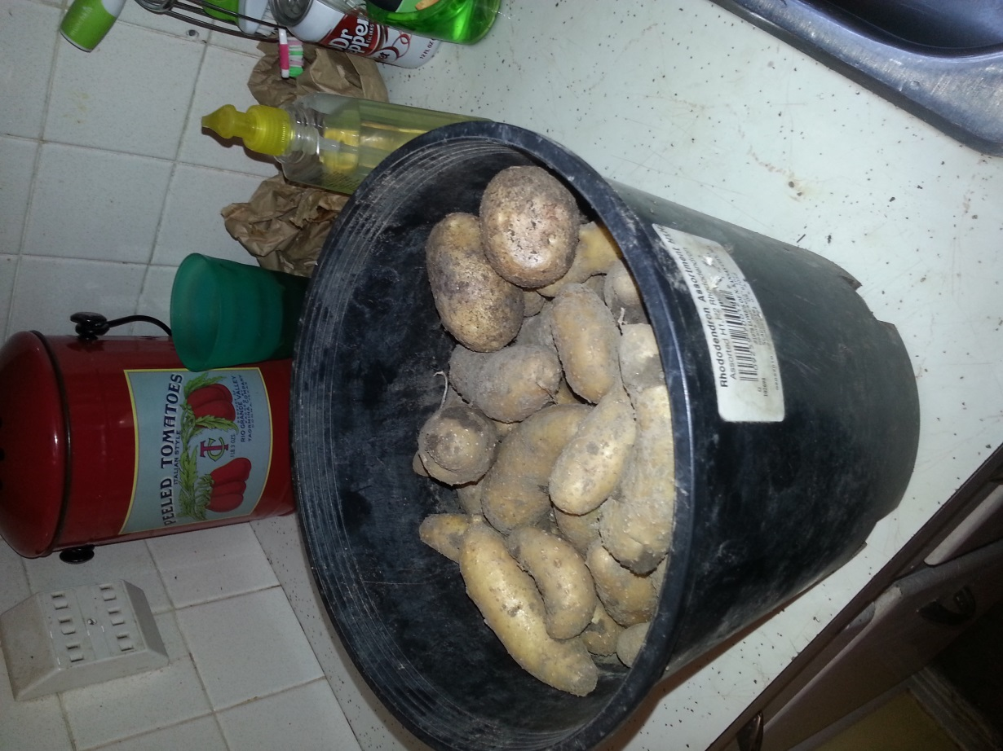
Growing Potatoes
Helping to grow one person, one
family, one community at a time!

Slide 2
Traditional vs. other growing methods
Rows
Vertical
Bags
Containers
Boxes

Slide 3
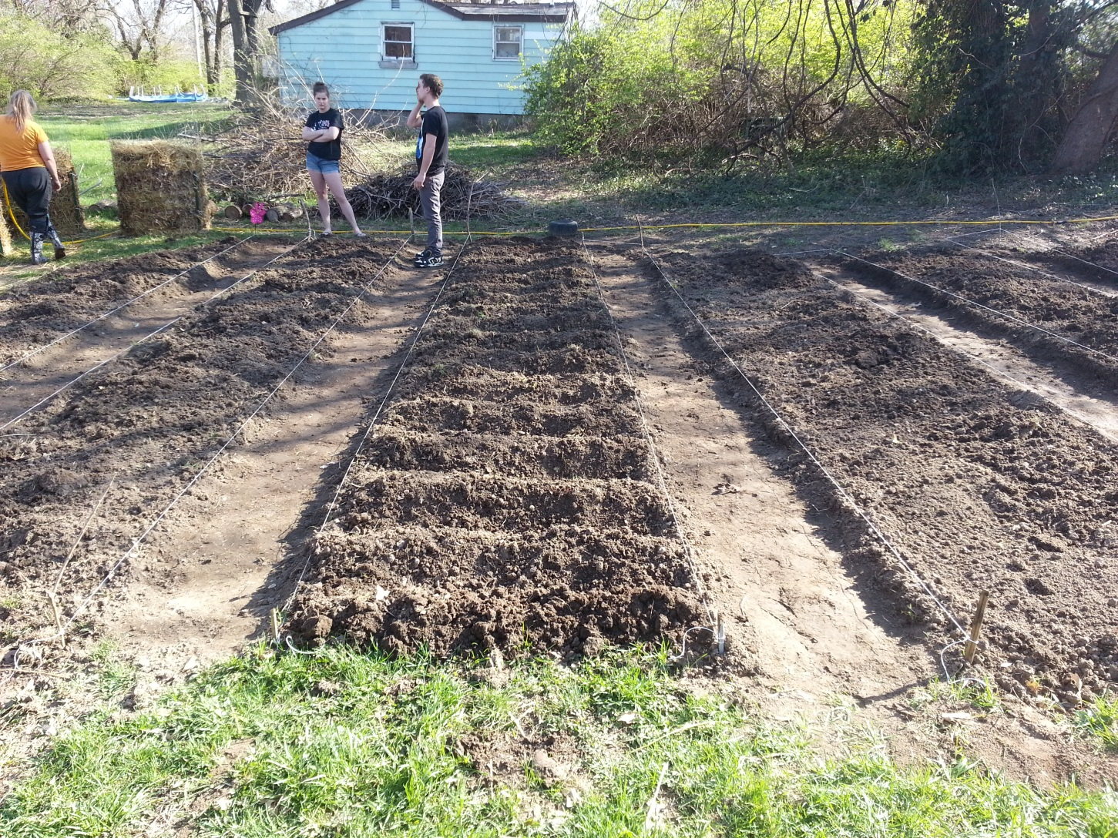
Planting potatoes in a 25 ft. row

Slide 4
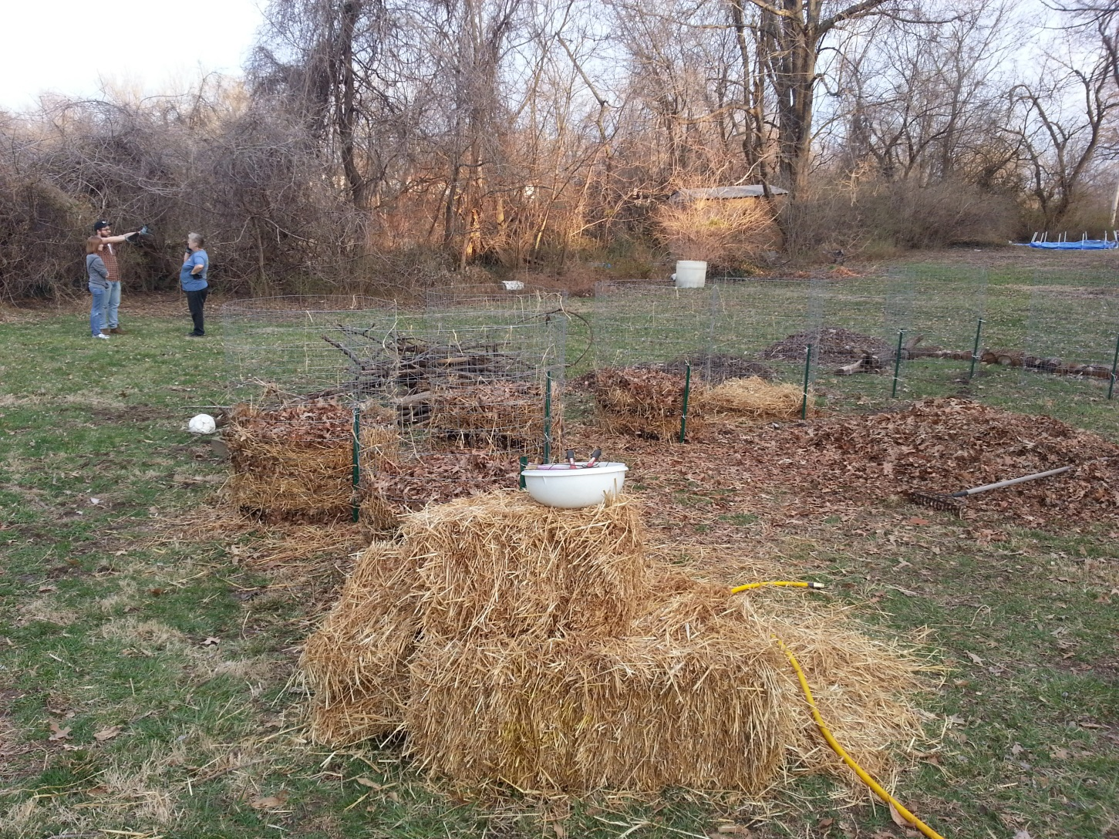
Making vertical cylinder wire potato cages

Slide 5
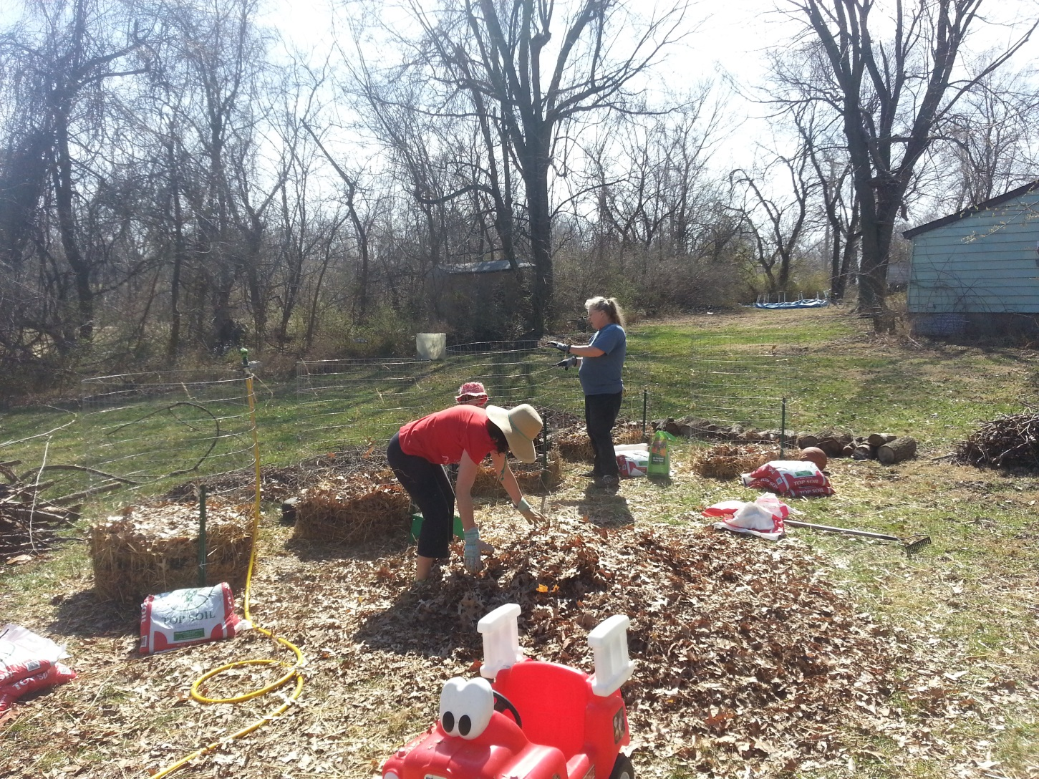
Building layers

Slide 6
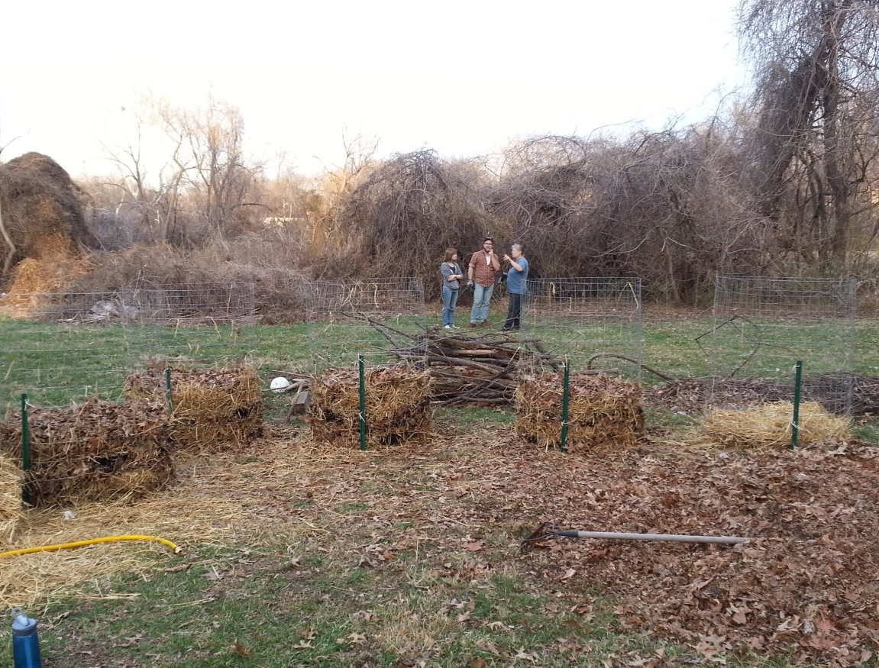

Slide 7
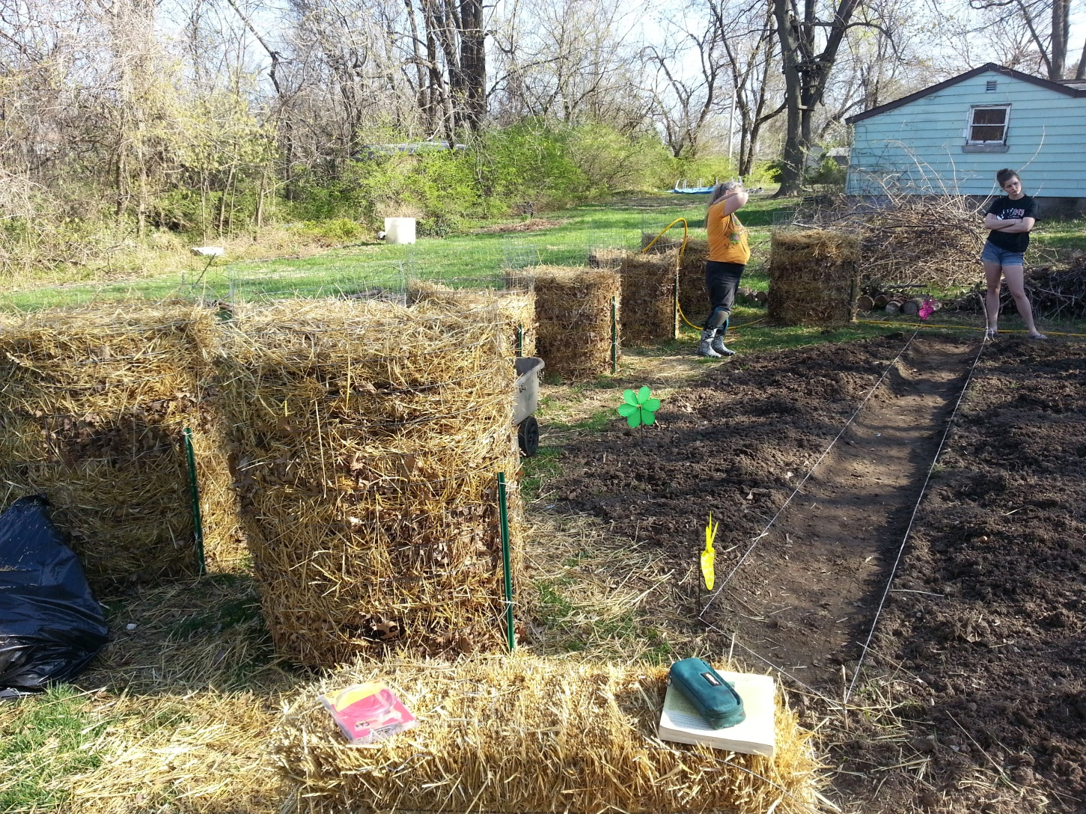
Vertical cylinder potato

Slide 8
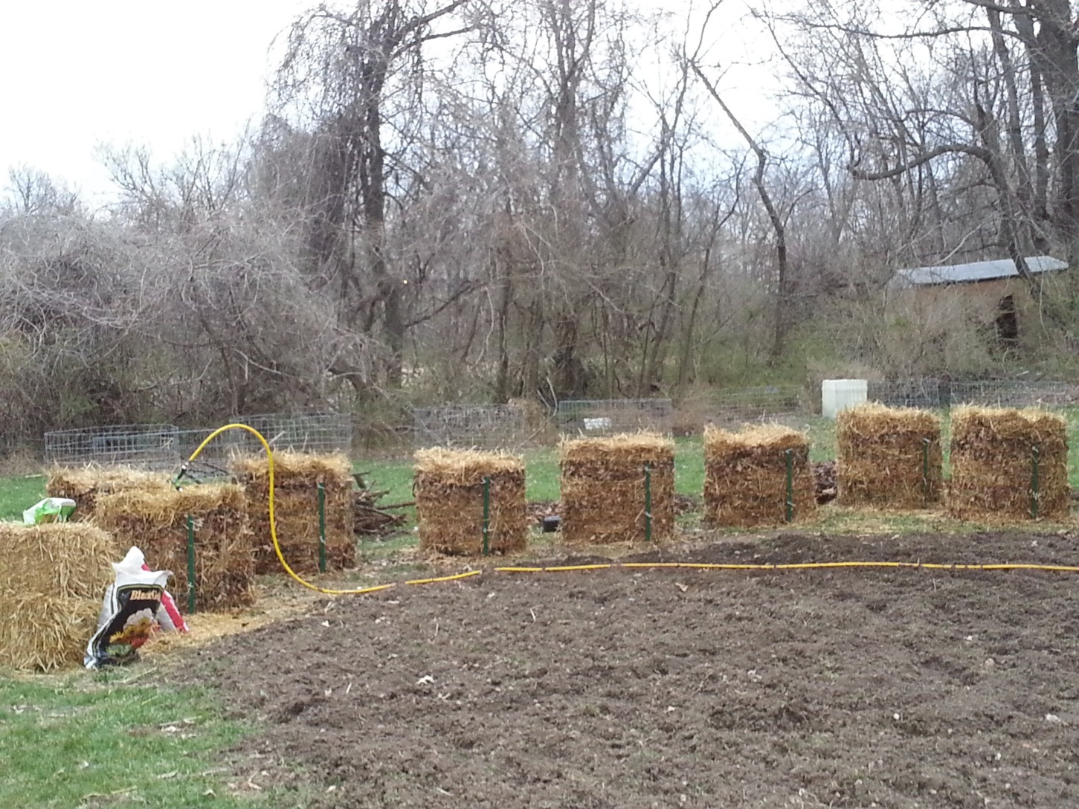
Water each layer

Slide 9
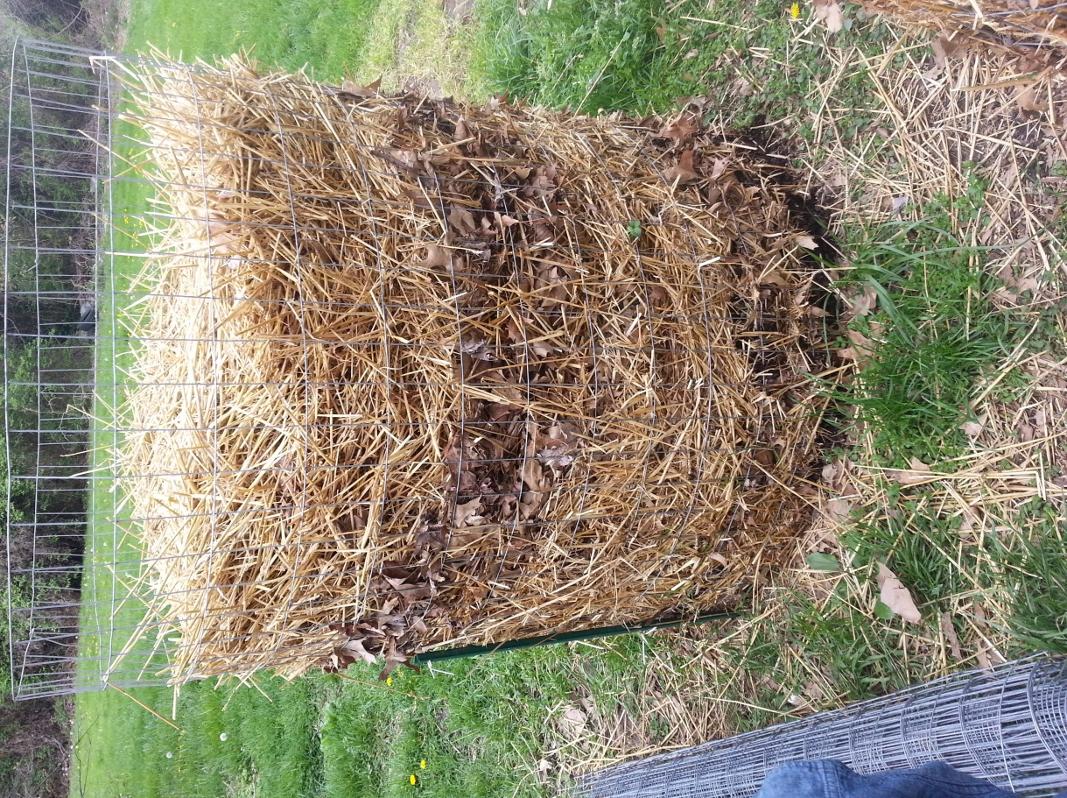

Slide 10
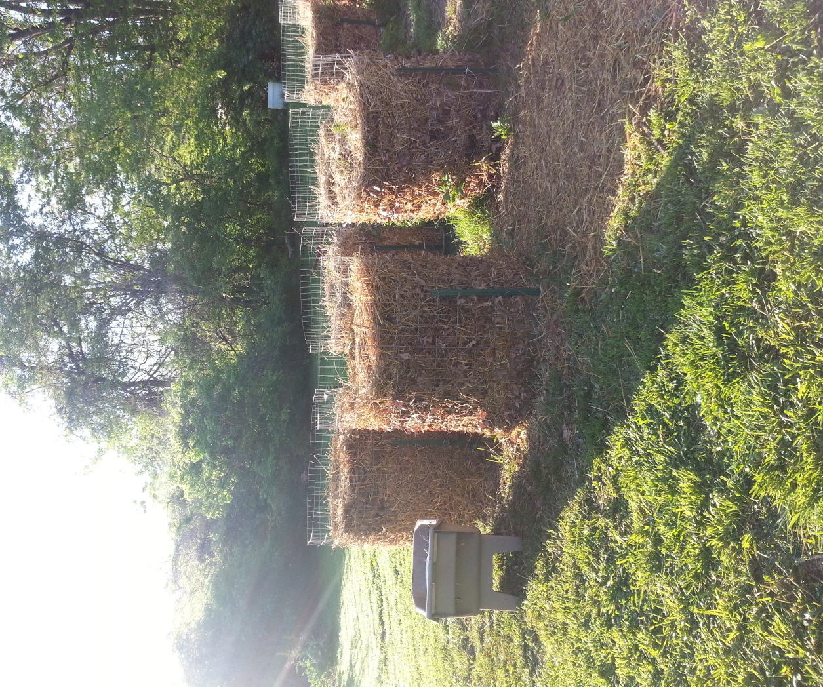

Slide 11
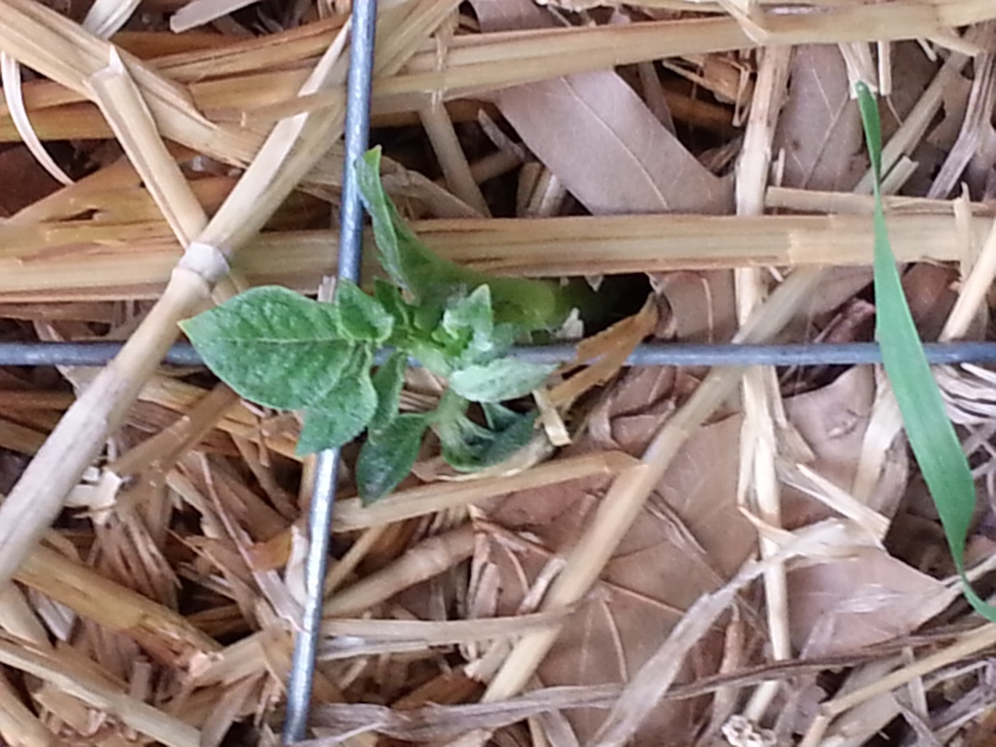
Potato Vine growing out of side

Slide 12
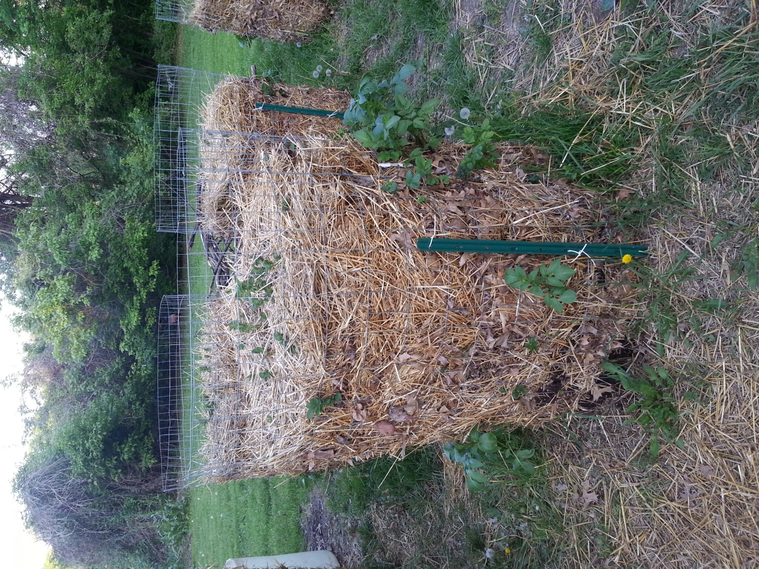

Slide 13
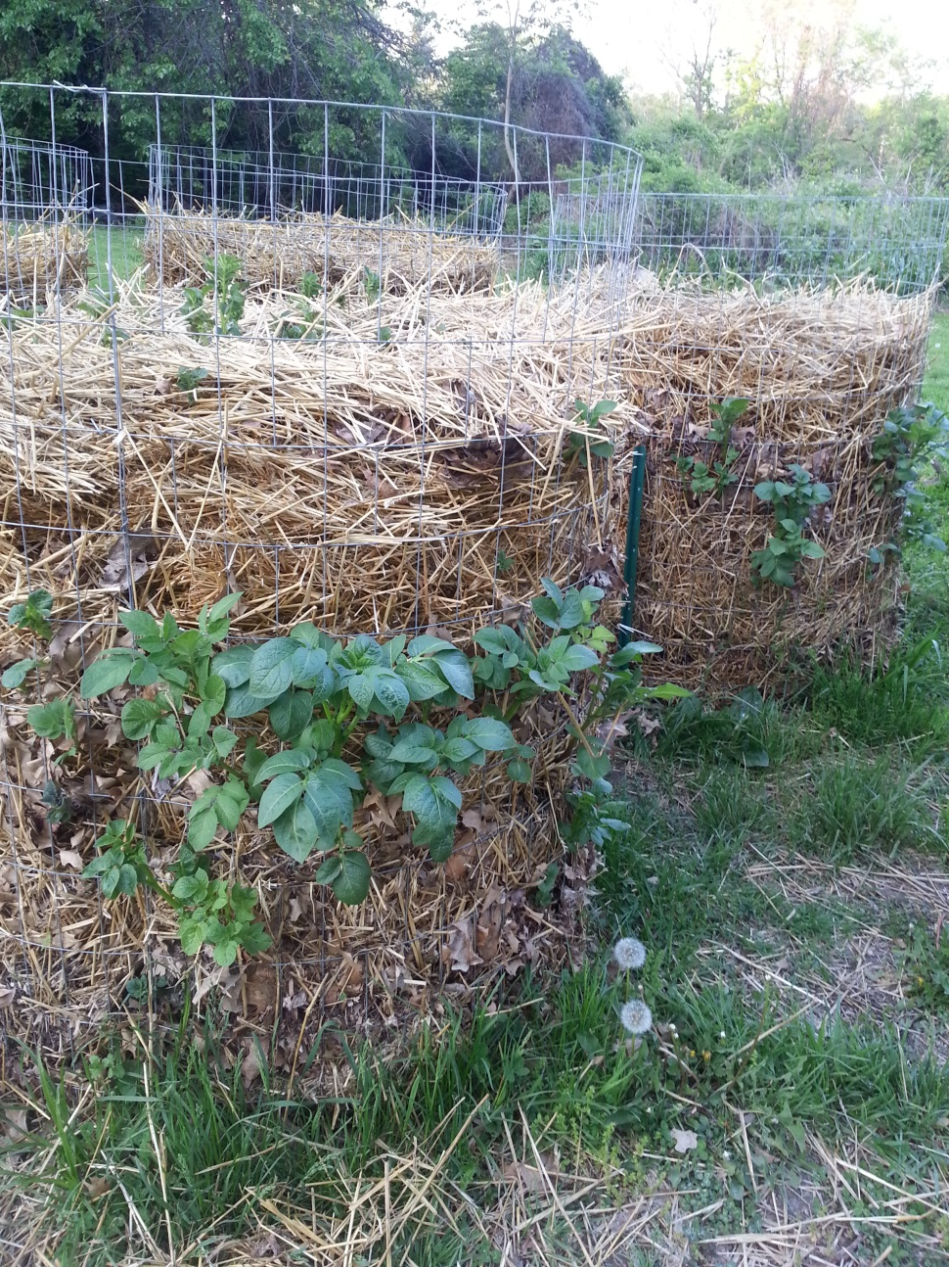

Slide 14
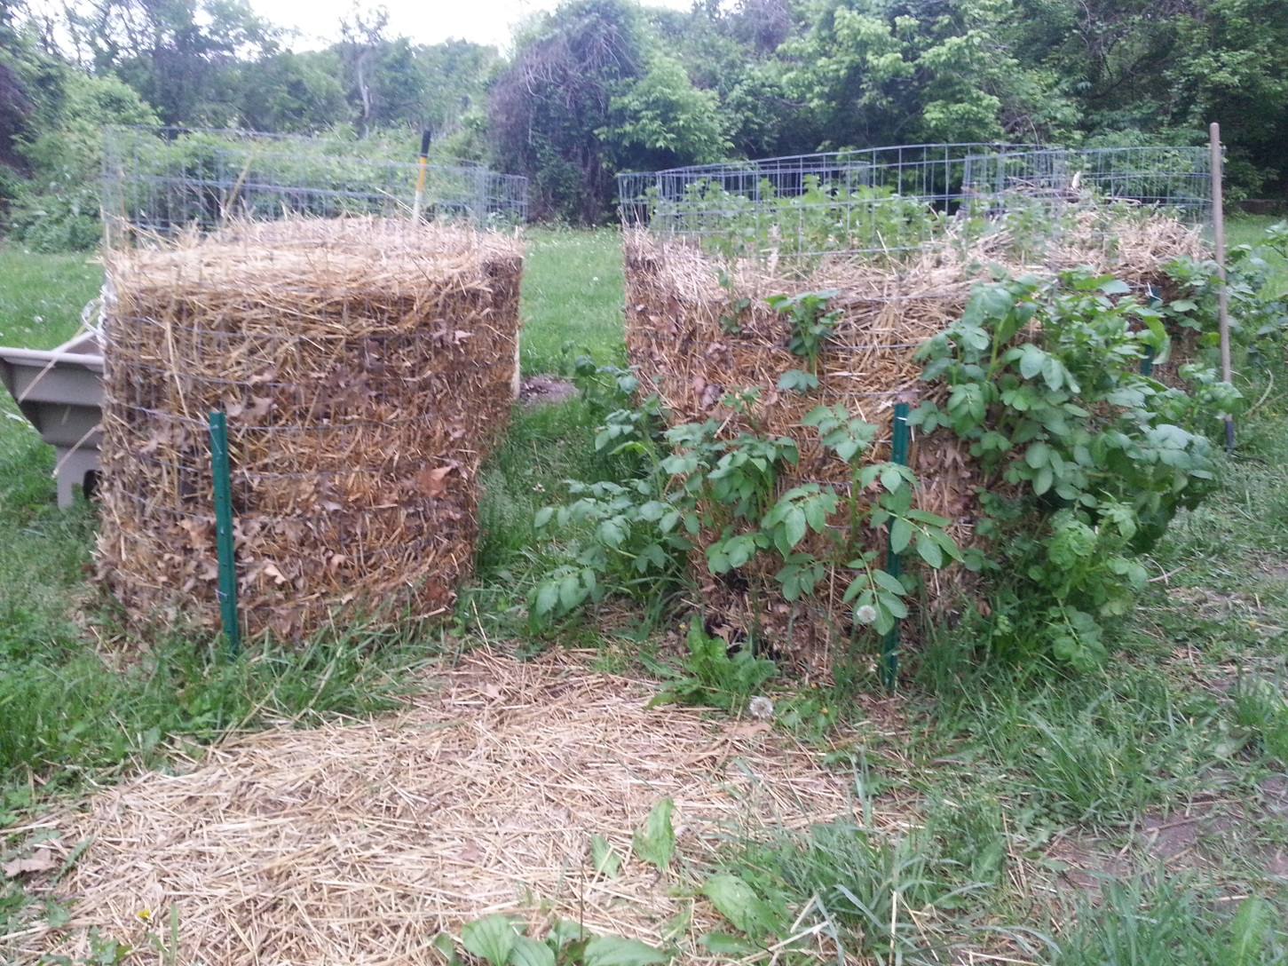
First cage really starting to fill out.

Slide 15
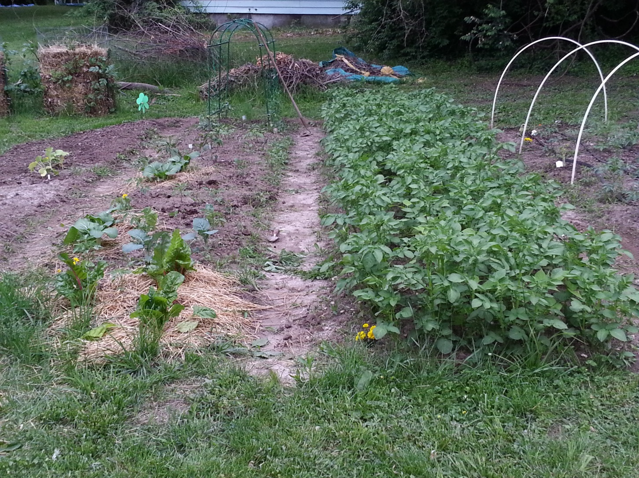
Row potatoes really growing well

Slide 16
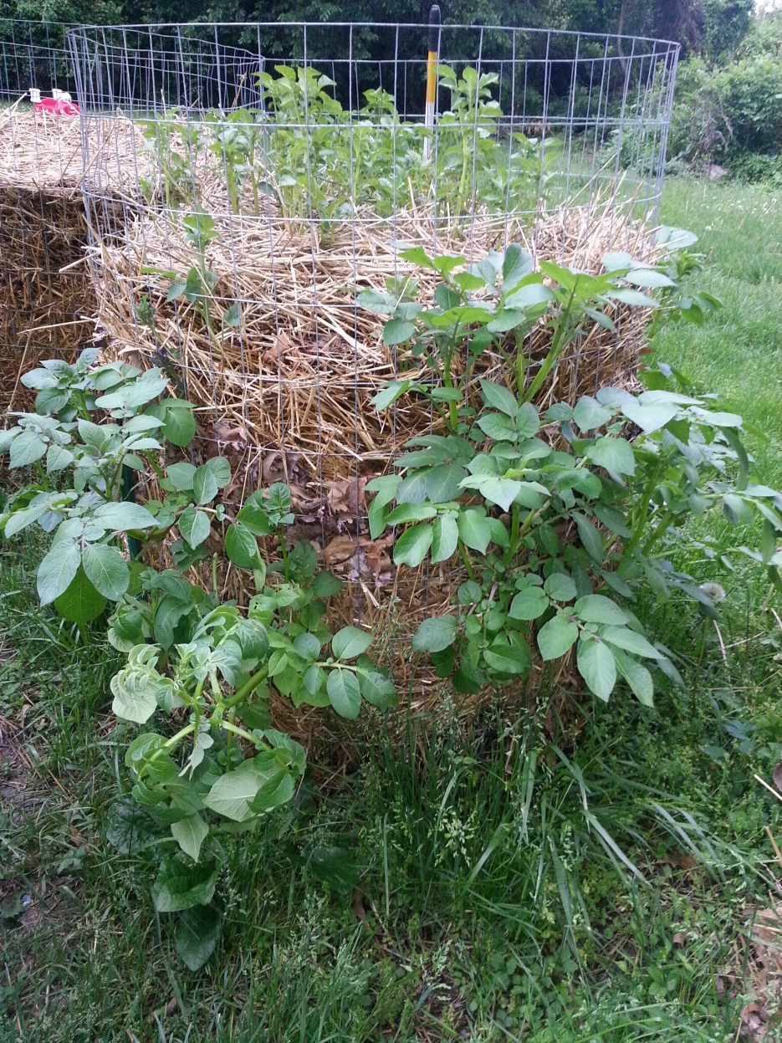
Towers growing really well

Slide 17
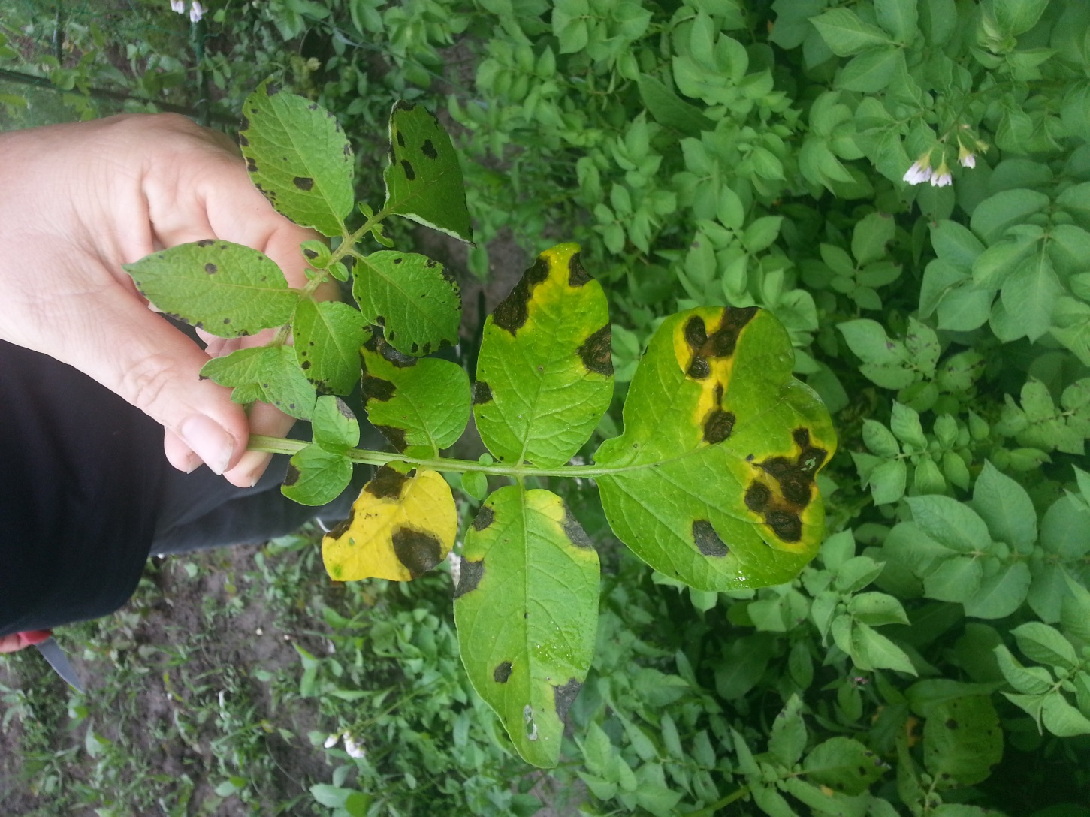
Then the rains came and came and came and so did leaf fungus in rows.

Slide 18

What we harvested

Slide 19
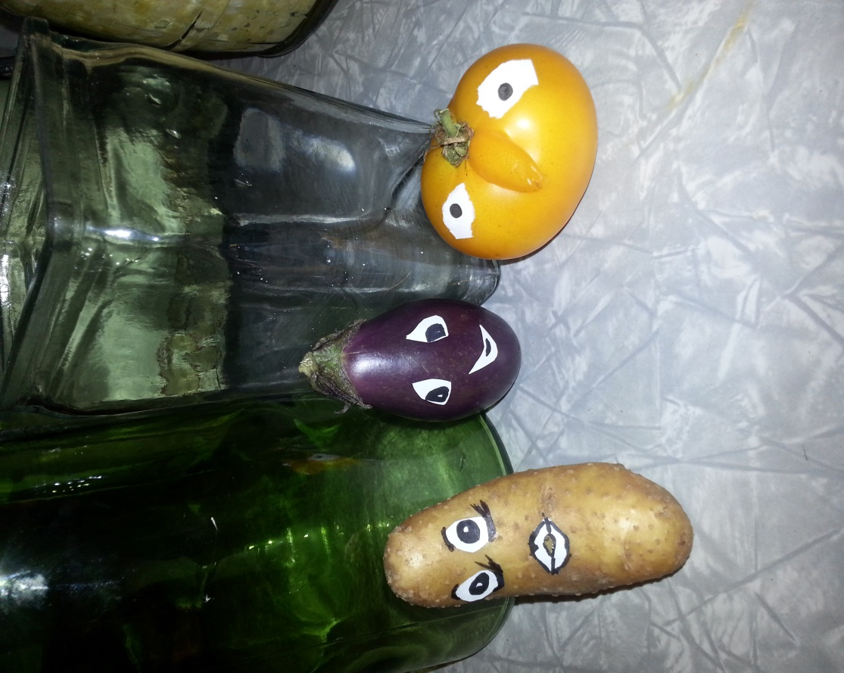
We did get some smiles from our harvest!!!

