Slide 1
Three Sisters Project – 2022 Growing Season Recap
Horticulture Research Station
Ames, IA

Slide 2
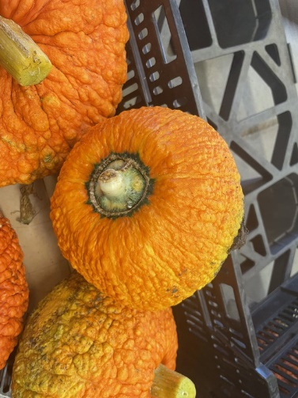
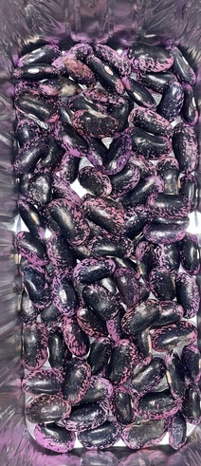
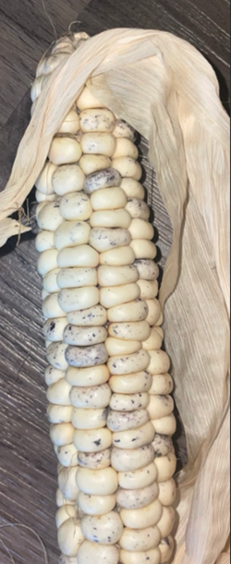
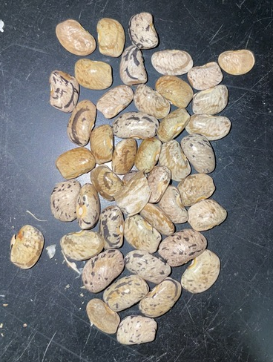
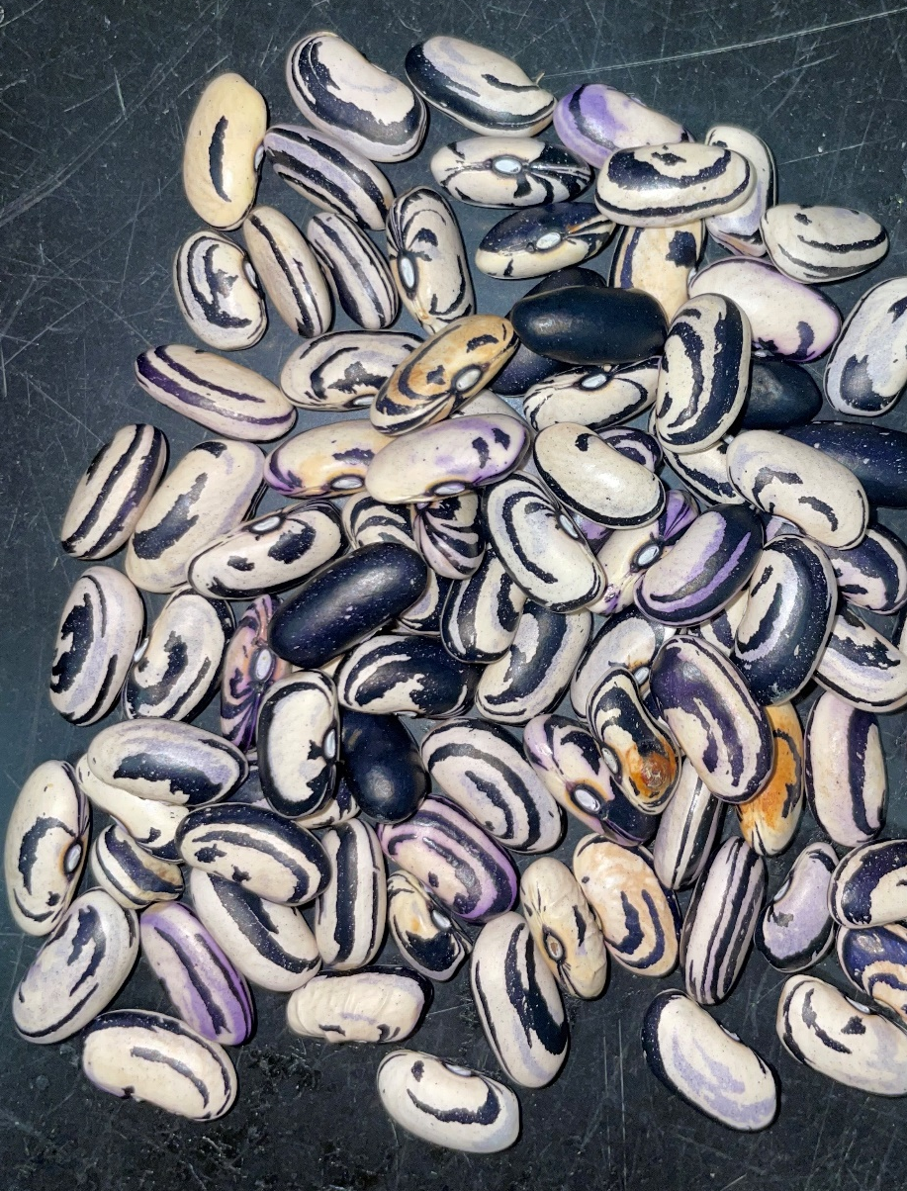
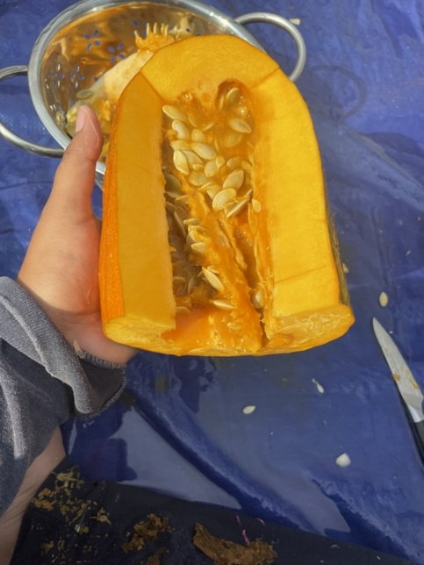
Varieties Grown
Grown in the Research Garden:
Winnebago Spotted
Scarlet Runner
Red Warren Turban
Grown in the Rematriation Garden:
Wampum Bean
USDA ‘Skunk’ Bean
Algonquin Long Pie Pumpkin

Slide 3
Seasonal Data Collected
In the field:
Weekly SPAD, and soil temperature and moisture
In the lab:
Soil gravimetric water content
Microbial biomass
Nitrate and ammonia in soil
Potential mineralizable carbon
Potential mineralizable nitrogen
Aggregate stability
Particulate organic matter

Slide 4
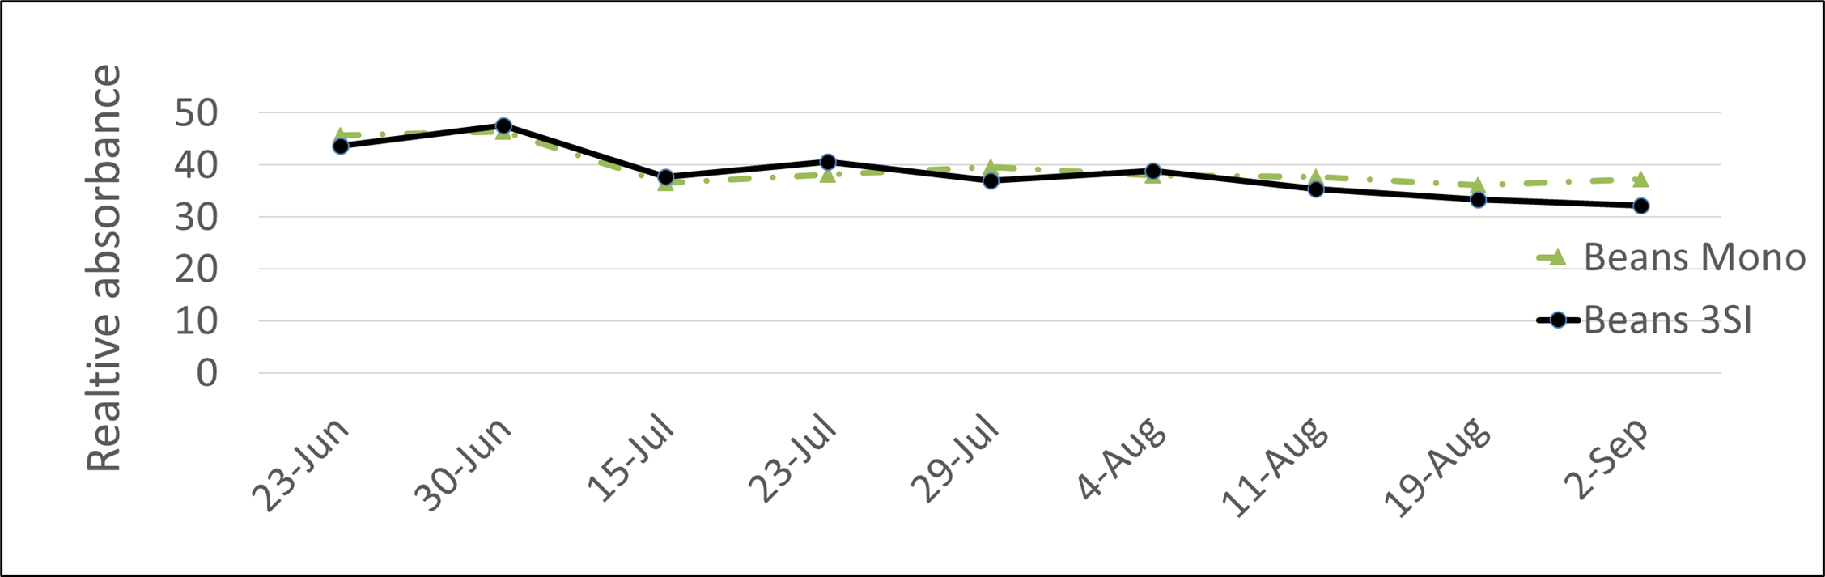
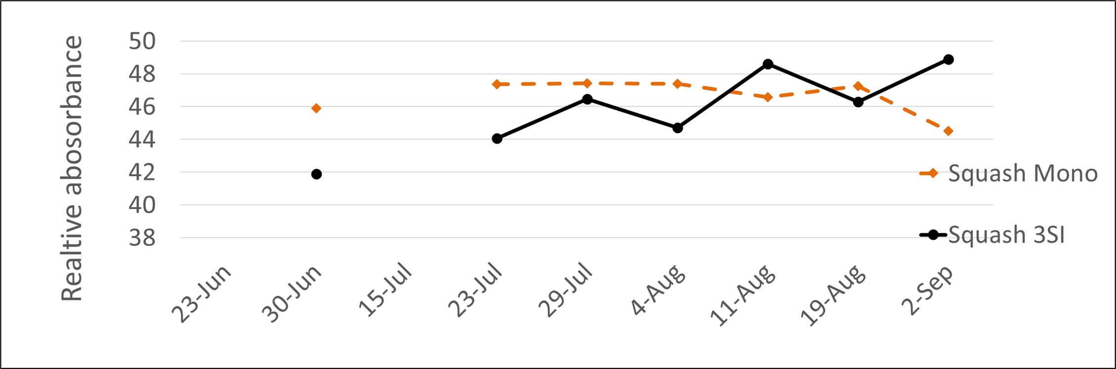
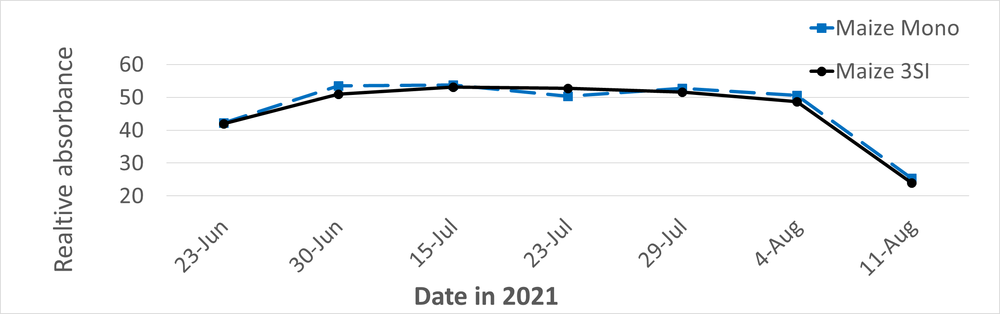
SPAD
Notes:
SPAD is a chollorphyll proxy
The higher the value the more green a plant = healthier = nutrient sufficient

Slide 5
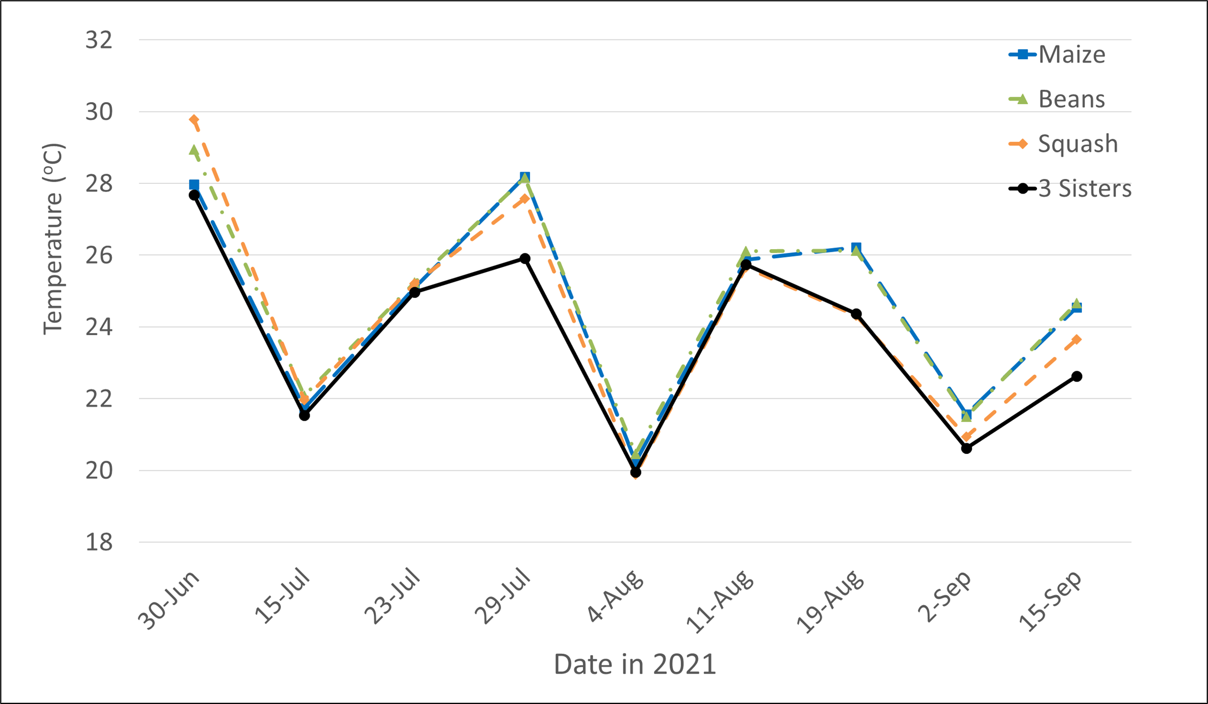
3SI has lower temperatures consistently throughout growing season
Notes:
Corn ideal is 85-90 F (29.4 – 32C)
Squash at least 70 (21C)
Beans 70-80 (21-26C)
3 SIS range then would be 85-80? (29.4 -26)

Slide 6
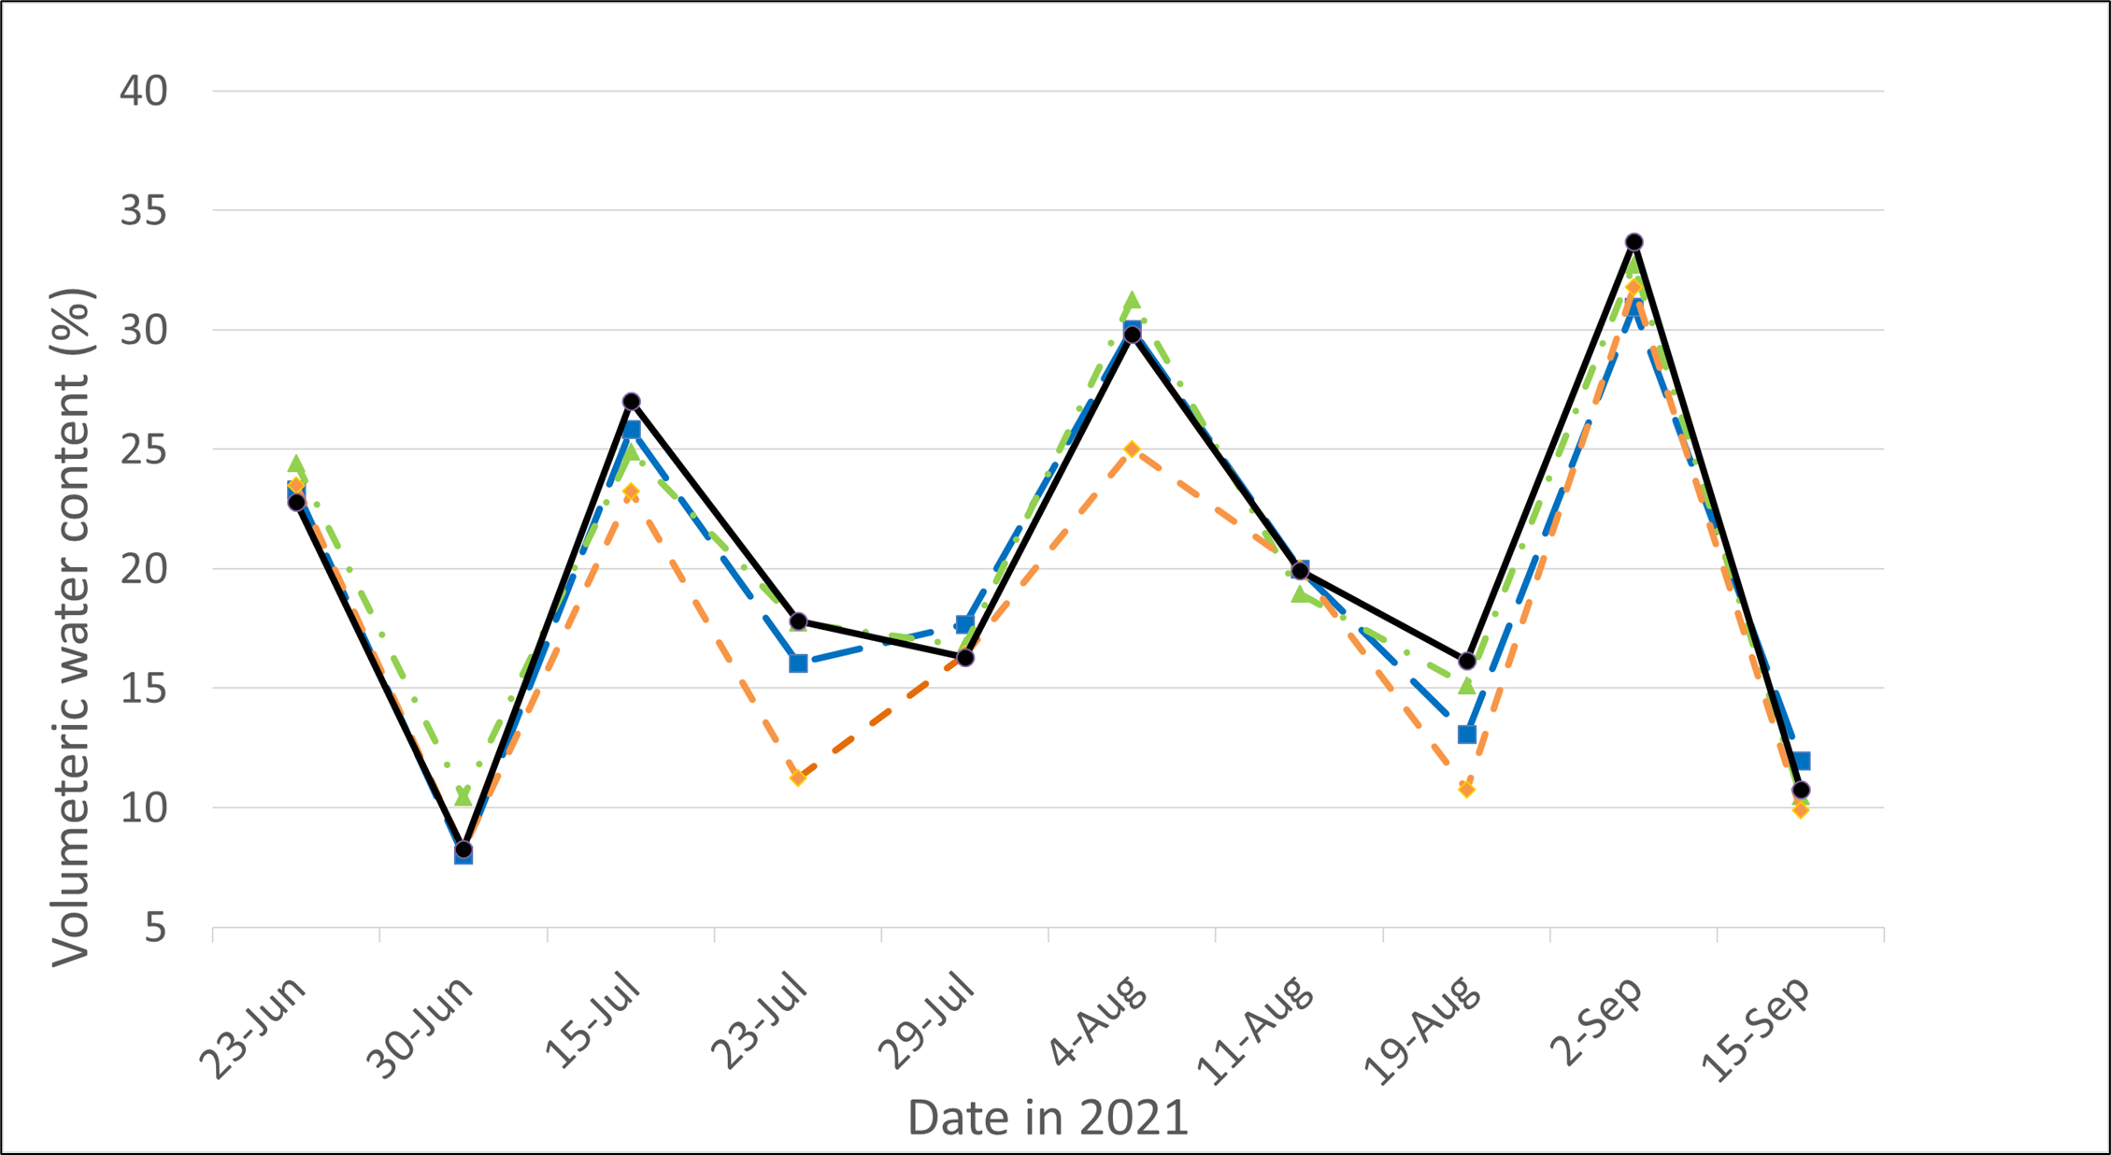
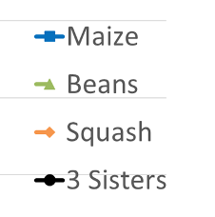
3SI has higher moisture content during mid-July to September

Slide 7
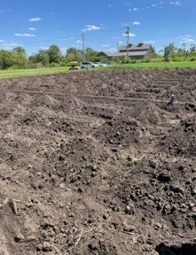
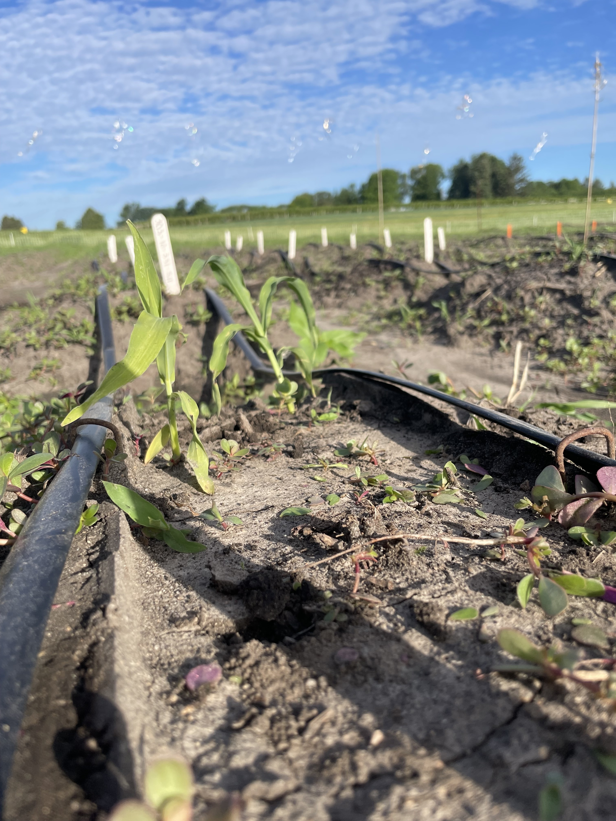
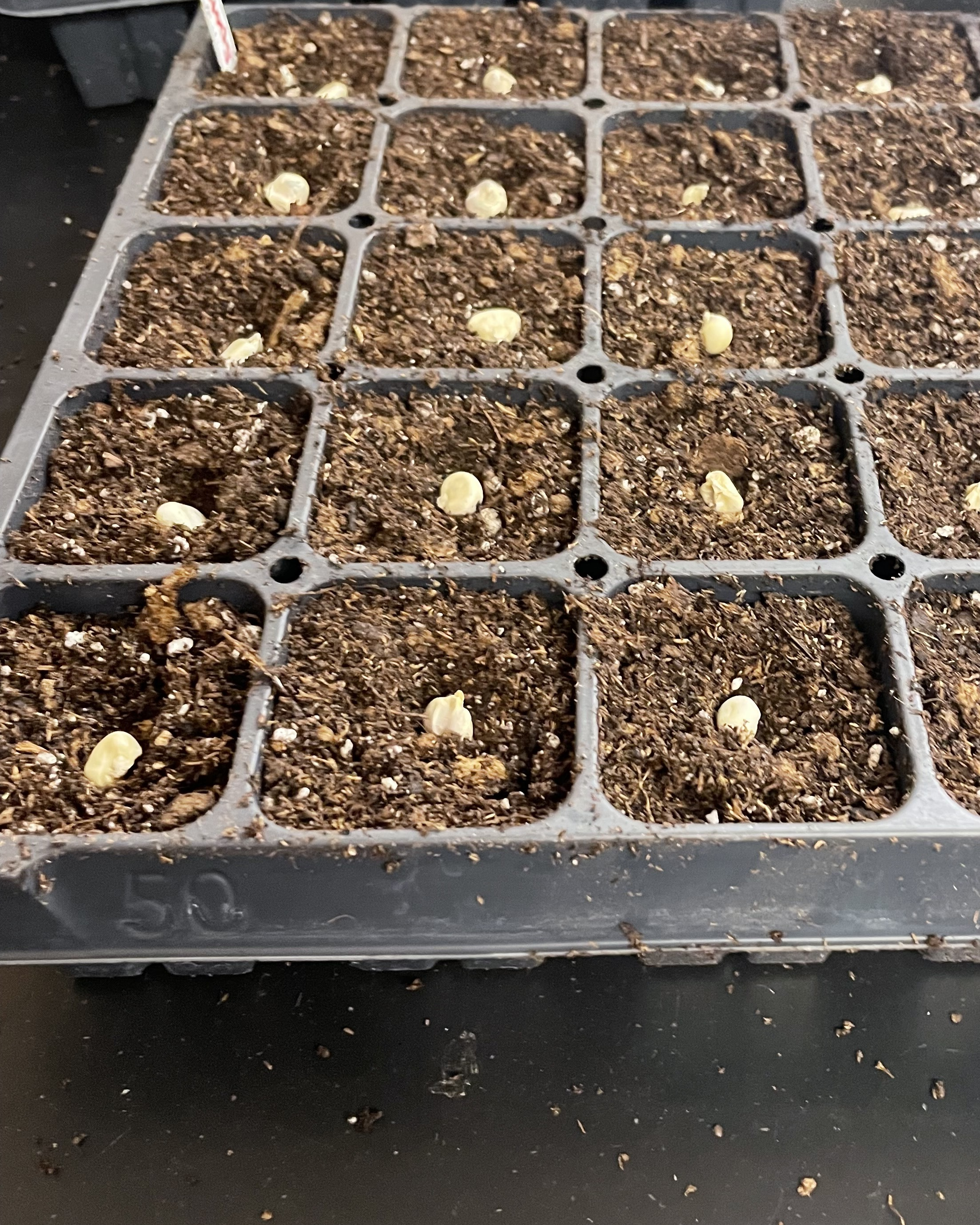
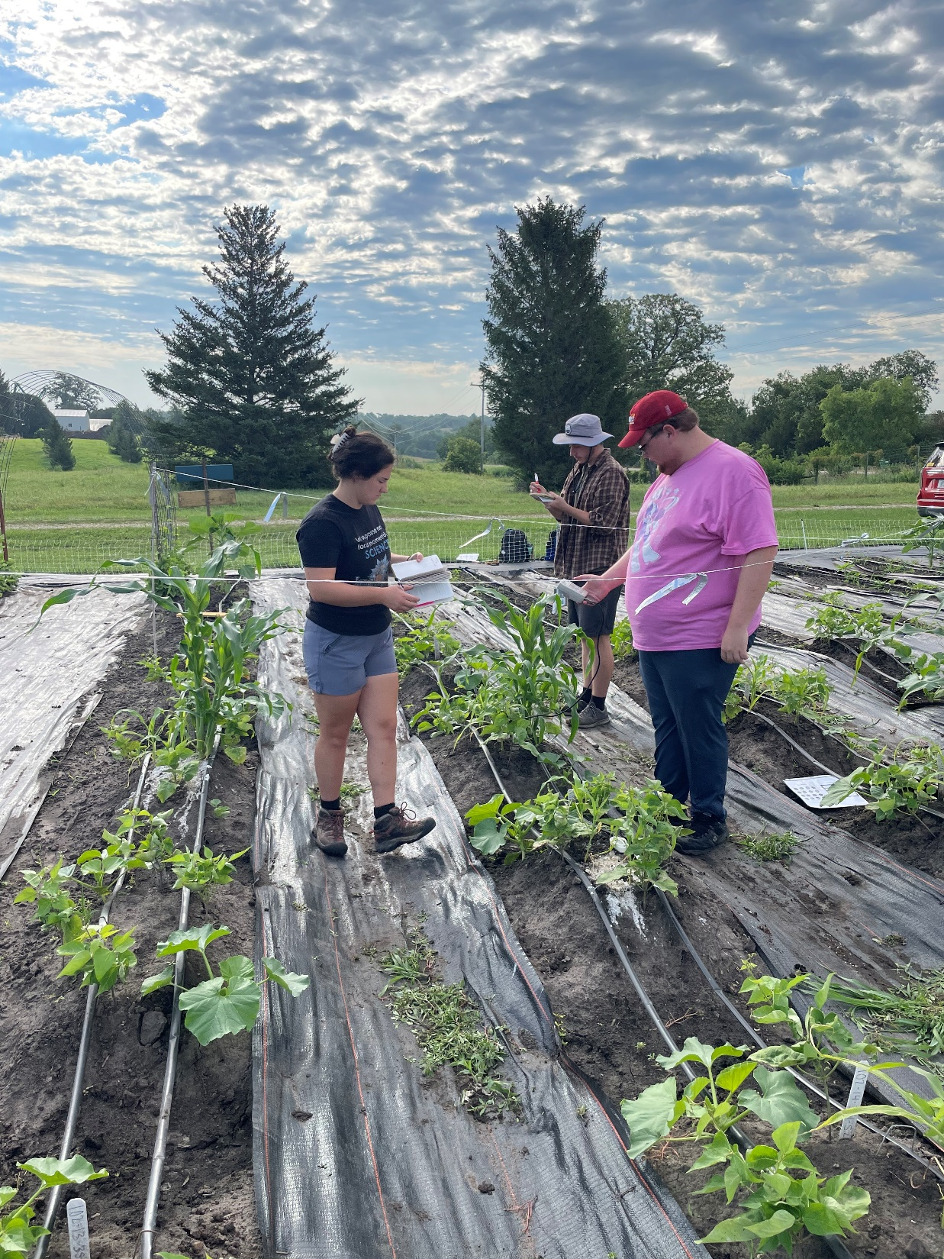
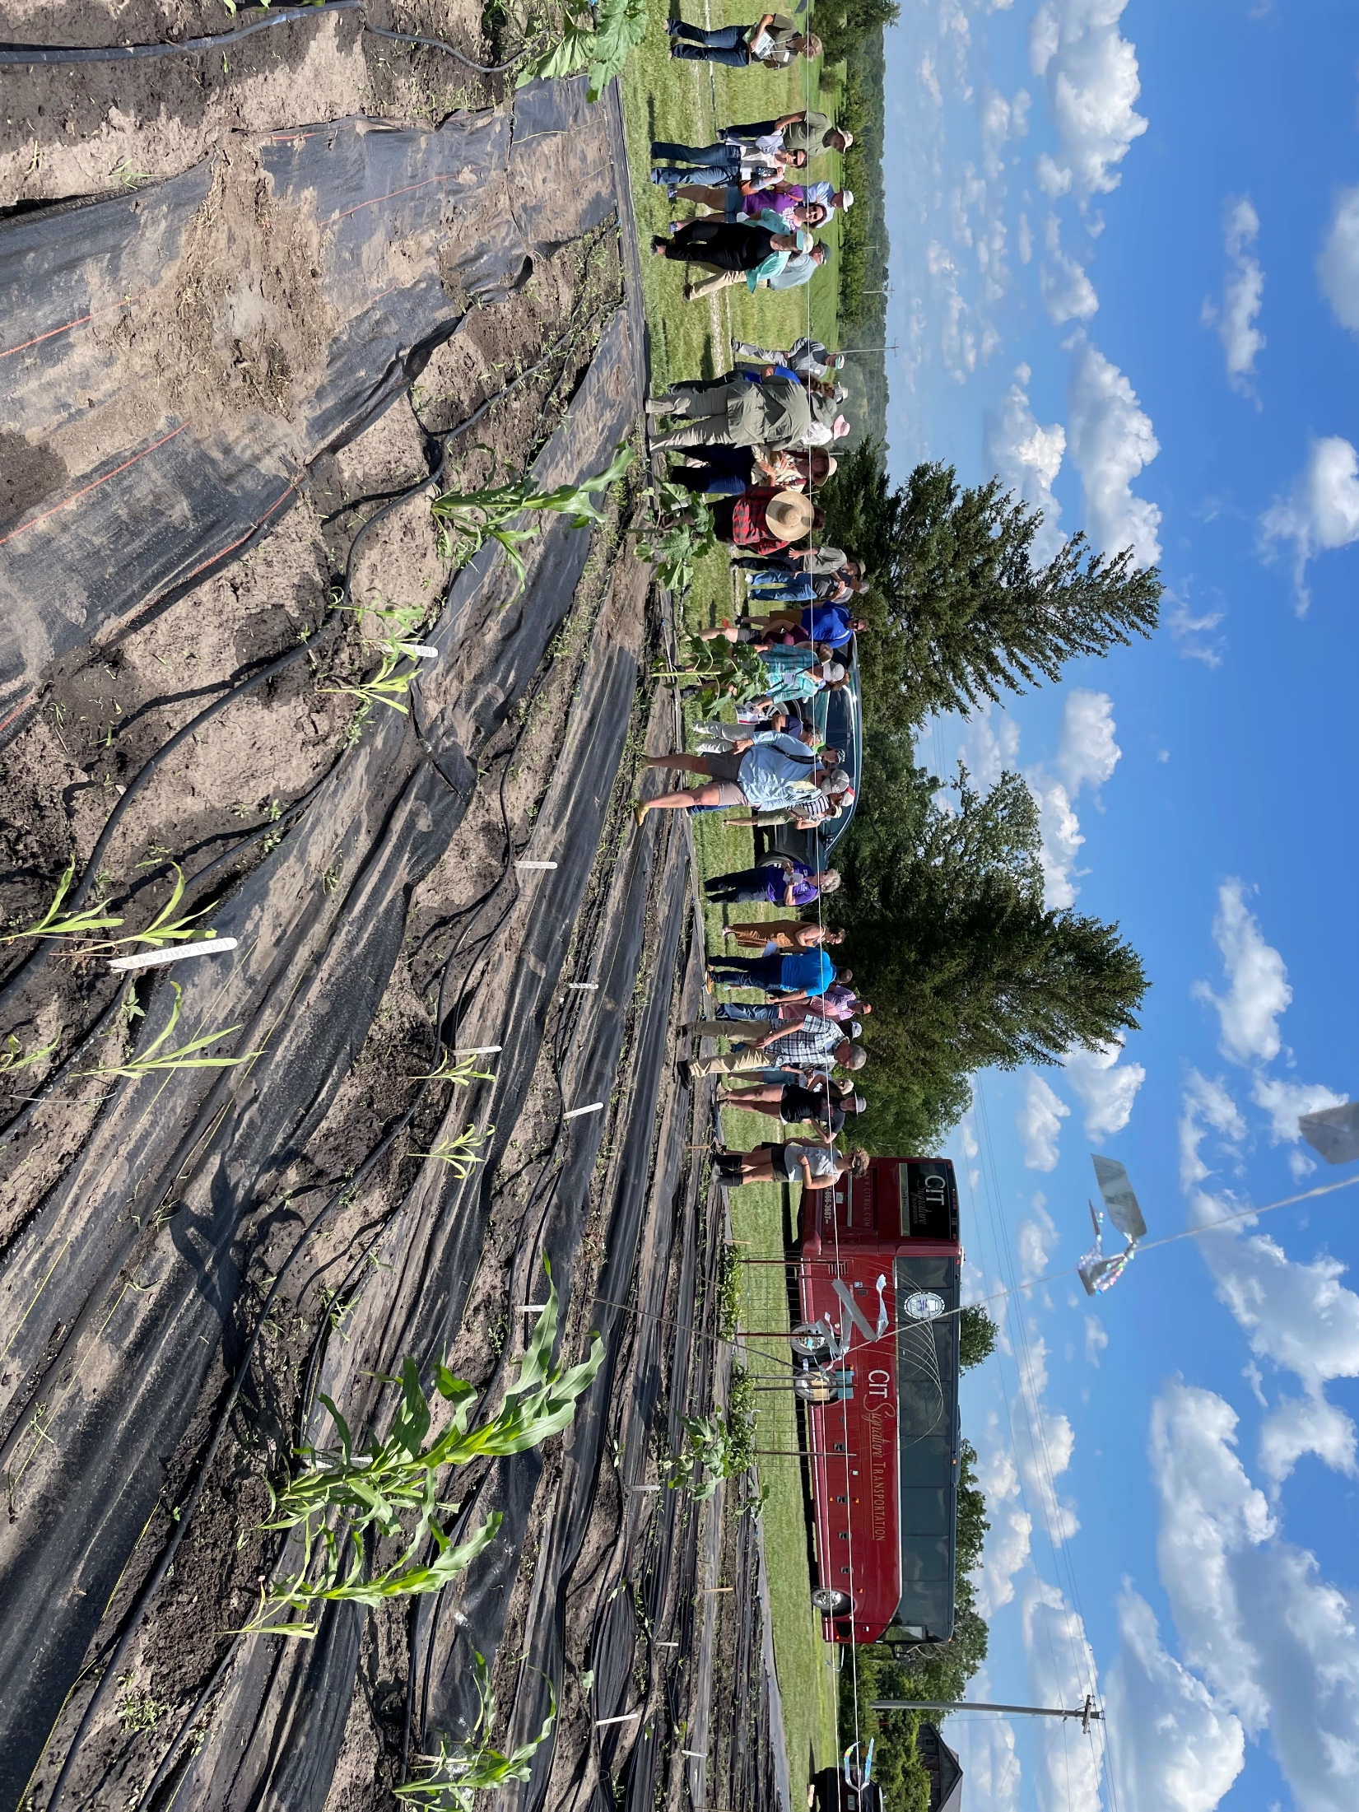
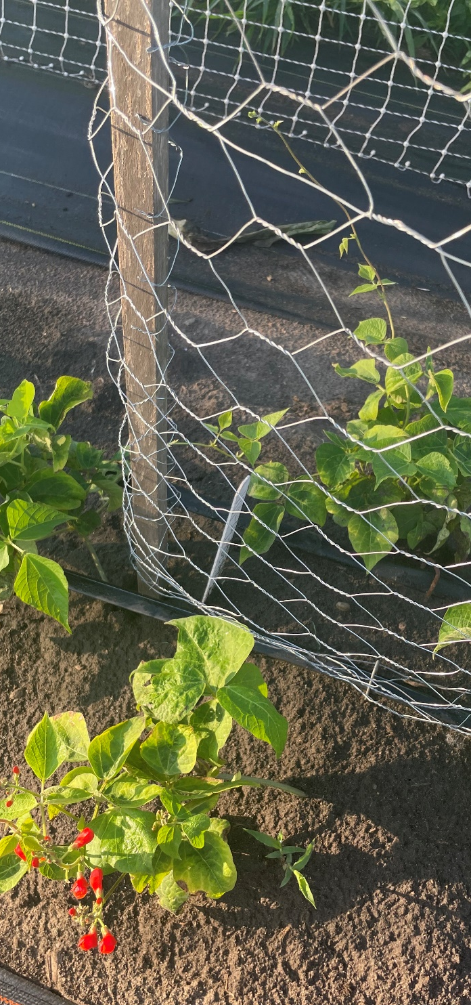
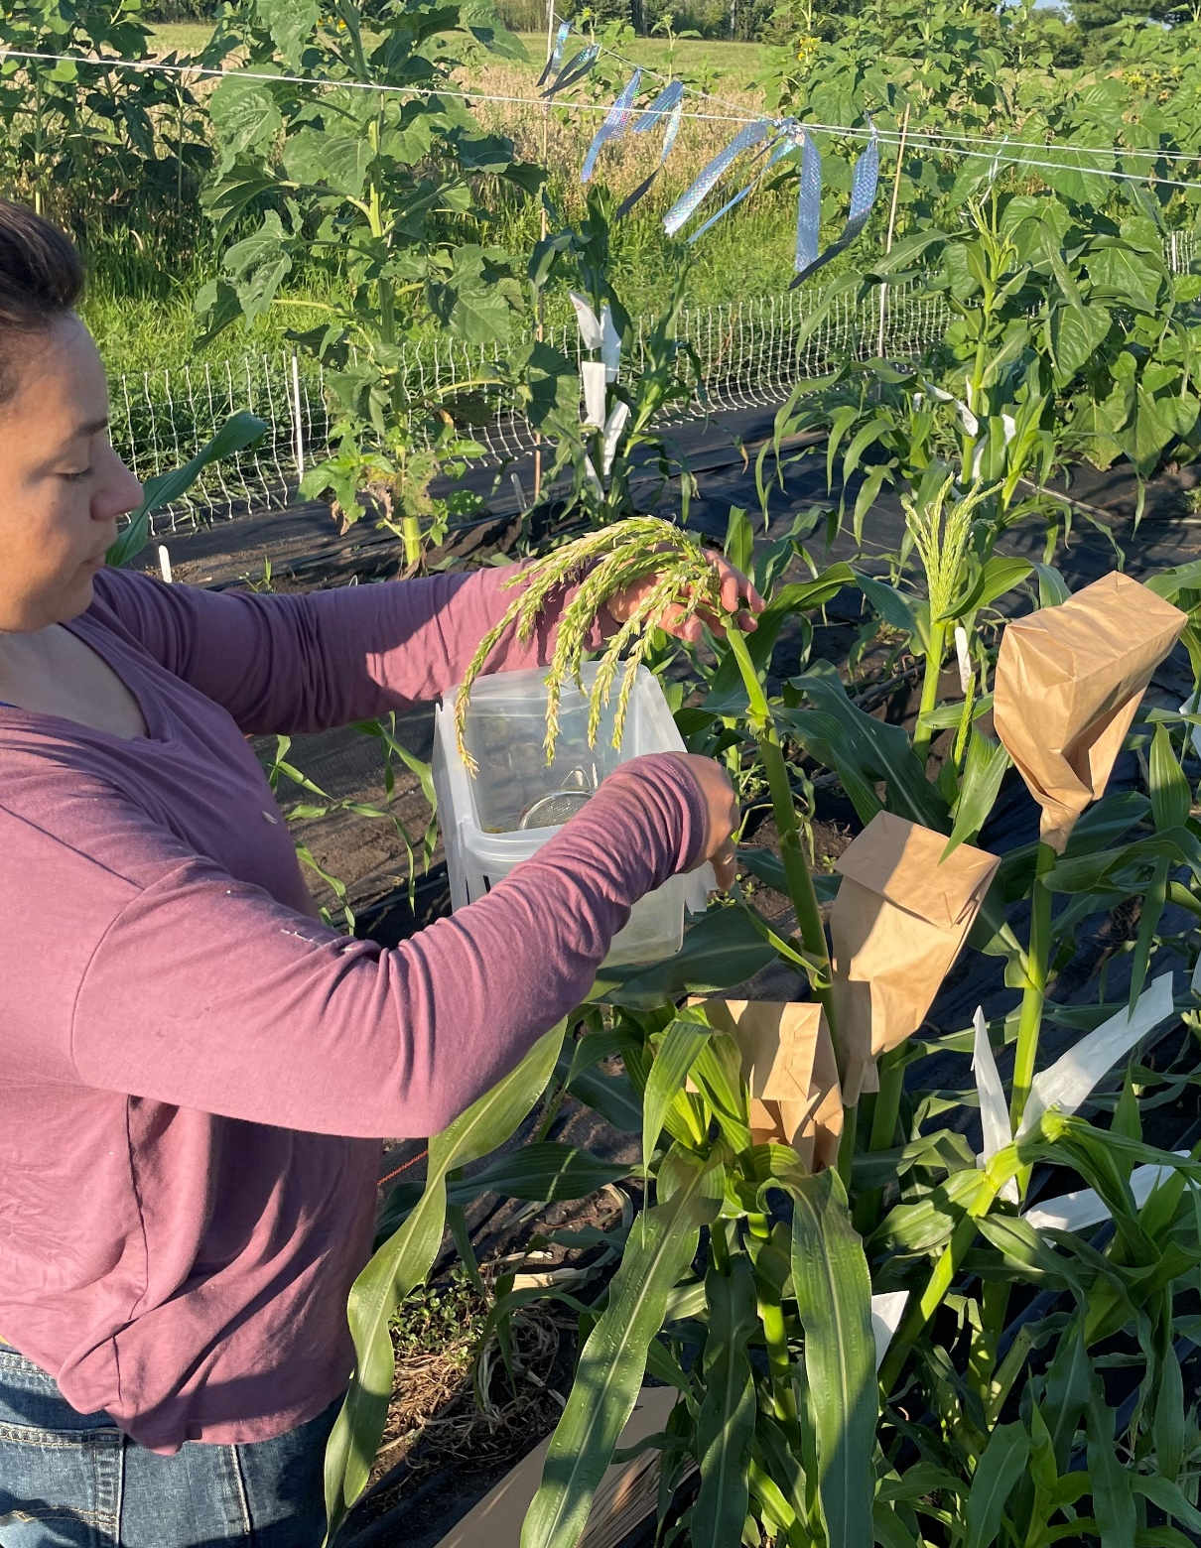
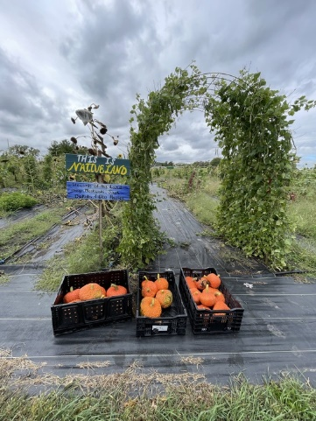
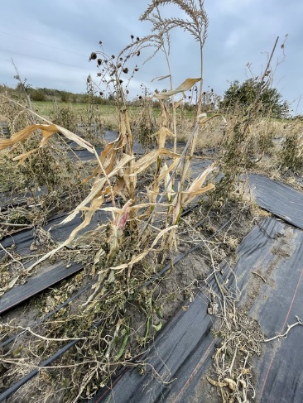
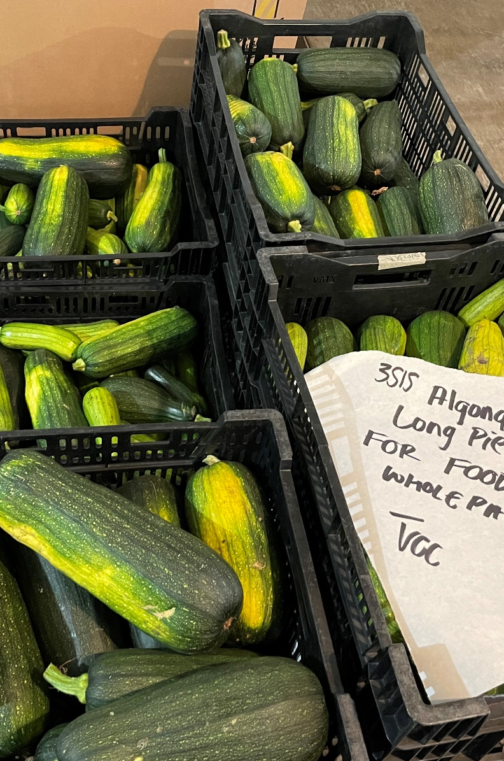
Season Timeline
June 2nd 2022 – bit of late start
Predation… greenhouse starts on June 22nd
Mid July - Field tours & data collection
Frost
Early Aug– Beans Flowering & Corn Hand Pollination
September – ALPP and Red Warren Turban Harvest
Corn & Rematriation Beans Harvested on October 14th

Slide 8
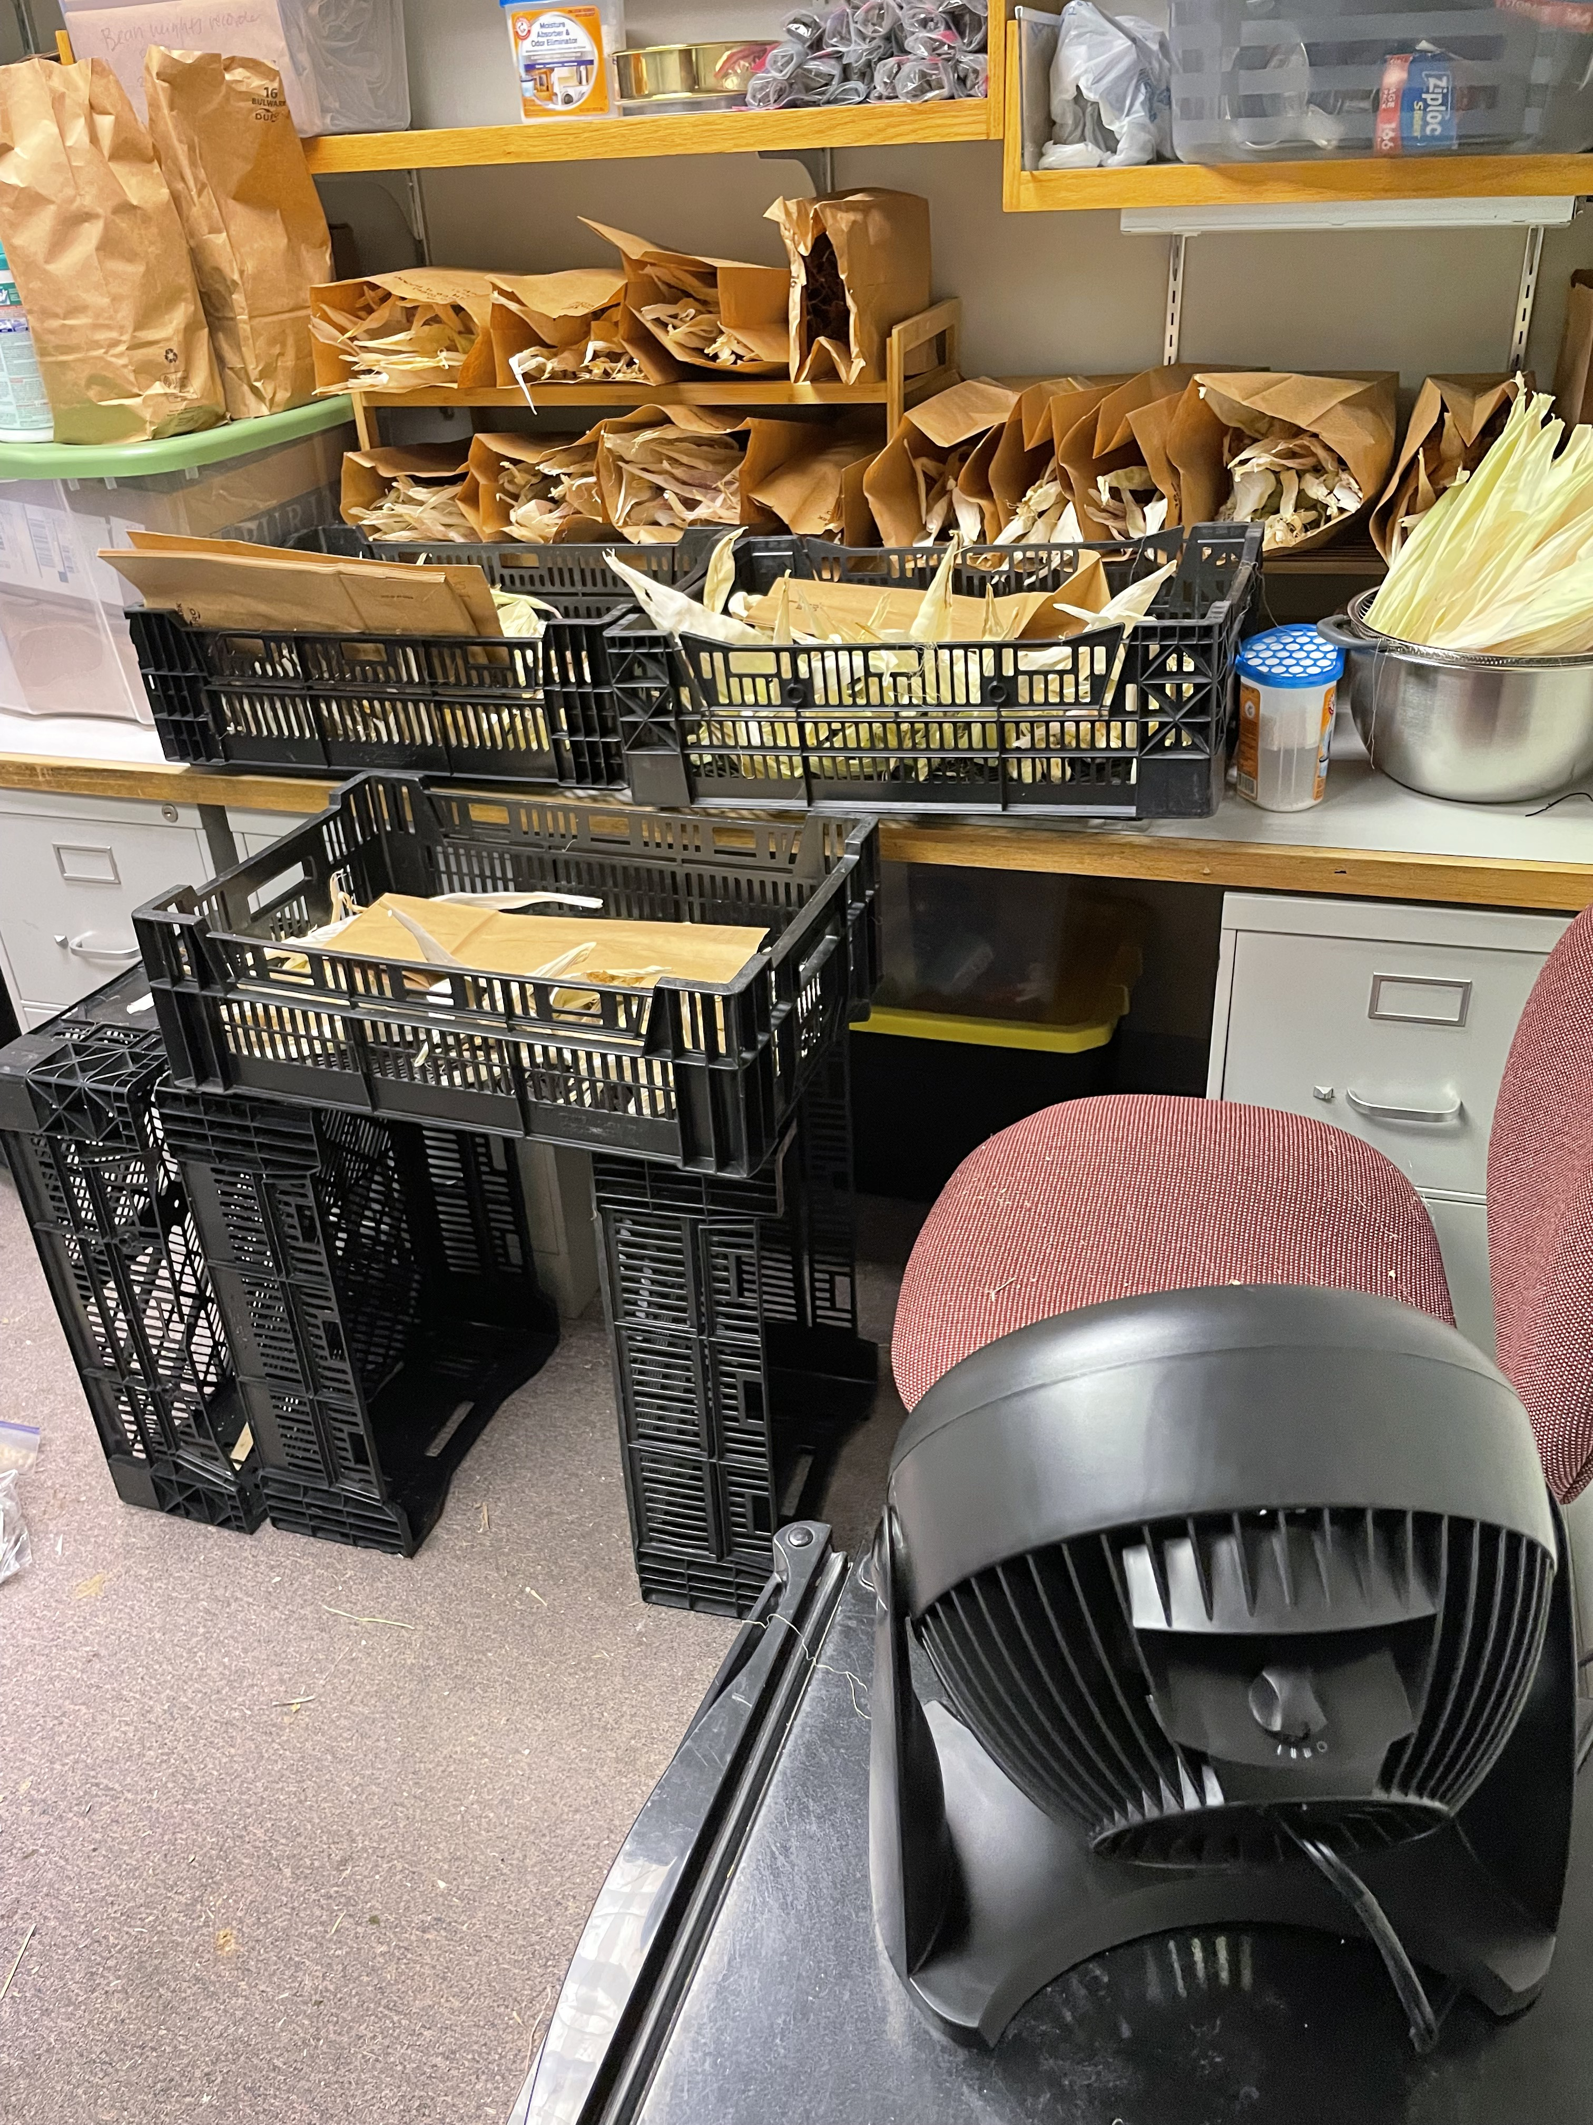
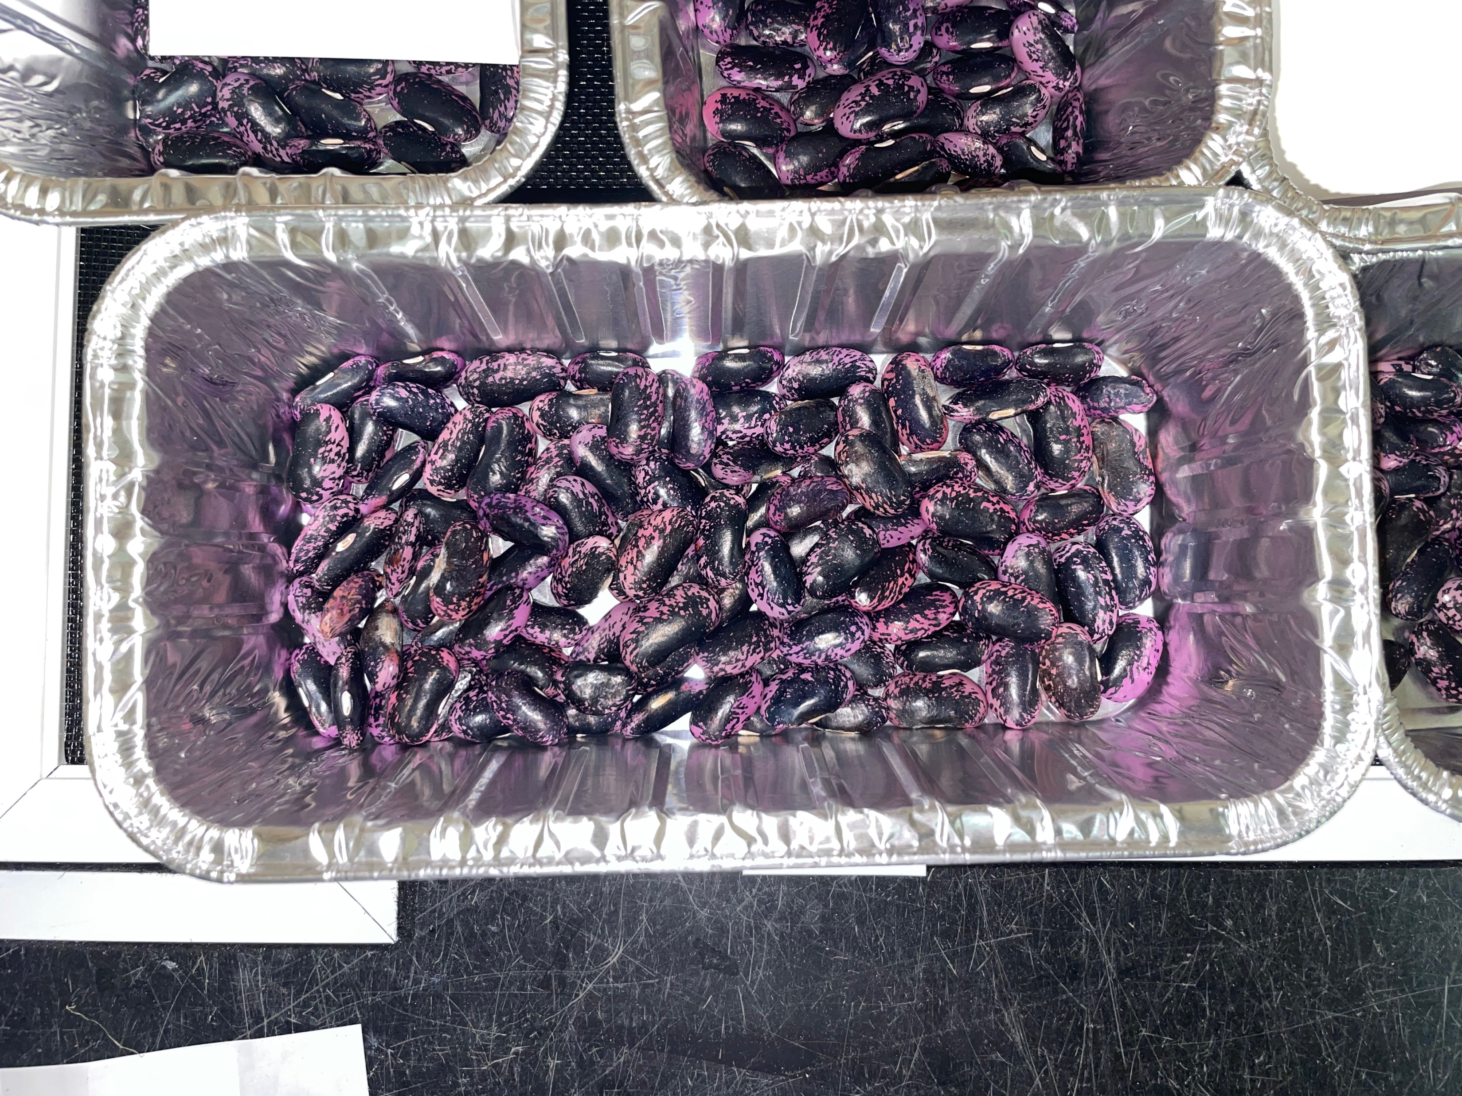
Harvest & Post Harvest Data
Corn:
Number of ears
Fresh weight
Beans:
Number of pods
Fresh weight
Beans and Corn:
Dried 100 seed count weight / 100 = individual seed weight
Post-harvest corn was husked and prepped for braiding

Slide 9
Seeds & Rematriation

Slide 10
Three Sisters Project Rematriation Seeds
2020
Turtle Mountain White Corn
Hidatsa Red Bush Bean
2021
Turtle Mountain White Corn
Hidatsa Red Bush Bean
2022
Algonquin Long Pie Pumpkin
Algonquin Long Pie Pumpkin*
Winnebago Spotted Corn
USDA 'Skunk' Bean & Wampum Bean
Algonquin Long Pie Pumpkin*

Slide 11

2021 Corn

Slide 12
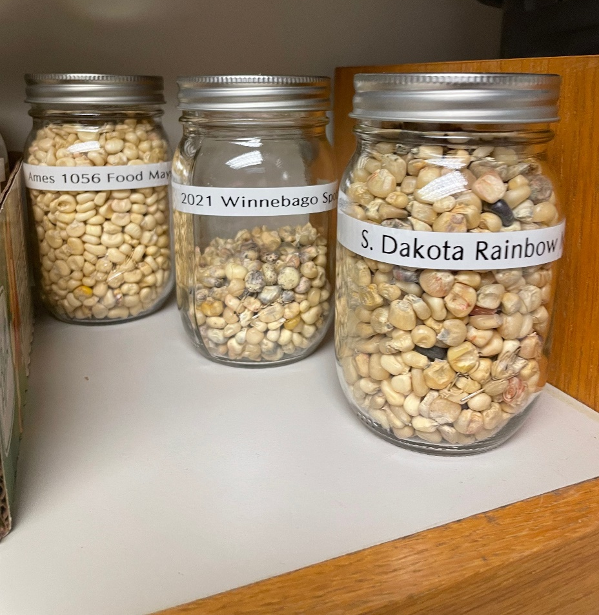
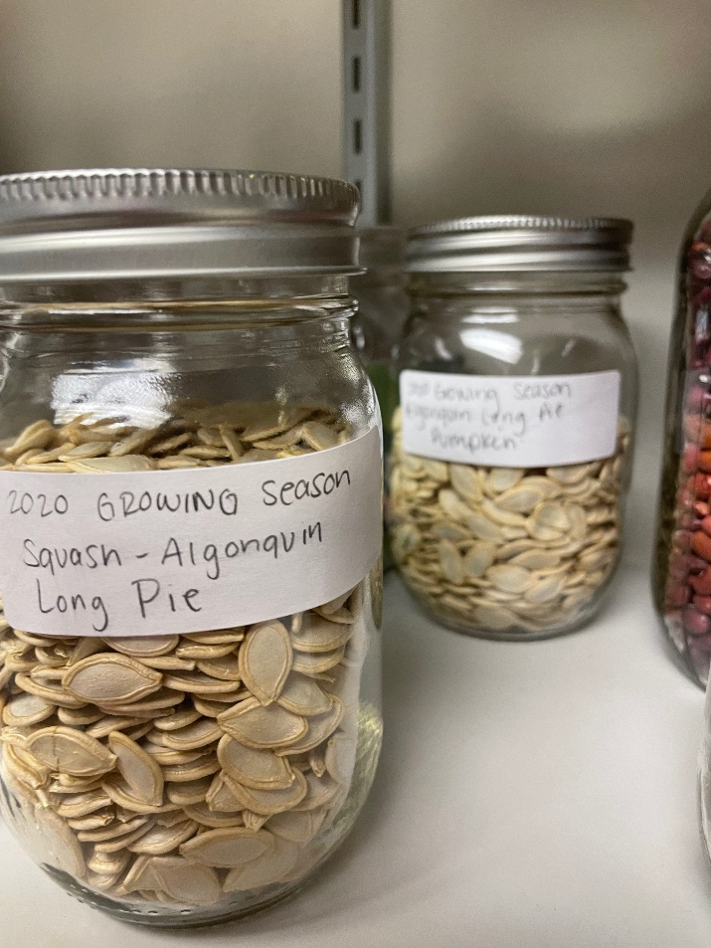
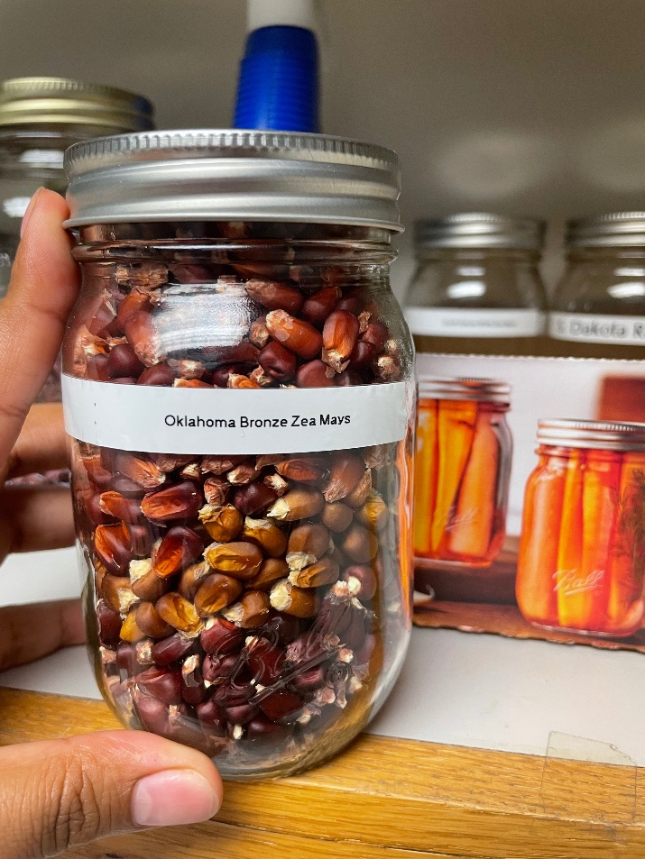
2020 & 2021 Seeds
These are currently being at room temperature in Agronomy Hall, 90% of the time in full darkness.
Corn that was not braided has been hand shelled (very carefully) and placed in glass jars.

Slide 13
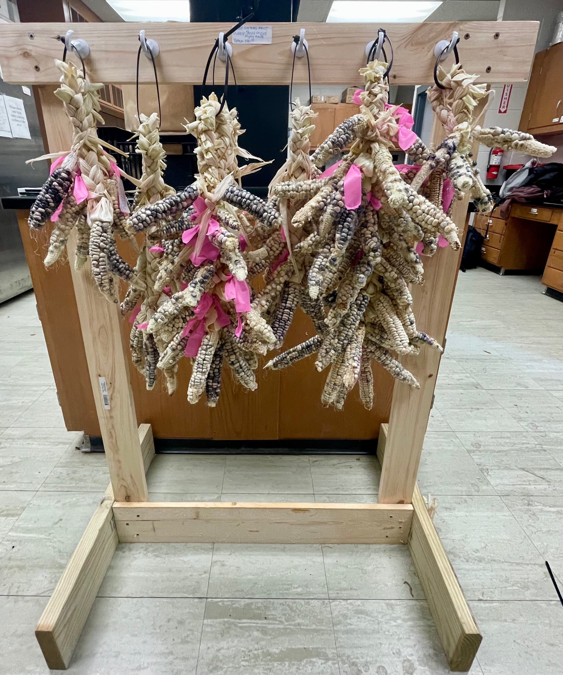
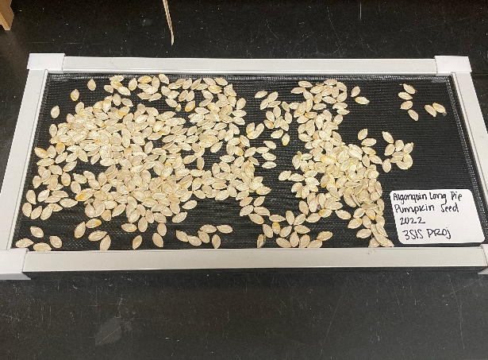
2022 Seeds
Corn and Squash seeds are currently air drying
Beans are still being shelled
24/7 fan since harvest to avoid mildew and spoilage

Slide 14

Distribution plans
50 grams of seed per envelope
Printed labels
Previous distribution has been hand delivered at workshops
Moving Forward:
What will work best for seeds and communities?
  Shipped
  Hand delivered
Continue with envelopes or move towards glass containers?
Keep corn on cob or remove kernels?
Label Includes:
Three Sisters Project
Horticulture Research Station
Ames, IA
Year seed was grown
Scientific Name
Common Name

Slide 15
Workshops & Community engagement

Slide 16
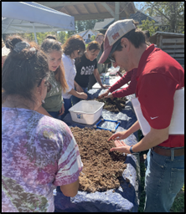
At a glance
Workshop Topics Covered
Soil fertility and health in home gardens
How to set up drip irrigation
Seed saving for home gardeners
DIY soil health test
Key insect pests of squash, beans, and corn
Composting basics & troubleshooting
Foods & culture (by Arlie, Anthony & LaVonne)
Drone basics (by Steve Webster)
Field Day at Horticulture Research Station
Soils basics and home gardening
Introduction to permaculture
Orchard care and start Up
Total Number of Workshop....................... 10
Pre-K-12 Workshops……………………3
Average attendees per workshop………25
Cooking demonstrations…………….…10
Ethnographic interviews……………......29
Number of collaborative grower……….7
Master Thesis & Publications……...……...5
(Updated July 2022)

Slide 17
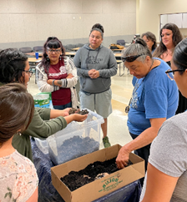
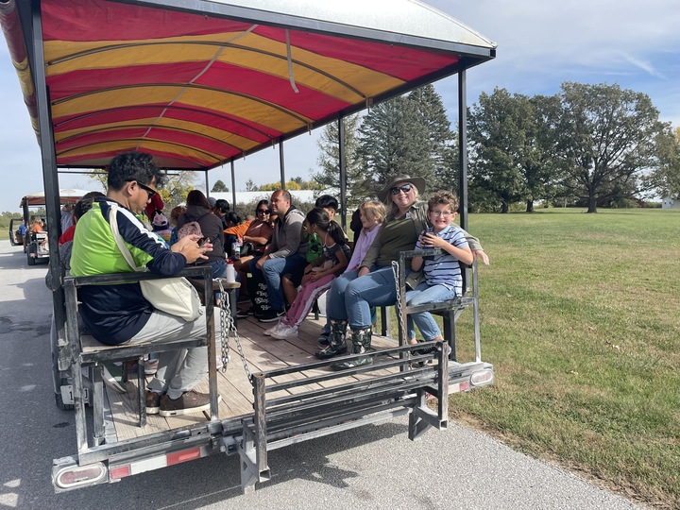
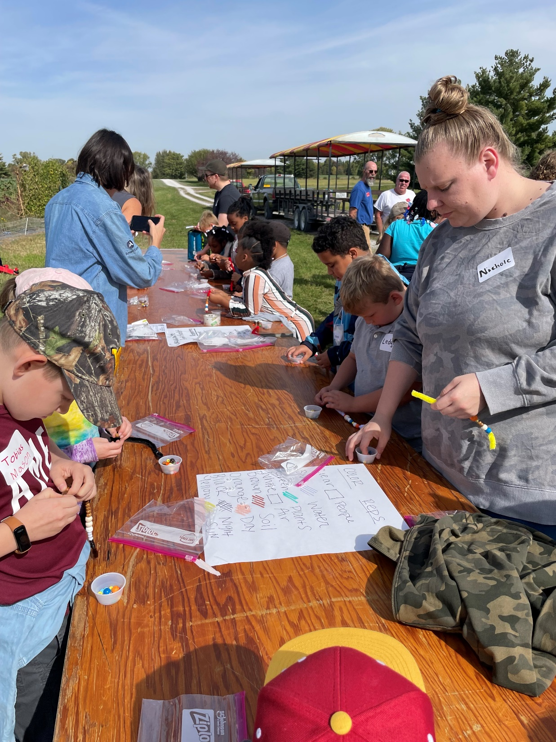
Continued…
August 27th
Macy Workshop: Permaculture and Small Scale Composting
October 4th
Horticulture Research Station Field Trip with Moore Elementary
  60+ kids and 10 adults
  Ecosystem bracelet activity and lesson on Three Sisters
  Sampled black bean brownie and Three Sisters Soup.
October 15th
Oneida Workshop: Orchard Care and Permaculture
October 24th
Soil and Water Conservation Club Presentation
Things to consider:
How do we measure impact?
How do we make resources available past project end date?

Slide 18
How to conclude a three-year project
Lets talk about it!

Slide 19

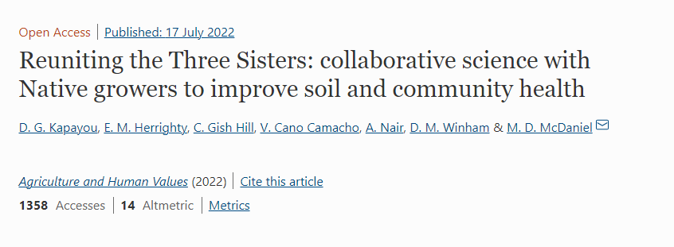
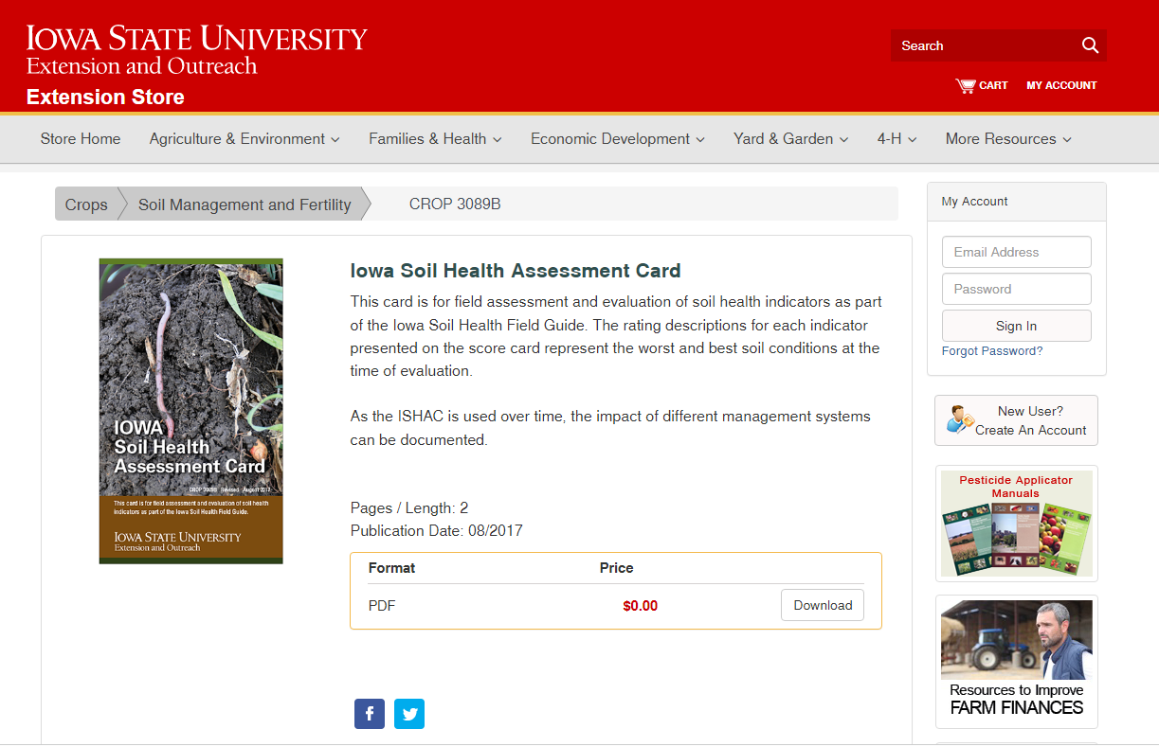
Pitching: Personal summary binder
Three Sisters Project Findings
2019-2022
What would you like to see inside?
Annual Summaries
Raw or Summarized Data
Extension Articles
Publications
Major Findings
Transcripts (each their own)

Slide 20
Let’s plan this out
Option A
We set a time and date to meet online
Online Meeting: Discuss in detail seed distribution
Option B
Set a time today to meet on location and bring seed with

Slide 21
ISU Team –Deliverables
Need | Due | Want
SARE Final Report |  | Research Garden Paper
NIFA Final Report |  | Extension – how to grow 3SI
 |  | Extension – pest and disease management of 3SI
 |  | Summary Binders

