Slide 1
Spotted Wing Drosophila Management using High Tunnels
Erik Gundacker,
FNC14-948
NCR-SARE’s Farmers Forum, 2016

Slide 2
Agenda
SWD Management using high tunnels
Expanding growing season to 9 months
Growing vertically
Vermicomposting for the farm

Slide 3
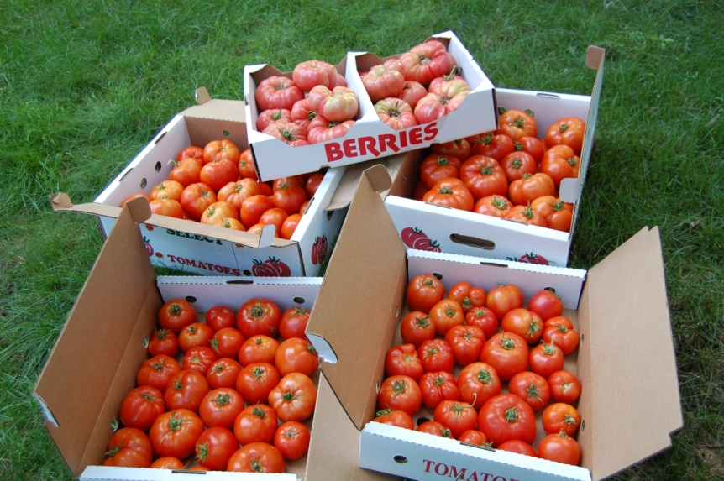
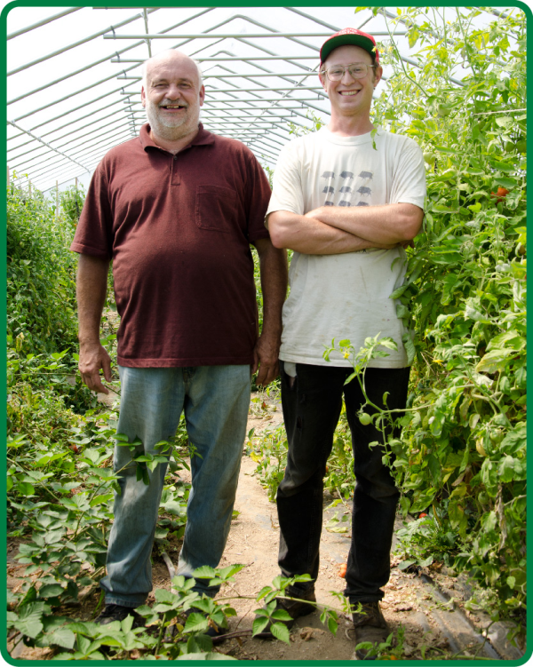
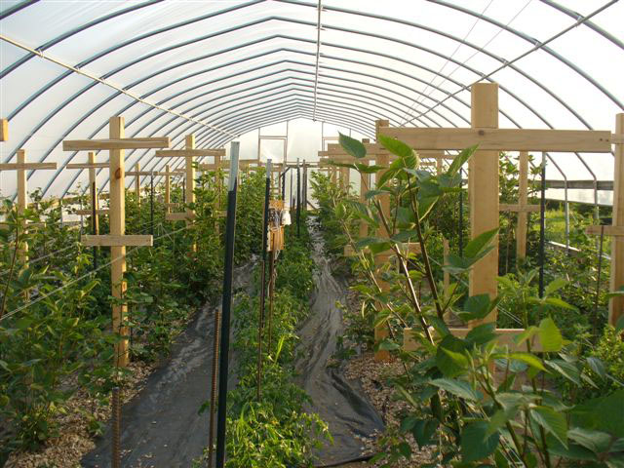
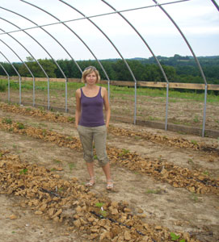
Scenic Valley Farms
Designs and manages high tunnels, climate control systems, and solar thermal heating technology
Fifteen high tunnels on farms in Minnesota and Wisconsin
Produces organically certified tomatoes, peppers, blackberries, strawberries, cucumbers, herbs, leafy green produce, ginger, garlic, etc
Decades of agriculture and engineering experience

Slide 4
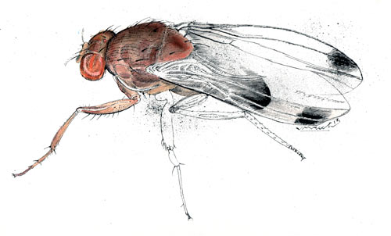
Them
.

Slide 5
SWD management using high tunnel
2 year SARE Grant to research management of Spotted Wing Drosophila using high tunnels
In 2015 4th year for SWD at SVF on blackberries, strawberries, peaches
In 2014 research was limited due to brutal winter on blackberries
In 2015 due to cold winter (normal winter) lost 90% of blackberries crop both Rosemount, MN and Readstown, WI
Installed insect netting on side walls, doors, and end walls
Insect netting bought from http://www.duboisag.com/en/proteknet-insect-netting.html
6’6” x328’-80gr - $304, maybe local supplier
Insect netting restricts air flow by 20%
Traps – cedar cider vinegar, liquid dish soap or sugar water & yeast
Set two traps inside and two outside tunnels
Install one Bumble Bee hive in each berry tunnel – close hive before spraying

Slide 6
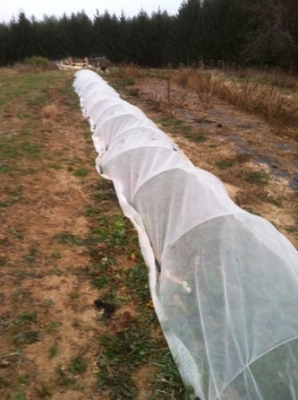
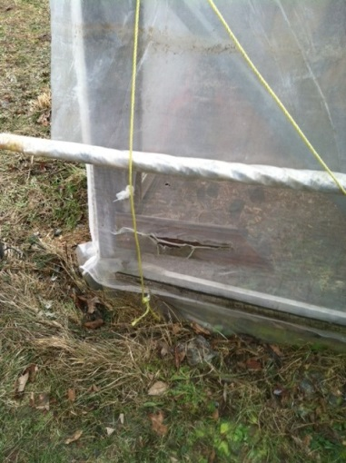
SWD management using high tunnel (results)
Results:
In 2014,2015 Noticed SWD in outside traps mid July
Rosemount blackberry tunnel – No SWD entire season
In 2014 Readstown blackberry tunnel – some SWD, came in thru door
In 2014 Readstown strawberry tunnel –unintentionally let in SWD thru door. Proceeded to pick all ripe berries, applied Pyganic for three consecutive days, then two applications of Entrust seven days apart – in two weeks eradicate SWD
Outside strawberry bed infected – picked clean, row cover hoops with netting attached using clothes pins, sprayed Pyganic and/or Entrust through netting. No sign of SWD after two weeks
Field grown management – Entrust and Pyganic on a 3 day rotation possibly Mustang Max (Non OMRI)
Pollinators?
Insect netting repair – 3M
Use netting for cucumber beetle before beetle appears
SWD on culled tomatoes
Lessons Learned – if SWD numbers significant in high tunnel, no eradication even with netting & spraying

Slide 7
Automated Solar Thermal high tunnels

Slide 8
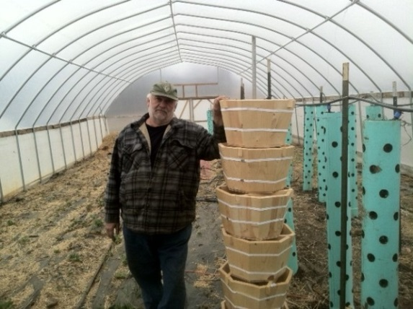
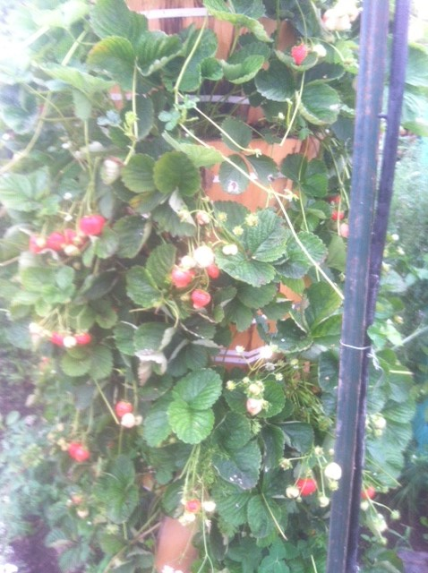
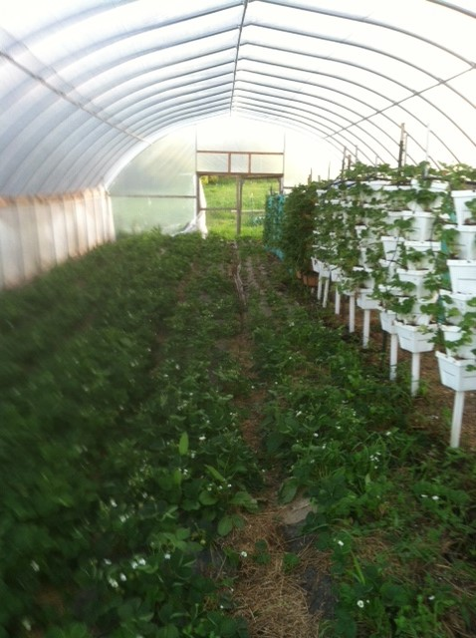
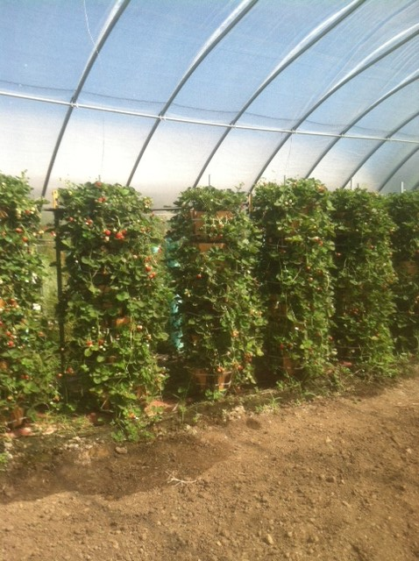
Vertical growing produce in tunnels
Grown in dirt not hydroponically using 6 - 8 sided stacked pots
year 1 – day neutral strawberries in PVC pipe
- not very good yields, does not over winter
year 2 – day neutral strawberries, lettuce, herbs in PVC pipe,
day neutral strawberries in 4 and 8 sided pots
year 3 – day neutral strawberries in 8 sided pots (goal ½# per plant,
actuals .21#s/plant July 23 to Nov 29th) )
year 4, 2016 – day neutral strawberries in 8-16 sided pots (goal ½# per
plant, plant by March 1, begin harvesting second week in May
Goal is 1# per plant for conventional market, organic certified, harvested for 7 months
Strawberries – 12K plants per 30x96 at 1/2# per plant- 10x the plants vs bedded plants
- Revenue $25k per 30x96 tunnel

Slide 9
Vermicomposting using tunnels (Next year)
SVF uses 150-200 cu yards of horse compost per year
Hard to get
Commercial composts in these quantities cost prohibited
Design and develop a vermicompost system to replace some of the horse compost
Used farm’s pruned plant material and culled produce
Use food waste from other sources
Use high tunnel to pre-compost (hot compost) inputs
Design a system that is available to other growers

Slide 10
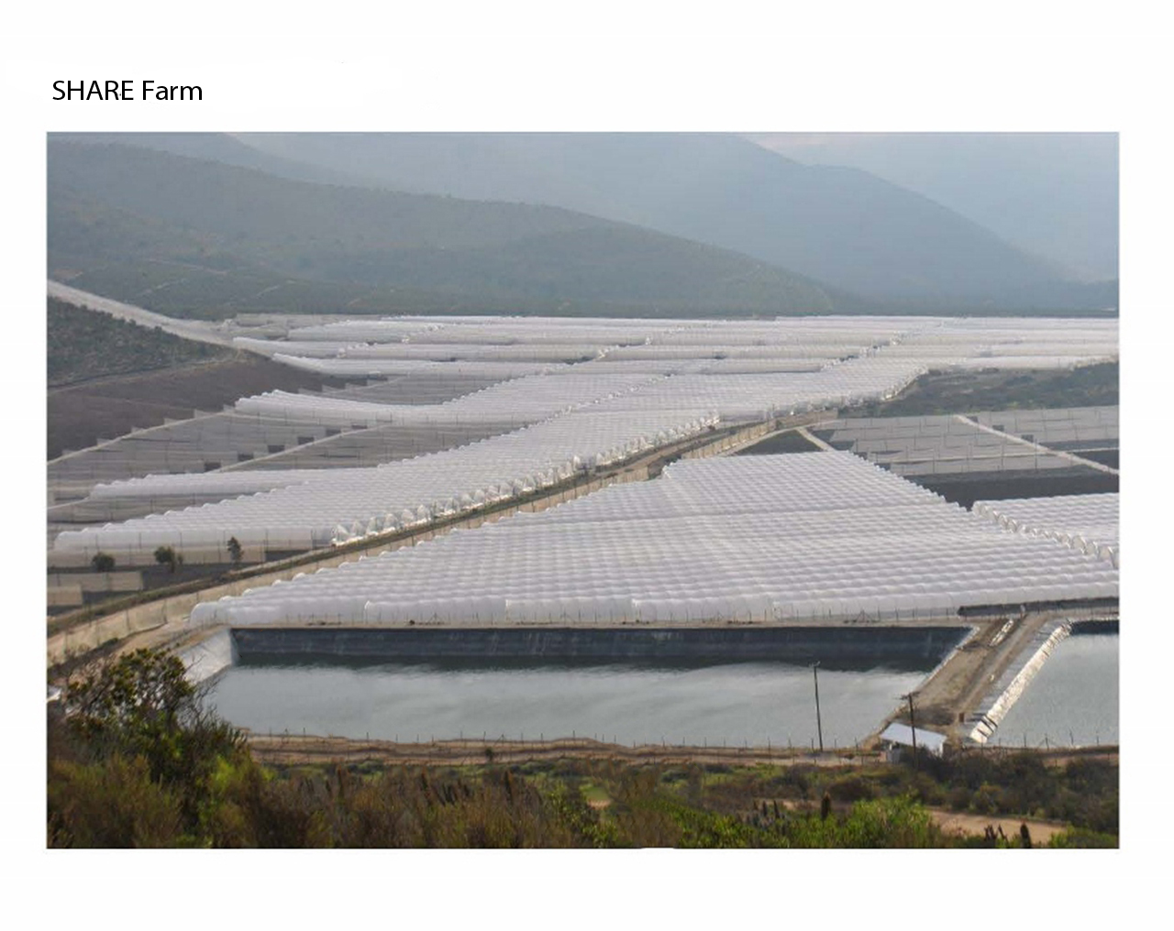
Located somewhere in SE MN or SW WI

Slide 11
Contact Us
Erik Gundacker
(563) 650-3654
gun@usinternet.com
Craig Gundacker
(612) 961-3871
cegundacker@scenicvalleyfarms.com
www.scenicvalleyfarms.com

