Slide 1
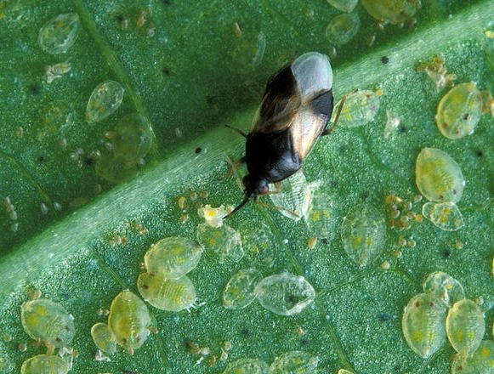
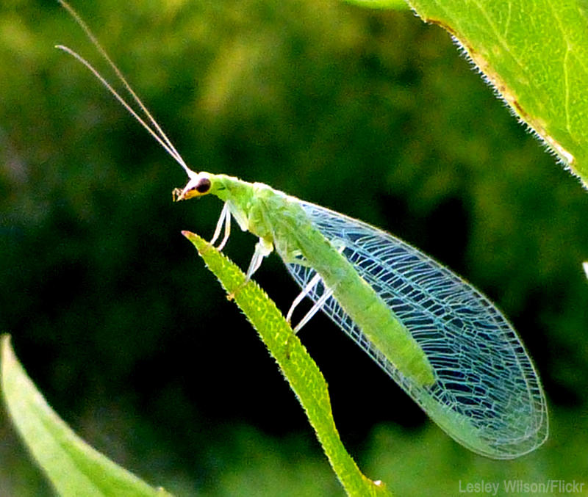
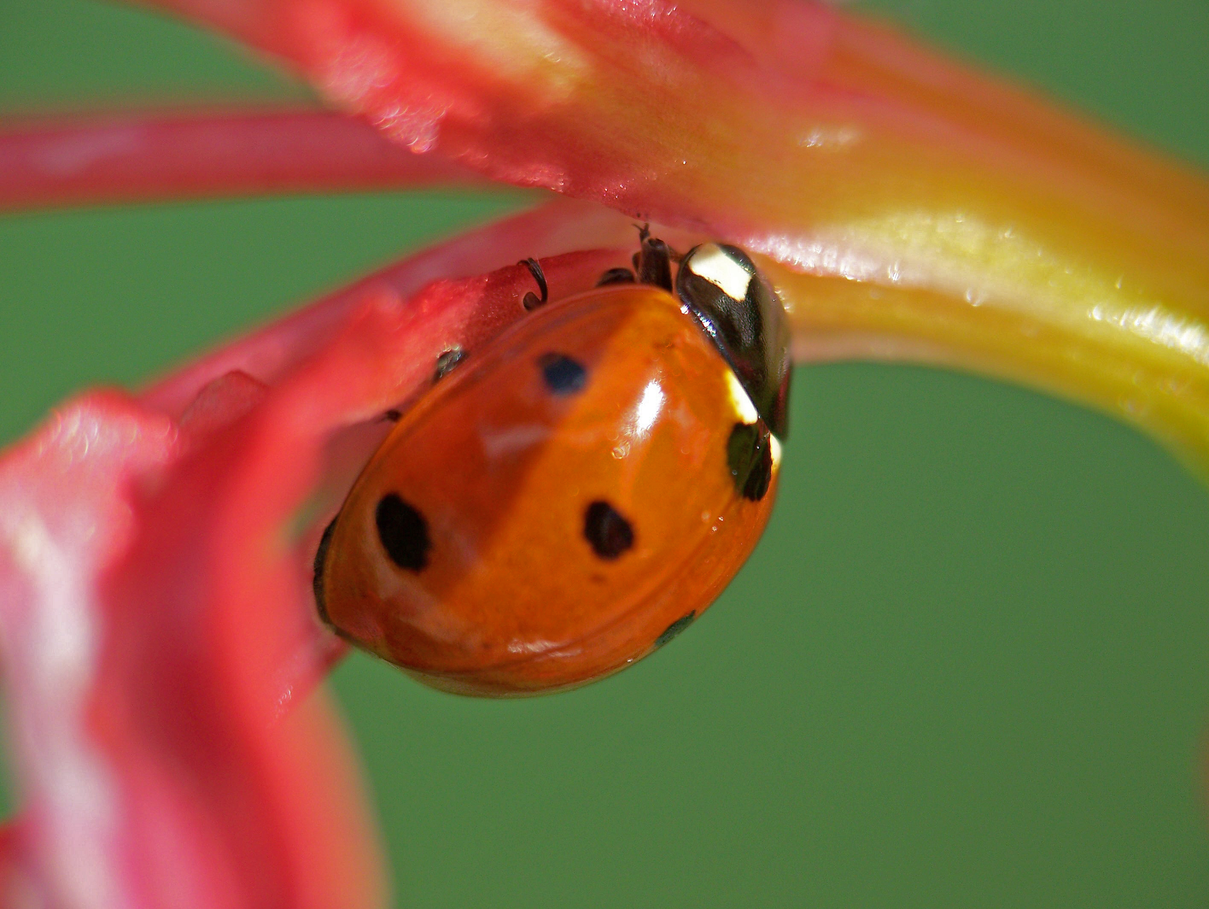
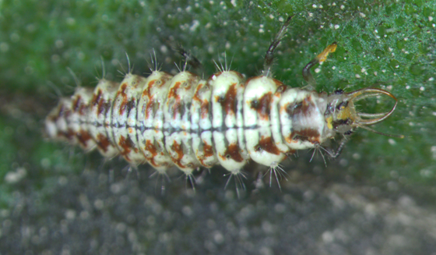
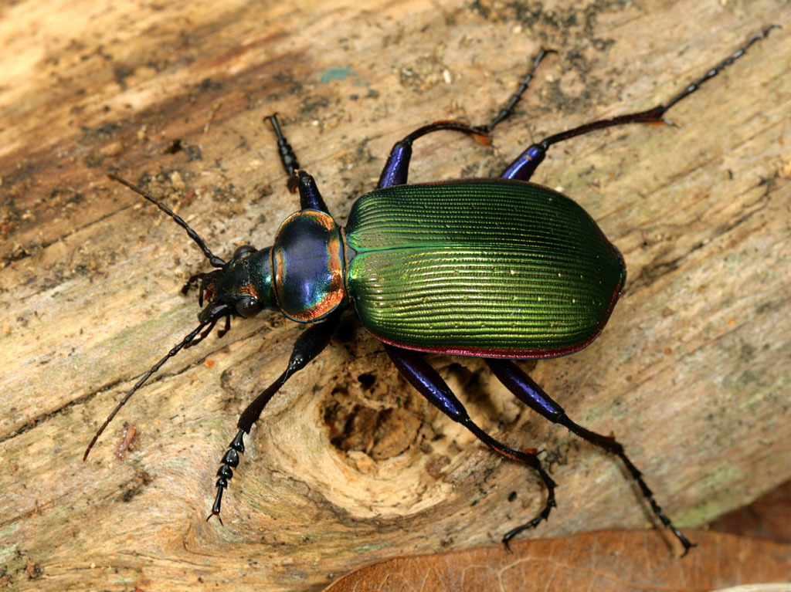
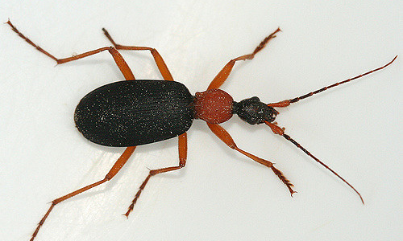
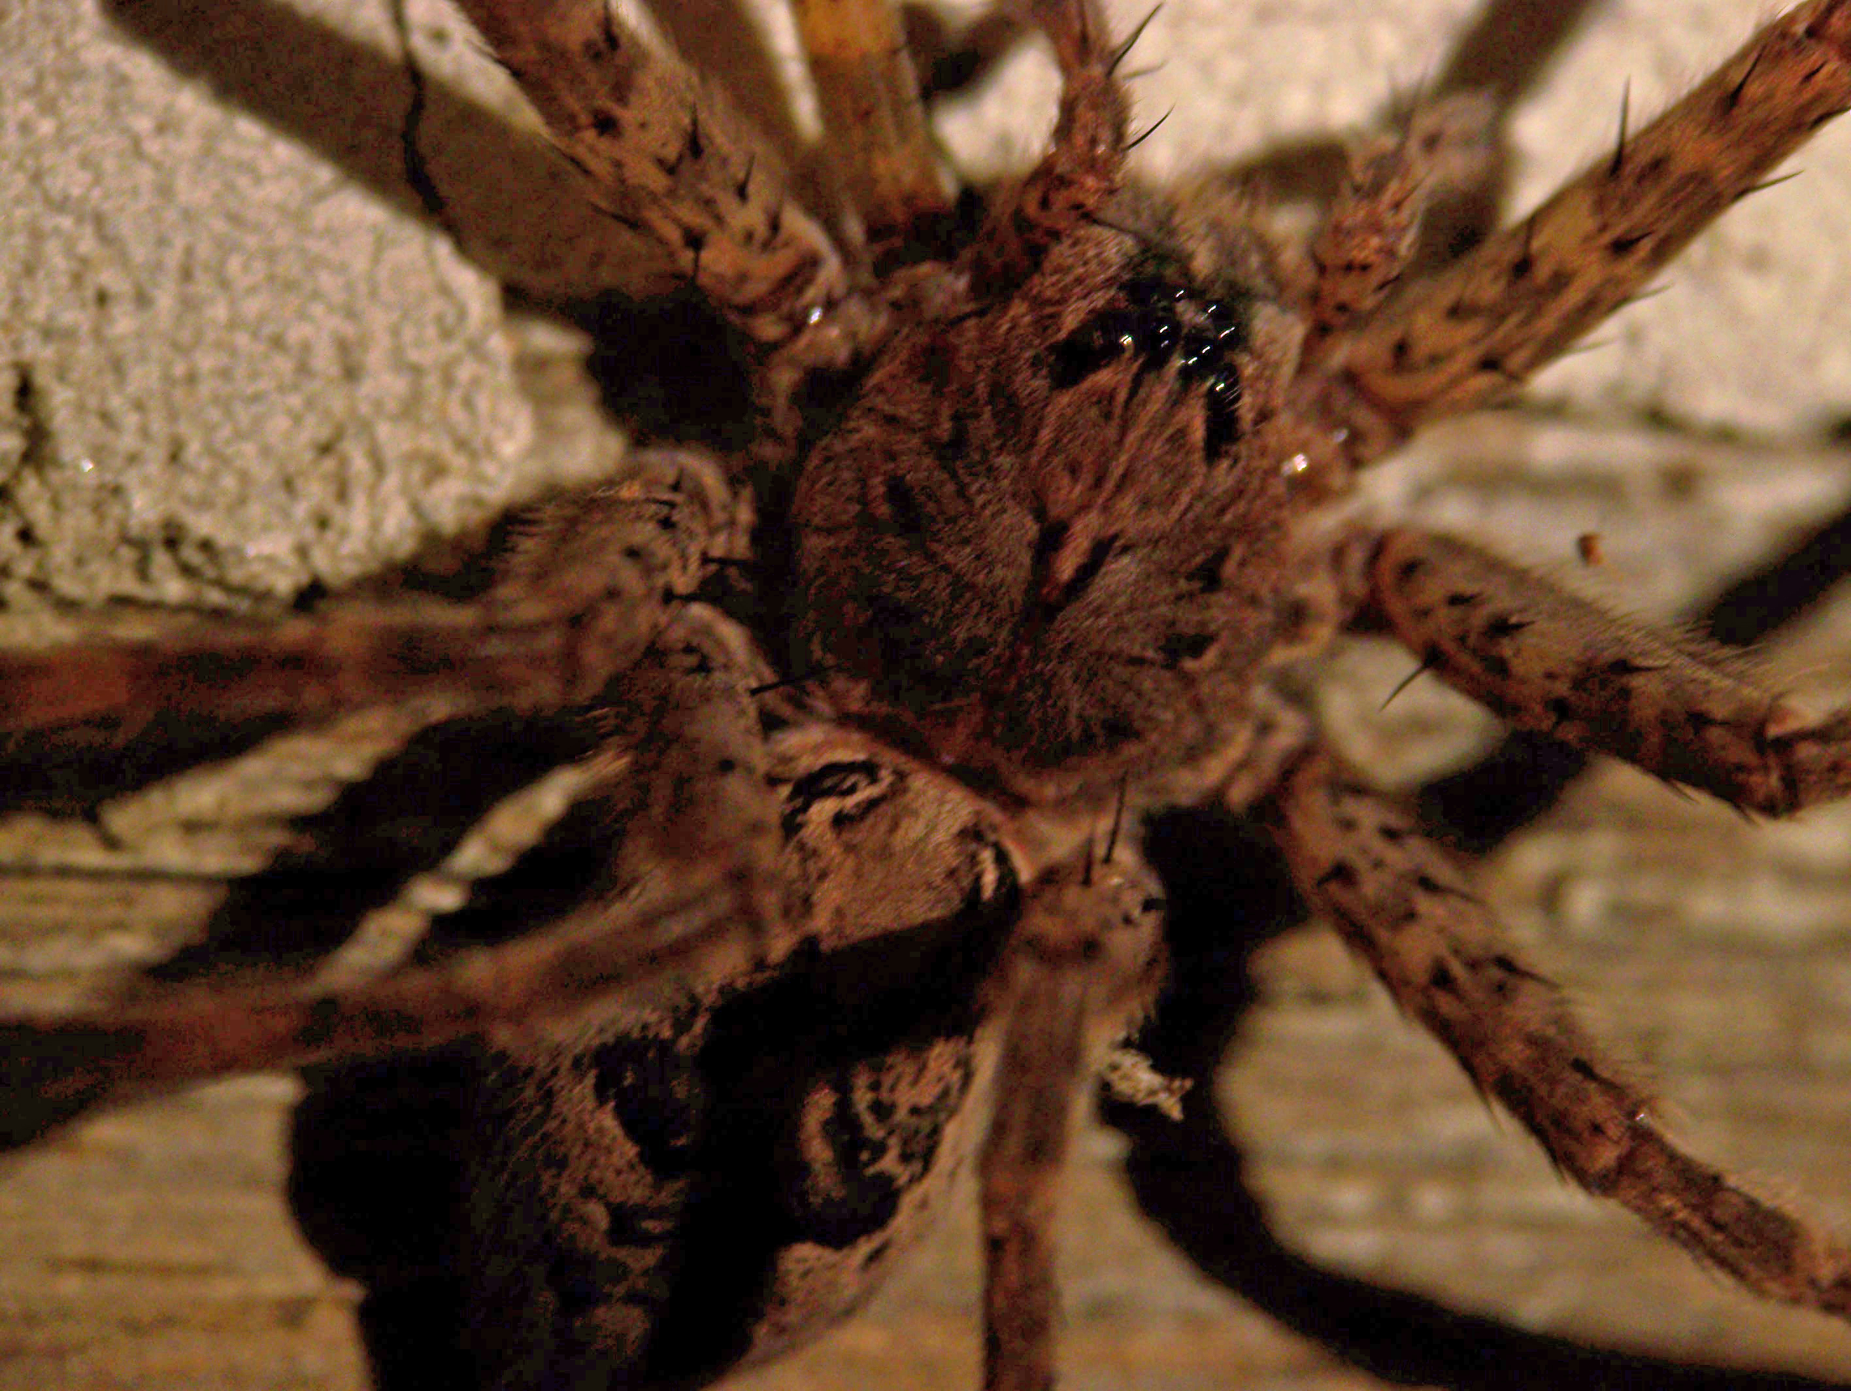
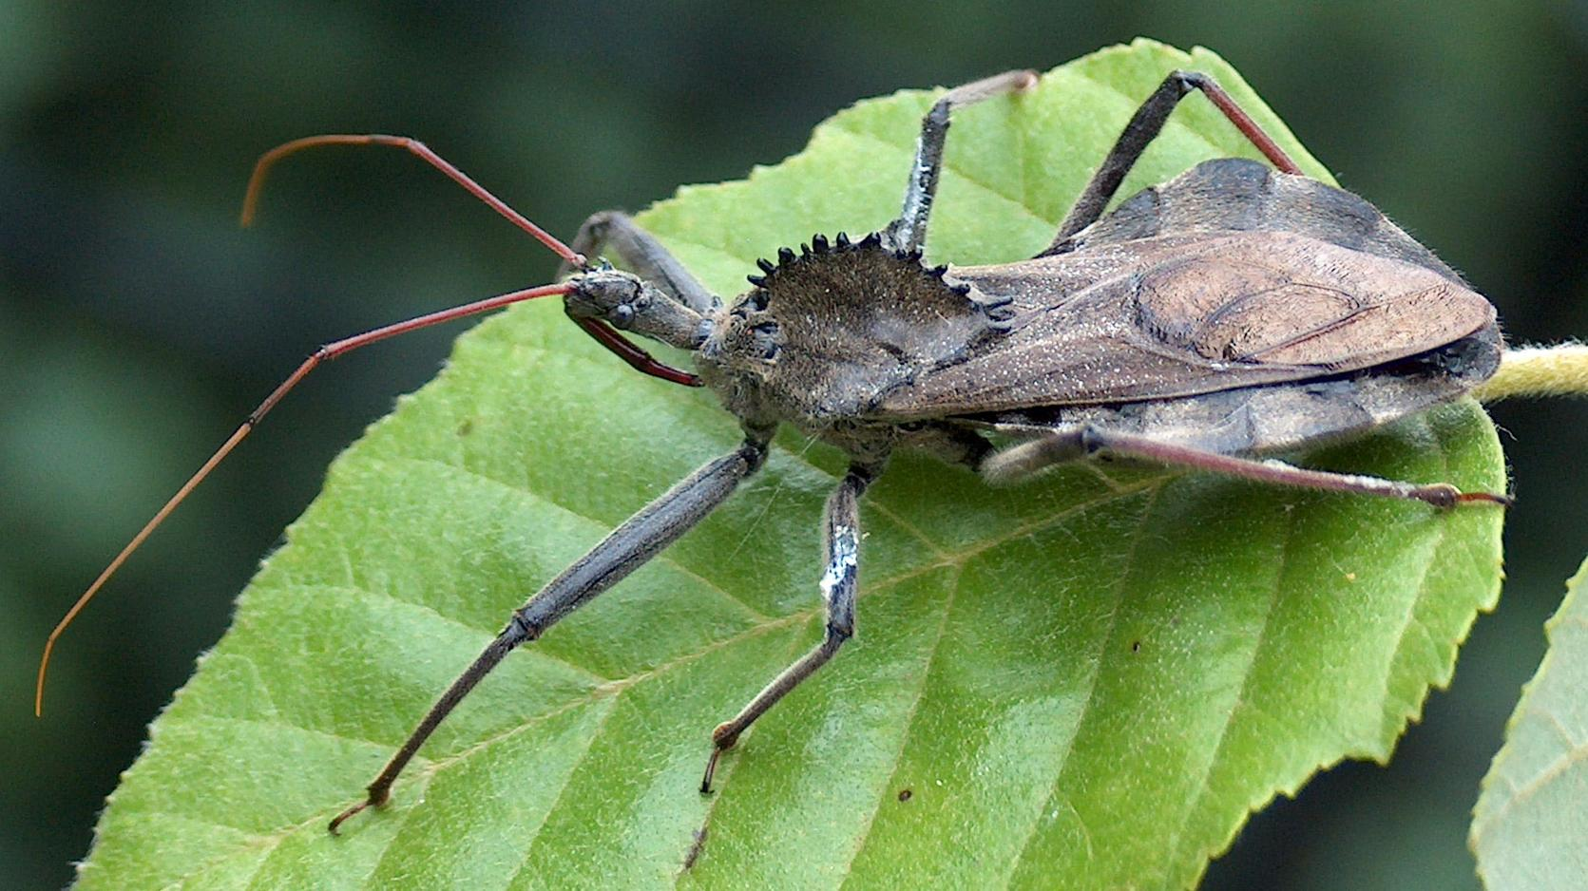
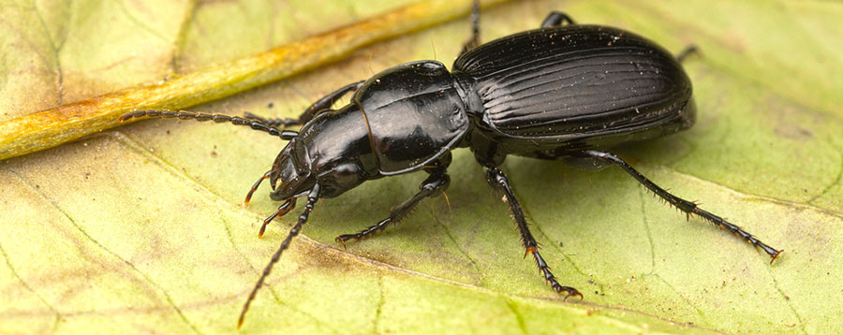
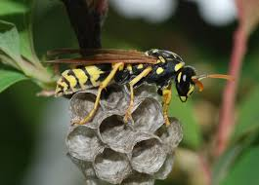
A quick guide to beneficial predacious insects
Arranged by: Scott Clem, Entomology PhD Candidate
Larva
Adult
Adult
Adult
Minute pirate bugs will kill and eat corn earworm eggs, aphids, and small caterpillars by puncturing them with their needle-like beaks.
Larva
Larva
Almost every pest species has its own specialized parasitoid wasp. They lay their eggs inside the pest, which develop into larvae and eventually kill their host. While some species are large, most are very small, about the size of a pinhead.
Ladybird beetles and their larvae can eat over 5,000 aphids over their lifetime! They also eat pest larvae, spider mites, and whiteflies. The multispotted Asian lady beetle (above) is most common, but there are many other species that occur in this area.
Hoverflies are both pollinators and predators. Larvae are voracious predators of aphids, and adults pollinate many crops. They may look like bees and wasps, but they can’t sting. If you look closely you’ll notice they only have two wings while bees and wasps have four.
Green lacewing larvae have large sickle-shaped jaws that are used to capture prey, which include aphids, small caterpillars, mites, whiteflies, scales, mealybugs, thrips, etc. They can consume up to 200 aphids in one week.
Assassin bugs often sit on the edge of leaves waiting for unsuspecting prey like moths and beetles, but will also attack caterpillars.
Praying Mantises will eat almost anything that crosses their path, but they are especially good at hunting larger pests like moths and beetles.
Ground beetles like the three species above are ground-dwelling predators that have an appetite for weed seeds, slugs, corn rootworms, and caterpillars like corn earworms.
Spiders are not insects, but are capable of regulating populations of a wide variety of pests.
Paper wasps eat caterpillar pests like corn earworms, armyworms, loopers, and hornworms. They are also great pollinators.
Questions? Contact Scott Clem, carlc2@Illinois.edu
Funding provided by North Central SARE project GNC17-238

