Slide 1
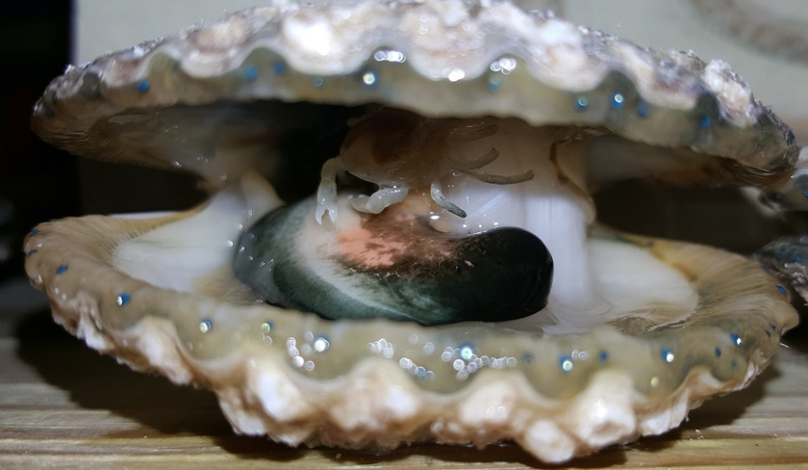
Marine macroparasite behavior and mitigation techniques in bay scallop aquaculture
Harrison Tobi
Ward Aquafarms, LLC

Slide 2
Bay scallop research
Ward Aquafarms has been growing bay scallops for four years
High prevalence of pea crabs and mud blister worms
Prevalence appeared to coincide with poor meat quality
Question: How can we mitigate the prevalence of pea crabs and mud blister worms to enhance meat quality?

Slide 3
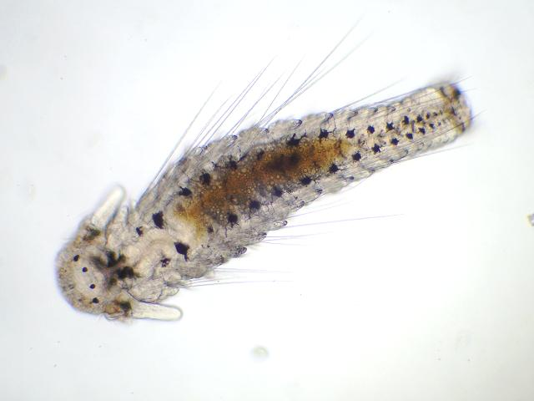
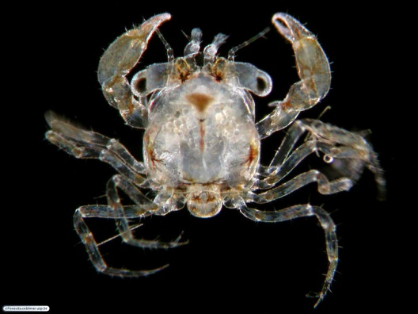
Parasites and aquaculture
Parasites can reduce economic value
Lower parasite prevalence = increased value
Note: Prevalence = % occurrence of parasite in host population
Understanding natural infection dynamics and potential mitigation strategies = lower parasite prevalence and increased economic value
Notes:
Many forms aquaculture seek or currently use different techniques to aid in avoidance of fouling communities, such as algae and barnacles
One method is the use anti-fouling paints. Anti-fouling paints typically create an undesirable environment for most fouling organisms via the creation of slippery surfaces.
The use of anti-fouling paints could aid in mitgating the settlement of macroparasite larvae
Many macroparasites, such as pea crabs and mud blister worms, have larval stages that actively settle on their host shellfish, and, in the case of aquaculture, the housing of cultured shellfish

Slide 4
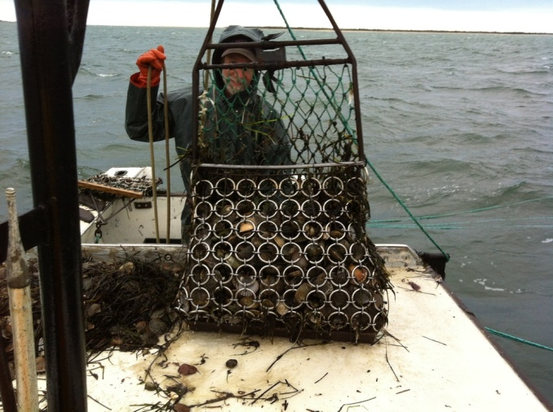
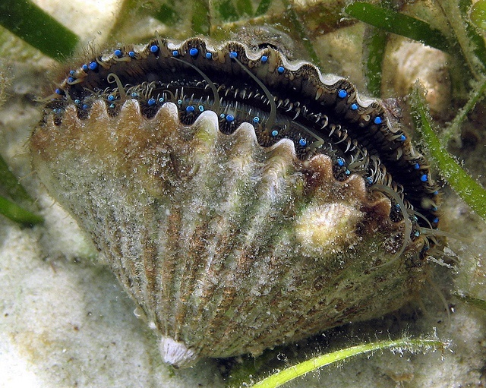
Research Host Organism
The bay scallop (Argopecten irradians)
Economic importance
Fisheries collapse in 1980’s
Restoration
Aquaculture
Ecological importance
Coastal filter feeders
Reduce turbidity
Promote benthic health
Notes:
My research host organism for all three objectives is the bay scallop
The bay scallop is economically important, and once supported a very successful fishery along the northeastern United States that collapsed in the 1980’s due over fishing and habitat loss.
To bring back the full economic potential of bay scallops, restoration and aquaculture efforts are currently underway along the bay scallop’s native range
However, the bay scallop is also ecologically important:
Bay scallops are coastal filter feeders
They reduce turbidity by consuming suspended microalgae
And they promote benthic health

Slide 5
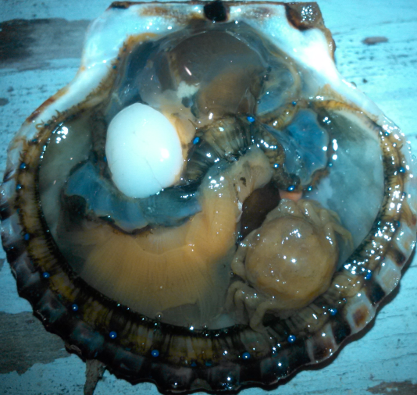
Parasite: Pea crab
(Pinnotheres maculatus)
Parasitic marine crab
Lives in host’s mantle cavity
Feeds off food particles on host’s gills
Reduction in food for host
Physical irritation
Notes:
My first parasite I would like to introduce is the pea crab.
The pea crab is a parasitic marine crab that often infects eastern oysters, blue mussels, atlantic sea scallops, and bay scallops.
The pea crab, which you can see circled in both pictures presented here, lives within the host shellfish’s mantle cavity.
While living within the host shellfish’s mantle cavity, the pea crab feeds of food particles on the shellfish’s gills, taking food directly away from the host. Additionally, while living within the mantle cavity of the host, the pea crab causes direct physical damage to the gills, gonads, and other vital tissues
Overall, the pea crab reduces the health and reproductive potential of its host shellfish

Slide 6
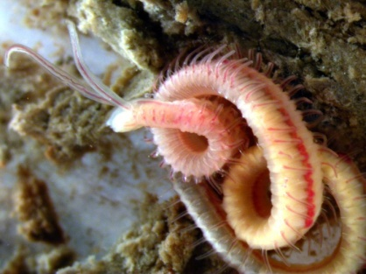
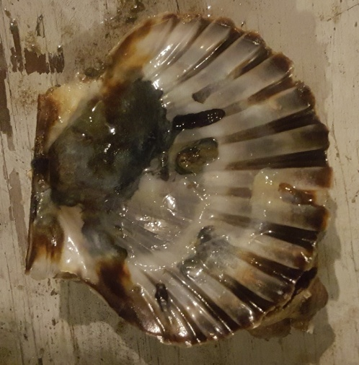
Parasite: Mud blister worm
(Polydora sp.)
Parasitic polychaete worm
Shell-borer
Reduces shell integrity
Host redirects energy towards “mud blister”
Notes:
My second parasite I would like to introduce is the mud blister worm.
The mud blister worm is a parasitic marine worm that bores into the shell of its host
It is also found in multiple shellfish species, including bay scallops
The physical act of boring into the shell of its host reduces the host’s shell integrity
Additionally, in response to the worm’s presence near the mantle cavity of the host shellfish, the host will secrete a “mud blister”, which is circled in the provided picture, due to physical irritation.
This takes energy away from the host’s growth and reproduction, therefore reducing the host’s fitness and reproductive potential

Slide 7
Research Objectives
Document seasonal timing of infection by mud blister worms and pea crabs in bay scallops
Determine the effectiveness of Netminder paint in reducing mud blister worm and pea crab prevalence in bay scallops
Determine infection success of pea crabs in bay scallops based on water temperature
Notes:
My first objective is to describe the natural infection dynamics of parasitic mud blister worms and pea crabs in host bay scallops
My second objective is to determine the effect of host bay scallop age, health, and shell height on parasitic pea crab infection success
And my third objective is to determine the effectiveness of anti-fouling paint on parasitic mud blister worm and pea crab infection success of host bay scallops

Slide 8
Research Objectives
Document seasonal timing of infection by mud blister worms and pea crabs in bay scallops
Determine the effectiveness of Netminder paint in reducing mud blister worm and pea crab prevalence in bay scallops
Determine infection success of pea crabs in bay scallops based on water temperature
Notes:
My first objective is to describe the natural infection dynamics of parasitic mud blister worms and pea crabs in host bay scallops
My second objective is to determine the effect of host bay scallop age, health, and shell height on parasitic pea crab infection success
And my third objective is to determine the effectiveness of anti-fouling paint on parasitic mud blister worm and pea crab infection success of host bay scallops

Slide 9
Objective I Rationale
High Pea crabs and mud blister worm prevalence documented in bay scallops at Ward Aquafarms in November, 2017
Mud blister worms = 96.8%
Pea crabs = 53.3%
Question: When does each parasite naturally infect host bay scallops?

Slide 10
Objective I Rationale
Previous research suggests mud blister worms spawn at lower temperatures than pea crabs
Mud blister worms ~ 6 – 15ºC
Pea crabs ~ 20 -25ºC
Hypothesized that bay scallops would be infected by mud blister worm earlier the season than when they’re infected by pea crabs
Pea crab larvae
Mud blister worm larvae
Jan
June
Aug
Sept
Dec
Notes:
Wanted to add figure showing timelines of both parasite life cycles

Slide 11
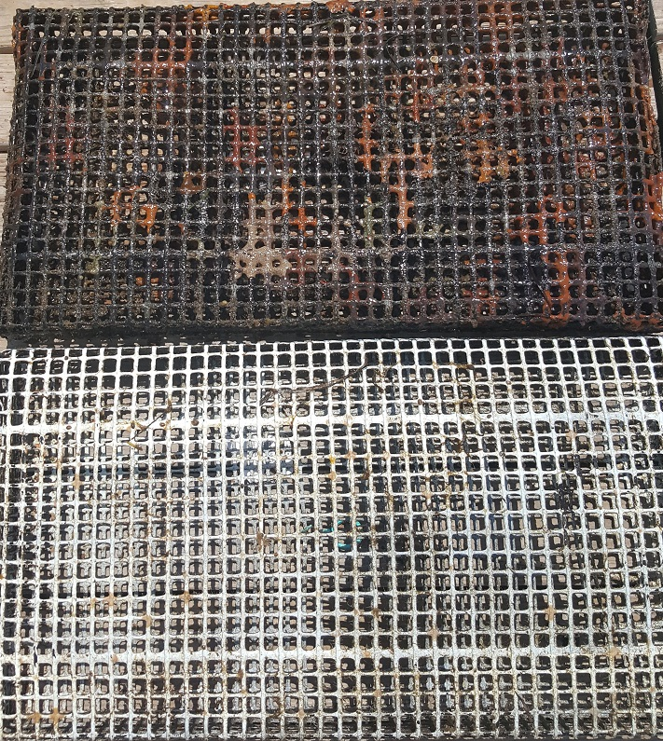
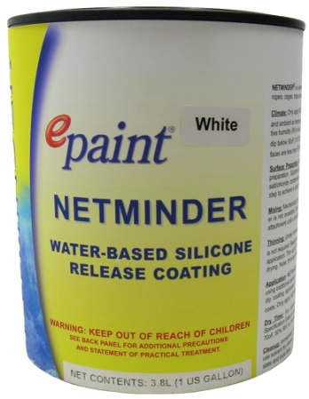
Objective II Rationale
Netminder
Non-toxic (not anti-fouling)
Releases bio-fouling at molecular level
Low levels of peroxide released by UV exposure
Reduces settlement of bio-fouling community members
Could reduce settlement of parasite larvae
Netminder-treated
Non-treated
Notes:
So, netminder is a non-toxic antifouling paint, meaning it can be, and is used in current finfish and shellfish aquaculture operations
Netminder reduces the settlement and establishment of biofouling community members such as tunicates, barnacles, tube worms, and algae, as seen on the image to the right.
Therefore, it may be able to prevent the settlement of larval mud blister worms and the infectious stage of pea crabs
Reducing mud blister worm and pea crab prevalence in bay scallops housed in gear treated with netminder compared to scallops housed in untreated gear

Slide 12
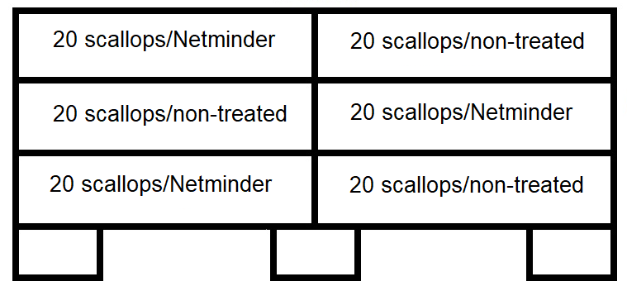
Objectives I and II
Phase 1
Deployment
December, 2017
Housing: bottom cages
Netminder treated and non-treated
20 scallops/bag
Notes:
For objective one, I split it into two phases. The first phase dealt with overwintering. The research location used, which was Megansett Harbor on Cape Cod, can have very severe wave and wind activity, and actually froze over last winter for about a month. Therefore, in the overwintering, or phase one of objective one, only bottom gear was used. I will elaborate in more detail why this is relevant.
For phase one though, I deployed six bottom cages stocked with six commercial aquaculture bags at 40 scallops per square meter.
Prior to deployment, a subsample of sixty scallops were shucked to confirmed naivety of mud blister worms and pea crabs
One cage, which housed the six bags, was pulled every month, from December 2017 through June 2018.
Three bags from each cage were selected for subsample
From each bag, ten scallops were destructively sampled, and presence/absence of mud blister worms and pea crabs was documented
Each scallop was measured for shell height, and the shucked and dried to obtain dried meat weight
The ratio of dried meat weight to shell height is used to as a proxy fitness

Slide 13
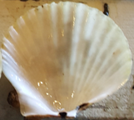
Objectives I and II
Phase 1
Sampling
Once a month from January, 2017 → June, 2018
Subsample of 60 scallops/month
30 from treated/30 non-treated
Quantified mud blister worm/pea crab prevalence
Quantified scallop condition index
= Shell height/dried meat weight

Slide 14
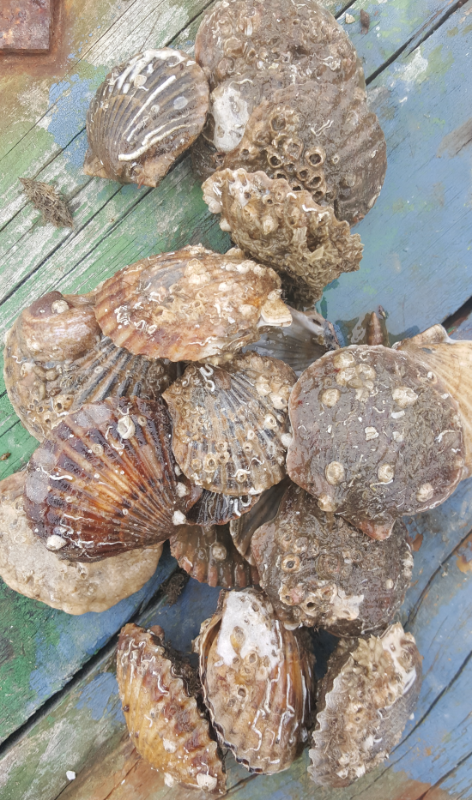
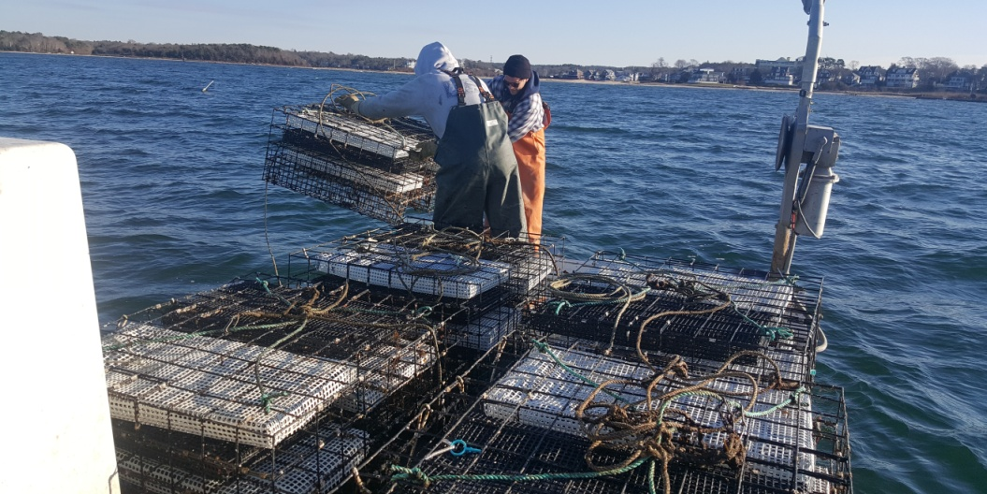
Objectives I and II
Phase 2
Deployment
June, 2018
Housing: bottom and surface cages
Six bags/cage
Netminder treated and non-treated
20 scallops/bag

Slide 15
Objectives I and II
Phase 2
Sampling
Once a month from July → September, 2018
Subsample of 120 scallops/month
60 from treated/60 non-treated
Quantified mud blister worm/pea crab prevalence
Quantified scallop condition index
= Shell height/dried meat weight
Notes:
One cage, which housed the six bags, was pulled every month, from December 2017 through June 2018.
Three bags from each cage were selected for subsample
From each bag, ten scallops were destructively sampled, and presence/absence of mud blister worms and pea crabs was documented
Each scallop was measured for shell height, and the shucked and dried to obtain dried meat weight
The ratio of dried meat weight to shell height is used to as a proxy fitness

Slide 16
Objective II: Netminder
Results:
December, 2017 to June, 2018
No mud blister worms or pea crabs documented in either treatments
July, 2018 – September, 2018
High mud blister worm prevalence in treated and untreated gear
Bag weight comparisons
Significant differences each month in weight (kg)

Slide 17
Objective I
Mud blister worm prevalence
July, August, September
Bottom gear
July = 65%
August = 45%
September = 63%
Surface gear
July = 38%
August = 40%
September = 38%
Mud blister worm virulence
Significant difference in condition index (CI)*
* ANOVA, α=0.05, df=1, 117, two-tailed P-value< 0.05
Notes:
So, given my last sampling point is at the end of the month, and I have seen increasing prevalence of both mud blister worms and pea crabs over the last two sampling periods, I expect to see a similar trend.
However, given that pea crabs have an infectious stage seasonally later than mud blister worms, I expect to specifically see greater pea crab prevalence in my last sampling period
Additionally, I expect to see higher prevalence of pea crabs in bay scallops that are also infected by mud blister worms.
I will test to see if bay scallops infected by pea crabs were facilitated by previous infection by mud blister worms by seeing if mud blister worm infected bay scallops from previous months had lower fitness than naïve scallops from that same sampling period.
Infection by both mud blister worms and pea crabs, as well as reductions in fitness caused by mud blister worms will only suggest facilitated coinfection though.

Slide 18
Objective I
Pea crab prevalence
July, August, September
Bottom gear
July = 3%
August = 7%
September = 2%
Surface gear
July = 0%
August = 3%
September = 2%
Pea crab virulence
No significant differences in CI or GSI
Not a high enough prevalence?
Notes:
So, given my last sampling point is at the end of the month, and I have seen increasing prevalence of both mud blister worms and pea crabs over the last two sampling periods, I expect to see a similar trend.
However, given that pea crabs have an infectious stage seasonally later than mud blister worms, I expect to specifically see greater pea crab prevalence in my last sampling period
Additionally, I expect to see higher prevalence of pea crabs in bay scallops that are also infected by mud blister worms.
I will test to see if bay scallops infected by pea crabs were facilitated by previous infection by mud blister worms by seeing if mud blister worm infected bay scallops from previous months had lower fitness than naïve scallops from that same sampling period.
Infection by both mud blister worms and pea crabs, as well as reductions in fitness caused by mud blister worms will only suggest facilitated coinfection though.

Slide 19
Surface vs. bottom gear in Woods Hole, MA
October 2018
Prevalence
Pea crabs
Bottom gear = 70%
Surface gear = 1%
Mud blister worms
Bottom gear = 89%
Surface gear = 67%
Virulence
Significant* reductions in bay scallop CI and meat yield
ANOVA, α=0.05, df=1, 117, two-tailed P-value< 0.05
Notes:
So, given my last sampling point is at the end of the month, and I have seen increasing prevalence of both mud blister worms and pea crabs over the last two sampling periods, I expect to see a similar trend.
However, given that pea crabs have an infectious stage seasonally later than mud blister worms, I expect to specifically see greater pea crab prevalence in my last sampling period
Additionally, I expect to see higher prevalence of pea crabs in bay scallops that are also infected by mud blister worms.
I will test to see if bay scallops infected by pea crabs were facilitated by previous infection by mud blister worms by seeing if mud blister worm infected bay scallops from previous months had lower fitness than naïve scallops from that same sampling period.
Infection by both mud blister worms and pea crabs, as well as reductions in fitness caused by mud blister worms will only suggest facilitated coinfection though.

Slide 20
Research Objectives
Document seasonal timing of infection by mud blister worms and pea crabs in bay scallops
Determine the effectiveness of Netminder paint in reducing mud blister worm and pea crab prevalence in bay scallops
Determine infection success of pea crabs in bay scallops based on water temperature
Notes:
My first objective is to describe the natural infection dynamics of parasitic mud blister worms and pea crabs in host bay scallops
My second objective is to determine the effect of host bay scallop age, health, and shell height on parasitic pea crab infection success
And my third objective is to determine the effectiveness of anti-fouling paint on parasitic mud blister worm and pea crab infection success of host bay scallops

Slide 21
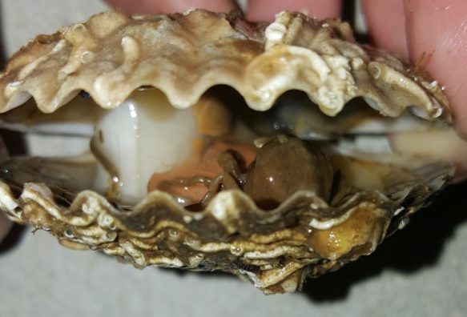
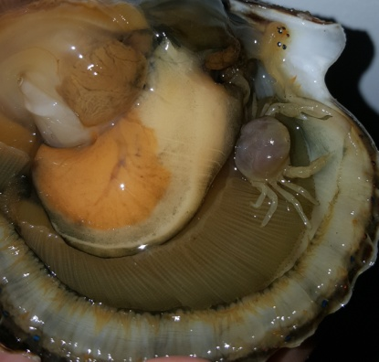
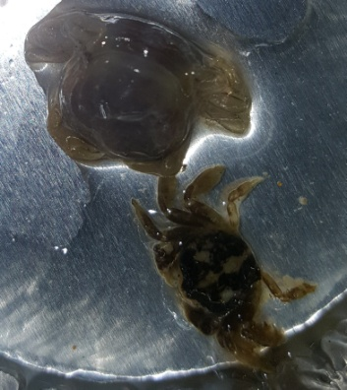
Objective III Rationale
Temperature may play a role in infection success
Colder water = slower metabolism and sometimes mobility
Cold months of the year = Surface gear exposed intense weather and potential freezing
Assess infection risk when gear may need to be placed on the bottom
Notes:
For this objective, I will be using two year classes of bay scallops. Since they only have a two year lifespan, these are the only two age classes available for testing
Year two bay scallops will be obtained from the same naïve population used for Objective I.
Year one bay scallops will be obtained from the nursery system at Ward Aquafarms.
The pea crabs used will be obtained from infected bay scallops obtained from Megansett Harbor and Woods Hole.
Both of which are located on Cape Cod

Slide 22
Objective III
Methods: Organisms
Year two bay scallops
~ 56 mm in shell height
Adult male or female pea crab
Notes:
For this objective, I will be using two year classes of bay scallops. Since they only have a two year lifespan, these are the only two age classes available for testing
Year two bay scallops will be obtained from the same naïve population used for Objective I.
Year one bay scallops will be obtained from the nursery system at Ward Aquafarms.
The pea crabs used will be obtained from infected bay scallops obtained from Megansett Harbor and Woods Hole.
Both of which are located on Cape Cod

Slide 23
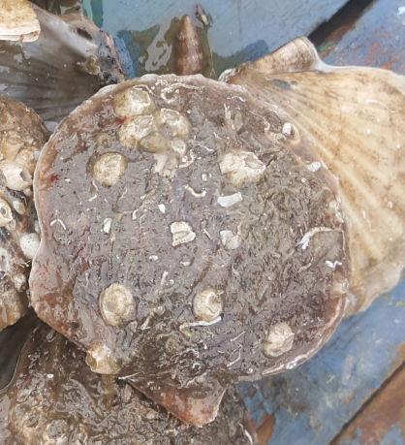
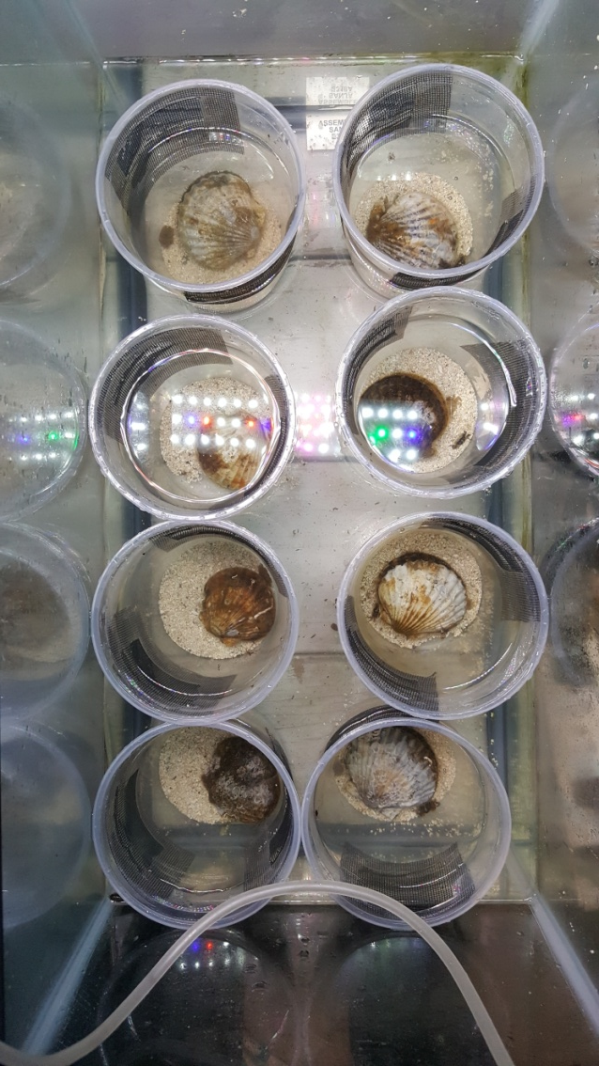
Objective III
Methods: Experimental Design
38 liter aquariums
Each with 8, 1-liter mesocosms
15 or 20ºC
Each mesocosm
1 bay scallop
1 pea crab
Male
Female
Notes:
My experimental design to test pea crab susceptibility in bay scallops consists of eight 1 liter mesocosms housed in a 38 liter aquarium, as seen in the red box on the right. I have multiple of these 38 liter aquaria set up to run as many trials as my pea crab collecting permits.
Within each mesocosm, seen in the red circle, I will place one bay scallop and one male and one female pea crab

Slide 24
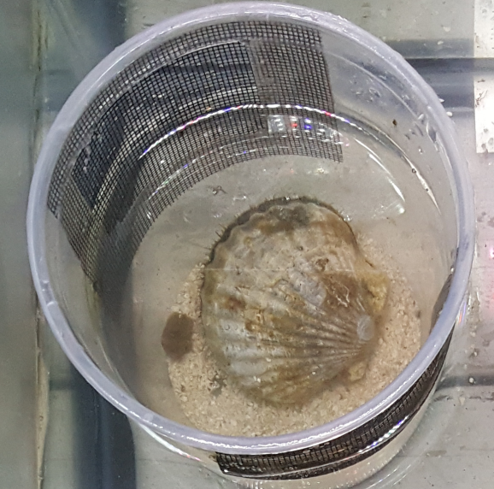
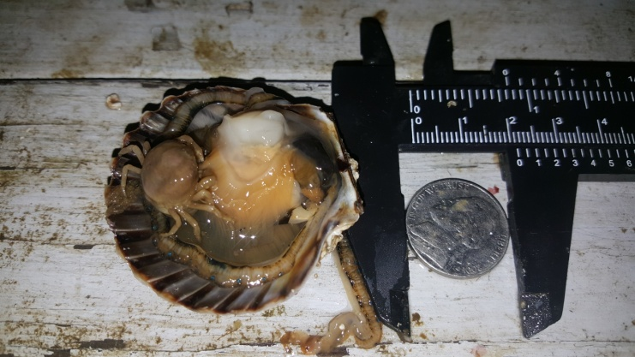
Objective III
Methods: Experimental Design
Prevalence → Every 12 hours, for 48 hours
After 48 hours, quantified:
Yes/no pea crab infection
Notes:
I will check to see if pea crabs have entered the host bay scallop every 12 hours, for 48 hours
At the end of the 48 hour period, I will obtain the shell height of the scallop, then shuck it, and dry the viscera to obtain dry meat weight to assess fitness via condition index
For the pea crabs at the end of 48 hours, I will document the sex of each, and it’s corresponding carapace height

Slide 25
Objective III
Results:
Female pea crabs
Warm = 58.5%
Cold = 12.5 %
Male pea crabs
Warm = 100%
Cold = 91%

Slide 26
Conclusion
Objective I:
Timing of infections
Bay scallops are naturally infected by mud blister worms when water temperatures hit 20 ºC
Bottom and surface gear
Both susceptible to mud blister worm infection
Surface gear may be a good pea crab mitigation strategy (Site and weather permitting)

Slide 27
Conclusion
Objective II:
Netminder
Significantly reduces biofouling
Reducing time needed to clean gear
Does not prevent settlement of mud blister worms on bay scallop
Not enough data on it’s ability to prevent pea crab infection

Slide 28
Conclusion
Objective III:
Effects of temperature on pea crab prevalence
Prevalence significantly reduced when temperature drops from 20 to 15 ºC
When water temps are below 15 ºC, risk of infection for bay scallops housed in bottom gear may be significantly reduced
Winter months
Rough surface conditions/ice
Cold water, reduced infection risk for bay scallops housed in bottom gear

Slide 29
Acknowledgements
Dr. Ward, PhD, Owner of Ward Aquafarms
Dr. Koop, PhD
Dr. Bromage, PhD
Matt Paquette – Ward Aquafarms
Andrew Davidsohn – Ward Aquafarms
Mike Coutes – Ward Aquafarms
Alex Walsh – Netminder, LLC
Mary Murphy – Sippewissett Oysters

Slide 30
Questions

