Slide 1
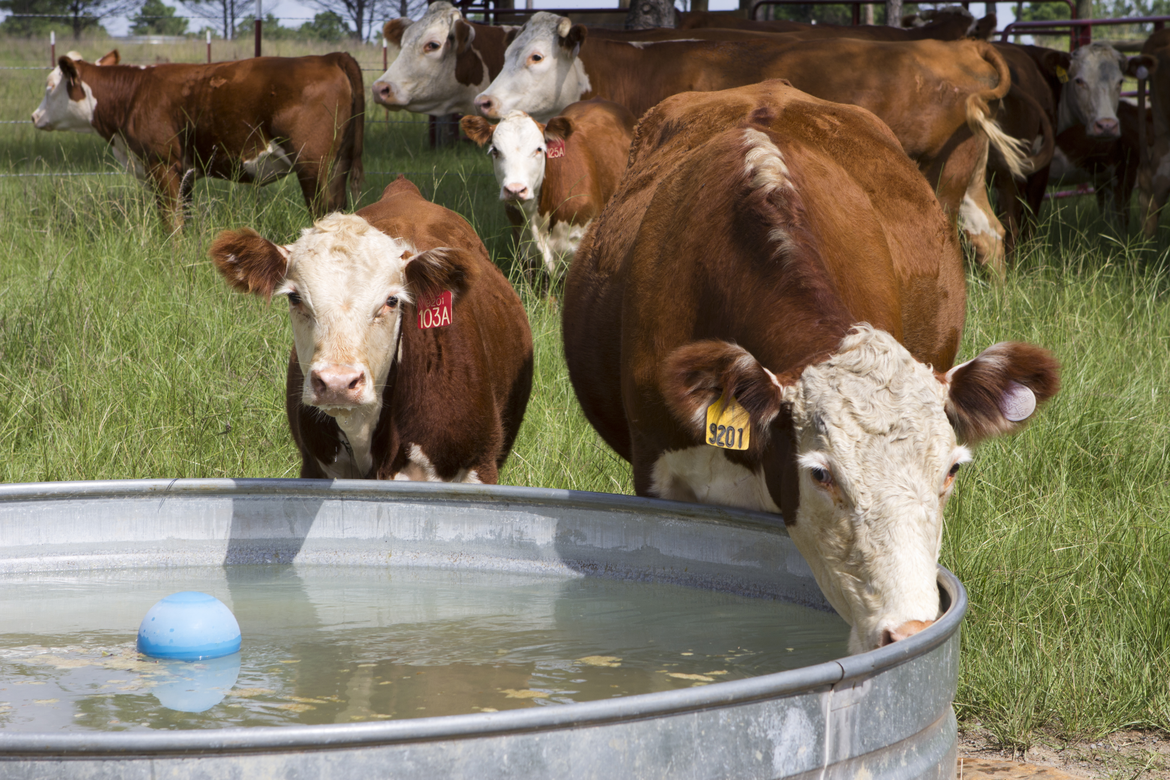
Dealing with Heat Stress and Dry Conditions in Beef Operations

Slide 2
Cattle Management is a Balancing Act
Climatic Conditions
Genetics
Forages, Nutrition, Weeds
Water
Reproduction
Facilities
Health

Slide 3
Tools for Monitoring Dry Conditions

Slide 4
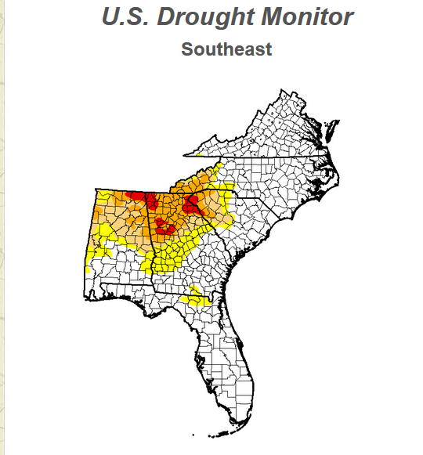
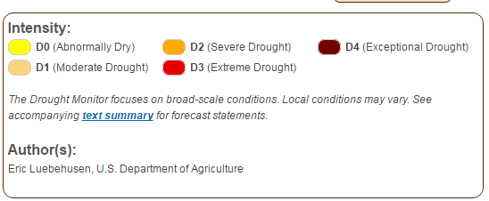
Drought Monitor Map
Web Resources
droughtmonitor.unl.edu
Updated weekly
Notes:
NOTES: Updated maps available at website listed above

Slide 5
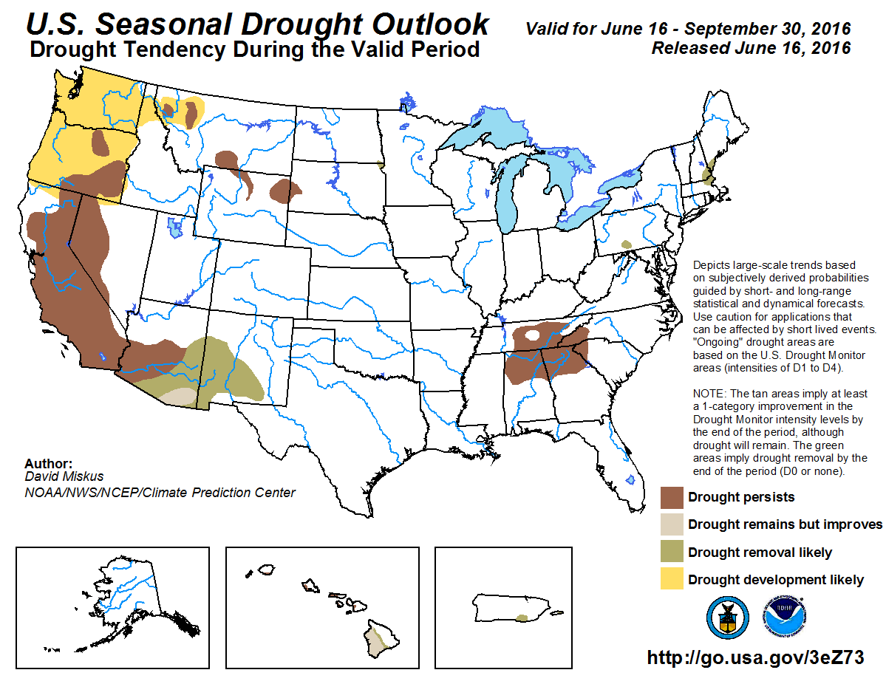
Notes:
Map can be updated at the following link: droughtmonitor.unl.edu

Slide 6
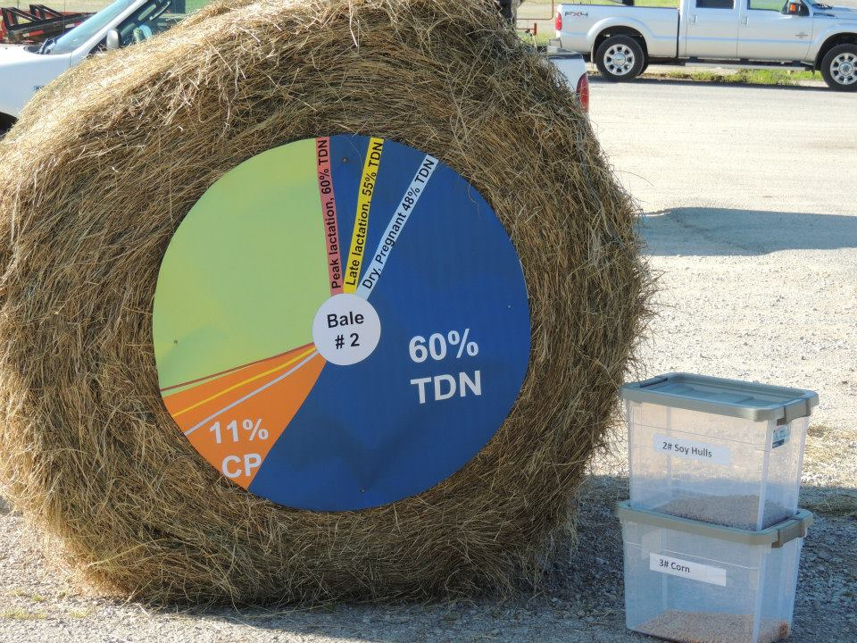
Current Hay Supply Status in Region
Updated Weekly – Alabama Department of Ag Market News
July 14, 2016
Hay prices steady
Trade moderate
Moderate supply and demand
Price per ton – good/premium hay, various sizes
Alabama Weekly Hay Report

Slide 7
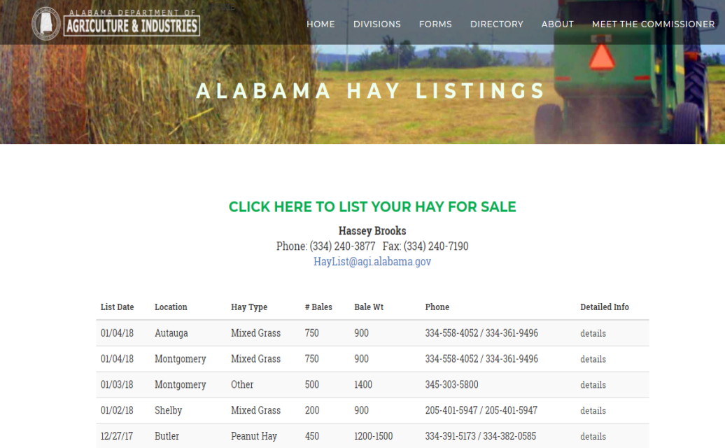
Planning Ahead
http://www.agi.alabama.gov/s/haylist
Hay for Sale on Alabama Hay List

Slide 8
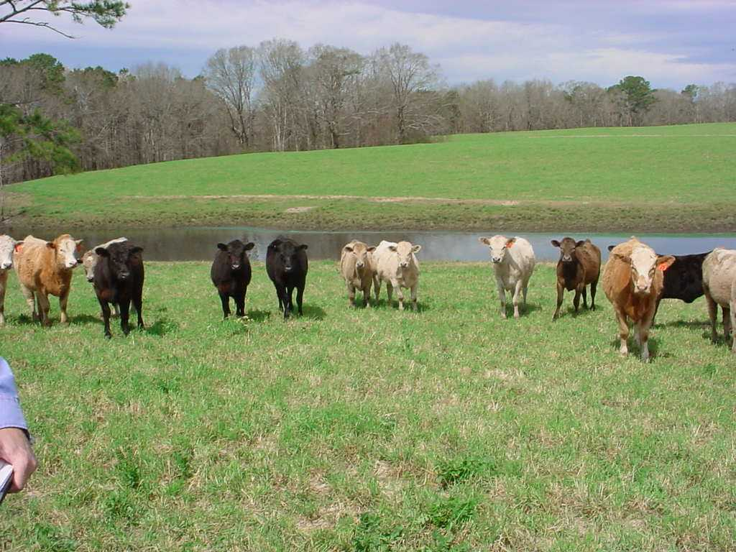
Forages
Water
Animal

Slide 9
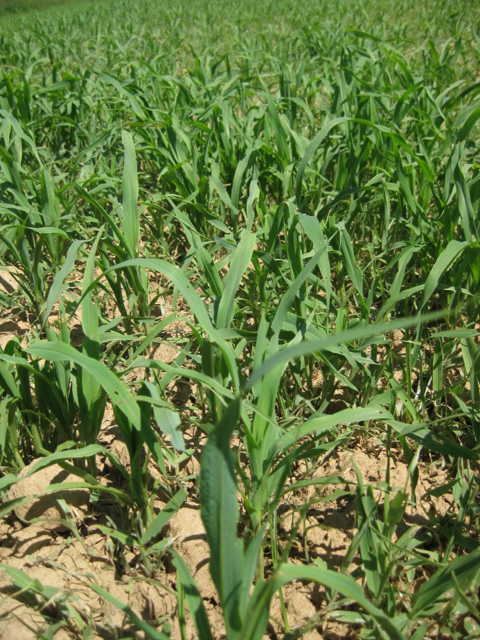
Nitrate Concerns
Occurs under conditions of plant stress:
  Low soil moisture
  High temperatures/humidity
Use caution if grazing heavily fertilized summer annuals, bermudagrass, Johnsongrass
Test forages
Remember: Nitrates may remain in stored forages

Slide 10
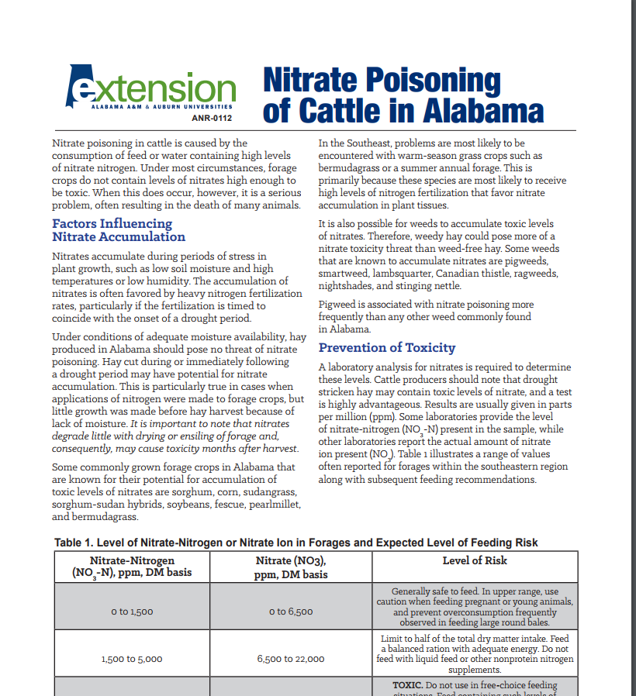
Nitrate Toxicity Publication
ANR-0112

Slide 11
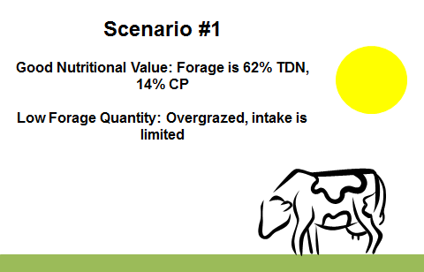
Forage Supply and Demand
Supply
Limited due to dry conditions
Plant growth has basically stopped
Demand
Intake continues regardless of if plants continue to grow
Especially depends on animal requirements
Bottom line: Overgrazing can occur
“The Golf Course”

Slide 12

The Three R’s
Residual
Stubble height remaining impacts stand regrowth potential. Min. of 2” for bermudagrass and 4” for tall fescue stands.
Rest
Remove cattle from grazed area. Rotate to new pasture or feed cattle in designated “sacrifice” area to allow for pasture rest.
Recovery
The combination of adequate residual and rest leads to recovery…plant regrowth occurs more rapidly when grazing intensity and frequency are managed.

Slide 13
Importance of Rest and Recovery….
Regrowth
Begins
Graze/Cut
Roots die back
Graze/Cut
Again
Adequate
Rest
Roots die back even more
Adapted from D. Hancock UGA

Slide 14
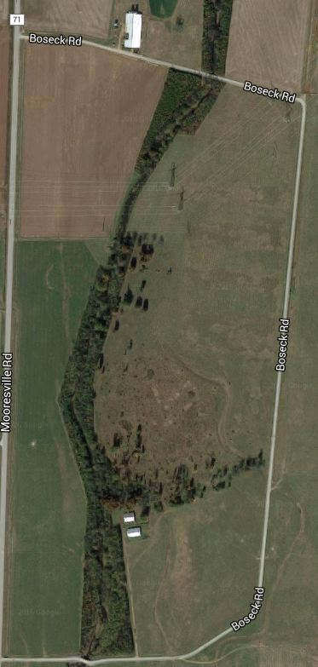
A plan for now and one for later
Pick one and shut the gates!
Pasture 1
Pasture 1
Stockpiled tall fescue
Pasture 2
Pasture 2

Slide 15
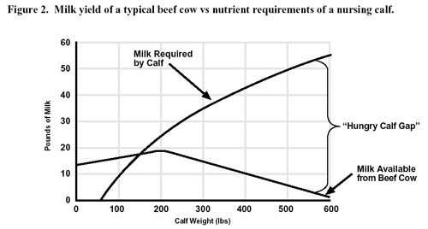
Animal Management – Three C’s
Creep
  Does not reduced demand on the dam
  May add gain – especially when forage is limited
  9:1 efficiency – average
  Actual cost-benefit varies widely

Slide 16
Animal Management – Three C’s
Cull
  Reduces forage demand immediately
  Allows opportunity to plan for future – am I overstocked?
  Consider the order:
    Old, open – especially with disposition problem
    Feet, legs, eyes, udders, body condition, etc.

Slide 17
Animal Management – Three C’s
Cull cont’d. – Early Weaning
Energy requirements decrease by about 35%
Weaning
Energy Requirements
Calving
Feb March Apr May June Jul Aug
Month

Slide 18
Animal Management – Three C’s
Control
  Other stressors than can influence animal performance
  Flies
    Can decrease grazing efficiency/time at the feeder
    Irritation, loss of blood, decreased gains, decline in milk production
    Numerous options:
      Sprays, dust bags and back rubbers, feed-throughs and insect growth regulators, pour-ons, insecticide impregnanted ear tags

Slide 19
Heat Stress

Slide 20
Heat Stress
Defined:
    Combination of high temperatures and high relative humidity
So What?
  Cattle are more sensitive to heat stress than humans
  Breathing and panting more than sweating

Slide 21
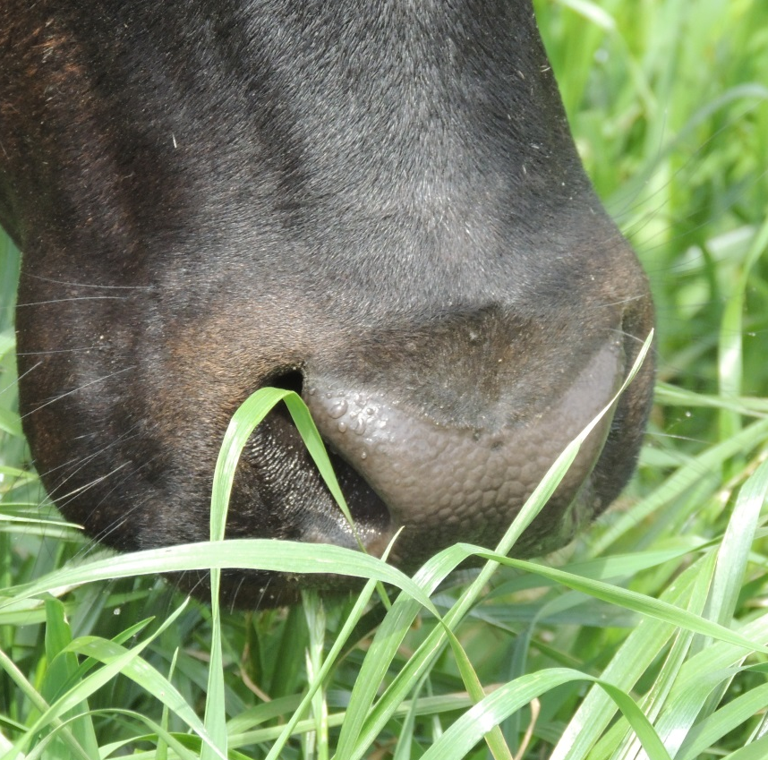
Heat Stress Means
Using up energy to dissipate the heat
Less time spent grazing
More time spent in the shade

Slide 22
Management Strategies – Heat Stress
Handle cattle early in the morning
Establish a grazing management plan
Ample supply of a quality water source
Transport, timing, and other tips

Slide 23
Handle cattle early in the morning
Handling increases body temperature of calves about 3°F
Other considerations
  Hair coat color – darker color, greater core body temperature (2°F)
  Disposition – excitable cattle

Slide 24
Establish a grazing management plan
Estimate supply and demand with available resources
Move cattle in the evening
  Temperatures are cooler
  Cattle often graze most during the early morning and in the evening
  May encourage active grazing into time of dusk
Shade
Pasture 1
Stockpiled tall fescue
Pasture 2

Slide 25

Ample supply of a quality water source
Stock pastures to match water supply
Water temperature
      70 to 95° F – 2x the need!
      Source: Shallow ponds and water troughs vs. deep ponds and ground water - pumped
2 gallons of water per 100 pounds of body weight

Slide 26
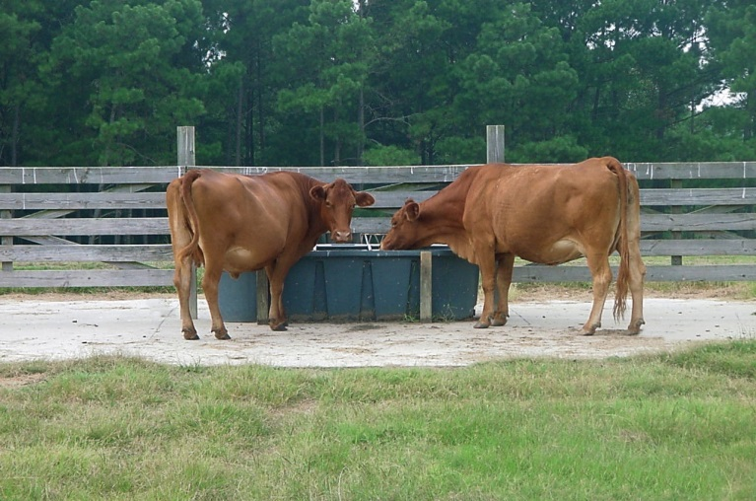
Ample supply of a quality water source
Monitor troughs – clean out algae, check flow to prevent stagnant water
    Breeding ground for biting flies and other pests
Impacts the bottom line
  Under limited water conditions – gains are reduced
  Consider marketing cows/calves early if water supplies are limited

Slide 27
Transport, timing and other tips
Shrink
with stressed calves
  1st level – a major stressor occurs
    Gut fill, urine loss
  2nd level – loss of fluid from body tissue

Slide 28
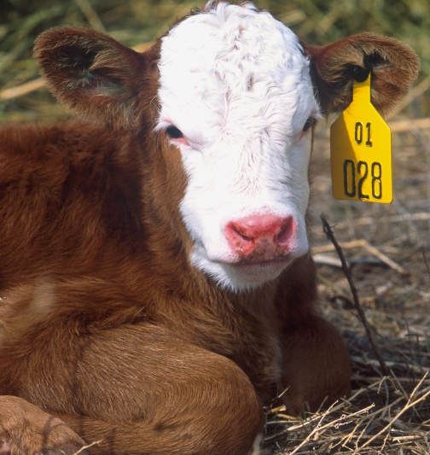
Shrink and the Summer
Weaning – Smaller, unweaned calves will have greater shrink
Water – Excessive amounts before/after sorting
Facilities – Stress from being driven and sorted
Load Density

Slide 29
Transport, timing and other tips
Table 1. Maximum recommended number of cattle† to load by trailer dimensions.
Trailer size, feet |  | Average cattle weight under, lb
Length | Width | 400 | 500 | 600
16 | 6 | 18 | 15 | 12
18 | 6 | 21 | 17 | 14
20 | 6 | 23 | 18 | 15
24 | 6 | 28 | 22 | 18
20 | 7 | 27 | 22 | 18
24 | 7 | 32 | 26 | 22
32 | 7 | 43 | 34 | 29
†Reduce trailer load by 5 to 10% during conditions of heat stress

Slide 30
Weaning/Receiving Calves
Feed cattle in the evening
Heat of digestion – increases calf body temperature
Minimize as many of the “other factors” as possible
  Fly Control
  Mineral Program
  Bunk Space

Slide 31
Weaning/Receiving Calves
Mineral program
  Consistent supply is important to maintain intake
  Cattle crave salt…especially in summer!
  Complete vs. trace
Bunk space
  1 to 2 ft per head minimum

Slide 32
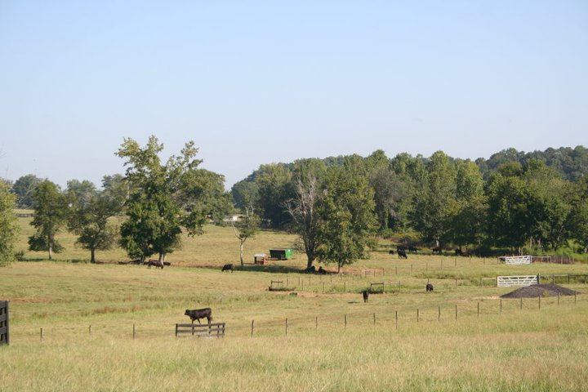
Conclusions

Slide 33
Take Home Points
Continue monitoring dry conditions – use web tools or contact local Extension office for update
Consider forage and animal demand
  Residual, rest, recovery
  Creep, cull, control

Slide 34
Take Home Points
Make management adjustments as needed
  Heat stress is prevalent – drought or not

Slide 35

Visit www.aces.edu/beefsystems

