Slide 1

Here Comes the Sun:
Solar Power as Energy Source
Ventilation System for Remote High Tunnels
A 2018 SARE Farmer Grant
Tommye Lou Rafes
Owner of T. L. Fruits and Vegetables LLC
tommyerafes@aol.com

Slide 2
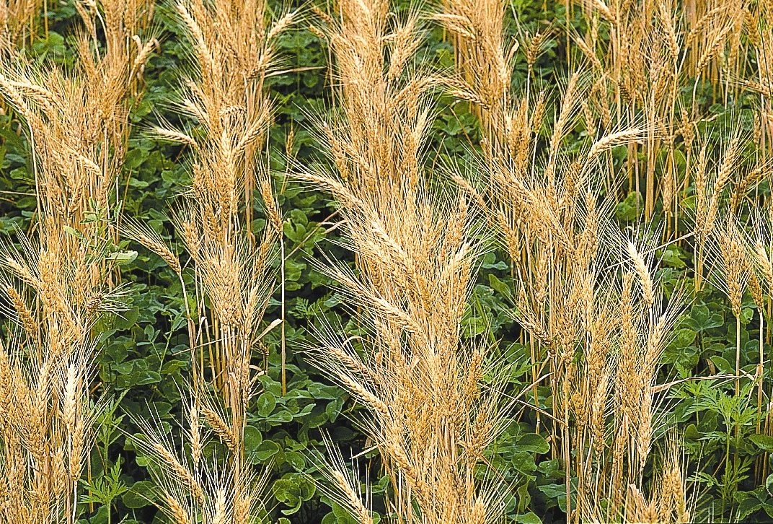
What is SARE?
Grants that fund research and education
Since 1988 SARE has funded 6,700 projects with grants for farmers, ranchers, extension agents, educators, researchers, nonprofits, students, and communities

Slide 3
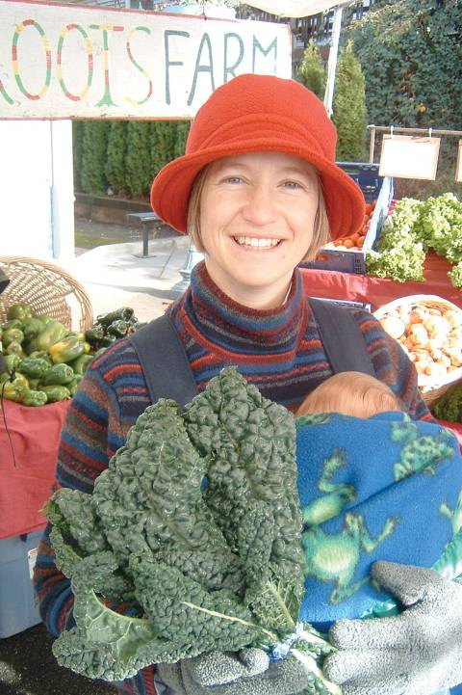
The
SARE Model
  Successful SARE grantees are engaged in projects that simultaneously address the
  3 pillars of sustainability:
  People – who depend on agriculture
_{Profit – over the long term}
Stewardship – of the nation’s land and water
Photo by Ted Coonfield

Slide 4
West Virginia Coordinators for SARE
Doolarie Singh-Knights @ WVU
304-293-7606
Barbara Liedl @ WV State University
304-201-4037
Since 1988 $2,673,353 grants have supported 86 projects

Slide 5
What can SARE funds be used for?
Salaries for a project leader, an employee, or hired laborer
Travel
Printing, mailing, photocopying
Consultants
Conference fees or Training fees
1/3 the cost of project specific materials or supplies
Maximum award for Farmer grants = $15,000

Slide 6
When Can You Apply?
Normally the Farmer grant applications are due the first of December each year
Applications are submitted online
You will need a Technical Advisor and a letter of support for your grant application
You will also need to offer outreach in a format such as a Farmer Field Day

Slide 7
FNE 18-907
What was the problem?
Growing produce during the fall, winter, and spring seasons of the year is challenging because the weather can fluctuate within a high tunnel from freezing to over 100 degrees, damaging or killing crops and/or making them susceptible to diseases.

Slide 8
Grant Objectives
Decrease crop failure due to disease
Decrease crop failure due to temperature
Increase ventilation
Reduce labor costs
Increase crop yield and quality of product
Encourage other growers to produce year-round

Slide 9
Project Methods
High Tunnel A – Automated using Solar Energy
High Tunnel B – Automated using on grid electricity
High Tunnel C – Control with no automation

Slide 10
What we already had at our farm
Three high tunnels all basically at the same elevation, orientation, and size
Customer demand for winter kale, collard greens, and spinach
Low tunnels inside each high tunnel to add winter protection
All three high tunnels were double layer plastic with same end walls and door openings

Slide 11
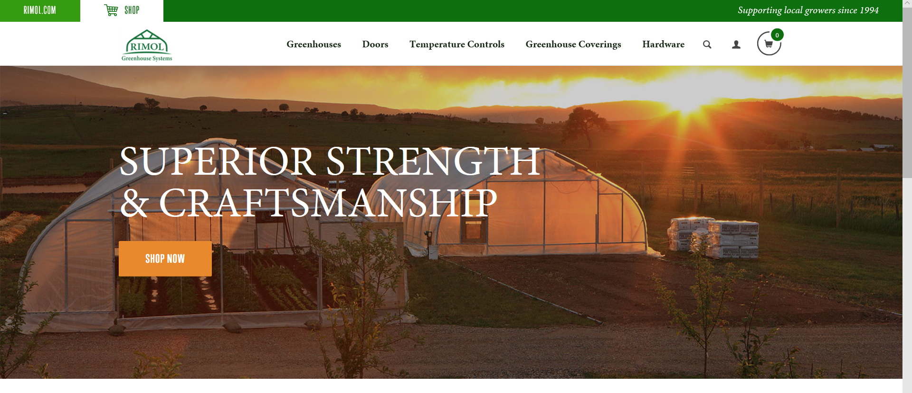
https://store.rimolgreenhouses.com/Greenhouses_s/1817.htm

Slide 12


Slide 13
Advancing Alternatives
Located in Lancaster, PA
Design Engineer is Rich Hyatt
Company motto is –
“treat customers as you expect to be treated.”

Slide 14
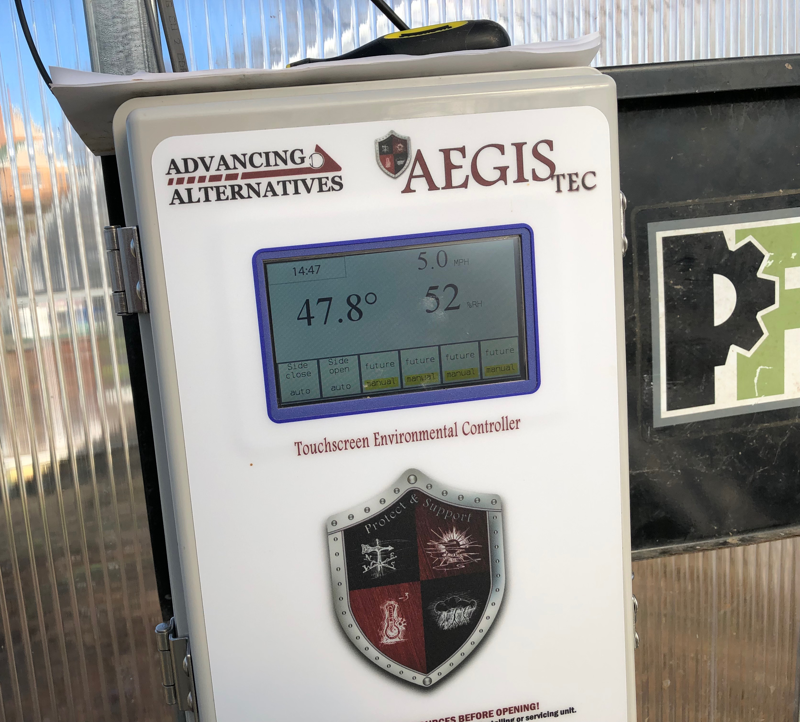
What we bought and used
(2) Aegis Solar Touchscreen Environmental Controller
(2) 100’ temperature sensor
(1) Solar Panel 140 Watt
(1) Battery 12 Volts
(2) Low Voltage Motor
(2) Humidity Sensor
(2) Wind Sensor
(2) Guide Pipe Hardware

Slide 15
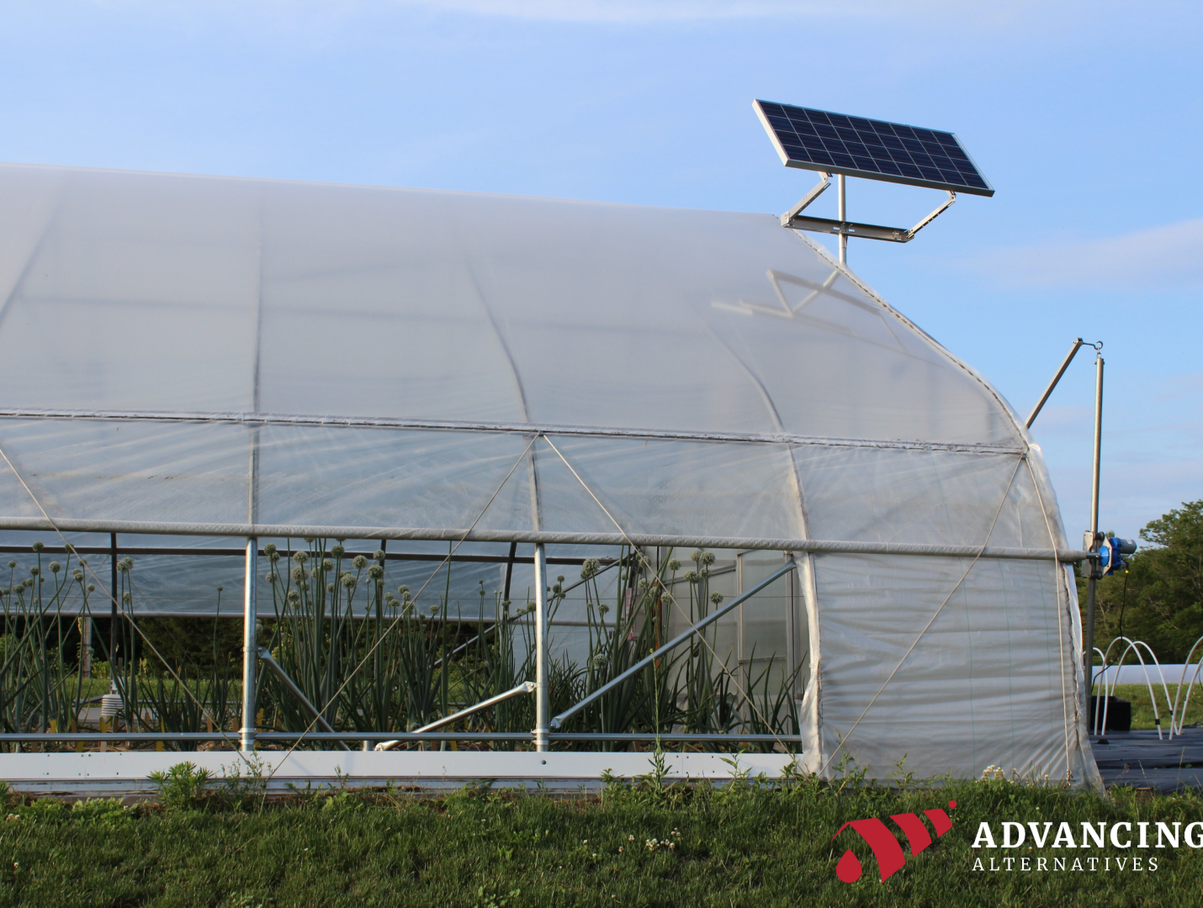
This is the solar panel mounting bracket and post sold by Advancing Alternatives = $865.00

Slide 16
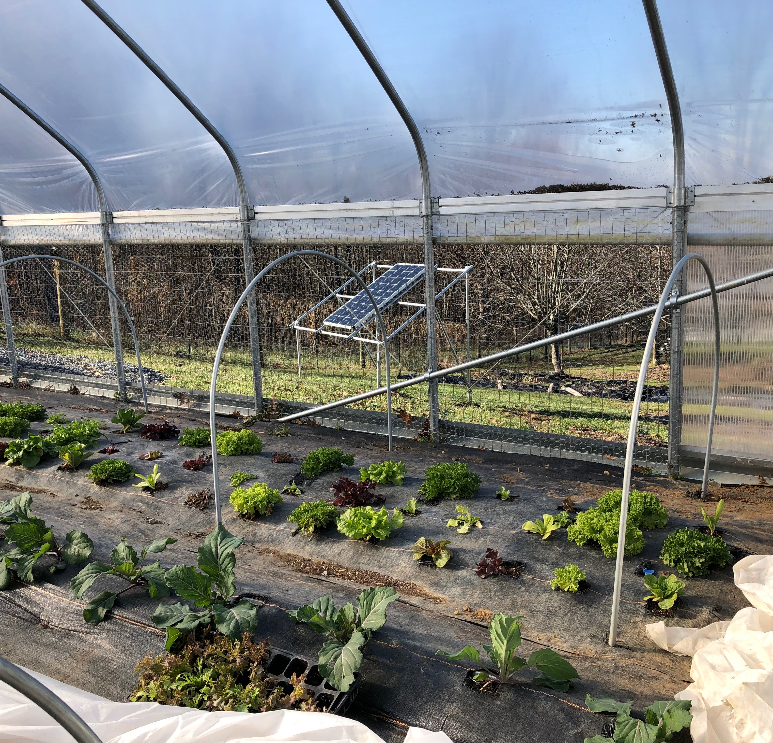
High Tunnel A
Solar Powered
Automated with a battery storage
Converts Solar energy to run the side wall curtains, monitors and controller
Easy to install
Works great

Slide 17
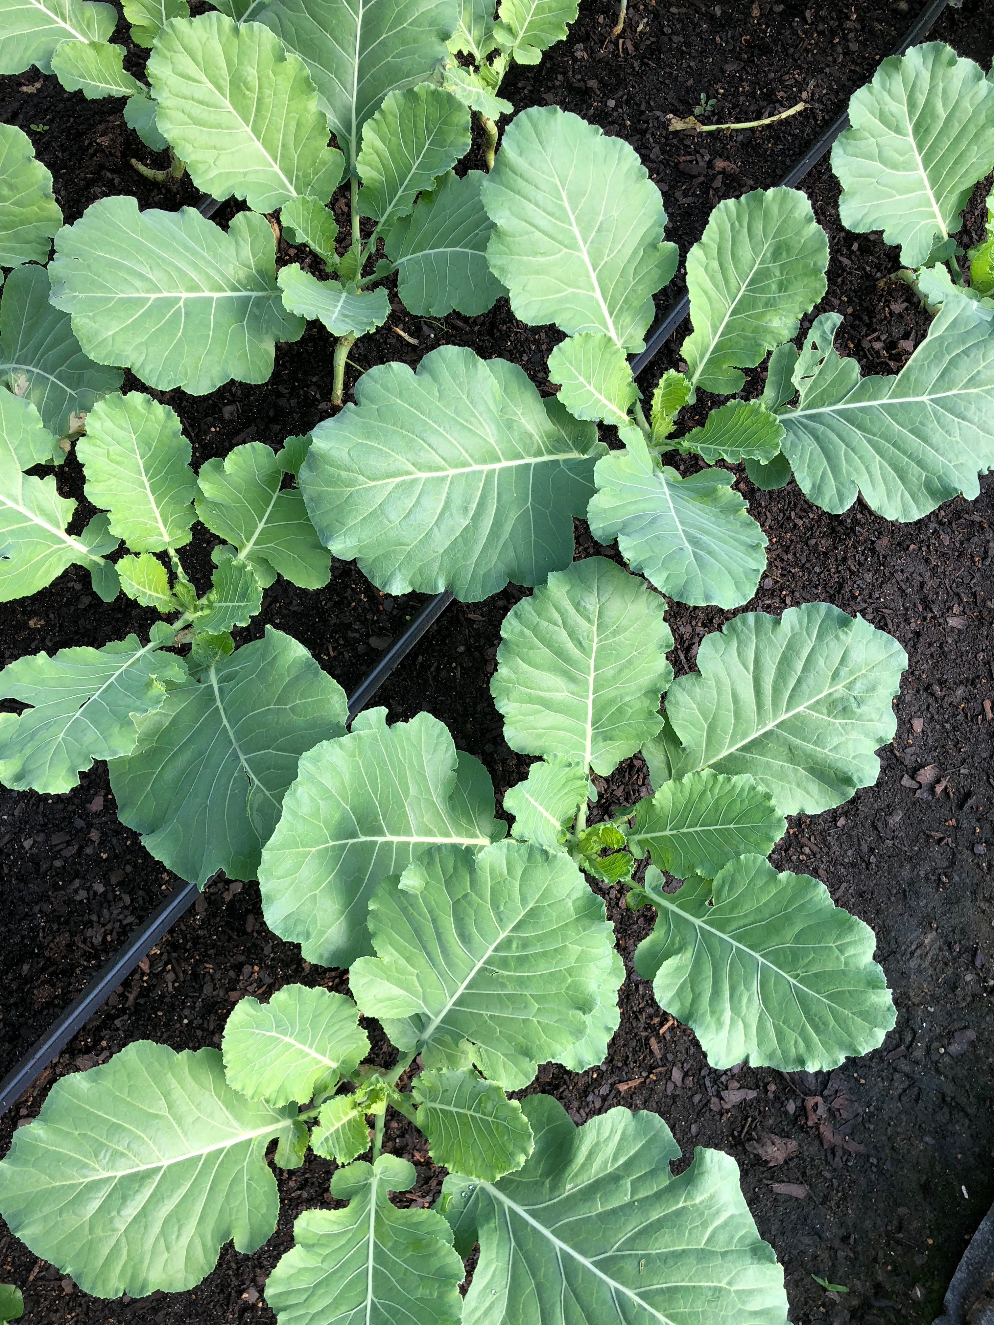
High Tunnel B
Hard wired
Automated side wall curtains, monitors and controllers
Easy to install
Works great!

Slide 18
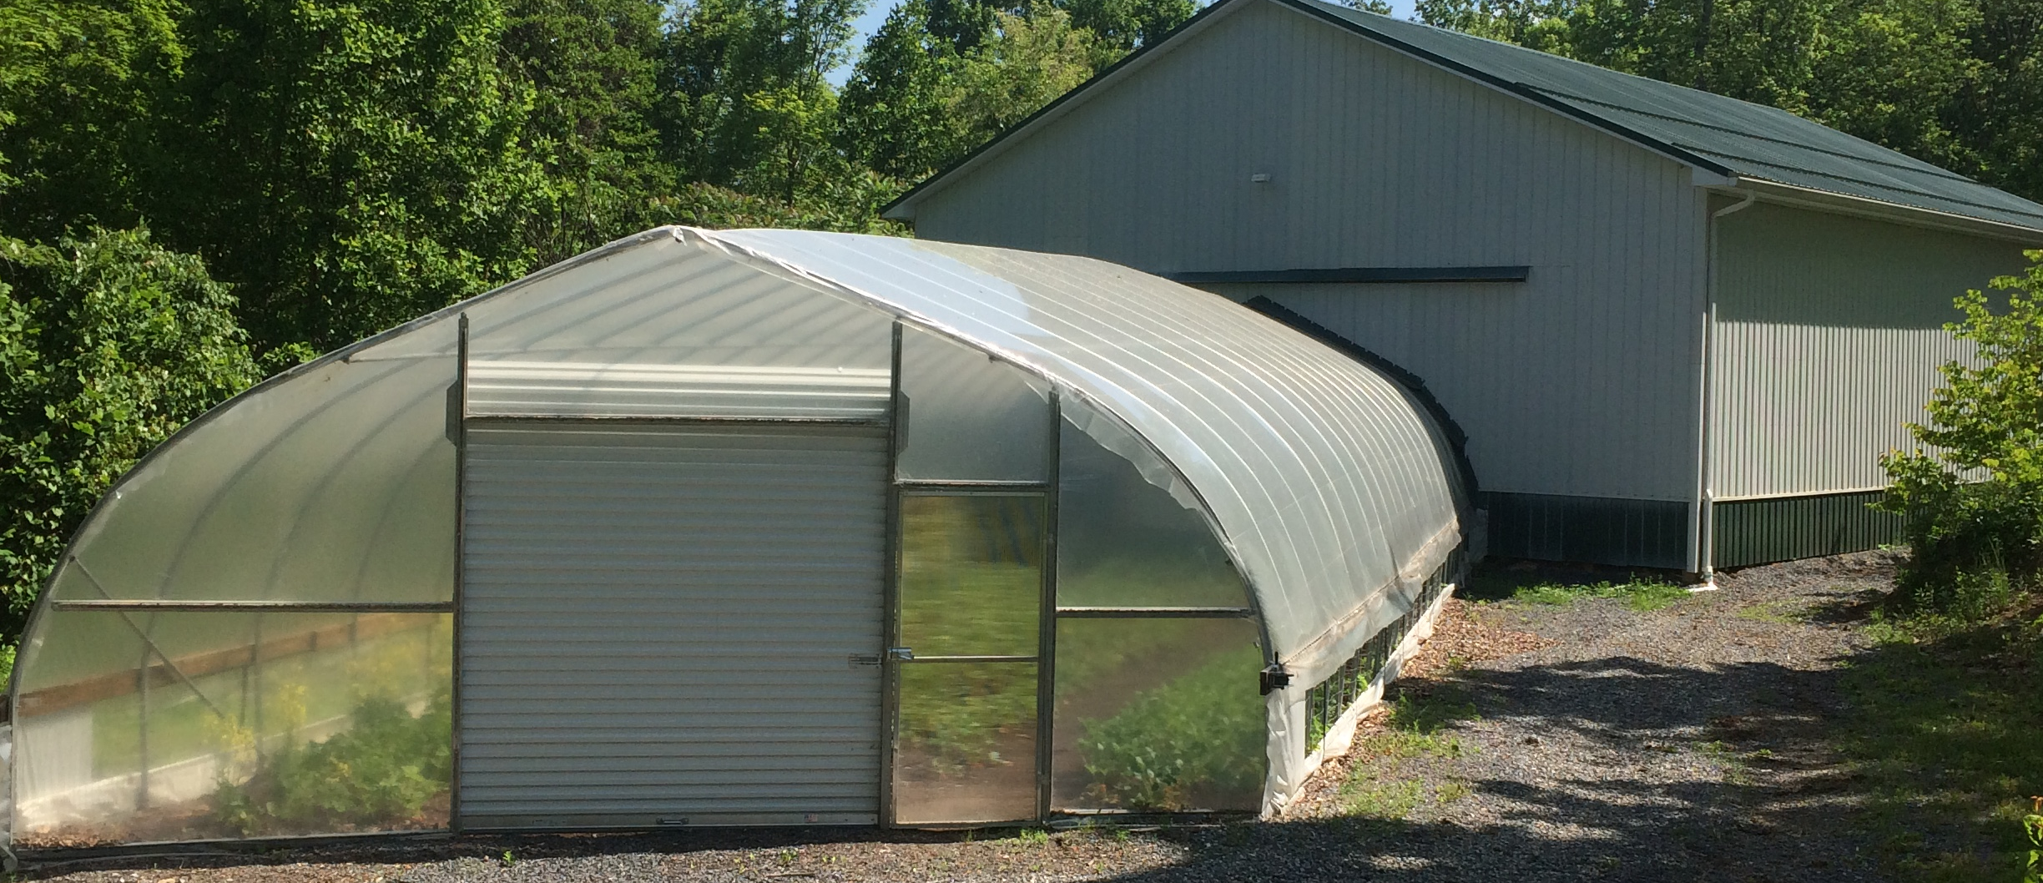
High Tunnel C
Our Control in the Experiment – Increases the reliability of our results.

Slide 19
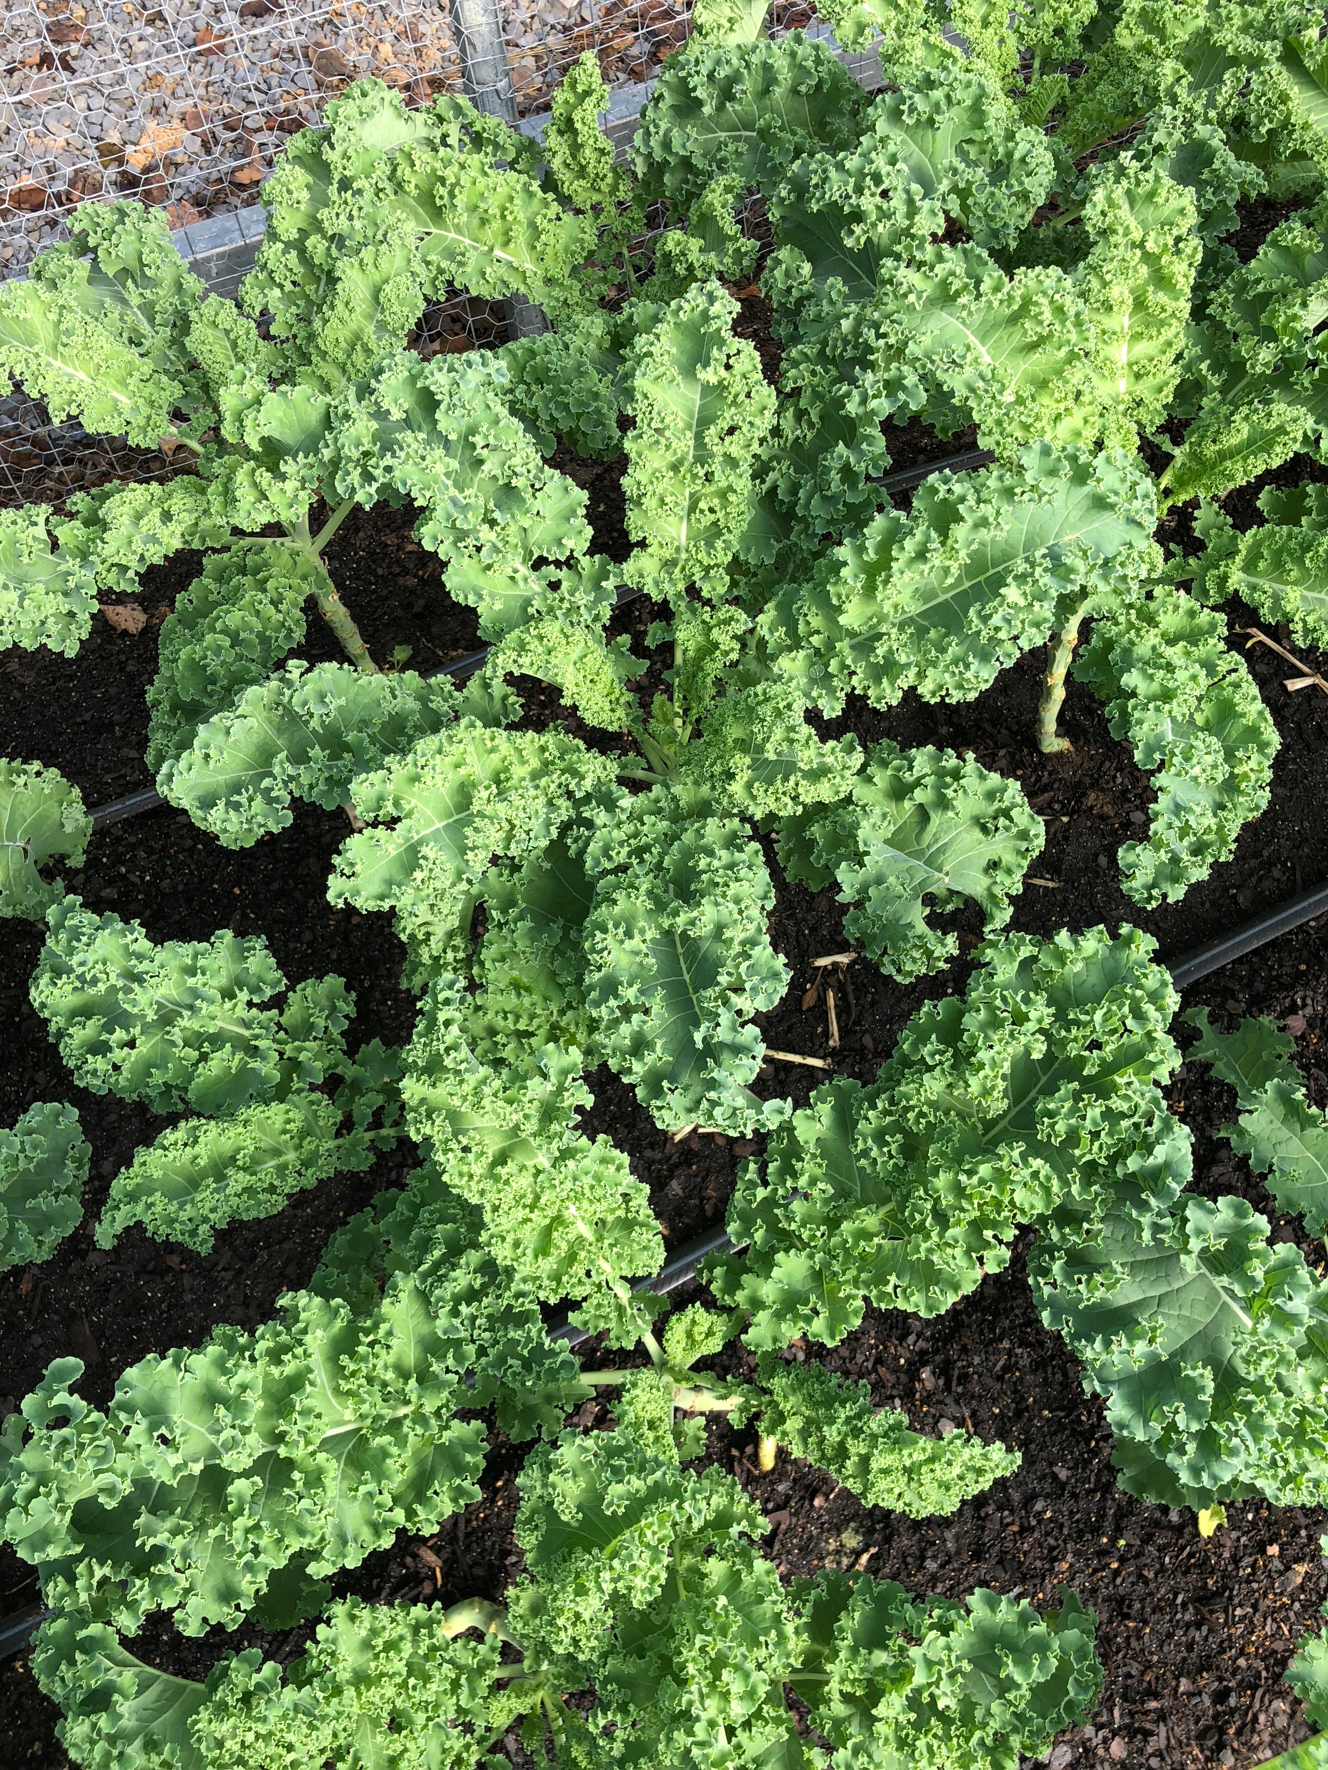
Winterbor Kale – one of our three experimental crops
4’ x 10’ area in each high tunnel were transplanted on August 4, 2018 spaced 12” apart.
First harvest was on September 9, 2018

Slide 20
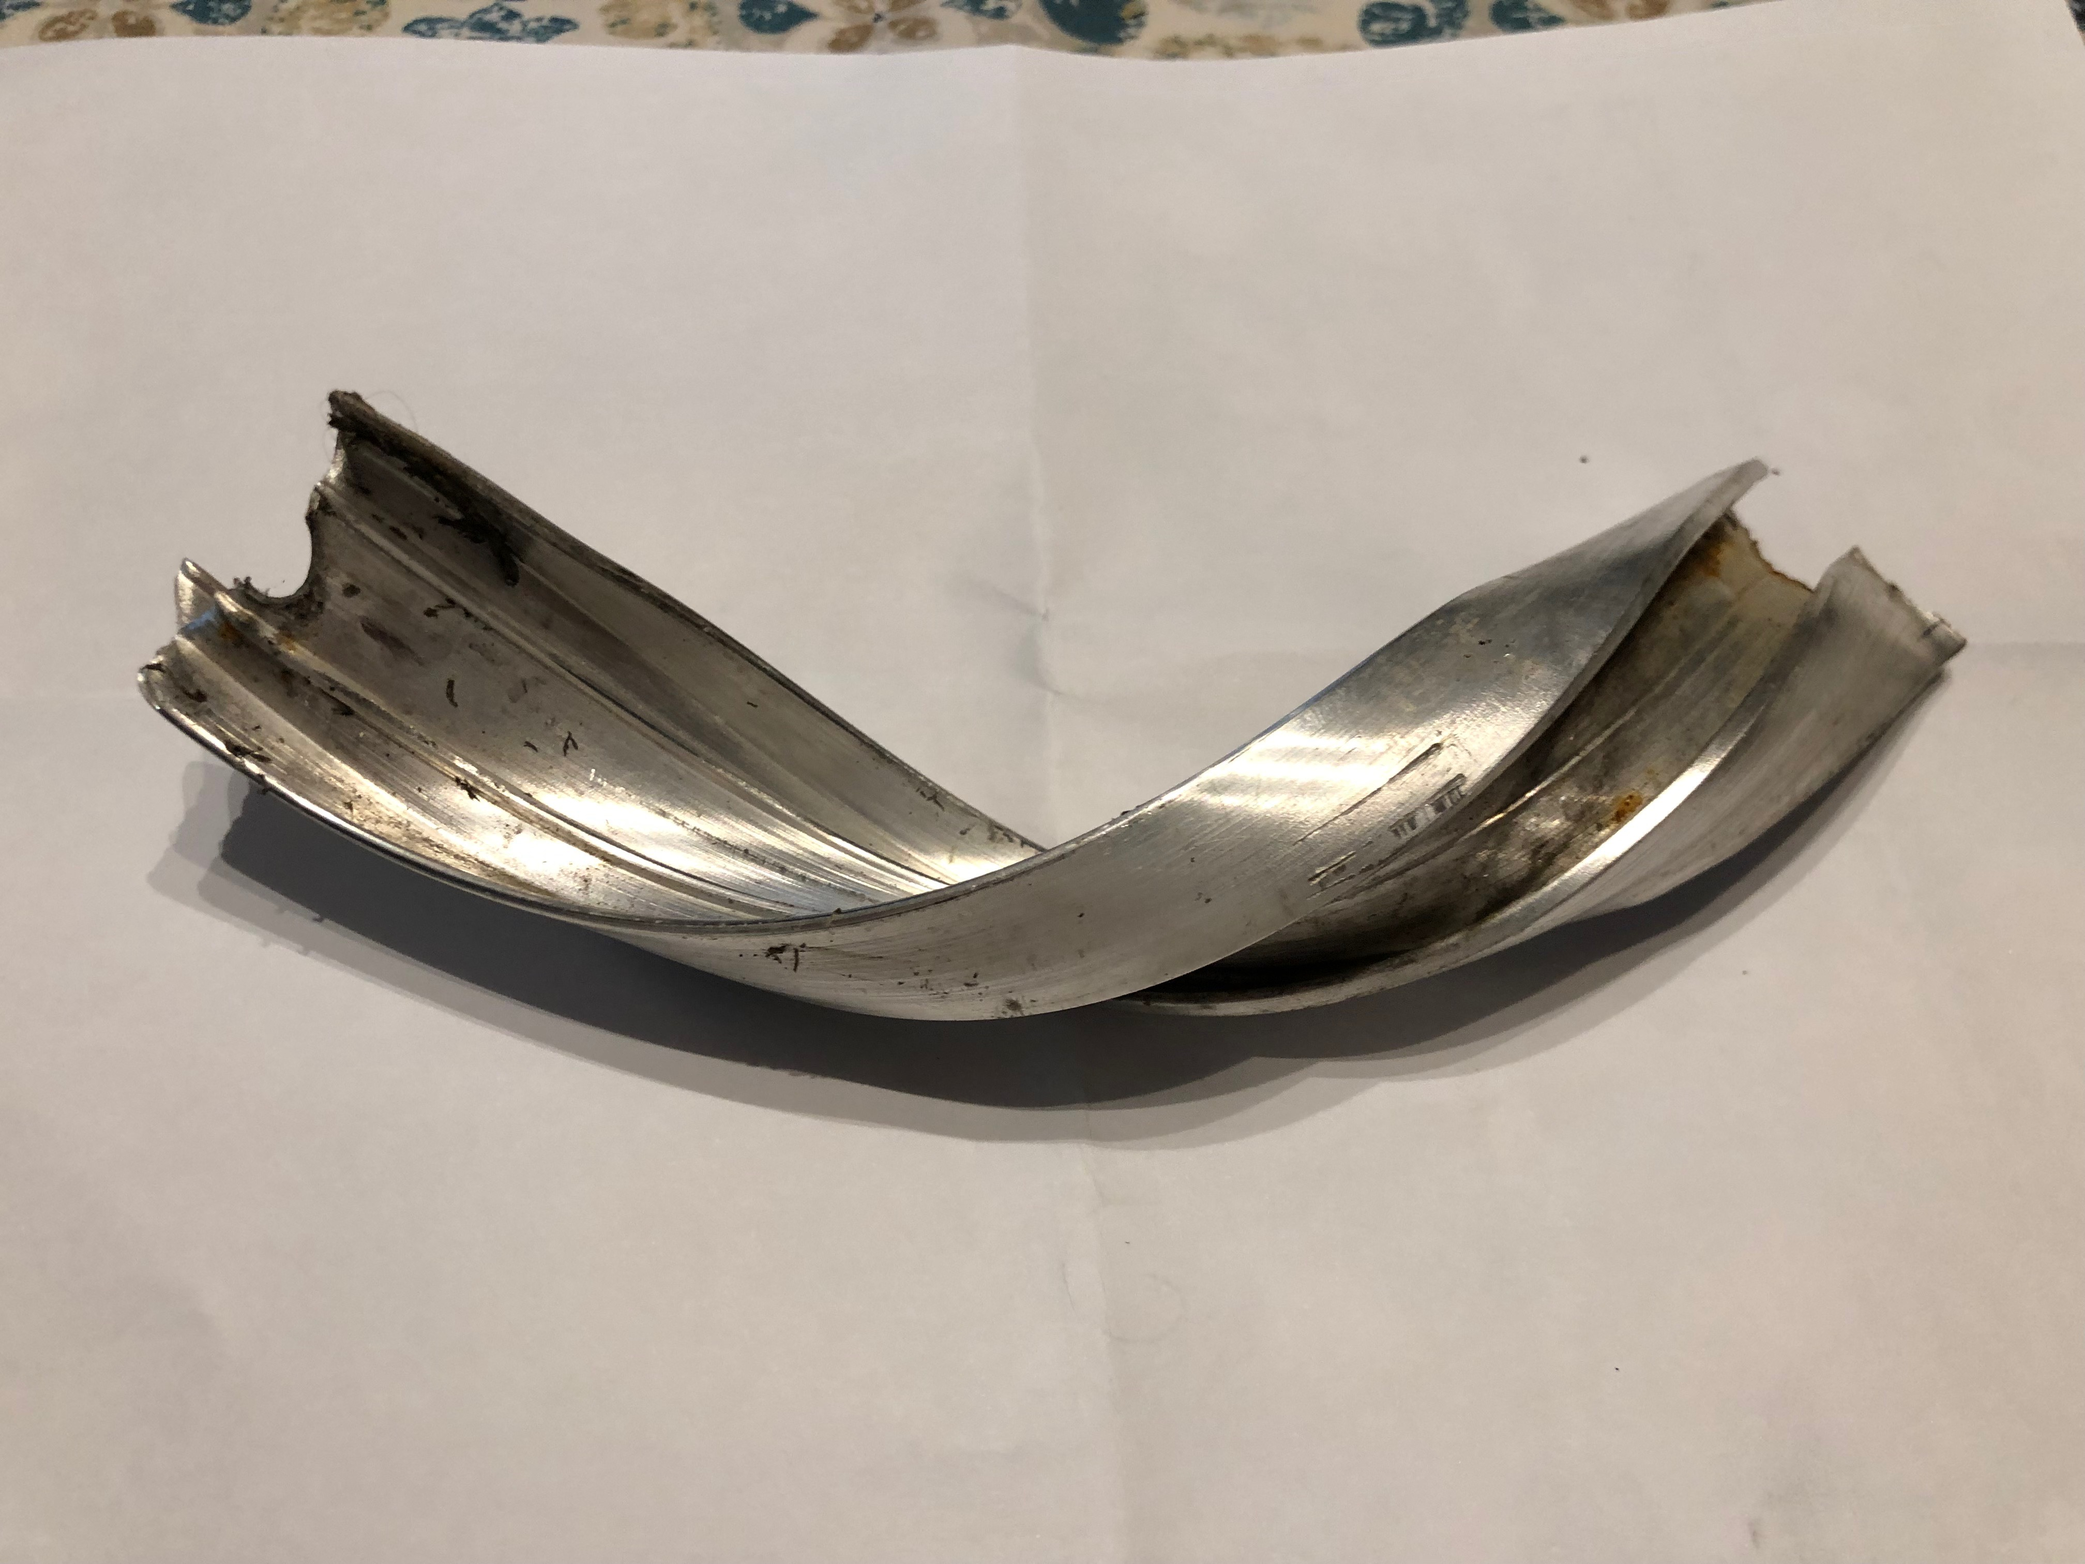
What we have learned
All components purchased by Advancing Alternatives are compatible
Our first solar panel was purchased by another distributor (less money) was too powerful and blew out the controller
Snow and Ice build up are a concern – we ended up turning off the automation during heavy snowfalls

Slide 21
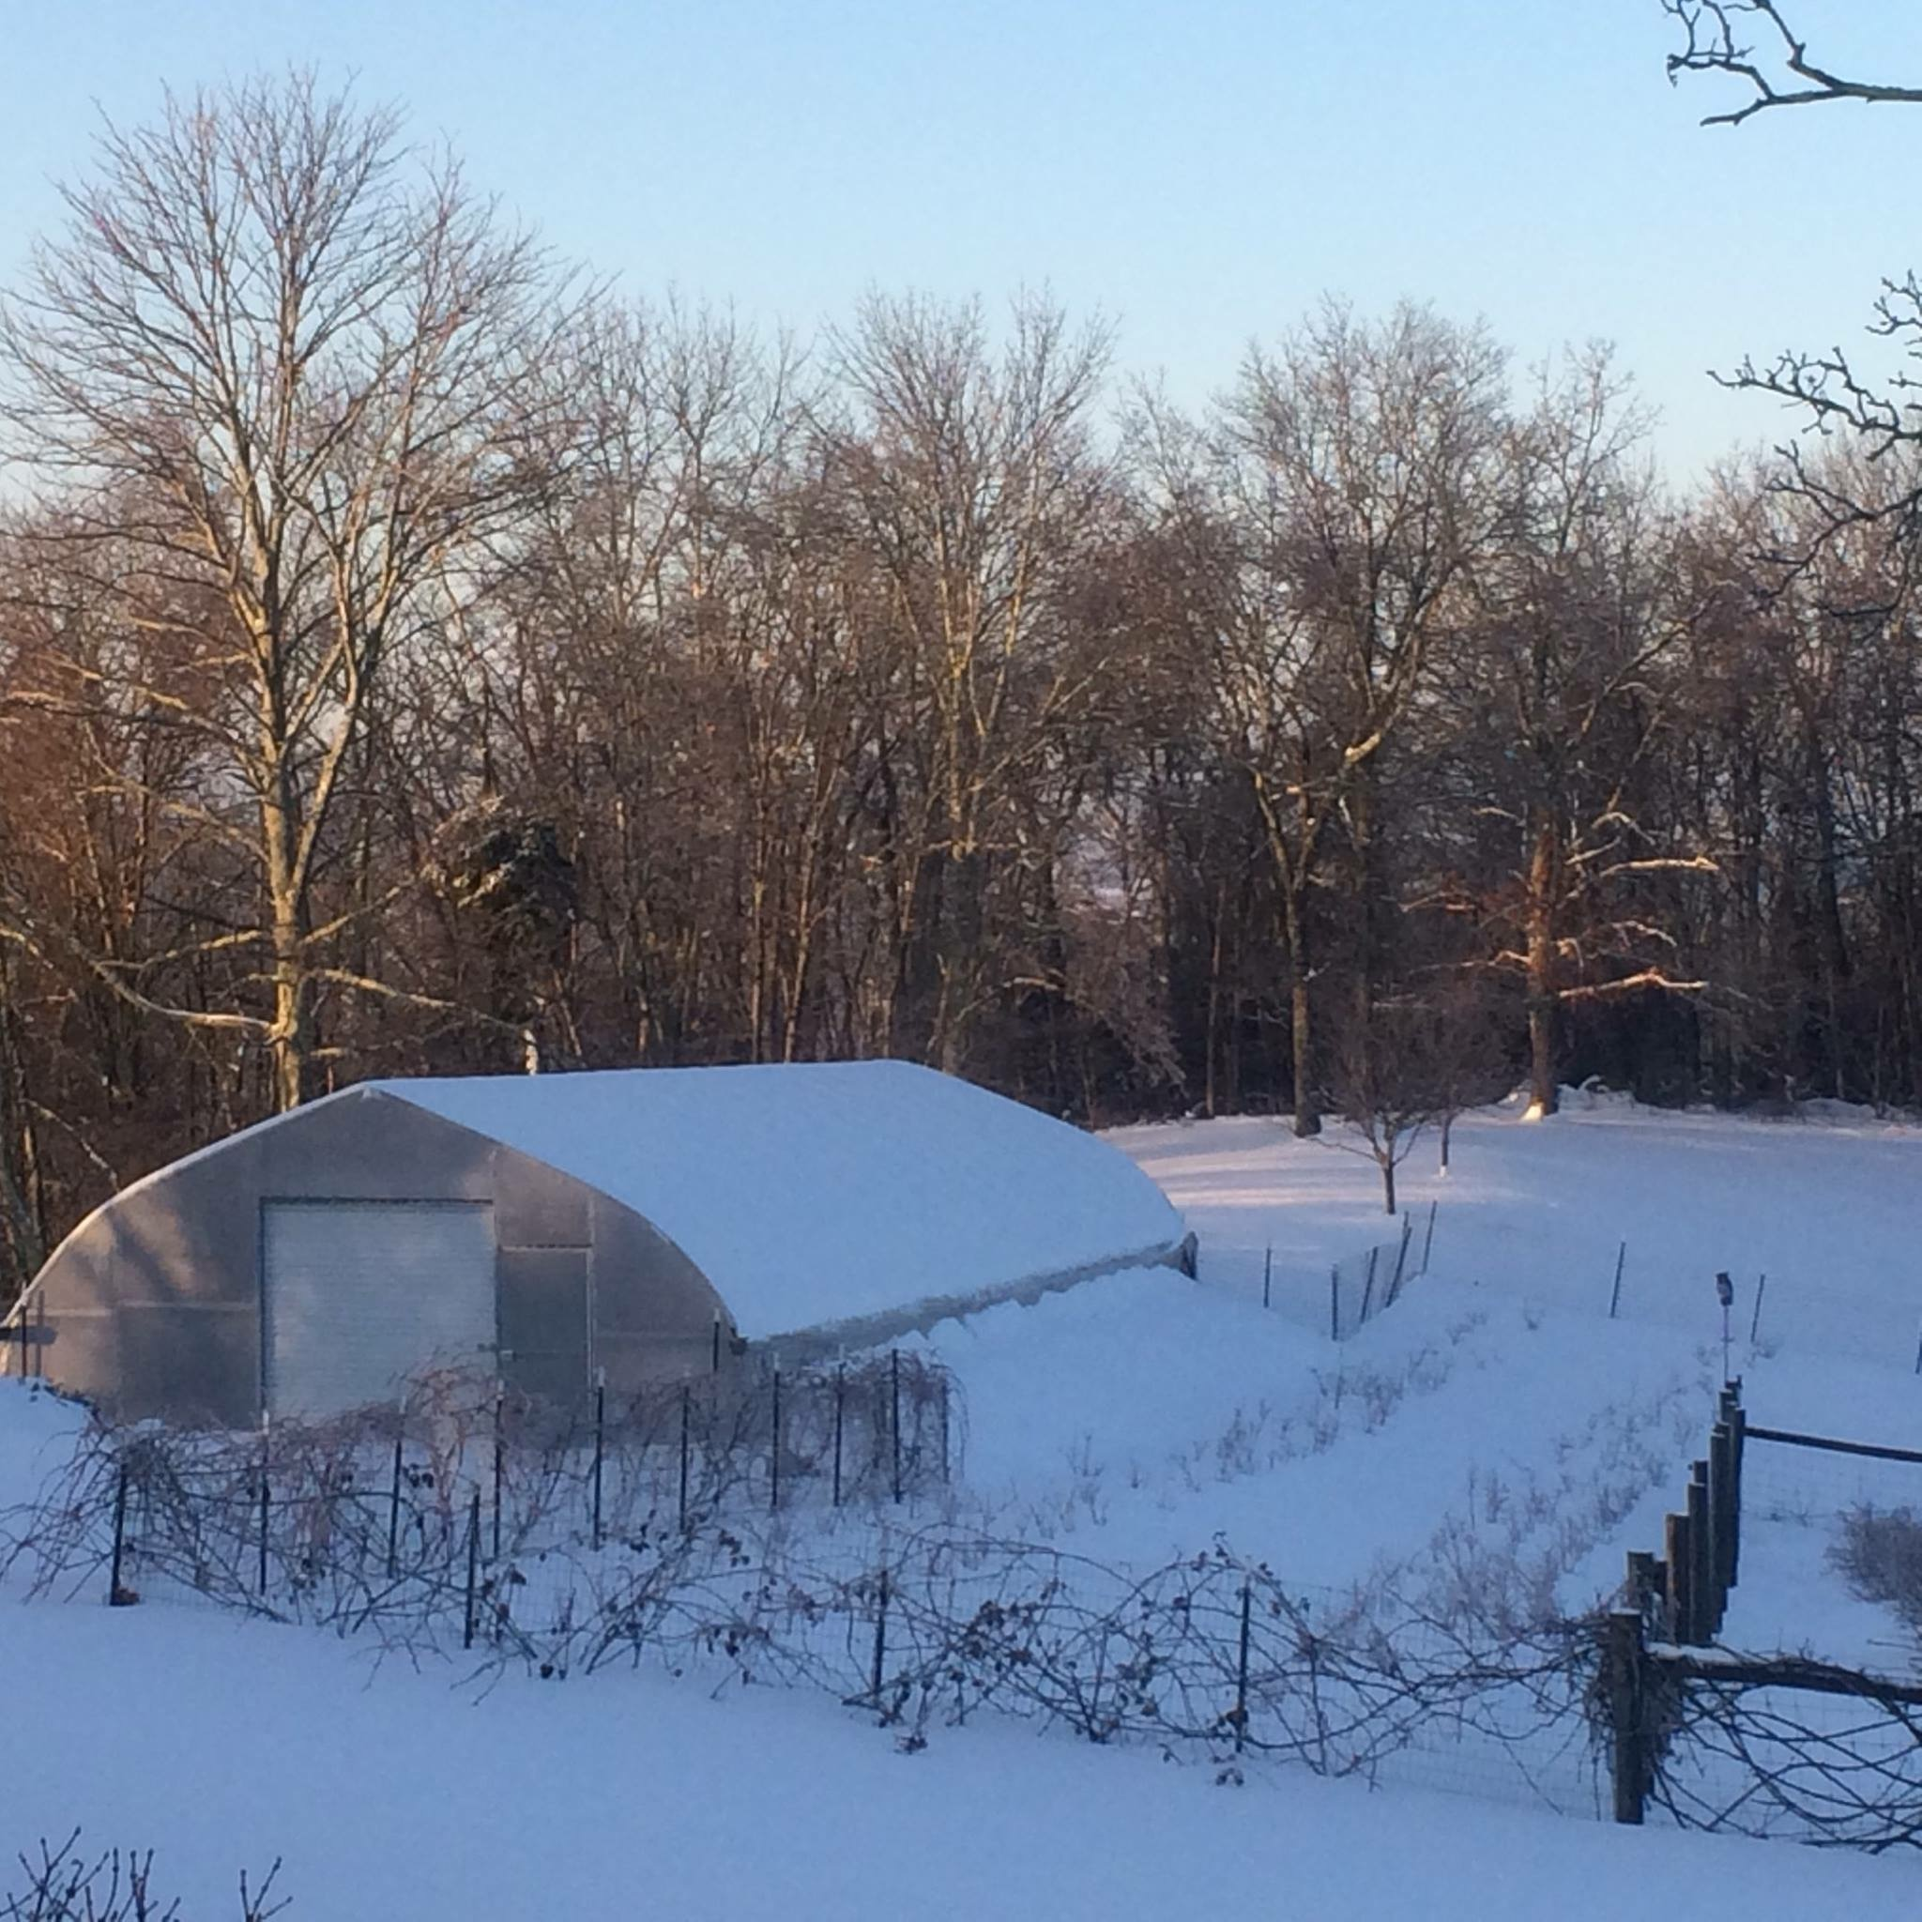

Slide 22
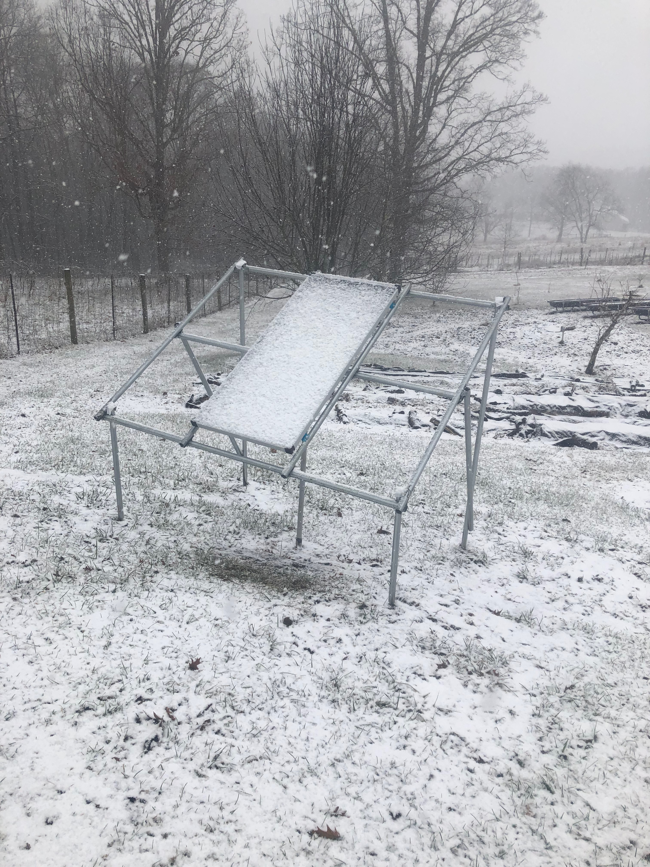
Any differences to solar versus hard wired automated curtains?
Solar costs more due to the expense of a solar panel, mounting of panel, and battery storage
Both worked exactly the same with no differences in systems this first year even though we have had numerous cloudy, snowy, and gloomy weather days

Slide 23
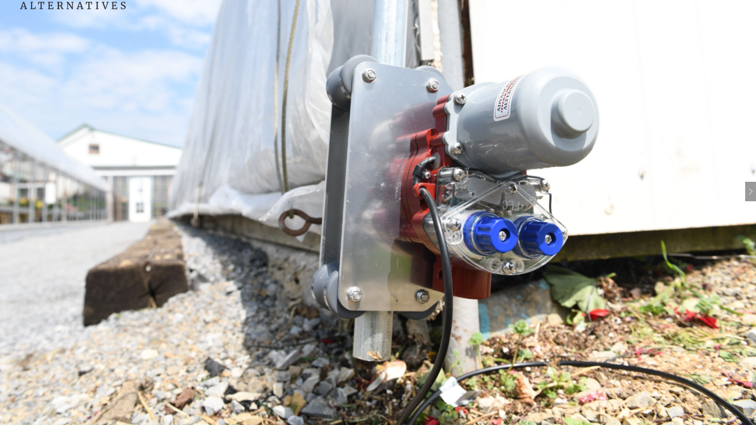
Low Voltage Motor
$250.00 each – same device is used in both High Tunnel A (Solar) and High Tunnel B (Direct Wired)

Slide 24
Pro’s
Easy to set up
Its automated based on your settings
You can leave for vacation without any worries
Excellent support from Company
Improves quality of growing environment to reduce disease and temperature damage to crops
Con’s
Extra time to install
Need to be able to turn off if ice or snow are expected
Costly
No local vendors available
More parts to maintain over the years

Slide 25
Crop Production – any differences yet?
Spring is coming…..
All three high tunnels have had excellent production of all three crops: Corvair Spinach, Tiger Collards, and Winterbor Kale
All three high tunnels have had critter damage
All three high tunnels have had insect damage

Slide 26
What is the total cost?
Solar touchscreen controller, sensors, motor, roll bar, guide pipe, solar panel, solar panel mount, and battery
Total Cost = $3,606.80
Touchscreen controller, sensors, motor, roll bar, and guide pipe
Total Cost = $1,817.00

Slide 27
SARE Farmer Grants
How to apply, when to apply, what they will cover
My grant application (problem, objectives, results)
Advancing Alternatives equipment we used
Pro’s and Con’s and cost of automated side wall curtains
Thank you
tommyerafes@aol.com

Slide 28
Giving Credit where credit is due
This material is based upon work supported by the National Institute of Food and Agriculture, U. S. Department of Agriculture, through the Northeast Sustainable Agriculture Research and Education program under subaward number FNE 18-907
WV Small Conference
Dr. Lewis Jett

