Slide 1
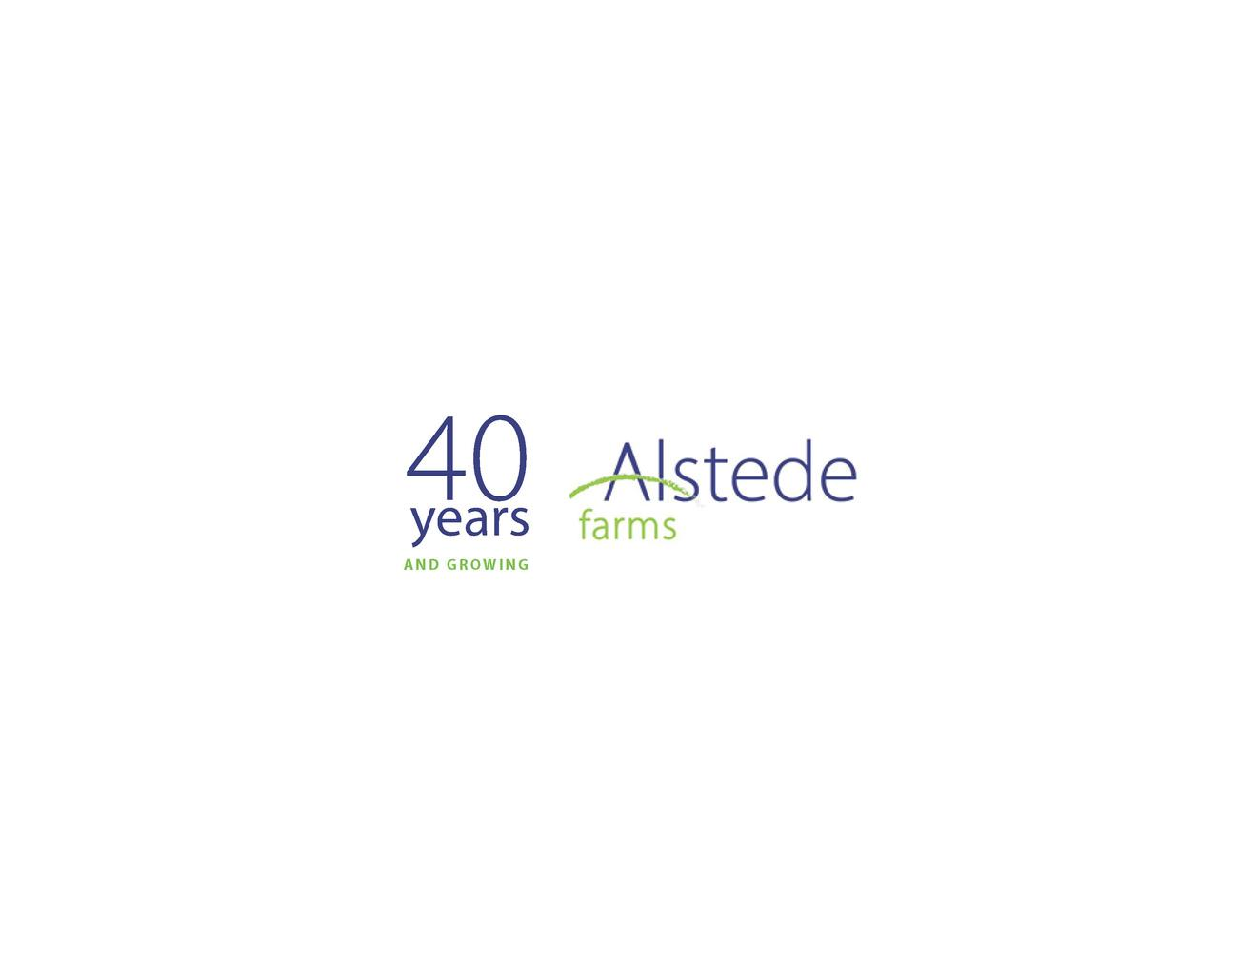
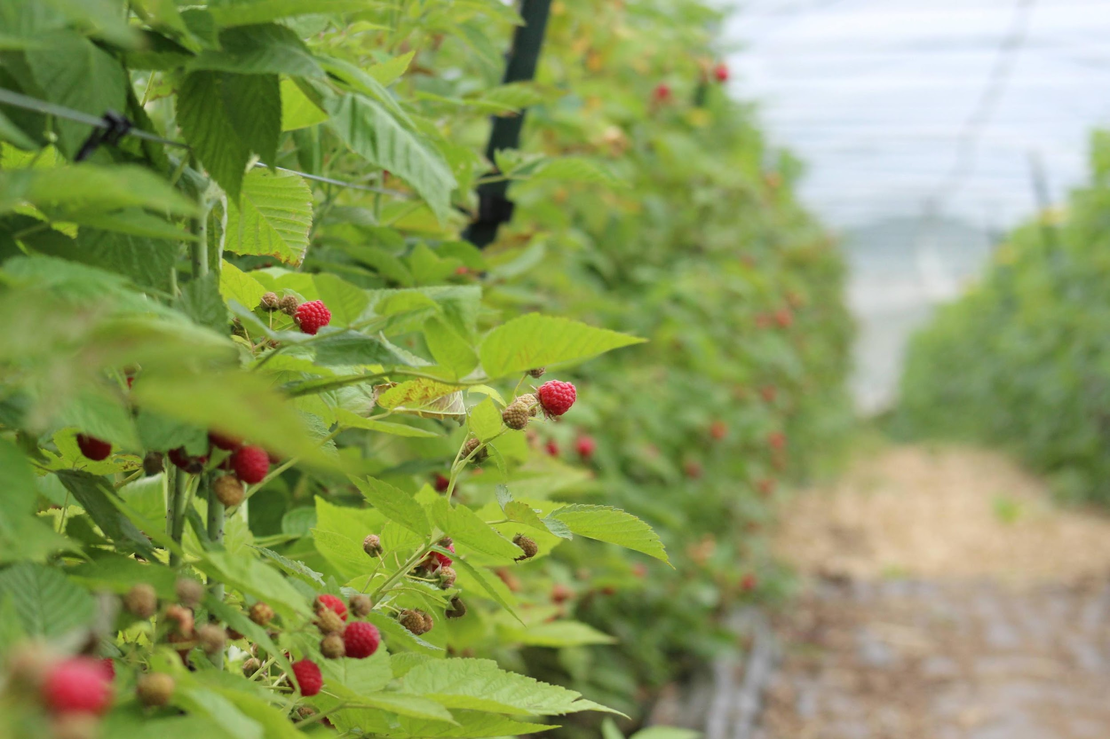
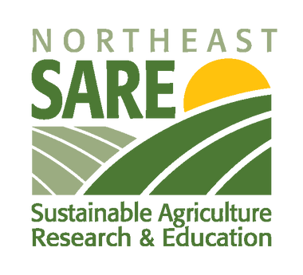
Season Extension Using
Organic High Tunnel Raspberry Production
Rebekah Alstede Modery
Colin Manning
"This material is based upon work supported by the National Institute of Food and Agriculture, U.S. Department of Agriculture, through the Northeast Sustainable Agriculture Research and Education program under subaward number FNE24-072

Slide 2
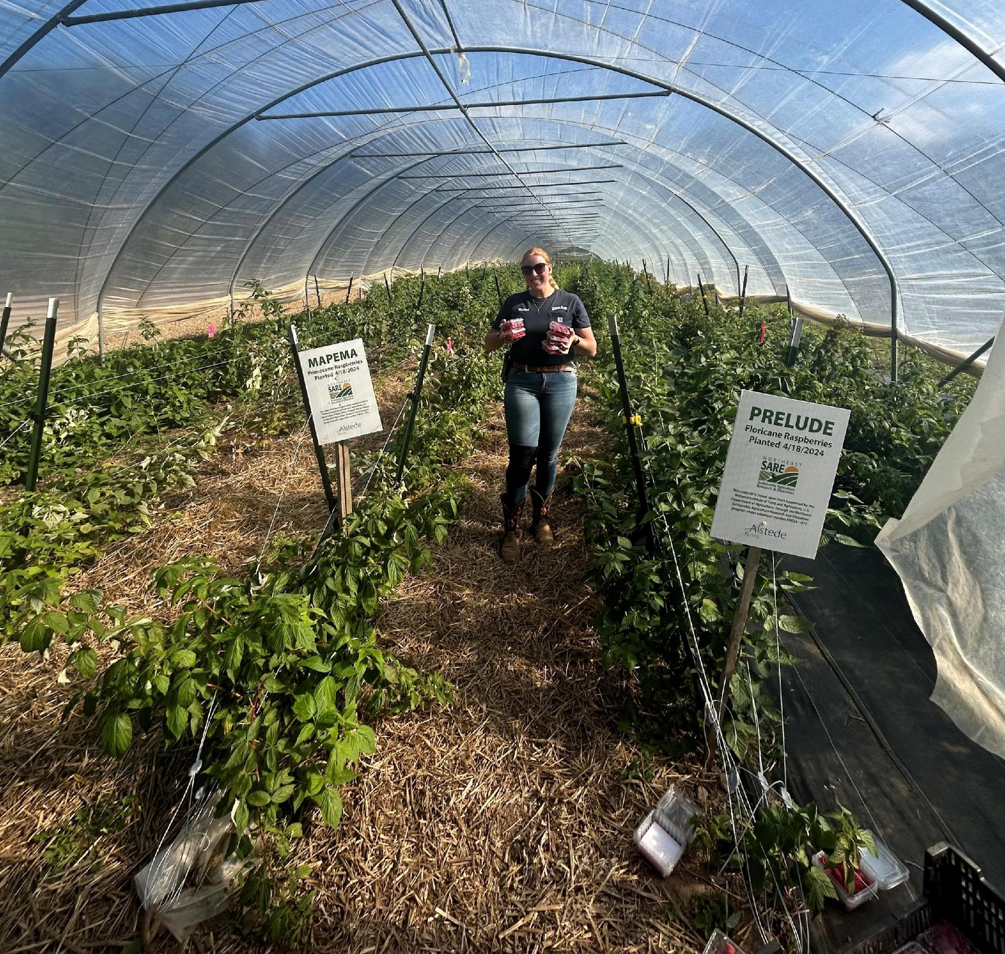
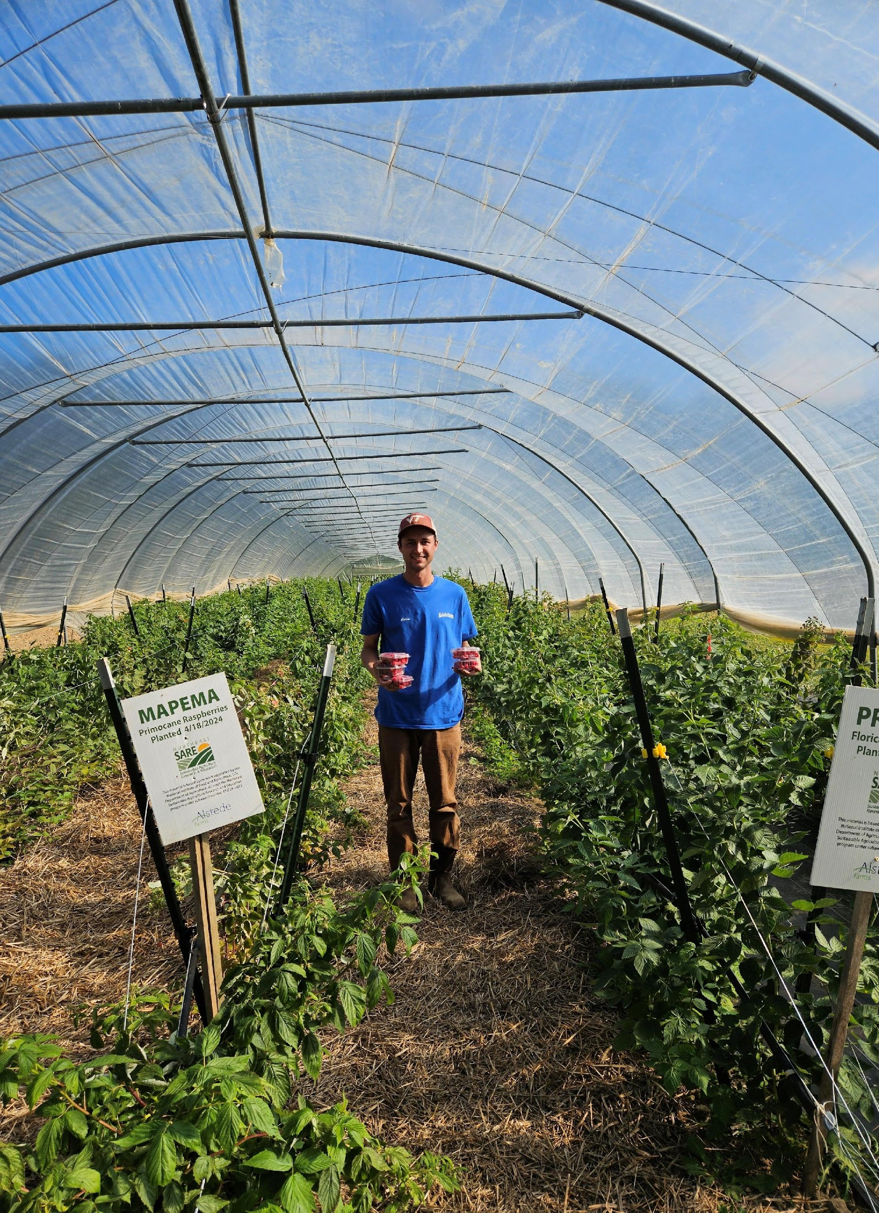
Project Overview:
Our farming background
Why Raspberries?
Why Organic?

Slide 3
Objectives:
Examine production of certified organic raspberries in NJ high tunnel with primocane and floricane raspberry vareities
Evaluate weed control efficacy and cost of landscape fabric, leaf cover, and straw mulch in the row middles
01
02
Compare cost requirements of three weed control strategies for weed management and see if they are more cost effective than hand weeding labor
Evaluate impact of weed control strategies on the growth and yield of organic raspberries and the overall management cost
03
04
5. Outreach and sharing of results

Slide 4
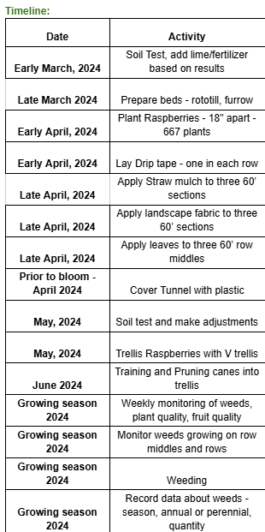
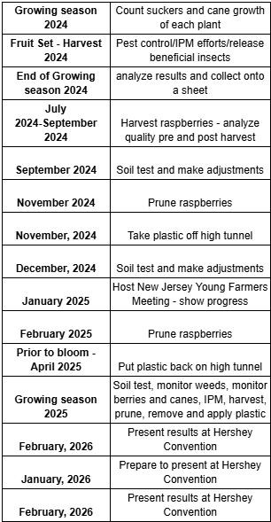
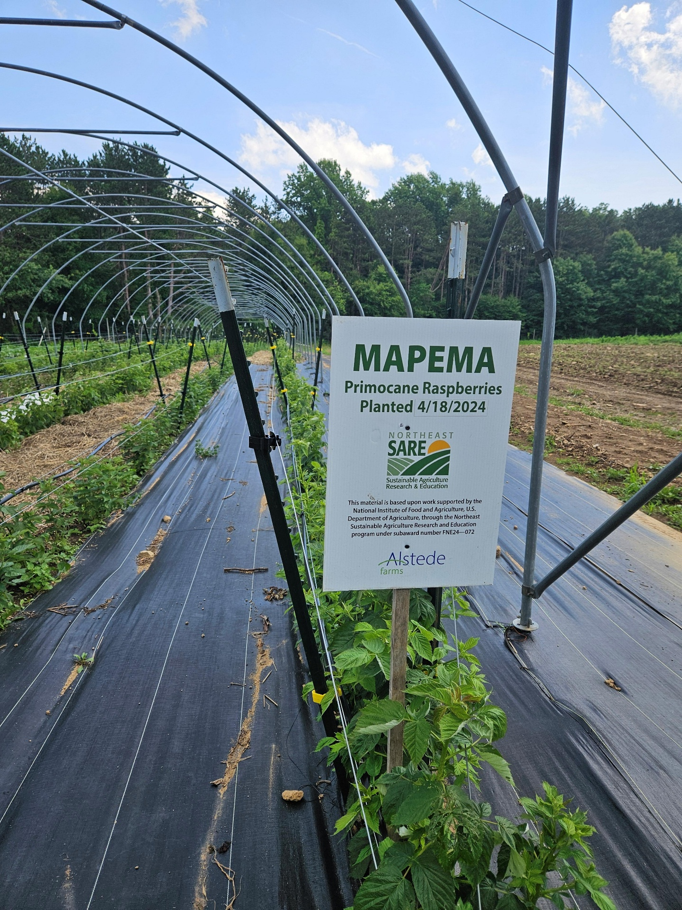
Project Timeline

Slide 5
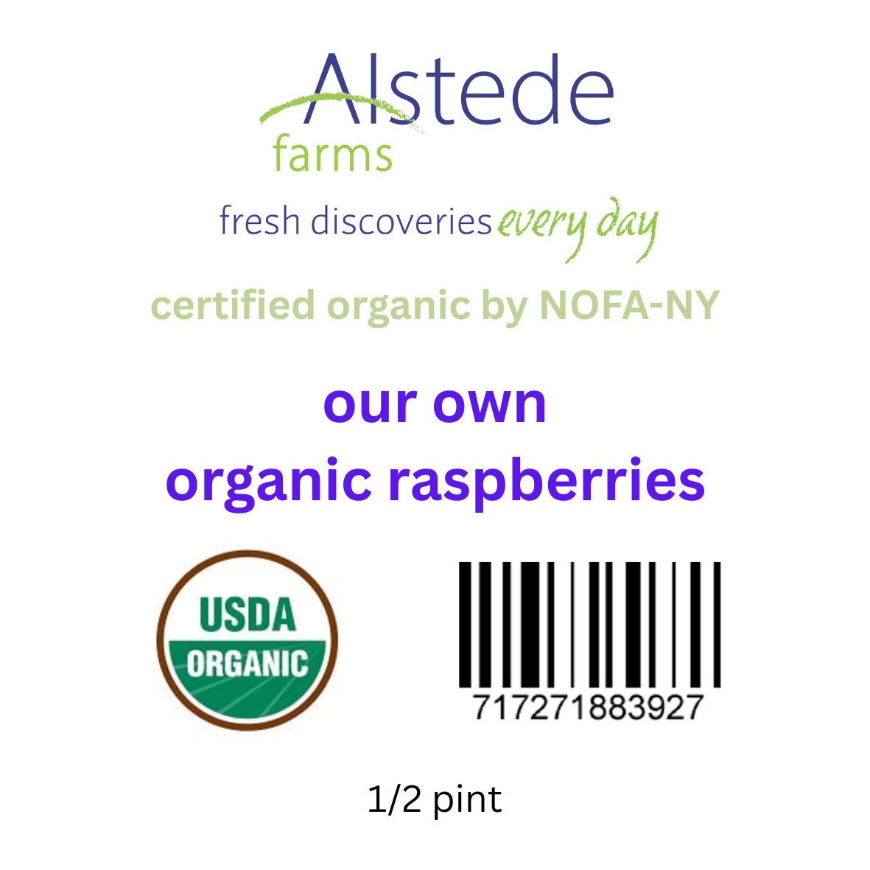
Integrated raspberries into existing certification
Year 1, farming organically, not able to utilize on marketing materials
Year 2, can officially market as certified organic
All inputs must be organic – straw produced by us without chemicals, municipal leaves approved in OSP, landscape fabric approved for multi-year use
Certifying agency must approve every marketing material, including label prior to sales
Annual inspections and audits
POS must notate organic products as organic when ringing customers up
Organic Compliance

Slide 6
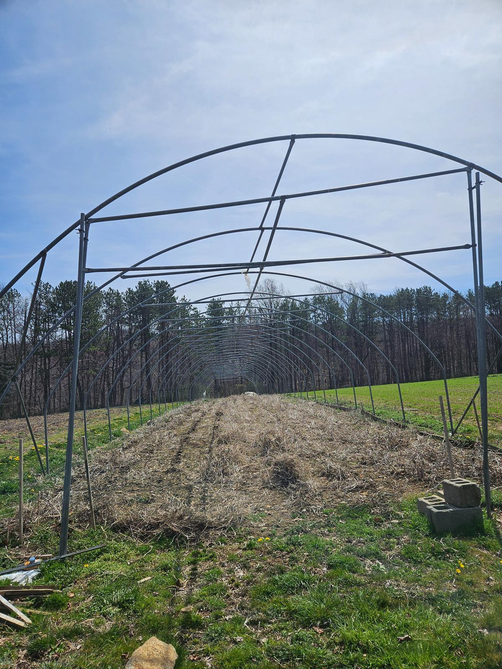
Pre-Plant Considerations:
Soil Test
Apply Sulfur to lower pH
(was at 7.2, want at 6.0-6.5)
Rototil beds

Slide 7
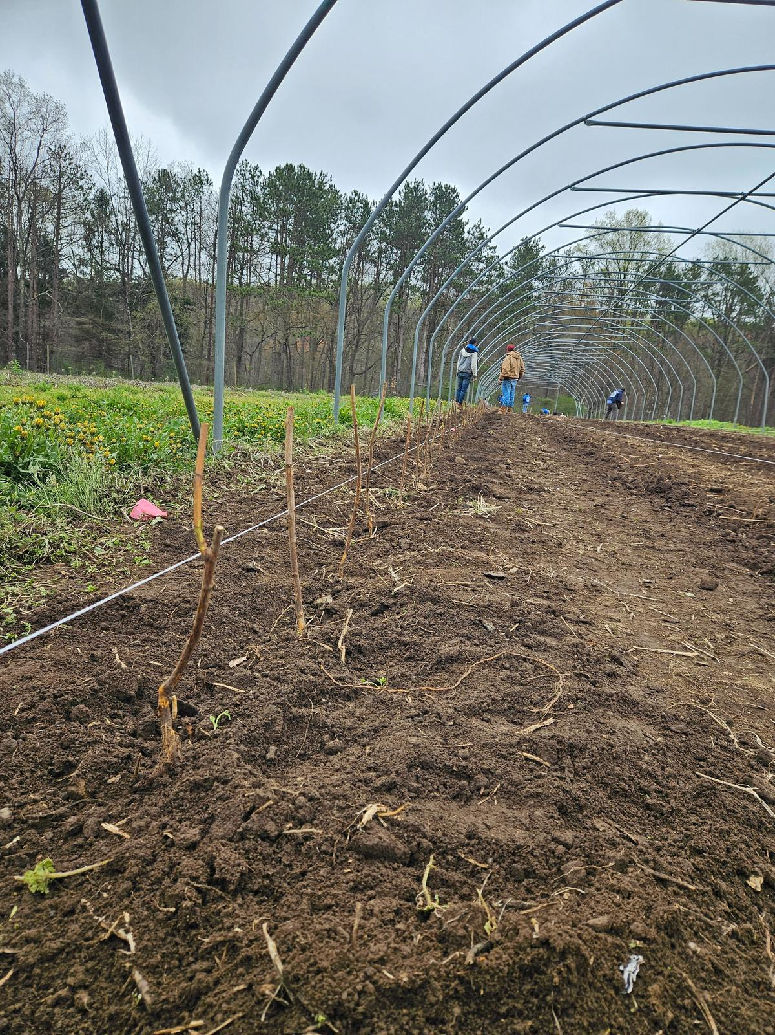
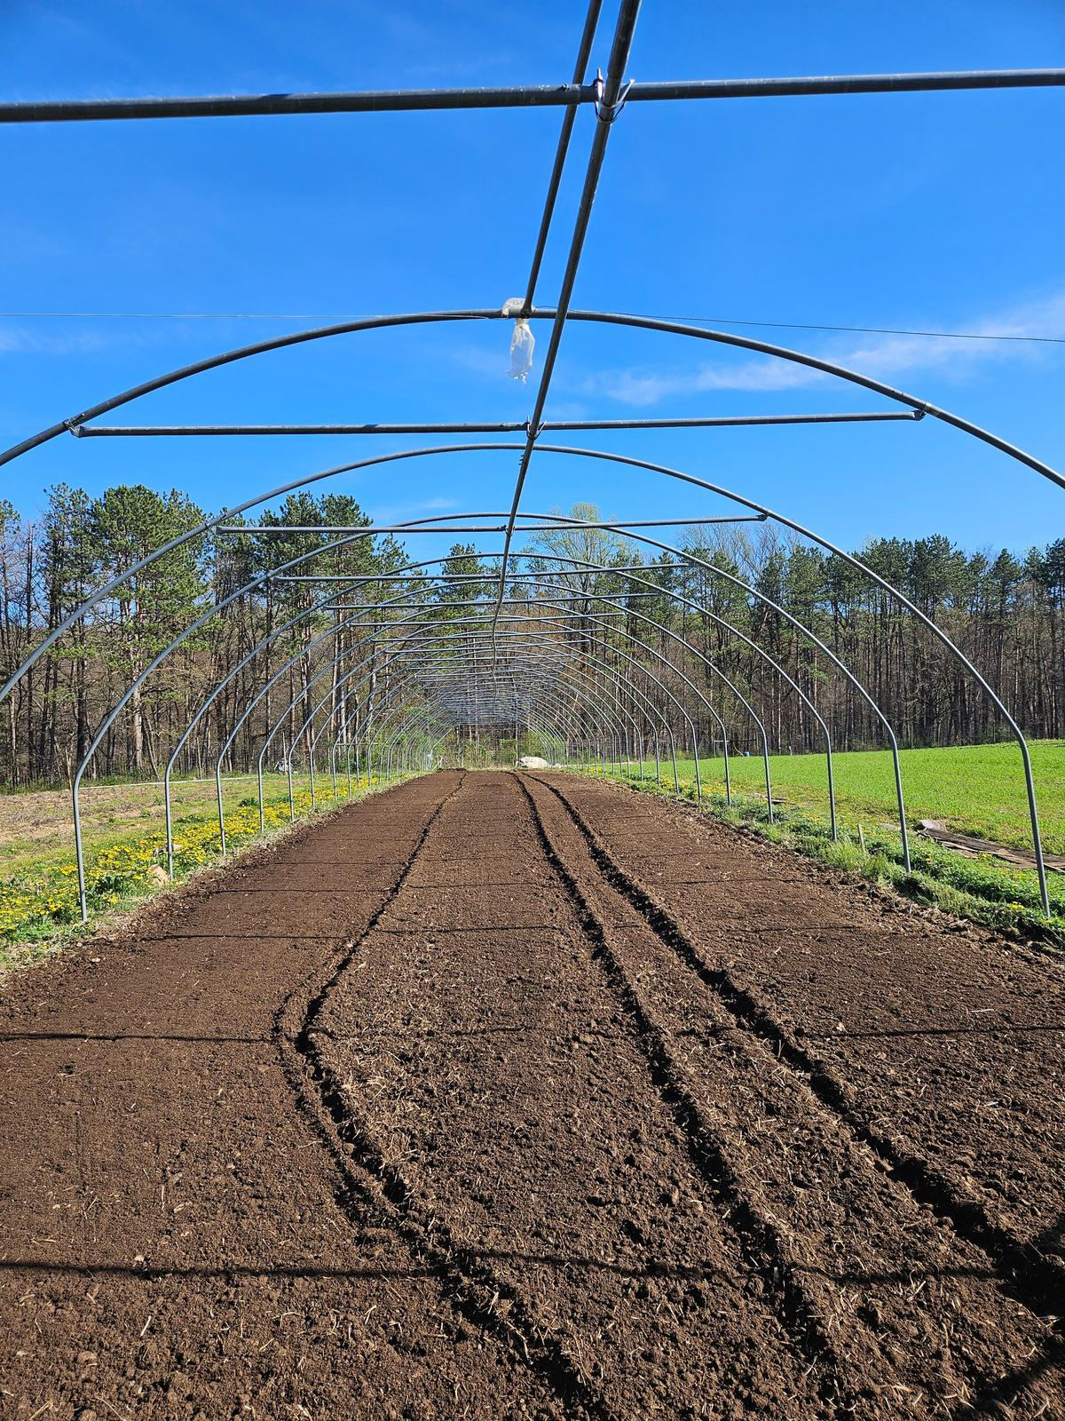
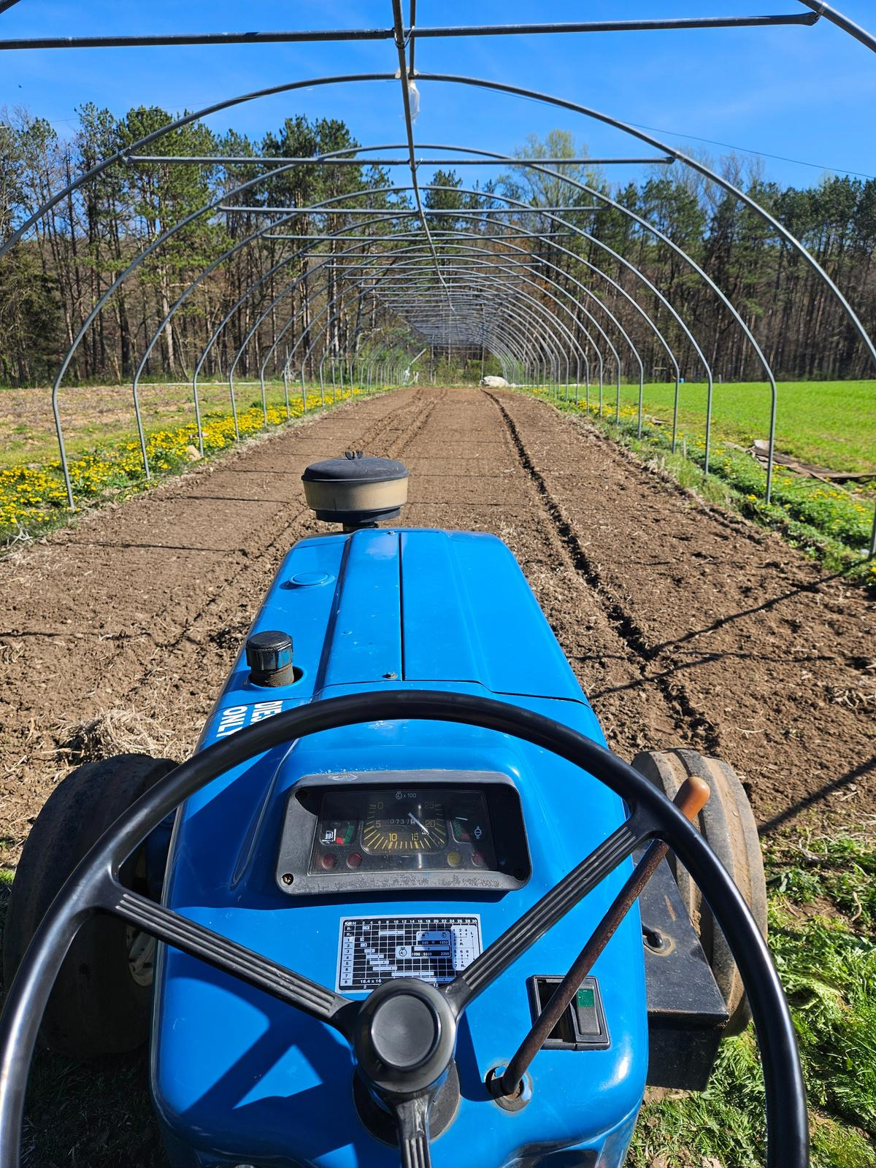
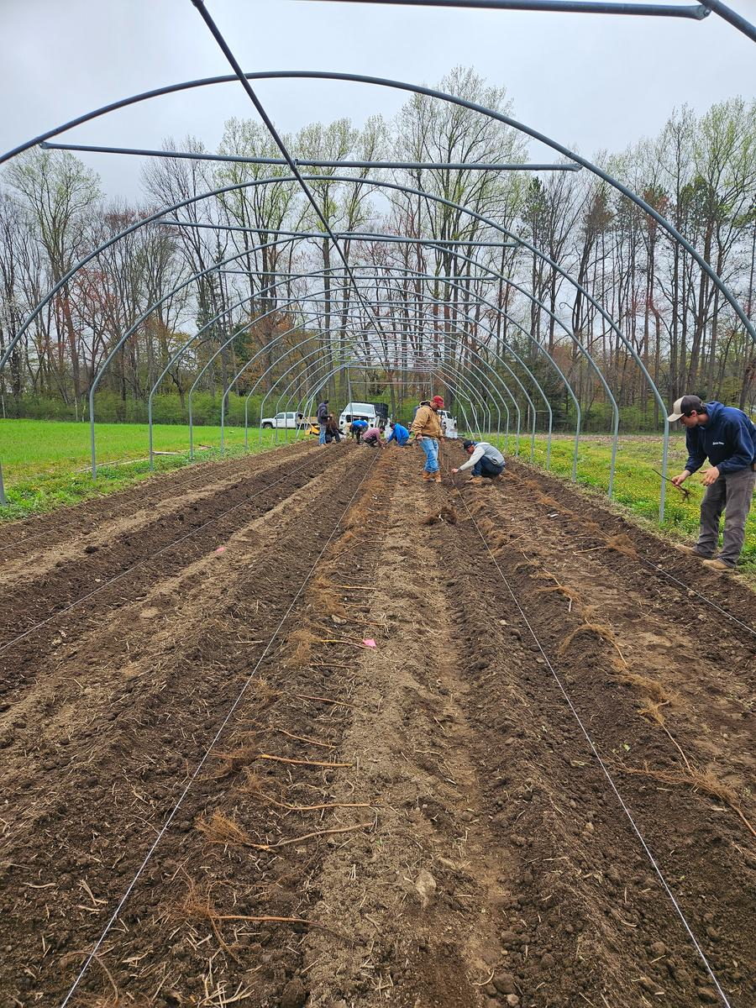
Planting Canes
Preparing High Tunnel
667 plants, 18" apart

Slide 8
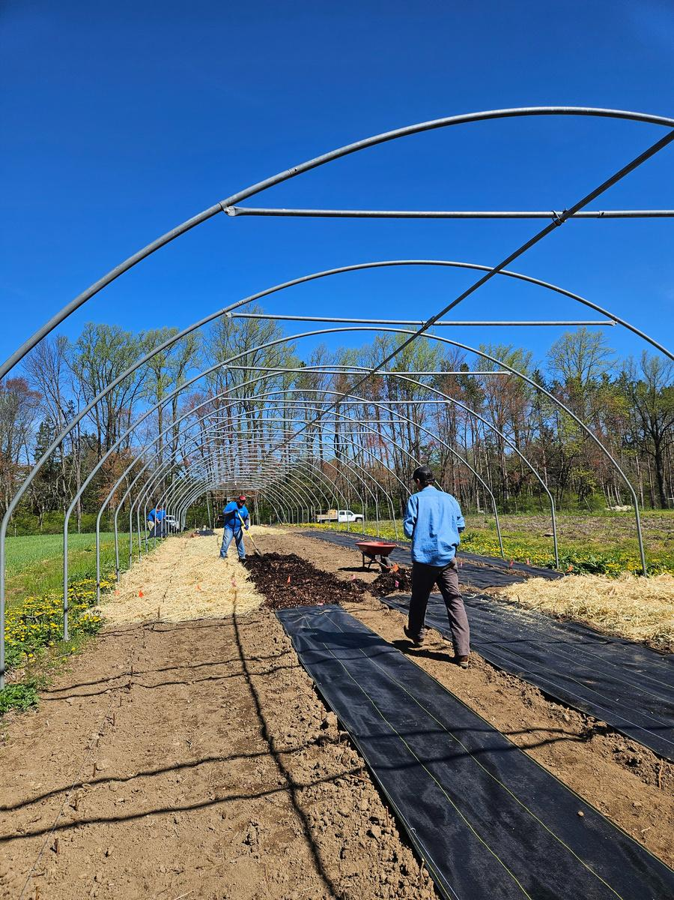
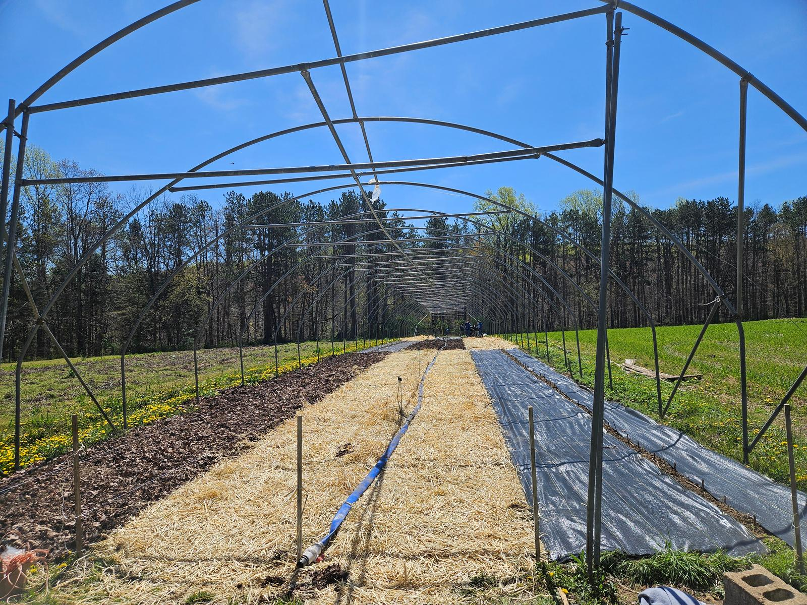
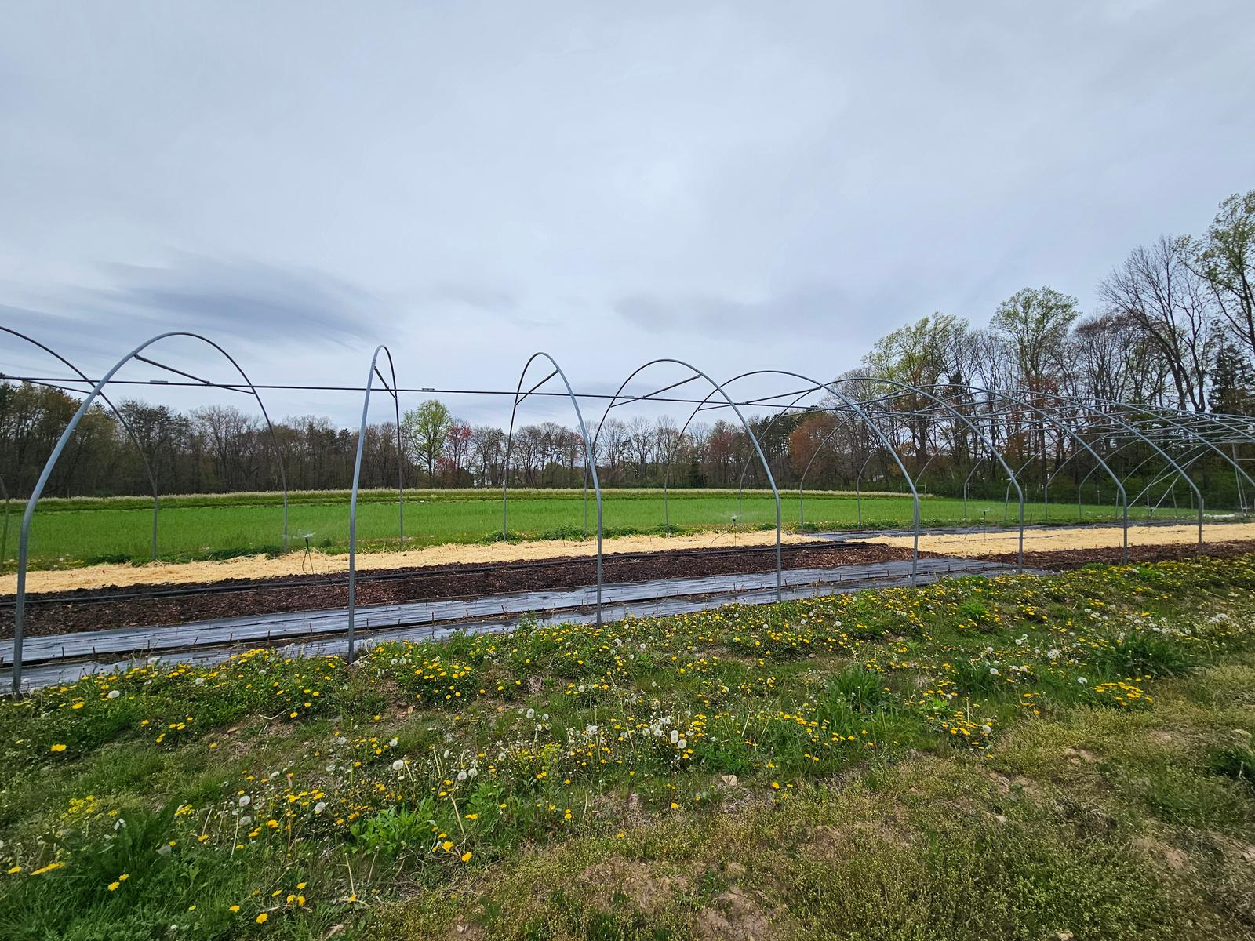
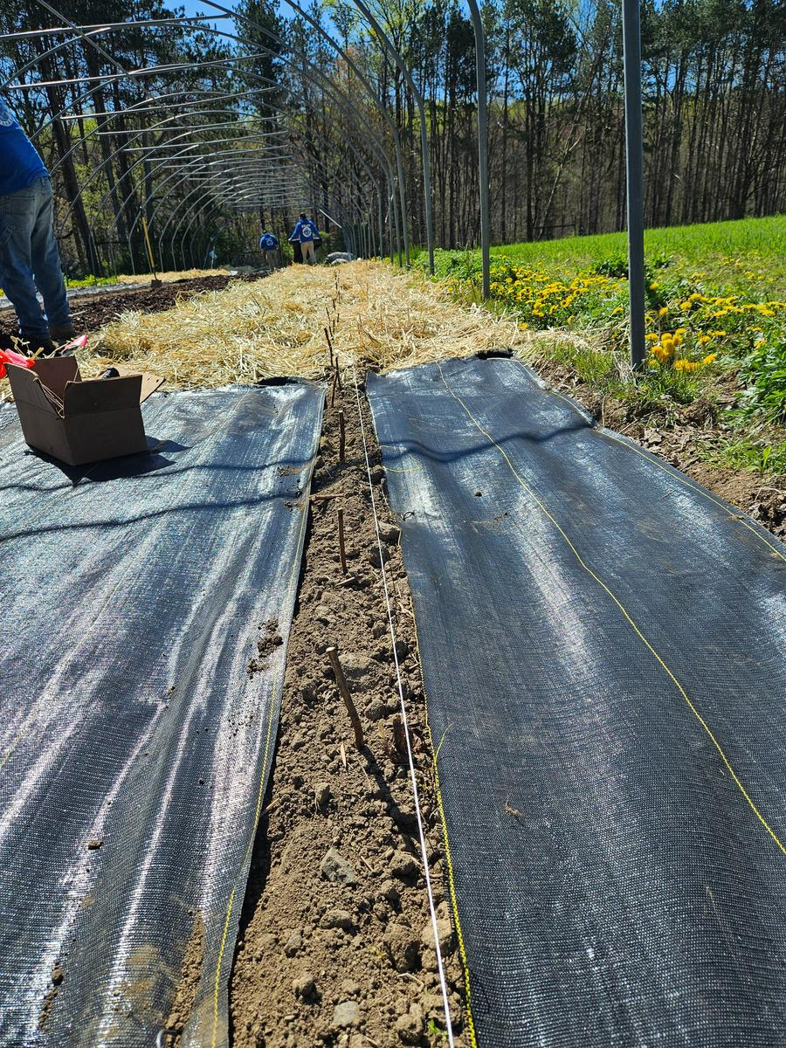
Ground Covers
Applied Fabric, Leaves, and Straw to the tunnel in 60 foot sections
Each was moved around the tunnel to more accurately measure effects
Landscape fabric was applied 1 layer thick with 4 inches around plants for growth
Straw was applied 3-4 inches thick and went right up to the plants
Leaves were applied 2-3 inches thick and went right up to the plants

Slide 9
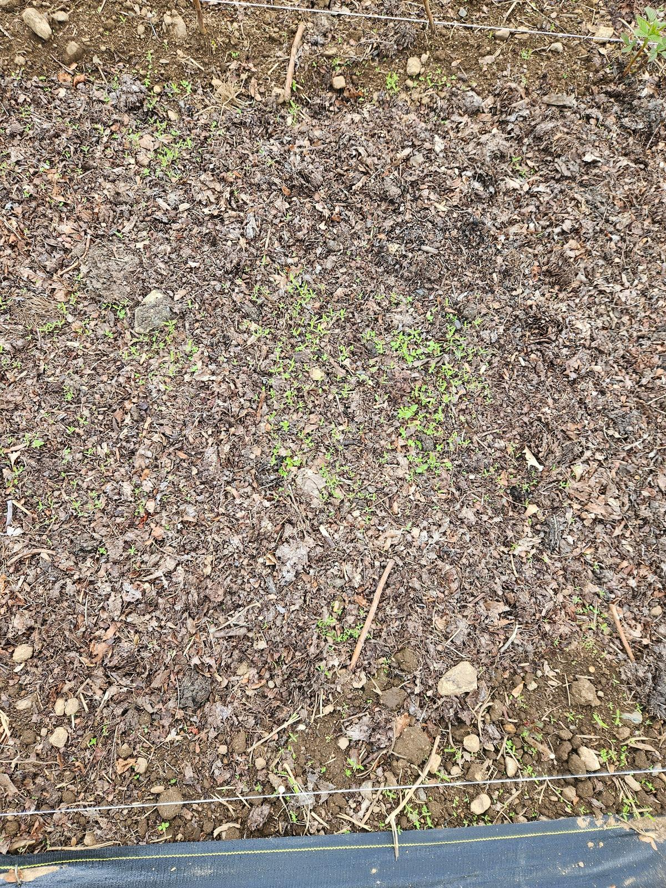
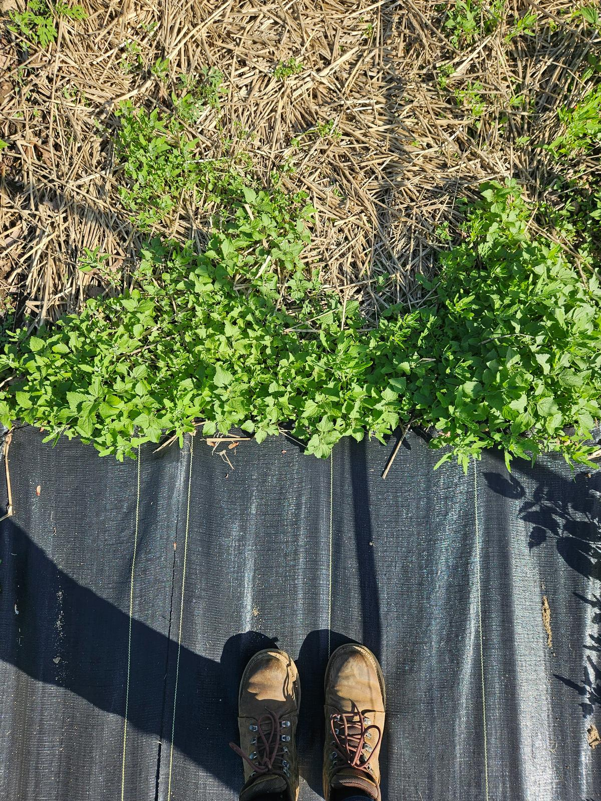
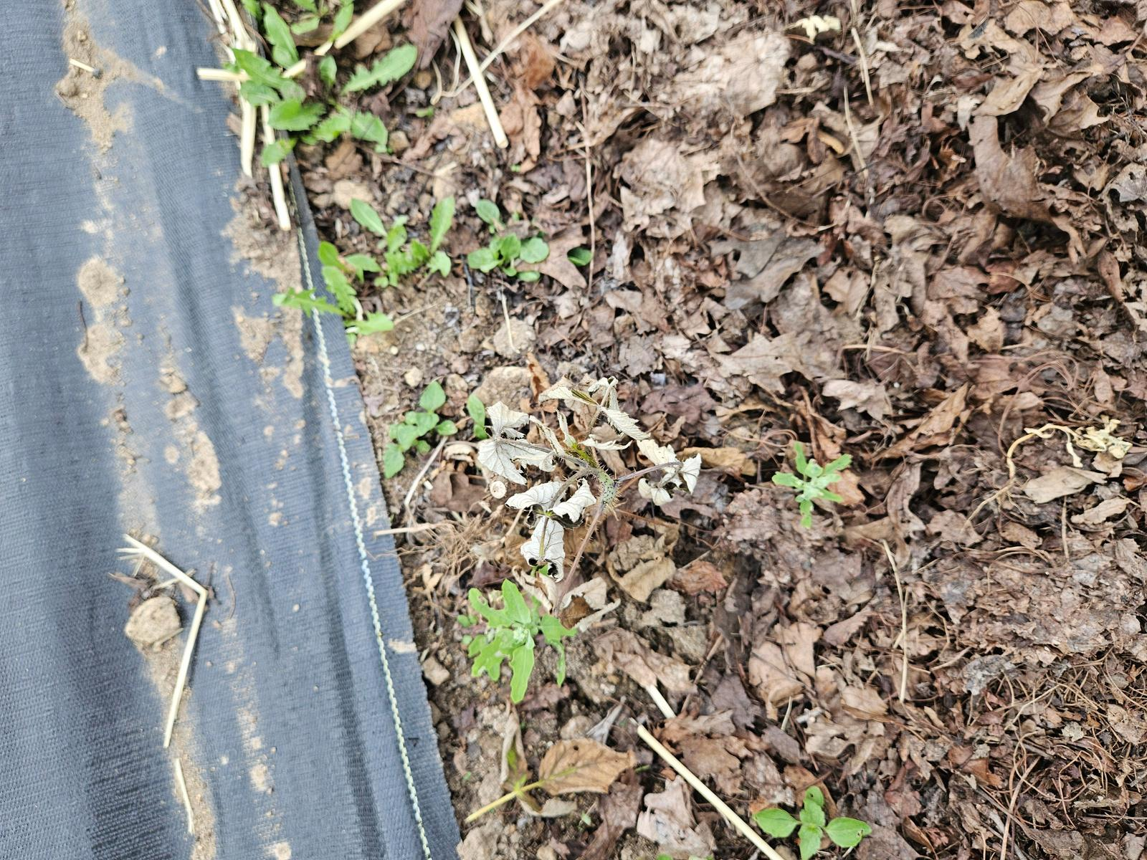
Weed Control Efficacy

Slide 10
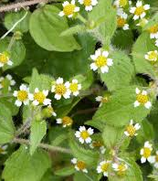
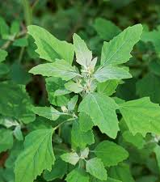
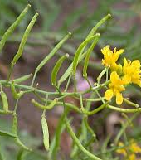
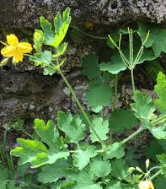
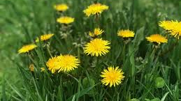
Common Weeds in the Tunnel
White goosefoot - leaves, landscape fabric
Shaggy soldier - leaves, straw
** Heavy in Mid Summer **
Dandelions- outside of tunnel, leaves and straw
Yellow cress - outside of tunnel
Greater celandine - edges of tunnel

Slide 11
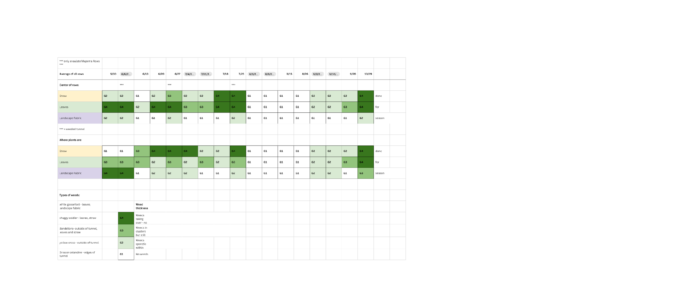
Weed
Thickness

Slide 12
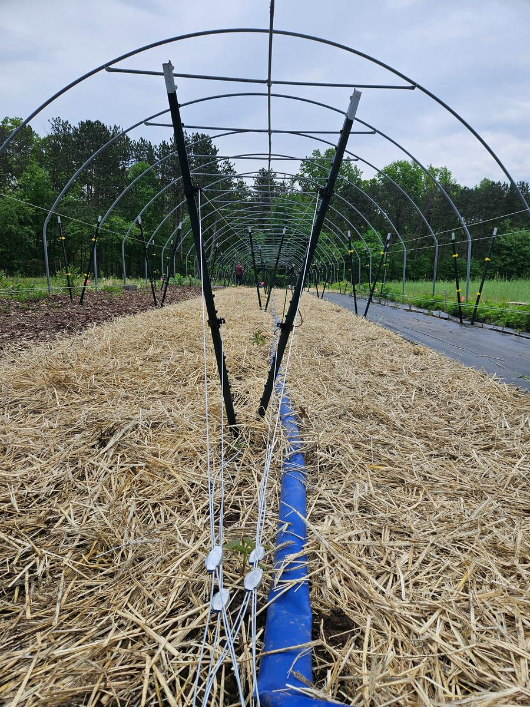
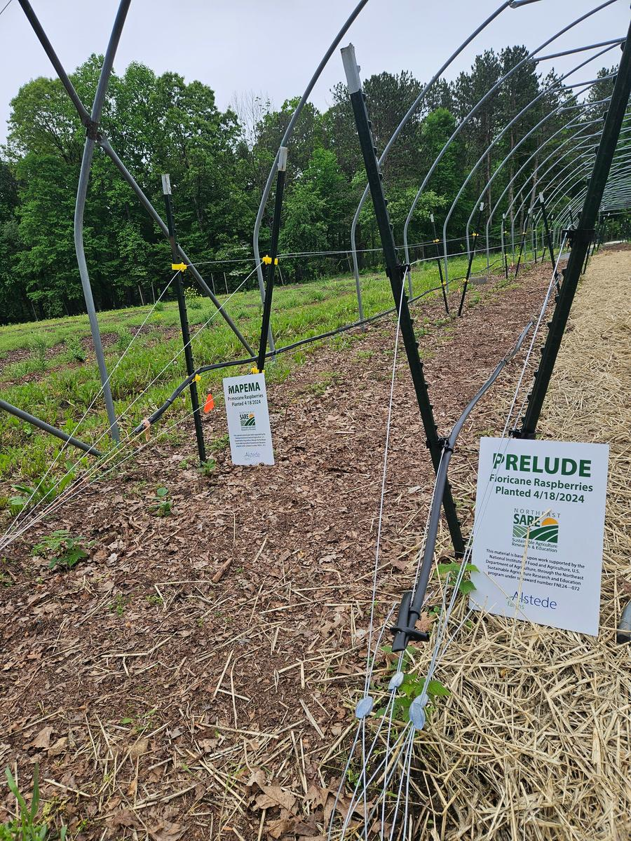
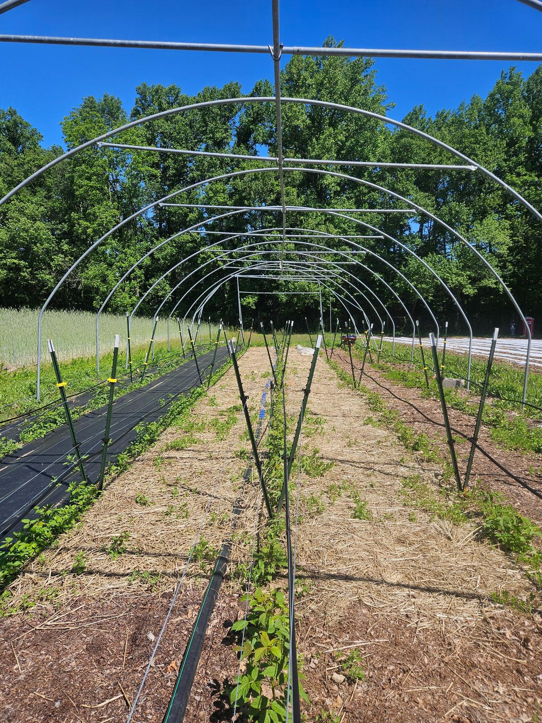
Trellising/Irrigation
Utilized V Trellis System to maximize walking space
one wire at 20" one wire at 40"
later added one more wire at 10" to catch growing canes
Ran drip irrigation, one line in each row
Connected to irrigation pump and fertilizer injector – 3-0-3 liquid fertilizer
Watered with 4lb of N through trickle each week

Slide 13
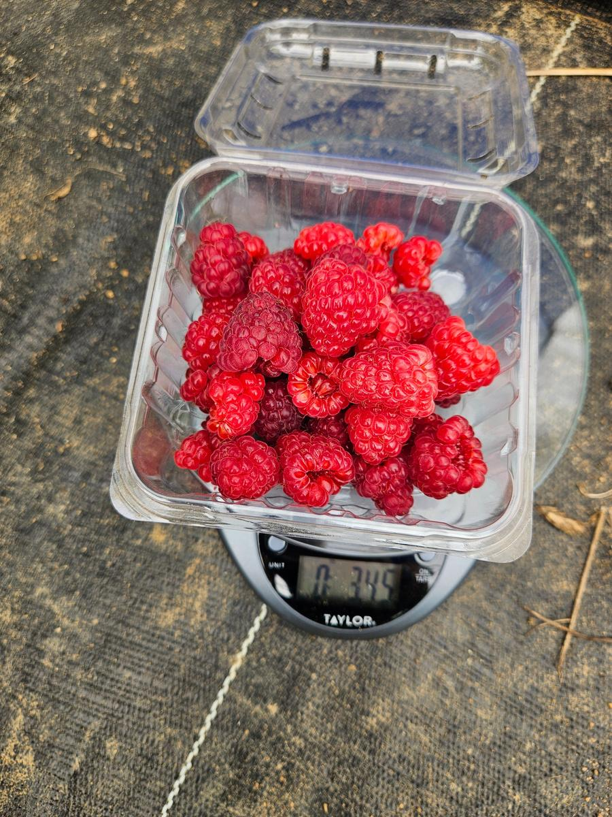
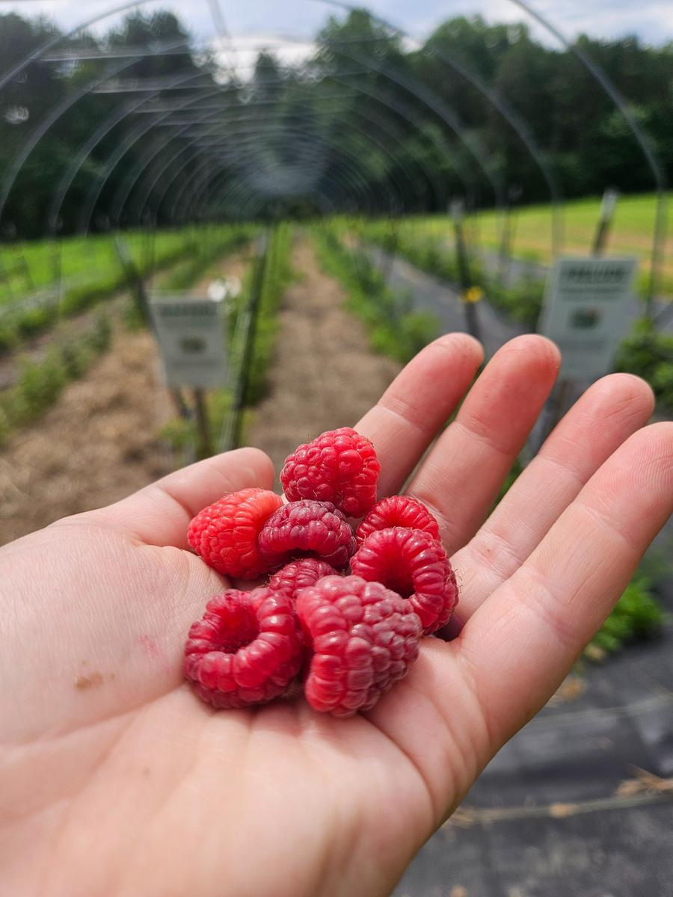
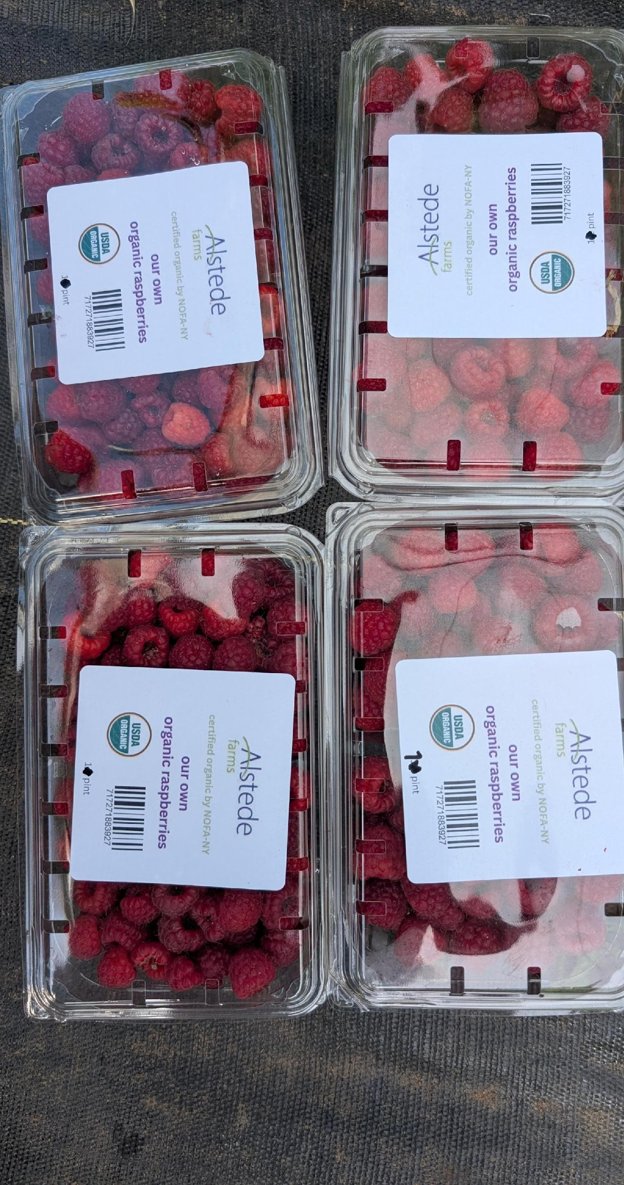

Harvest Season
Berry harvests were measured in 20' sections year 1
this was to maximize efficiency and have more accurate counts
Year 2 we counted in pints due to the large amount of berries
measured by weight - low yields, not filling pints until August
utilized ½ pint containers for retailing

Slide 14
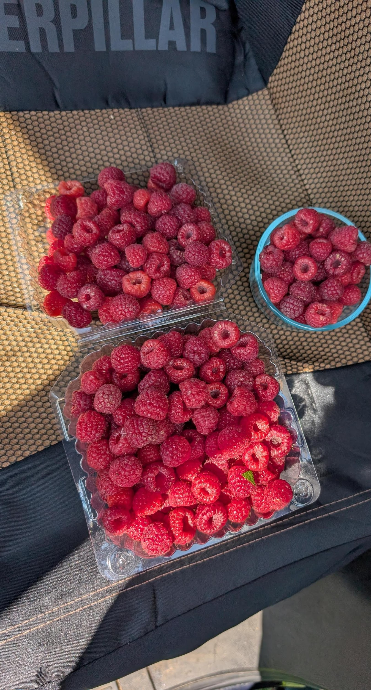
Harvest Season
Year 2:
measured by container - high yields starting in June
moved to pint sized containers for retailing due to demand and yields
Were able to gain a higher price due to the organic label
Outer rows performed better earlier in the year
Middle row was strong mid season

Slide 15
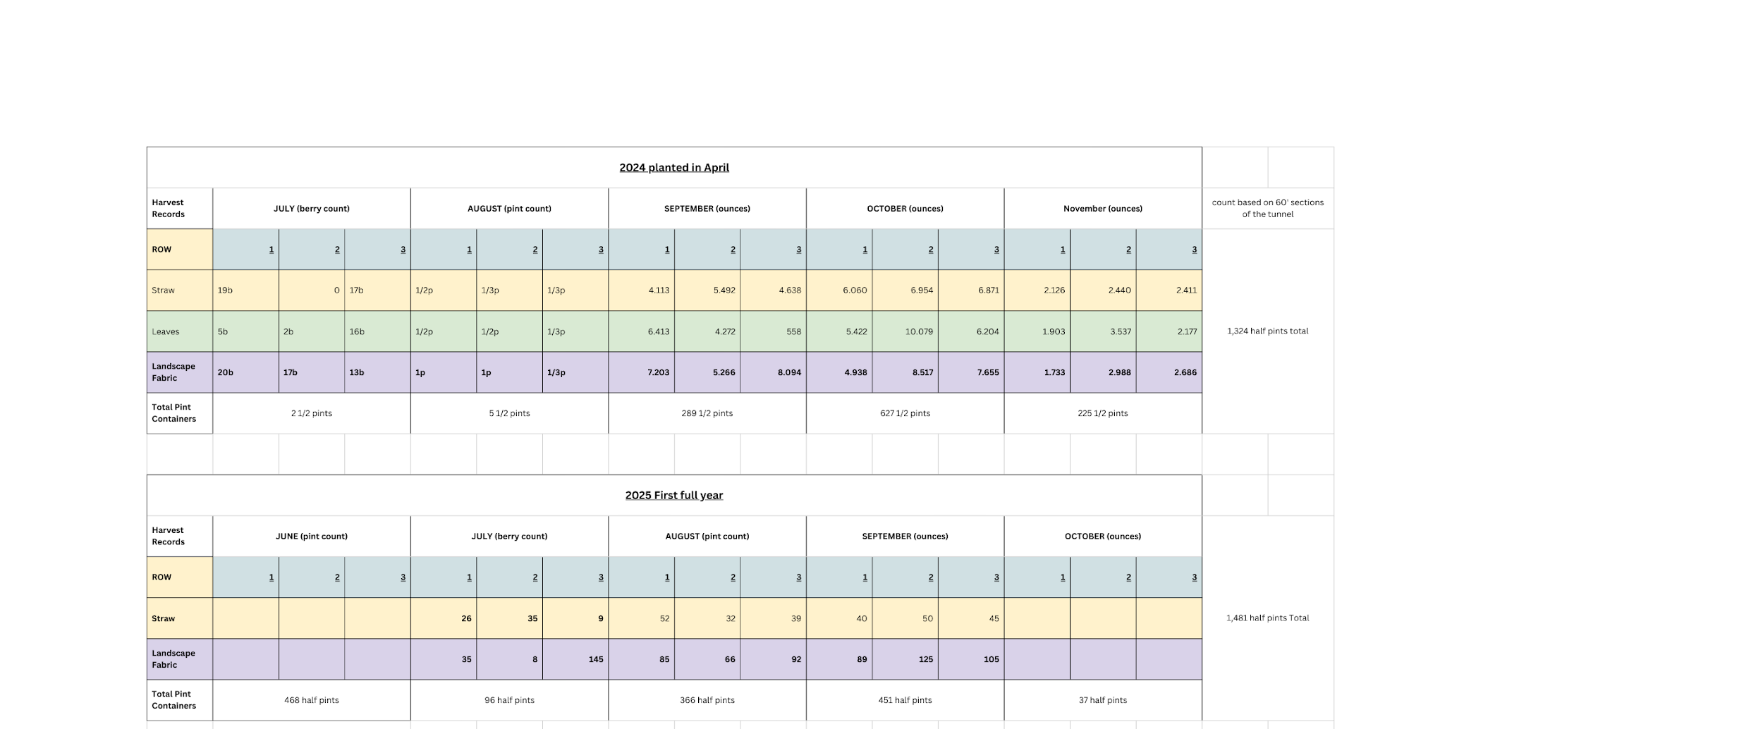
Harvest Records

Slide 16
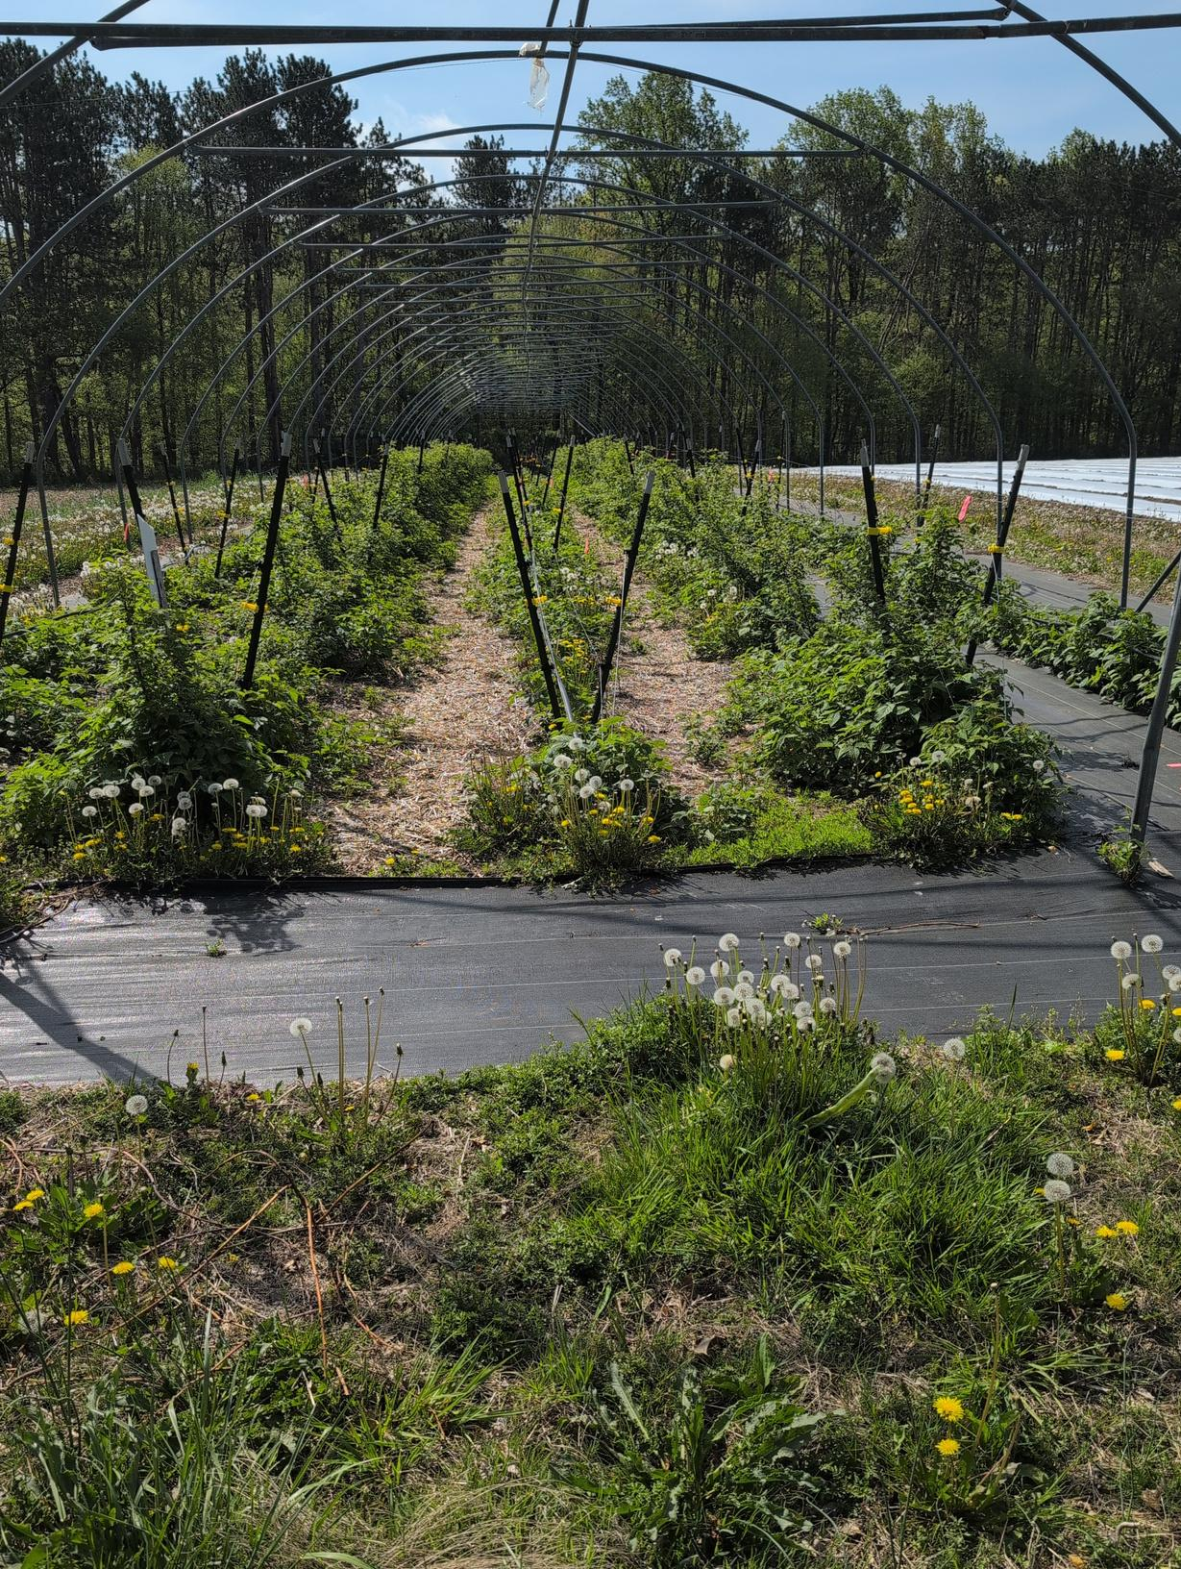
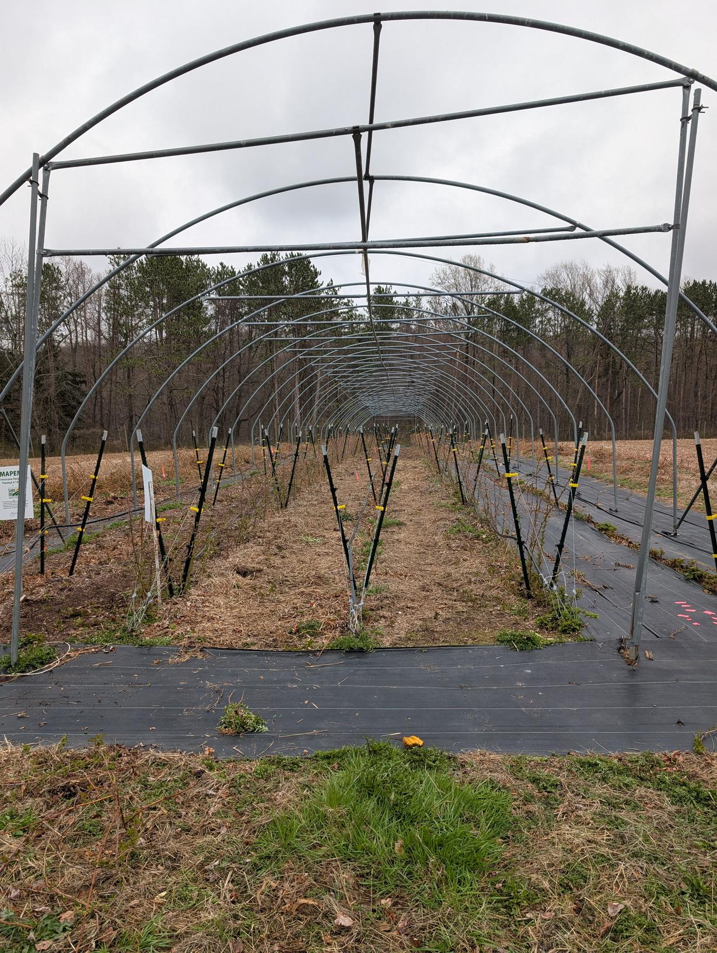
Winter Care 2024-25
Uncovered Tunnel in November after last harvest
Canes were not fully dormant until February
Weed Whacked Mapema down in March, hand pruned Prelude
No active weed control
April 2025
November 2024

Slide 17
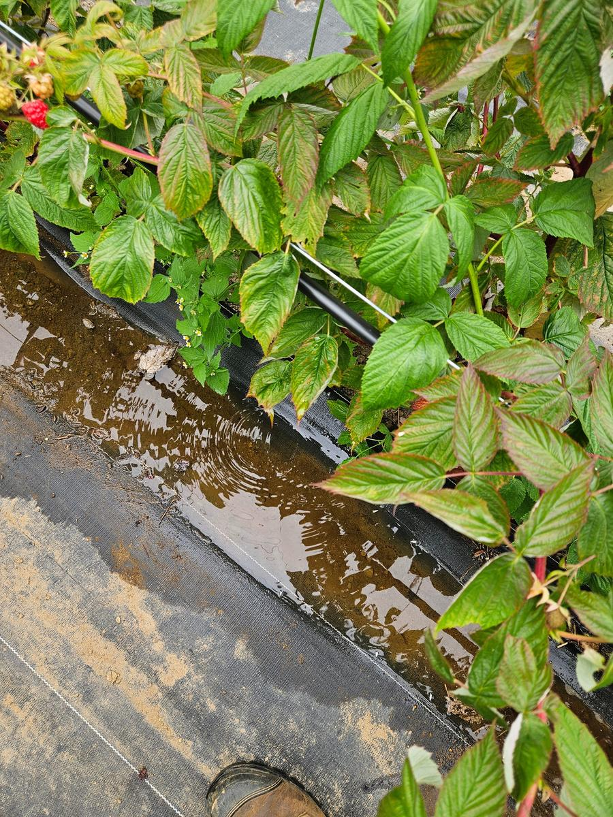
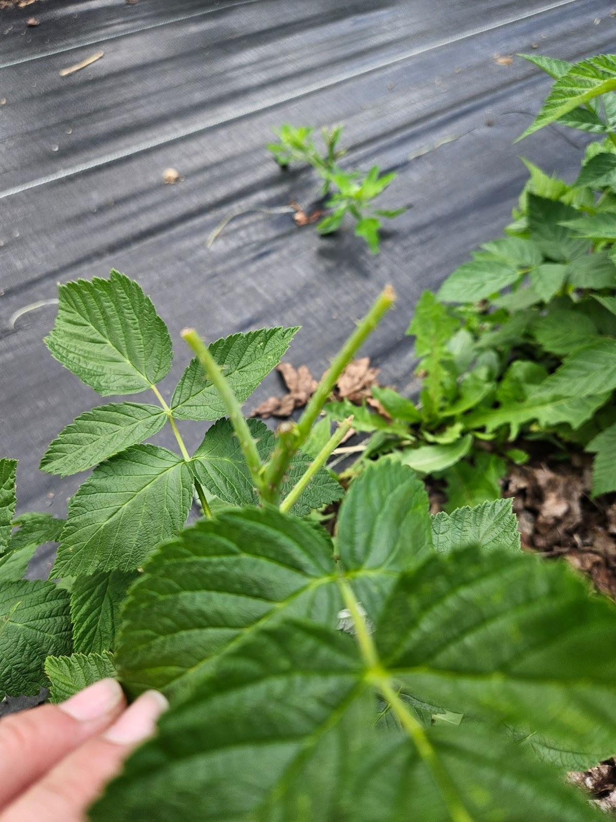
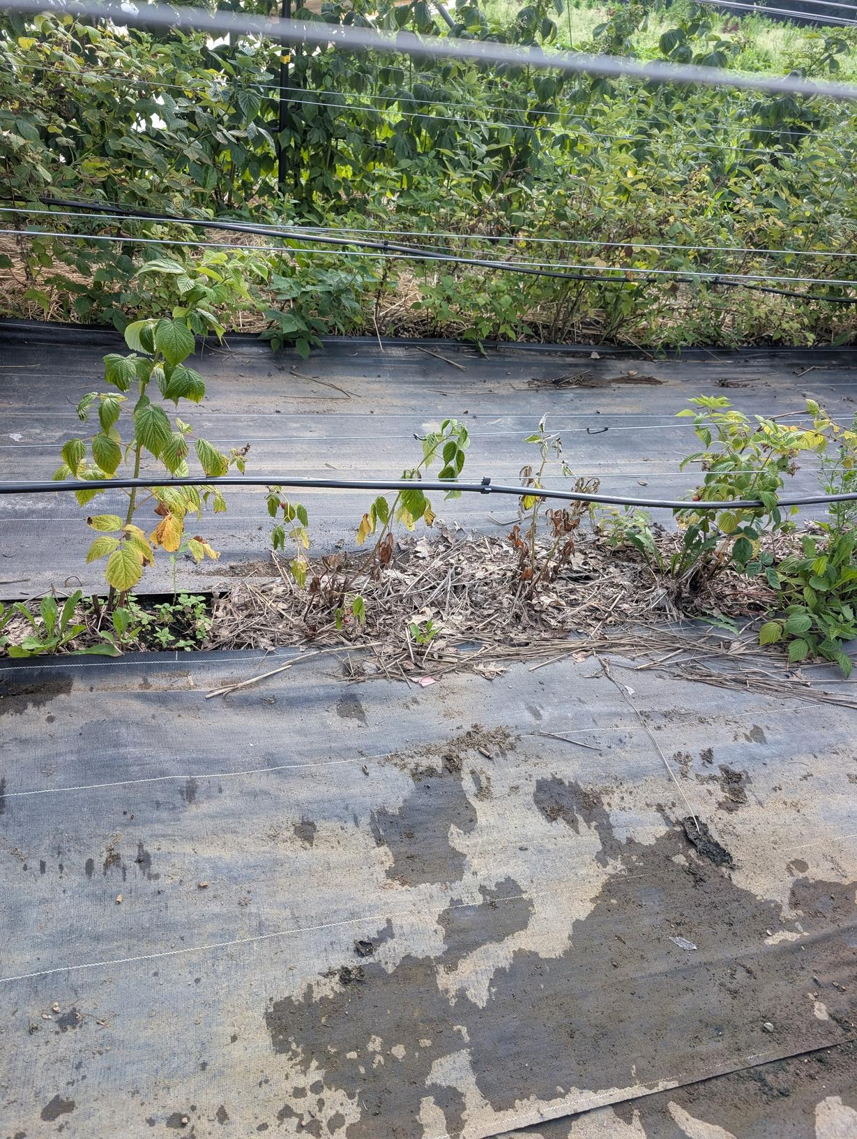
Challenges
End row irrigation issues
Excess water, fungal pressure
Deer Damage

Slide 18
Research Results
01
02
03
While organic production has less control methods for pests and diseases, the overall production in a controlled environment makes for a beautiful raspberry crop that rivals the conventional fields
Retail opportunities for organic fruit exist in the local area and we are able to get a premium for fresh raspberries
Landscape fabric ultimately takes care of the most weeds, reduces labor, and does not have any significant impact on soil health

Slide 19
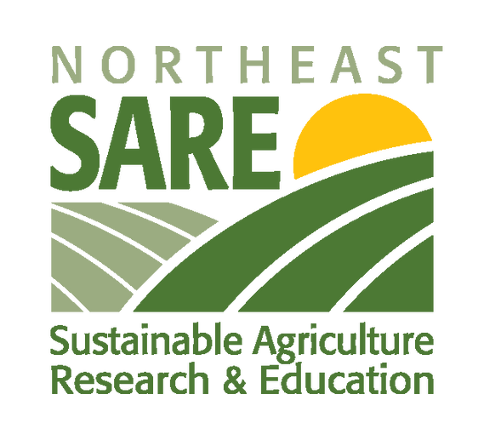
Grants with SARE
Fantastic Staff
Relatively Easy Application Process
Great Communication
Easy Invoicing/Prompt Payment

Slide 20
Any Questions?
Rebekah Alstede Modery
rebekah@alstedefarms.com
908-895-8543
Colin Manning
colin@alstedefarms.com
"This material is based upon work supported by the National Institute of Food and Agriculture, U.S. Department of Agriculture, through the Northeast Sustainable Agriculture Research and Education program under subaward number FNE24-072

