Slide 1
Seasonal High Tunnels 101
Joe Rowland

Slide 2
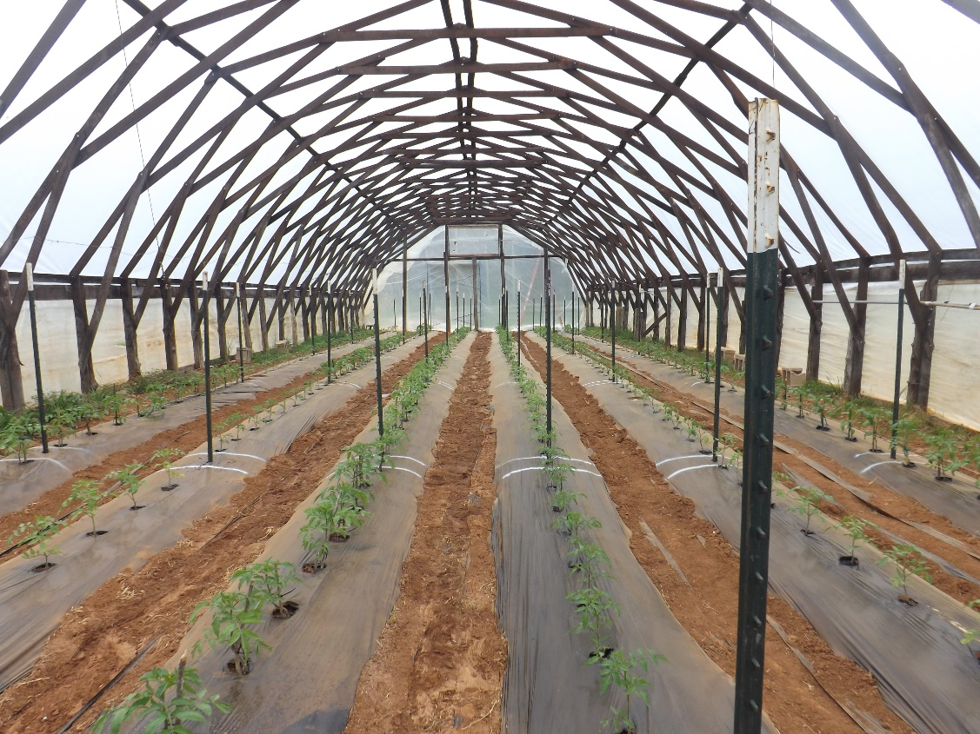
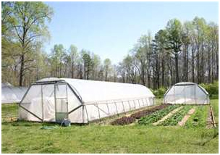
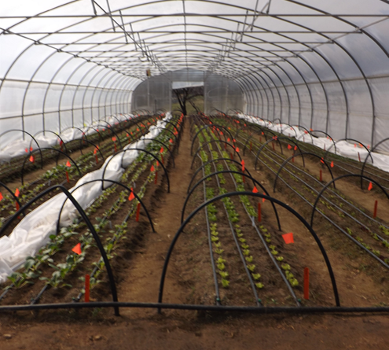
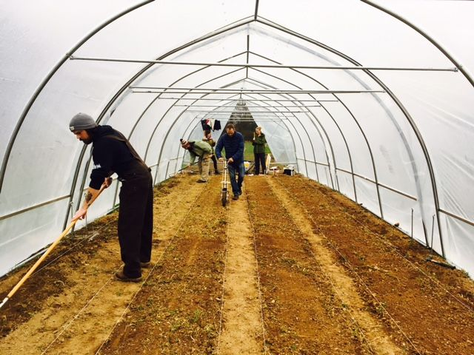
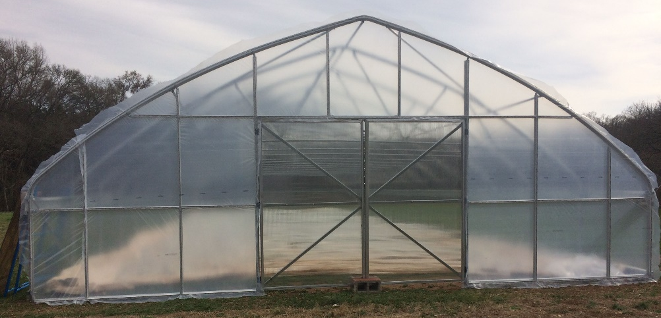
What is a high tunnel?

Slide 3
Establishing a Need
Establishing a need helps develop what type of high tunnel and what specifications are needed during the purchasing and installation process
Avoiding vacant tunnels

Slide 4
Benefits to high tunnel production
Season Extension
Early spring, late fall, and winter production
Clean fruit/plants
Protected from elements
Reduced disease pressure
Controlled growing environment
Slower to freeze, faster to thaw
4-6 degrees protection, I assume 4!
Bigger, cleaner, better quality, earlier/later in season

Slide 5
Season Extension
What is the need?
Crops
Benefits
Higher profit margins
Capturing customers early in season
Helps in a competitive marketplace
High fruit quality
Capturing shoulder season markets
Tomato
Pepper
Cucumber
Lettuce
Greens/Spinach
Many others

Slide 6
Exotic Crops
Crops that are unable to grow in the field
Niche market
Ginger
Turmeric
Berries, small fruits
Special needs: soil fertilizer inputs, shade cloth, irrigation, seed prep and post harvest

Slide 7
Winter Production
Year-round harvests
Possible in all parts of NC/SC
Great for restaurants, year-round farmers markets/CSAs
Can only produce cool season crops
Limiting factors: day length, soil temperature, viable market
Special Considerations:
Management needs
Double plastic layer/blower
Row Covers
Temperature/humidity monitoring
Crop variety selection
Extending the harvest

Slide 8
Organic Production
Reduced dependence on pesticides
Covered space = low disease
Spring/Winter season extension = less pests
High fruit quality = less post harvest needs and longer shelf life
Clemson Student Organic Farm Clemson, SC

Slide 9
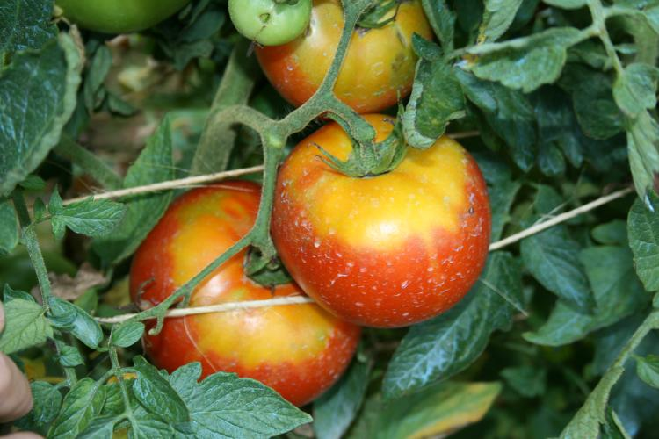
Drawbacks to high tunnel production
Pollinator Exclusion
Temperature Extremes
Summer Heat
Humidity
Soil Health
Maintenance Inputs
Perimeter Weed Management
Timothy Coolong, University of Kentucky

Slide 10
Drawbacks
Runoff – Water diverted from roof can cause drainage issues
Shading – High tunnel will cast shade potential changing field planting capacities
Grading – Top soil movement, sediment runoff
Placement can create odd shaped fields, difficult to plant in
Cost – expensive to construct and continually manage
Worrying about the structure during extreme weather events

Slide 11
Cost of a High Tunnel
Size, type, truss system!
Price Estimate for 30 x 72
Low end $10,000
High End $20,000
Atlas Budget Plus →

Slide 12
Cost Continued
Many outside cost not included in original purchase of kit
Grading
Driving sidewall post (contracting or renting equipment)
Hired labor or contracting for installation
Drills, Impact Drivers, Chop Saw, Reciprocating Saw, Drill Bits, Nut Drivers, Ratchets
Materials for endwalls
Doors

Slide 13
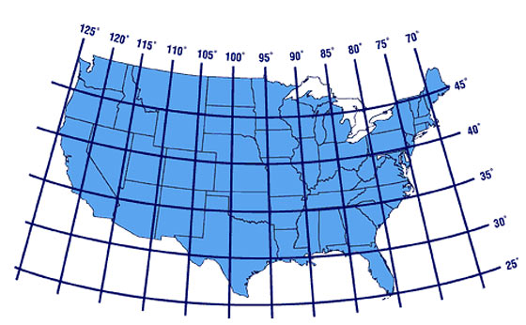
E/W
N/S

Slide 14
Site Selection
Site selection is more important than orientation!!!
Maximize the morning sun
Why? Warm up sooner, evaporate moisture build up
Afternoon Sun
Ventilation
Irrigation Access
Level Ground
Lomax Incubator Farm Concord, NC

Slide 15
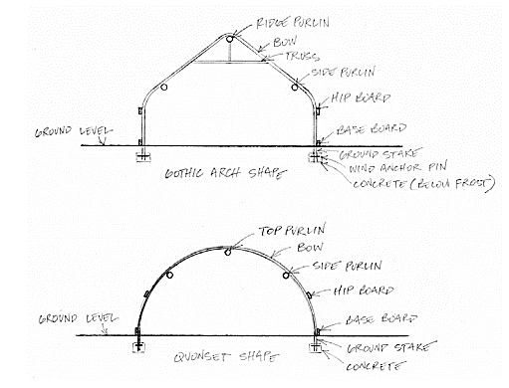

Slide 16
Building Materials
Metal tubing
Diameter ranging between ¾” to 2 ¾”
Chain link top rail
Square and round tubing
Baseboards and Hip Boards
Metal, treated wood, untreated wood
Concrete
End walls
Metal, treated wood, untreated wood
Cabin Branch Organic Farm Columbia, SC

Slide 17
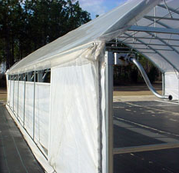
Side Walls:
Drop Down
Roll Up
**Tunnel Height
Dancing Pines Farm
Efland, NC
www.growingformarket.com
Notes:
Side walls. All the differences.

Slide 18
Height
Gothic Tunnels are typically taller than other types
Additional height may require gable vents
Taller side walls = taller tunnel height
Roof pitch will impact height
Snow
Access to truss structure
Sierra Nevada Brewing Company Gardens Mills River, NC

Slide 19
Dancing Pines Farms Efland, NC
Puckett Greenhouses – Quonset High Tunnel

Slide 20
Bow Spacing
Typical bow spacing is between 4’ and 6’
This also indicates the spacing on the side post
Decisions on bow spacing depends on production requirements, environmental concerns, and tunnel specs
Are you accessing the truss system during production? (trellising, hanging baskets, etc…)
Are snow load and winds a concern?
What is the diameter/stability of steel tubing used?
Closer bow spacing increases the strength of the tunnel to withstand more weight, both from outside pressure and hanging weight inside

Slide 21
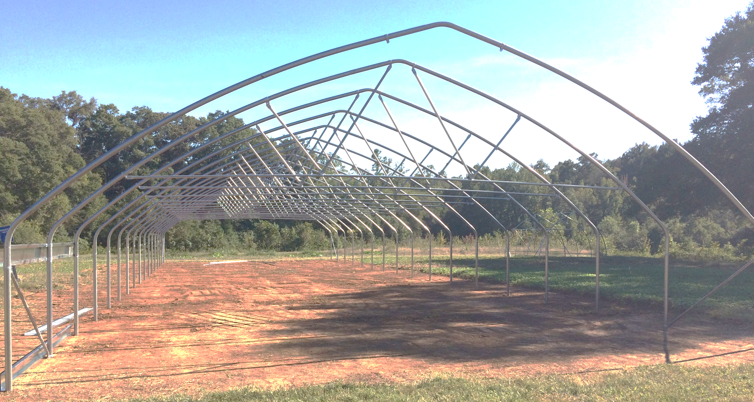
6’
Lomax Incubator Farm Concord, NC

Slide 22
Truss Systems
Installing a truss system is usually an “upgrade” from basic high tunnel kits
Materials can be purchased or made to install to an existing tunnel
What are the benefits?
Lowers the cross brace for accessibility to connect trellis systems
Increases strength
Decreases damage risk from snow, ice and wind
Trusses can be installed on every bow OR at equal intervals throughout the tunnel

Slide 23
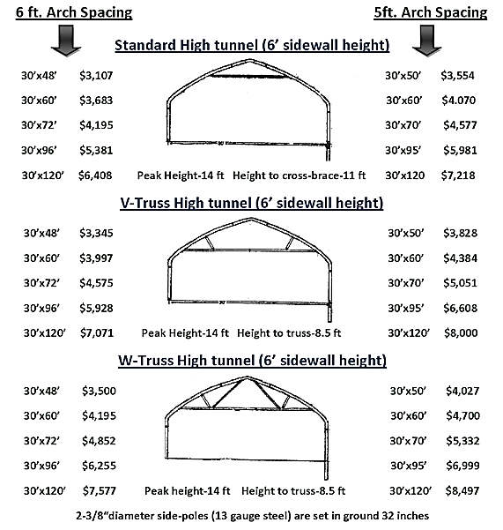
www.zimmermanhightunnels.com

Slide 24
Plastic
Most common is a single layer of plastic
Double Layer increases heat retention and reduces damage risk
Inflation works with two layers
Requires a blower and electricity
Aged plastic has reduced light transmission
Plant stress
Reduced heating capacity
6 mil 4 year greenhouse plastic (UV Stable)
6 mil Infrared Anti-condensate plastic
Bubble Wrap Type
Shade cloth
Note: Most plastics should not touch PVC!

Slide 25
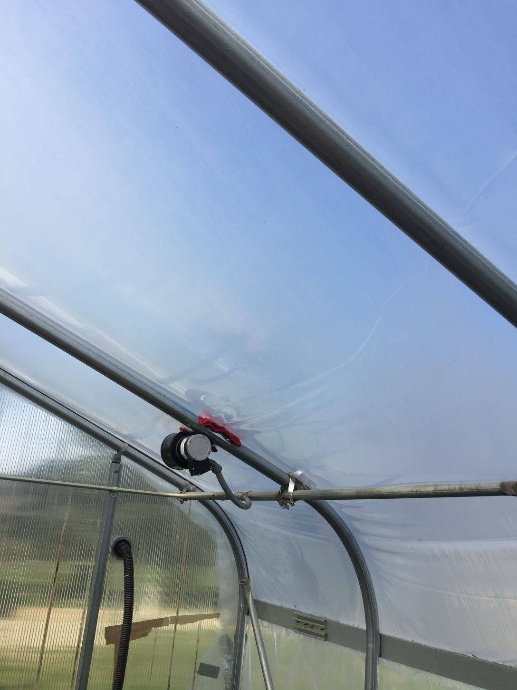
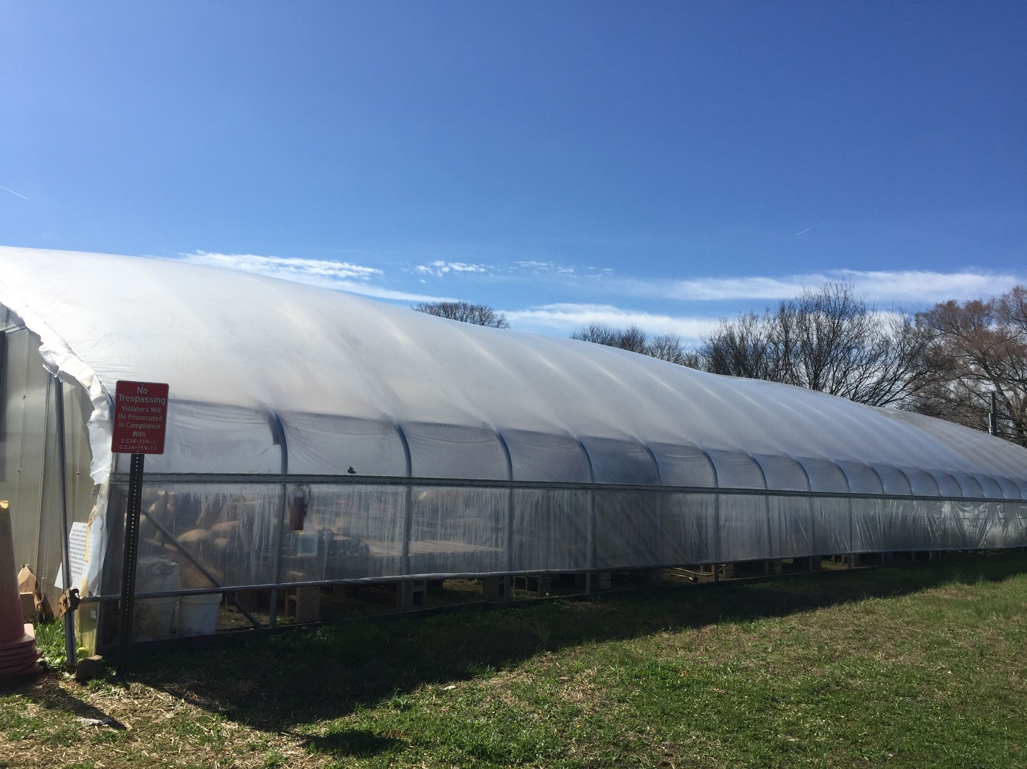
Lomax Incubator Farm Concord, NC
Double plastic layer on greenhouse

Slide 26
Wiggle Wire
Chanel used to secure plastic
Plastic is held in with curved wire that “wiggles” into place
Can be used on wood or metal
Furring strips are also common
www.growerssupply.com

Slide 27
Endwalls
Many kits do not include material to frame out endwalls
Framed endwalls are considered an upgrade from basic kits
Framing provides strength and increase heat retention
Framing also provides a structure to hang doors, vents and fans if desired
Doors – range in size. Provide openings for tractors and cross ventilation
Multiple door style options
Vents are usually installed near the peak on both ends
Fans – used as needed for increased ventilation

Slide 28
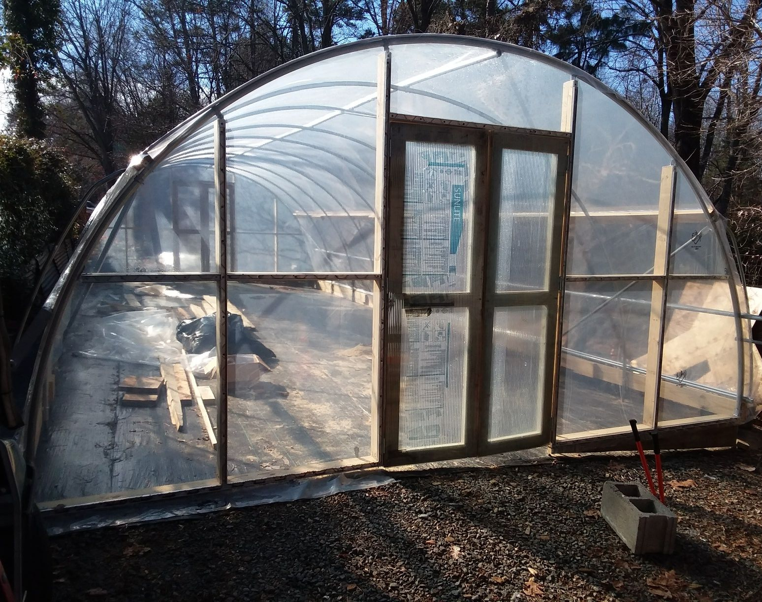
Lomax Incubator Farm Concord, NC UNC Charlotte Botanical Garden Charlotte, NC

Slide 29
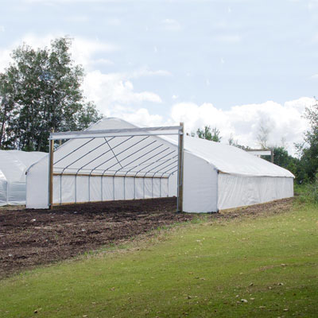
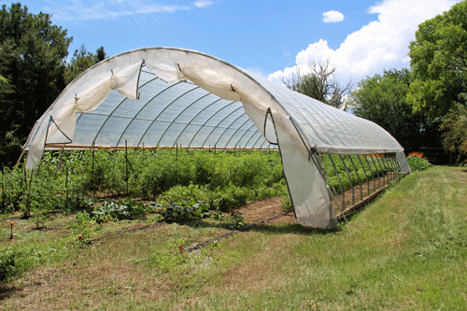
www.nrcs.usda.gov
www.growerssupply.com

Slide 30
Irrigation
Basics
Drip is best
Plants can be placed at each emitter
Needs: pressure reducer, filter, fittings, injection system
Over head is necessary for cover crops. Install above the maximum height of the cover crop and irrigate as needed.
Higher pressure is needed to run these
Suspended from trusses or bows or wobblers mounted on ground for overhead
Depends on long term needs and management

Slide 31
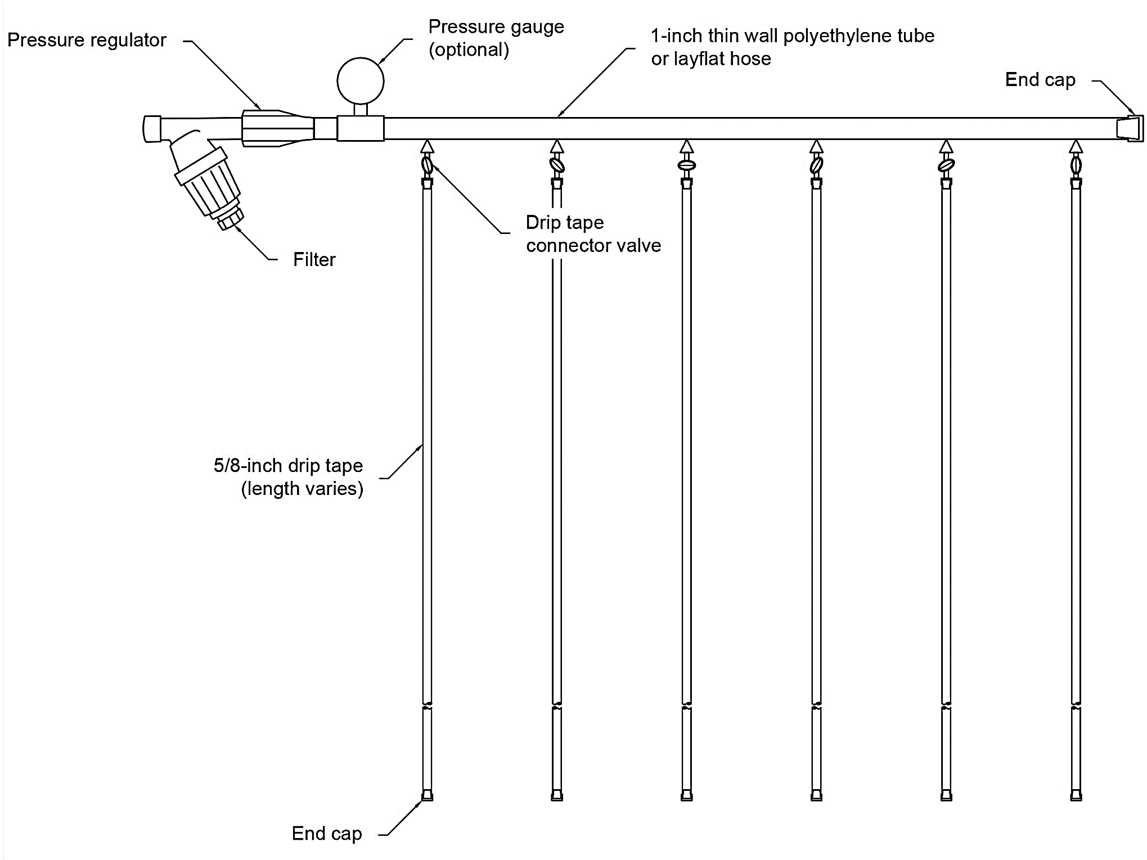

Slide 32
Moveable Tunnels
Tracks
Sleds
Set placements
Typically, two locations
Rollers on metal tracks
Weeds can be huge issue
Metal or wood sleds
Typically need a tractor to move
Multiple locations
Can twist during moving events
Caterpillars
Must be anchored down!!!

Slide 33
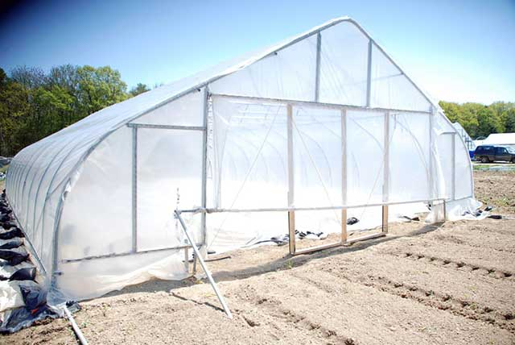
www.gothicarchgreenhouses.com

Slide 34
Movable Tunnels Continued
Benefits
Drawbacks
Multiple growing locations
Crop rotations
Season extension
Increased soil health
Easy to disassemble and move
Typically, smaller
More management requirements
Some may require additional labor
Higher risk of damage do to extreme environmental events

Slide 35
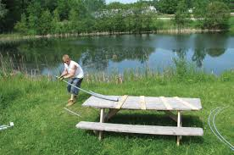
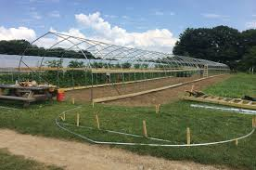
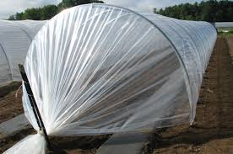
DIY High Tunnels
Farmers Friend Caterpillar Tunnel
Pre bent
Cost effective
Upgrades available
Multiple lengths
Johnny’s Selected Seeds has several models available
Benders
Chain link top rail

Slide 36
Increase Capacity on Small Acreage
High tunnel can support closer spacing as compared to the field
Plants are dryer
Trellising considerations
Specialized irrigation schedules ** no rain or precipitation
Urban Farms
Small 1 to 2 acre operations
Increased harvest/income from the same amount of space

Slide 37
Crop Economics
High tunnels can gross more pre square foot as compared to field production
Input cost vary from farm to farm
Tomatoes | High Tunnel | Field
Row Feet | 400 of 30” bed | 400 of 30” bed
Bed Spacing | 2 rows at 2’ spacing | 1 row at 18” spacing
Total Plants | 400 | 266
Avg Marketable Harvest | 20 lbs per plant | 10 lbs per plant
Total Marketable lbs | 8,000 | 2,660
Avg Price per lb | $2.00 | $1.75
Gross Income | $16,000 | $4,655

Slide 38
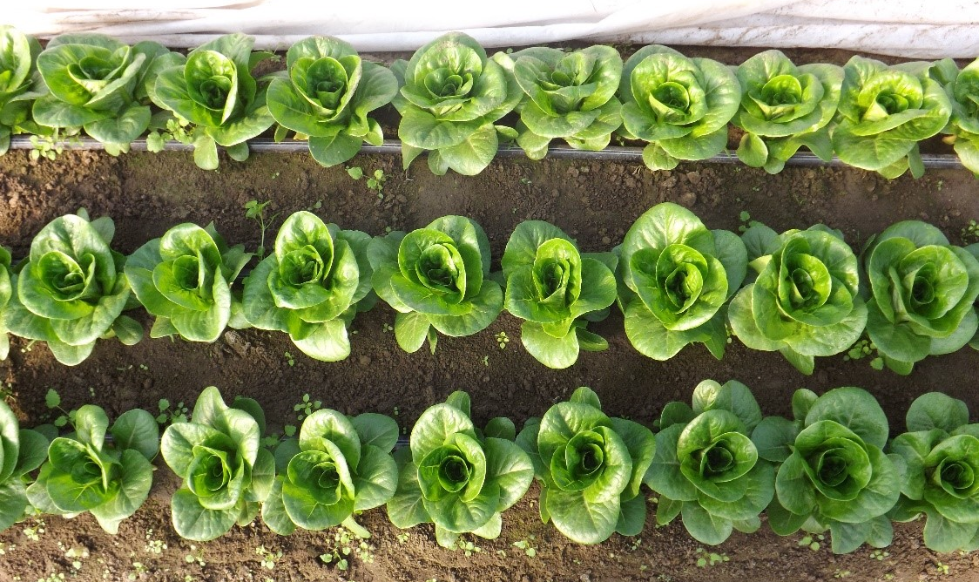
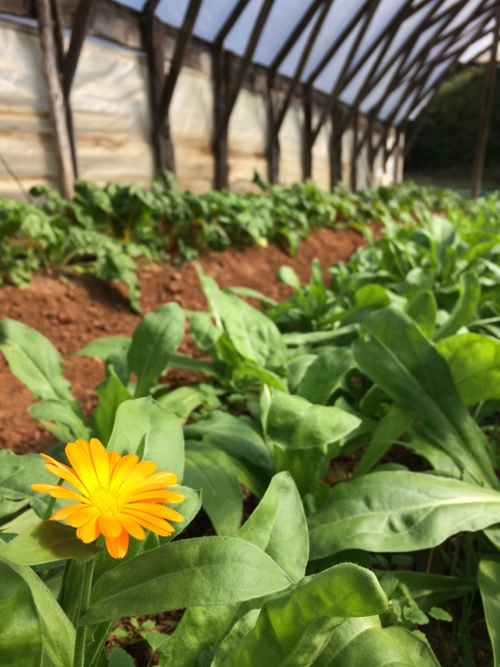
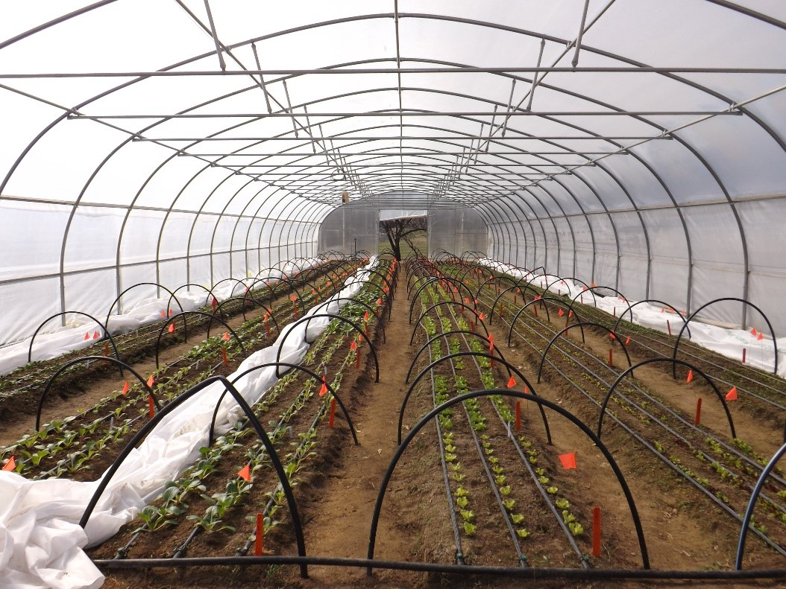
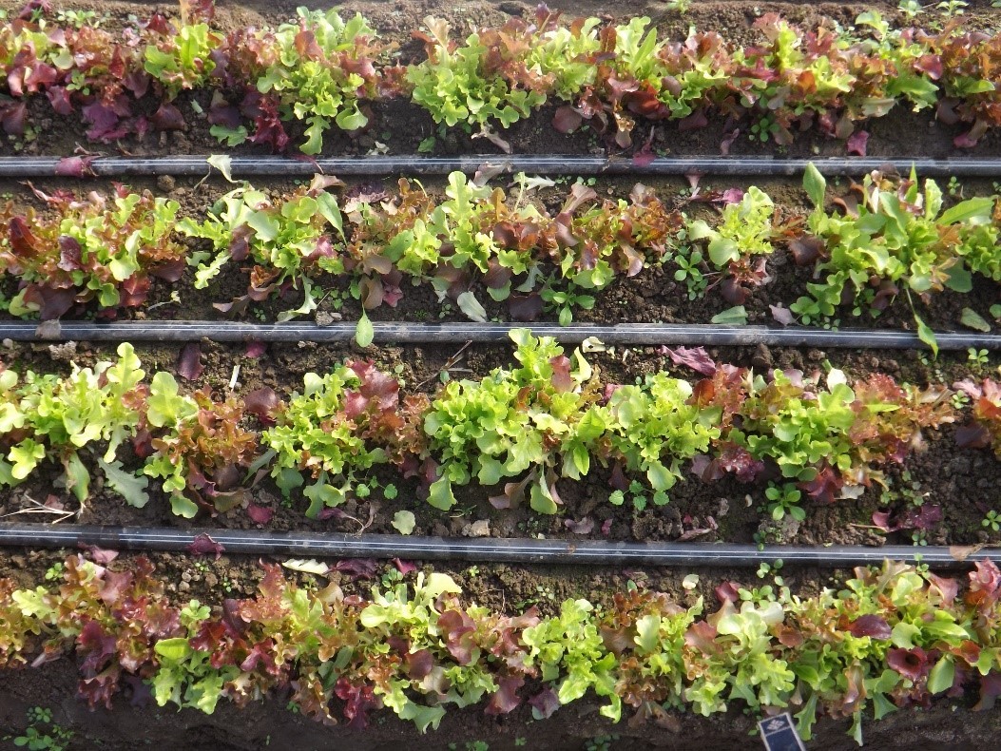

Slide 39
Recommended Resources

Slide 40
High Tunnel Hoop House Construction Guide
Different tunnel styles
Purchasing decisions
Construction Tips
Visual examples (photos)
Terminology
https://web.extension.illinois.edu/bcjmw/downloads/54183.pdf

Slide 41
High Tunnel Crop Production Handbook
NCAT
Great for new high tunnel farmers
Detailed informative production information

Slide 42
High Tunnel Micro-irrigation Guide
Drip and overhead systems for high tunnels
Set up diagrams and irrigation calculations
Soil information and bed prep
Rooting depth information
https://www.carolinafarmstewards.org/high-tunnel-micro-irrigation-guide/

Slide 43
Seasonal High Tunnel Production: Organic Tomato Guide
Varieties
Economics
Production scheduling
Care and maintenance
https://www.carolinafarmstewards.org/seasonal-high-tunnel-production-organic-tomato-guide/

Slide 44
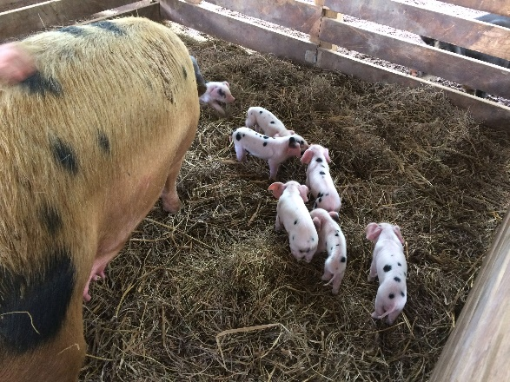
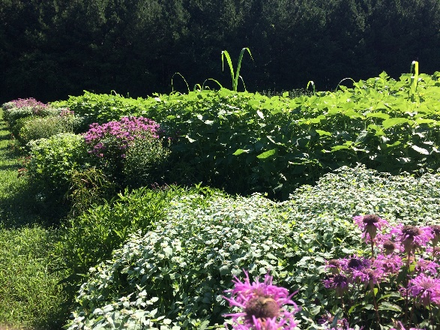
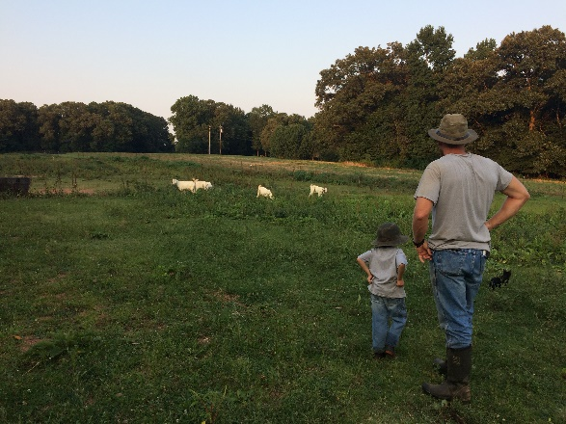
CFSA PROGRAMS
FARM SERVICES: Technical assistance on organic production/ certification, food safety, seasonal high tunnel production, post-harvest handling, and selling into wholesale markets.
Elma C. Lomax Incubator Farm: Certified organic incubator farm in Concord, NC. That provides beginning farmers with access to land and equipment to start their own farm business. Onsite organic research program.

Slide 45
CFSA PROGRAMS
FOOD SYSTEMS: Provide business development assistance to farmers and businesses looking to supply the local food system.
EDUCATION: Host SAC, OCLC, and the Piedmont Farm Tour
ADVOCACY: We work to change agriculture laws and regulations to benefit local and organic small and mid-sized farms.

Slide 46
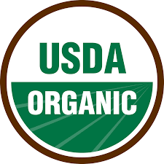
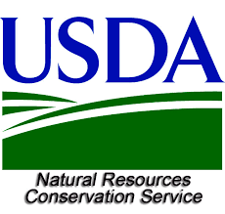
CFSA’s Consulting Services: Organic Certification
Organic Transition: guidance choosing a certifying agent and record keeping system, Q&A on NOP regulations, and records and application review.
Conservation Activity Planning (CAP-138): a farm resource inventory, identification of resource concerns and options to address them, a soil and water quality impact analysis for each option.

Slide 47
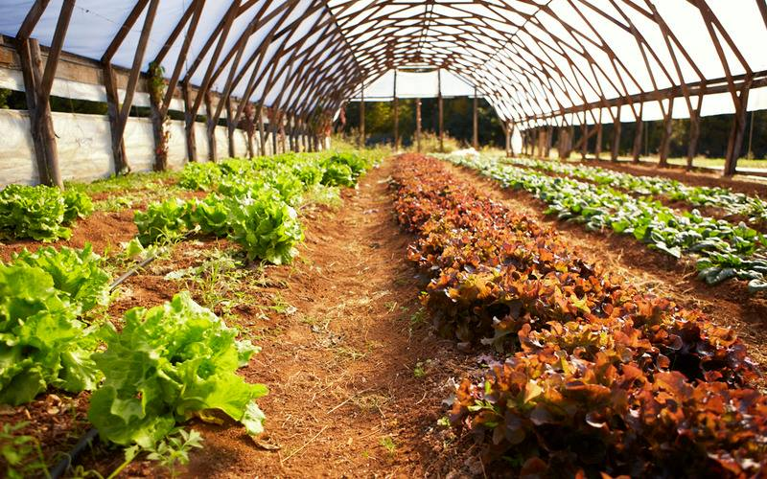
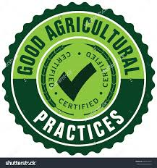
CFSA’s Consulting Services: Production
High Tunnel Production: Help farmers identify best management practices including planting dates, varieties selection, and irrigation, soil fertility and pest management.
Good Agricultural Practices (GAP): Conduct risk assessments, identify ways to mitigate pathogen risks, review Food Safety Plans, and provide assistance preparing for an audit.

Slide 48
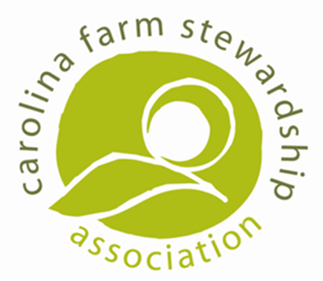
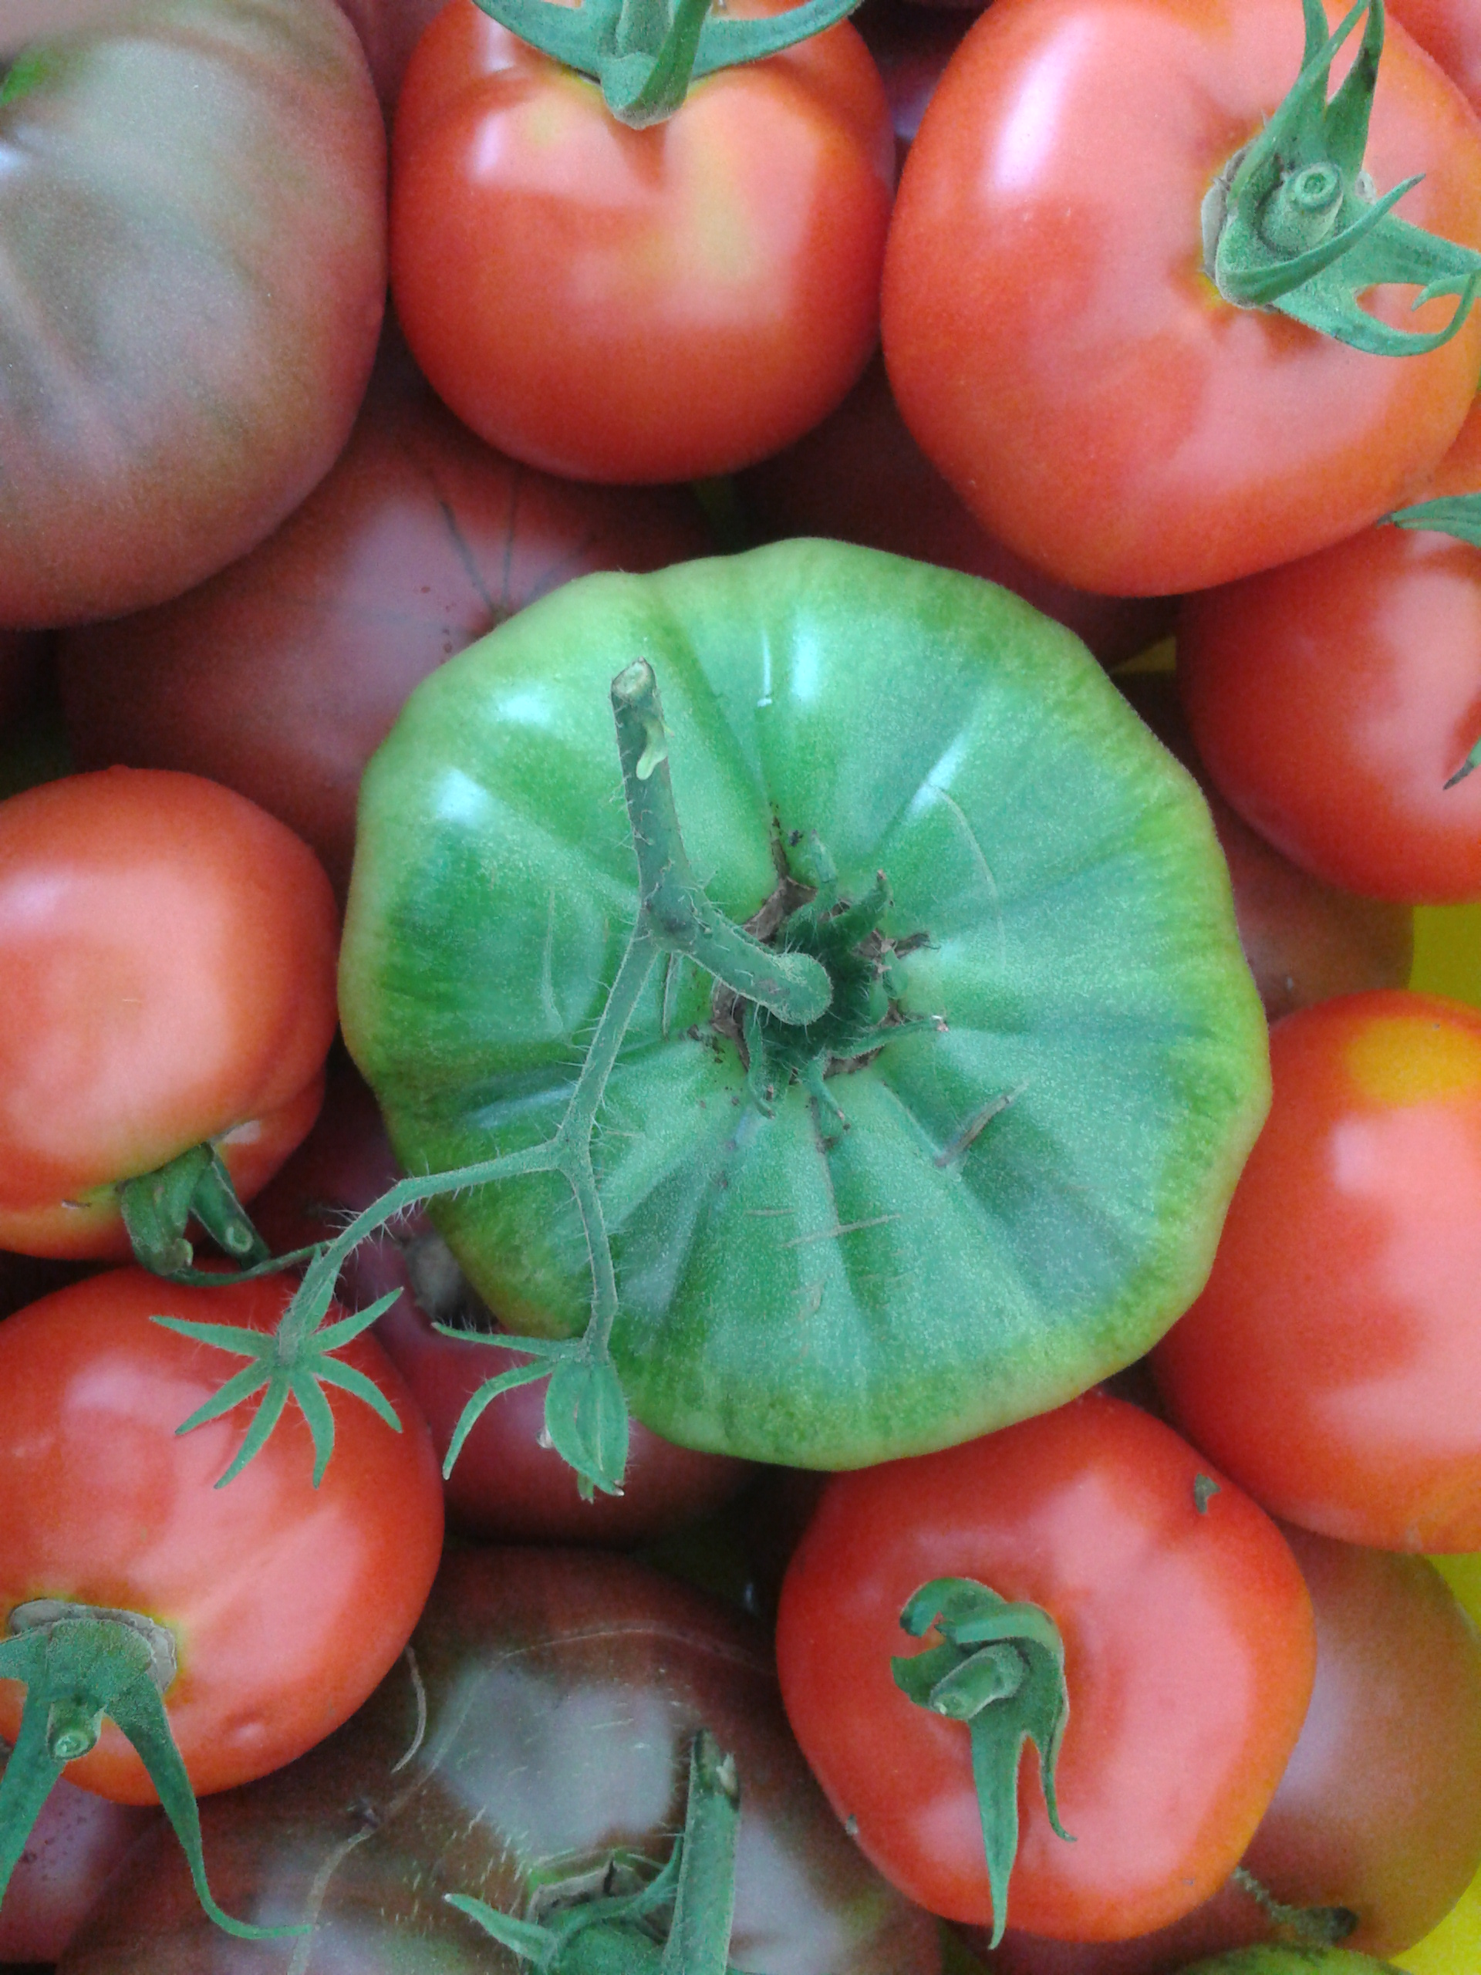
Building Wholesale Capacity
This consulting program will help you:
Assess whether or not wholesale is right for you.
Decide what kind of wholesale is right for you.
Design postharvest handling strategies to maximize efficiency, food safety, and workflow.
Understand infrastructure, packaging, labeling, traceability, transporting and basic food safety norms to meet wholesale buyer requirements.

Slide 49
CFSA Resources
Seasonal High Tunnel Production: Organic Tomato Guide
High Tunnel Micro-irrigation Guide
Infrastructure Toolkit
GAPs Manual and Videos
Sample CAP Plan
Organic Transition Handbook for Produce Farmers
Organic Enterprise Budgets
Organic Inputs and pest Control Finders
Downloadable recordkeeping templates
www.carolinafarmstewards.org

Slide 50
Questions & Survey
Thank You!

