Slide 1
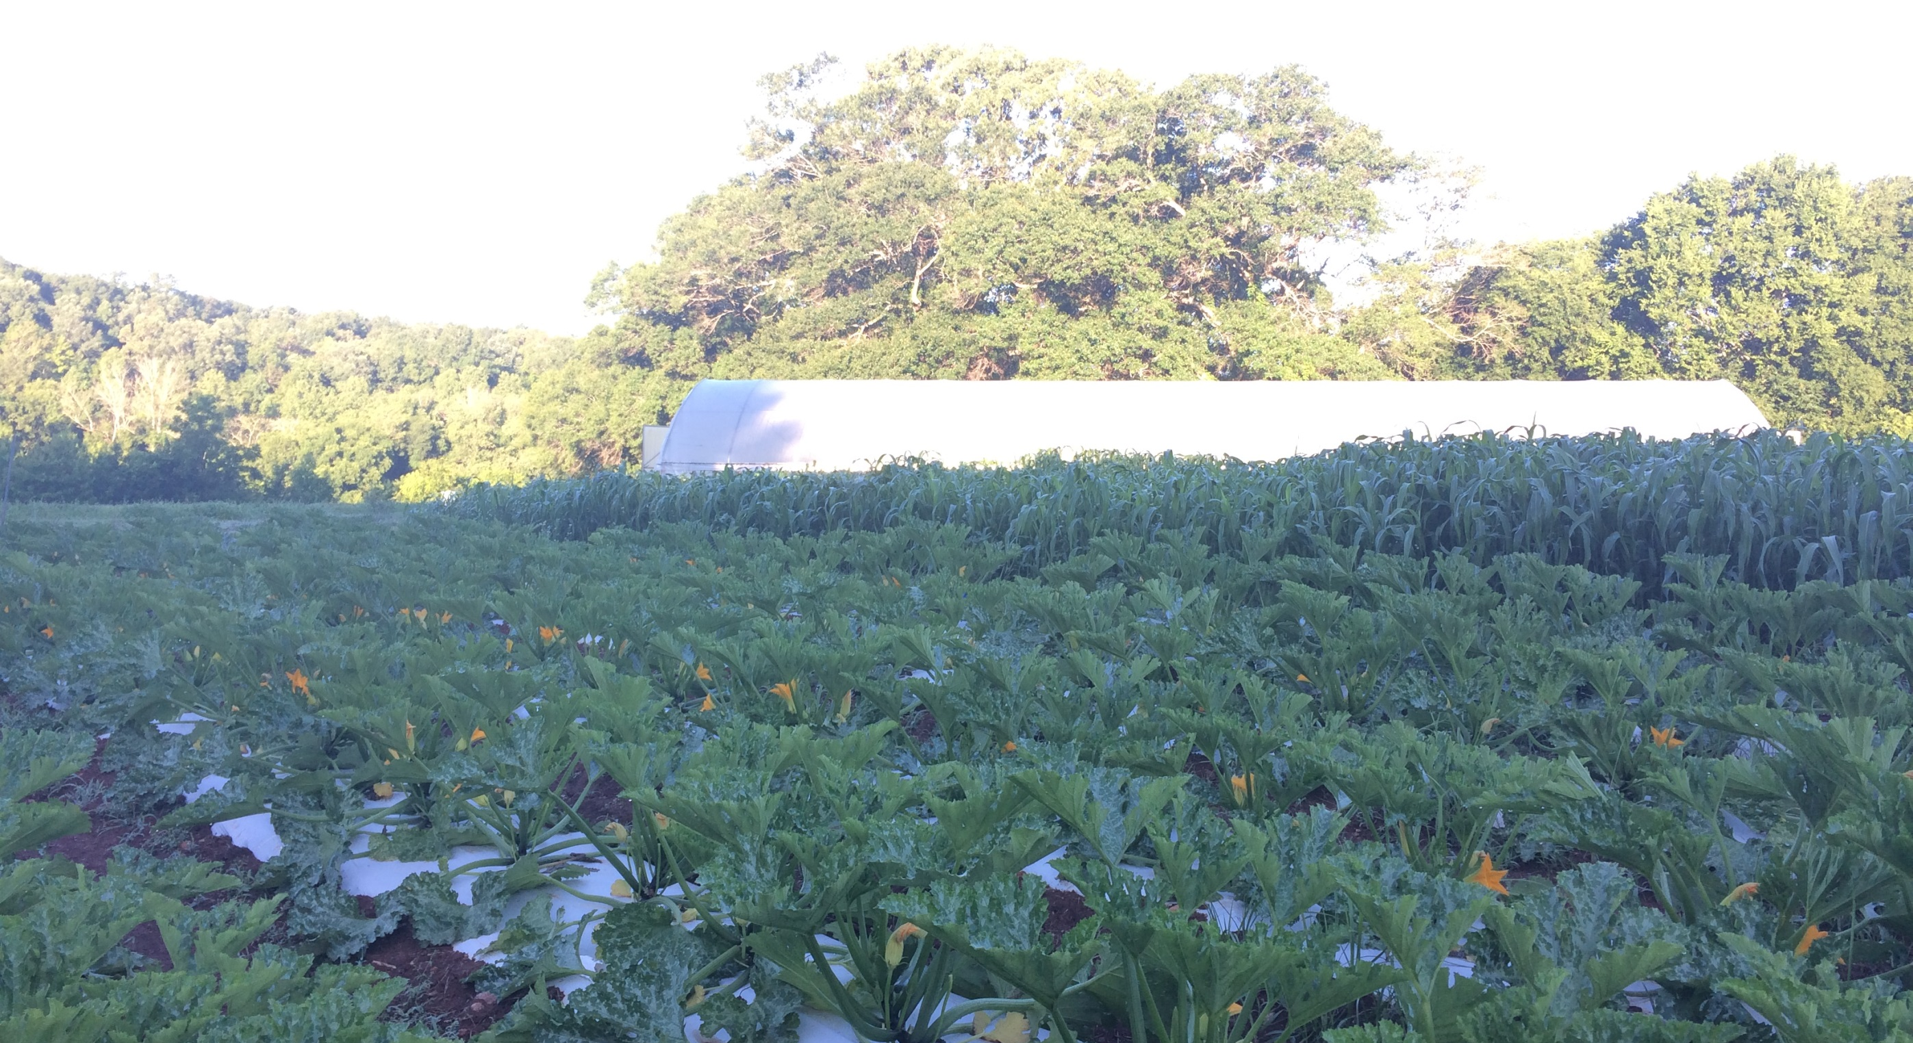
High tunnel Bed PreP & Planting
Joe Rowland
Organic Initiatives Coordinator
Notes:
Please stop me if you have a question or want more information on anything.
These presentations will be made available online.

Slide 2
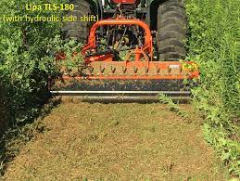
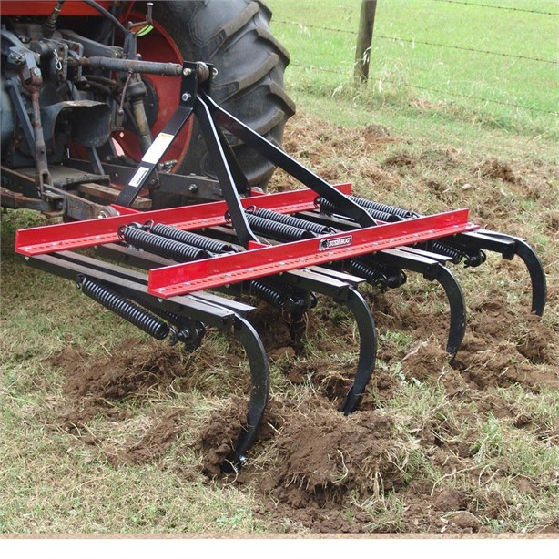
Flail Mower Scarifier/Field Cultivator Sub-Soiler
Notes:
These are the things you need to consider when planning out the space in your tunnel.
I’ll touch a little more on each of these.
Picture and why that set up works in there for that production.

Slide 3
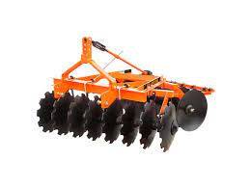
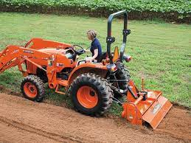
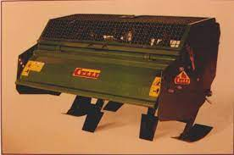
Disc Harrow Roto-Tiller/Vator Spader
Notes:
These are the things you need to consider when planning out the space in your tunnel.
I’ll touch a little more on each of these.
Picture and why that set up works in there for that production.

Slide 4
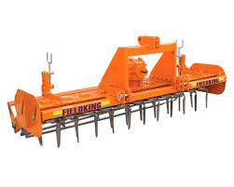
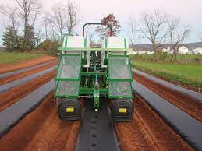
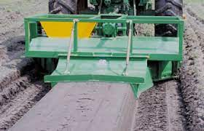
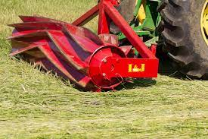
Power Harrow Water Wheel Transplanter
Bed Shaper Roller/Crimper
Notes:
These are the things you need to consider when planning out the space in your tunnel.
I’ll touch a little more on each of these.
Picture and why that set up works in there for that production.

Slide 5
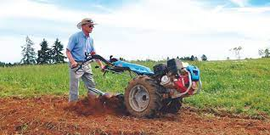
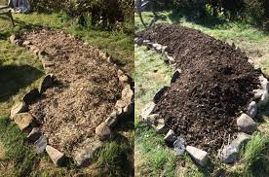
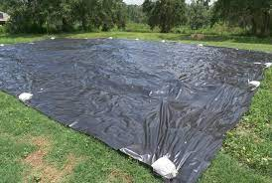
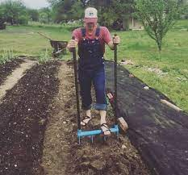
Walk Behind Tractor/BCS/Grillo Hugelkultur/Deep Mulch/Compost
Tarping/Occultation/Solarization/Plasticulture Broadfork/Permanent Beds/Landscape Fabric
Notes:
These are the things you need to consider when planning out the space in your tunnel.
I’ll touch a little more on each of these.
Picture and why that set up works in there for that production.

Slide 6
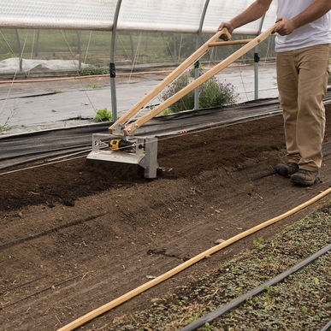
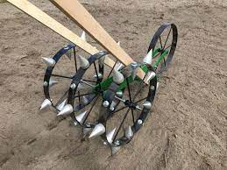
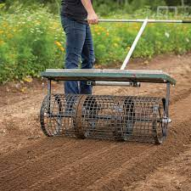
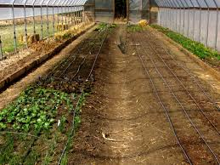
Tilther Dibbler
Bed Roller/Marker Raised Beds/Drip Irrigation used for spacing
Notes:
These are the things you need to consider when planning out the space in your tunnel.
I’ll touch a little more on each of these.
Picture and why that set up works in there for that production.

Slide 7
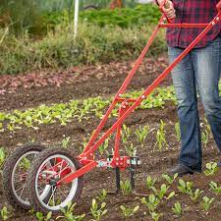
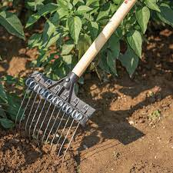
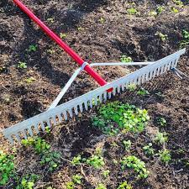
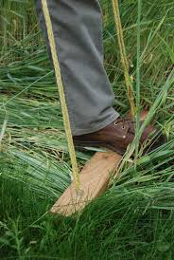
Wheel Hoe Tine Rake
Bed Rake
Colinear Hoe Hand-Held Roller/Crimper
Notes:
These are the things you need to consider when planning out the space in your tunnel.
I’ll touch a little more on each of these.
Picture and why that set up works in there for that production.

Slide 8
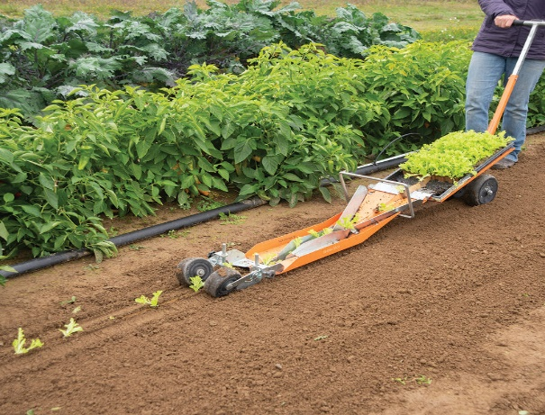
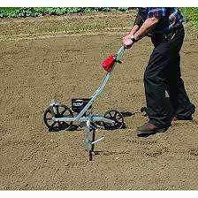
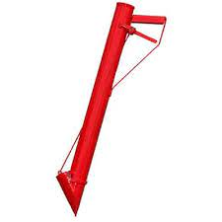
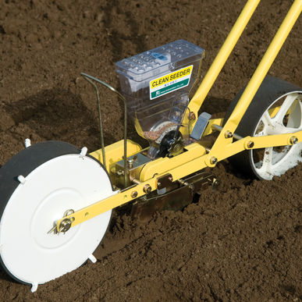
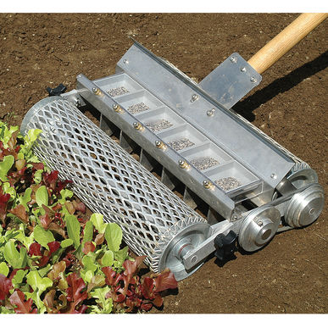
Paper Pot Transplanter
Vacuum Seeder
Earthway Seeder
Stand n Plant/Jab Seeder
Jang Seeder
4 & 6 Row Seeders
Notes:
Hiller and tilther

Slide 9
Tools – Johnny’s Seeds, Never Sink Tools, Farmers Friend, Bootstrap Farmer, Agri-Supply
Supplies – Country Farm & Home, Seven Springs Farm, Nolt’s Greenhouse Supplies, Martin’s Produce Supplies
High Tunnels – Williamson Greenhouses, Puckett’s Greenhouses, Jaderloon, Atlas
More resources, educational materials and technical assistance from Carolina Farm Stewardship Association
joe@carolinafarmstewards.org
Notes:
These are the things you need to consider when planning out the space in your tunnel.
I’ll touch a little more on each of these.
Picture and why that set up works in there for that production.

