Slide 1
High Tunnel Construction
Joe Rowland

Slide 2
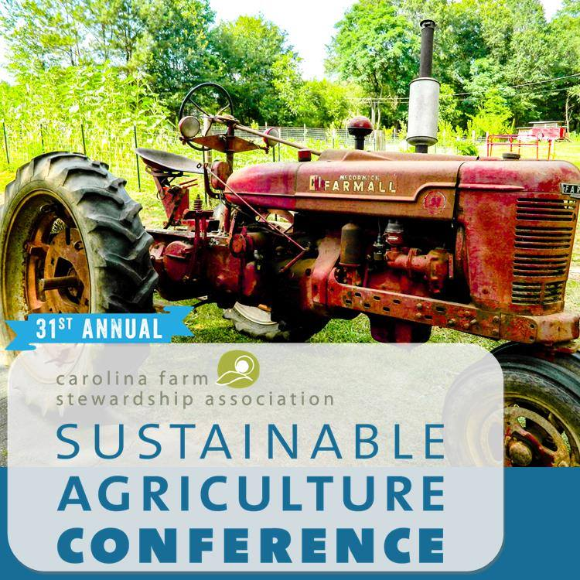
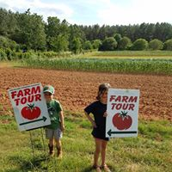
CFSA’s MISSION
We help people in the Carolinas grow and eat local, organic food by advocating for fair farm and food policies, building the systems that organic family farms need to thrive, and educating communities about local, organic farming.

Slide 3
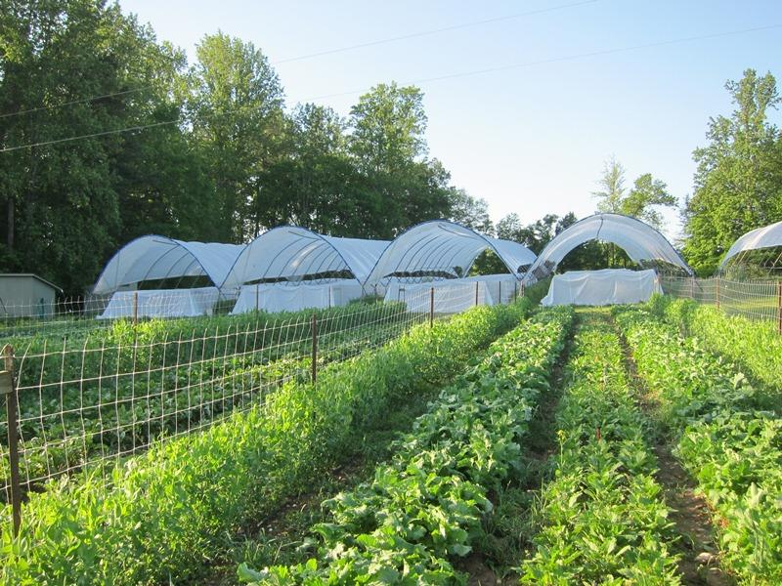
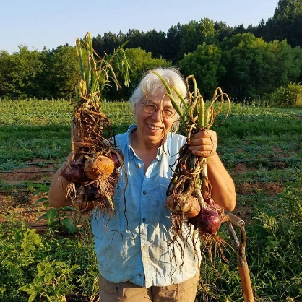
CFSA’s VISION
Create a regional food system that is good for consumers, good for farmers and farmworkers, and good for the land.

Slide 4
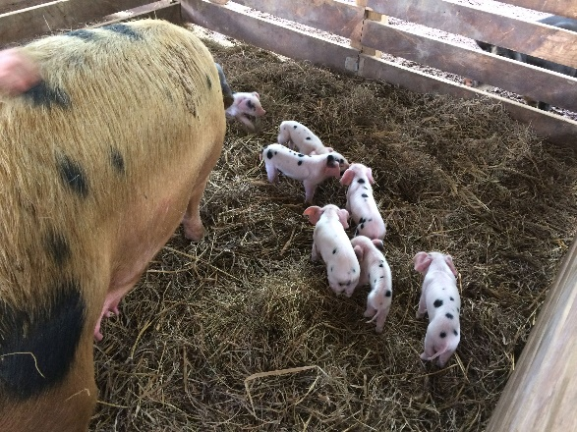
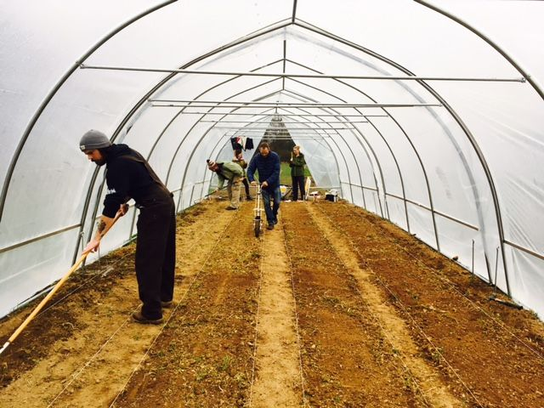
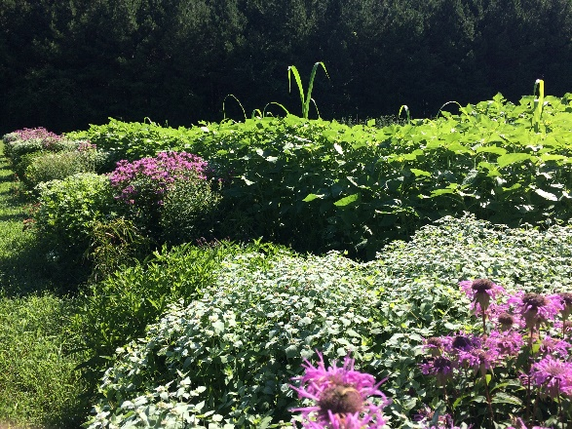
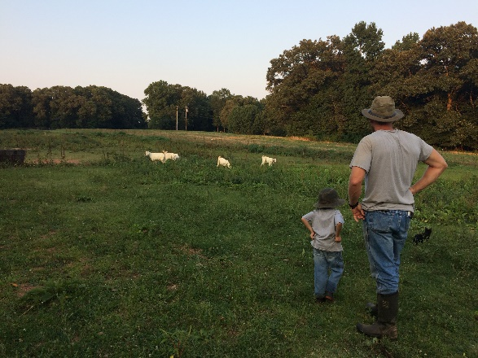
CFSA PROGRAMS
FARM SERVICES: Technical assistance on organic production/ certification, food safety, seasonal high tunnel production, post-harvest handling, and selling into wholesale markets.
Elma C. Lomax Incubator Farm: Certified organic incubator farm in Concord, NC. That provides beginning farmers with access to land and equipment to start their own farm business. Onsite organic research program.

Slide 5
CFSA PROGRAMS
FOOD SYSTEMS: Provide business development assistance to farmers and businesses looking to supply the local food system.
EDUCATION: Host SAC, OCLC, and the Piedmont Farm Tour
ADVOCACY: We work to change agriculture laws and regulations to benefit local and organic small and mid-sized farms.

Slide 6
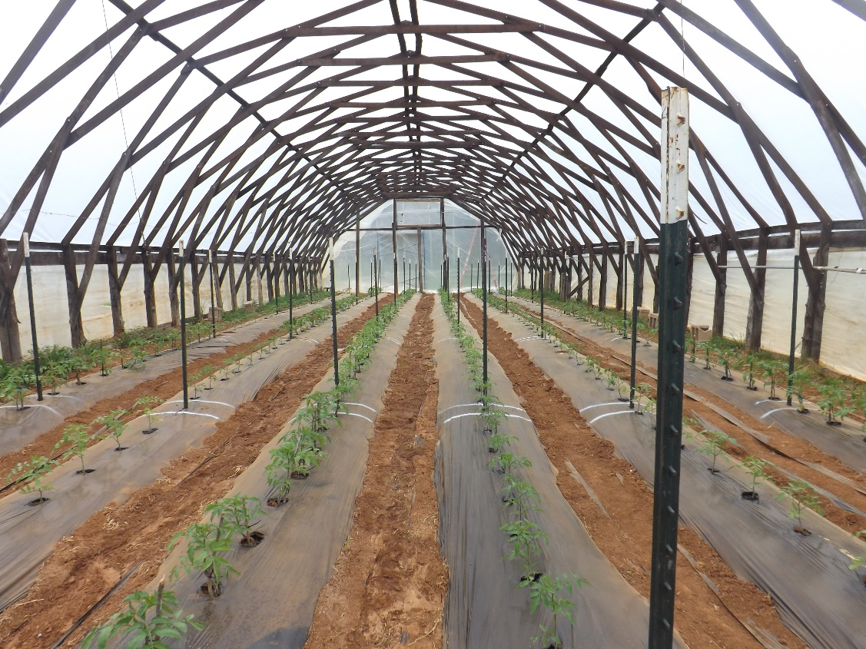
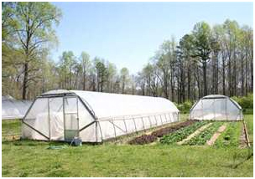
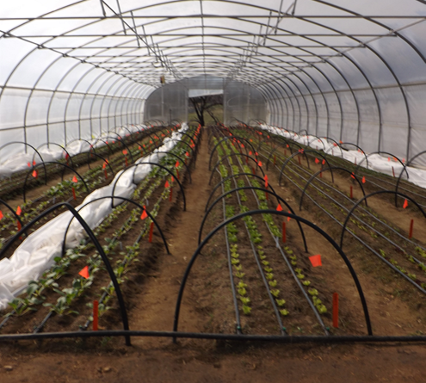
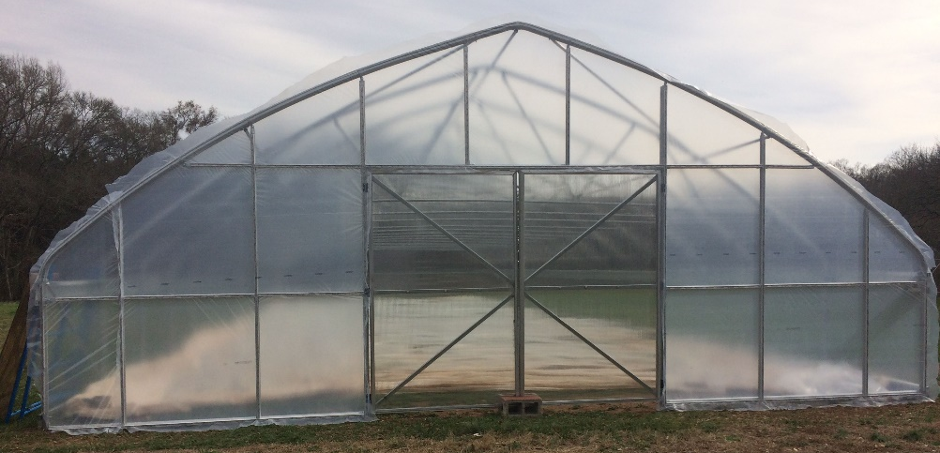
What is a high tunnel?

Slide 7
Benefits to high tunnel production
Season Extension
Early spring, late fall, and winter production
Lower input cost as compared to greenhouses
Clean fruit/plants
Protected from elements
Reduced disease pressure
Controlled growing environment
Spring Forth Farm Hurdle Mills, NC

Slide 8
Benefits Continued
How it can fit into your farming model
Winter Harvest
Planting/harvesting times
Coordinate planning around current time schedule
Ten Mothers Farm Hillsborough, NC

Slide 9
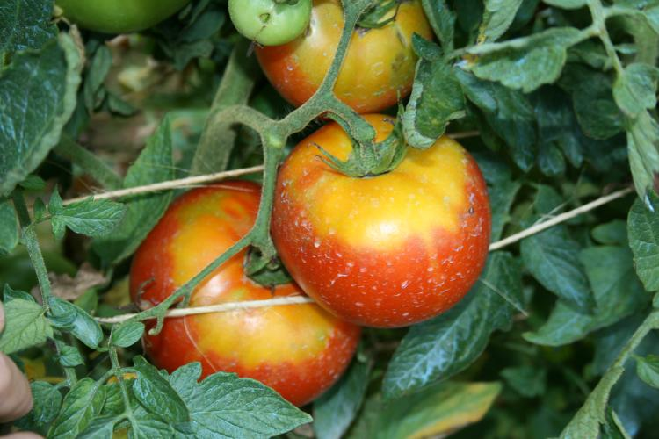
Drawbacks to high tunnel production
Pollinator Exclusion
Temperature Extremes
Summer Heat
Humidity
Soil Health
Maintenance Inputs
Perimeter Weed Management
Timothy Coolong, University of Kentucky

Slide 10
Drawback Continued
Runoff – Water diverted from roof can cause drainage issues
Shading – High tunnel will cast shade potential changing field planting capacities
Grading – Top soil movement, sediment runoff
Placement can create odd shaped fields, difficult to plant in
Cost – expensive to construct and continually manage
Worrying about the structure during extreme weather events

Slide 11
Cost of a High Tunnel
Size, type, truss system!
Price Estimate for 30 x 72
Low end $10,000
High End $20,000
Atlas Budget Plus →

Slide 12
Cost Continued
Many outside cost no included in original purchase of kit
Grading
Driving sidewall post (contracting or renting equipment)
Hired labor or contracting for installation
Drills, Impact Drivers, Chop Saw, Reciprocating Saw, Drill Bits, Nut Drivers, Ratchets
Materials for endwalls
Doors

Slide 13
NRCS EQIP
Natural Resources Conservation Service : Environmental Quality Incentives Program
Provides Cost Share to help conduct practices to preserve natural resources and increase environmental health which includes high tunnels
Applications due in November and are approved yearly
The grower pays upfront and if reimbursed based on high tunnel square footage after the tunnel in constructed

Slide 14
Other Funding Options
Slow Money Institute www.slowmoney.org
Kiva Loans www.kiva.org
Local Grants
These vary depending on your area
Most are small amounts
Loans
NC Farm Credit
Farm Bureau
AgSouth Farm Credit
Chickadee Farm Clayton, NC

Slide 15
Orientation
Maximizing angle and exposure to sunlight
Capitalizing on greenhouse effect to gain and retain warmth
Avoid shading within the tunnel
Most recommendations hinge on latitude

Slide 16
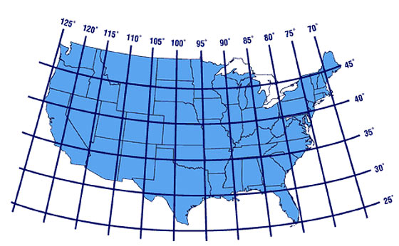
E/W
N/S

Slide 17
Site Selection
Site selection is more important than orientation!!!
Maximize the morning sun
Why?
Afternoon Sun
Ventilation
Irrigation Access
Level Ground
Lomax Incubator Farm Concord, NC

Slide 18
Size Options
Single Bay
Most used sizes are 30’ x 72’ and 30’ 96’
Repurposed cold frames are typically thinner 15’ x 20-150’
Multi Bay
Multiple single bays put together
Gutter connect
Benefits and drawbacks
DIY
Farmers Friend
Johnny's Selected Seeds Models
Johnny’s Stationary Gothic Peak Model

Slide 19
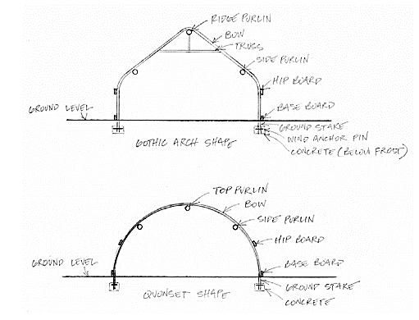

Slide 20
Building Materials
Metal tubing
Diameter ranging between ¾” to 2 ¾”
Chain link top rail
Square and round tubing
Baseboards and Hip Boards
Metal, treated wood, untreated wood
Concrete
End walls
Metal, treated wood, untreated wood
Cabin Branch Organic Farm Columbia, SC

Slide 21
Side Walls
Curved vs straight
Burying post/soil types
Roll Up vs Drop Down
Curtains material
Pockets vs No pockets
Seal of the tunnel during cold events
Air in and out during high winds
Johnny’s Stationary Elliptical Model

Slide 22
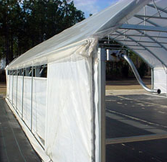
www.growingformarket.com
The Farm at Penny Lane Pittsboro, NC

Slide 23
Height
Gothic Tunnels are typically taller then other types
Additional height may require gable vents
Taller side walls = taller tunnel height
Roof pitch will impact height
Snow
Access to truss structure
Equipment Access
Sierra Nevada Brewing Company Gardens Mills River, NC

Slide 24
Tunnel Style
Gothic
Quonset Hut
Ridge vent
Gutter Connect
Morgan County Seeds – Gothic High Tunnel

Slide 25
Dancing Pines Farms Efland, NC
Puckett Greenhouses – Quonset High Tunnel

Slide 26
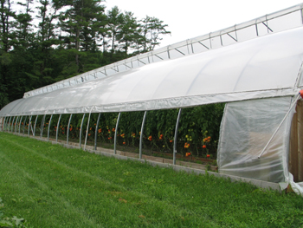
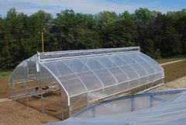
Four Season Tools
www.extension.org

Slide 27
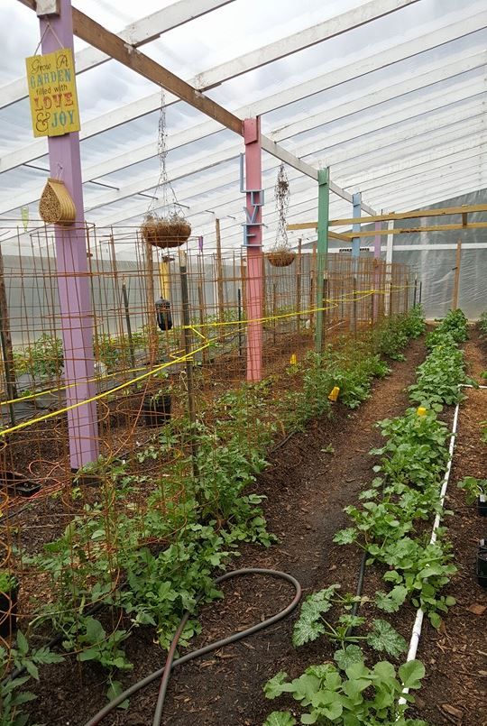
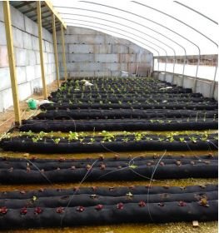
http://missouribeginningfarming.blogspot.com
Maters and More Mt Pleasant, NC

Slide 28
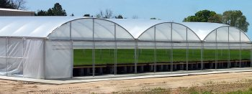
Atlas Greenhouses – Gutter Connect

Slide 29
Bow Spacing
Typical bow spacing is between 4’ and 6’
This also indicates the spacing on the side post
Decisions on bow spacing depends on production requirements, environmental concerns, and tunnel specs
Are you accessing the truss system during production? (trellising, hanging baskets, etc…)
Are snow load and winds a concern?
What is the diameter/stability of steel tubing used?
Closer bow spacing increases the strength of the tunnel to withstand more weight, both from outside pressure and hanging weight inside

Slide 30
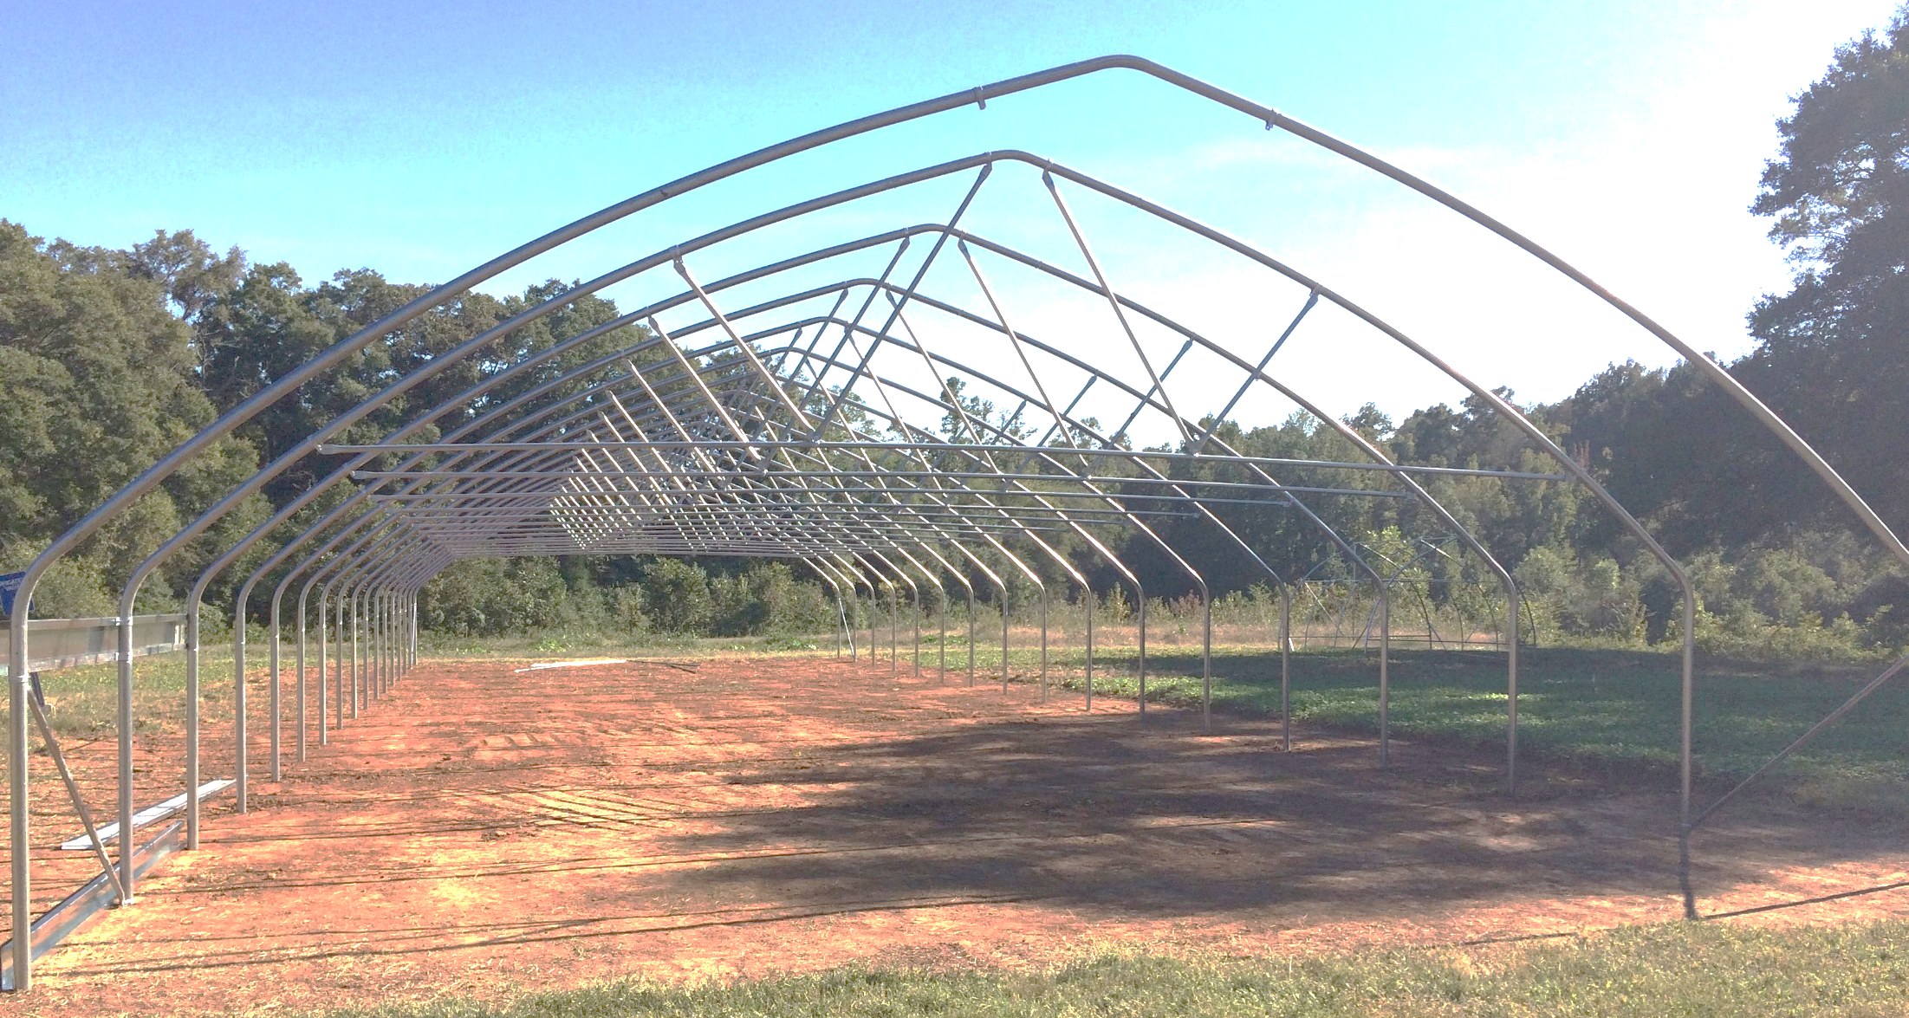
6’
Lomax Incubator Farm Concord, NC

Slide 31
Truss Systems
Installing a truss system is usually an “upgrade” from basic high tunnel kits
Materials can be purchased or made to install to an existing tunnel
What are the benefits?
Lowers the cross brace for accessibility to connect trellis systems
Increases strength
Decreases damage risk from snow, ice and wind
Trusses can be installed on every bow OR at equal intervals throughout the tunnel

Slide 32
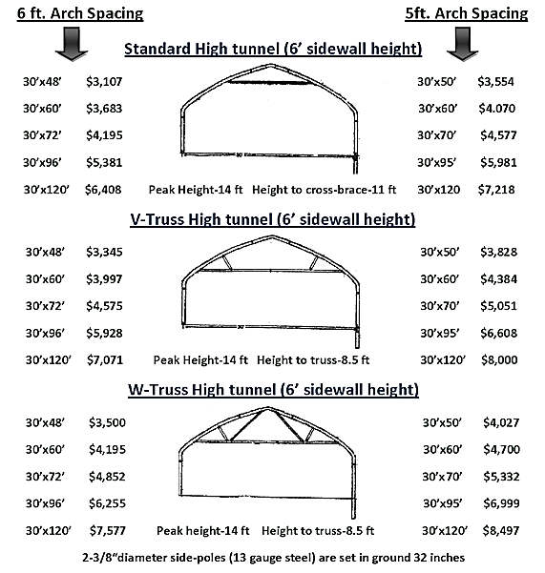
www.zimmermanhightunnels.com

Slide 33
Plastic
Most common is a single layer or plastic
Double Layer increases heat retention and reduces damage risk
Inflation works with two layers
Requires a blower and electricity
Aged plastic has reduced light transmission
Plant stress
Reduced heating capacity
6 mil 4 year greenhouse plastic
6 mil Infrared Anti-condensate plastic
Shade cloth
Note: Most plastics should not touch PVC!

Slide 34
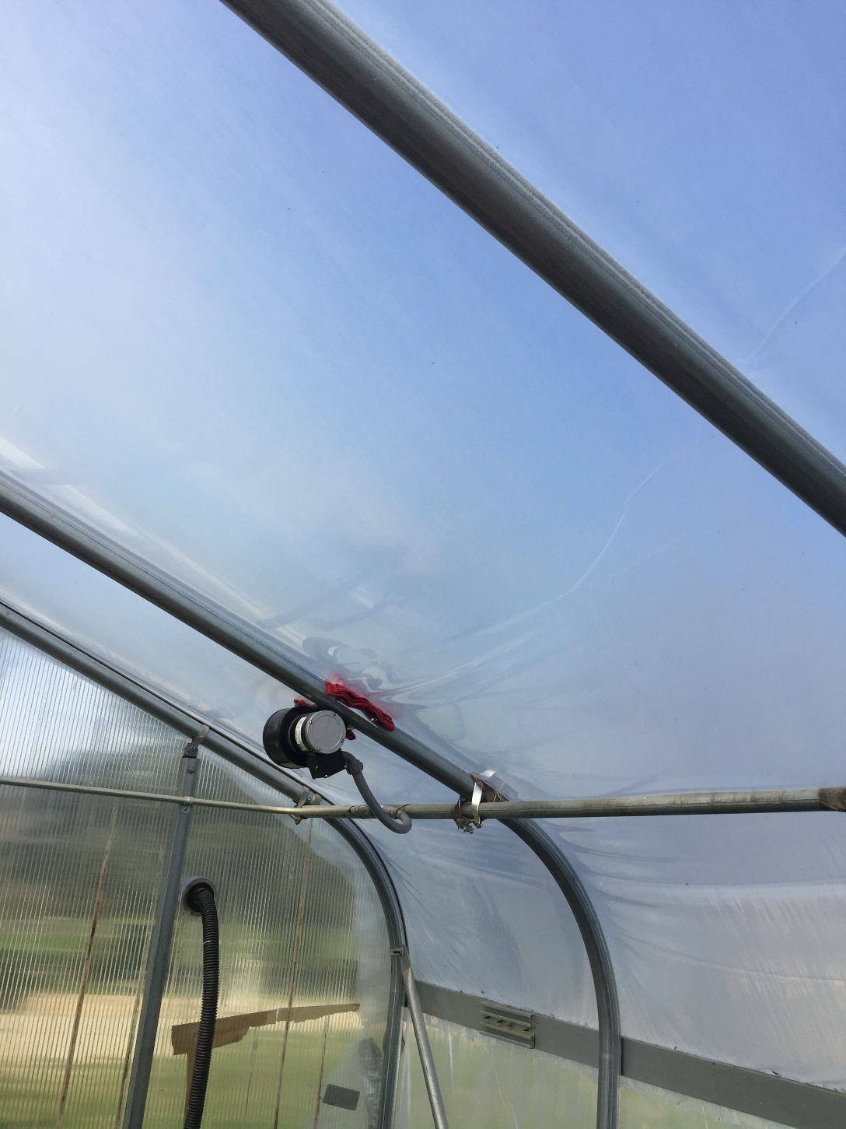
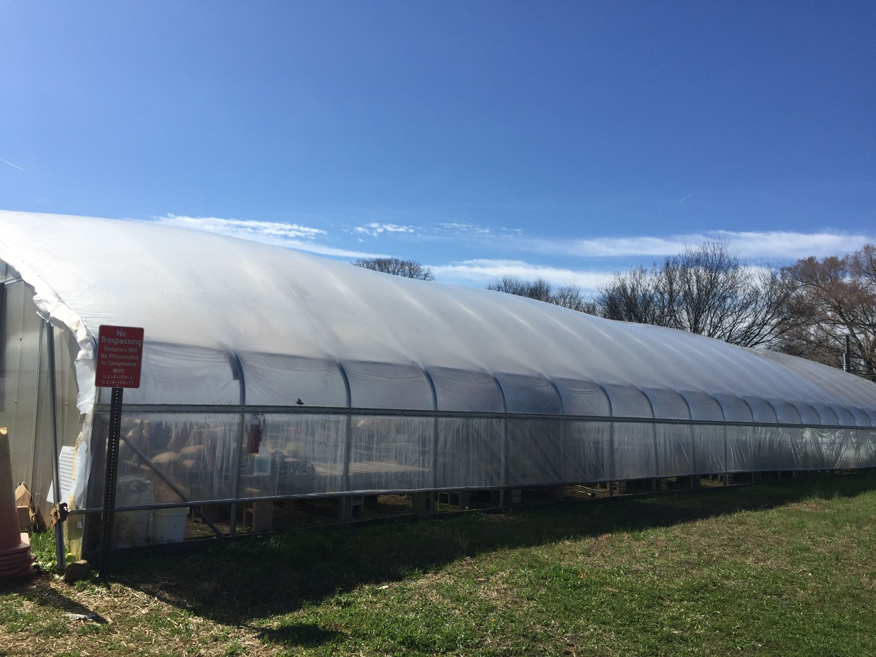
Lomax Incubator Farm Concord, NC
Double plastic layer on greenhouse

Slide 35
Wiggle Wire
Chanel used to secure plastic
Plastic is held in with curved wire that “wiggles” into place
Can be used on wood or metal
Furring strips are also common
www.growerssupply.com

Slide 36
Endwalls
Many kits do not include material to frame out endwalls
Framed endwalls are considered an upgrade from basic kits
Framing provides strength and increase heat retention
Framing also provides a structure to hang doors, vents and fans if desired
Doors – range in size. Provide openings for tractors and cross ventilation
Multiple door style options
Vents are usually installed near the peak on both ends
Fans – used as needed for increased ventilation

Slide 37
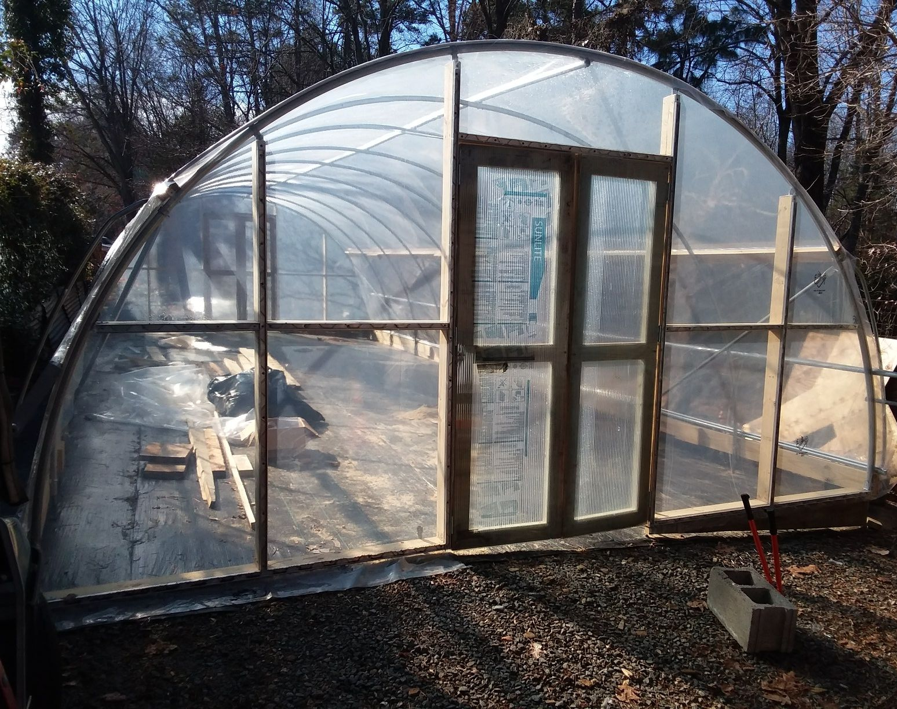
Lomax Incubator Farm Concord, NC UNC Charlotte Botanical Garden Charlotte, NC

Slide 38
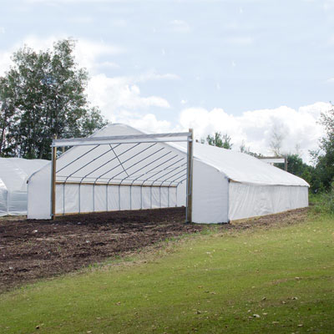
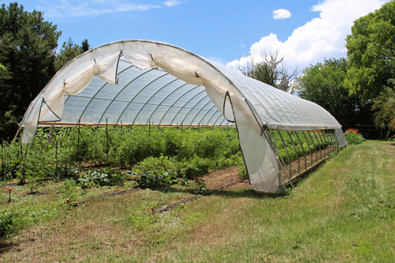
www.nrcs.usda.gov
www.growerssupply.com

Slide 39
Endwalls continued
Plastic
Inflation
Polycarbonate
www.atlasgreehouses.com

Slide 40
Irrigation
Basics
Drip is best
Plants can be placed at each emitter
Needs: pressure reducer, filter, fittings, injection system
Over head is necessary for cover crops. Install above the maximum height of the cover crop and irrigate as needed.
Higher pressure is needed to run these

Slide 41
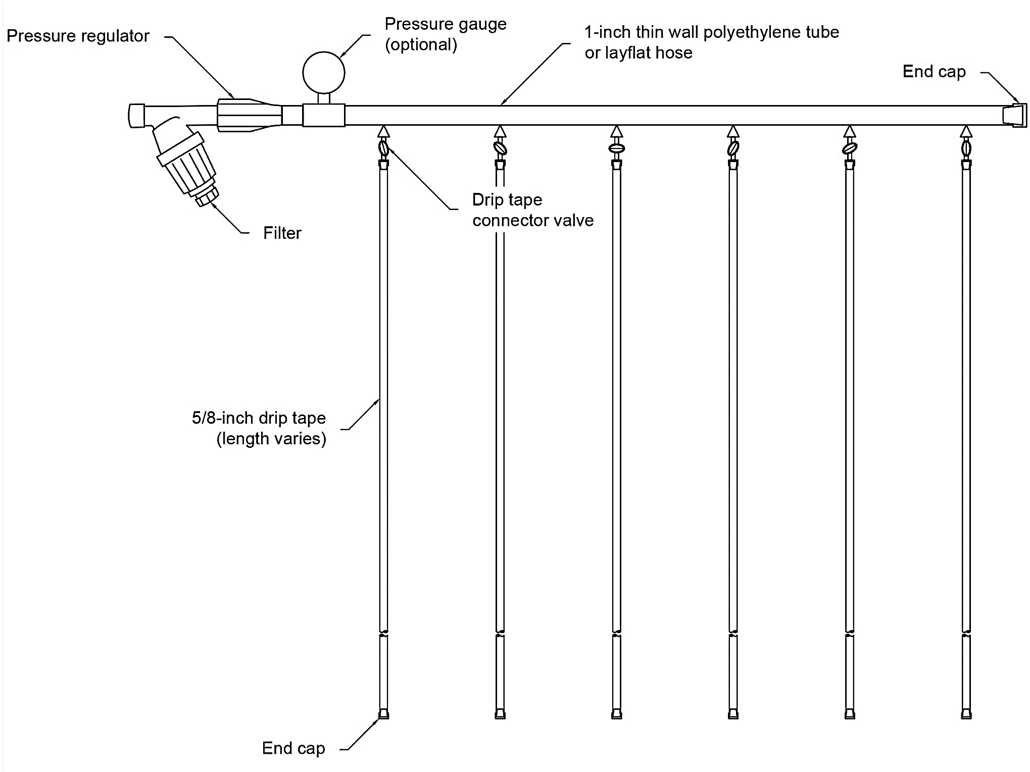

Slide 42
Moveable Tunnels
Tracks
Sleds
Set placements
Typically two locations
Rollers on metal tracks
Weeds can be huge issue
Metal or wood sleds
Typically need a tractor to move
Multiple locations
Can twist during moving events
Must be anchored down!!!

Slide 43
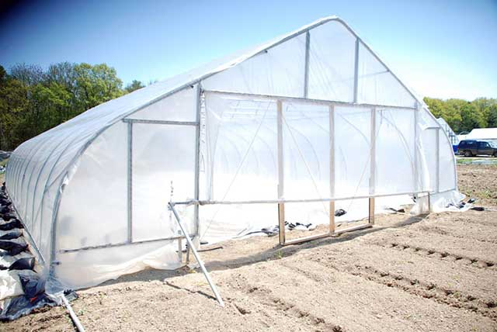
www.gothicarchgreenhouses.com

Slide 44
Movable Tunnels Continued
Benefits
Drawbacks
Multiple growing locations
Crop rotations
Season extension
Increased soil health
Easy to disassemble and move
Typically, smaller
More management requirements
Some may require additional labor
Higher risk or damage do to extreme environmental events

Slide 45
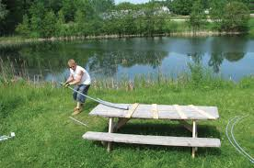
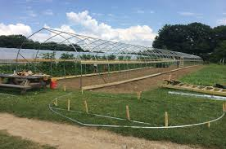
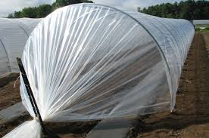
DIY High Tunnels
Farmers Friend Caterpillar Tunnel
Pre bent
Cost effective
Upgrades available
Multiple lengths
Johnny’s Selected Seeds has several models available
Benders
Chain link top rail

Slide 46
Multiple Tunnels
Clemson Student Organic Farm Clemson, SC

Slide 47
List of Suppliers
Carolina Greenhouses – Kinston, NC
Farm Tek (Grow Span Structures) - Dyersville, IA
Jaderloon (The Greenhouse Company) – Columbia, SC
Nolt’s Greenhouse Supplies – Ephrata, PA
Tunnel Vision Hoops - Shaker Heights, OH
Atlas Greenhouses – Alapaha, GA
Puckett Greenhouse – Ararat, VA
Berry Hill Irrigation – Buffalo Junction, VA
Rimol Greenhouse Systems – Hooksett, NH
Farmer’s Friend – Centerville, TN
Williamson Greenhouses – Clinton, NC
Morgan County Seed – Barnett, Missouri
Four Season Tools – Kansas City, Missouri
Zimmerman Greenhouses – Versailles, Missouri
A more comprehensive list on www.hightunnels.org

Slide 48
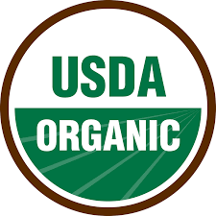
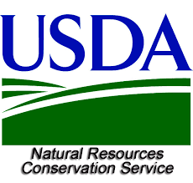
CFSA’s Consulting Services: Organic Certification
Organic Transition: guidance choosing a certifying agent and record keeping system, Q&A on NOP regulations, and records and application review.
Conservation Activity Planning (CAP-138): a farm resource inventory, identification of resource concerns and options to address them, a soil and water quality impact analysis for each option.

Slide 49
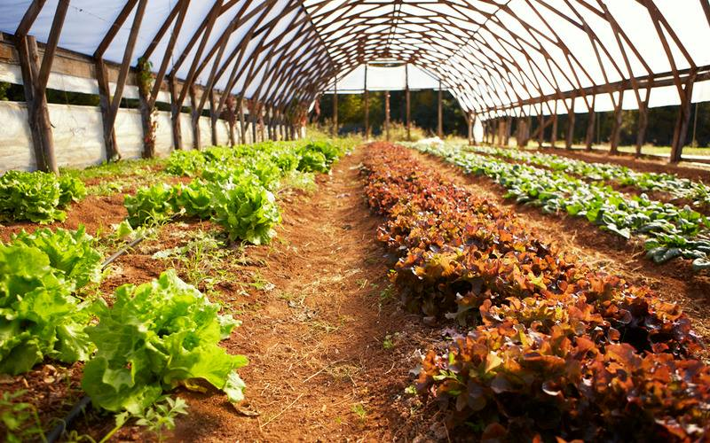
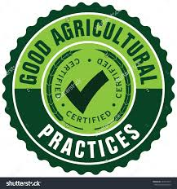
CFSA’s Consulting Services: Production
High Tunnel Production: Help farmers identify best management practices including planting dates, varieties selection, and irrigation, soil fertility and pest management.
Good Agricultural Practices (GAP): Conduct risk assessments, identify ways to mitigate pathogen risks, review Food Safety Plans, and provide assistance preparing for an audit.

Slide 50
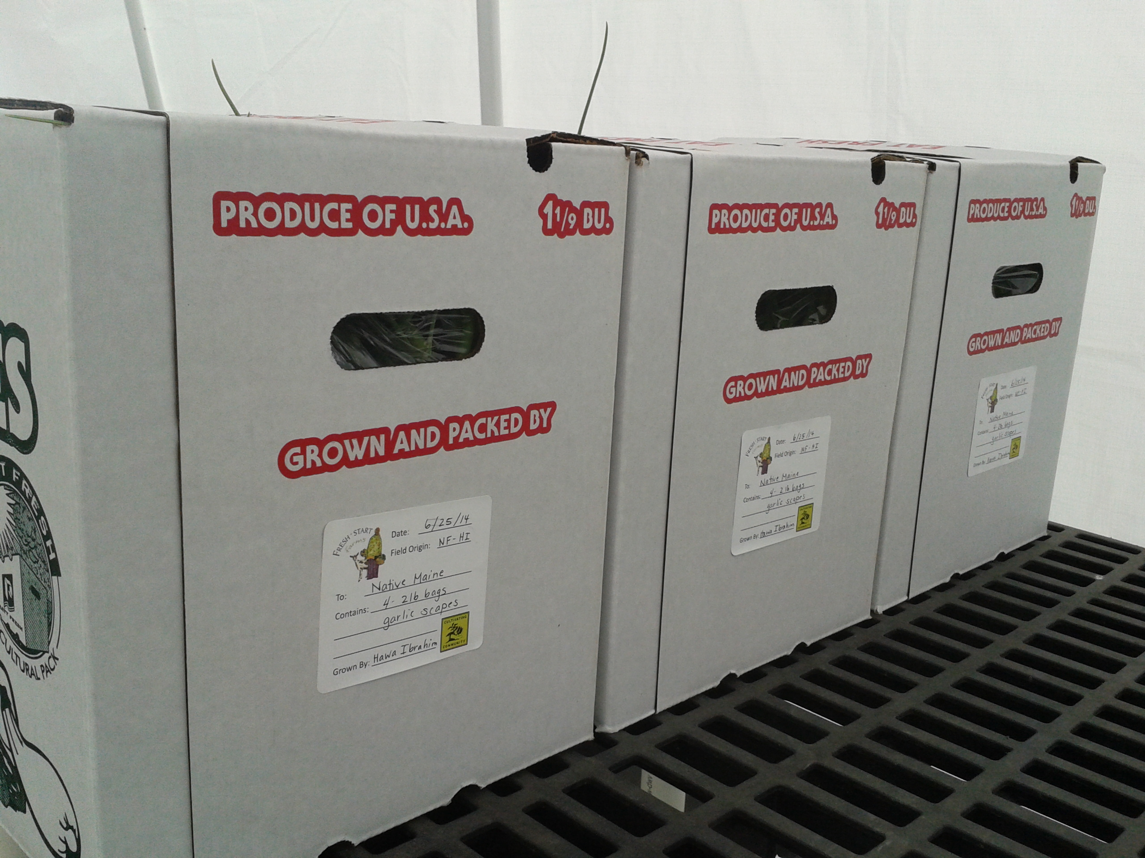
CFSA’s Consulting Services: Wholesale Readiness
Building Wholesale Capacity:
Help farmers assess wholesale readiness and understand post-harvest handling infrastructure, packaging, labeling, traceability, transportation and basic food safety norms to meet wholesale requirements

Slide 51
CFSA Resources
Seasonal High Tunnel Production: Organic Tomato Guide
High Tunnel Micro-irrigation Guide
Infrastructure Toolkit
GAPs Manual and Videos
Sample CAP Plan
Organic Transition Handbook for Produce Farmers
Organic Enterprise Budgets
Organic Inputs and pest Control Finders
Downloadable recordkeeping templates
www.carolinafarmstewards.org

Slide 52
Questions & Survey
Thank You!

