Slide 1
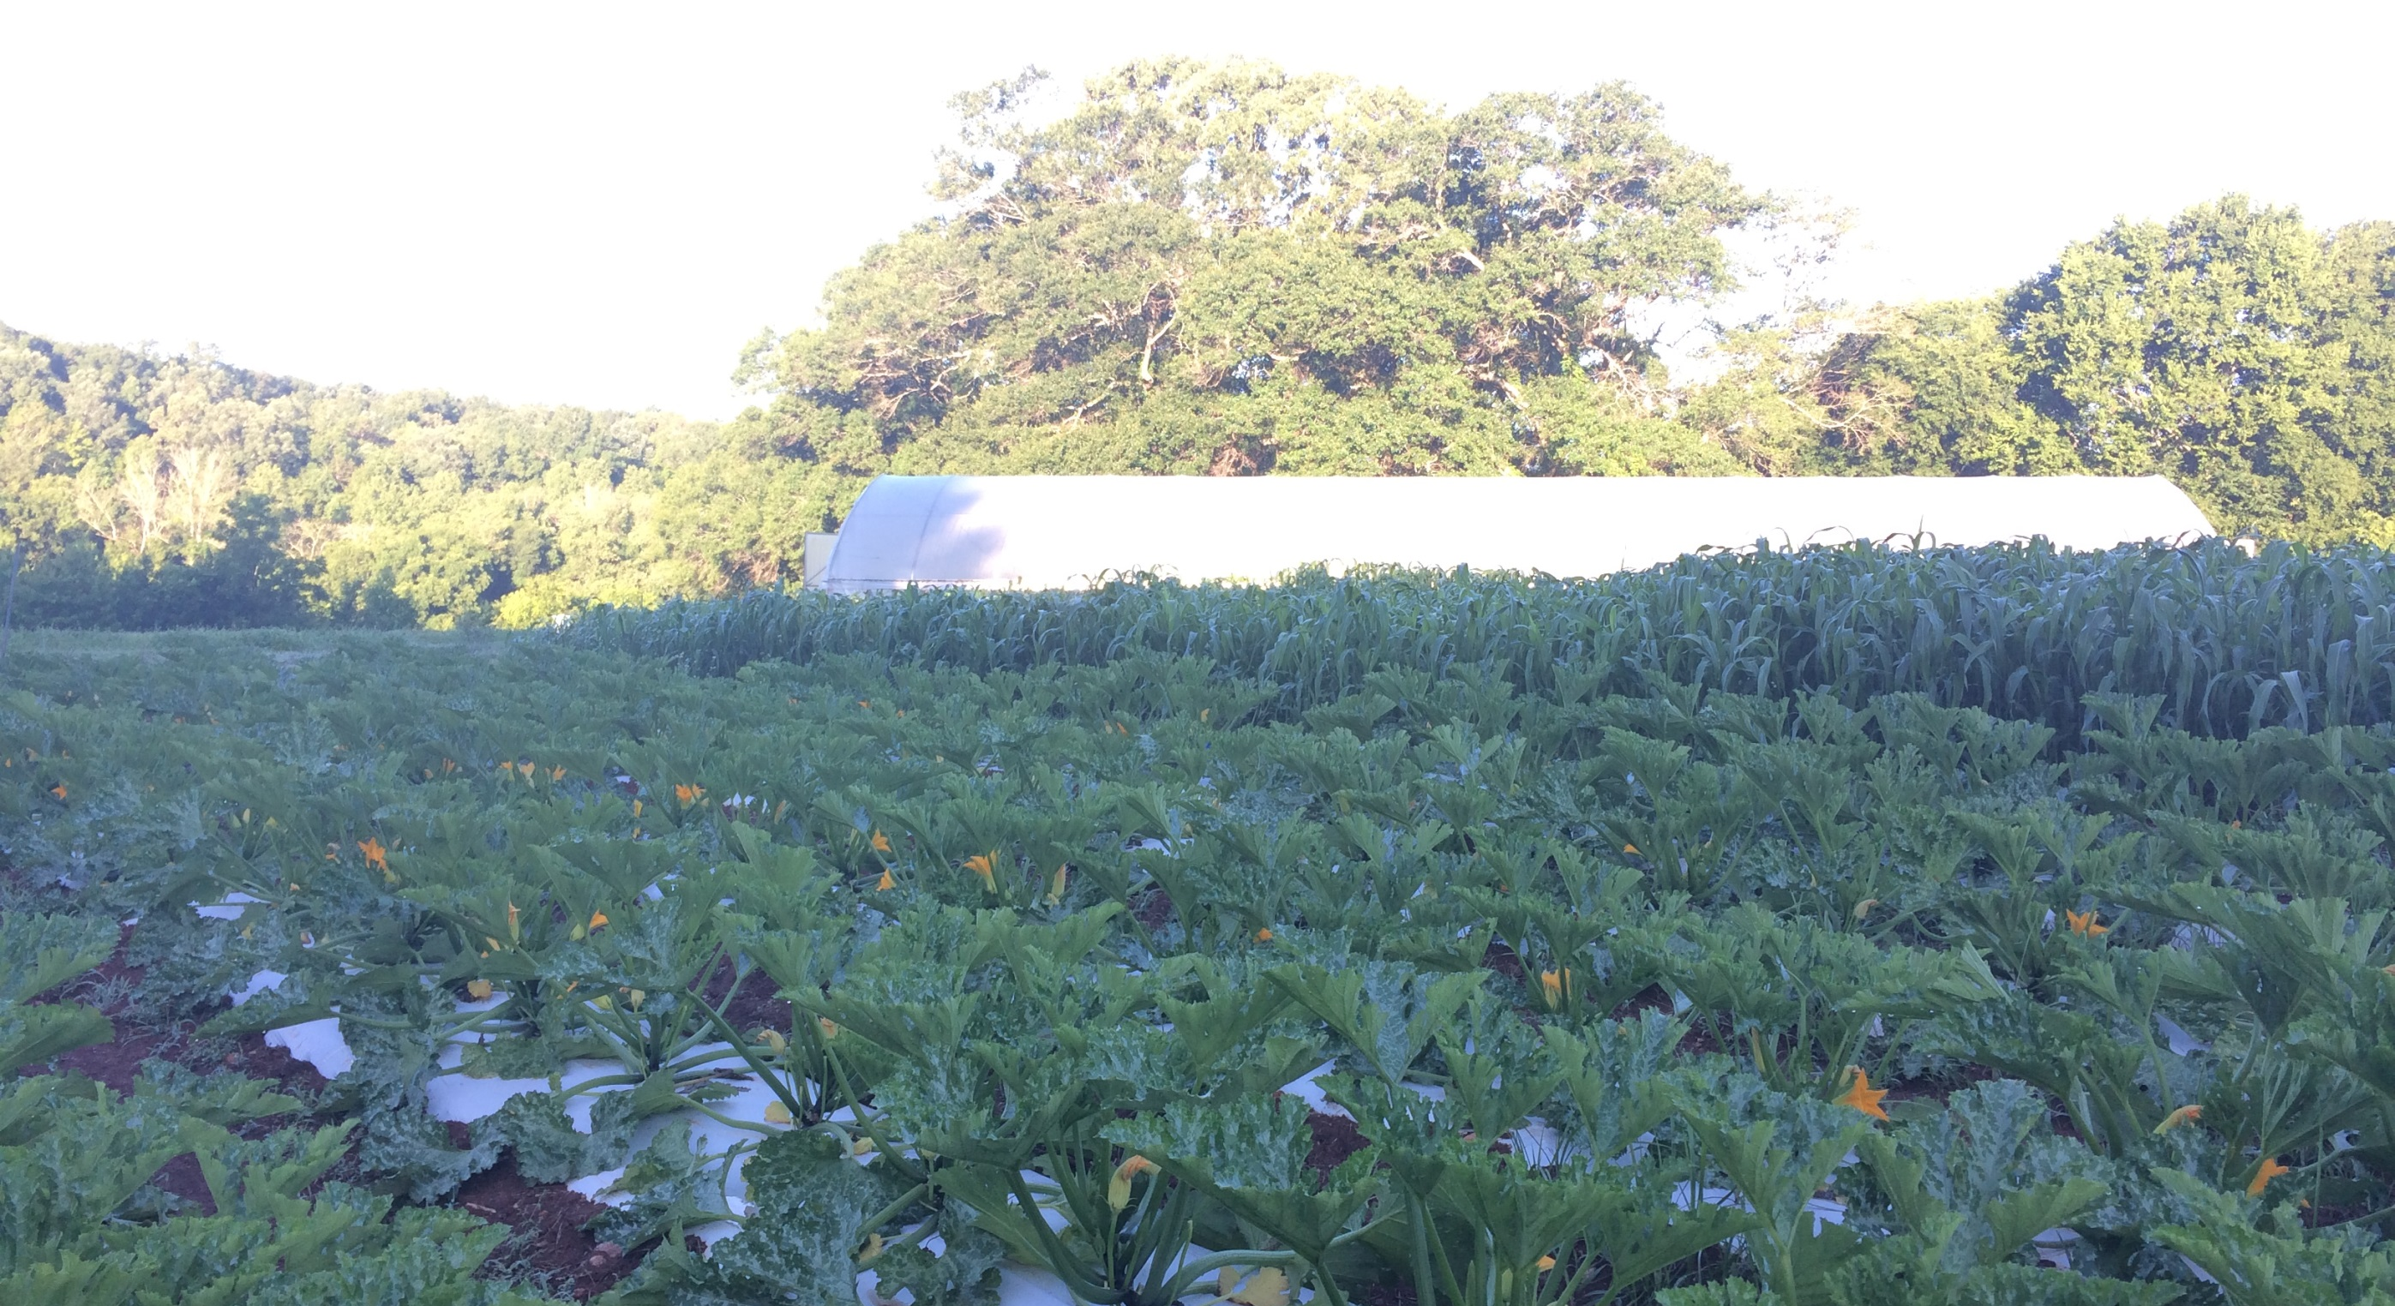
HIGH TUNNEL FERTILITY & NUTRIENT MANAGEMENT
Joe Rowland
Organic Initiatives Coordinator
Notes:
Please stop me if you have a question or want more information on anything.
These presentations will be made available online.

Slide 2
Properties of Soil
Physical
Chemical
Biological
Notes:
These are the topics I’m planning on addressing today.
I have pictures throughout the presentation for pictoral representation of what I’m talking about.

Slide 3
PHYSICAL
Structure
Parent Material –weathered rock that determines original supply of nutrient elements
Mineral Component – loss and retention
Pore Space, Air Space,top soil, bedrock, Organic Matter
Heavy, Light, Compacted, Sandy, Clay, Loam
45% Parent Material
25% Air
25% Water
5% Organic Matter
Particles sizes =
Gravel, Sand, Silt, Clay
Soil Web Survey
Soil Triangle

Slide 4
CHEMICAL
Soils are negatively charged
More reaction sites on smaller particles, i.e. clay
pH – amount of hydrogen
Availability
CEC, Cations & Anions
17 Essential Nutrients for Plants
N, P, K, Mg, S, Ca
Mo, Ni, Cu, Mn, Co, Zi, Fe, Cl
BORON

Slide 5
BIOLOGICAL
Soil Biome – Micro/Macro Flora & Fauna
Bacterial dominated in Ag/grassland soils, Fungi in forests
Bacteria, protozoa, algae, fungi and actinomycete
Decomposition, nutrient transformation, aggregation, N fixation, mycorrhizal symbiosis
Symbiotic relationships between plant roots and exudates and soil microbes that mine and accumulate plant nutrients
Earthworms, beetles, termites, ants, millipedes
Soil decomposition, aggregation, porosity, fertility, moisture and aeration

Slide 6
SOIL HEALTH MATTERS
Balancing the physical, chemical, and biological components in a positive way
Three-Legged Stool, each component affects the others - Examples?
Driving with the gas and brake! We use fertilizer in place of proper structure and biology
Building or sustaining organic matter, encouraging a diverse microbial population while optimally feeding plant and animal life
Compost, Beneficial Bacteria/Fungi, Foliar Sprays, Organic Matter, Feeding Soil microorganisms
Notes:
These are the things you need to consider when planning out the space in your tunnel.
I’ll touch a little more on each of these.
Picture and why that set up works in there for that production.

Slide 7
FERTILITY CONSIDERATIONS
What is your soil type? Sand, silt, clay, loam
What is the past land use and fertilizer applications
Covers crops, etc
When are you planting? Timing for amending fields and having ground prepped for crops
What is your pH? How to adjust it?
Affect on micro-nutrients, understanding different sources of lime, how much to apply to change pH, sulfur/calcium/magnesium
What are the plants needs for fertility?
Perennial or annual, heavy feeder, light feeder, short/long season, crop specifics, i.e. beets and broccoli like boron, peppers need calcium, tomatoes need potassium, carrots don’t like too much nitrogen
Life cycle & growth habit
Pre-Plant and Post-Plant Fertilizer applications
70-80% of fertility should come pre-plant, may depend on soil type and available post-plant fertility
Fertigation, side dressing, composting, etc
Notes:
These are the things you need to consider when planning out the space in your tunnel.
I’ll touch a little more on each of these.
Picture and why that set up works in there for that production.

Slide 8
SOIL TESTING
Test the area in an X or grid pattern, taking samples every certain distance evenly across the sample area
Mix all soil cores together well to create a representative sample
May want to sample multiple different plots and/or sample depending on specific crops
Choose a lab, NCSU and CLEMSON are most affordable, but not always the most detailed
Kinsey Lab, Haney, WayPoint Analytical, Waters Agricultural
Notes:
These are the things you need to consider when planning out the space in your tunnel.
I’ll touch a little more on each of these.
Picture and why that set up works in there for that production.

Slide 9
BASICS OF NUTRIENT MANAGEMENT
Apply the proper amount at the proper time in the proper way
Cover crops, add OM, break compaction, scavenge, preserve, cycle nutrients
Tie up nutrients, source of weed seeds, how to manage, terminate, incorporate, etc
Mulch, keeps soil covered, reduce transpiration, reduces weeds, mediates soil temps for critters
Not too deep, understand where it came from and what it’s made from, may tie up nutrients
Compost, adds some fertility, improves structure, source of OM
Can burn plants if not properly composted, may tie up nutrients, may leach and/or add too much fertility or be inconsistent in delivery
No more than 2 inches per year!?***

Slide 10
MINERALS
Non-synthetic, non-petroleum based products
Derived from natural, organic, living sources, i.e. blood meal, bone meal, alfalfa meal
Some mined substances, rock dusts, potassium, phosphorous
Understand the action of the fertilizer, fast or slow, water soluble, pelletized
Notes:
These are the things you need to consider when planning out the space in your tunnel.
I’ll touch a little more on each of these.
Picture and why that set up works in there for that production.

Slide 11
FERTILIZERS CALCULATIONS
COMPLETE VS INCOMPLETE
Does the fertilizer offer all 3 numbers on the bag, N-P-K
If not, you will need to apply multiple products
Analysis is the % of each nutrient in the bag of fertilizer
Convert this number based on the area to be amended, i.e. 1000 sq ft
Simple equation: WANT divided by HAVE
The soil tests results should be in actual nutrient amounts, not fertilizer amounts
WANT - What amount of ACTUAL nutrient you want to apply, i.e. 100lbs N per AC
HAVE – What % of that nutrient the fertilizer you are using contains. This will need to be in decimal form.
EXAMPLE: You want 100lbs of actual N per AC, you have a fertilizer that is 12% N, 100/.12=833lbs of that fertilizer to supply 100lbs of N per AC
Not fertilizing an acre? Adjust that final figure by the 5 of an acre you are growing, 833/4=208.25lbs fert per ¼ ac OR make the adjustment on the amount you WANT before doing calculation, i.e. 25/.12=208.33 lbs of fertilizer
Consider other nutrients and amounts being added when using a complete fertilizer, sometimes easier with individual products, but more expensive
Read the suggested recommendations on the bag or work with an extension agent, CFSA, or a reputable fertilizer distributor to determine amounts. I would not ask someone selling fertilizer to tell you how much to use and this may not be crop specific
Notes:
These are the things you need to consider when planning out the space in your tunnel.
I’ll touch a little more on each of these.
Picture and why that set up works in there for that production.

Slide 12
HOW TO APPLY FERTILIZERS
Broadcast
Bag spreader, cone spreader, drop spreader, manure spreader, bucket and cup, earthway (sidedressing)
Sidedressing
Apply a small amount of fertilizer beside the growing plant
Incorporate for fastest action, till, rake, compost/mulch over, expose to microbes faster
Foliar Sprays/Compost Teas/Beneficials Microbes
Apply to surface of leaf, verify no phototoxicity, root drenches, soak roots before transplant
Molasses soil stimulant
Notes:
These are the things you need to consider when planning out the space in your tunnel.
I’ll touch a little more on each of these.
Picture and why that set up works in there for that production.

Slide 13
Products
Complete Fertilizers: Harmony, Nature Safe, Fox Farm, TRUE
N Sources: Blood Meal, Feather Meal, Alfalfa Meal, Soy Meal, Chilean Nitrate*,
P Sources: Rock Phosphate, Bone Meal, Fertoz, Fish Meal
K Sources: Potassium Sulfate, Sunflower Hull Ash
Lime/Calcium: Dolomitic/Calcitic Limestone, Gypsum(no pH)
Micros, Liquids, Biologicals: Lots to choose from depending on your specific needs
N, P, K, Mg, Ca, S, B, balance pH and check for any glaring micro- nutrient deficiencies
Notes:
These are the things you need to consider when planning out the space in your tunnel.
I’ll touch a little more on each of these.
Picture and why that set up works in there for that production.

Slide 14
Sources
Country Farm & Home, Pittsboro, NC
sustainable_ag_pricing_updated_january_30_2024.pdf (chathamfarmsupply.com)
Seven Springs Farm Supply, Check, VA
Seven Springs Farm Supply (7springsfarm.com)

Slide 15
Tools – Johnny’s Seeds, Never Sink Tools, Farmers Friend, Bootstrap Farmer, Agri-Supply
Supplies – Country Farm & Home, Seven Springs Farm, Nolt’s Greenhouse Supplies, Martin’s Produce Supplies
High Tunnels – Williamson Greenhouses, Puckett’s Greenhouses, Jaderloon, Atlas
More resources, educational materials and technical assistance from Carolina Farm Stewardship Association
joe@carolinafarmstewards.org
Notes:
These are the things you need to consider when planning out the space in your tunnel.
I’ll touch a little more on each of these.
Picture and why that set up works in there for that production.

Slide 16
Questions & Survey
Thank You!

