Slide 1

High Tunnel Pest & Disease Management
Joe Rowland
Organic Initiatives Coordinator

Slide 2
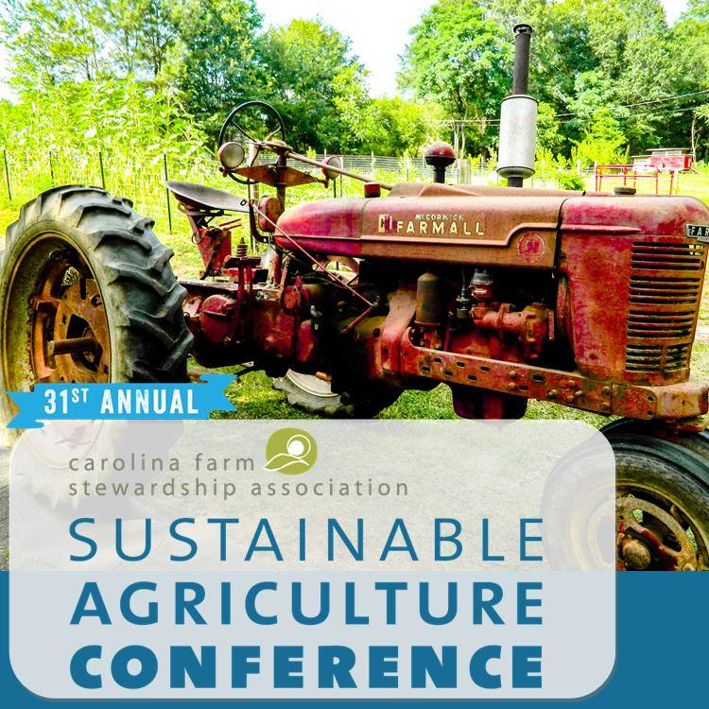
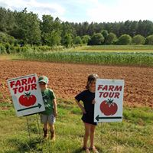
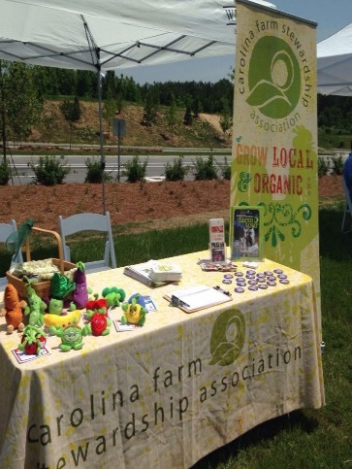
CFSA’s MISSION
We help people in the Carolinas grow and eat local, organic food by advocating for fair farm and food policies, building the systems that organic family farms need to thrive, and educating communities about local, organic farming.

Slide 3
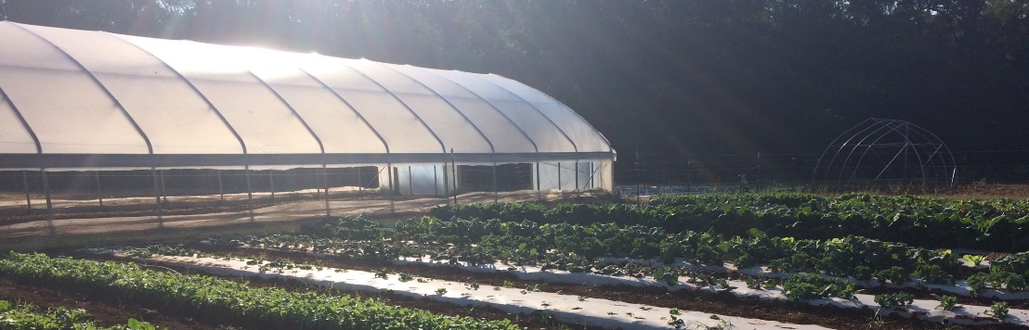
Overview
Pest Control Overview
Insect prevention and control
Disease prevention and control
Weed prevention and control
Scouting
Sourcing materials, application and tips

Slide 4
Many Little Hammers
Matt Liebman and Eric Gallant, 1997
Pest management is achieved through the combination of multiple control methods.
  The whole is greater than the sum of its parts.
    Increase control through the use of multiple control tactics.
  Reduce the risk of crop failure or serious loss by spreading the burden of control across several methods.
  Decrease pest resistance by reducing exposure to any one management tactic.

Slide 5
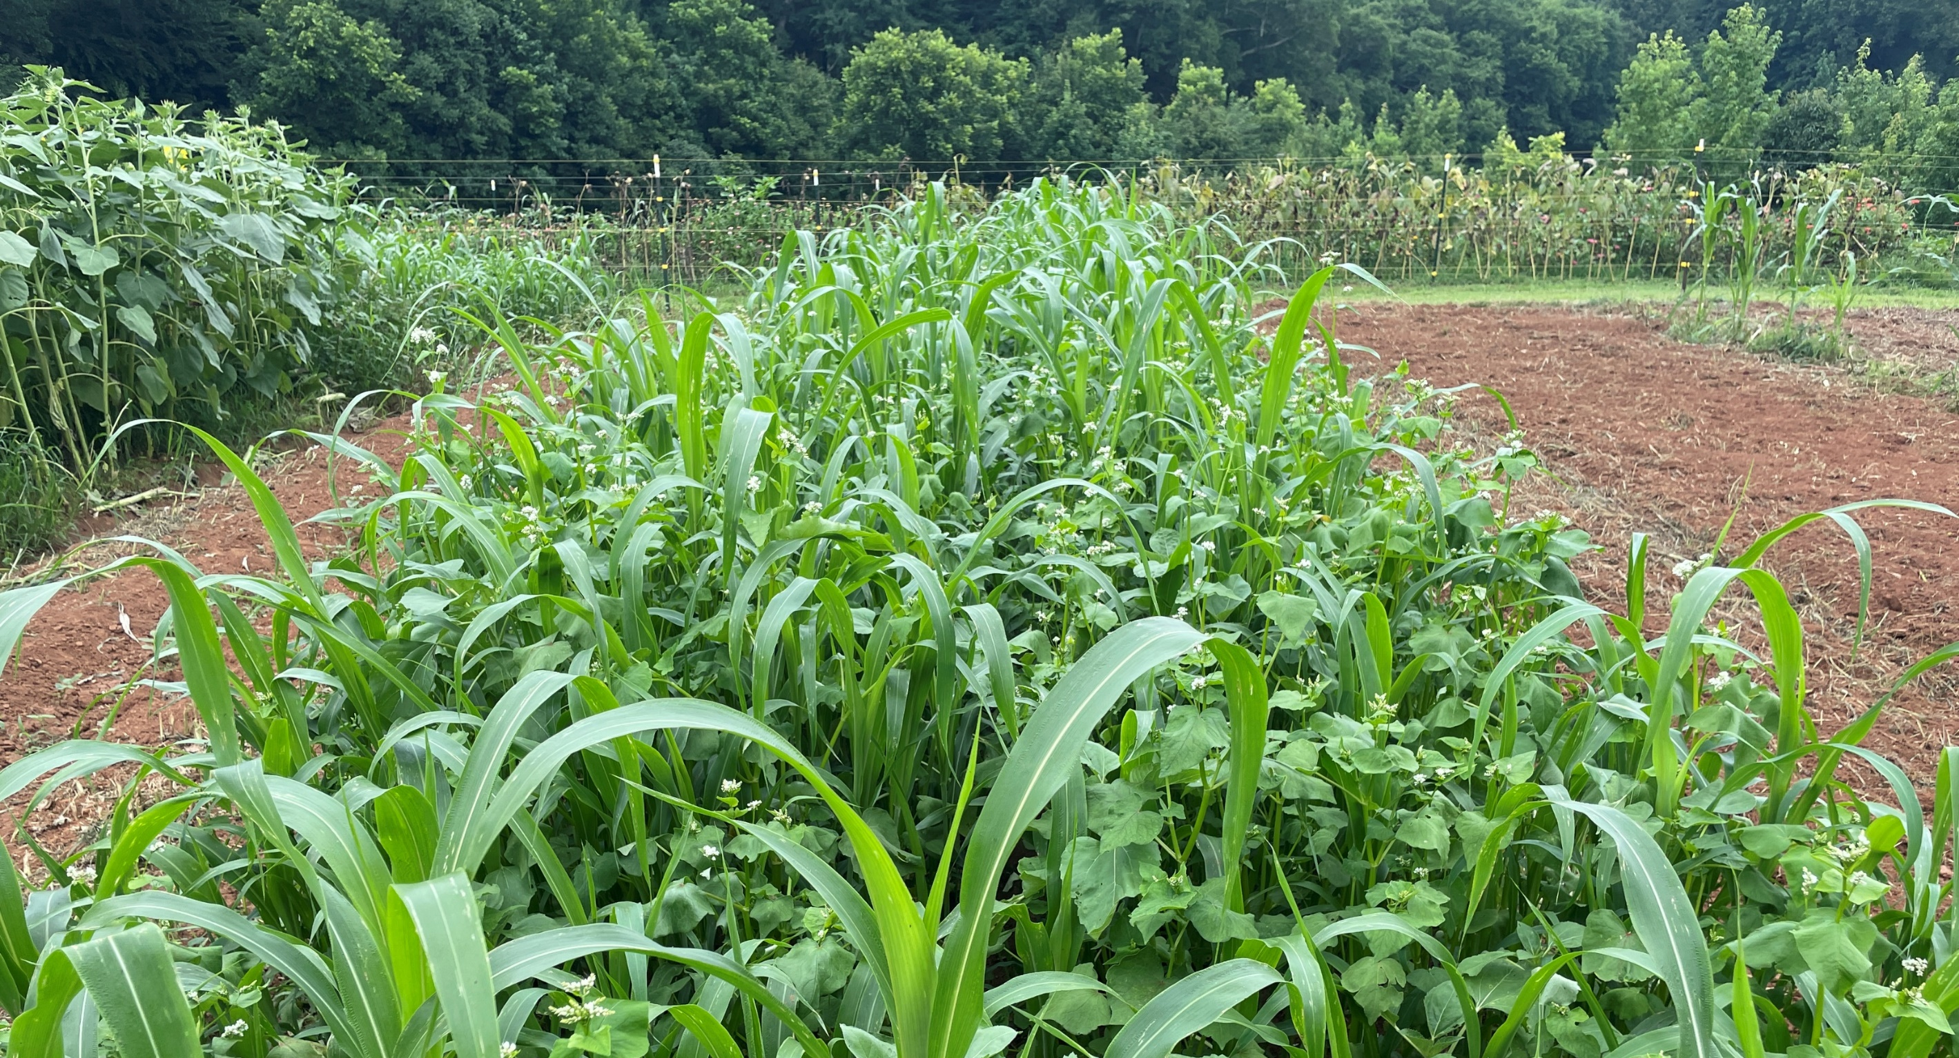
Many Little Hammers
Big Hammers (Direct Control)
  Pesticides
  Large scale Cultivation
Little Hammers (Indirect Control)
  Crop genotype
  Planting date
  Row spacing
  Seeding density
  Nutrition
  Residue management
  Tillage intensity
  Intercropping
  Biological

Slide 6
Terms
Cultural Control: Methods that alter the environment, the condition of the host, or the behavior of the pest.
Sanitation, variety selection, crop rotation, water & nutrient management, plant spacing.
Mechanical Control: Devices, equipment, physical control.
Cultivation, exclusion (row covers), trapping.
Biological Control
Natural enemies: insects, bacteria, fungi
Organic Pesticides
Natural materials: animals, plants, bacteria, and non-synthetic mineral products.

Slide 7
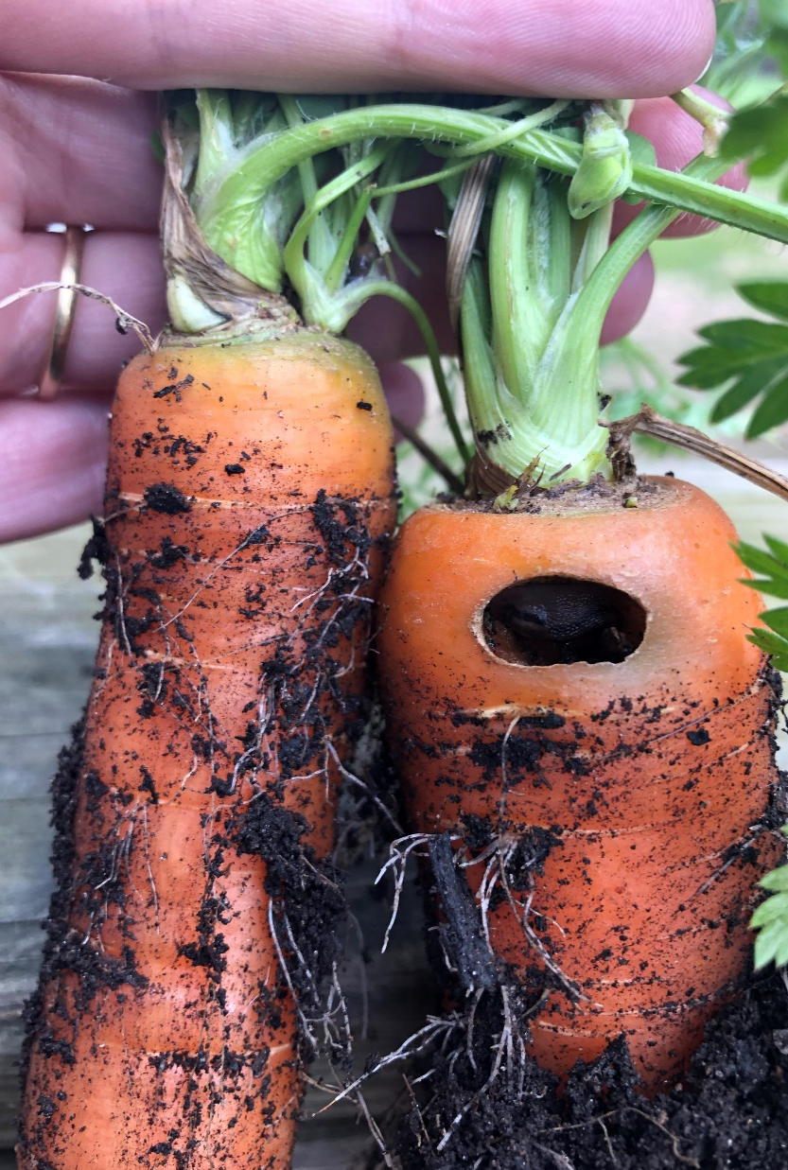
Insect AND ANIMAL pest

Slide 8
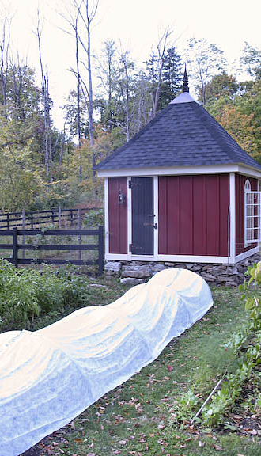
Insect Control
Mechanical
  Physical barriers
  Hand picking
Cultural
  Crop rotation
  Soil/plant health
  Sanitation
Biological
  Intercroping
  Farmscaping
  Natural enemies
Biopesticides
  Bt, pyrethrins

Slide 9
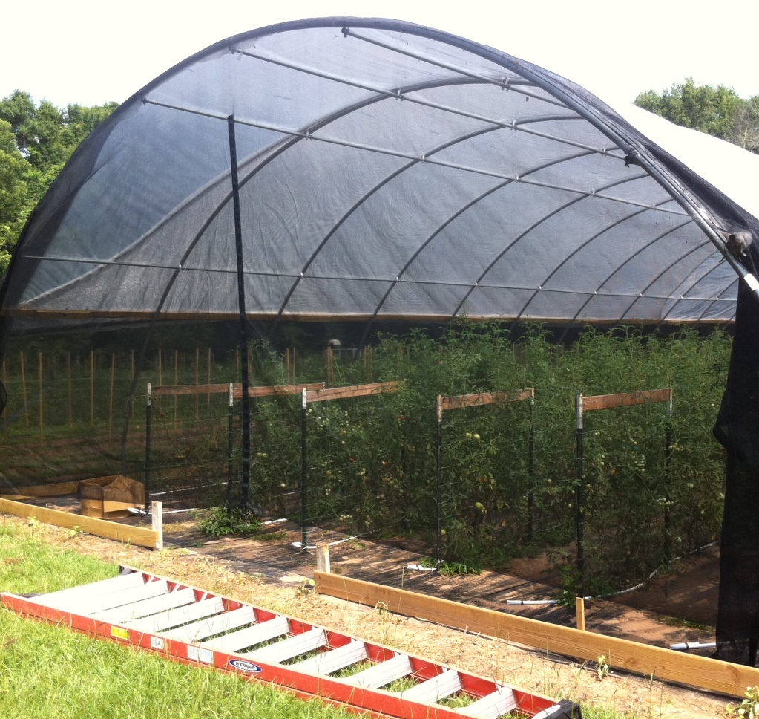
Insect netting
Endwalls and side walls
How is it attached?
Pollination
Ventilation

Slide 10
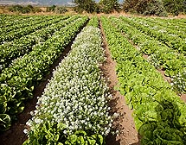
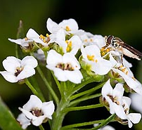
Conservation Biological Control
Maintain / enhance natural enemy populations
  Don’t kill them
  Increasing / maintain habitat
    Farmscaping
    Intercropping
    Strip cropping

Slide 11
Augmented Biocontrol
Inoculative: releasing a few organisms at a critical point.
Inundative: releasing millions of organisms.
BioControl Network: http://www.biconet.com/index.html

Slide 12
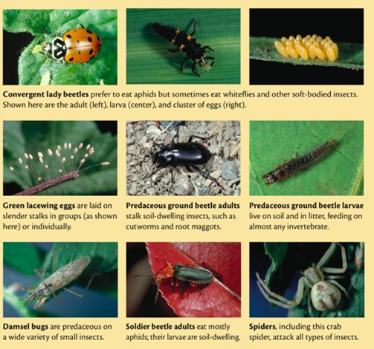
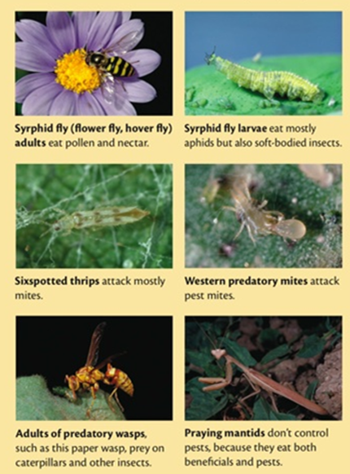
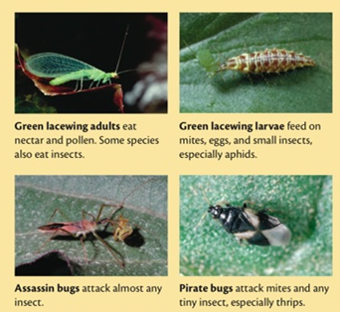
Beneficial Insects

Slide 13
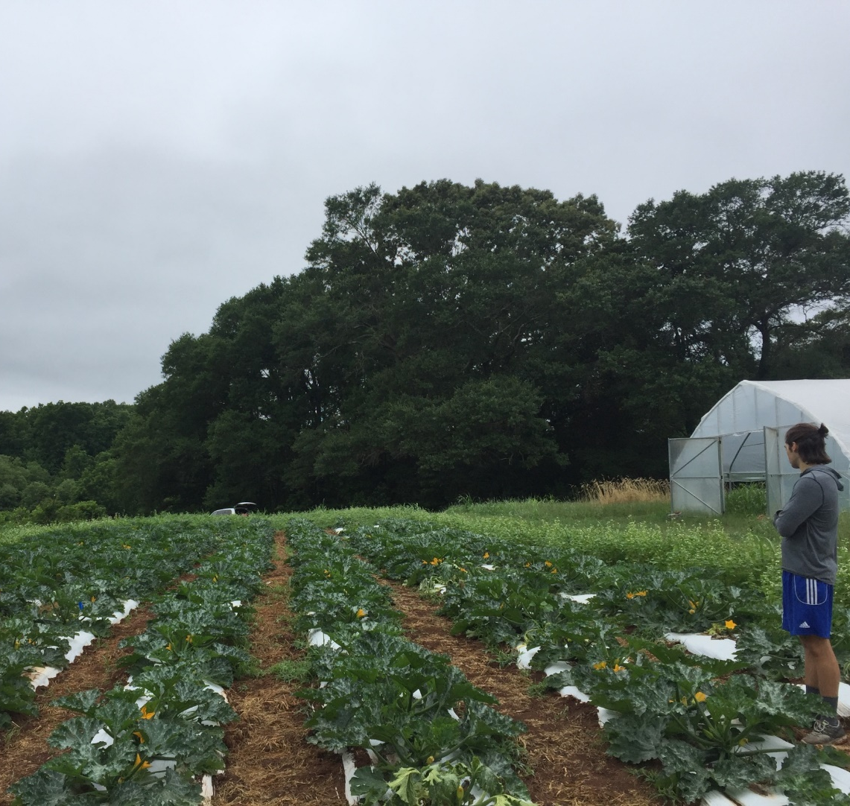
Looking Outside
Perimeter plantings as deterrents
  Herbs
  Flowering plants/shrubs
Pollinator feeding and habitat strips
Coordinating crops in adjacent fields

Slide 14
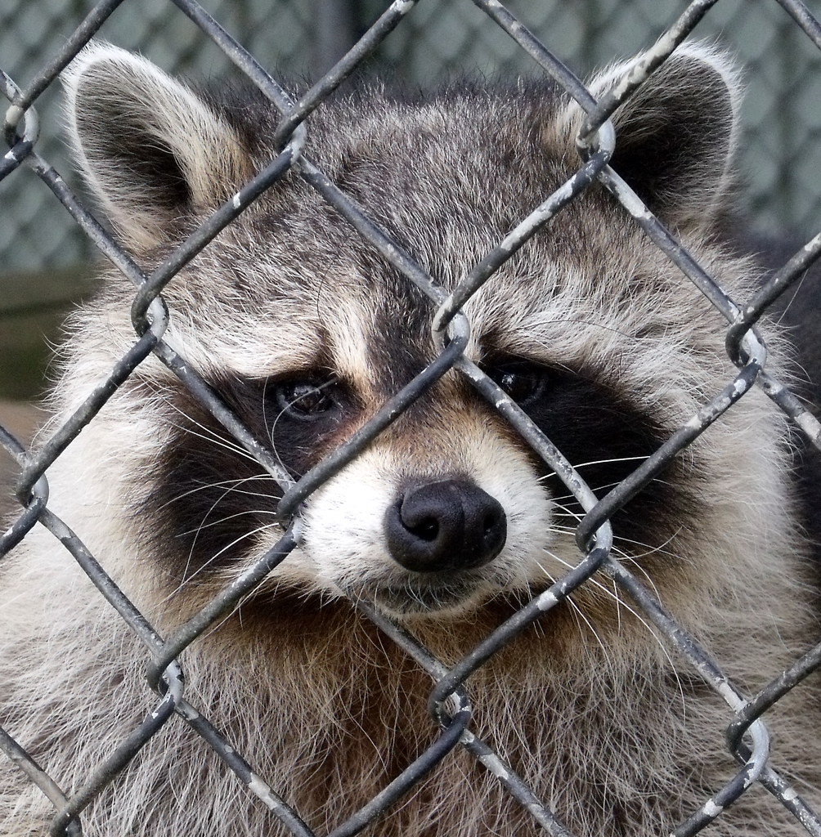
Animal Pest
Interior fencing
  Mesh vs electric
Buried fencing
Localized deterrents
  Scents, noise makers, bells etc…
Bait and trap
Perimeter plantings
Utilizing interior side beds
This Photo by Unknown Author is licensed under CC BY-SA

Slide 15
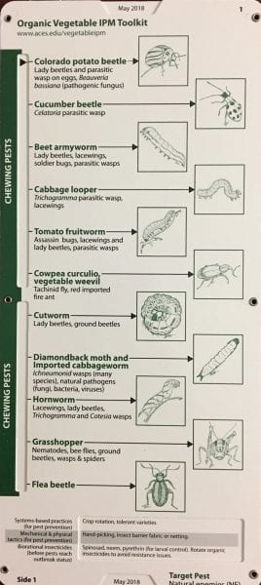
Additional Resources
Clemson IPM | College of Agriculture, Forestry and Life Sciences | Clemson University, South Carolina
https://www.aces.edu/blog/category/farming/ipm-farming/

Slide 16
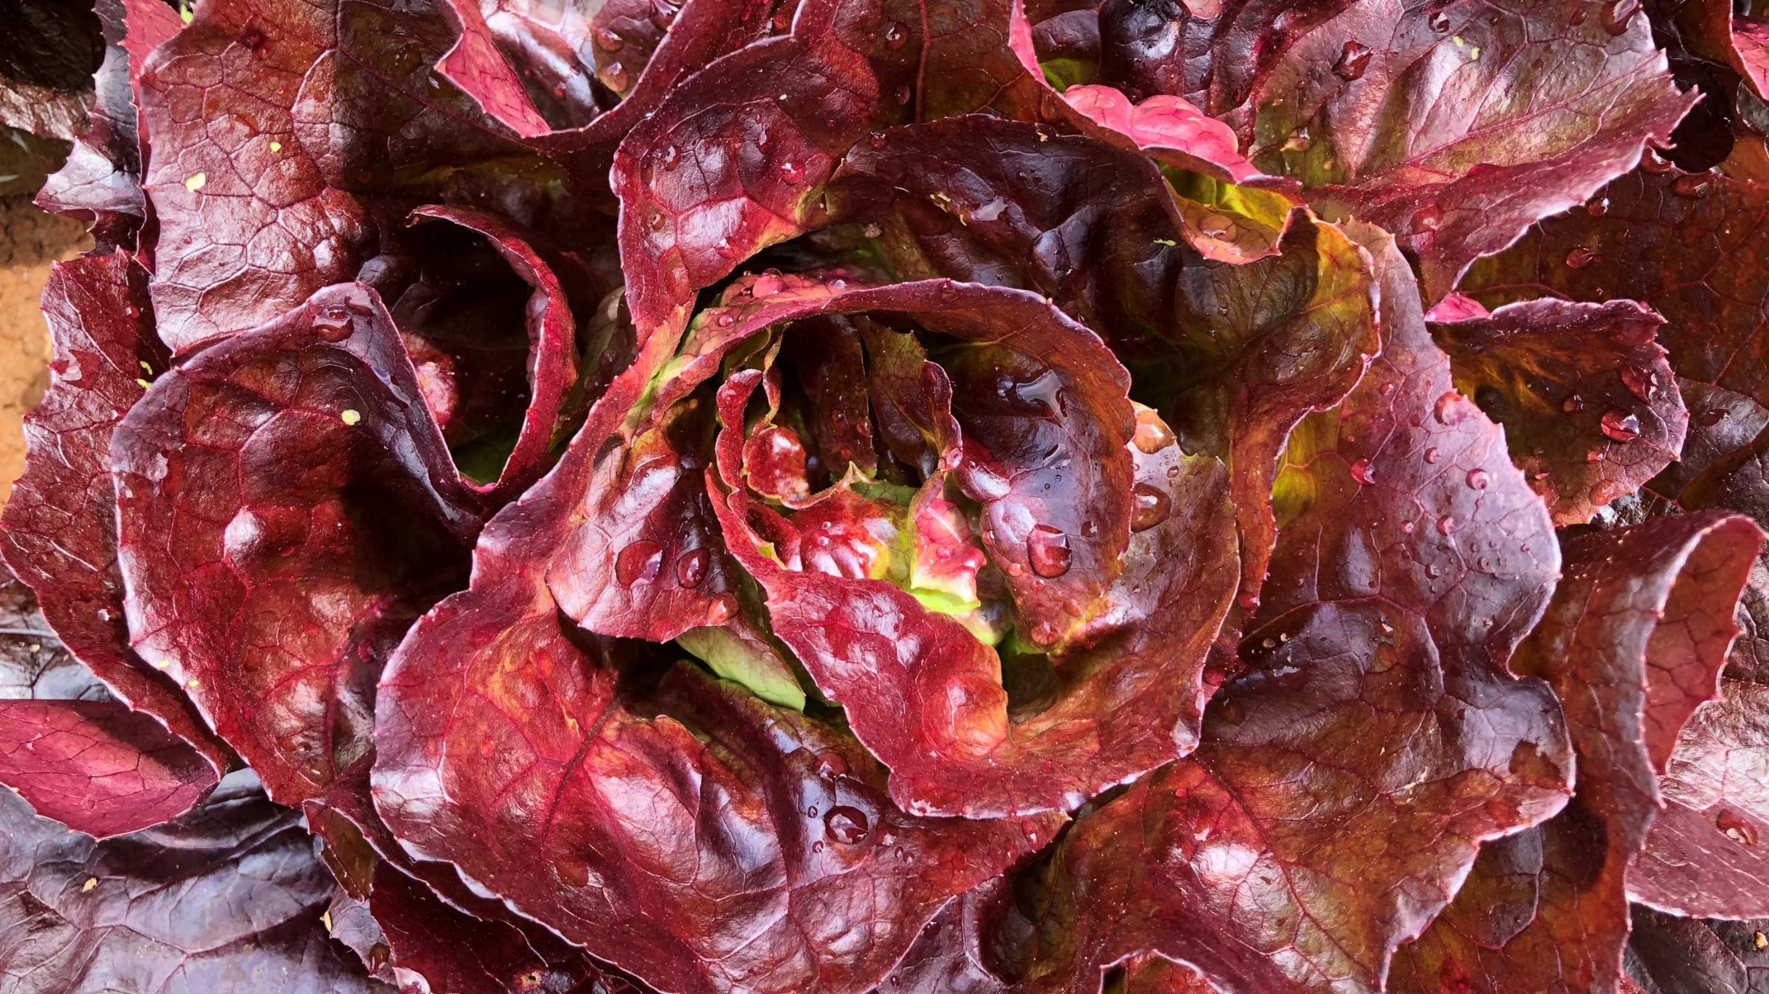
Disease Control

Slide 17
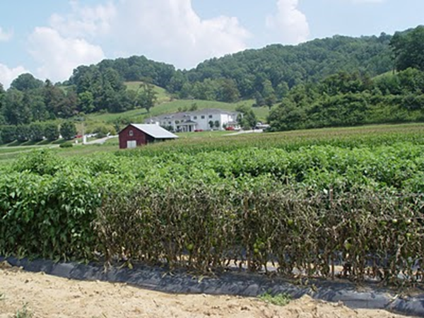
Disease Control
Mechanical
Cultural
  Crop rotation
  Sanitation
  Resistant varieties
  Plant spacing
  Irrigation mngt.
Biological
Biopesticides
  microbial fungicide and bactericide
Variety trials comparing late blight resistant and susceptible tomato varieties in Henderson County, NC.

Slide 18
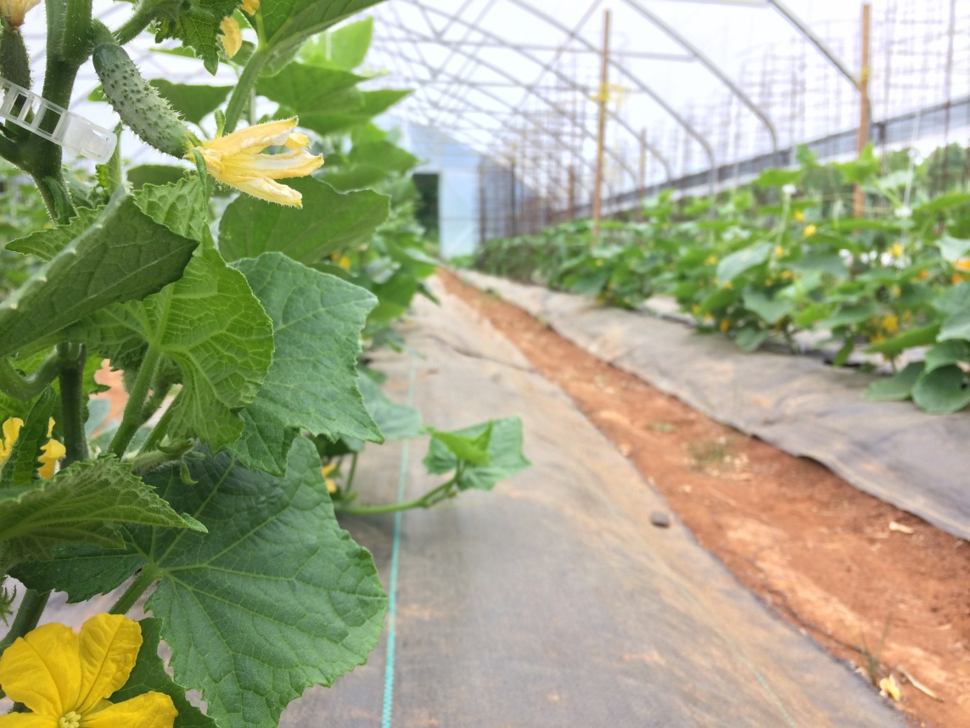
Preventative Measures
Plasticulture and Mulching
Spacing
Pruning
Variety Selection
Production Techniques
Crop Rotation
Insect Control
Weed Control

Slide 19
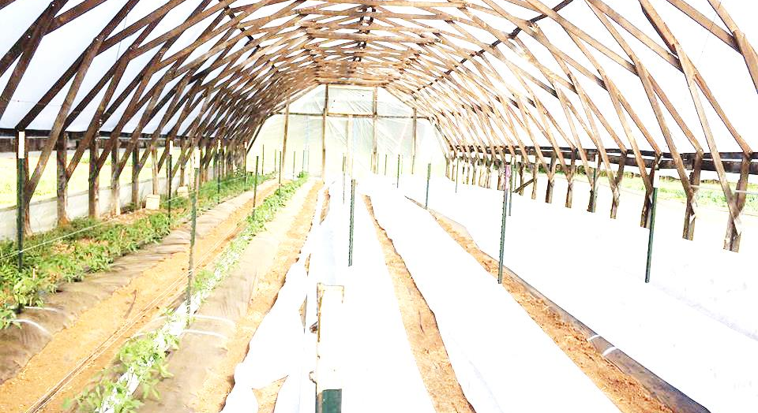
Plasticulture and Mulch
Plastic mulches
  Benefits – great barrier between soil and plants, retain and control moisture
  Drawbacks – Not reusable, Hard to apply and remove from field
Low tunnels and covers
  Benefits – Manipulate temperature, early plantings, insect barrier
  Drawbacks – increase humidity and soil contact, more labor
Landscape fabric as mulch
  Benefits – breathable for soil health, good barrier between soil/plants, reusable
  Drawbacks – should be sanitized, standard plant spacing, labor
Natural mulches
  Benefits – great for soil, OK barrier and moisture control
  Drawbacks – contamination, sourcing, limited weed prevention

Slide 20
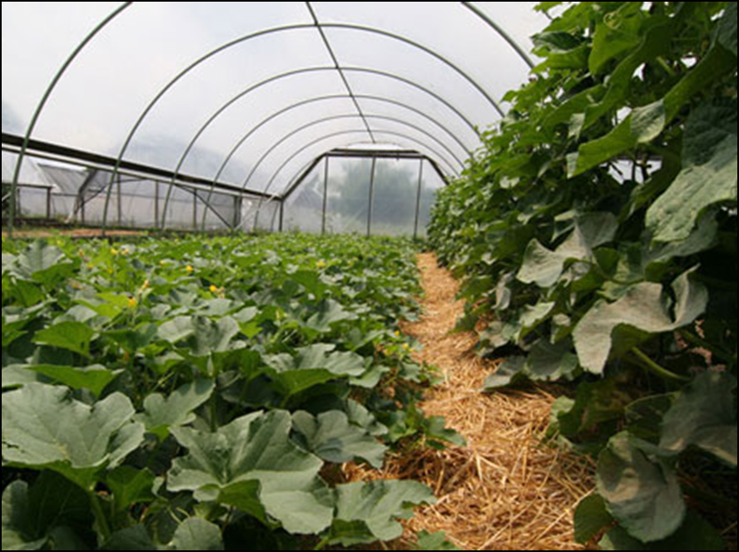
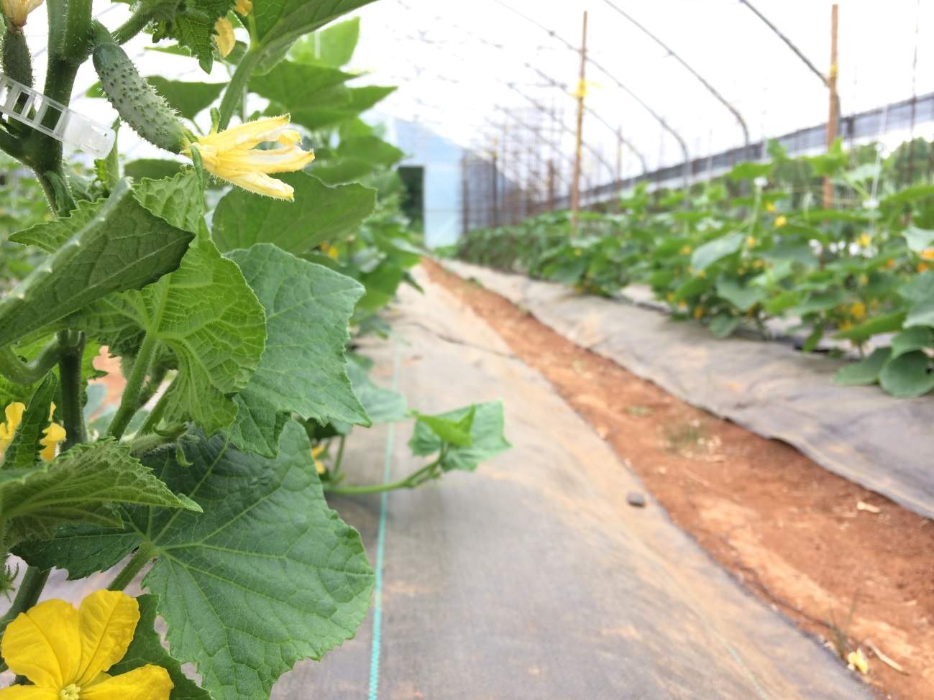
https://growingsmallfarms.ces.ncsu.edu
Lomax Research and Ed. Farm

Slide 21
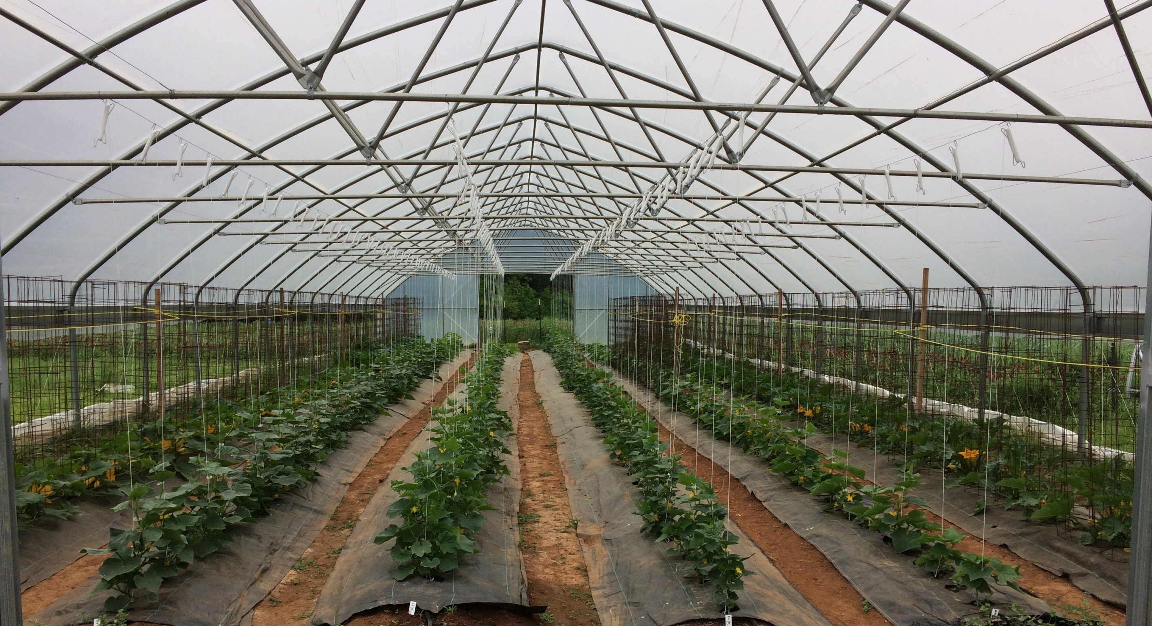
Spacing and Pruning
Raised beds vs. level ground
  Types of raised beds
Number of beds and placement in the tunnel
  Width of bed
Between row spacing
In row spacing
Edge beds
Equipment needed?
Keep foliage off the ground
Prune for air flow
Vertical growth maximizes space
Choose the right trellising structure
  Use clean supplies
Cull out diseased plants!

Slide 22
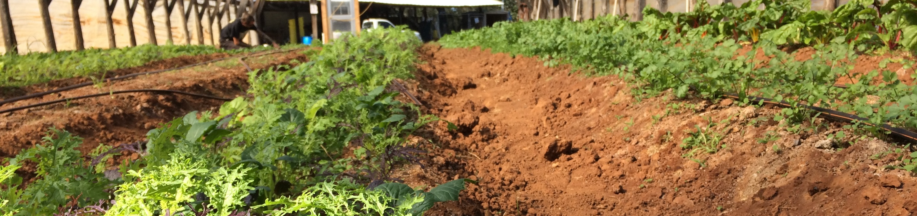
Variety Selection
The best way to prevent disease is to start with the right variety for your area and management practices!!
Think about high tunnel conditions vs field conditions in your area
Find a balance between market requests and what you can grow well

Slide 23
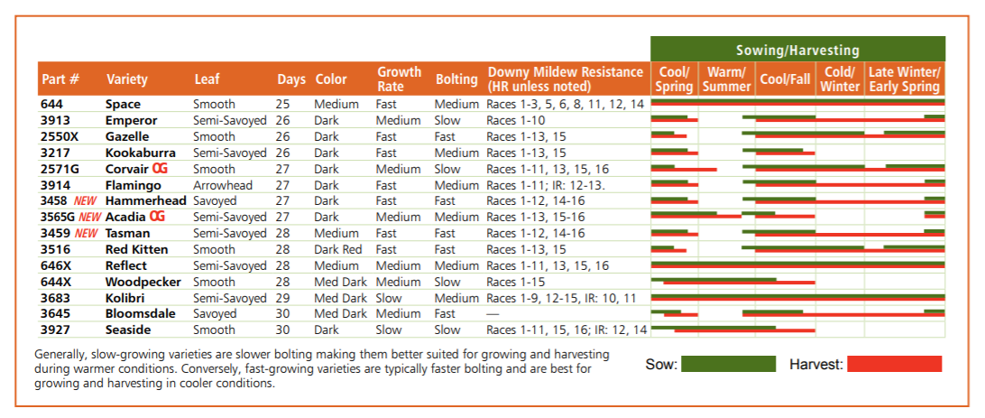
Spinach Comparison Johnny’s Selected Seeds; Crop Comparison

Slide 24
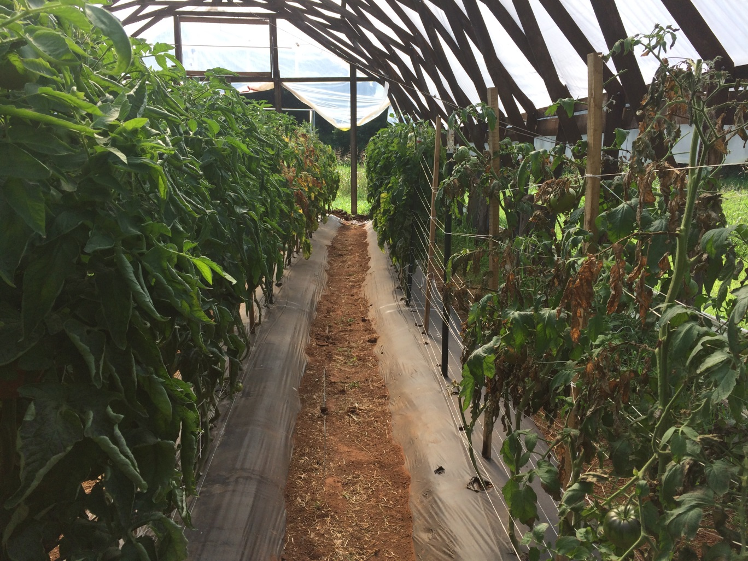
Grafting
Reduced disease incidence
Increased overall plant vigor
Mainly used for tomatoes
  Cucumbers
Grafting yourself
Purchasing grafted plants
Production tips!

Slide 25
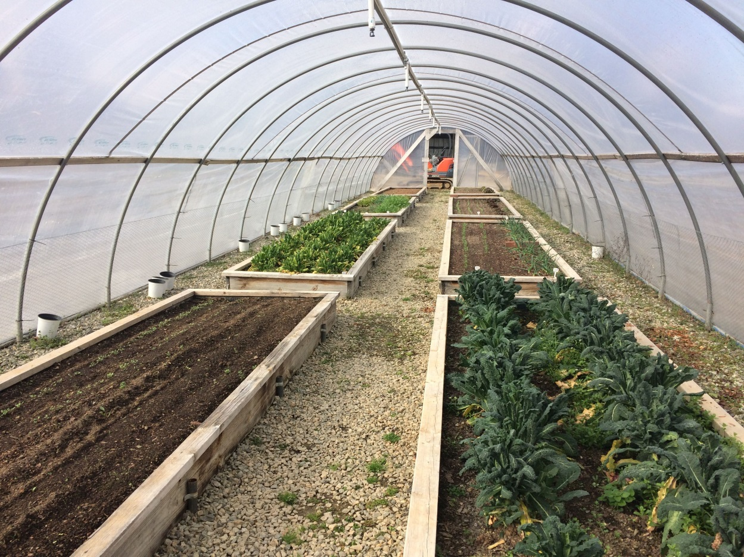
Production Techniques
Keep Everything as clean and dry as possible!!!
Anticondensate plastic
Keep row covers clean and dry
Vents
Fans
  Out-take and circulation
Control flooding
Control other pest like weeds and insects

Slide 26
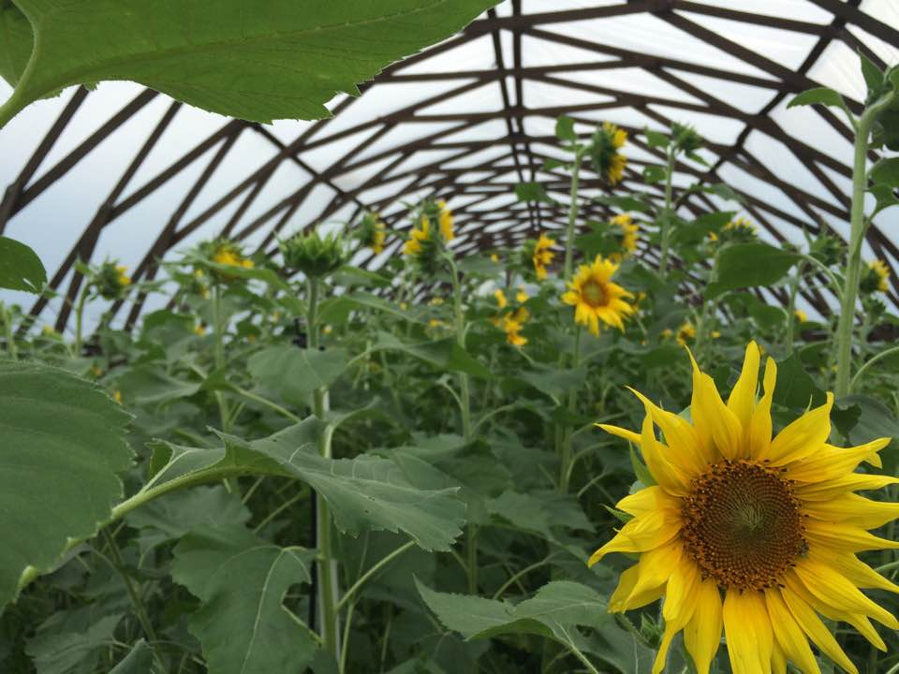
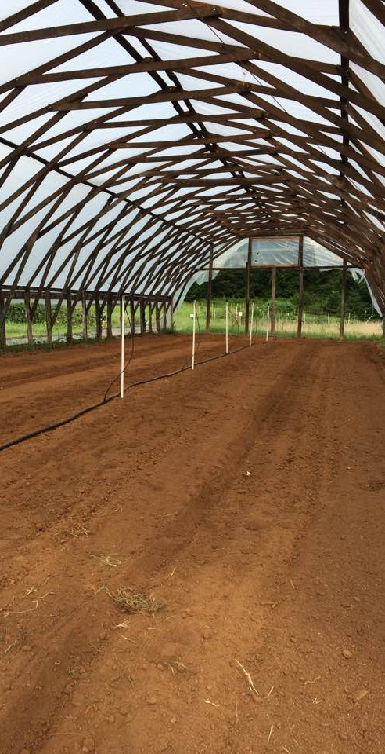
Crop Rotations in Tunnels
Accomplish rotations however you can
Whole tunnel rotation
Permanent bed

Slide 27
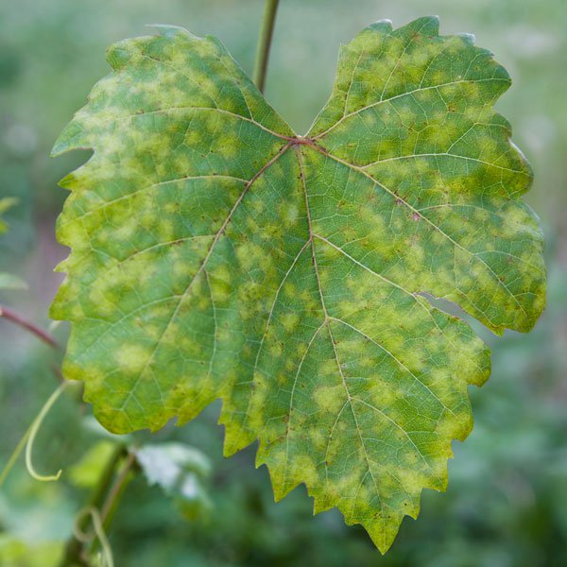
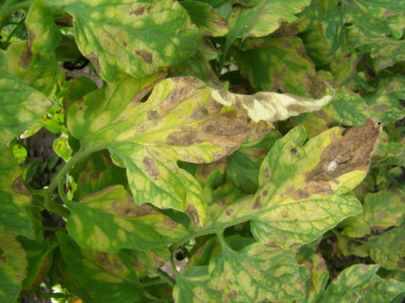
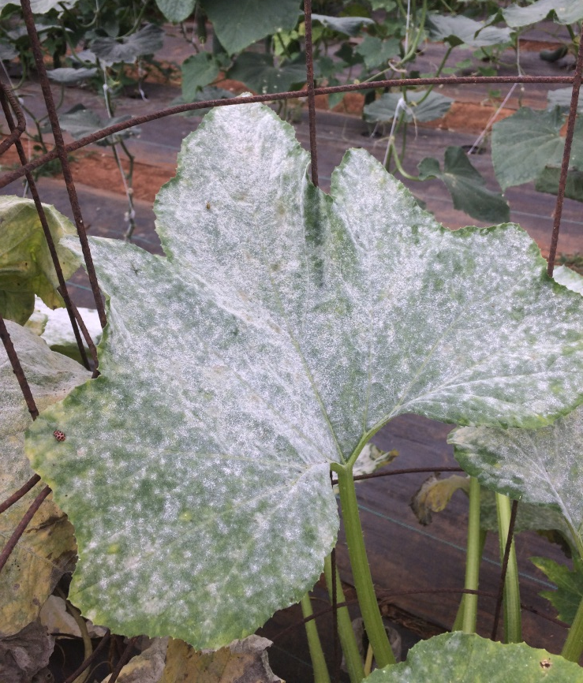
Powdery Mildew
Downy Mildew
Plasmopara viticola
Leaf Mold
P. fulva

Slide 28
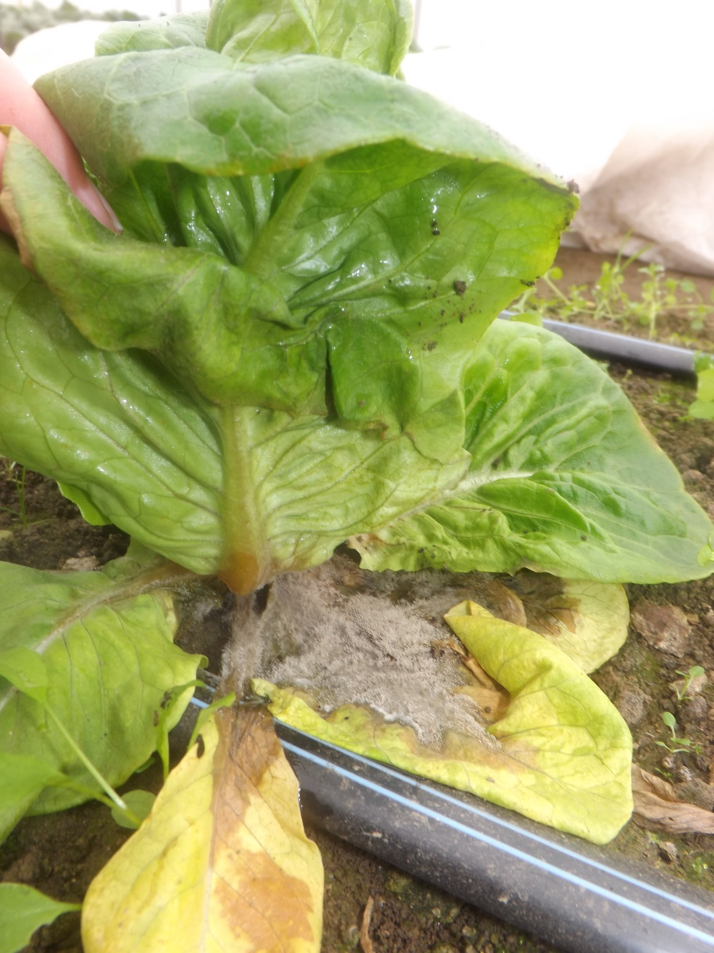
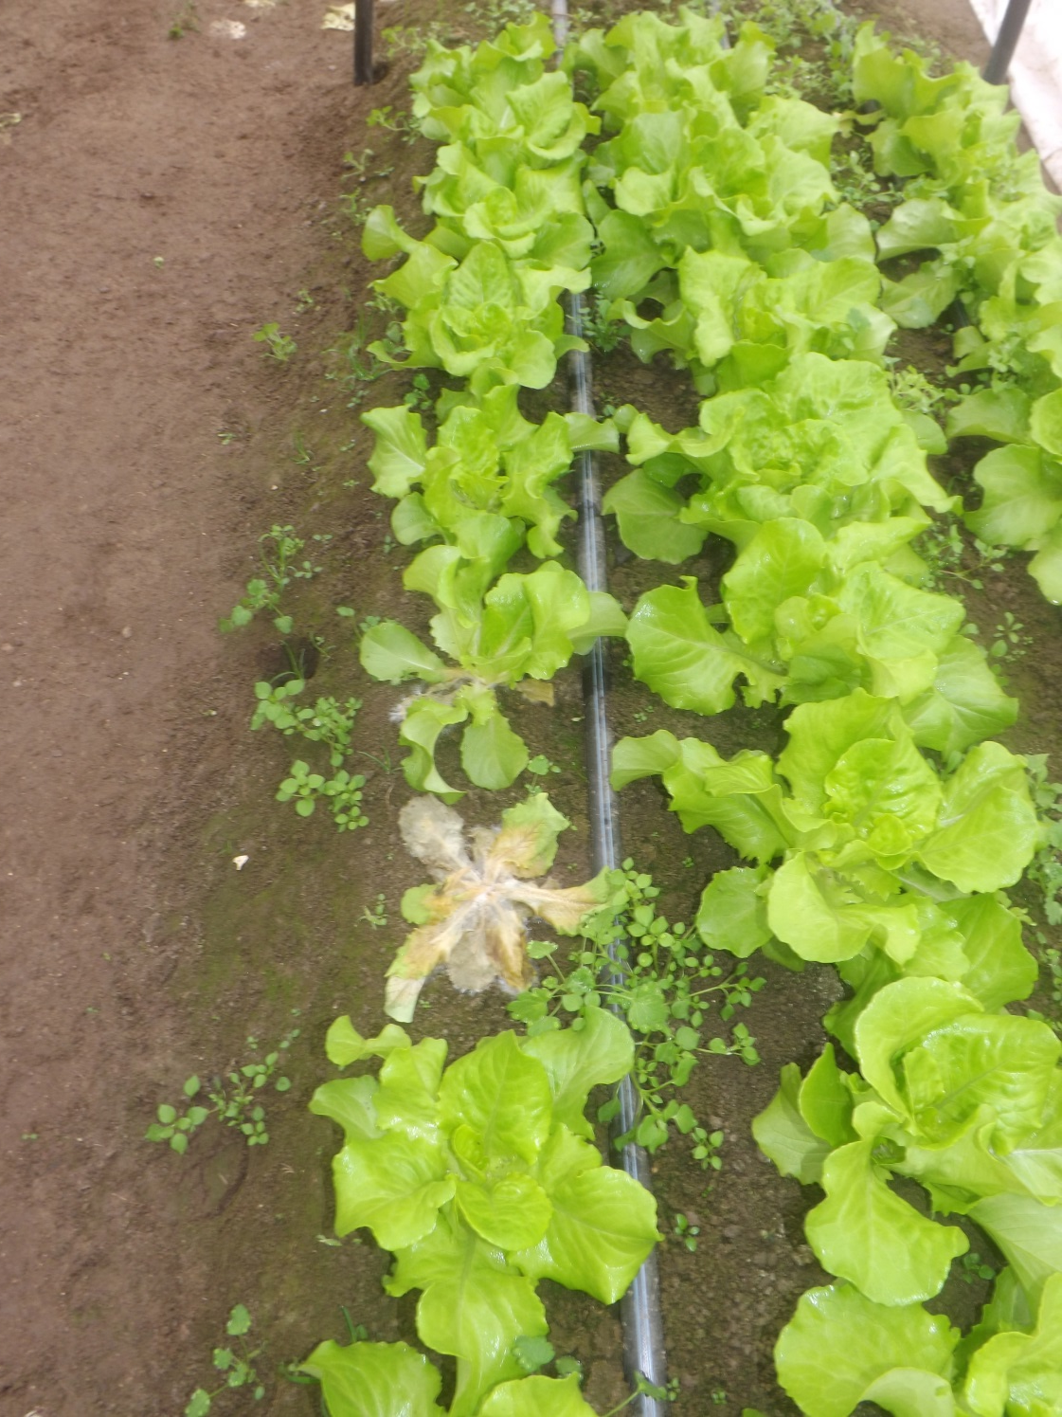

Slide 29
Resources
Foliar Fungal Diseases on High Tunnel and Greenhouse Tomatoes
  https://content.ces.ncsu.edu/foliar-fungal-diseases-on-high-tunnel-and-greenhouse-tomatoes

Slide 30
Pest and Disease Diagnosis
Plant and Pest Diagnostic Clinic | Public | Clemson University, South Carolina
NCSU Plant Disease and Insect Clinic

Slide 31
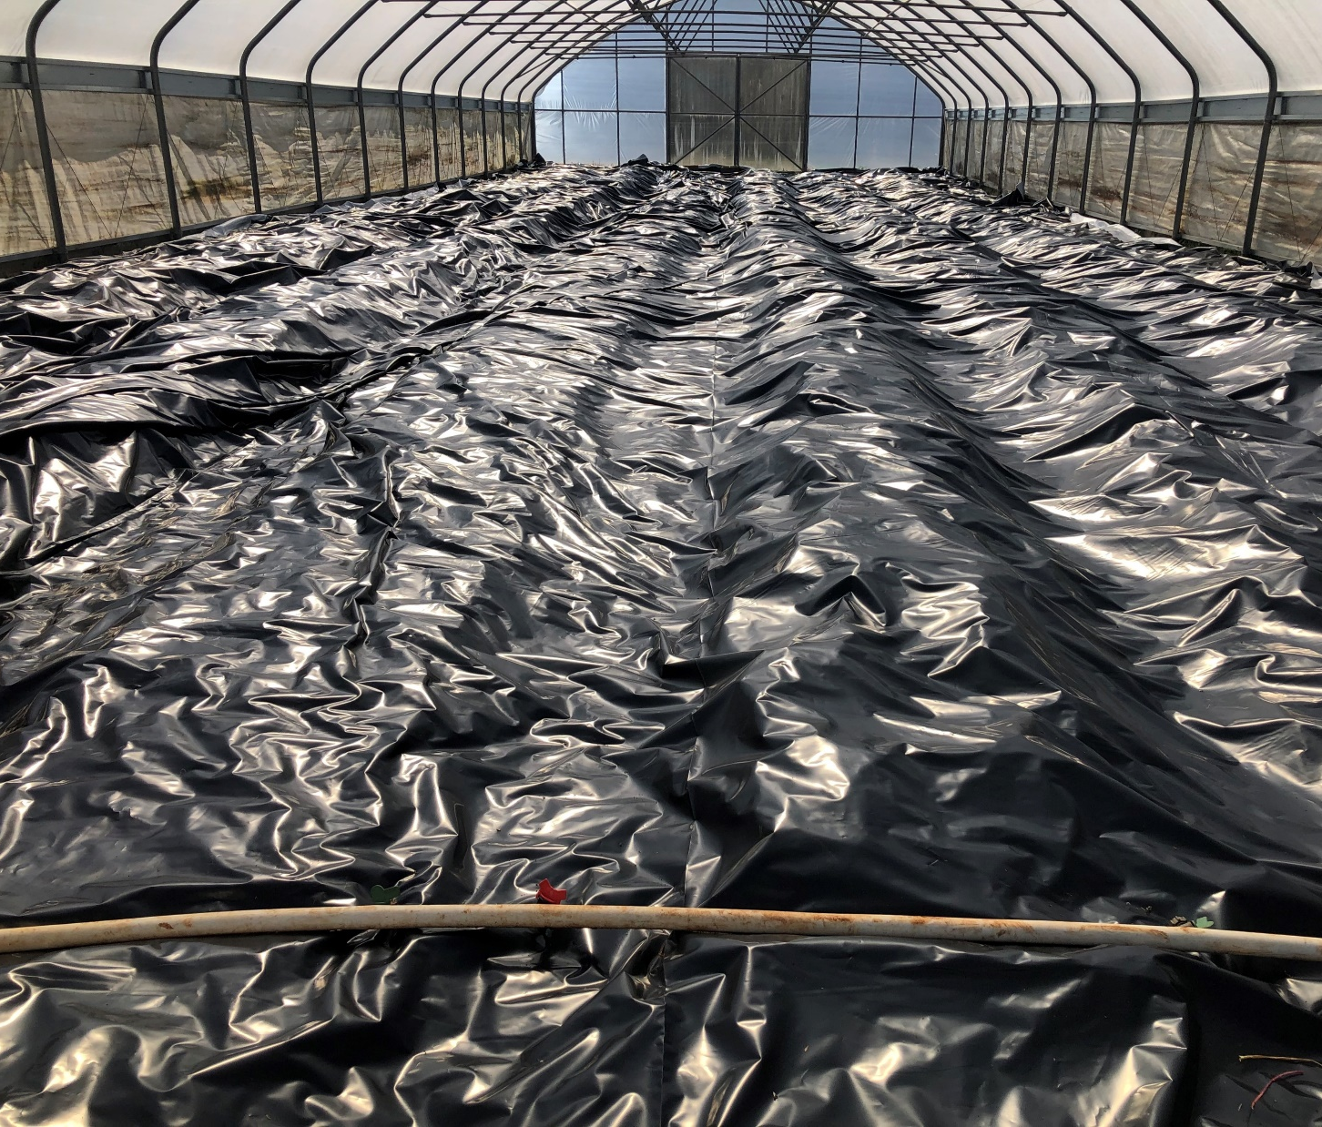
Weed Control

Slide 32
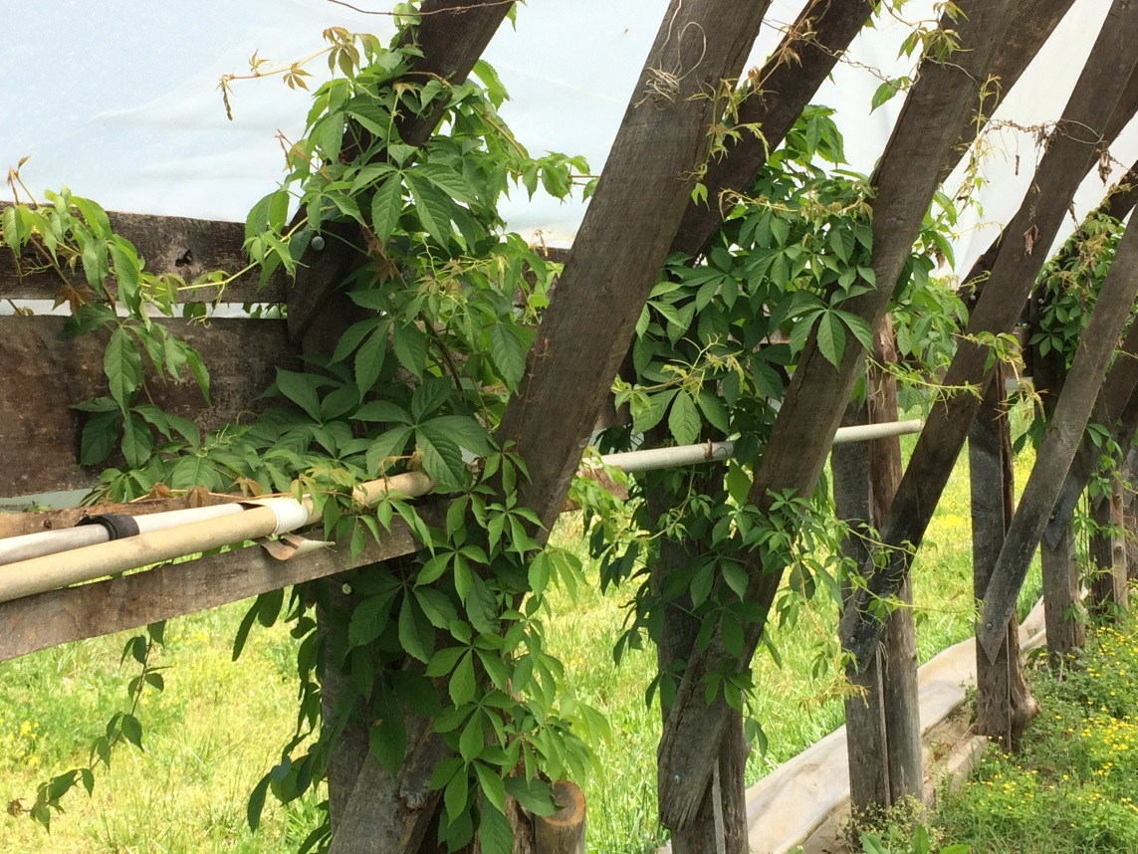
Why are Weeds Bad?
Overwintering harmful pest
Host for disease
Impacts air flow
Damage to structure/plastic
Competes for resources/light
Causes mobility issues inside the tunnel
Increased labor and management needed

Slide 33
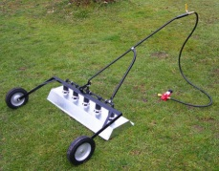
Weed Management
Mechanical
  Flame weeding.
  Mechanical tillage.
  Plastic and straw mulches.
  Stale seedbed
Cultural
  Crop rotation
  Irrigation/nutrient placement
  Cover crops
Biological
  Biopesticides
  Lemonene, vingar, soaps

Slide 34
Seed Production and Longevity of Common Weed Species
Source: MSU Weed Science. www.msuweeds.com

Slide 35
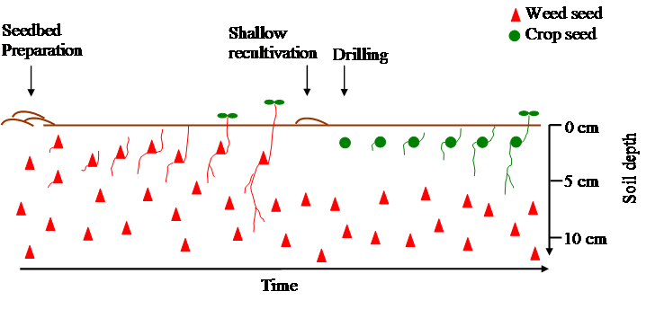
Stale Seedbed
Till the soil early in the spring, encouraging weed seeds to germinate.
After the weed cover is established, the emerged weeds are killed, with minimal soil disturbance.

Slide 36
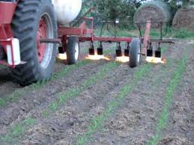
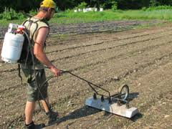
Flame Weeding
Pre-emergent
  Carrots
Post-emergent
  Sweet corn: 4 in. – canopy
  Irish potatoes: Less then 10 cm (CPB).
  Tomato: when transplants are eight weeks old.
  Onions: 2 to 3 inches high.
  Cole crops: 2–3 weeks after transplanting.

Slide 37
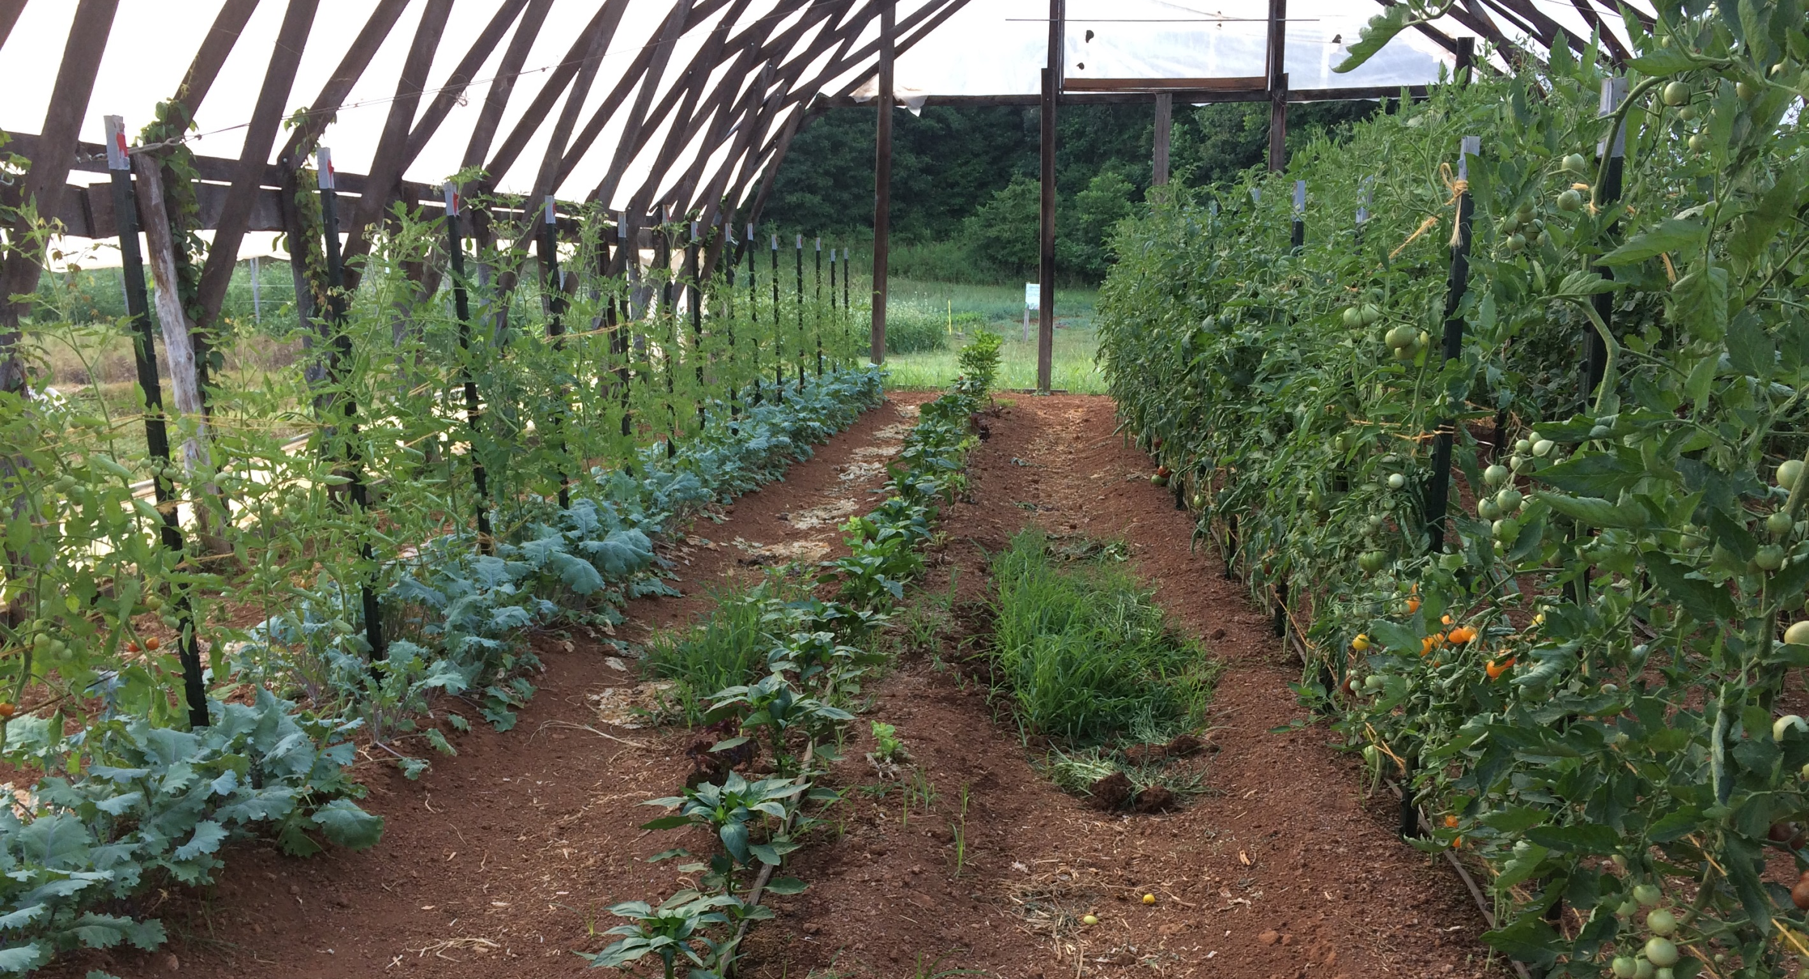
Basic Choices
Control the Irrigation
Barriers
Solarize
Using Equipment
Helpful Hand Tools
Timing
Helpful Weeds

Slide 38
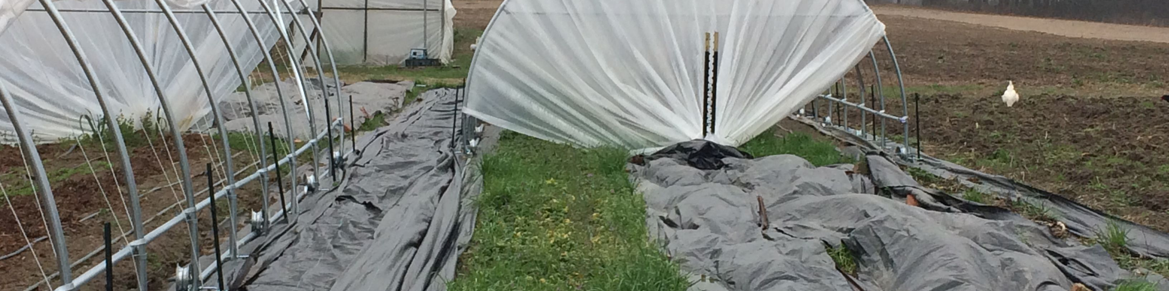
Barriers
Plastic: Not a good choice for permanent use. Not breathable. Can’t withstand traffic.
Landscape Fabric: Can be semi-permanent. Breathable. Can take minimal traffic.
  Can be used inside, outside and down the side walls

Slide 39
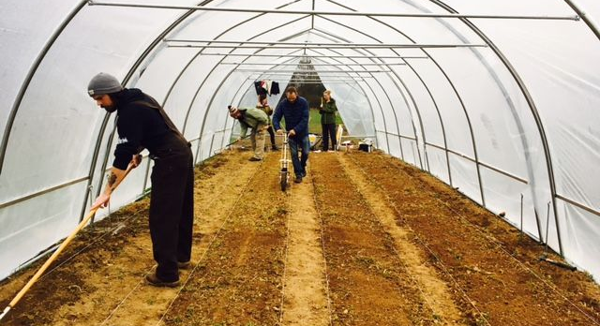
Using Equipment and Solarizing
Cultivator/sweeps
  Efficient way to reduce established weeds
Tilther
  Weed prevention and bed prep
Flame Weeder
  Weed prevention and termination of young weeds
  Can be dangerous around sidewalls
Stale Seed Beds
Solarization/Occultation
Reduces some soil born disease
Reduces weeds and weed seed viability
How to: Moisten soil well and cover with CLEAR plastic. Close up tunnel for 4-6 weeks.
Black/White for occultation

Slide 40
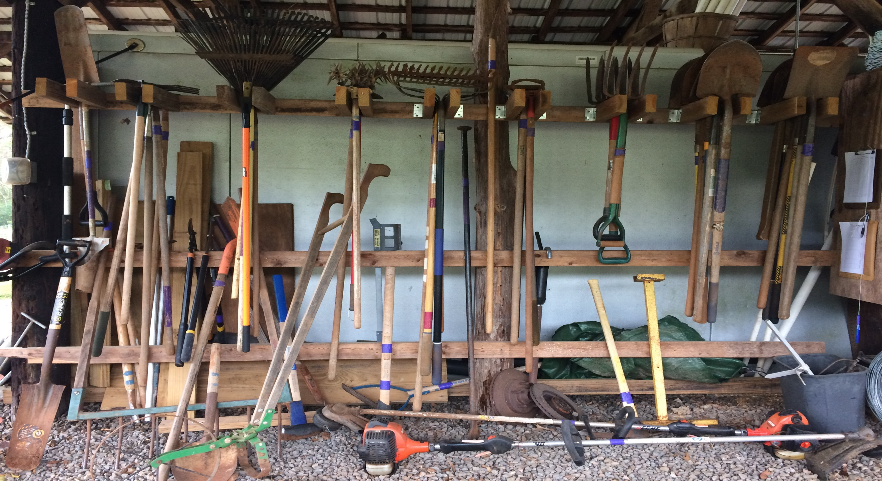
Helpful Hand Tools
Wheel Hoe
Soil knife
Wire weeders
Specialty hoes
Use plant and row spacing that compliments your equipment
TIMING is everything!
Wet the soil prior to weeds to loosen the soil around stubborn roots
Deter fire ants with organic bate
  Fire ants love black plastic and landscape fabric

Slide 41
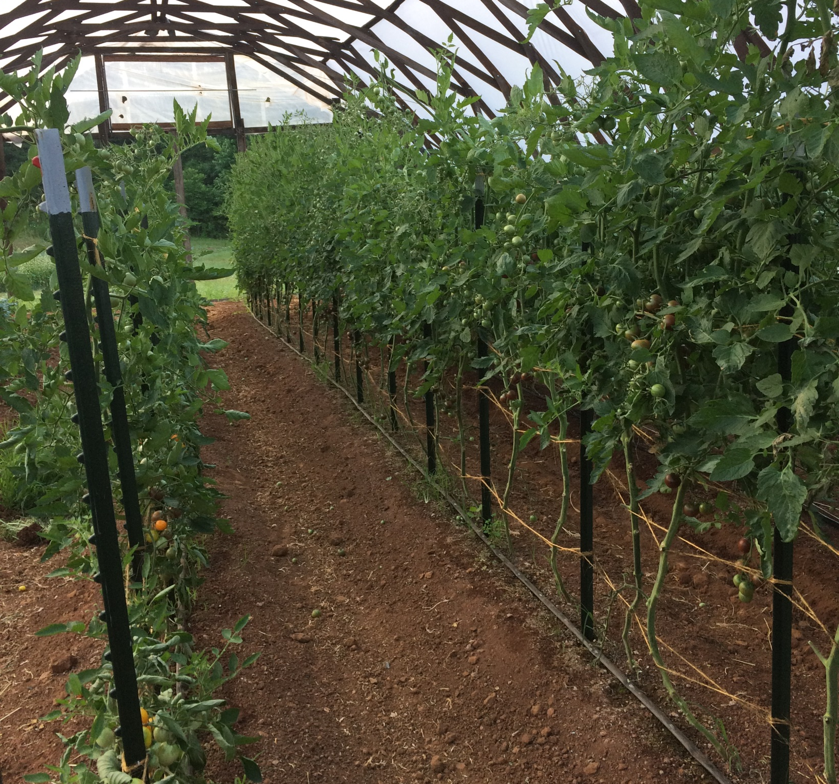
Timing
Terminating weeds at the correct time is key
Avoid letting weeds spread or get well established
  Whether you weed mechanically or spray, the younger the weeds the more successful the control
  Mowing and string trimming
Don’t let anything go to seed!
Use cover to suppress weeds early and remove after plant establishment

Slide 42
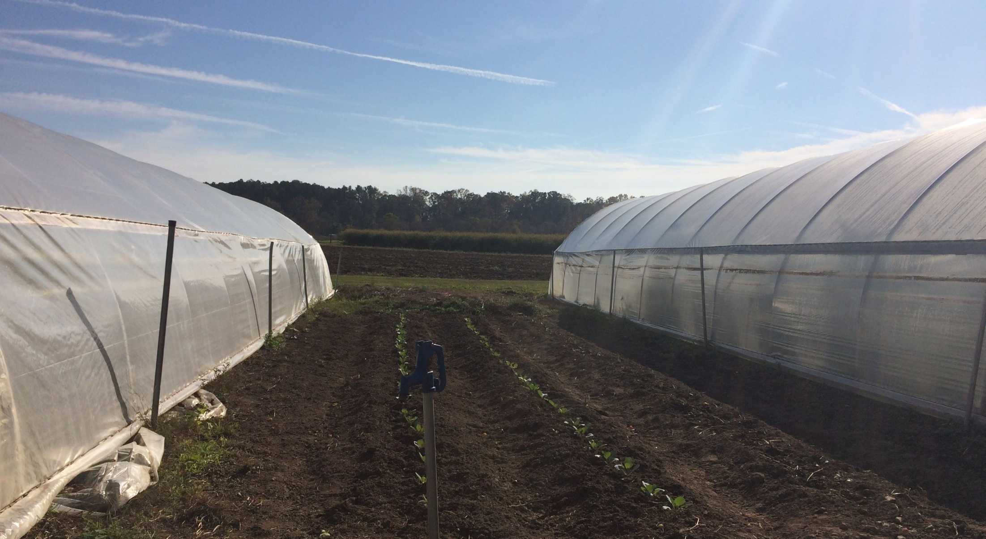
Choose Your Weeds
Having a living cover can be a good thing
Heat retention/insulation over winter
Attracting pollinators
Erosion control along tunnel edges
Increase income with herbs, etc.

Slide 43
Herbicide
Surrogate Weed
  Grain Amaranth
  Japanese Millet
Three Herbicides
  All Down
  Avenger
  Ecoblend
Sprayed per label instructions for 4 weeks
Weed counts, leaf area, and dry weight

Slide 44
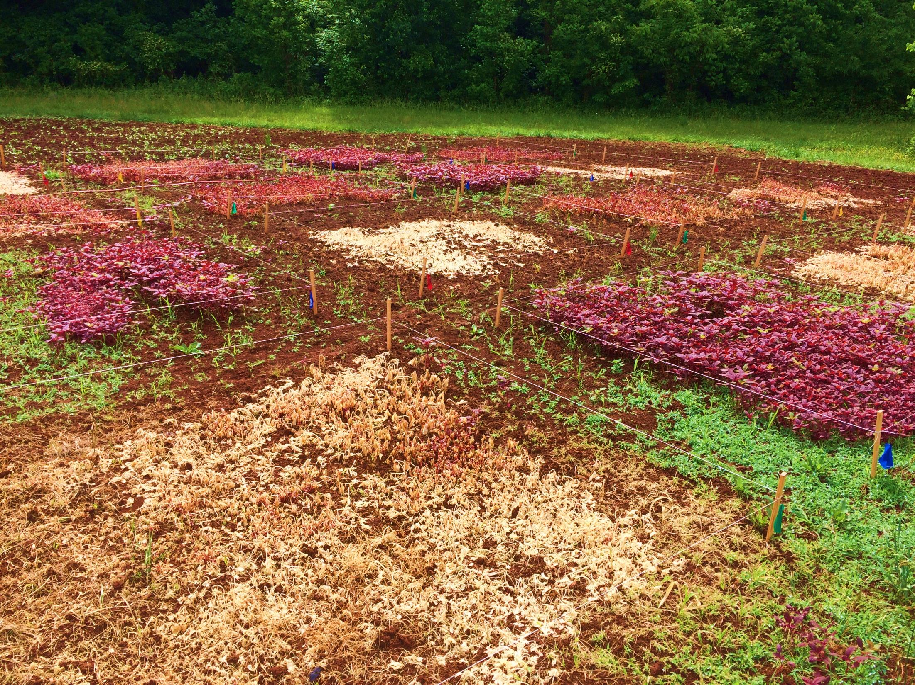

Slide 45
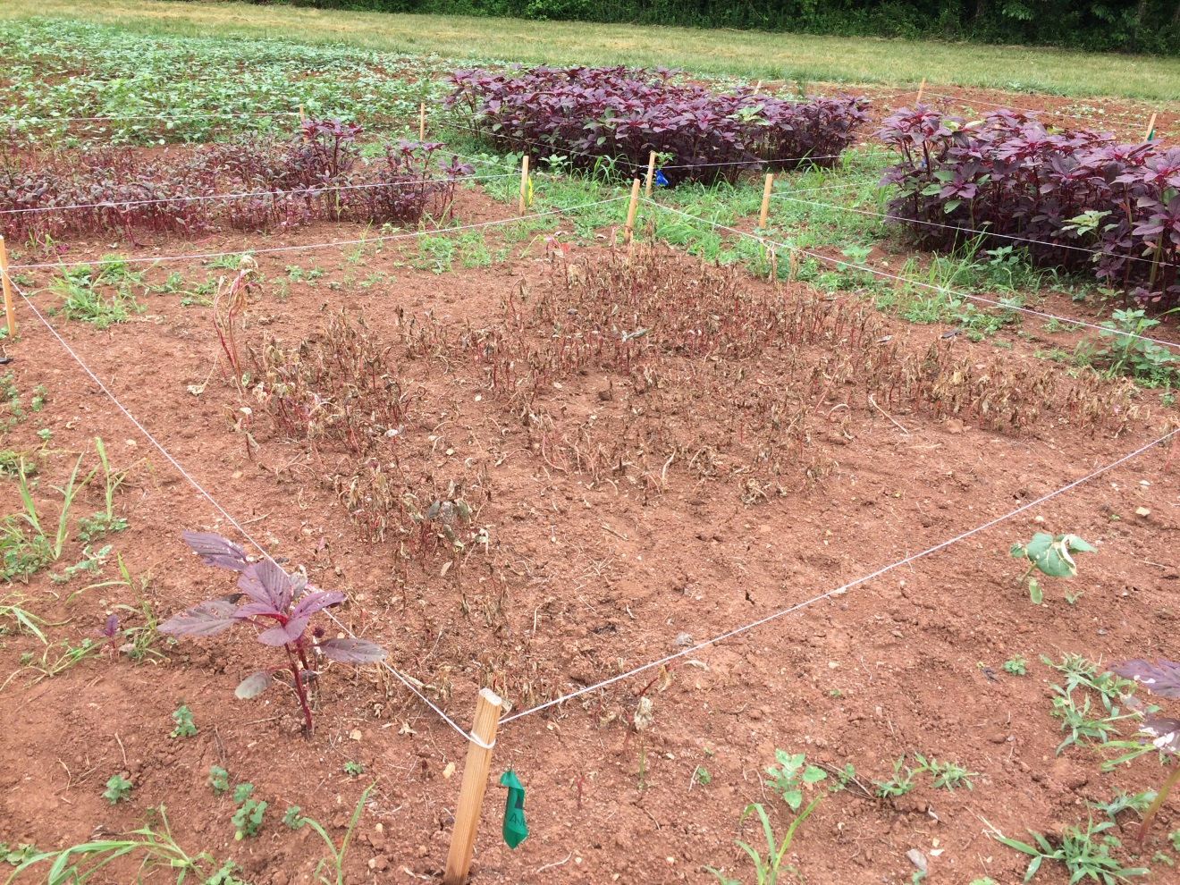
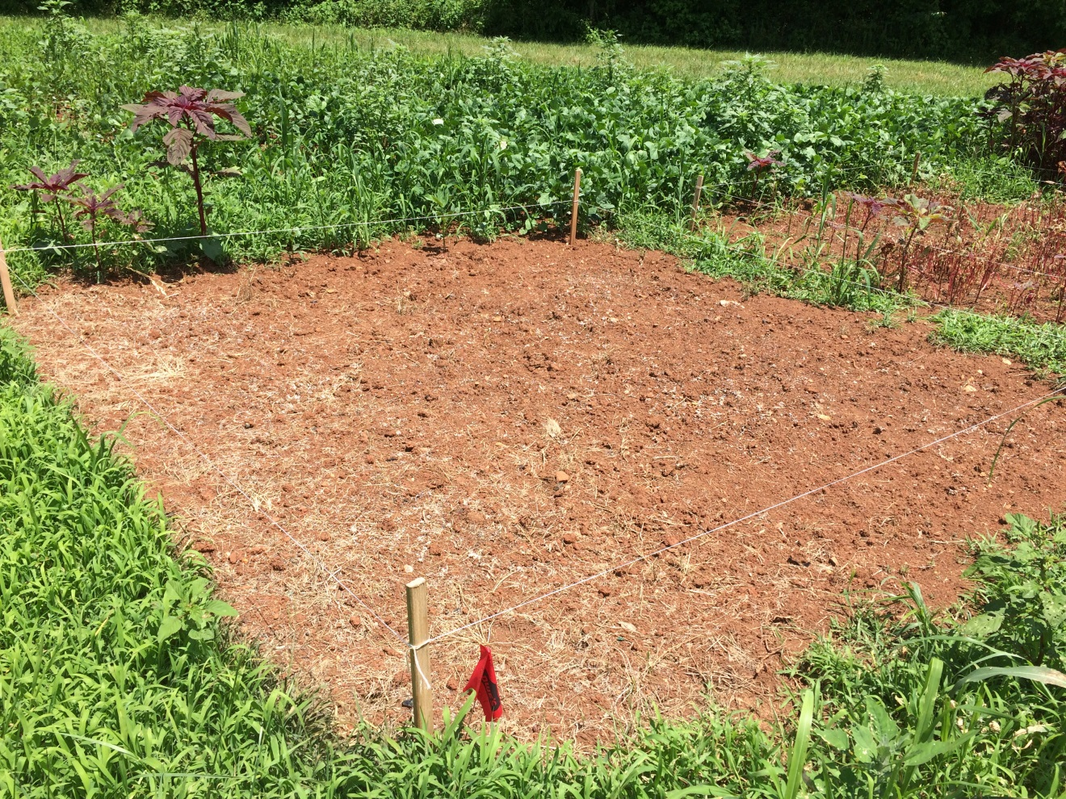

Slide 47
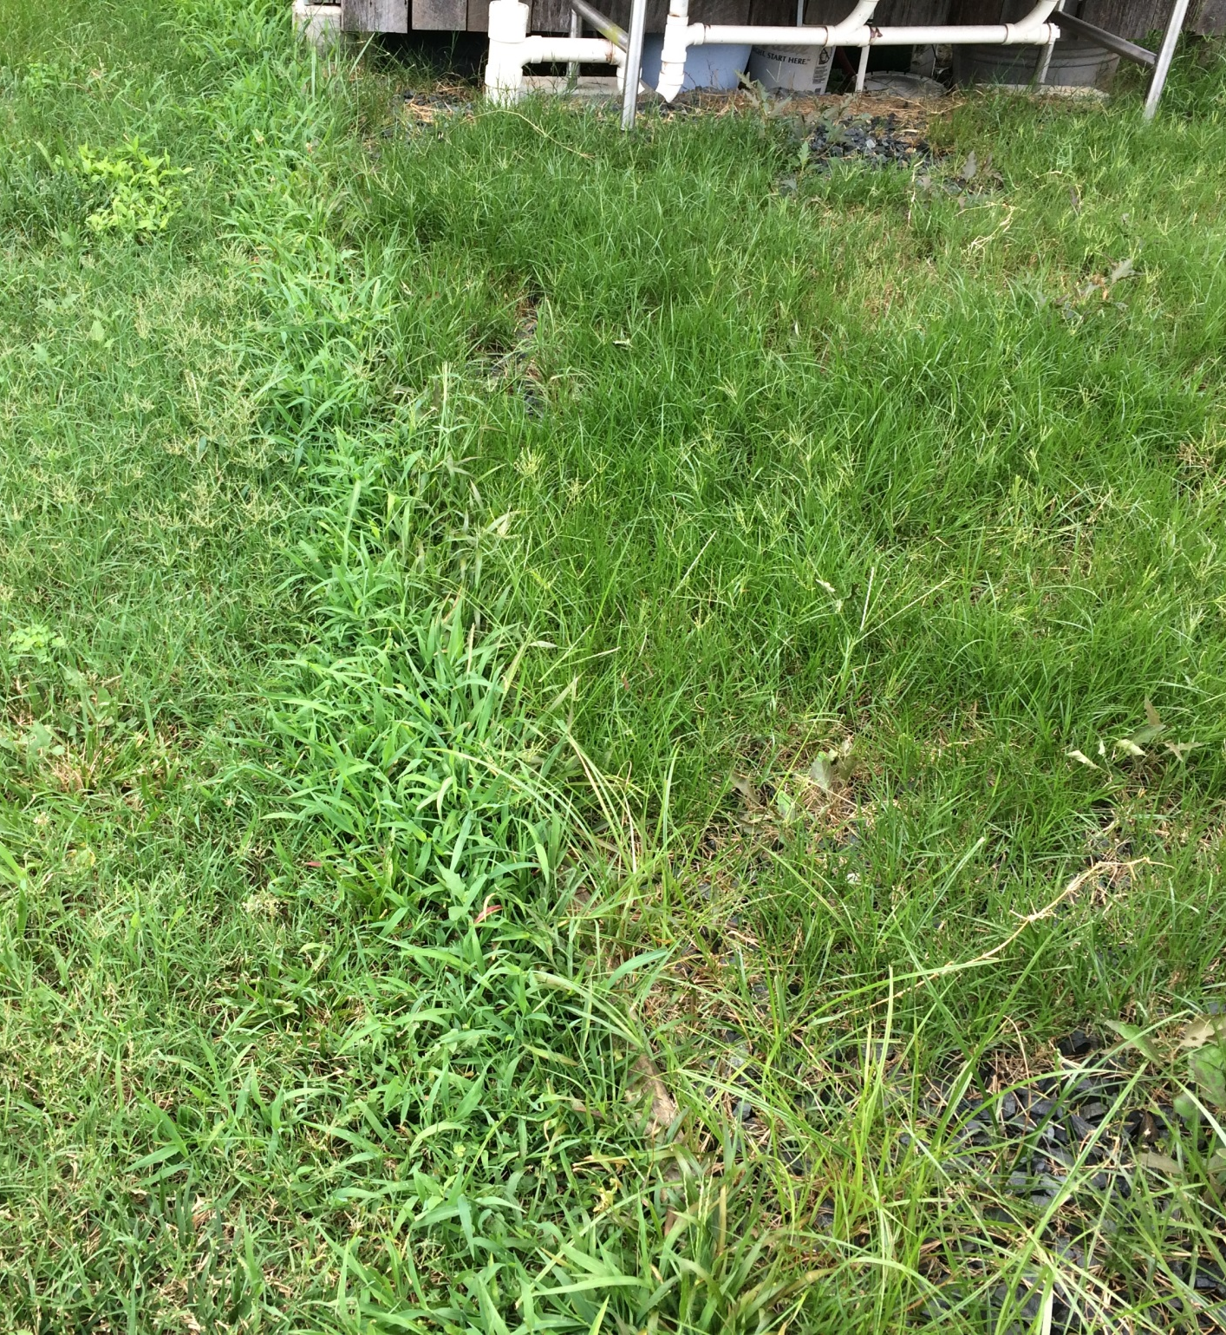


Slide 48
Scouting and Record keeping

Slide 49

Pest Monitoring
How do you monitor the effectiveness of your management program?
Weeds:
Weed counts
Observation of weed types
Comparison of crop yields
Insects:
Insect monitoring with traps
Observation of crop health
Comparison of crop yields
Crop quality testing
Diseases:
Soil testing
Microbiological testing
Observation of crop health
Comparison of crop yields

Slide 50

Pest Thresholds
Level at which pests will become an economic threat.

Slide 51
Recordkeeping
Date | Crop/Variety | Field/Tunnel | Pest Indicated | Pressure Level | Treated? | Product/Amount
6/2/21 | Tomatoes | Tunnel 1 | Army worms | low | yes | Bt; 2 gallons mixed
6/9/21 | Tomatoes | Tunnel 1 | Army worms | low | yes | Bt; 2 gallons mixed
6/9/21 | Cucumbers | Tunnel 1 | None | NA | No
6/16/21 | Tomatoes | Tunnel 1 | Weeds | low | Yes | Manual cultivation
6/16/21 | Cucumbers | Tunnel 1 | Cucumber bet. | low | Yes | Spinosad; 1.5 gal mixed

Slide 52

Recordkeeping
Keep all scouting and applications information
Look back on crops to determine how well they did
Assess any trial varieties against others
Assess and adjust IPM practices!

Slide 53

Finding What you need

Slide 54

Accessing Equipment and Materials
Local stores will have limited options
Greenhouse supply stores and Seed Companies
Seven Springs Farm
Country Farm and Home
Purple Mountain Organics
See other venders at our conference in November

Slide 55

Materials
Familiarity with product ingredients critical
Recommend trusted database:
  ORMI or WSDA websites
Notes:
OMRI: Organic Materials Review Institute
WSDA: Washington State Dept of Ag
Both have online databases of allowed materials and the products they’re in.
Hyperlink to omri.org for demonstration.
OSP: Organic System Plan; more information in later slides

Slide 56


Materials
Organic Materials Review Institute (OMRI)
WA State Department of Ag
ATTRA’s Biorationals Database (link)
Search online “site:edu” “site:gov”

Slide 57

Reading Your Label
Always follow label instructions
  Application Amount
  Personal Protective Equipment
  Re-entry and Days to Harvest
  Environmental Hazards
What your spraying/applying MUST be labeled for your target control or crop

Slide 58


Equipment

Slide 59

Special Notes for Fungicides
High tunnels are considered enclosed environments and typically require special PPE
Excessive heat may interfere with some products
  Also think about personnel with required PPE in excessive heat
For most fungicide products the best application requires:
  Early morning application
  Close sides and doors when making the application
  Use a mister or other equipment with full coverage and small droplet size
If you're spending the money and time to use fungicides make sure to do it in the most effective way!

Slide 60

Special Notes for Insecticides
Consider using ‘spot treatments’ to target high infestation areas
Use trap crops
Set low thresholds for certain pest, like caterpillars/moths, and treat early!
Be conscious of beneficial insects and pollinators

Slide 61


Special Notes for Herbicides
Selective vs Non-selective
Designate a tank/sprayer for this purpose
Mark areas after spraying to avoid pesticide transfer on shoes and equipment
Always check time to replant!

Slide 62


Pesticide Safety and Your Farm
What is a pesticide license?
When do you need a license?
Beyond proper application:
  Beneficial Insects
  Pollinators
  Farm animals/livestock
  Customer Concerns

Slide 63
Resources
https://content.ces.ncsu.edu/foliar-fungal-diseases-on-high-tunnel-and-greenhouse-tomatoes
Southeastern Vegetable Crop Handbook
NCDA&CS Pesticide Section
SC Department of Pesticide Regulation
ATTRA Ecological Pest Management Database
EPA Pesticide Search
Planet Natural

Slide 64

Create the Environment You Want
Healthy soils
Adequate fertilizer
Clean beds

Slide 65

Questions & Survey
Thank You!

