Slide 1
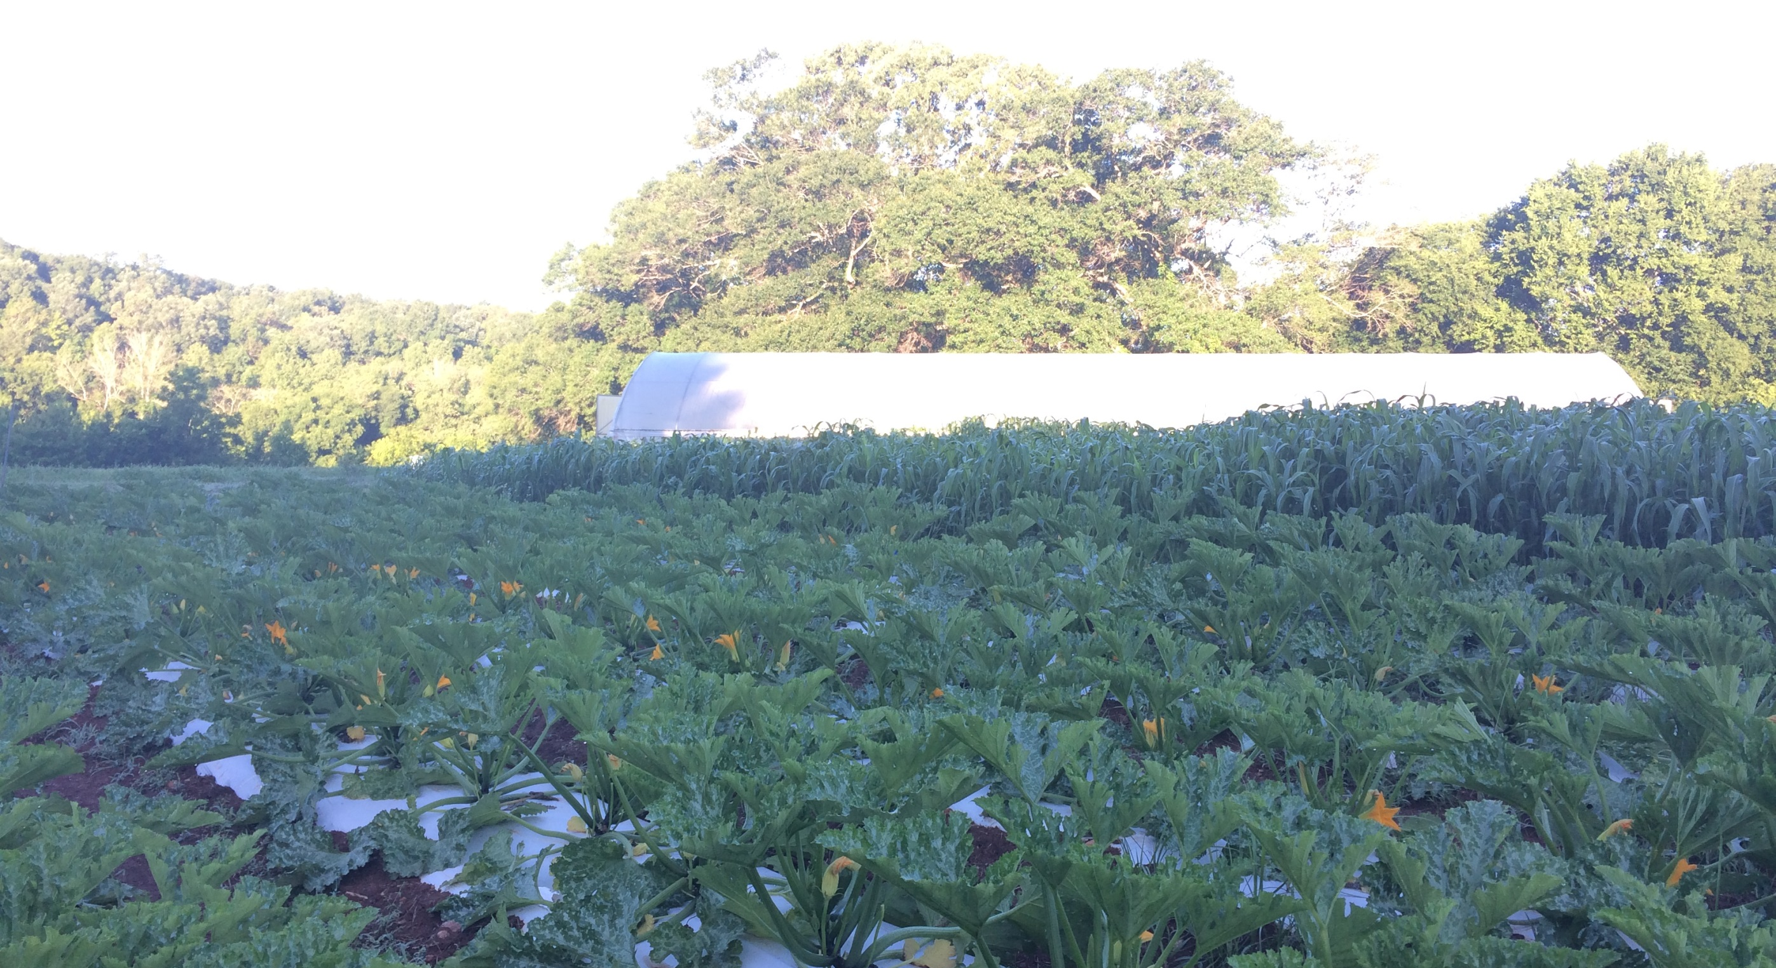
High tunnel Soil health
Joe Rowland
Organic Initiatives Coordinator
Notes:
Please stop me if you have a question or want more information on anything.
These presentations will be made available online.

Slide 2
Properties of Soil
Physical
Chemical
Biological
Notes:
These are the topics I’m planning on addressing today.
I have pictures throughout the presentation for pictoral representation of what I’m talking about.

Slide 3
PHYSICAL
Structure
Parent Material –weathered rock that determines original supply of nutrient elements
Mineral Component – loss and retention
Pore Space, Air Space,top soil, bedrock, Organic Matter
Heavy, Light, Compacted, Sandy, Clay, Loam
45% Parent Material
25% Air
25% Water
5% Organic Matter
Particles sizes =
Gravel, Sand, Silt, Clay
Soil Web Survey
Soil Triangle

Slide 4
CHEMICAL
Soils are negatively charged
More reaction sites on smaller particles, i.e. clay
pH – amount of hydrogen
Availability
CEC, Cations & Anions
17 Essential Nutrients for Plants
N, P, K, Mg, S, Ca
Mo, Ni, Cu, Mn, Co, Zi, Fe, Cl
BORON

Slide 5
BIOLOGICAL
Soil Biome – Micro/Macro Flora & Fauna
Bacterial dominated in Ag/grassland soils, Fungi in forests
Bacteria, protozoa, algae, fungi and actinomycete
Decomposition, nutrient transformation, aggregation, N fixation, mycorrhizal symbiosis
Earthworms, beetles, termites, ants, millipedes
Soil decomposition, aggregation, porosity, fertility, moisture and aeration

Slide 6
WHAT IS SOIL HEALTH?
Balancing the physical, chemical, and biological components in a positive way
Three-Legged Stool, each component affects the others - Examples?
Driving with the gas and brake! We use fertilizer in place of proper structure and biology
Building or sustaining organic matter, encouraging a diverse microbial population while optimally feeding plant and animal life
How to achieve it!?!
Notes:
These are the things you need to consider when planning out the space in your tunnel.
I’ll touch a little more on each of these.
Picture and why that set up works in there for that production.

Slide 7
PRINCIPLES OF SOIL HEALTH
Know Your Context
Minimize Soil Disturbance
Keep Soil Covered
Increase Diversity
Living Roots in Soil
Integrate Animals

Slide 8
KNOW YOUR CONTEXT
Who - Know yourself, your experience, limitations, interests, partners
What - Growing, raising, selling, building, creating
When - Timeline for implementation of practices, objectives
Where - Hardiness zone, heat index, rainfall, microclimate, native plants, historical farming practices, in a TUNNEL!
Why - Goals, objectives, reasons for enterprise, i.e. money, ecology, community, nourishment
How – Education, execution, resources, diversity, mentors, friends, family, community, cooperation
Notes:
These are the things you need to consider when planning out the space in your tunnel.
I’ll touch a little more on each of these.
Picture and why that set up works in there for that production.

Slide 9
MINIMIZE SOIL DISTURBANCE
Minimize the mechanical disturbance to soil, soil layers and soil organisms
No/Minimal inversion of soil layers
Reduce tillage, chemical fertilizers, pesticides
How:
No-Till (roller/crimper, drill)
Know (Minimum/Knowledgeable) Till
Power Harrow, Spader
Tilther
Broadfork
Deep mulch, Silage Tarps, Landscape Fab
Walk-behind tractor
Permanent beds/pathways
Notes:
These are the things you need to consider when planning out the space in your tunnel.
I’ll touch a little more on each of these.
Picture and why that set up works in there for that production.

Slide 10
KEEP SOIL COVERED
Always keep soil surface covered to reduce erosion, retain moisture, provide cover and food for beneficial organisms
Soil armor, cover crops, living/dead organic material, i.e. mulch
Leaves, compost, cardboard, wood chips*, landscape fabric, plastic mulch*, silage tarps, hay/straw
Notes:
These are the things you need to consider when planning out the space in your tunnel.
I’ll touch a little more on each of these.
Picture and why that set up works in there for that production.

Slide 11
LIVING ROOTS
Keep living roots in the soil for as much of the year as possible, perennials are great for this!
Living plants continue to photosynthesize, capture carbon and provide for soil organisms, holding soil, limiting erosion
Cover crops, overseeding cover crops into cash crops, companion/interplanting for continuous growth, perennials, fallow periods with native cover (careful of weeds!)
Notes:
These are the things you need to consider when planning out the space in your tunnel.
I’ll touch a little more on each of these.
Picture and why that set up works in there for that production.

Slide 12
INCREASE DIVERSITY
Increase diversity in all areas of your operation, production related and other
Diversity is resilient and gives stability to systems
Plant hedgerows, build bird/bee/bat houses, improve soil health, multi-species cover crops, beetle banks, pollinator gardens, companion/interplanting, release beneficials or plant to attract them
SNAP for beneficials, Shelter, Nectar, Additional Prey, Pollen
Think in space and time, prolonging bloom time
Border tunnel plantings, in between tunnels
Notes:
These are the things you need to consider when planning out the space in your tunnel.
I’ll touch a little more on each of these.
Picture and why that set up works in there for that production.

Slide 13
INTEGRATE ANIMALS
Fertility, microbes, organic matter, aeration, structure, free feed source, mimic nature
Have one or more types of animals move across your fields
Planned grazing, raise your own, partner with another farm, utilize wildlife*
Chickens in a tunnel
Fundamentals of Regenerative Grazing:
Timing
Frequency
Intensity
Duration
Rest
Notes:
These are the things you need to consider when planning out the space in your tunnel.
I’ll touch a little more on each of these.
Picture and why that set up works in there for that production.

Slide 14
HIGH TUNNELS
Preparing the site/soil
Orient tunnels north/south* or east west, assuring no shade or obstructions to direct sunlight
Grade to ensure proper drainage?*
Build up the pad/growing area with soil, compost if possible/necessary
Initial tillage, tarping, compost, deep/sheet mulch
Raised beds can be built before or after the structure if you can avoid compaction during installation
8 x 30”Bed spacing
Rotation & cover crops important for disease/pest control
Plan for weed prevention around perimeter of structure

Slide 15
TUNNEL IRRIGATION
It never rains in a tunnel
Build up of salt from fertilizer and water
Utilize sprinklers to leach excess salts through the soil profile
Leave tunnels uncovered for a time whenever changing plastic
Understand the water source and pros/cons of that source
municipal, well, surface
Hard/soft, nutrients, additives
Notes:
These are the things you need to consider when planning out the space in your tunnel.
I’ll touch a little more on each of these.
Picture and why that set up works in there for that production.

Slide 16
EQUIPMENT
Lots of innovative, small-scale tools and equipment exist for growing in confined spaces
BCS/Grillo Walk-Behind Tractors with attachments
Roller/Crimper, Tarps, Bed roller, Tilther, Power Harrow
Seeders – Jang, Earthway, Paper Pot Transplanter, Stand and Plant, 4-6 Row Seeder
Hand Tools – Broadfork, collinear hoe, wheel hoe
Notes:
These are the things you need to consider when planning out the space in your tunnel.
I’ll touch a little more on each of these.
Picture and why that set up works in there for that production.

Slide 17
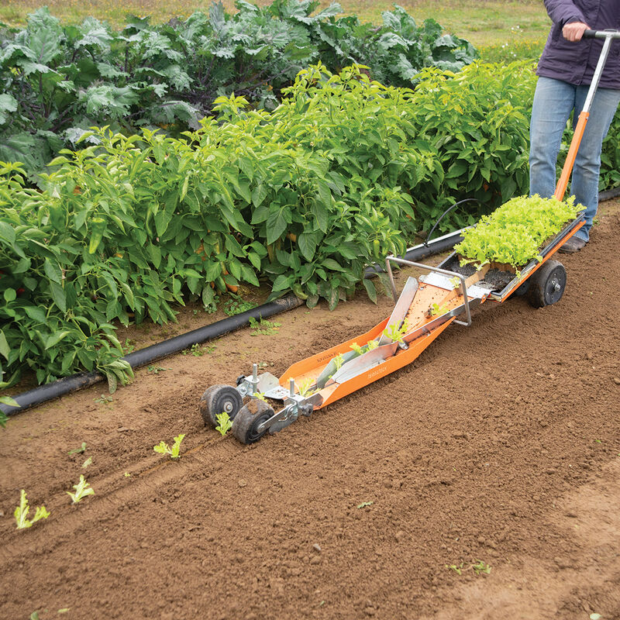
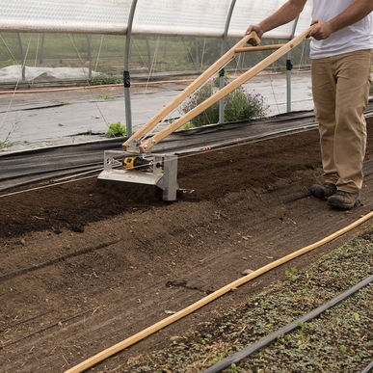
Paper Pot Transplanter
Tilther
Notes:
Hiller and tilther

Slide 18
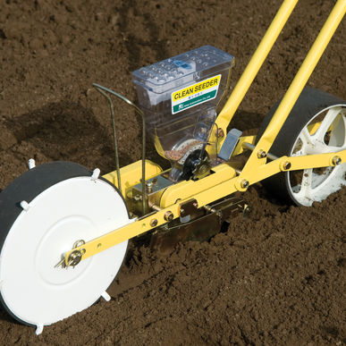
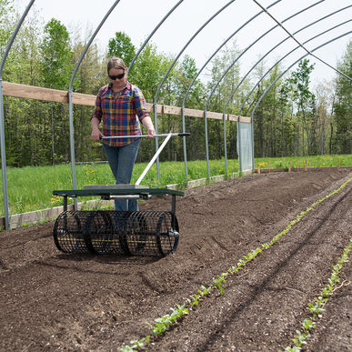
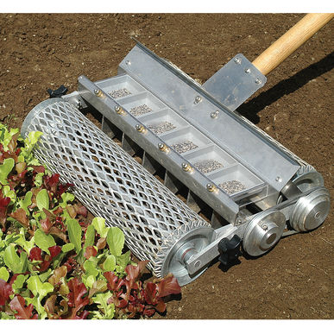
Bed Roller,
Jang,
6 Row Seeder
Notes:
Bed roller, precision seeders

Slide 19
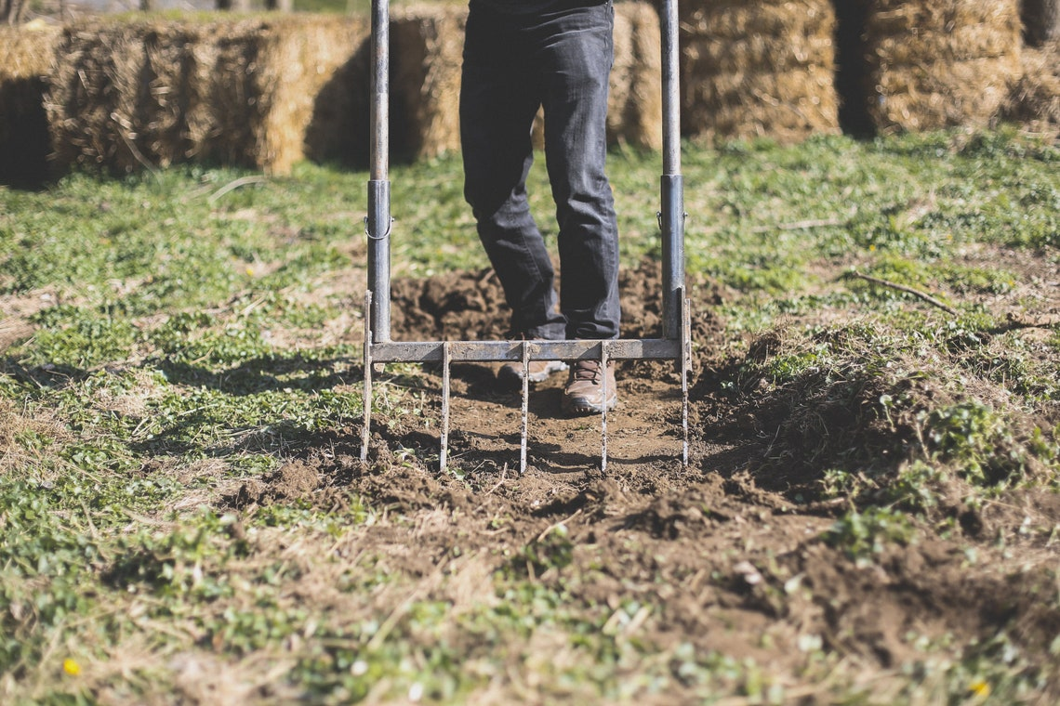
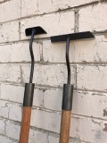
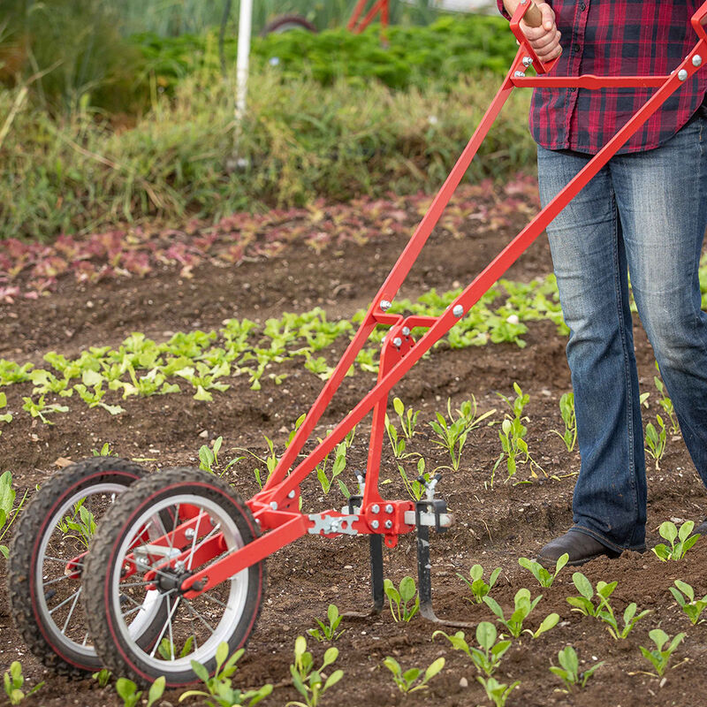
Broadfork, Collinear Hoe, Wheel Hoe
Notes:
Bed roller, precision seeders

Slide 20
Tools – Johnny’s Seeds, Never Sink Tools, Farmers Friend, Bootstrap Farmer, Agri-Supply
Supplies – Country Farm & Home, Seven Springs Farm, Nolt’s Greenhouse Supplies, Martin’s Produce Supplies
High Tunnels – Williamson Greenhouses, Puckett’s Greenhouses, Jaderloon, Atlas
More resources, educational materials and technical assistance from Carolina Farm Stewardship Association
joe@carolinafarmstewards.org
Notes:
These are the things you need to consider when planning out the space in your tunnel.
I’ll touch a little more on each of these.
Picture and why that set up works in there for that production.

Slide 21
Questions & Survey
Thank You!

