Slide 1


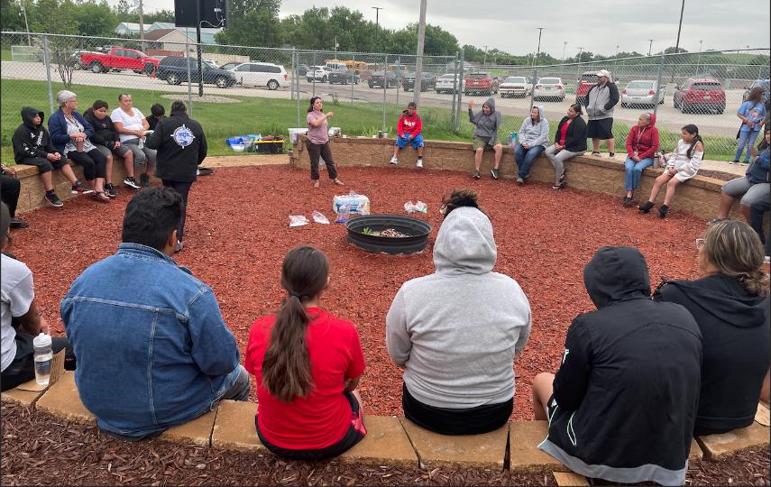
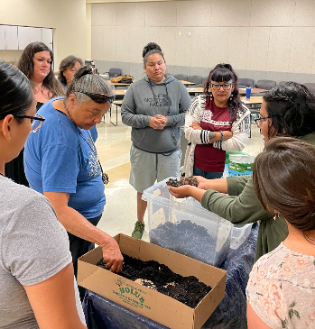
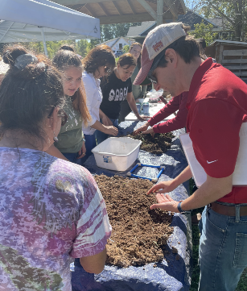
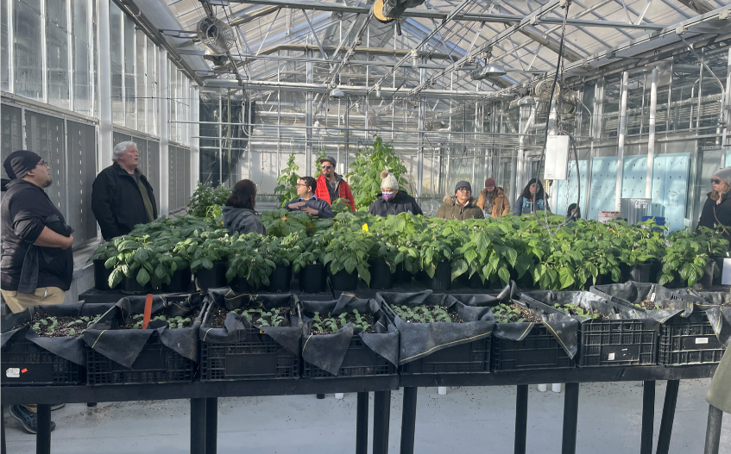
Reuniting the Three Sisters: Enhancing Community and Soil Health in Native American Communities
This project engages Native citizen scientists and bring communities together in a network of experiments for a greater understanding of how the Three Sisters affects soil and plant health.
Project Director: Dr. Christina Gish Hill, Professor of American Indian Studies and Anthropology at Iowa State University
USDA Award number: 2019-68008-29913

Slide 2
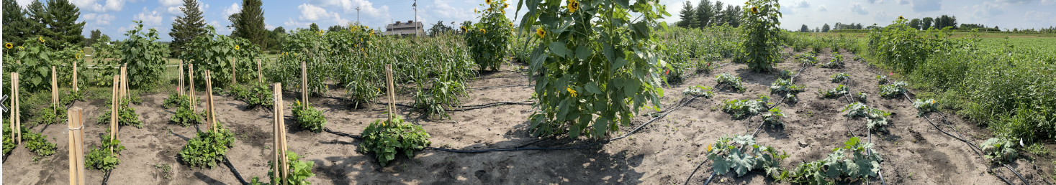

Project Overview
Objective One:
Objective Two:
Assess importance of 3SI practice to Midwestern Native American communities, determine the reasons for decline and current obstacles to revitalization, and potential for revitalized 3SI practice to improve nutrition and rural community economics. This includes ethnography, nutrition assessments and advisory board meetings.
Determine, document, and disseminate the agronomic benefits of 3SI intercropping to crop production and soil health. This includes soil health, plant health, and yield research at ISU Horticulture Farm plots, as well as on farm visits and workshops in Native collaborating communities.

Slide 3
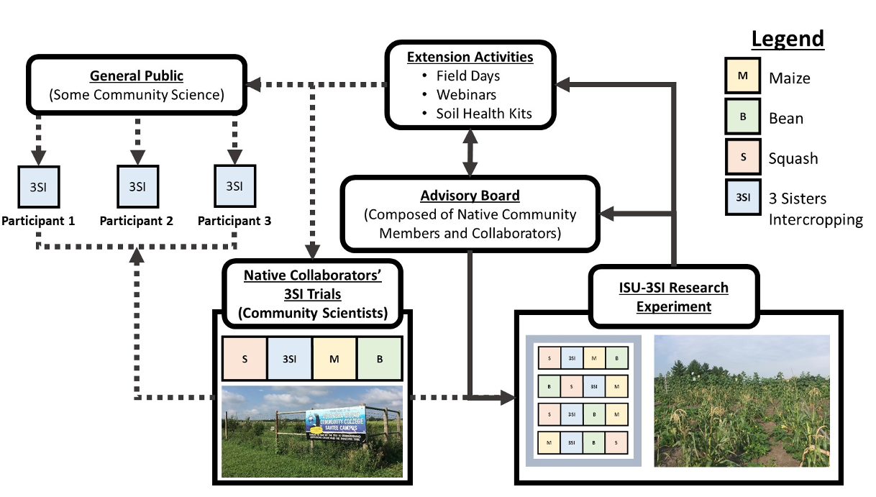
Spotlight on Meaningful RE/E Integration
Notes:
Conceptual diagram showing the importance of collaborative science and public outreach in the Three Sisters Intercropping Network (3SI-Net) project. The Iowa State University 3SI Research Experiment (ISU-3SI) receives input from an Advisory Board composed of Native Americans (many of whom are also Collaborators or Participants). This feedback between the ISU-3SI and Advisory Board drives the logistics and research agenda at the main research experiment and extension activities that engage Native Collaborators and Participants wanting to grow the Three Sisters and/or conduct DIY soil health measurements. Photos: Left, M.D. McDaniel photo of Nebraska Indian Community College garden in Santee, NE; Right, E.M. Herrighty photo of ISU-3SI Research Experiment near Story City, IA

Slide 4
Impacts
Our number of Three Sisters Gardens in Native communities has grown each year.
Native growers have new resources to support their expanded gardens, including workshop take aways, website resources, and materials like seeds, seedlings, compost bins, and rainwater catchment systems.
We have grown collaborative networks between researchers and Native food growers among several communities.
This project has led to continued collaborations beyond the scope of this grant.
Project at a Glance | #
Total Number of Workshops | 13
K – 12 Workshops | 3
Average attendees per workshop | 25
Cooking demonstrations | 10
Ethnographic Interviews | 29
Number of collaborative growers | 7
Master Thesis & Publications | 5

Slide 5
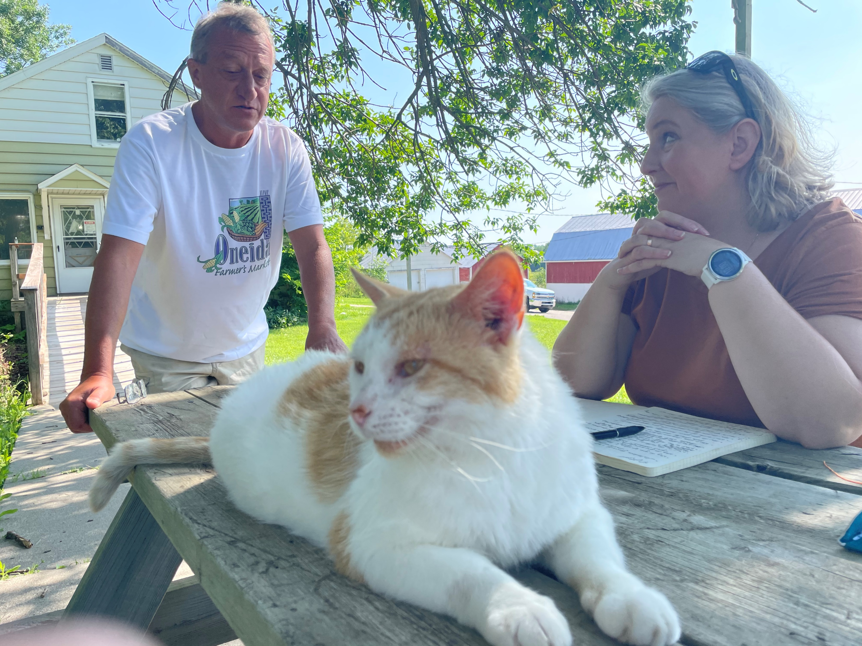
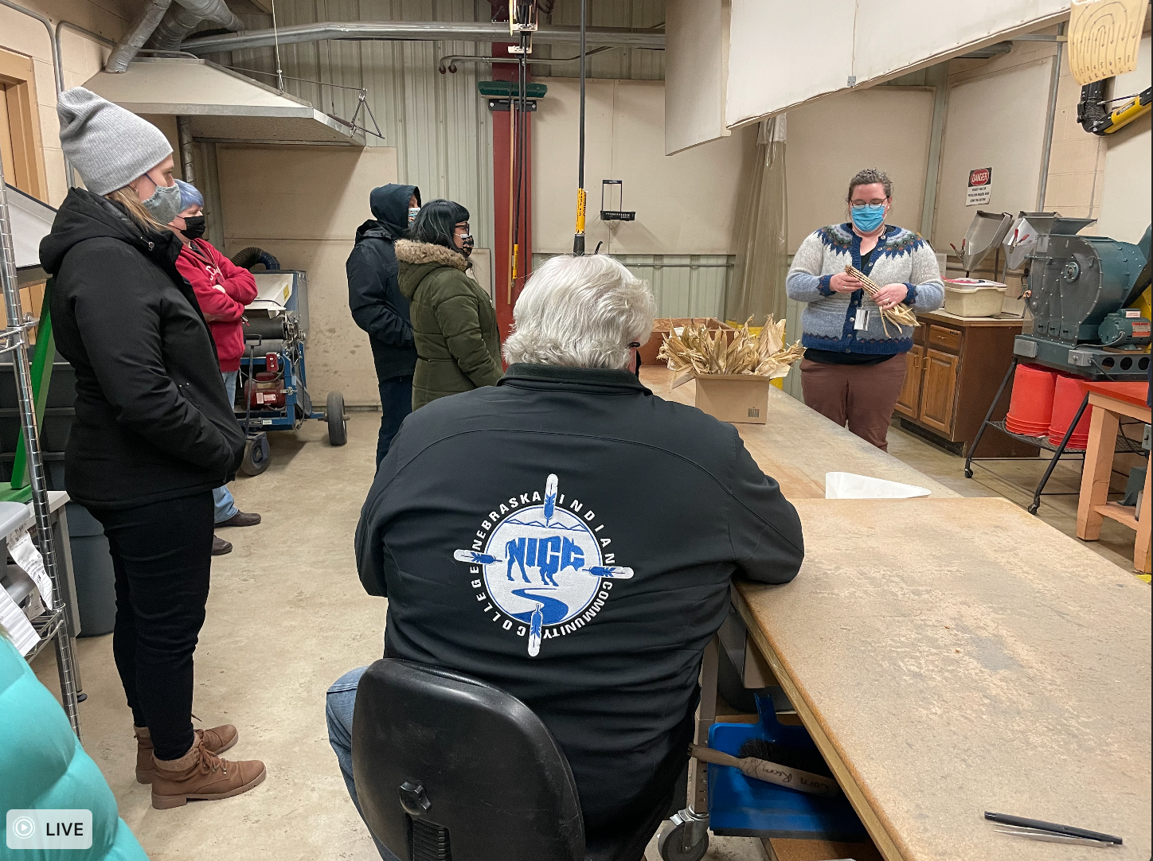
Objective One: Social Science Research
Ethnography
Conducting participant observation with Native growers
  Including touring gardens
  Helping weed and harvest
  Helping to process garden produce for meals
Conducting interviews with Native people knowledgeable about traditional growing practices
  Including questions about food sovereignty, growing practices, Indigenous varieties, and barriers to expanding access to culturally appropriate foods
Nutrition
Grocery store assessments to determine access to fresh, nutritious food for Native collaborating communities.
Advisory Board
Annual meetings to disseminate information about the project, data collected, and to request feedback about project methods

Slide 6
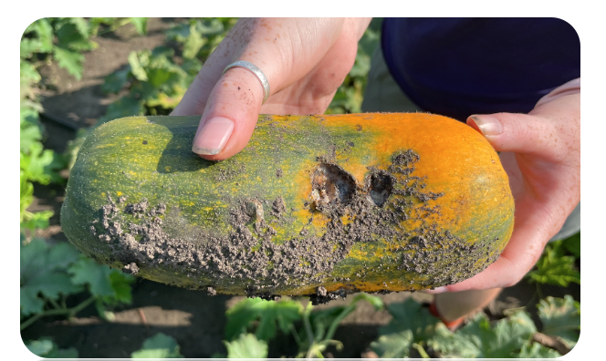
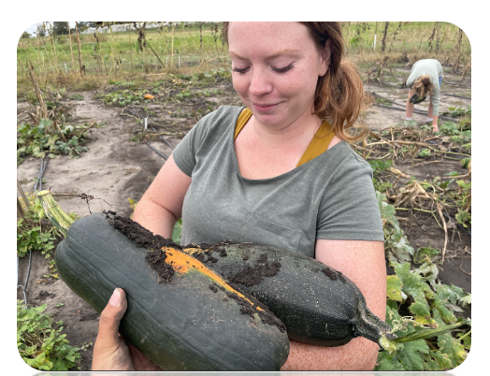
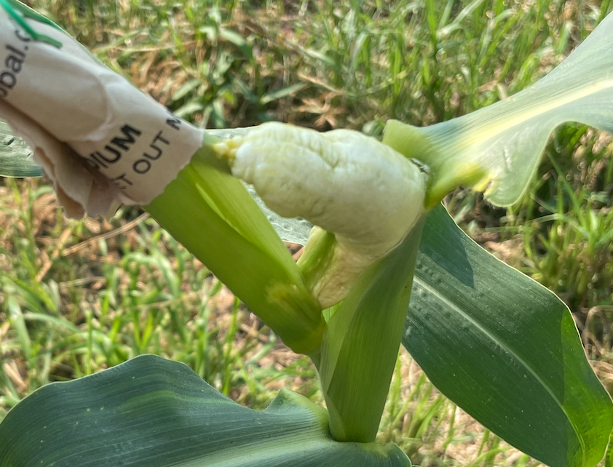

Objective Two: Research Garden at Iowa State
RCBD with 4 treatments and 4 replications
Treatments:
  Turtle Mountain White (Turtle Mountain Ojibwe)
  Hidatsa Red (Hidatsa – Three Affiliated Tribes)
  Algonquin Long Pie Pumpkin (Abenaki)
Yield was lower in 3SI on average
However, LER is considered high (Xu et al., 2020)
Usually range 1.22 – 1.3
More productive with less land, and intense limitations
  Corn smut
  Bacterial spot of cucurbit
  Environmental conditions
    Drier year in 2021
    Derecho 2020
for 2021 Growing Season

Slide 7
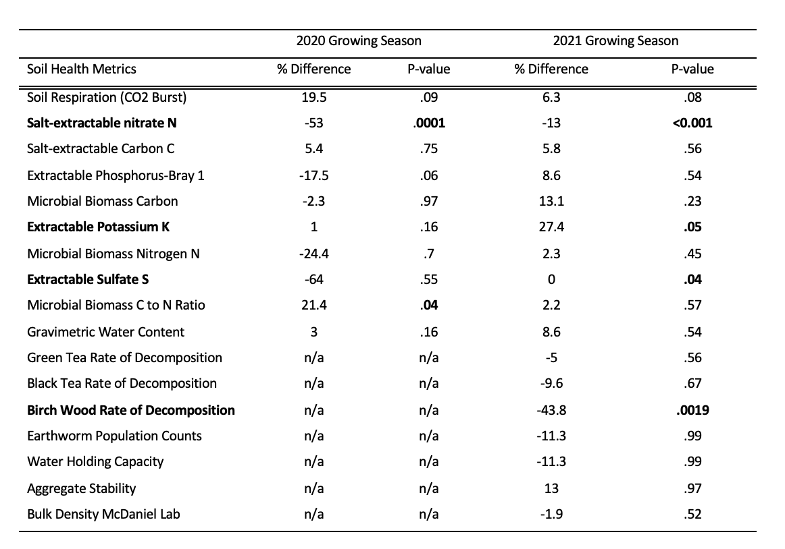
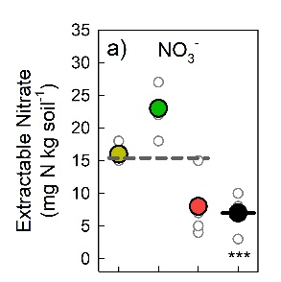
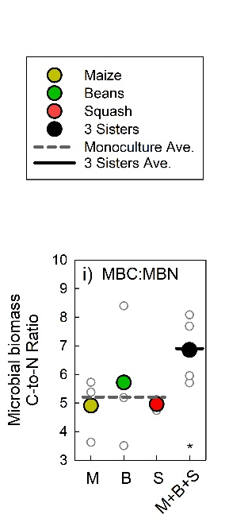
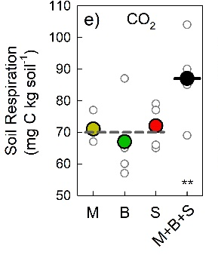
Objective Two: Soil Results from 2021 Growing Season
Salt-extractable NO₃⁻ was consistently significantly lower in the 3SI treatment compared to controls
Soil respiration was consistently marginally higher in the 3SI treatment compared to controls
Decomposition rates of 3SI treatment was significantly lower to controls
2020 Growing Season
* = P-value less than 0.05 alpha

Slide 8
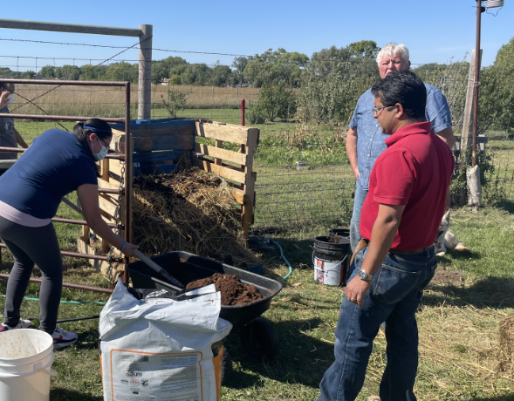
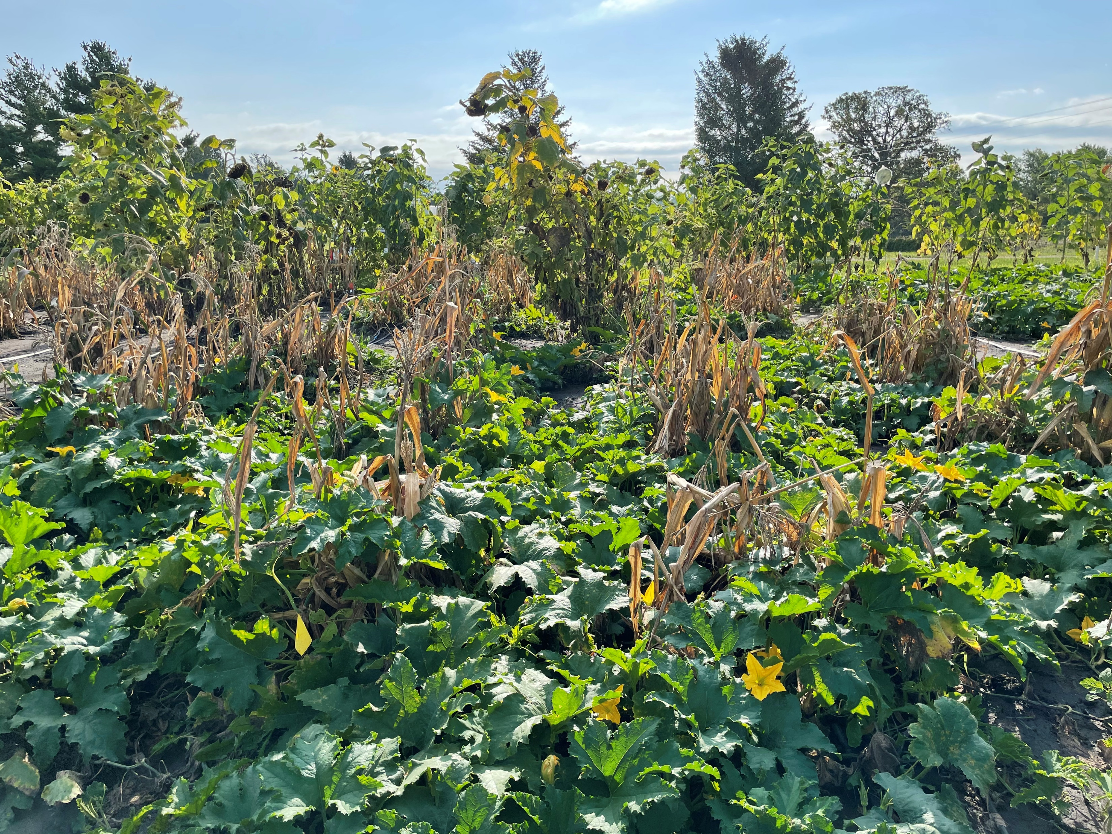
Objective Two: On Farm Visits and Workshops
On Farm Visits Included farm tours, workshops, and soil health assessments and recommendations for collaborating Native growers.
Workshop Topics Covered:
Soil fertility and health in home gardens
How to set up drip irrigation
Seed saving for home gardens
DIY soil health test
Key insects pest of squash, beans, and corn
Composting basics & troubleshooting
Foods & culture (by Arly, Anthony, LaVonne)
Drone basics (by Steve Webster)
Field Day at Horticulture Research Station
Soil basics and home gardening
Introduction to permaculture*
Orchard care and start up*
*upcoming in 2022

