Slide 1
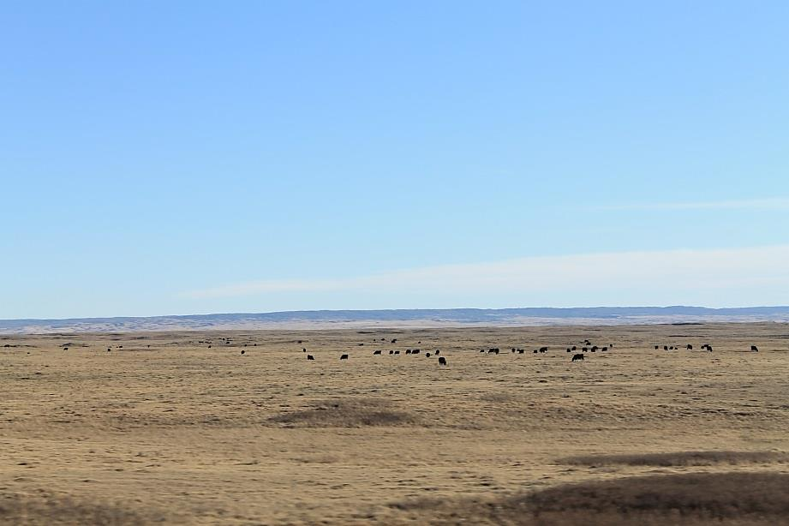



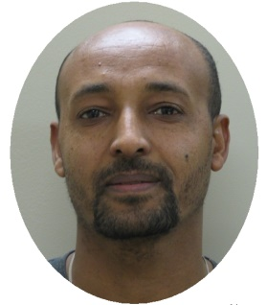
S. Pogue – ecosystem services specialist
R. Kröbel – ecosystem modeller
Lethbridge Research and Development Centre
Aklilu W. Alemu
Holos Model Training
Urban and Small Farms Conference
February 21st, 2019

Slide 2
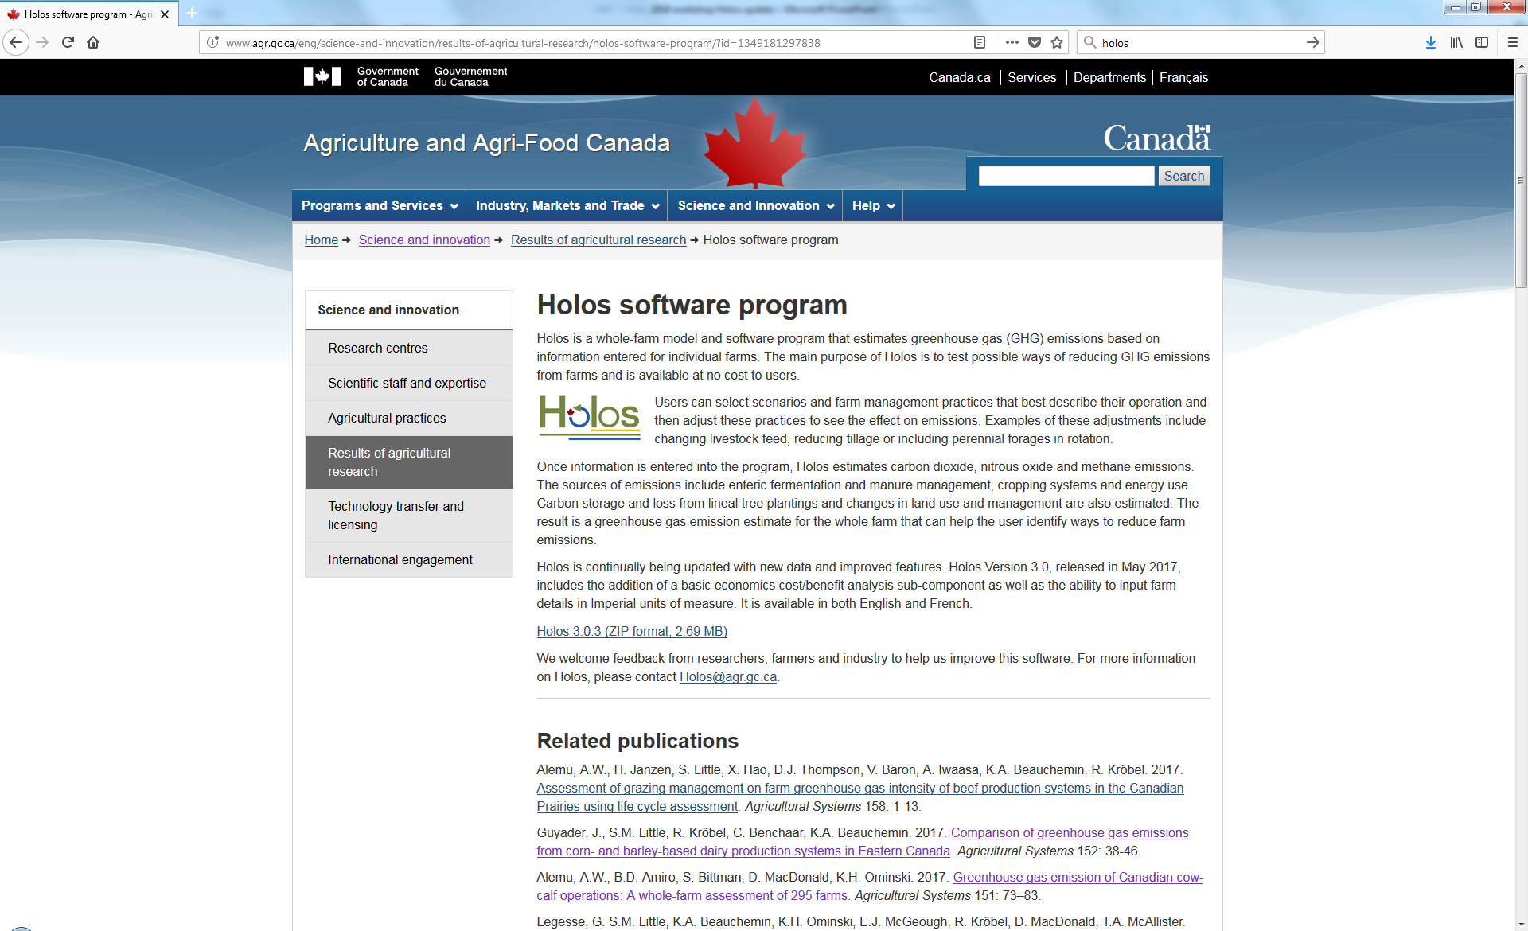
www.agr.gc.ca/holos-ghg

Slide 3

“The whole is more than the sum of its parts“…
Aristotle
... a Greek word meaning all, entire, total (holistic).
Transparent & Science based
Science mentors: H.H. Janzen, K.A. Beauchemin, E. Smith
Software development: A. McPherson, A.W. Alemu, C. Vanin
Postdoctoral researchers: S.J. Pogue, M. Cordeiro
Team (past): B. Helgason, J. Lindemann, J. Barbieri, K. Maclean, M. Martel, L.L. Chai, R. Karimi-Dekhordi, S.M. Little

Slide 4
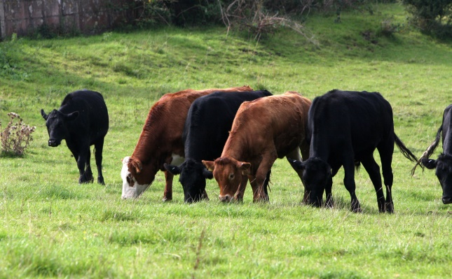
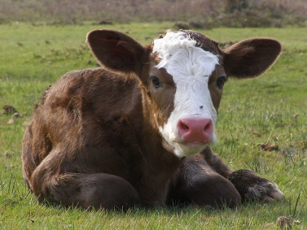
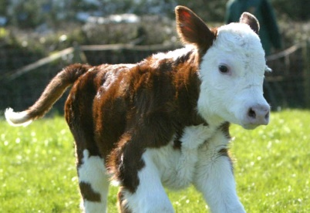
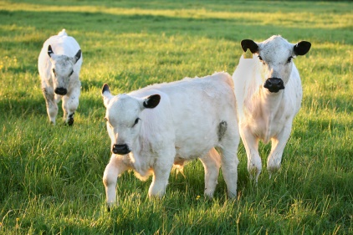
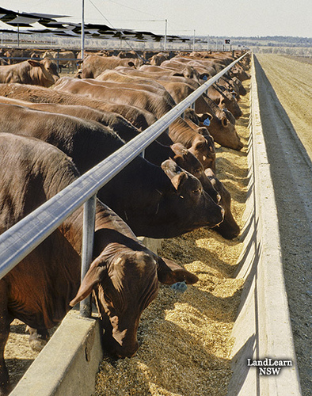
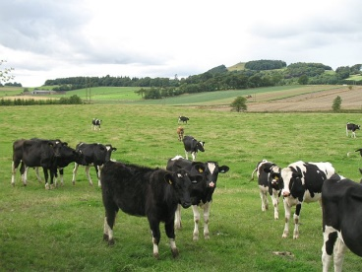
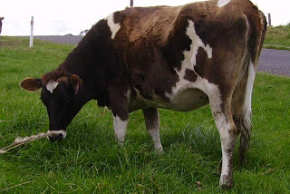
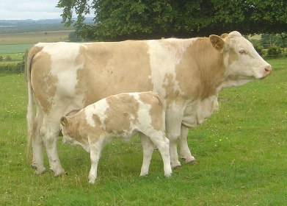
Enteric methane
Ym = 5.5 – 7.5 %
Dry matter intake:
  Maintenance (cold > warm)
  Activity
  Growth (average daily gain)
  Pregnancy
  Milk
* Energy content (18.45 MJ/kg DM) =
Gross Energy Intake
  Tier 2 (DMI = 10 kg d⁻¹)
  183 to 250 g CH₄ d⁻¹
  67 to 91 kg CH₄ yr⁻¹
Ym = 2 – 4%
multiplied by
Notes:
Tier 2
Estimate DM intake required
Animal requirements (maintenance + growth + pregnancy + lactation + activity + cold weather)
Energy content of feed
Gross energy (GE) intake (feed contains 18.45 MJ/kg DM)
Ym, methane conversion factor (% of GE intake converted to methane)

Slide 5
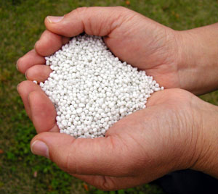
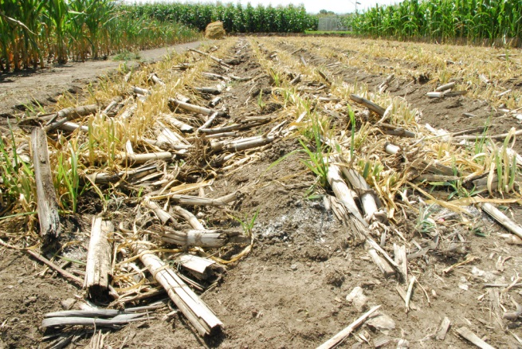
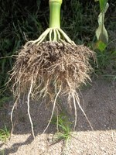
Nitrous Oxide emissions
User input
(N fertilizer)
User input
(crop yield)
Fertilizer N
Crop residue N
Root N
P = ecodistric specific growing season precipitation
PE = ecodistrict specific potential evapotranspiration
Average of 1971 – 2000 (climate normal) is used
Total biomass
Total N
supply
* 0.022 * P/PE * -0.0048

Slide 6
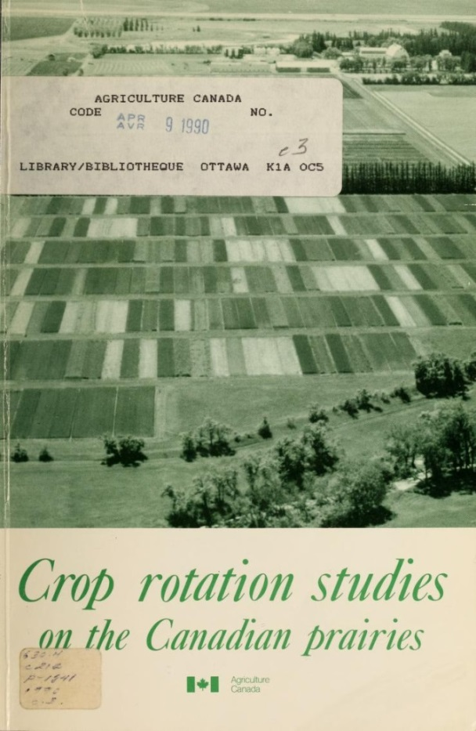
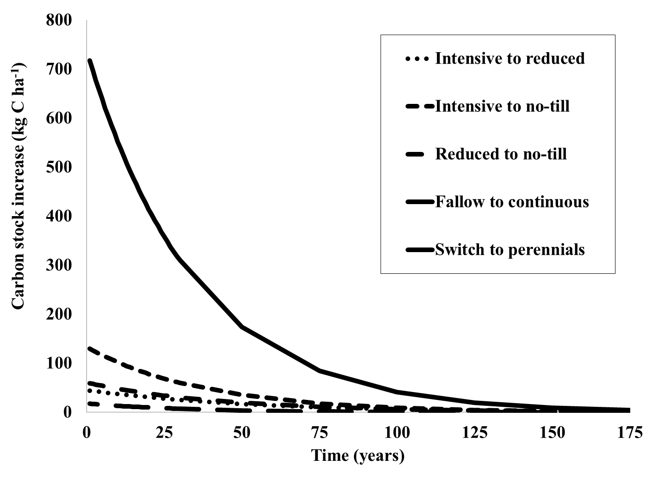
Carbon stock change
Management based carbon change estimate:
6

Slide 7
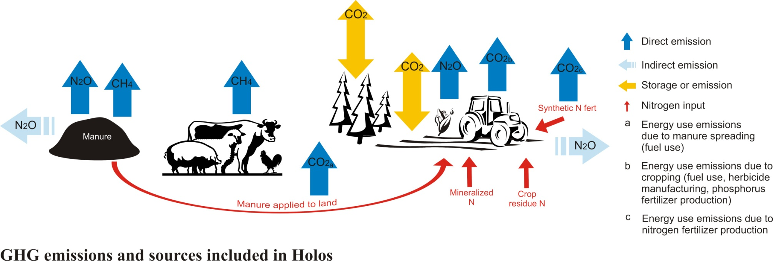
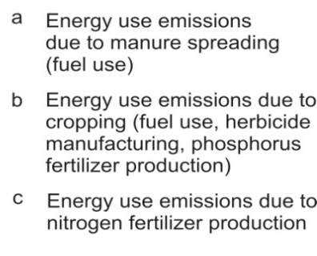

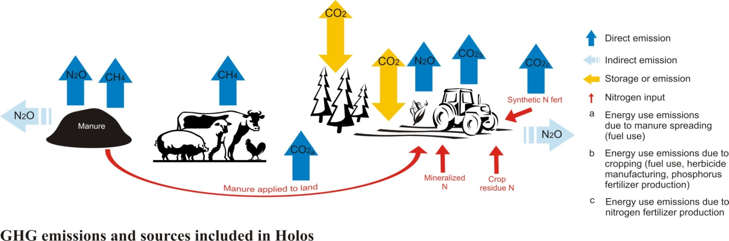
About Holos

Slide 8
Using Holos in LCA
CO₂eq per kg beef produced
Life cycle (8 years)
Total CO₂eq
Whole-farm model /
Systems analysis
NRC Nutrient Requirements
Beef life cycle assessment
Basic structure (IPCC Tier 2)
Canadian methodology for soil C estimation
Canadian methodology for N₂O estimation
Life cycle assessment
Holos is not a stand-alone LCA tool!

Slide 9
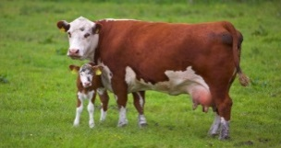
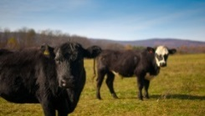

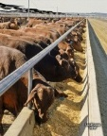
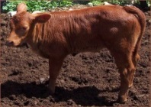
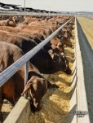

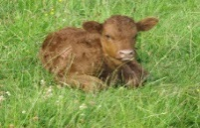
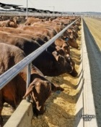


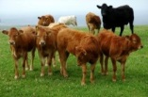




Holos model – time steps
Holos
Production cycle
Annual cycle
Monthly cycle

Slide 10
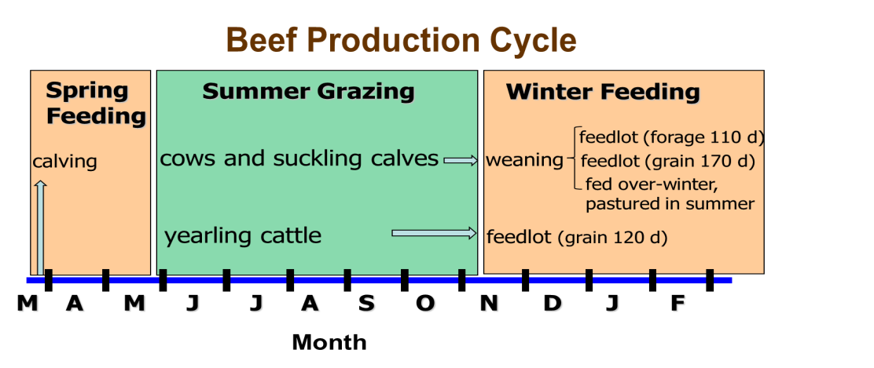
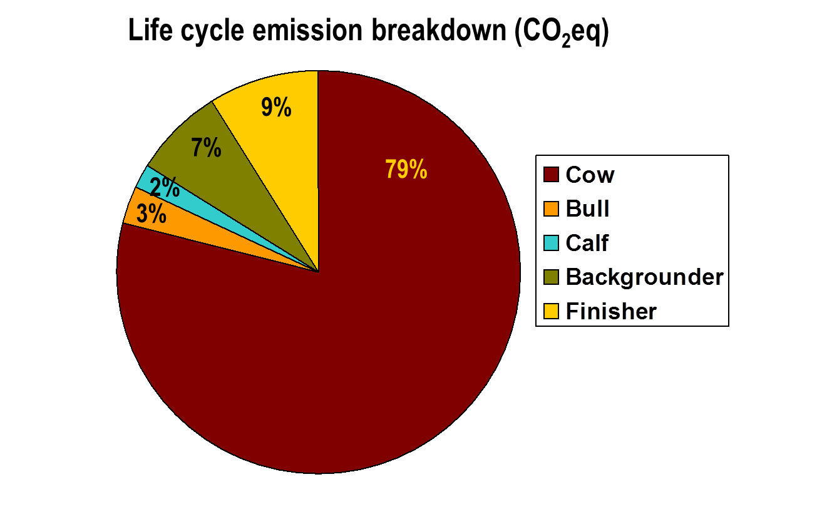
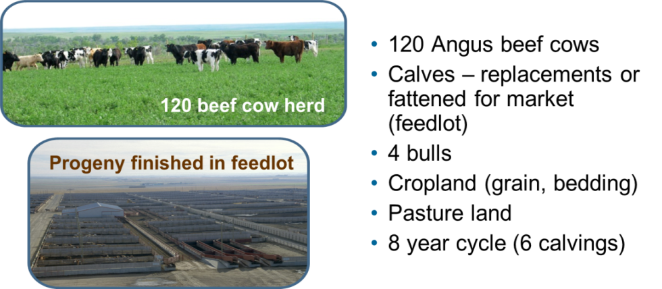
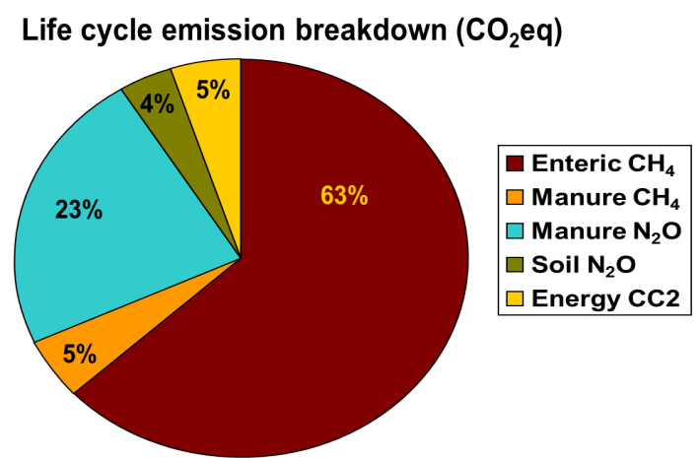
Beef GhG in Western Canada: A case study
Beauchemin et al. (2010). Agr. Syst. 103:371–379

Slide 11


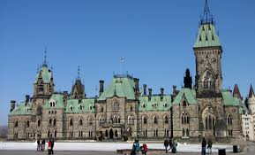
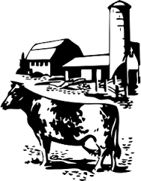
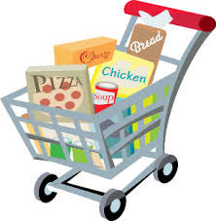

For whom?

Slide 12
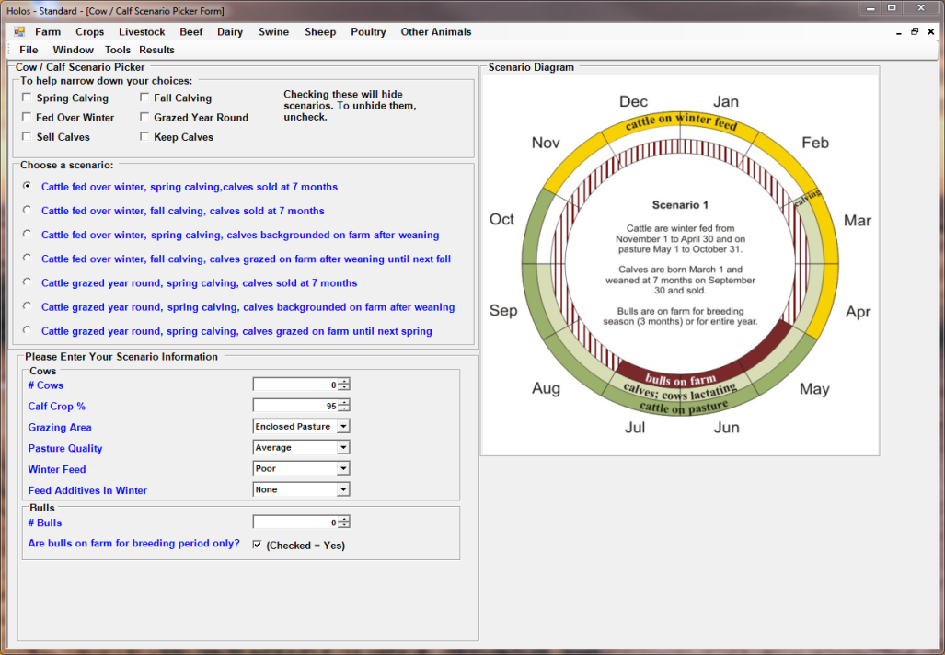
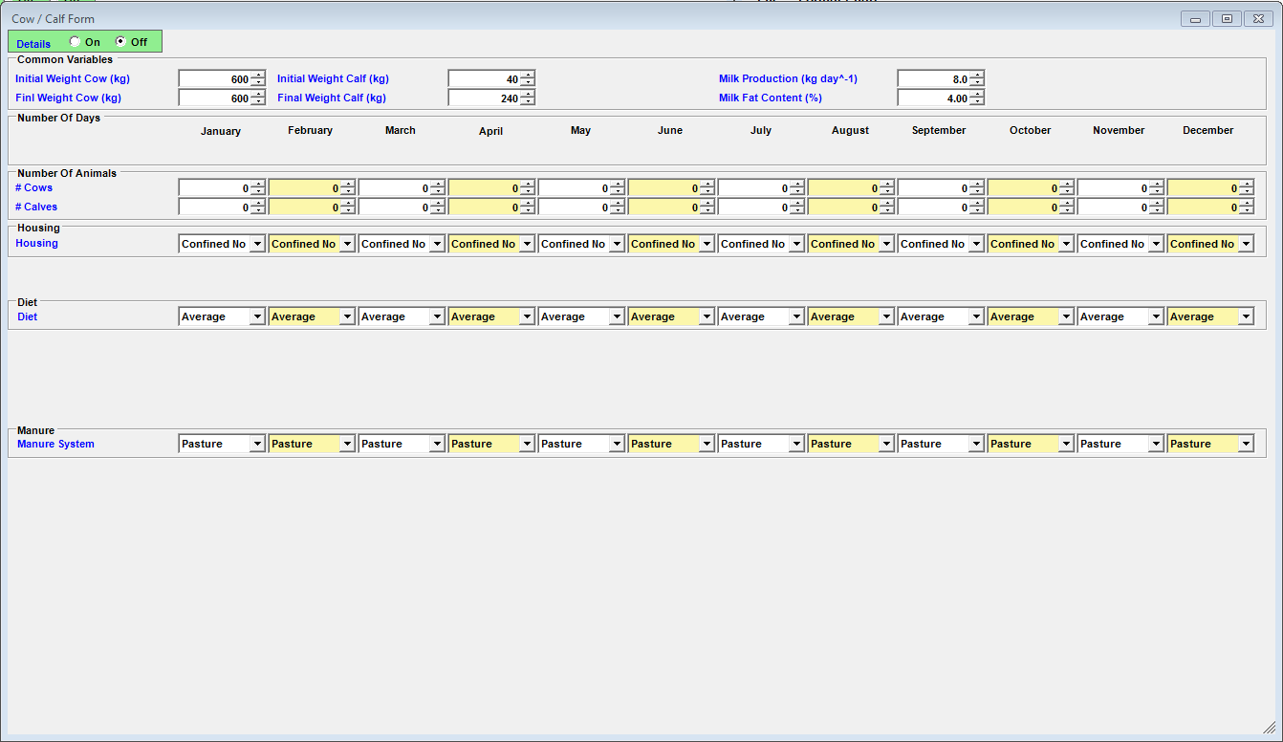
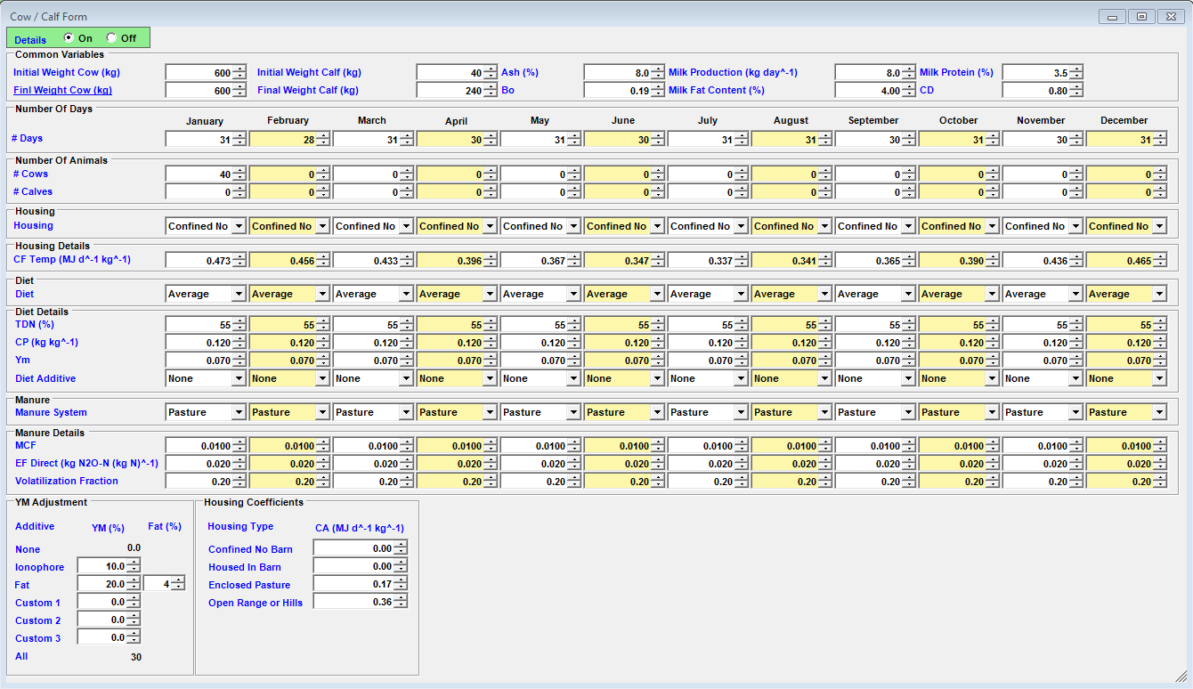
Holos interface
Simple -> complex
Holos provides defaults
User override where needed

Slide 13
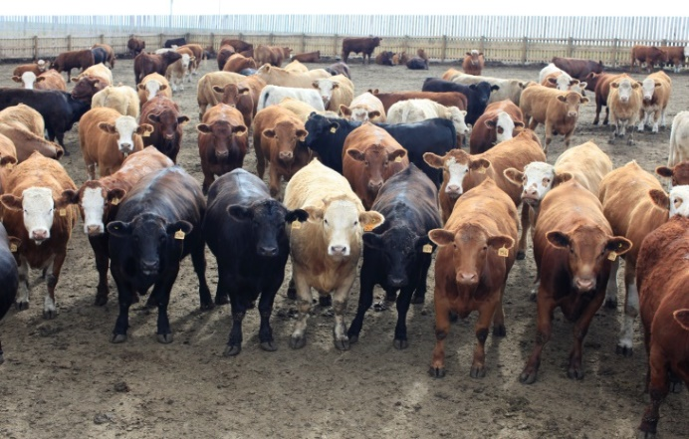
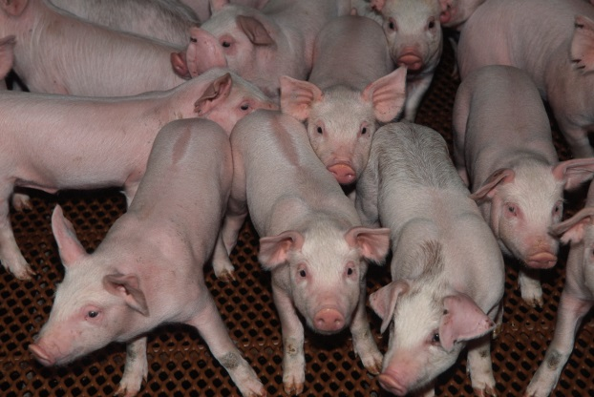
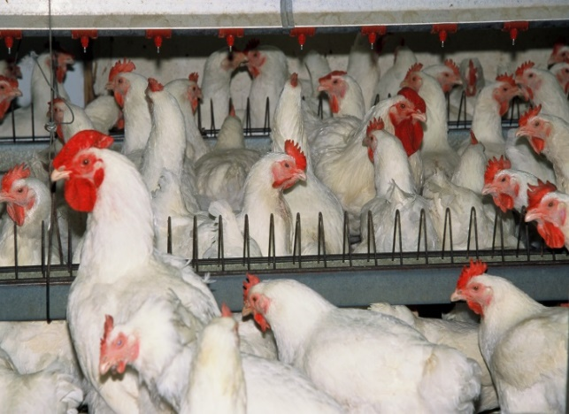
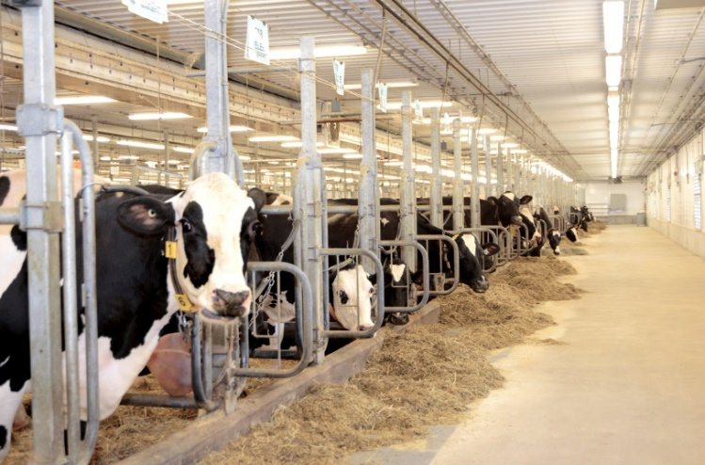
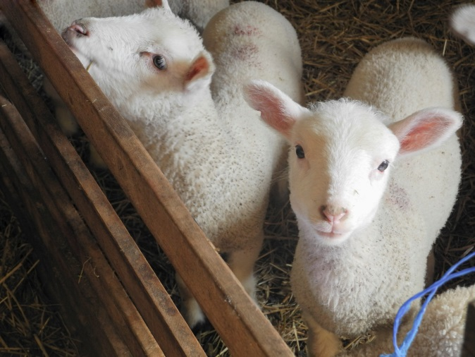
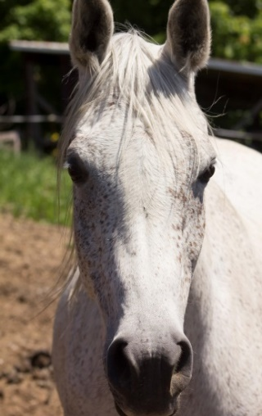
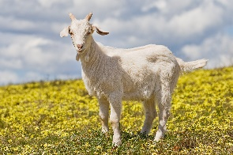
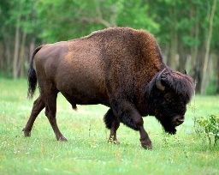
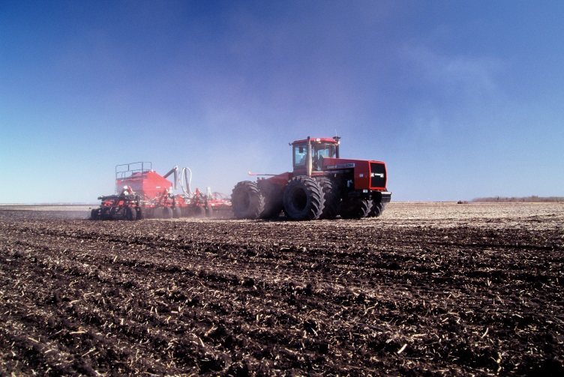
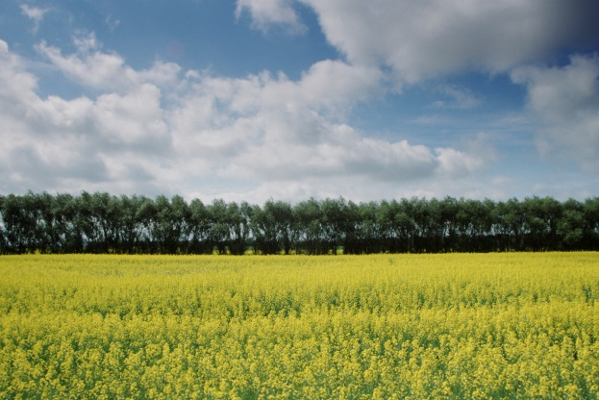
Farm operations/components in Holos
Beef production
Swine production
Poultry production
Other animals
Dairy production
Sheep production
Beef production
Soil (Crop, Forage)
Lineal tree planting/shelterbelts
Notes:
The Holos model can estimate greenhouse gas emissions from several different livestock production systems including: beef, dairy, swine, sheep, poultry and other animals such as goats and horses.
It also simulates different stages of production within these production systems, such as the grazing and confined feeding stages of beef production and the feed production stages, which we will discuss in greater detail later on.
The user can include one or more of these components when using Holos to estimate the impacts of management practices on GHG emissions for their operation.

Slide 14
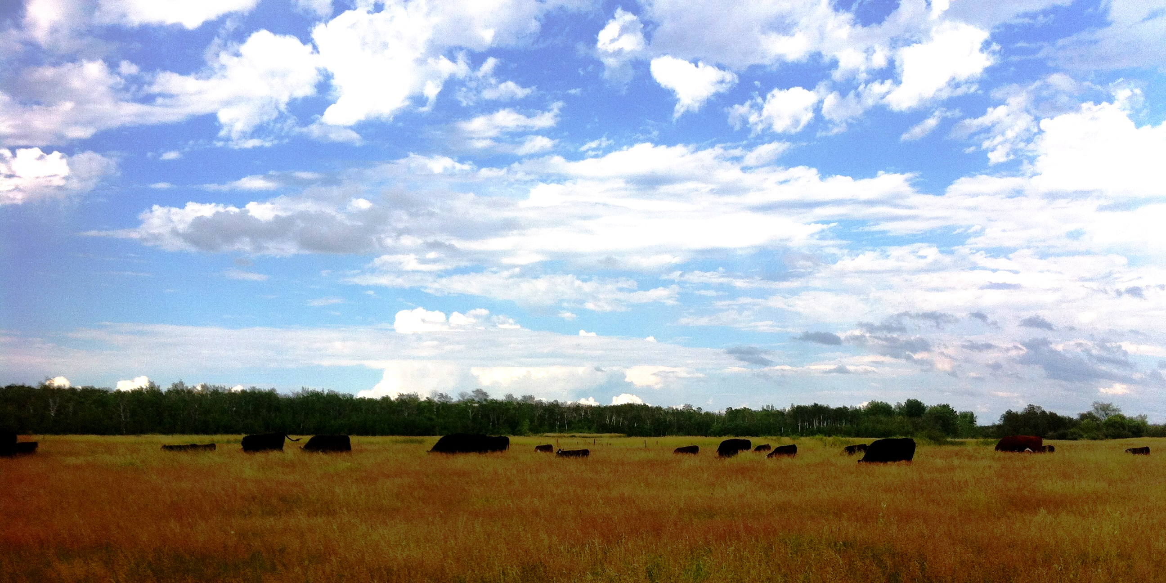

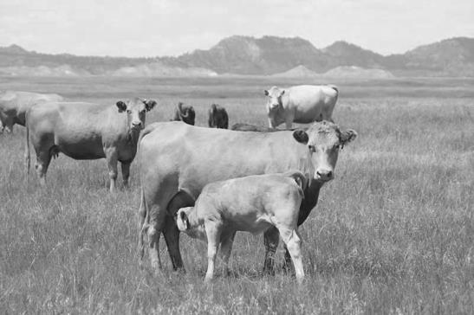
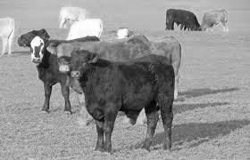

Canadian beef production systems
Three-phase production system
  Cow-calf operation – maintain breeding stock (produce calves)
  Backgrounding/stocker operation – transition to finishing phase (managed on high-forage diets)
  Finishing/feedlot operation – fed high-energy finishing diets
Weaned calf
(225-275 kg)
~ (400-450 kg)
Cow-calf
Backgrounding
Finishing/Feedlot
~ (600-630 kg)
Notes:
As we come from Canada, our exercise today is going to be based on a “typical” Canadian beef production operation, although the main purpose of our training session is to familiarize you with the Holos software, show you what it can do and how, so that you can later use it for your own farms.
Most Canadian beef is produced via a three-phase production system, involving the cow-calf, backgrounding and finishing stages. There is a lot of heterogeneity in Canadian beef production with many differences among farms. Some may only have cow-calf, while others may incorporate two or even three stages of production. The model farm we are looking at today is not an actual beef farm, but a kind of “virtual” farm that we use to examine how management practices across all three stages of production can impact net GHG emissions.
In the cow-calf stage: the breeding stock are on pasture, typically from March to September, with their calves;
In the backgrounding stage, weaned calves are fed on a forage-rich diet (in our example farm, barley silage), for about 4 months;
In the finishing stage, calves move from backgrounding to a feedlot, where they are fed on a grain-rich diet (barley grain) they reach slaughter weight.
The birth and death of the calves mark the boundary of our system, which does not calculate GHG emissions from post-slaughter operations such as meat processing, packaging or delivery to the consumer.

Slide 15

System boundary – Farm-gate (cradle to farm-gate)
Farm boundary
Crop/soils
(N₂O, CH₄, CO₂)
INPUTS
Materials
Feed supp.
Fertilizer
Machinery
Energy
Fuel
Chemicals
Herbicide
Farm operations
(CO₂)
OUTPUTS
Main product
Live animals
(Finishers &
Culled cows)
Manure storage
(CH₄, N₂O)
Enteric CH₄
Feces & urine on
pasture (CH₄, N₂O)
Photo by Stéphane Gauthier
Notes:
The various components and processes of the beef farm can act as either sources or sinks of greenhouse gases – carbon dioxide (CO₂), methane (CH₄) and nitrous oxide (N₂O), and as such should all be considered in a whole-farm GHG emissions analysis, as indeed they are in Holos.
CO2 is produced by on-farm energy use; enteric CH4 is produced by cattle at all stages of their life; CH4 and N2O are released from cattle manure, synthetic fertilizers, soils and crop residues.
Holos also includes some GHG emissions that do not strictly speaking occur on the farm but are instead produced upstream, such as CO2 produced during the manufacture of the pesticides and fertilizers used on the farm.
As our farm is a cradle-to-farm gate operation, our final output is live animals from the finishing stage.

Slide 16

Emission intensity (Carbon footprint)
Emission intensity: mass of GHGs per unit product (e.g., beef, milk, egg, protein)
kg CO₂ eq
Emission intensity =
kg beef
Carbon footprint
CO₂ eq = Carbon dioxide equivalent
      GWP - CO₂ = 1
            CH₄ = 28
            N₂O = 265
Notes:
Ultimately, what we would like to know and what Holos can help us to understand, is how the different management practices that we adopt on our farm at different stages of production, can impact net GHG emissions per unit of final product, i.e., the GHG emission intensity of producing a particular product.
This final product can be live animals, beef, milk, or eggs, and the GHG emission intensity is calculated as the kg CO2 eq. from the production process divided by kg of product produced.
CO2 equivalent is a way if expressing, in a common unit, the emission of different GHGs and it is based on the Global Warming Potential of the different GHGs. For example, CO2 is equal to 1 CO2 eq., while N2O, which is a much more powerful GHG, is equal to 265 CO2 eq. That is, one unit of N2O has a global warming potential 265 times that of one unit of CO2, or it warms the earth 265 times more than CO2 over a given time period. So, even if less N2O is emitted, it is a much more potent GHG.

Slide 17

Model beef farm (for practice)
Beef cows
Backgrounders
Finishers
Bulls
120 cows (600 kg BW)
102 calves (15% calf loss)
Calving month – March 1
Calving weight – 40 kg
100 backgrounders
Steers:heifer – 1:1
Initial wt = 240 kg
ADG = 1 kg/d
98 finisher
Steers:heifer - 1:1
Initial wt = 350 kg
ADG = 1.5 kg/d
4 bulls (820 kg)
Calves
Beef operation (hypothetical average farm)
Notes:
To describe our model beef farm in a little more detail:
During the cow-calf stage, the breeding stock remain with the calves on pasture over the summer months, from March to September; on our farm we have 120 cows, who produce 102 calves (15% calf loss); the calves are born on the 1st of March and they are weaned on Oct 1st;
Following weaning the calves move into the backgrounding stage; 100 calves move into this stage (there is a small loss), and 50% are steers and 50% are heifers; their initial weight is 240 kg and they gain 1 kg weight per day on a barley silage-rich diet;
Animals leave the backgrounding stage in mid-January and then move into a finishing feedlot where they are fed on a barley grain-rich diet until July; they gain more weight on this diet – 1.5 kg per day, and are slaughtered when they reach a weight of about 600 kg.
We also have 4 bulls on the farm.

Slide 18







Feed production (self-sufficient farm)
Barley grain
Barley silage
Mixed hay
Native pasture
76 ha
Yield = 2960 kg/ha
N app = 42 kg N/ha
P app = 25 kg P₂O₅/ha
No irrigation
18 ha
Yield = 2000 kg/ha
N app = 80 kg N/ha
P app = 30 kg P₂O₅/ha
No irrigation
164 ha
Yield = 3220 kg/ha
No irrigation, No herbicide, No N fert
2000 ha
Yield = 3220 kg/ha
No irrigation, No N fert
Notes:
To maintain all of these animals we also need to produce the feed for them to sustain them, so Holos also calculates GHG fluxes associated with the forage and feed production stages.
Normally, the area of land needed for all feed crop requirements is calculated outside of Holos based on various factors including animal DM intake, crop yield, harvest losses and pasture utilisation rates, etc. However, for ease we provide you with all of these areas today; ALTERNATIVELY, if you have actual data on the amount of land you need to grow different crops to feed your animals, you could use those data.
We need:
Barley grain to feed to animals in the finishing feedlot;
18 ha of barley silage to feed backgrounding animals;
164 ha of mixed hay (grass/legume mix) to feed cows and bulls (breeding stock) over the winter months while they are in a drylot;
2,000 ha of native pasture on which the breeding stock graze during the summer.

Slide 19

Holos - whole-farm model

Slide 20



Starting the model
Notes:
Now we will start the model:
Click on the “Holos 3.0” icon;
The first window allows you to choose your preferred language at the top, and then click “OK”;
On the next window click “Holos research” and then the program will open.

Slide 21











Starting the model
Holos Dashboard and Icons to work with
Open file => “Practice_Utah State University Beef Farm2019.holosR”
Notes:
Just to show you some of the main menus and functions:
The “File” menu allows you to create new Holos farms and open existing ones;
The “Results” menu, which we will be using at the end of the exercise, allows you to visualise the model results in different ways;
Beneath the “File” menu:
The “Farm” button allows you to see the basic details of your farm (farm location, soil type, etc.) ;
The “Energy” button shows you the relationships between farm processes and energy use, e.g., how much energy is used in the production of a kg of synthetic N fertilizer;
The “Economics” button shows you the revenue and expenditure associated with different farm processes and practices, e.g., how much is earned from selling a finished beef animal, or how much it costs to irrigate a hectare of barley.
The “Beef” menu is where we will open forms to enter information for the animals at each stage of production – cow-calf, backgrounding, finishing, bulls
The “Crops” menu is where we will open forms to enter information for each of the crops we grow to feed the farm animals
The other menus for “Dairy”, “Sheep”, etc. are used for the relevant production systems, but we will not need those for this workshop.
Open the file “Practice_Utah State University Beef Farm2019.holosR”

Slide 22



Farm location
Make sure that your computer is connected to an Internet to access the map
We assume that the farm is located near Winnipeg, MB, Canada (Ecodistrict 849)
Notes:
On the “Farm information form”, click on the “Ecodistrict Map” button to open up a map of Canadian ecodistricts – YOU NEED TO BE CONNECTED TO THE INTERNET TO USE THIS FUNCTION;
Navigate to the province of Manitoba, zoom if and select the red marker closest to the city of Winnipeg (just to the west of the city), and click OK;
If you do not have internet access, you can also select the ecodistrict using the drop-down menu – select ecodistrict # 849;
Change the name of the farm to “MyFarm”;
Remember to save your work as we move through the exercise.

Slide 23

Cow-calf (365 and 184 days, respectively)
Open the “cow-calf screen”
# of cows and calves
  Cows => 120 every month
  Calves => 102 from March to September
Housing – “enclosed pasture” from May to October
Notes:
Now that we have determined the location of our farm, which in turn automatically specifies farm characteristics such as soil type and texture, we will begin to enter the data for our animals;
Go to the “Beef” menu and open the “Cows/Calves” form; some of the data we need have already been entered, but we will need to make some additions/changes:
Change the number of cows to 120 for every month of the year (as these are breeding animals and so are present on our operation all year round);
Change the number of calves to 102 for the months Mar-Sep ONLY; for all other months the number of calves should be ZERO, as these animals are present with the cows on pasture only from Mar-Sep;
Under housing, set this to “enclosed pasture” from May-Oct.

Slide 24

Bulls (365 days)
Open the “Bulls” screen
Bulls => 4 every month
Diet => “medium energy/protein” for November – April
Notes:
Now we will enter data for the bulls; on the “Beef” menu open the “Bulls” form;
Enter 4 bulls for every month of the year, Jan-Dec;
Change the diet to “medium energy/protein” for the months Nov-Apr (these are the months that the animals are fed mixed hay, often in a drylot).

Slide 25

Backgrounding Group 1 (110 days)
110 days = Oct. (31) + Nov (30) + Dec (31) + Jan (18)
Open the “Backgrounding Group 1” screen
Crossing into the second year!
Turn the details ‘On’
Jan = 18 days
Initial BW = 240 kg
Notes:
On the “Beef” menu, open the “Backgrounding Group 1” form, so that we can enter information for our weaned calves that have now moved into the backgrounding stage:
The calves are in the backgrounding stage from Oct 1st until Jan 18th, so first we need to specify this; TURN THE DETAILS ON, and then change the number of days in January to 18 (by default, the maximum number of days in the month is normally specified);
Then, change the starting weight of the animals in October to 240 kg, and make sure that the average daily gain (ADG) is set to 1 for the months Oct-Jan. YOU WILL NEED TO DO THIS FOR BOTH STEERS AND HEIFERS – NOTE that there are separate sections for these two groups.

Slide 26

Finishing Group 1 (170 days)
Open the “Finishing Group 1” screen
Turn the details “on”
# of days in January (13) and July (7) = 170 days
Change diet from “corn” to “custom”
  Adjust:
    TDN values to “81”,
    CP content into “0.120” and
    Ym unadjusted to “0.04”
Notes:
The animals leave the backgrounding stage and enter the finishing stage on January 19th, so we move to the finishing form; on the “Beef” menu, open the “Finishing Group 1” screen and again, turn the details “on”:
As the animals enter the finishing feedlot on January 19th, they remain there only 13 days, so change the number of days in January to “13”; similarly, they leave the feedlot on July 7th, so change the number of days in July to “7”;
For the months of January to July, we need to change the diet from “corn” to “custom”; once we do this the values in the “Diet details” section can be modified: change the TDN to “81”, the CP to “0.120” and the Ym unadjusted to “0.04” – this reduces the quality of the feed.

Slide 27

Annual crop (Barley grain and silage)
Open the “Annual Crop” screen
Yield:
  Barley grain => ‘2960 kg/ha’
  Barley silage => ‘10,000 kg/ha’
N application:
  Barley grain => ’42 kg/ha’
  Barley silage => ’80 kg/ha’
Notes:
For the feed crops we must produce, open the “Annuals” form on the “Crops” menu:
Change the yield for barley (grain) and barley silage to “2,960” and “10,000” respectively;
Change the N application rate to “42” and “80” kg per ha for barley and barley silage respectively.

Slide 28


Last steps
Perennial cropping operation
Mixed-hay => Put “3220 kg/ha” as a yield value
No N and P applications - change to zero N and P
Pasture / grassland
No N and P applications - change to zero N and P

Slide 29




Results
Notes:
We can visualise the outputs of the model in different ways using the “Results” menu at the top of the page:
The “Simple emissions” chart shows the GHG emissions from each emission category or type; to see the values, hover your mouse over the different sections of the chart; REFRESH THIS CHART to show the results of the changes we have made to this farm file;
The “Emissions Pie” shows the proportion of total GHG emissions from each emissions category;
The “Emissions details CO2e report” shows us, on an annual and monthly basis, the emissions associated with each animal type and stage of production; IT IS FROM THIS FORM THAT WE WILL EXTRACT SOME DATA TO ENTER INTO OUR EXCEL SPREADSHEET;
At the top of the “Emissions details” report, click the “Change units to kg” button;
Near the bottom right of the report, we want to copy the value in red – this is the net farm GHG emissions value – enter this into the “Net farm GHGs (kg CO2 eq)” cell on the “Average farm” tab in the Excel file;
We also need to enter the final live weight of finishers into the next cell – we can find this value in the “Finishing Group 1” form – it is 604 kg.
The number of finishers was 98 (49 steers and 49 heifers) – enter this value into the next cell.
The GHG emission intensity will be calculated automatically – this tells us that our farm produces 11.98 kg CO2 eq. per kg of live weight produced.

Slide 30
Holos - whole-farm model
Exploring Changes in Management Practices

Slide 31
Holos - whole-farm model
Exploring Changes in Management Practices
 | Management practice | Emission intensity (kg CO₂ eq/kg beef) |  | Estimated effect (% reduction) | Rank
 |  | Average farm | After change in management
A | Increase weaning rate from 85 to 90%
B | Increase total digestible nutrient (TDN) of winter feed in the cow-calf diet
C | Add 2% fat to livestock diets
Notes:
Before making the changes for each scenario, click “Save as” and save your farm under a different name, e.g., “MyFarm_WeaningRate”

Slide 32
1. Increase weaning rate from 85 to 90%
Affects the number of calves born and finished in feedlot.
Affects the amount of feed required.
Increase # of weaned calves from 102 → 108
Increase # of backgrounded animal 100 → 106 (53 heifers, 53 steers)
Increase # of finisher from 98 → 104 (52 heifers, 52 steers) – this increases your live weight production at the end of the production season
Change land for barley grain from 76 → 81 ha
Change land for barley silage from 18 → 20 ha

Slide 33
2. Increase TDN of winter feed in the cow-calf diet
Change diet from “medium energy/protein” to “high energy/Protein” for “November - April”.
This will change:
TDN (%) from 55 → 65 and
CP (kg/kg) from 0.12 → 0.18
Ym unadjusted from 0.07 → 0.065
In order to see the changes, turn “on” the “details”

Slide 34
3. Add 2% fat into livestock diets
Select “2% fat” under “diet additives” for the cow-calf, bull, backgrounding and finishing animals throughout the year
This will change:
Ym Adjusted (%) from 0.0 → 10 (implying that the methane conversion factor (Ym) is reduced by 10%)
To see the change, turn on the “detail”

Slide 35



Results
1. Increased weaning rate
2. Increased TDN
2.71%
12.02%
3. Increased fat
7.51%

Slide 37



More information
Aklilu Alemu
Agriculture and Agri-Food Canada
Telephone: 403-317-3446
aklilu.alemu@canada.ca
To download Holos: www.agr.gc.ca/holos-ghg
Questions - Email: aafc.holos.acc@Canada.ca
Notes:
- Holos publications are listed on our website, along with software download.

Slide 38
Purpose of Holos
Whole-systems approach
  Estimate all GHGs from entire, integrated farm
  Ensures effects of changes are transferred through entire system
  Emphasizes interactions
Envision hypothetical scenarios and test possible ways of reducing GHG emissions before implementation
Intended to look into the future and ask “What if?”
Learning and communication tool
Research explorations
This material is based upon work that is supported by the National Institute of Food and Agriculture, U.S. Department of Agriculture, under award number 2017-38640-26913 through the Western Sustainable Agriculture Research and Education program under subaward number GW18-156. USDA is an equal opportunity employer and service provider. Any opinions, findings, conclusions, or recommendations expressed in this publication are those of the author(s) and do not necessarily reflect the view of the U.S. Department of Agriculture.

