Slide 1
This material is based upon work supported by the National Institute of Food and Agriculture, U.S. Department of Agriculture, through the Northeast Sustainable Agriculture Research and Education program under subaward number ONE21-400.

Slide 2
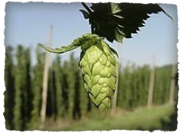
Hops Trellising
Straight Line
In row V-style
V-style

Slide 3
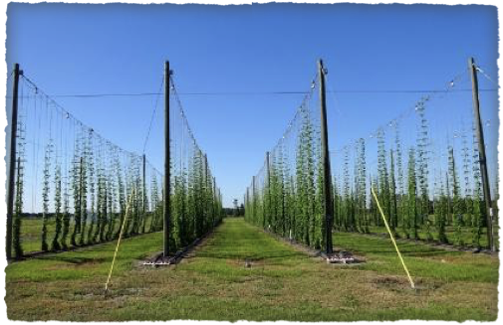
Straight Line Trellis System
-Straight Line Trellis: 3-4 bines grow up one line in a straight row
-Pro: more airflow, easy harvest, easy visual inspection
-Cons: less yield, more weeds, more watering, higher potential for pests (mites)

Slide 4
Examples of Straight Line
Trellising System Layout
Common Parameters
for 1/4 acre hop yard
-Pole spacing every 35’ (varies per varietal needs)
-Plant spacing every 3’6” (varies per varietal needs for side arm growth)
-Row width 10’-12’
-1/2 acre or less
-typically hobby or showcase yards

Slide 5
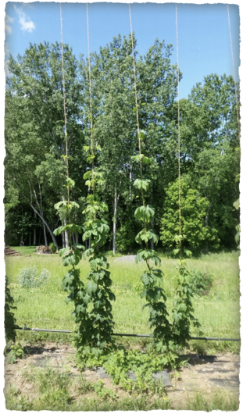
In Row V-Style Trellis System
-In Row V-Style Trellis: Two strings per plant for 3-4 bines per string totaling 6-8 vines per plant, grows in a straight row
-Pro: higher yield with less plants
-Cons: harder harvesting, more weeds, more watering, higher potential for pests (mites)

Slide 6
Examples of In Row V-Style
Trellising System Layout
Common Parameters
for 1/4 acre hop yard
-Pole spacing every 35’ (varies per varietal needs)
-Plant spacing every 6’-7’ (varies per varietal needs for side arm growth)
-Row width 10’-12’
-1/2 acre or less
-typically hobby or showcase yards

Slide 7
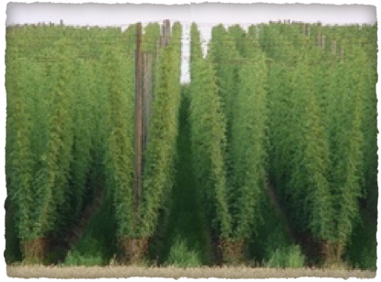
V-Style Trellis System
-V-Style Trellis: Two strings per plant for 3-4 bines per string totaling 6-8 vines per plant, grows in rows at angle toward the middle of the alleys
-Pro: higher yield, if done correctly less weeds, pest and disease
-Cons:If not done correctly or managed can have greater disease pressure

Slide 8
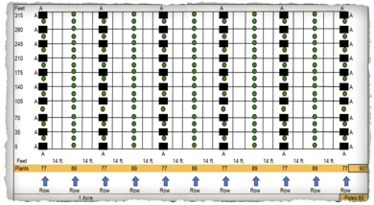
Examples of V-Style
Trellising System Layout
Common Parameters
for 1/4 acre hop yard
-Pole spacing (grid), different layouts available
-Plant spacing every 3’6” (varies per varietal needs for side arm growth)
-Row width 12’-15’
-1/2 acre or more
-typically serious/commercial scale

Slide 9
Differences At A Glance
 | Straight Line Design | Straight In Line V Design | V Design
# of Poles | 110 | 110 | 60/82/110
# of Plants | 819 | 572 | 907/892/693
# of Strings per Plant | 1 | 2 | 2
Bines per String | 3-4 | 3-4 x 2 | 3-4 x 2
Yield | 0.5-0.75 lbs per plant 410-615 lbs dry per acre | 1-1.5 lbs per plant 572-858 lbs dry per acre | 1-1.5 lbs per plant 693-1,360 lbs dry per acre
Recommended | 1/2 acre or less | 1/2 acre or less | 1/2 acre or more
Level | Hobby/Showcase | Hobby/Showcase | Serious Grower

Slide 10
Test Varieties
Variety | Harvest Time | Disease | Approximate Price per lb pellet wholesale | Approximate Pellet Yield | Profit Per Acre Pelleted Hops
Cascade | Mid-late fall | downy mildew: resistant in the crown, moderately susceptible in shoots and cone flowers, verticillium wilt: moderately resistant | $9 lb/pellet | 1st year: 450-550 lbs/acre. 2nd year: 900-1,100 lbs/acre. 3rd year: 1,350-1,650 lbs/acre 4th year: 1800-2200 lbs/acre | 1st year: $4,050-$4,950. 2nd year: $8,100-$9,900. 3rd year: $12,150-$14,850. 4th year: $16,200-$19,800
Centennial | Early fall | downy mildew: moderately resistant, verticillium wilt: probably tolerant, viruses: slight latent infection with Hop Mosaic, Hop Latent, and American Hop Latent viruses, symptomless | $10 lb/pellet | 1st year: 307-425 lbs/acre 2nd year: 615-850 lbs/acre 3rd year: 922-1,275 lbs/acre 4th year: 1,230-1,700 lbs/acre | 1st year: $3,070-$4,250. 2nd year: $6,150-$8,500. 3rd year: $9,220-$12,750. 4th year: $12,300-$17,000
Nugget | mid to late fall | downy mildew resistant, verticillium wilt resistant, free of all major hops viruses | $9 lb/pellet | 1st year: 380-475 lbs/acre. 2nd year: 760-950 lbs/acre. 3rd year: 1,140-1,425 lbs/acre. 4th year: 1520-1900 lbs/acre | 1st year: $3,420-$4,275. 2nd year: $6,840-$8,550. 3rd year: $10,260-$12,825. 4th year: $13,680-$17,100
Willamette | mid fall | downy mildew resistant, verticillium wilt: tolerant to moderately susceptible, viruses: free of Prunus, apple and hop mosaic virus | $10 lb/pellet | 1st year: 425-550 lbs/acre. 2nd year: 850-1,100 lbs/acre. 3rd year: 1,275-1,700 lbs/acre. 4th year: 1700-2200 lbs/acre | 1st year: $4,250-$5,500. 2nd year: $8,500-$11,000. 3rd year: $12,750-$17,000. 4th year: $17,000-$22,000
Columbus | Late fall | downy mildew: susceptible, similar to Galena or Clusters, verticillium wilt: resistant, powdery mildew: susceptible | $6 lb/pellet | 1st year: 445-557 lbs/acre. 2nd year: 890-1,115 lbs/acre. 3rd year: 1,335-1,672 lbs/acre. 4th year: 1780-2230 lbs/acre | 1st year: $2,670-$3,342. 2nd year: $5,340-$6,690. 3rd year: $8,010-$10,032. 4th year: $10,680-$13,380
Zeus | late fall | downy mildew: resistant, verticillium wilt: resistant | $20 lb/pellet | 1st year: 600-750 lbs/acre. 2nd year: 1,200-1,500 lbs/acre. 3rd year: 1,800-2,250 lbs/acre. 4th year: 2400-3000 lbs/acre | 1st year: $12,000-$15,000. 2nd year: $24,000-$30,000. 3rd year: $36,000-$45,000. 4th year: $48,000-$60,000
Cluster (early) | Early fall | downy mildew: susceptible, verticillium wilt: resistant; virus free (start to exhibit some after 10-15 yrs on commercial scale | $12 lb/pellet | 1st year: 450-525 lbs/acre. 2nd year: 900-1,050 lbs/acre. 3rd year: 1,350-1,575 lbs/acre. 4th year: 1800-2100 lbs/acre | 1st year: $5,400-$6,300. 2nd year: $10,800-$12,600. 3rd year: $16,200-$18,900. 4th year: $21,600-$25,200
Chinook | mid-late fall | downy mildew: moderately resistant, verticillium wilt: resistant, viruses: suspetible to hop mosaic virus | $9 lb/pellet | 1st year: 450-600 lbs/acre 2nd year: 900-1,200 lbs/acre. 3rd year: 1,350-1,800 lbs/acre 4th year: 1800-2400 lbs/acre | 1st year: $4,050-$5,400. 2nd year: $8,100-$10,800. 3rd year: $12,150-$16,200. 4th year: $16,200-$21,600

