Slide 1
Soil Sampling and Soil Analysis
Jeremy Moore
WVU Doddridge County Extension
Jeremy.Moore@mail.wvu.edu

Slide 3
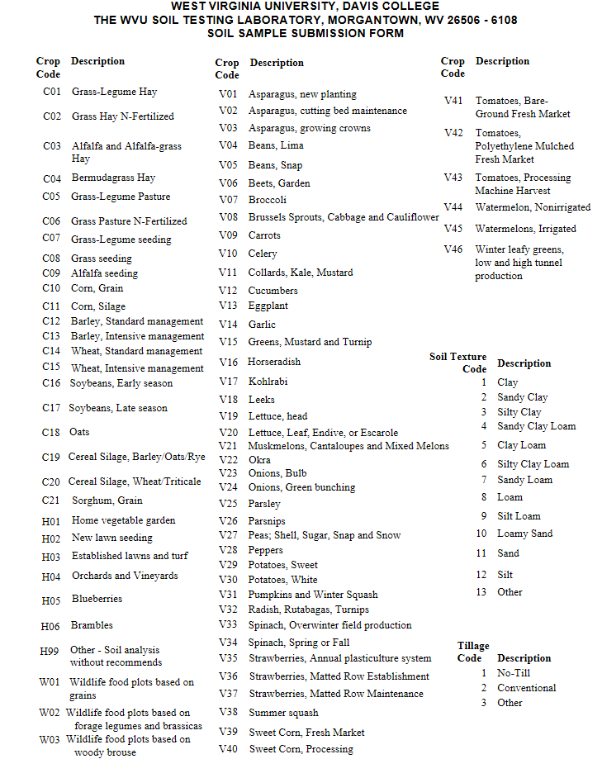

Slide 4
Soil Test Results

Slide 5
Soil Test Results
Nitrogen Application | Production Year
75 lb/acre | 1
100-150 lb/acre | 2+
Soil Test Level P | P2O5 lb/acre
0-30 ppm | 60-100
31-60 ppm | 0-60
Over 60 ppm | 0
Soil Test Level K | K2O lb/acre
0-100 ppm | 80-120
101-200 ppm | 0-80
Over 200 ppm | 0
*Oregon State University Extension Service

Slide 7
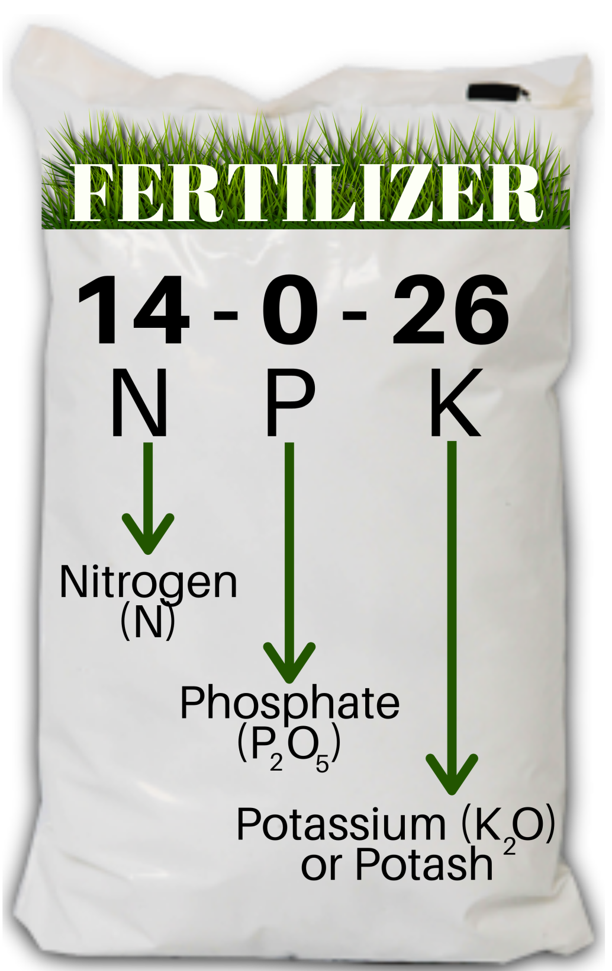
Fertilizer
N-P-K
Urea (46-0-0)
46% P2O5 by weight
50lb bag=23lbs P₂O₅
Potash (0-0-60)
60% K2O by weight
50lb bag=30lbs K₂O

Slide 8
Thanks To
This material is based upon work supported by the National Institute of Food and Agriculture, U.S. Department of Agriculture, through the Northeast Sustainable Agriculture Research and Education program under subaward number ONE21-400.

