Slide 1
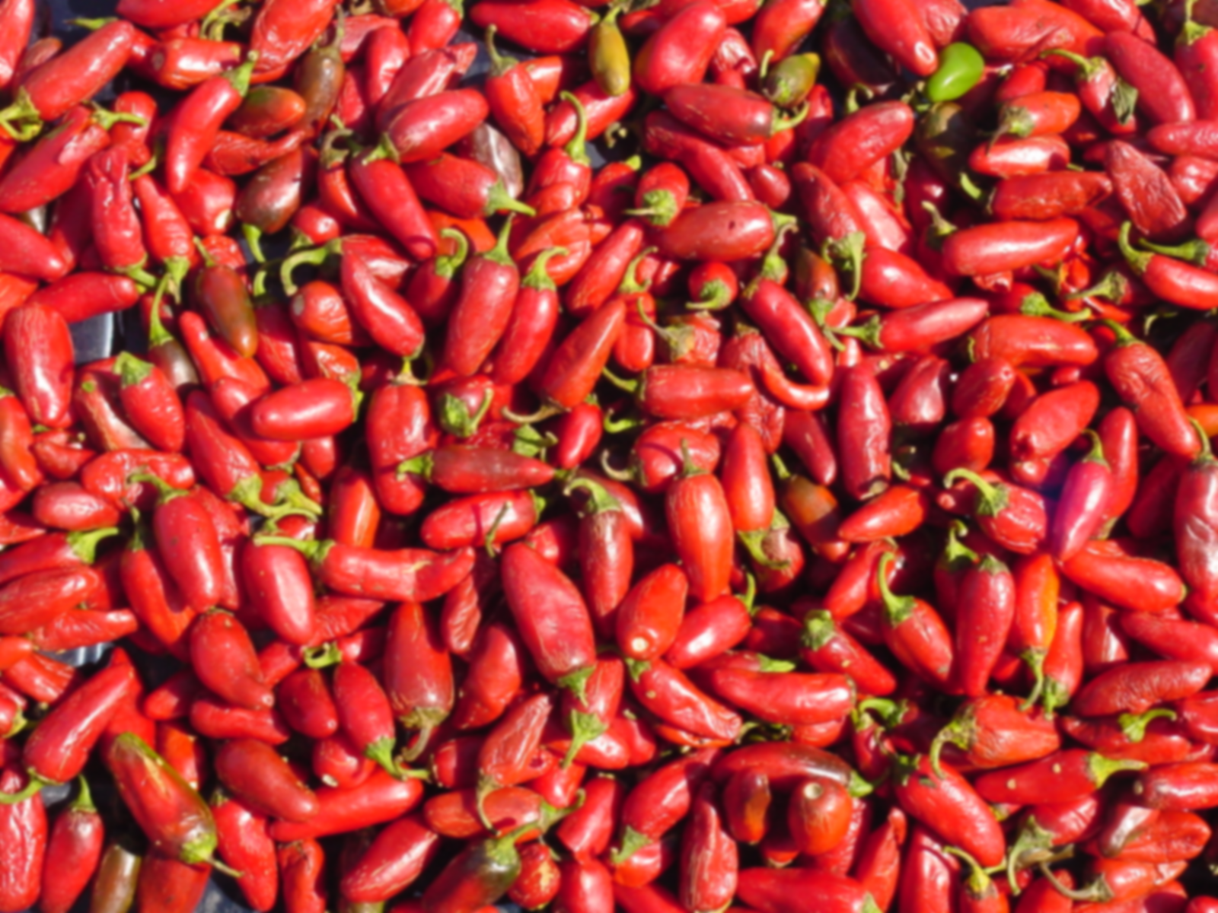
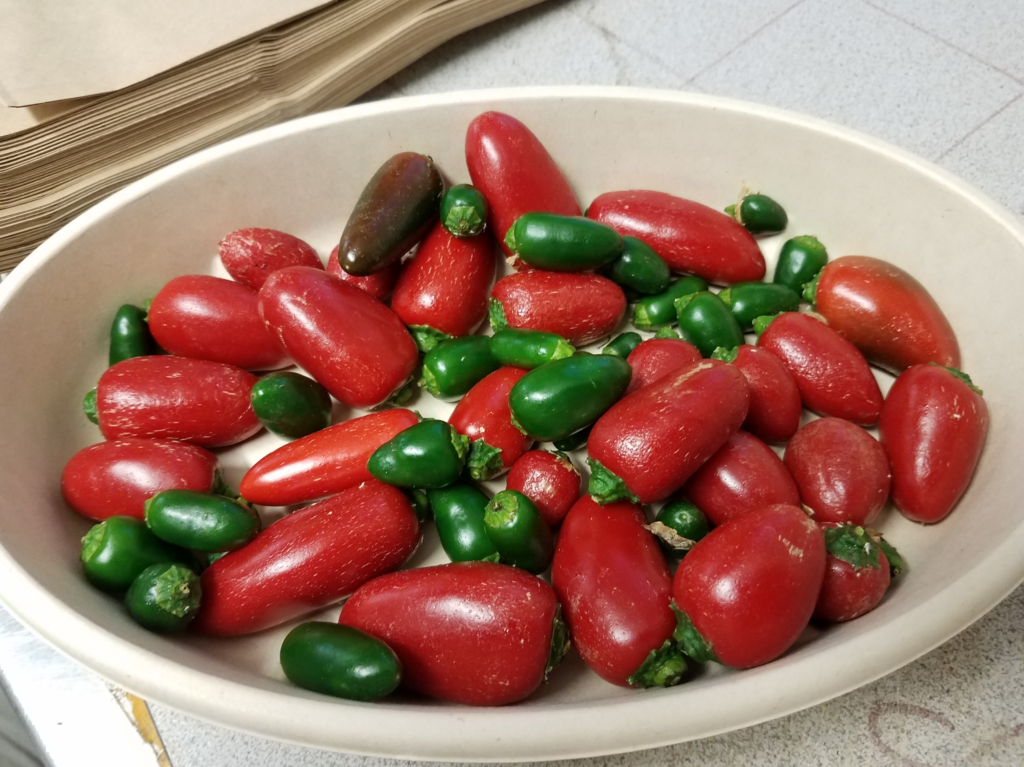
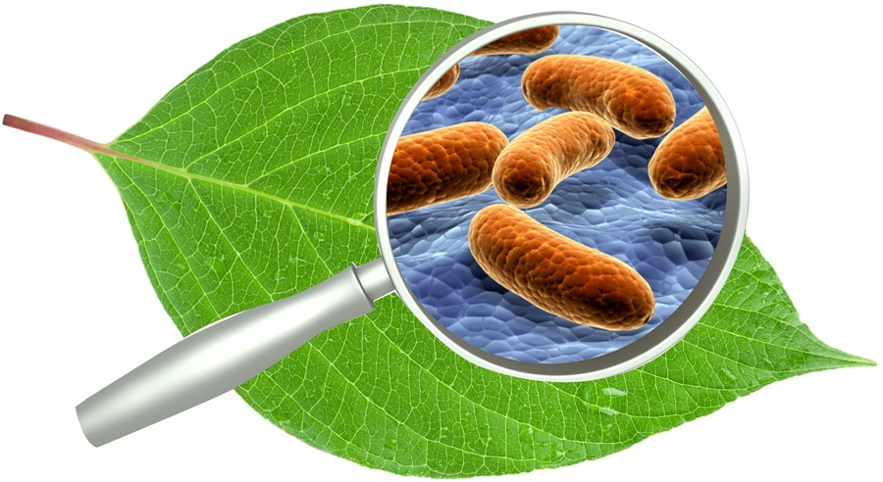
Jalapeño Response to Inoculation by the Novel Bacterial Endophyte G. diazotrophicus Yields Interesting but Economically Unimportant Results.
Ryan L. Sebring April 9, 2021

Slide 2

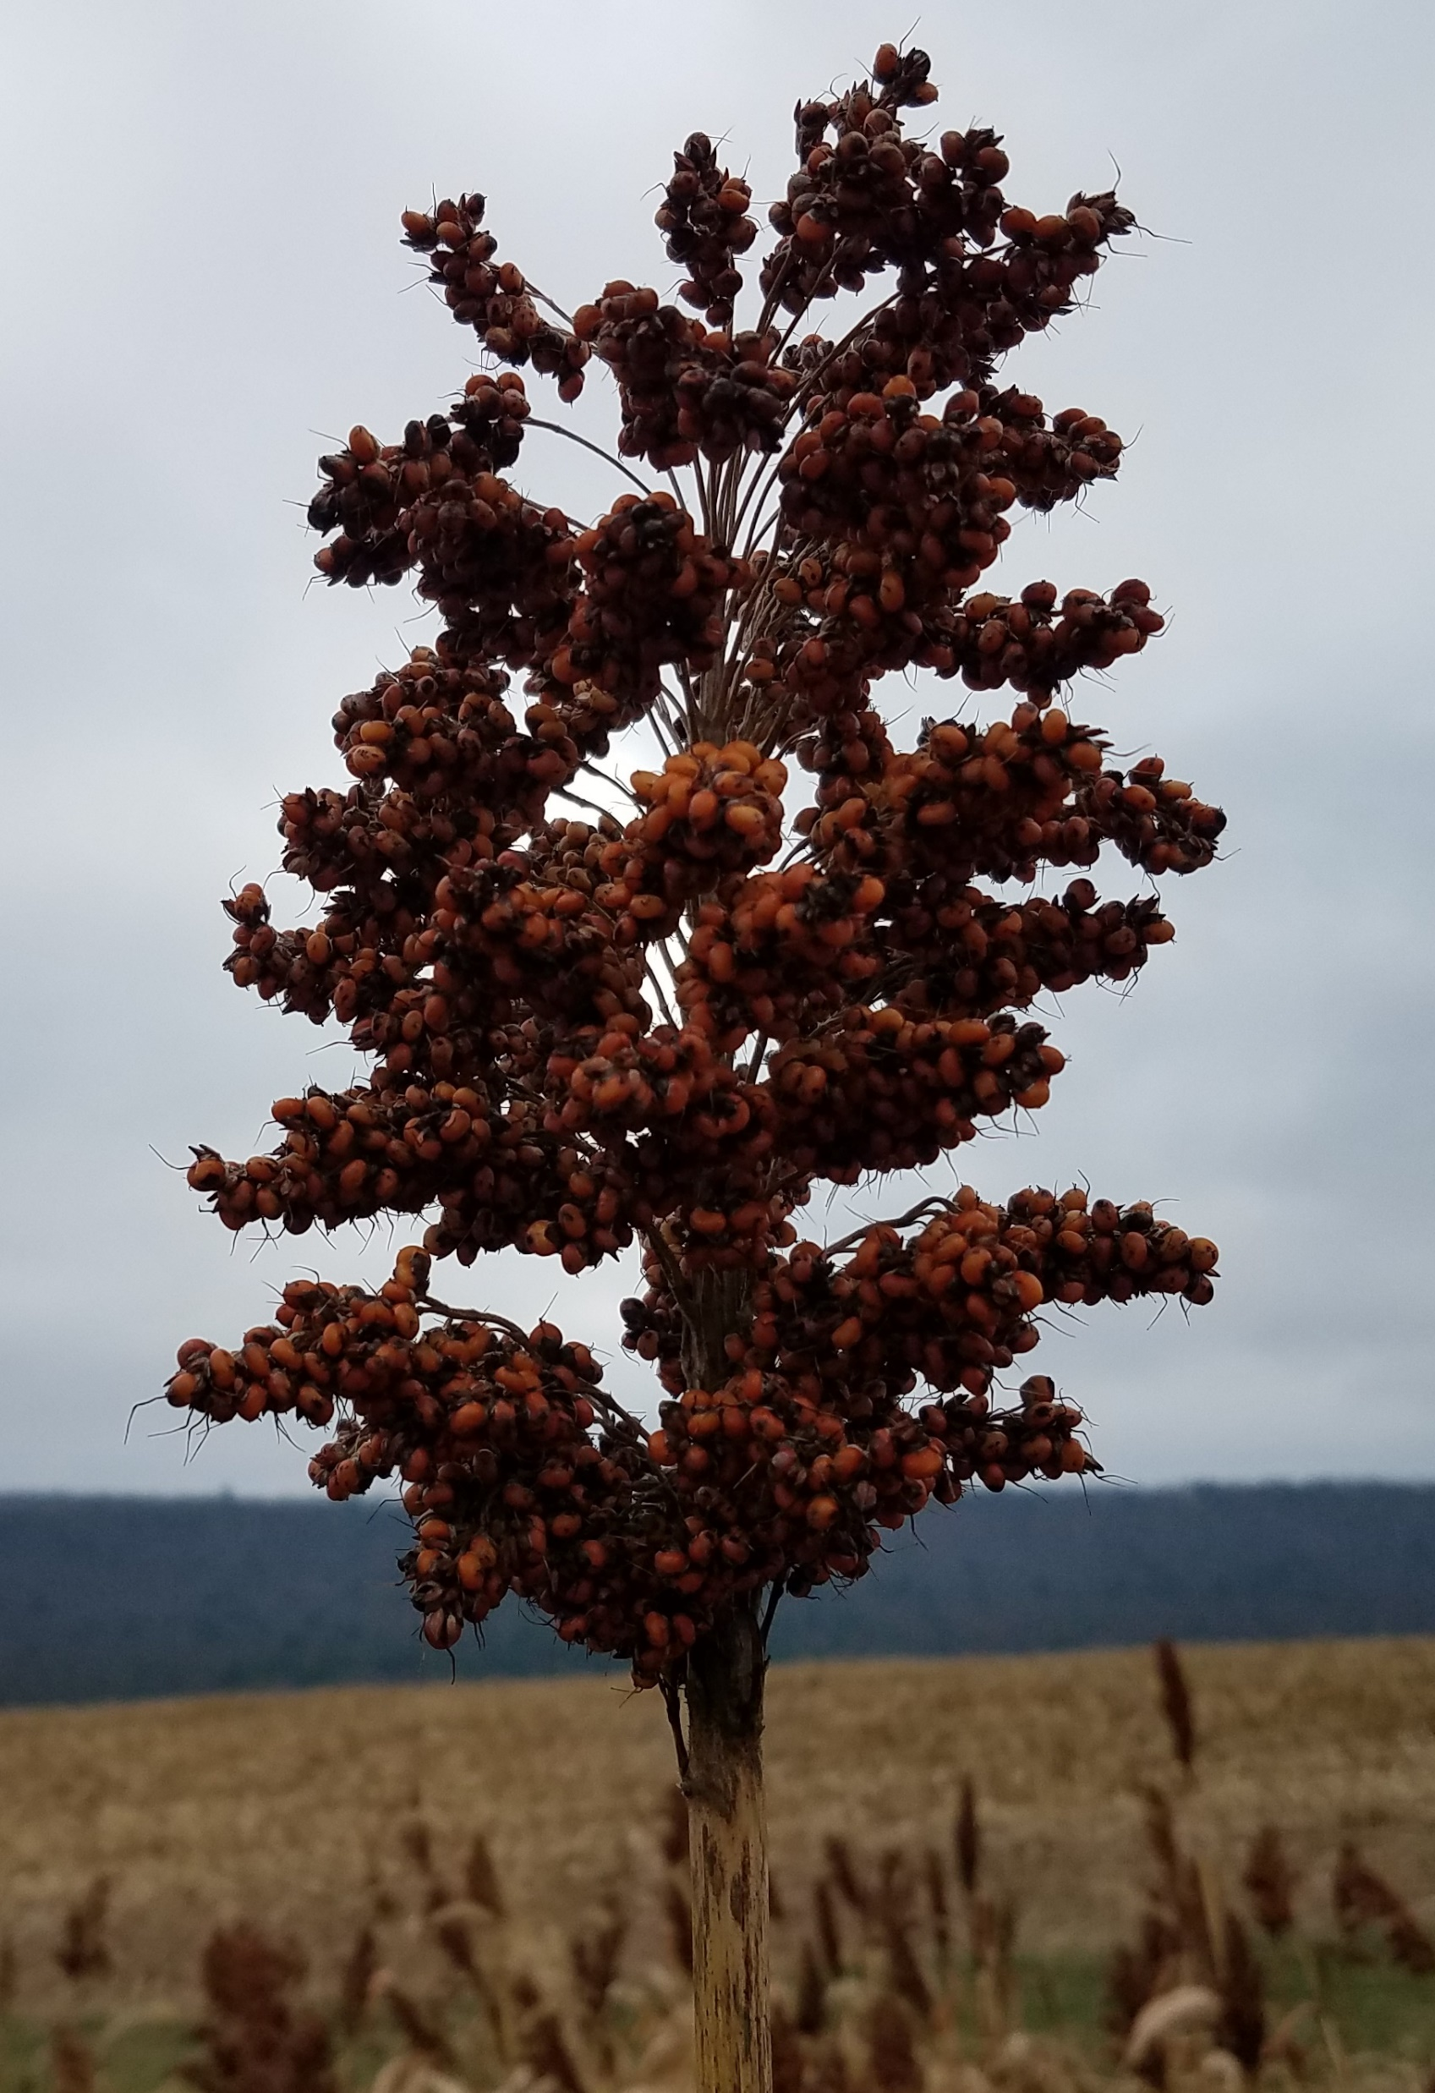
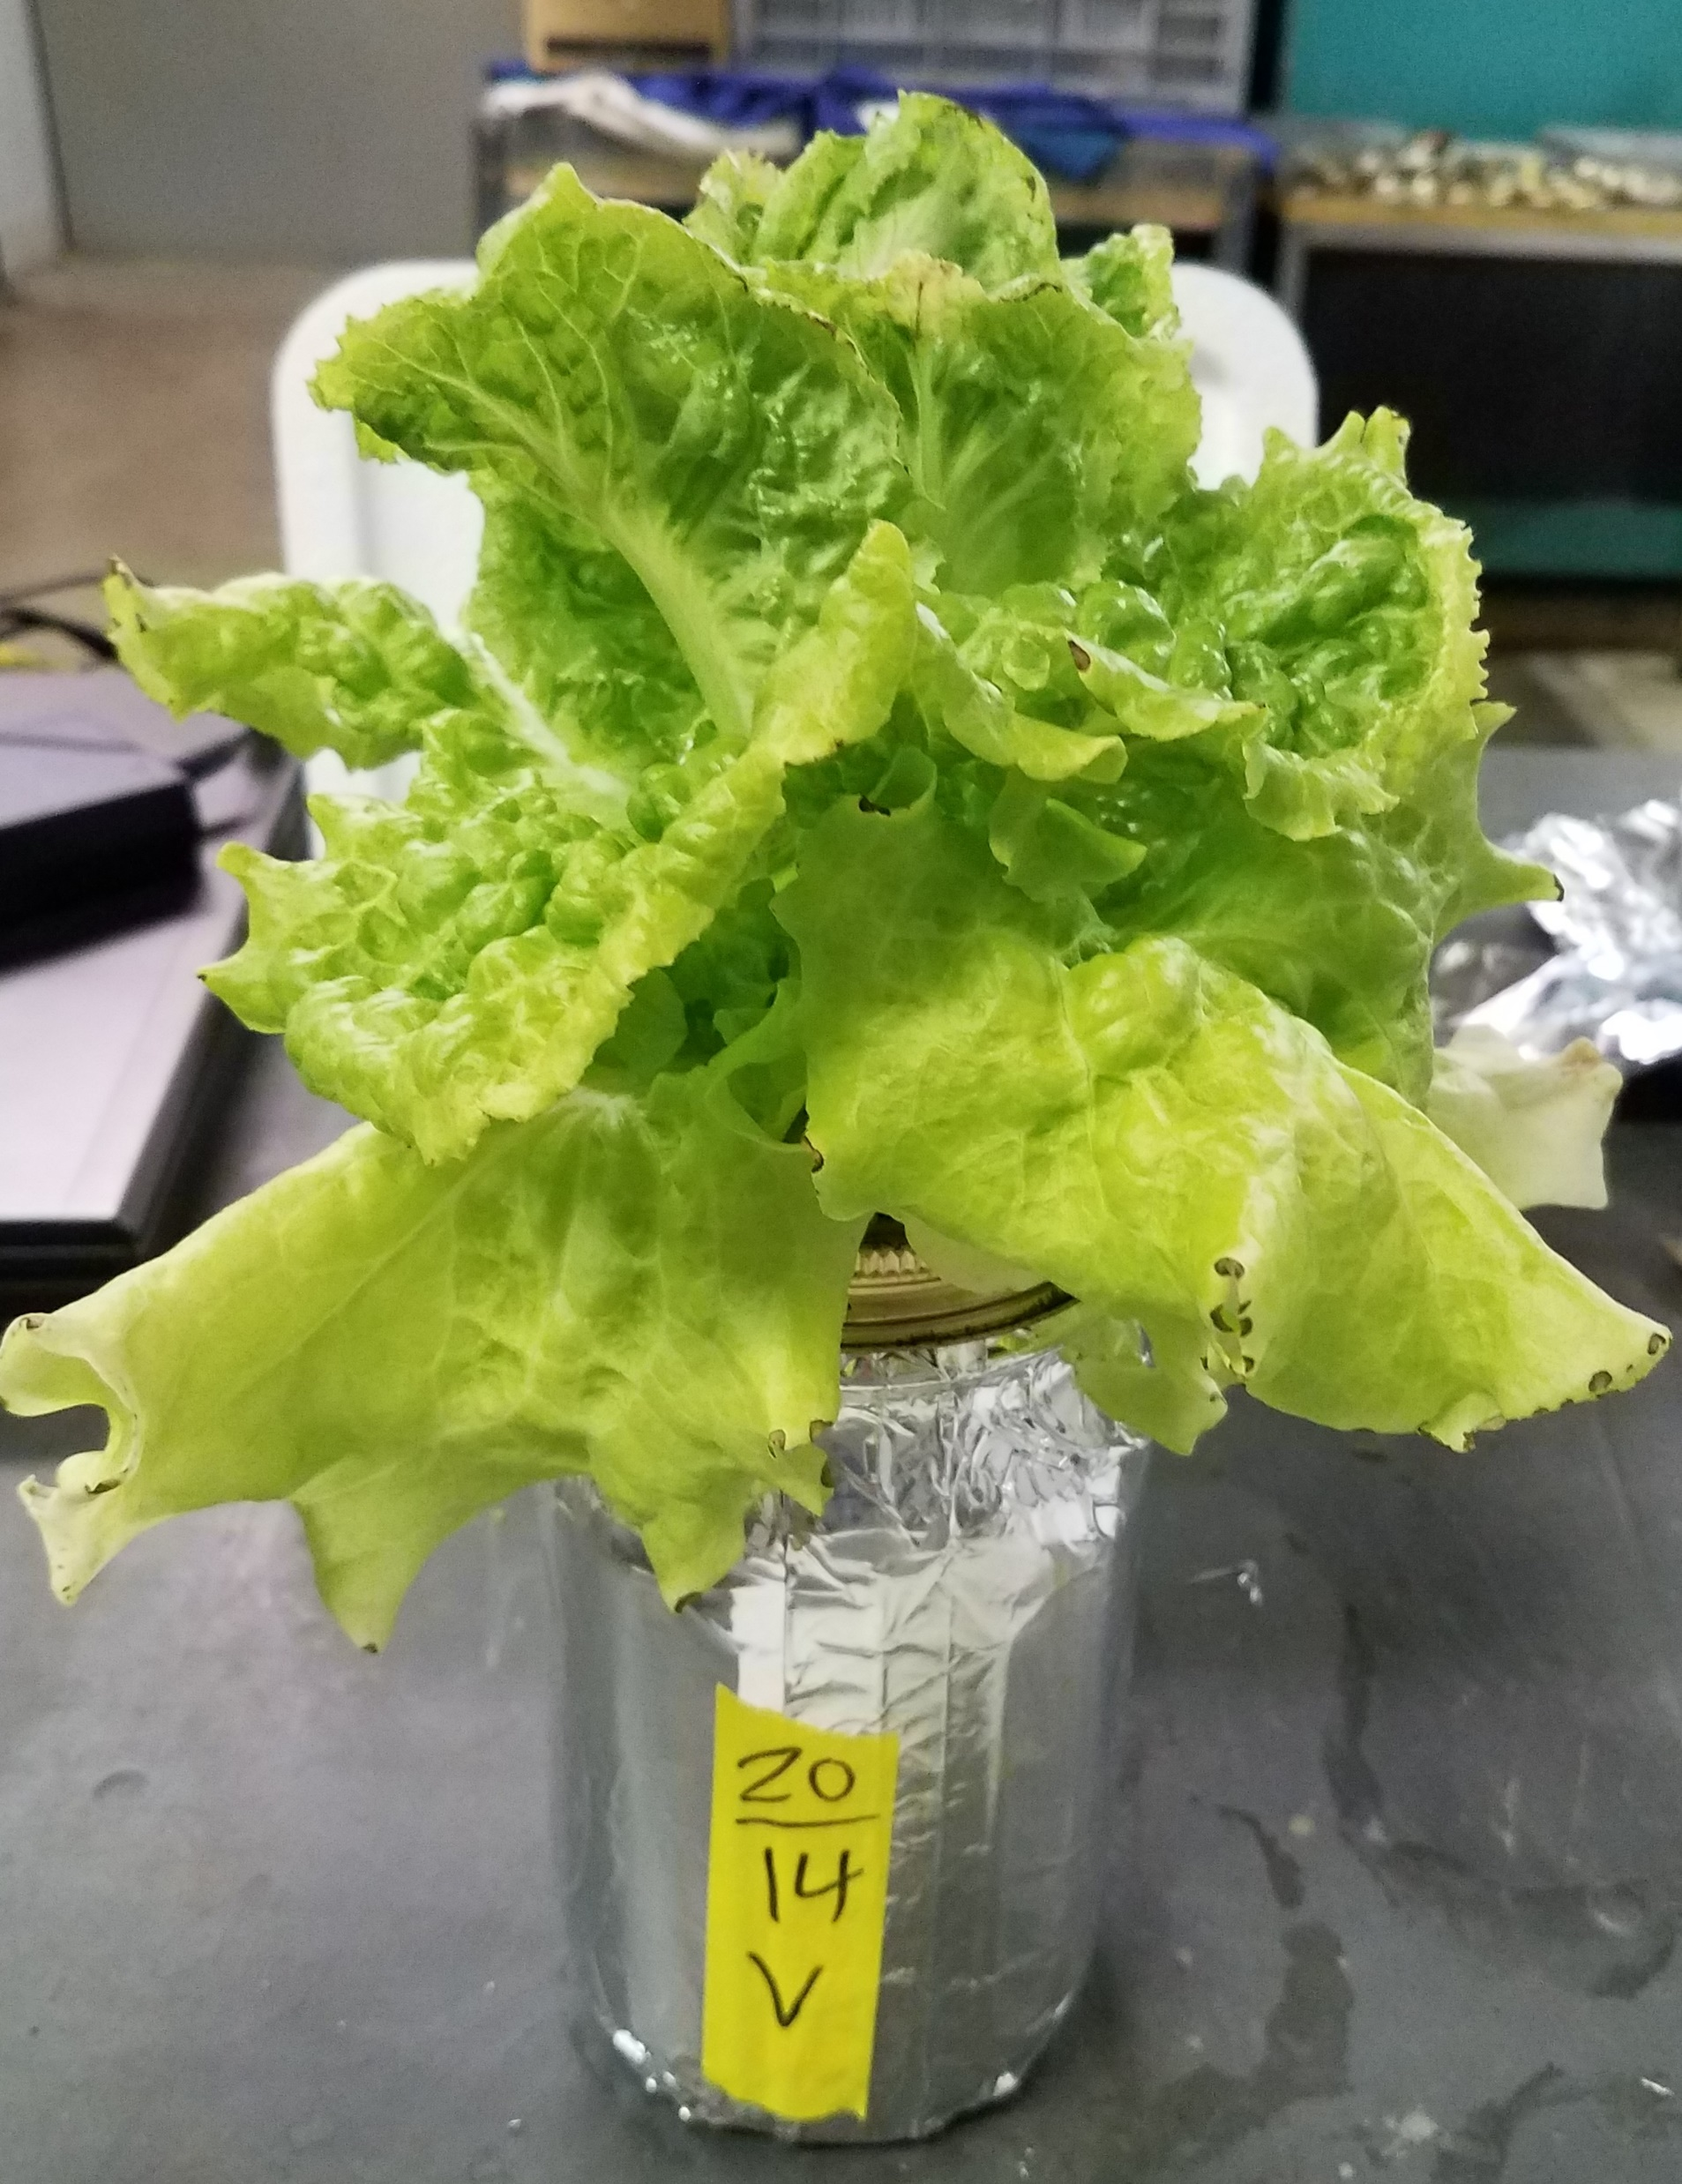
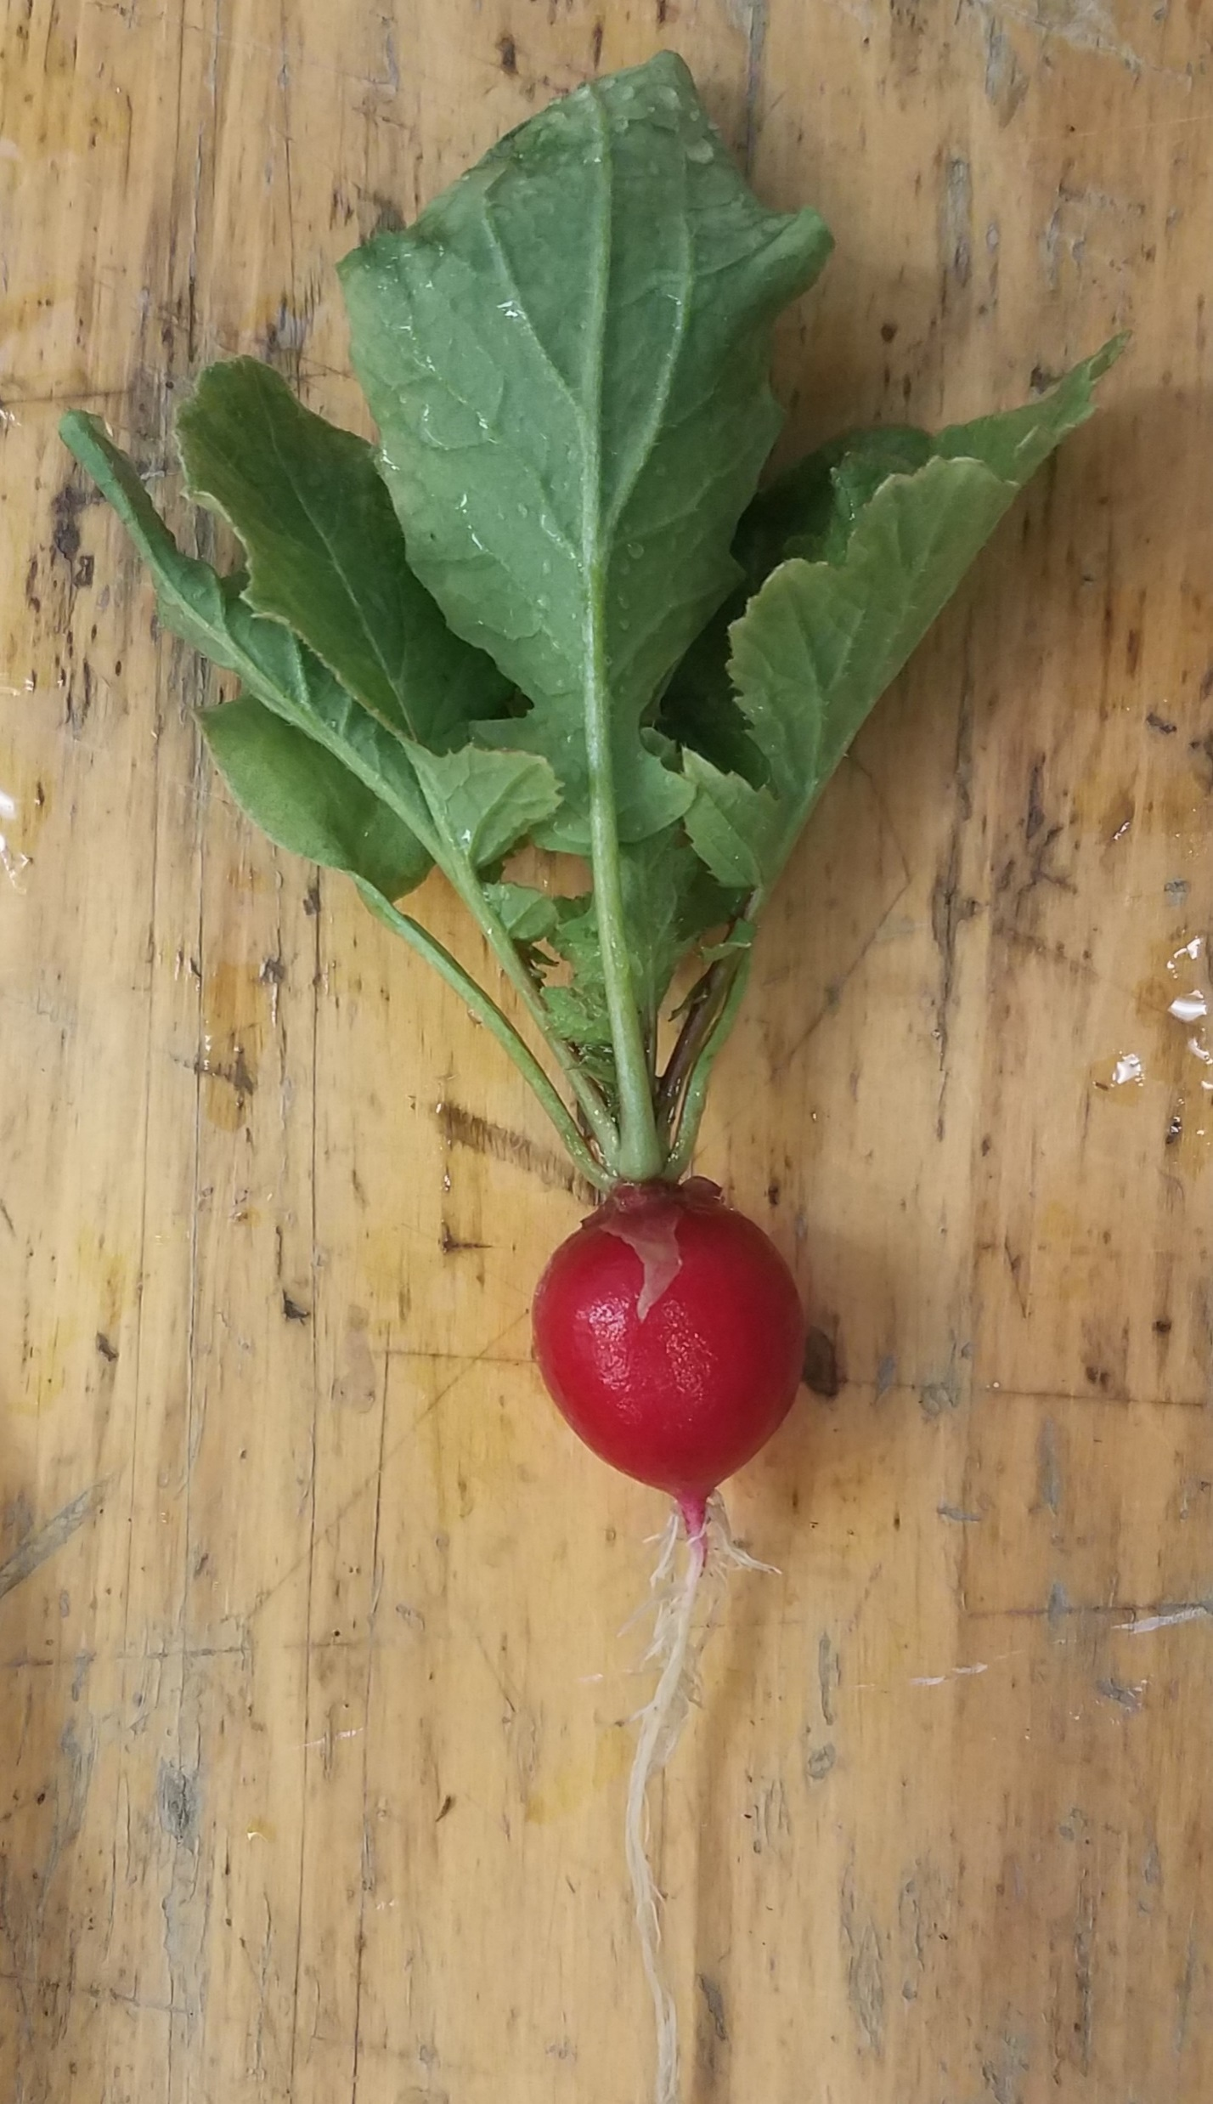
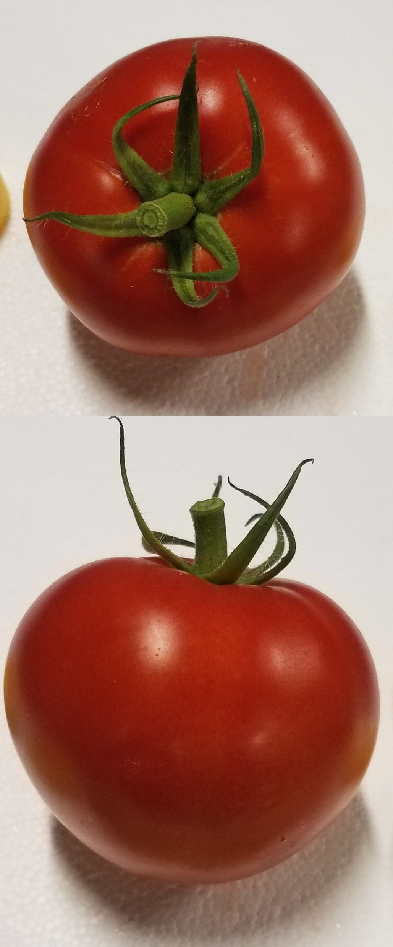
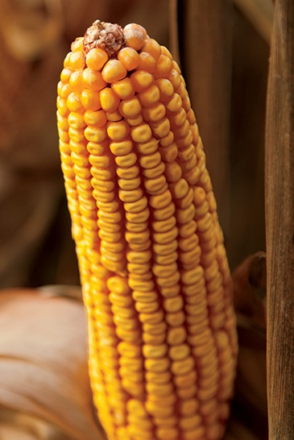
Todays Presenter – Ryan Lawrence Sebring
Ph.D. Candidate, Penn State 2021
Agronomic impacts of G. diaz on yield, biomass, product quality, nutrition and disease in myriad crops.
M.S. Agronomy, Penn State 2017
Inoculation of Forage and Amenity Turfgrass by the novel bacterial endophyte, G. diazotrophicus
B.Sc. Dev. Biology & Genetics, PSU 2013

Slide 3
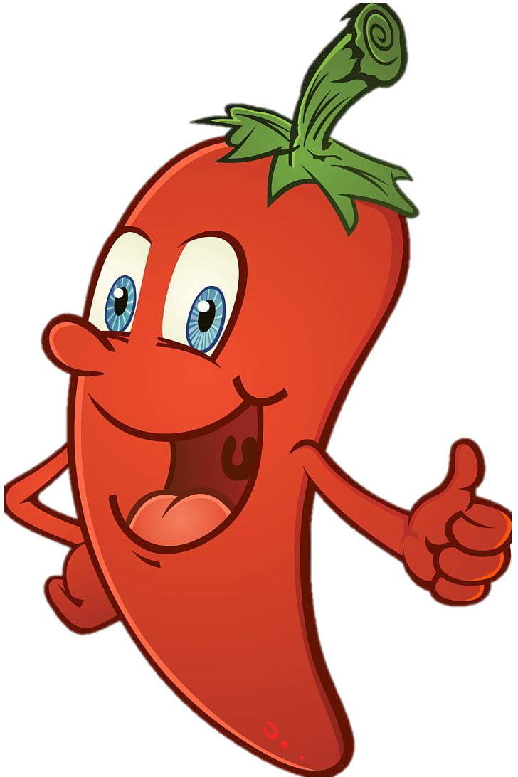
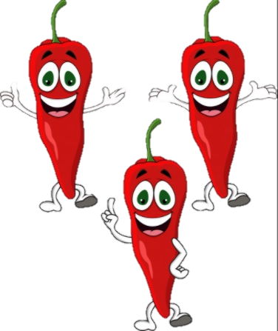



Novel Techniques in Sustainable Agriculture
Traditional Method
Greater Counts
Larger Produce
Increased Nutrition
Environmentally Friendly
Intrinsic/Other Value

Slide 4
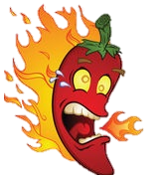

Novel Techniques in Sustainable Agriculture
Traditional Method
Opportunity Costs
Greater Counts
Larger Produce
Increased Nutrition
Environmentally Friendly
Intrinsic/Other Value
Other Defects

Slide 5
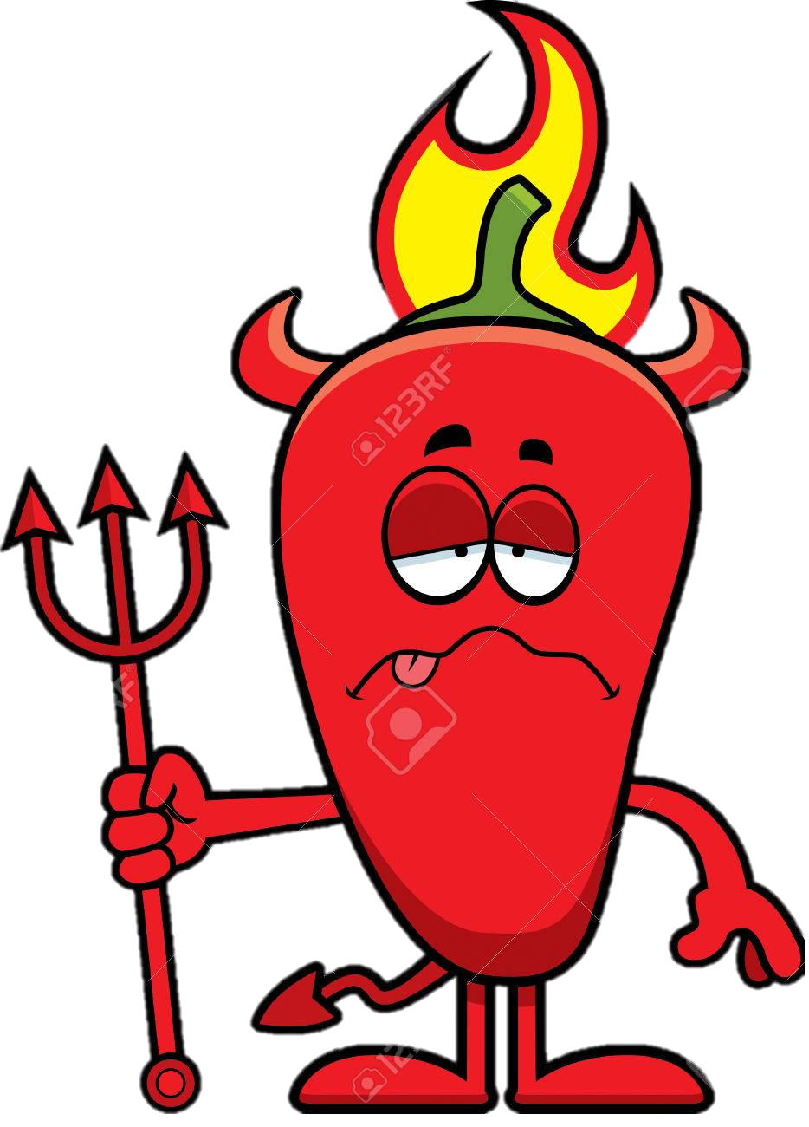
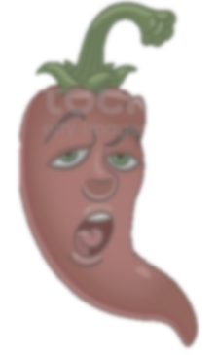
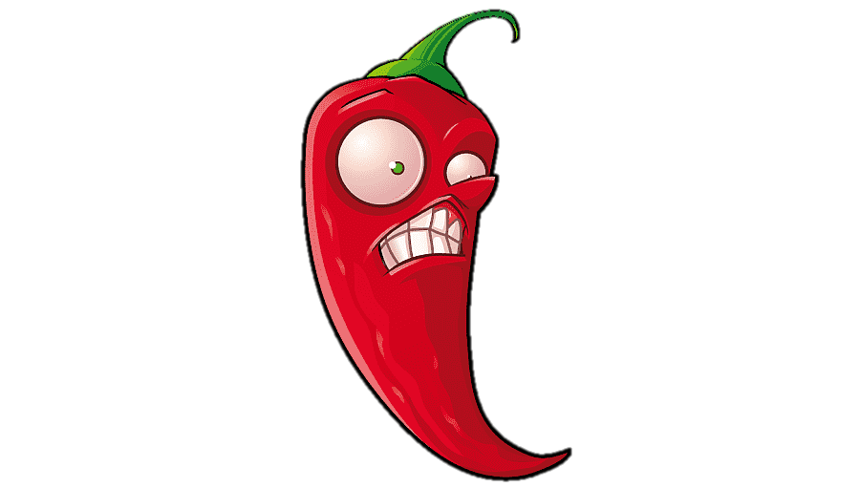
Deleterious Effects of ‘Improvement’
Traditional Method
Increased Nutrition
Unwanted Compounds
Reduced Appeal
Larger Produce
Misshapen Fruit
Greater Counts
Decreased Size

Slide 6
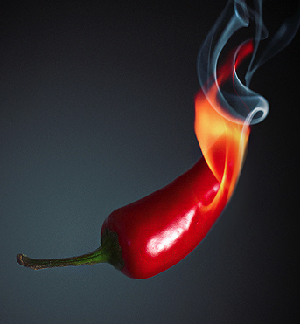
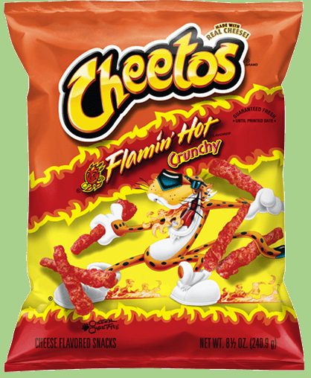
Pepper - Capsicum annuum var. ‘Early Jalapeño’
Economically Valuable $16.50/bushel
Bell pepper $14 Eggplant $10.20 Beans $8.40
USDA-AMS 2020 Commodity Rated
Nutritious
Vitamins A, C, B6
High in Fiber, Low in Calories
Delicious
Capsaicin and dh-Capsaicinoids
Add piquancy, that fiery ‘bite’
Purported health benefits

Slide 7
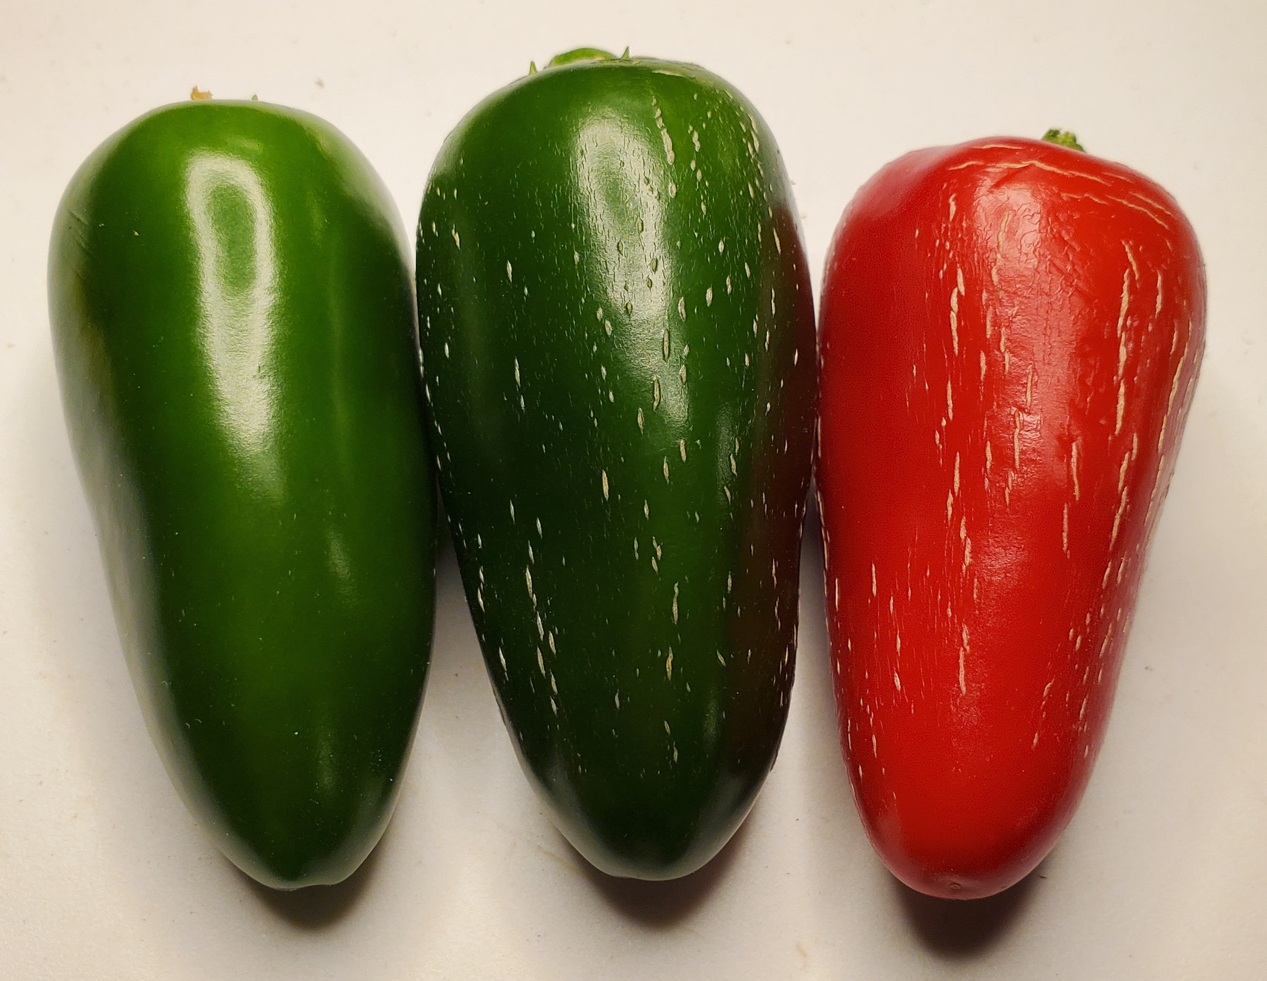
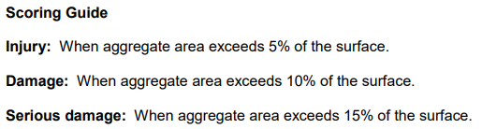
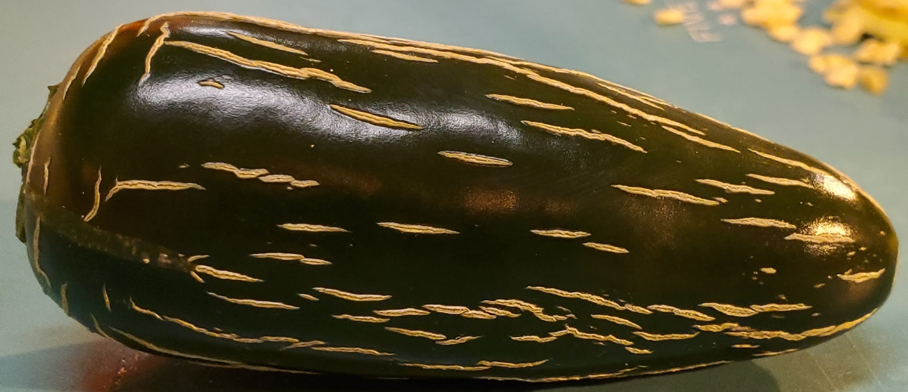
Pepper - Capsicum annuum var. ‘Early Jalapeño’
B
USDA-Agricultural Marketing Service
C
A
B
U.S. Fancy - Retail U.S. No. 1 - Canning U.S. No 2 - Processing
A
B
C

Slide 8
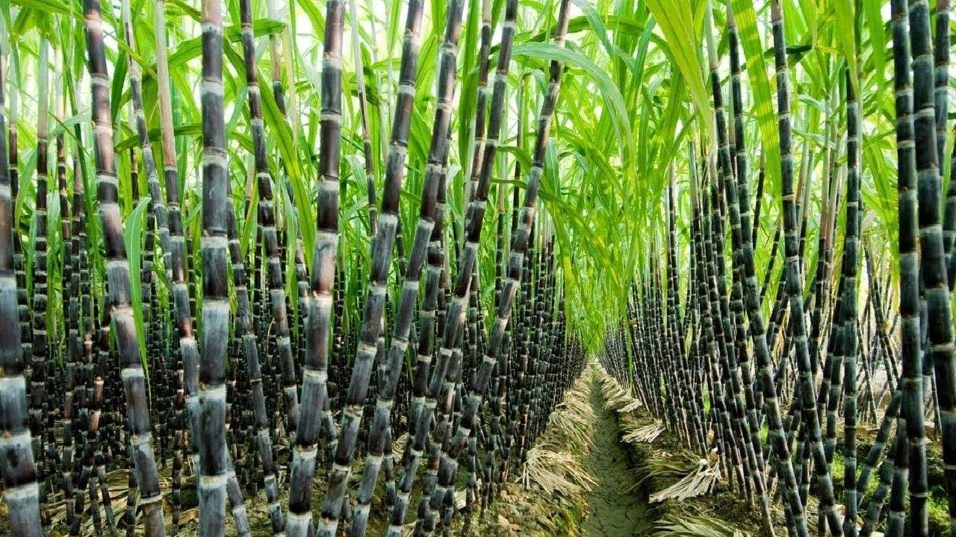
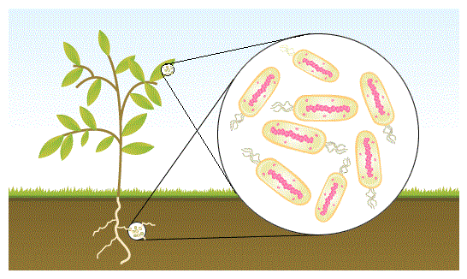
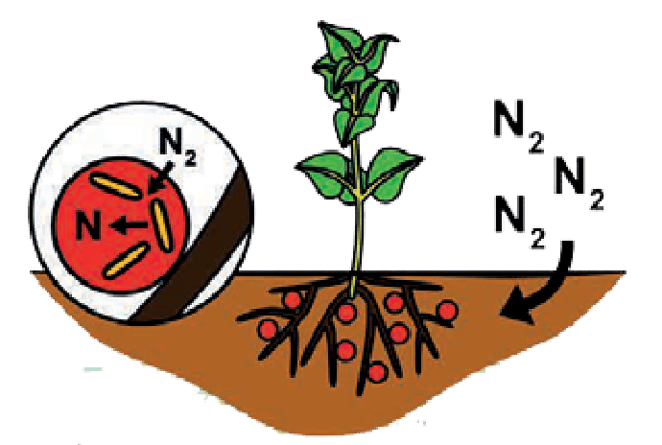
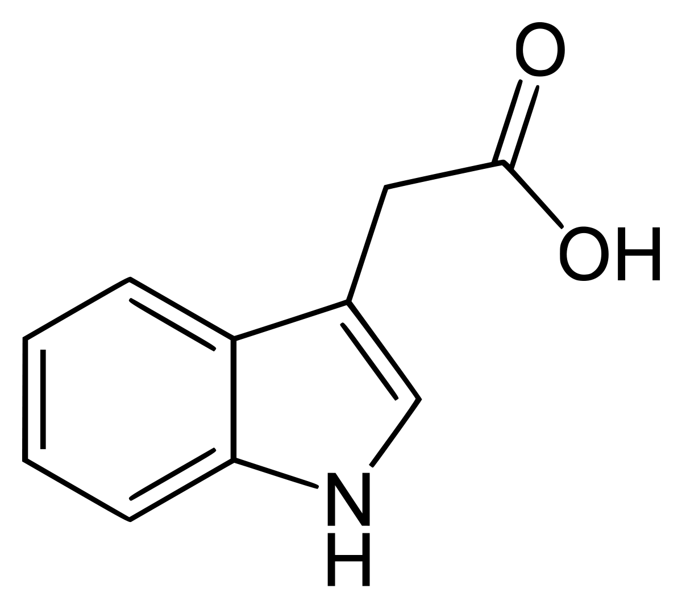
Bacterium - Gluconacetobacter diazotrophicus
Nitrogen Fixation (Boddey et. al. 2001)
Plant Hormones (Fuentes-Ramirez, et. al. 1993)
Indole-3-Acetic Acid – Fruit development/ripening
  (Waseem et. al., 2018)
Gibberellin A1, A3 – Increase fruit number and size, especially under N stress
  (Pichardo-González et. al., 2018)

Slide 9
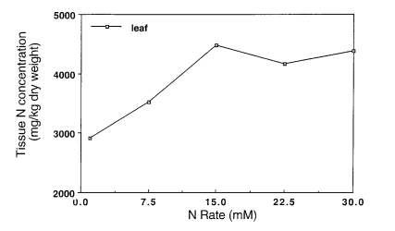


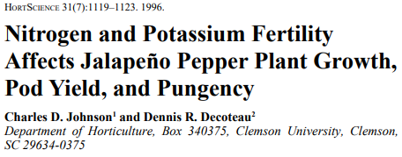
Nitrogen's Role in Syngerism
Fixation is partially feedback inhibited by high N levels, but plant responses remain

Slide 10
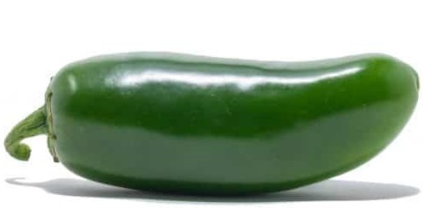
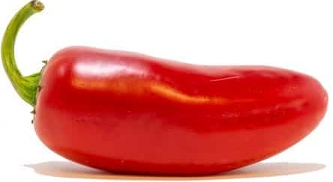
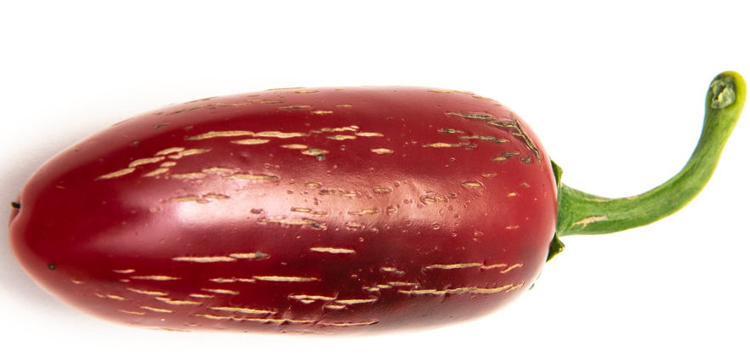
Hypothesis / Objectives
Assess Impacts of G. diaz Inoculation of Jalapeño on Fruit Quality, Quantity, Maturity, and Plant Vigor
H: With N-fixation and PGP traits, Gd inoculation will alter fruit produced and plant biomass accumulation.
Total counts, weights
Average weights / fruit
Damage/Coloration
N-stress response
Null = No differences Observed

Slide 11
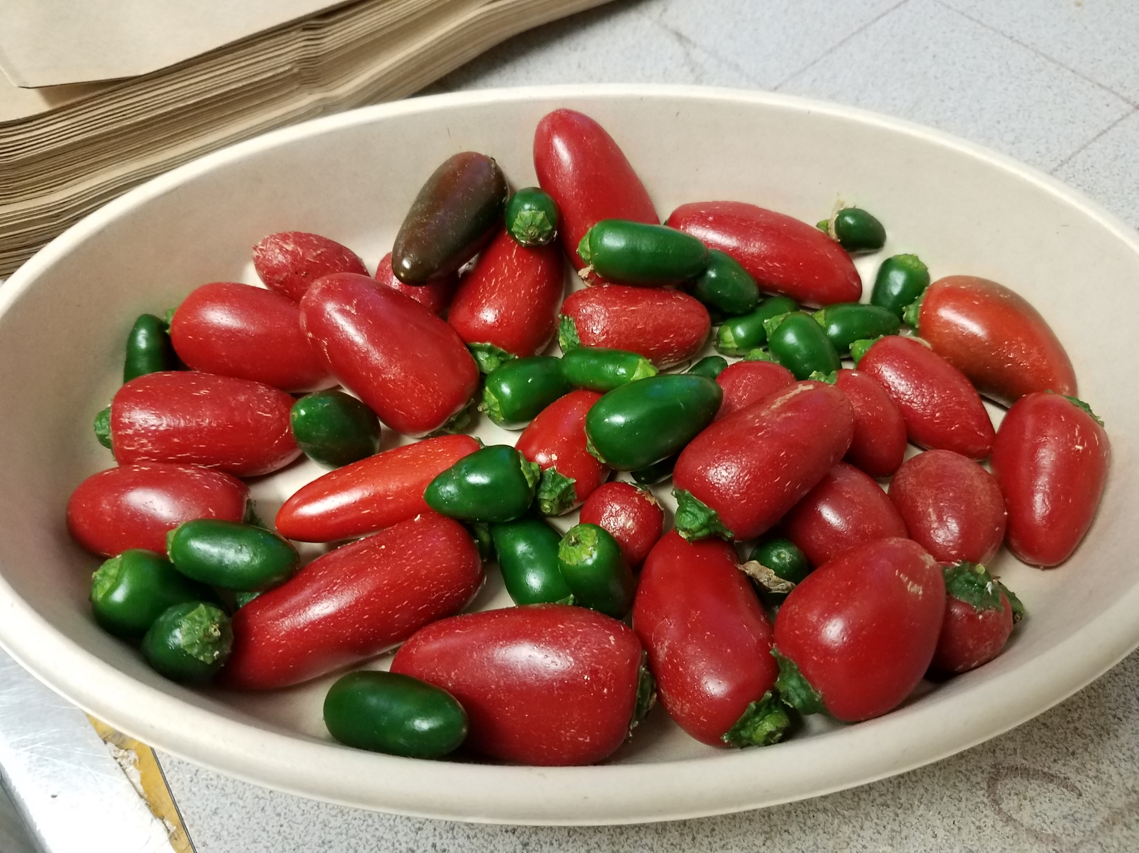
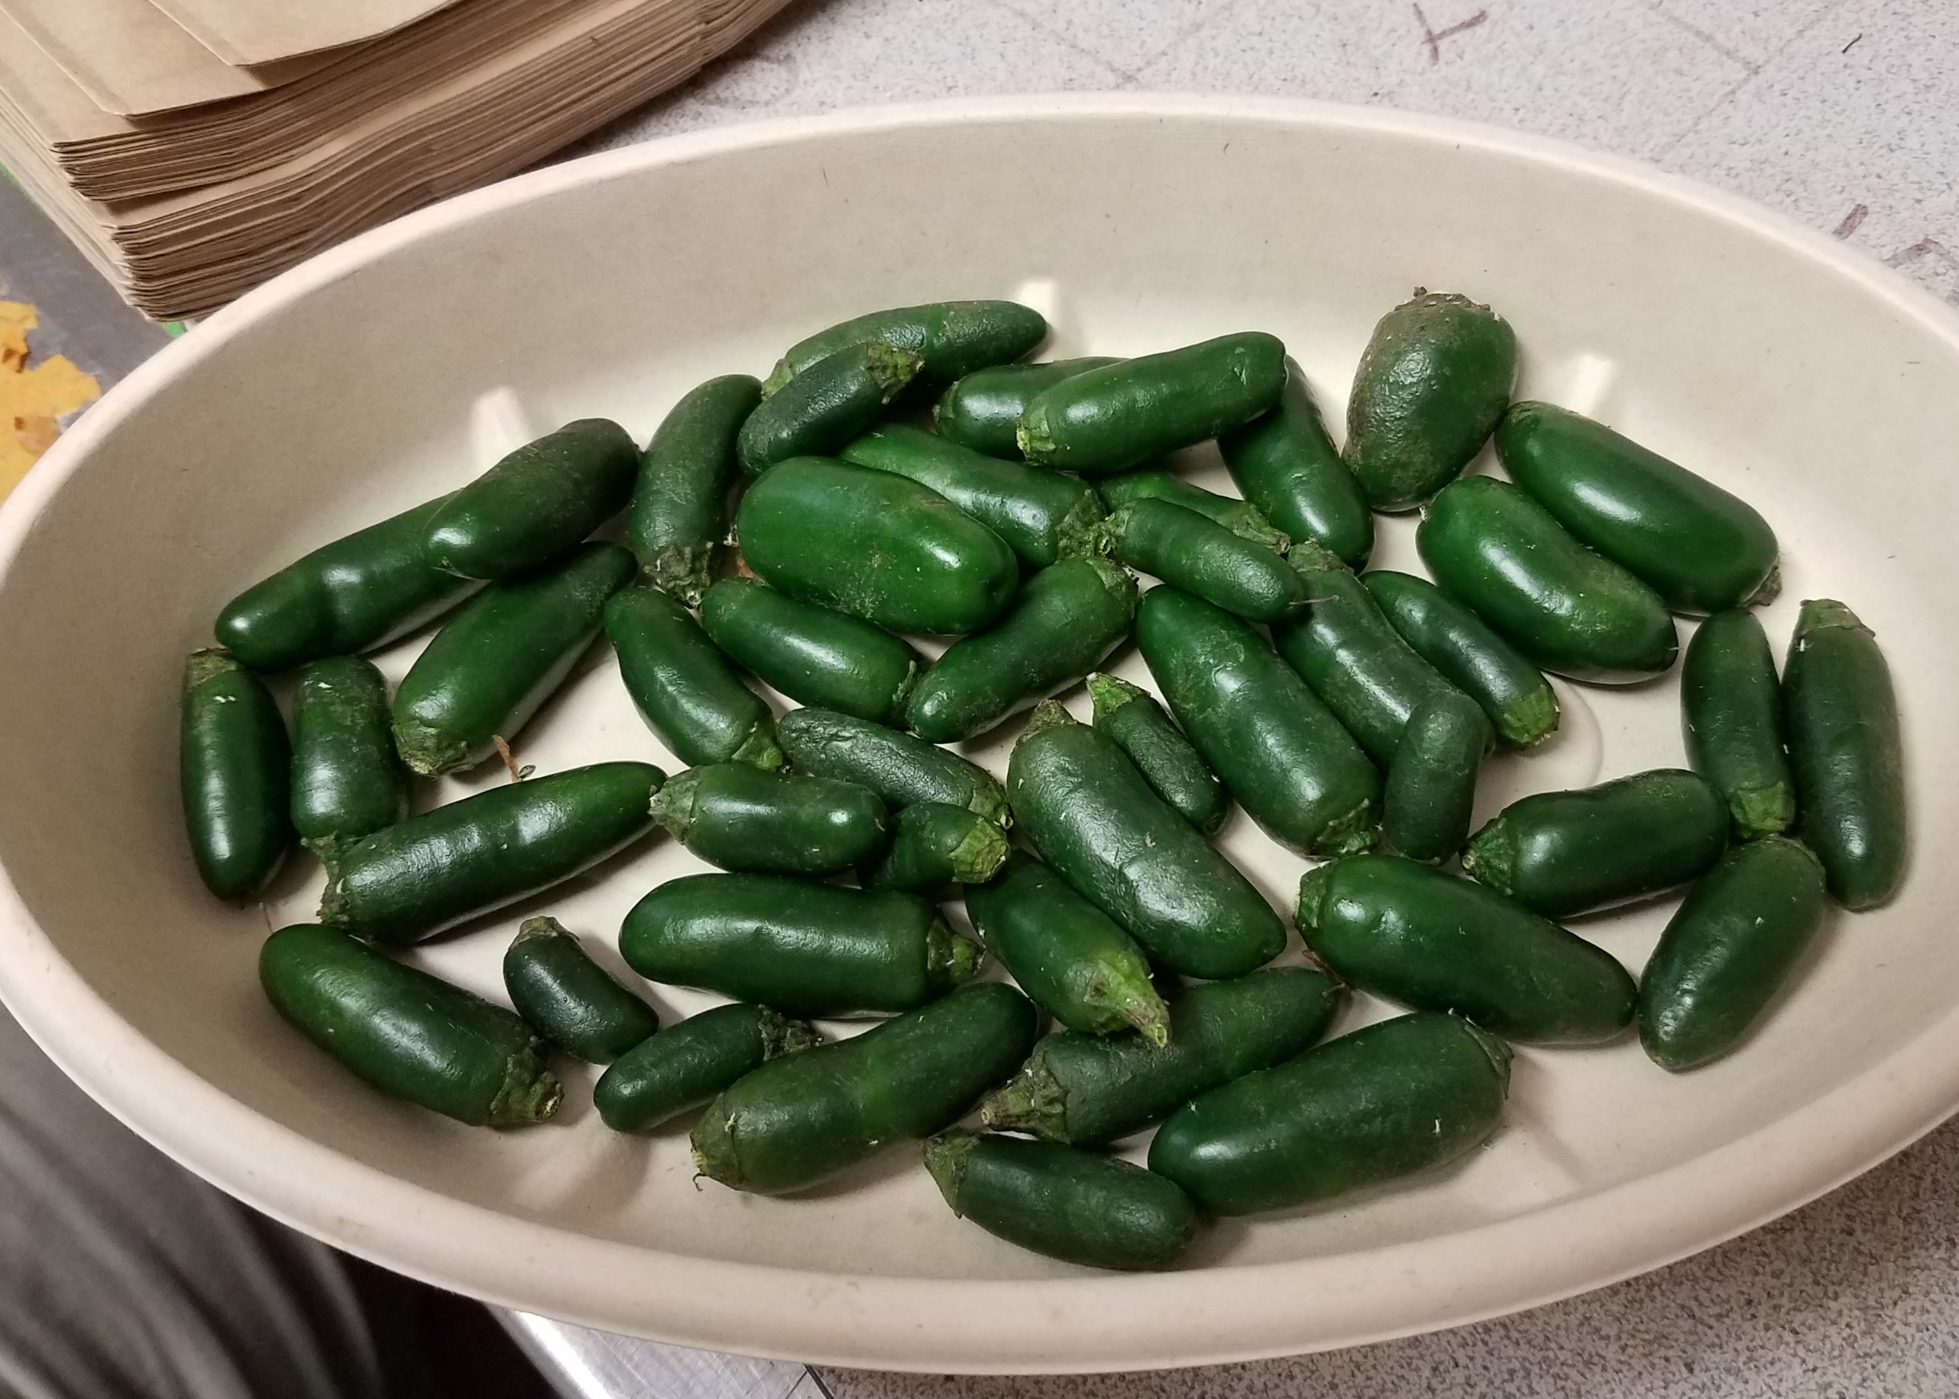
Which is the Better Result??
50% Fancy Green, 50% Damaged Red
100g Green, 300g Red
100% Damaged Green, No Red Fruit
200g Green
Same number of Fruit, n = 49

Slide 12
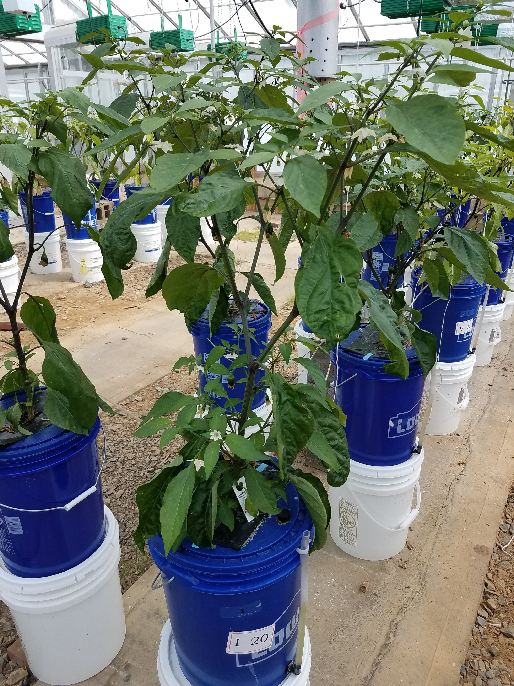
Experimental Design
2 Inoculation Levels
‘INOC’ – Seed treatment G. diaz was applied
‘VIRGIN’ – Seed treatment was sterile
6 Nitrogen Levels
Deficient – 48, 83, 119 ppm N
Sufficient/Optimal – 150, 190 ppm N
Supra-optimal – 226 ppm N
4 Replication in RCBD
-----------------------------------------------------------
48 Experimental Units
USDA-ARS GH 1C,1D; ASI GH A112

Slide 13
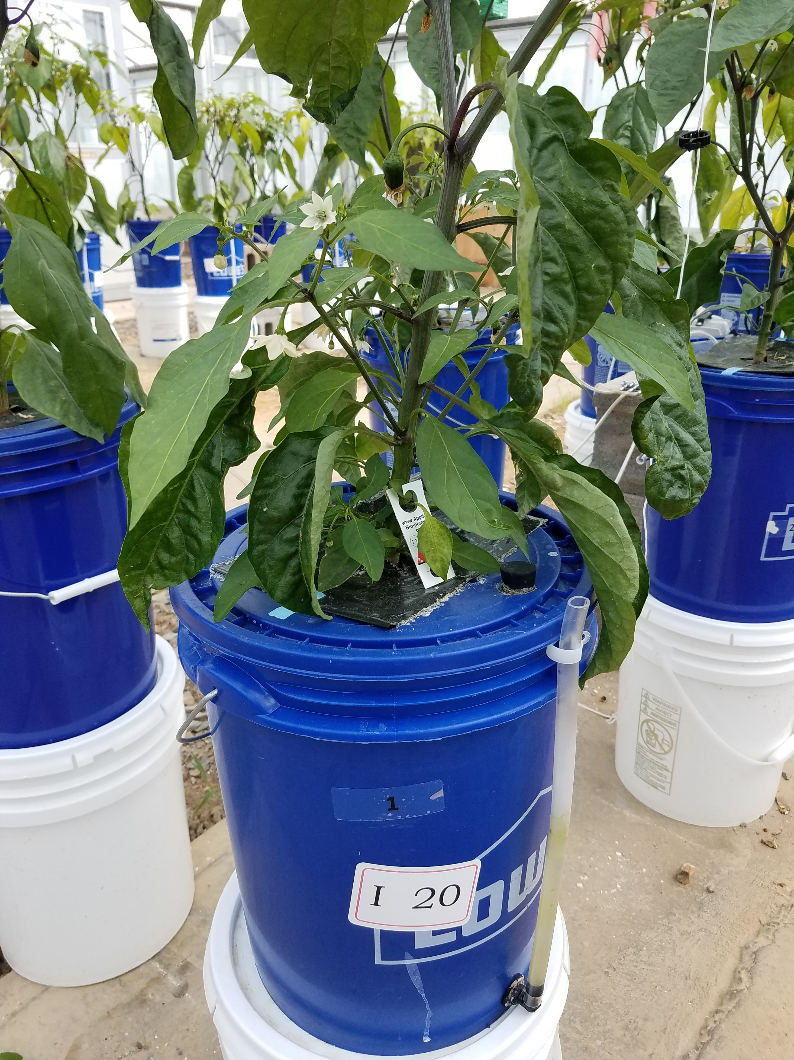
Cultivation Conditions
Hydroponic Cultivation - DWC
Single plant per 19L bucket
Aerated 24/7 10L/min
Aerial support to prevent fallover
Bacterial Application
Agronomic mirrored seed soak, 10 mins
9.0 x 10⁸ Colony Forming Units /ml
Environmental Conditions
Watered to 15-18L at all times
16/8 Day/Night cycle, 55-70 mw/m²
21ºC – 29ºC with evaporative cooling
Biologic IPM for mites, aphids, thrips
Sonication 2x/week once flowers formed

Slide 14
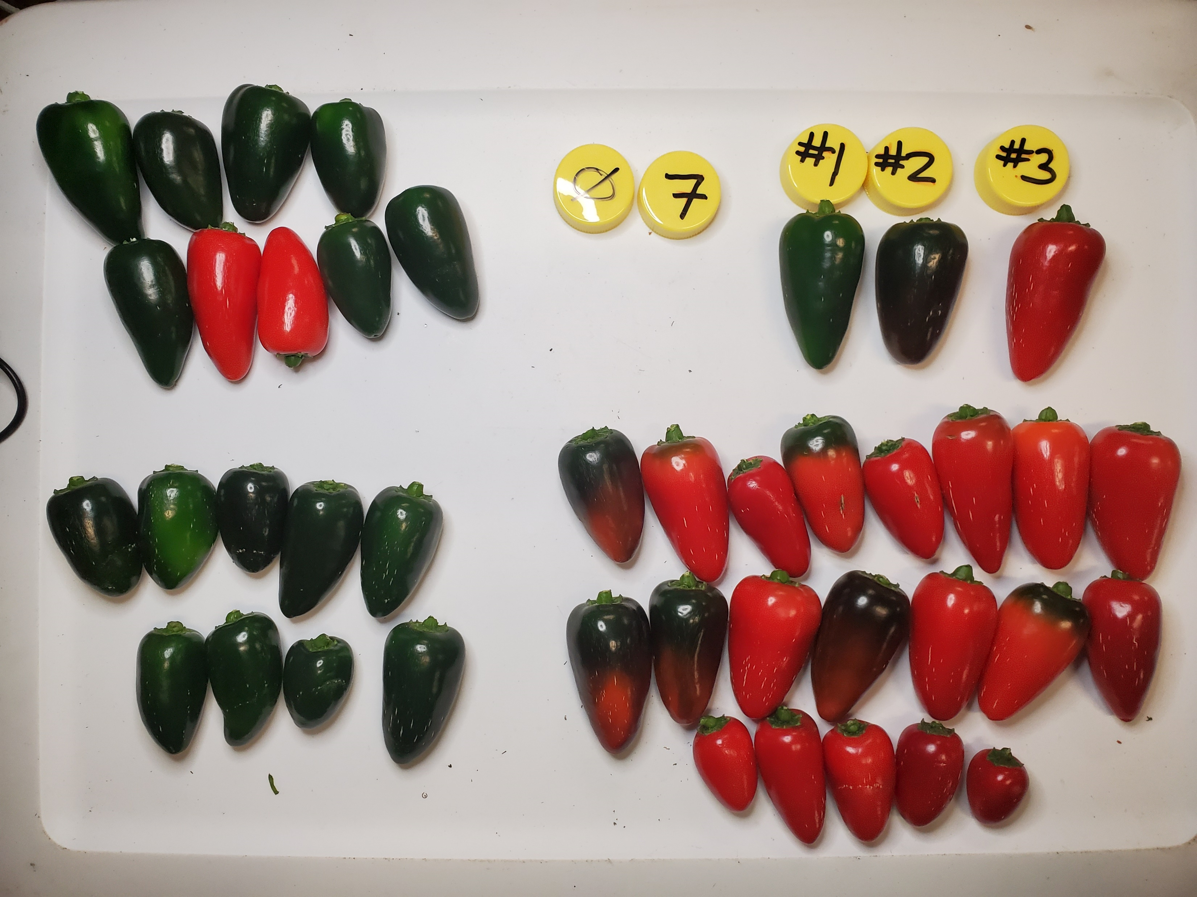
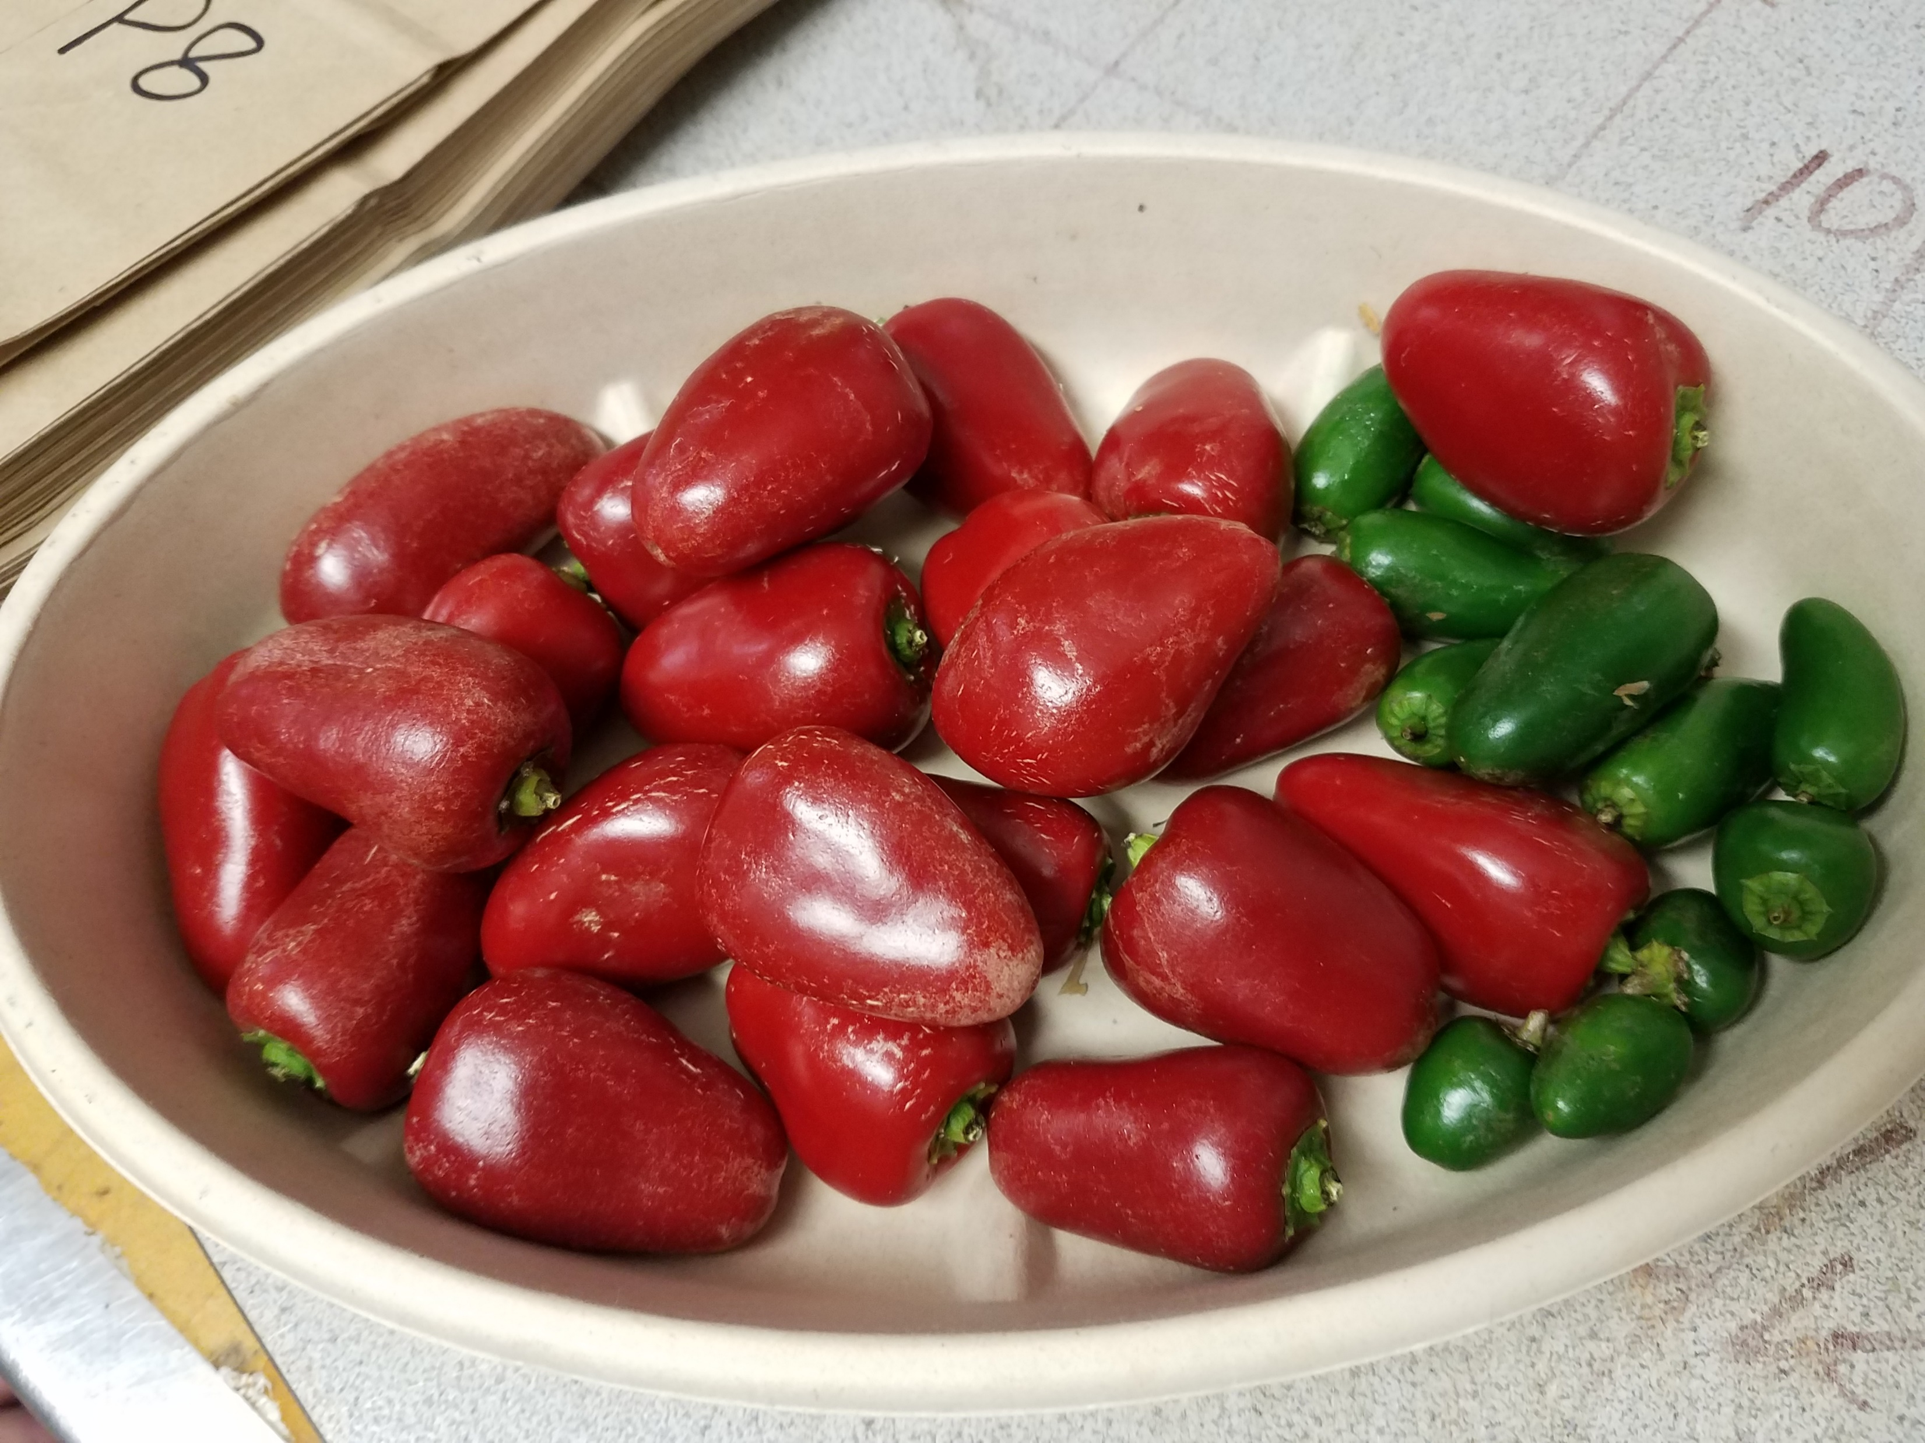
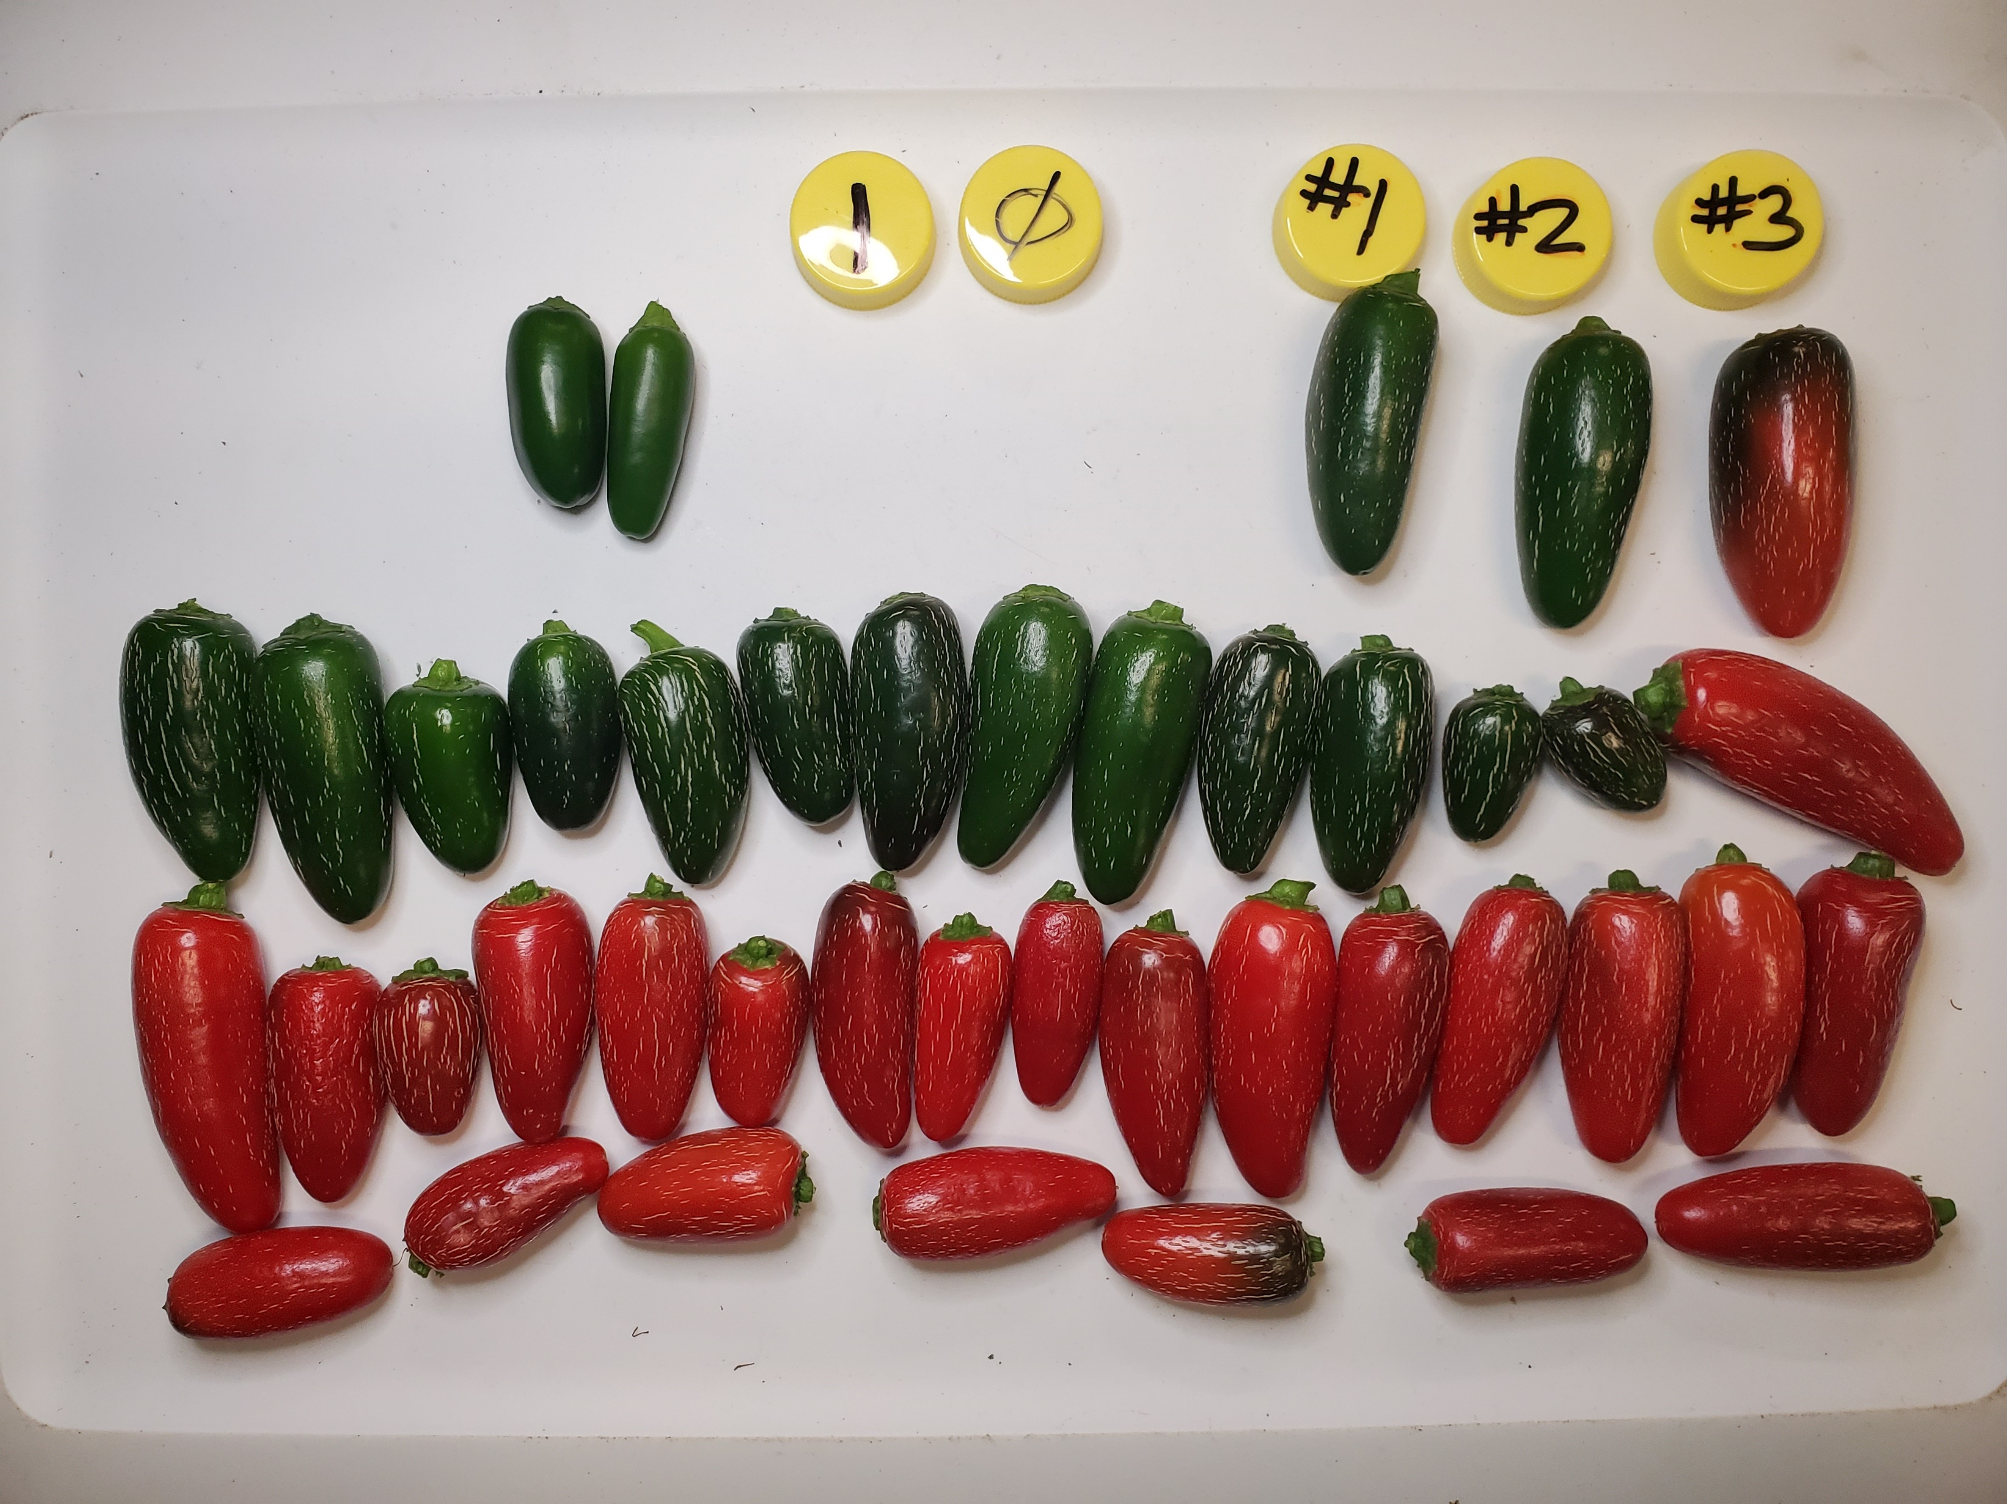
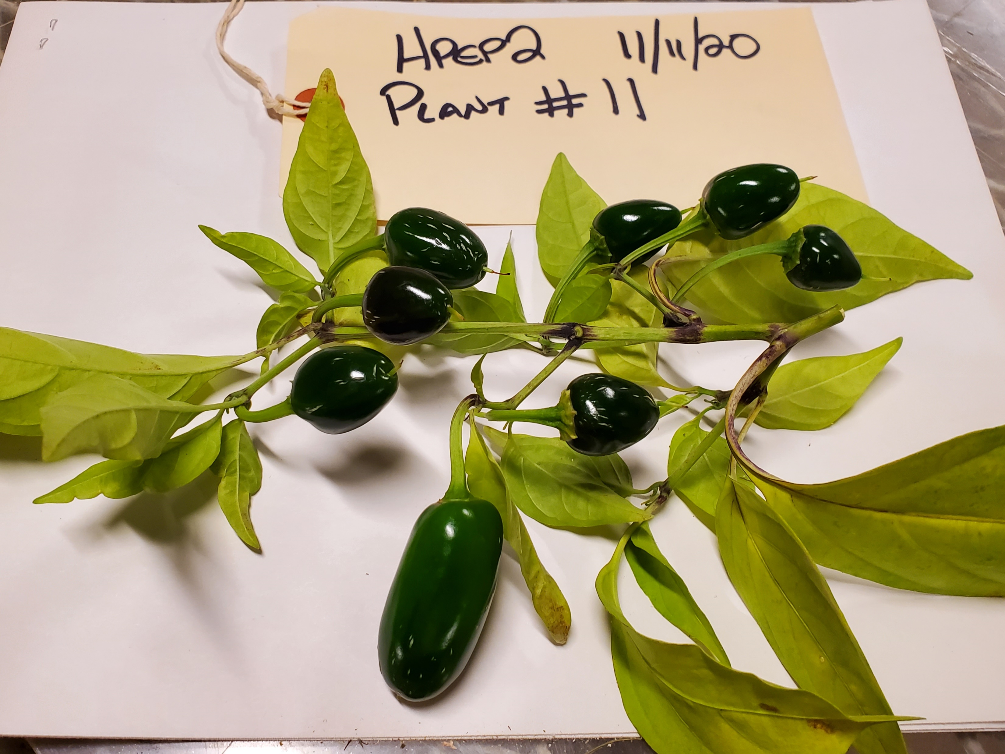
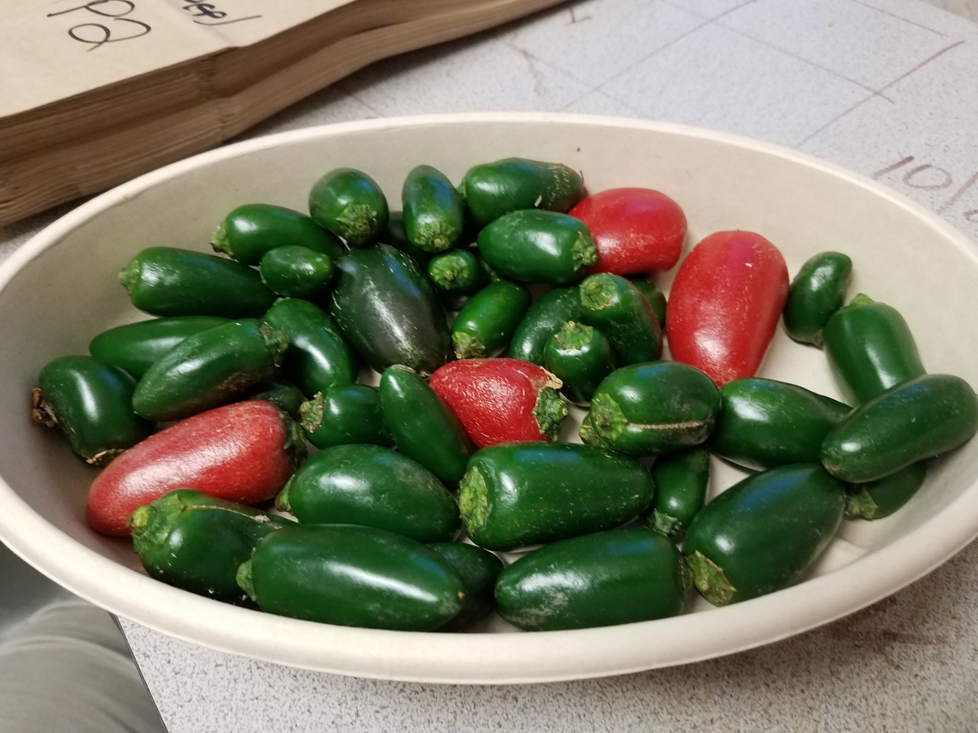
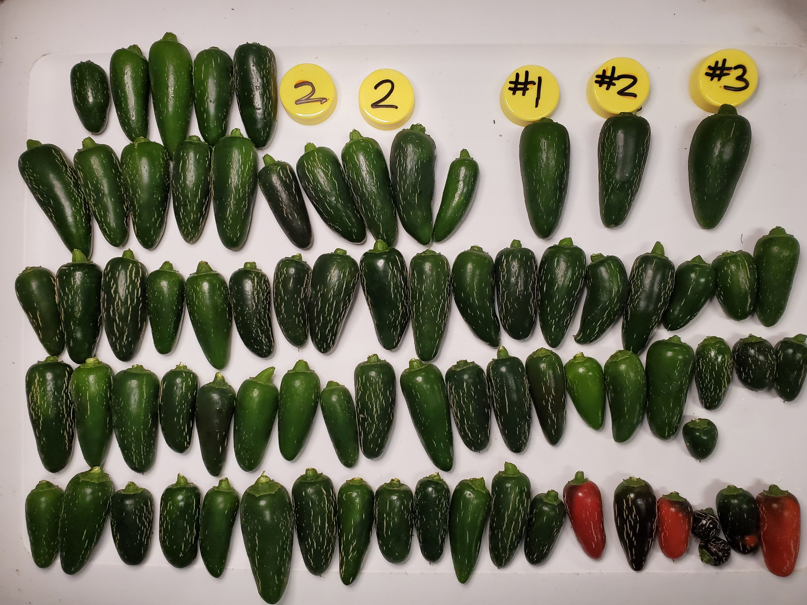
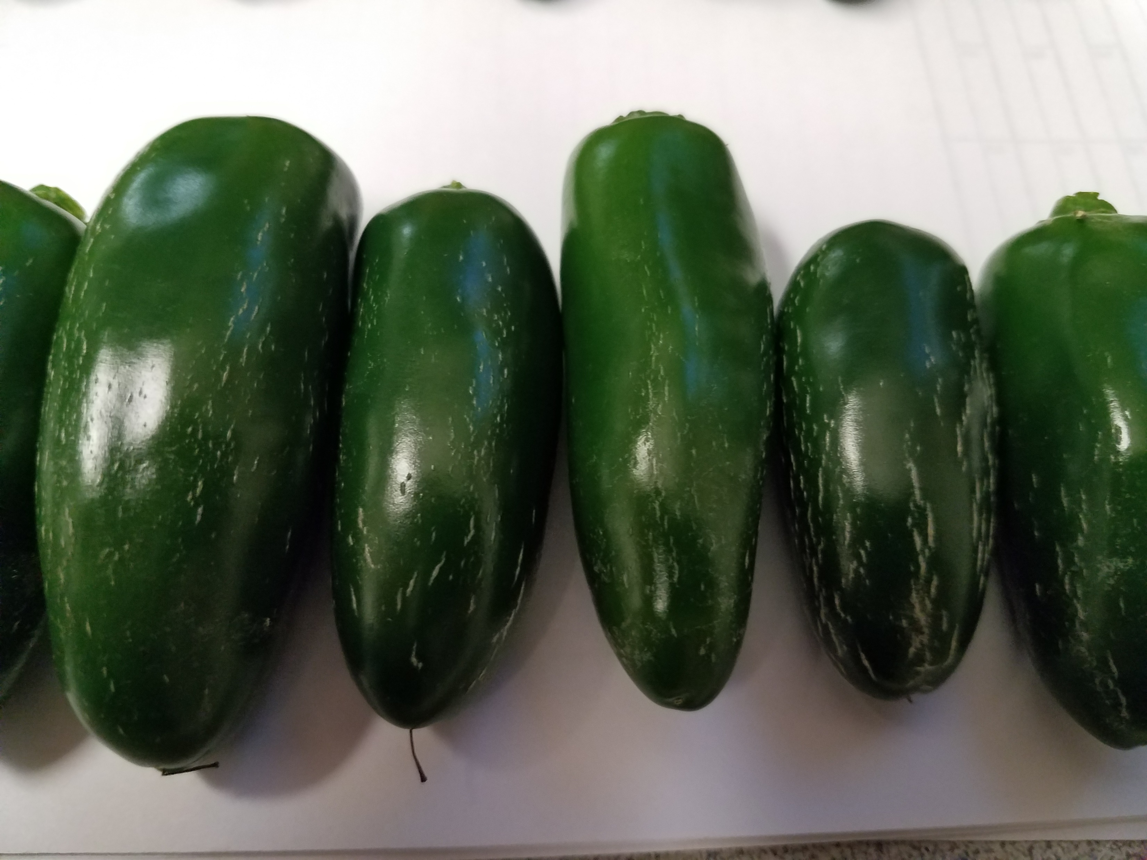
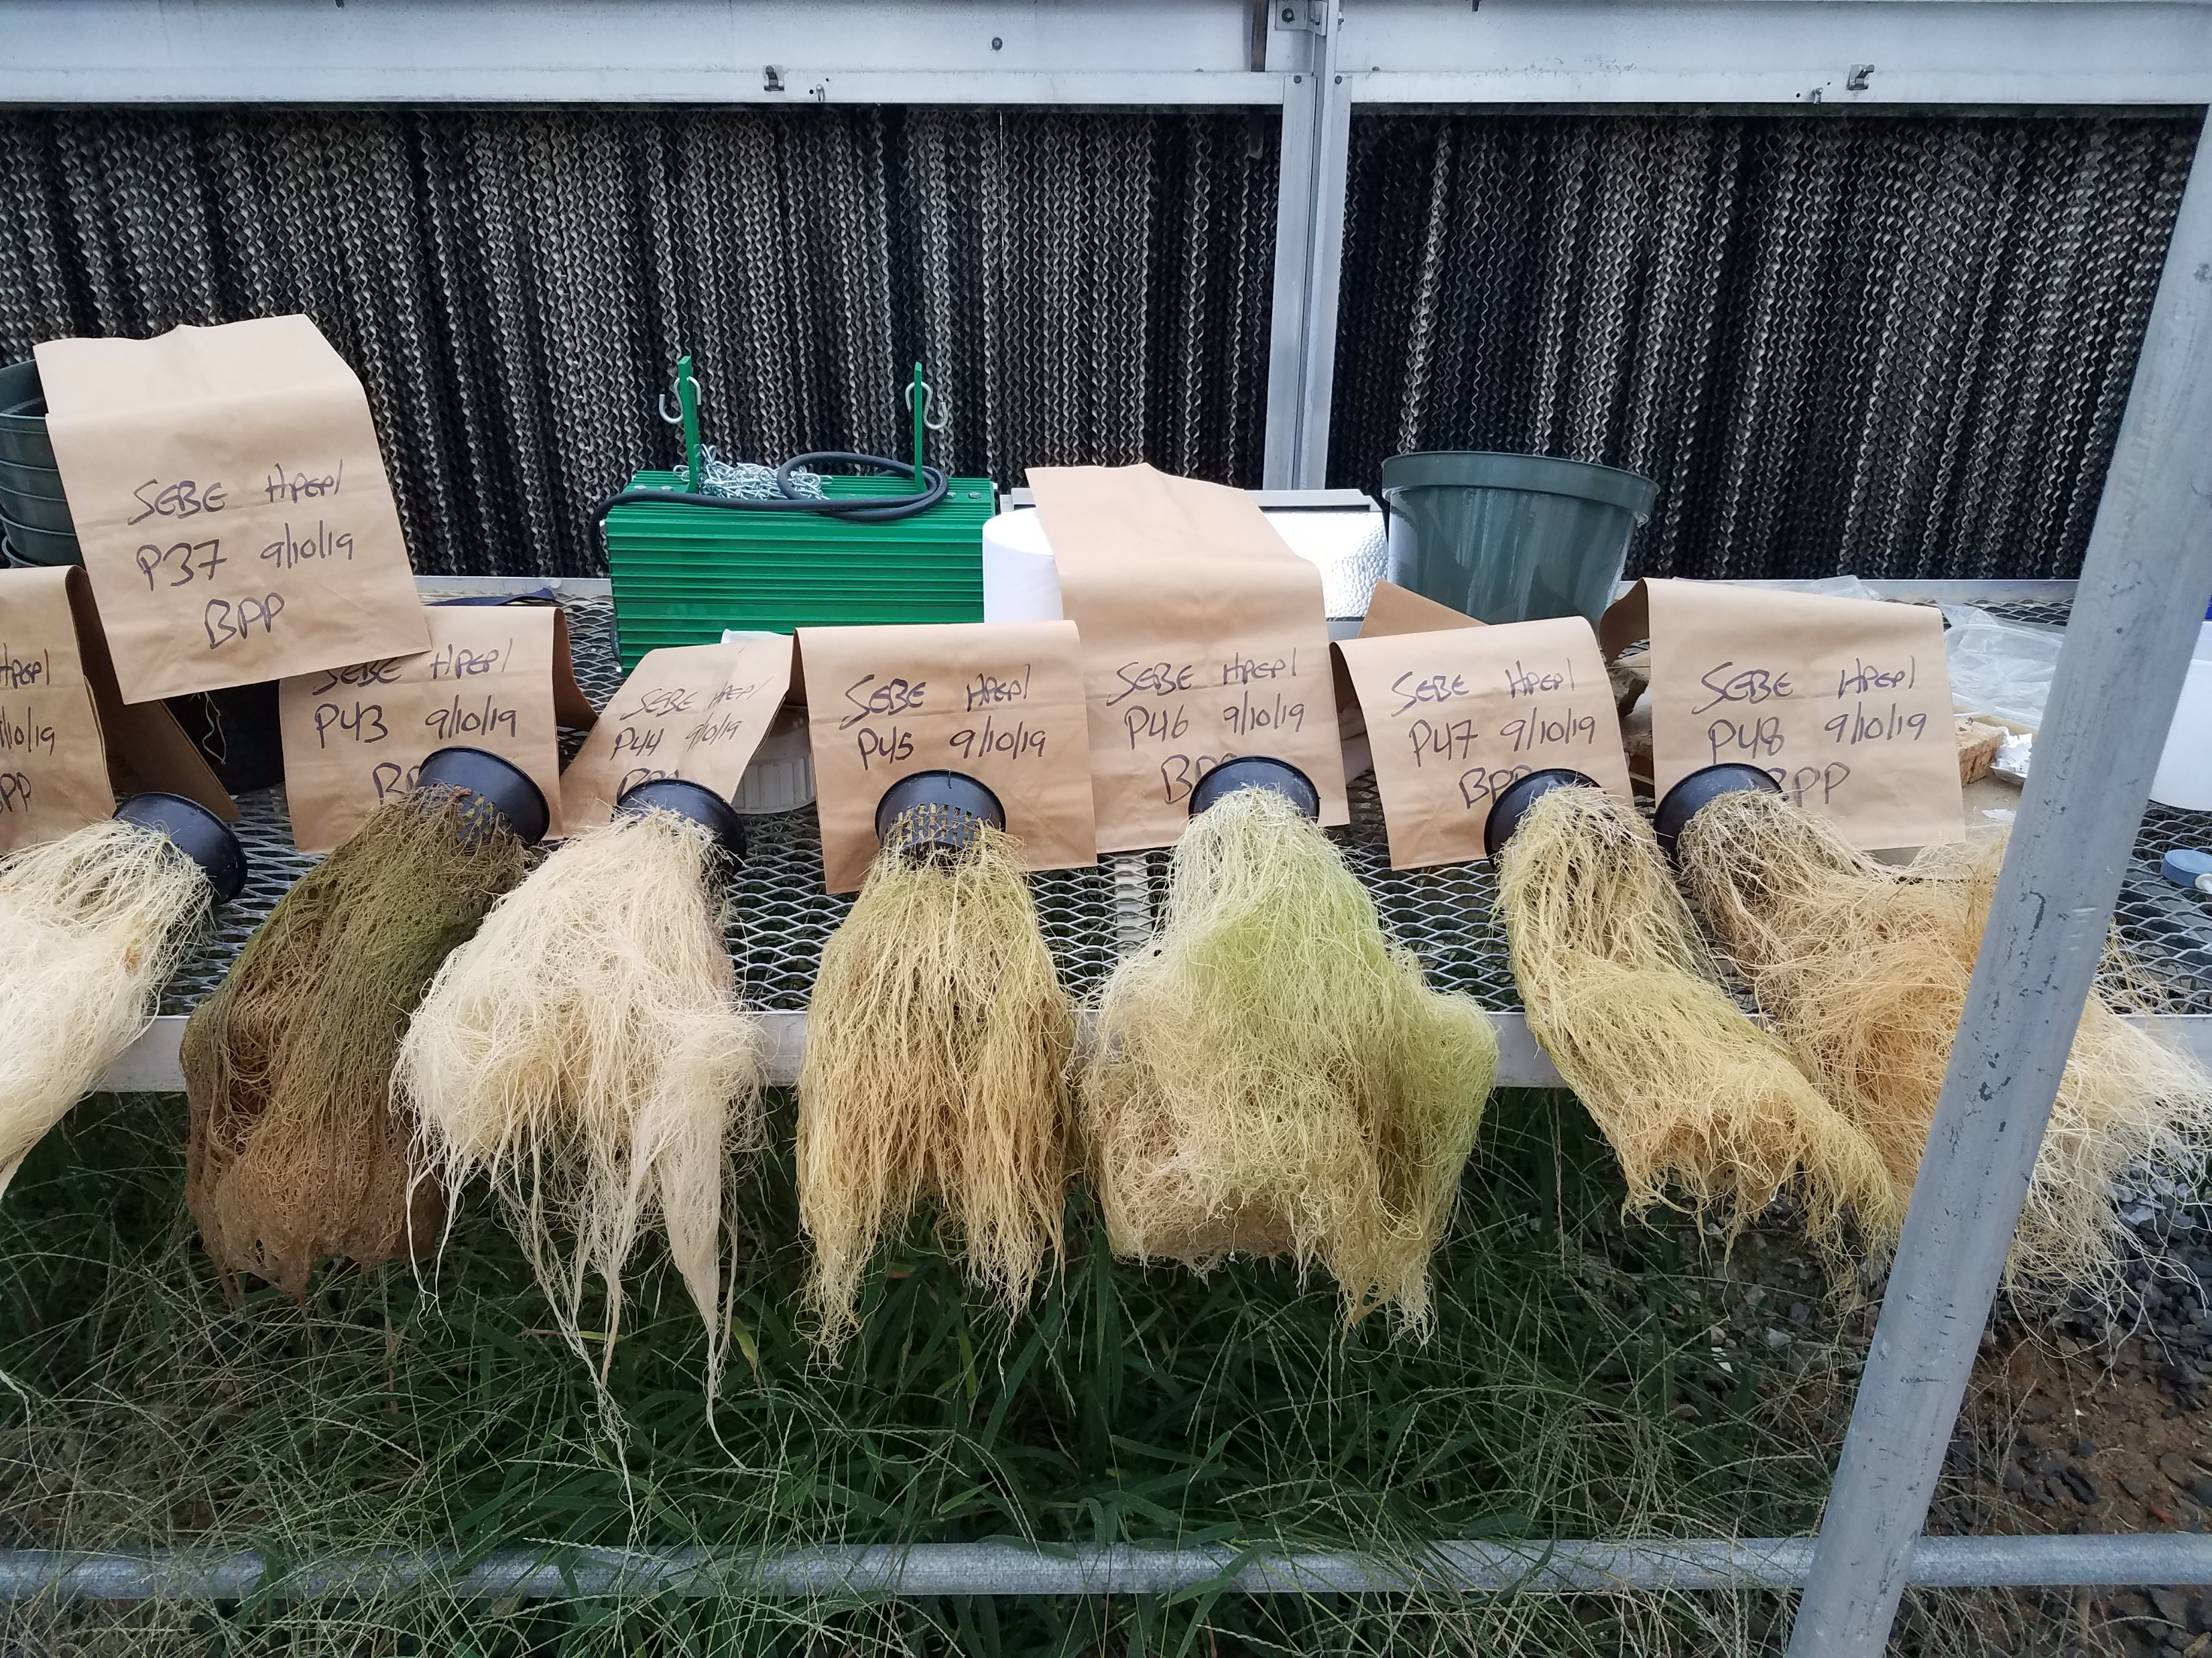
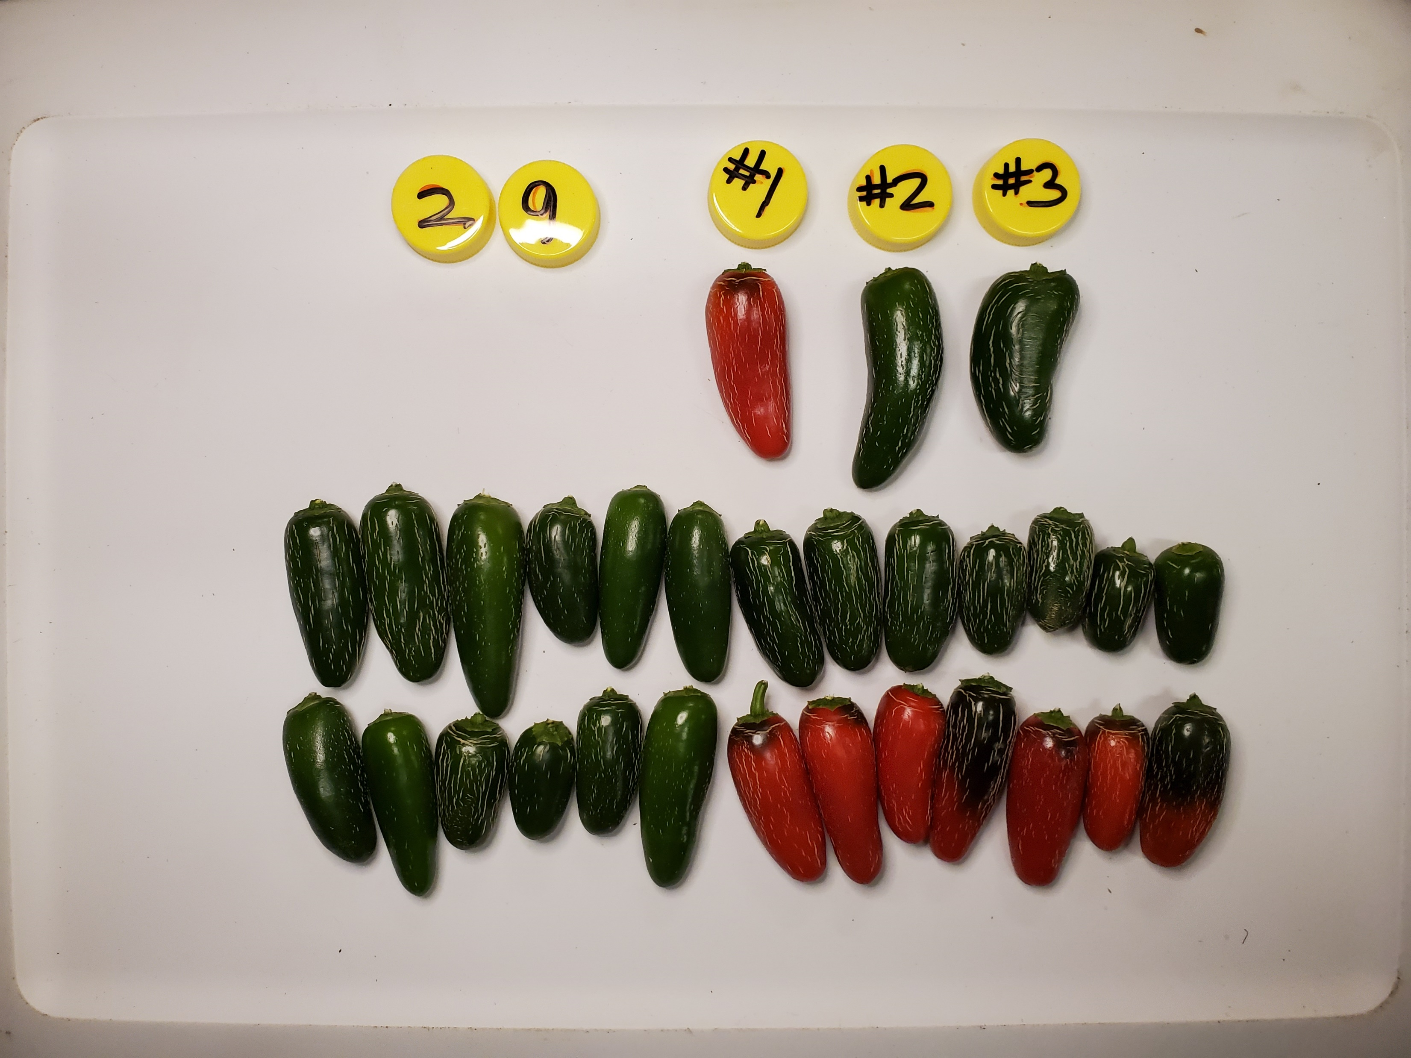
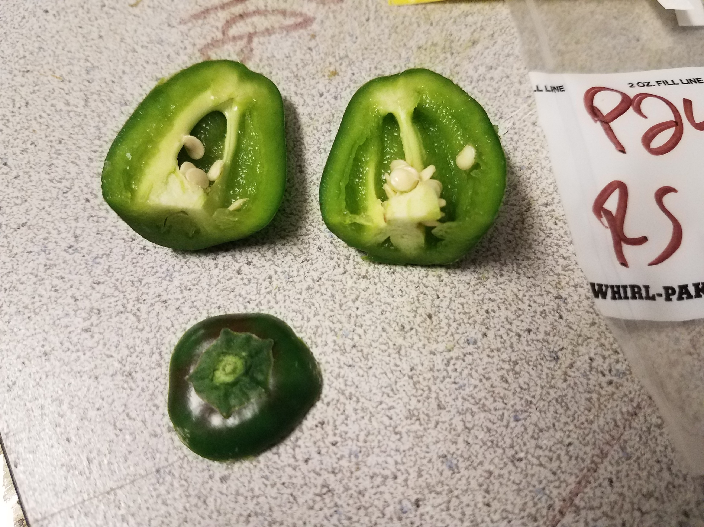
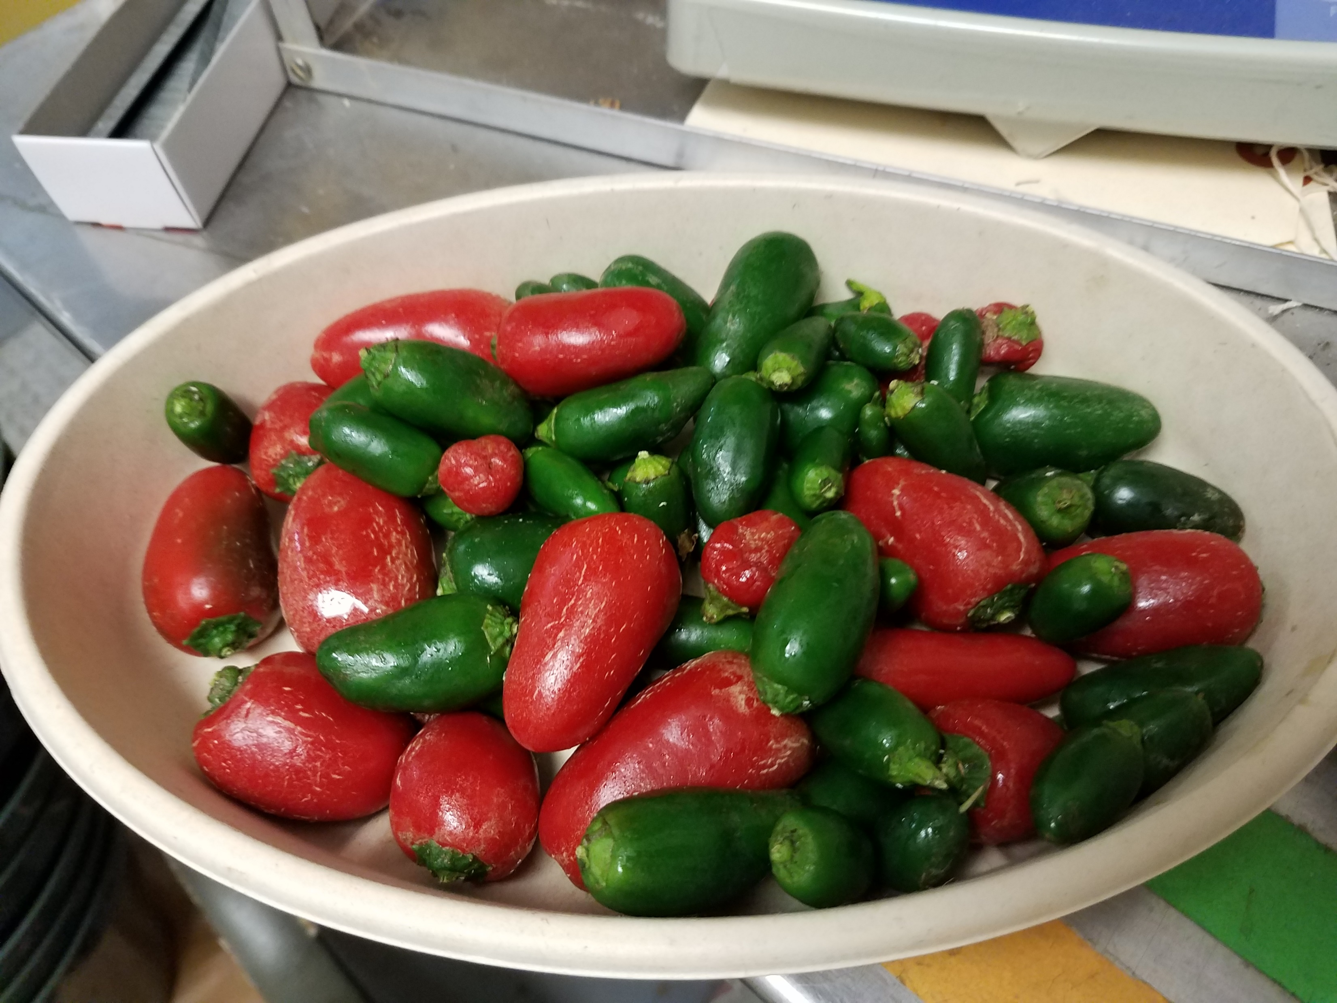
Harvesting and Assessment

Slide 15
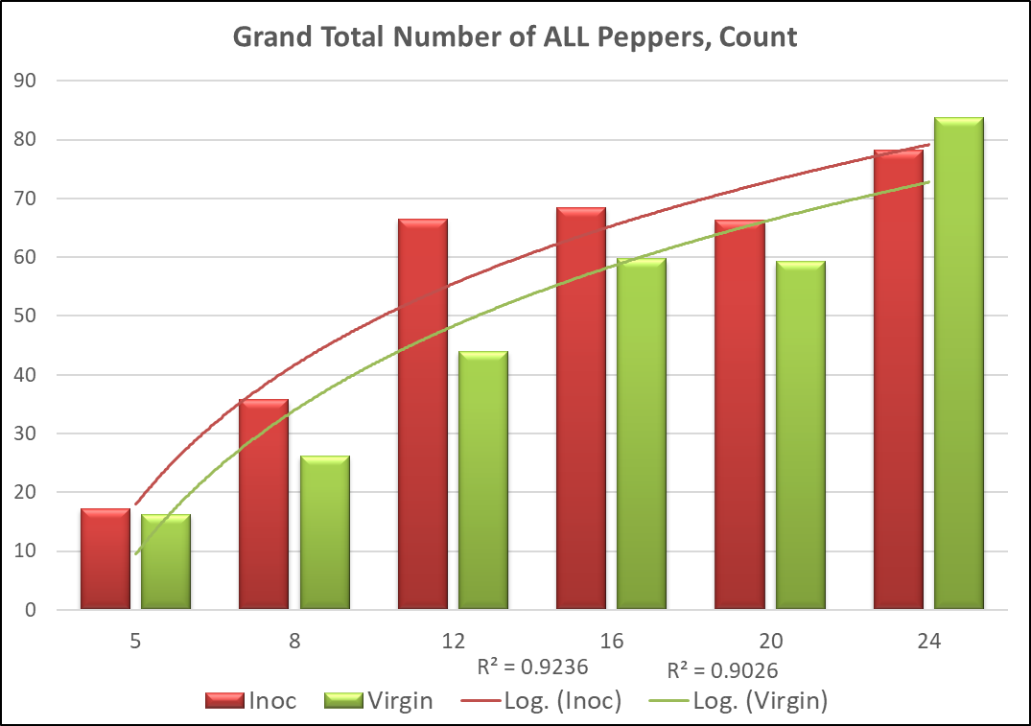
Results – Total Pepper Number Production
FERT p < 0.0001
INOC p < 0.0006
INTX p < 0.0044
**
**
Fert 8 = 83 ppm N
INOC 9.5 fruit +/- 3.6
p < 0.0975
S
Fert 12 = 119 ppm N
INOC 22.5 fruit +/- 4.5
p < 0.0001

Slide 16
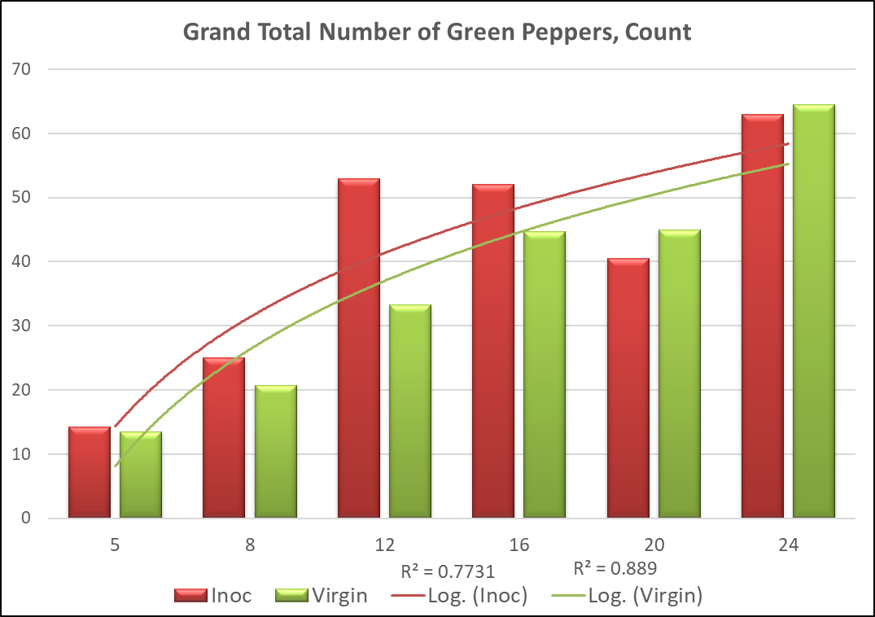
Total Green Pepper Production
FERT p < 0.0001
INOC p < 0.0215
INTX p < 0.0039
**
Fert 12 = 119 ppm N
INOC 19.8 fruit +/- 2.3
p < 0.0001

Slide 17
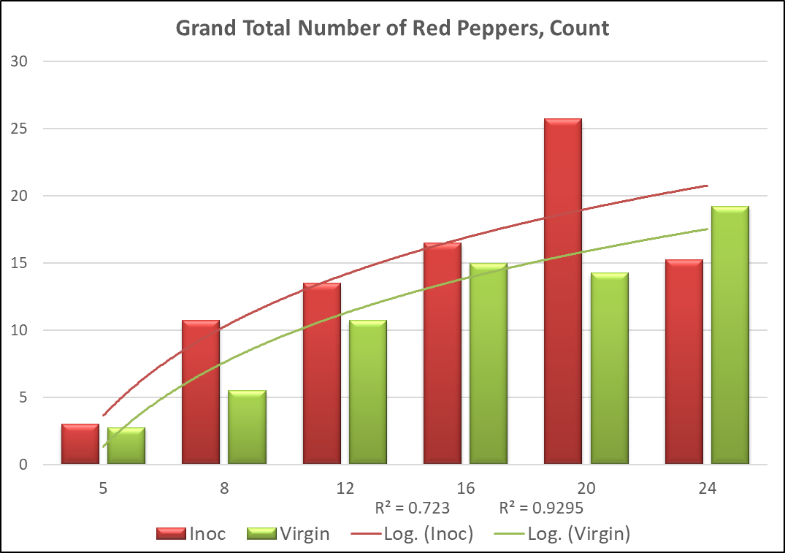
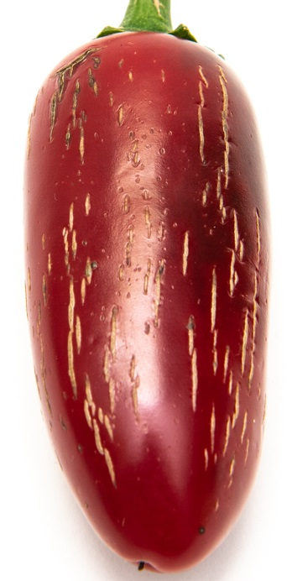
Total Red Pepper Production
FERT p < 0.0001
INOC p < 0.0184
INTX p < 0.0071
**
**
Fert 8 = 83 ppm N
INOC 5.3 fruit +/- 1.6
p < 0.0634
S
Fert 20 = 190 ppm N
INOC 11.5 fruit +/- 2.6
p < 0.002

Slide 18
Production by Color
**
**
**
S
**
v
S
Evidence for a ‘Sweet Spot’ for Green Fruit Production? One for Red as well?
Potentially, let’s look further

Slide 19
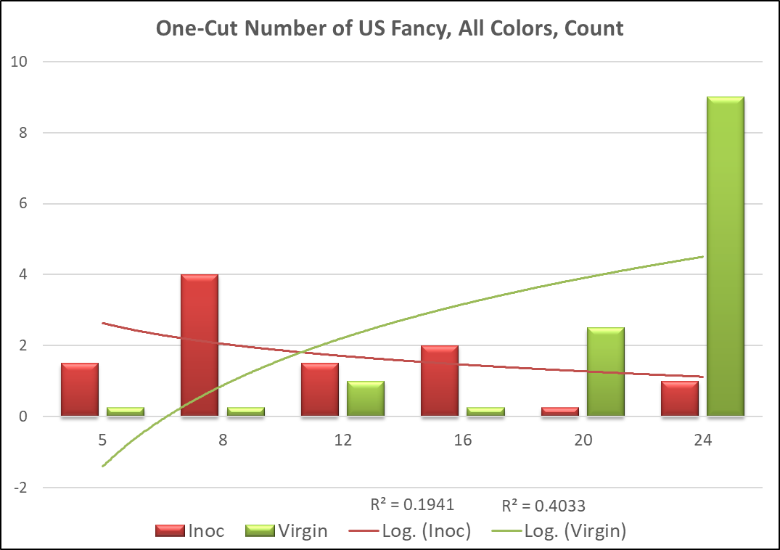
Total US Fancy Pepper Production
FERT p < 0.0365
INOC p < 0.2535
INTX p < 0.0001
**
Fert 8 = 83 ppm N
INOC 3.8 fruit +/- 0.5
p < 0.0429
**
Fert 24 = 226 ppm N
INOC -8.0 fruit +/- 0.6
p < 0.0002

Slide 20
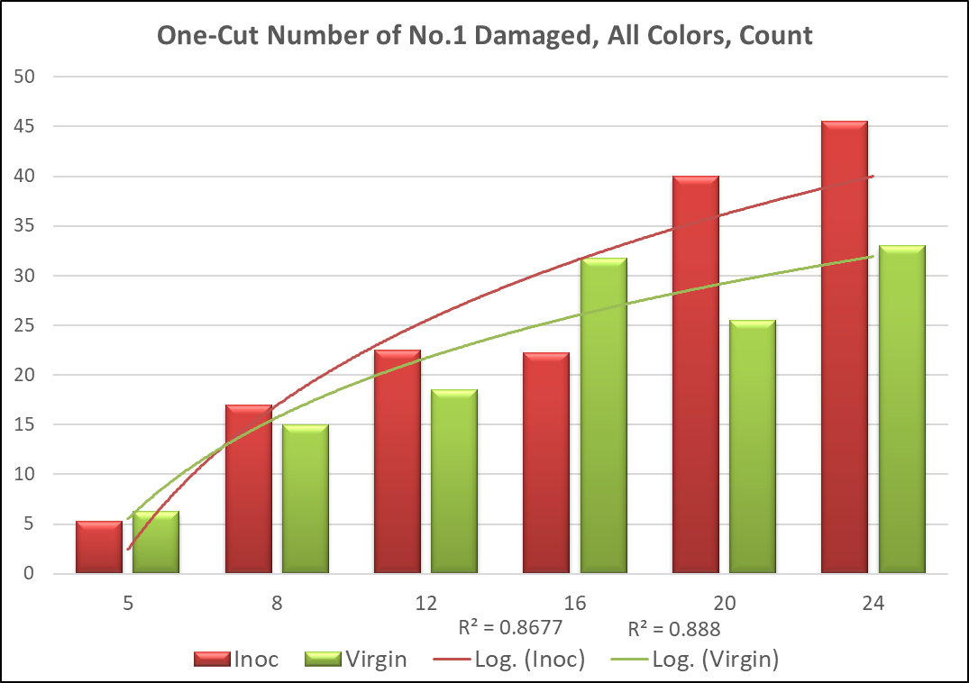
Total No. 1 (Corked) Pepper Production
FERT p < 0.0001
INOC p < 0.2001
INTX p < 0.0004
*
**
Fert 16 = 154 ppm N
INOC -9.5 fruit +/- 3.3
p < 0.0607
S
Fert 20 = 190 ppm N
INOC 14.5 fruit +/- 3.4
p < 0.0023
Fert 24 = 226 ppm N
INOC 12.5 fruit +/- 4.0
p < 0.0298

Slide 21
Production by Grade
**
*
**
S
**
US Grade A Fancy
At lower Nitrogen levels, INOC plants produced a higher proportion of US Fancy
At higher Nitrogen, more peppers were damaged
US No. 1 Damaged

Slide 22
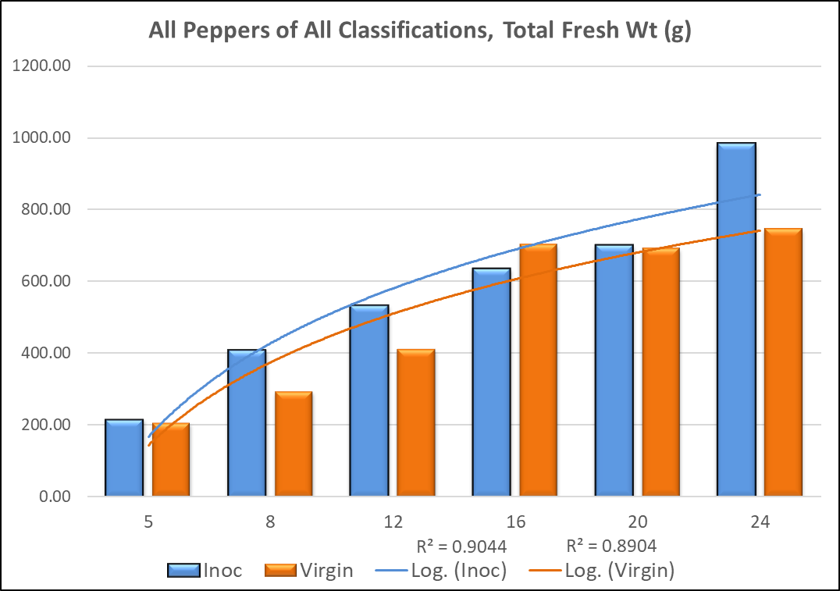



Total Fruit Biomass, Fresh and Dry (g)
Only Fertilizer Significant.
No Additional Biomass.

Slide 23

Total Green Fresh Weight (g)
Fertilizer Significant
No effect from Inoculation Status

Slide 24

Total Green Count and Average Wt (g)
**
Net Positive Impact on Green Production
Surpassed adjacent Fertilization Level
Lowest average wt of all the Fert levels

Slide 25

Total Red Fresh Weight (g)
Fertilizer Significant
No effect from Inoculation Status

Slide 26


Total Red Count and Average Wt (g)
Net Positive Impact on Red Production?
Not significant, but -5.0 grams/pepper (-31%)
Also, we should remember…

Slide 27

The peppers produced were lower grade
Net Positive Impact on Red Production?
No difference in weight per pepper, but…

Slide 28

US Grade A Fancy Fresh Wt (g)
Fertilizer Significant
No effect from Inoculation Status

Slide 29


Total Fancy Count and Average Wt (g)
This variety demonstrated a very strong propensity to produce Corked fruit
Numerous 0 value measures

Slide 30

Halving production might be a tough sell
This variety demonstrated a very strong propensity to produce Corked fruit
Numerous 0 value measures

Slide 31

No. 1 (Corked) Fresh Wt (g)
Fertilizer Significant
No effect from Inoculation Status

Slide 32

Total Corked Count and Average Wt (g)
Increased production of corked peppers
Beneficial if that is your market
  Exports? Processors?
AMS lowest pricing, no differentiation
USA Demand is highest for Fancy – Heavy imports, which are low cost

Slide 33

Opportunity Costs are readily apparent
39% Decrease in size
Full transparency is important to not misrepresent ‘Improvements’

Slide 34


Results – Root Biomass Dry Matter (g)
Fertilizer Significant
No effect from Inoculation Status

Slide 35


Results – Shoot Biomass Dry Matter (g)
Fertilizer Significant
No effect from Inoculation Status

Slide 36



Results – Total Plant Biomass Dry Matter (g)
Fertilizer Significant
No effect from Inoculation Status

Slide 37

Conclusions
Significant differences are exhibited, in fruit production only, often interacting with N fertilization levels
Reporting selectively Bigger/Better/More! results would give a false sense of only positive synergism
G. diaz may have use in Jalapeno production
  Targeted markets
  Nutrient profiling
  Secondary metabolites
Average ½ Plant per Bucket

Slide 38








Thank you for your Time!!

Slide 39
Thank you for your Time!!
Ryan Sebring
Sebe@psu.edu
Rlsebring@hotmail.com

