Slide 1
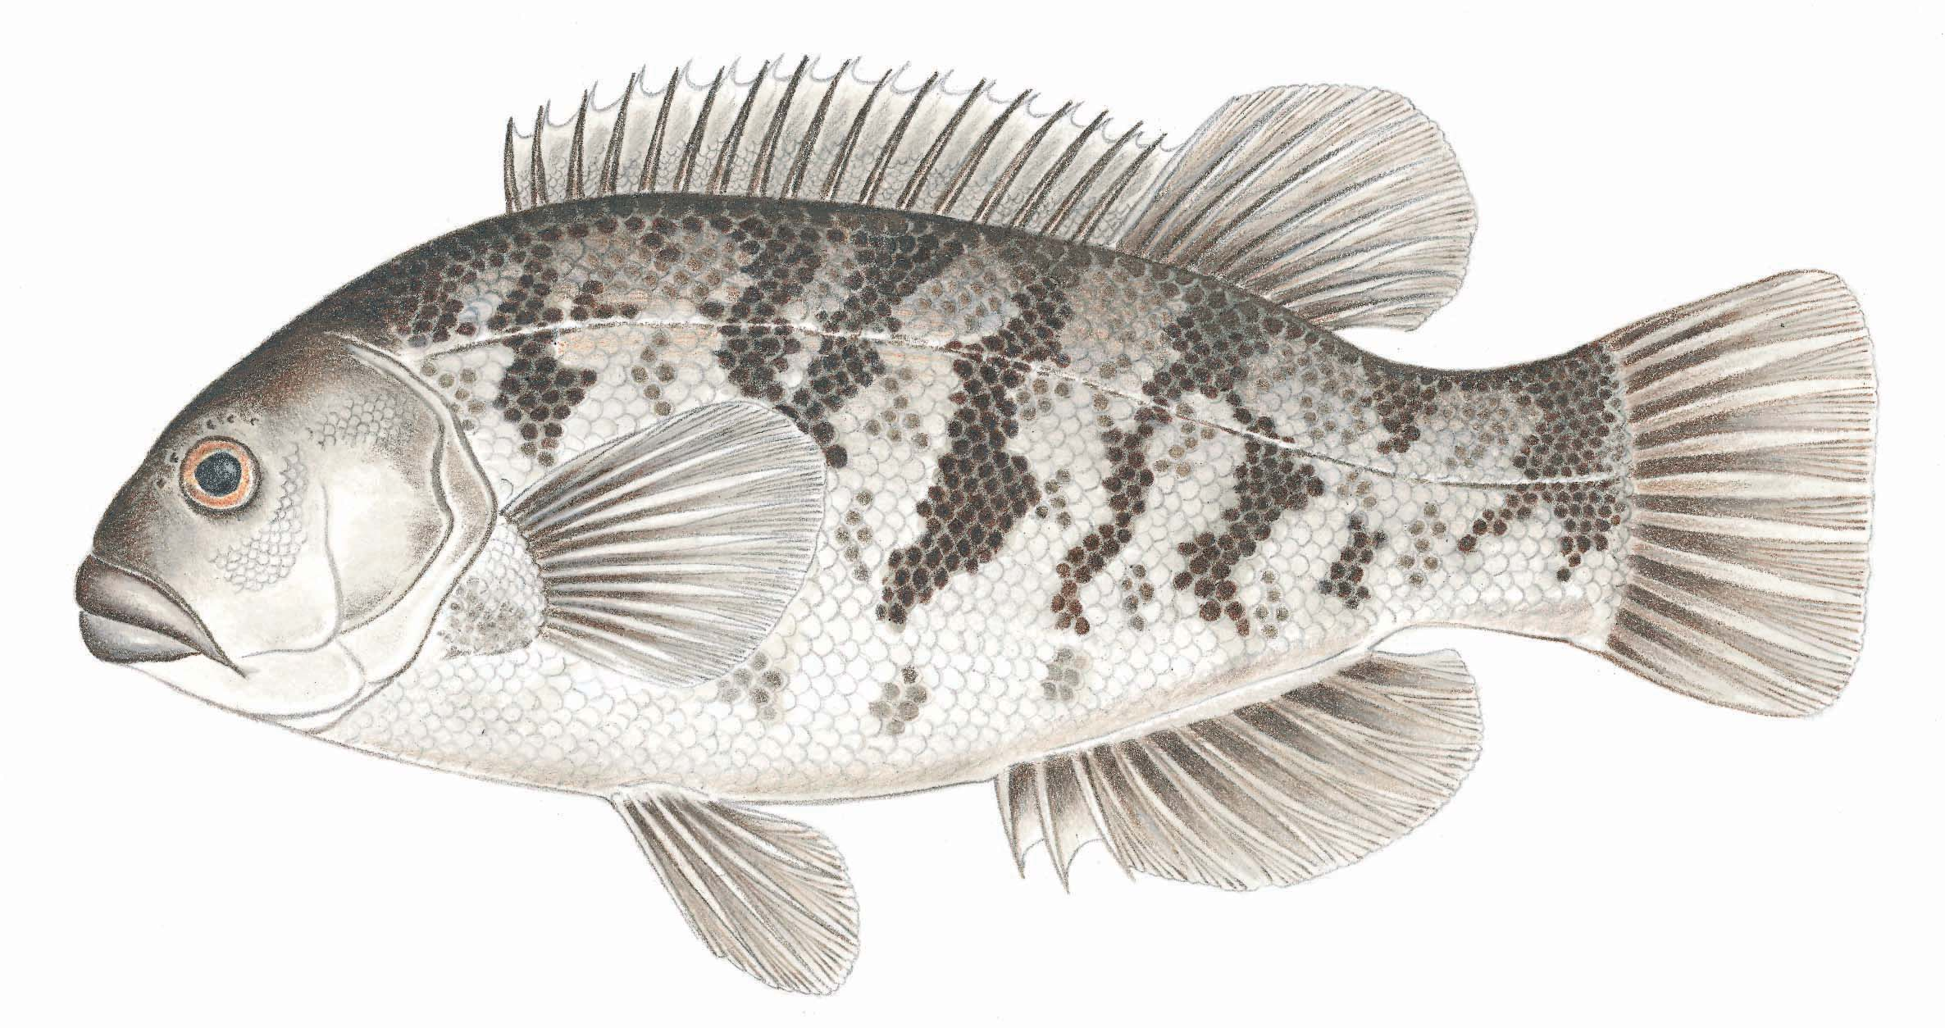
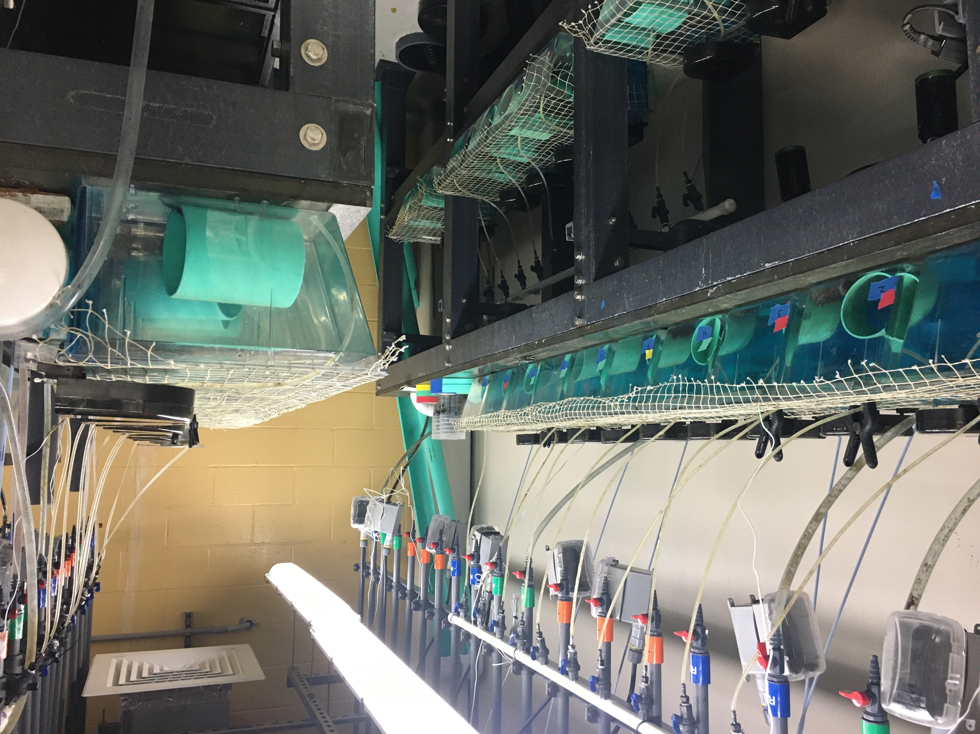
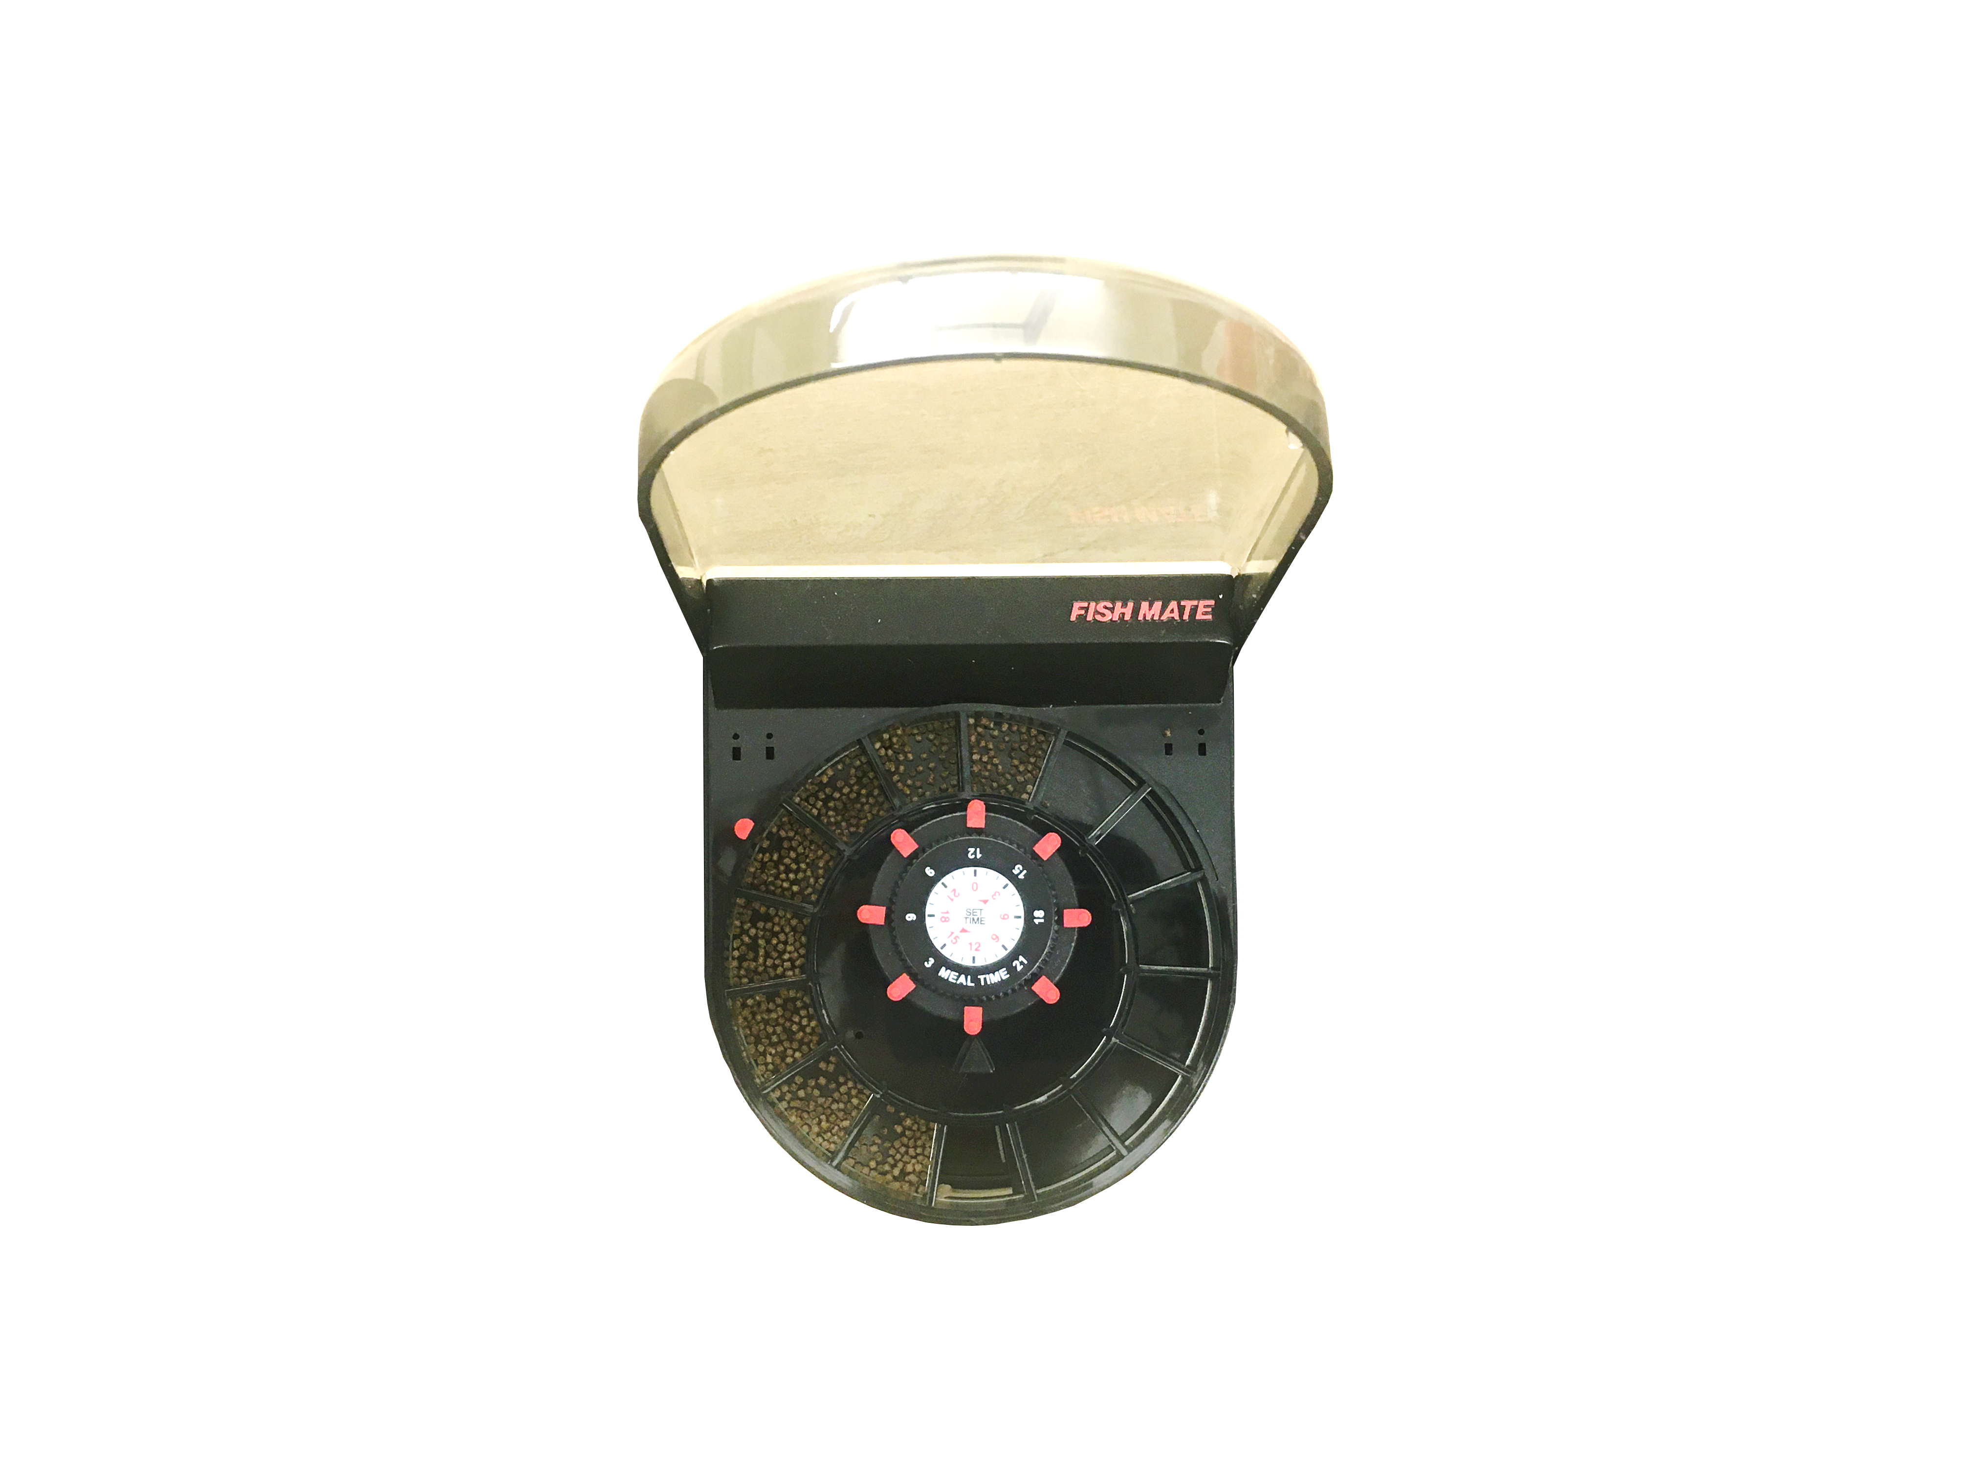
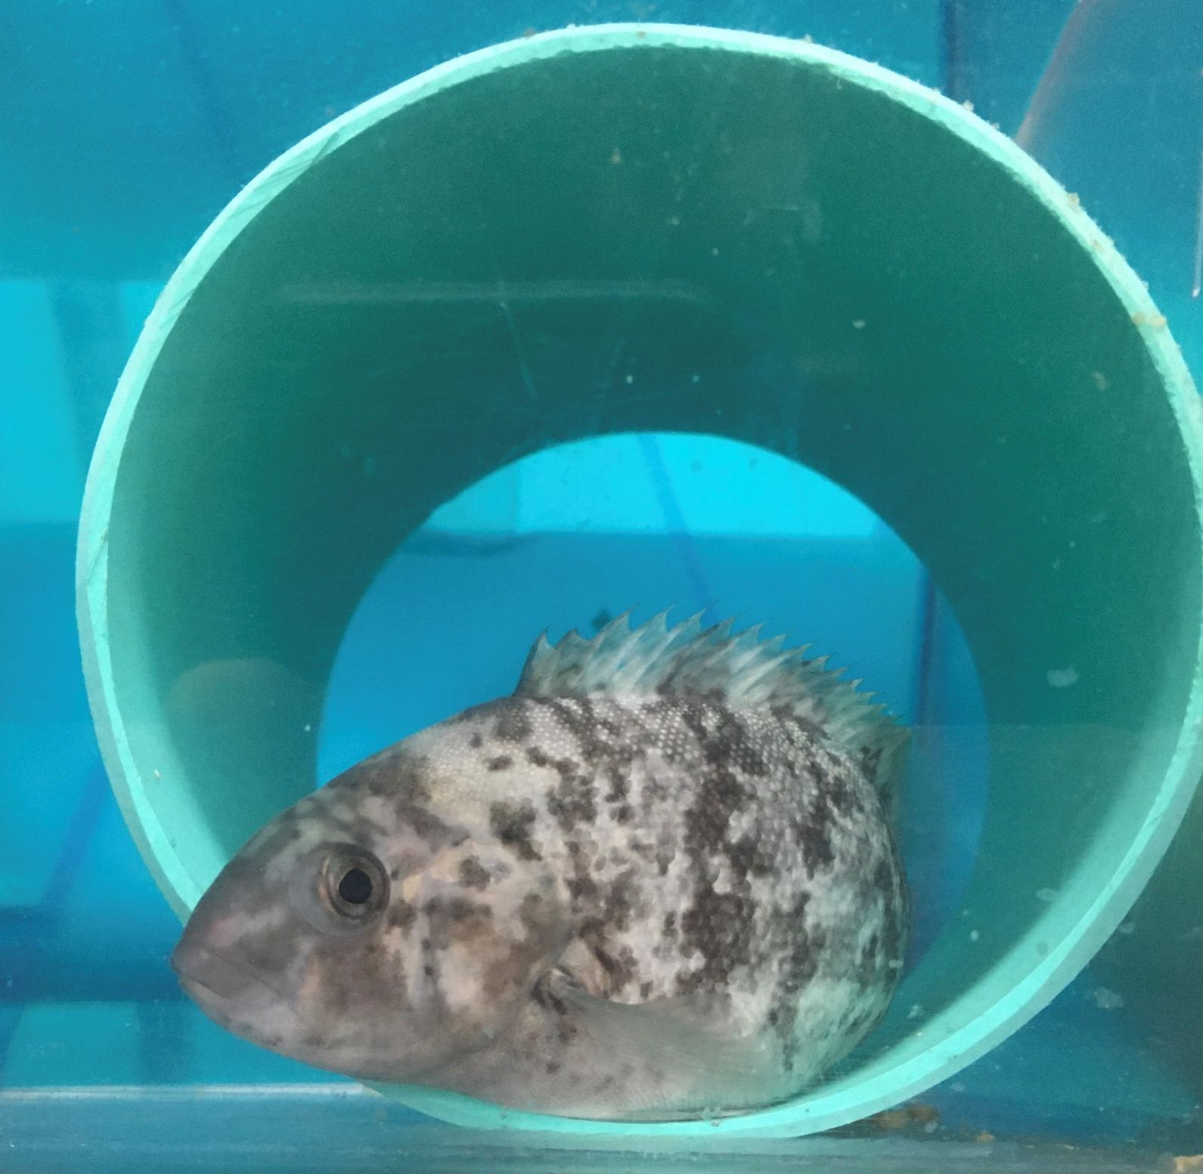
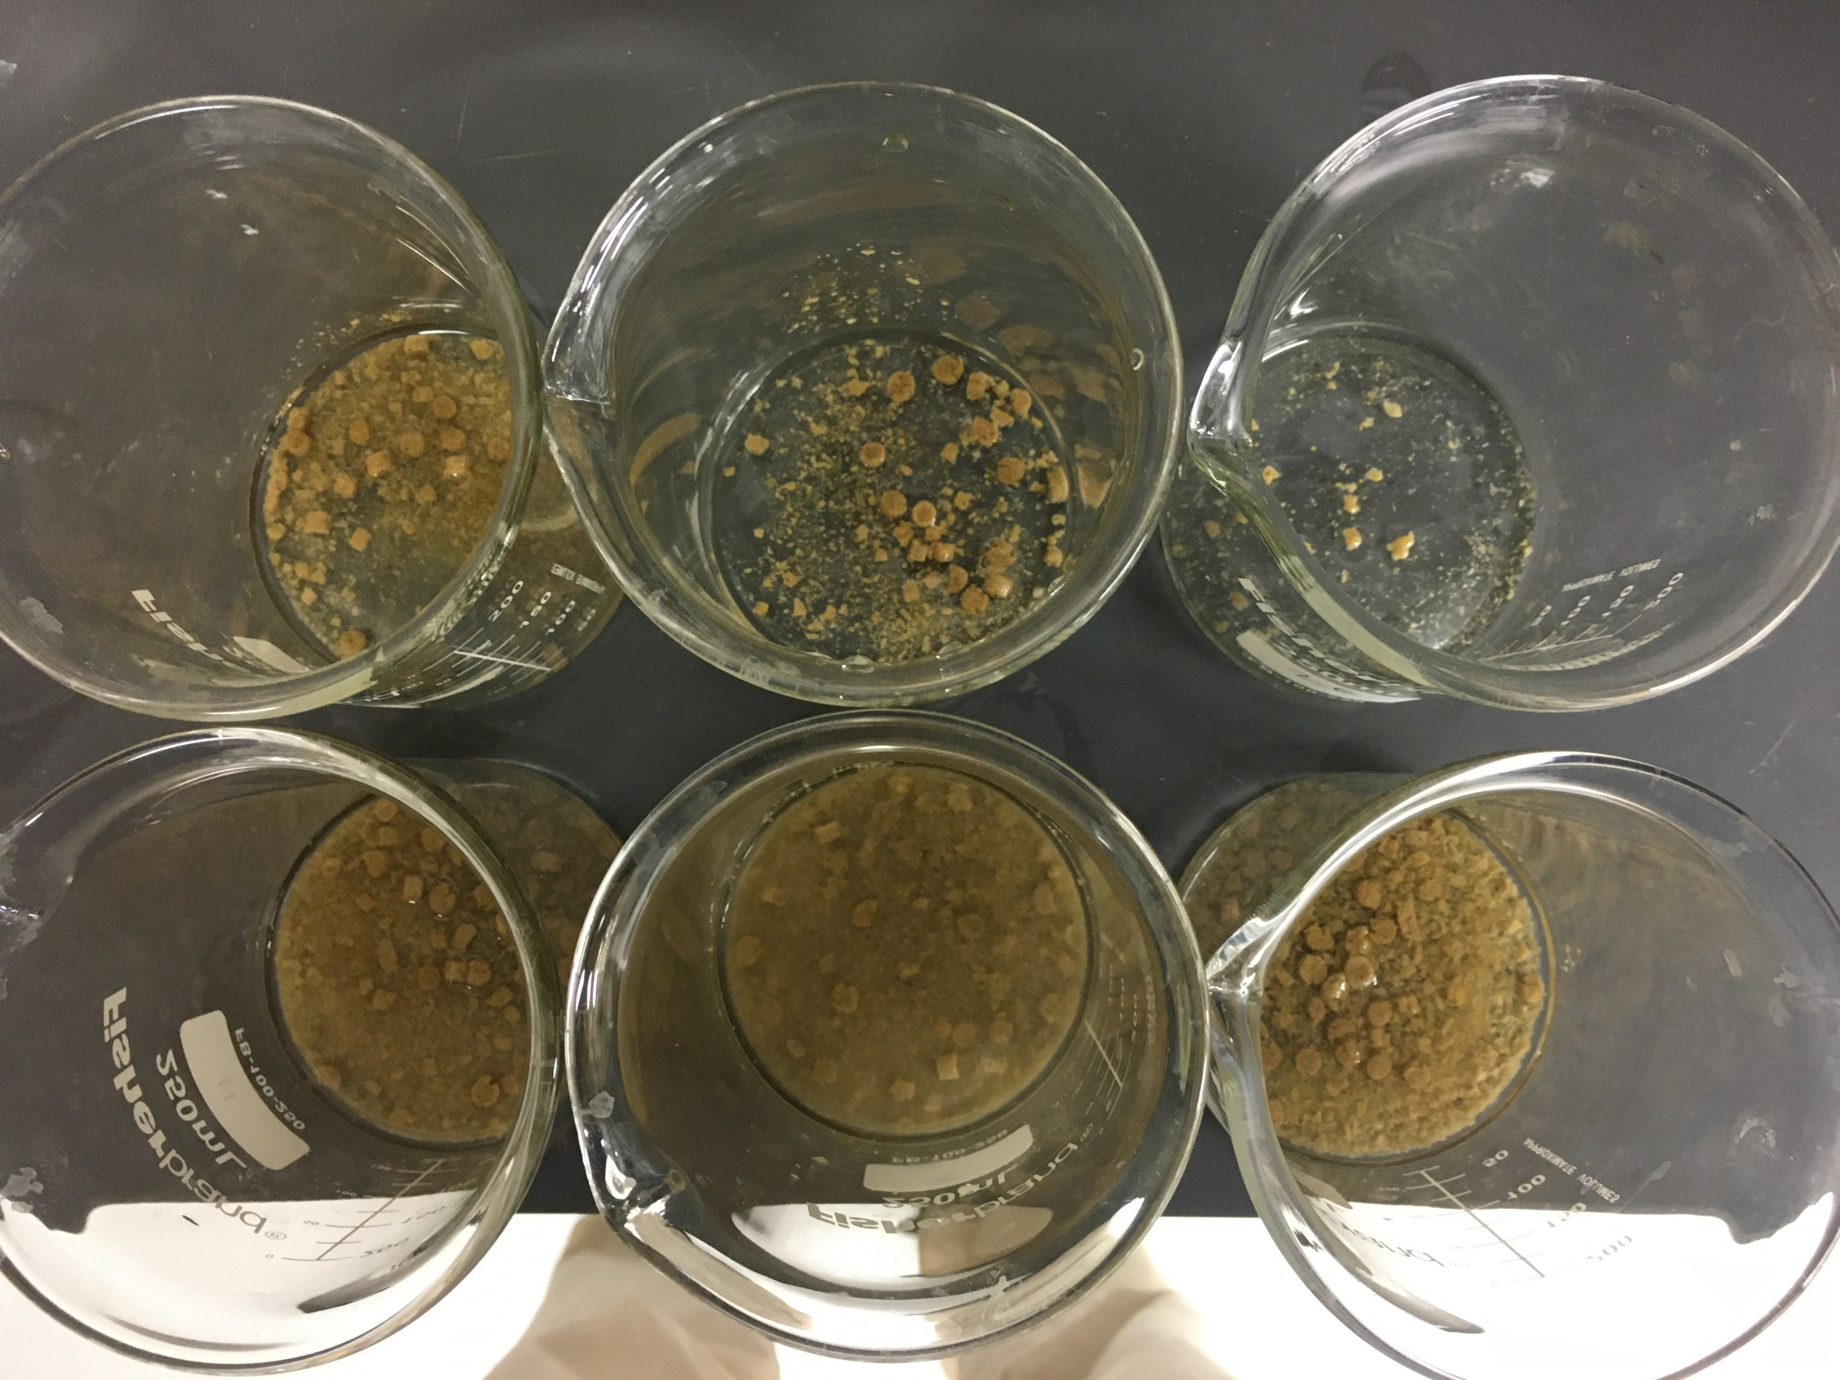
“The Impact of Feeding Frequency on the Food Consumption of Juvenile Tautog (Tautoga onitis) in Recirculating Aquaculture Systems”
Michael Coute¹, Pingguo He¹, Chris Rillahan¹ , Dan Ward², ¹ University of Massachusetts Dartmouth, ² Ward Aquafarms
Project Background
Tautog are opportunistic grazers:
H₀: if tautog are fed food more frequently, the fish will consume more food
H_{A}: There will be no difference in consumption between treatment groups
Results
R
Average Consumption:
2x & 4x groups were significantly higher than the 8x group, but not different from each other
(Tukey HSD: P<0.05)
Methods
Trial Begins:
Fish weighed measured & placed into individual 9L tanks (30 tanks)
Random treatment assignment
Automatic feeders loaded & begin feeding at 0900
Conclusion
Equal
amounts of
food for each
Less frequent feedings results in higher consumption and less feed waste
Reducing feed waste improves water quality and business economics
Treatments
Uneaten feed collected with siphon and 50μm sieve
Drying oven loaded with samples (60ºC)
Samples weighed after 24 hours
Feeding Frequencies
2x
0900 & 2100
4x
0900, 1500, 2100, 0600
8x
0900, 1200, 1500, 1800, 2100, 2400, 0300, 0600
Process repeated for 12 consecutive days

