Slide 1

Organic Certification
Rosalyn Lehman, executive director
Iowa Organic Association

Slide 2
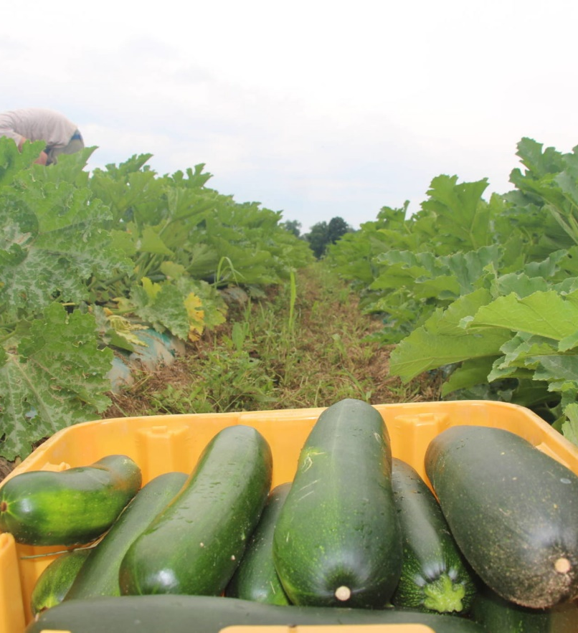
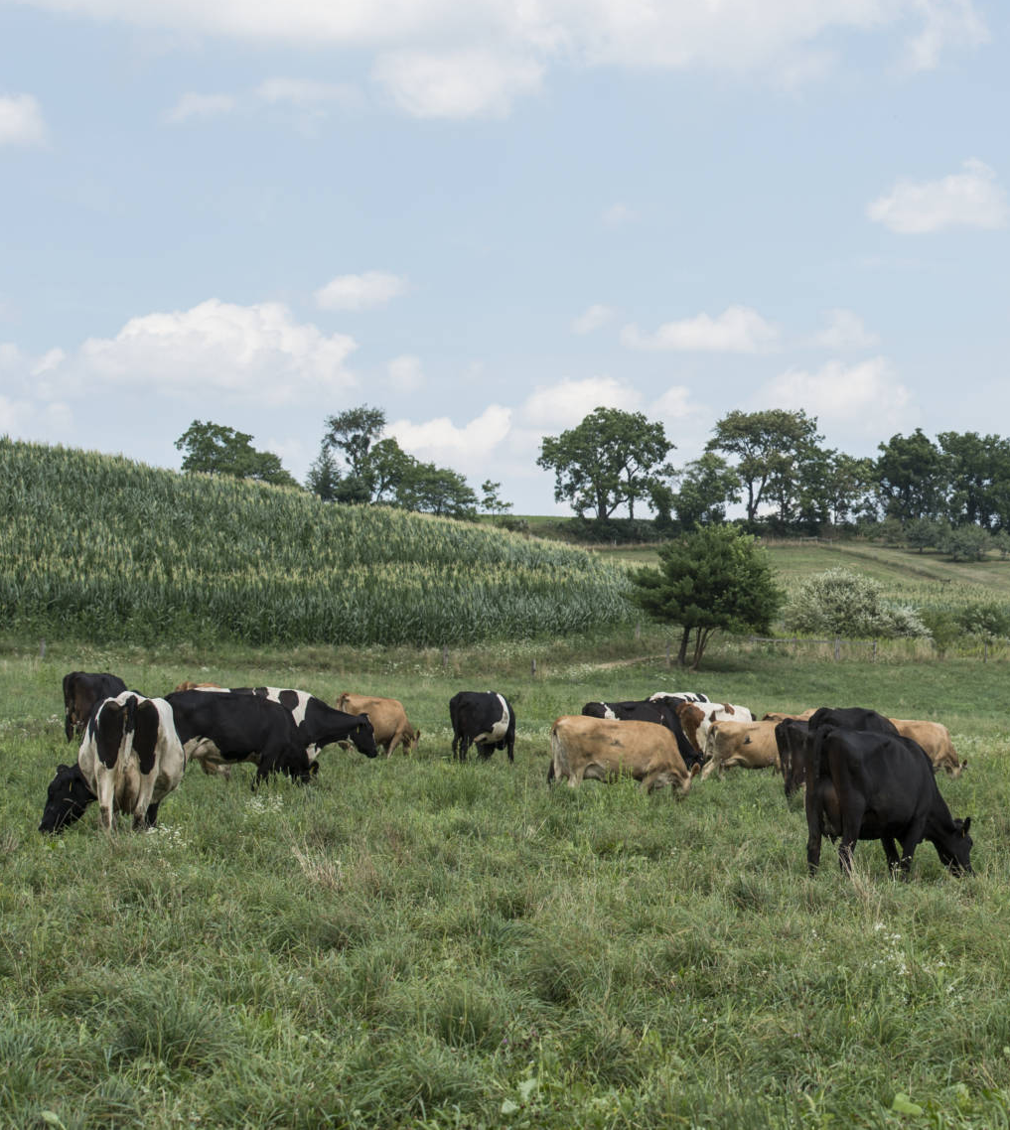
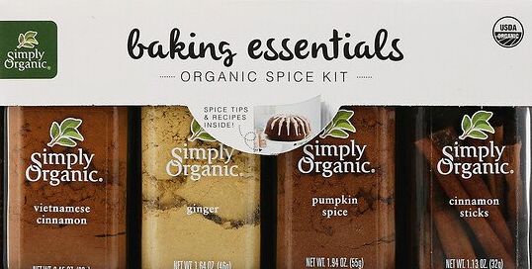
Types of Organic Operations
Crops Handling Livestock
Notes:
Wild crop

Slide 3
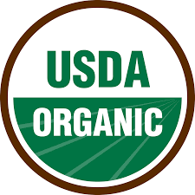
Who is involved in Organic Certification?
Farmer/Handler
Inspector
Accredited Certifying Agency
(47 in US and 31 abroad)
USDA National Organic Program
Consumer

Slide 4

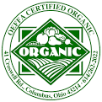
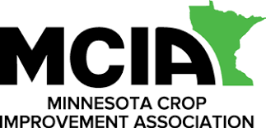
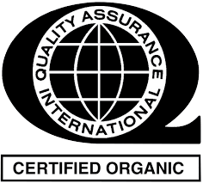
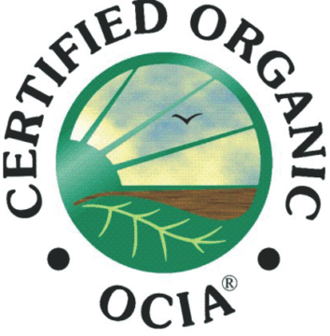
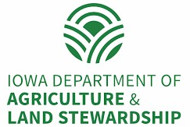
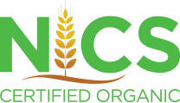
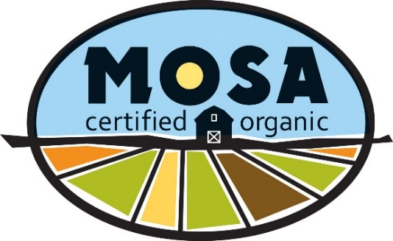
Certification: Select a Certifier
Currently 19 options in Iowa
Considerations:
Fee structure
Areas of expertise
Responsiveness
Other services offered
Structure: state,
for-profit, non-profit
Note: This is not an endorsement by IOA; nor is this list exhaustive

Slide 5
Certification: Organic Systems Plan
The Organic System Plan, or OSP, is the foundation for your application for organic certification. It is the primary document that demonstrates compliance with the applicable organic standards on all aspects of their operation.
Your OSP will be your action plan --- it will spell out exactly what you do, how you plan to do it, everything you anticipate using, and how your records will verify your practices.
Notes:
Each certifier has their own forms and processes…reach out to the certifier you intend to use to make sure your application, documentation and record-keeping is in-line with their systems.
When thinking about your timeline for certification, remember to set aside ample time to plan, organize and verify your OSP. The certification process typically takes about 8-12 weeks once your application has been received.
TSPs in some areas of the state…

Slide 6
Certification: Organic Systems Plan
Farm Map – must include the name or code of the parcel to be certified, the location, description and size of any buffer areas, neighboring land uses, processing areas, location of buildings and the presence or use of treated lumber on the farm.
History of Land Use and Materials Application – records of all land use practices and materials applied over the last 3 years. This includes a signed statement or affidavit that no prohibited materials were applied or used.
Planned Materials – a list of all materials including seeds, fertilizers, pest, weed and disease control materials applied to crops during the upcoming year.
Planned Crops – a list of your crops to be produced, include the location and acreage for each crop. You can change your OSP throughout the year, just make sure to notify your certifier.
Notes:
Each certifier has their own forms and processes…reach out to the certifier you intend to use to make sure your documentation and record-keeping is in-line with their systems.
Transitioning to organic takes a lot of preparation and planning, including time and resources…consider different approaches to transitioning your land
Full Transition – all land into organic at once
Gradual Transition – one field, set # of acres, with the end goal of certifying all land eventually
Split Transition – manage both conventional and organic land

Slide 7

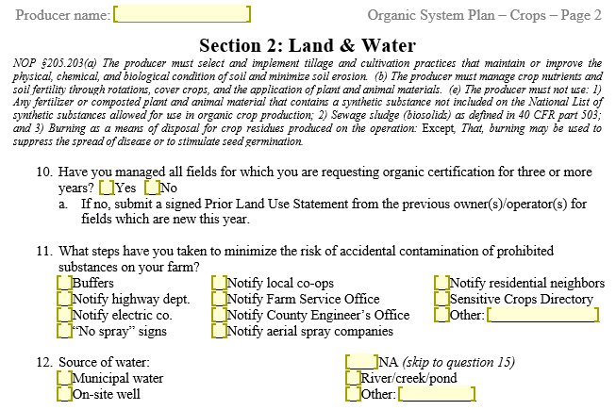
Organic System Plan

Slide 8
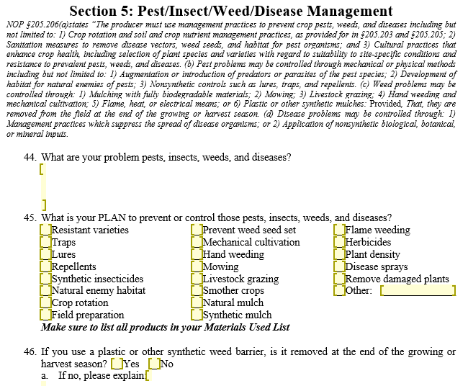
Organic System Plan

Slide 9
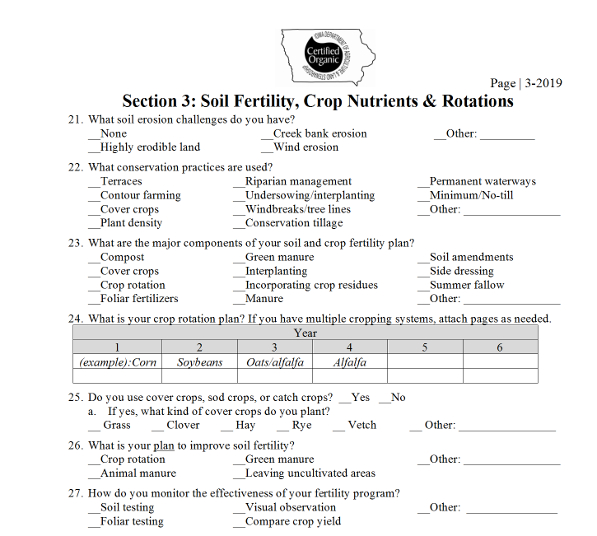
Certification: Crops Organic Systems Plan
Crops and acres
Land and water
Soil fertility, crop nutrients, and rotations
Seeds and planting stock
Pest/Insect/Weed/Disease management
Greenhouse/High tunnel production
Split, parallel, and buffer production
Harvest, post-harvest, storage, and marketing

Slide 10
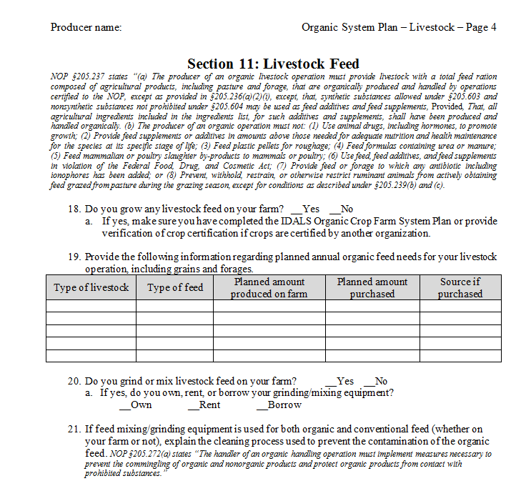
Certification: Livestock Organic Systems Plan
Types and number of livestock
Feed
Storage
Outdoor access
Water
Grazing (ruminants only)
Healthcare practices
Living conditions
Manure management
Pest Control
Equipment

Slide 11
Certification: Transition Rules & Regulations
Harvested crops are intended to be sold, labeled, or represented as “organic,” must have had no prohibited substances…applied to it for a period of 36 months immediately preceding harvest of the crop.
Example: Synthetic seed planted May 1, 2016, certification eligibility date May 2, 2019.
Livestock = 12 month transition period
Only use allowable materials found on the USDA National List of Allowed and Prohibited Substances.
ALWAYS confirm all materials with your certifier BEFORE use to be sure the material is allowable for your organic production.
The approval of any input for organic use is at the discretion of the certifier.

Slide 12
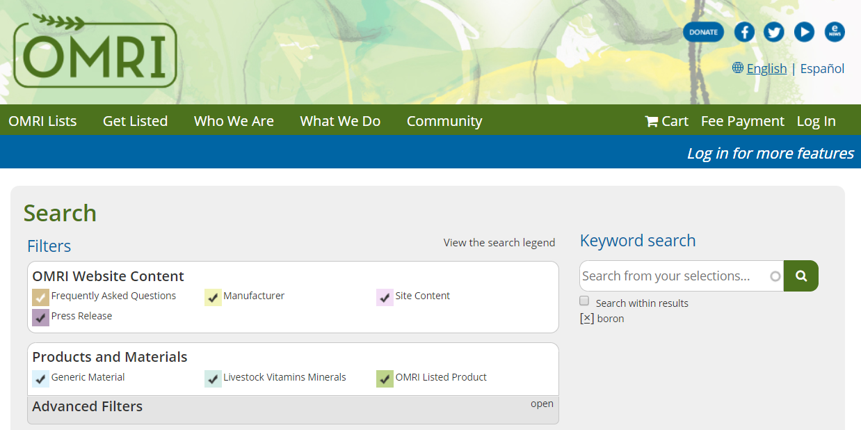
Certification: Rules & Regulations Organic Materials Review Board (OMRI)
Independent, non-profit organization
Reviews substances for use in organic production
Maintains database
“Allowed”, “Restricted”, or “Prohibited”
Adheres to National List of Allowed Synthetic and Prohibited Non-synthetic substances
Notes:
Products bearing the OMRI Listed® seal have been reviewed and determined to be allowed for organic use in accordance with U.S. NOP organic standards.
ALWAYS CHECK WITH YOUR CERTIFIER BEFORE APPLYING ANYTHING TO YOUR GROUND OR CROP.

Slide 13
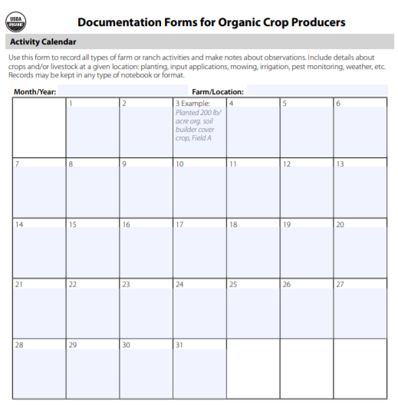
Certification: Recordkeeping
Records demonstrate compliance with NOP Standards
Be readily understood, auditable, and sufficient to demonstrate compliance
Kept on file for at least 5 years
Tailored to the operation:
Production
Field Map
Field Activity Log
Inputs (Seeds, fertilizer, pest management)
Harvest/Sale
Bin log
Bill of lading / Clean truck doc.
Scale ticket / Invoice
Handling (may not apply – unless processing on farm and marketing)

Slide 14
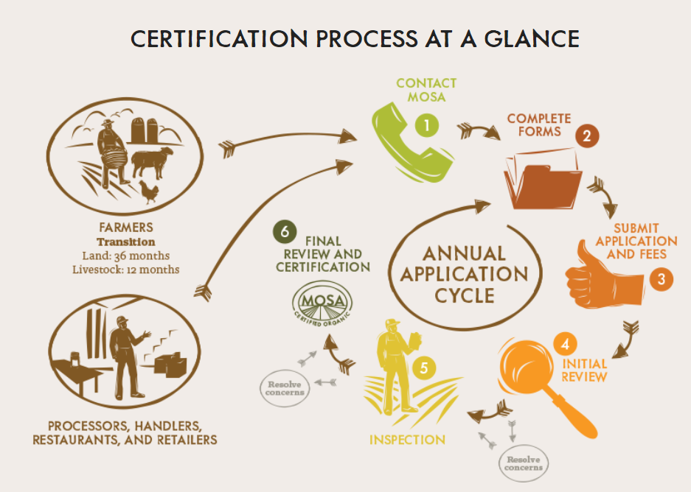
Certification: Application and Fees
Submit application 4-5 months in advance of expected harvest
Fees vary by certifier, IDALS example:
Base price: $125
Inspection: $300 (crop)
Travel costs
Hourly rate
Certification fee: $125+ (varies, ex: $6/ac corn; $27/ac vegetables)
Varies by crop and/or acres
Notes:
Priority for inspection based on eligibility date and/or harvest

Slide 15
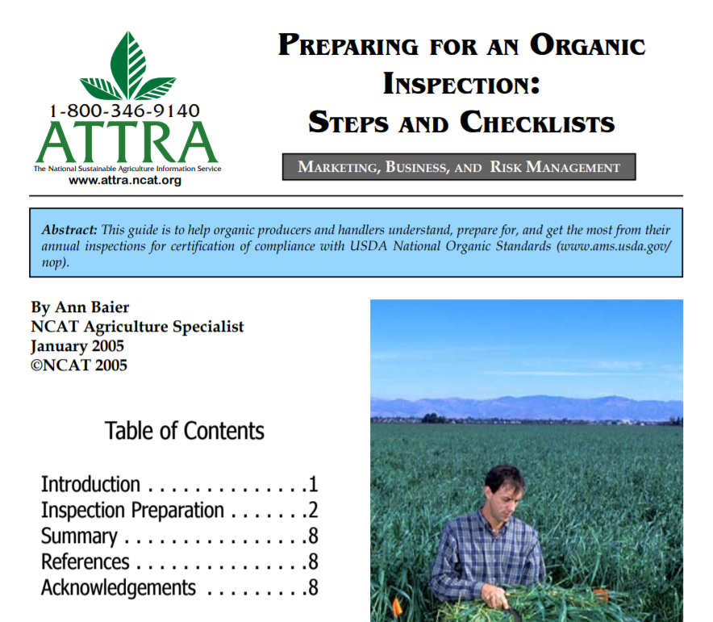
Certification: Initial Review
Certifier reviews application, OSP, and all additional forms to evaluate compliance.
Sends a letter in response:
Your operation is eligible for organic certification
More information is needed
May indicate possible issues of concern
File is sent to organic inspector

Slide 16
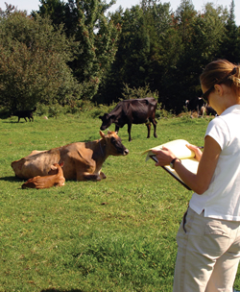
Certification Process: Inspection
Review letter from certifying agent
Expect 3-5 hours for inspection
Don’t be in a rush
More time for 1st time inspection
Add additional time for livestock
Have records organized and ready
When did you last use that input?
Safely dispose of unneeded materials
Inspections are confidential
The role of the inspector is to verify the OSP is accurate and indicate possible violations
Do NOT make any decisions regarding certification
CANNOT provide consultations
Notes:
Notified by inspector 1-3 months in advance to set date/time for inspection
Inspectors are either employees of the certifying agent or contract employees
May try to group travel to save $$$ and time

Slide 17
Certification Process: Exit Interview and Report
Exit Interview:
A closing meeting at the farm
Review areas of concern (no surprises later)
Requests additional documents
Confirms accuracy of observations
Inspection Report:
Completed after the inspection (off-farm)
Details all on-farm observations for certifying agency
Includes forms and photos from the farm

Slide 18
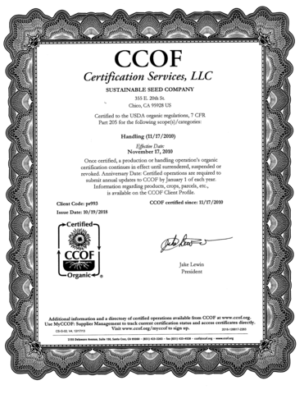
Certification Process: Final Review and Decision
Certification specialist reviews all documents
May request more information from farmer
May issue a major or minor non-compliance
May need resolution prior to issuing certificate
Possible residue testing
Unannounced inspections
Decision
Certification Letter
Organic Certificate
Annual OSP updates and inspection to maintain certification

Slide 19
Barriers to Certification

Slide 20
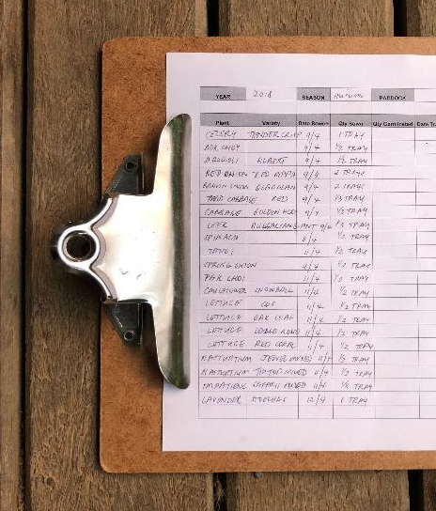
Barriers
Cost
Paper work
Support, resources?
Local market, know farmer
More on production barriers/challenges later

Slide 21
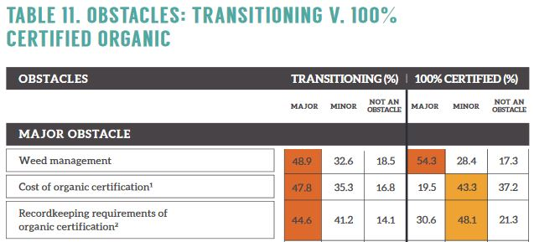
Transition

Slide 22
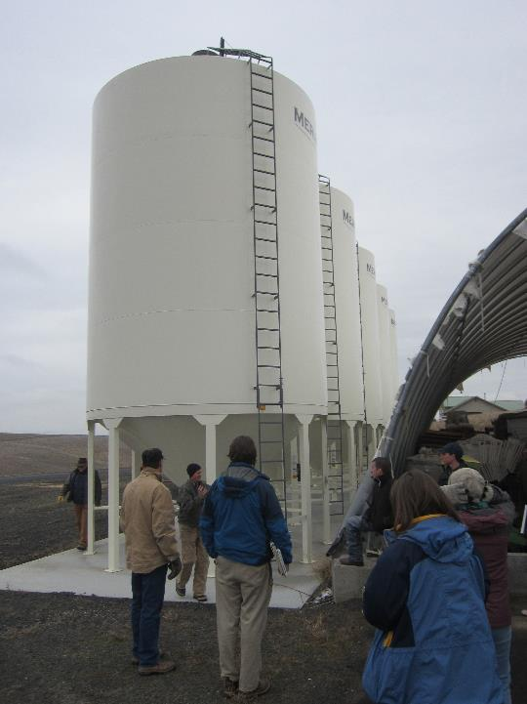
Imports
2008-2016 organic livestock industry tripled, but only 20% increase in US organic grain acres
Imports increase to meet demand ($42m in 2011-$401m in 2016)
Organic grain premiums decreased (~25%)
Turkey previously top supplier, big drop as leading supplier lost organic certification

Slide 23
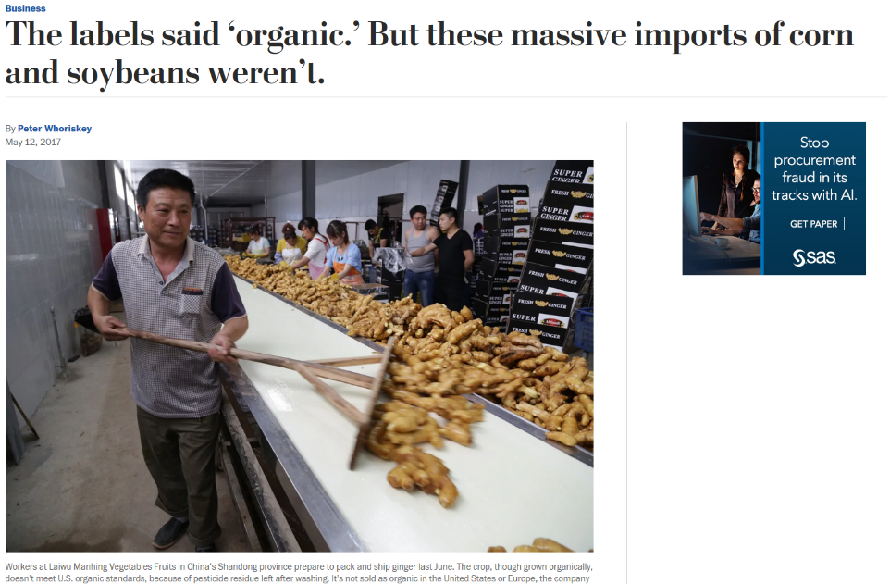
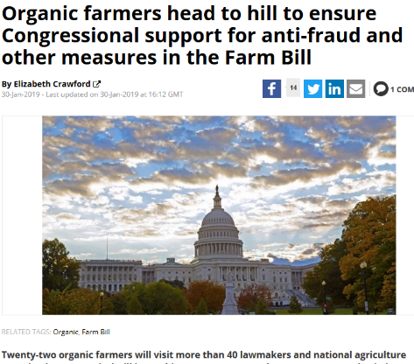
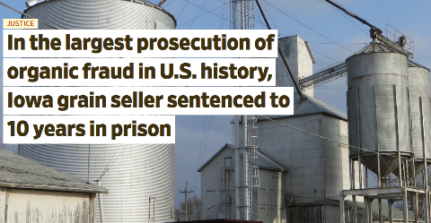
Fraud

Slide 24
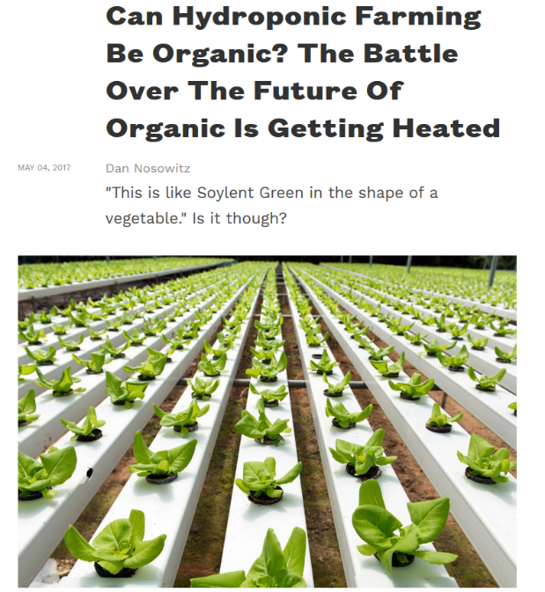
Erosion of Federal Standards
Hydroponics
Dairy herds – outdoor access
Organic integrity – fraud
Allowable substances

Slide 25
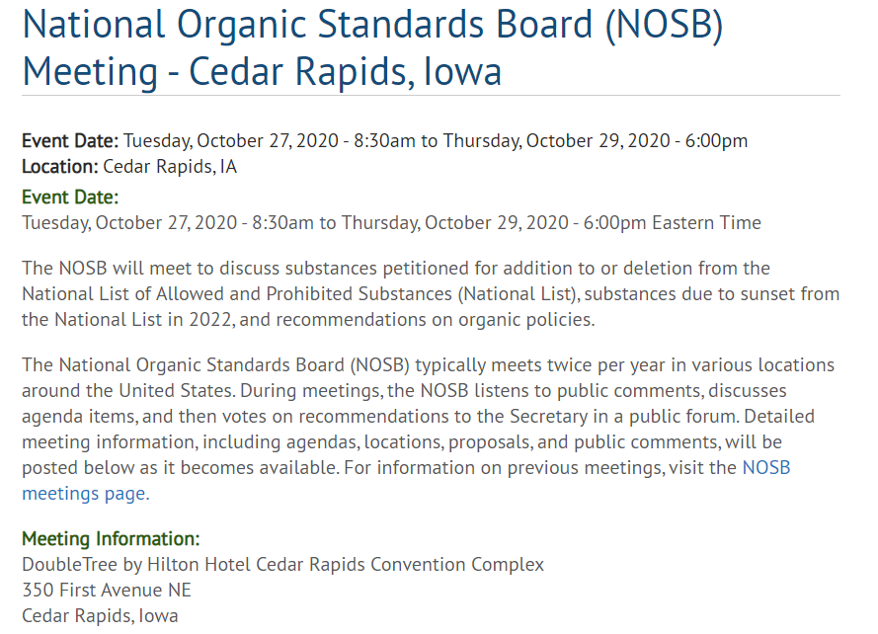
The National Organic Standards Board

Slide 26
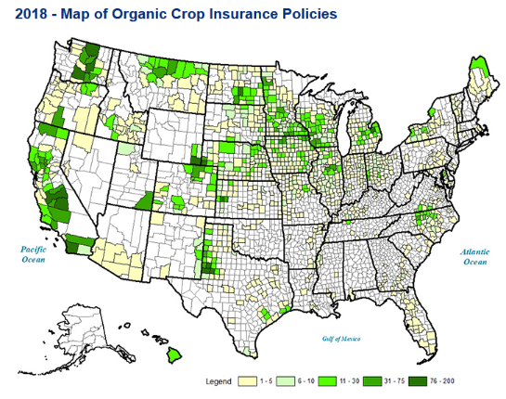
Crop Insurance
Availability?
~80 crops have an organic price election, but not all available in every county.
Multi-Peril Crop Insurance includes yield and sometimes revenue-based coverage.
Whole-Farm Revenue Protection available

Slide 27
Organic Farming and Certification
Challenges
Changes in management / mindset
Cost of certification
Paperwork / records
Yield gap during transition ($)
Risks
Loans
Crop insurance
Erosion of federal standards?
Benefits
Universal and regulated standard
Communication with consumers
Your farm counts (census/surveys)
Records for decision-making
Lower input costs
Conservation of natural resources
Boost farm profitability

Slide 28
Rosalyn Lehman, executive director
515-608-8622 | roz@iowaorganic.org
www.iowaorganic.org

