Slide 1
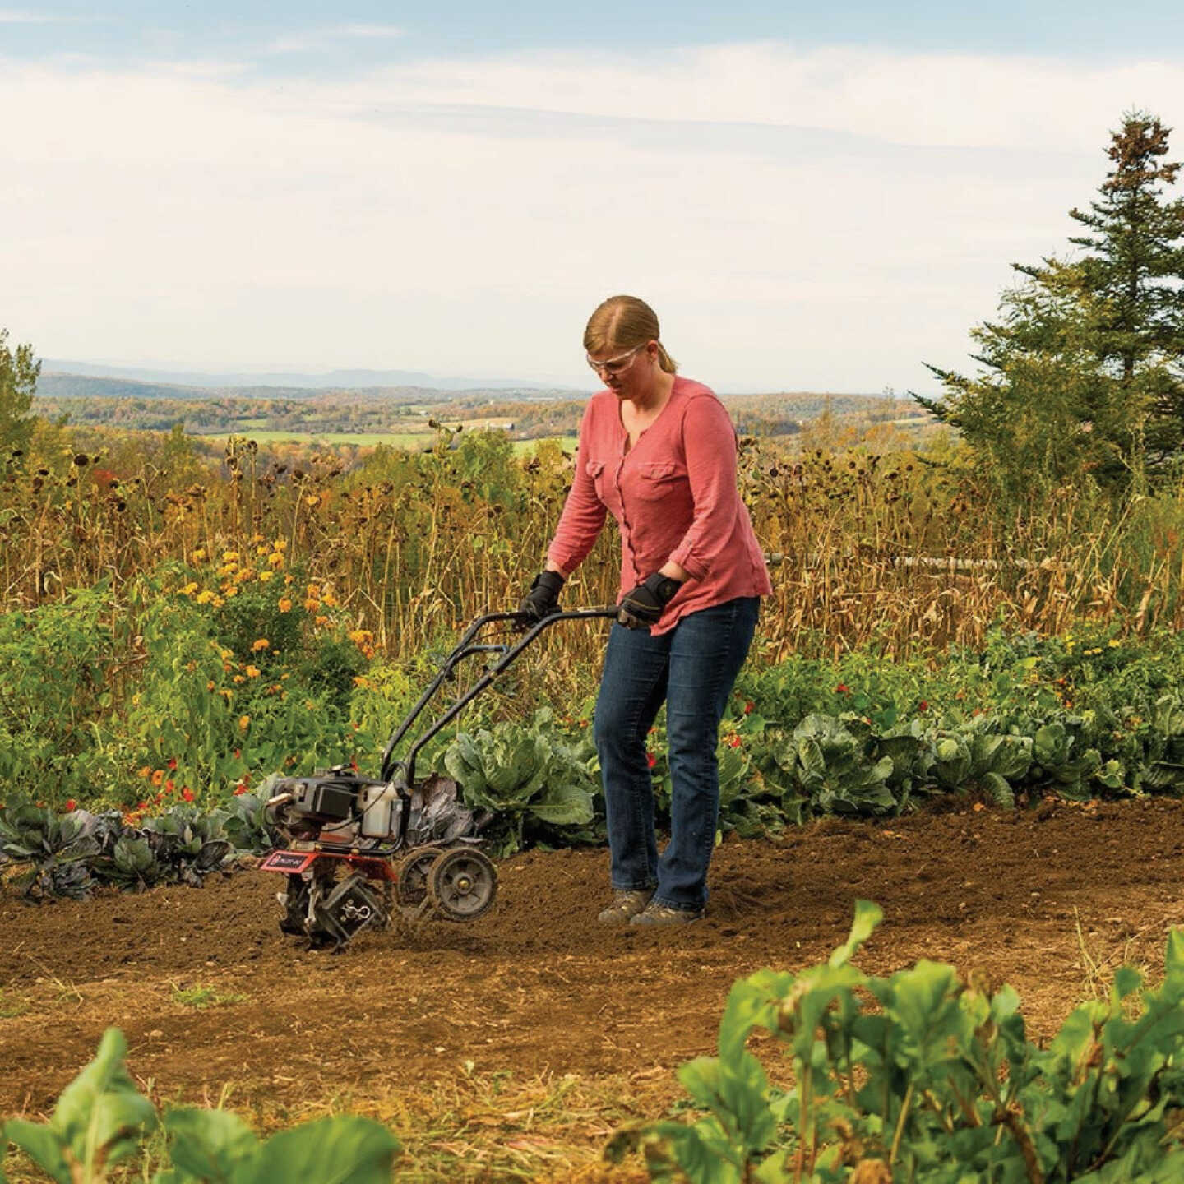


Ergonomic and Performance Optimization of a Smart Electric Auger Tiller:
Comparative Evaluation with Rear- and Front-Tine Models
Felix Oguche, Jianfeng Zhou, Karen Funkenbusch, Marcia Shannon, Aaron Yoder
2025 ISASH Annual Conference Portland, Mane

Slide 2
Presentation Outline
Background – Addressing Musculoskeletal Strain in Farm Tool Use
Ergonomic Design Innovation – Auger Tiller vs. Conventional Tillers
Methodology - Improving the Auger Tiller
Research Findings – Vibration, Force, and Physiological Outcomes
Performance & Ergonomics – Comparative Efficiency and User Feedback
Conclusion & Recommendations – Safer, Smarter Tool Design for Farmers

Slide 3
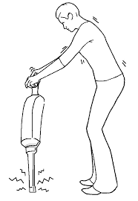
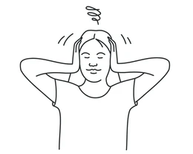
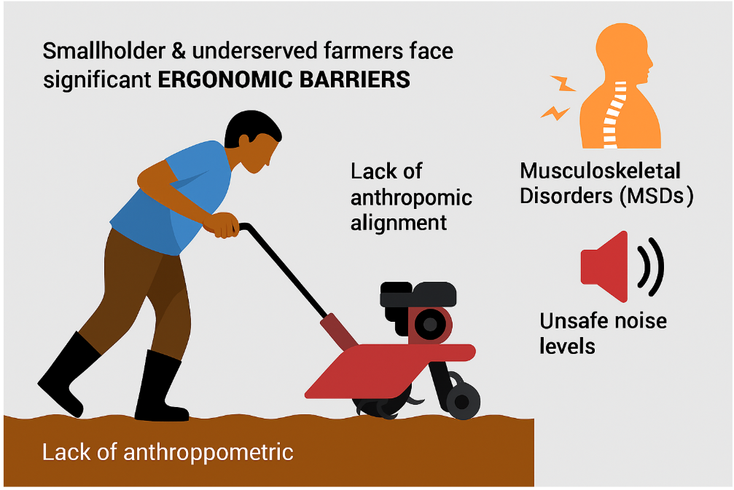
The Problem
Mechanized Tillage: A Double-Edged Sword
Boosts efficiency and crop yields (Srivastava et al., 2006).
Yet, smallholder and underserved farmers face significant ergonomic barriers.
Tools often lack anthropometric alignment, causing poor posture and fatigue (Mojica et al., 2016).
Health Risks
Long hours with traditional tillers lead to:
Musculoskeletal Disorders (MSDs)
Hand-Arm Vibration Syndrome (HAVS)
Unsafe noise levels
🛑 ISO 5349-1 and OSHA/NIOSH warn of these hazards in poorly designed equipment.

Slide 4
The Opportunity for Innovation
Toward Safer, Smarter Tillage
Ergonomic handle design and noise/vibration reduction systems are now emerging.
IoT and sensor integration enhance user safety through:
Real-time feedback
Remote monitoring
Obstacle avoidance (Miah et al., 2023; Rao & Rao, 2023)
Persistent Gaps
Most tillers lack:
Inclusive ergonomic features
Field-tested safety automation
Call for user-centered redesign that meets the physical and digital needs of diverse farmers.

Slide 5
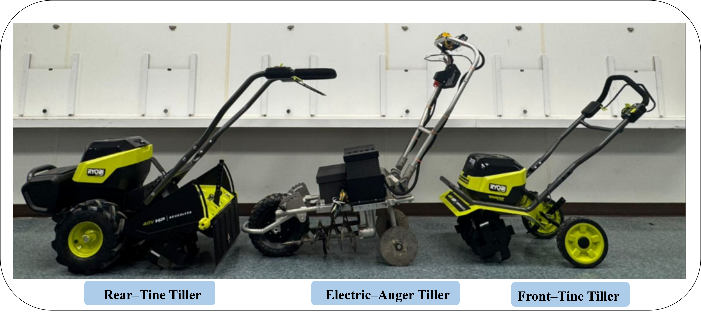
Research Objectives
This study was guided by the need for inclusive mechanization that is ergonomically optimized and digitally enhanced.
Objectives
Design and test an ergonomic electric tiller tailored to underserved farmers.
Evaluate vibration, force, and posture metrics across rear-tine, front-tine, and auger tillers by Dr. Aaron M. Yoder (Green Heron Prototype)..
Reduce operator strain while maintaining or improving tilling performance

Slide 6
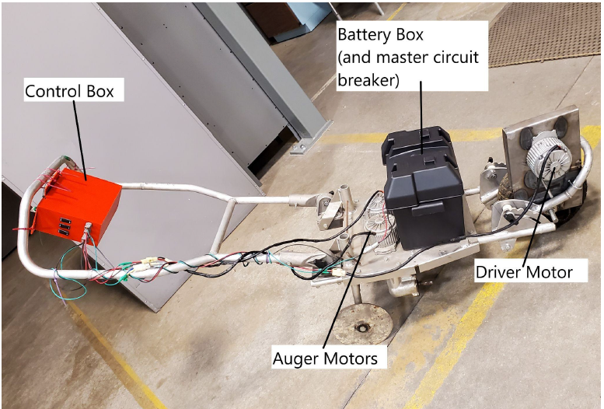
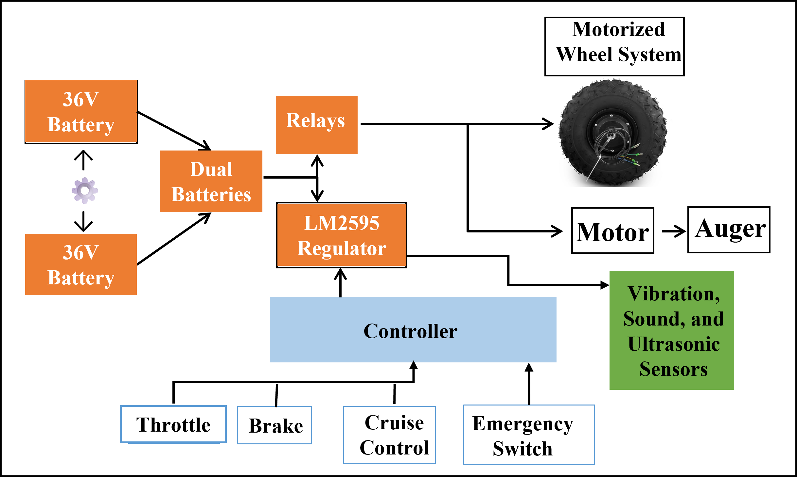
Improving the Auger Tiller (Before Comparison)
We started by upgrading the base auger system using several innovations:
Dual 36V Battery Integration For uninterrupted operation with smart switching.
LM2595 Buck Converter Regulates voltage for all onboard sensors and control logic.
Arduino-Based Control System Includes emergency stop, cruise control, and real-time feedback.
Integrated Sensors Vibration, sound, and ultrasonic sensors reduce strain and alert users to obstacles.
(Green Heron Prototype)

Slide 7
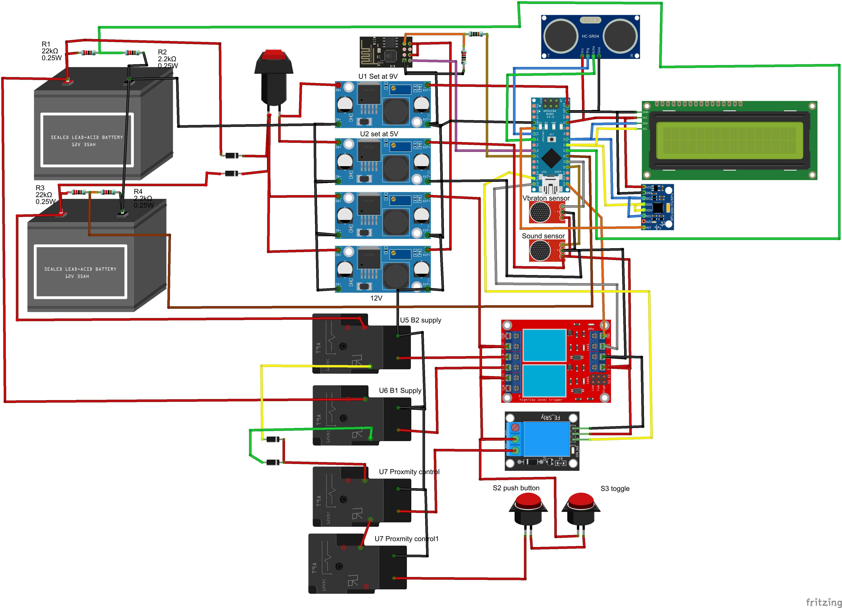
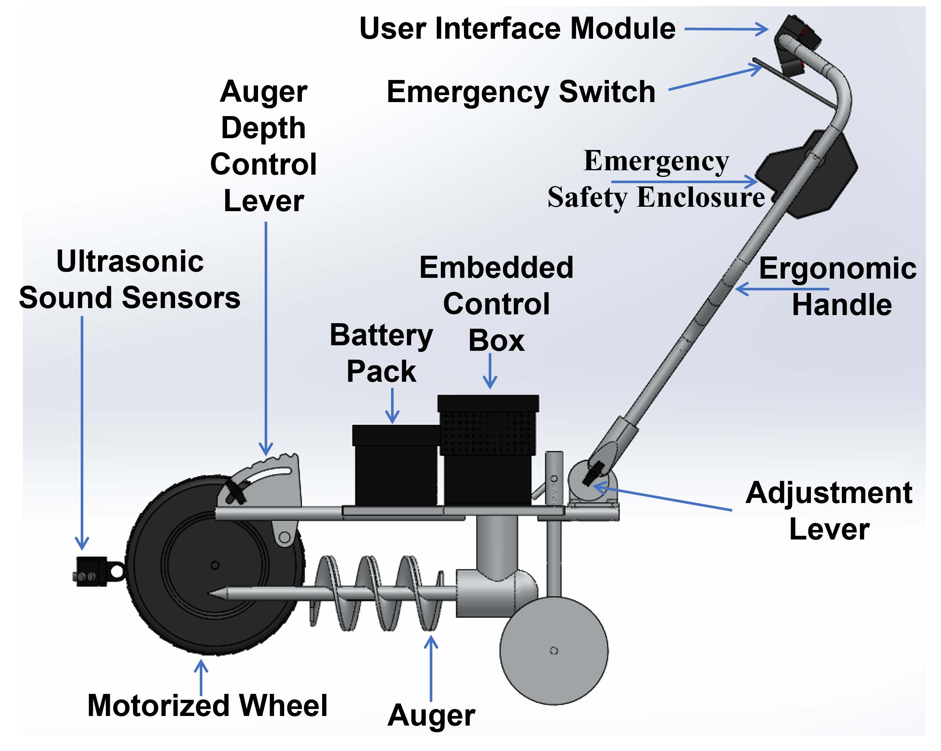
Integrated Wiring and Control Architecture of the Smart Electric Auger Tiller
Modifications to Auger Electric Tiller (Green Heron Prototype)

Slide 8
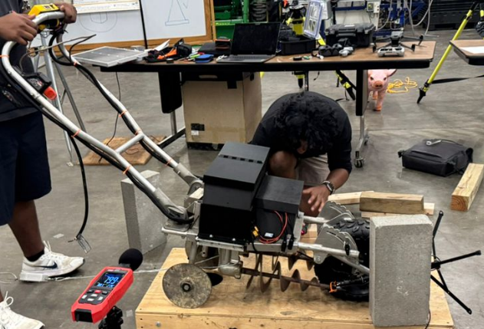
Smart Electric Auger Tiller System Design
Auger Tiller: Ergonomics Meets Automation
36V 350W brushless hub motor ensures low-noise propulsion
Dual 36V battery system with automatic switchover for continuous use
Key Features:
Real-time LCD battery level and motor speed
Arduino-controlled logic for obstacle detection and stop triggers
IoT module (ESP8266) tracks vibration and usage data remotely for feedback to users
Ultrasonic sensors for forward obstacle detection
Bench Testing of Auger Electric Tiller (Green Heron Prototype)

Slide 9
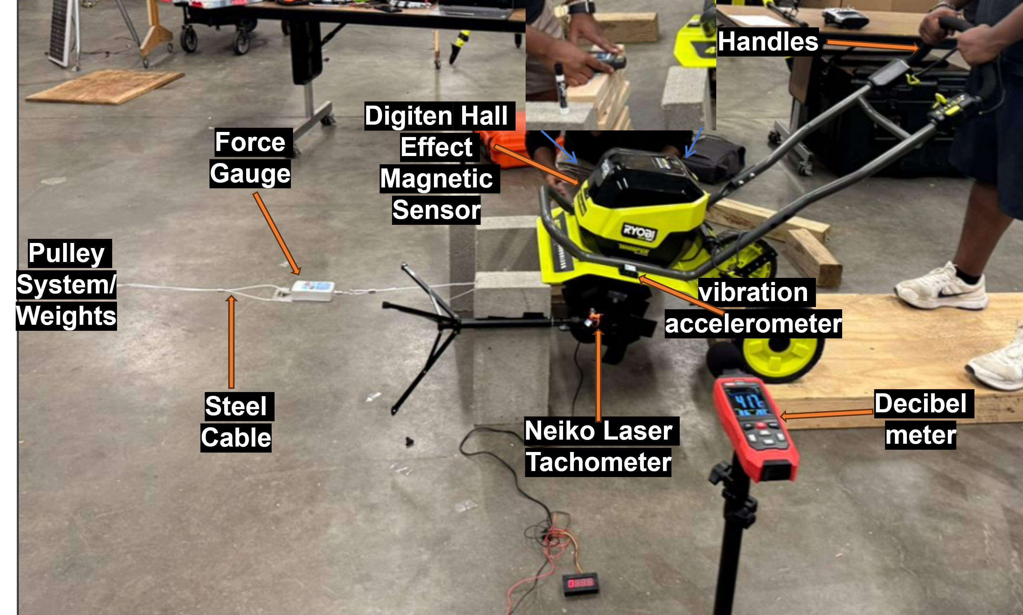
Experimental Setup
Static Bench Testing of 3 Tiller Types
Rear-Tine, Front-Tine, and Auger Tiller tested under consistent conditions.
Bench rig equipped for controlled torque, force, and vibration monitoring.
Instruments Used:
RPM tachometer – shaft speed
Push–pull gauge – draft effort
Triaxial accelerometer – vibration (A(8), VDV)
Digital sound meter – operator noise exposure
Speed Conditions:
Three operational levels: S1 (Low), S2 (Medium), S3 (High)

Slide 10
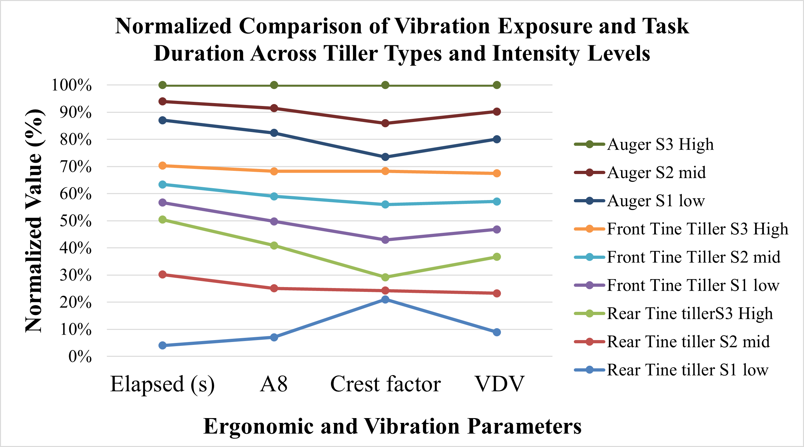
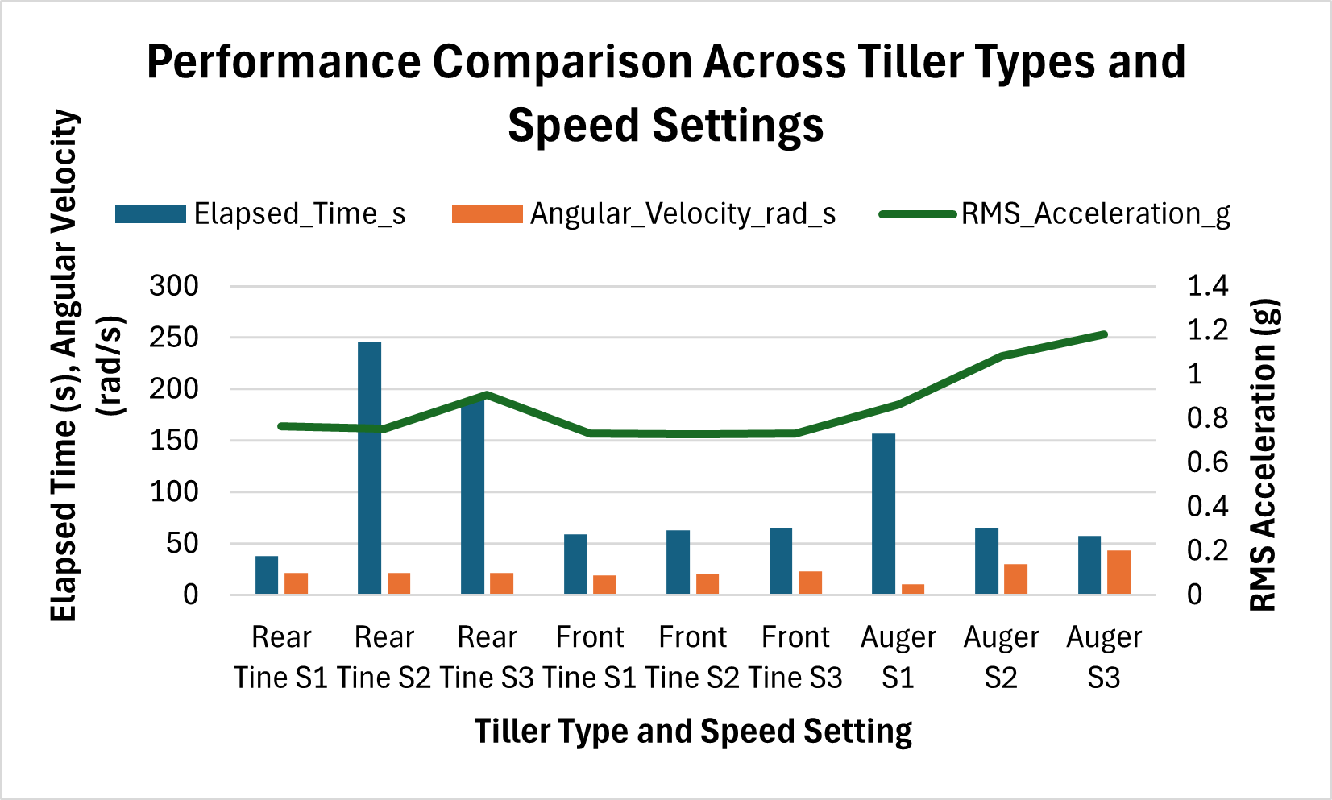
Mechanical Performance Output
Auger Outperformed in Angular Velocity
Peak Angular Speed:
Rear-Tine (S3): 31.85 rad/s
Front-Tine (S3): 36.26 rad/s
Auger Tiller (S3): 43.46 rad/s
Torque Generation (Nm):
Rear-Tine: High torque, poor balance
Front-Tine: Low torque, frequent stalling
Auger: Stable torque across speeds

Slide 11
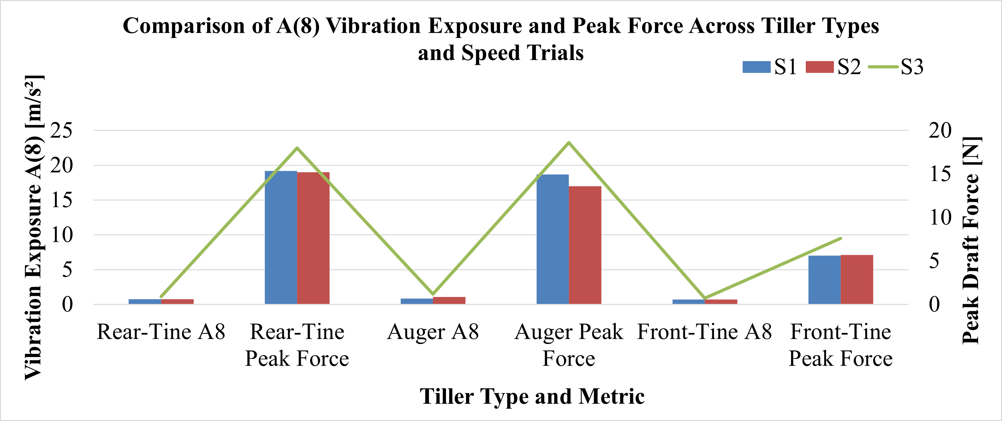
Draft Force vs. Vibration Analysis
.
Effort and Comfort Under Load
Draft Force @ S3:
Rear-Tine: 18.0 N
Front-Tine: 7.5 N
Auger: 18.6 N (efficient load balance)
Vibration Exposure (A(8)) @ S2:
Rear-Tine: 0.068 m/s²
Front-Tine: 0.059 m/s²
Auger: 0.053 m/s² – best ergonomic profile
Notes:
Conventional tools contribute to high MSD risks. Can ergonomic enhancements provide relief?

Slide 12
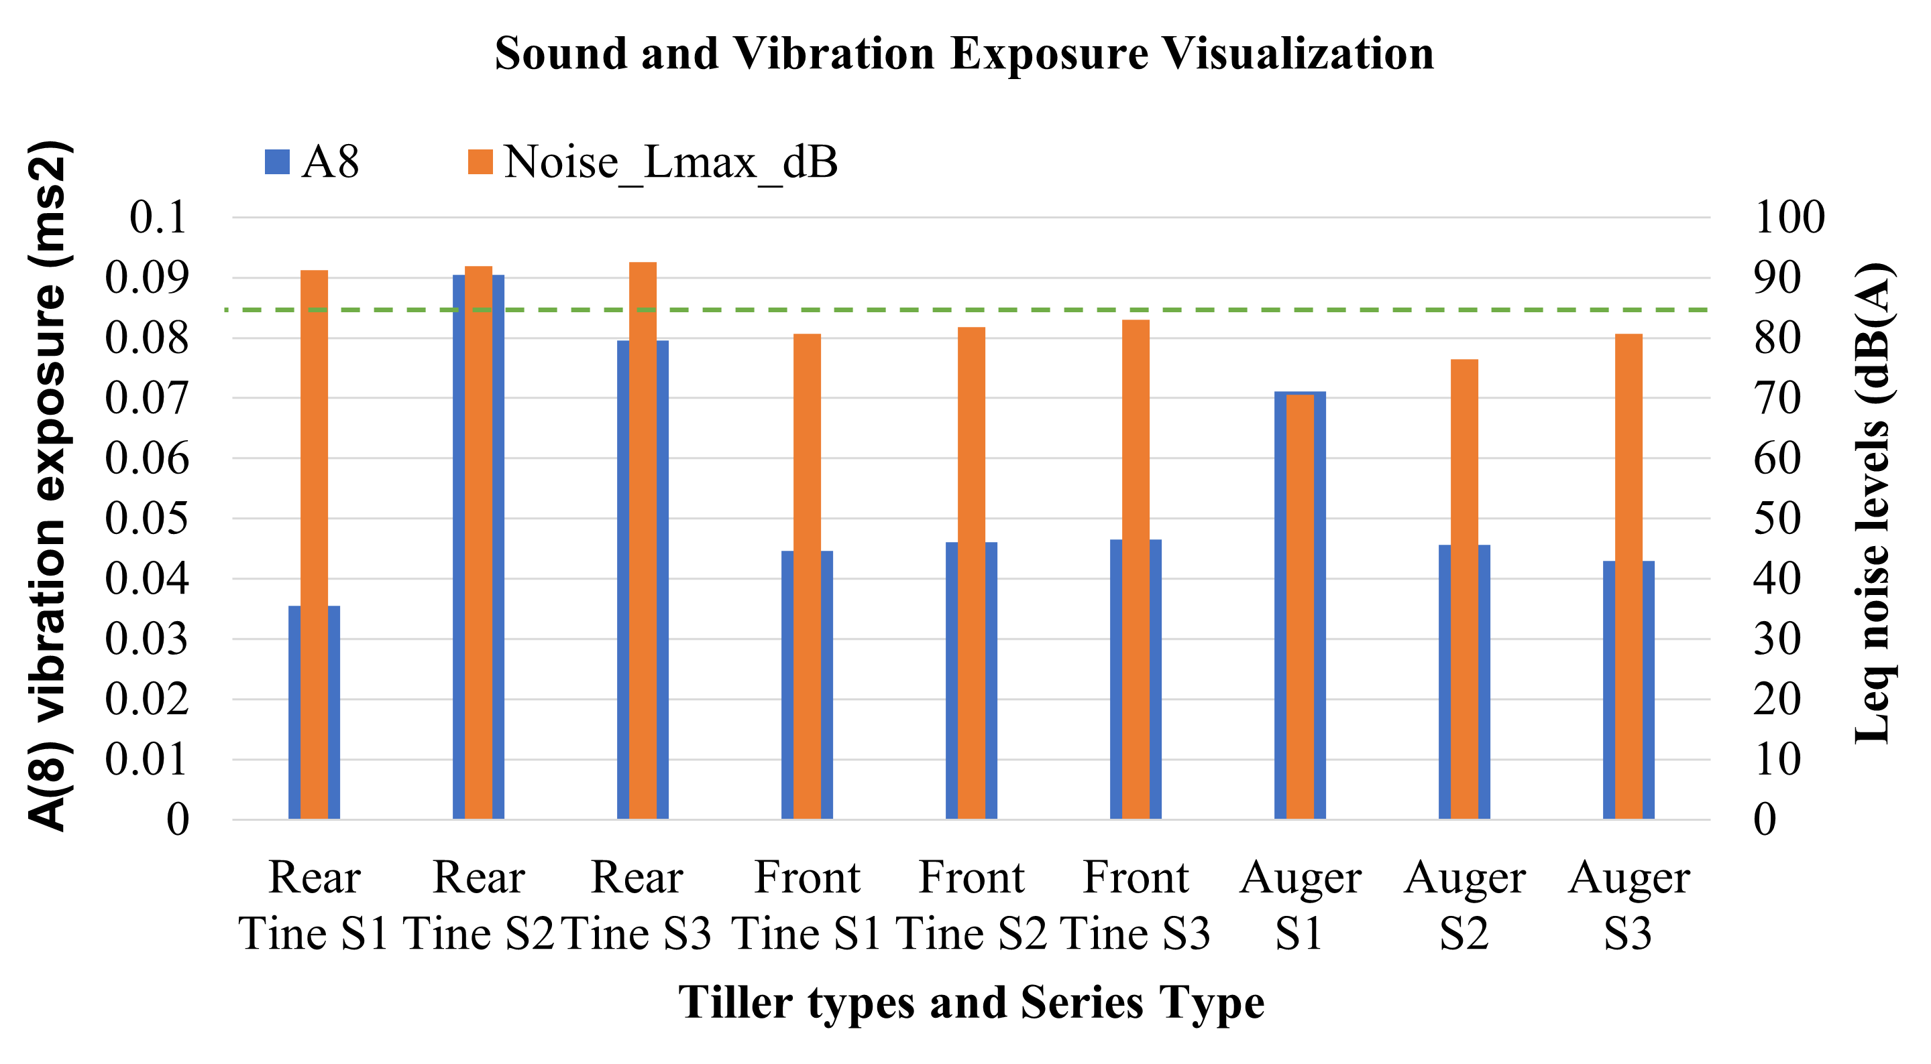
Operator Noise Exposure
.
Comparative Acoustic Output
Rear-Tine: 92.6 dB(A) – exceeds OSHA limit
Front-Tine: 86.2 dB(A) – marginally safe
Auger: 80.4 dB(A) – OSHA/NIOSH compliant
OSHA/NIOSH LIMIT
Notes:
Conventional tools contribute to high MSD risks. Can ergonomic enhancements provide relief?

Slide 13
Physical Dimensions and Usability
.
Specification | Rear-Tine Tiller (mm) | Front-Tine Tiller (mm) | Auger Tiller (mm)
Overall Length (mm) | 1676.4 | 1073.2 | 1727.2
Overall Width (mm) | 504.8 | 489.1 | 495.3
Overall Height (mm) | 1517.7 | 1162.1 | 1241.4
Tilling Width (mm) | 457.2 | 406.4 | 335.3
Tilling Depth (mm) | 203.2 | 203.2 | 154.9
Handle Height Max (mm) | 1517.7 | 1162.1 | 1241.4
Handle Length (mm) | 1187.5 | 1022.4 | 892.2
Wheel Diameter (mm) | 355.6 | 247.7 | 317.5
Track Width (mm) | 482.6 | 489.1 | 350.9
Tine/auger ID Diameter (mm) | 304.8 | 260.4 | 174.6
Ground Clearance (mm) | 76.2 | 171.5 | 260.4
Weight (kg) | 74.8 | 22.68 | 54.8
Footprint Area (mm²) | 229677 | 132540 | 45645
Notes:
Conventional tools contribute to high MSD risks. Can ergonomic enhancements provide relief?

Slide 14
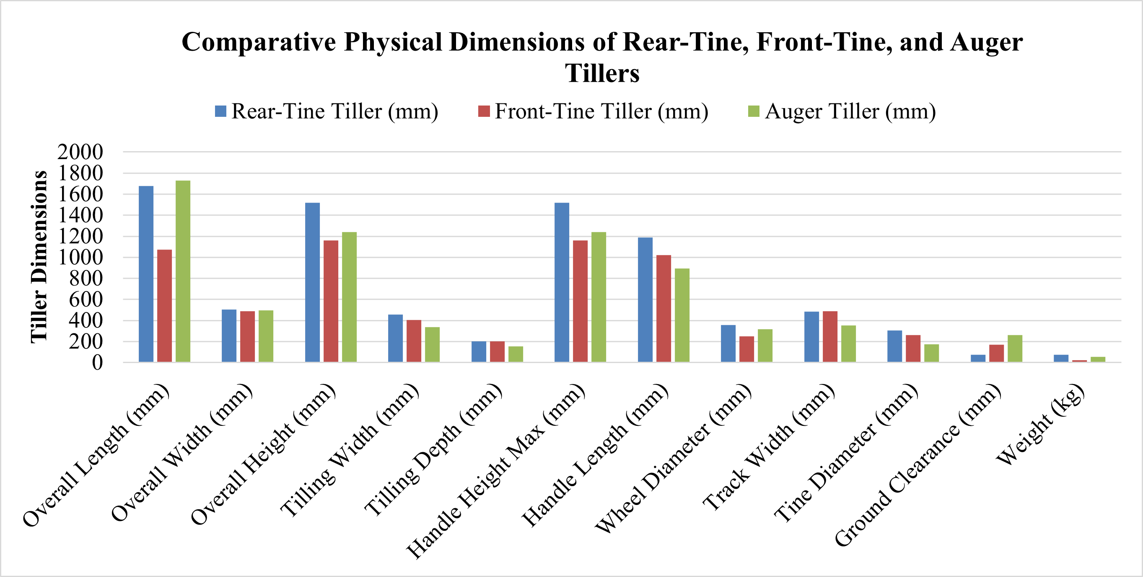
Physical Dimensions and Usability
.
Notes:
Conventional tools contribute to high MSD risks. Can ergonomic enhancements provide relief?

Slide 15
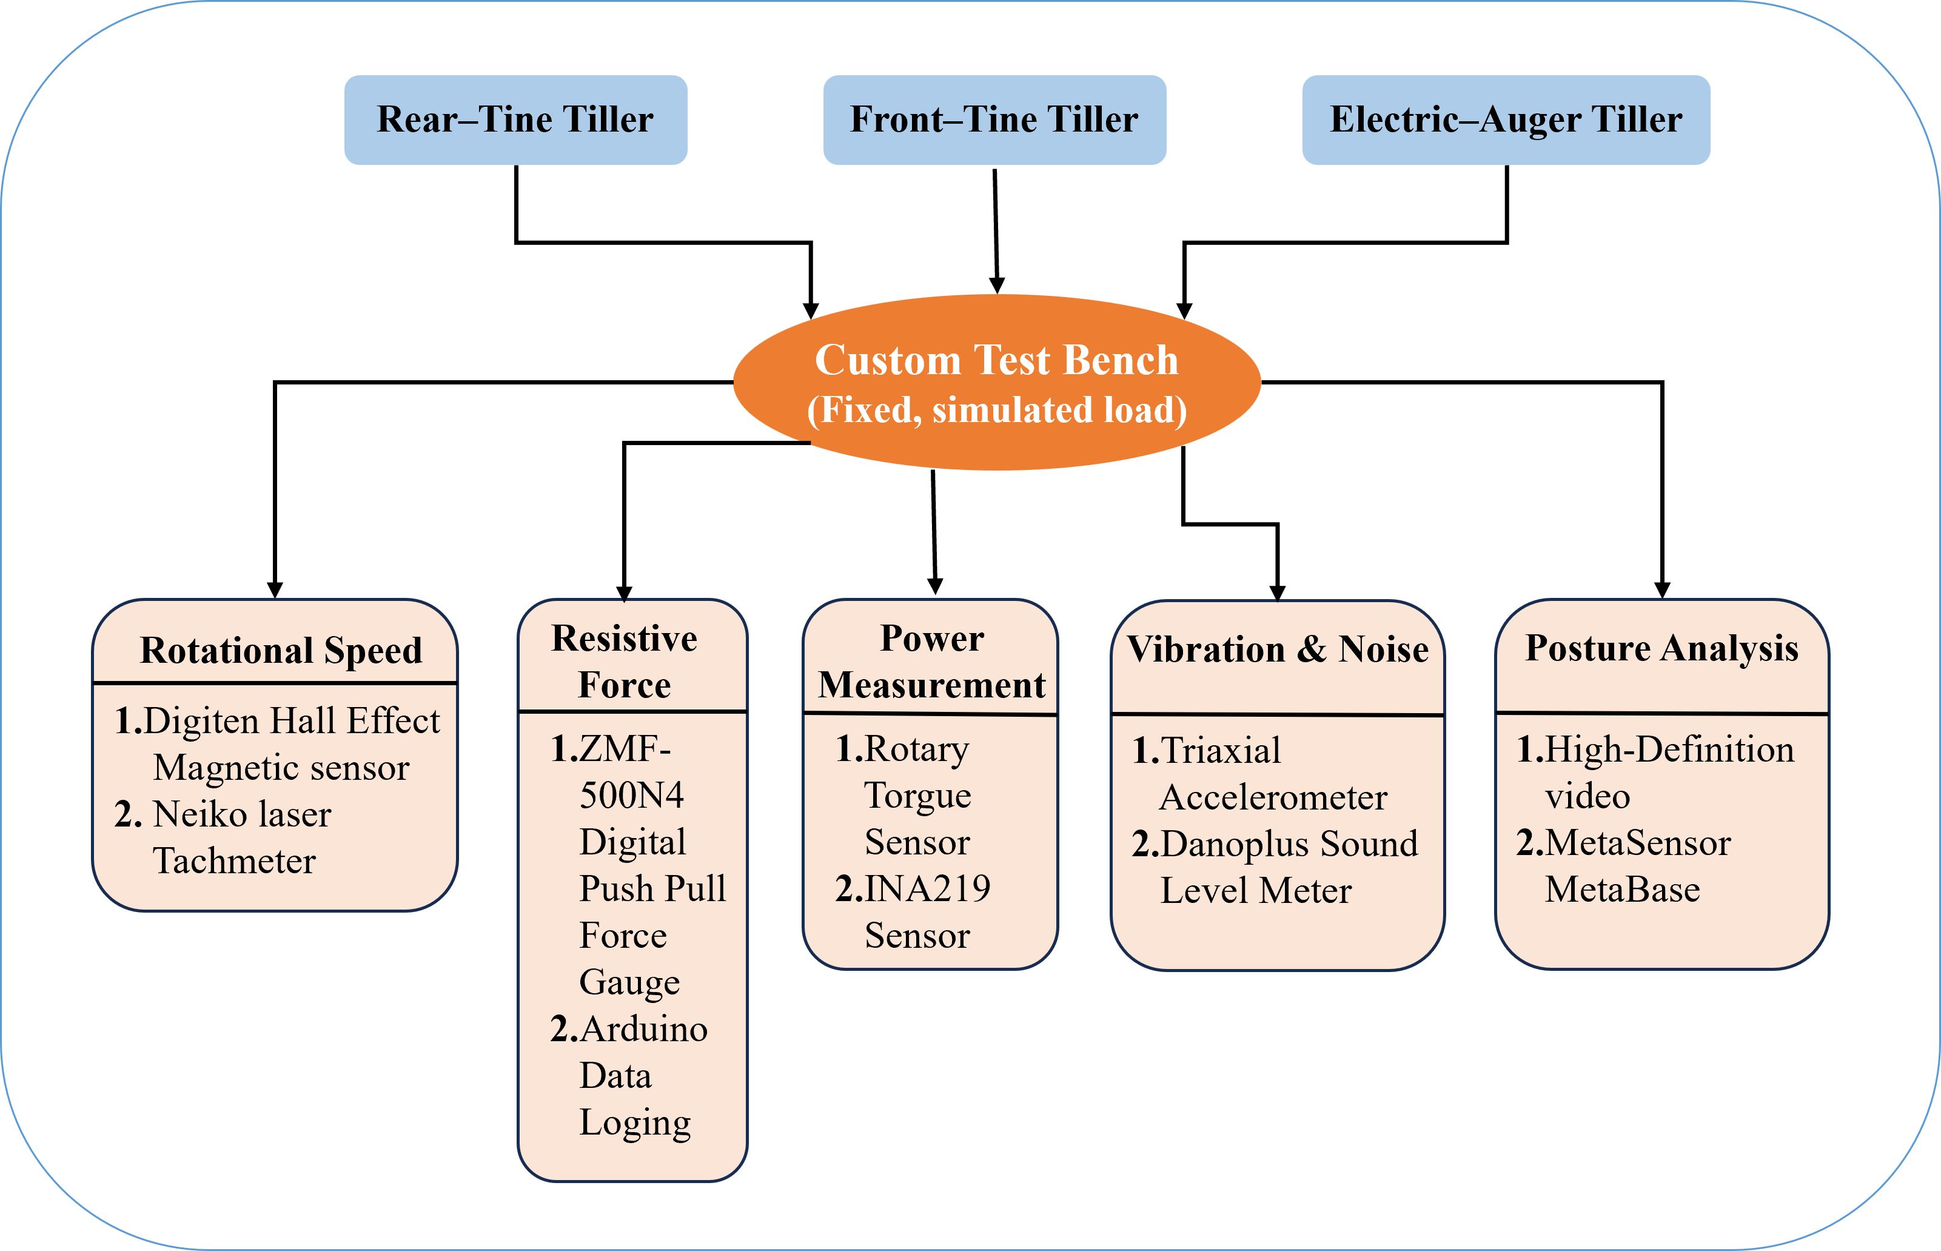
Workflow & Functional Design Summary
Transformation from traditional to smart tiller
Motor integration and ergonomic handlebars
Sensor positioning for real-time feedback
Handle height selection based on anthropometric data

Slide 16
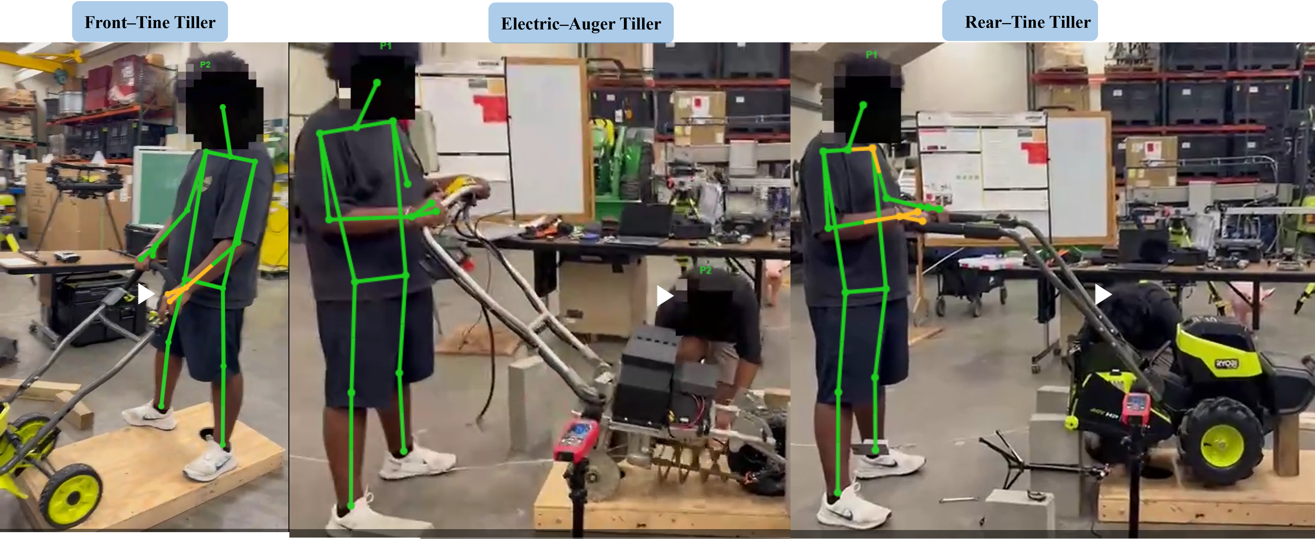
Key Takeaways
.
Electric Auger Tiller provided:
Low vibration exposure (A(8) = 0.053 m/s²)
Improved mechanical efficiency (43.46 rad/s peak)
Safe sound levels (80.4 dB(A))
Better ergonomics: lower handle, higher clearance
Best suited for diverse users, including women and older farmers
Notes:
Conventional tools contribute to high MSD risks. Can ergonomic enhancements provide relief?

Slide 17
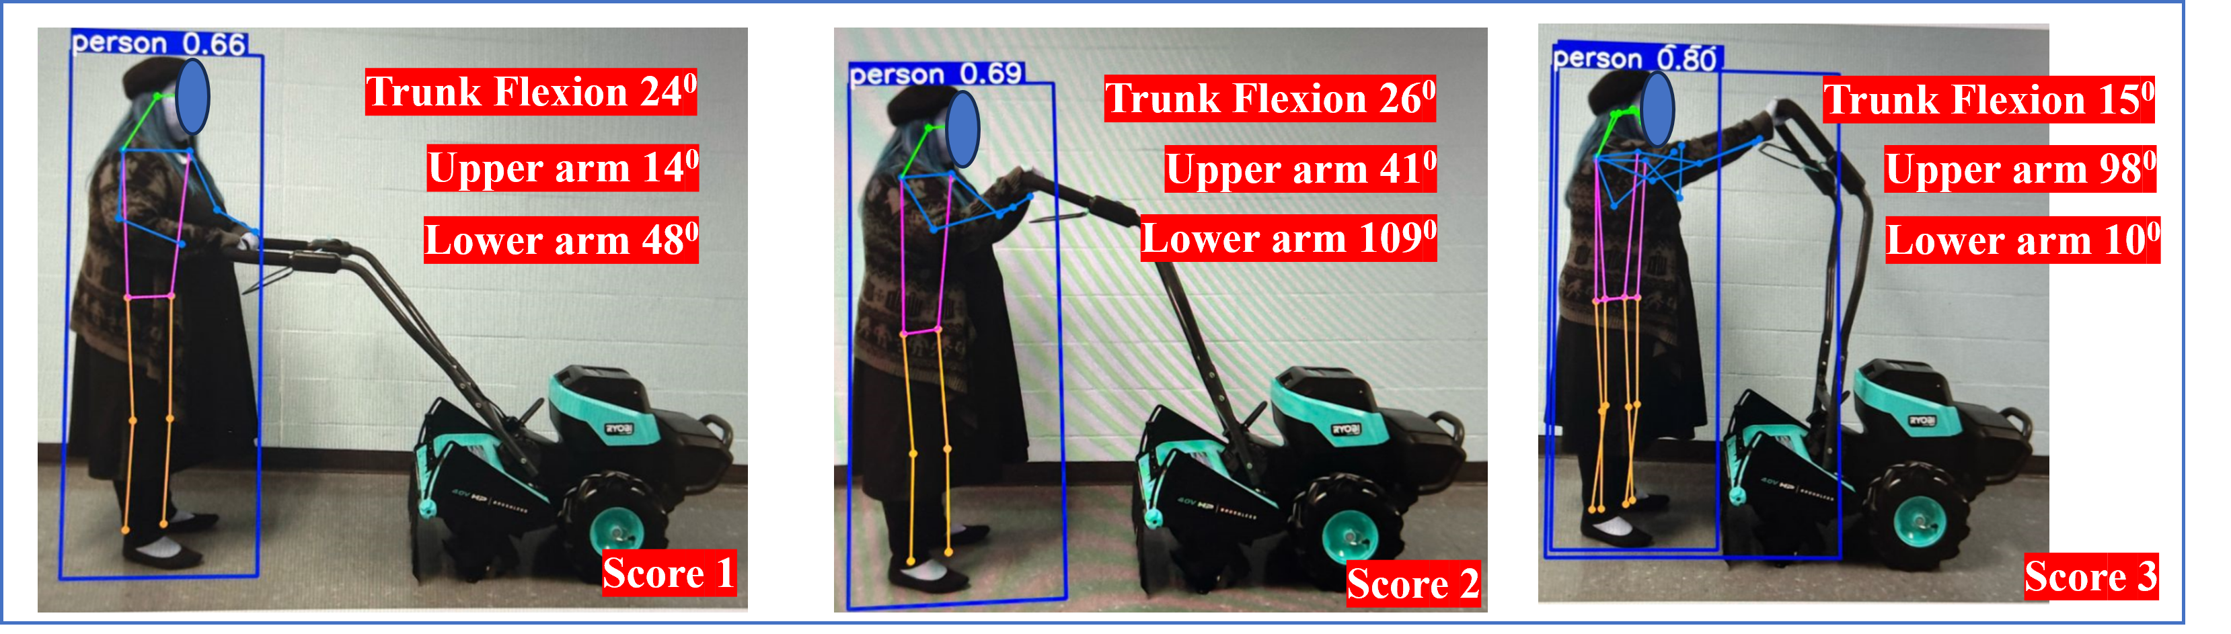
Future Work
.
Conduct multi-soil type field trials with human subjects
Explore modular handle inclination adjustments
Integrate a mobile app dashboard for live feedback
Add wearable IMUs for real-time posture tracking
Annotated images showing real-time ergonomic posture analysis of a tiller operator using YOLO pose estimation. Key angles measured include trunk flexion, upper arm, and lower arm positions, with corresponding ergonomic risk scores (1–3) based on postural deviation and joint loading
Notes:
Conventional tools contribute to high MSD risks. Can ergonomic enhancements provide relief?

Slide 18



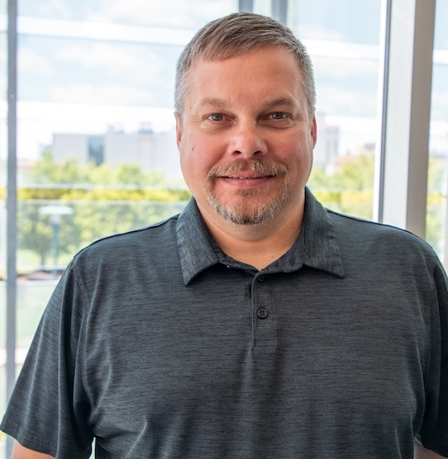
Acknowledgments
Special thanks to the North Central Sustainable Agriculture Research & Education (SARE) for their generous support and funding.
Appreciate the National Institute for Occupational Safety and Health (NIOSH) and the United States Department of Agriculture (USDA) for their support and guidance.
Jianfeng Zhou, Karen Funkenbusch, and Marcia Shannon, University of Missouri for their mentorship and guidance.
Aaron Yoder and Central States Center for Agricultural Safety and Health at the University of Nebraska Medical Center for their support.
Thank you to the women at the University of Missouri who participated in this research study
Grateful to my colleagues for their feedback and assistance.
Jianfeng Zhou
Karen Funkenbusch
Marcia Shannon
Aaron Yoder
Notes:
Visual Aid: Summary infographic highlighting key findings and recommendations. Statement: "Future research will refine ergonomic designs for better health outcomes."
Imagine starting your day with the tools designed to ease your workload, but ending it with intense back pain and sore wrists. This is the daily reality for many women farmers using conventional tools. Our study aims to change that."

Slide 19

Felix Michael Oguche
PhD Student | Biological Engineering
📧 fofdt@umsystem.edu🌐 https://farmtechforher.com

